Slide 1
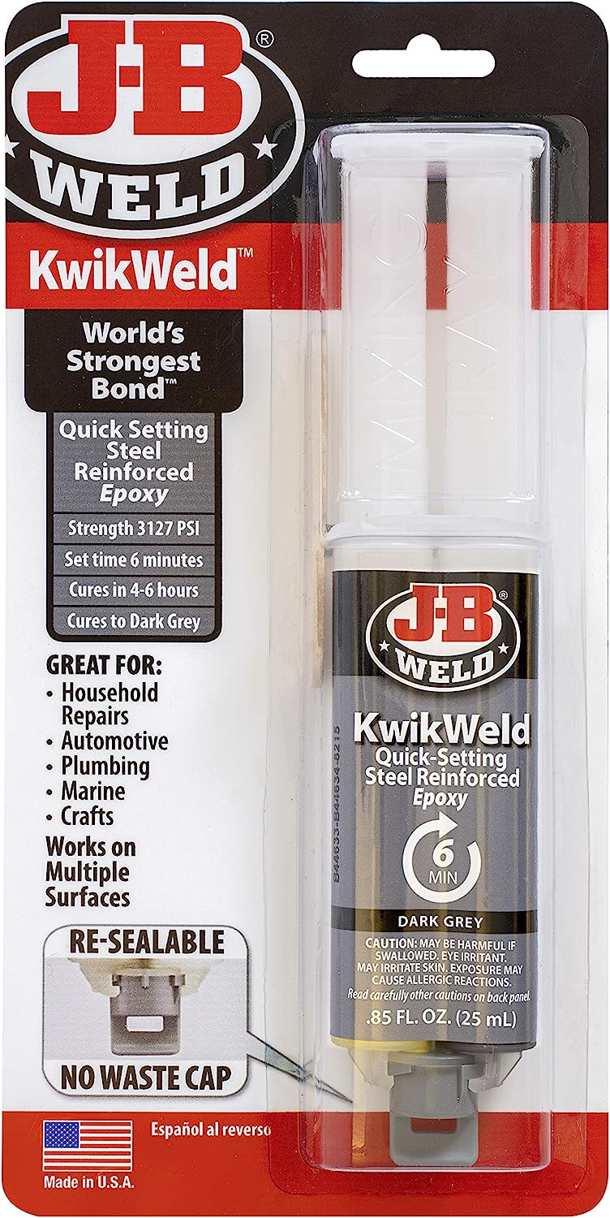

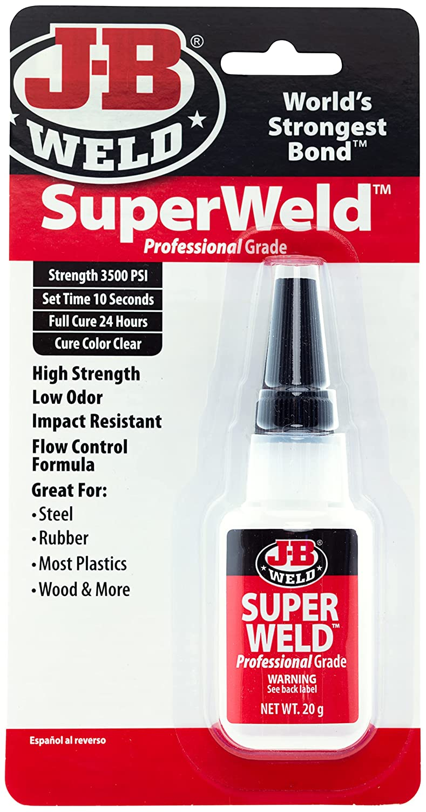
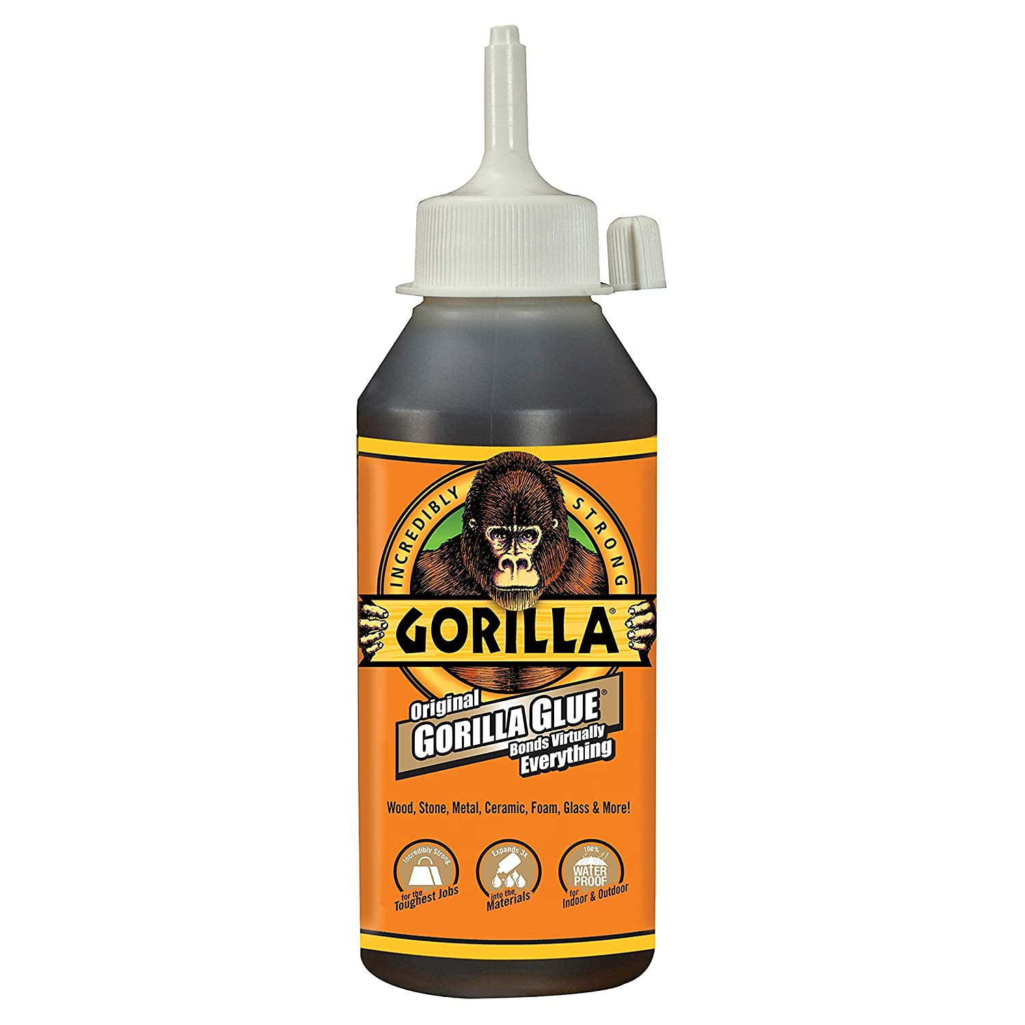
Adhesives tried

Slide 2
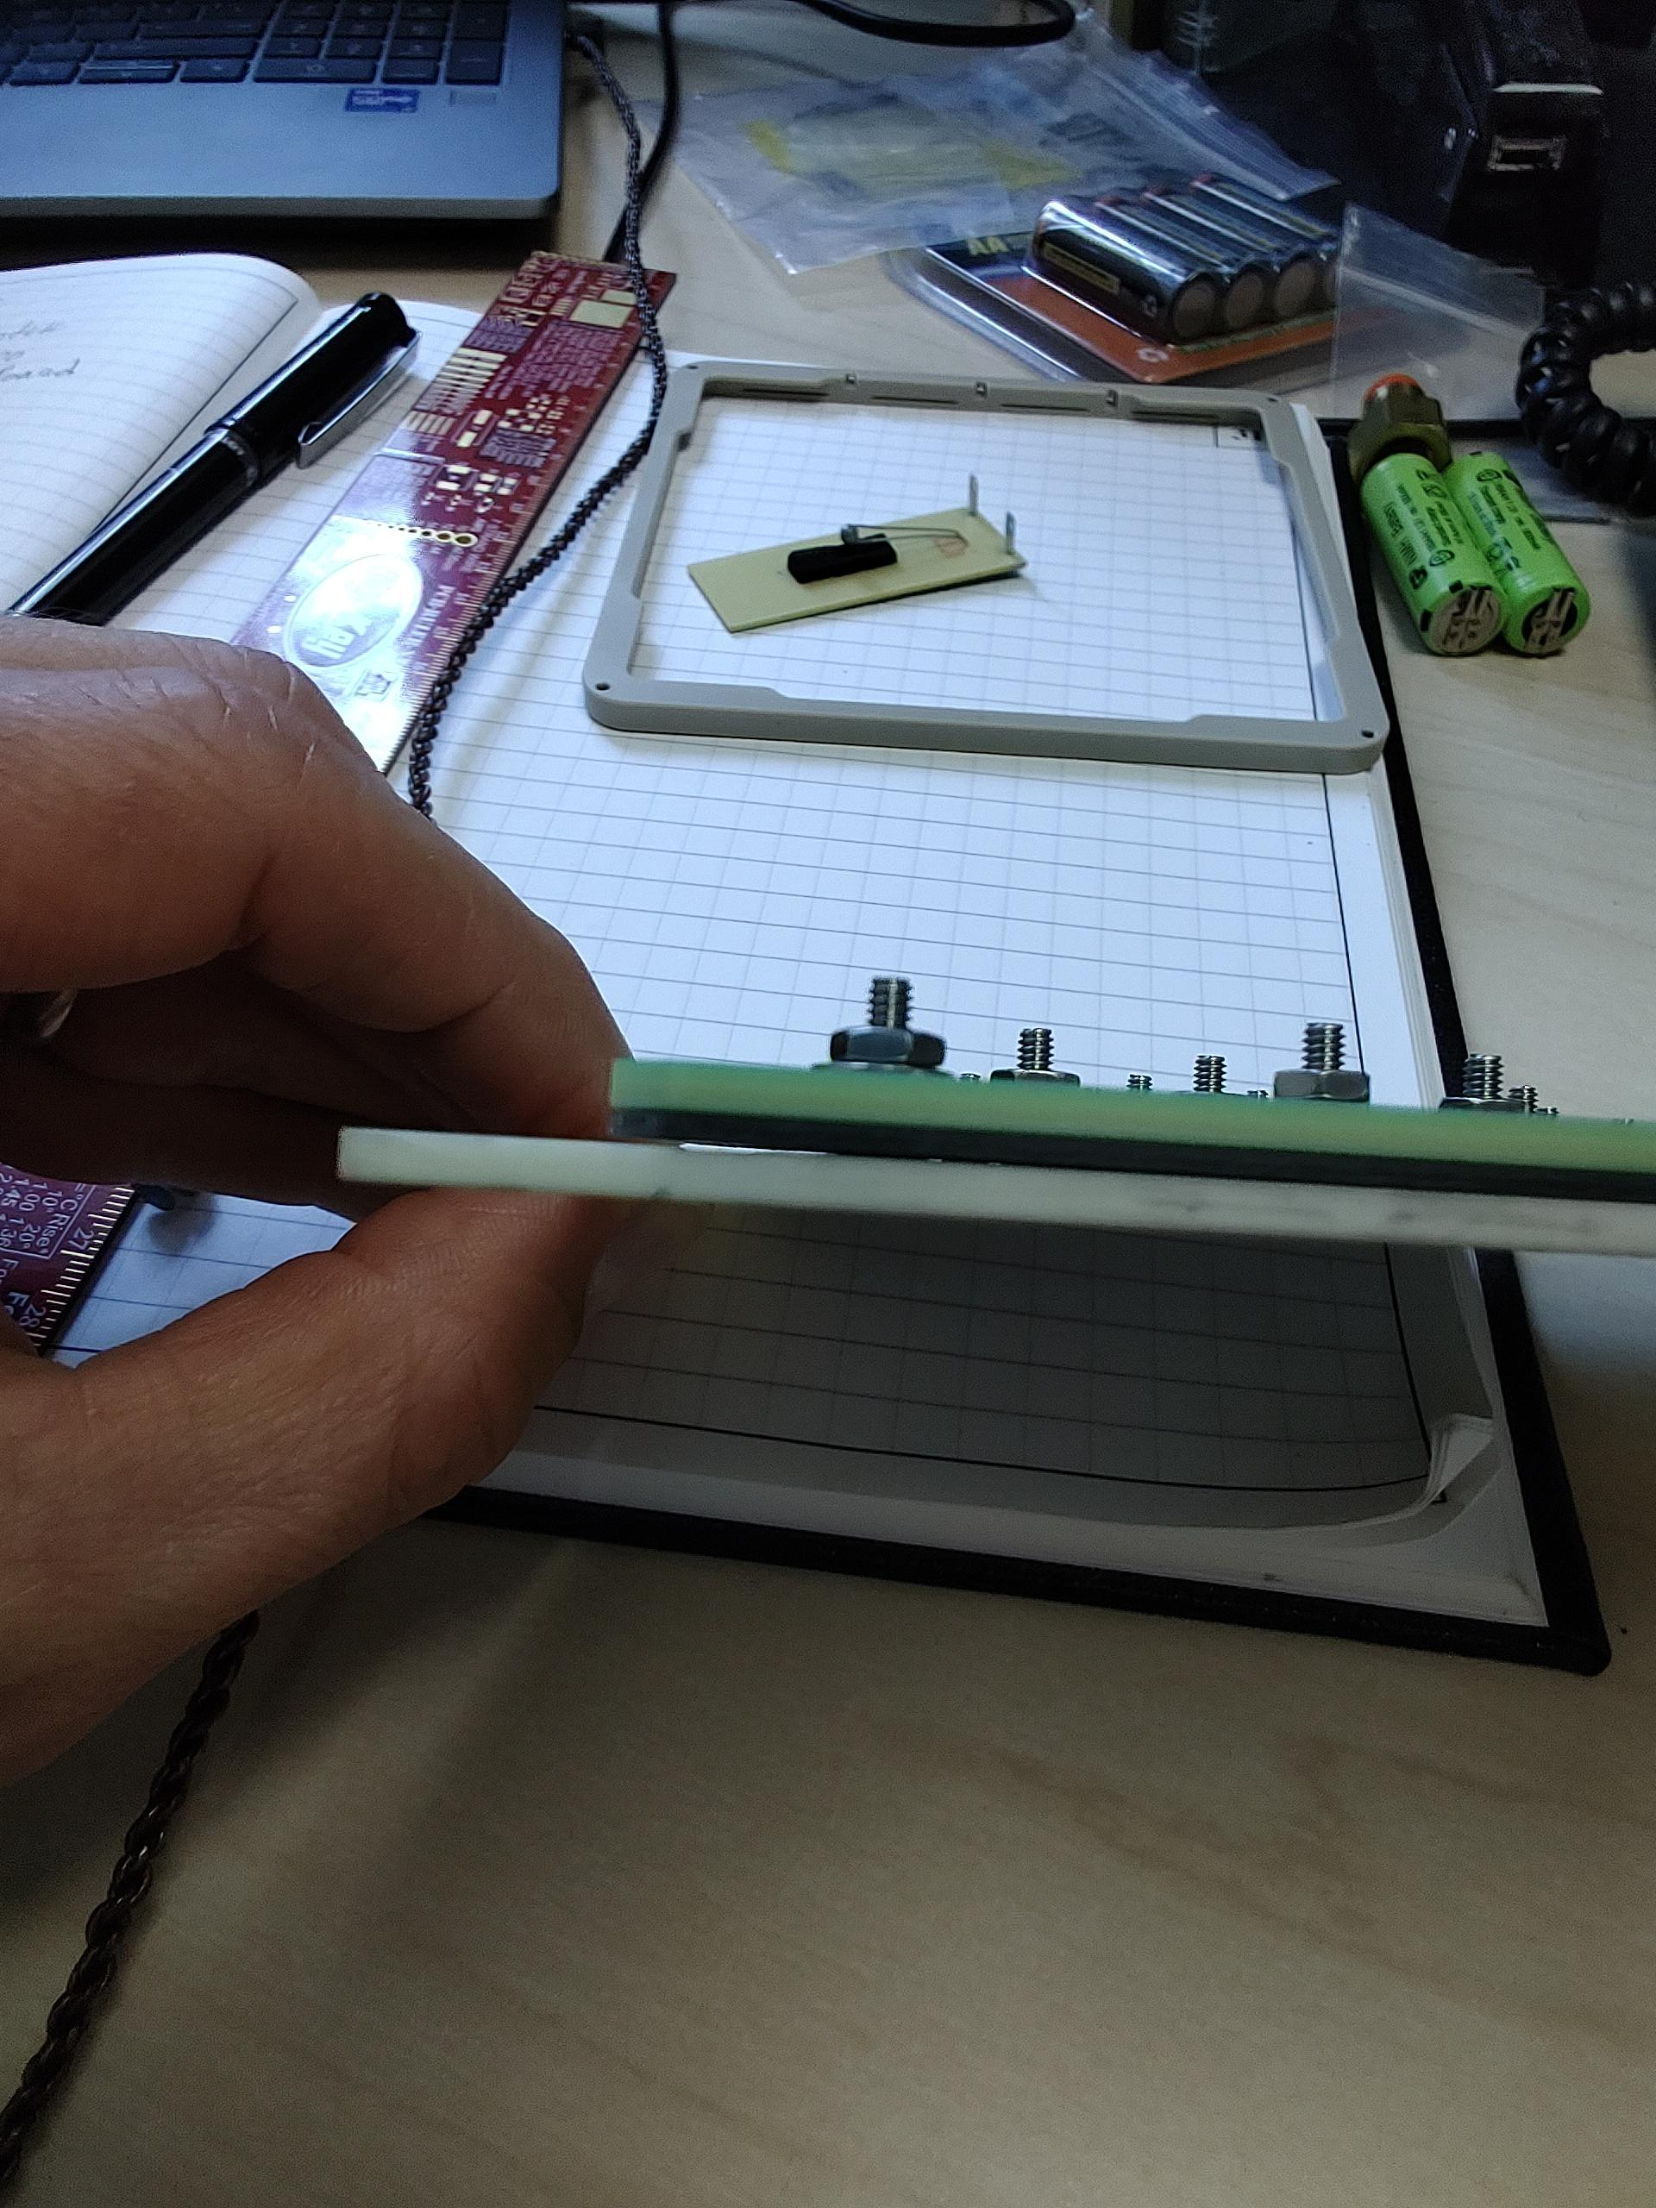
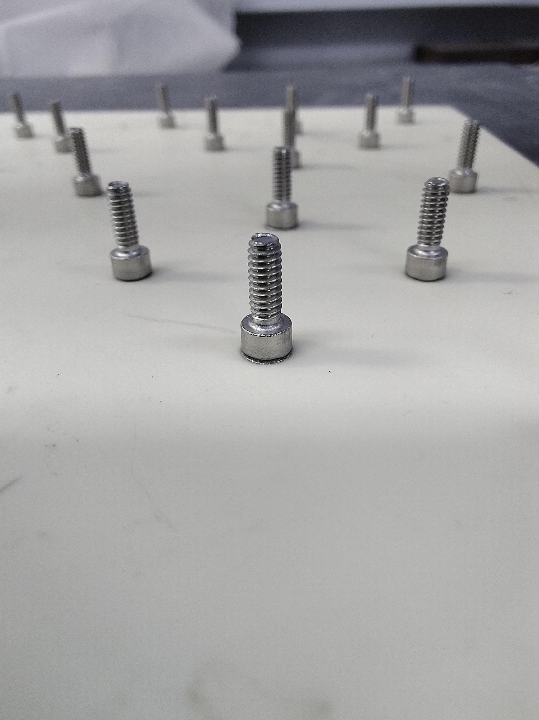
Possible issues
gap
Epoxy spreading around the screw head. Spacer is not sitting tight on the anode.
Torque applied on the nut is limited. Screws may be pulled out with sufficient force.

Slide 3
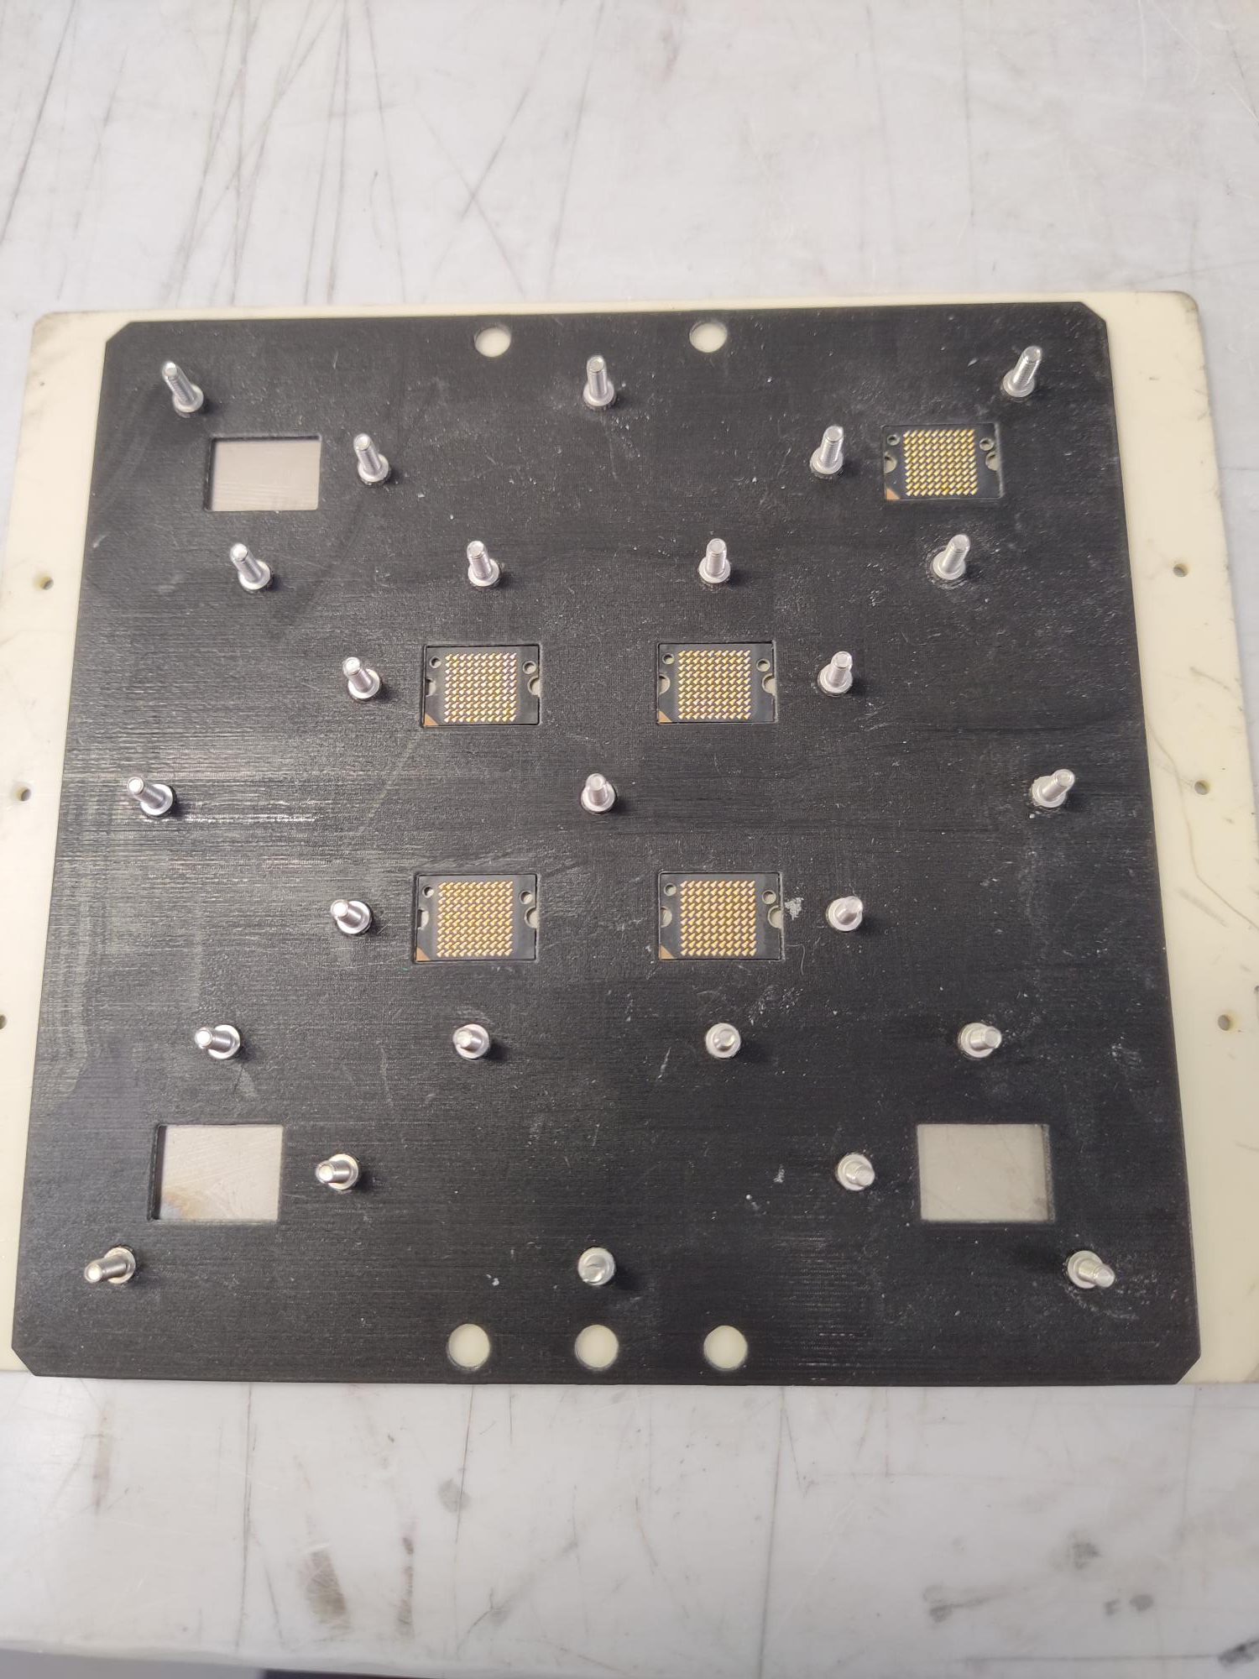
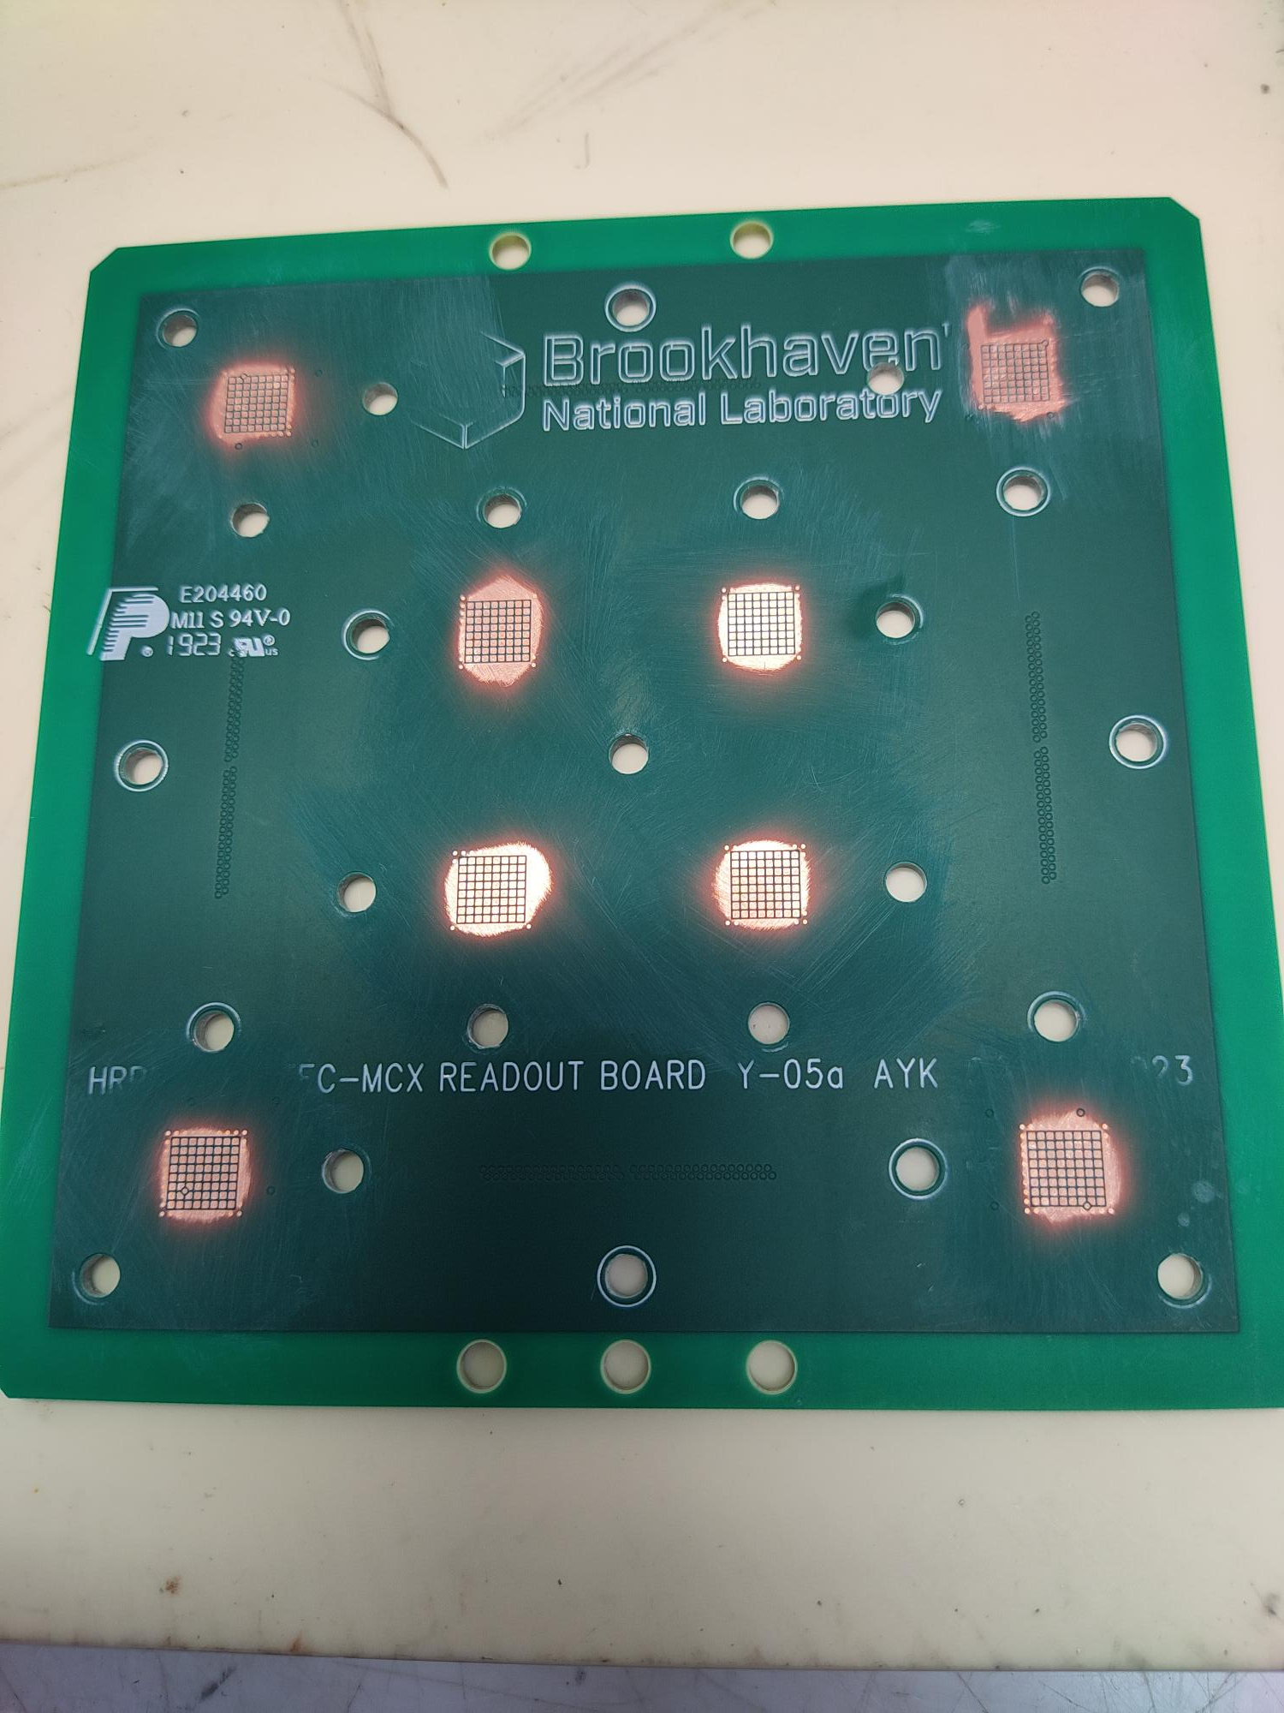
HRPPD anode: glued screws
Holes were expanded to 0.144”

Slide 4

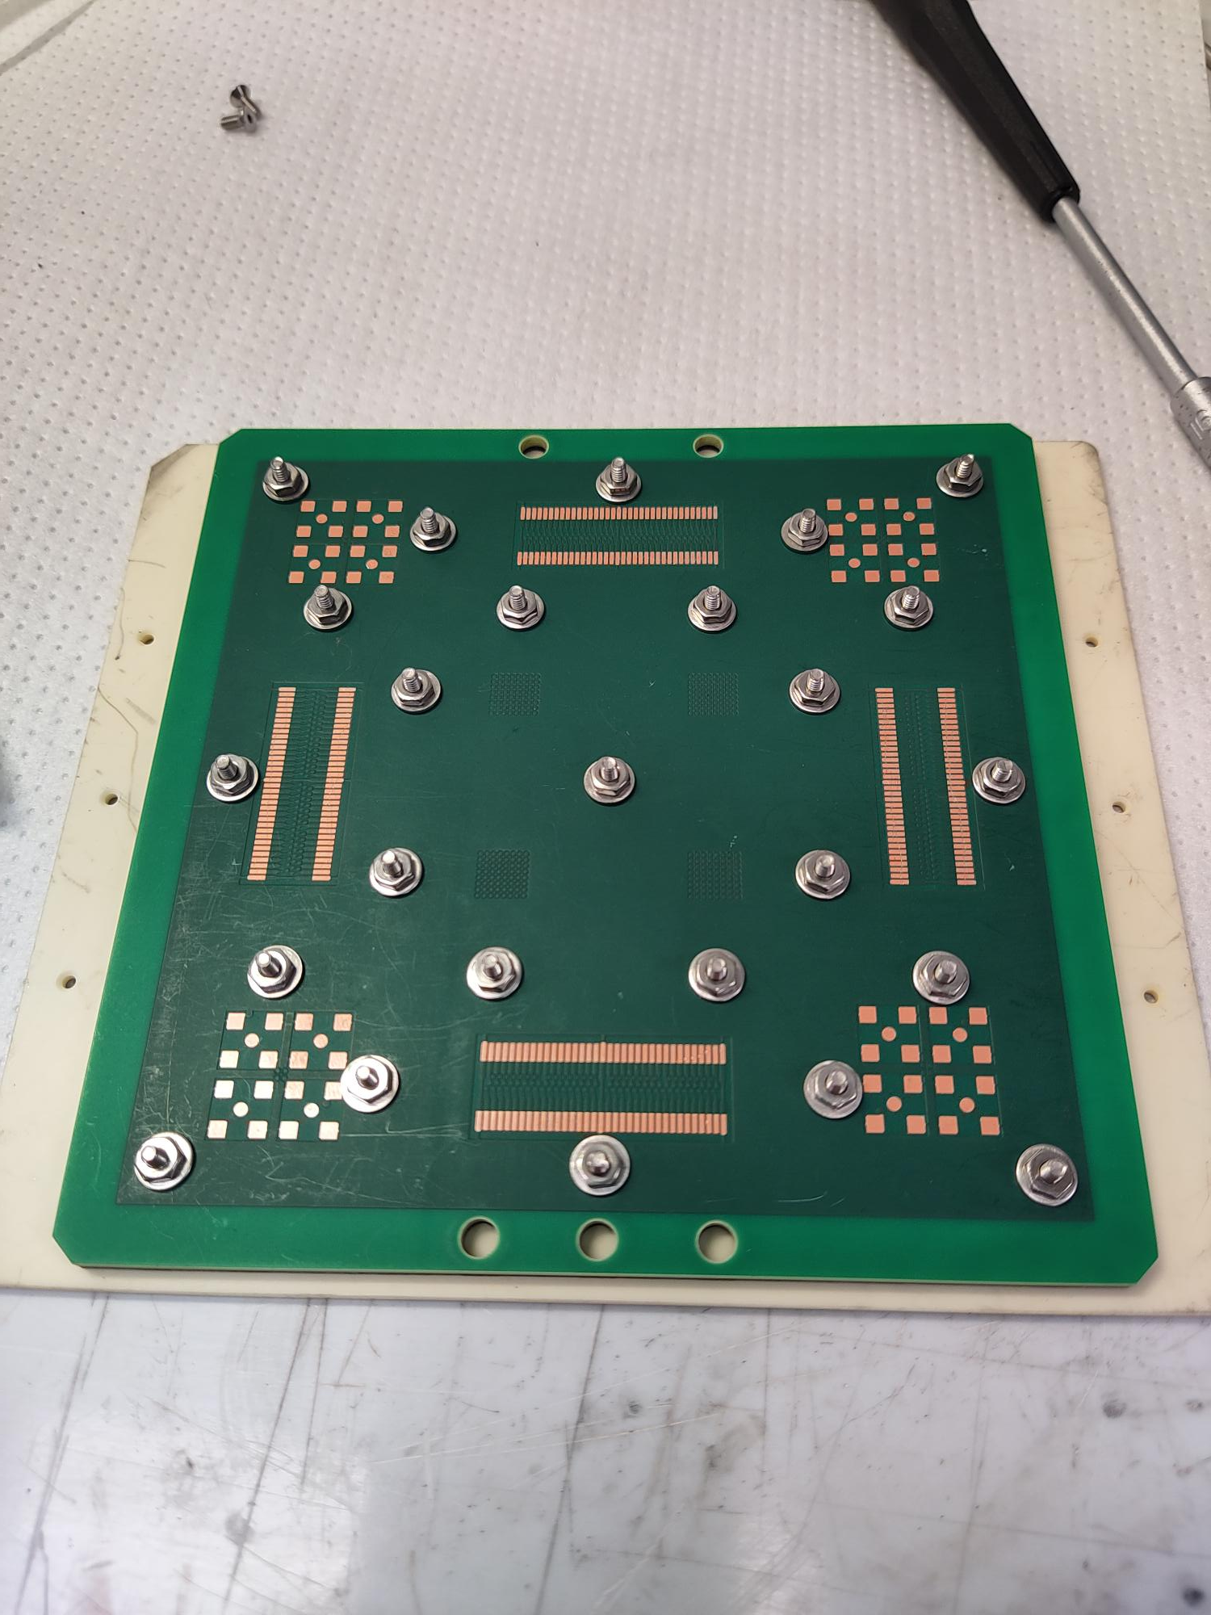
Contacts checked
All 64 X 4 contacts were checked for continuity

