Slide 1
Requested correlation plots for PAC document
Hinako, Jaein, Takashi, Ryota, Maya,

Slide 2
Requested plot list by Rachid for PAC
These are the plots that we need for the PAC commissioning document (limited pages) to prove that the INTT detector is working properly: 1- Hit's clusters (or raw hits) correlation of the full Word inner barrel versus full Word outer barrel 2- Hit's clusters (or raw hits) correlation of full INTT detector versus the MBD 3- Vertex distribution 4- To prove that readout are working we need: a) Felix synchronization plot like: FullBCOxFFF - chips BCO, b) Hits clusters (or raw hits) correlation for each Felix Note: using latest progress synchronization within 4 BCO, or better... this is important Optional (depend on the document space), but it can be an interesting plot: Cluster hit's correlation INTT north versus INTT south. Note: the plots don't need to be preliminary for now. They will be approved when the sPHENIX PAC committee review the draft.

Slide 3
1- Hit's clusters correlation of the full inner vs. full outer barrel
Run #20444
20K events
First full barrel correlation.
Plotted by Hinako
* This was taken soon after masking Slow Control to block calibration fake trigger.

Slide 4
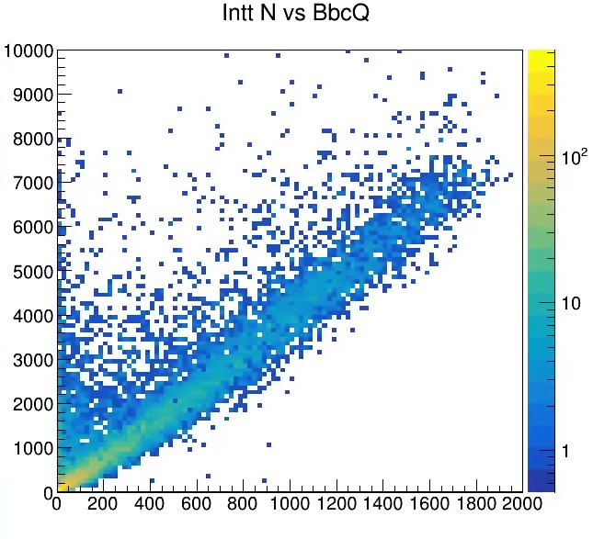
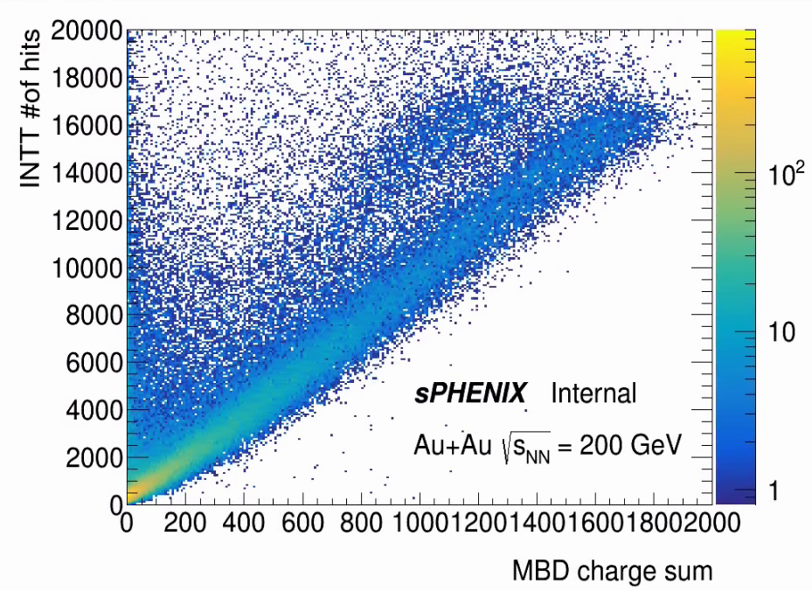
2- Hit's clusters (and raw hits) correlation of full INTT vs. the MBD
Run # 20708 Plotted by Takashi and Maya
10K events
INTT # of clusters vs. MBD charge sum
100K events
INTT # of raw hits vs. MBD charge sum
INTT # of clusters
MBD charge sum
We used BCO_full & 0xFFFF vs. Femclk correlation to check the synchronization.
There are offset between INTT event counter and MBD event counter.

Slide 5
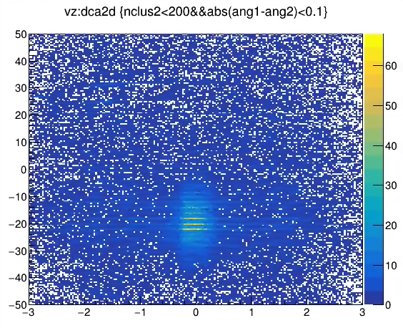
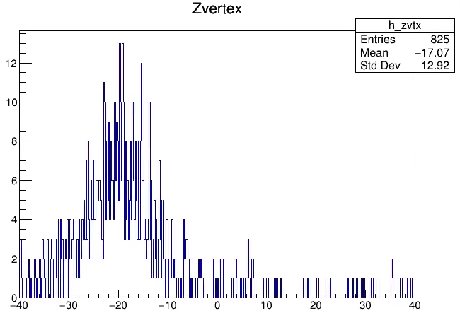
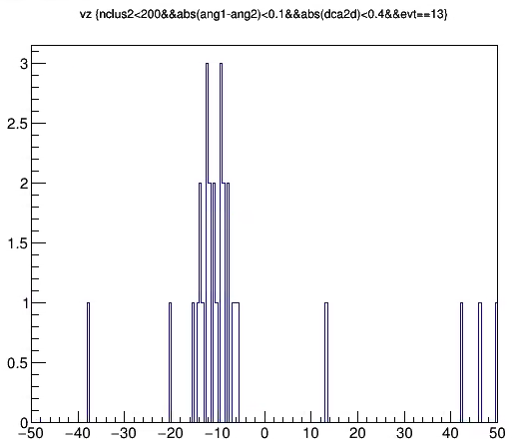
3- z Vertex distribution with Zero-Field run
Run#20869 ZF plotted by Takashi
DCAZ
Projection of Z
Event=13
Z=-11.0
DCA2D
Used peripheral events to reduce the BG

Slide 6
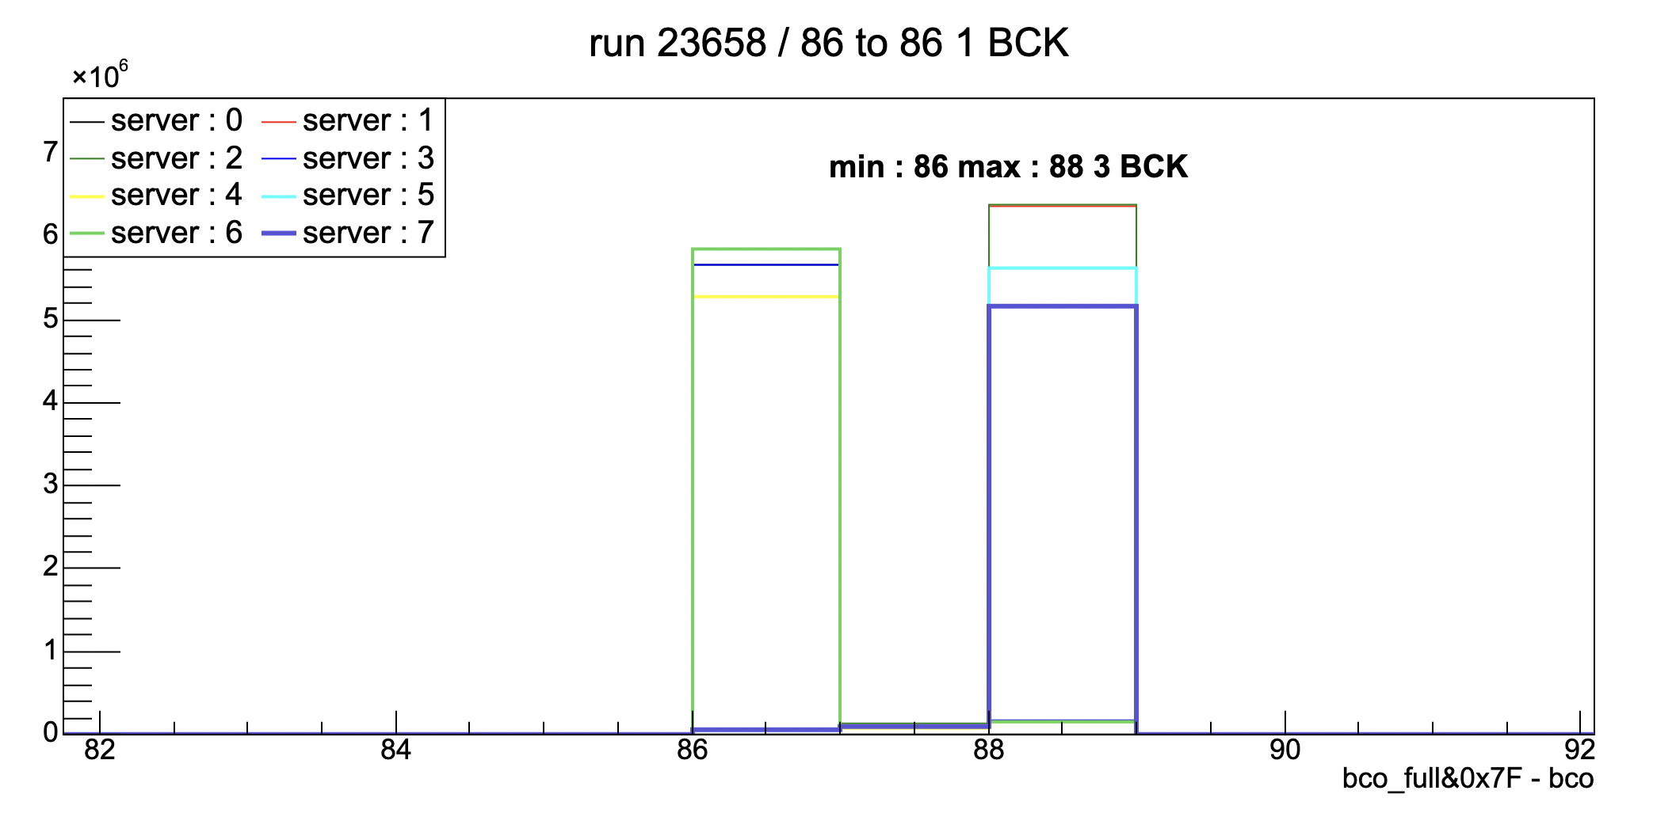
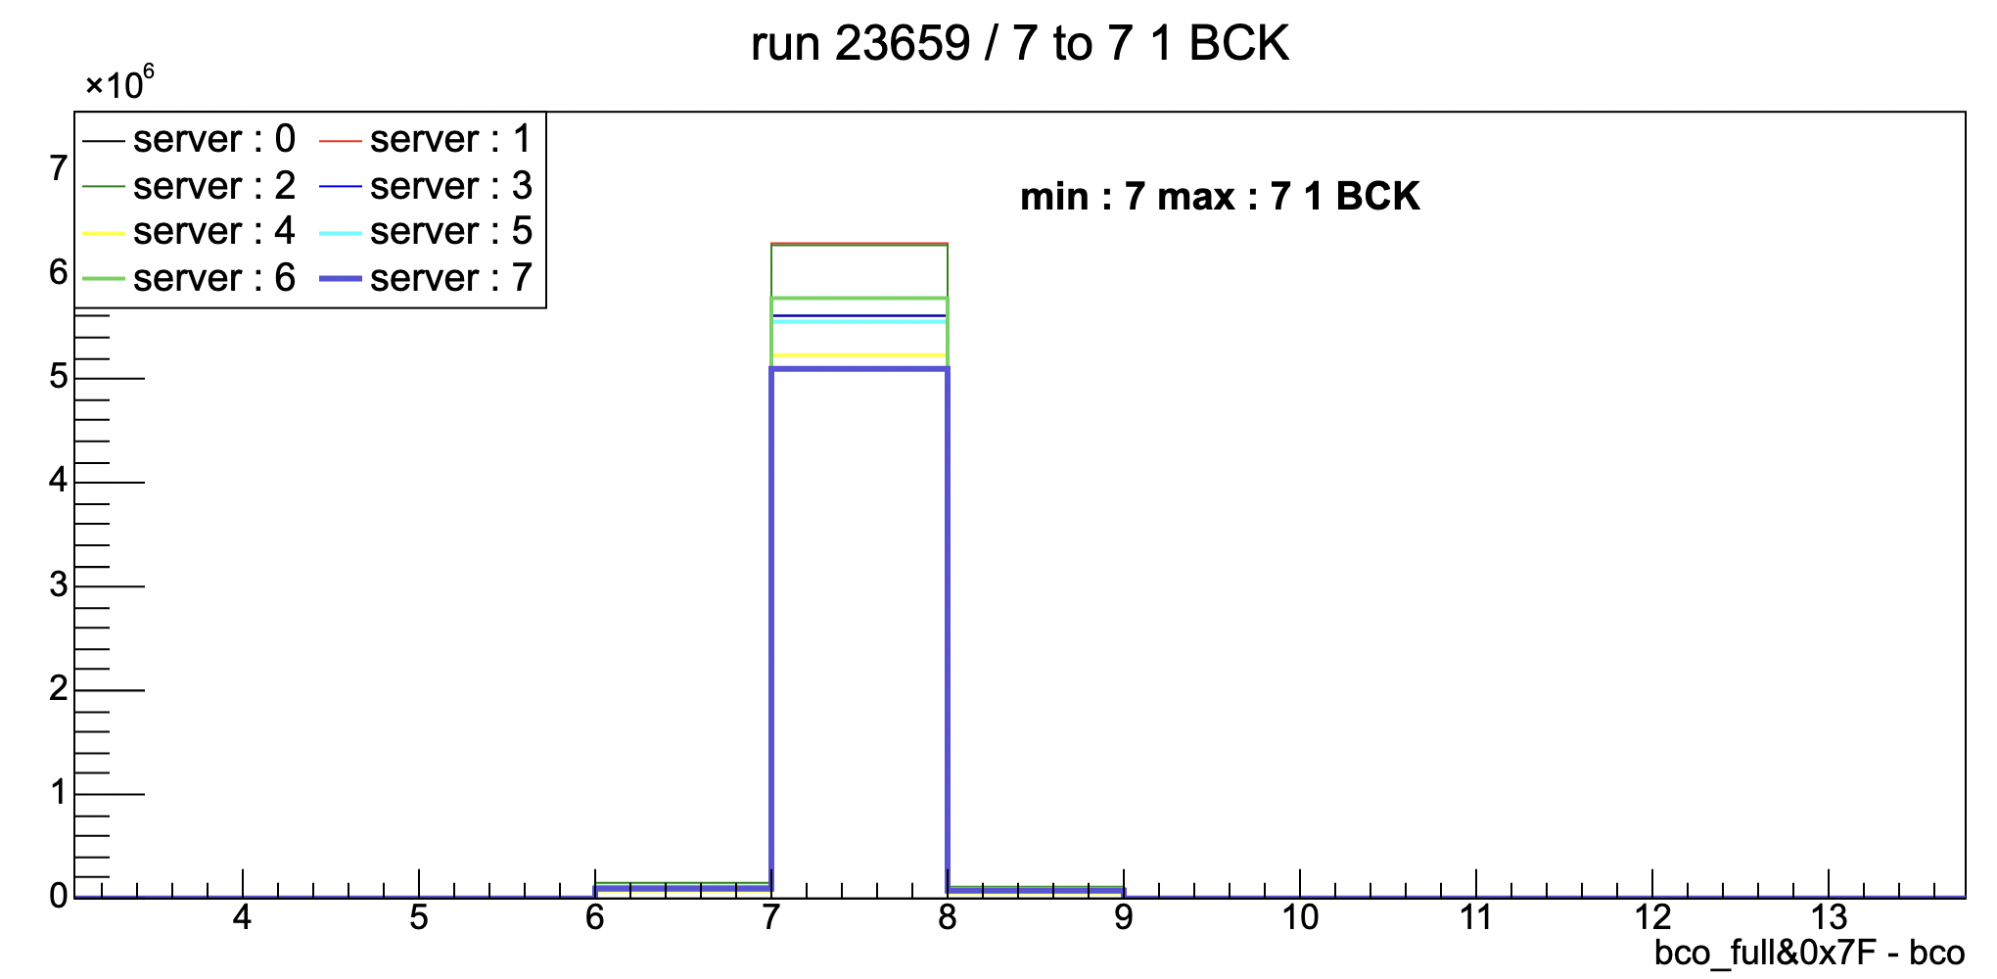
4- To prove that readout are working we need: a) Felix synchronization plot like: FullBCOxFFF - chips BCO
Plotted by Jaein
Run # 23658 modebit : 92 / n_coll = 2
Run # 23659 modebit : 92 / n_coll = 2
Timing synchronize among 8 Felix.
The largest separation is 3 beam clocks now.

Slide 7
4- To prove that readout are working we need: b) Hits clusters (or raw hits) correlation for each Felix
Plotted by Hinako and Takashi
Correlations between INTT3 and others.
Correlation between INTT5 and others.
You can see same rapidity (North or South) has narrower correlations.

Slide 8
Optional (depend on the document space), but it can be an interesting plot: Cluster hit's correlation INTT north versus INTT south.
Run #20444
20K events
Same data set of # 2 plot
Plotted by Hinako

Slide 9
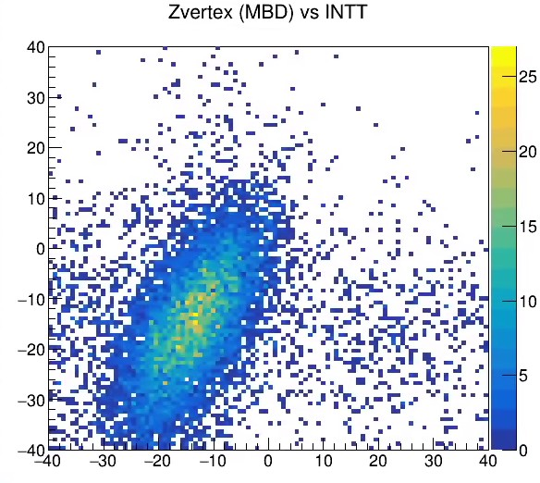
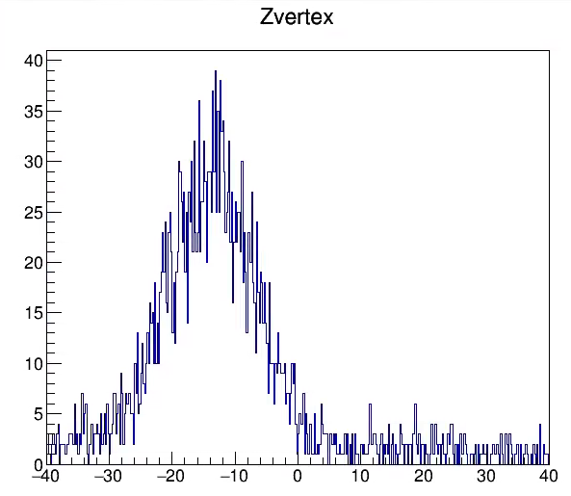
NEW! Correlation between INTTz - BBCz
INTT z
MBD z [cm]
INTT z [cm]
Run # 20708
Field on
Before z vertex was moved to z=0
Plotted by Takashi
INTT z [cm]
The first field-on z vertex measured by INTT
Clear correlation is seen between INTTz and MBDz although slop is not one.

Slide 10
Official preliminary plots
You can find here.
https://indico.bnl.gov/event/19862/
Correlation between Inner and outer (part of INTT is used)
Correlation between 2 different felix (part of INTT is used)
Time-in
https://indico.bnl.gov/event/20139/
Correlation between MBD and INTT (part of INTT is used)
Correlation between TPOT and INTT (at Hugo’s presentation)
https://sphenix-invenio.sdcc.bnl.gov/records/h56xd-aer60
The note for the correlation between TPOT and INTT (with preliminary logo)
https://sphenix-invenio.sdcc.bnl.gov/uploads/7xd7k-7x532
The note for the Correlation between MBD and INTT

Slide 11
Back up
Not requested but maybe useful to understand.

Slide 12
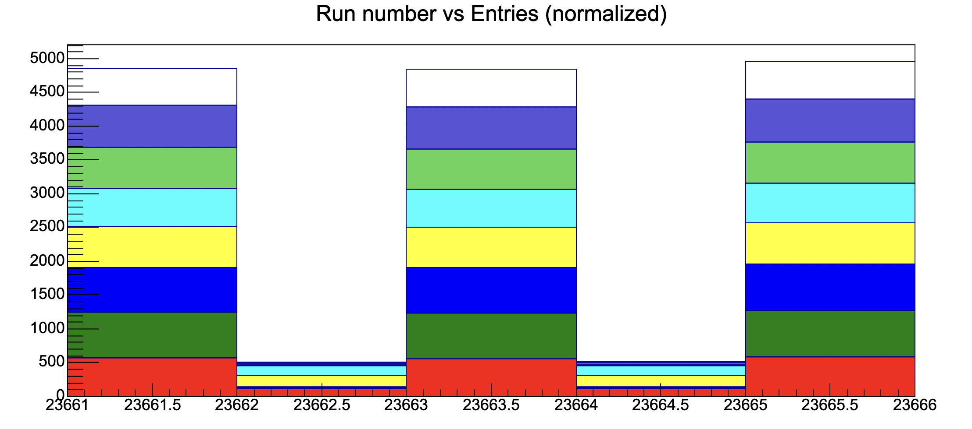
The behavior of time-in /no-time-in with the same set up.
Run # 23661 ~ 23665 modebit : 91 / n_coll = 0
plotted by Ryota
Time_in
Time_in
Time_in
Server 7
Server 6
Server 5
Server 4
Server 3
Server 2
No_Time_in
No_Time_in
Server 1
Server 0

