Slide 1
HEPMC File Merger and Background Effects on Tracking Reconstruction
By Benjamen Sterwerf

Slide 2
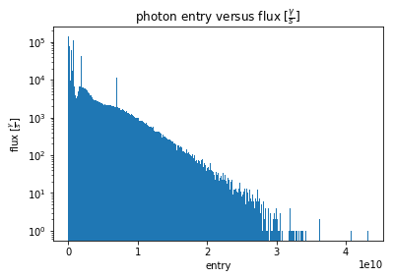
SR Generator
Store each photon and its flux as a bin in a histogram.
Randomly sample photons using this flux distribution as the sampling distribution.
Each selected photon contributes 1/flux to the time integration
Integration Window for 1 Event
Length of Time Integration

Slide 3
Old Recombination Scheme
Pythia HEPMC Files
DIS Root Files
GEANT
Combined
Events
Synchrotron Radiation Facet Files
Generator
SR HEPMC Files
GEANT
SR Root Files
Event Processing
Separated SR Event Data frame
SR Event Tracker

Slide 4
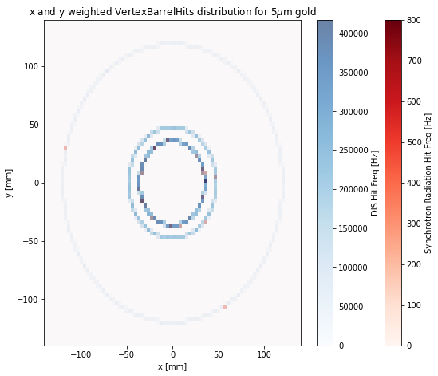
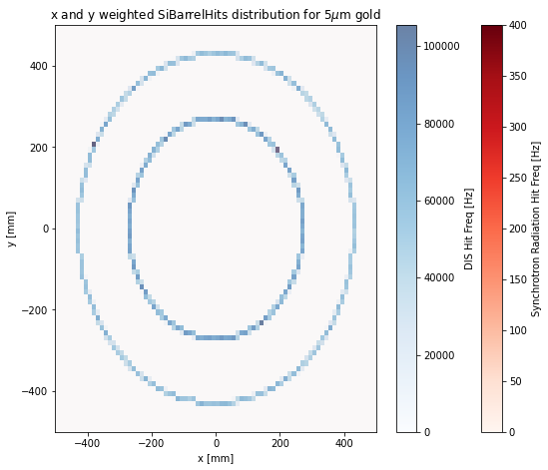
Combined DIS and SR Plots Per Subdetector (XY)
Cons: Cannot be used for Tracking Reconstruction studies because the files are separated

Slide 5
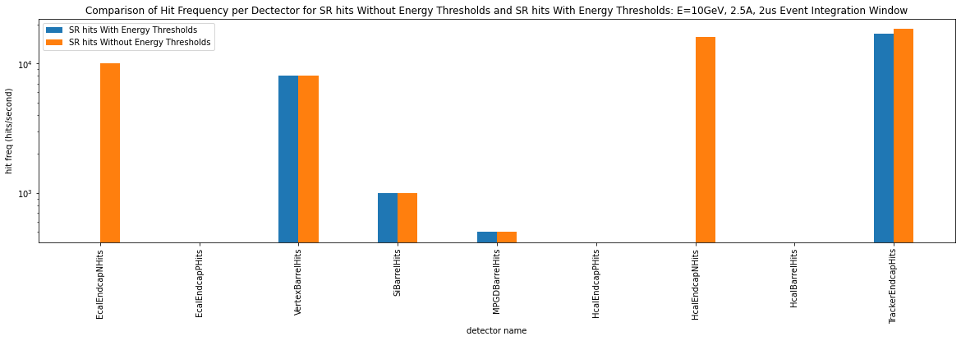
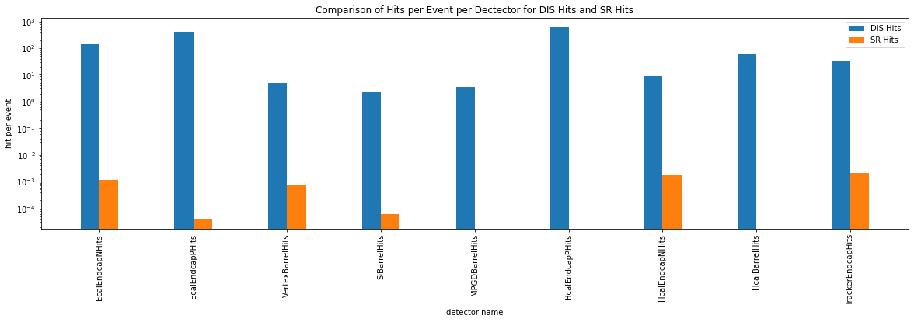
Results Of the Preliminary SR Study

Slide 6
New Background Merger (HEPMC File Level)
Signal + Background = Combo Event
p2 bp2 p2
/ / /
P1----v1----p3 p5 + bp1-----bv1---bp3 = central axis----p1-----v1-----p3 p5
\ / \ \ \ /
p4----v2-----p6 bp4 \ p4----------v2 -----p6
\ \ \
p7 \ p7 bp2
\ /
bp1---------------------------------------- bv1-----bp3
\
bp4

Slide 7
HEPMC File Merger
Allows for any signal event to be combined with any number of background events in order to simulate accelerator events realistically prior to being propagated through GEANT.
Signal File(s)
Merger Code
GEANT
Analysis
Background Files

Slide 8
Tracking Reconstruction Effects of Backgrounds
Now that We have the capability to send background merged signal events through GEANT we can now do studies on the effect of the background on the tracking reconstruction with both Truth and Realistic seeding
Using DIS for the signal event
10x100 GeV
Three Main Background Types included in the study:
Synchrotron Radiation
Hadron Gas: 31347 Frequency in Nanoseconds
Electron Gas: 333 Frequency in Nanoseconds

Slide 9
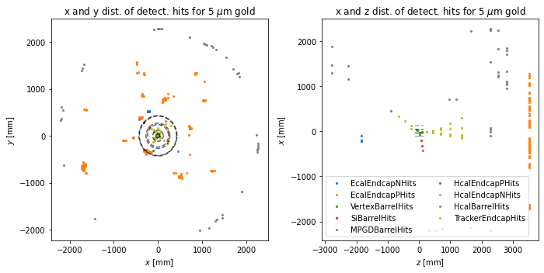
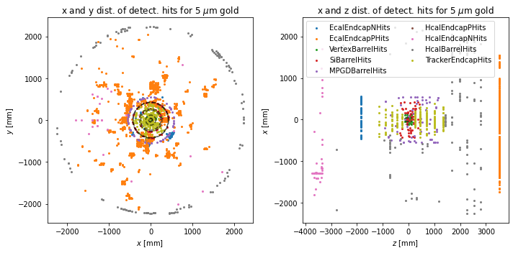
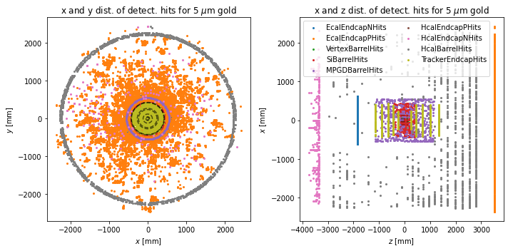
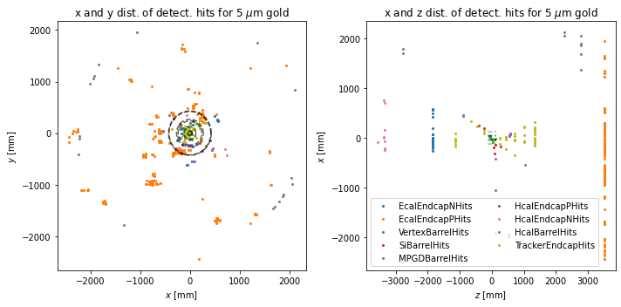
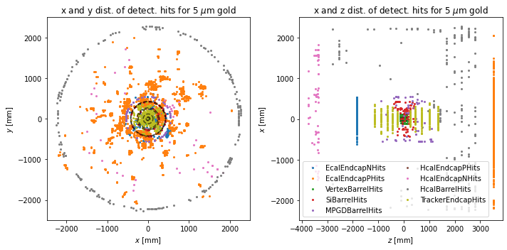
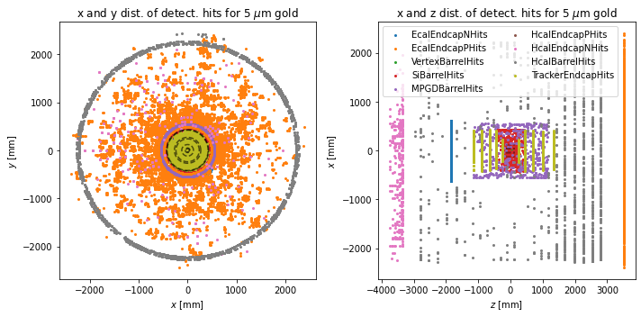
Testing the HEPMC Input with GEANT
1 Event
10 Events
100 Events
Pure signal
Signal & Background

Slide 10
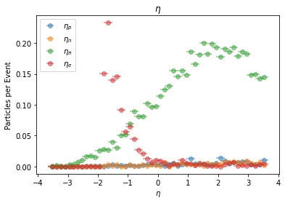
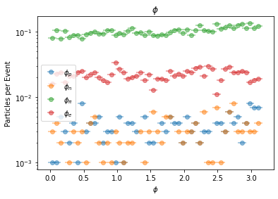
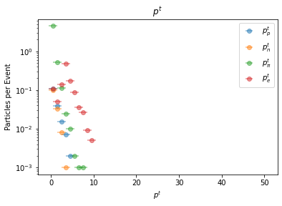
Particle Distributions Based on Particle Type
Particle Species include:
Protons (blue)
Electrons (red)
Neutrons (yellow)
Pions (green)

Slide 11
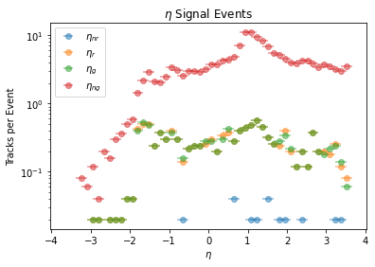
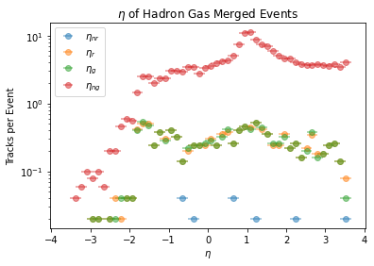
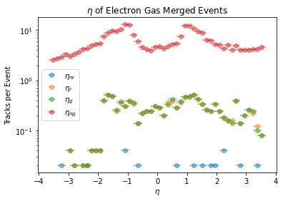
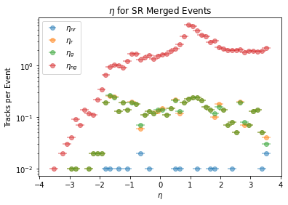
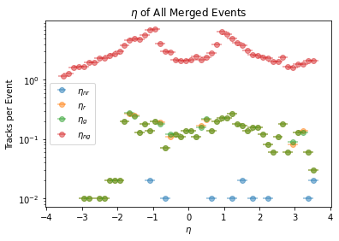
Reconstructed Eta Distributions Truth Seeding

Slide 12
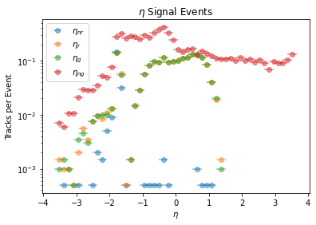
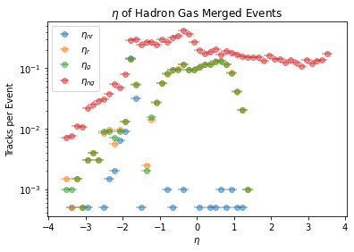
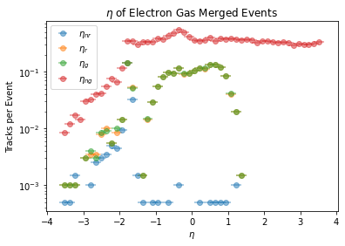
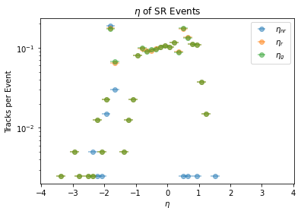
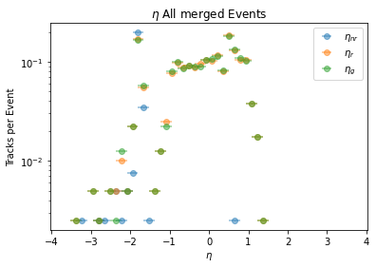
Reconstructed Eta Distributions Realistic Seeding

Slide 13
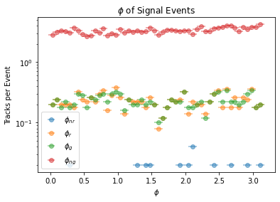
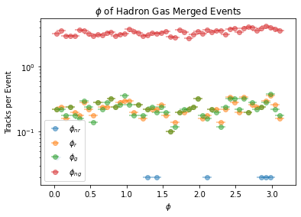
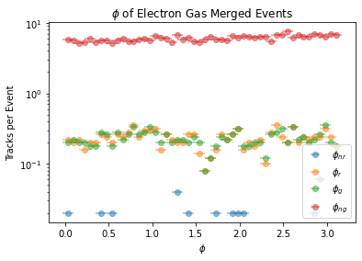
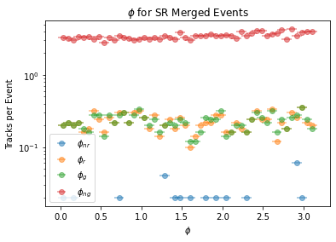
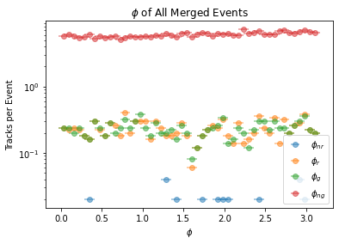
Reconstructed Phi Distributions Truth Seeding

Slide 14
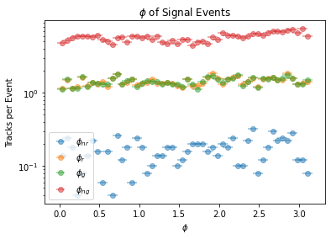
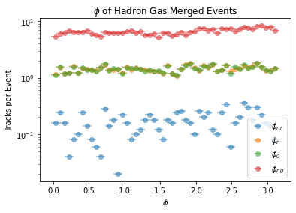
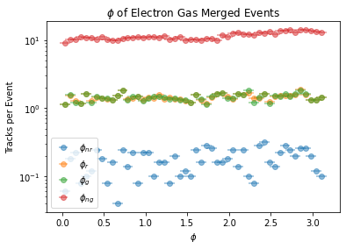
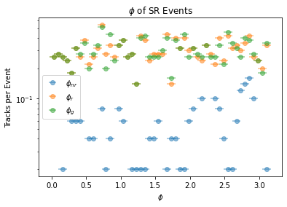
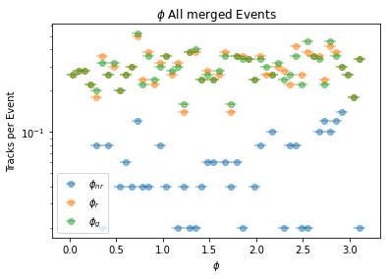
Reconstructed Phi Distributions Realistic Seeding

Slide 15
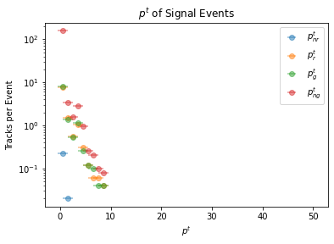
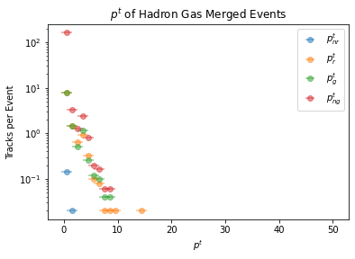
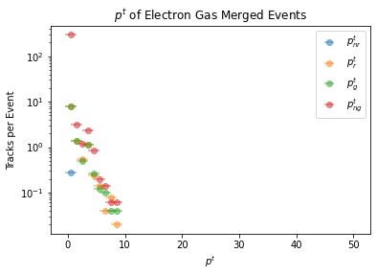
Reconstructed Pt Distributions Truth Seeding

Slide 16
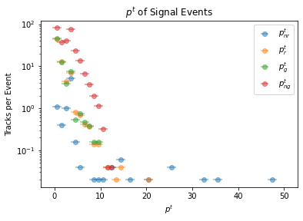
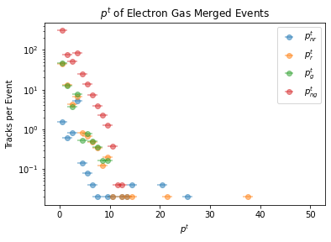
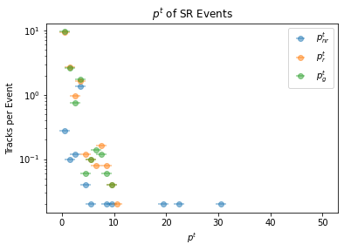
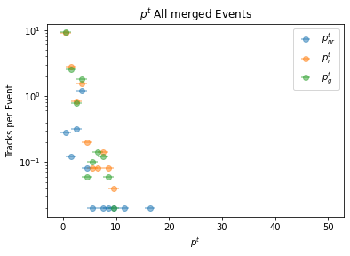
Reconstructed Pt Distributions Realistic Seeding

