Slide 1
pfRICH
LED Pulser
Fernando Barbosa (JLab)
10 August 2023

Slide 2
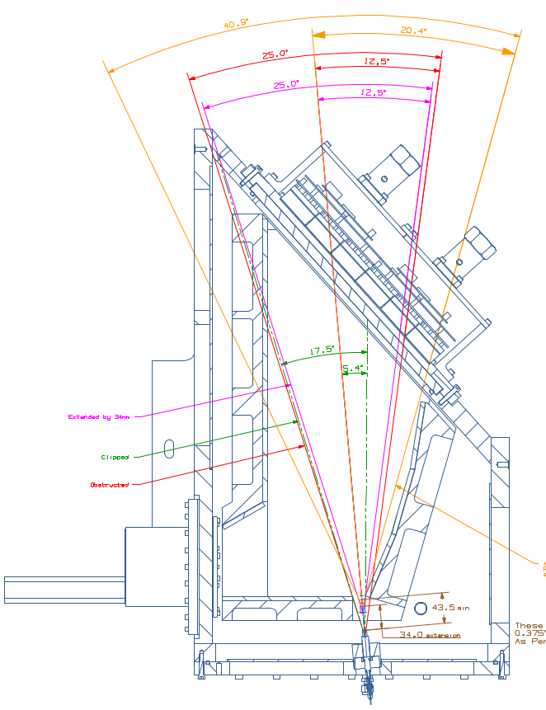
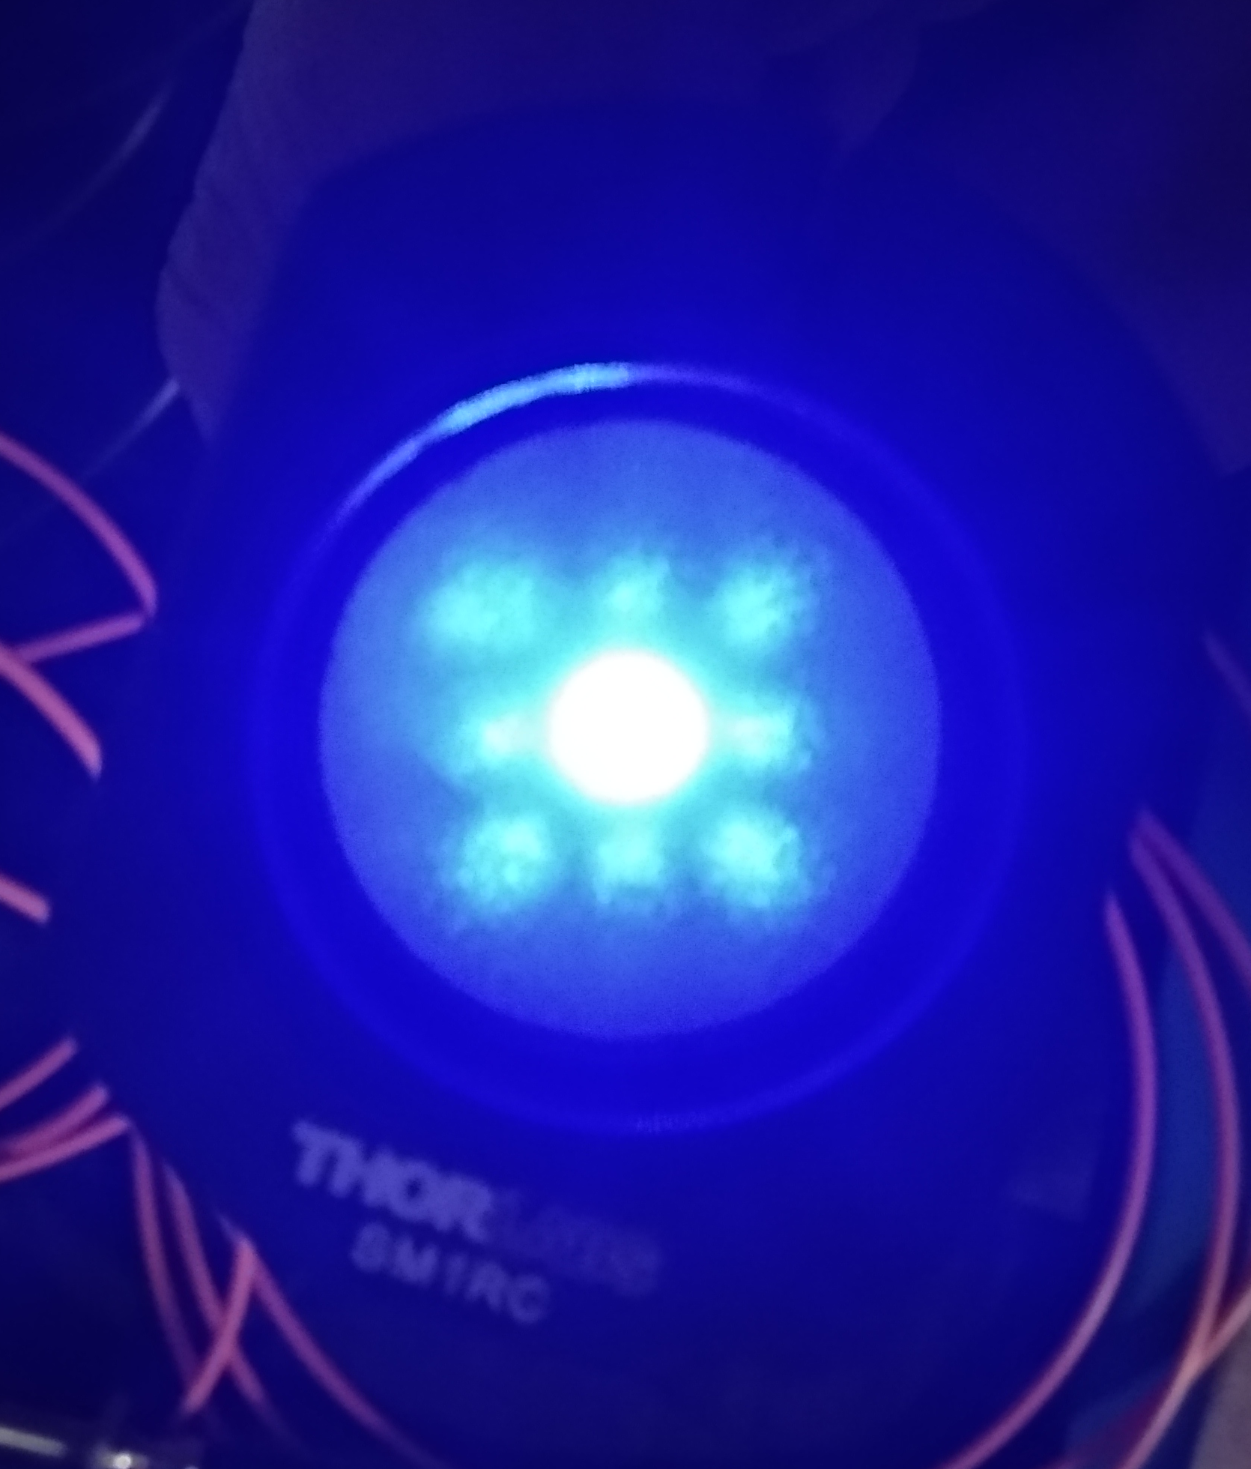
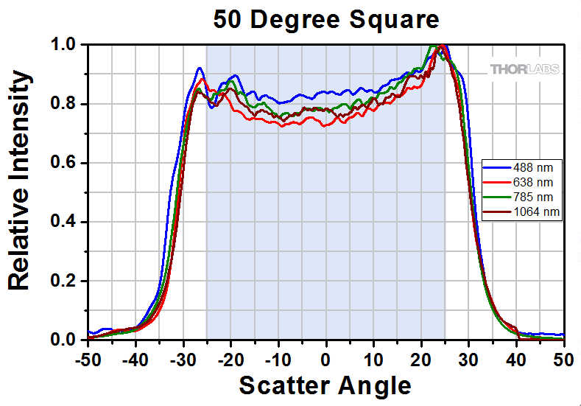
GlueX DIRC LED Pulser Setup – refer to Wenliang Li presentation
Thorlab 1” square engineered diffuser
Mirrors
PMTs
Quartz Window
DIRC Bar
Optical Port Feedthrough

Slide 3
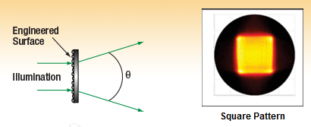
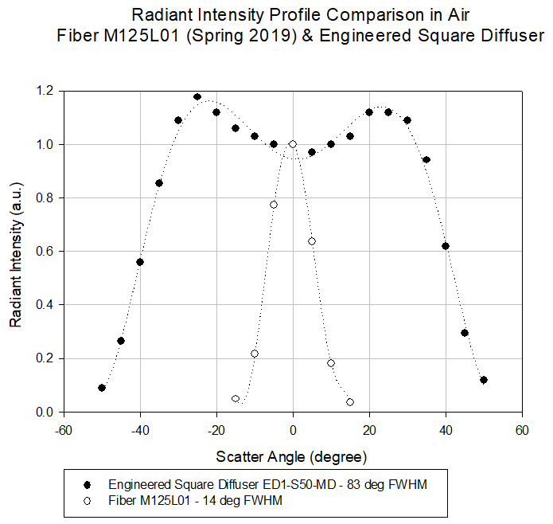
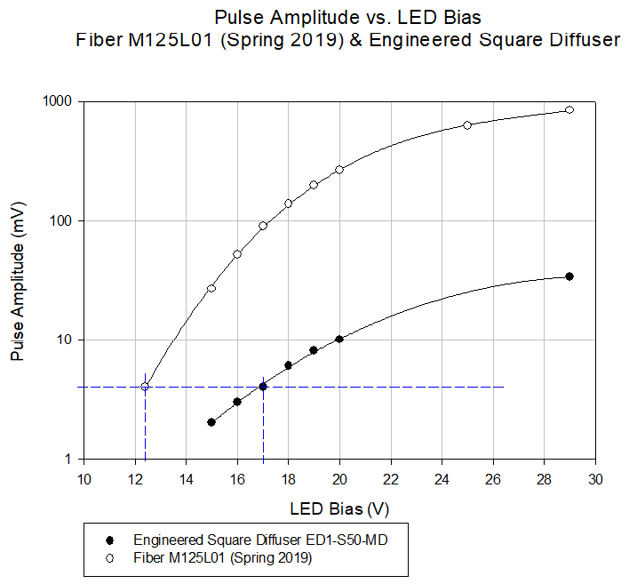
Diffuser characteristics and impact on LED pulser
Optical intensity and LED Bias:
  LED Bias: from ~12 V (fiber) to ~17 V (diffuser).
Opening angle ~62º in water.

Slide 4

Hall D Collaboration FJ Barbosa Electronics
DIRC Calibration System
DIRC LED Pulser
Chassis
MM, 0.22 NA, UV-VIS, 365/400 um
MM, 0.22 NA, UV-VIS, 1000/1100 um
2 m ~ 10 ns delay
From CAEN V1495/
V2495 Pulser (TTL)
LED
Source
15 m
17 m
15 m
19 m
17 m
19 m
Monitor
(SiPM)
Optical Port
PMT Readout Planes
Monitor
Out
SMA-SMA
Coupler
Out - Out +
1-to-7 FO Fan-out
MM, 0.22 NA, UV-VIS, 365/400 um
∆t = 10 ns
D
ADC
TDC
DIRC
N Optical Box
DIRC
S Optical Box
Timing requirements: tr < 2 ns, Jitter < 50 ps.
LED source has cost advantages.
Monitor – Allows checking source & FO performance.
One Optical Calibration Chassis.
Uses same Hall D infrastructure as other pulsers in the hall: V2495, MPOD
27 September 2018

Slide 5
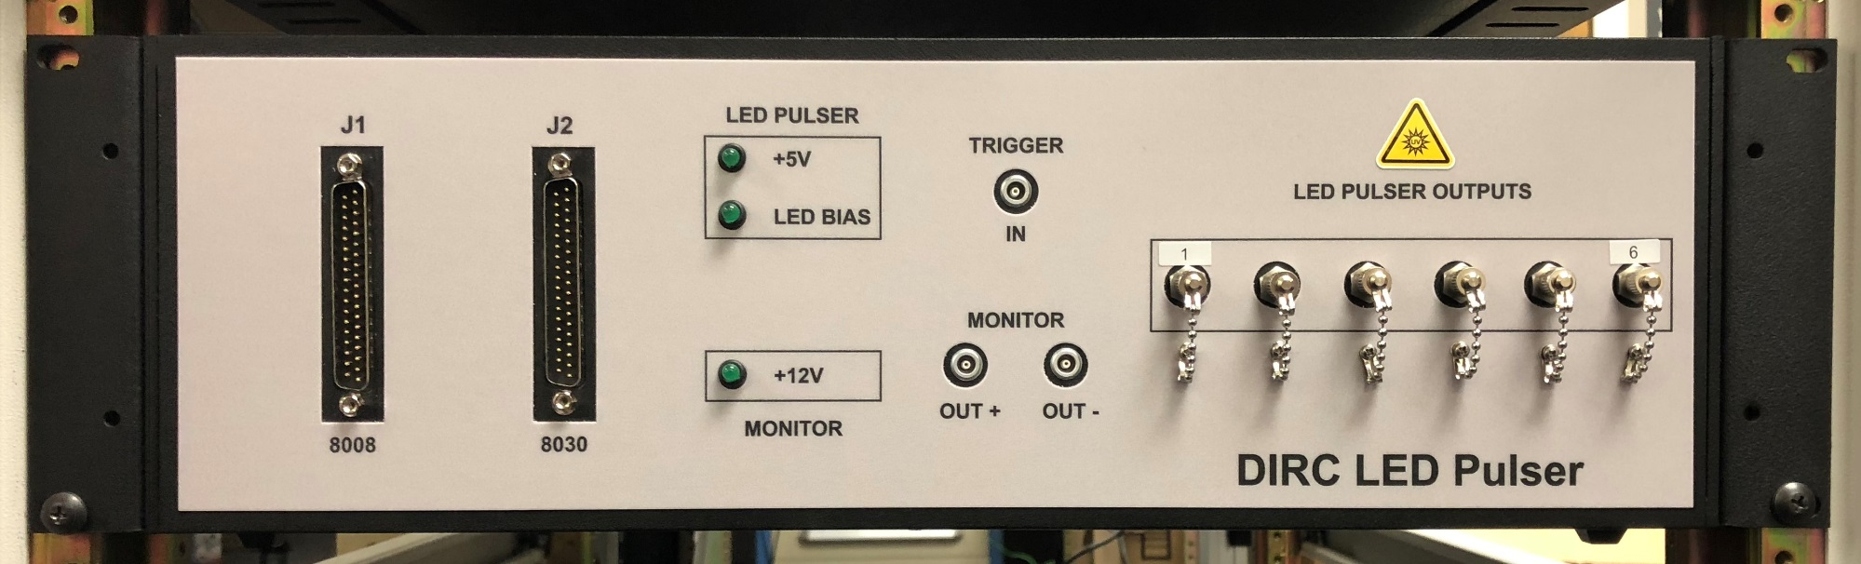
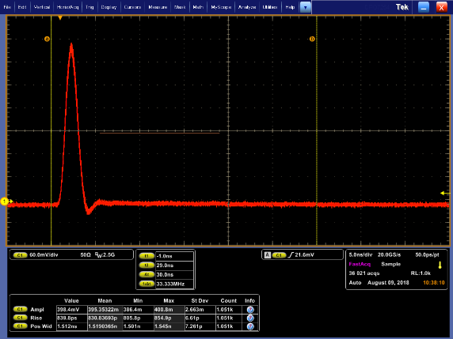
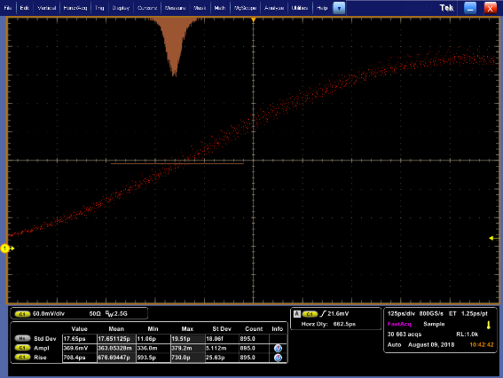
Hall D Collaboration FJ Barbosa Electronics
Hall D DIRC LED Pulser System (COMCAL uses LED Pulser module only)
  6-Port LED Pulser [SMA Optical, High OH, 365 µm UV MM fibers]
  Uses Hall D MPOD-based LV & controls (J1, J2)
  Modular design: LED Pulser & SiPM Monitor. These can be used individually.
  System Specifications (nominal):
    λ=405 nm (430, 465, 470 available)
    Trise=840 ps
    Twidth=1.5 ns FWHM
    Jitter σj=18 ps
    Amplitude Stability σA=2.5 %
    Port Amplitude Matching=±7 %
27 September 2018
  Preliminary information using Tek DPO7254 [2.5GHz, 40 GSPS, Tr=160 ps, σj=1.5 ps].

Slide 6
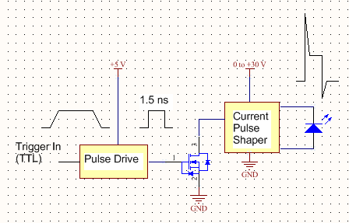
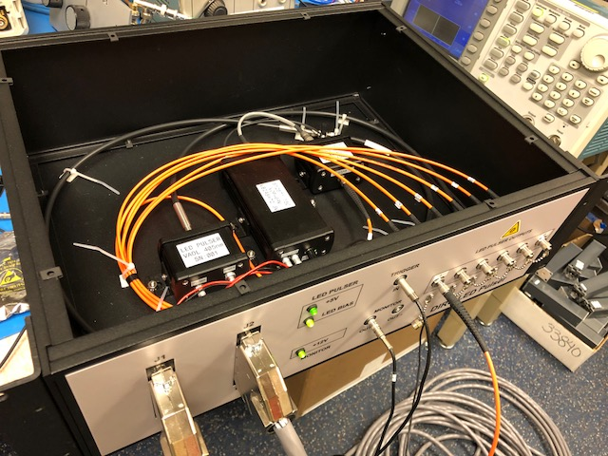
Hall D Collaboration FJ Barbosa Electronics
LED Source
SiPM Monitor
Bias Source & Output Driver
LED Source optical intensity is set via MPOD +30V supply.
SiPM bias is fixed and has been set per spec.
SiPM Monitor is temperature compensated for T ambient.
LED Source
 | Tr (ps) | Tw (ns) FWHM | Jitter σj (ps)
LED Pulser | 755 | 1.1 | 14
SiPM Monitor | 416 | 1.0 | 11
DIRC System | 840 | 1.5 | 18
  Preliminary information using Tek DPO7254 [2.5GHz, 40 GSPS, Tr=160 ps, σj=1.5 ps].
27 September 2018

