Slide 1
Barrel HCAL Electronics Chain and Requirements
J. Lajoie
D. Anderson
Iowa State University

Slide 2
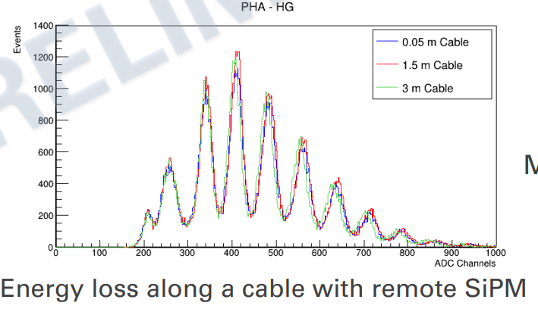
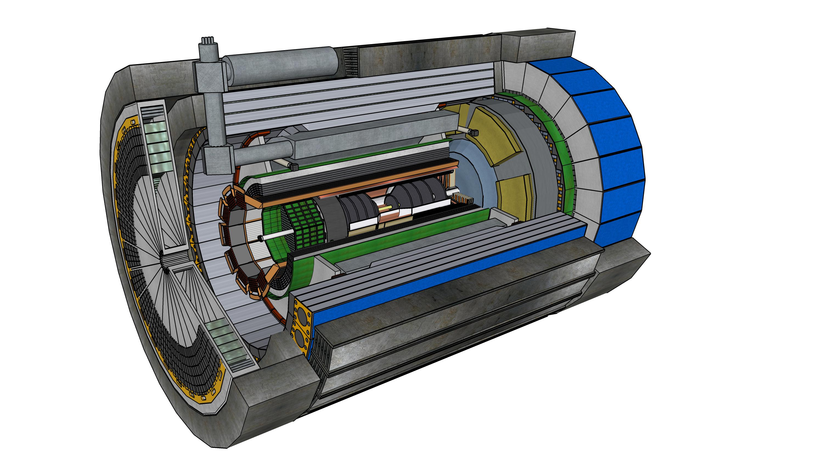
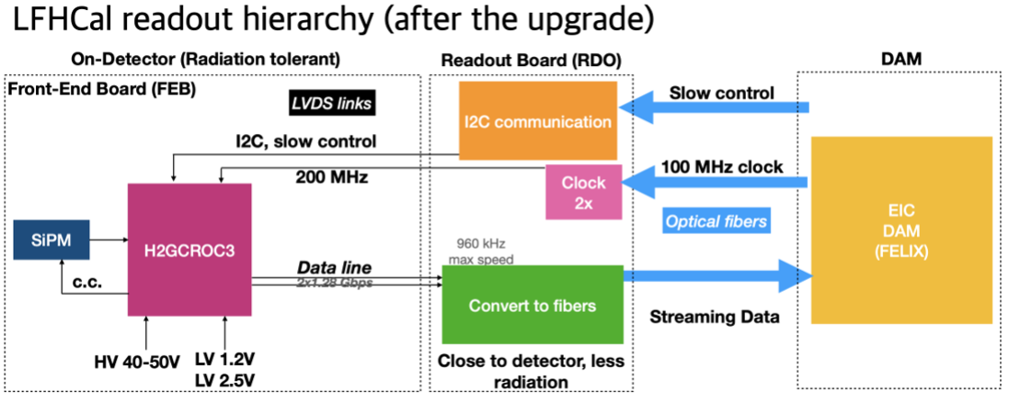
Readout Chain
One sector -> 8 H2GCROC3 boards. Cable SiPM’s out to end of barrel HCAL to keep accessible for maintenance.
~3m (μcoax)
120 cables/end
~5m (Cu)
4 cables
RDO’s
H2GCROC3 (4) + LED driver board
Fiber(s) to DAM

Slide 3
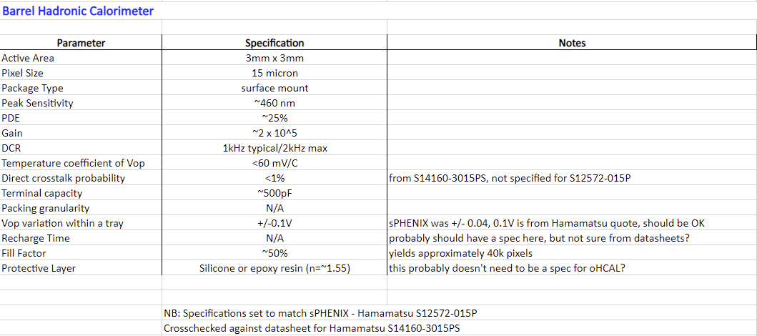
SiPM Specifications

Slide 4
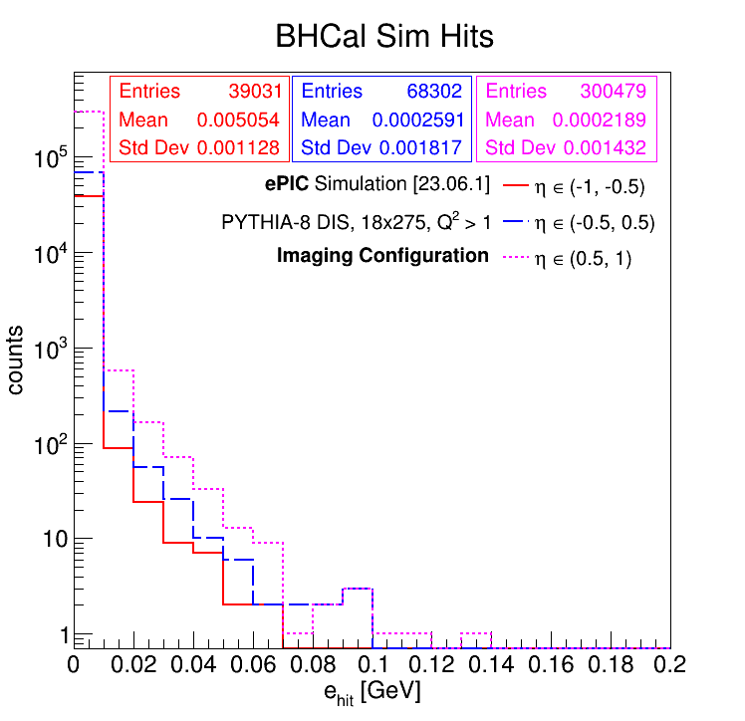
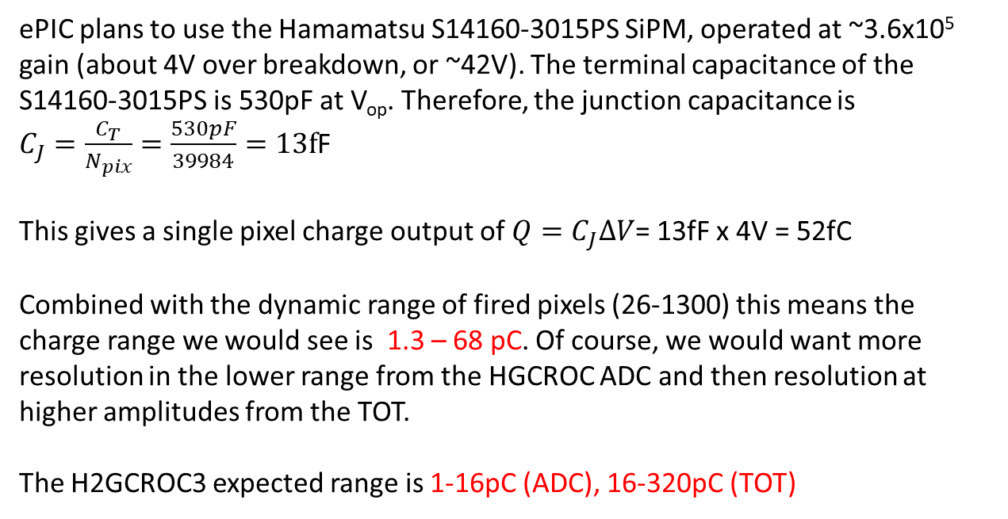
Readout Requirements – Dynamic Range
0.3 GeV of *visible* energy corresponds to ~1300 SiPM pixels firing
Single muon requirement sets lower limit at ~26 pixels
(see backup, using sPHENIX calibration and new SiPM).
ePIC plans to use the Hamamatsu S14160-3015PS SiPM, operated at ~3.6x10⁵ gain (about 4V over breakdown, or ~42V). The terminal capacitance of the S14160-3015PS is 530pF at V_{op}. Therefore, the junction capacitance is
$C_{J}=\frac{C_{T}}{N_{pix}}=\frac{530pF}{39984}=13f$F
This gives a single pixel charge output of $Q=C_{J}ΔV$= 13fF x 4V = 52fC
Combined with the dynamic range of fired pixels (26-1300) this means the charge range we would see is 1.3 – 68 pC. Of course, we would want more resolution in the lower range from the HGCROC ADC and then resolution at higher amplitudes from the TOT.
The H2GCROC3 expected range is 1-16pC (ADC), 16-320pC (TOT)
This is the distribution of energy deposited in the scintillating tiles (*visible* energy) in an ePIC simulation of 18x275 GeV DIS events (10k events total). The regions are split in rapidity, and the higher overall energy deposition at positive rapidity is visible.

Slide 5
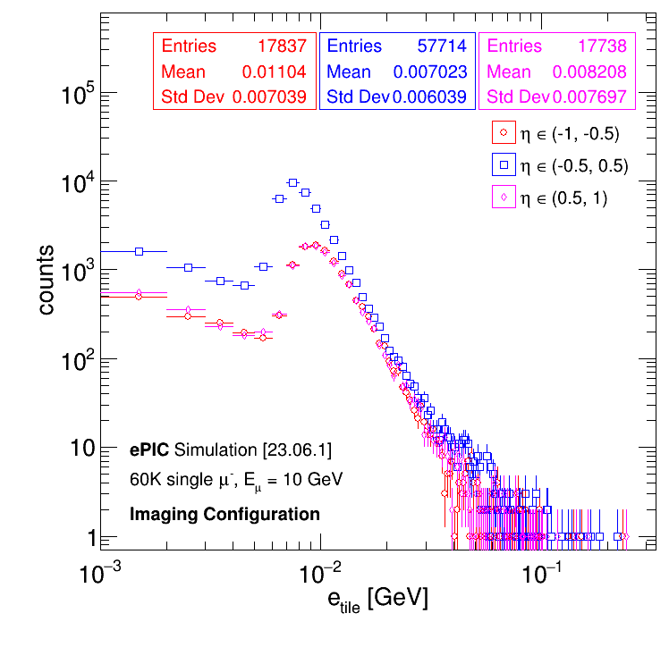
Muons in Simulation
Single muon peak in simulations is at 0.01 GeV/tile
This corresponds to:
0.01 GeV * 3200 pixels/GeV * (0.32/0.25) = 41 pixels
This is a lower than the sPHENIX tower estimate using the sampling fraction (~100 pixels). Close to the lower end of the dynamic range of the H2GCROC, but still within in.
Will need to worry a lot about noise to make sure the MIP peak is not swamped. May be able to mitigate incoherent noise by adding scintillators.

Slide 6


Slide 7
This is the distribution of energy deposited in the scintillating tiles (*visible* energy) in an ePIC simulation of 18x275 GeV DIS events (10k events total). The regions are split in rapidity, and the higher overall energy deposition at positive rapidity is visible. (Simulation and plot courtesy of Derek Anderson, ISU.)
How does this compare to sPHENIX?
sPHENIX had a range to 50 GeV total energy in a tower (5 scintillators). Correcting for the sampling fraction and number of scintillators in a tower:
50 GeV*0.03/5 = 300 MeV
is the equivalent single scintillator slat energy for sPHENIX. So, this is not all that different from the sPHENIX requirements.

Slide 8
sPHENIX sees ~16000 pixels per GeV of *visible* energy in the scintillator (per Jin Huang, 7/21/22 email and 2016 sPHENIX test beam).
16000 pixels/GeV/5 scintillators = 3200 pixels/GeV (ePIC)
So 0.3 GeV of *visible* energy corresponds to ~960 SiPM pixels firing. (As we know already, we are not using anything like the full range of the 40k pixels in the SiPM, so linearity issues with the SiPM should not be a concern.)
At the other end of the spectrum, a MIP muon loses about ~1GeV in traversing the HCAL from inner to outer radius. This corresponds to:
1 GeV * 0.03 * 3200 pixels/GeV = ~96 pixels/scintillator
We need a little bit of room on the lower end, so let’s say 20 pixels.
So – the dynamic range in fired pixels we want in ePIC is in the range of ~20-1000 pixels.
(TO DO – look at the tile energy distribution for single muons to get an understanding of efficiency.)

Slide 9
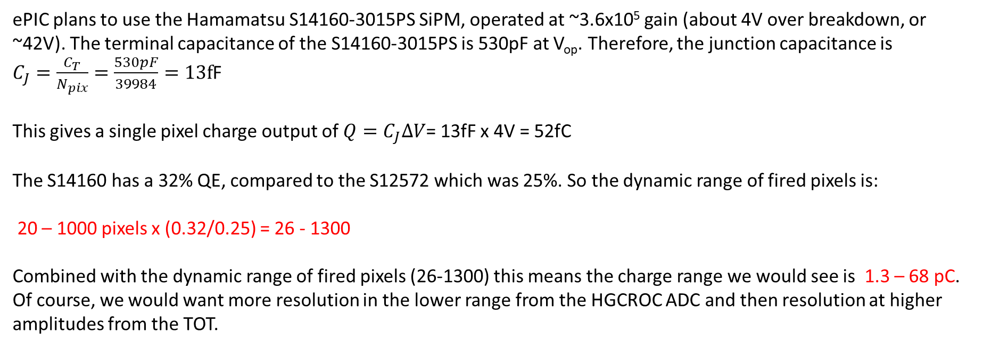
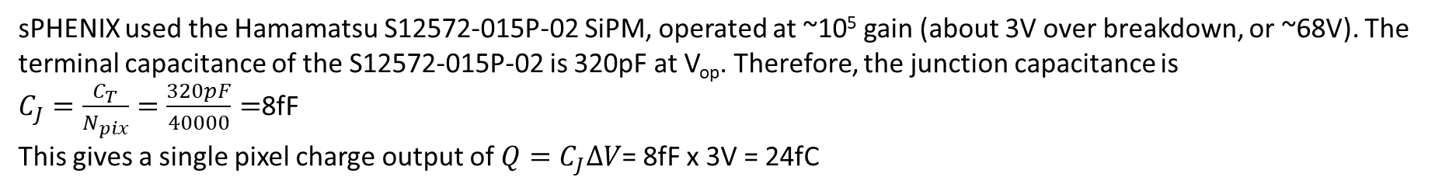
sPHENIX used the Hamamatsu S12572-015P-02 SiPM, operated at ~10⁵ gain (about 3V over breakdown, or ~68V). The terminal capacitance of the S12572-015P-02 is 320pF at V_{op}. Therefore, the junction capacitance is
$C_{J}=\frac{C_{T}}{N_{pix}}=\frac{320pF}{40000}=$8fF
This gives a single pixel charge output of $Q=C_{J}ΔV$= 8fF x 3V = 24fC
ePIC plans to use the Hamamatsu S14160-3015PS SiPM, operated at ~3.6x10⁵ gain (about 4V over breakdown, or ~42V). The terminal capacitance of the S14160-3015PS is 530pF at V_{op}. Therefore, the junction capacitance is
$C_{J}=\frac{C_{T}}{N_{pix}}=\frac{530pF}{39984}=13f$F
This gives a single pixel charge output of $Q=C_{J}ΔV$= 13fF x 4V = 52fC
The S14160 has a 32% QE, compared to the S12572 which was 25%. So the dynamic range of fired pixels is:
20 – 1000 pixels x (0.32/0.25) = 26 - 1300
Combined with the dynamic range of fired pixels (26-1300) this means the charge range we would see is 1.3 – 68 pC. Of course, we would want more resolution in the lower range from the HGCROC ADC and then resolution at higher amplitudes from the TOT.

