Slide 1
simulation update
Chandradoy Chatterjee
dRICH e/pi separation
Photon impinging angle (discusssion with Wouter)
pfRICH IRT integration BNL NPPs support
Git task list Revisit

Slide 2
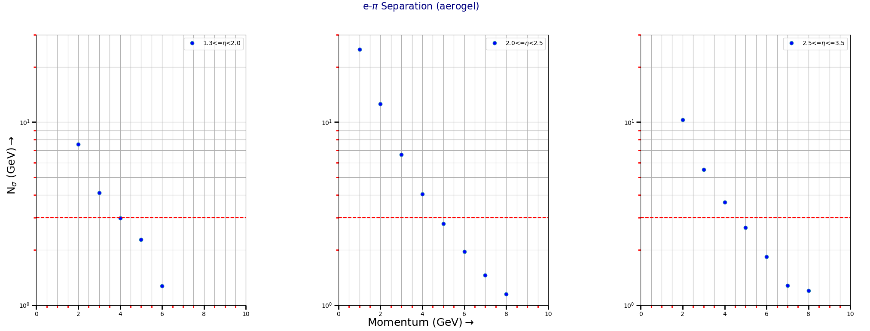
electron-pion separation (aerogel)

Slide 3
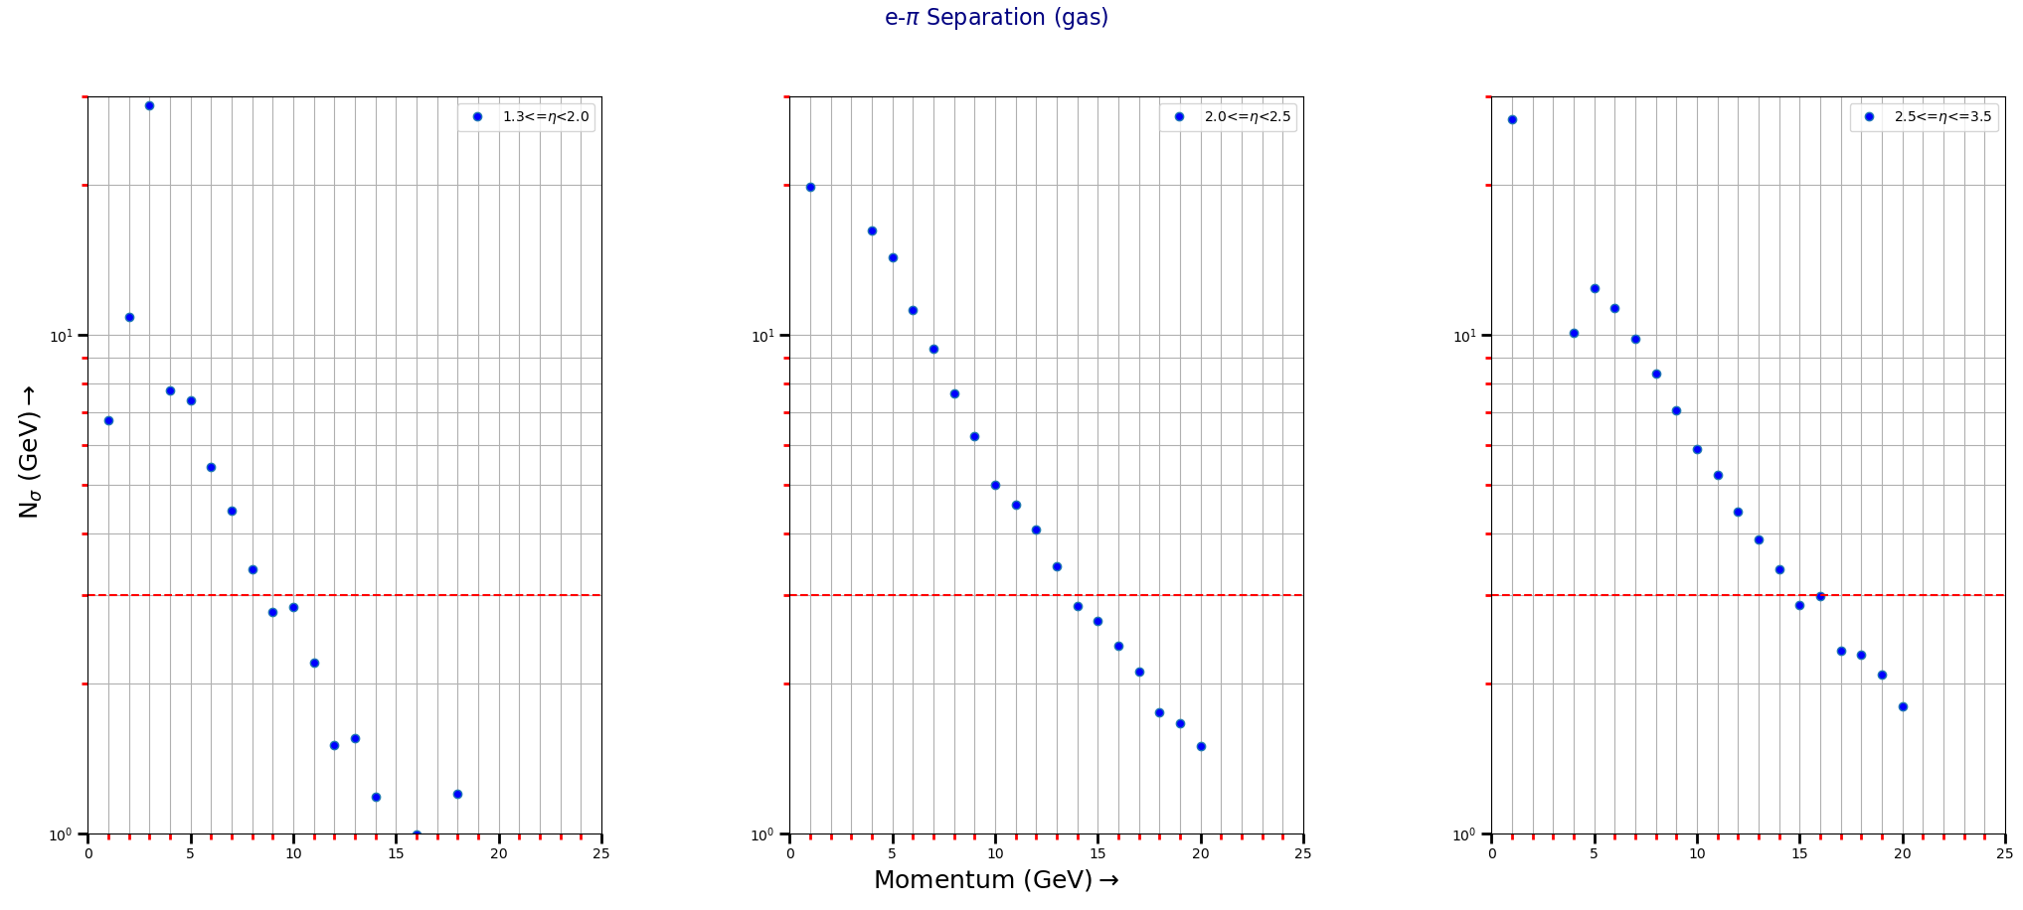
electron-pion separation (gas)

Slide 4
Photon Impinging angle Studies
Discussion with Wouter
EDM4EIC
Reconstruction Benchmark
Data Model
Users
Outputs
Analysis Files
Reconstructed
EICRecon
We cannot access the locally changed data-model reconstruction benchmark (however, I think I can use it inside the EICRecon).
Changing Data-model is not appreciated by Wouter. Because only needed variables are allowed. The need cannot be whatsoever, it is only the needed variable to interface the different reconstruction method of different reconstruction methods.
A PR can be opened with clear statements on requirement and so on.

Slide 5
PfRICH IRT Integration
Meeting today at 21:00 CET

