Slide 1
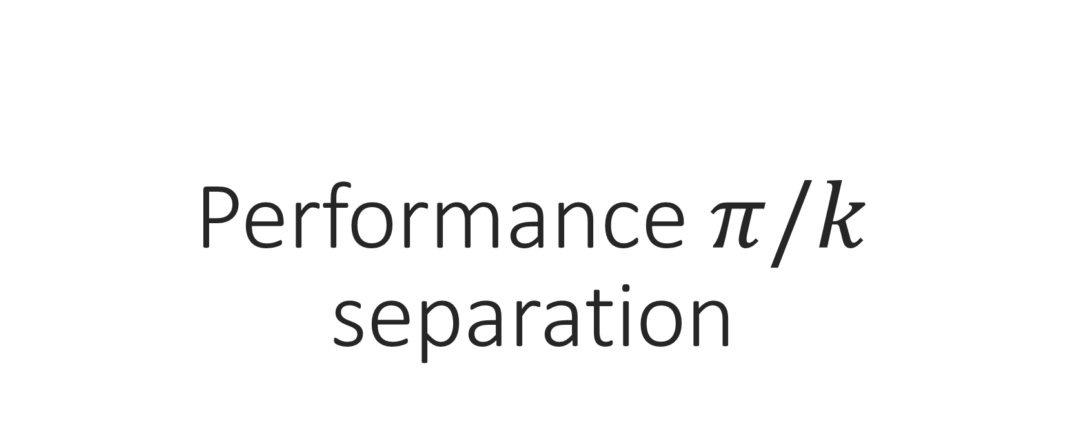
Performance $π/k$ separation
Luisa occhiuto,
Università della calabria & infn cosenza
09 august 2023

Slide 2
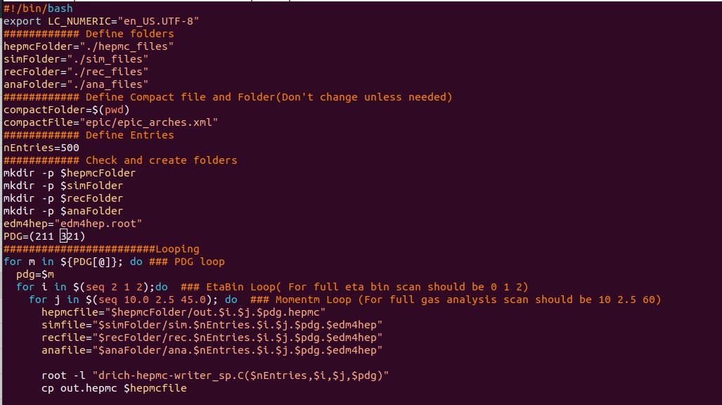
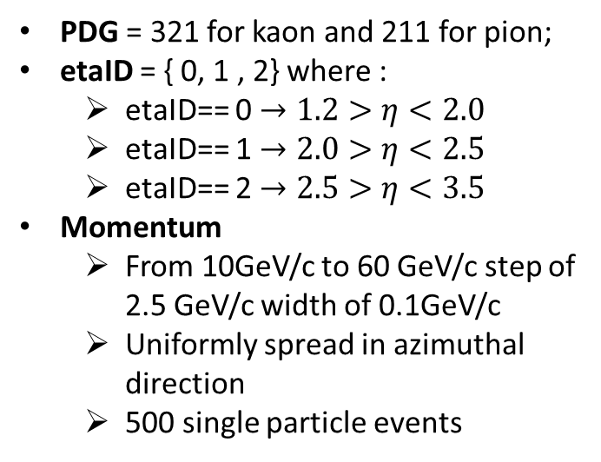
Algorithm
PDG = 321 for kaon and 211 for pion;
etaID = { 0, 1 , 2} where :
etaID== 0 $→1.2>η<2.0$
etaID== 1 $→2.0>η<2.5$
etaID== 2 $→2.5>η<3.5$
Momentum
From 10GeV/c to 60 GeV/c step of 2.5 GeV/c width of 0.1GeV/c
Uniformly spread in azimuthal direction
500 single particle events

Slide 3
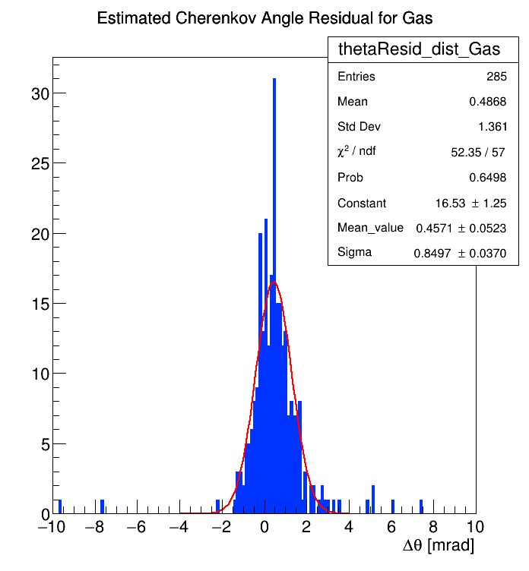
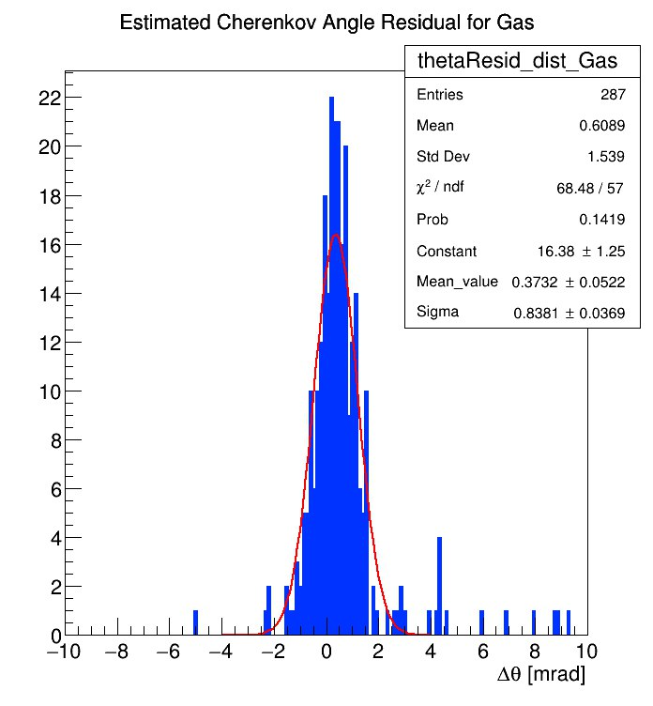
Estimated Cherenkov angle distribution for Gas
$$π$$
$$p=40.0GeV/c$$
$$K$$
$$η=[1.2, 2.0]$$

Slide 4
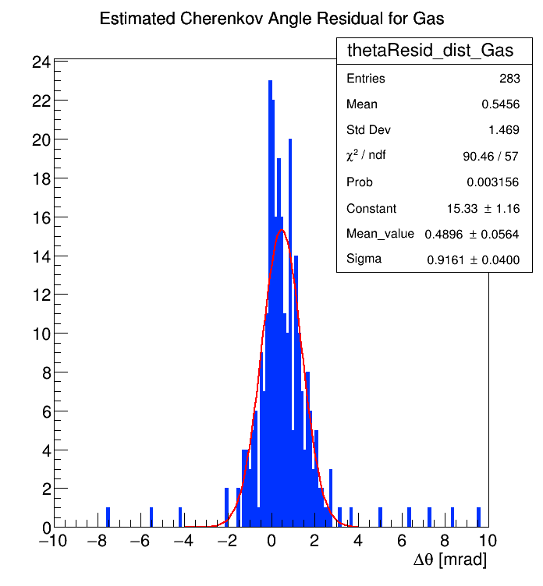
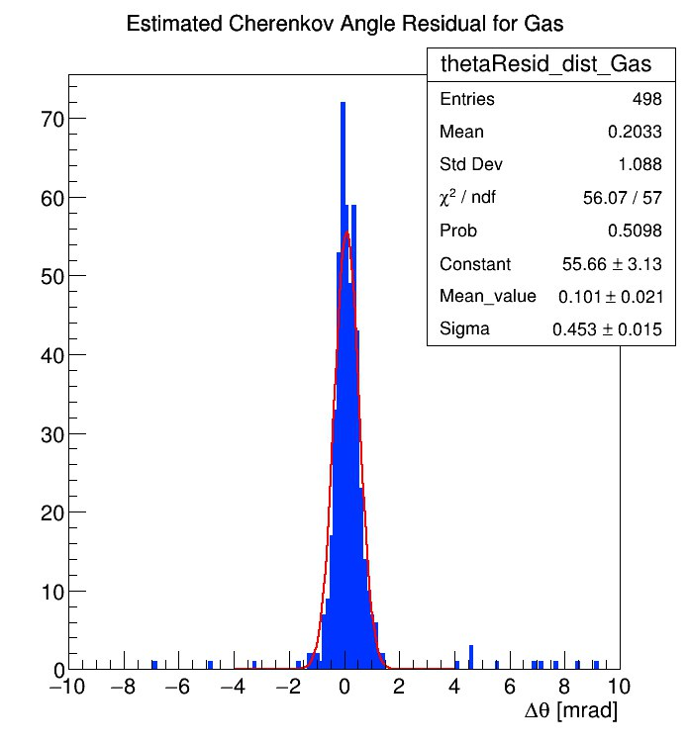
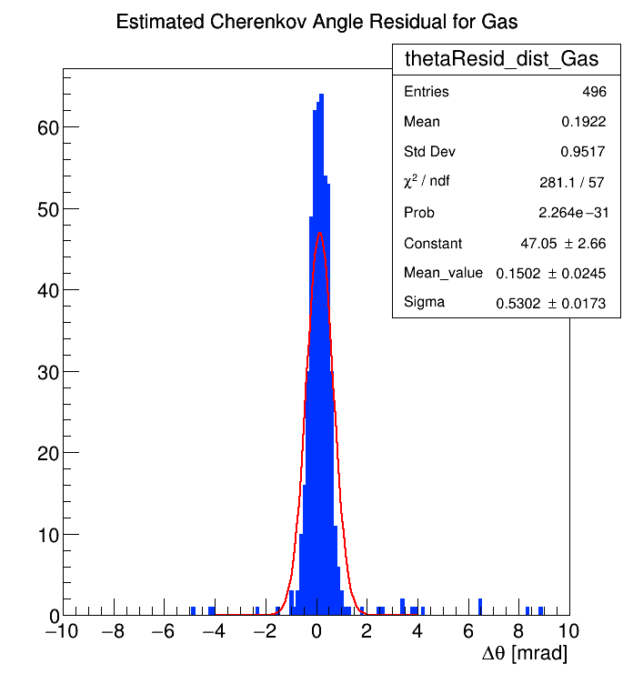
Estimated Cherenkov angle distribution for Gas (for $π$ at $p=42.5 GeV/c$)
$$η=[1.2, 2.0]$$
$$η=[2.0, 2.5]$$
$$η=[2.5, 3.5]$$

Slide 5
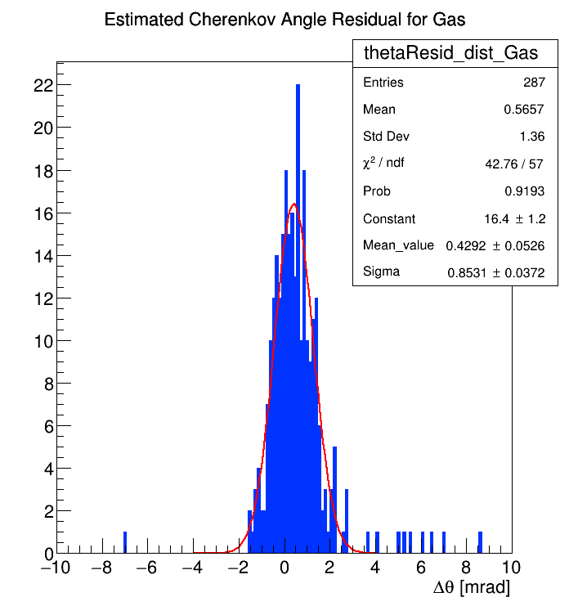
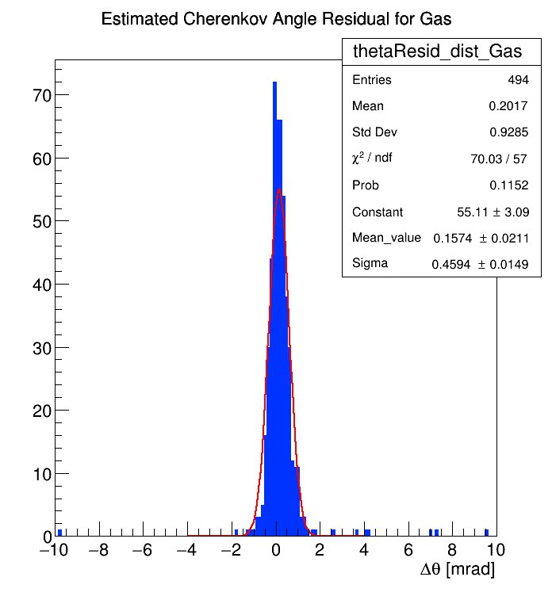
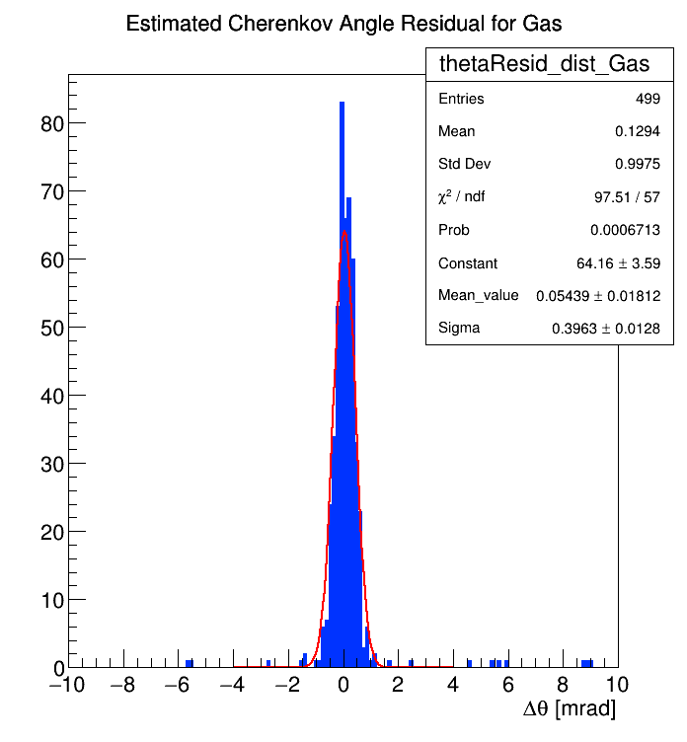
Estimated Cherenkov angle distribution for Gas (for K at $p=42.5 GeV/c$)
$$η=[1.2, 2.0]$$
$$η=[2.0, 2.5]$$
$$η=[2.5, 3.5]$$

Slide 6
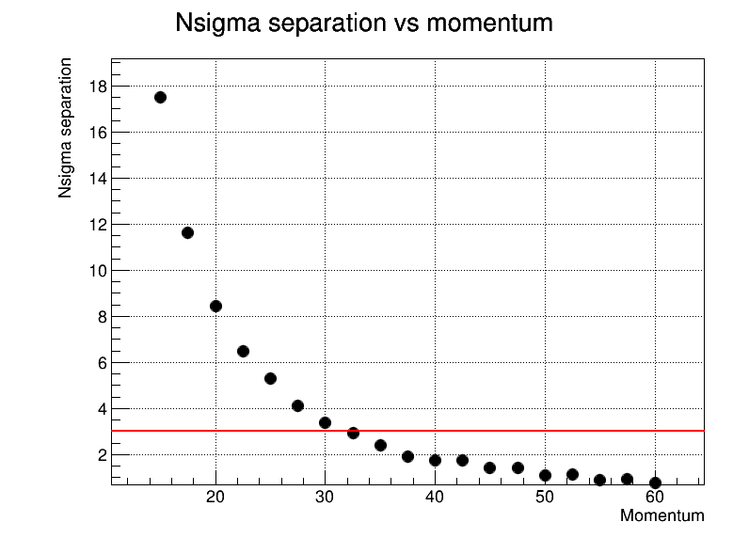
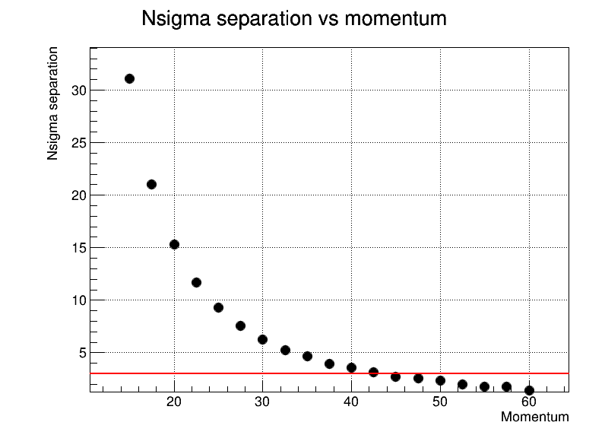
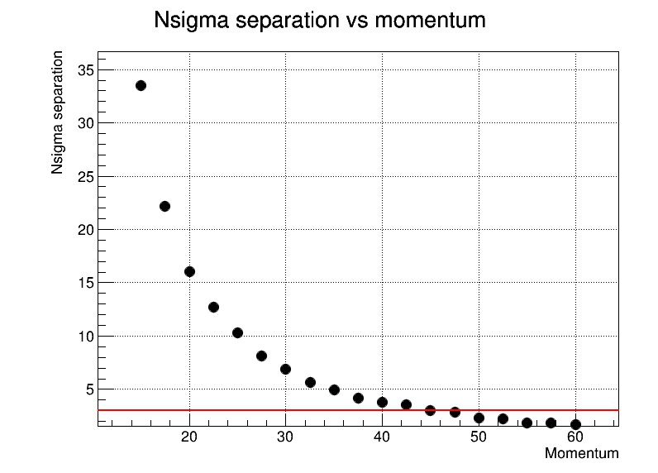
Performance $π/k$ separation
$$η=[1.2, 2.0]$$
$$η=[2.0, 2.5]$$
$$η=[2.5, 3.5]$$
$$p≃32.5 GeV/c$$
$$p≃42.5 GeV/c$$
$$p≃44.5 GeV/c$$

Slide 7
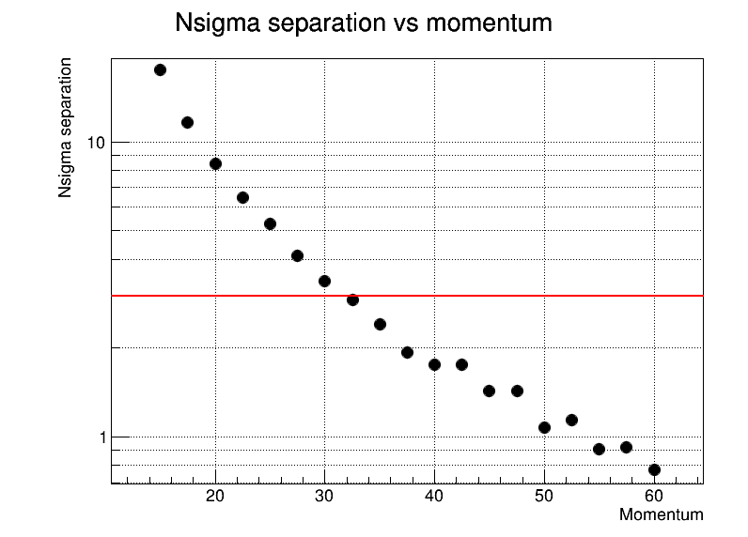
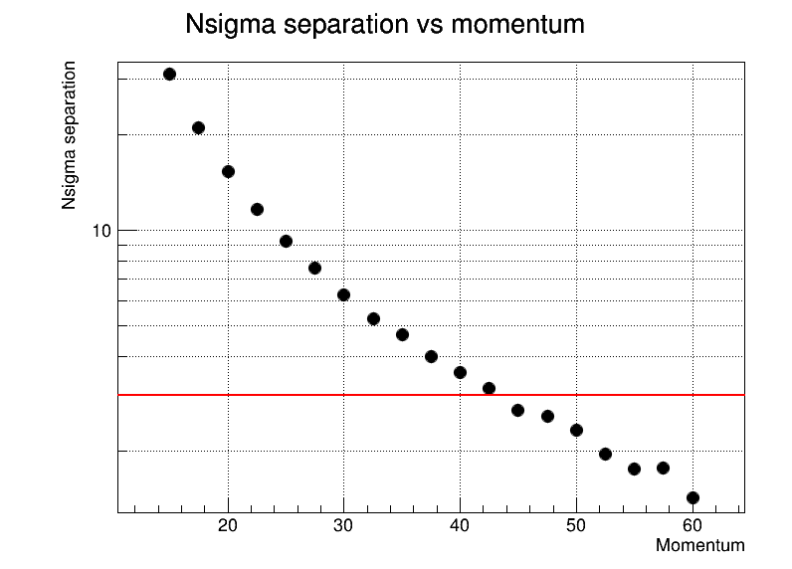
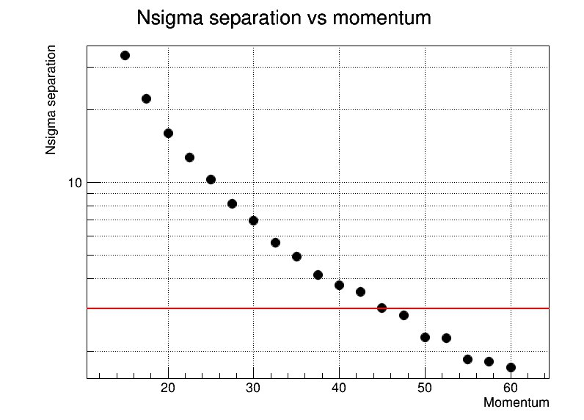
Performance $π/k$ separation
$$η=[1.2, 2.0]$$
$$η=[2.0, 2.5]$$
$$η=[2.5, 3.5]$$
$$p≃32.5 GeV/c$$
$$p≃42.5 GeV/c$$
$$p≃44.5 GeV/c$$

Slide 8
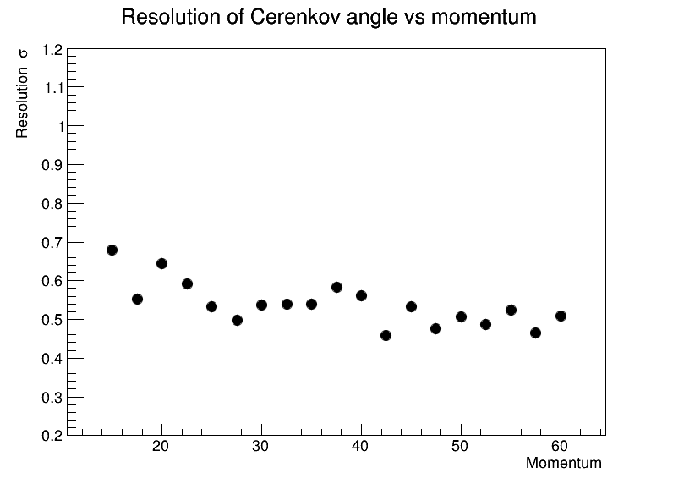
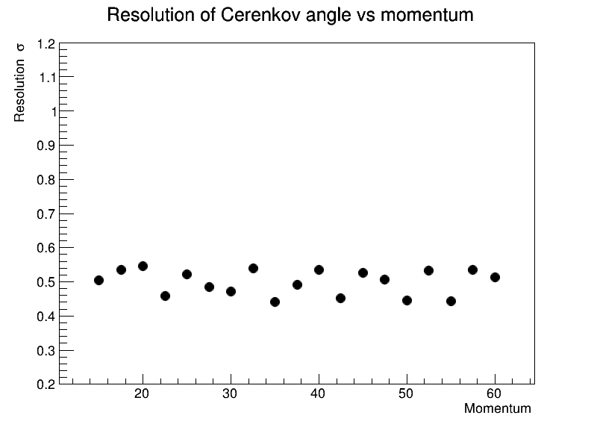
Resolution vs momentum
K
$$π$$
$$η=[2.0, 2.5]$$
$$η=[2.0, 2.5]$$

Slide 9
Thanks for you attention!

