Slide 1
Isotope Production: Using beams to produce isotopes
Postdoc Retreat
August 25, 2023

Slide 2

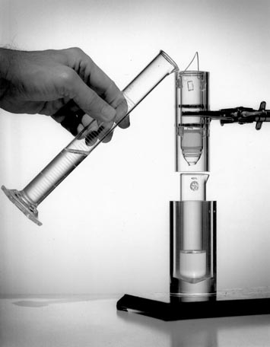
Role of the Department of Energy
The development of most, if not all, isotopes used in medicine was fostered by DOE or its predecessor agencies:
  C-14 (Oak Ridge National Lab)
  Mo-99/Tc-99m (Brookhaven National Lab)
  I-131 (Lawrence Berkeley National Lab)
  Sr-90/Y-90 (ORNL)
  F-18 FDG (BNL)
  Pb-212/Bi-212 (Argonne National Lab)
  Sr-82 (Los Alamos National Lab)
  Ac-225/Bi-213 (ORNL)
The BNL Tc-99m Generator

Slide 3
DOE Isotope Program Mission
Produce and/or distribute radioactive and stable isotopes that are in short supply; includes by-products, surplus materials and related isotope services
Maintain and upgrade the infrastructure required to produce and supply priority isotope products and related service
Conduct R&D on new and improved isotope production and processing techniques which can make available priority isotopes for research and application. Develop workforce.
Ensure robust domestic supply chains. Reduce U.S. dependency on foreign supply to ensure National Preparedness.

Slide 4
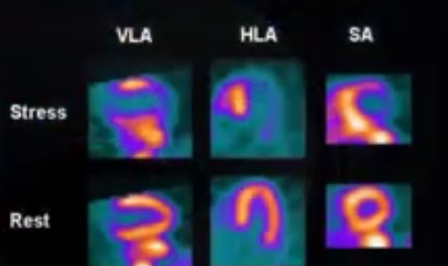
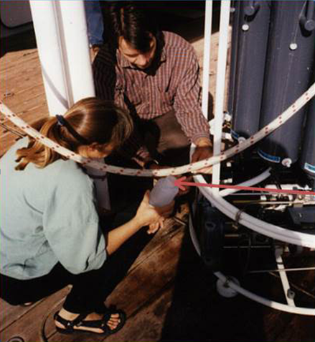
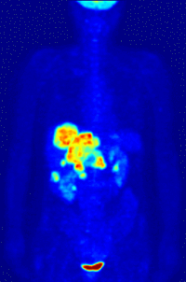
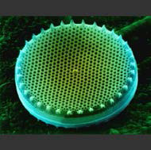
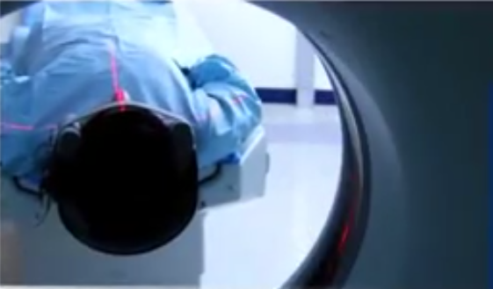
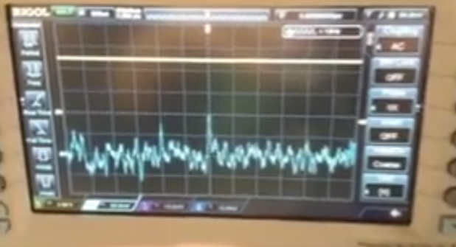
Applications – Accelerator Isotopes
Ge-68/Ga-68:
Generator-
cancer imaging
Sr-82/Rb-82:
Generator- cardiac imaging
Si-32: Environmental applications
Na-22: Source for PET imaging
Cd-109: X-ray fluorescence source
Notes:
Focusing initially on accelerator isotope products, LANL and BNL are engaged in the routine production of Ge-68 for Ga-68 generator applications (cancer imaging) and Sr-82 for cardiac imaging application. Both sites produce a variety of other products like Cd-109 (for X-ray….), Na-22 (a calibration source for PET imaging) and Si-32 (for environmental imaging) to name a few. The accelerator sites are also engaged in active R&D campaigns to make new isotopes available for applications development in the areas of fundamental R&D, medical research, and national security applications
Ge-68 (271 day)/Ga-68 (68 min)
Sr-82 (25 day)/Rb-82 (75 sec)
Si-32 (approx 170 years)
Cd-109 (461 days)
Na-22 (2.6 years)

Slide 5
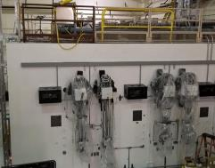
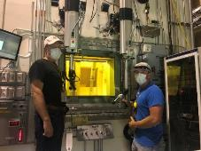
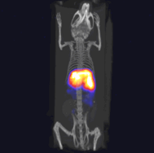
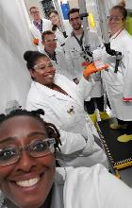
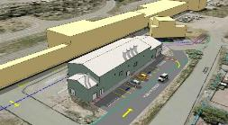
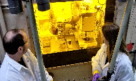
DOE Accelerator Facilities
BNL BLIP
200 MeV, 165 μA p+ beam
Ac-225, Ti-44, Se-72, Be-7, Y-86, Rb-83, Zn-65
New hot cells under development for processing of alpha emitting isotopes
19 MeV cyclotron for Ac-225
Ops coordinated with RHIC
LANL IPF
100 MeV, 300 μA p+ beam
Ac-225, Am-241, Al-26, As-73, NA-22, Zr-88, Y-88
Ops parasitic with LANSCE
New processing capability (joint NNSA/DOE IP)
ANL LEAF
20-55 MeV electron machine
Cu-67: theragnostic radioisotope: therapy and diagnostic capabilities in a single isotope.
Sc-47 and Ac-225 production is under development.
Diagnostic demonstration of Cu-67 in living mice, in collaboration with University of Alabama-Birmingham
Safe radioisotope processing during the COVID-19 pandemic
Newly refurbished hot cells for alpha-processing
Hot cell processing of Cu-67
Outstanding hands-on training in smaller facilities
Drawing of the new a-Target Processing Facility to be located next to IPF

Slide 6
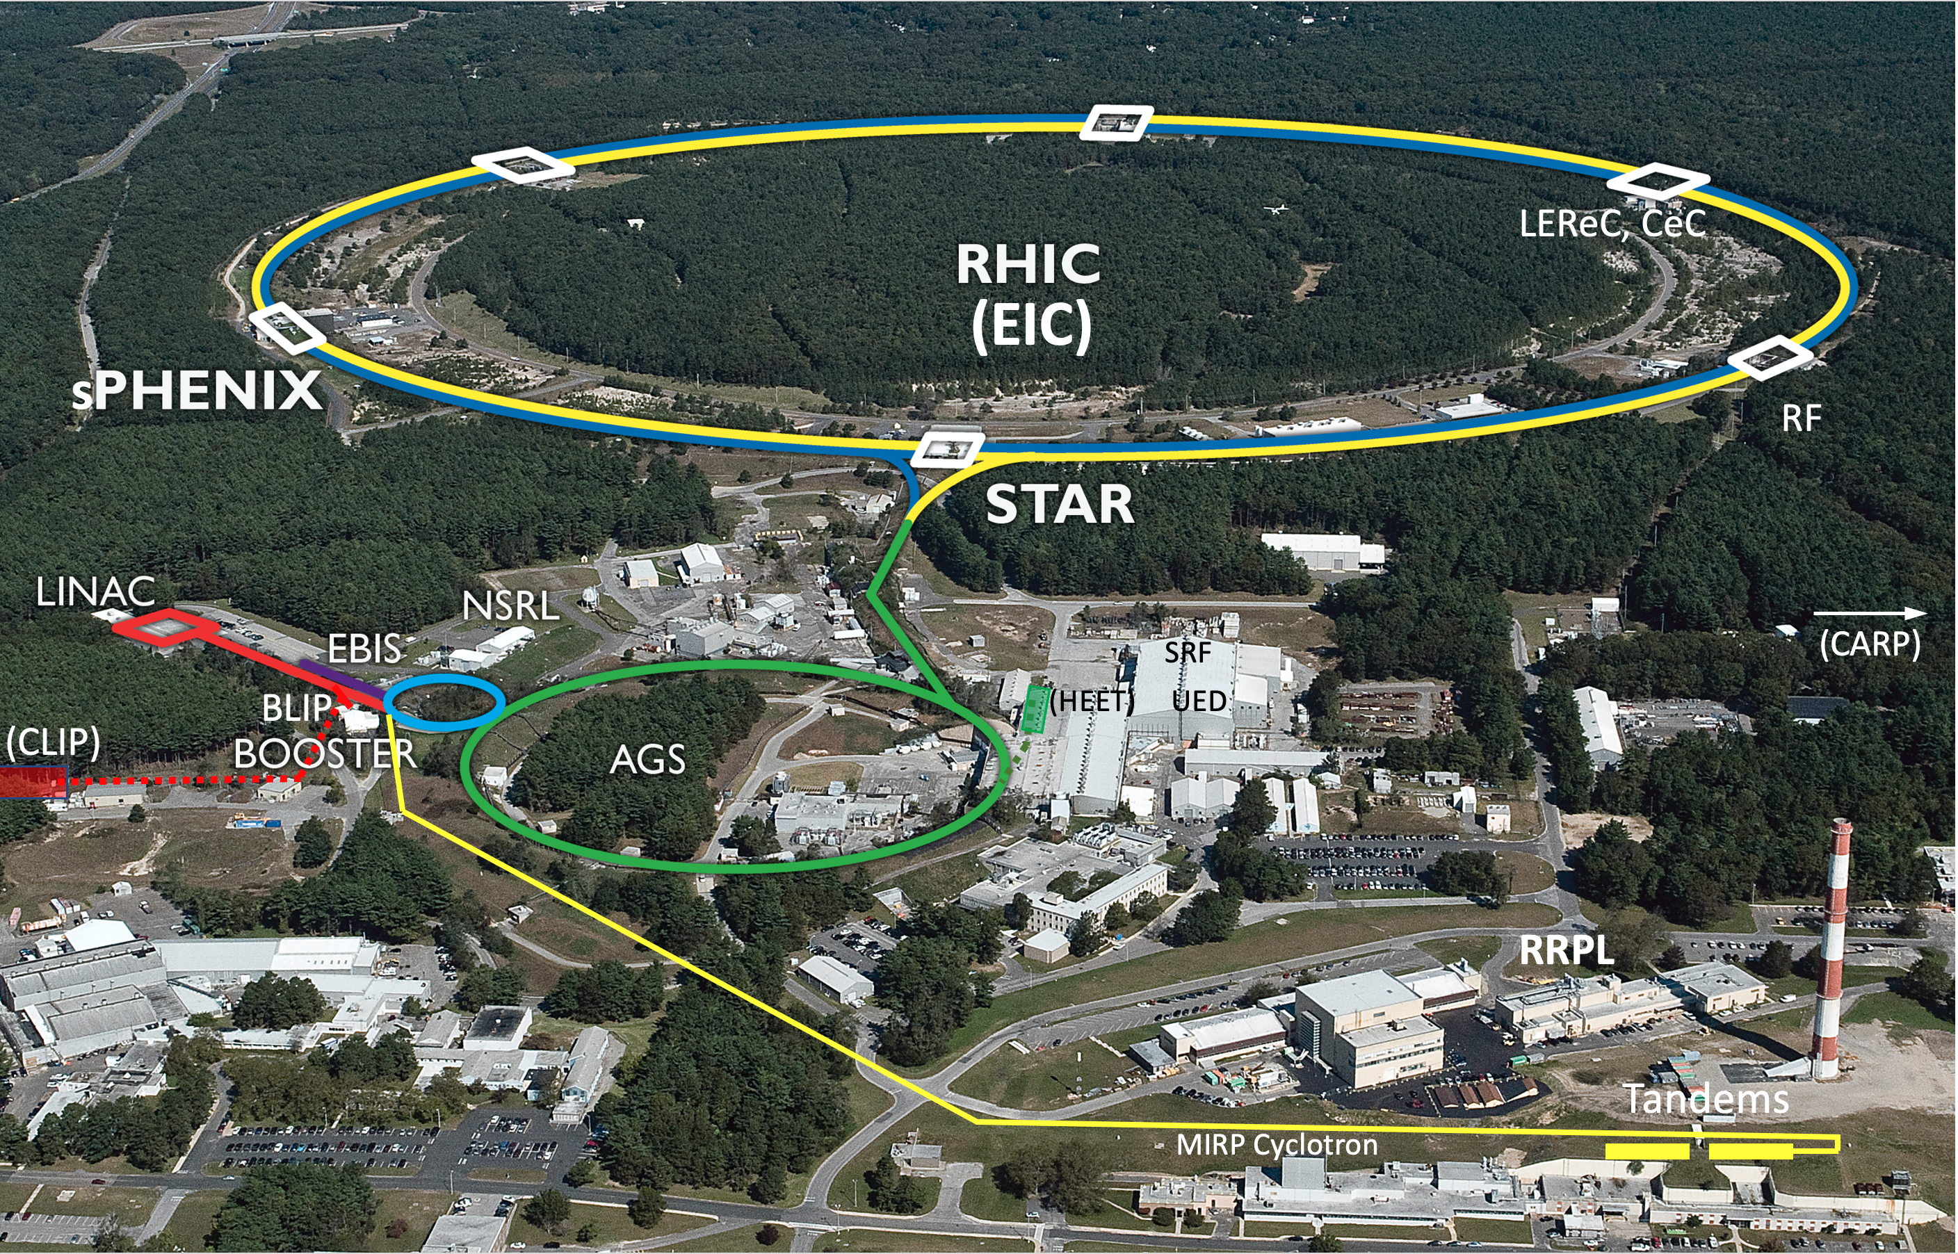
Collider-Accelerator Department facilities

Slide 7
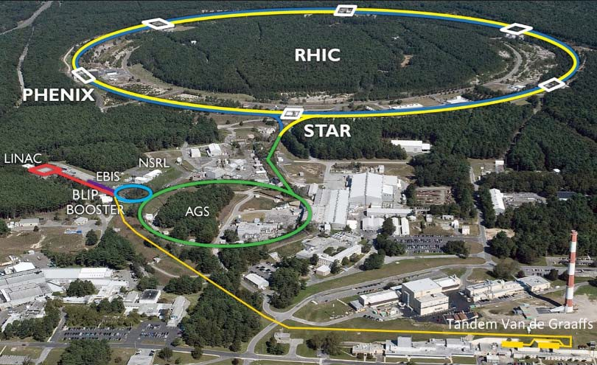
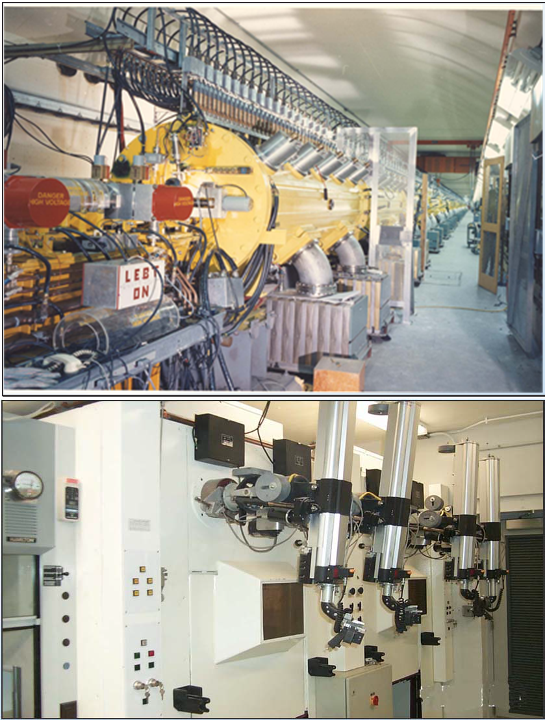

Brookhaven LINAC Isotope Producer
BLIP utilizes the beam from the proton Linac injector for the Booster, AGS, and RHIC accelerator (nuclear physics)
Excess pulses (~92%) are diverted to BLIP. Energy is incrementally variable from 66‐ 202 MeV.
The BLIP beam line directs protons up to 165μA intensity to targets; synergistic operation with nuclear physics programs for more cost-effective isotope production.
Target Processing laboratories contains hot cells and radiochemistry labs GMP compliant
Key production isotopes Sr‐82, Ge‐68; R&D isotopes Ac‐225, Sc‐44, Cu‐67, As‐72,
Re‐isotopes
http://www.bnl.gov/cad/Isotope_Distribution/Isodistoff.asp

Slide 8
Opportunities for isotope production and R&D at BLIP
^{nat}Ga(p,xn)⁶⁸Ge
⁷⁵As(p,4n)⁷²Se
⁸⁶Sr(p,n)⁸⁶Y
¹⁸⁶Re/¹⁸⁹Re
⁴⁵Sc(p,2n)⁴⁴Ti
^{nat}Rb(p,xn)⁸²Sr
⁸²Sr - API for Bracco’s Cardiogen-82® generator
⁷⁵As(p,4n)⁷²Se
²³²Th(p,2p6n)²²⁵Ac
⁶⁸Zn(p,2p)⁶⁷Cu

Slide 9
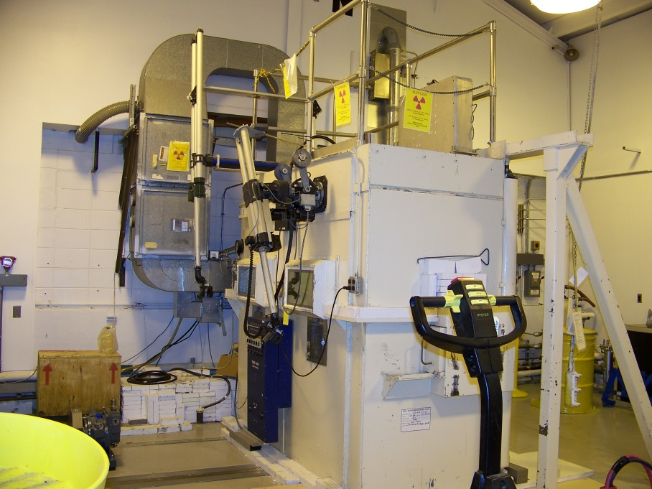
Brookhaven Linear Isotope Producer (BLIP)

Slide 10
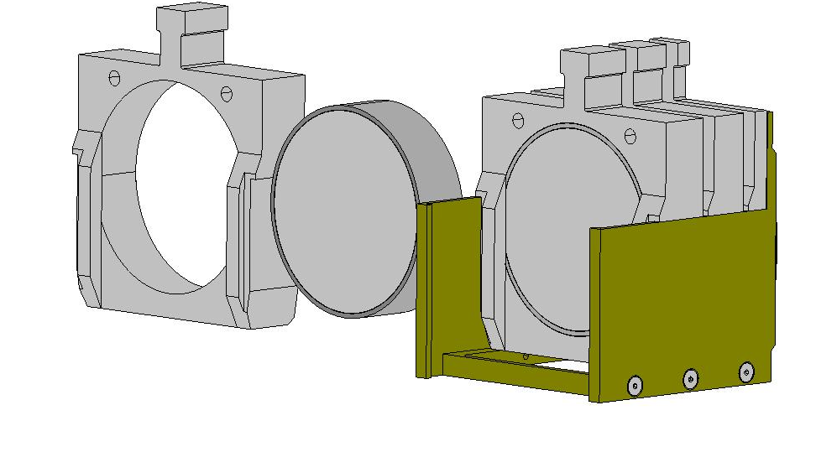
BLIP target assembly
Welded Target d~70 mm
Target holder
Support basket
~80 mm
For high energy irradiation 2 baskets can be irradiated at the same time one after another resulting 160 mm long target stack

Slide 11
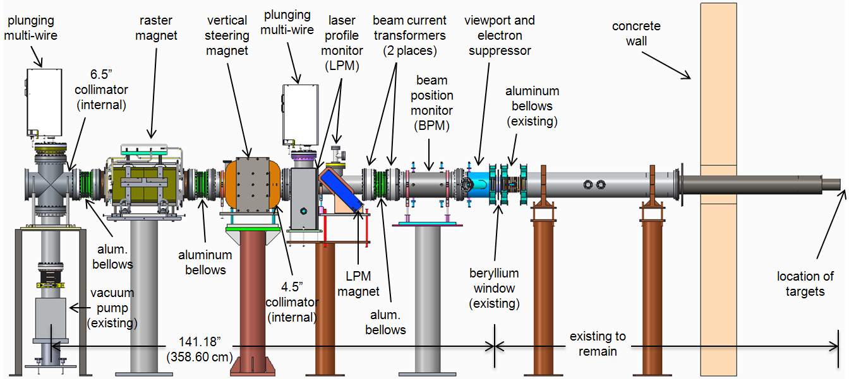
BLIP Beam Enhancements
BLIP beam raster system
Reduction in localized target heating
  Enables increase in beam current from 100 µA to 165 µA (greater isotope yields)
  Greatly lowers possibility of target failures
Linac intensity upgrade
  Phase 1 increased current to 165 µA
  Phase 2 Will increase current to 250 µA by increasing pulse length
Notes:
Project scope: Design, fabricate, install and commission a BLIP Raster system containing the components shown in the beam-line layout, and including all required mechanical, electrical and software systems.

Slide 12
Alpha Therapeutic Agents
Alpha Emitters
  Ability to deliver target-specific radiation dose due to short & well-defined track length (<100 µm)
  High linear energy transfer (LET) properties of alpha can be therapeutically effective in cells with low sensitivity to low-LET radiation (Quality factor = 5)
  Also effective against dormant tumor cells in G_{o} phase
  Cytotoxicity at both high and low-dose rates
  Works in hypoxic tissues
  Overcome required resistance
  Limited use due to availability, complexation chemistry needs development, requires specialized facilities for handling

Slide 13
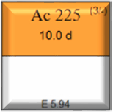
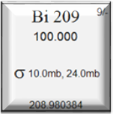
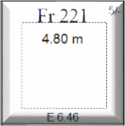
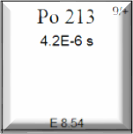
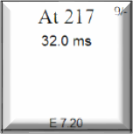
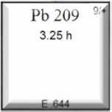
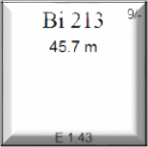
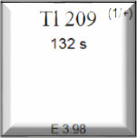
Actinium-225 nuclear data and applications
Ac-225 is an alpha emitter, T_{1/2}=9.92 d, that decays, producing 4 alpha particles – suitable nuclide for alpha radiotherapy
α
α
β
-
α
_{β}-
α
α
_{β}-
Ac-225 is a parent nuclide for Bi-213 (T_{1/2}=45.7 min) in a Ac-225/Bi- 213 generator pair. Bi-213 radiotherapeutic alpha emitter; also emits gamma ray suitable for SPECT imaging Eγ=440 keV, 27.3%
2

Slide 14
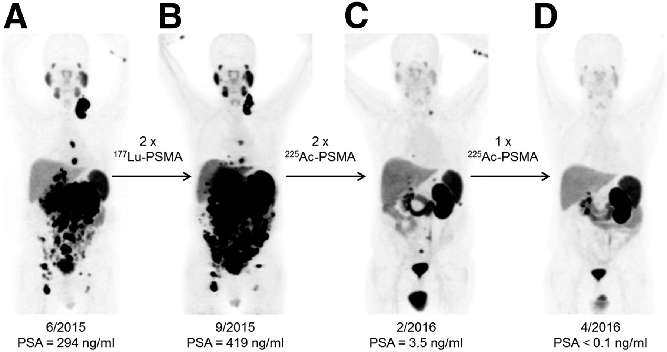
Actinium-225 vs Lutetium-177
⁶⁸Ga-PSMA-11 PET/CT scans of patient monitoring ²²⁵Ac-PSMA treatment after ¹⁷⁷Lu-PSMA
Kratochwil et al. J Nucl Med. 2016

Slide 15
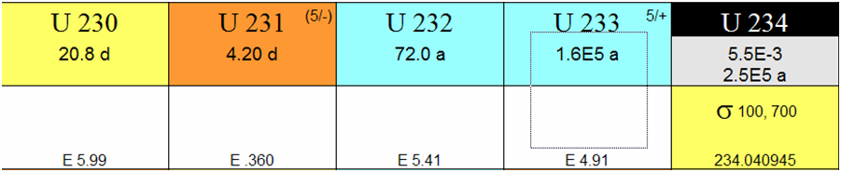
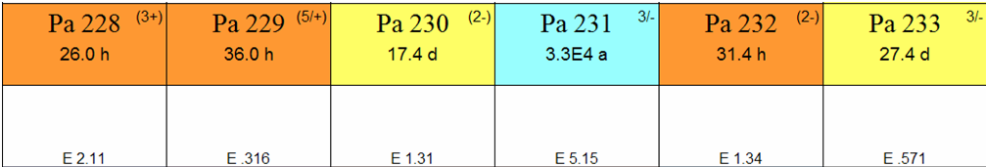
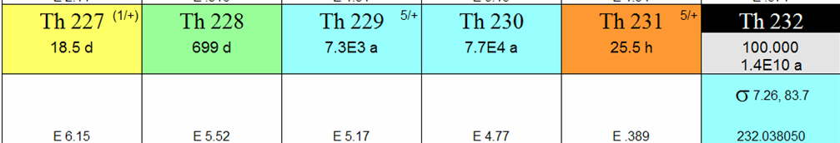
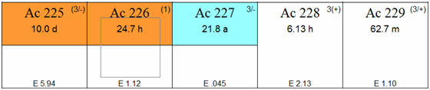
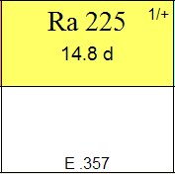
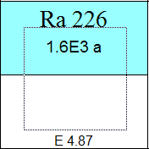
Pre-2013 Ac-225 production routes
Decay from Th-229
  ~100 mCi of Ac-225 is separated from 150 mCi of Th-229 stock at ORNL every 8 months (Ball
et al, 2005, JARI. 62(5) p 667)
  ~40 mCi available from the Institute for Transuranium Elements, Karlsruhe, Germany
(Apostolidis et al, J.Label.Compd. Radiopharm. 2001, 44(S1), p S806)
Cyclotron production through the Ra-226(p,2n)Ac-225 reaction
  Radioactive target material (Apostolidis et al, 2005, JARI, 62(3), p383)
²²⁶Ra(p,2n)²²⁵Ac
D. Medvedev. 2019 MIRP Science and Tech targetry update
nology revi
ew, Thoriu
m
3

Slide 16
Actinium-225 Production at ORNL
ORNL has been the main supplier of ²²⁵Ac (via decay of existing ²²⁹Th stock) since 1997
>10 Ci of ²²⁵Ac shipped in >2000 packages
Approximately 1 Ci of ²²⁵Ac is harvested annually from 130 mCi ²²⁹Th stock at ORNL
Thirteen campaigns are performed per year, with weekly customer shipments
²³³U
α 1.6x10⁵ y
²²⁹Th
α 7.9x10³ y
²²⁵Ra
β 15 d
²²⁵Ac
Rationale for pursuing additional routes for production of ²²⁵Ac
The present supply is insufficient to meet the growing research and medical applications demands for ²²⁵Ac
α 10 d

Slide 17
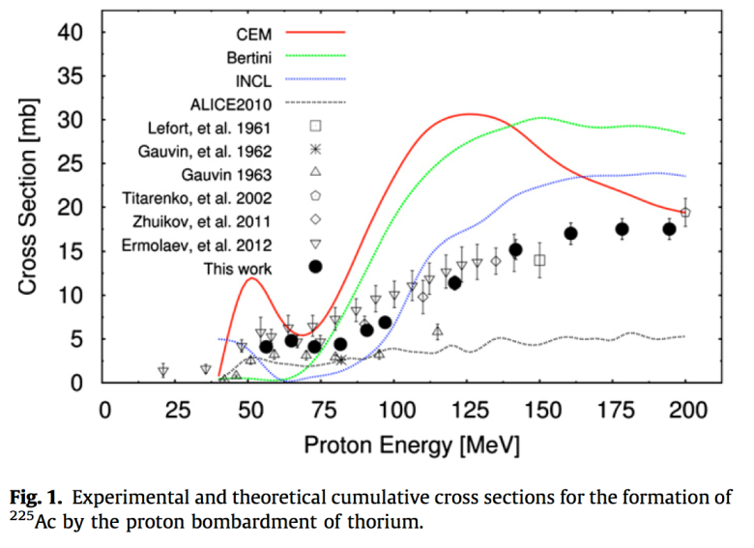
Accelerator Production via ²³²Th(p,x)²²⁵Ac:
Initial R&D Promised Significant Impact
Facility | Anticipated Single Target Ac-225 Yields (10 day irradiation)
LANL (100 MeV, 250-450 µA) | 1.3-2.3* Ci
BNL (200 MeV, 165 µA) | 2.2 Ci
* Theoretical maximum value assumed for production with 450 µA on target resulting from recent facility investments.
J.W. Weidner et al. Appl. Radiat. Isot. 70 (2012) 2602
J.W. Engle et. al. Phys. Rev. C. 88 (2013) 014604
J.W. Engle et. al. Radiochim. Acta 102 (2014) 569
J.R. Griswold et. al. Appl. Radiat. Isot. 118 (2016) 366
Facility investments at IPF and BLIP have increased our projected production capacity

Slide 18
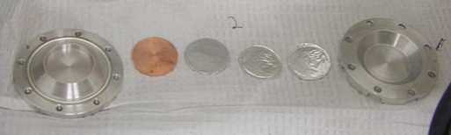
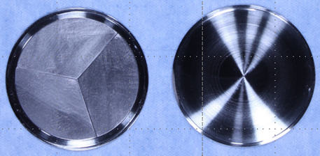
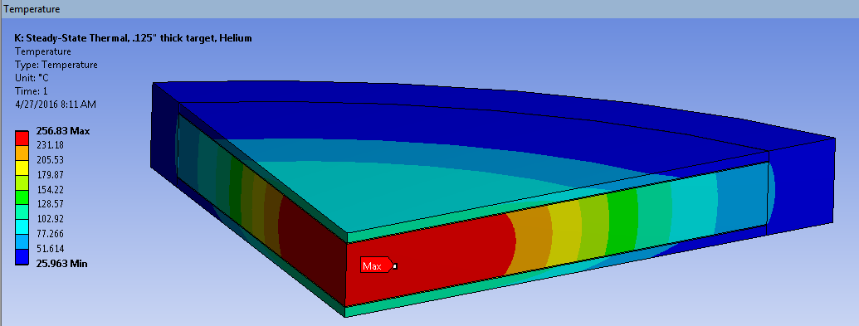
Target Challenge: develop thick Th targets to withstand high beam current to support clinical scale production
Targetry and Inventory
Initial targets were thin Th foils (0.127mm, 0.9g) encapsulated in Al. Used to support small scale production for chemistry development and for ²²⁵Ac cross section determinations.
Next larger diameter (0.38mm thick,13g )BNL targets to support new rastered beam at BLIP were sealed in inconel by electron beam welding.
Primary risk associated with Ci-Scale targets (~100g) is overheating. Capsule MP (1290°C) is lower than thorium MP (1755°C).
Thermal behavior at Th/capsule interface is key.
Thermal calculation for 165μA at 191 MeV incident energy assuming ideal thermal contact for a 3 mm thick target (105g) predicts low peak temperature but actual thermal contact conductance will be lower.

Slide 19
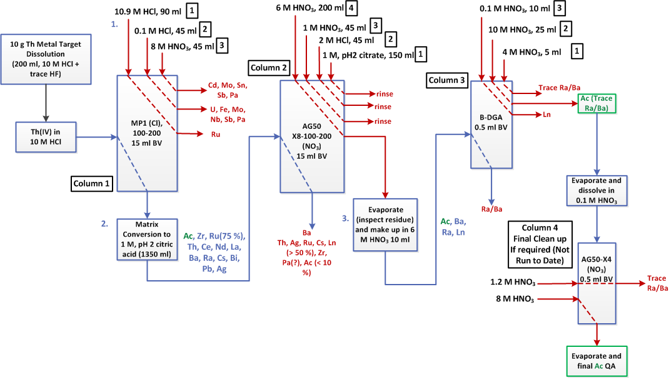
Chemical recovery ~90%, >99% radiopurity, ²²⁵Ac/²¹³Bi generator performance is equivalent to generators prepared from ²²⁹Th-derived ²²⁵Ac.
Preliminary Chemistry Flow Sheet

Slide 20
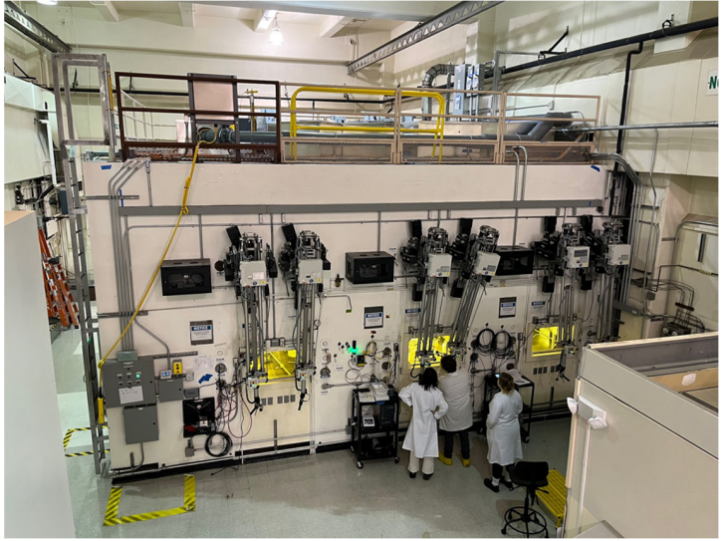
Processing Facilities at BNL: Latest News
Commissioned new AP hot cells for processing of Ac-225 to meet growing demand
AP hot cells in routine operations
This year a major milestone was achieved!
MIRP put 112 mCi of Ac-225 into inventory by irradiation and processing all conducted here onsite (BLIP and AP hot cell) – great accomplishment!
DOE IP now has two processing sites: ORNL and BNL
Consist of three hot cells, two ready rooms, dedicated ventilation, acid scrubber system, clamshell for target introduction to reduce dose to operators.

Slide 21
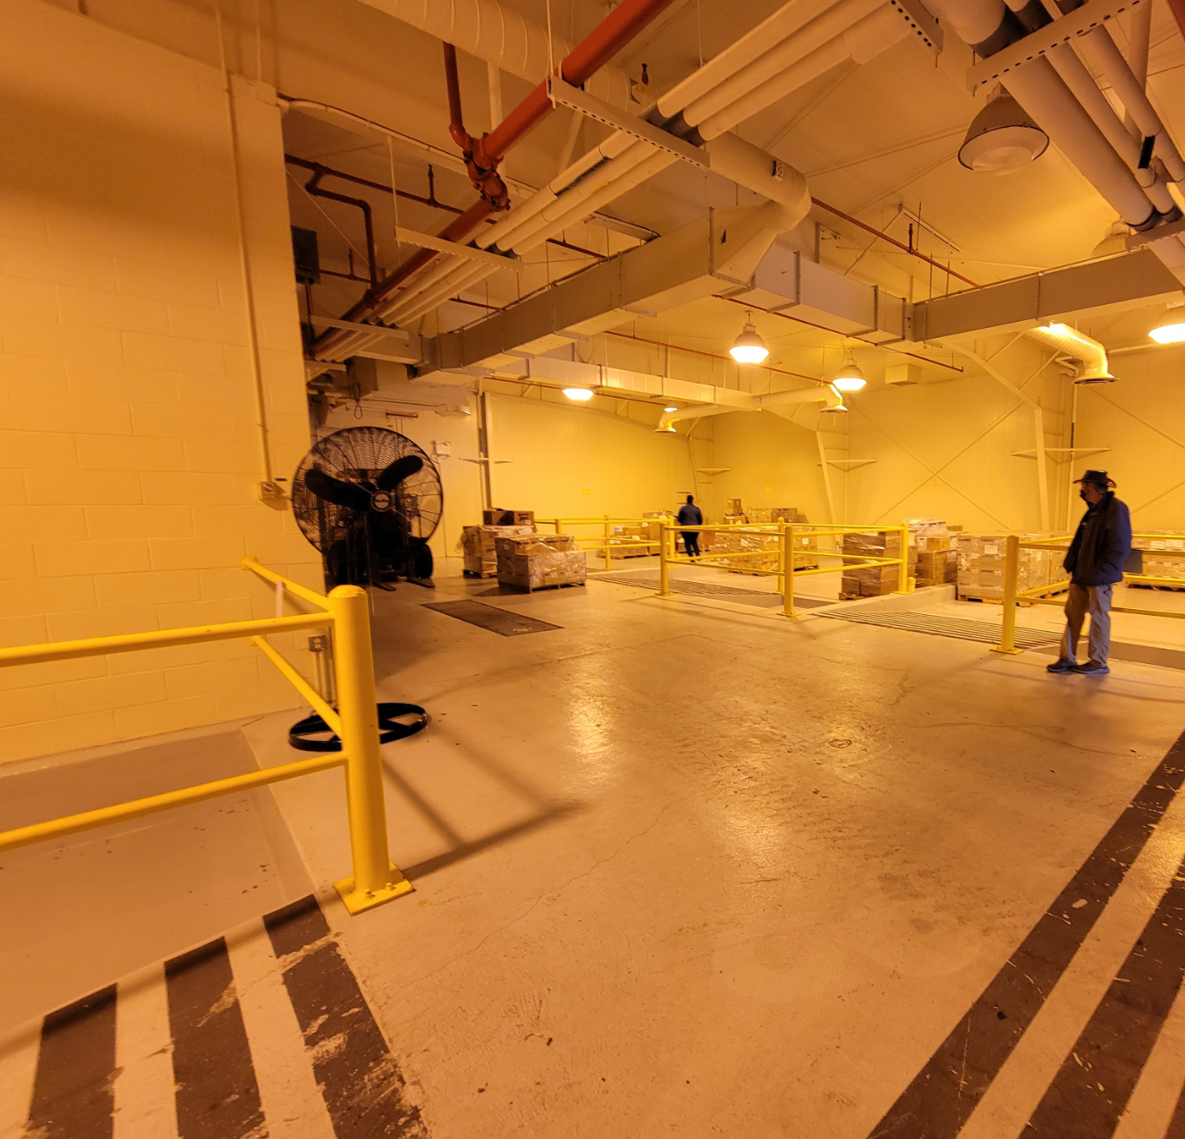
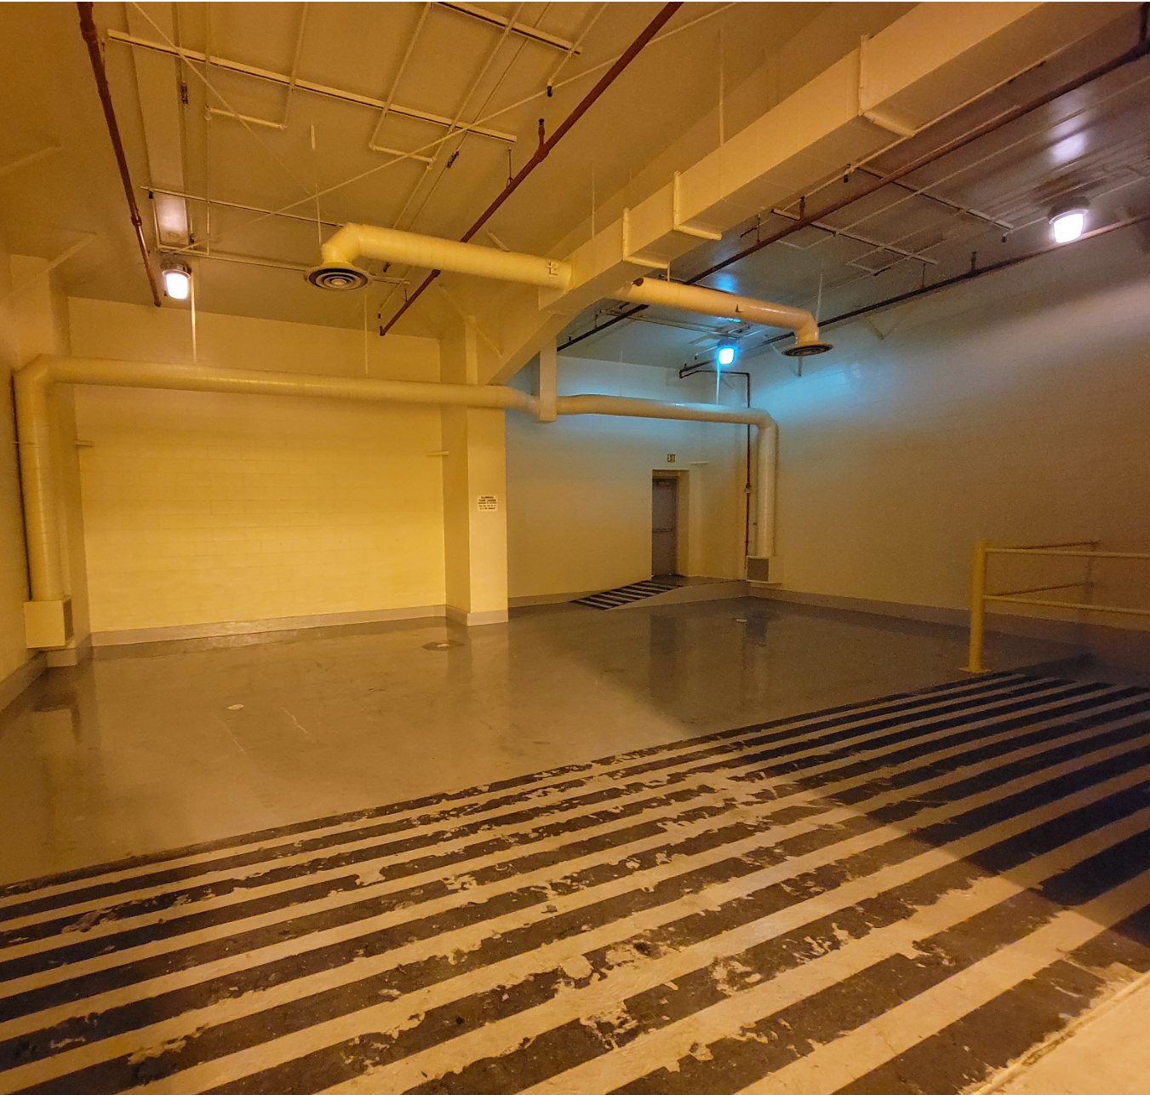
Repurposing Former HC3 Facility, Bldg. 870
Waste management Facility was designed as a Haz Cat-3 facility and has two bays that we could add hot cells.
New building originally built for mixed waste not used has a number of bays and a lab allowing for hot cell installation.

Slide 22
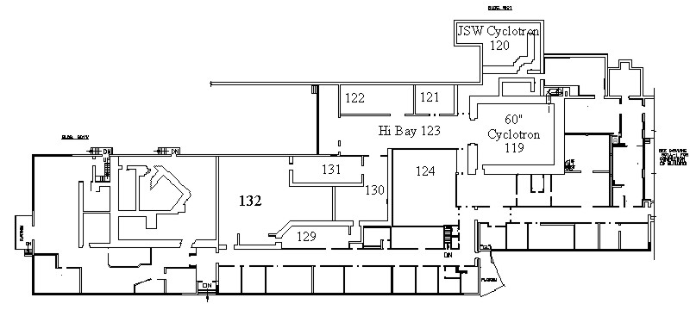
Cyclotron in Building 901 Room 130
MIRP Cyclotron
Model ACSI TR19
ITD

Slide 23
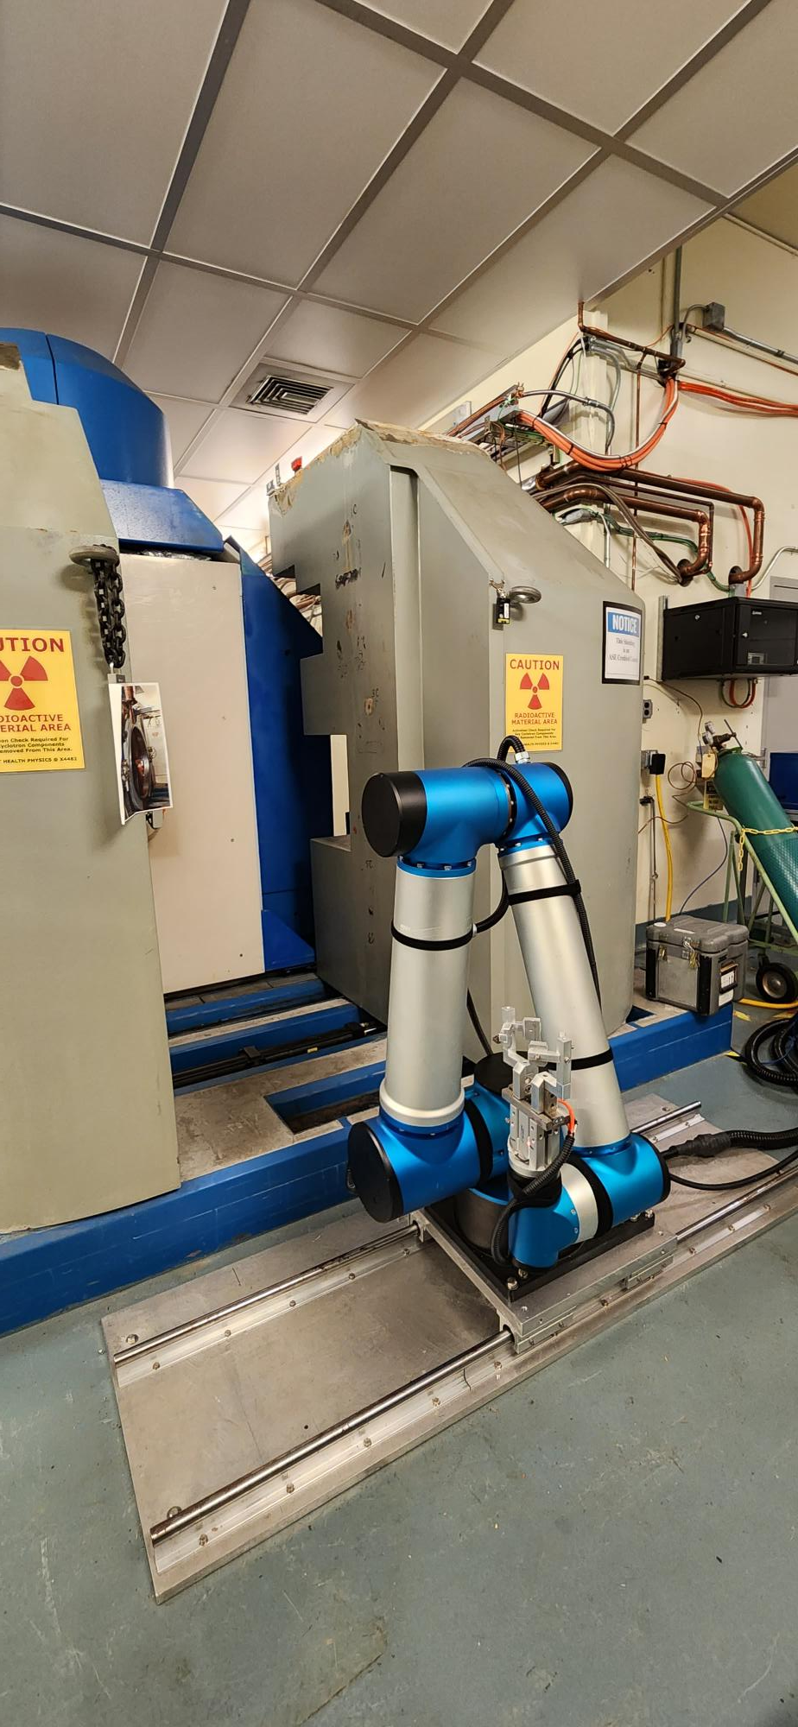
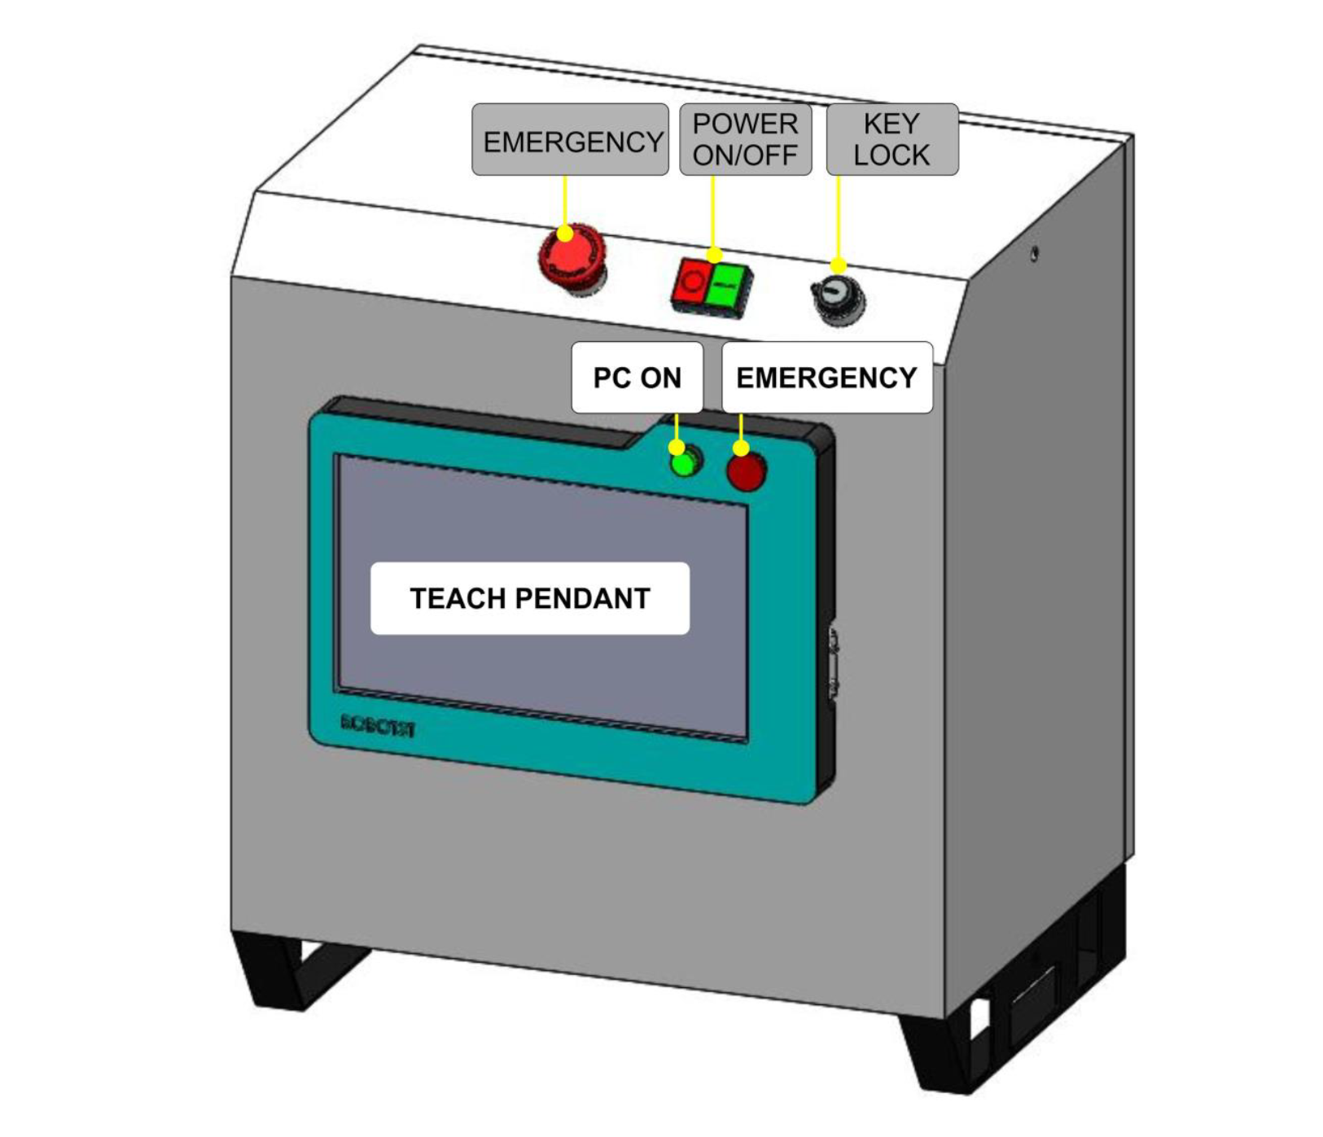
Robotic Arm
Payload | 13 lb
Reach | 5 ft
Joint 0 (Base) | ± 150°
Joint 1 (Shoulder) | 0° to 120°
Joint 2 (Elbow) | -110° to +150°
Joint 3 (Wrist 1) | -210° to 30°
Joint 4 (Wrist 2) | ± 360°
Max Speed | 180°/s for all Joints
Repeatability | ± 0.0019 “
I/O ports | Digital: 48 Analog: 8
Cabling | 66 ft
Power | 200 – 240 V, 50 -60 Hz
Joint 2
Joint 0
Joint 1
Joint 3
Joint 4

Slide 24
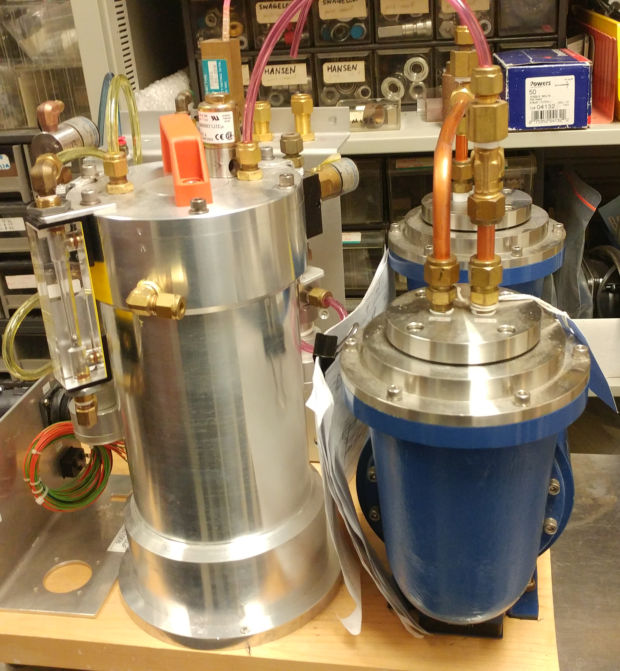
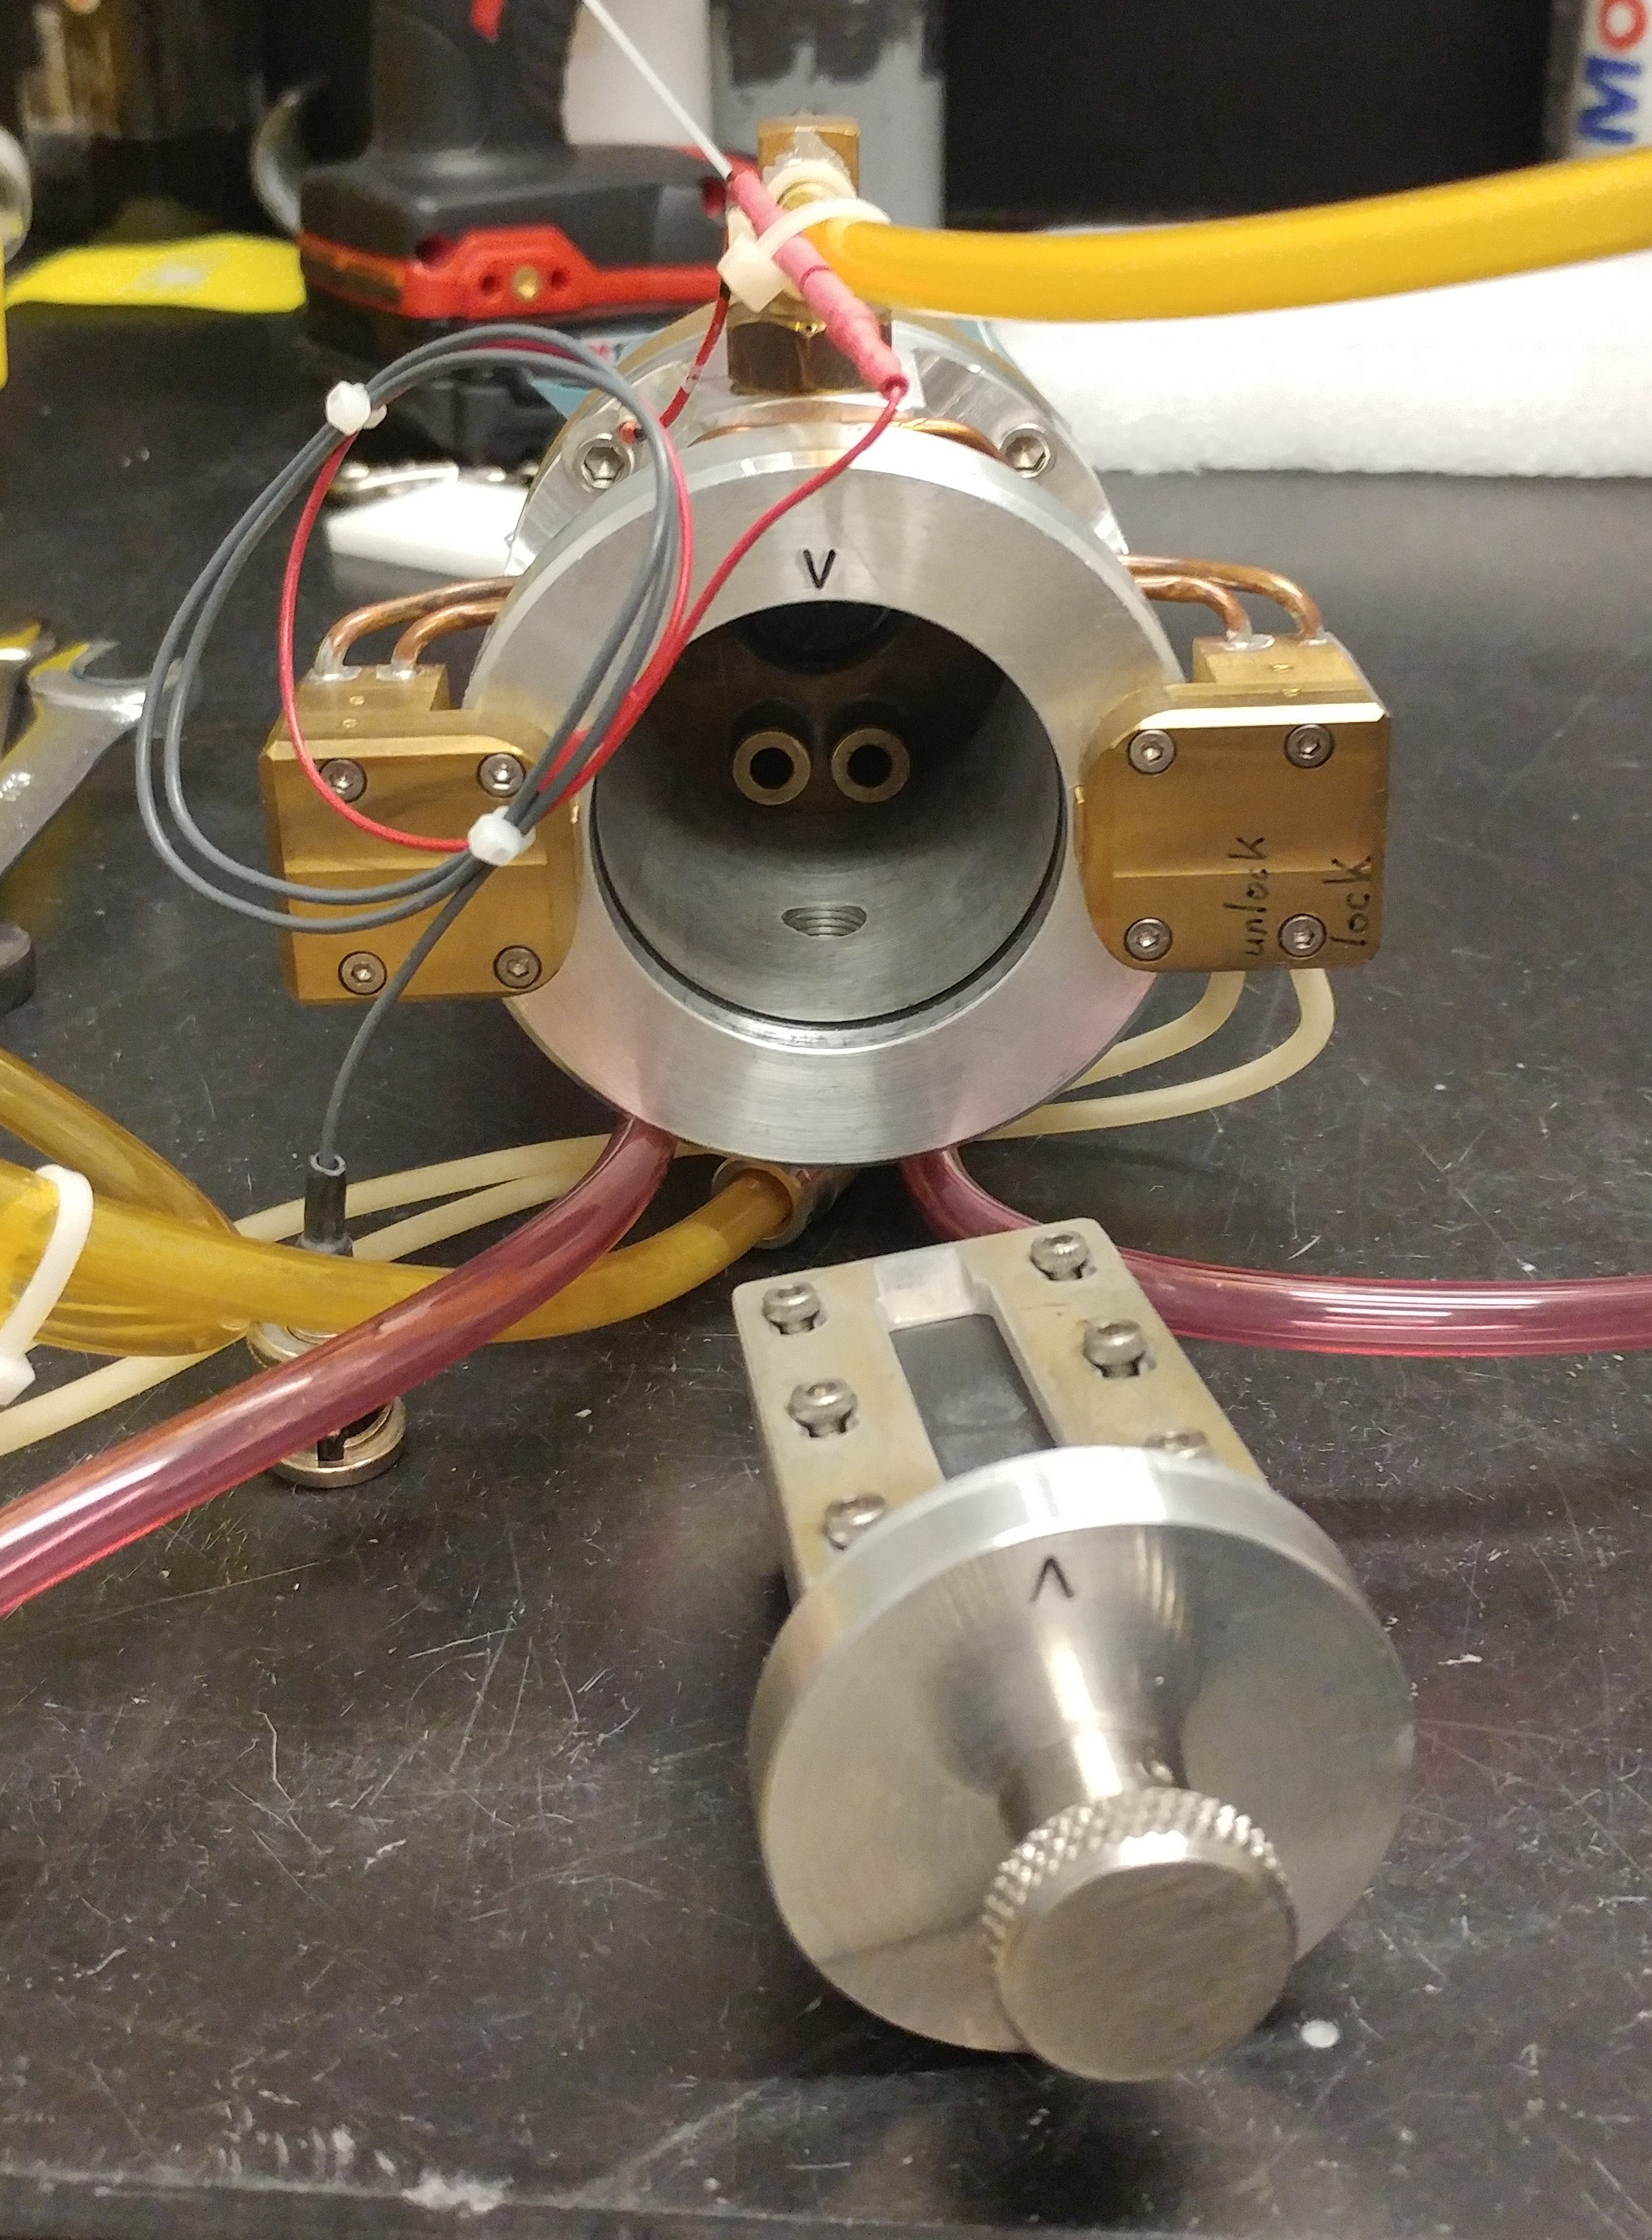
Low Energy Cyclotron
Production of ²²⁵Ac from ²²⁶Ra at low energies free from ²²⁷Ac (single port)
Radiometal production for theragnostic applications: ^{44, 47}Sc, ^{186/189}Re, ⁷²As, ⁸⁶Y, ¹⁰⁹Cd (secondary port) without beam energy degradation
Add lab space near the cyclotron

Slide 25
Summary
Accelerators play a key role in Isotope production and it’s growing
Production methods for alpha emitters are expanding making them available for clinical evaluation
DOE brings together multidisciplinary teams to solve the nations major challenges
DOE IP is growing and bringing on new capabilities in irradiations and processing to meet nations needs.

Slide 26
Questions

