Slide 1
Professional Development for Postdocs
Erica Collins, Sr. Leadership Training Specialist
August 25, 2023

Slide 2
What is Mentoring?
A commitment of 2-way continuous learning.
Focus is on career and professional development.
A partnership with a climate of trust to encourage open and honest conversation.
A safe place to explore career/life guidance, challenges and valuing of differences.
An opportunity to accelerate individual growth that aligns with BNL mission and values.
Mentoring is not….
Spontaneous or casual advice.
The same as coaching or managing.
Performance management.

Slide 3
Postdoc Mentorship Program
Total: 79 Postdocs are paired with a mentor of which 23 are from NPP
Goals and Objectives
Increase organizational knowledge
Provide an environment for scientific growth and professional development
Provide career guidance and cross-functional networking opportunities
Enhance the research efforts of BNL
Address STEM equity & inclusion
Notes:
47 NPP Postdocs total- 12 started since Feb this year.

Slide 4
Program Structure
Time Commitment
Learning Events
Mentoring Development Plan
1:1 Mentoring
Duration
Enrollment
One mentor is matched with one mentee based on interests, goals and preferences identified during the enrollment process.
Complete a mentee profile by accessing the BNL
Postdoc Mentorship
Program SharePoint site.
Additional Professional development courses held quarterly
Minimum of 1 hour per month.
Identify career and professional goals
Until end of appointment
Mentoring Connect Meetings

Slide 5
Tools and Resources
Program Guide
Mentor Guide
Mentee Guide
Conversation topics
Mentoring Agreement
Guide to Handling Roadblocks
MDP Worksheet and/or MyIDP

Slide 6
Mentoring Development Plan
Create 1-3 goals to accomplish
Identify competencies to be developed by leveraging NPA Six Core Competencies Guide
Discipline specific conceptual knowledge, research skill development, communication skills, professionalism, leadership and management skills and responsible conduct of research
Milestones/progress measurements
Postdocs periodically assess goal progression/achievement
Postdocs are to communicate goals to mentors and supervisors and develop a plan on how to achieve them.
To provide structure from the start of the program, postdocs are encouraged to complete a Mentoring Development Plan
Notes:
The NPA classifies the six core competencies as:
#1. Discipline-specific conceptual knowledge- an overall understanding of implications of work on a broader field, the importance of creativity and innovation, and grasp of cultural, technical and language discipline-specific knowledge.
#2. Research skill development- ensure that PD are adequately equipped to carry out independent research
#3. Communication skills- PD should master communication skills which ensures that messages are heard & understood by appropriate audience
#4. Professionalism- PD instills the virtues of honor, integrity, compassion, cooporation, reliability and enhance the perception of this work in society
#5. Leadership and management skills- PD should understand leadership styles appropriate in a situation & increase performance and productivity.
#6. Responsible conduct of research- PD are responsible for upholding & engaging the ethical norms

Slide 7
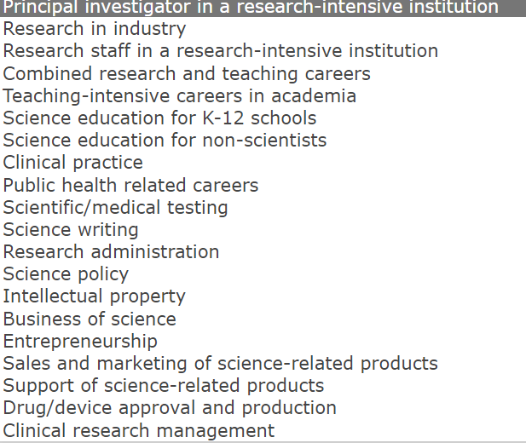
myIDP- Science Careers Individual Development Plan
Myidp.sciencecareers.org)
Notes:
Career-planning tool specific for PhD Students and Postdocs in the sciences.

Slide 8
National Postdoc Association
All postdocs have access to a National Postdoc Association account sponsored by BNL.
Instructions to create your account

Slide 9
FY 23 Postdoc- Specific Learning Opportunities
Shipley Associates: Proposal Content Management: A Secret Weapon
Principiae: Making the Most of Your Presentations
Brian Palermo: Communicating Your Science
Upcoming, 9/7: SciPhD: The Business of Science
*Learning events subject to change based on participant needs.

Slide 10
What Are Postdocs Enjoying Most About the Program?
Having an additional resource to ask questions to about my research project
Ability to attend conferences that may not have been available if it weren’t for the program
Ability to improve my resume through the honest feedback my mentor provided
Having greater access to development opportunities
Networking with colleagues
Increased knowledge in preparing proposals
Additional access to career advice and guidance
Exposure to new career perspectives
Learning about different aspects and research projects at the laboratory
Program flexibility
Insight into effective leadership skills through my mentor
Appreciation of the opportunity to receive constructive feedback in my work

Slide 11
Thank You!

