Slide 1
Association of Students And Post-docs ASAP@BNL
Atiya Banerjee, President 2023
08/25/2023

Slide 2
ASAP 2023 Board

Slide 3
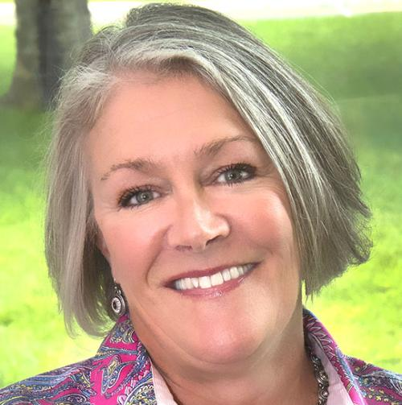
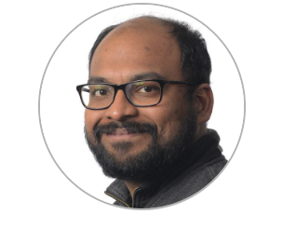
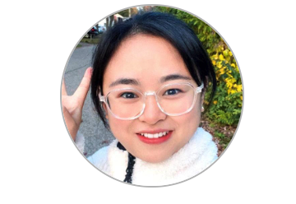
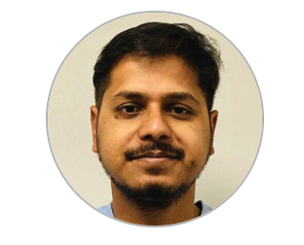
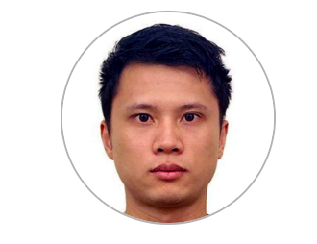
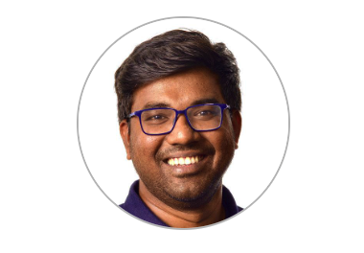
CURRENT BOARD MEMBERS
Christine Carter (Advisor) –
Guest Services Division (Bldg. 400A)
Adam Merone (Guest Services Divison)
Atiya Banerjee (President) –
Center for Functional Nanomaterials (Bldg. 735)
Jhongjing Jiang (Vice President) –
Environmental and Climate Sciences (Bldg. 815E)
Bhawin Dhital (Communications Secretary) –
Collider Accelerator Department
(Bldg. 911C)
Zihan Lin (Events Secretary) –
Biology Department (Bldg. 463)
Aswin Anbalagan (Events Secretary) –
National Synchrotron Light Source II Bldg. 741
Notes:
You can add at the end that we would like to encourage more volunteers (from all directorates)
as in person events need more work to organize!
Also, you can focus that we are all from different groups (could act as a point for diversity)

Slide 4
What is our mission?

Slide 5
MISSION
improve the quality of life of our members
act as a magnet to bring together students and postdocs in a social setting
advocate for and represent its members collectively at BNL
provide professional development opportunities to its members

Slide 6
Who can be a member?

Slide 7
MEMBERSHIP
Regular members
All postdocs whose primary research takes place at BNL are automatically granted regular membership
ASAP Board
President, Vice President, Secretary, and Treasurer
ASAP Advisors
Permanent BNL staff serving as Advisors to ASAP. Includes BNL’s Recreation Supervisor ex officio.
Students and scientific staff within five years of their last degree become regular members upon signing up

Slide 8
Where are we located?

Slide 9
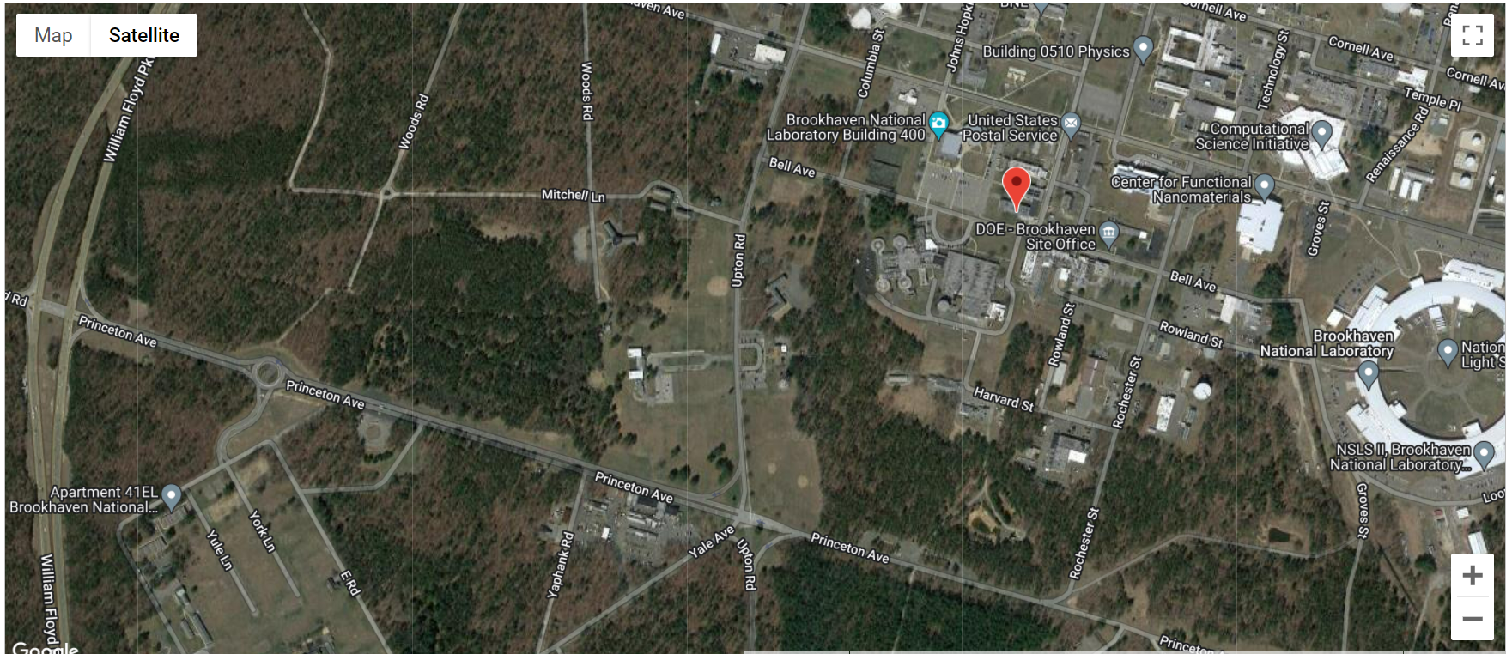
Gymnasium (Bldg 461)
Research Support (Bldg400)
Main gate
ASAP Lounge (Bldg462)
Apartments

Slide 10
EVENTS
New logo design contest – TBD
ASAP Lounge grand reopening – April 15, 2023
-Join us every 2nd Tuesday of the month for a slice and a chat!
-Speakers/Guests joining

Slide 11
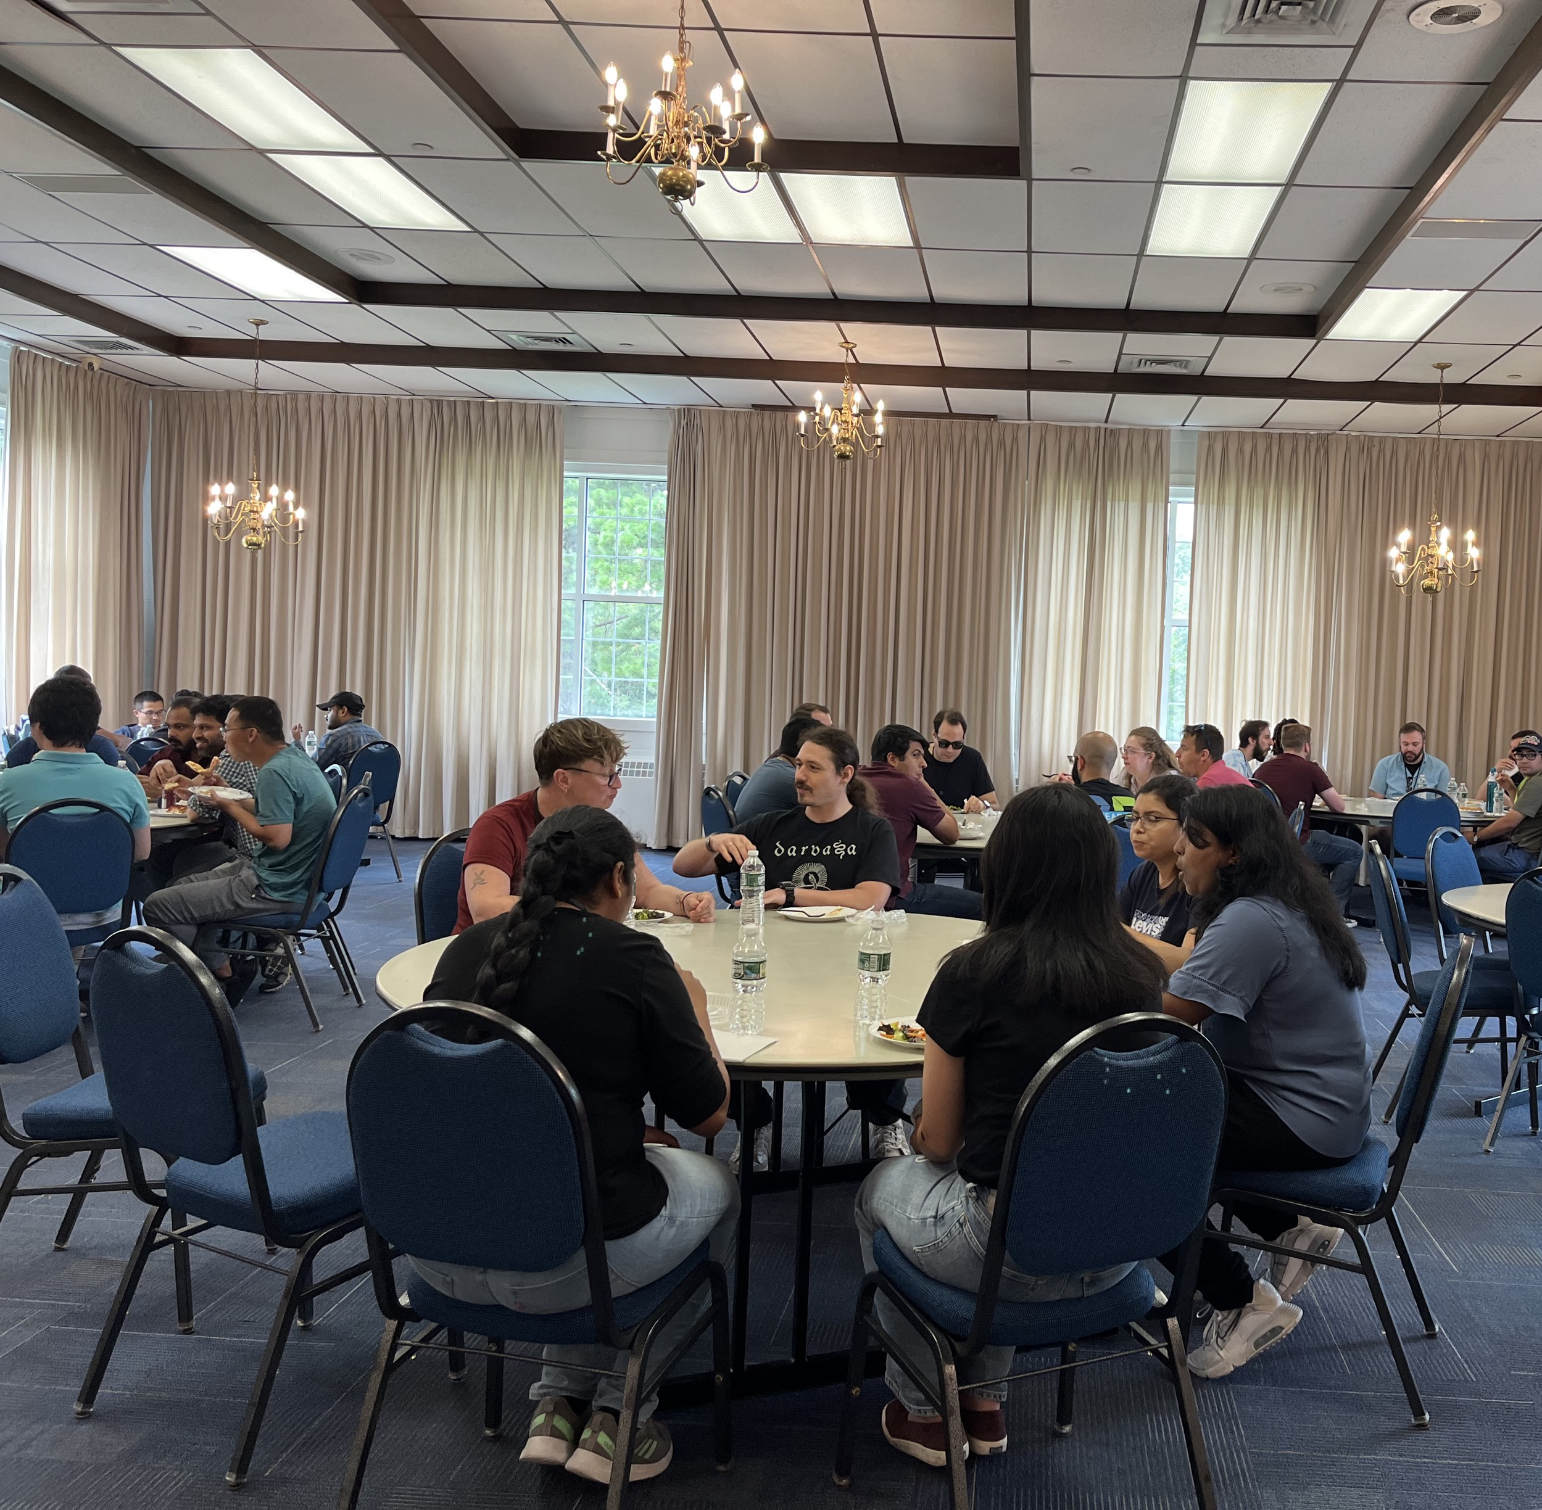
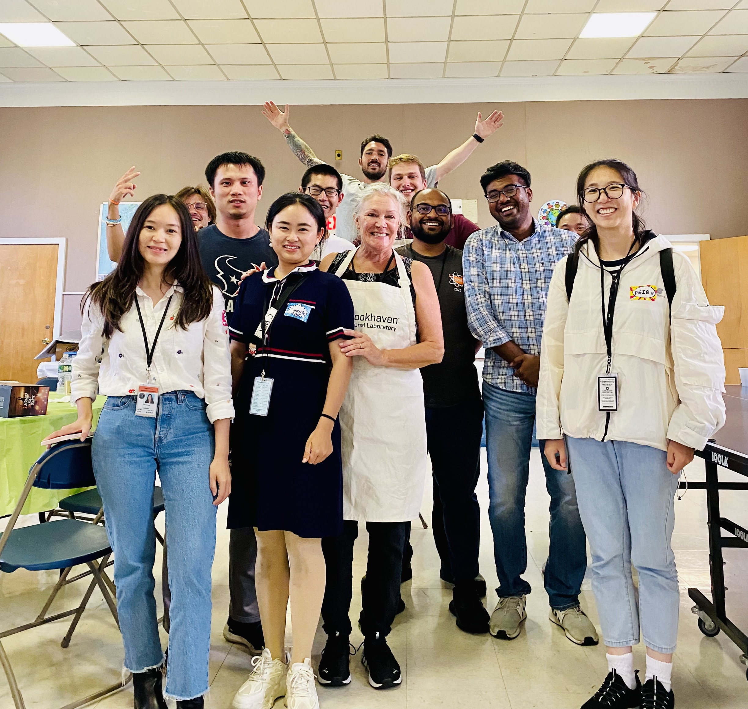

Slide 12
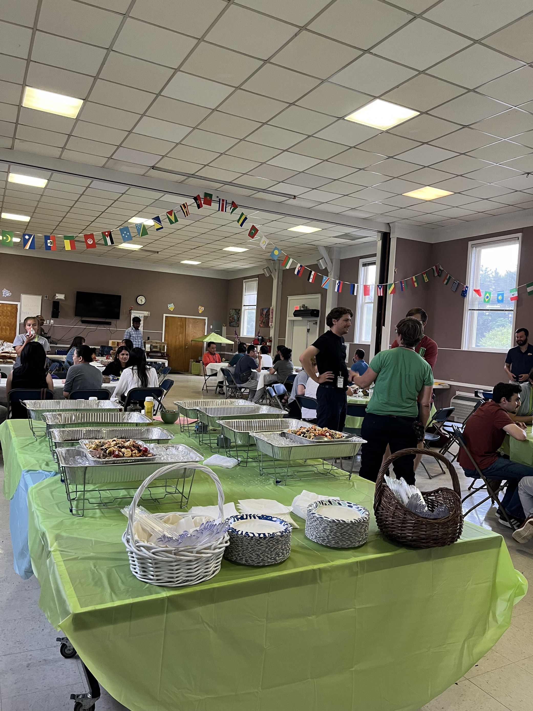
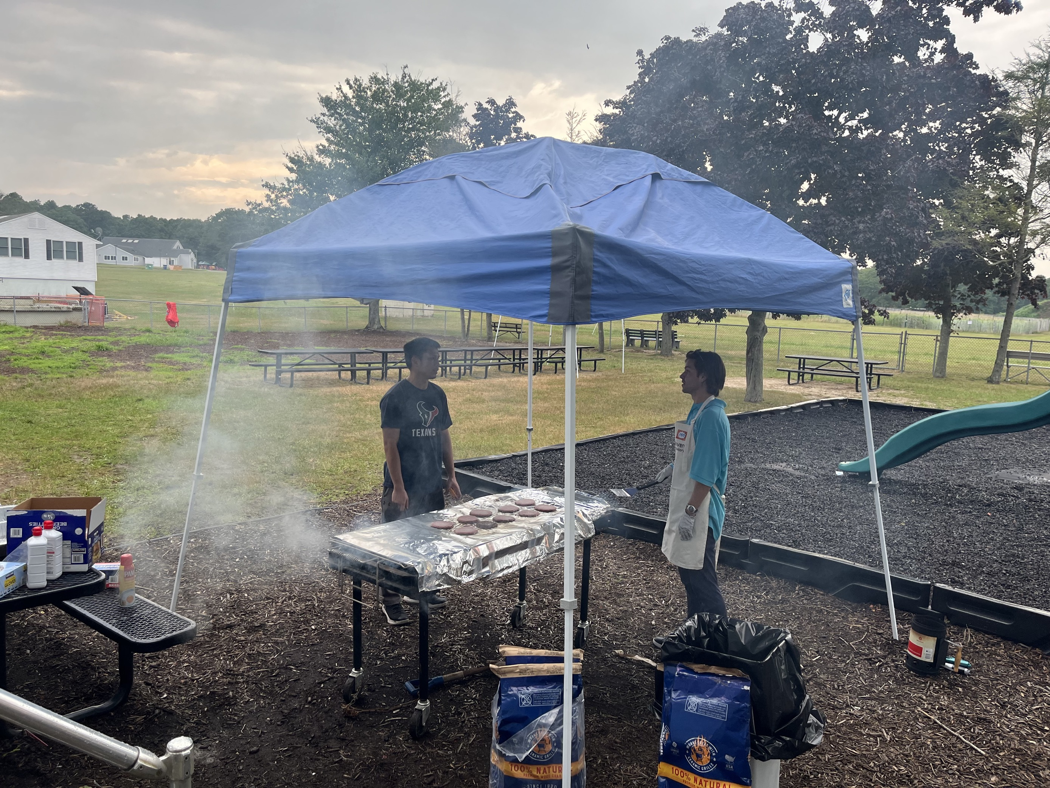

Slide 13
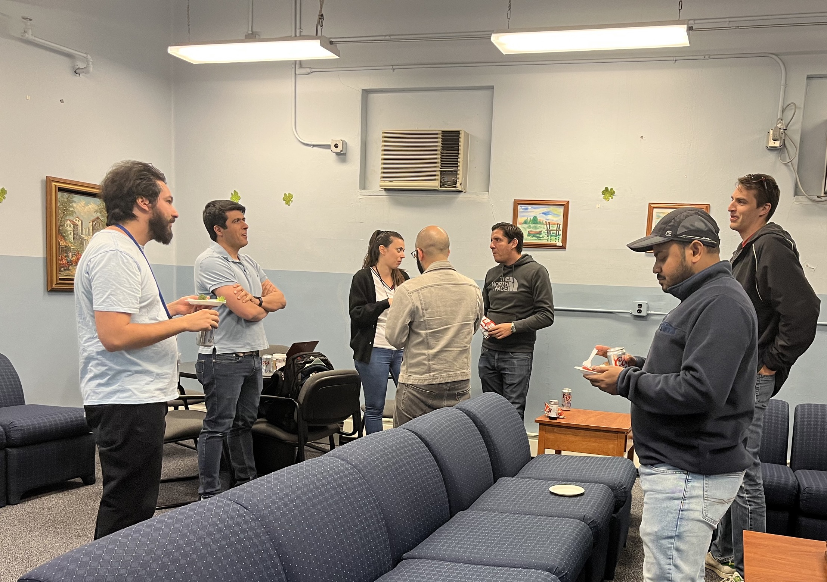
EVENTS
- Game/boardgame night
- Summer Barbeque
- Informal Gatherings/ Peer to peer discussions
- BNL Mentoring Program (Erica Collins)
- Career Resources
- Early Career Research Symposium
- Postdoc Appreciation Week
- National Lab Research SLAM Competition

Slide 14
How to connect?

Slide 15
CONNECT WITH US
ASAP website @ http://wpw.bnl.gov/asap
ASAP TEAM&Channels @
Microsoft teams
EMAIL ADDRESS
ASAP@BNL.gov
BNL ASAP
Facebook group

