Slide 1
The Coherent Electron Cooling Pop Experiment (CeC)
Kai Shih
Postdoc, CeC Group, C-AD

Slide 2
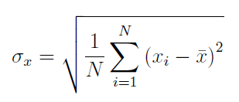
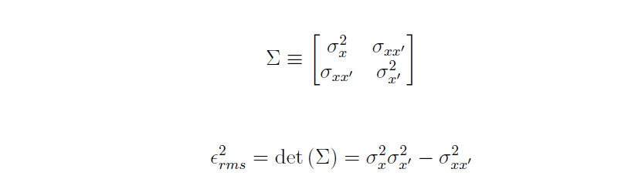

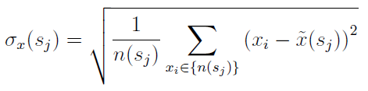


Introduction
Beam Projection:
Beam Parameters
Quantify beam quality with RMS emittance $ε_{rms}$
Slice parameters can be obtained by isolating slice particles ensemble $n(s_{j})$
Slice RMS emittance and slice current $I(s_{j})$ affect electron beam instability growth in PCA
The j th beam slice:
SBU, Physics
Kai Shih

Slide 3
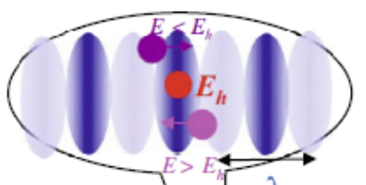
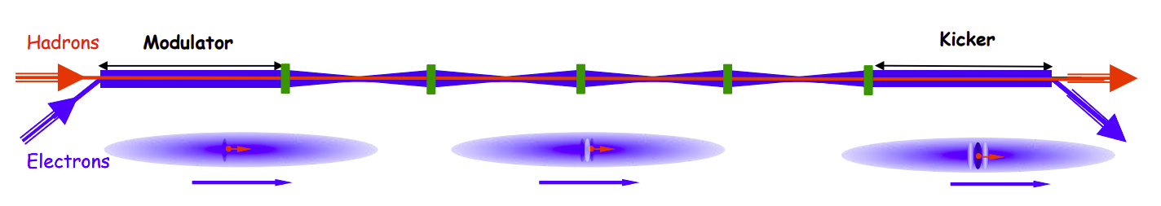
Introduction
Coherent Electron Cooling
High bandwidth Stochastic cooling
Electron beam act as a pickup and a kicker
Signals will be amplified by the PCA
PCA utilizes beam instability growth for amplification
Amplification affected by electron beam quality
1
(Pickup)
PCA (Amplifier)
SBU, Physics
Kai Shih

Slide 4
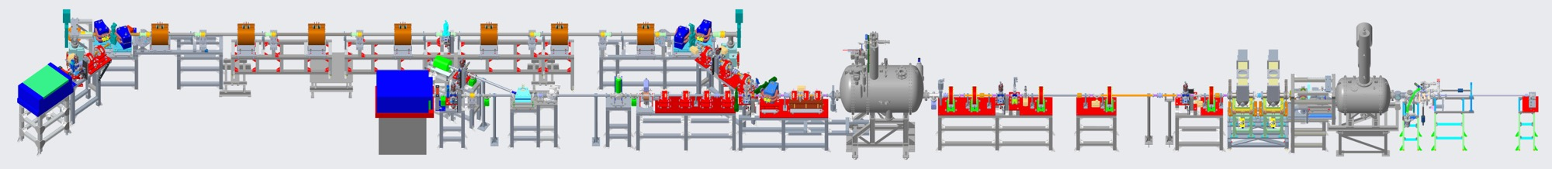
The Coherent Electron Cooling Pop Experiment (CeC)
Interaction Section
The CeC Pop Experiment
RHIC
RHIC
Electron beam
Diagnostic Section
Low Energy Beam Transport (LEBT)
SBU, Physics
Kai Shih

Slide 5
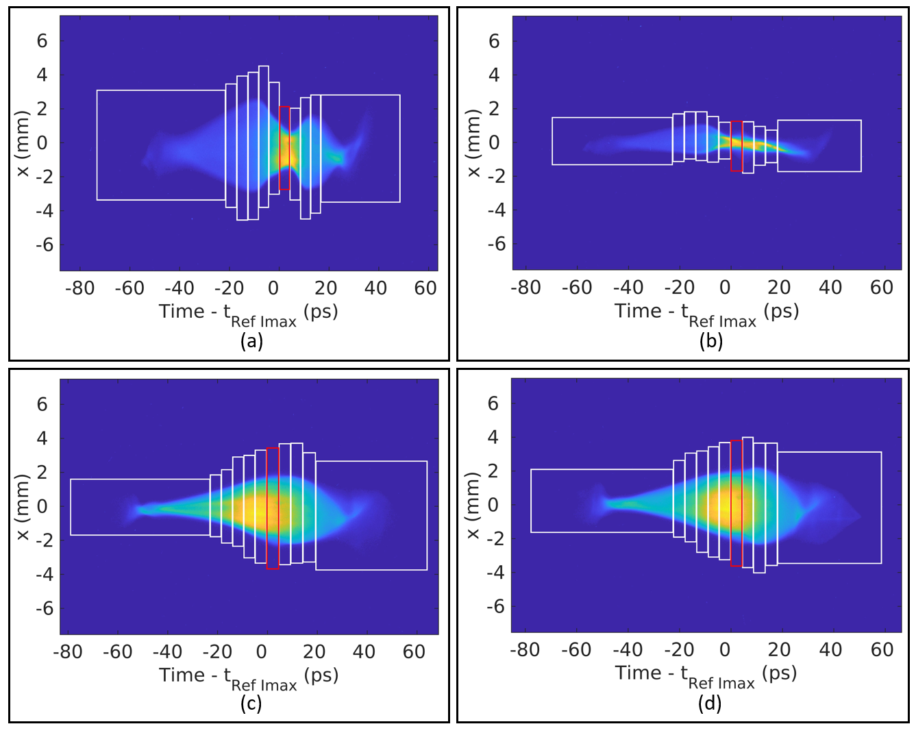
Beam Diagnostics
Vertical direction
N slices
Slicing CeC Electron Bunch
(a)-(d) at different 𝜈
Beam longitudinal profiles were displayed vertically on the YAG screen
Beams were sliced up vertically by the constant charge method
constant charge method requires measurement of the beam current profile
constant charge method has high resistances for beam drifting and beam enlargement
Slices are about the same size, to keep the resolution a constant
SBU, Physics
Kai Shih

Slide 6
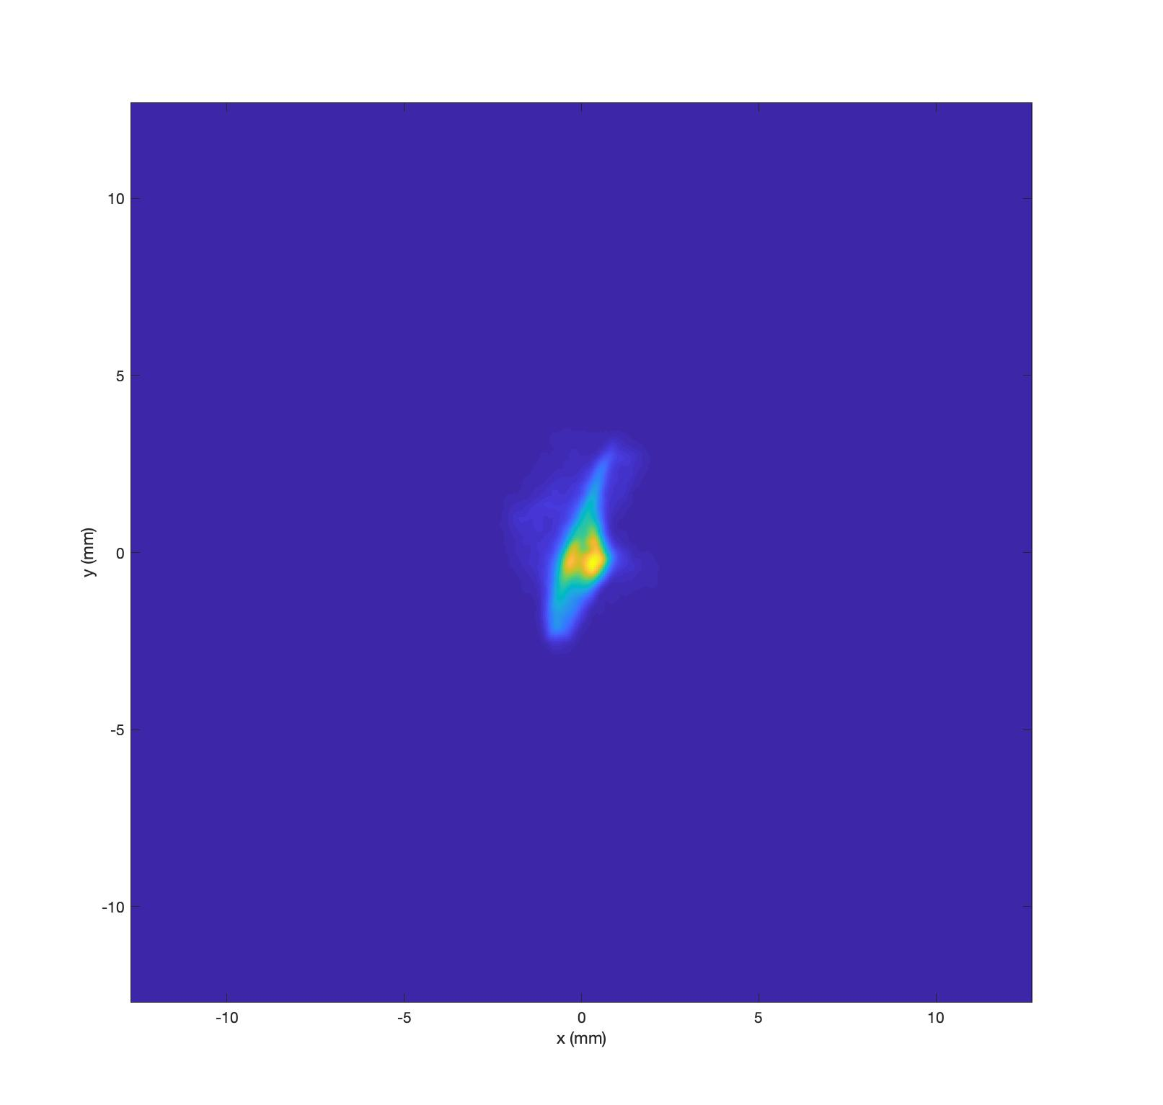
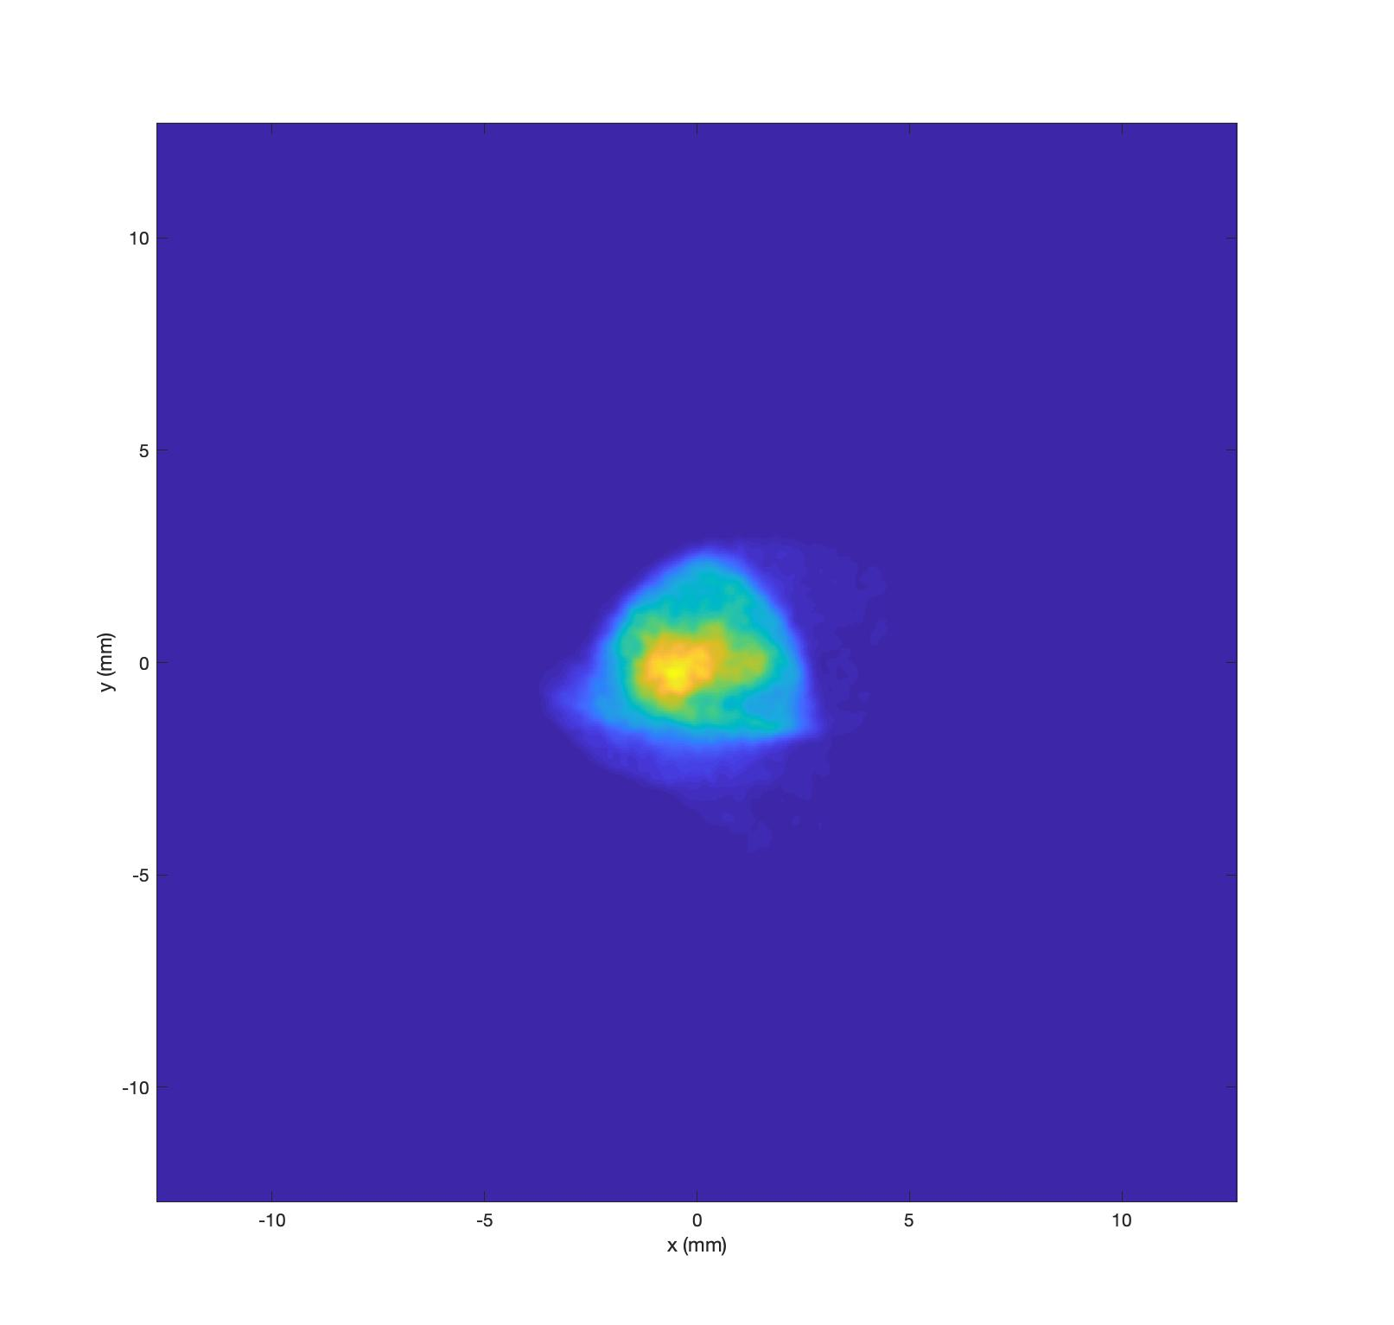
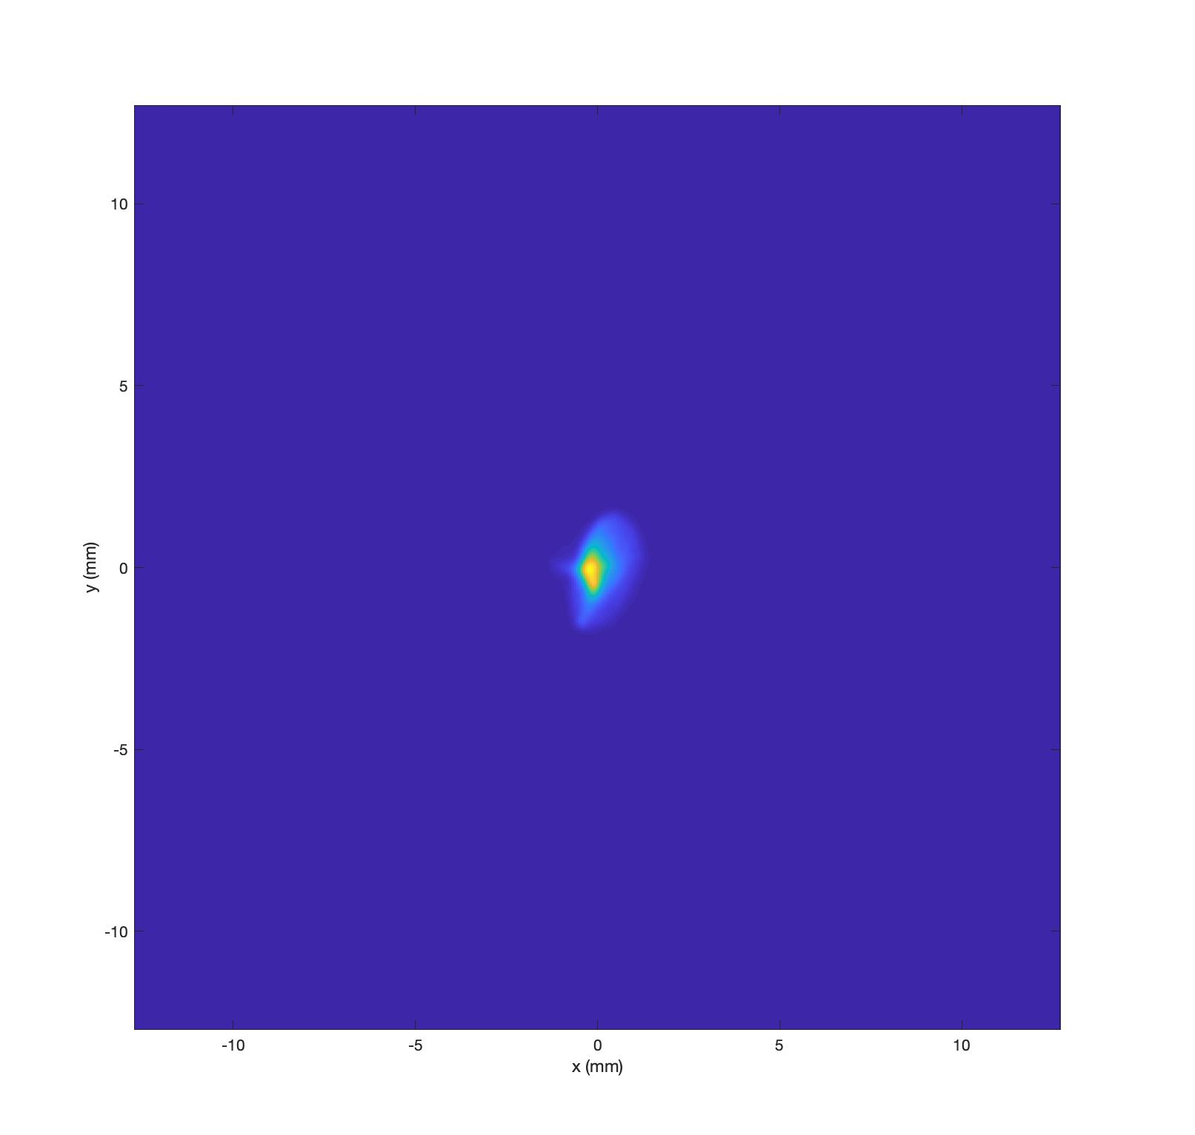
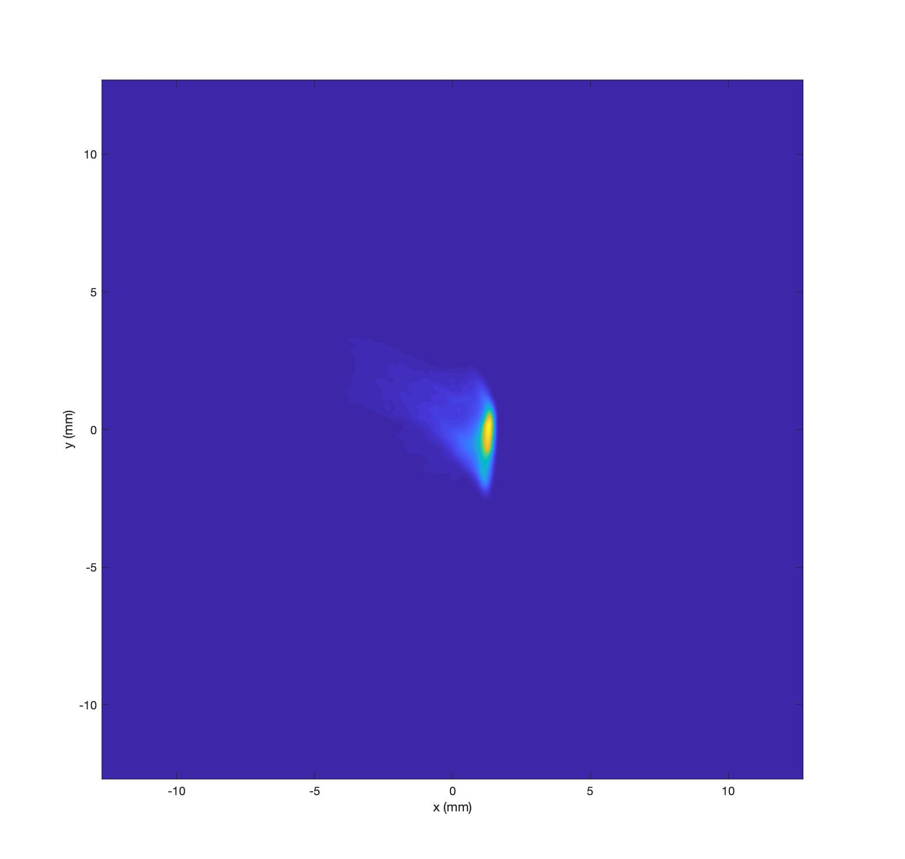
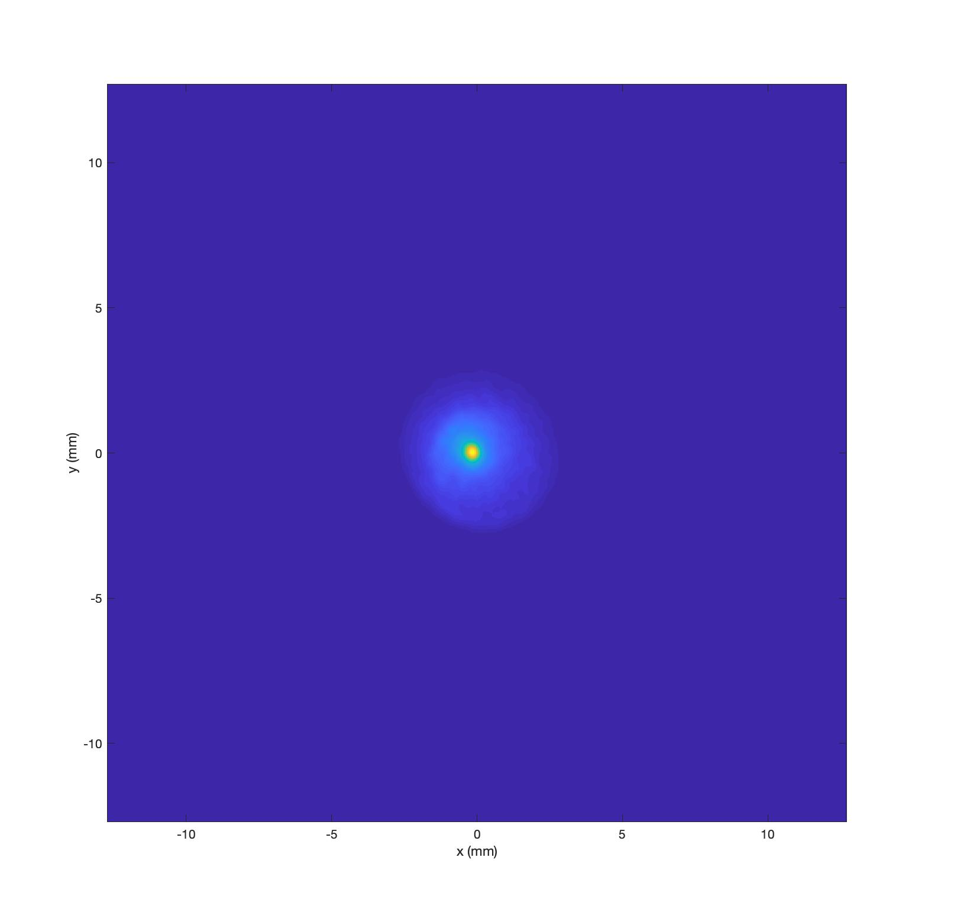
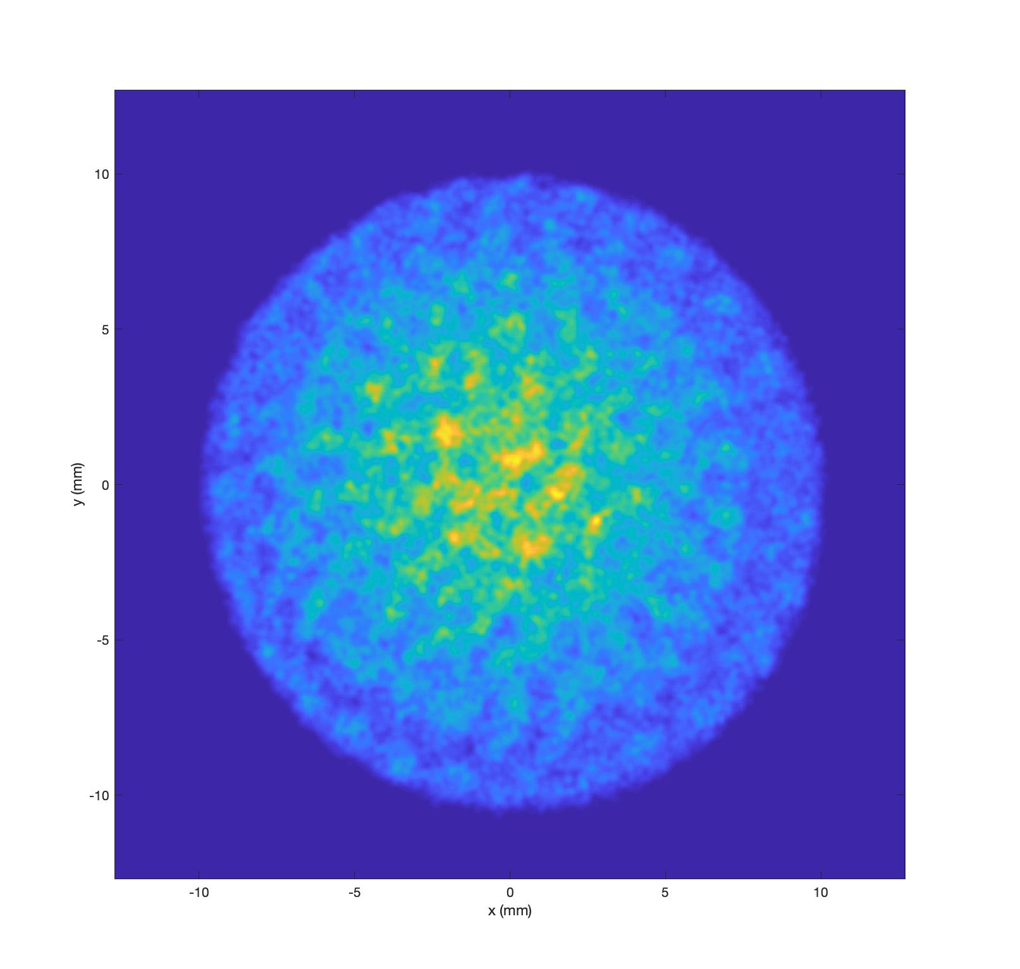
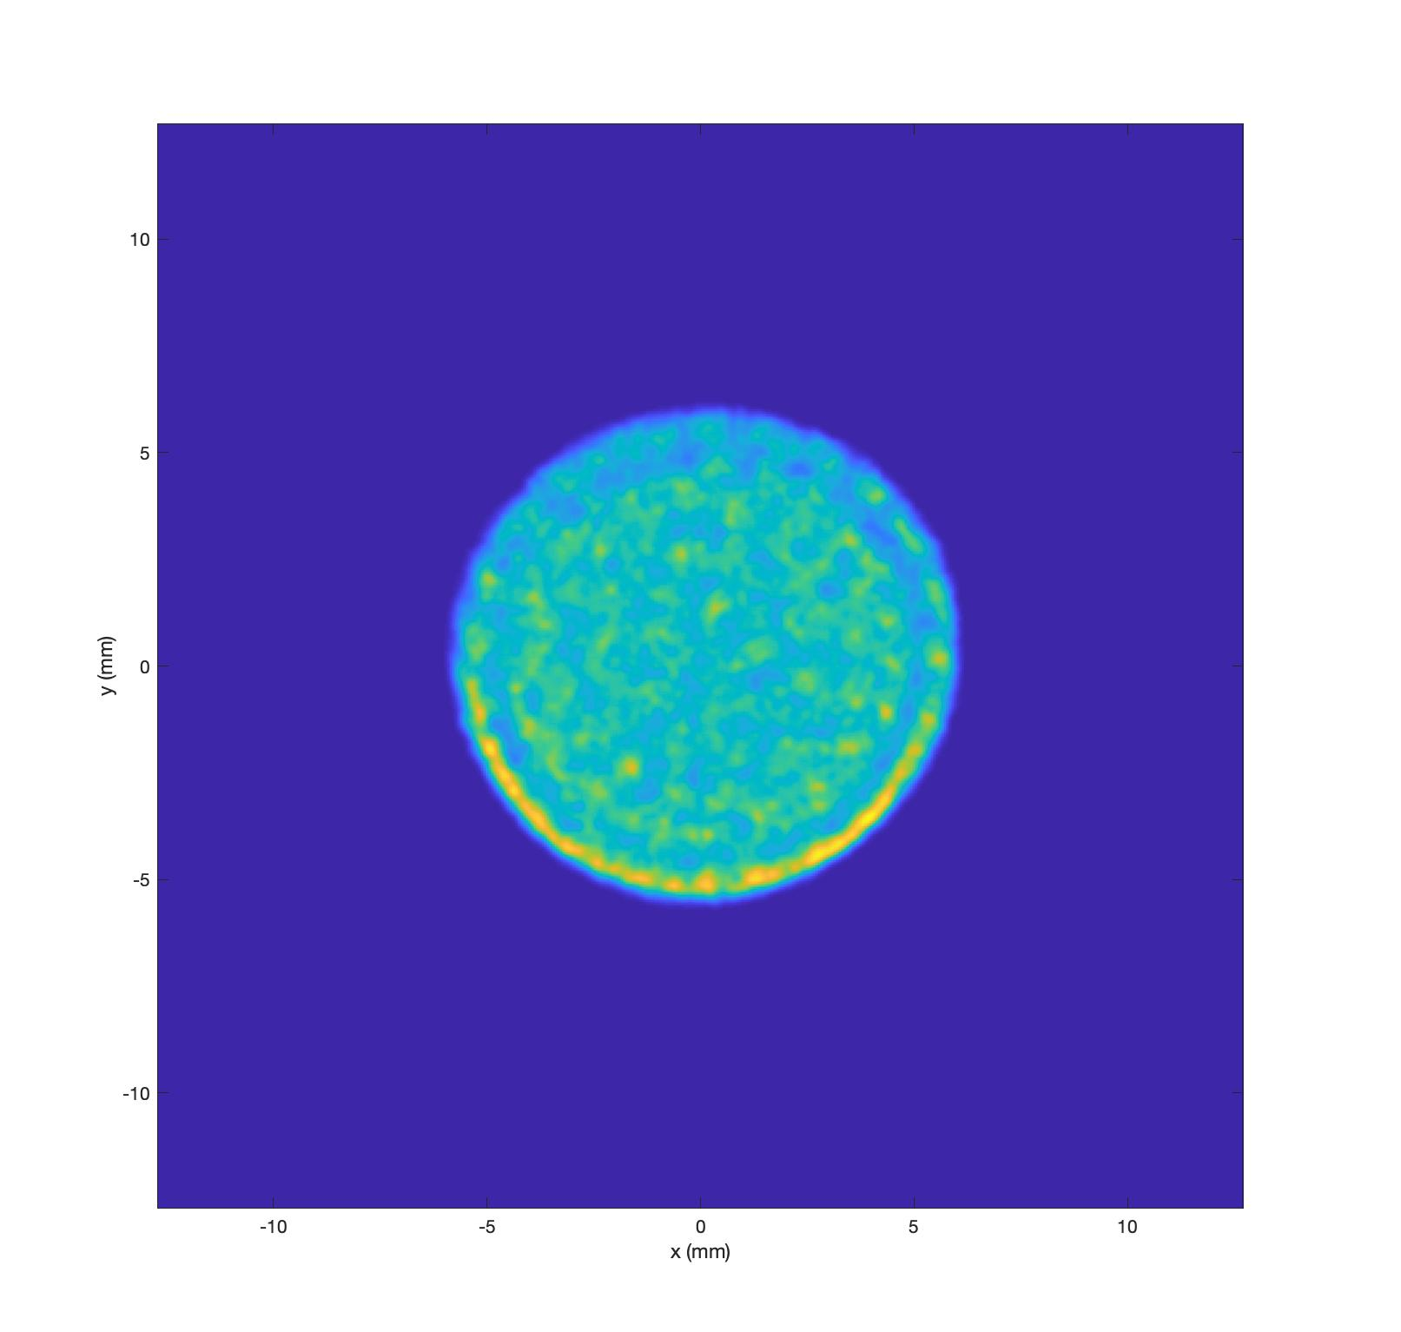
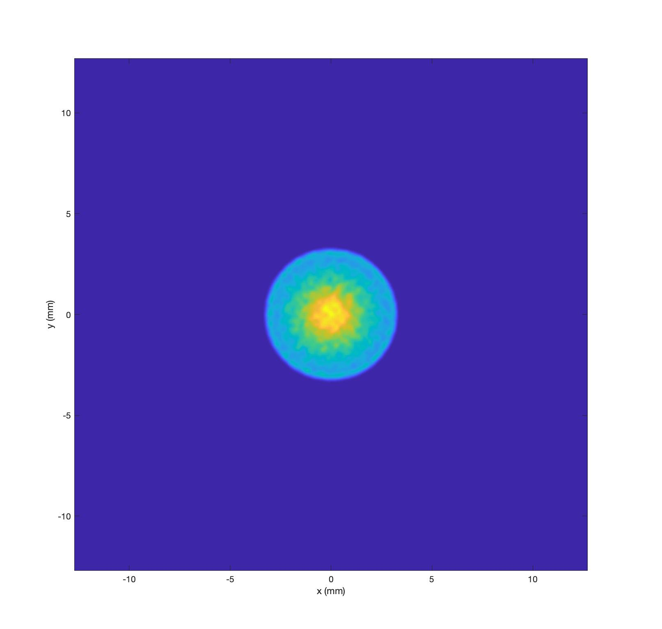
CeC Simulations
CeC Start-to-End Simulation
end
Start
Full 3D Impact-T simulations
CeC misalignments were also included
3D asymmetric cavity fields were used
Large energy gradient in the GUN was addressed
Real Laser profile was used in beam injection
SBU, Physics
Kai Shih

Slide 7
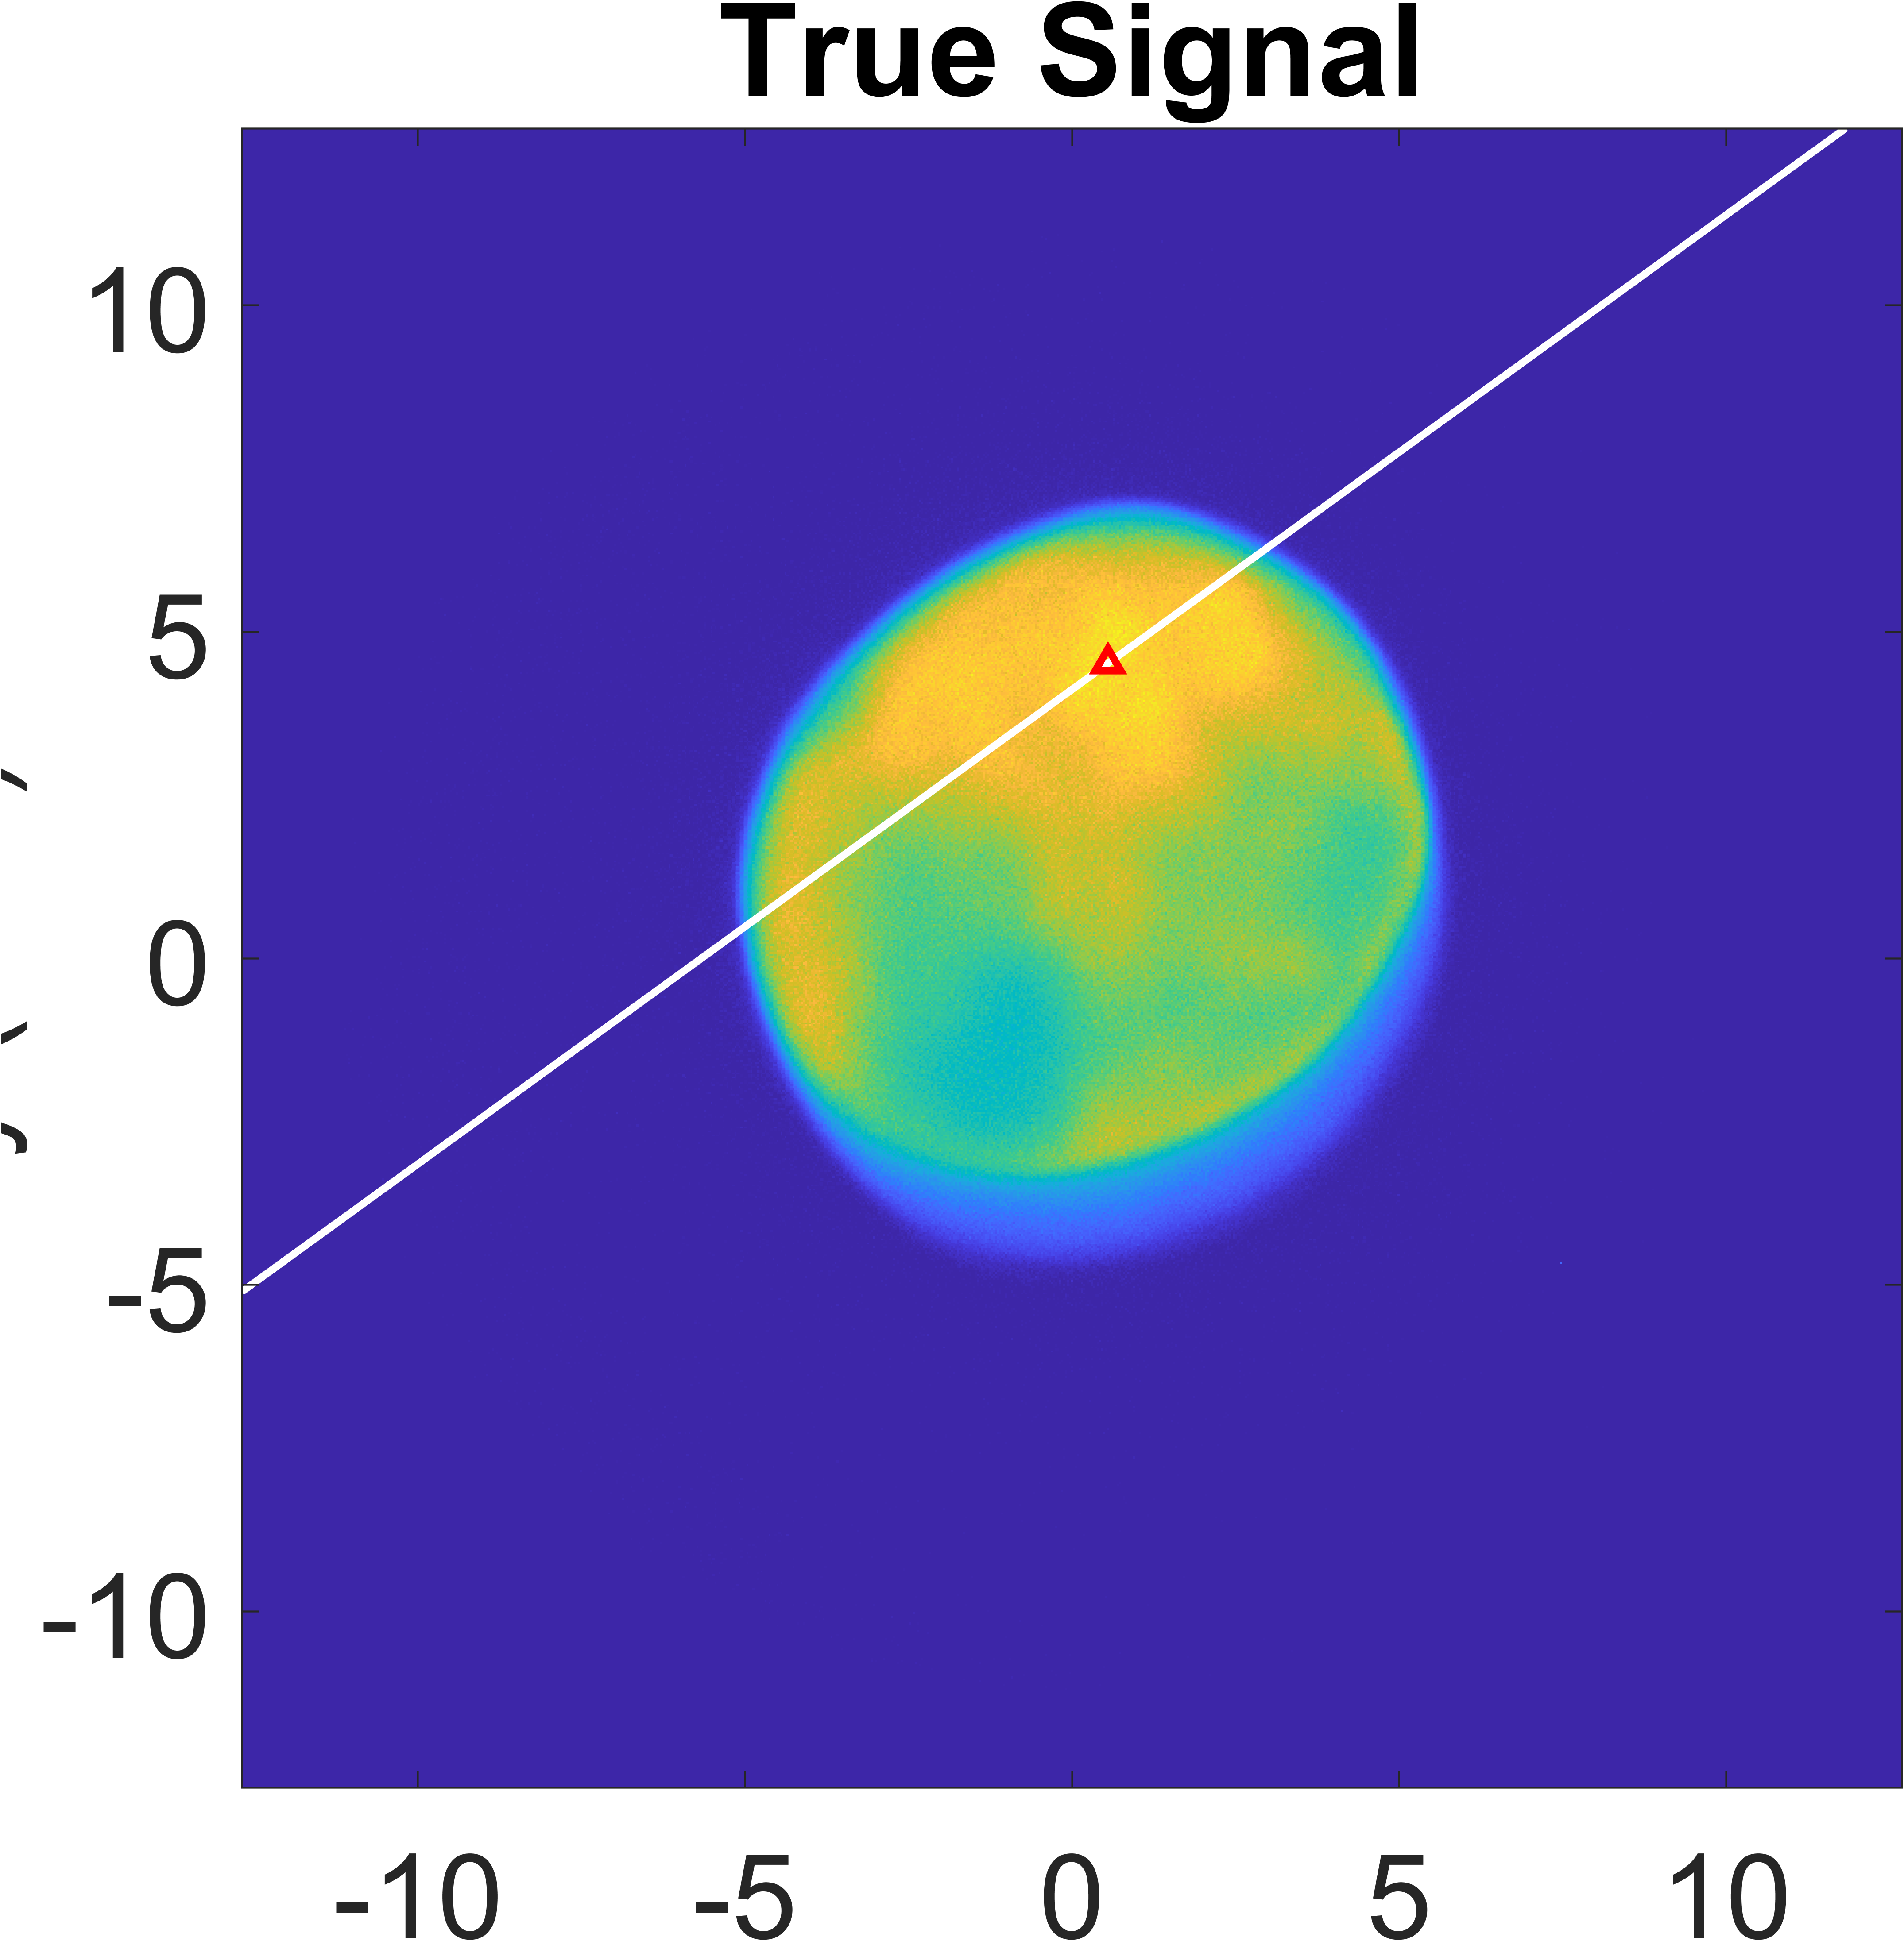
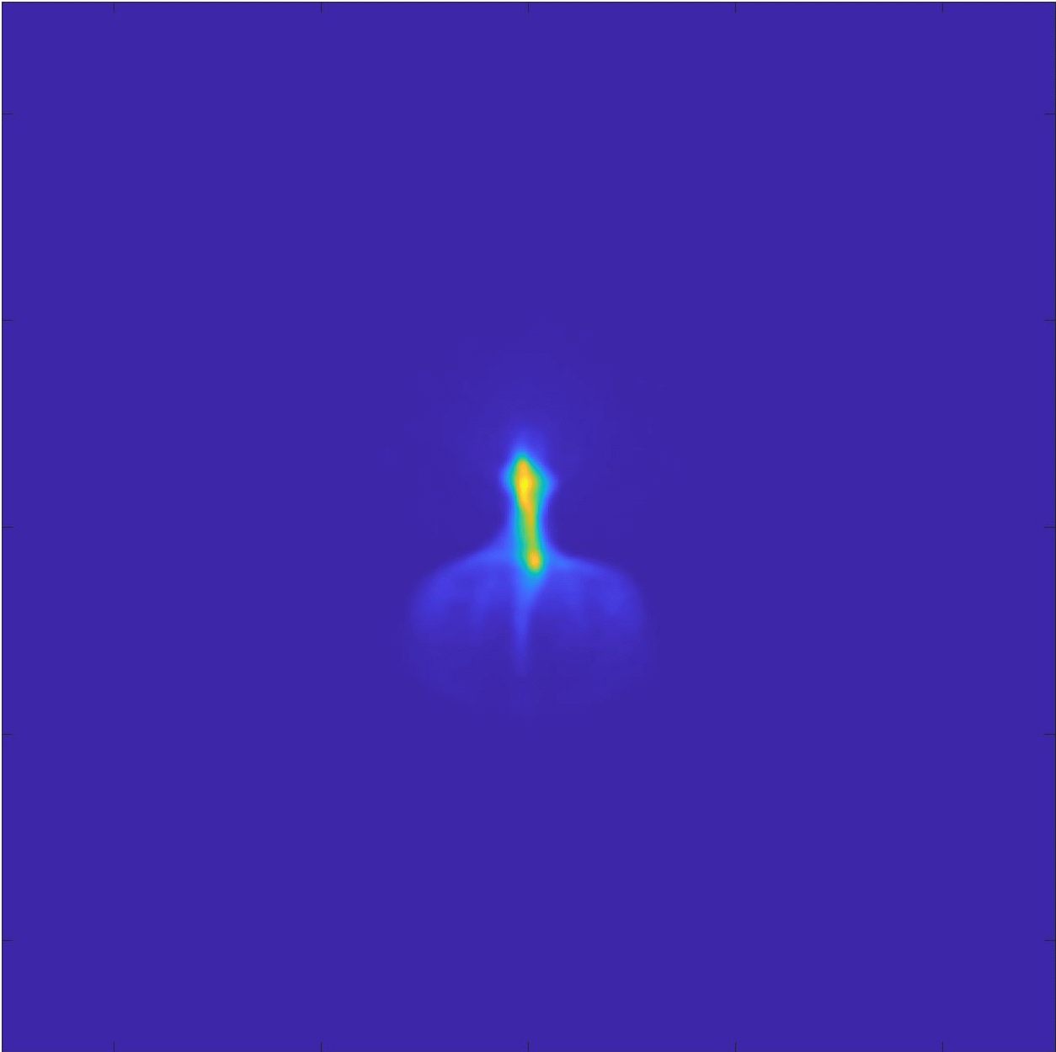
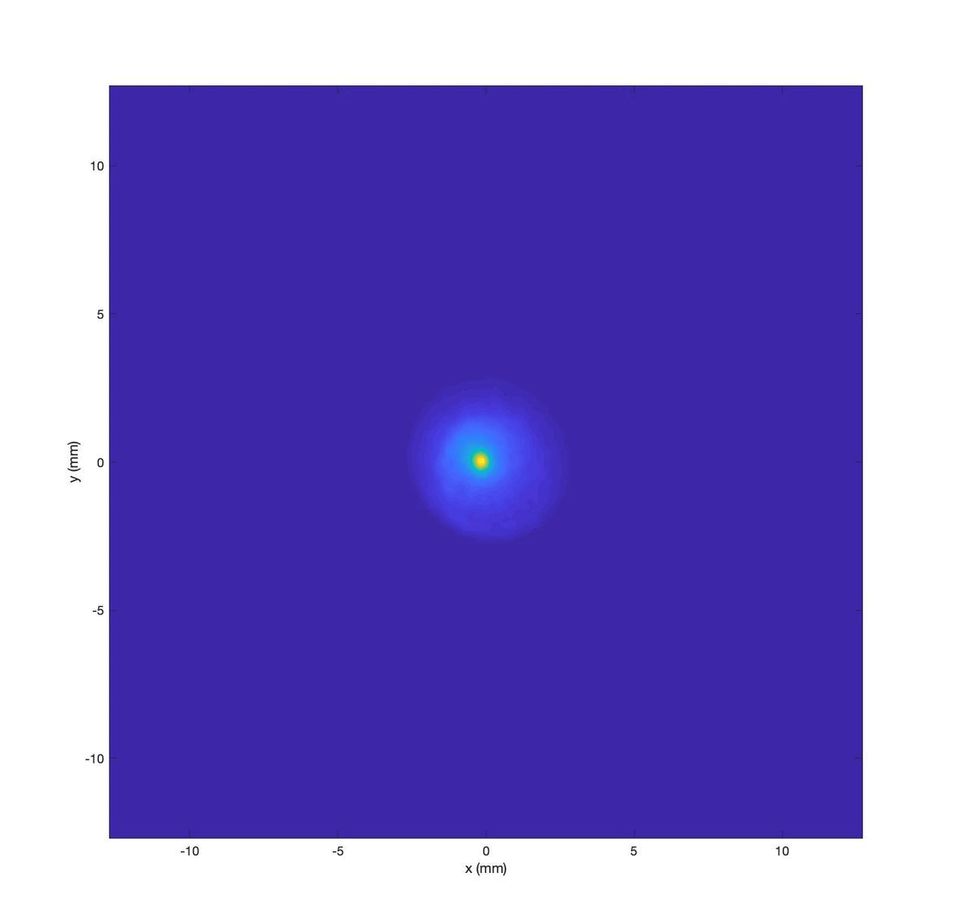
CeC Simulations
Slice Emittance Measurement
h',2',2
y (mm)
x (mm)
Quadrupole Scan on YAG with TDC on
SBU, Physics
Kai Shih

