Slide 1
Postdoctoral Retreat Presentation
Todd Poe
8/24/23

Slide 2
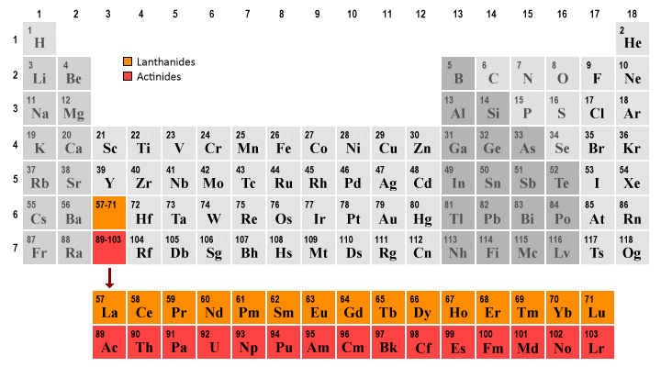
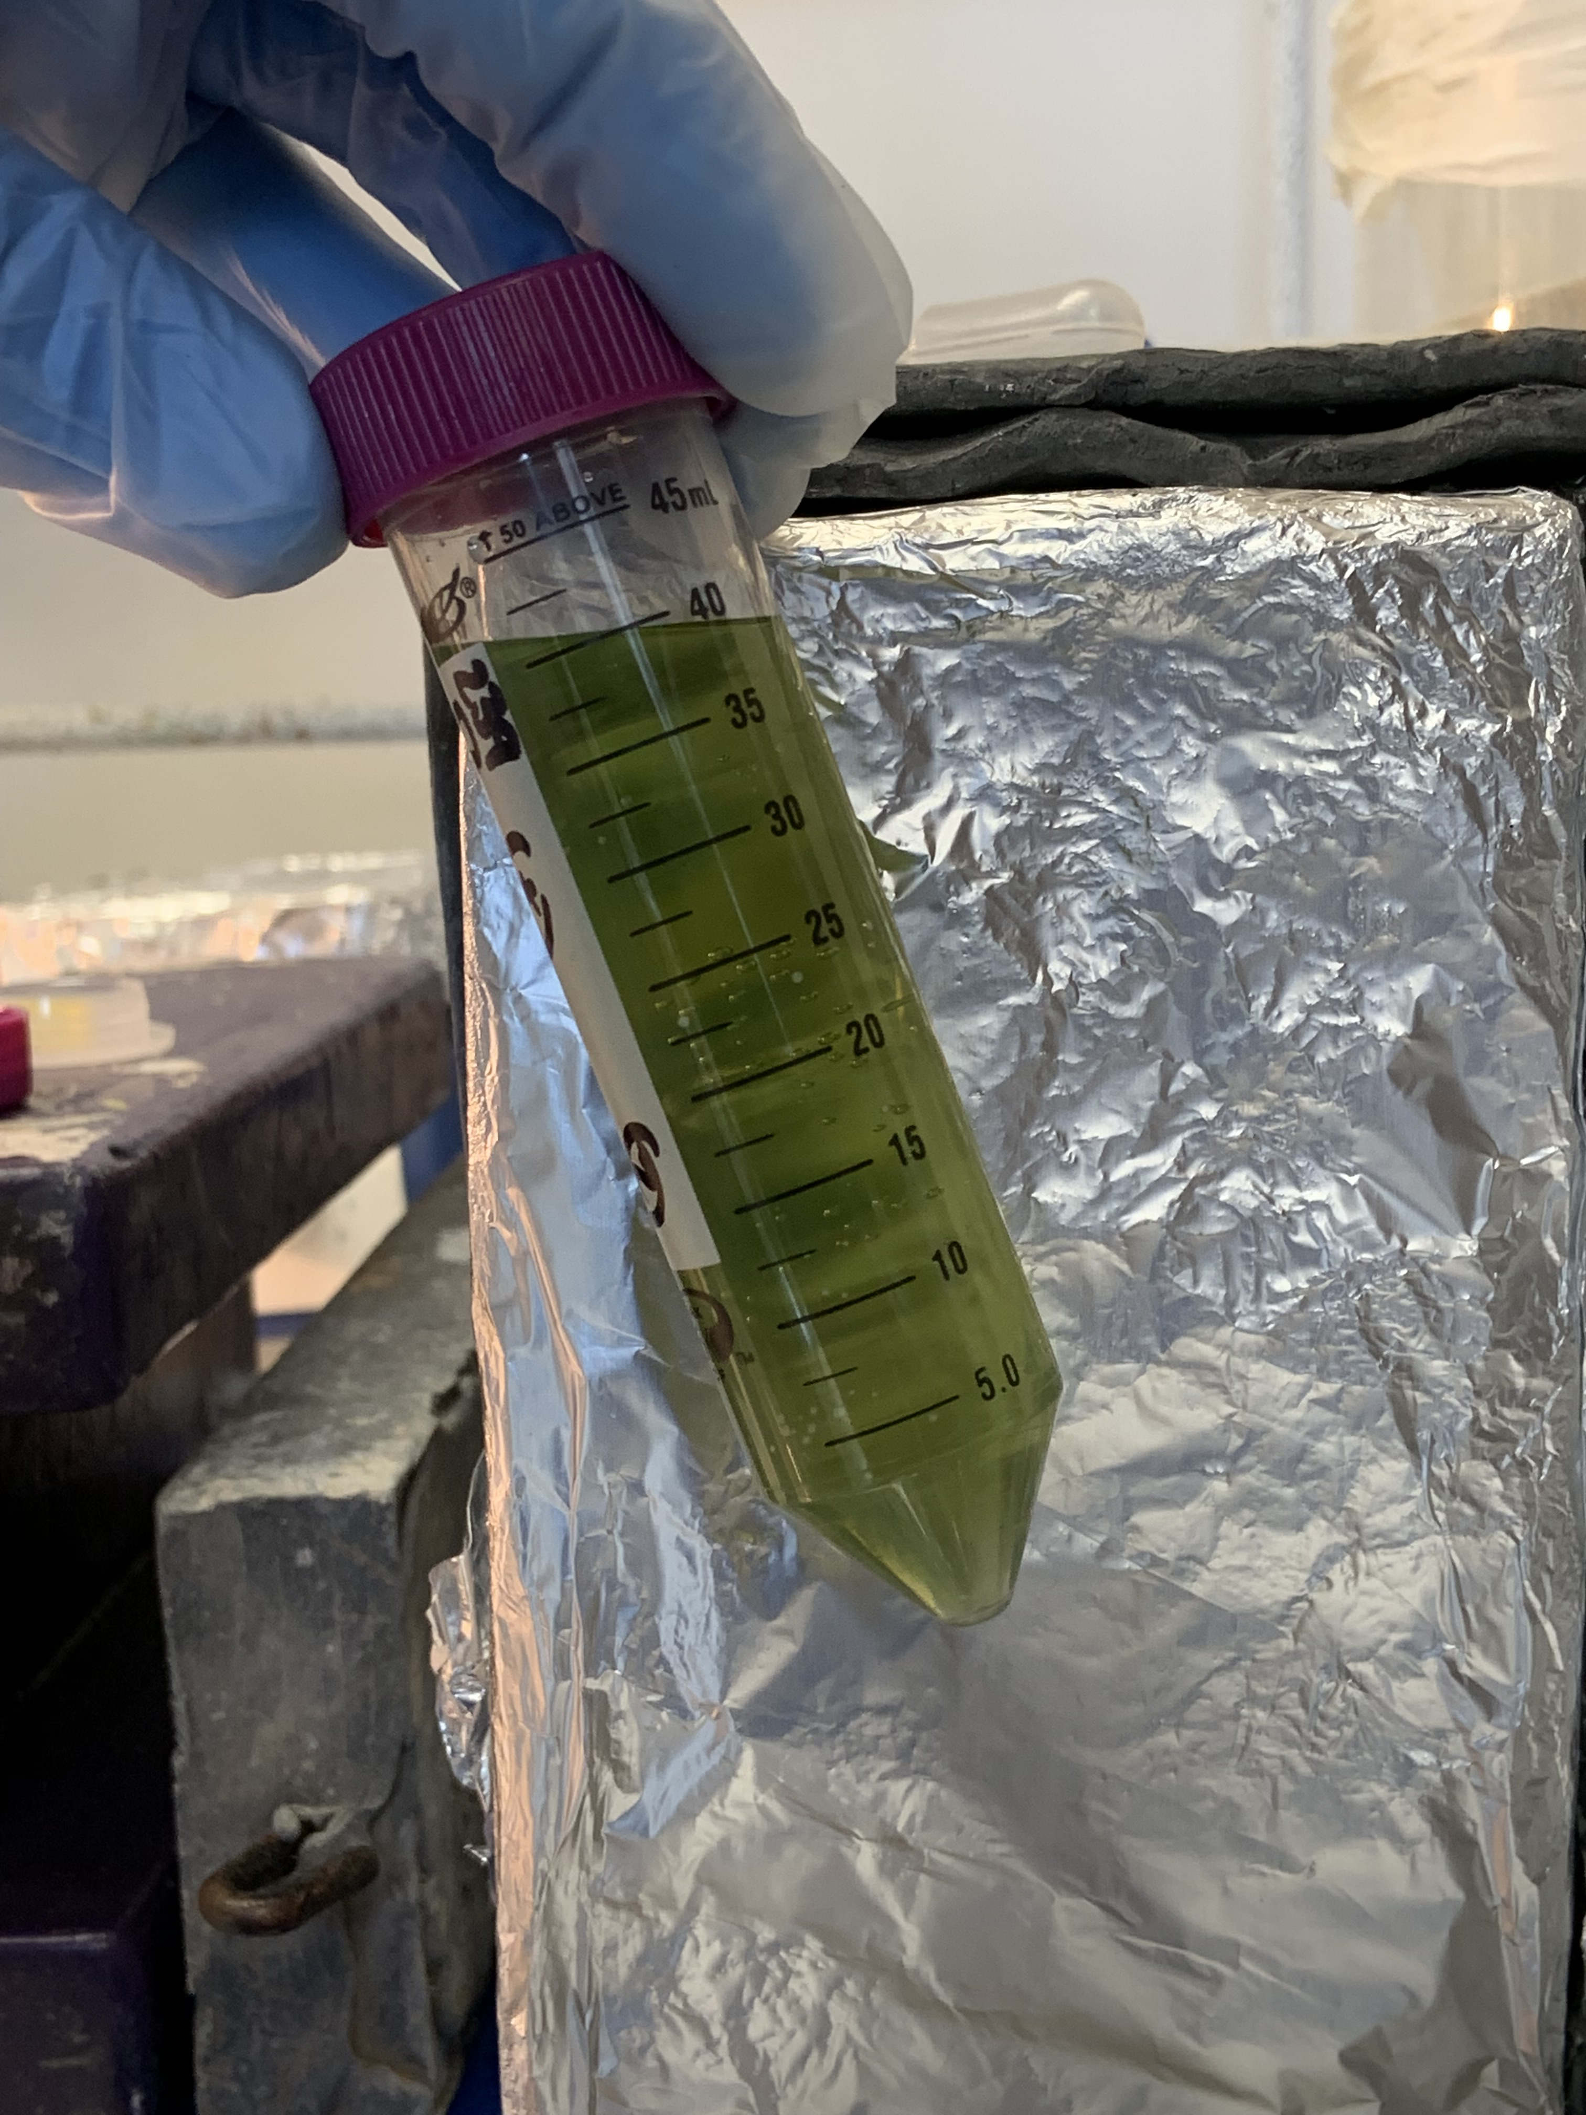
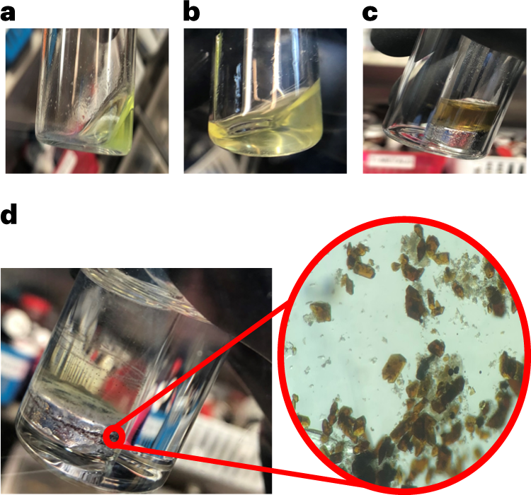
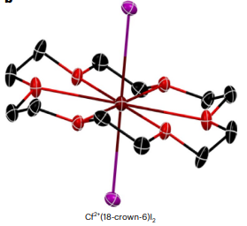
About Me
Th-232
U-238
Pu-239, Pu-242
Am-243
Cm-248
Bk-249
Cf-249
Common oxidation states of the actinide elements
Poe, T.N., Ramanantoanina, H., Sperling, J.M. et al. Isolation of a californium(II) crown–ether complex. Nat. Chem. 15, 722–728 (2023).

Slide 3
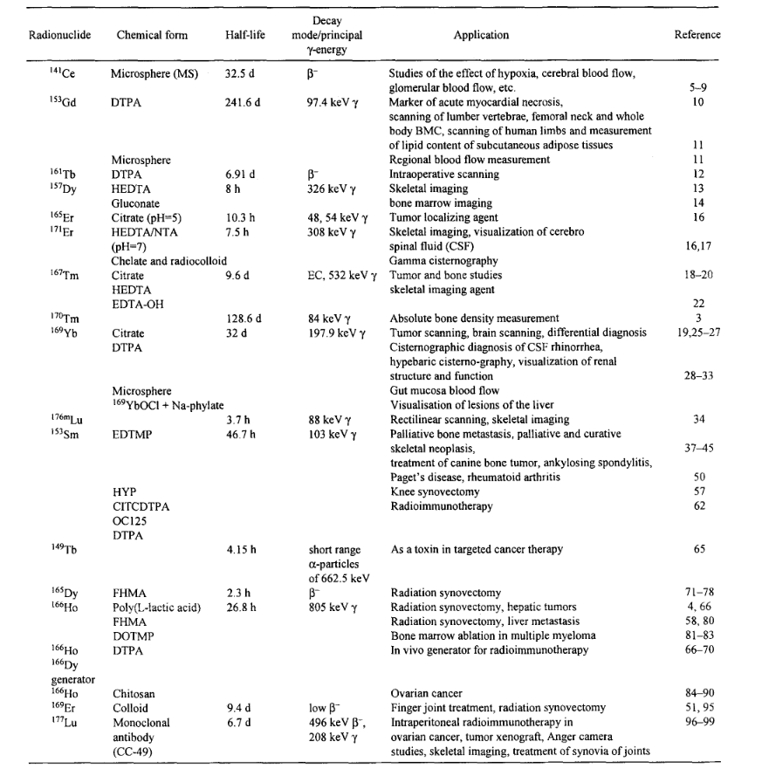
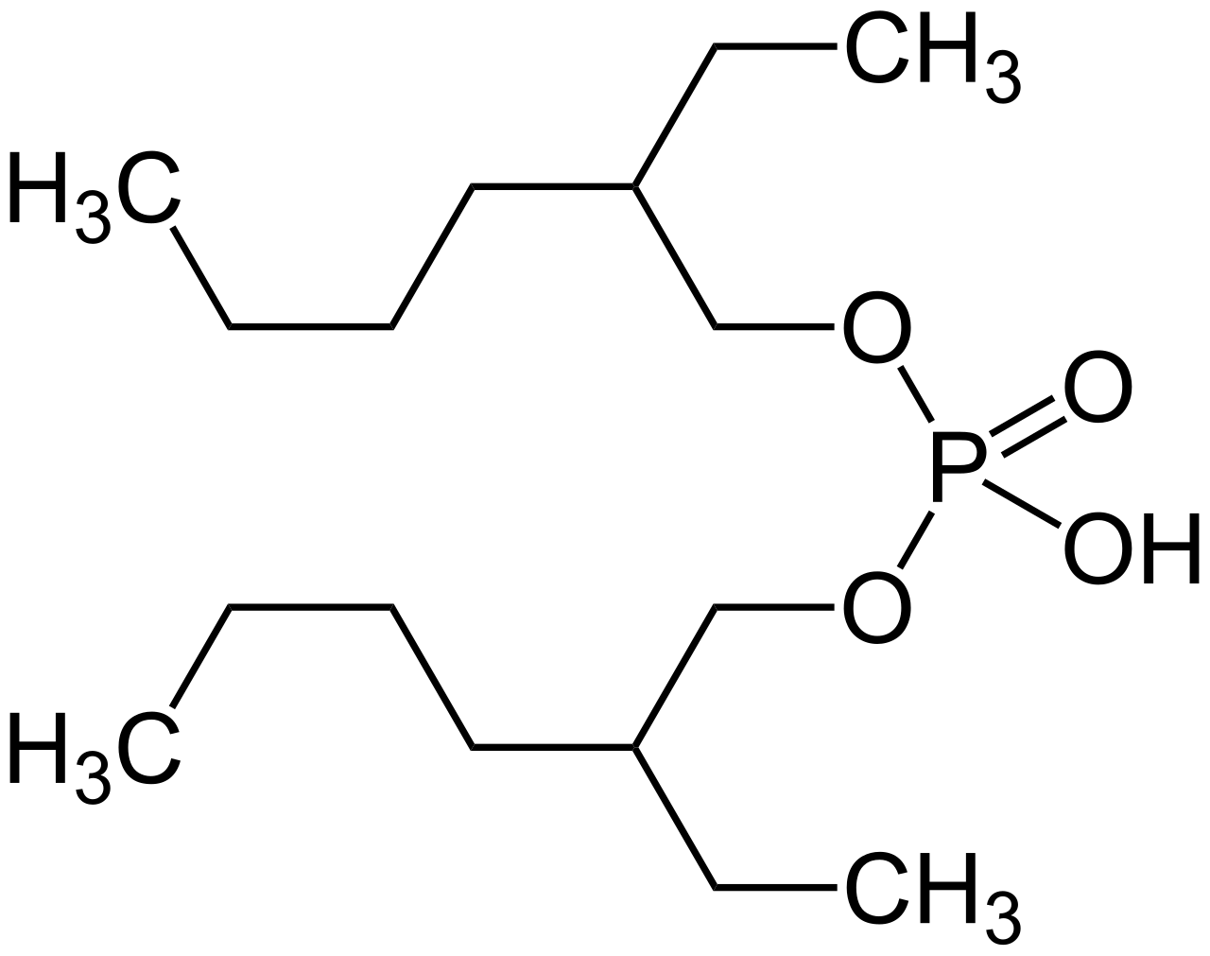
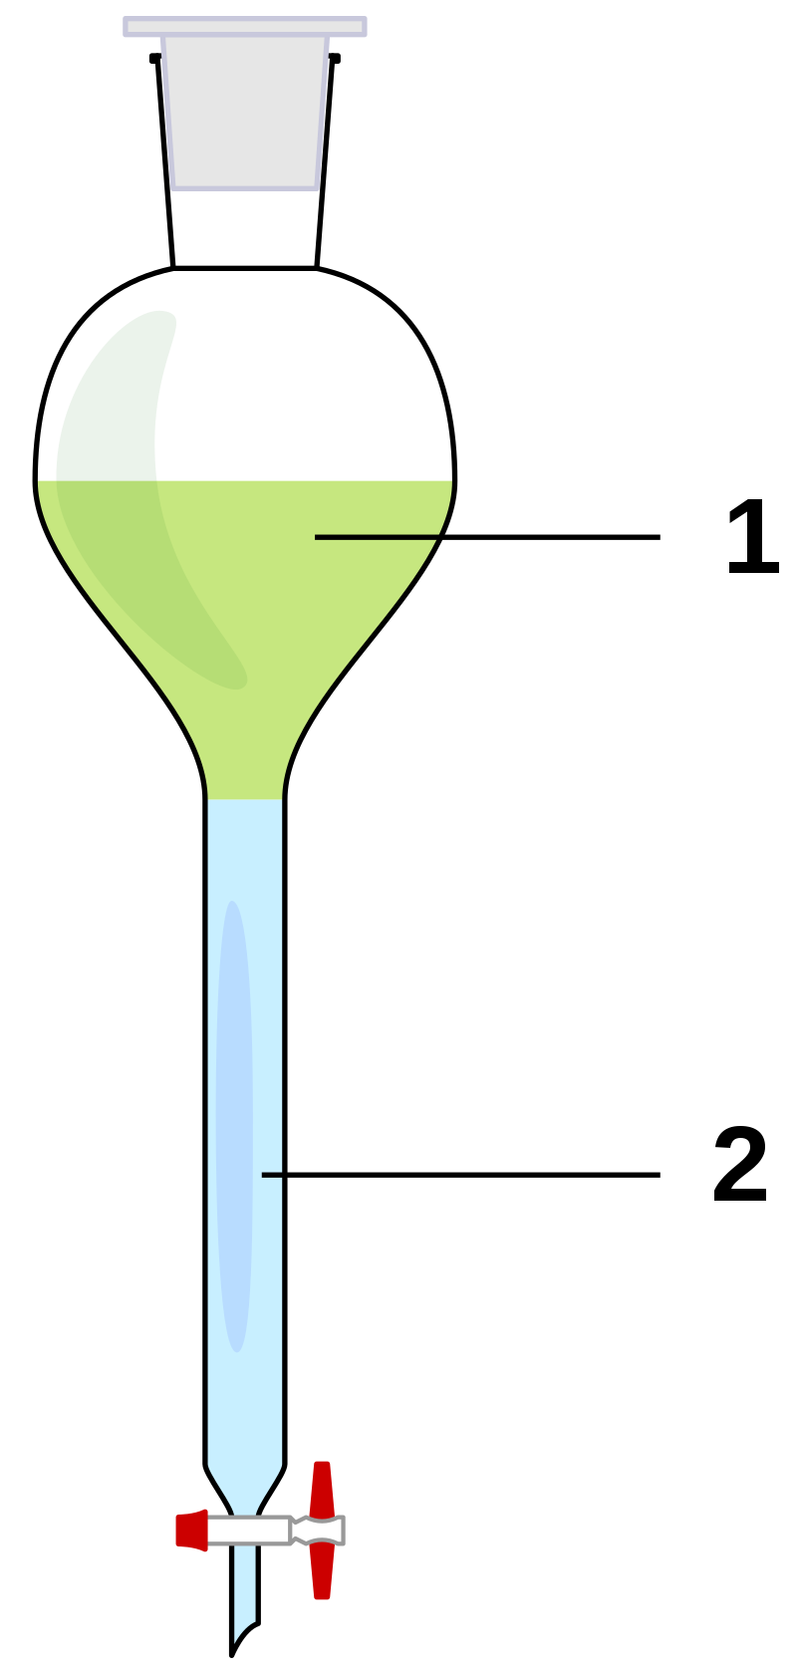
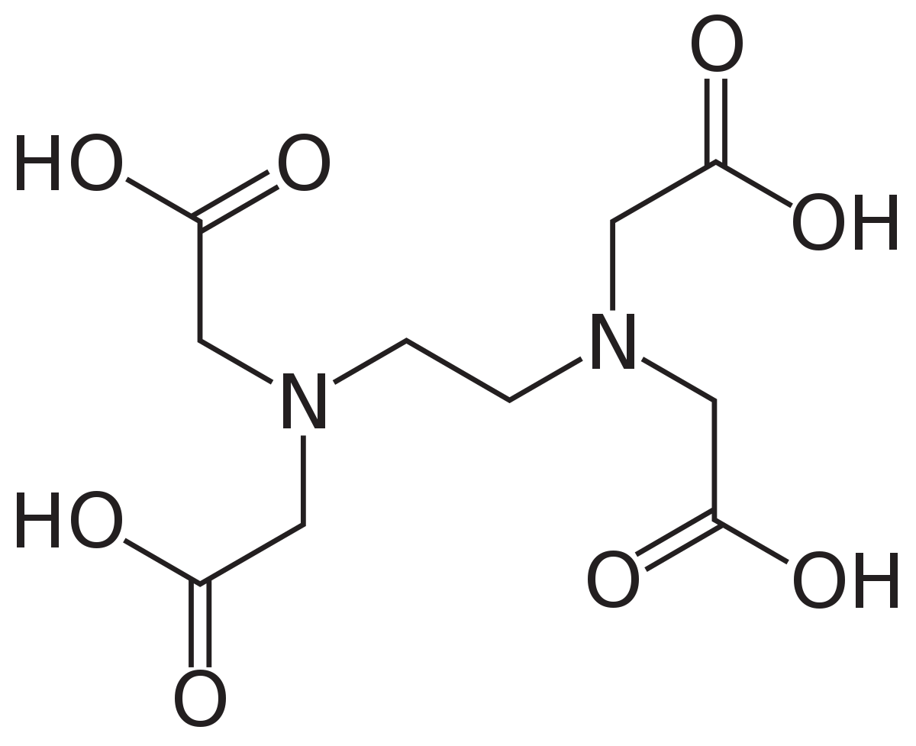
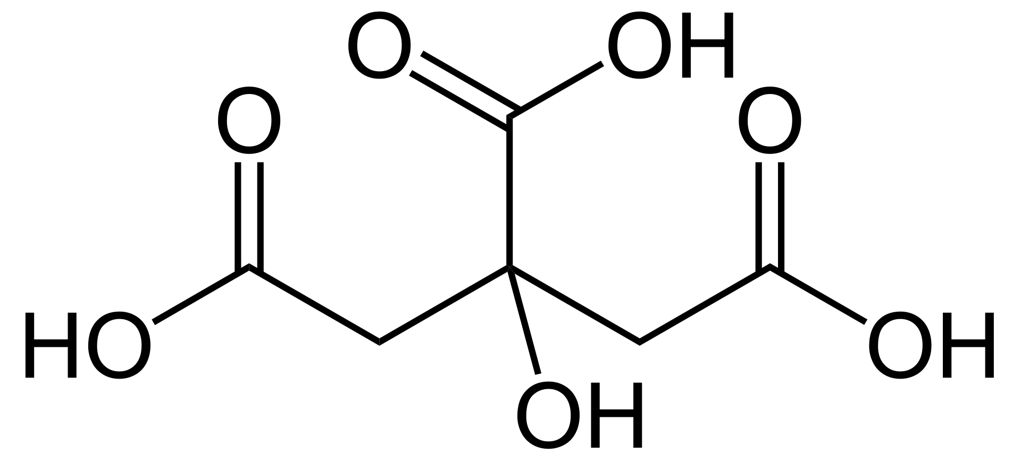
Current Work
Lanthanide separations
+3 oxidation state
Similar behaviors
Lanthanide contraction
ionic radii
103
102
99
98.3
97
95.8
94.7
93.8
92.3
91.2
90.1
89
88
86.8
86.1
(pm)
Liquid-liquid extractions
Currently used for bulk lanthanide separations
Inefficient – requires multiple steps
Competitive Chelator – more efficient partitioning?
Extractant
(for example: D₂EHPA)
Lanthanides
(Pr, Nd)
Competing Chelator
(EDTA, citric acid)
Citric acid
EDTA
Many Medically Relevant Radioisotopes

