Slide 1
C-AD through 2025 and EIC
Michiko Minty
Accelerator Division Head, C-AD
RHIC Retreat,
30 August 2023

Slide 2
Content
RHIC Science Priorities
RHIC Runs 2023 - 2025
Accelerator Physics Experiments (APEX)
Transition from RHIC Operations to the EIC
EIC-related R&D
Accelerator Safety
Notes:
25 min, <= 20 slides

Slide 3
RHIC Science Priorities
NSAC Long Range Plan
NPP Program Advisory Committee
RHIC Run Scenarios

Slide 4
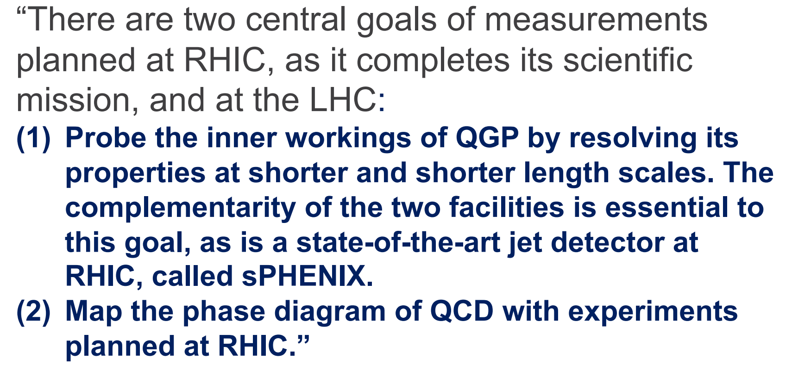
RHIC in the 2015 NSAC* Long Range Plan
Next NSAC LRP in planning process with report anticipated this year. Subcommittees and white papers available at https://nuclearsciencefuture.org
* Nuclear Science Advisory Committee (NSAC) – advises the DOE and NSF on the national program for basic nuclear research,
NSAC DFO (Designated Federal Officer): Dr. Tim Hallmann

Slide 5
NPP Program Advisory Committee (PAC) 2022
“The PAC has endorsed sPHENIX as the highest priority construction project and scientific program in 2023-2025 …”
“The PAC continues to strongly supporting focusing in Run 23 on sPHENIX commissioning using 200 GeV Au+Au collisions. This is the highest priority and must come first.”
“STAR has made a strong case for a broad, diverse, and complementary science program that it will be able to carry out using Au+Au data, beginning in Run 23.”
“… the PAC anticipates revisiting the questions of how to optimize Runs 24 and 25 next year … at present we support running pp and p+Au in Run 24, and Au+Au in Run 25.”
2023 NPP PAC meeting on 11-12 Sep 2023 will provide further guidance on science priorities.

Slide 6
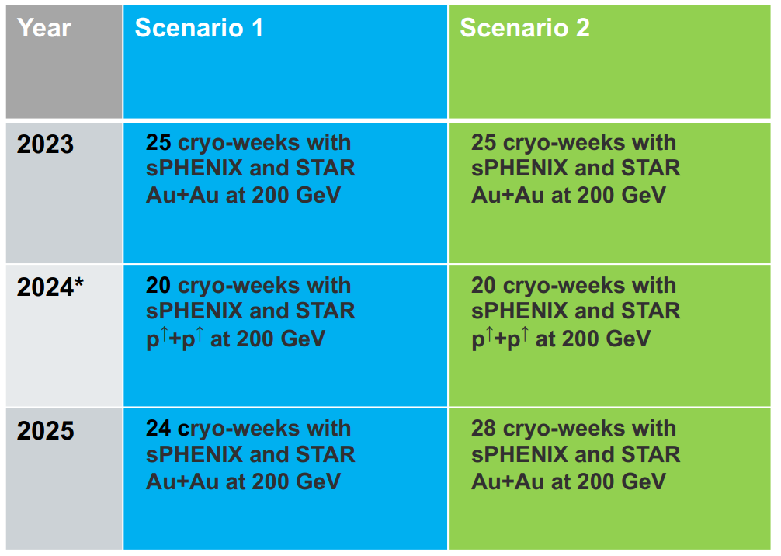
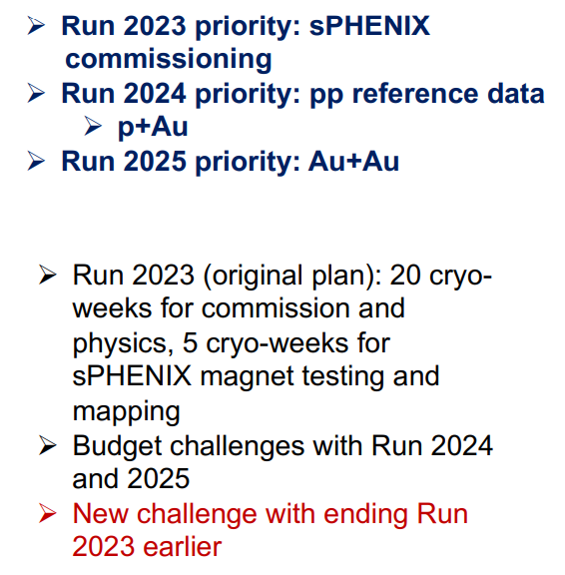
RHIC Run Scenarios 2023 - 2025
H. Gao, 22 Aug 2023
DOE NP RHIC Site Visit
(presented to DOE-NP in FY2025 Budget Briefing, Feb 2023)
* Run 2024: six cryo-weeks of Au+Au at 200 GeV approved for carry-over from FY23

Slide 7
RHIC Runs 2023 - 2025

Slide 8
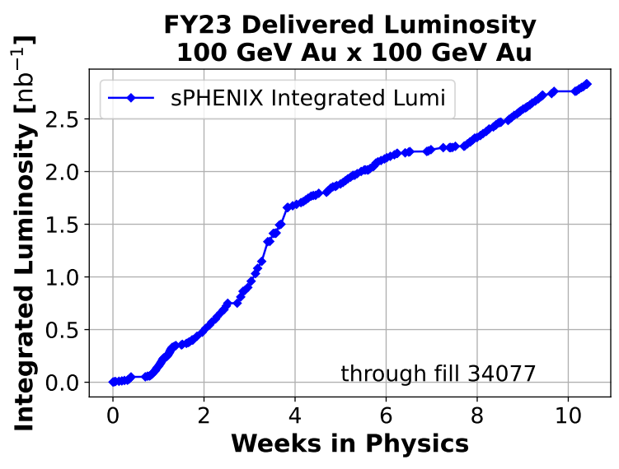
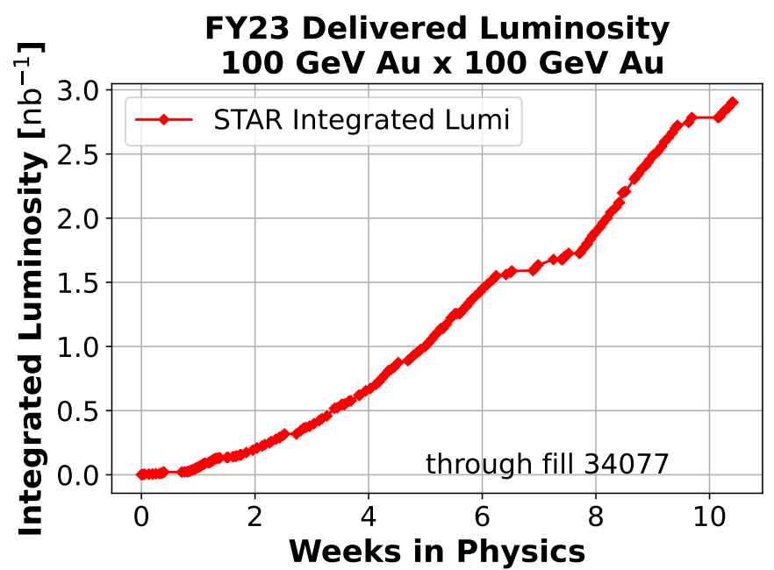
RHIC Run 2023
Timeline
  4K cooldown 5 May 2023
  First beam injection 8 May 2023 (Blue)
  10 May 2023 (Yellow)
  sPHENIX commissioning with beam 18 May 2023
  STAR physics “declared” 20 May 2023
  APEX and maintenance alternating weeks starting 24 May 2023
  Blue Ring 1004B valve box failure 1 August 2023
  End of RHIC Run 2023 4 August 2023
Au beams provided by Tandem
Provided wide variety of RHIC beam conditions (number of bunches, bunch intensities, up to 2 mrad crossing angles) as requested for sPHENIX commissioning.
Provided collisions also for STAR with 1 mrad crossing angle and luminosity-leveling; ~30% of minimum-bias goal (Run23+25) collected.
preliminary
preliminary
DOE noted favorably the “great flexibility in providing various running conditions” and “RHIC, STAR, PHENIX, and soon to be sPHENIX programs are some of the most spectacular enterprises in Nuclear Physics” (T. Hallmann, 2023 RHIC S&T Site visit, Aug 2023)
8

Slide 9
RHIC Availability
p↑+p↑
Au+Au
100 GeV
255 GeV
courtesy C. Naylor
72.7% 2023
85.8% 10-year average
RHIC Availability [%]
Time [Fiscal Year]
Availability = beam time / scheduled beam time
(denominator excludes scheduled maintenance)
Availability goals: 82.5% < FY20,
85% FY21-FY22
82.5% FY23
RHIC Run 2023: 72.7%
Average over last 10 years: 85.8%
Availability impacted by environmental factors (heat, humidity, storm-related issues). Early start for RHIC Runs 24-25 planned (8 Jan 2024 for Run 24)

Slide 10
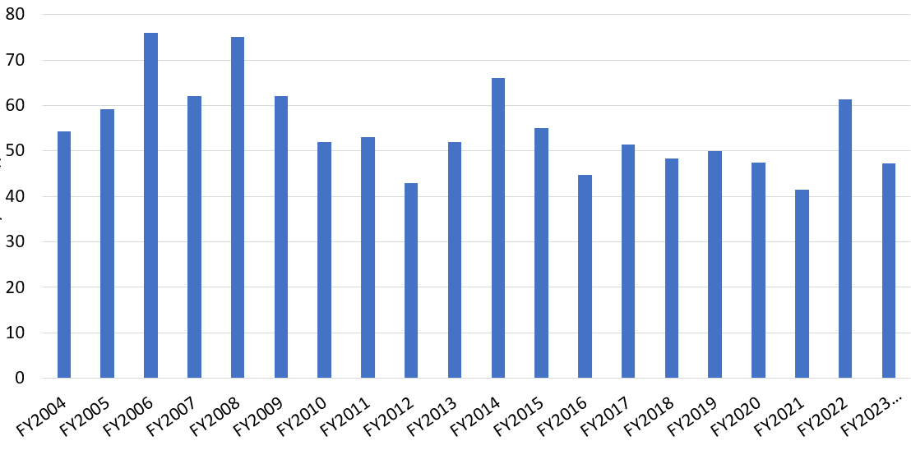
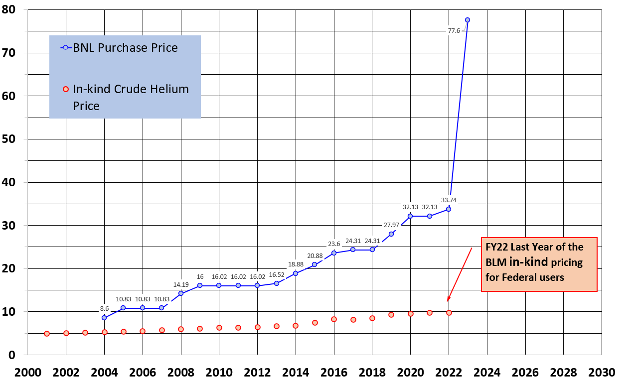
Supply chain and inflation*: Helium and Electrical Costs
*Thank you to all for providing input for the S&T review
Electrical costs
  no fixed price contract, price volatility
    FY21: $41.4/MWh
    FY22: $61.4/MWh
    FY23: $47.3/MWh actual
    (had planned for $70.0/MWh)
    FY24: planning for $82.4/MWh (conservative)
Electricity Rates
$57/MWh
$55.1 average
Cost of LHe
FY23: no more “in-kind” pricing from Bureau of Land Management (BLM) Reserves due to 2013 Act eliminating Federal Helium Reserves
Helium Pricing Trends
$77.6
  FY21: $32.1/LHe gallon
  FY22: ~$33.7/LHe gallon
  FY23: $77.6/LHe gallon
  (had planned for $50/LHe gallon)
  FY24: planning for $77.6/LHe gallon
RHIC operating costs impacted by inflation which could affect duration of RHIC Runs 24-25

Slide 11
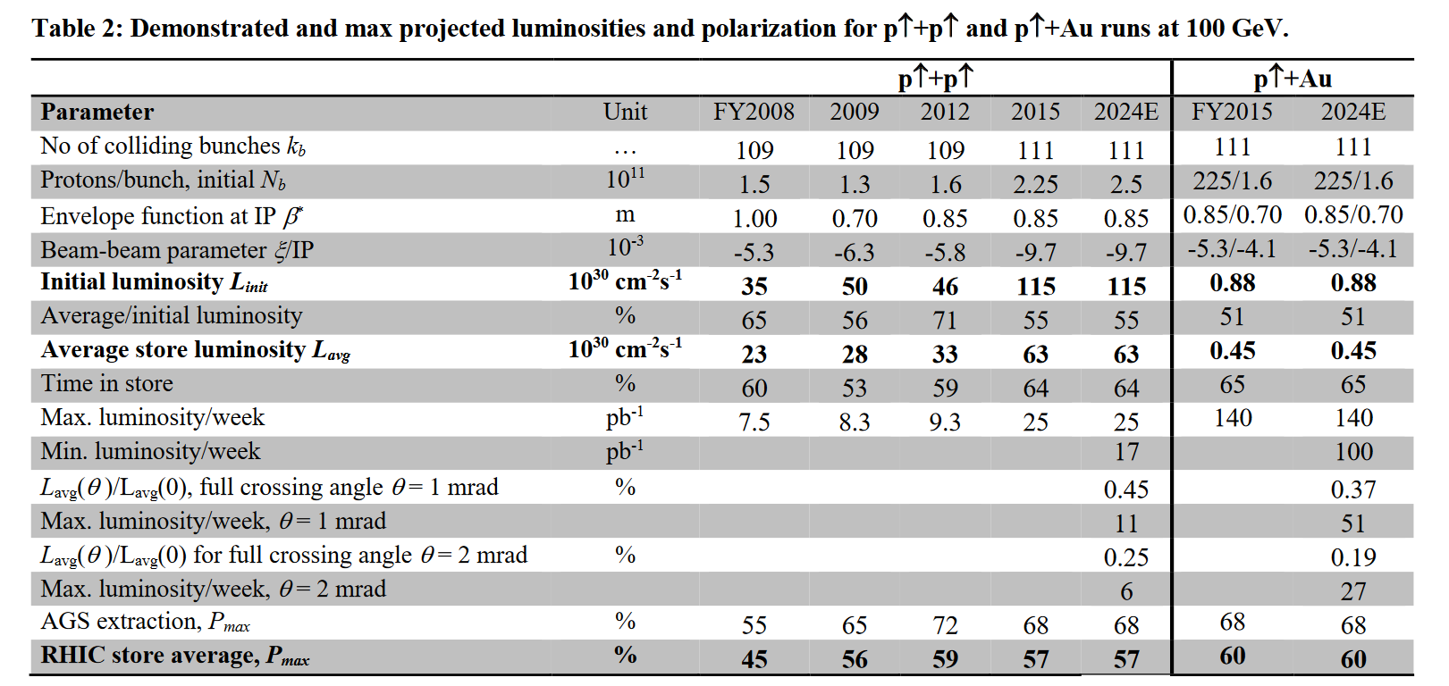
Projections updated
Luminosity projections reduced for Run-24 and Run-25
  challenging to re-establish peak performance after ~decade (Au+Au and p+p), assume previous performance as max now
  observed higher Secondary Electron Yield (SEY) in Run-23 compared to Run-22 – deconditioning of vacuum surfaces
  effect of Au beam longitudinal profiles on L reduction with crossing angle larger than calculated
  enhancement from 56 MHz SRF cavity (not yet re-commissioned with early end of Run-23) not included

Slide 12
Accelerator Physics Experiments (APEX)

Slide 13
Y. Luo
Recent APEX Overview
APEX Beam Time (hours)
focus: experiments to inform EIC design
focus: experiments to inform EIC design, beam cooling studies
focus: beam cooling studies
(Low Energy Au runs, COVID)
Low Energy Au runs
From DOE S&T Review (Aug 2023) : “The Lab is commended for the APEX activities during the shortened RHIC Run 23 on critical questions for EIC design. Demonstration of … are all directly related to the most important EIC beam parameters, the luminosity and polarization. The EIC project will benefit greatly from APEX activities in future runs.”

Slide 14
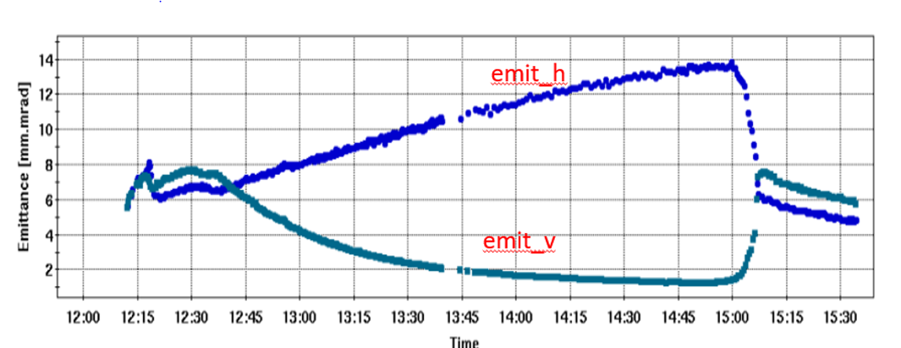
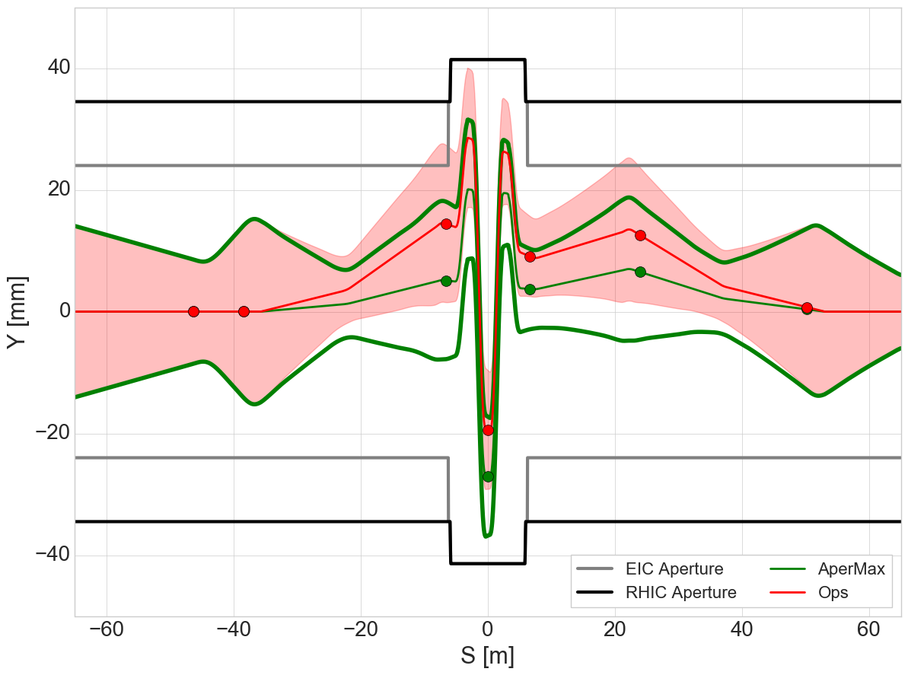
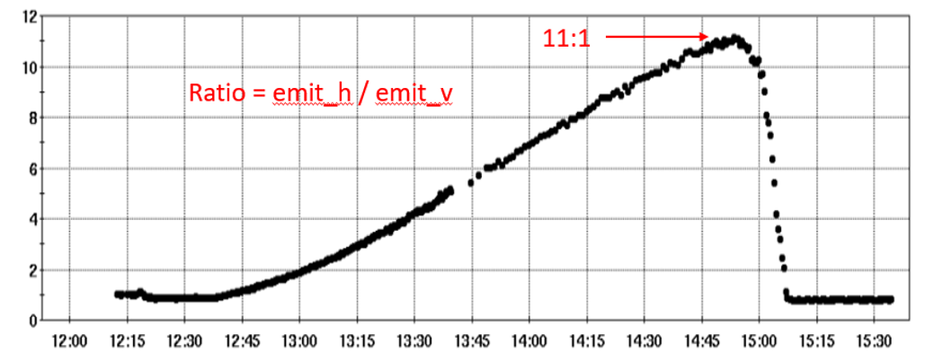
Two APEX highlights from RHIC Run 23
Vertical trajectory in snake
horizontal
g9-lm7
snk-blm
g9-lm8
g9-lm9
Emittance [μm]
vertical
+/- 6𝞂 beam envelopes
2.5 um norm rms emit.
Emittance Ratio
Ratio
RED = Operational trajectory
GREEN = Proposed trajectory
Time [hr:min]
Precision Decoupling, Y. Luo et al. demonstration of >10:1 emittance ratio as required for the EIC.
Siberian Snake aperture optimization, V. Schoefer et al. Experiments demonstrated RHIC beam optics compatible with EIC vacuum chamber design.
Note: no experiments in beam cooling with RHIC beams took place in Run-23.

Slide 15
Transition from RHIC Operations to the EIC

Slide 16
25+ Year Upgrade Plan
R. Michnoff et al
Initiated in 2018 for RHIC, the injector complex with considerations for the EIC
Assessed annually based on need for
  performance upgrades
  upgrades of obsolete systems
Assumes no further large performance upgrades of RHIC after LEReC until end of RHIC operations
Next update mid-Oct, 2023
Upgrade Plan and Goals
  Maintain technical infrastructure
  Ensure hadron injector complex ready for EIC commissioning while also running for external users (e.g. NSRL and BLIP), possibly HEET
  Ensure that system upgrades satisfy both short-term injector and RHIC needs as well as longer-term EIC requirements
  Develop near-term plans to allow new systems to be tested prior to the end of RHIC beam operations
16

Slide 17
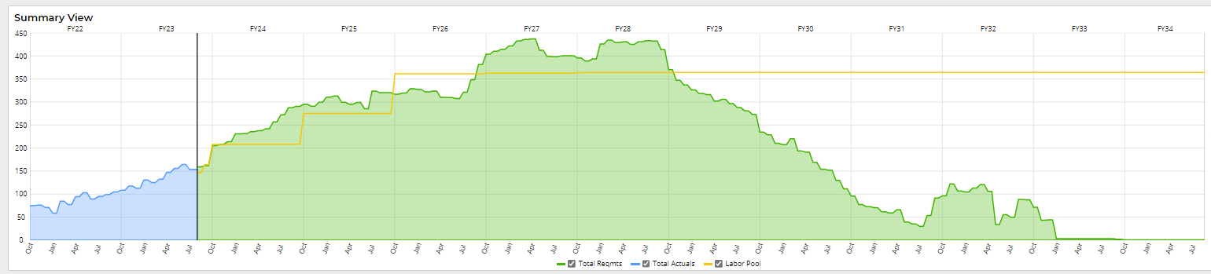
Staffing
D. Hatton et al
Actual labor charges to EIC
EIC Staffing Requirements
Data Date – August 18, 2023
Staff Available to work on EIC
staff requirements for the EIC Project will be finalized at CD-2
anticipated staffing requirements exceed staff availability (C-AD and EIC combined)

Slide 18
EIC - related R&D

Slide 19
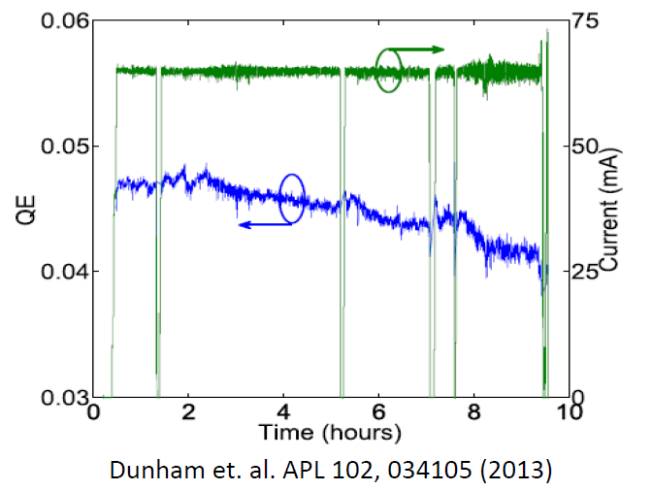
High-current electron guns, NC
From W. Fischer
22 Aug 2023
DOE NP RHIC Site Visit
EIC electron beam coolers require stable long-term electron source with ~100 mA for
low-energy coolers (13 and 22 MeV electrons)
high-energy cooler (150 MeV electrons)
Operational experience with DC guns to date:
Cornell University DC gun:
Demonstrated 65mA over several hours
LEReC DC gun:
1) 24/7 operation at about 20 mA current (2020-21)
2) Achieved stable operation at 50mA in tests (April 2022)
Future work:
LEReC Gun: Explore operation at high currents up to 100mA.
EIC R&D: 500kV inverted gun under design.
19

Slide 20
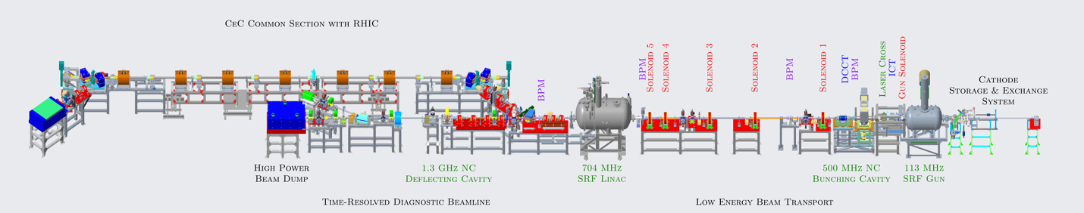
High-current electron guns, SRF
From W. Fischer
22 Aug 2023
DOE NP RHIC Site Visit
Increase average SRF unpolarized e-beam to
1-3 mA in Phase I
30-100 mA in Phase II
Phase I: high rep-rate seed laser, new quadrupoles and solenoids, new MPS and diagnostics
Phase II: requires significant modification of the SRF gun and additional funding for
new Fundamental Power Coupler (FPC).
100 kW CW RF system in the Bldg. 912 at BNL.
assembly and tests of 100 kW FPC and supporting accessories.
procurement and tests of the cavity tuner.

Slide 21
Machine Learning at C-AD
From W. Fischer
22 Aug 2023
DOE NP RHIC Site Visit
Gaussian Process (GP) Bayesian Optimization (BO), applied to LEReC
Emittance Measurement Speedup with Machine Learning at CeC & NSRL
Accelerator self-diagnosis and automating ORMs
Reconstructing transfer functions using beam-based analysis (Booster)
Polarization, FOA funded (10/23-09/25), goal: 5% increase
Natural Language Processing (NLP) for elogs and other apps
Ionization Profile Monitor Channel Gain Calibration with ML
Anomaly detection from RHIC Cryogenics data
Adopting and using XOpt and Badger (and eval of Geoff and COI)
Collaboration with FNAL/JPARC for slow spill control
Optimization of a Longitudinal Bunch Merge Gymnastic with ML
RadiaSoft collaboration – Virtual emittance diagnostic (using IPMs & other instruments)

Slide 22
Accelerator Safety

Slide 23
Accelerator Safety - Readiness Reviews and USIs
Booster/LINAC
  IRR: July 2025
  ARR: September 2025
AGS
  IRR: July 2026
  ARR: September 2026
Expectations for All Staff when performing work
up-to-date procedure MUST be present and used at the job site
performing work with an incomplete work permit (specifically signatures and review) is NOT ALLOWED
pre-job briefings ARE ALWAYS REQUIRED, note: walkdown during review of work permit is not the same as the pre-job briefing
constructive feedback (procedures and work plans) is welcome and encouraged

Slide 24
Supplementary Slides

Slide 25
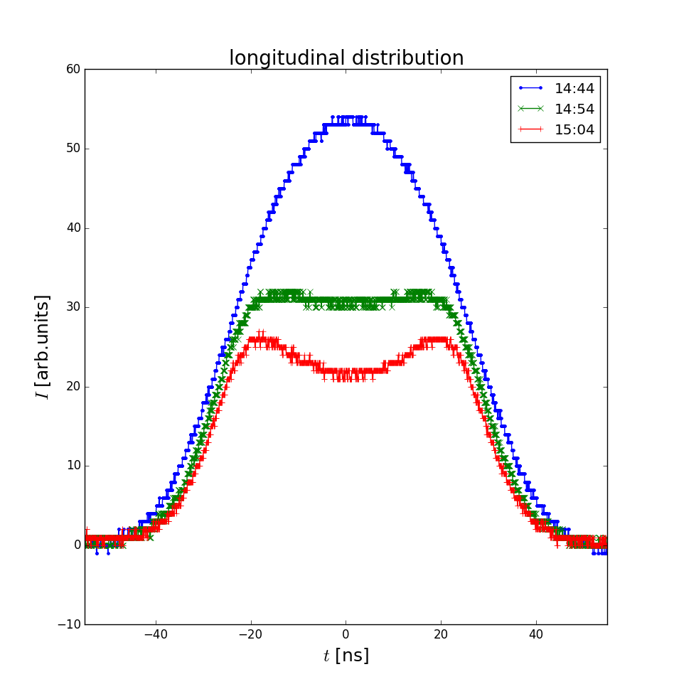
APEX - Advanced Beam Cooling
While both LEReC and CeC established electron beam operations, no beam cooling experiments took place in Run 2023.
LEReC – advances in accelerator science
Analyzed data from APEX 2022 and published (details in backup slides):
Experimental demonstration of circular attractor at relativistic energy using LEReC
S. Seletskiy, A. Fedotov, D. Kayran, “Experimental studies of circular attractors in the first rf-based electron cooler”, PRAB 26, 024401 (2023).
Demonstrated influence of circular attractor on CeC
S. Seletskiy, A. Fedotov, D. Kayran, “Circular attractors as heating mechanism in coherent electron cooling” PRAB 25, 054403 (2022).
Measured ion bunch evolution in the presence of a circular attractor
Electron beams re-established in 2023 reproducing design beam parameters.
APEX for LEReC this year (10 hours) was devoted to establishing 3.85 GeV beam (with 100 GeV initial conditions).
M. Minty DOE 2023 RHIC Science & Technology Site Visit

Slide 26
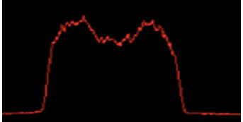
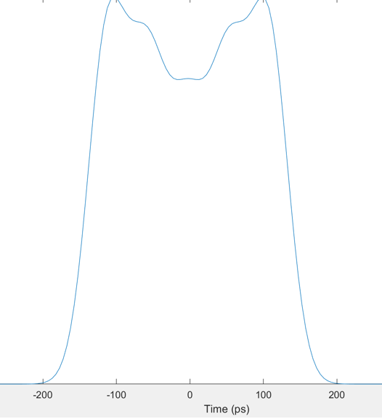
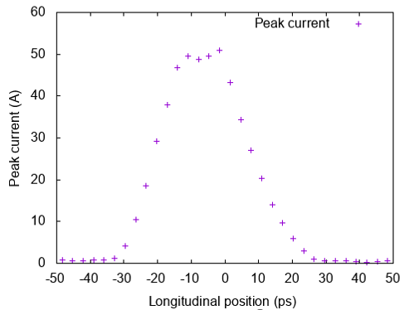
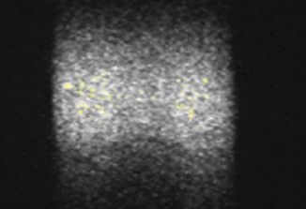
APEX - Advanced Beam Cooling
CeC – advances in accelerator technology
Updated cooling simulation require the electron beam in cooling section to have uniform current distribution (<10% peak-to-peak variation) as well as good quality over 15 ps duration
Beam dynamics simulations show that the uniform distribution can be achieved using a new (non-Gauusian) distribution of the laser pulse profile.
The laser system was upgraded to produce five overlapping Gaussian laser pulses (using five interferometers). Efforts underway to ensure same laser profile at laser gun table.
simulation: electron current distribution (in ps)
proposed laser pulse shape
streak camera measurement
(laser trailer)
-200 -100 0 100 200
at gun
in cooling region
Manufacturing process has started for new 500 MHz bunching cavity.
New transfer system for photocathodes successfully tested.
M. Minty DOE 2023 RHIC Science & Technology Site Visit

