Slide 1
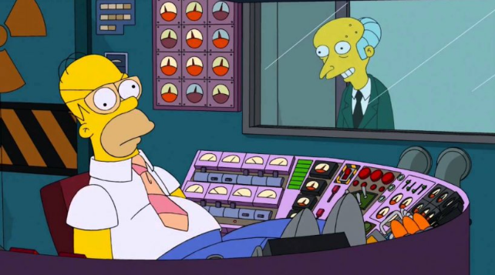
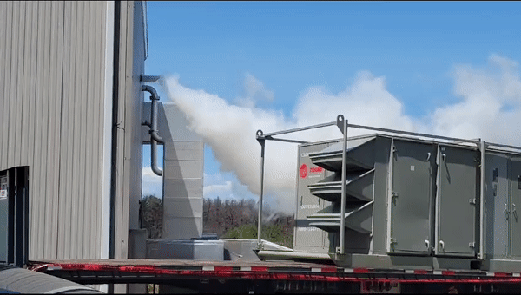
View From Operations FY23 RHIC Retreat
Gage Tustin
August 30, 2023

Slide 2
Long Shutdown into Hectic Startup
Run22 ended mid-April 2022 heading into a long shutdown with many major projects
sPHENIX, EBIS upgrade, 56 MHz, RHIC PS Work (bo9 snake repair)
Original plan to startup RHIC in March 2023, pushed back to early May (20 Cryo weeks)
Shutdown extension with 20 Cryo week run required us running through the hottest months of the year (more on Summer running later)
Final cool down to 4K began May 8 putting first blue beam setup scheduled for May 12
Difficult start up, there were many RHIC PS and QLI issues to sort out – put out start up fires during day and setup overnight
Despite initial struggles, store setup finished on time late May 17, first 56x56 experimenter setup fill was early in the morning May 18
Kudos to system experts for startup efforts: T. Shrey, K. Mernick, R. Guillaume, A. Drees, C. Lui, R. Hulsart, R. Michnoff

Slide 3
Procedure Upkeep
Procedure/documentation upkeep is crucial, OPM revamp and clean up underway but still a work in progress
Some examples that directly affected operations early on: H11-blw and blue injection kicker
AGS H11 blw crowbar trips – Pulsed Power set to address this on May 13
Issues with LOTO procedure introduces hazard to workers and increases downtime, original 1 hour estimate becomes an 8 hour job for procedure update and review
Blue injection kicker issues – Gas pockets and blumlein oil replacements May 23-24
Procedure not in place, extensive job becomes more difficult now to write proper procedure, plan, and execute under pressure, first of a few >24 hour failures we encountered
Want to re-emphasize importance of proactively reviewing procedures as they age and making sure systems have procedures in place

Slide 4
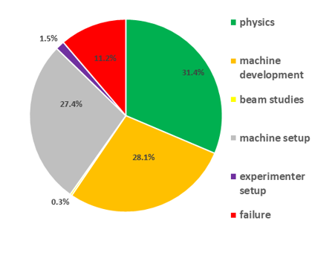
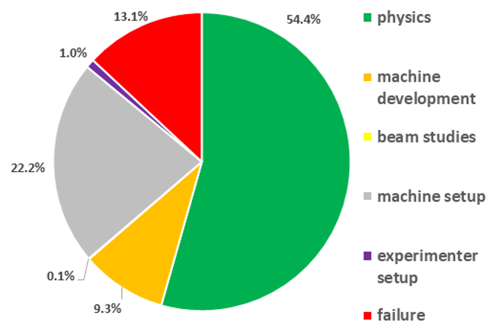
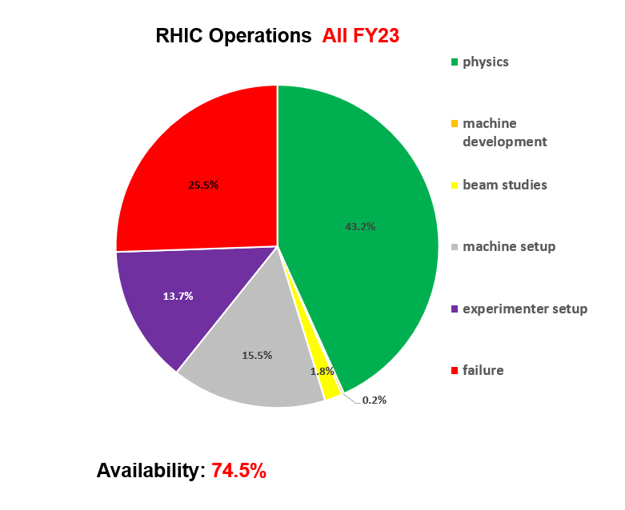
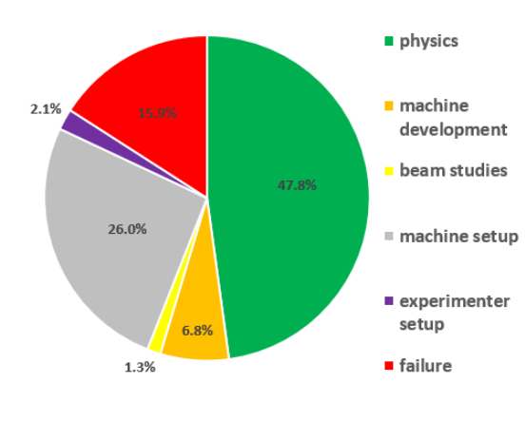
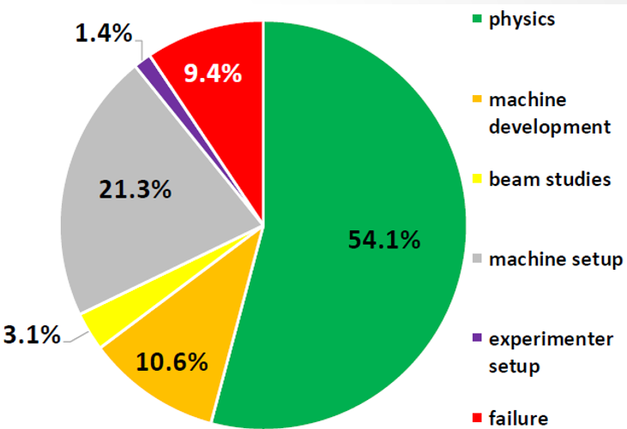
FY19
FY20
FY21
FY22

Slide 5
Failures Behind Experimenter Setup
Along with large percentage of time in failure, we have many experimenter setup hours due to sPHENIX time without beam for commissioning
Should be noted some failure time is hidden by impromptu experimenter setup
Flexibility of experiments and groups is great to alleviate the weight of lengthy failures
We are juggling many ongoing issues at any given time, complicated machine with many different groups and efforts to coordinate
if there are things that can be done with no beam it makes more sense to schedule around the machine’s availability instead of the whole facility around a few experimenter system experts
Maybe we could implement a rotating call in for experiment experts to be available when downtime occurs?
Flexibility of groups with submitted jobs to work behind longer limiting factor failures is also appreciated

Slide 6
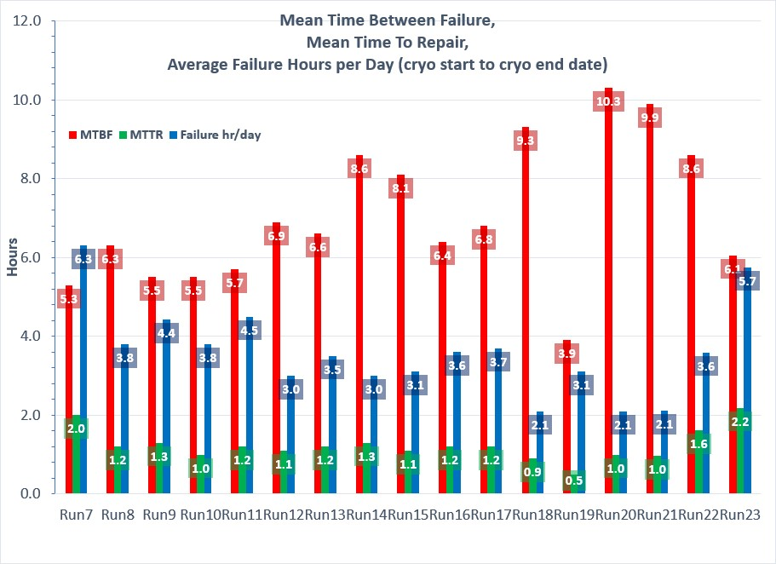
The worst run for Mean Time To Repair
Among the worst for Failure Hours per Day and Mean Time Between Failure

Slide 7
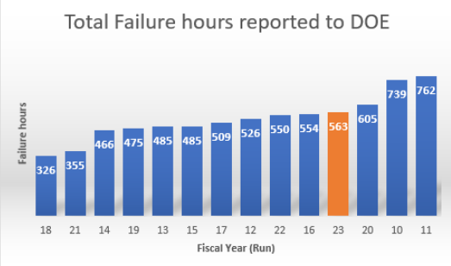
Among worst total failure hours this run
Considering we were only ~half way through the run, we were on track to break to compete for the top spot

Slide 8
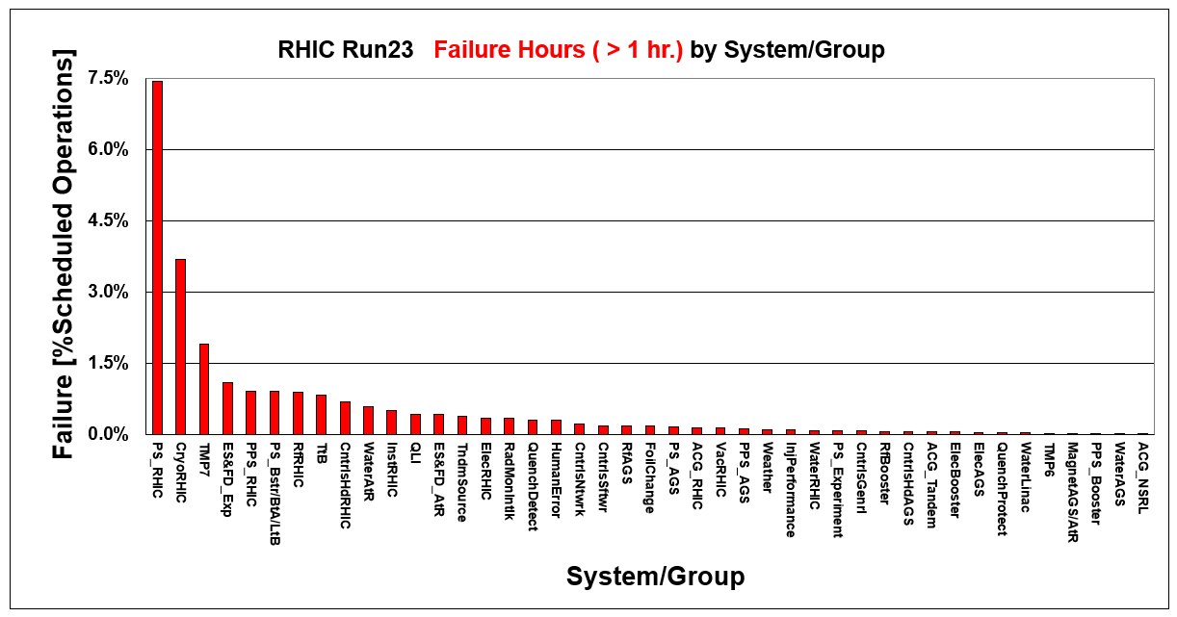

Slide 10
PS Failures
There were significantly more PS Failures this run than the previous
Following numbers are all full ps replacements documented in OC logs, does not include the other frequent issues like bad connections/card replacements etc.
FY23 RHIC PS Replacements – 20
FY22 RHIC PS Replacements – 6
PS Group would have better insight on different factors contributing to this, but running in the Summer does not help

Slide 11
Summer Running
Electronics don’t like heat and humidity
Power dips are always a threat (see Run22), but more so during Summer months with tropical storms (severe weather stand downs) and increased energy demand for cooling systems, more failures and down time
Had a few significant power dips this year as well, all of which happened in second half of July
Some limited call-in access with Summer vacations and holidays
Reminder: When we are running, we are running. Holidays are just another day from the operations perspective. Update Call in Lists for vacations and rotate them so its not always the same people getting called if possible

Slide 12
Summer Issues
Many service building and alcove temperature alarms, hard to get a hold of AC techs to check in on repair statuses, we get most of our information second hand through CAS
Common response is that parts are on order – can we stock up on parts before Summer running?
Last few times we ran in the summer it was low energy, little to no RHIC ramping
Sitting at high current in hot months gives significantly more stress on systems

Slide 13
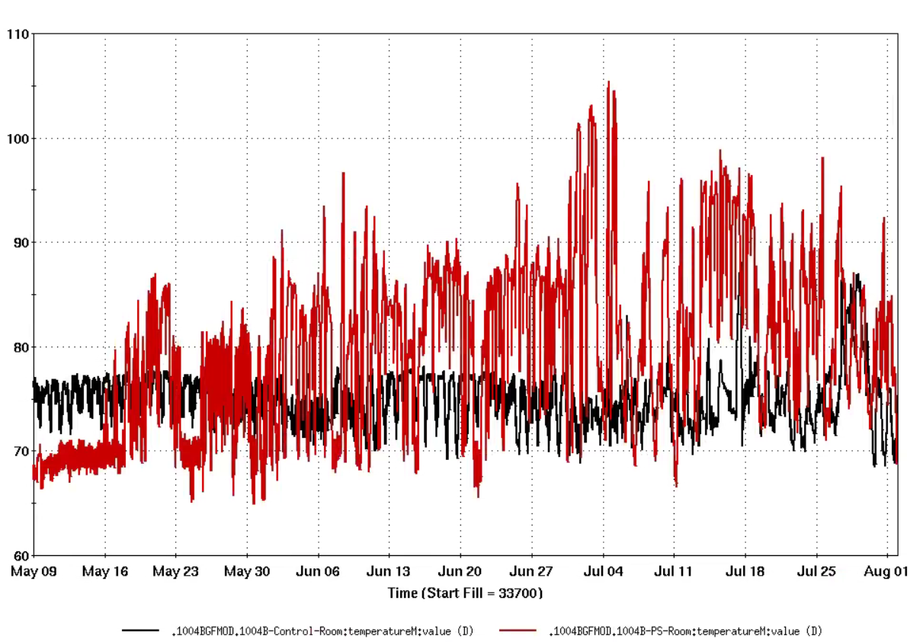
1004B
1004B cooling system was not fully functioning
Many RHIC PS issues and failures associated with this building: blue mains, yellow mains
Temperature regulated enclosures in RMMPS had issues during peaks in early July, we had to ramp RHIC magnets down so things could cool off, extra store downtime

Slide 14
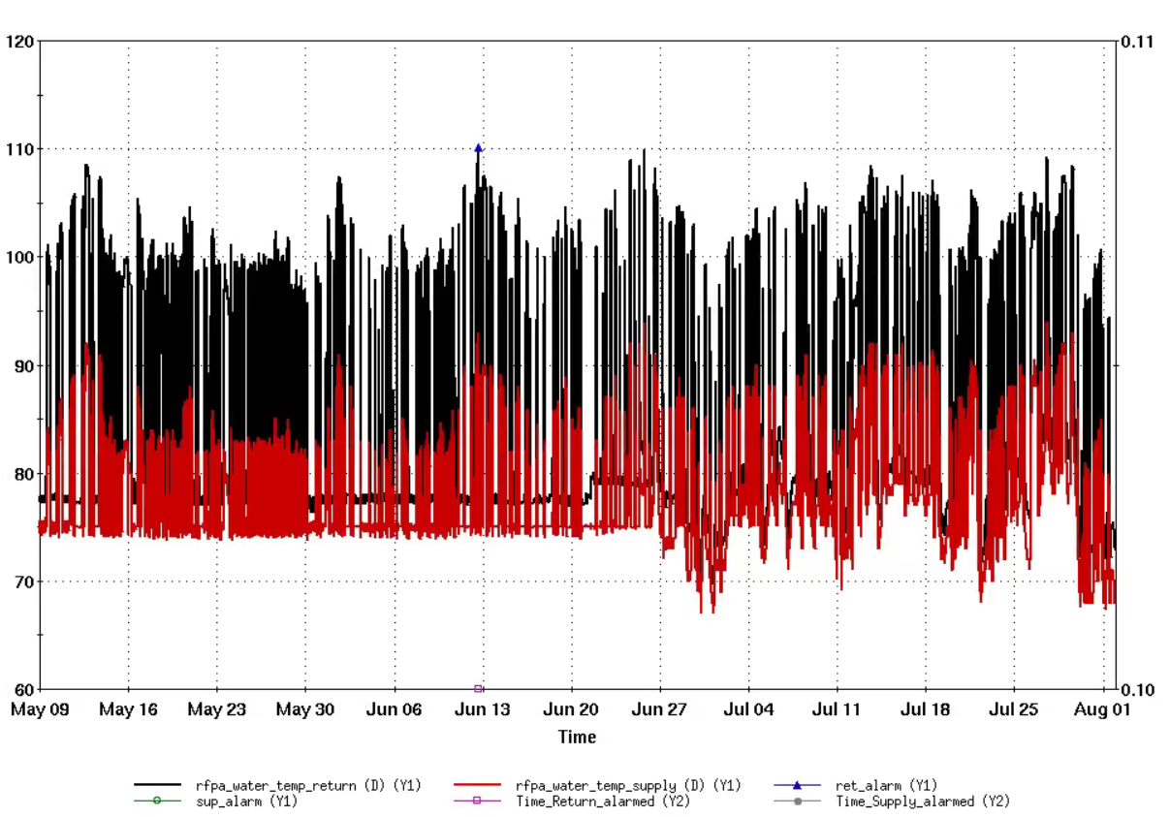
AGS RFPA Cooling
Worked much better this run after initial hiccup that water group promptly addressed
Was a terrible annoyance in past runs, had to inhibit AGS RF and let cool down in the middle of fills

Slide 15
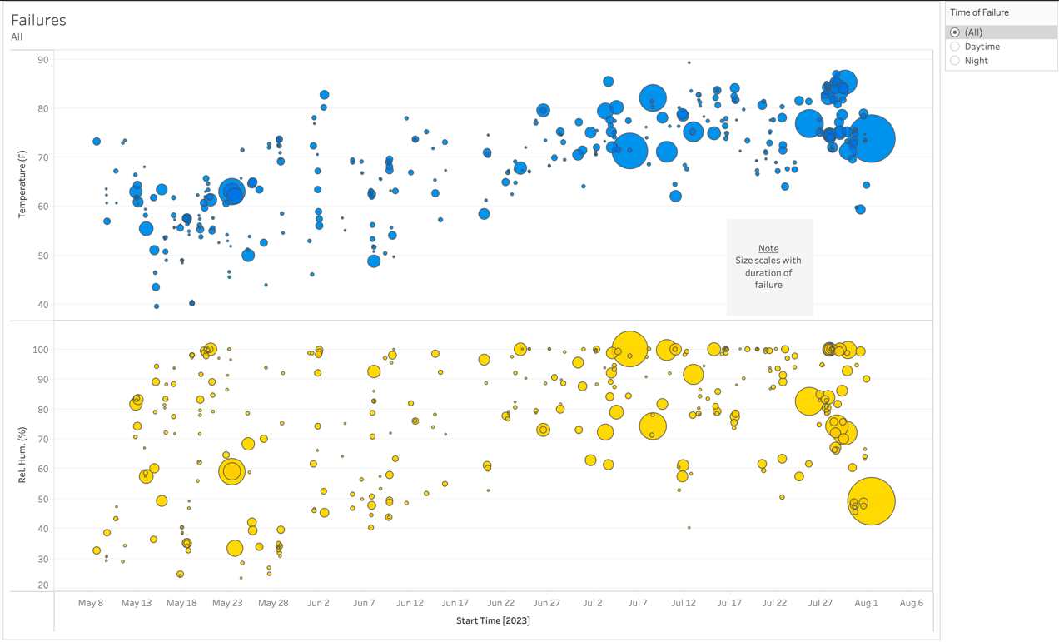
Hard to See Direct Correlation of Failures to Temp/Humidity
Plot courtesy of B. Salis

Slide 16
Many Long Failures
Blue injection kicker oil replacement – 23.23 hours
Tandem MP7 chain repair – 42.40 hrs
Tandem TtB PS Failure – 14.53 hrs
Blue-qmain fiber optics cable – 24.07 hrs
Blue-qmain blower replacement – 13.47 hrs
Blue QLI/QPA Chassis replacement – 26.23 hrs
AtR SWM flow switch – 19.38 hrs
Booster qtrimV-ps 16.92 hrs
1004 valve box – 75.30 hrs
Many other 6+ hour RHIC PS failures
For a few failures (in red above) we were just sitting overnight waiting for efforts to resume
100% understand needing a break, but there should be multiple people who can help look to pass on to so we can make best use of cryo hours, eliminate single sources of failure

Slide 17
Single Source Points of Failure
Just to name the most immediate ones:
C. Schultheiss – RHIC PS and quench link recovery
K. Mernick – Stochastic Cooling
L. Smart – RHIC Vacuum Valves (hopefully can be resolved run)
Experiment Experts – A few instances of trying to move planned no beam time around behind failures that we couldn’t since a single expert wasn’t available
Al Marusic Departure – document special knowledge and disperse workload
Shout out to E. Becker who has done a great job documenting Al knowledge of RHIC BBQ and Feedback/FF Systems for Operations
Guillame and Chuyu (just to name a few) have done a good job of taking on some expert responsibilities Al used to

Slide 18
Chronic Issues and Band Aid Fixes
A lot of band aids for the run
Booster q-trimv – nuisance trips, we could reset it most of the time but it would trip off consistently and kill beam
F4 blw – Keith tuned around it in injectors
AtR, switching magnet and drooping magnet setpoints messing with us during hot days (Summer issue) – had to adjust strengths and retune or constantly cycle some AtR ps
Problem with PLC for RHIC sector valves in 3, 4, 5, and 6
MCR had no remote control over these valves, had to call vacuum personnel to operate these for maintenance days
This caused some annoyances, thanks to Loralie for her availability in helping this but we seriously need to have control over vacuum valves in MCR
Portable AC units in trouble areas like 1004B – good band aid to have on hand in emergency but needs work during shutdown

Slide 19
Elogs
Document failures and issues!
OC log documents initial issues and quick descriptions of solutions from experts filtered through our limited understanding of the systems
Document solutions in group elogs with more detail
Good example: PS Group – few instances with recurring problems were diagnosed faster due to elog documentation
Also, when posting, do not use contextless pictures. Add words, even if the picture is clear and its message is obvious, words help the search function

Slide 20
Call In Lists: Check Numbers and Update Regularly for Vacation (and Training/Conferences!)
Call in lists have gotten better with new setup
Still had a few issues with missing people on call in lists during set up
Rotate personnel to help with burnout – Group Leaders should update this, or maybe there is a way to automate rotation? People get busy and this can be forgotten but is important
HARD TO REACH GROUPS DURING OFF HOURS:
Vacuum, Water, RHIC PS

Slide 21
Work Control Coordinators
New work control coordinator role in identifying high hazard work makes arranging fixes more difficult, especially off hours
Remember with this new requirement work control coordinators need to be contacted and then a follow up with MCR is necessary

Slide 22
Remote/Local Work Balance
FY23 - 1st post-Covid run
More faces in MCR this run for setup and APEX
Best way for operators to learn is watching experts and bugging them in person
Experts/technicians were onsite during the regular business hours
Personnel who do software/(computer work) were readily available to help both during and off regular business hours
The hybrid (in person + remote) meetings are very nice to accommodate everyone's needs

Slide 23
Access Training
Many blown sweeps this run – time waster
If it has been a while since last access (or first time) – Let MCR know on the phone or when picking up the key, we can give reminders of the process
If initial attempt does not work, STEP AWAY FROM THE DOOR AND CALL x7400

Slide 24
MCR Computer Issues and RH8
New double wide display consoles in MCR are nice, but some hardware issues
Had an MCR console just turn off on me randomly right before I was about to run the Up.tape (application automating ramping RHIC to store energy), BAD to get lost in this, we could have been stuck sitting at store energy blasting the experiments with backgrounds
MCR is halfway upgraded to RH8, still working out some minor bugs and default settings
AGS IPM Application Issue
Trouble loading elogs sometimes on certain machines
No rigid window locking → Messy screen setups
Default maximize when trying to place window in corner/screen edge
And more, actively working with controls on some issues but there is still some work to be done

Slide 25
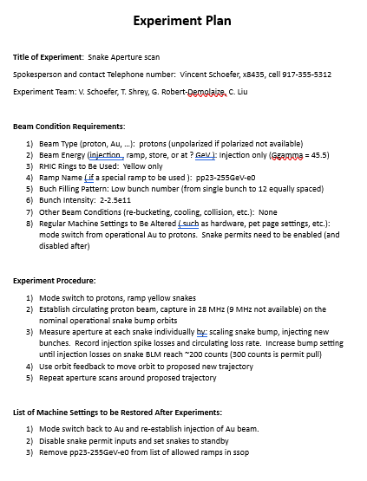
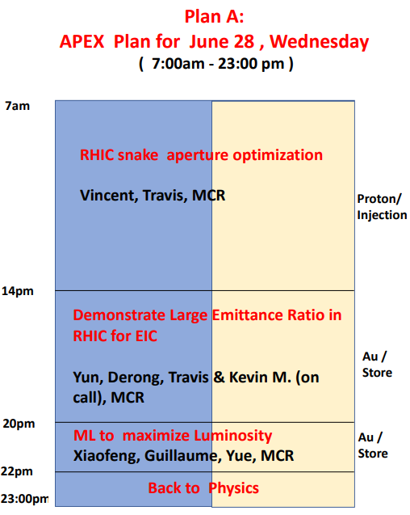
APEX Communication was Excellent!
This was an issue last year, day of notice for non-trivial setups and operation
Detailed plans were emailed to OCs before the day of APEX and then sent to Operators
Let’s us plan the most efficient ways to provide what is necessary and consult with experts if necessary

Slide 26
Communication with MCR
Preferred method of course is always in person – Operators can learn from watching machine experts, the more we can learn the less we will have to call you
Second best option is calling – immediately gets our attention
Last option is Microsoft Teams “MCR Live Chat”
Good for non-urgent questions, or coordinating multiple efforts remotely
Microsoft teams is not supported on Linux – it can sometimes act up on MCR consoles
Our screens are full of applications and monitors and sometimes Teams notifications can get lost in the noise, phones are most reliable way to notify us immediately of something
Previous run issues of elog information being put only in teams has gotten better, but useful reminder
Downside: Lets you take the stress of control room home, people can get addicted to checking up on it like other social media scrolling and can contribute to burn out
Take a break and decompress! If there is anything urgent MCR will call

Slide 27
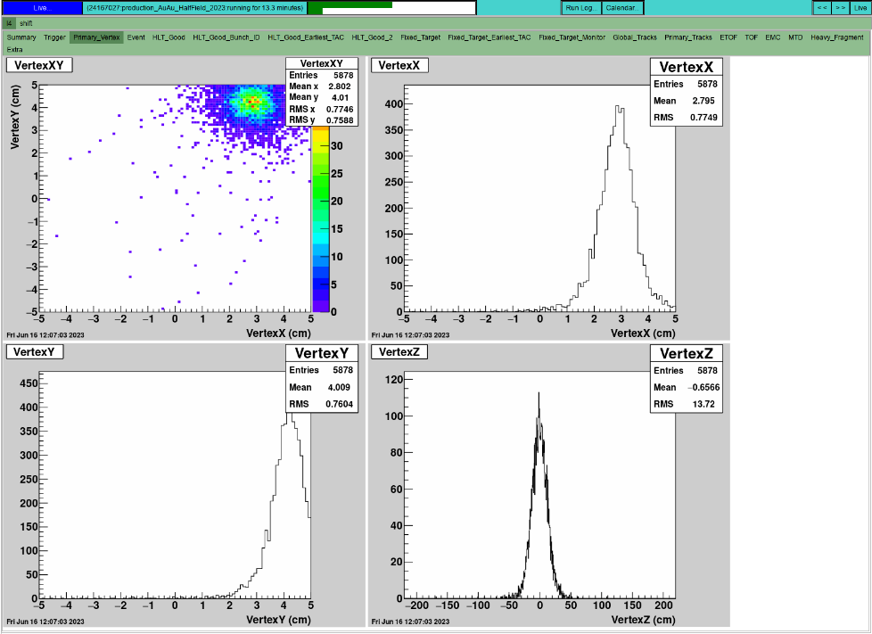
Experiment Communication/Signals
First run for all Operators with two experiments – communication between control rooms was good
Plans were changing pretty frequently to adjust for failures and impromptu maintenances – following up with all CRs to touch base could be a little better on our end
STAR vertex control used to be done over phone – “Vertex has drifted please adjust”
Then we had access to online plots showing event distributions, better but slow for actively tuning

Slide 28
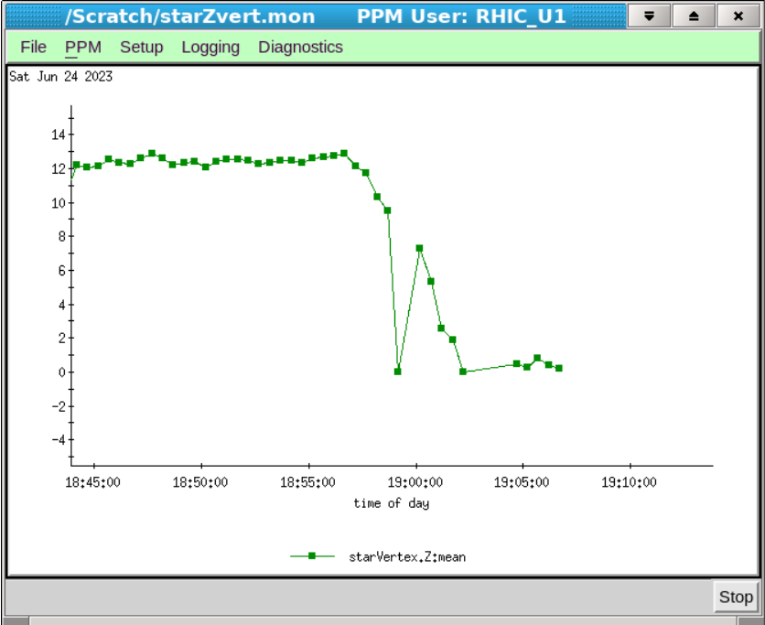
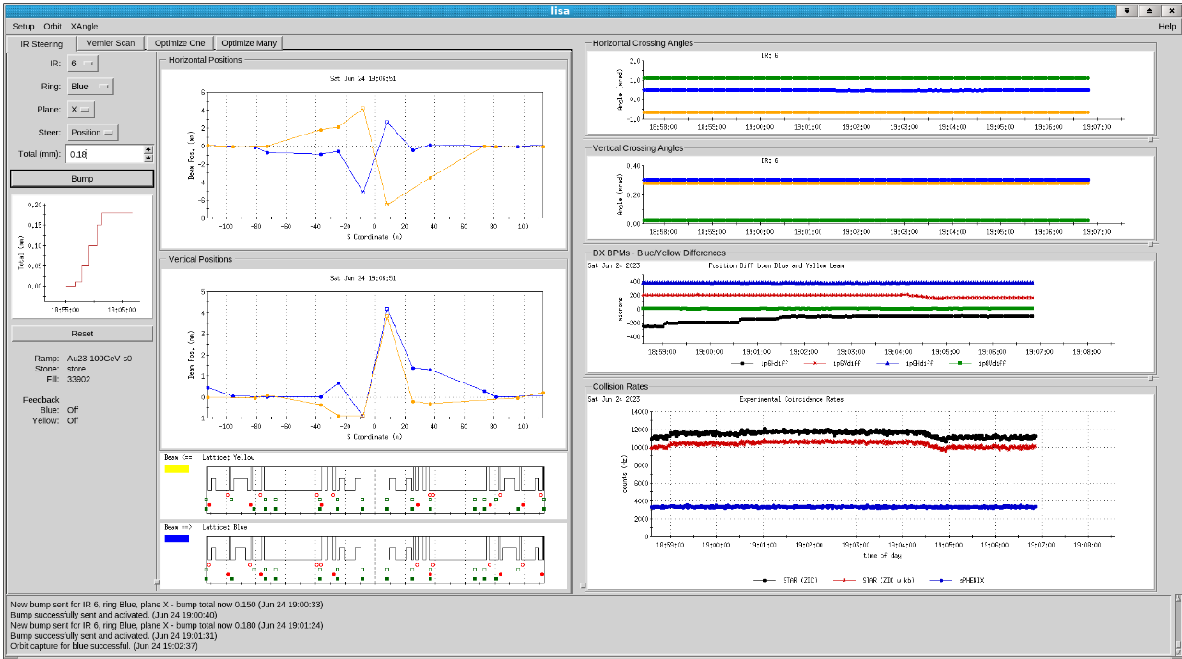
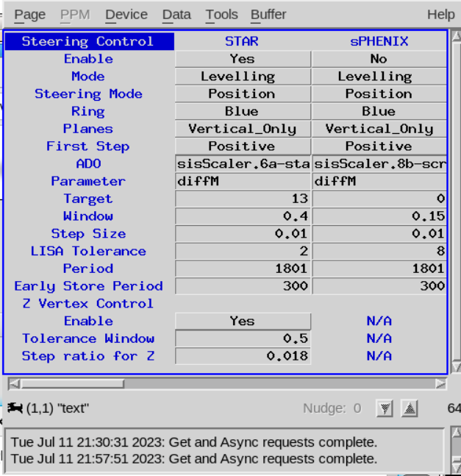
Experiment Signals
Then STAR Z vertex data and we could automate Z vertex to zero (thanks Ian)
sPHENIX was working on getting us usable signal to tune off of
Any other signals experiments can think of to share for tuning?

Slide 29
MCR Self Critiques
Operations needs to work on its own communication between those in MCR while on shift
Announcements to the room, take calls on speaker so everyone is in the loop, more thorough shift changes and elog documentation, discussing shift game plans and best operating methods before implementing – bounce more ideas off one another
Even if you are a little unsure of something, ask the room – OCs have many more years of experience
Some leftover remote work baggage – used to following moving pieces remotely
We are good at limping along in degraded state and making things work, need to be more proactive in resolving nuisance issues that aren’t show stoppers but ones we shouldn’t have to deal with daily
Keep up on Alarm screen, annotate all alarms – hectic run but during downtime tackle the alarm display
More proactive in asking questions, insert ourselves into expert troubleshooting to learn so next time we may be able to do it ourselves, share the work load – not just delegation when possible

Slide 30
Special Shoutouts (that weren’t previously mentioned)
RHIC PS Group for taking brunt of Summer running – working intense hours from the beginning of the run
Keith Zeno – Help with Injector Tuning and Setup
EBIS Staff – Hard work with EBIS upgrade and efforts getting Au ready before Run ended
Tandem Staff – Flexibility with RHIC beam and local users and extended failure efforts
Travis – double duty as run coordinator and RHIC system expert
And the many others in C-AD I do not have room to mention!

Slide 31
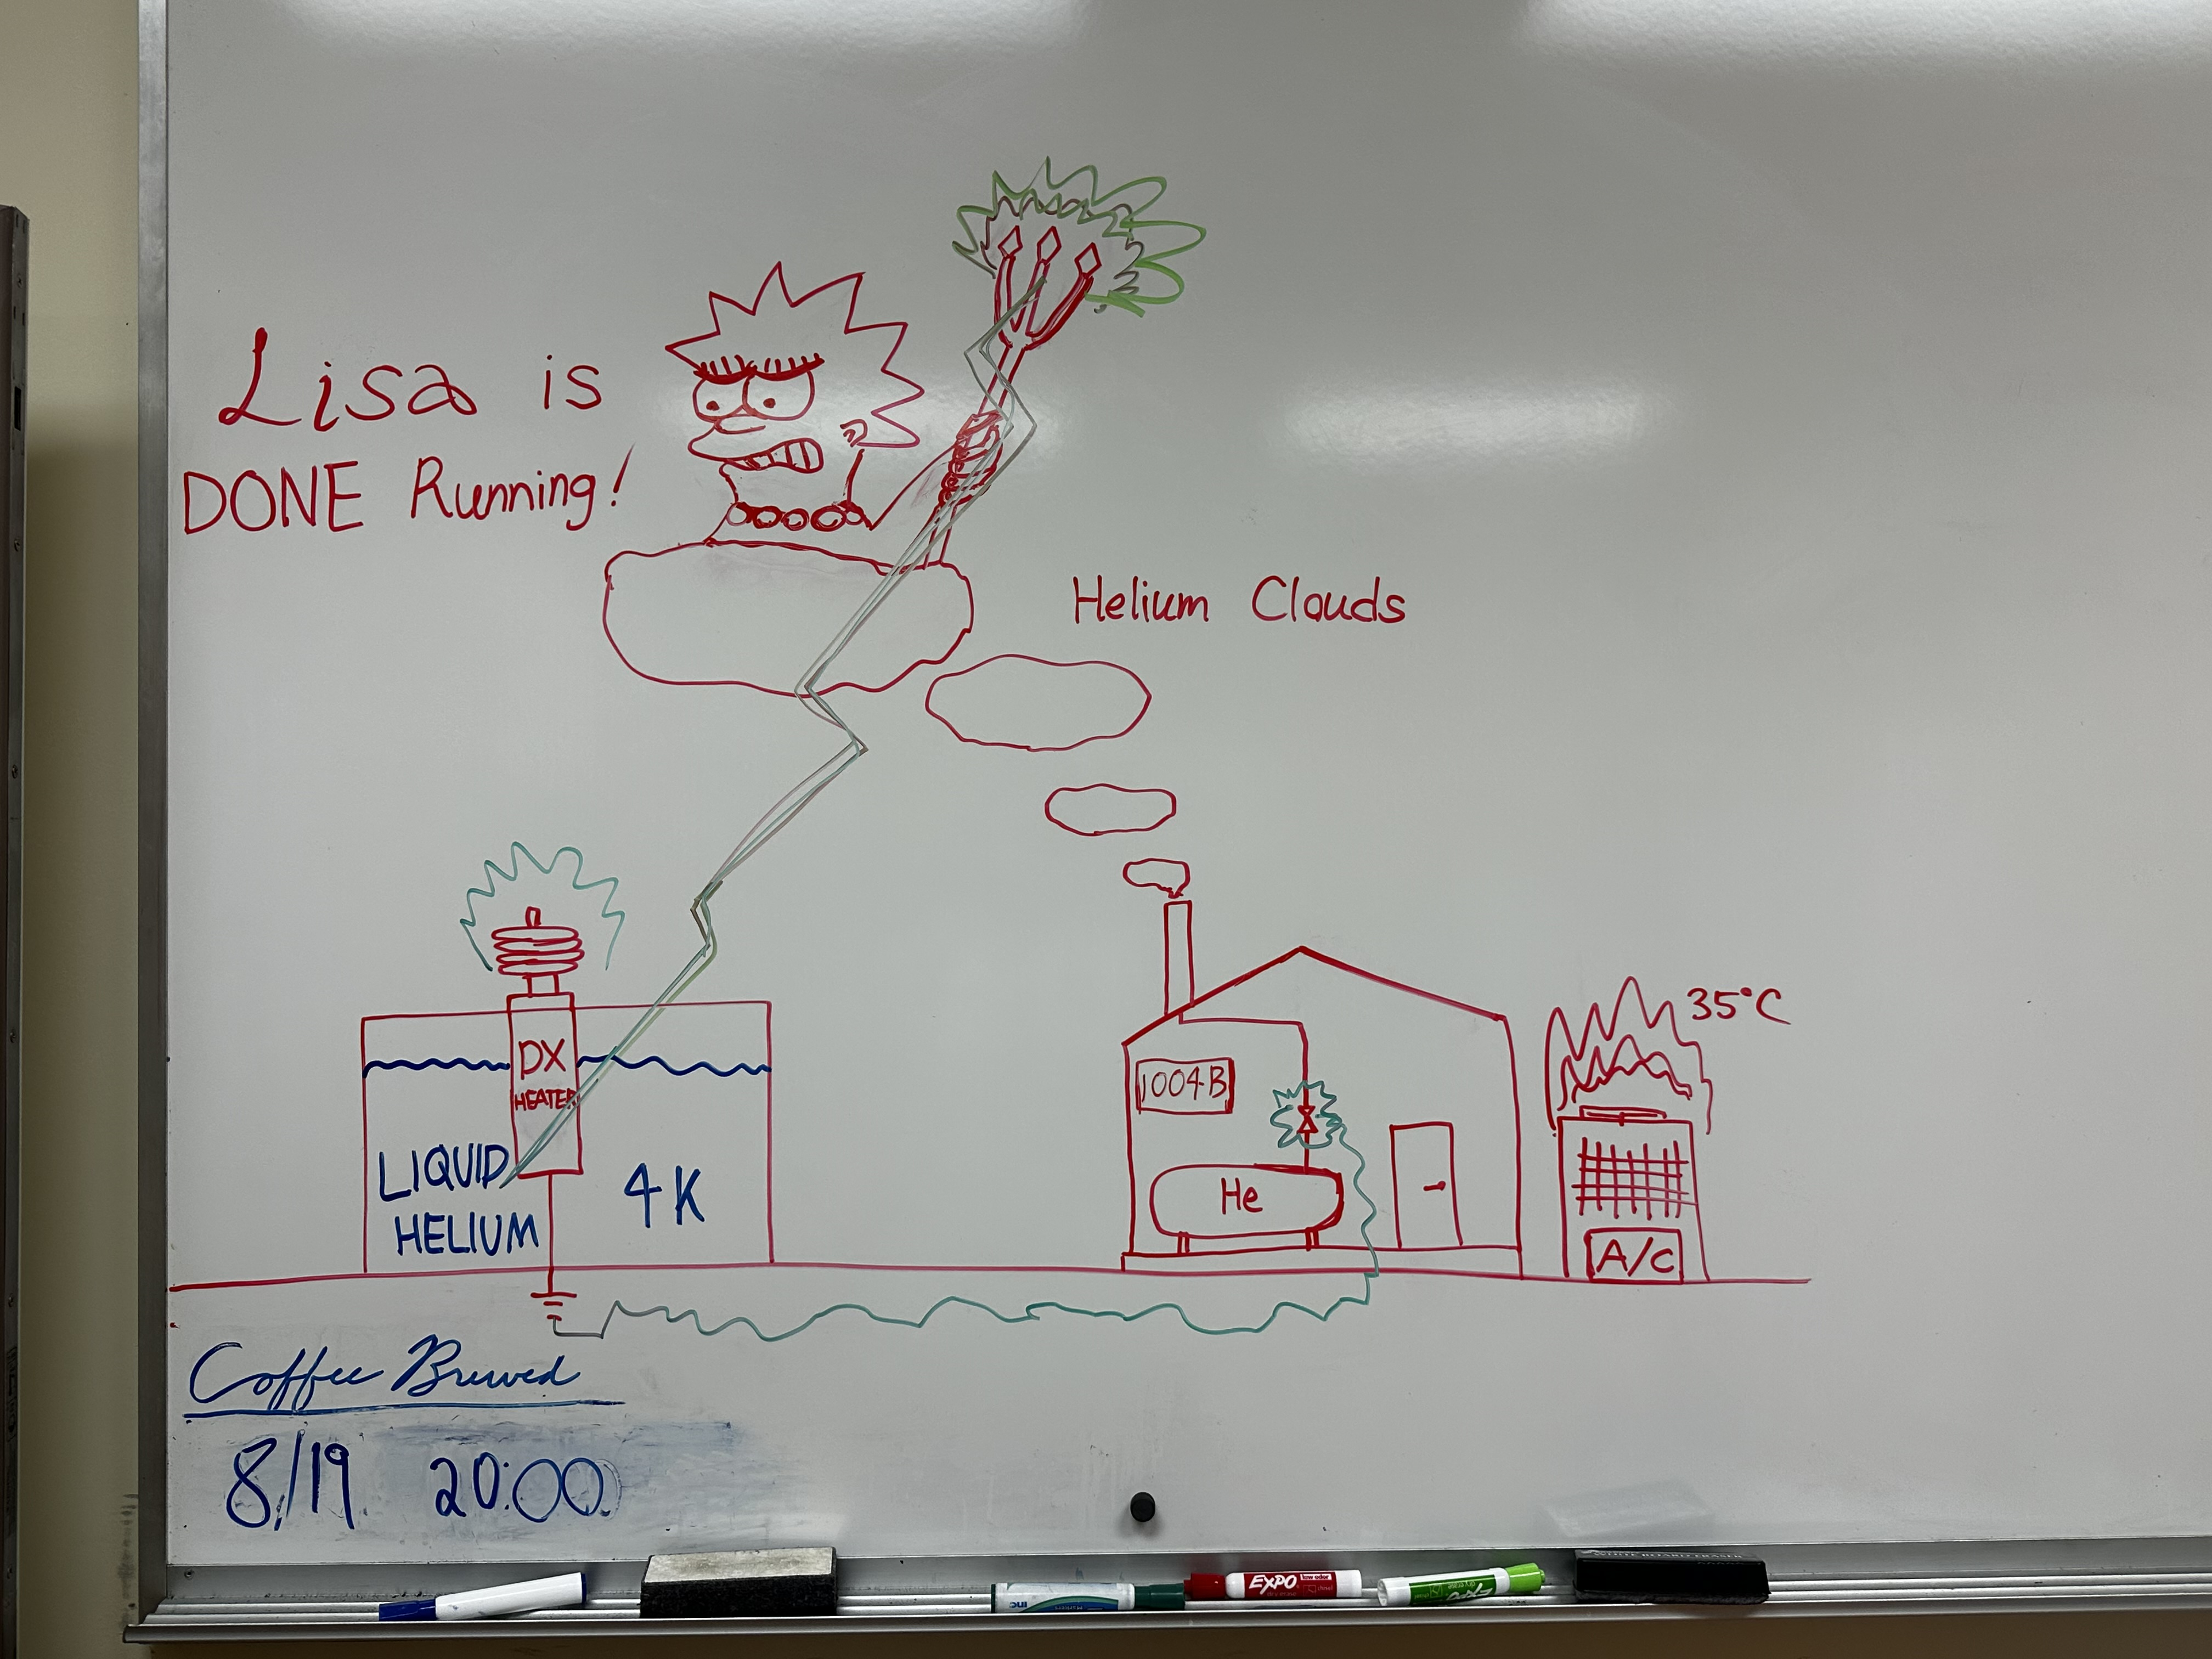
Thanks!
(working QLI/valve box theory)
LISA-
Luminosity and IR Steering Application

Slide 32
Backup Slides

Slide 33
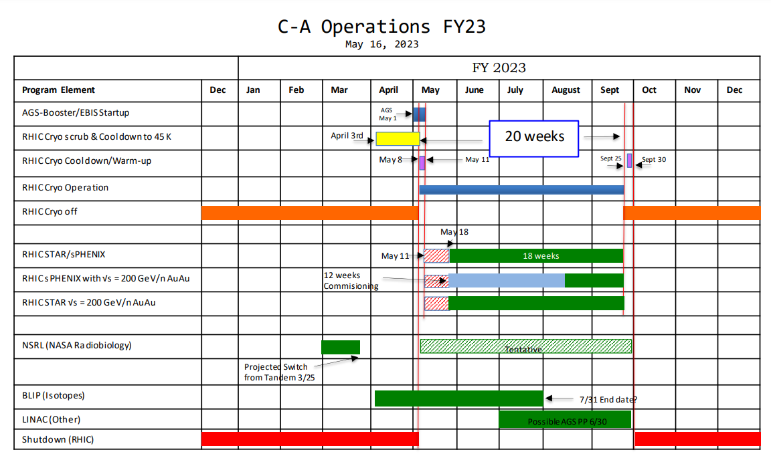
Run Plan

Slide 37
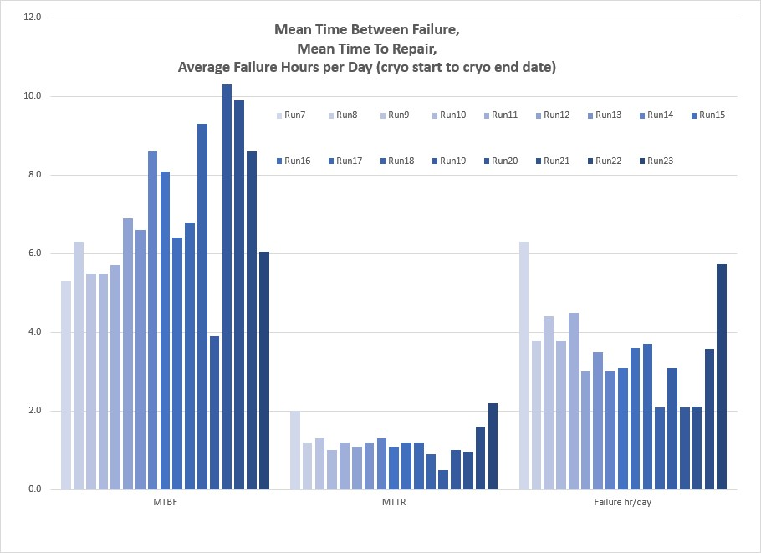

Slide 38
Number of PS Replacements by Alcove
11B – 2
9C – 2
12A – 3
1C – 2
7C – 3
9B – 1
7A – 1
2B – 1
9A – 2
6B - 3

