Slide 1
Shutdown ‘23
Paul Sampson
Date August 30th 2023

Slide 2
Agenda
General information
Status
Progress
Schedules
Summary

Slide 3
General Info:
Unscheduled early start
Short duration
Injector programs running
Procedure issues
Major knowns
Unknowns…

Slide 4
CAD Status
EBIS running beams for NSRL
LINAC: run ends today, next run Friday
Booster: Running for NSRL
AGS- Shutdown
A10 HVAC repairs deferred; temporary unit installed.
AtR- Shutdown

Slide 5
RHIC Status
RHIC LHe offloading ✅
Warm up sector 4/5 and 8/9 Blue ✅
Vacuum bleed up, 4/5, 8/9 Blue ✅
Shielding: Sector 8/9 and 12/1 Bock removed
Sector 4 pending
Sector 6 & 8 under discussion
CeC and LEReC equipment secured

Slide 6
RHIC HVAC
1004B Package unit #4- replacement ordered
1004B Package unit #3- running ½ capacity, awaiting parts (20 weeks and counting)
1004B Package unit #1 (CR)- Awaiting parts (6 weeks estimated)
1002F Laser Trailer- Awaiting parts (4 weeks estimated)
1007 dehumidifier- repairs underway
1008IR 2 of 4 units installed, awaiting parts for install completion

Slide 7
Systems Status:
Cooling towers:
930, 957 on for NSRL running
AGS RFPA, 1000P, 1004: On for testing
1010 on for sPHENIX 80k circulation
RF systems:
AGS on for testing, PA installation
AtR magnet tests in progress
Other systems off or turning off for shutdown

Slide 8
Progress:
AGS opened, works in progress
Skew quad installation and hookup continues
RF work continues
Booster and NSRL Maintenance bi-weekly
LINAC maintenance between BLIP runs, NSRL needs
Shutdown maintenance and other approved work in RHIC has begun
Major works planning in progress:
Valve box – Approvals for initial inspection this morning, work in progress
Sector 8/9 work (Snake installation and diode inspection): Work plans being reviewed, pre-work (sampling, posting etc.) under way
9MHz common cavity removal: Work plan is progress
1007 Tower shutdown complete, some pre-work for fan control upgrade this shutdown

Slide 9
Issues:
Unscheduled shutdown reduced planning time
Review and approvals hampered by outdated OPMs
EWPs necessary for outdated OPMs or references for:
Valve Box entry
RMMPS LOTO
RHIC SNAKE installation
RHIC Diode removal
Many times, the owners had submitted reviews long ago…

Slide 10
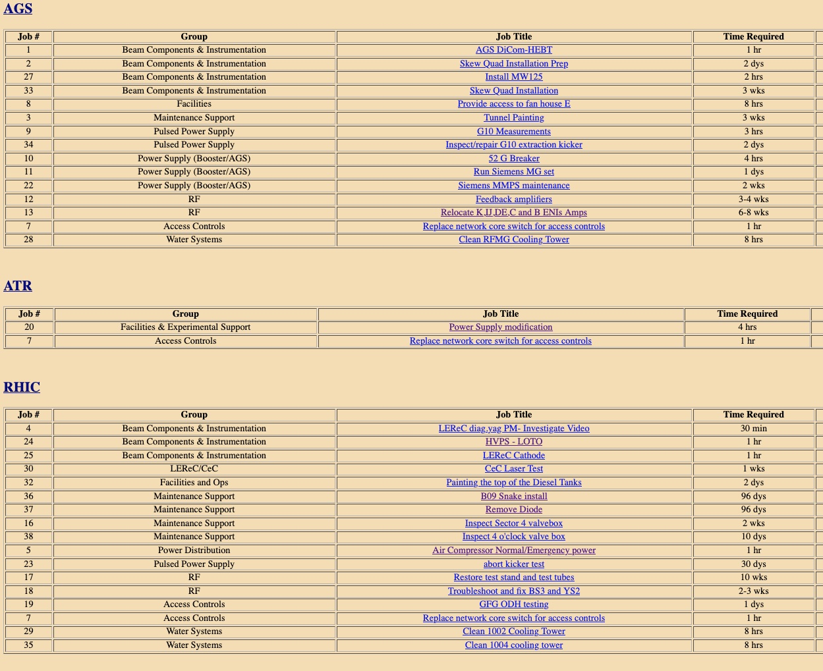

Slide 11
Schedules

Slide 12
CAD Schedule

Slide 13
Full schedules and timelines:
Available on the web “This Week”.
Discussed at meetings:
Supervisor’s meeting (weekly).
Shutdown “Time” Meetings
Links:
This Week
Shutdown Status
JRS
Web Status
Overview Project

Slide 14
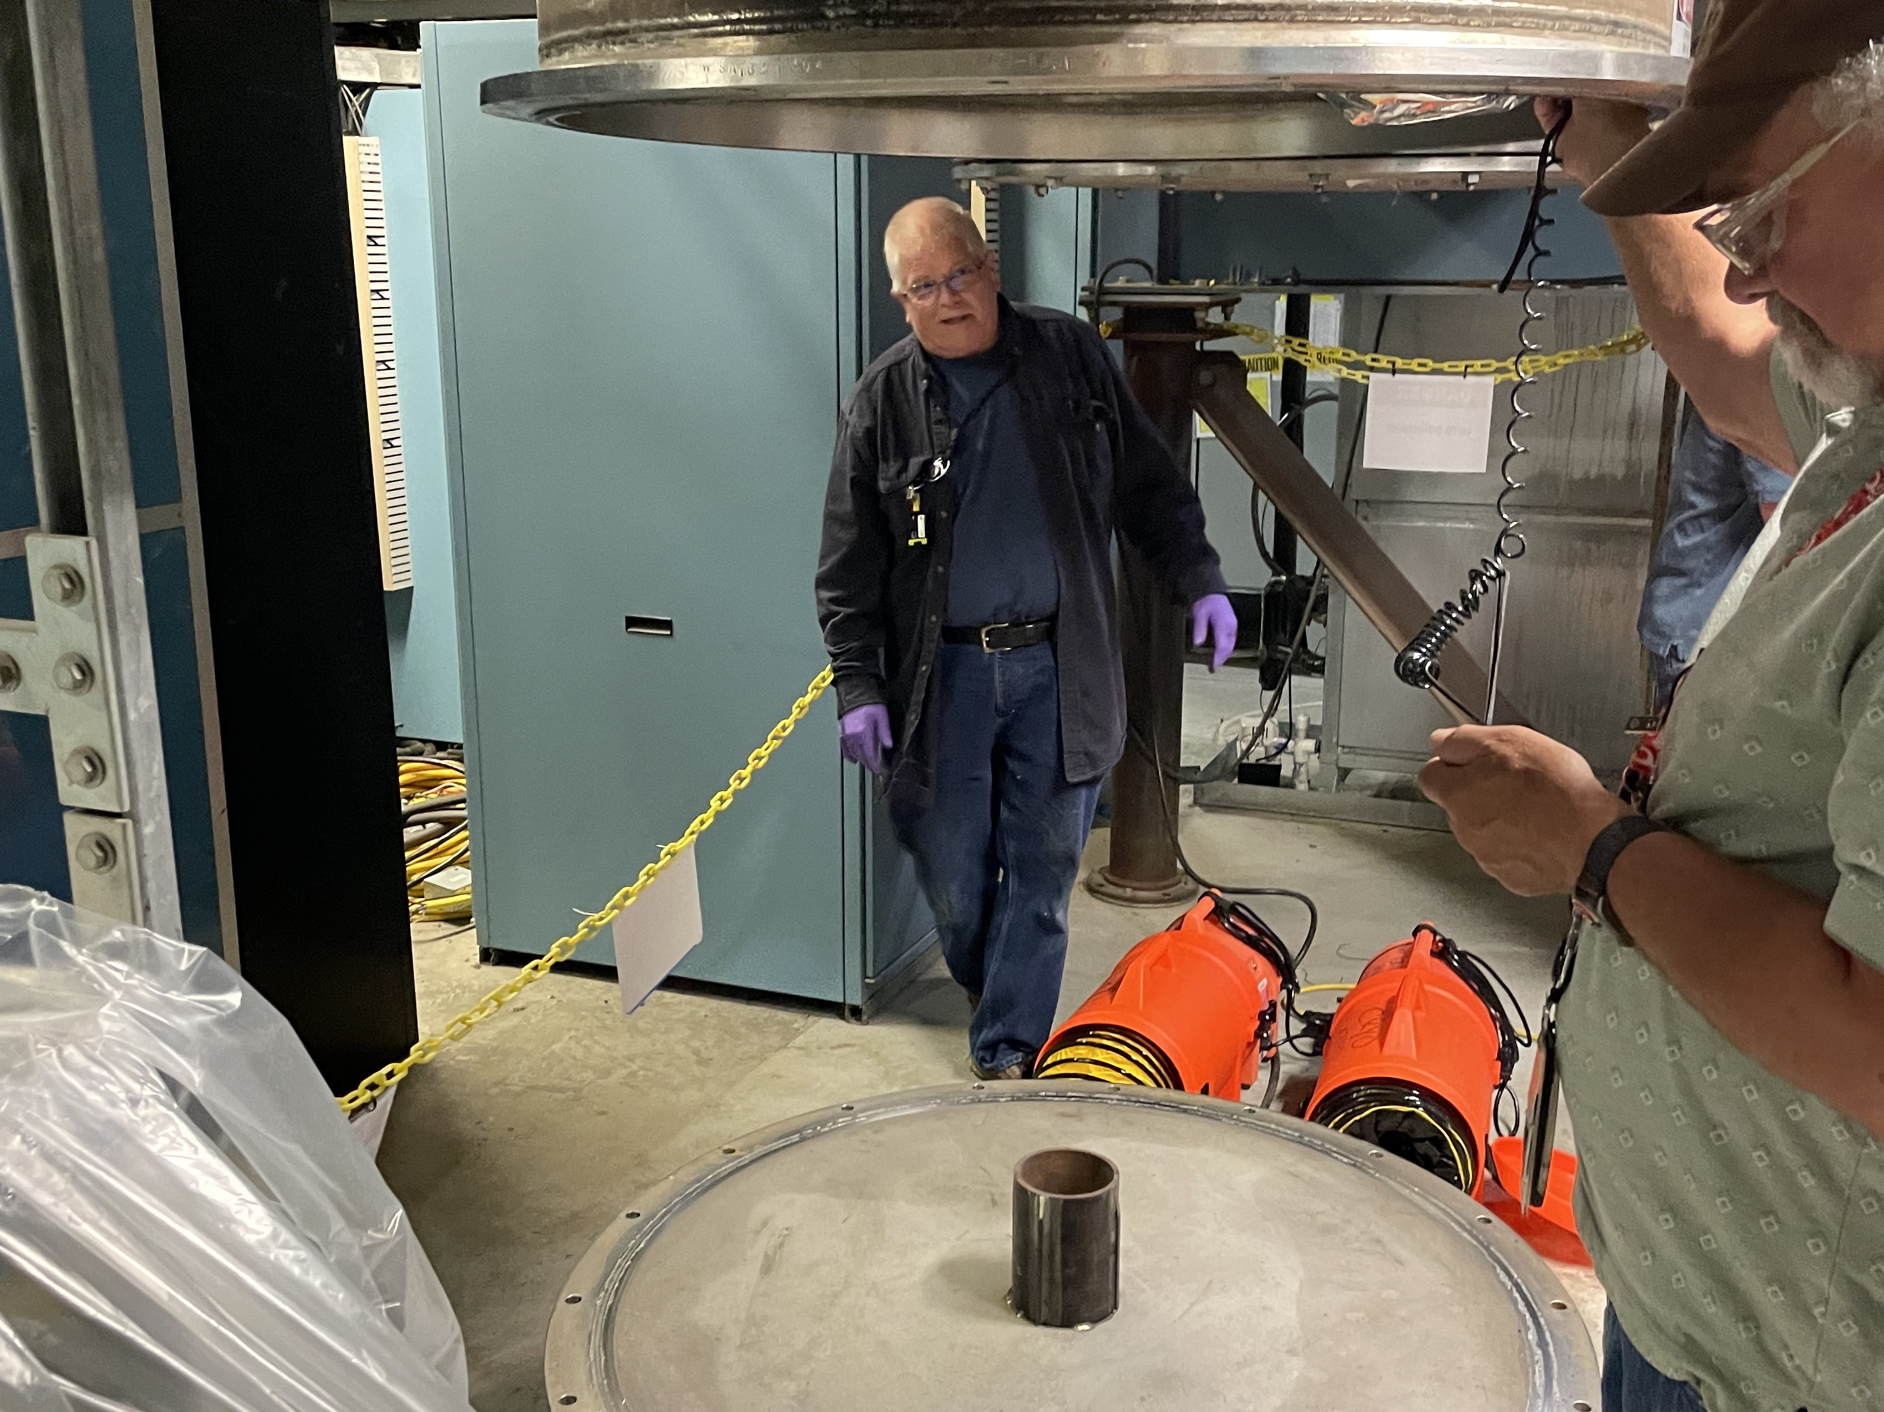

Slide 15
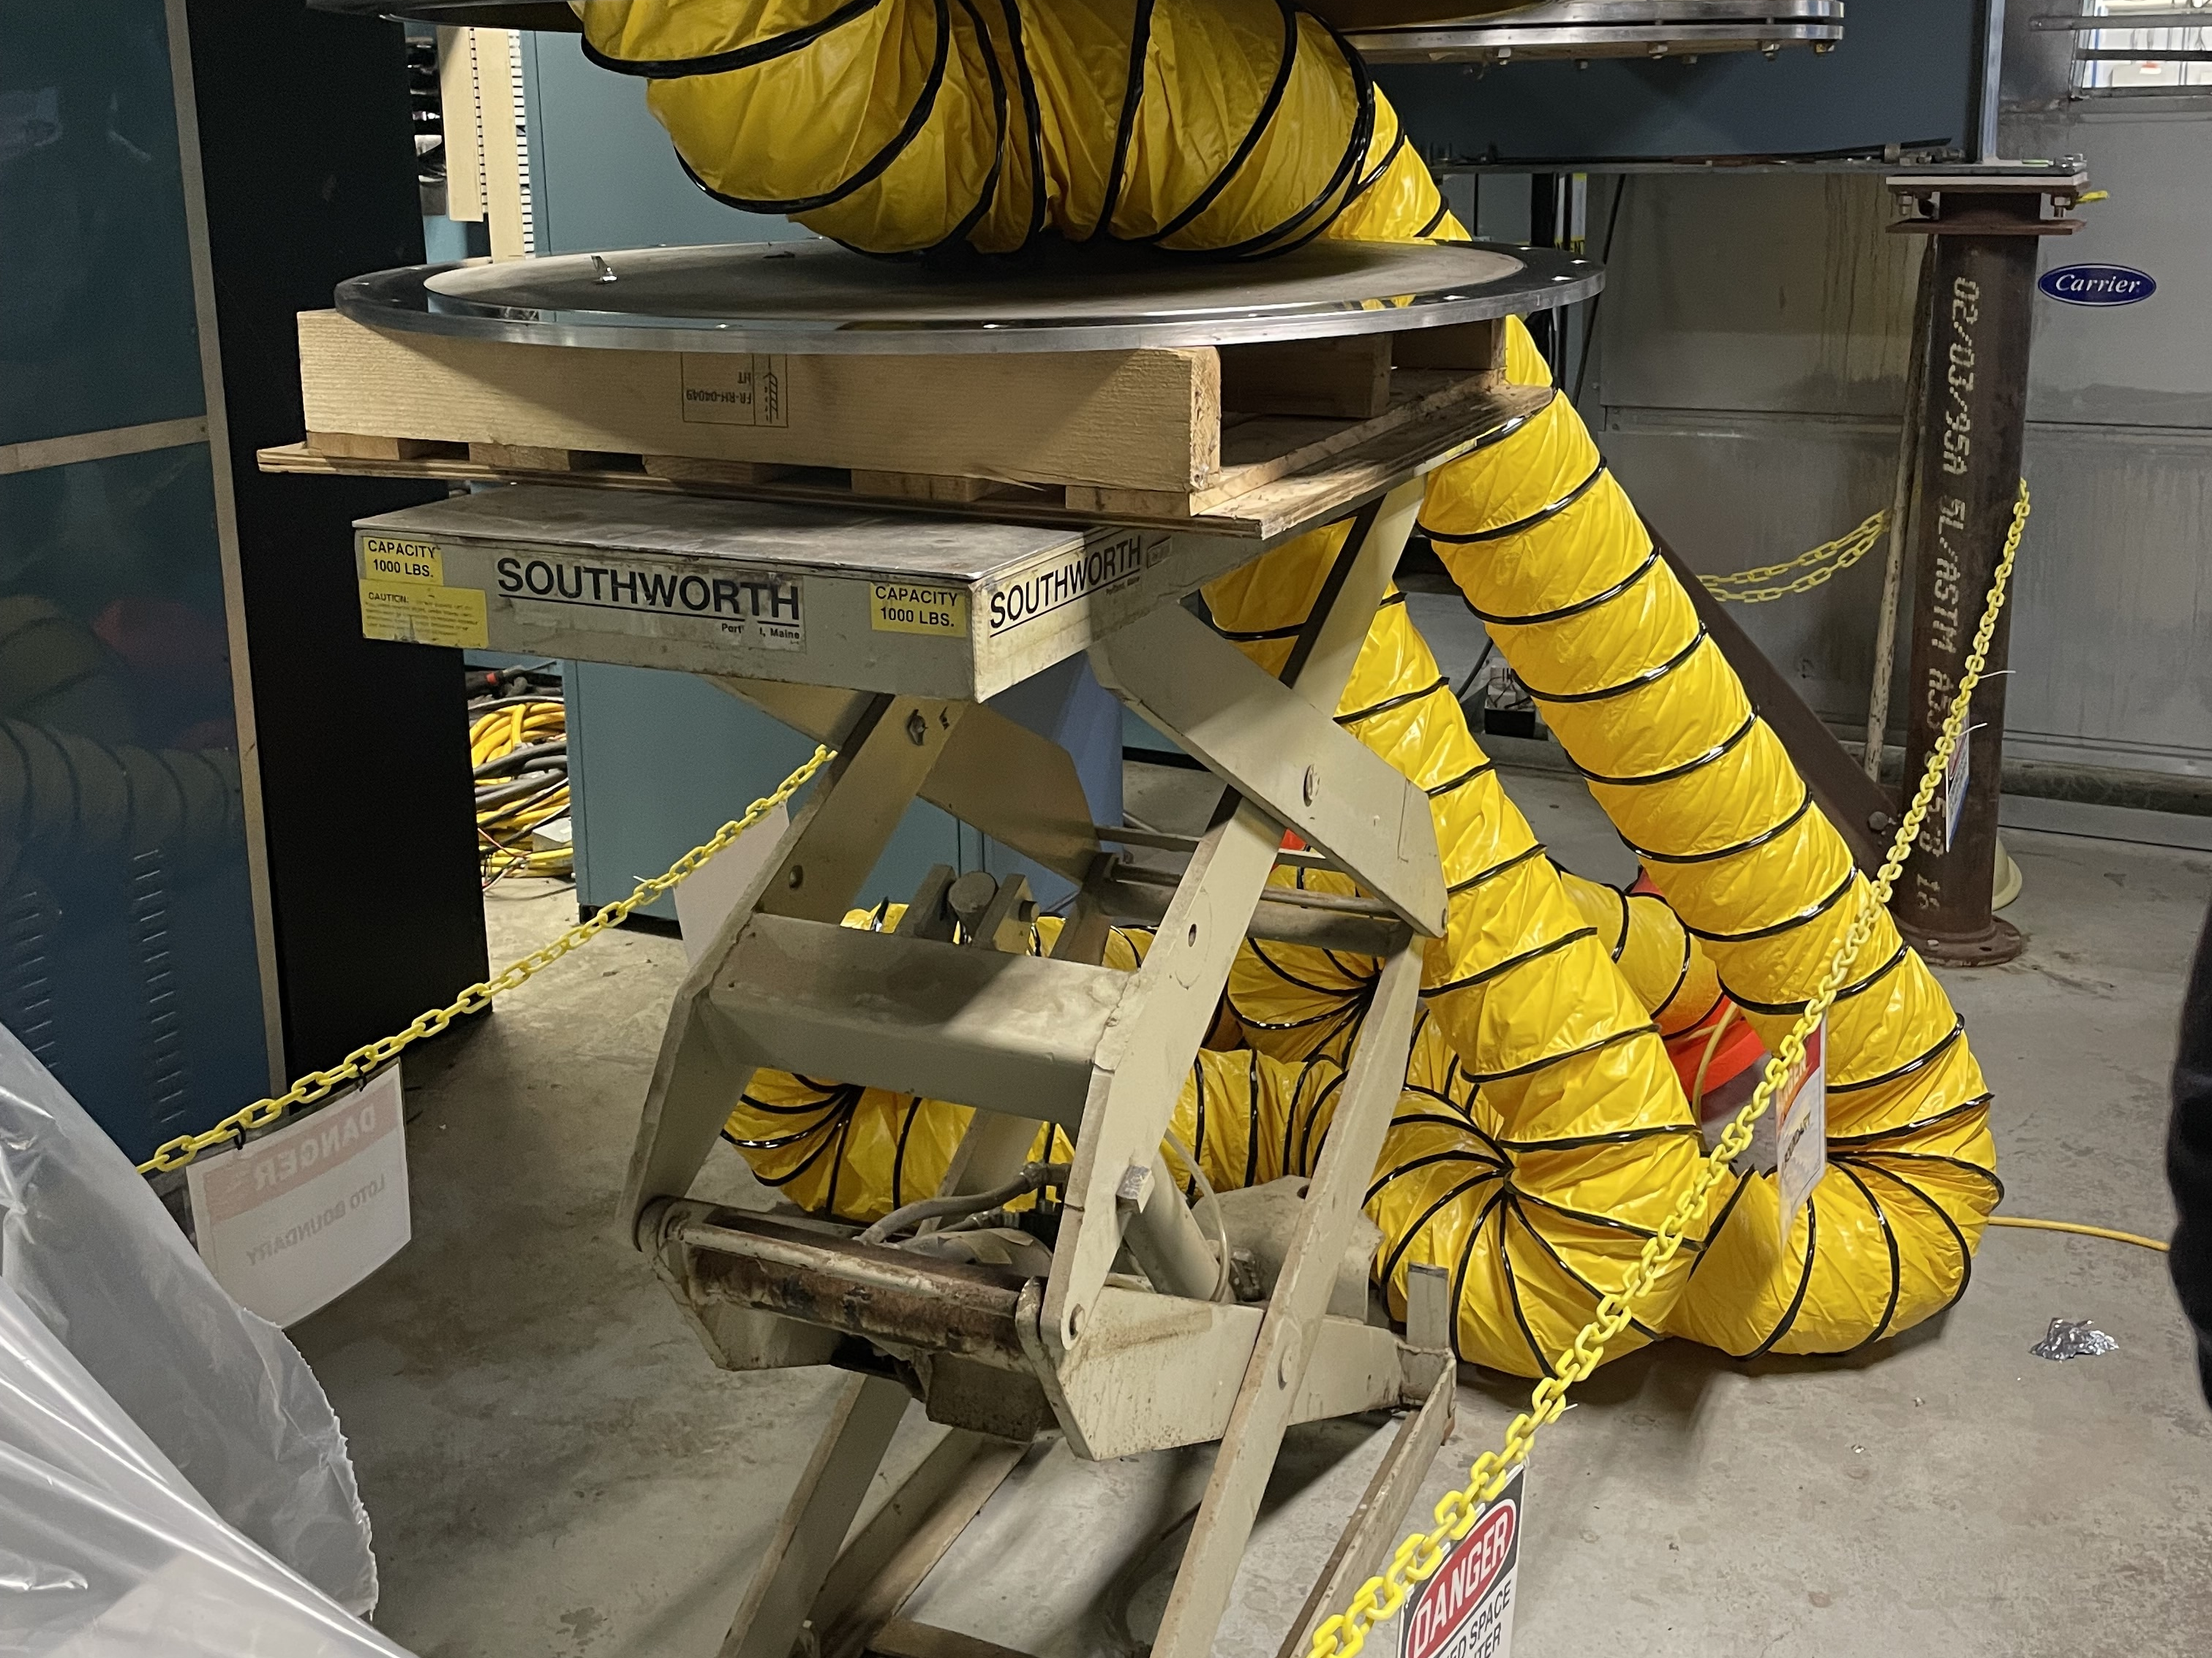

Slide 16
Summary and comments:
This is an extremely short shutdown, with a very large amount of work
The valve box and other critical job(s) are still emerging
New staff learning curve: Additional time necessary to gain experience
Procedure issues and oversite are adding to the workload
As always, coordination, communication and cooperation are key to success.
Planning for major works for shutdown ‘23!

Slide 17
Thank you

