Slide 1
Polarized Proton Acceleration at RHIC
V. Schoefer for C-AD
8/25/2023

Slide 2
Overview
Facility overview
Basic intro to spin, polarization and how we ruin it
Brief intro to each of the proposed areas of improvement for the ML study i.e.
Booster injection optimization
Longitudinal splits/merges optimization
Energy measurement improvements
Resonance compensation optimization

Slide 3
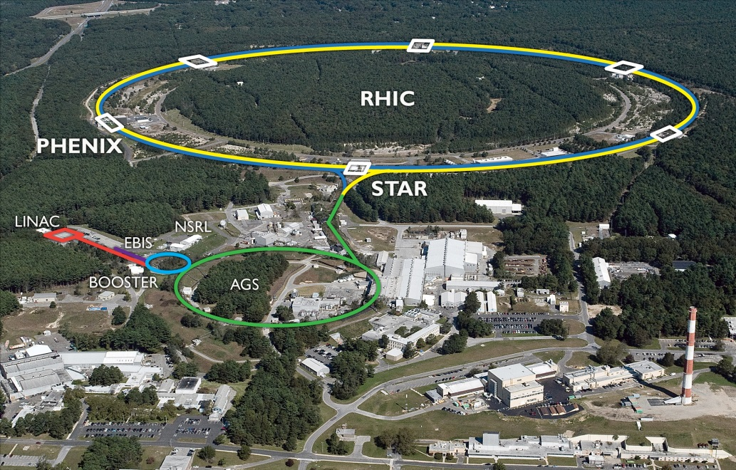
RHIC Accelerator Complex
Accelerator Rings
 | Circumference [m]
Booster | 201
AGS | 807
RHIC | 3833
~1.2 km
Typical Top Energies [Total, GeV/N]
 | Au | Pol. Protons
Linac (H⁻) | -- | 1.1
Booster | 1 | 2.3
AGS | 10 | 23.8
RHIC | 100 | 255
Tandem van de Graaff
Heavy Ions | Protons
E-beam Ion Source (EBIS) | OPPIS (polarized)
Tandem Van de Graaf | High-intensity H⁻ (unpolarized)
3

Slide 4
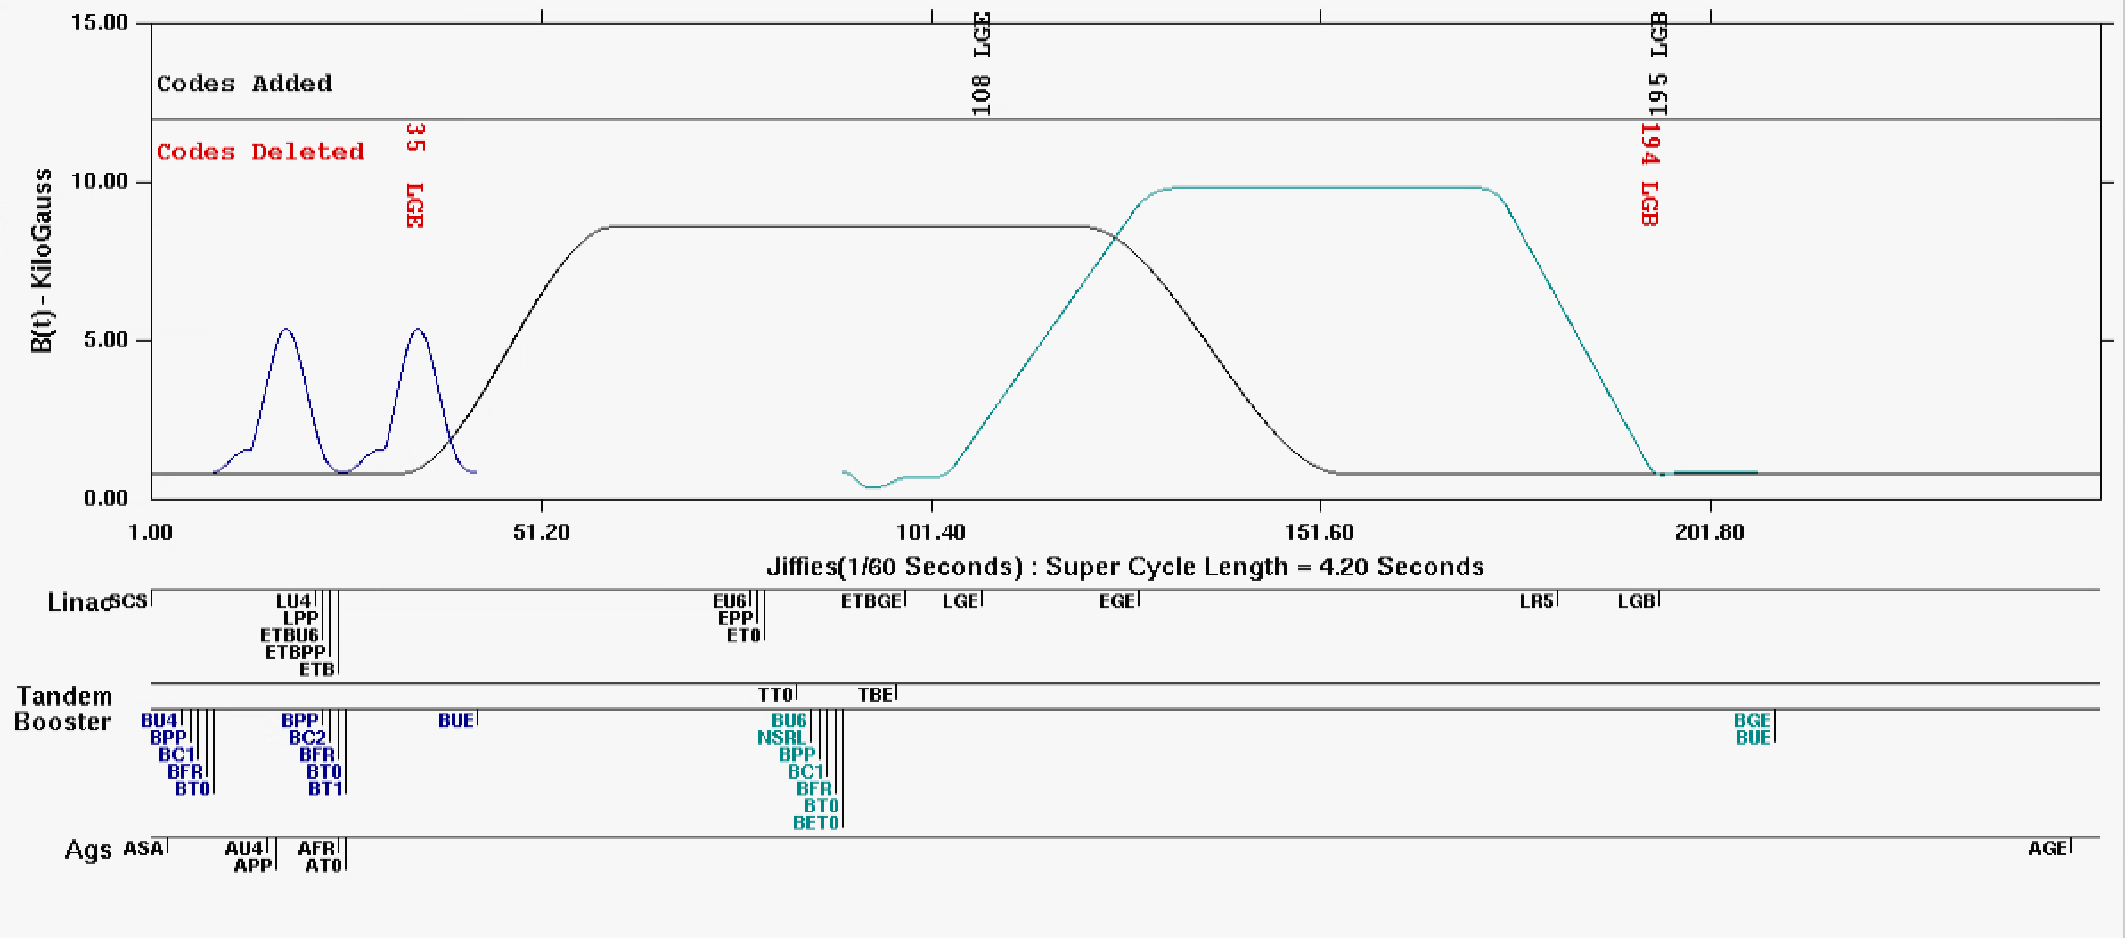
RHIC Injector Cycle
The “supercycle” is the collection of all the injectors cycles (sources, Booster, AGS)
Typically 4-6 seconds long
Single pulse of Linac protons becomes a single bunch at AGS extraction
Each RHIC ring (blue and yellow) takes 111 bunches for a fill
Fill setup take 1-2 hours
A RHIC proton store lasts ~8-9 hours
RHIC per bunch intensity 2.5-3x10¹¹
Booster main magnet cycles
AGS main magnet
Booster NSRL cycle
hysteresis

Slide 5
Luminosity, $ℒ$
It’s what experimenters crave
How many collisions/sec can a collider deliver?
 | $\sqrt{s}$ [Gev] | $$ℒ_{peak}$$ [cm-2 s-1]
Au | 200 | ~10²⁸
p | 510 | ~10³²
$$ℒ= \frac{1}{4π}∙N_{b}f_{rev}∙\frac{N^{2}}{β^{∗}ε}$$
Set by accelerator design (circumference,energy, RF cavities)
$N_{b}$= number of circulating bunches
$f_{rev}$ = revolution frequency
$N_{b}f_{rev}$ = collision frequency
$N$ = intensity, particles in each bunch
$β^{∗}$ = beta function at collision point (*)
$ε$ = beam emittance
THIS is the focus of most accelerator operation: increase intensity, don’t dilute the emittance, design your lattice carefully
$\frac{N^{2}}{β^{∗}ε}$ = $\frac{N^{2}}{beam size}$ ~beam density
$$ℒ P^{2}$$
$$ℒ P^{4}$$
Transverse polarization
For polarized collisions with polarization,P:
Figure of merit =
Longitudinal polarization

Slide 6
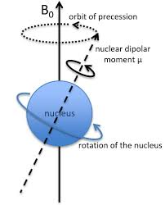
RHIC as Polarized Hadron Collider
Polarization of a beam is the degree to which the individual spins of the particles are aligned along a specified direction
Polarization allows colliding beam experiments to detect spin dependent effects (usually by asymmetries in the collision products since the spin ‘picks out’ a special direction)
For protons at RHIC energies, synchrotron radiation too small to spontaneously polarize beams, so high polarization requires creating a polarized beam (beyond scope of this talk) and maintaining the polarization during acceleration
Trouble: the spin gives the protons a magnetic moment (usually denoted G for ions, a for electrions) which will cause it to precess around any magnetic field it encounters.
Does the bending and focusing we need for stable beam dis-orient the spins and ruin polarization?
(In general….yes).
G_{proton} ~= 1.79
G_{electron} ~= 1.1⨉10⁻³
G_{He3} ~= -4.18

Slide 7
Spin motion A gross simplification
Field region
The rate of precession of the spin is energy dependent:
If the particle is bent by B through an angle θ,the spin vector precesses Gγθ times around B
G is dipole moment
γ is the relativistic factor
For one turn around a ring in a pure dipole field, the spin makes Gγ precessions
Number of precessions per turn is the spin tune (analogous to betatron tune)
Sets the natural frequency of the spin motion
Depolarization occurs due to resonances
Frequency of sampled perturbing field shares a component with the spin tune and rotations add constructively.
Since the spin motion is energy dependent and we accelerate through many units of γ, this condition is met quite often
Proton trajectory
θ
Gγθ
This schematic works for any approximately constant field region e.g.:
Top down view of motion in a dipole
Side view of particle being vertically focused in a thin quadrupole

Slide 8
Depolarizing resonances
Primary spin direction is usually vertical, to be aligned with dominating main bend field
Rotations away from vertical come from horizontal fields, which are mostly due to vertical motion in quadrupoles
Can be due to closed orbit (imperfection resonance) or finite emittance (intrinsic emittance)
Imperfection resonance
Intrinsic resonance
Large amplitude
envelope
Small amplitude
envelope
Closed orbit offsets in quads repeat every turn
Driven by quad misalignments (even if orbit is corrected to “zero”)
All particles experience the same depolarization
Resonance condition:
Gγ = N (an integer)
Particles oscillate within the beam envelope even with perfect alignment
Driven by betatron motion in the quads
Depolarization depends on betatron amplitude
Smaller emittance => better polarization
= Vert foc quad
Resonance condition:
Gγ = N +/- Q_{y}
= Vert defoc quad

Slide 9
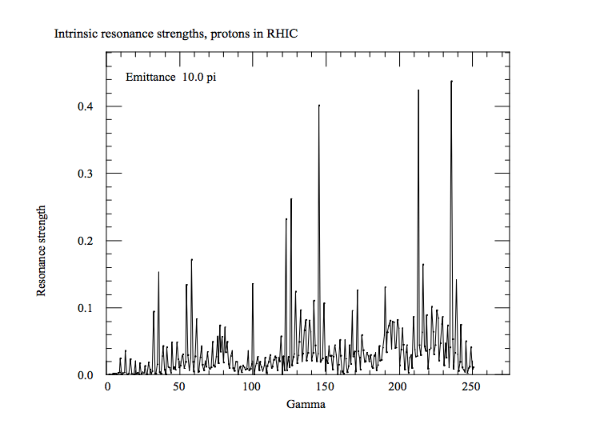
Counting up resonances
Without mitigating efforts, the polarization would be lost very quickly during the numerous resonance crossings
Machine | Gγ range | # imperfection | # intrinsic | # strong vert intrinsic | Qy
Booster | 2.1 |  |  |  | ~ 4.8
 | 4.5 | 2 | 0 | 0
AGS | 4.5 |  |  |  | ~ 9
 | 45.5 | 41 | 82 | 7
RHIC | 45.5 |  |  |  | ~ 29.68
 | 191.5 | 146 | 292 | ~5
 | 477.5 | 432 | 572 | ~5
RHIC Intrinsic Res Strengths
“Strong” intrinsics driven by symmetries in the magnetic lattice

Slide 10
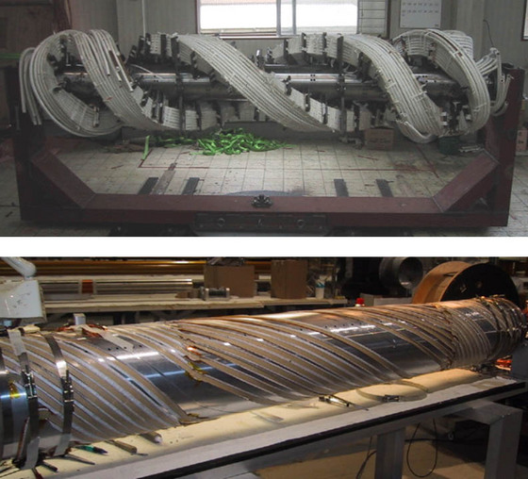
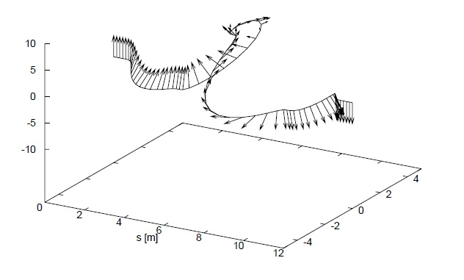
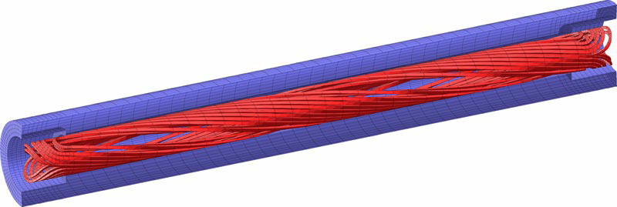
Retaining polarization: Snakes
Primary strategy for retaining polarization is employing SNAKES (helical dipoles)
Helical dipole magnets provide large local spin rotations
Adjust the spin tune away from Gγ to avoid the resonance conditions
Provide cancellation of spin perturbing kicks
AGS Warm snake
AGS Cold snake
RHIC
Two Full 180 deg spin flip snakes
Spin tune = ½, energy independent
Strong resonance cancellation
AGS
Two Partial snakes (6 and 10 deg)
Avoids strongest resonances
Drives other, smaller, resonances
Booster
No snakes (imperfections compensated with harmonic bumps)
RHIC Full helical dipole snake
Trajectory and spin orientation in a RHIC snake

Slide 11
Polarization Performance
 | Max Energy [GeV] | Pol. At Max Energy [%] | Polarimeter
Source+Linac | 1.1 | 82-84
Booster | 2.5 | ~80-84
AGS | 23.8 | 67-70 | p-Carbon
RHIC | 255 | 55-60 | Jet, full store avg*
Tandem van de Graaff
 | Relative Ramp Polarization Loss (Run 17, full run avg)
AGS | 17 %
RHIC | 8 %
Polarimetry available at:
Source
End of Linac (200 MeV)
AGS extraction
RHIC injection energy
RHIC flattop
(No Booster polarimeter!)s

Slide 12
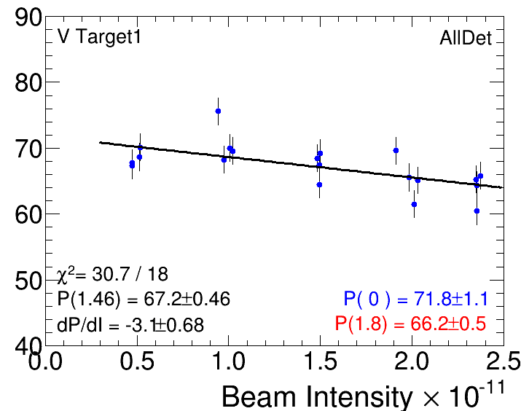
Polarization losses and what to do about them
Polarization measured at AGS extraction decreases with intensity (i.e. with increasing emittance)
Implies residual emittance dependent polarization loss mechanisms.
Areas of attack from the proposal:
Decrease the transverse emittance
Improve Booster injection/capture
known to sensitively affect the emittance
Ameliorate effects of space charge with longitudinal splitting/merging scheme
Lowers peak current
Compensate spin resonances directly
Precision energy measurements
Determines resonance frequency and timing
Optimize resonance corrections
Skew quad based resonance compensation during AGS acceleration
(Why not polarization vs emittance?
Side effort: improve emittance measurement accuracy and intensity-dependent systematics…)

Slide 13
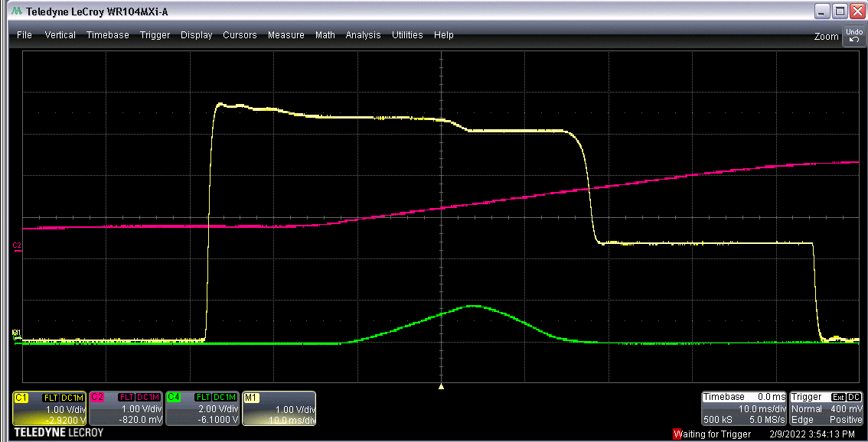
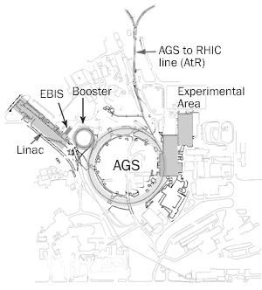
Booster injection
Intensity
Main mag
Booster injection/early acceleration process sets maximum beam brightness for rest of acceperation though RHIC
Linac pulse of 300 us, H⁻ beam ~6-9x10¹¹ protons
Multi-turn, f_{rev} ~ 1 us
Strip injected through a carbon foil
Beam steered off foil after pulse finished
Coasting beam adiabatically captured by RF and accelerated
Intenstional horizontal and vertical scraping reduce emittance (and intensity) to RHIC requirements ~2.5x10¹¹ protons
Injection
V scrape
Extraction
Capture
H scrape

Slide 14
Booster injection
Intensity
Main mag
Booster injection/early acceleration process sets maximum beam brightness for rest of acceleration though RHIC
Many ”knobs”
Linac to Booster trajectory/optics matching
Optimization of time on foil (Linac pulse length vs height)
Linac RF phases affect capture and acceleration efficiencies
Booster RF capture rate affects longitudinal emittance (and transverse, via space charge)
Booster orbit and optics affect foil scattering, matching and intensity transmission.
Betatron ‘stop band’ correctors for intensity, emittance preservation.
Difficult instrumentation
WCM, BPMs don’t work until after capture
No transverse profile monitor in Booster
Scraping efficiency as proxy
Measurable in the extraction line via multiwire
Injection
V scrape
Extraction
Capture
H scrape

Slide 15
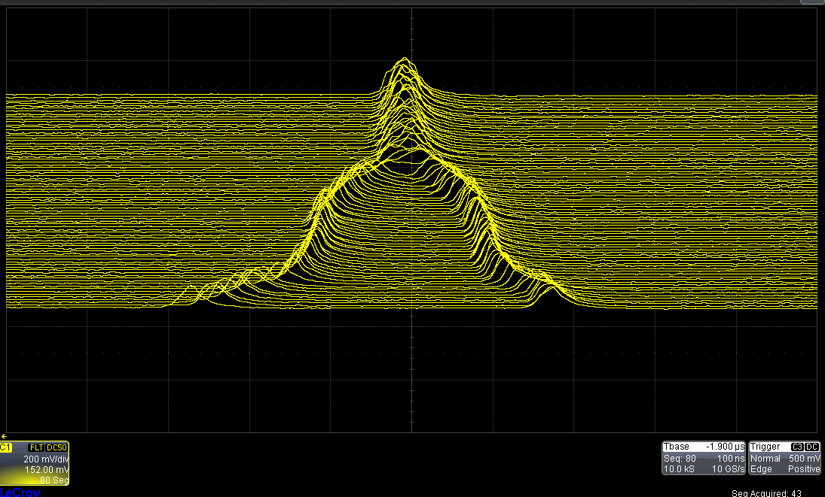
Longitudinal splitting/merging
Normal operation
One linac pulse is captured as one bunch in the Booster and remains one bunch in AGS and RHIC
Peak current (space charge) at AGS injection can be reduced by splitting the bunch into 2 longitudinally in Booster before transferring to AGS
Bunches are later merged at AGS extraction
Bunch merges require expert tuning of many parameters (RF voltages, phases)
Prone to drift over time
Tuning often done ‘by eye’ using WCM mountain ranges (no real time signal analysis)
Side benefit for heavy ion operation which makes heavy use of merges to get required intensities
Merge of AGS proton bunches at flattop
Time

Slide 16
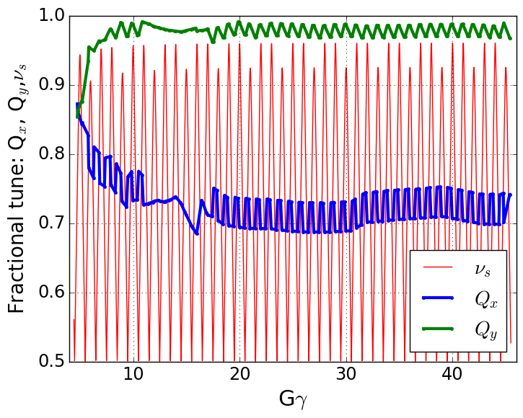
Energy measurement
Betatron and spin tunes during AGS ramp
Partial snakes in the AGS prevent the spin tune from taking some values near the integer (>0.96), the “spin tune gap”
Vertical resonances are avoided, but the horizontal tune still satisfies the resonance condition
Horizontal resonance are weak (~0.1% loss per resonance)
But many of them (82)
Presently ‘jumped’ by moving the horizontal tune through the resonance
Jump requires precise timing (+/- 100 us), translates to precise measurement of the beam energy.
Spin tune gap
Hor resonance crossings
Tune
jump

Slide 17
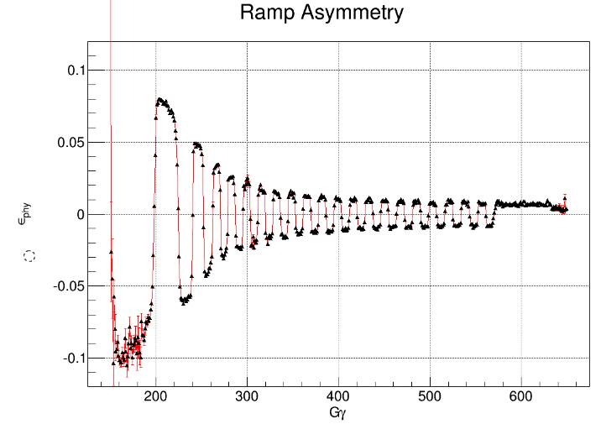
Energy measurement
Method 1
Measure beam and machine parameters throughout cycle (rev frequency, radial offset, magnetic field via flux coil
Calculate energy two ways (with different systematic dependencies)
Fit unknown-to-sufficient-precision parameters to make calculations equal
Parameters measurable on every cycle, but prone to unexplained drifts and lurches over time
Method 1: Fit B-field and freq based energy calculations
From RF frequency
From field
Method 2: Find timing of spin flips using polarimeter
Method 2
Insert polarimeter target for full AGS cycle
Spin flips (from partial snakes) happen at well-defined energies
Interpolate to resonance times
Analysis is straightforward and precise, but measurement takes 8 hours (no real time monitoring, no info about machine systematic errors)

Slide 18
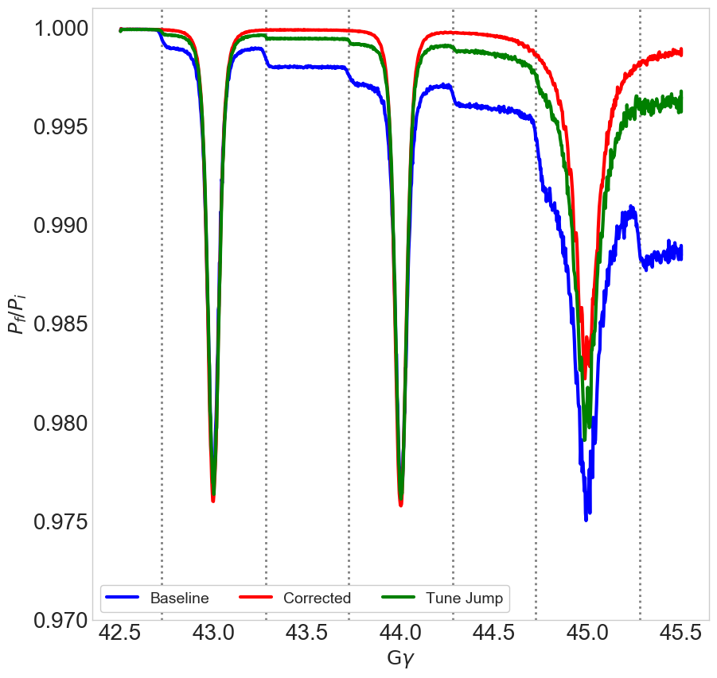
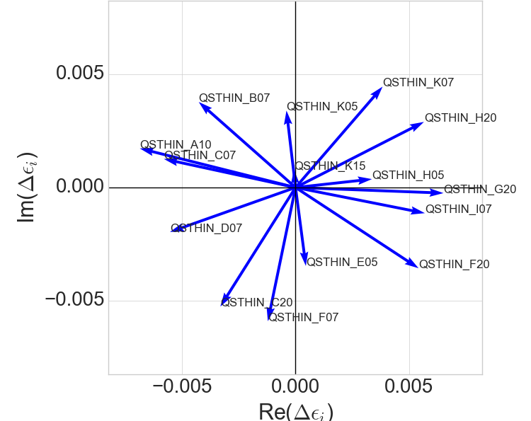
Resonance compensation with skew quads
The tune jump still leaves residual loss from horizontal resonances
Proposal to use 15 pulsed skew quadrupoles to eliminate the resonance drive entirely
Correcting any one resonance is a 4x15 linear algebra problem (two resonance terms, two coupling terms to minimize), so there are 82 such problems to optimize
Individual resonance by resonance tuning is impractical
Polarization impact of any one resonance too small to measure in reasonable time
AGS polarimeter yields a 2% precision measurement in 5 minutes
Ways forward?
How to find correlated errors, to reduce number of required ‘knobs’?
Can we make use of information from betatron coupling (TBT bpm?)? Rather than rely on polarimetry alone
$$\left\langle P_{n}\right\rangle$$
Spin resonance terms from skew quads in AGS
Gɣ = 43.72
18

Slide 19
Comments on tasks from proposal
Booster injection optimization
Requires support from C-AD (instrumentation and controls) to update, maintain, possibly upgrade available tools
E.g. reviving neglected BPMs, LtB multiwires
Needs careful consideration of figures of merit for optimization (obvious, maybe, but it is a many-to-few mapping)
Would benefit from side projects in calibrating instrumentation (multiwires, IPMs)
Useless to future operation if a non-ML-expert tool isn’t available at the end of this
Bunch splitting/merging optimization
Needs controls support to parse/analyze mountain range data (ongoing)
AGS energy measurement
Seems ripe for parameter estimation and uncertainty quantification techniques
Relatively small, self-contained problem
Skew quad resonance correction
Hardest of the four outlined tasks
Optimization based strictly on polarimetry might be impossible in practice.

Slide 20
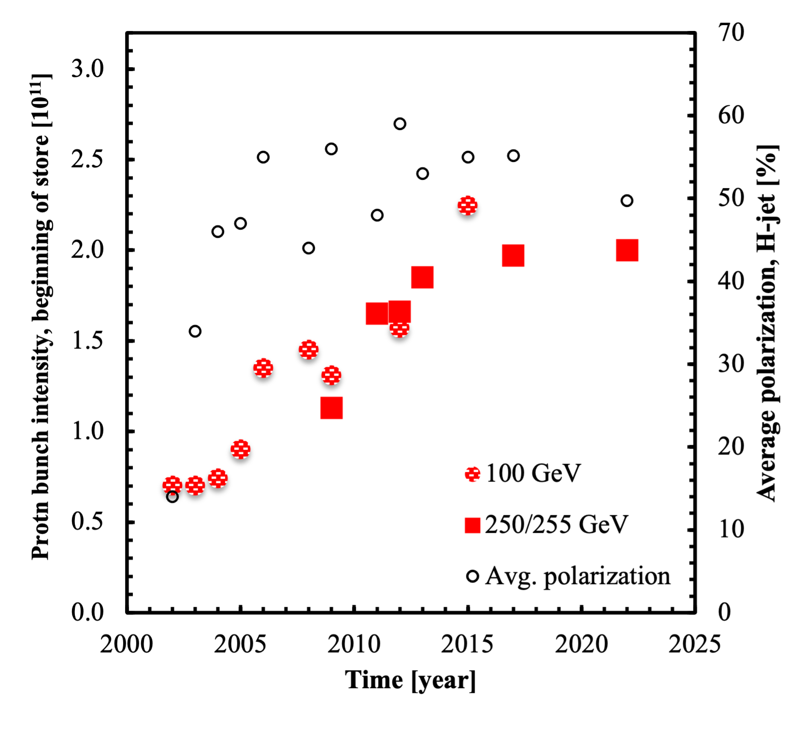
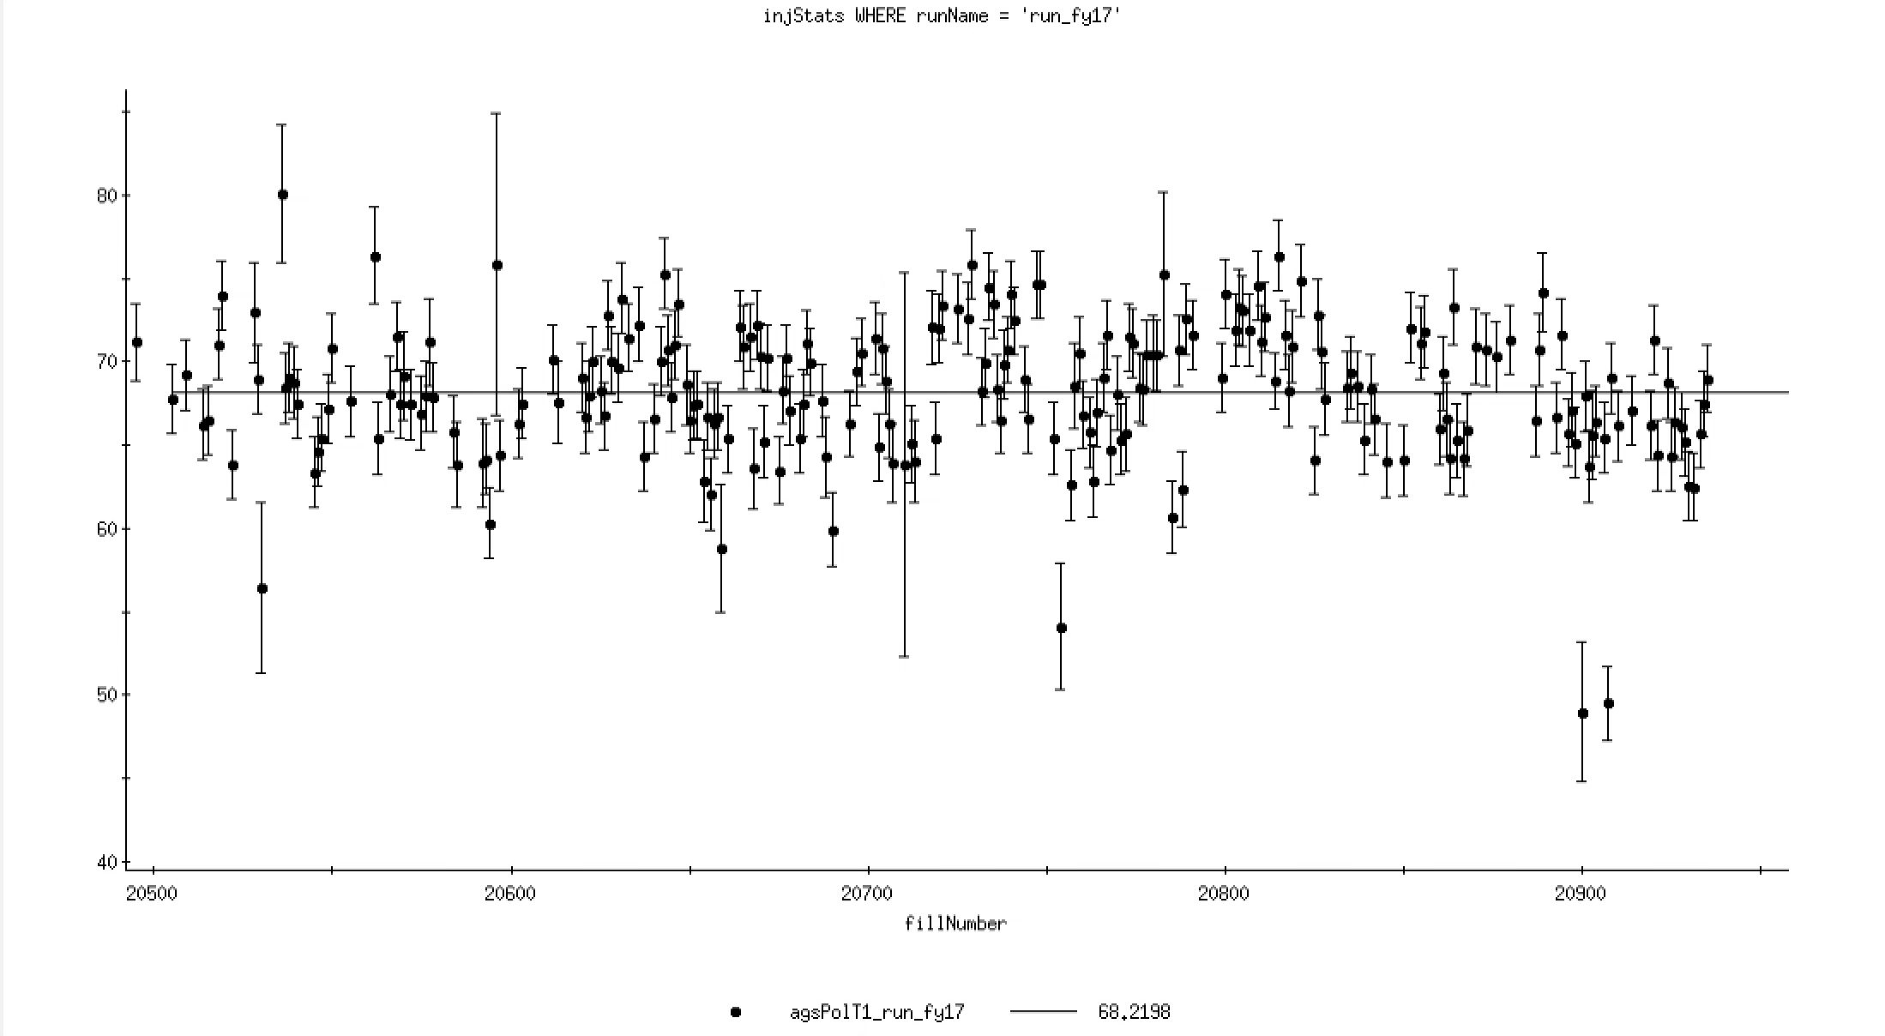
5% is not small….
RHIC Polarization (Avg) by Run
Polarization mostly increases due to
Introduction of new equipment (e.g. snakes, tune jumps)
Then long incremental optimization
Improvement from the ML efforts could come from both:
Increasing the peak at the optimum
Holding the peak more consistently
Avoiding days/weeks of suboptimal polarization
(100 GeV)
= 255 GeV
AGS Polarization by Fill
Systematically high/low periods
Polarization [%]
RHIC Fill number

