Slide 1


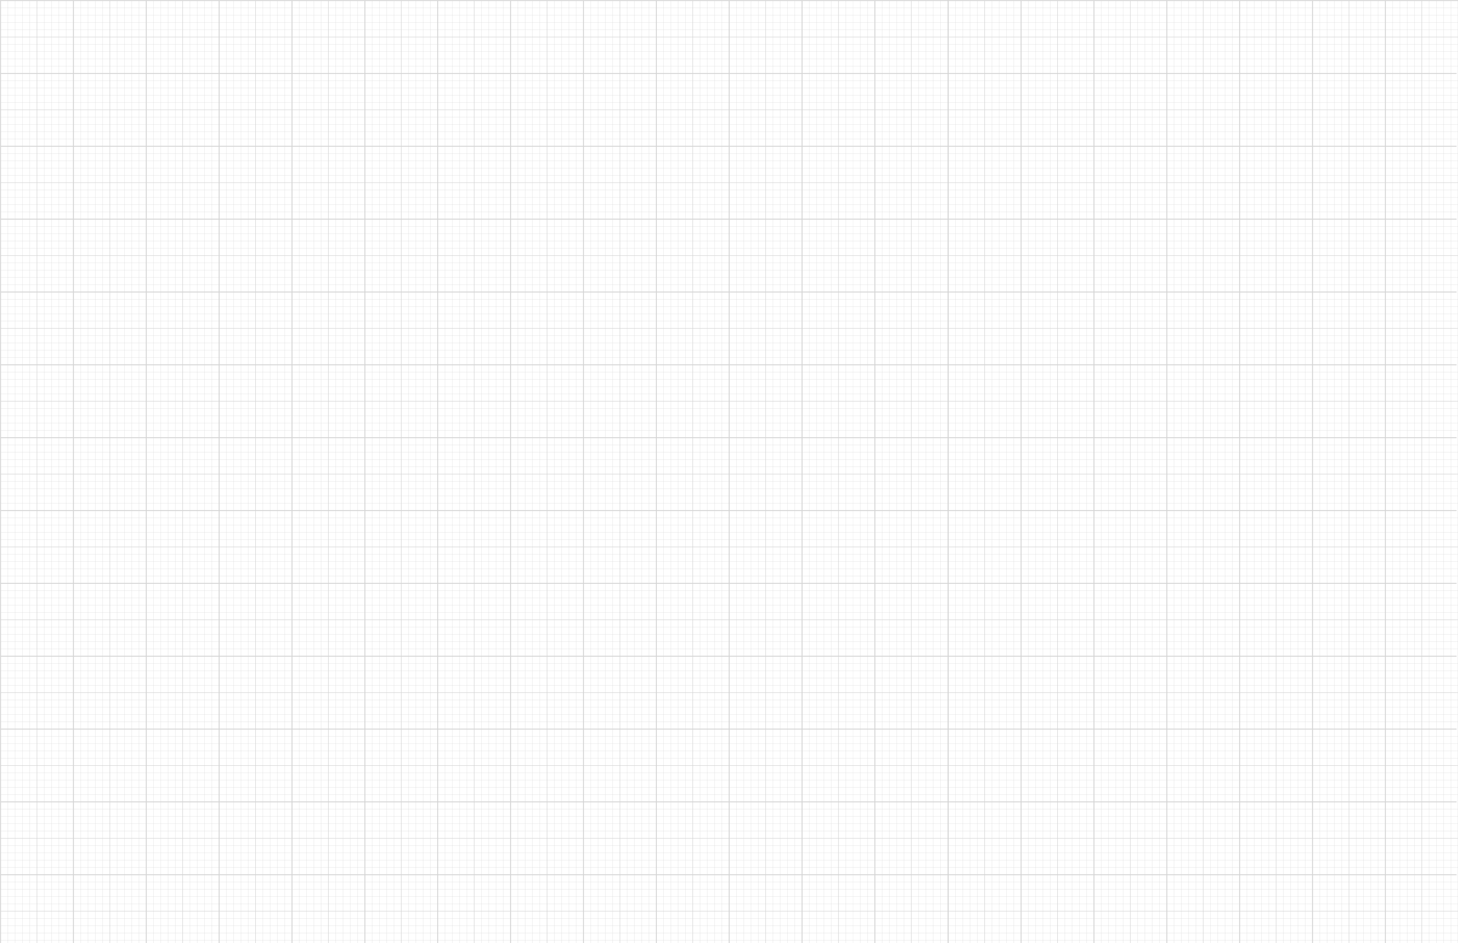
Introduction to Bayesian Optimization
Yinan Wang, Ph.D.
Assistant Professor, Department of Industrial and Systems Engineering
Rensselaer Polytechnic Institute
Collaboration Meeting on Aug. 25 @ Cornell U.

Slide 2
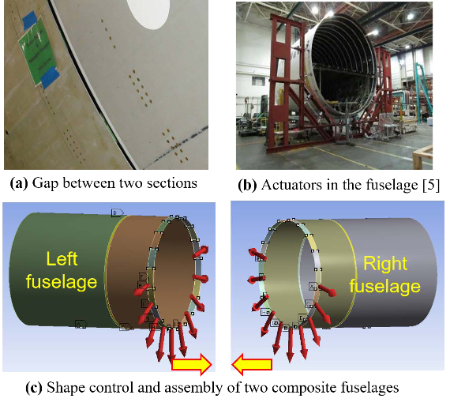
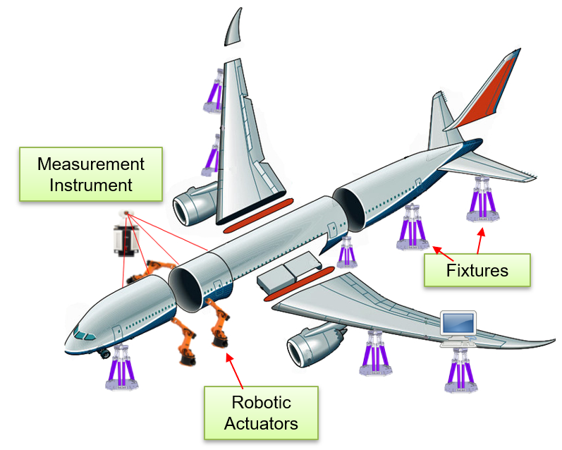
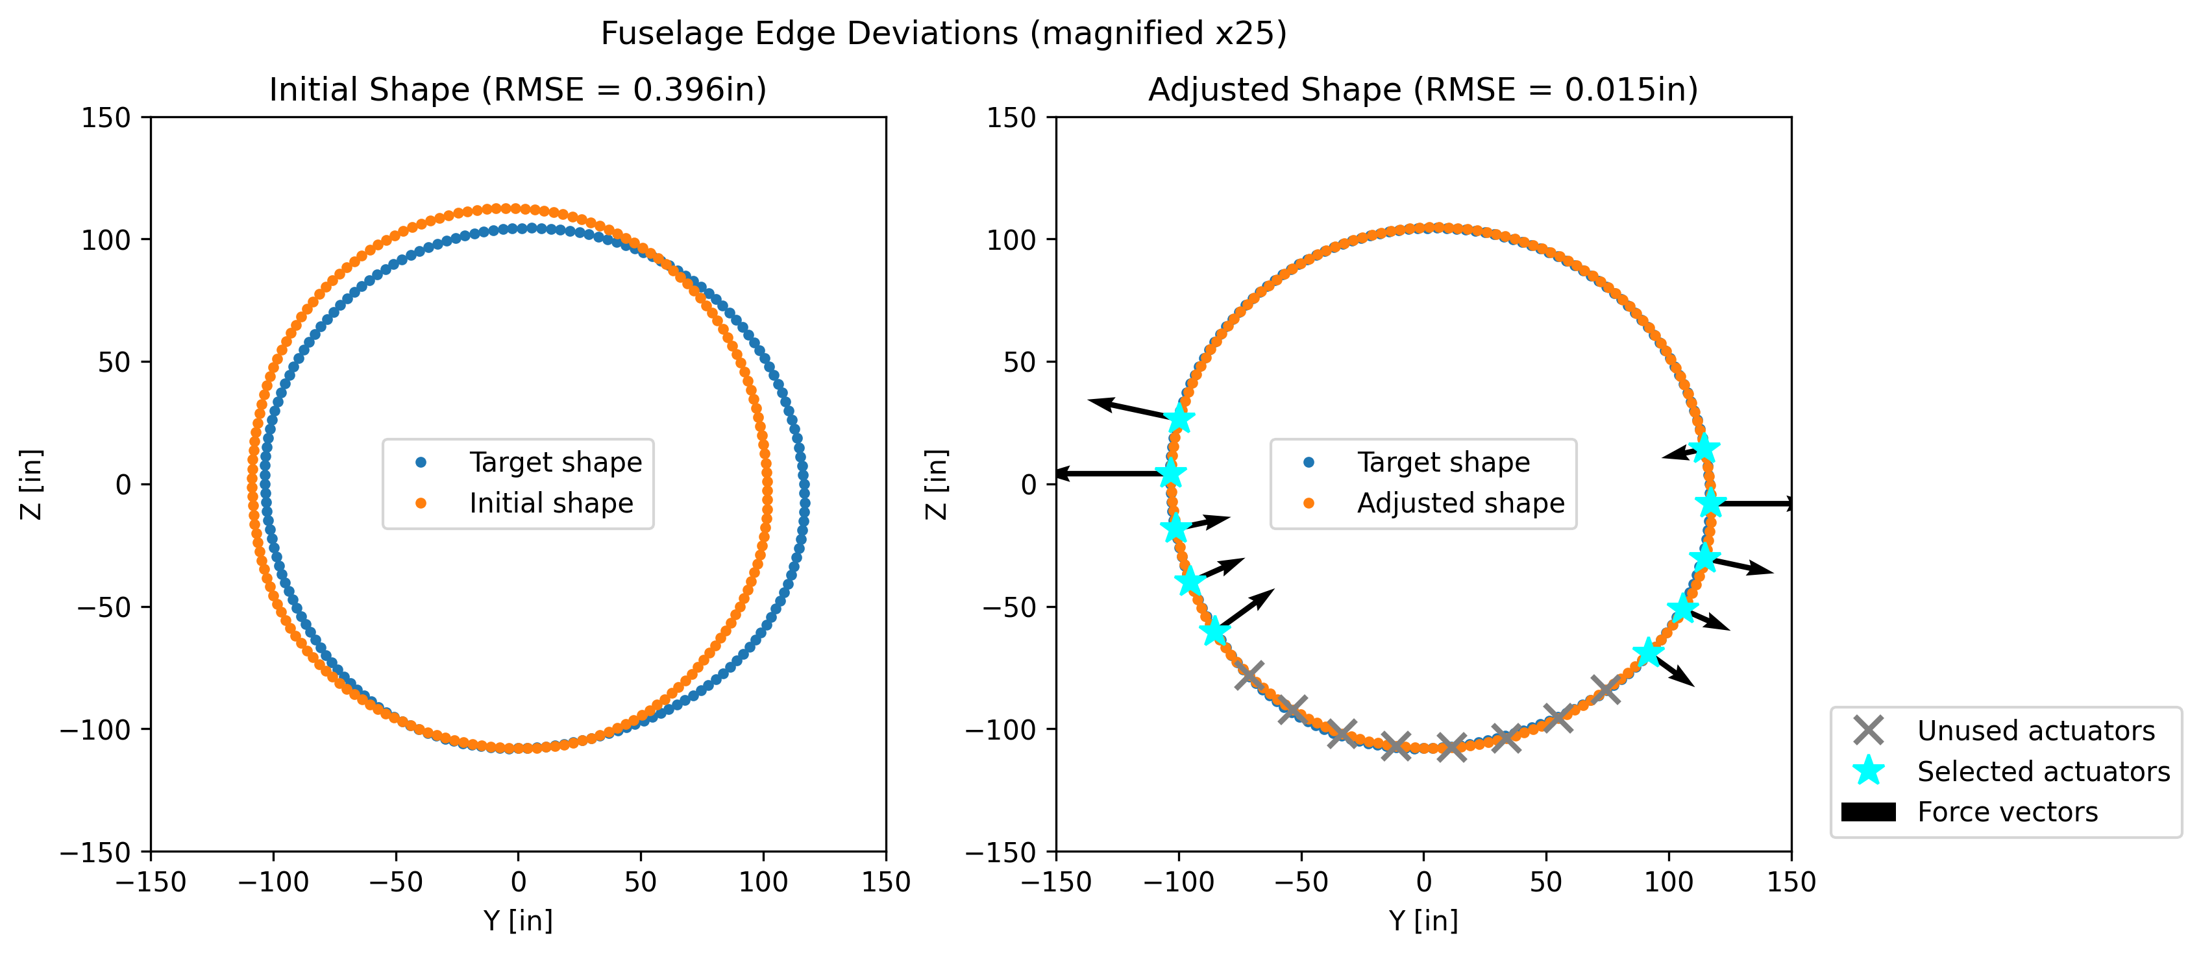
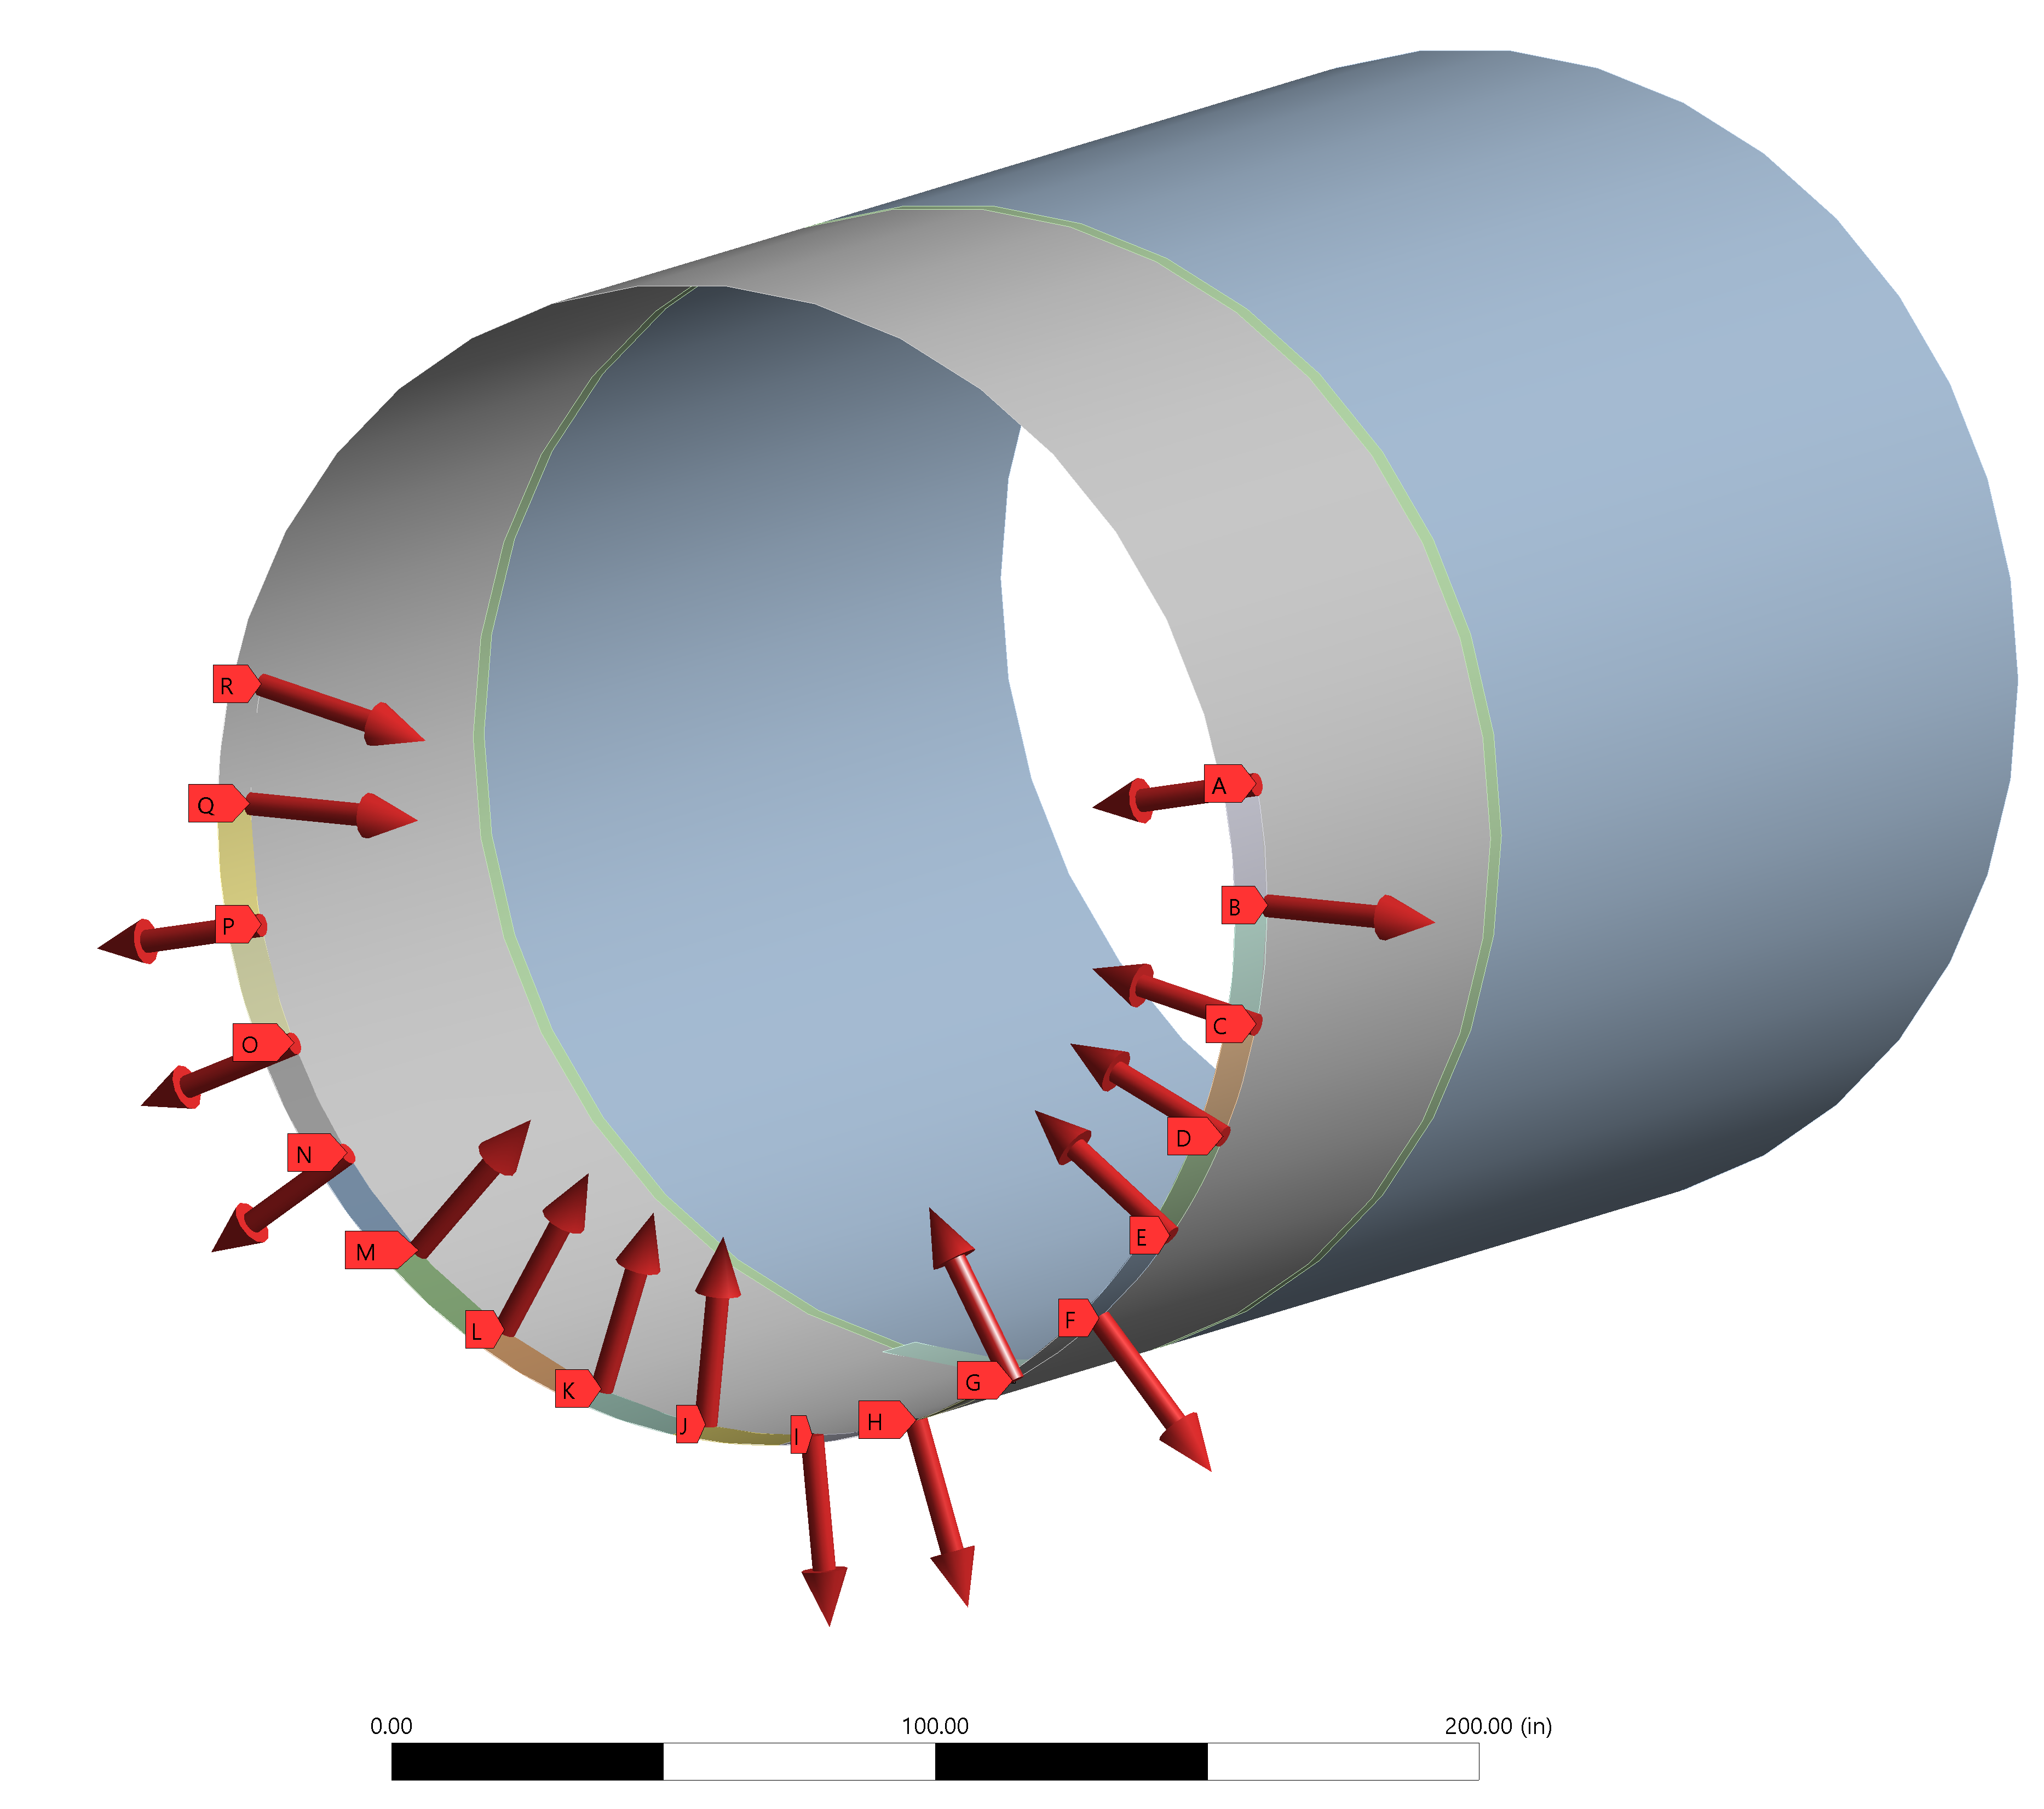
Motivation
Prediction
Identify the dimension gap
Set the locations and forces of actuators
Generate corrected dimension
Fuselage Assembly
Optimization

Slide 3
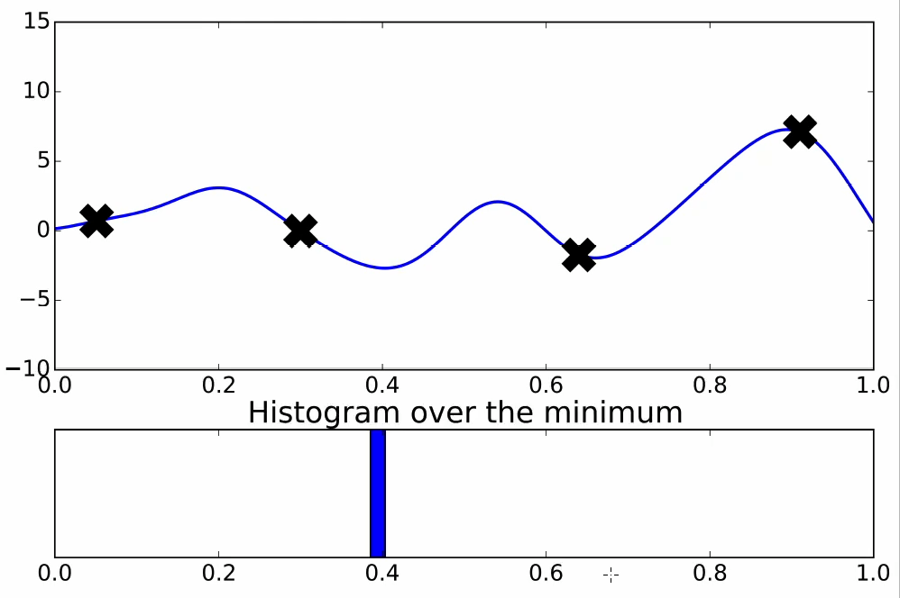
Intuitive Example of Bayesian Optimization
Data Visualization

Slide 4
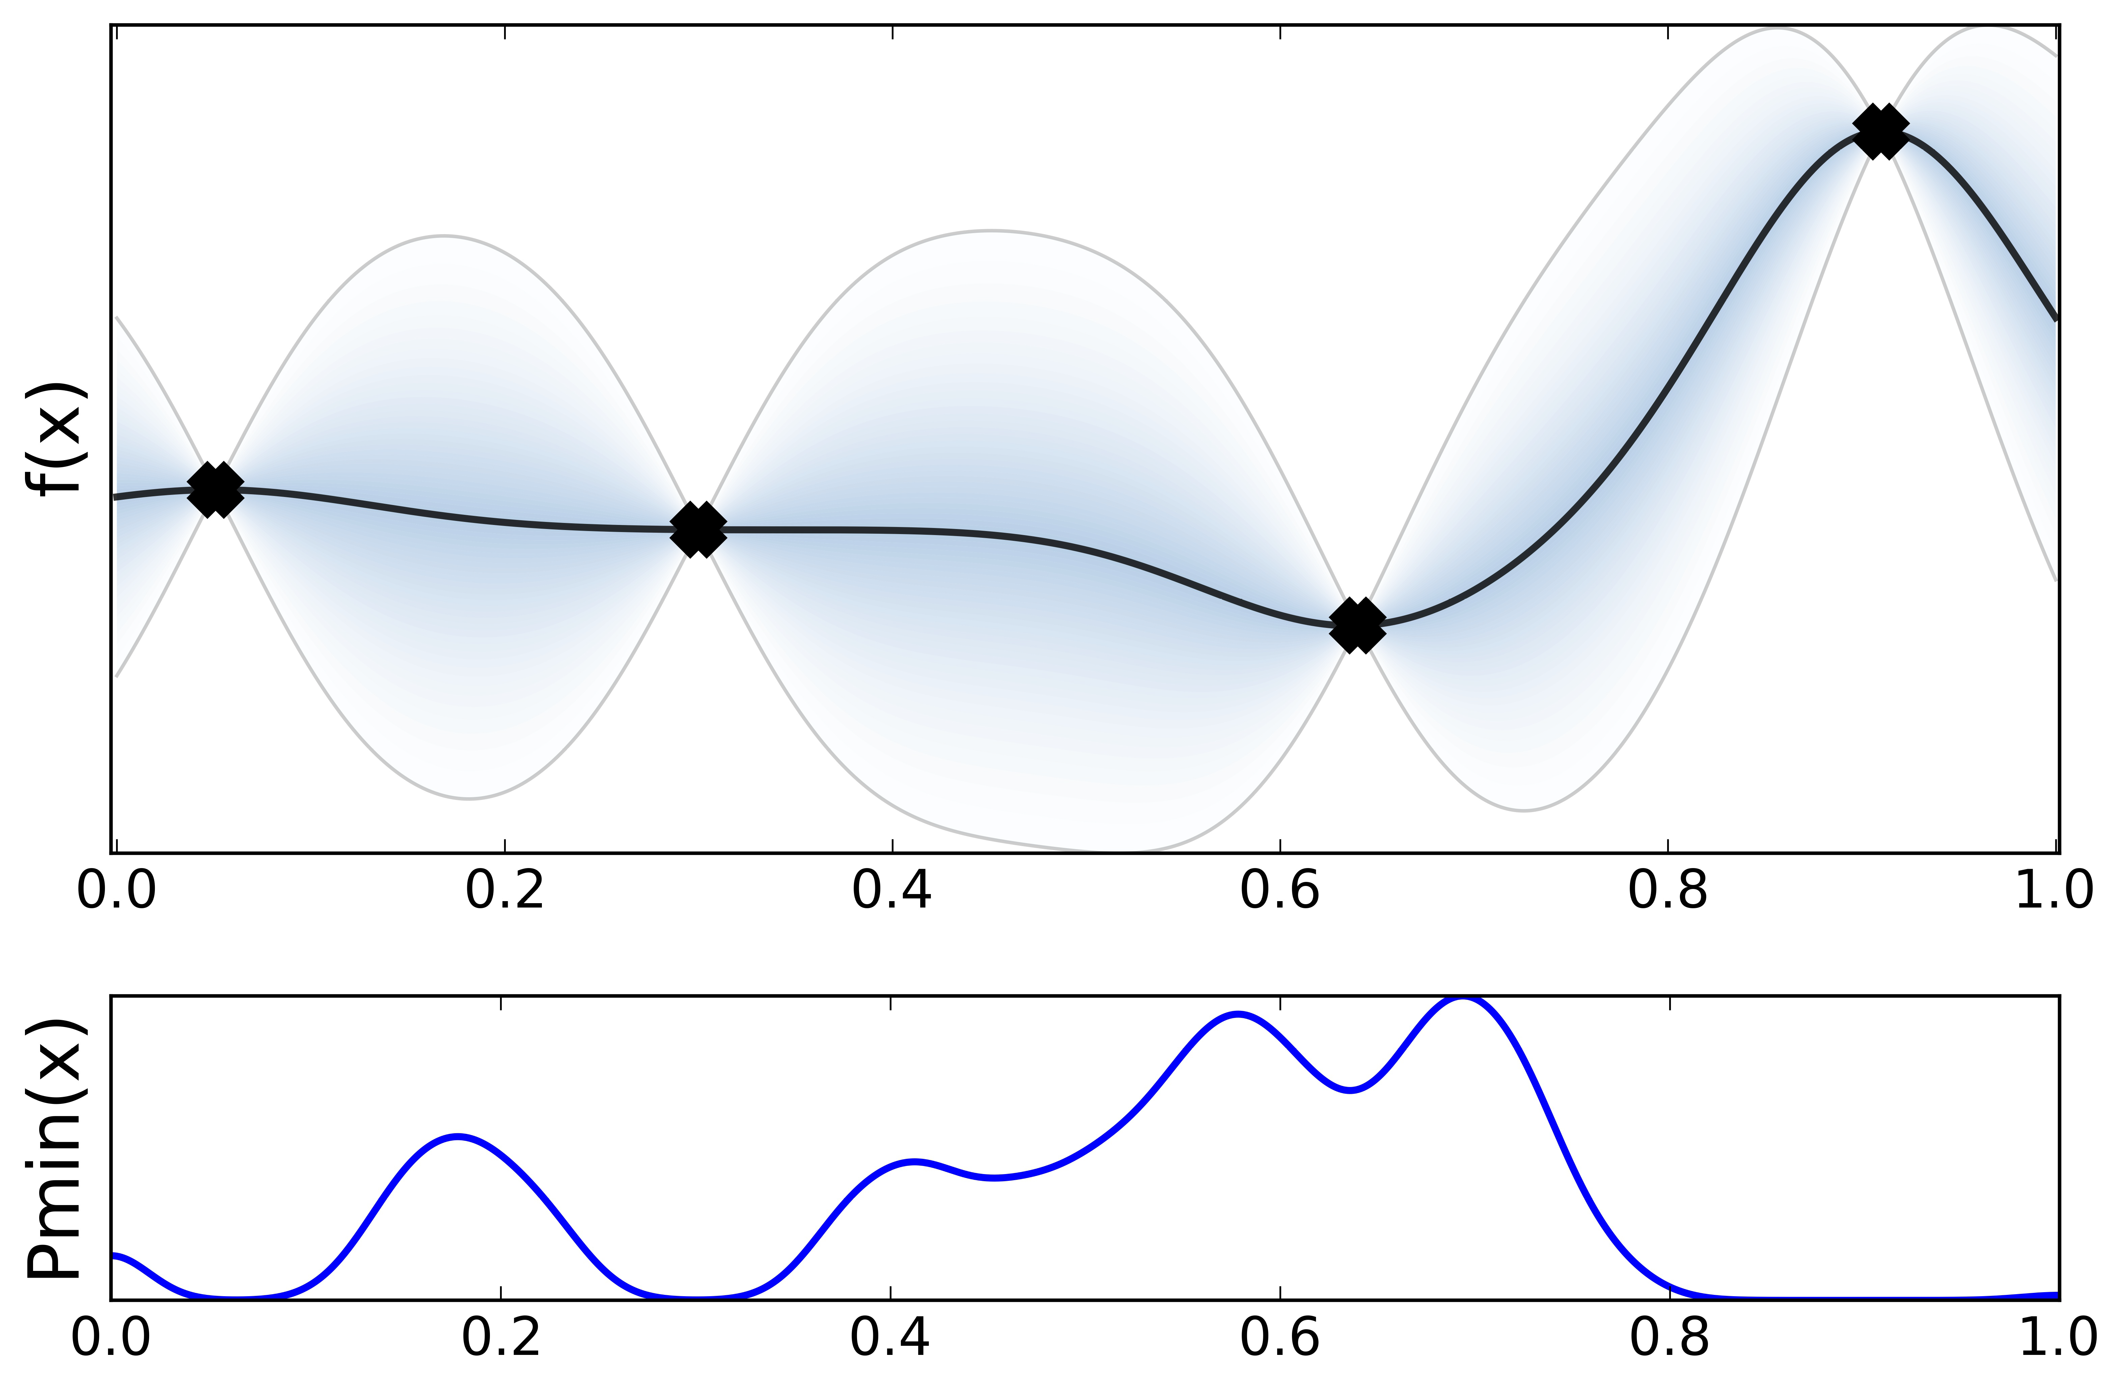
Intuitive Example of Bayesian Optimization
Data Visualization
Surrogate model
Acquisition function
Note: With an appropriately defined surrogate model and an acquisition function, we can efficiently evaluate the point that will highly likely lead to the optimized output.

Slide 5
General Formulation
Data Visualization
Note: With an appropriately defined surrogate model and an acquisition function, we can efficiently evaluate the point that will highly likely lead to the optimized output.

Slide 6
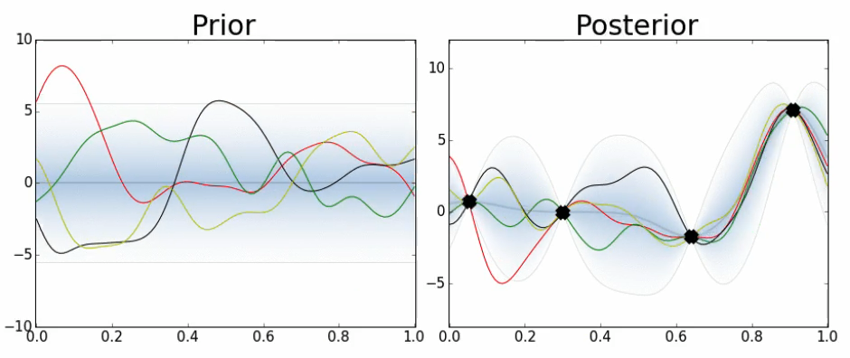
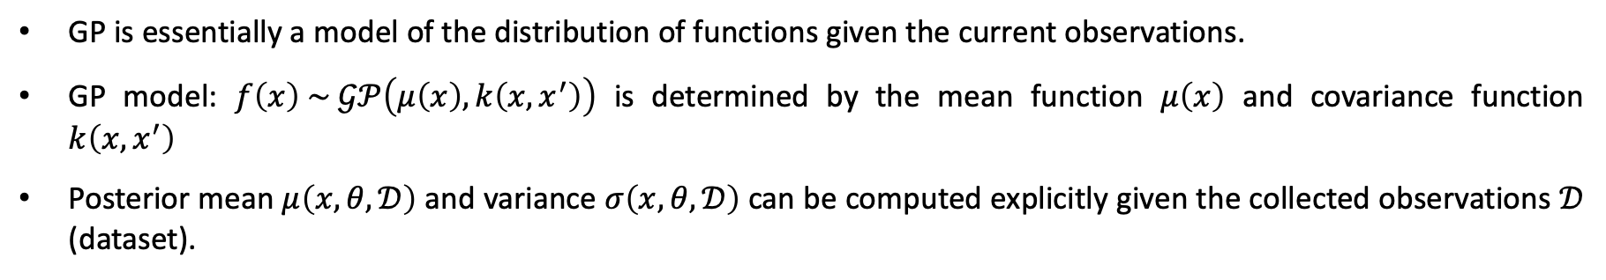
Surrogate Model: Gaussian Process (GP)
GP is essentially a model of the distribution of functions given the current observations.
GP model: $f\left(x\right) \sim 𝒢𝒫\left(μ\left(x\right),k\left(x,x^{′}\right)\right)$ is determined by the mean function $μ\left(x\right)$ and covariance function $k\left(x,x^{′}\right)$
Posterior mean $μ\left(x, θ,𝒟\right)$ and variance $σ\left(x, θ,𝒟\right)$ can be computed explicitly given the collected observations $𝒟$ (dataset).

Slide 7




Surrogate Model: Multi-layer Deep Gaussian Process (MGP)
$L$-layer MGP: Formulation
$L$-layer MGP: Marginal likelihood
Transformation of input (feature space)
input
response
Mean function in the $L_{th}$ layer
Covariance kernel
Gram matrix of the kernel function $k(x,x^{′})$
Note: MGP is proposed to learn the complex dependency of the underlying process and improve global optimum function approximations.
AlBahar, A., Kim, I., Wang, X., & Yue, X. (2022). Physics-constrained Bayesian optimization for optimal actuators placement in composite structures assembly. IEEE Transactions on Automation Science and Engineering.
Wang, Y., Yue, X. (2023). Multi-modal Deep Learning Methods with Applications to Advanced Manufacturing (under review).

Slide 8
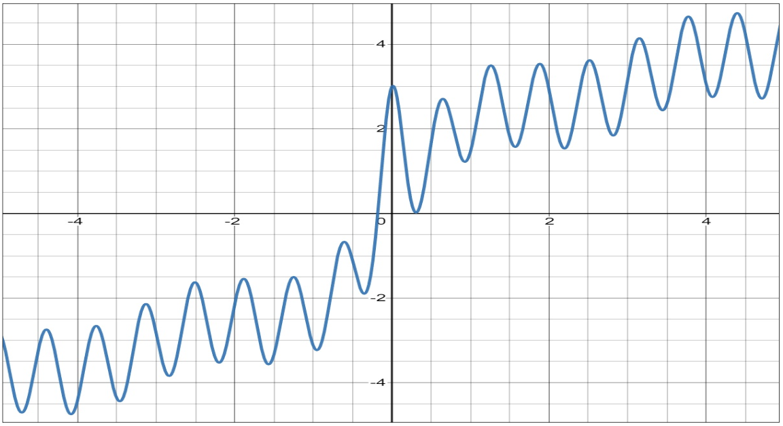
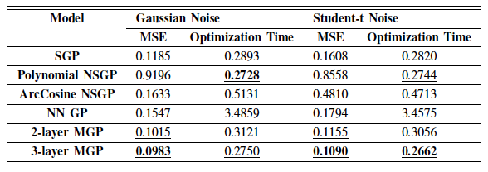

Surrogate Model: Performance Comparison
SGP: Stationary GP with Matern kernel.
NSGP: Non-stationary GP with Polynomial or ArcCosine kernels.
NNGP: NN for mean function and Matern kernel.
MGP: Multi-layer GP for mean function and Matern kernel.
Gaussian or Student-t distributed noise
Visualization of $f(x)$
Note: Nonstationary GP allows the model to adapt to functions whose smoothness varies with the inputs; Stationary GP has the covariance between any two points is a function of Euclidean distance.
AlBahar, A., Kim, I., Wang, X., & Yue, X. (2022). Physics-constrained Bayesian optimization for optimal actuators placement in composite structures assembly. IEEE Transactions on Automation Science and Engineering.
Wang, Y., Yue, X. (2023). Multi-modal Deep Learning Methods with Applications to Advanced Manufacturing (under review).

Slide 9
Surrogate Model: Performance Comparison
Note: The 95% confidence intervals of the predictive posterior distributions of the 2-layer MGP and 3-layer MGP have a better coverage on observations with narrower intervals.
AlBahar, A., Kim, I., Wang, X., & Yue, X. (2022). Physics-constrained Bayesian optimization for optimal actuators placement in composite structures assembly. IEEE Transactions on Automation Science and Engineering.
Wang, Y., Yue, X. (2023). Multi-modal Deep Learning Methods with Applications to Advanced Manufacturing (under review).

Slide 10
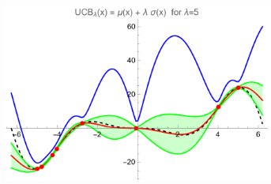
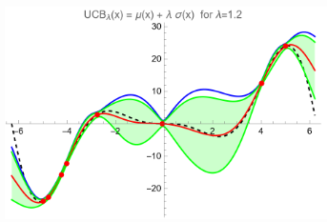
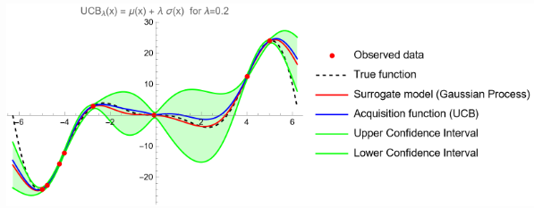

Acquisition Function: GP Upper Confidence Bound (GP-UCB)
Exploitation
$$α_{UCB}\left(x,λ\right)=μ\left(x\right)+λσ(x)$$
Exploration
Note: UCB is a weighted sum of the expected performance captured by $μ(x)$ and the uncertainty $σ(x)$. It will favor exploitation with smaller $λ$ and exploration with larger $λ$.
https://ekamperi.github.io/machine%20learning/2021/06/11/acquisition-functions.html

Slide 11
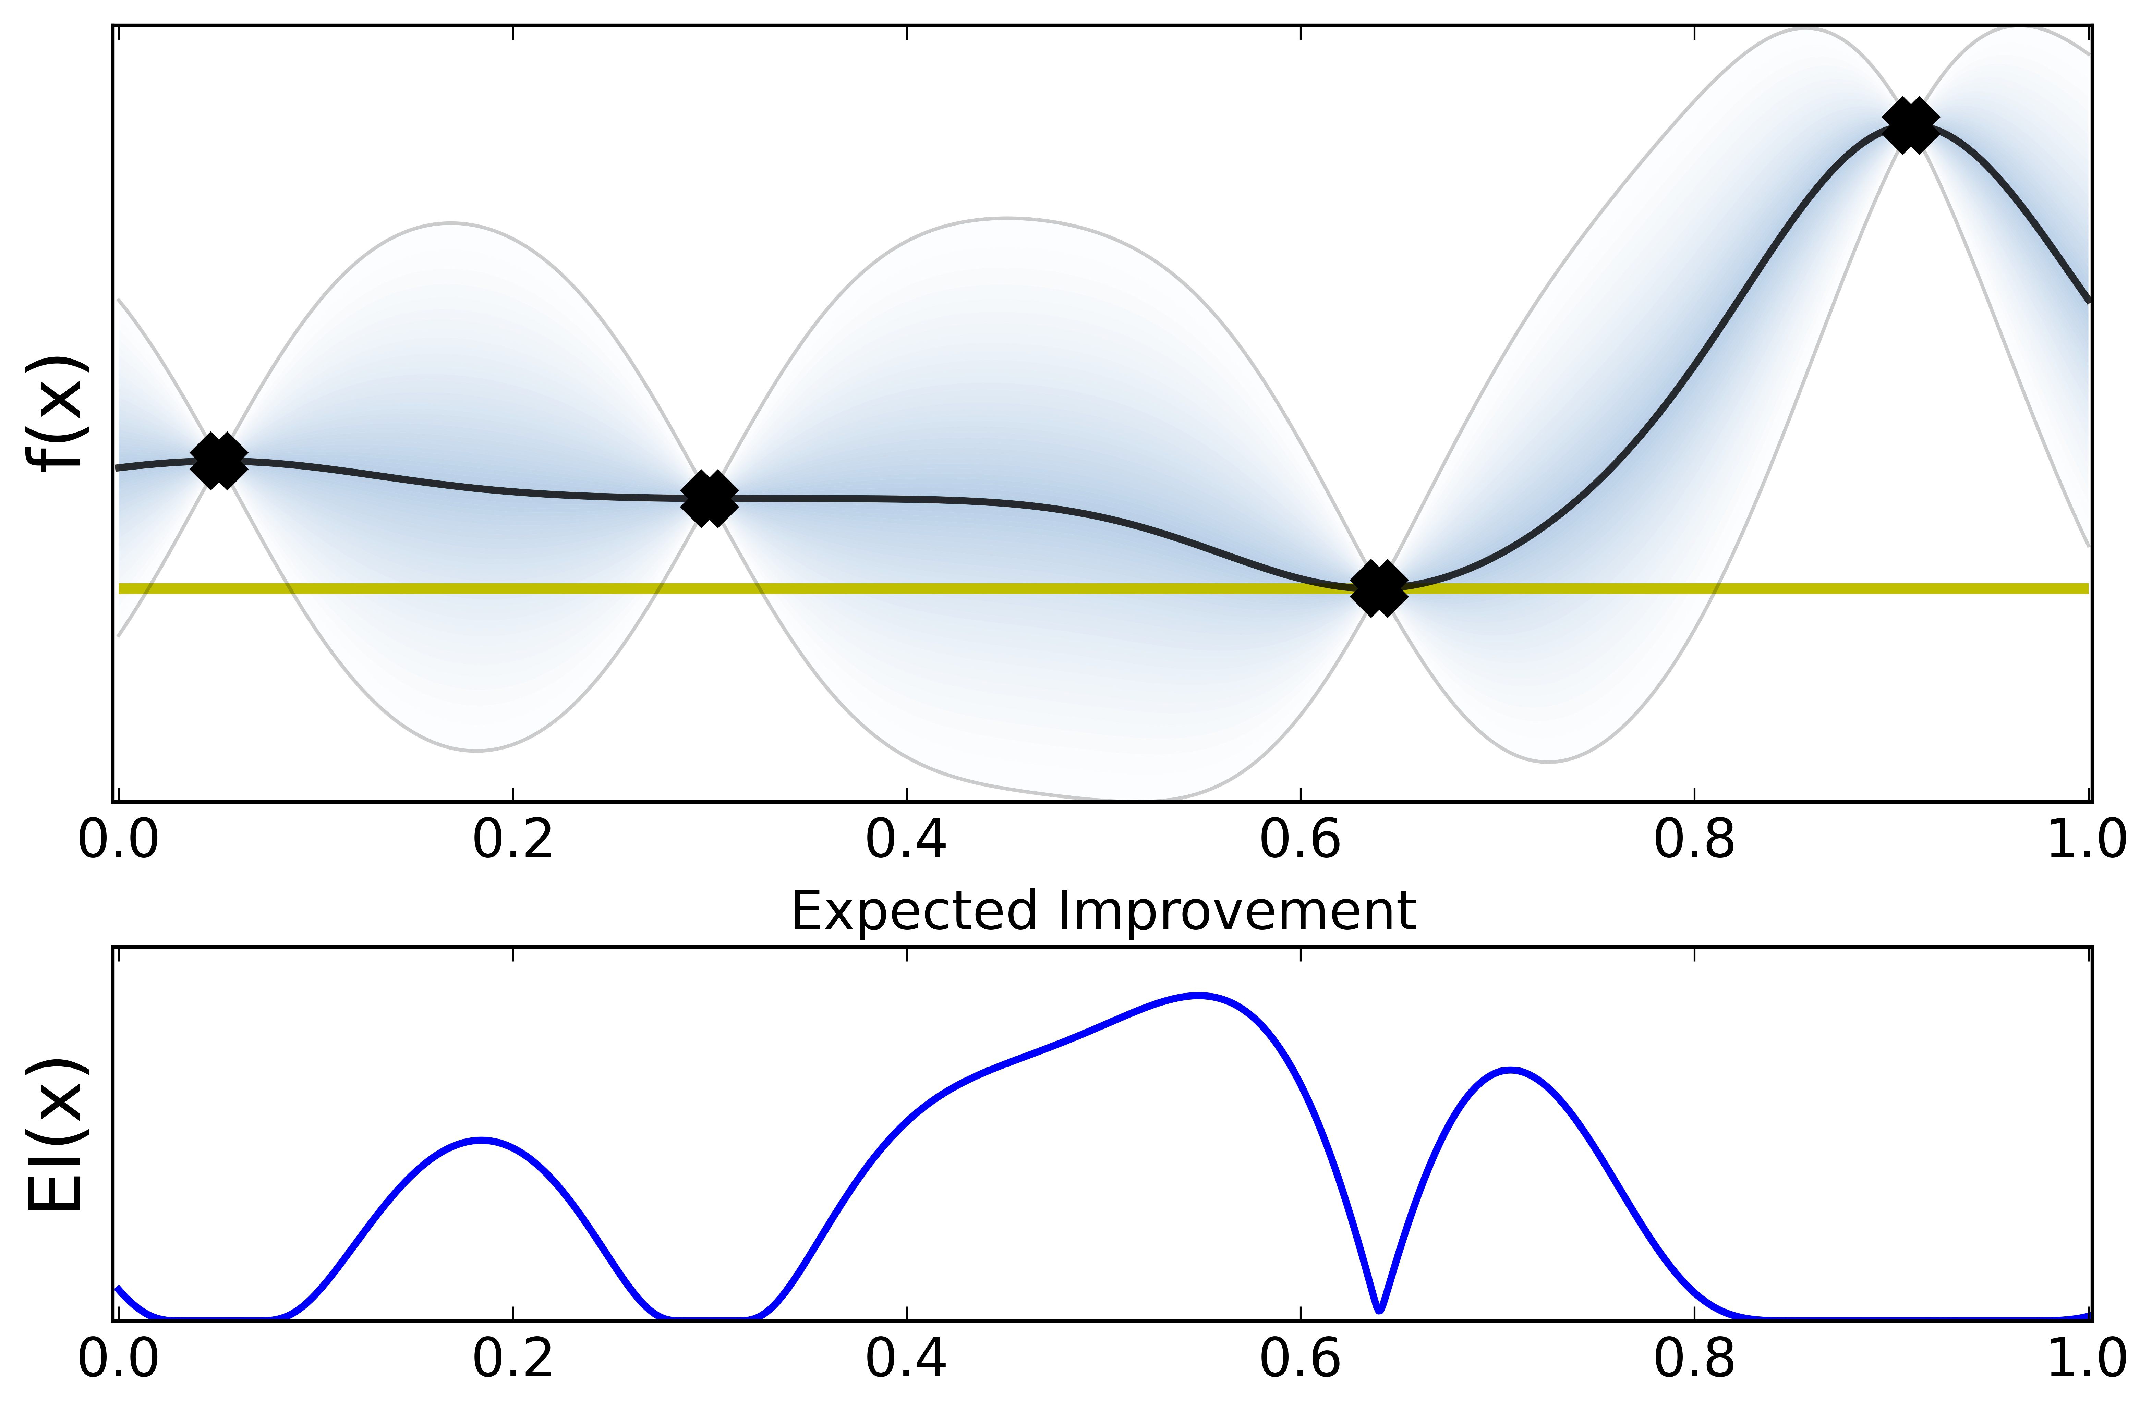
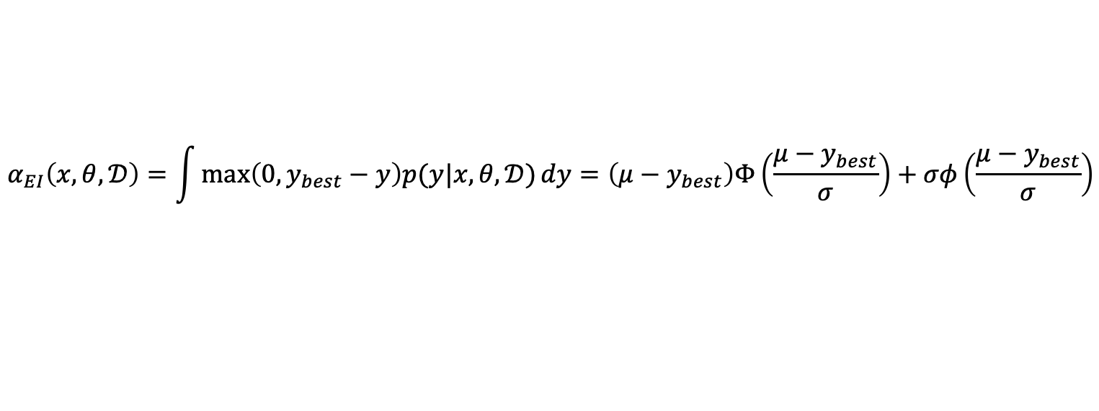
Acquisition Function: Expected Improvement (EI)
$$α_{EI}\left(x,θ, 𝒟\right)=\int{\max\left(0,y_{best}−y\right)p(y|x,θ,𝒟)}dy=\left(μ−y_{best}\right)Φ\left(\frac{μ−y_{best}}{σ}\right)+σφ\left(\frac{μ−y_{best}}{σ}\right)$$
Exploitation
Exploration
Note: The trade-off between exploitation and exploration can be adjusted by introducing a hyper-parameter in $(μ−y_{best}−η)$. A larger value of $η$ will encourage exploration.

Slide 12
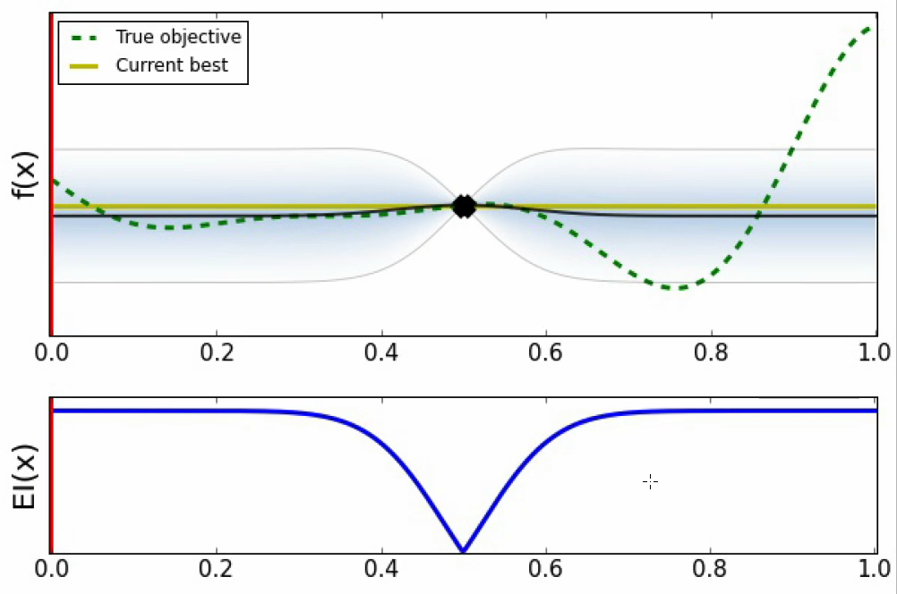
Demonstration of BO

Slide 13
Constrained Expected Improvement (cEI)
Optimization with linear constraints
Objective and constraints as GPs
Integrate the feasibility through the CDF
infeasible
Note: The idea of cEI can naturally benefit to the physics-constrained optimization.

Slide 14
Case Study: Physics-Constrained Bayesian Optimization
Initial deviation
Displacement matrix
Adjusted deviation
Note: The objective is to place a set of actuators in all feasible locations to minimize the total variations under the constraints of feasible ranges of forces and a maximum number of actuators.
AlBahar, A., Kim, I., Wang, X., & Yue, X. (2022). Physics-constrained Bayesian optimization for optimal actuators placement in composite structures assembly. IEEE Transactions on Automation Science and Engineering.
Wang, Y., Yue, X. (2023). Multi-modal Deep Learning Methods with Applications to Advanced Manufacturing (under review).

Slide 15
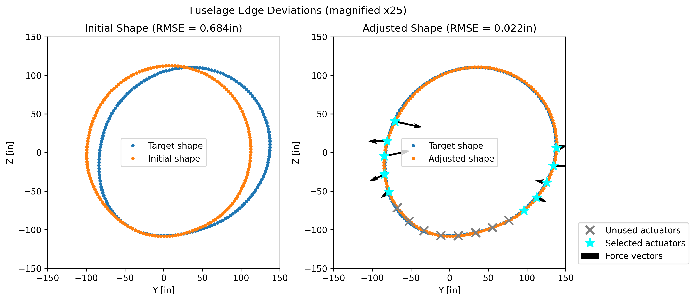
Case Study: Results
Performance comparison between physics-constrained BO and other optimization method
Note: MGP-CBO achieves smaller shape deviation using fewer actuators and smaller forces.
AlBahar, A., Kim, I., Wang, X., & Yue, X. (2022). Physics-constrained Bayesian optimization for optimal actuators placement in composite structures assembly. IEEE Transactions on Automation Science and Engineering.
Wang, Y., Yue, X. (2023). Multi-modal Deep Learning Methods with Applications to Advanced Manufacturing (under review).

Slide 16
Summary
Bayesian optimization is a sequential optimization framework with the interaction between surrogate model and acquisition function.
Domain knowledge or physical insights can be incorporated into the design of surrogate model and/or acquisition function to develop physics-informed Bayesian optimization.
There is still no uniform framework for Pi-BO, which is worth exploring for specific application task (i.e., optimization of Beam polarization) and generalizing into widely applicable framework.

Slide 17
Thank you!
Q & A
Yinan Wang (wangy88@rpi.edu)

