Slide 1
Uncertainty Quantification for p-p Acceleration
Natalie M. Isenberg, Nathan M. Urban
Applied Mathematics, Computational Science Initiative
August 25, 2023

Slide 2
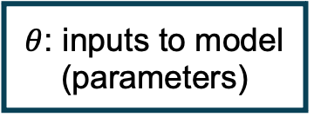


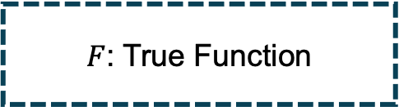

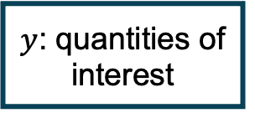
Why Uncertainty Quantification?
Computational science relies on the use of models to make predictions
We often work in a deterministic framework
Nominal Conditions
Simulator
$θ$: inputs to model (parameters)
$F$: Model
$y$: quantities of interest
Real Process
Reality
$F$: True Function
$$θ^{∗ }∈ Θ$$
$$y^{∗ }∈Y$$

Slide 3
Why Uncertainty Quantification?
UQ is mostly just another term for statistics
  Some communities have specific meanings, like “statistics of physical computer models”
Types of UQ
Spatiotemporal statistics
Sensitivity analysis
Uncertainty Propagation
Parameter estimation
Data assimilation
Other inverse problems
Applications of UQ
Optimal Experimental Design
Forecasting
Robust Control
Active Learning
Image Processing
Bioinformatics
If we intend to use computer models for real-world decision-making (e.g., maximizing polarization via control), we want to build confidence in the models!
Notes:
Uncertainty quantification can be thought of as just a set of formalisms for applying statistical analysis to computer models. There are lots of different flavors of UQ, and you can basically choose them a la carte for a given application depending on what sort of uncertainties are present, what data you have available, and what kind of model you have.
Spatiotemporal statistics is theory for applying Bayesian statistical methods to dynamical spatiotemportal models

Slide 4
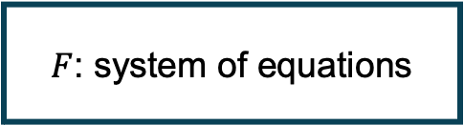



Bayesian Uncertainty Quantification for Computer Models
$F$: system of equations
$$θ^{∗ }∈ Θ$$
$$y^{∗ }∈Y$$
$F\left(Θ\right)=Y$
Forward UQ (Propagation)
  Propagate input uncertainty through model to quantify output uncertainty
Inverse UQ (Inference)
  Use available output data to improve characterization of input uncertainties (e.g., parameter estimation)
$F^{−1}\left(Y\right)=Θ$

Slide 5
Parameter Estimation via Bayesian Inference
Determining the most likely values of unknown parameters in a probabilistic model given observed data via Bayes’ theorem

Slide 6
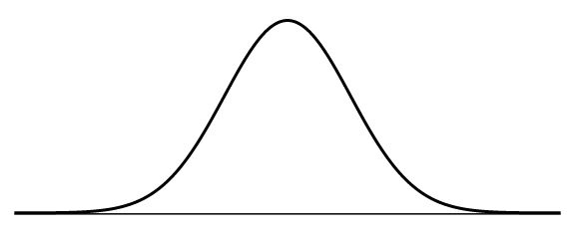

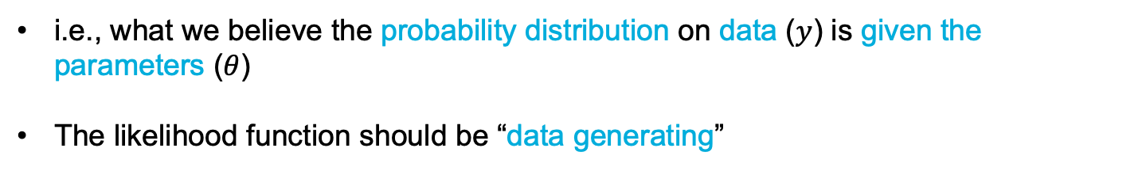
Parameter Estimation via Bayesian Inference
Determining the most likely values of unknown parameters in a probabilistic model given observed data via Bayes’ theorem
Data likelihood
PDF
$$y$$
i.e., what we believe the probability distribution on data ($y$) is given the parameters ($θ$)
The likelihood function should be “data generating”

Slide 7
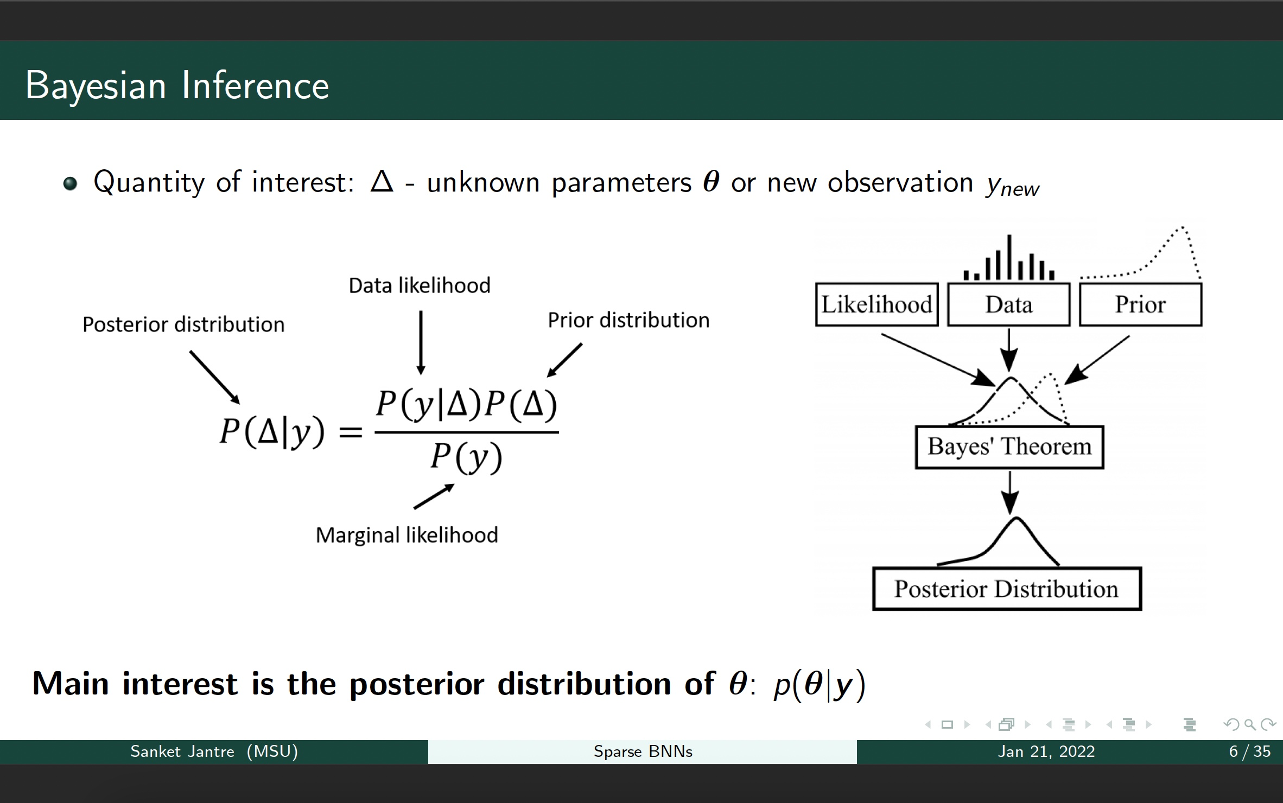

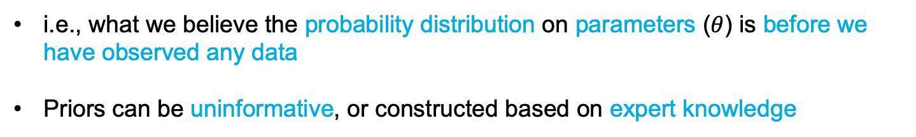
Parameter Estimation via Bayesian Inference
Determining the most likely values of unknown parameters in a probabilistic model given observed data via Bayes’ theorem
Prior distribution
PDF
$$θ$$
i.e., what we believe the probability distribution on parameters ($θ$) is before we have observed any data
Priors can be uninformative, or constructed based on expert knowledge

Slide 8

Parameter Estimation via Bayesian Inference
Determining the most likely values of unknown parameters in a probabilistic model given observed data via Bayes’ theorem
Marginal likelihood
PDF
$$y$$
i.e., “the evidence.” It acts as a normalization factor to ensure that the posterior distribution integrates to 1
In practical inference algorithms, the evidence is ignored because we have methods for sampling the posterior directly given the likelihood and prior

Slide 9
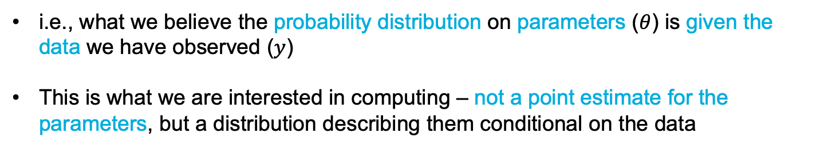
Parameter Estimation via Bayesian Inference
Determining the most likely values of unknown parameters in a probabilistic model given observed data via Bayes’ theorem
Posterior distribution
PDF
$$θ$$
i.e., what we believe the probability distribution on parameters ($θ$) is given the data we have observed ($y$)
This is what we are interested in computing – not a point estimate for the parameters, but a distribution describing them conditional on the data

Slide 10
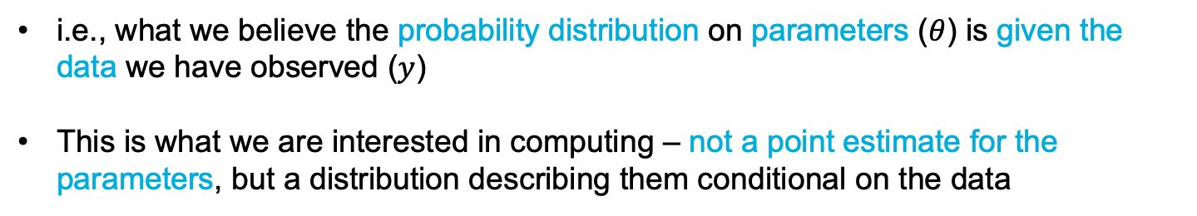
Parameter Estimation via Bayesian Inference
Determining the most likely values of unknown parameters in a probabilistic model given observed data via Bayes’ theorem
Posterior distribution
PDF
$$θ$$
i.e., what we believe the probability distribution on parameters ($θ$) is given the data we have observed ($y$)
This is what we are interested in computing – not a point estimate for the parameters, but a distribution describing them conditional on the data
Bayesian inference provides a formalism for calibrating a computer model to data and is the basis of optimal experimental design
(see Lucy’s talk for ongoing work applying this to Booster)

Slide 11
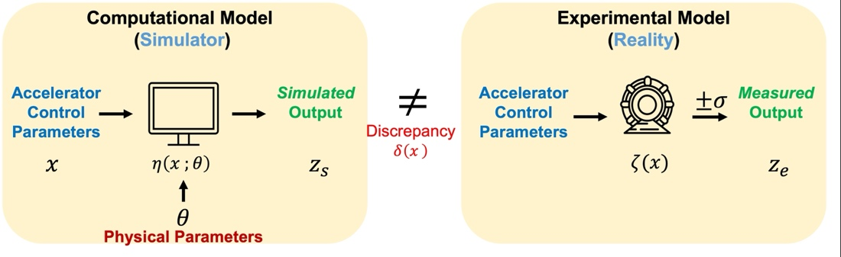
Bayesian Model Calibration for Accelerators
Use Bayesian Inference to calibrate our computer model to real data for more accurate predictions
There’s no point in optimizing a model if it doesn’t represent reality sufficiently well!
Sources of Uncertainty
Physical parameters (e.g., magnet misalignment)
Model structure (what physics is/isn’t modeled?)
For large number of uncertain parameters, sensitivity analysis can help reduce to key parameters
Sources of Uncertainty
Measurement error (not necessarily standard noise filtering)
Imperfect design actualization
Kennedy, M. C., & O'Hagan, A. (2001). Bayesian calibration of computer models. Journal of the Royal Statistical Society: Series B (Statistical Methodology).
Brynjarsdóttir, J., & OʼHagan, A. (2014). Learning about physical parameters: The importance of model discrepancy. Inverse problems.

Slide 12
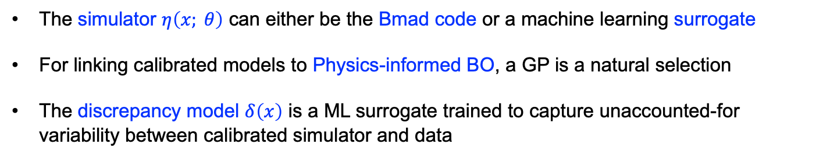
Bayesian Model Calibration for Accelerators
The simulator $η\left(x; θ\right)$ can either be the Bmad code or a machine learning surrogate
For linking calibrated models to Physics-informed BO, a GP is a natural selection
The discrepancy model $δ\left(x\right)$ is a ML surrogate trained to capture unaccounted-for variability between calibrated simulator and data
Kennedy, M. C., & O'Hagan, A. (2001). Bayesian calibration of computer models. Journal of the Royal Statistical Society: Series B (Statistical Methodology).
Brynjarsdóttir, J., & OʼHagan, A. (2014). Learning about physical parameters: The importance of model discrepancy. Inverse problems.

Slide 13
Bayesian Model Calibration for Accelerators
Modeling assumption: reality can be represented by linear combination of a calibrated simulator and a discrepancy term
calibrated simulator
discrepancy model
Balance model fit between calibration and discrepancy
$$ζ\left(x\right) = η\left(x; θ\right) + δ\left(x\right)$$

Slide 14
Bayesian Model Calibration for Accelerators
Modeling assumption: experimental observation can be represented by linear combination of a calibrated simulator, a discrepancy term, and measurement error
Calibrated Accelerator Model(s) for Linac, Booster, AGS
$$z_{e} = η\left(x; θ\right) + δ\left(x\right) +ε$$
$$ε ∼ N\left(0, σ^{2}\right)$$

Slide 15
Bayesian Optimal Experimental Design
Determining the experimental setting/design (e.g., currents) that maximize information gained about uncertain model parameters
Driven by model improvement – what data should I collect in the experiment to most reduce uncertainty about my model?
Alternative would be to identify experimental setting that minimizes uncertainty in a model prediction (e.g., polarization)
Synergy with Bayesian Optimization
  Utilize BOED to reduce uncertainty in simulator/GP surrogate
  Utilize BO in outer loop to identify which currents to explore in BOED (would need to use a variational approach to inference as opposed to full MCMC)

Slide 16
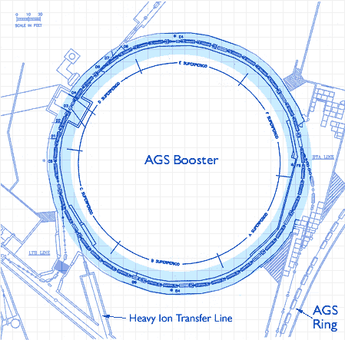

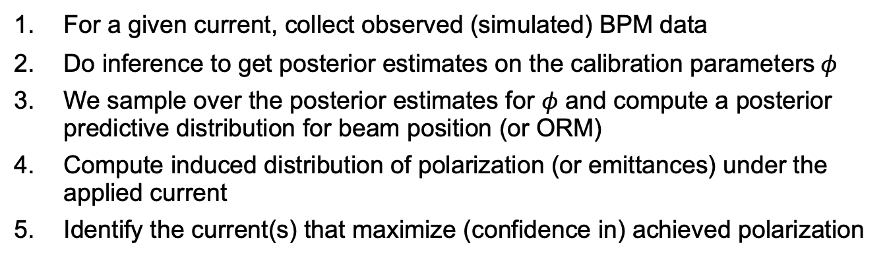


Booster Example
Calibration parameters: $φ$
(See Lucy’s presentation for more)
Observed data: $X_{BPM}$
Control settings: $I$
Currents (I) are controls; therefore, they are treated differently than calibration parameters
We may choose to use a surrogate model (NN), a calibrated discrepancy model, or directly use the simulator
Procedure:
For a given current, collect observed (simulated) BPM data
Do inference to get posterior estimates on the calibration parameters$φ$
We sample over the posterior estimates for $φ$ and compute a posterior predictive distribution for beam position (or ORM)
Compute induced distribution of polarization (or emittances) under the applied current
Identify the current(s) that maximize (confidence in) achieved polarization
Why is this useful?
Instead of a point-estimates of the beam, we get a probabilistic description of what polarization it will have given a specific set of currents
Notes:
In the case of a calibrated disc. Model, every iteration is like a model update because the calibrated model will change with each posterior update…a NN or simulator would not

Slide 17
Questions for UQ in the Booster Study
Determining the calibration parameters
Determining prior probability distributions for these parameters
Residual analysis between model and experimental data to determine a form for the likelihood function
A least-squares point estimate for calibration parameters could be useful to acquire before estimating posteriors
…

Slide 18
UQ for Linac and AGS and beyond
Special considerations for applying UQ and OED to these systems? Anyone see opportunities for their application area?
How can we tractably optimize polarization simultaneously across the whole pre-accelerator chain? Sequential modular approach?
  The proposal is split up into applications for maximizing polarization that seem to span multiple elements of the chain (e.g., transverse emittance in Booster depends on alignment with trajectory of beam from Linac)
  Its possible that not considering these as a joined system will decrease the overall polarization improvement
…

