Slide 1
Accurate accelerator models for Booster and AGS
Lucy Lin
ML Collaboration Meeting on polarization improvement
August 25, 2023

Slide 2
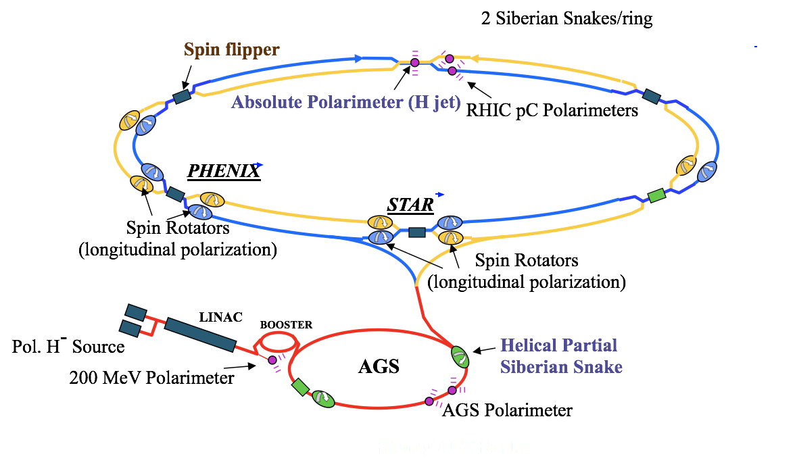
RHIC site map
Injector Compound

Slide 3
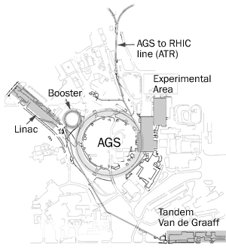

Alternating Gradient Synchrotron (AGS)
Alternating gradient / strong focusing principle: achieve strong vertical and horizontal focusing of charged particle beam at the same time
Accelerates proton to 33 GeV in 1960
12 super-periods (A to L), 240 main magnets, 810 m circumference
Now serves as injector for Relativistic Heavy Ion Collider (RHIC)

Slide 4
AGS lattice by element type in Bmad
AGS main lattice
conversions
elements
bumps
rbends
straights
correctors
bpms
quads
sexts
snakes
extraction
cavity

Slide 5
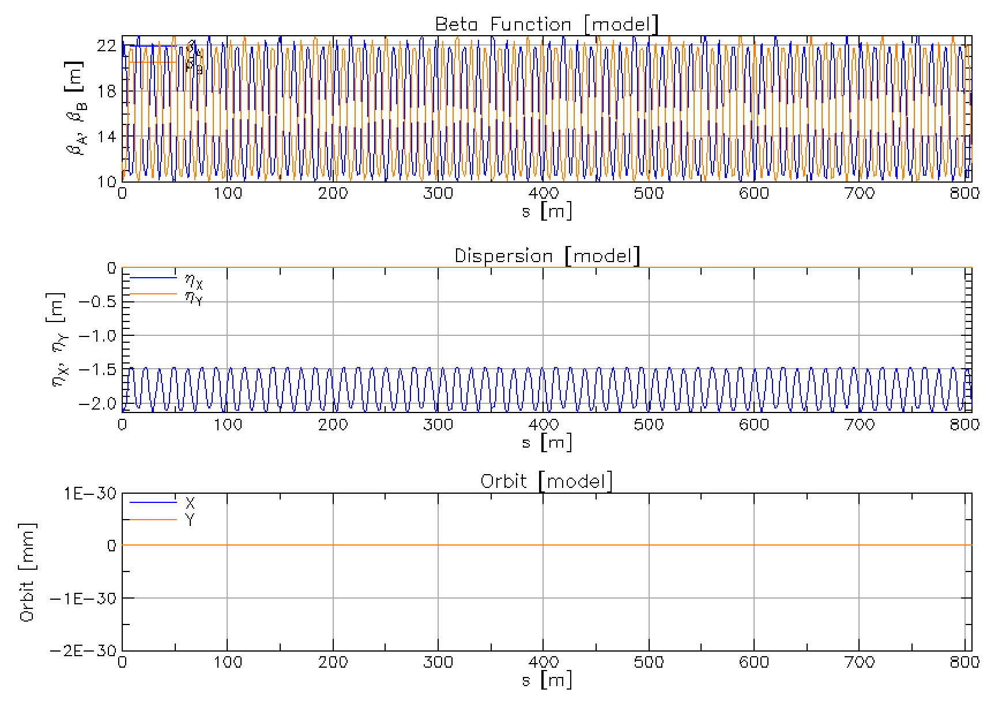
Bare machine in Bmad

Slide 6
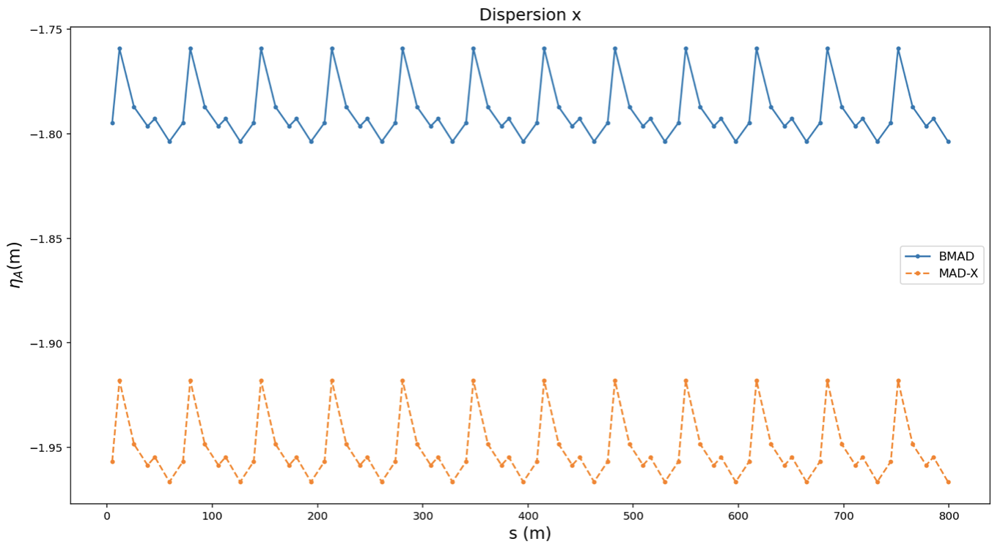
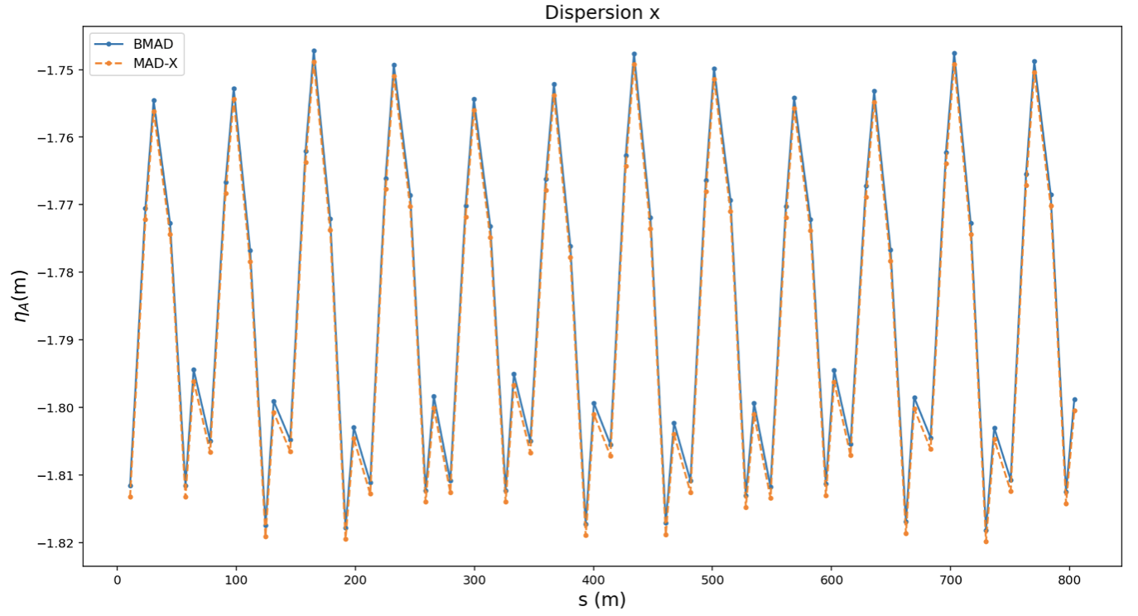





Note: difference in dispersion
Agree only when $γ≫1$
MAD-X: $z=−c∆t\left(s\right), P_{z}=\frac{∆E}{E_{0}}$
BMAD: $z=−β\left(s\right)c∆t\left(s\right), P_{z}=\frac{∆P}{P_{0}}$
$$γ=2.51$$
$$γ=23.2$$

Slide 7
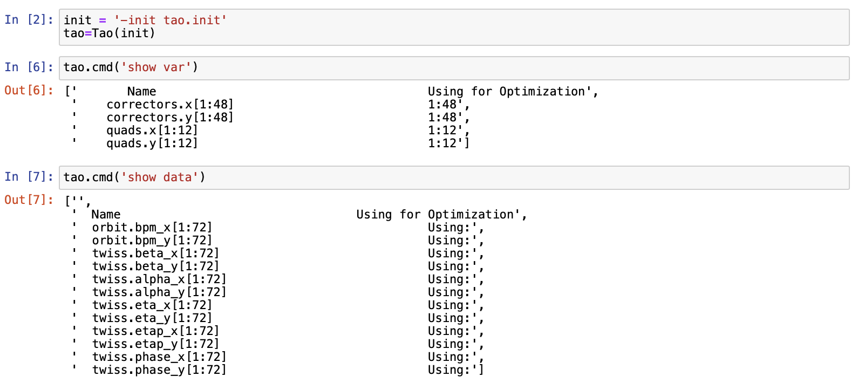
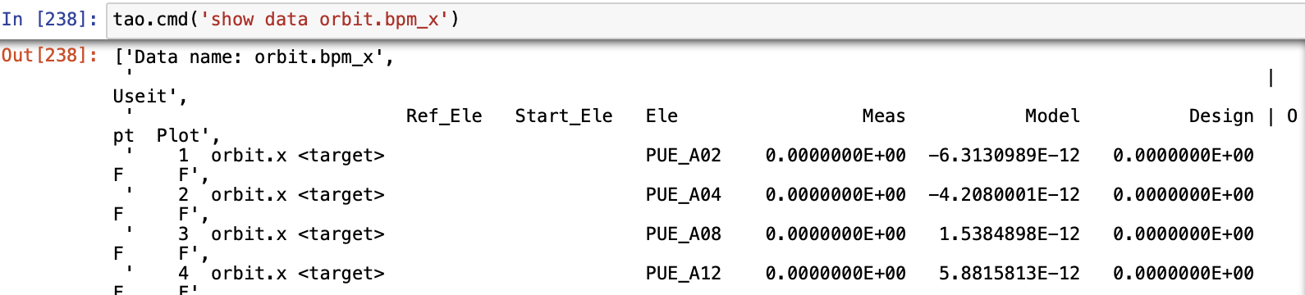
Python interface: PyTao

Slide 8
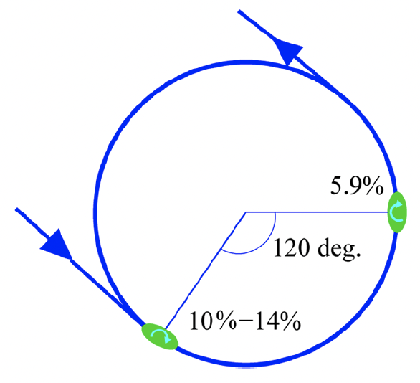
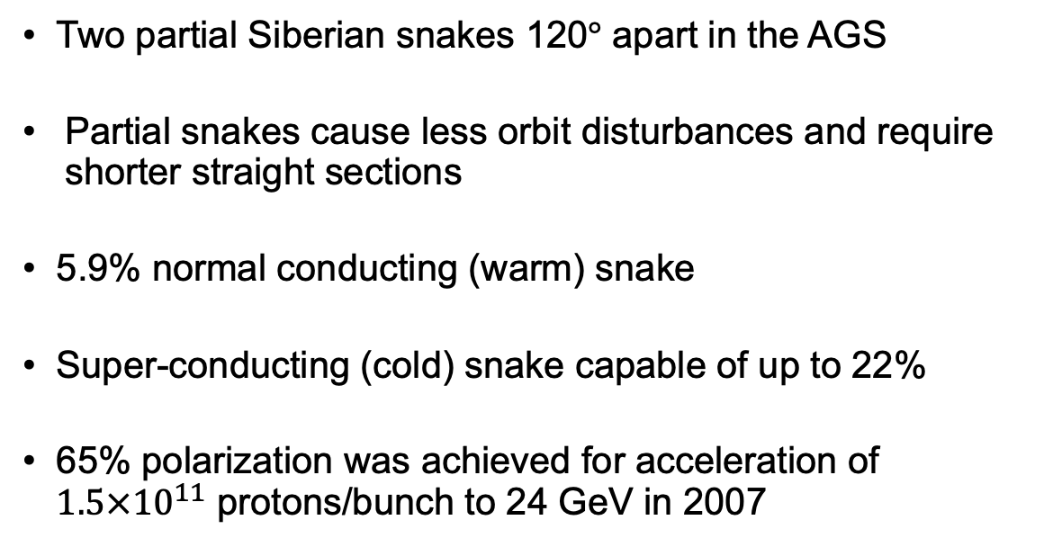
Siberian Snake in the AGS
Two partial Siberian snakes 120$°$ apart in the AGS
Partial snakes cause less orbit disturbances and require shorter straight sections
5.9% normal conducting (warm) snake
Super-conducting (cold) snake capable of up to 22%
65% polarization was achieved for acceleration of $1.5×{10}^{11}$ protons/bunch to 24 GeV in 2007

Slide 9
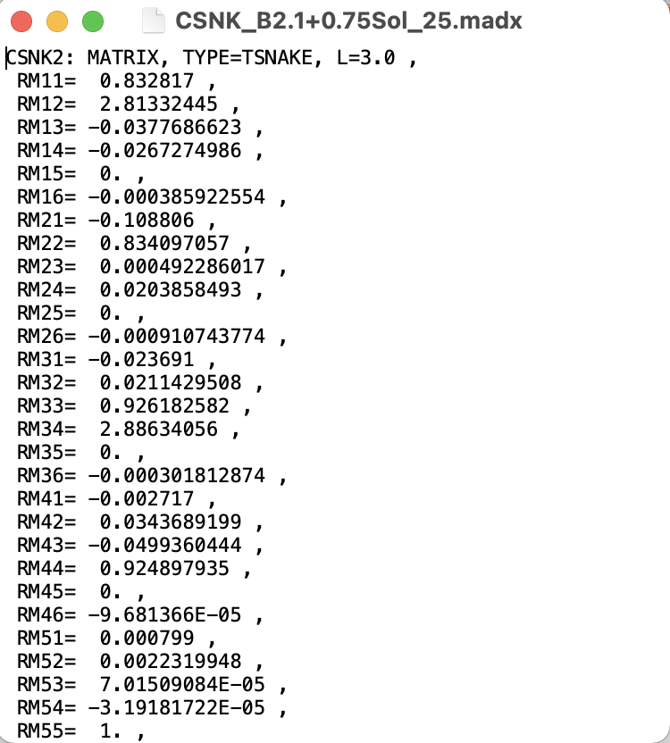
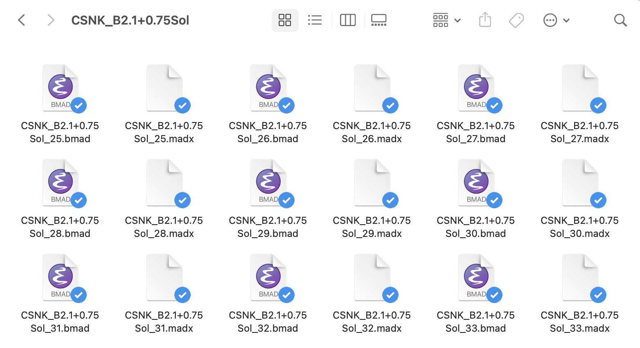
AGS Snakes in MAD-X
MAD-X: call matrix file with closest gamma value, non-physical jumps, no spin tracking

Slide 10
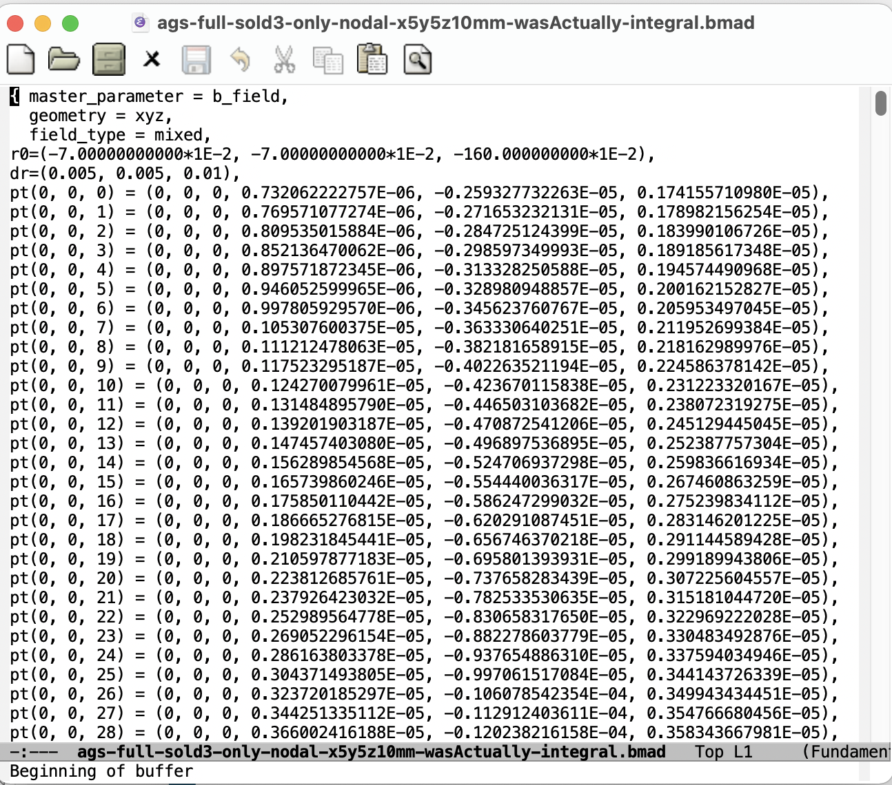
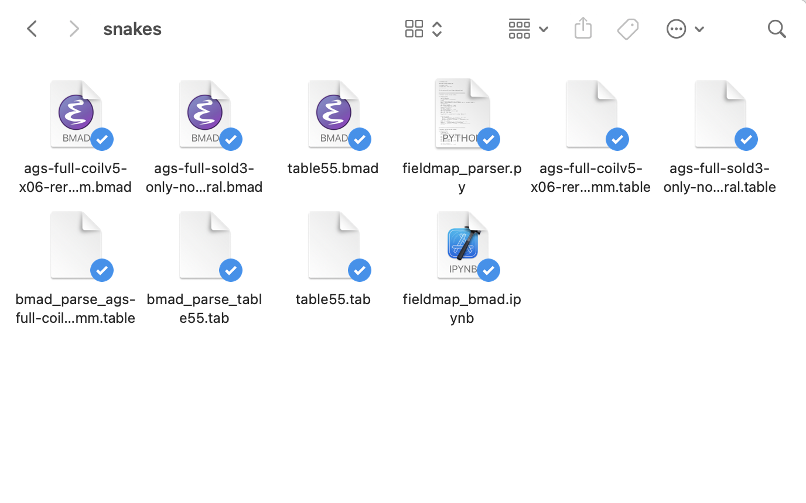
AGS Snakes in Zgoubi
Bmad can use grid fieldmap files like in Zgoubi, but fieldmap files are very large, tracking takes longer

Slide 11

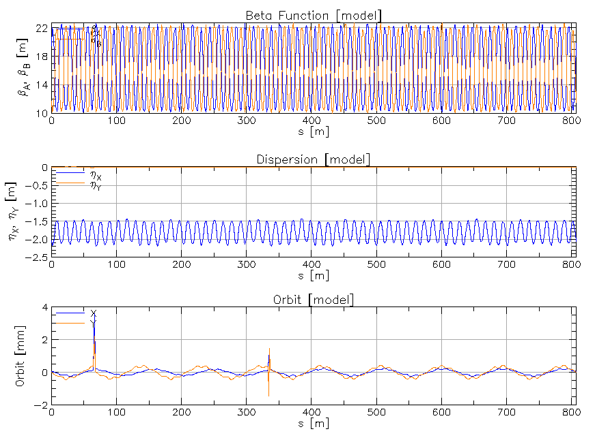
Closed orbit in Bmad with grid snakes
Reasonable orbit distortions for two snakes
Need to adjust closed orbit absolute tolerance from 1e-11 to bigger than 1e-8 to get convergence

Slide 12
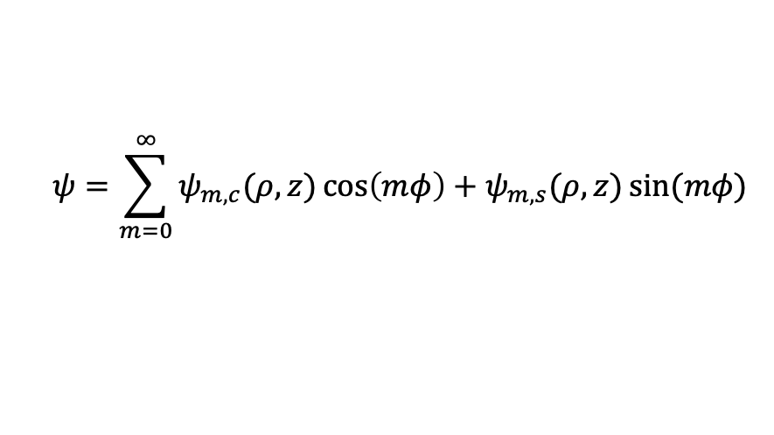
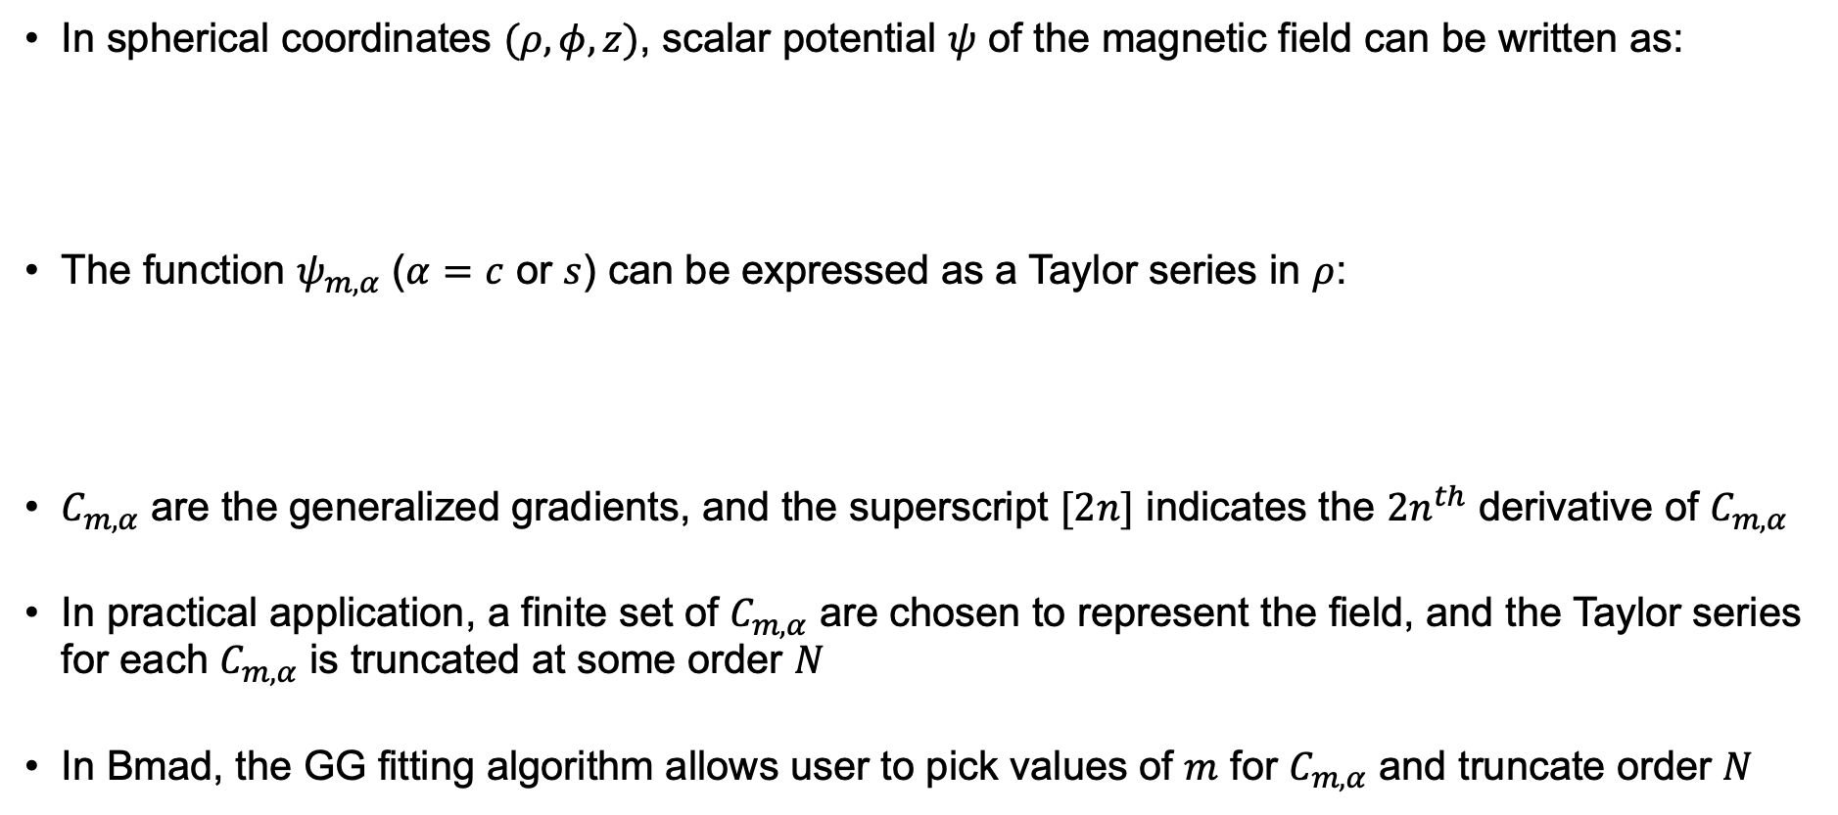
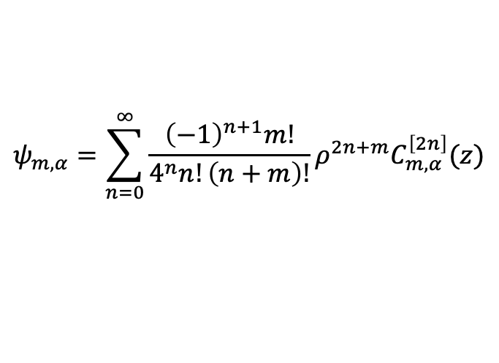
Generalized Gradient (GG)
In spherical coordinates $(ρ,φ,z)$, scalar potential $ψ$ of the magnetic field can be written as:
The function $ψ_{m,α}$ ($α=c$ or $s$) can be expressed as a Taylor series in $ρ$:
$C_{m,α}$ are the generalized gradients, and the superscript $[2n]$ indicates the ${2n}^{th}$ derivative of $C_{m,α}$
In practical application, a finite set of $C_{m,α}$ are chosen to represent the field, and the Taylor series for each $C_{m,α}$ is truncated at some order $N$
In Bmad, the GG fitting algorithm allows user to pick values of $m$ for $C_{m,α}$ and truncate order $N$
$$ψ=\sum_{m=0}^{∞}{ψ_{m, c}(ρ,z)\cos\left(mφ\right)+ψ_{m,s}(ρ,z)\sin{(mφ)} }$$
$$ψ_{m,α}=\sum_{n=0}^{∞}{\frac{{\left(−1\right)}^{n+1}m!}{4^{n}n!\left(n+m\right)!}ρ^{2n+m}C_{m,α}^{\left[2n\right]}(z)}$$

Slide 13
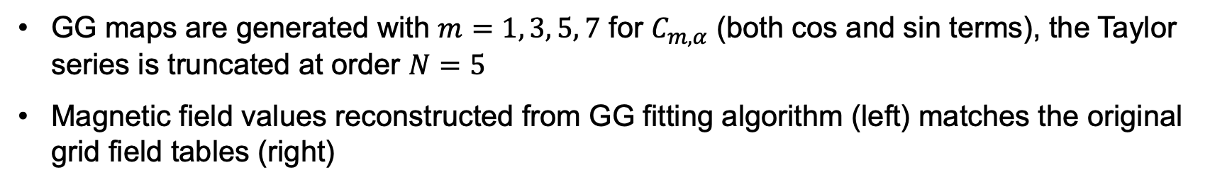
GG tracking results: magnetic field
GG maps are generated with $m=1, 3, 5, 7$ for $C_{m,α}$ (both cos and sin terms), the Taylor series is truncated at order $N=5$
Magnetic field values reconstructed from GG fitting algorithm (left) matches the original grid field tables (right)

Slide 14
GG tracking results: twiss & orbit
GG map (left) produces accurate beta function and orbit tracking results compared to grid field table (right)
GG map
Grid table

Slide 15
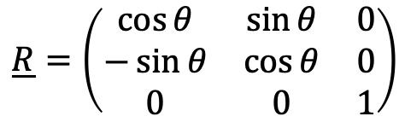
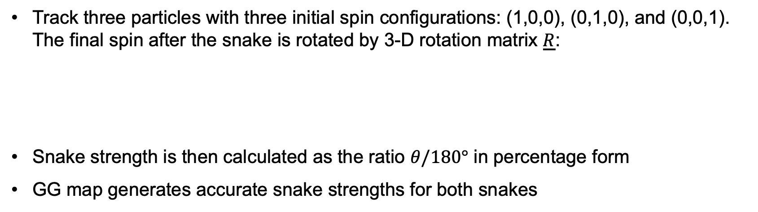
GG tracking results: snake strength
Track three particles with three initial spin configurations: (1,0,0), (0,1,0), and (0,0,1). The final spin after the snake is rotated by 3-D rotation matrix $\underline{R}$:
Snake strength is then calculated as the ratio $θ/180°$ in percentage form
GG map generates accurate snake strengths for both snakes
$$\underline{R}=\left(\begin{matrix}\cos{θ} & \sin{θ} & 0 \\ −\sin{θ} & \cos{θ} & 0 \\ 0 & 0 & 1\end{matrix}\right)$$
AGS Snake Strength Calculation Results
Snake | GG map | Grid table
Warm | 5.9% | 5.86%
Cold | 11.4% | 11.4%

Slide 16
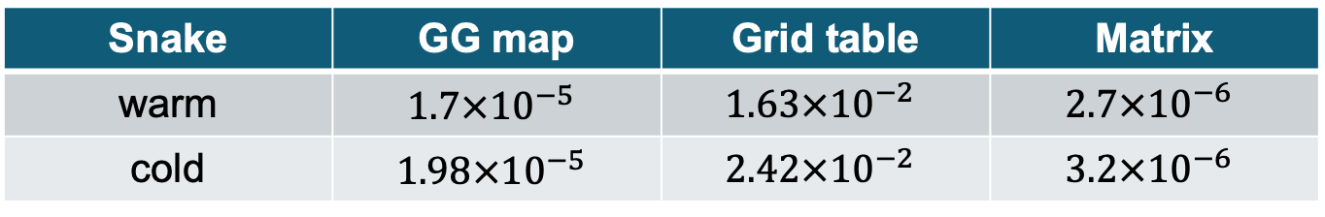
GG tracking results: tracking time
Compare three tracking methods:
  Taylor map tracking derived from GG field map
  Runge-Kutta tracking using grid table
  Tracking using matrices generated for specific current and energy settings (traditional way for MAD simulation)
GG maps are 1000 times faster than grid table, matrix generated at prefixed energy is fastest but has no spin rotation simulation
AGS Snakes Tracking Times (sec)
Snake | GG map | Grid table | Matrix
warm | $$1.7×{10}^{−5}$$ | $$1.63×{10}^{−2}$$ | $$2.7×{10}^{−6}$$
cold | $$1.98×{10}^{−5}$$ | $$2.42×{10}^{−2}$$ | $$3.2×{10}^{−6}$$

Slide 17
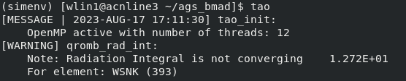
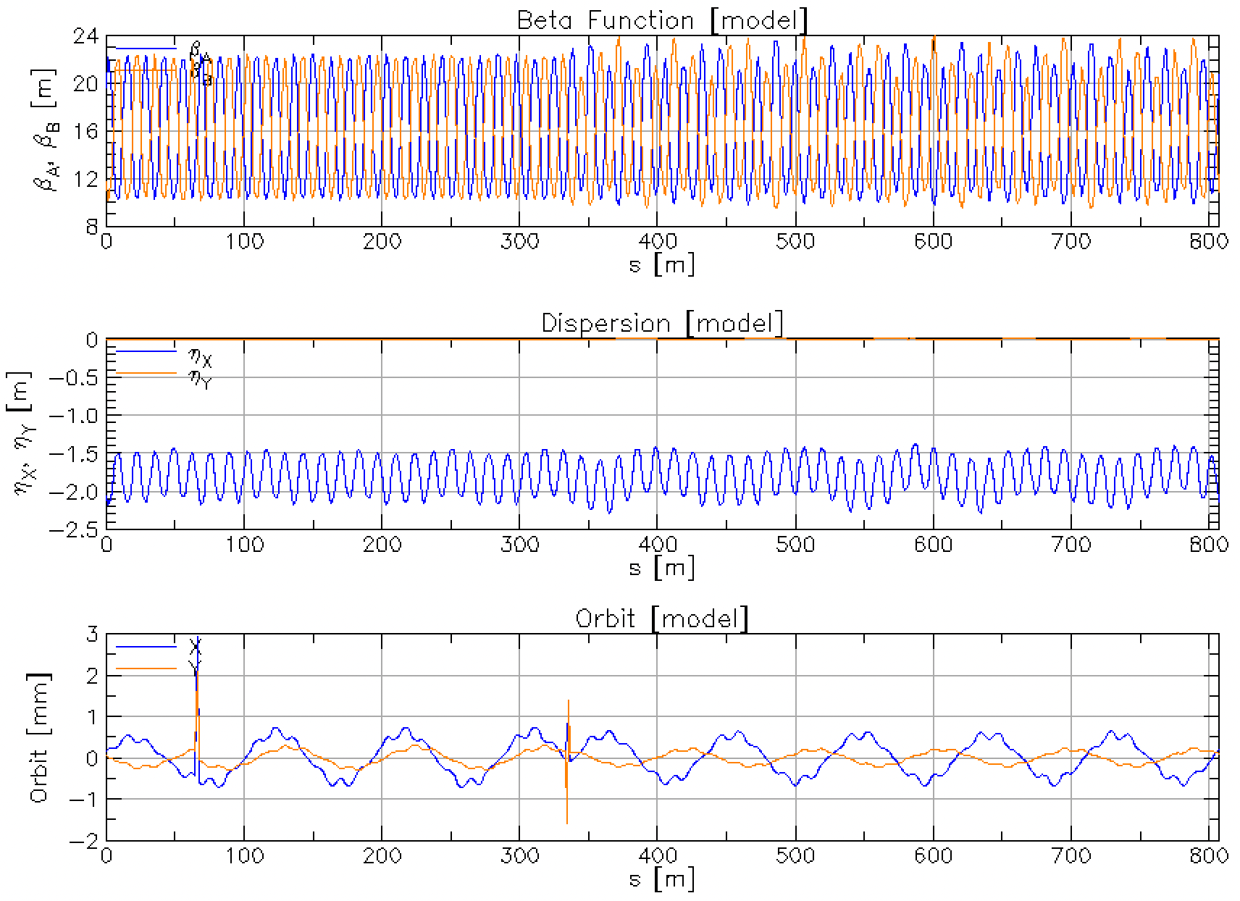
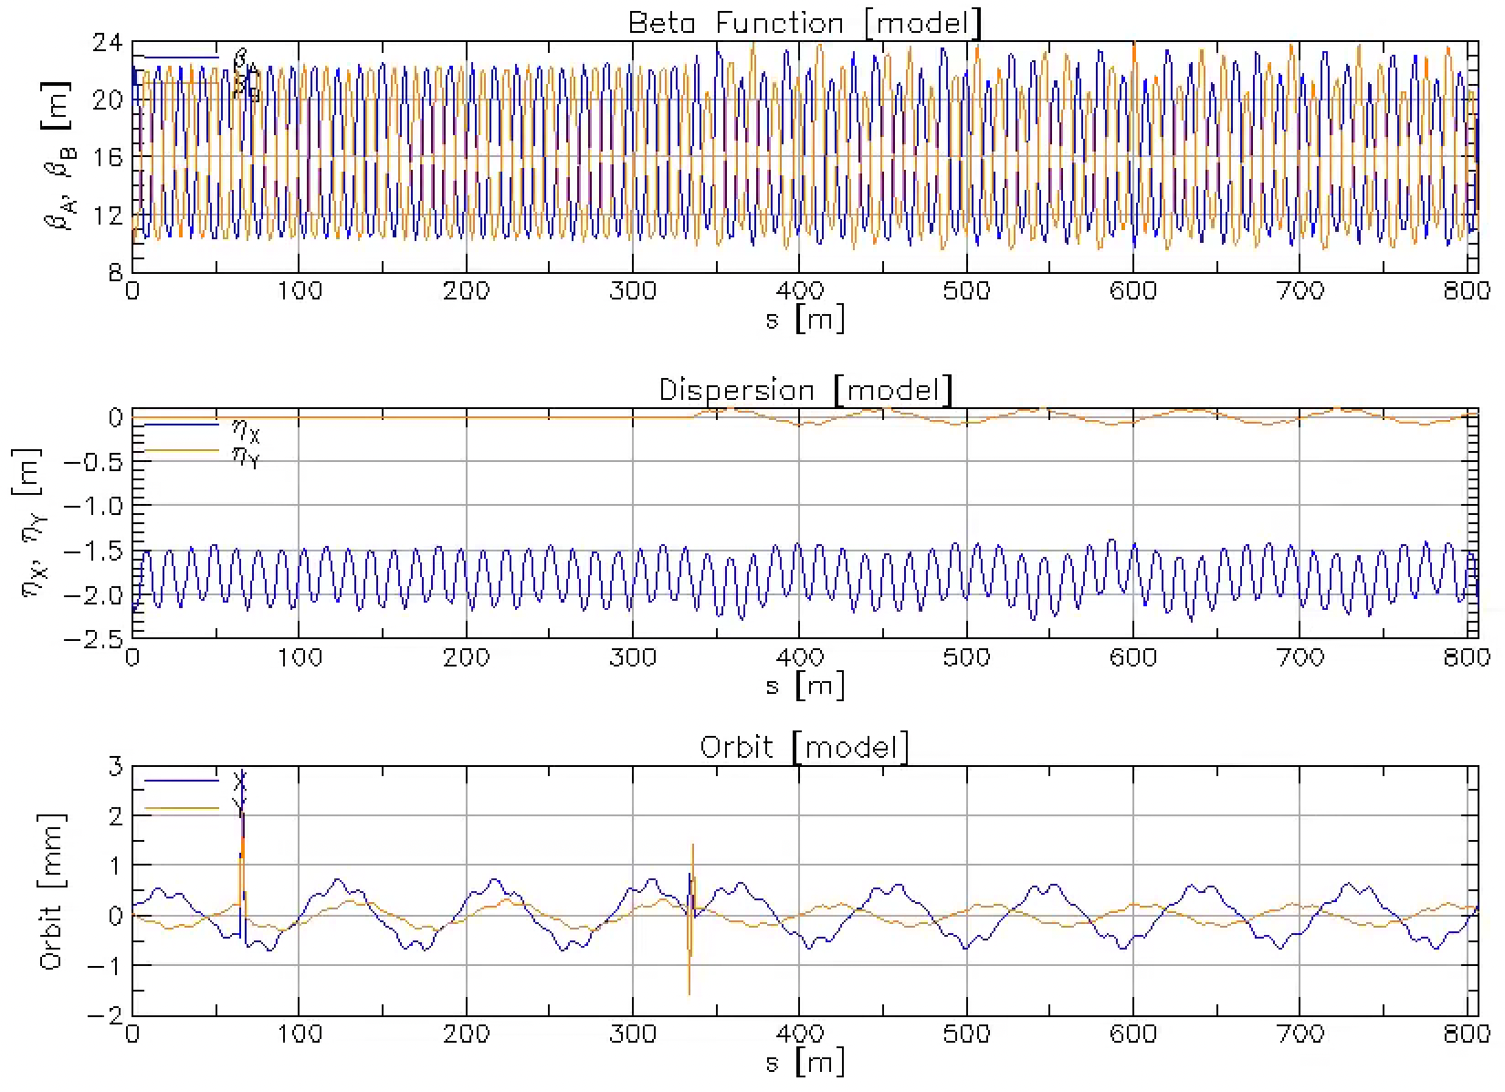
Closed orbit in Bmad with GG snakes
Horizontal orbit & beta slightly different from grid maps
Radiation integral not converging, symplectic errors
Snake symplectify = F
Snake symplectify = T

Slide 18
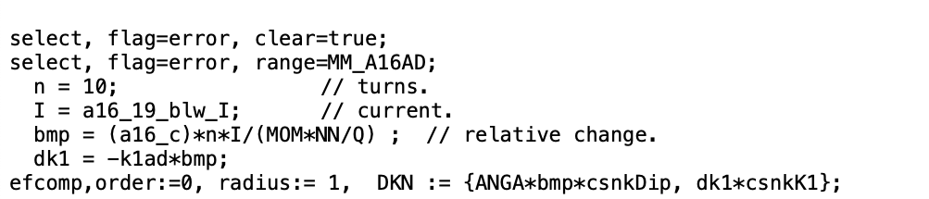
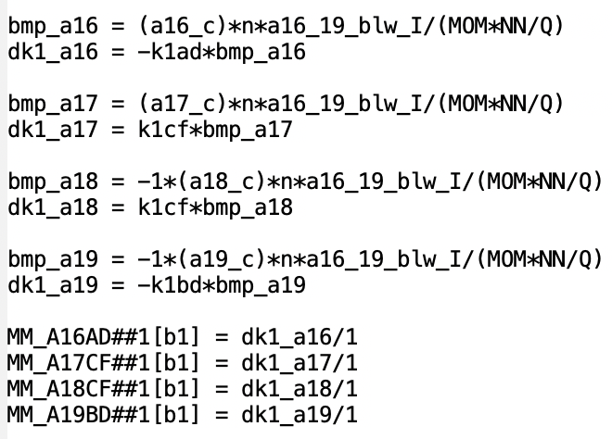
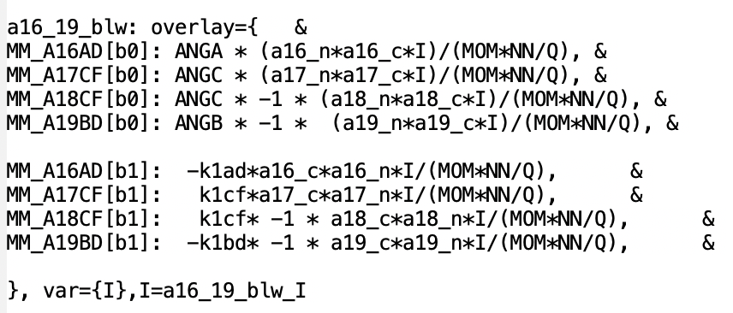
Bumps in the AGS
MAD-X: efcomp
Bumps are added in MAD-X as field errors using EFCOMP
Can be added in Bmad to b0, b1,… components of magnets as field errors or as overlays
Using overlays can make bump currents variables for optimization
Bmad: field error
Bmad: overlay

Slide 19
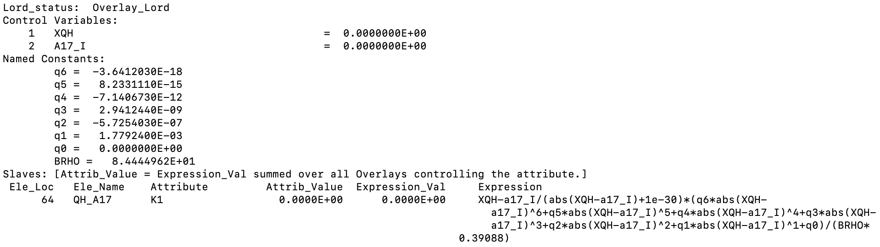

Magnets with multiple power supplies
Can use overlay in Bmad for magnets (tune quads etc.) with multiple power supplies

Slide 20
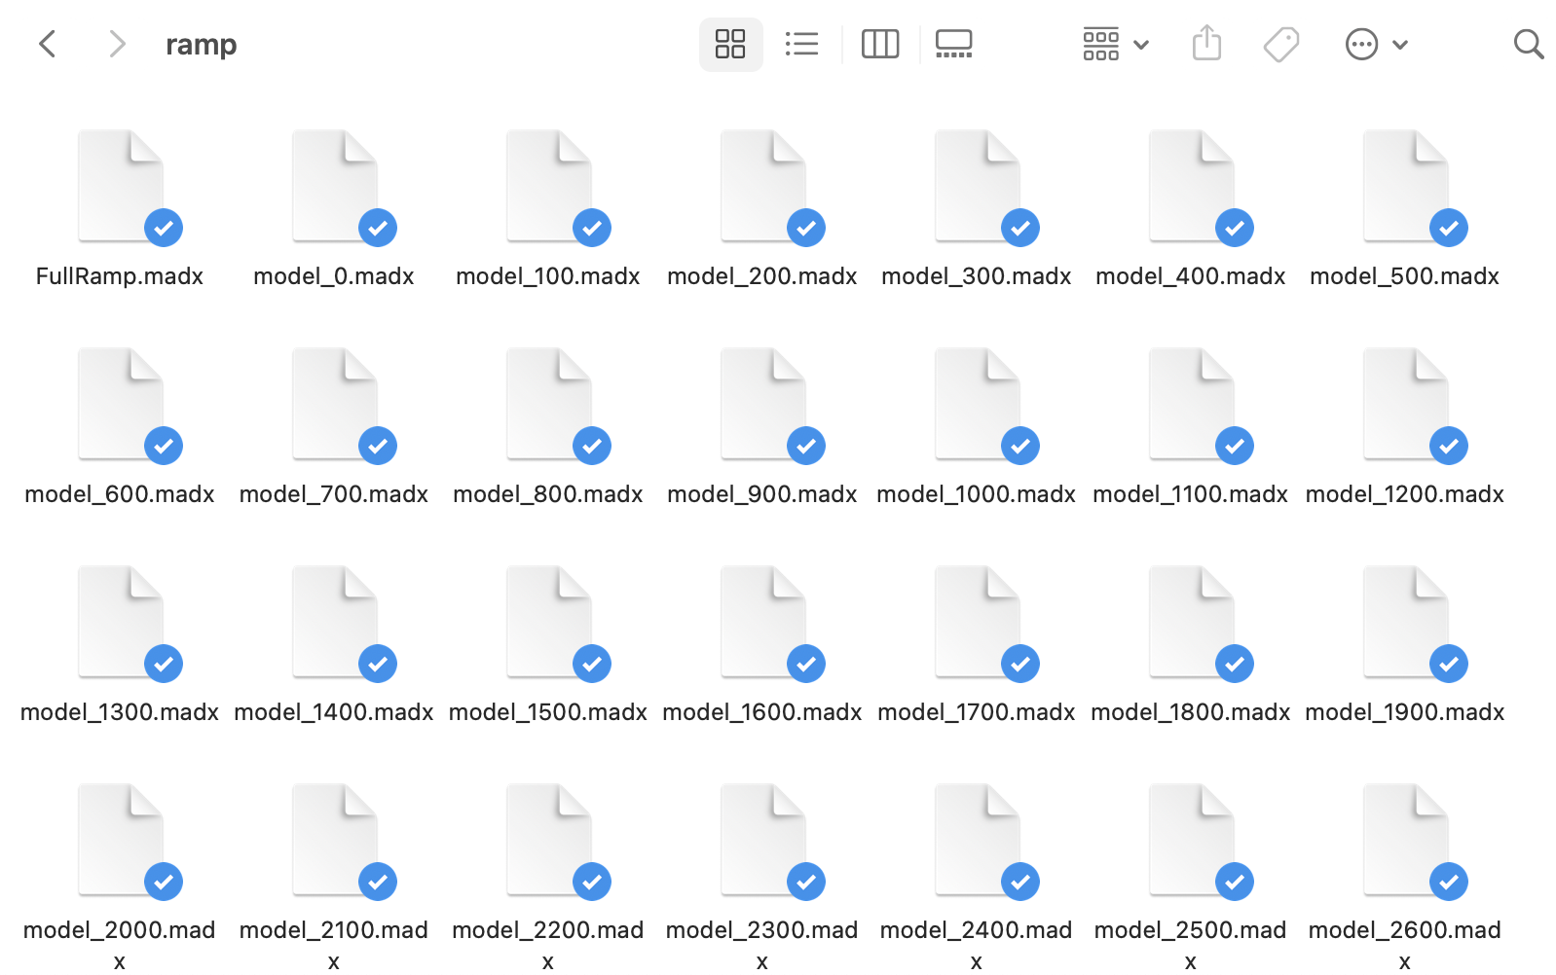
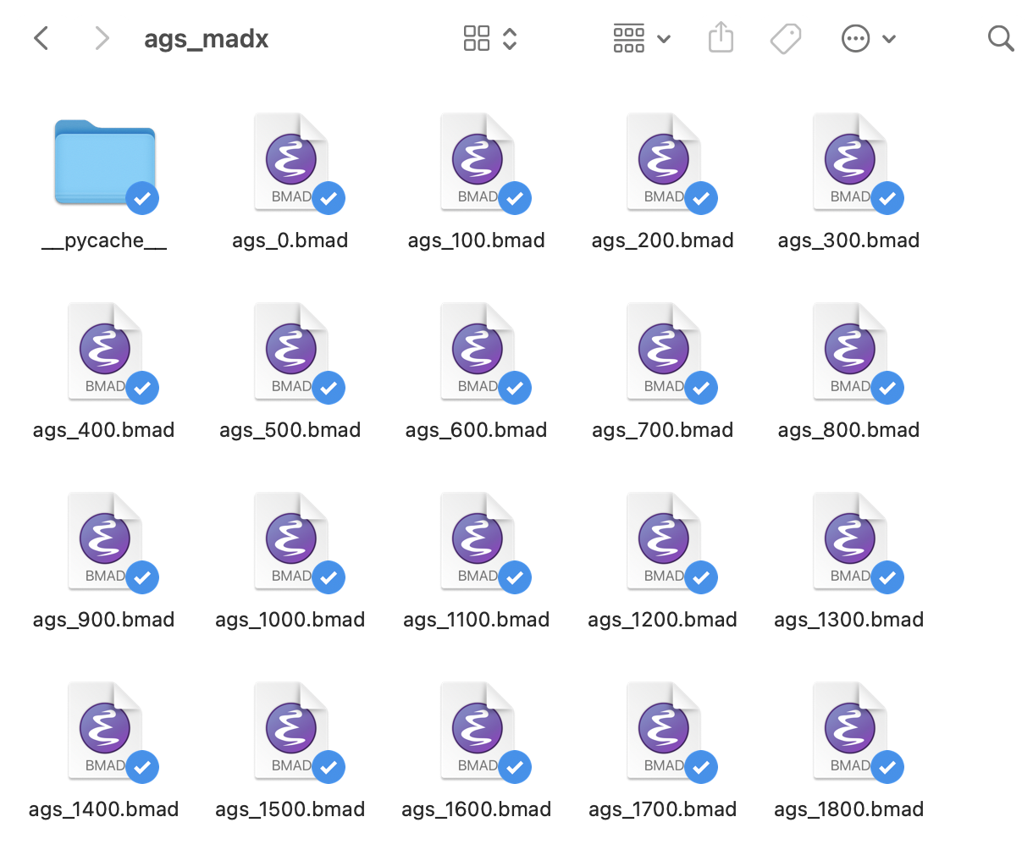
To do: AGS ramping
MAD-X: cmd line tool to produce lattice files and twiss results at different time stamps (snap ramps)
Bmad: can create scripts to do the same, or consider dynamic ramping

Slide 21
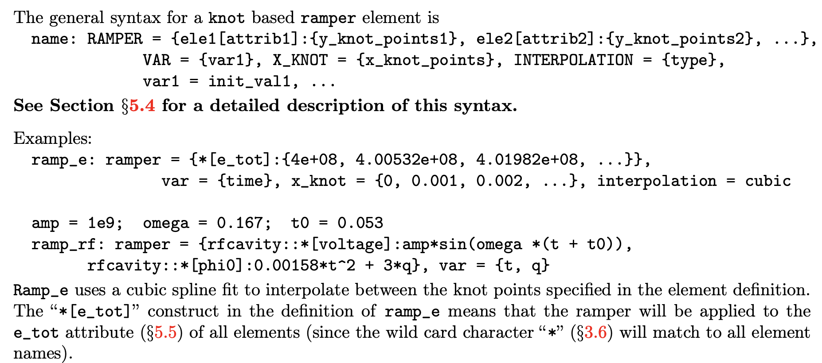
To do: AGS ramping
Possible solution for dynamic ramping with particle tracking: use ramper in Bmad to vary magnet strengths as a function of time
Difficulty: need to put in transfer function polynomials for all magnets

Slide 22
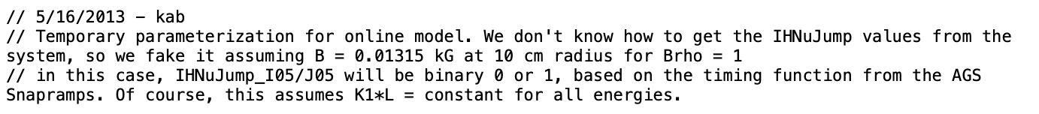
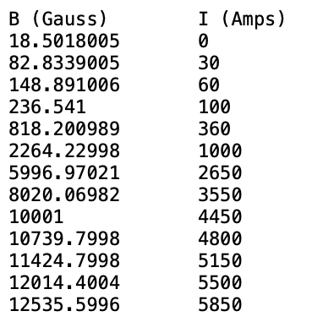
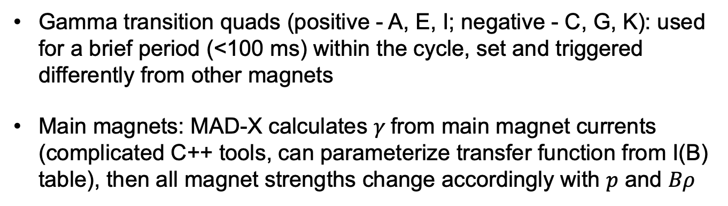
To do: special magnets
Horizontal tune jump quads (I05, J05): pulse intermittently during the acceleration ramp, MAD-X checks on/off state with binary variable (1 if on, 0 if off), assume ideally powered, fixed in strength
Gamma transition quads (positive - A, E, I; negative - C, G, K): used for a brief period (<100 ms) within the cycle, set and triggered differently from other magnets
Main magnets: MAD-X calculates $γ$from main magnet currents (complicated C++ tools, can parameterize transfer function from I(B) table), then all magnet strengths change accordingly with $p$ and $Bρ$
Main Magnet I to B

Slide 23
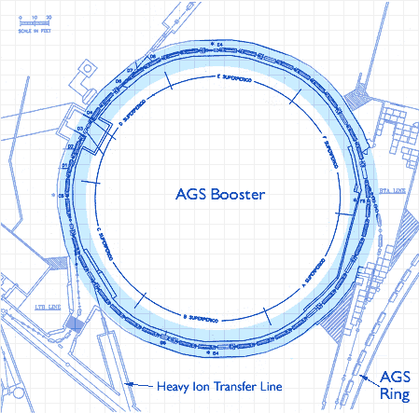
Alternating Gradient Synchrotron (AGS) Booster
Pre-accelerate particles entering the AGS ring
Accepts heavy ions from EBIS or protons from 200 MeV Linac
Serves as heavy ion source for NASA Space Radiation Laboratory (NSRL)
6 super-periods (A to F), 72 main magnets

Slide 24
Booster lattice by element type in Bmad
Booster main lattice
conversions
elements
bumps
sbends
straights
correctors
bpms
quads
sexts
injection, extraction, sublines
cavity

Slide 25
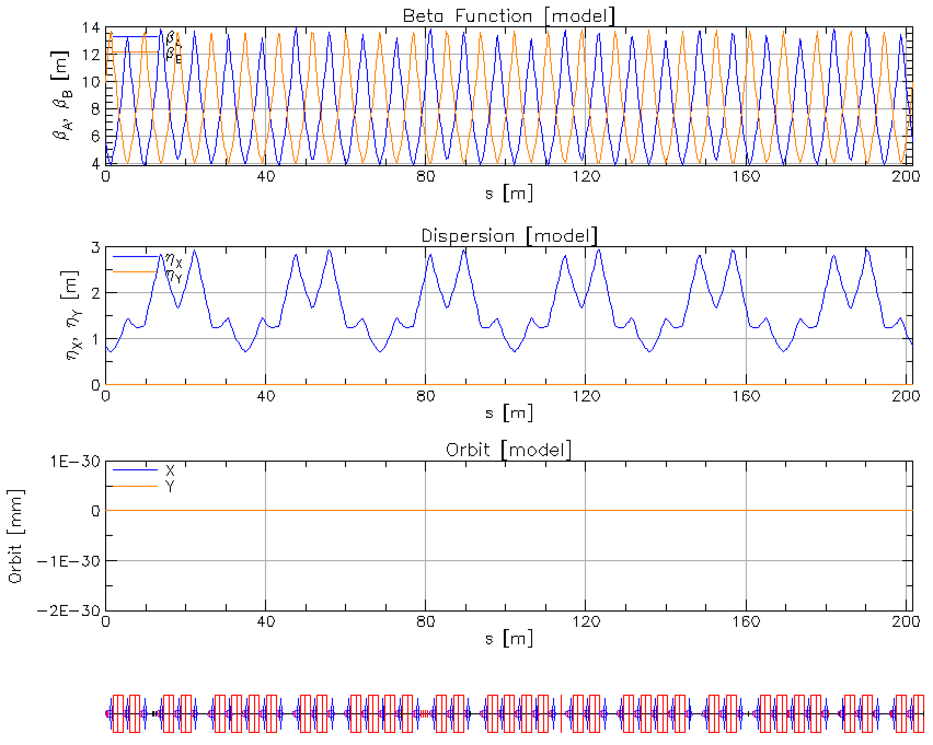
Bare machine in Bmad

Slide 26
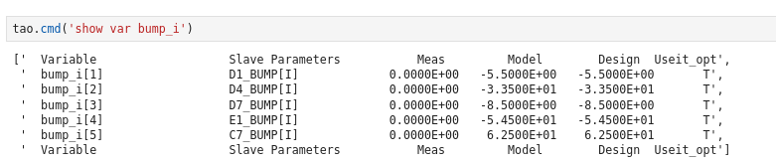
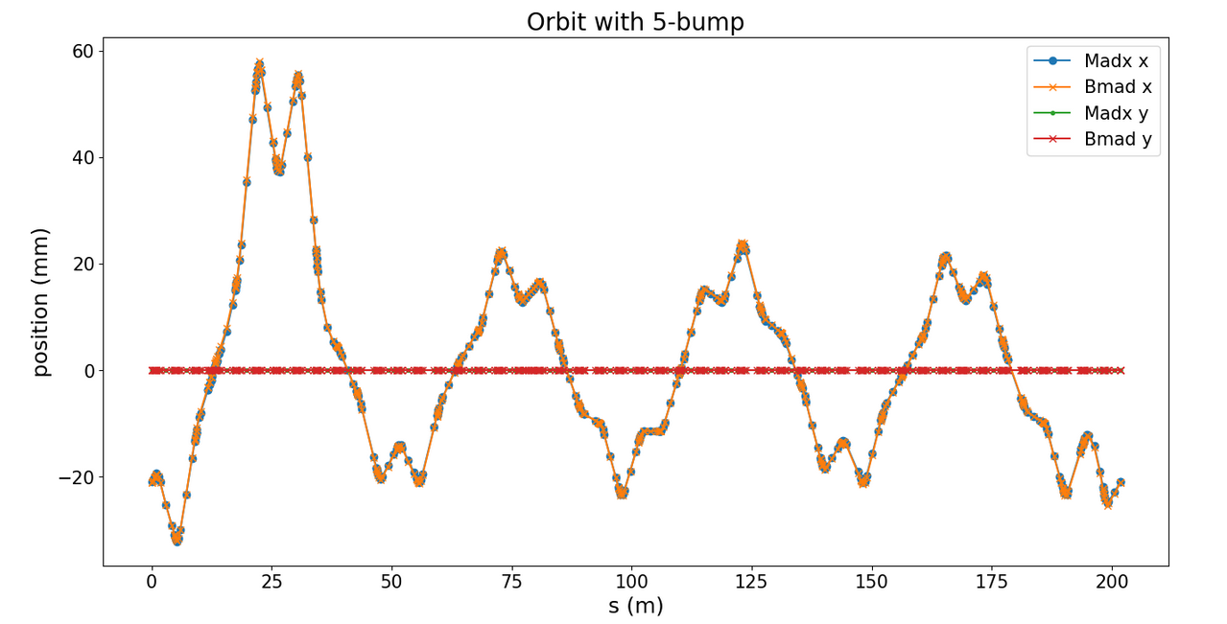
Bumps in the Booster
5-bump in Booster for slow extraction: C7, D1, D4, D7, E1
Tested adding as overlays in Bmad and agreed with MAD-X tracking results

Slide 27
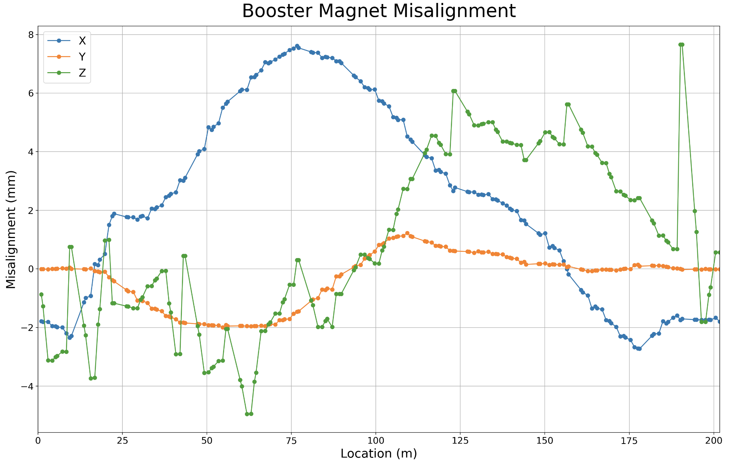
Booster magnet misalignment
Girder location in real machine from 2015 survey data
Translate to misalignment data for quadrupoles (BPMs share same misalignment as quads) and dipoles

Slide 28
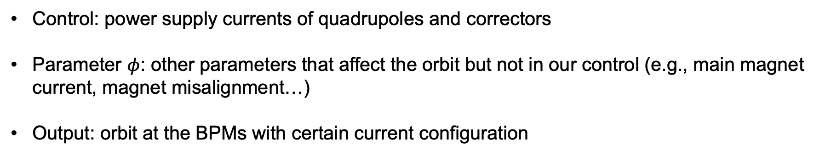
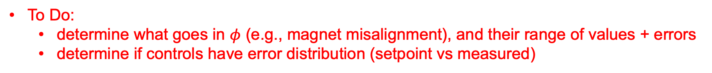
Booster orbit response mapping
$$\left(I_{quad},I_{corr},φ\right)⟺\left(X_{BPM}^{(I_{quad}^{\left(1\right)},{ I}_{corr}^{\left(1\right)},{ φ}^{(1)})},{ X}_{BPM}^{(I_{quad}^{\left(2\right)},{ I}_{corr}^{\left(2\right)},{ φ}^{(2)})},⋯\right)$$
Control: power supply currents of quadrupoles and correctors
Parameter $φ$: other parameters that affect the orbit but not in our control (e.g., main magnet current, magnet misalignment…)
Output: orbit at the BPMs with certain current configuration
To Do:
  determine what goes in $φ$ (e.g., magnet misalignment), and their range of values + errors
  determine if controls have error distribution (setpoint vs measured)

Slide 29
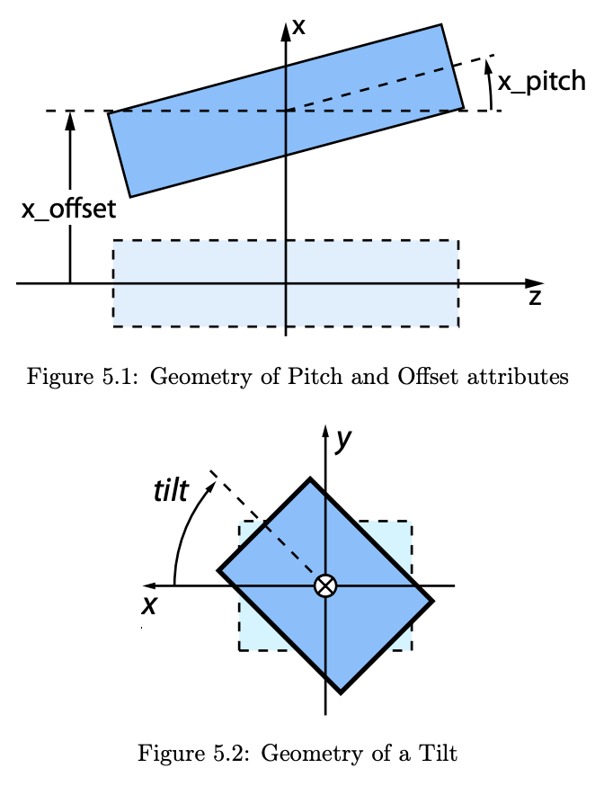
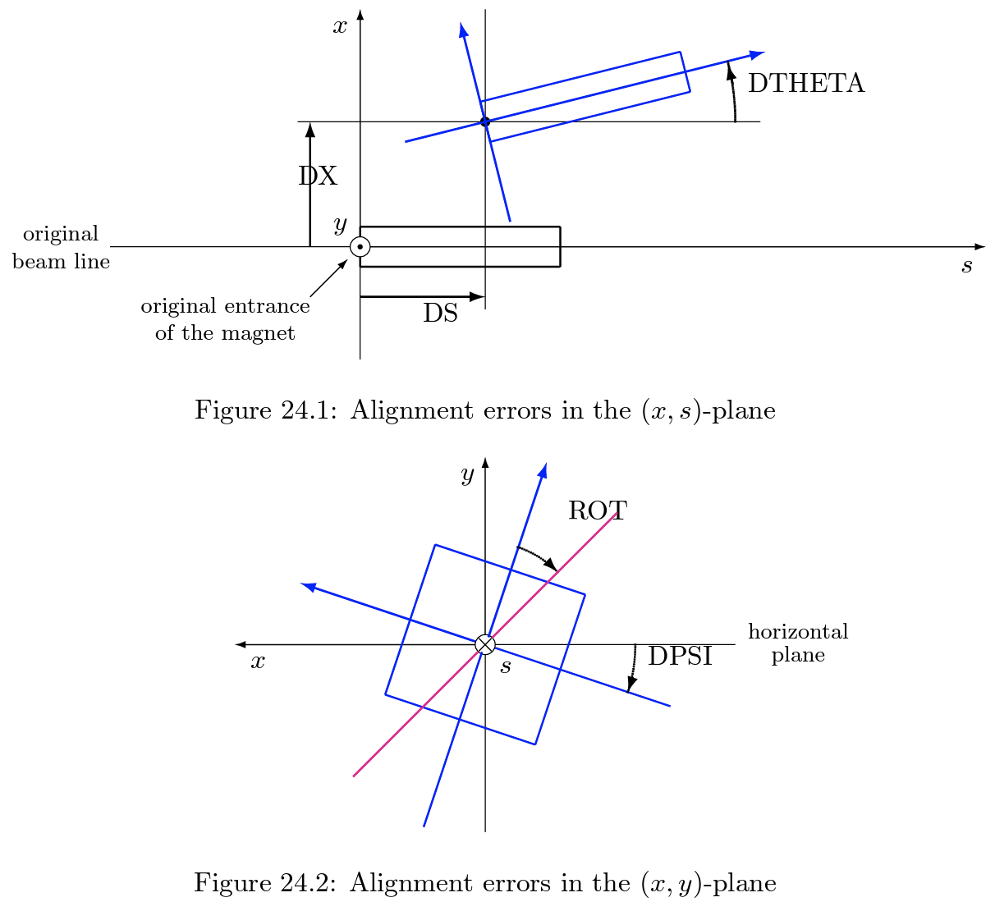
Bmad vs. Madx: offset definitions
Rotation around y axis: x_pitch = dtheta, around x axis: y_pitch = - dphi
Note: x_pitch and y_pitch rotations are about the center of the element, dtheta and dphi misalignments rotate around the entrance point
Rotation around z axis: tilt = dpsi or tilt
Bmad
MAD-X

Slide 30
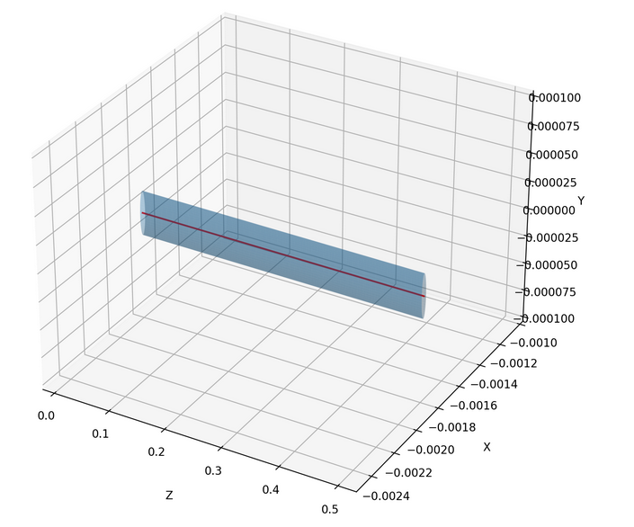
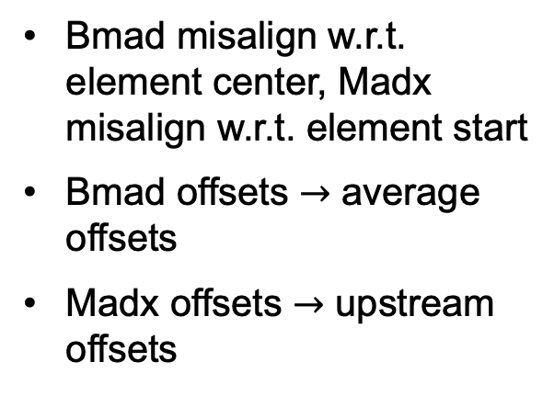
Quad offset: QVD1
Location | S (m) | dX (mm) | dY (mm) | dZ (mm)
upstream | 0.989875 | -1.7853929 | -0.0085697 | -1.7853929
downstream | 1.493875 | -1.8057309 | -0.0074198 | -1.2771865
x_pitch = -4.045e-5 rad
y_pitch = -2.28e-6 rad
tilt = 4.039e-5 rad
Bmad misalign w.r.t. element center, Madx misalign w.r.t. element start
Bmad offsets $→$ average offsets
Madx offsets $→$ upstream offsets
dtheta = -4.045e-5 rad
dphi = 2.28e-6 rad
dpsi/tilt = 4.039e-5 rad

Slide 31
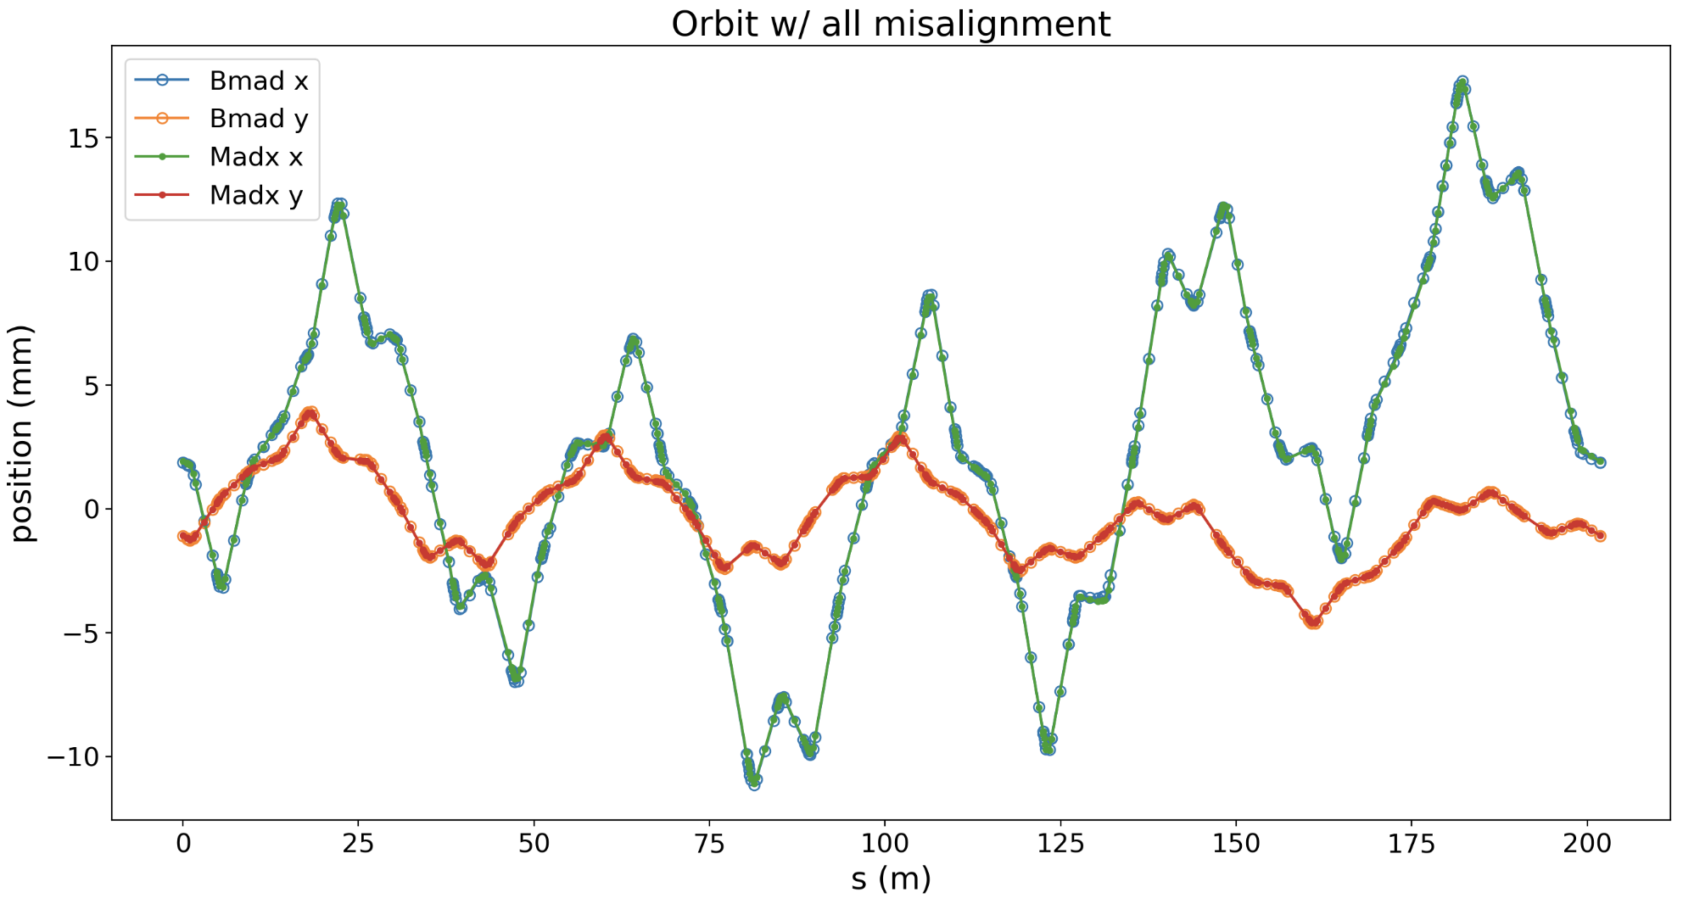
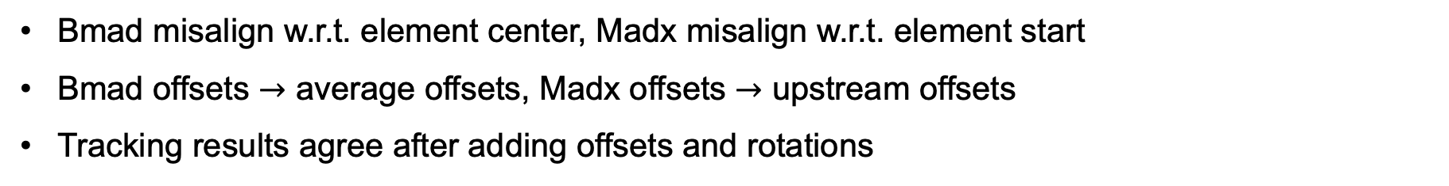
Add misalignment to all magnets
Bmad misalign w.r.t. element center, Madx misalign w.r.t. element start
Bmad offsets $→$ average offsets, Madx offsets $→$ upstream offsets
Tracking results agree after adding offsets and rotations

Slide 32
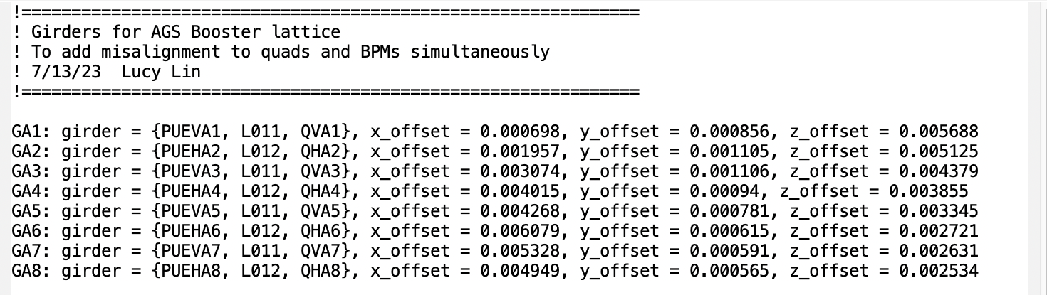
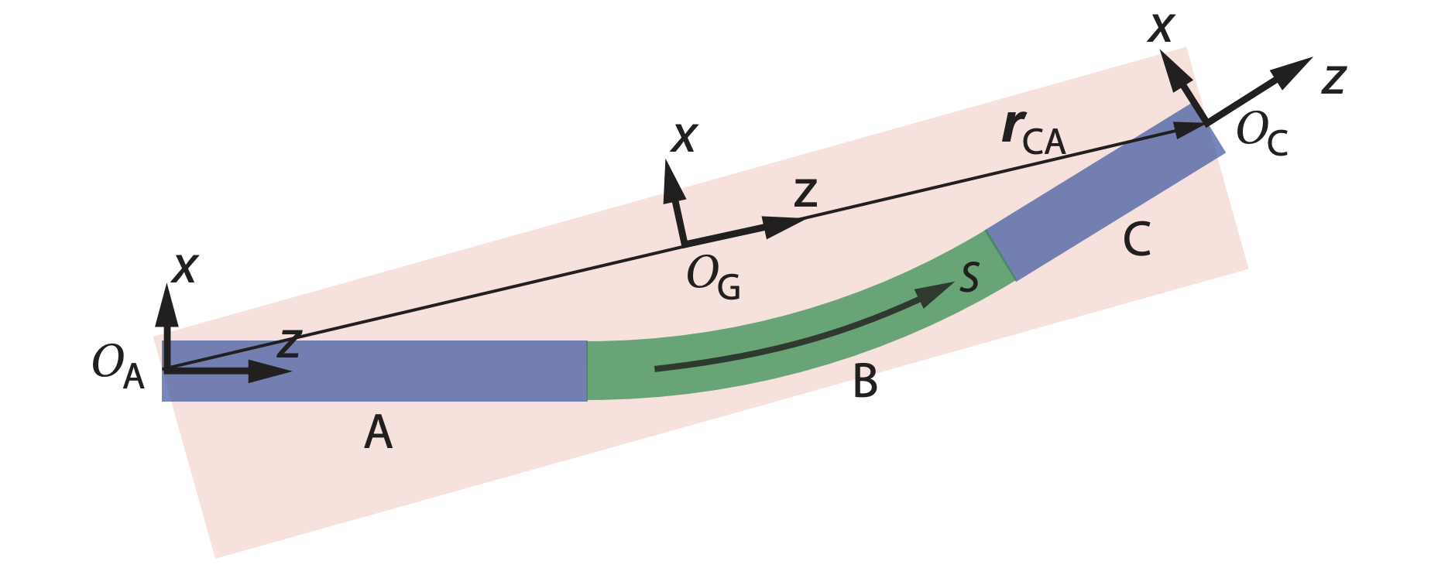
BPM offsets: add girder elements
BPMs are mounted together with quadrupoles
Put quads and BPMs on girders in Bmad so they share same misalignment

Slide 33
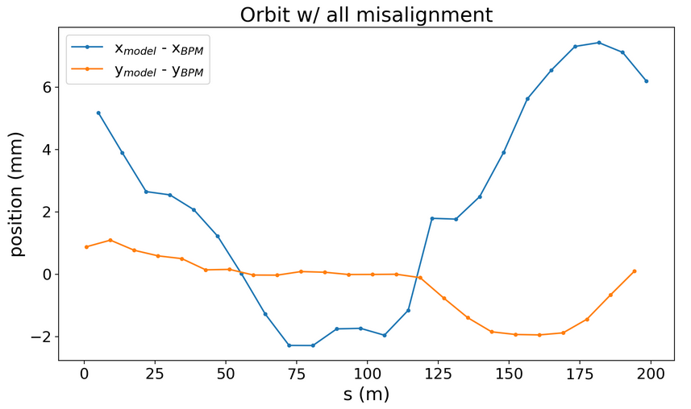

Add misalignment to BPMs
Add quad misalignment to BPM with girders: difference between BPM orbit and model orbit equals to quad misalignment
Bmad
Survey data

Slide 34

Historical orbit vs. simulation
Bare vertical orbit saved on May 26, 2022 at 13:55 and 14:02, for Qv = 4.8 and Qv = 4.7

Slide 35


Historical orbit vs. simulation
Loaded saved snap ramp magnet settings (saved at 14:04, supposedly for Qv = 4.7) to Bmad model, got Qv = 4.63
Simulated vertical orbit is smaller than actual vertical orbit, need to look more into this with Kiel, who got good matching results before

Slide 36



Transfer lines: Linac to Booster (LtB)
200 MeV polarized H⁻ beam (2 e⁻) from the drift tube linac (DTL), carbon foil strips electrons at Booster injection
3 sections: High Energy Beam Transport (HEBT) from LINAC tank 9, $126°$ achromatic bend region (DH2 – DH5), optics matching region into Booster C5
Booster
$126°$
bend
HEBT

Slide 37


Transfer lines: Booster to AGS (BtA)
Extraction septum at F6 in Booster, injection septum at L20 in AGS, lattice includes L20 – A15 in AGS
15 quadrupoles, 2 major bends (DH2 & 3, overbend, 15$°$ instead of 10$°$), 3 small bends (2$°$ DH1, 1$°$ DH4, 8$°$ DH5)
Multiwires MW006, MW060, MW125, MW166
Currently only in MAD-X format
Note: fringe fields from AGS main magnets leaking into BtA are ignored in model for now

Slide 38

Transfer lines: AGS to RHIC (AtR)
Extraction septum at H10 in AGS, injection into two RHIC rings via X and Y line
80 dipoles, 31 quadrupoles, 35 correctors, 2 Lambertson septum magnets
Currently only in MAD-X format

