Slide 1
ML in the control system and digital twin thoughts
Kevin A. Brown, brownk@bnl.gov
Brookhaven National Laboratory, Upton, NY 11973, USA
ECE Dept., Stony Brook University, Stony Brook, NY 11794, USA
August 25, 2023 ML for Polarization Collaboration Meeting
Cornell Univ.,

Slide 2
First, a quick tour…

Slide 3
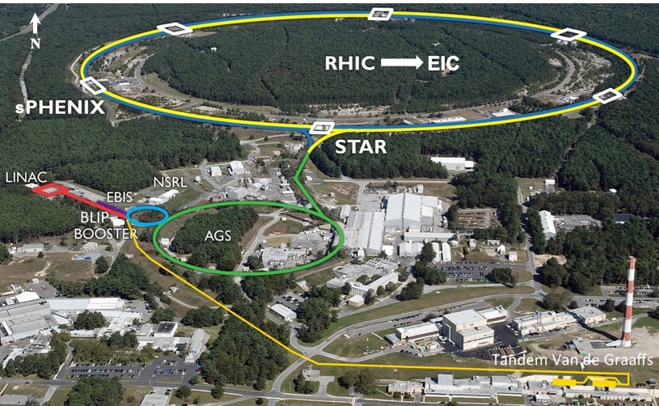

Slide 4
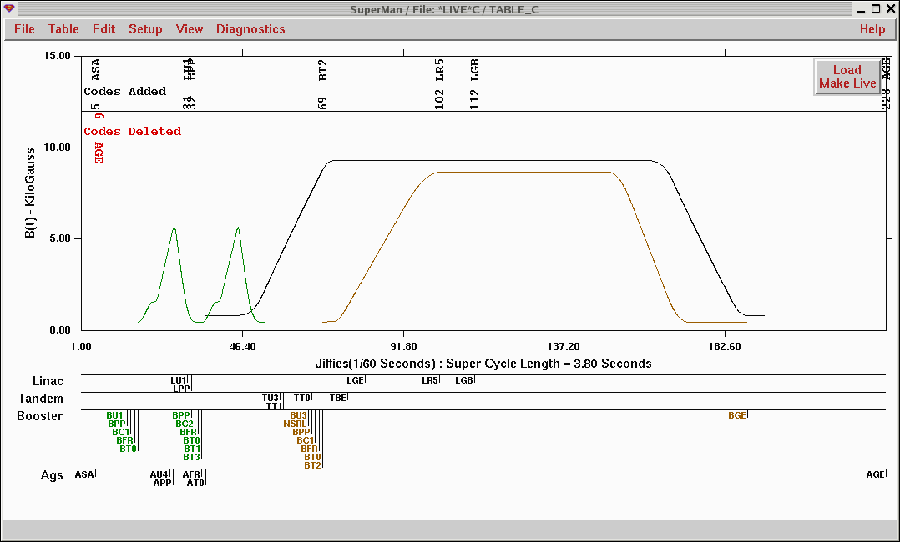

Slide 5
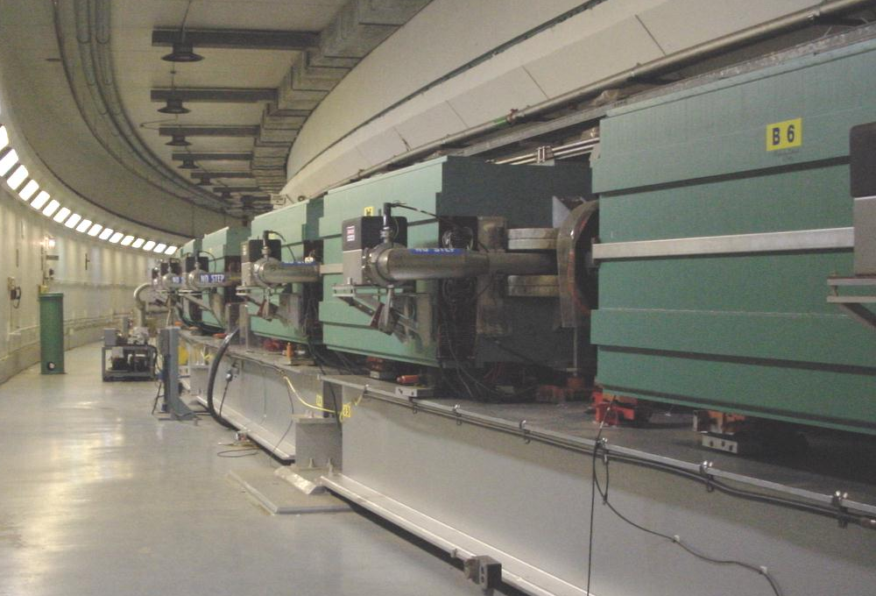
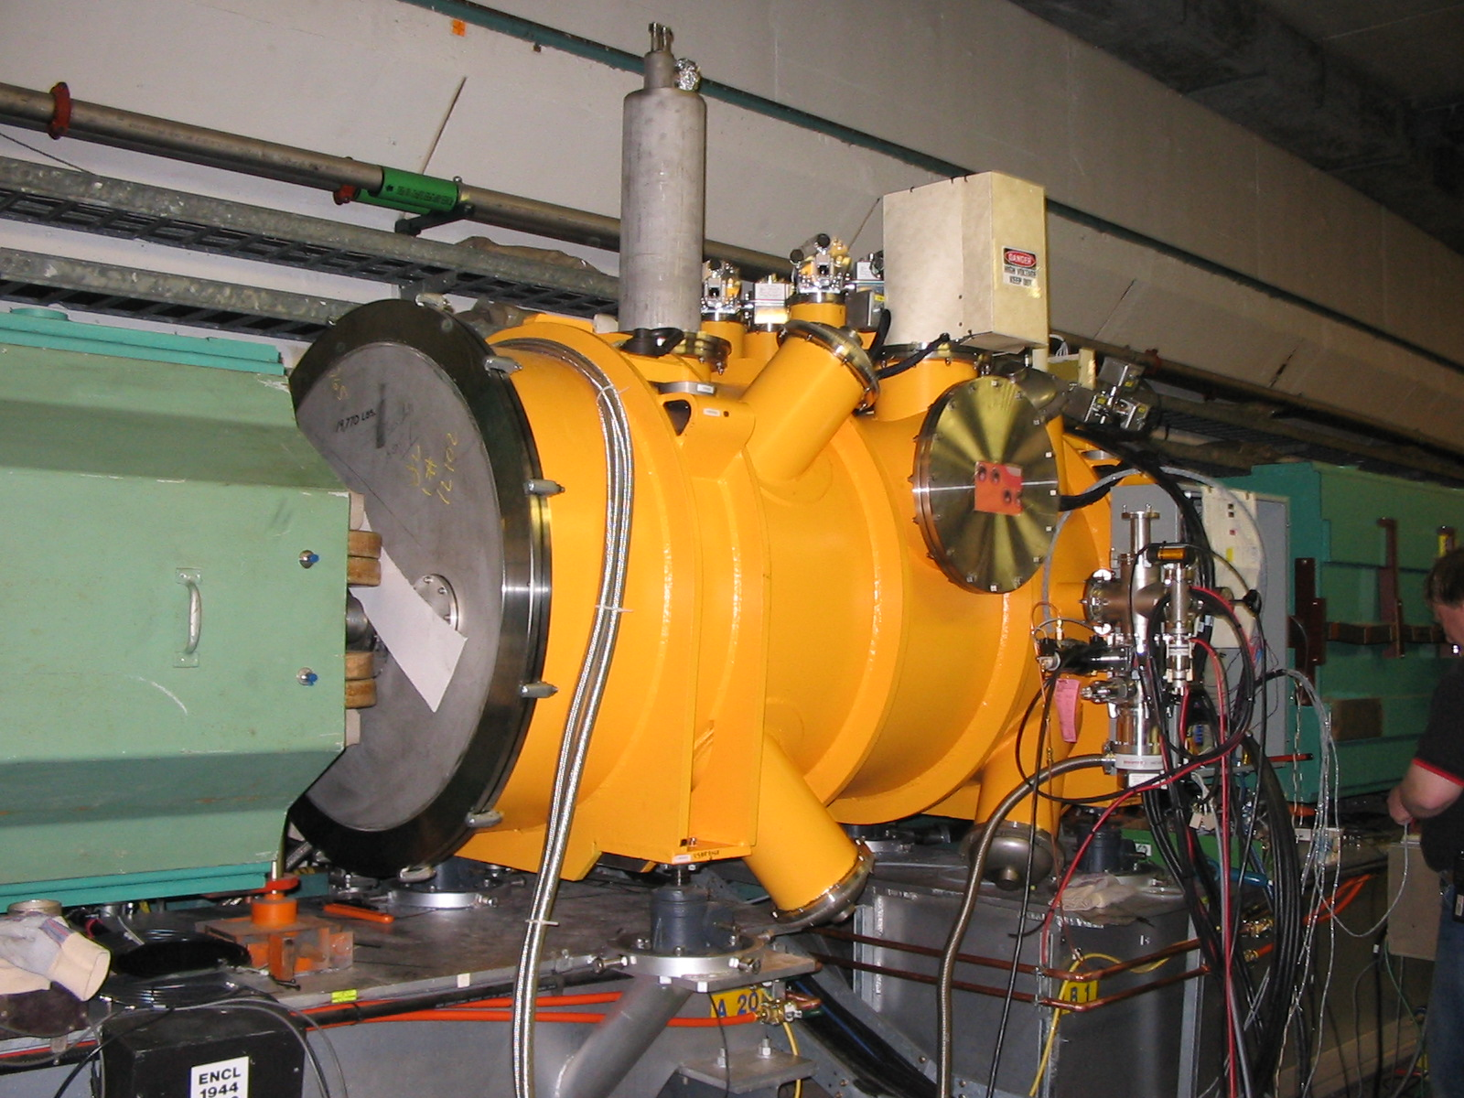
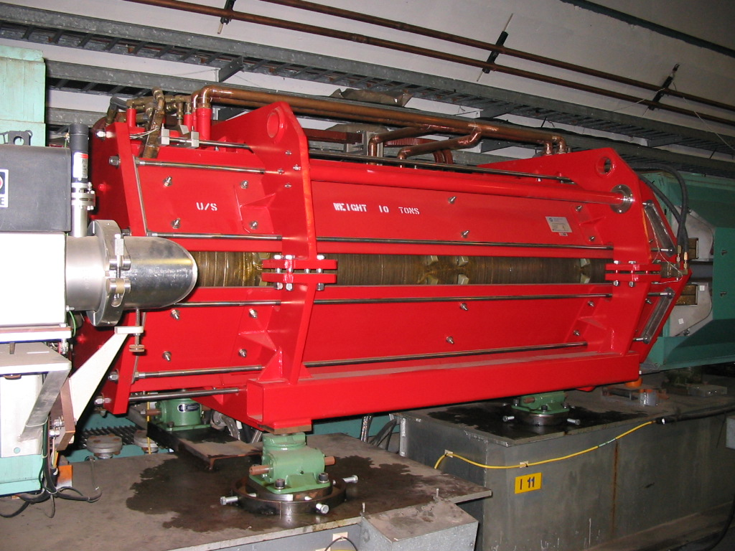
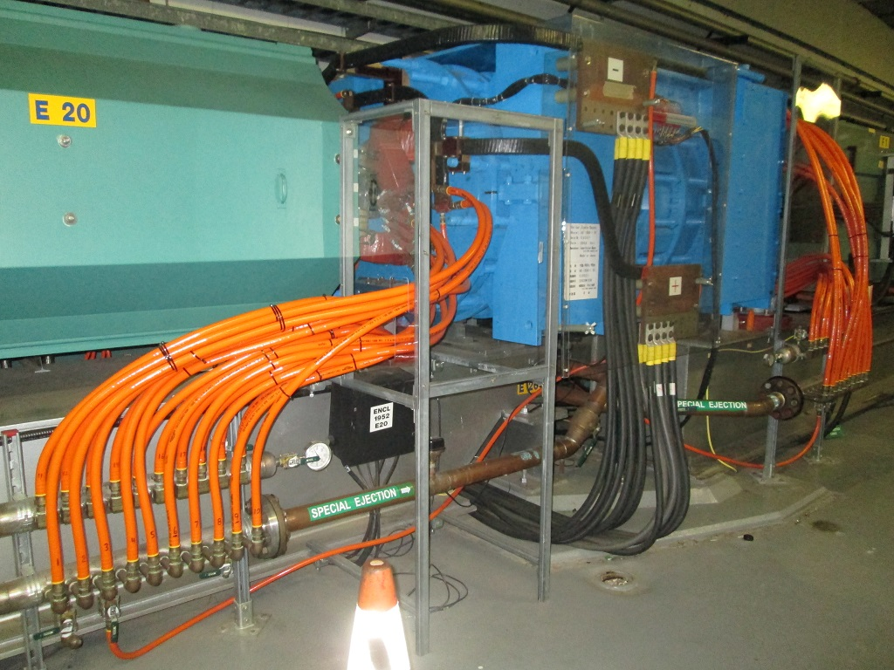
The AGS
&
Snakes
A20
E20
I10

Slide 6
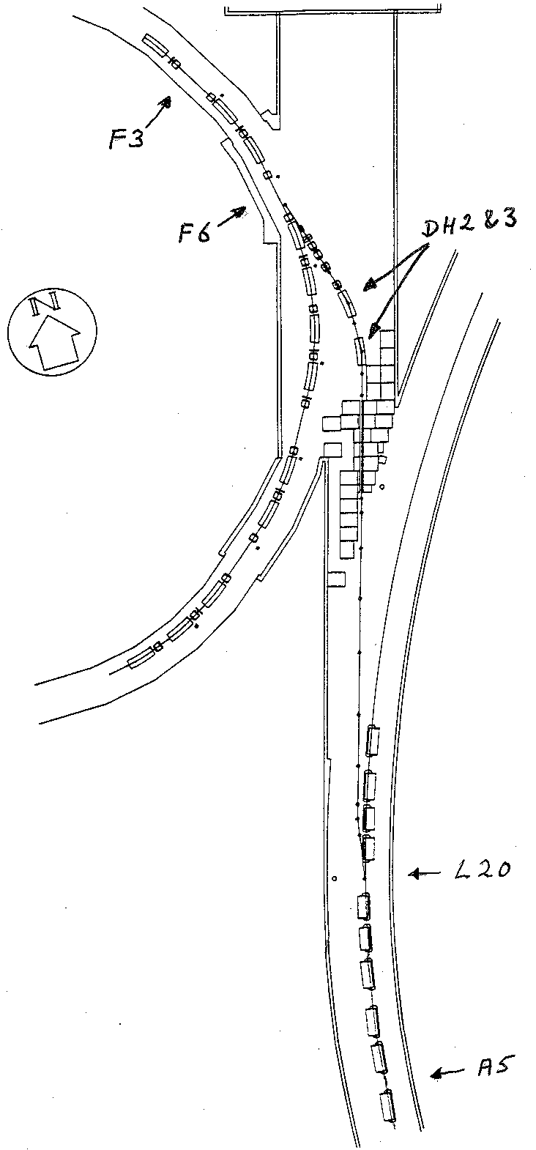
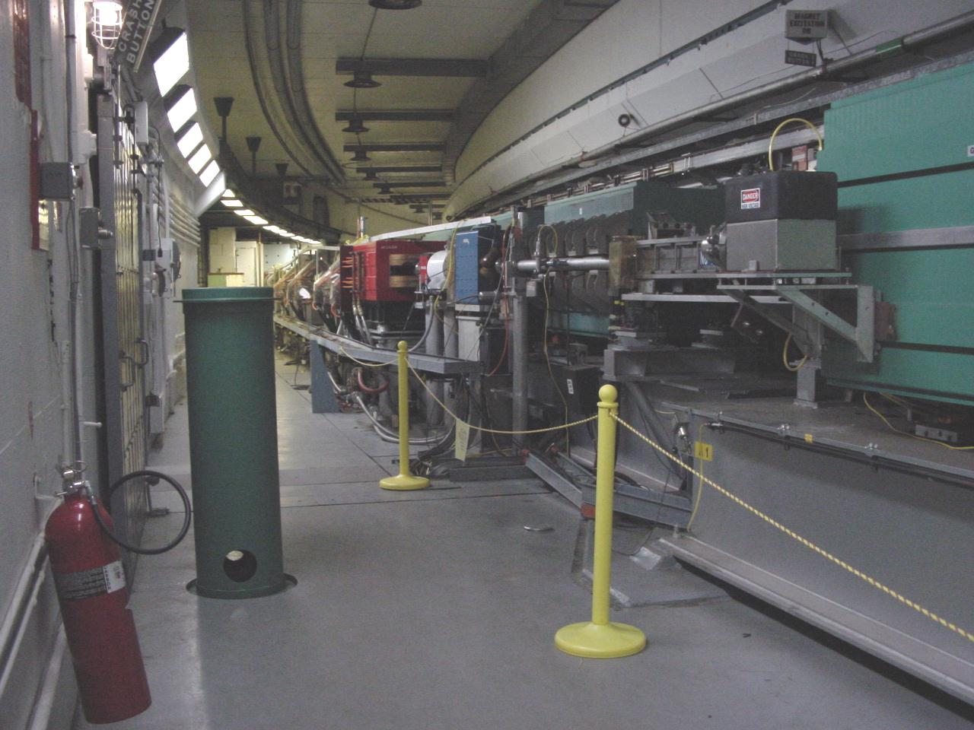
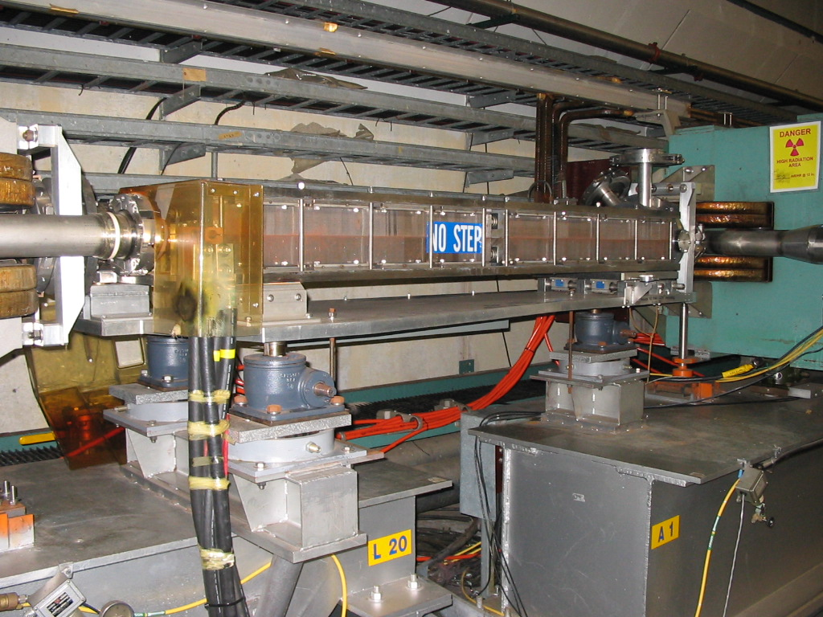
BtA & AGS Injection
BtA Line and L20
5 mrad
143 mrad
L20 Inflector Magnet
Copper septum, 1 turn
A5 – injection kicker. Designed to put beam on equilibrium orbit for 1.5 GeV protons.
110 mrad
2.85 mrad

Slide 7
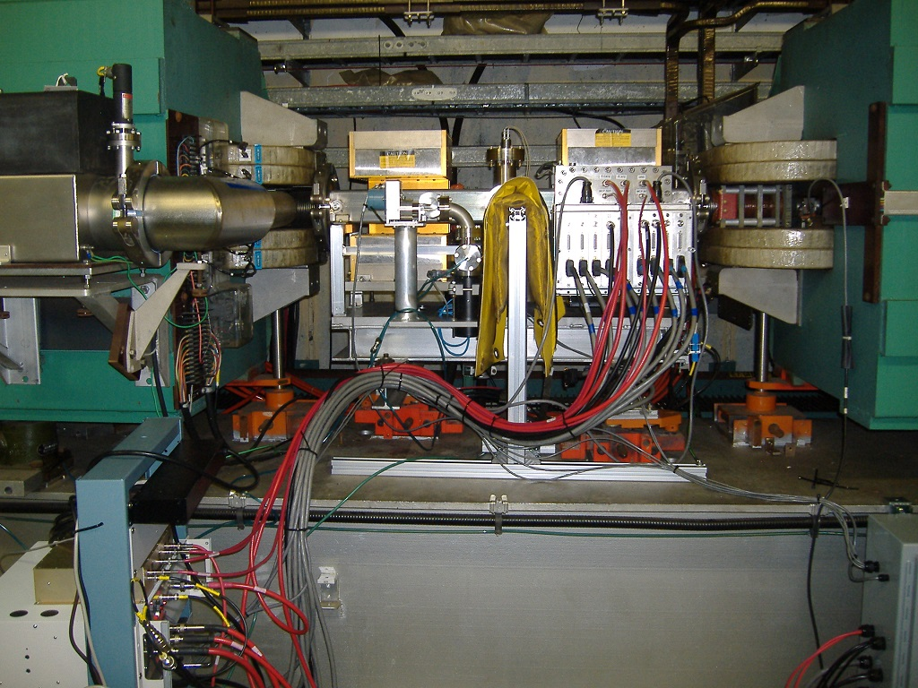
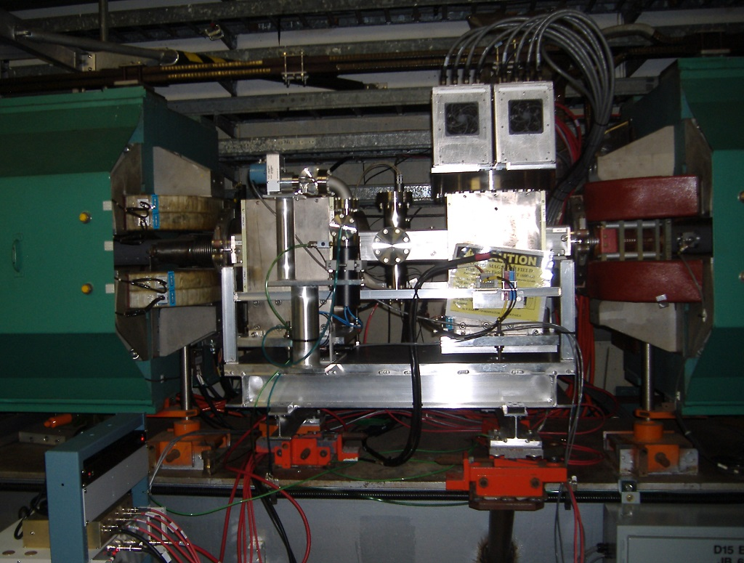
Electron Collector profile monitors - uses microchannel plates, can do turn-by-turn
D5 eIPM
D15 eIPM

Slide 8
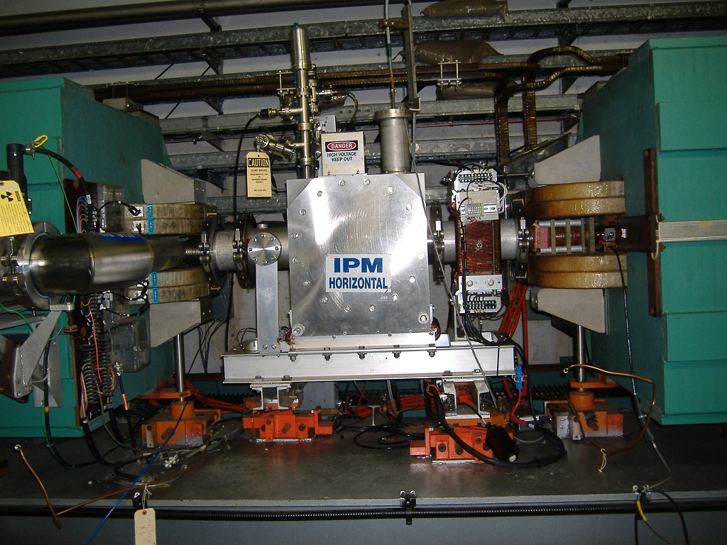
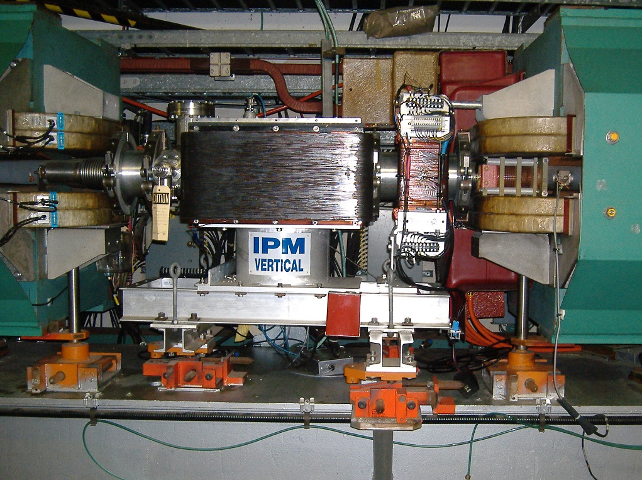
Ion Collecting Profile Monitors – 4 samples/cycle, controlled leak, long integration…
E15 IPM
C5 IPM

Slide 9
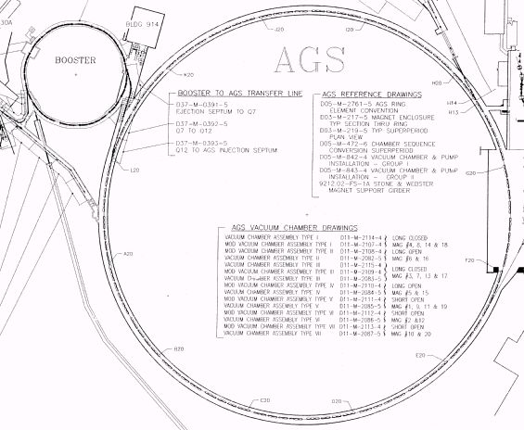
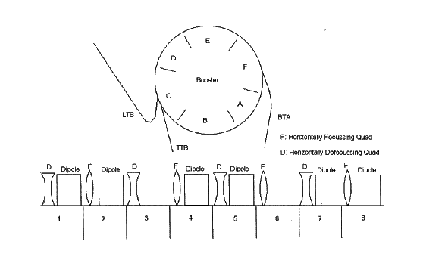
J
K
I
L
Extraction Section
To AtR line
H
Injection Section
BtA line
A
G
C_{AGS} = 807m
B
C_{Boo} = 202m
F
C
E
C5
IPM
D
E15
IPM
eIPM’s

Slide 10
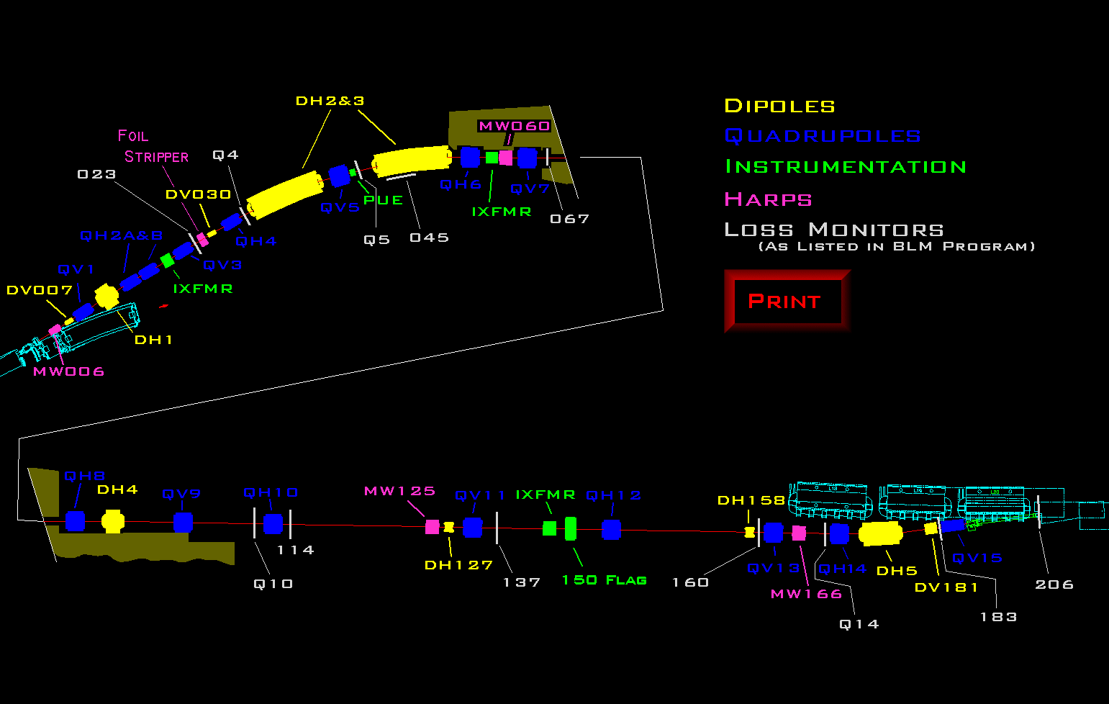

Slide 11
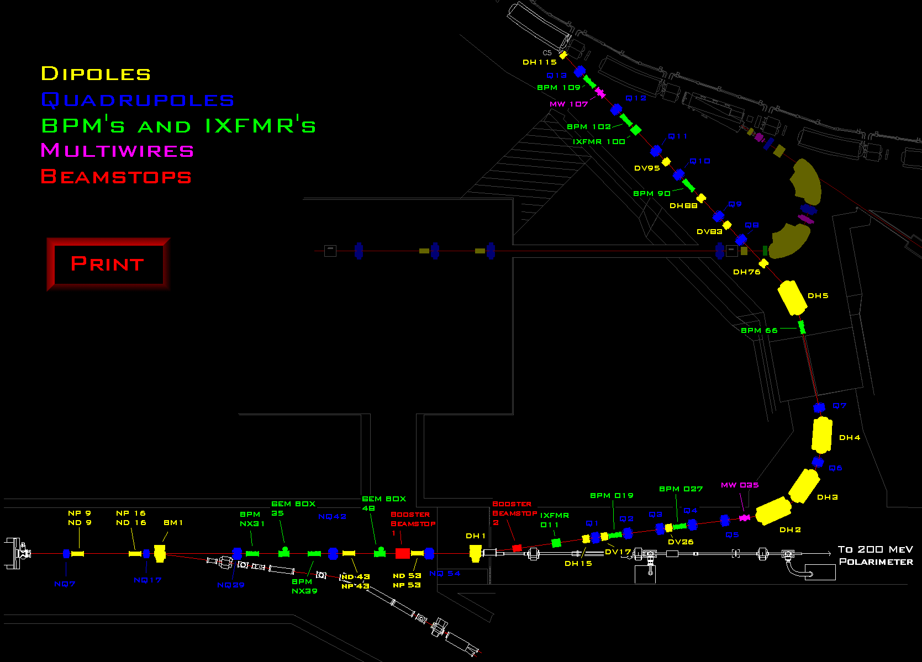

Slide 12
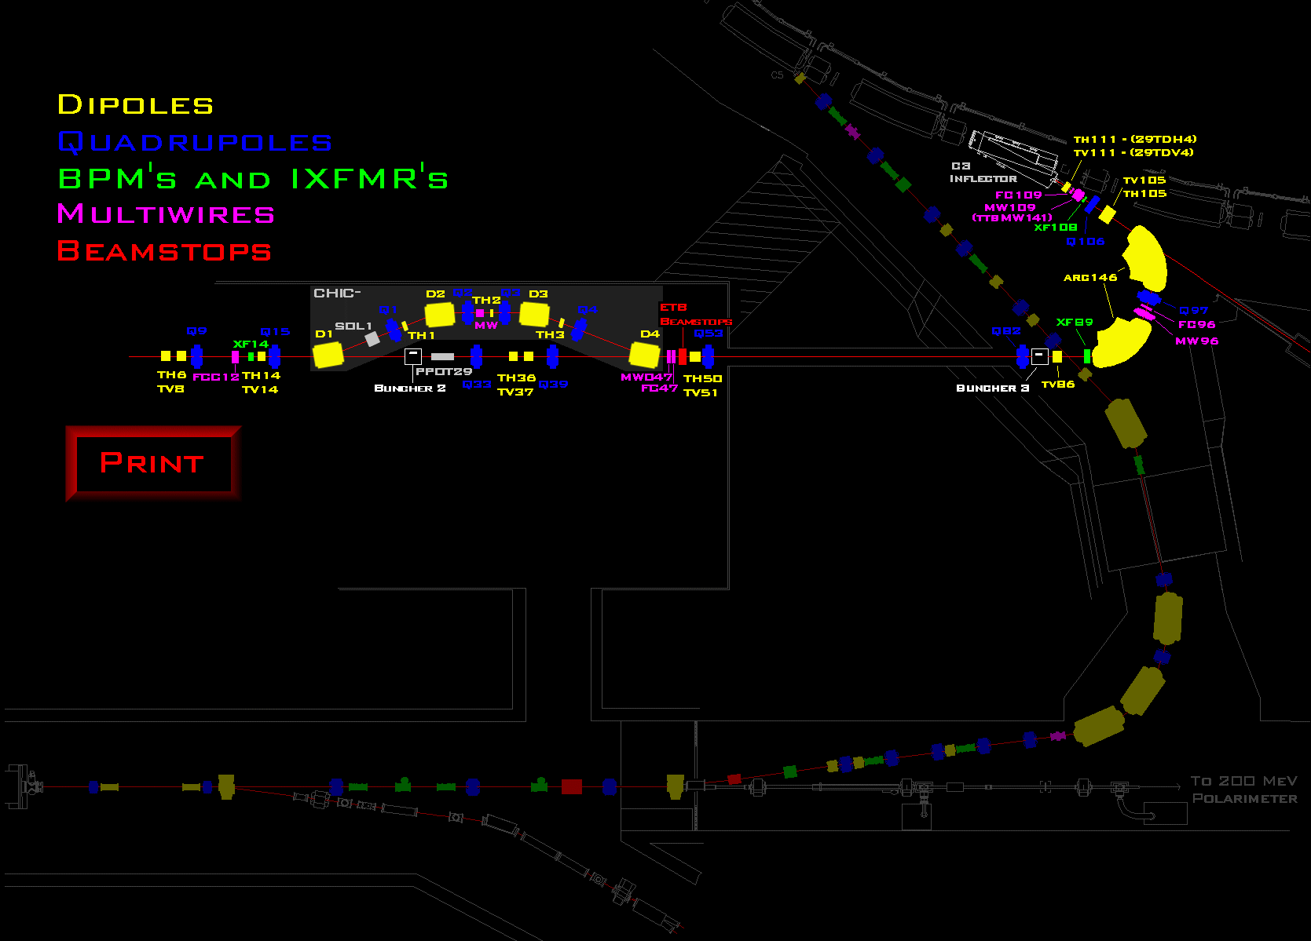

Slide 13
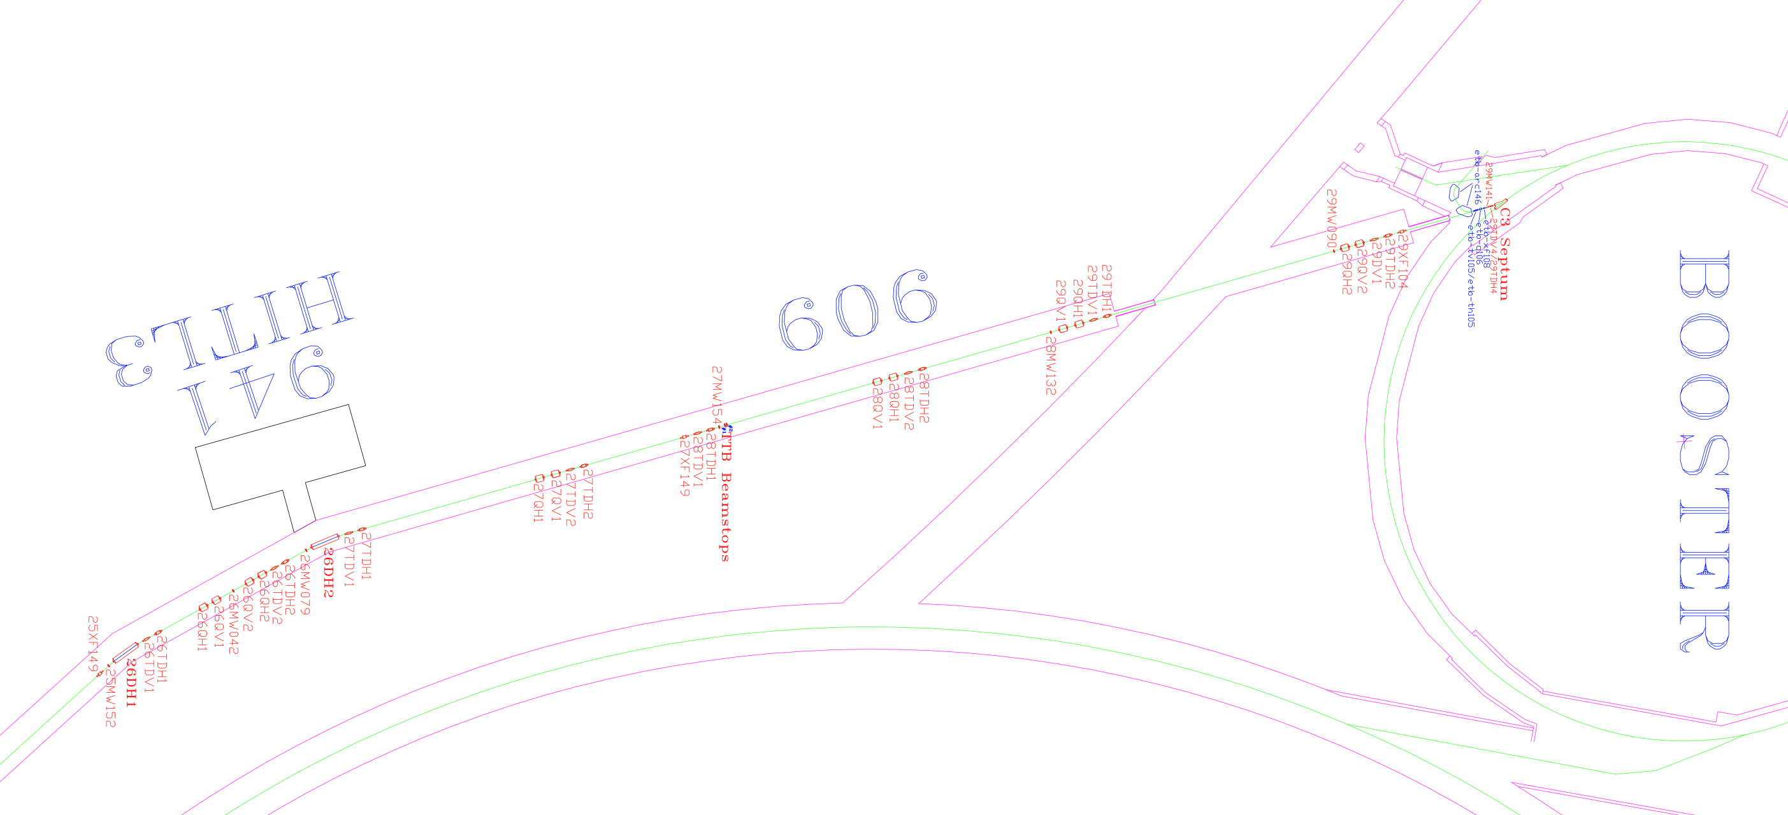

Slide 14
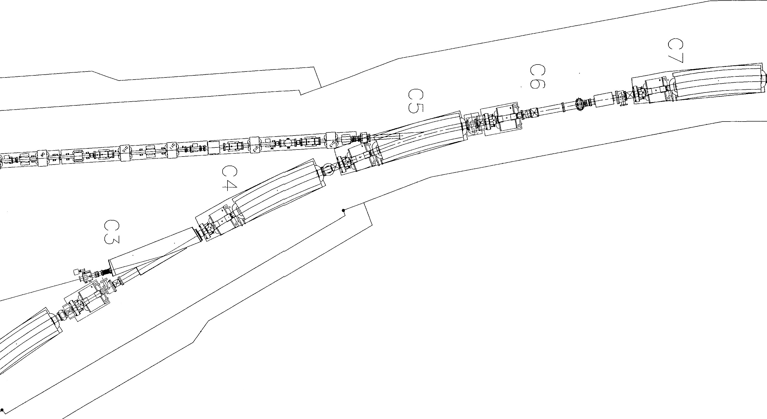
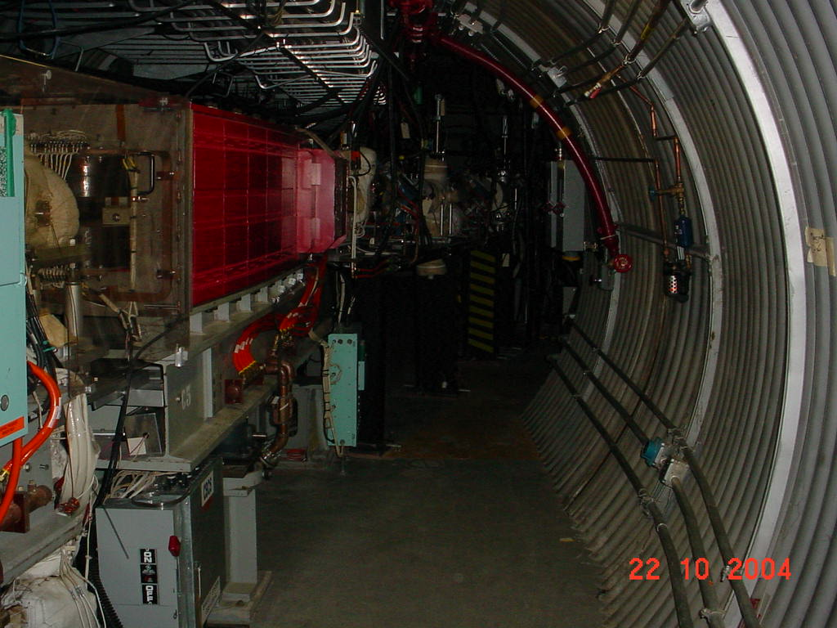
Booster Injection
H- injection
Stripping Foil
1998 Coil Failure
HI injection
2003 Coil Failure

Slide 15
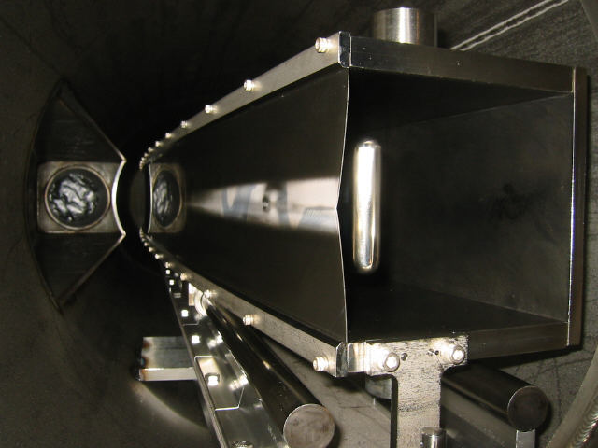
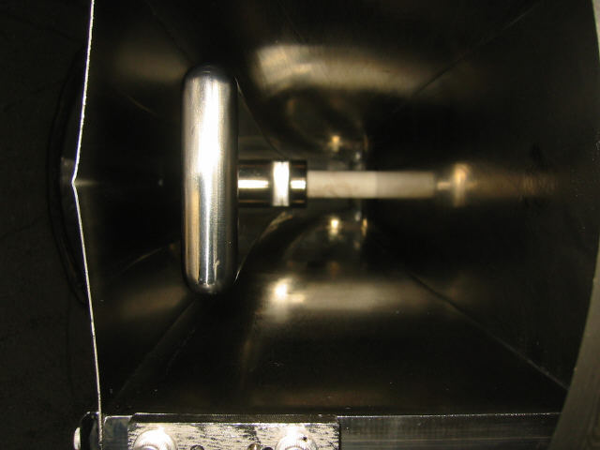
C3 Inflector Protection
Inflector septum distortion. Should be perfectly flat. Presumed cause is high intensity protons scraping on the septum.

Slide 16
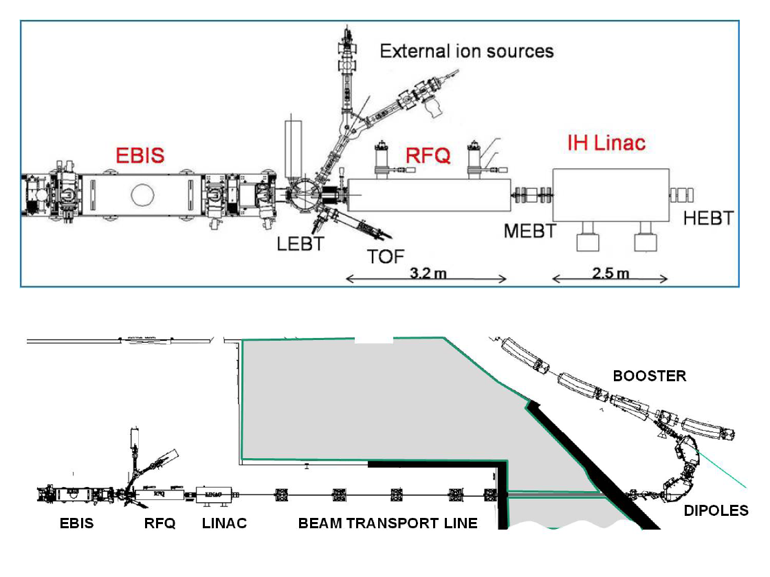
EBIS – Electron Beam Ion Source
Laser Ion Source
Hollow Cathode Sources
C3 Inflector

Slide 17
Control Systems

Slide 18
System Overall Architecture
Red Hat Linux
Sun Servers w/ Sybase
C++, JAVA, Python, Matlab client/server
VME Front Ends (VxWorks)
Accelerator Device Objects (C++, Python)
In-house waveform generators, PS digital controllers, DAC, ADC, etc.
Notes:
A complex control system is organized very similarly to that of the architecture of a parallel computer. The more work being done at the FEC level, the more efficient the system. But it is designed and built with an engineering model of the controls in mind.
MVME162, MVME2100, MVME3100 (and MVME4100)
RF interfaces = FPGAs with embedded PowerPC processors abstracted as a VME front end

Slide 19
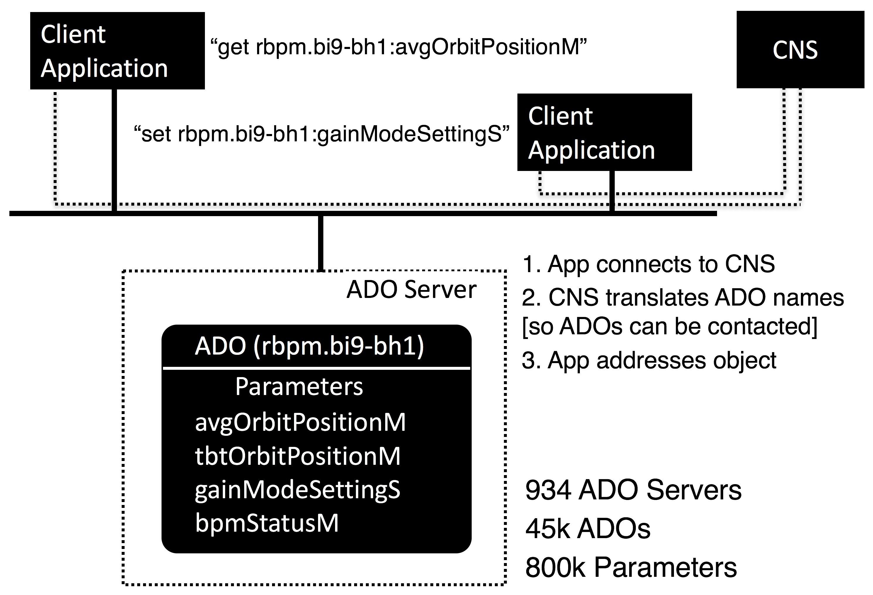
ADO Communication
ADO (Accelerator Device Object)

Slide 20
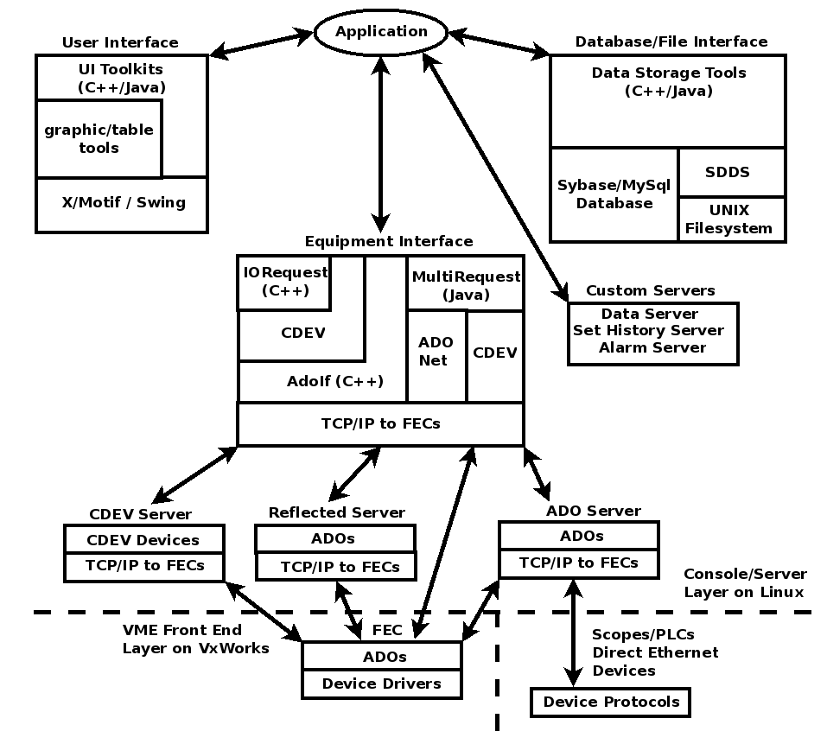
General Software Architecture in C-AD Controls

Slide 21
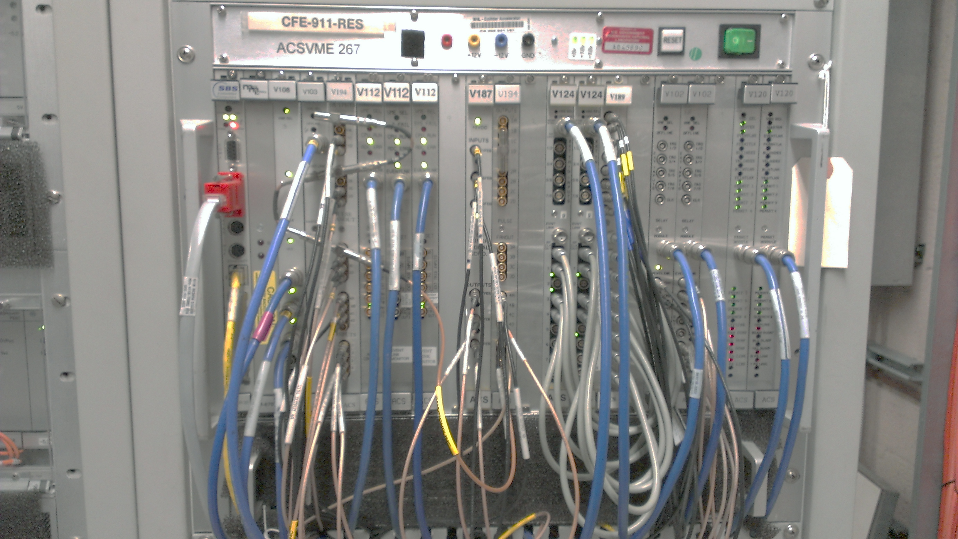
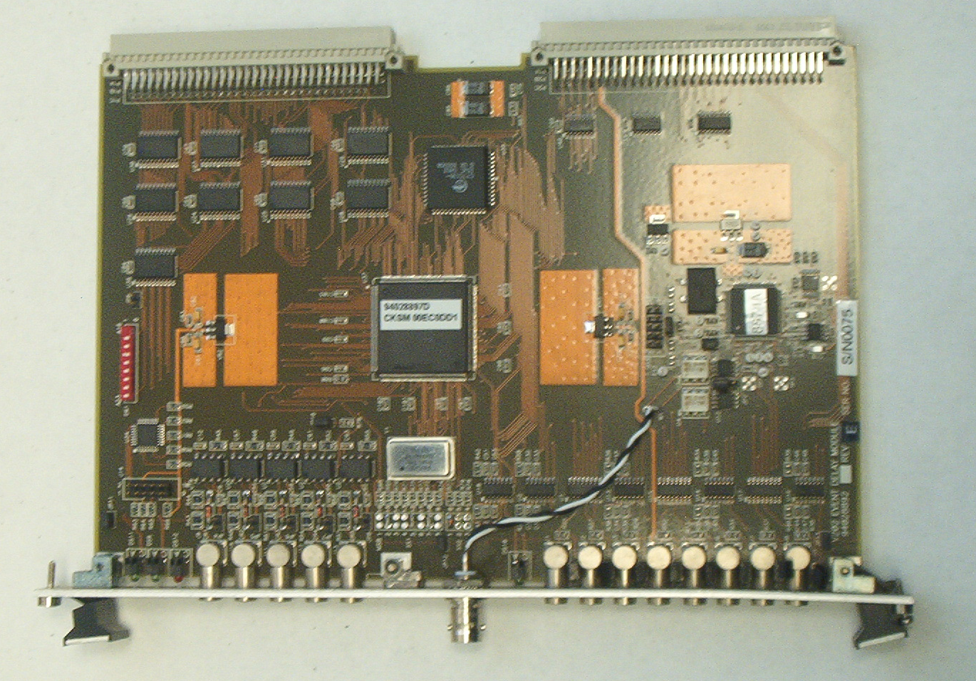

Slide 22
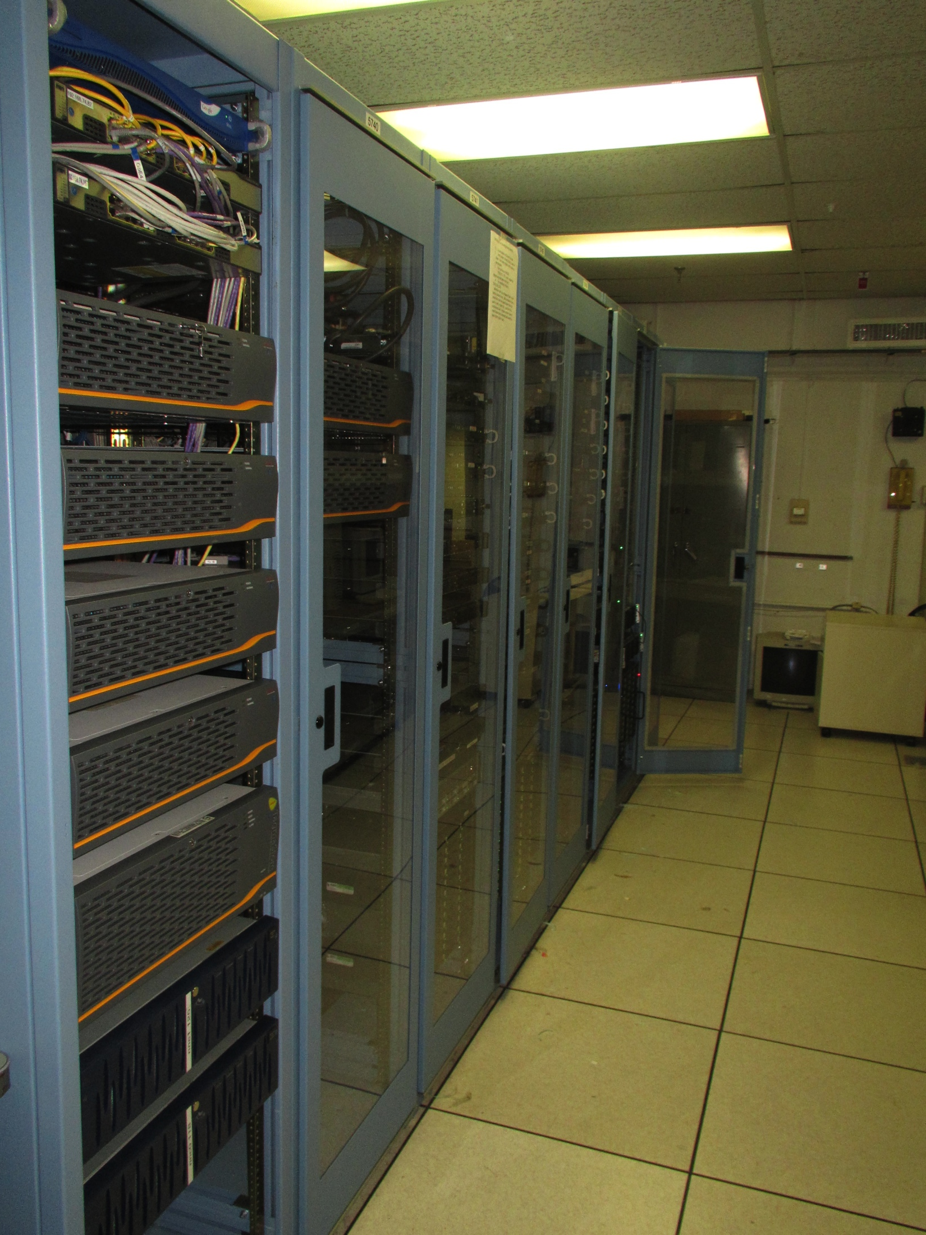
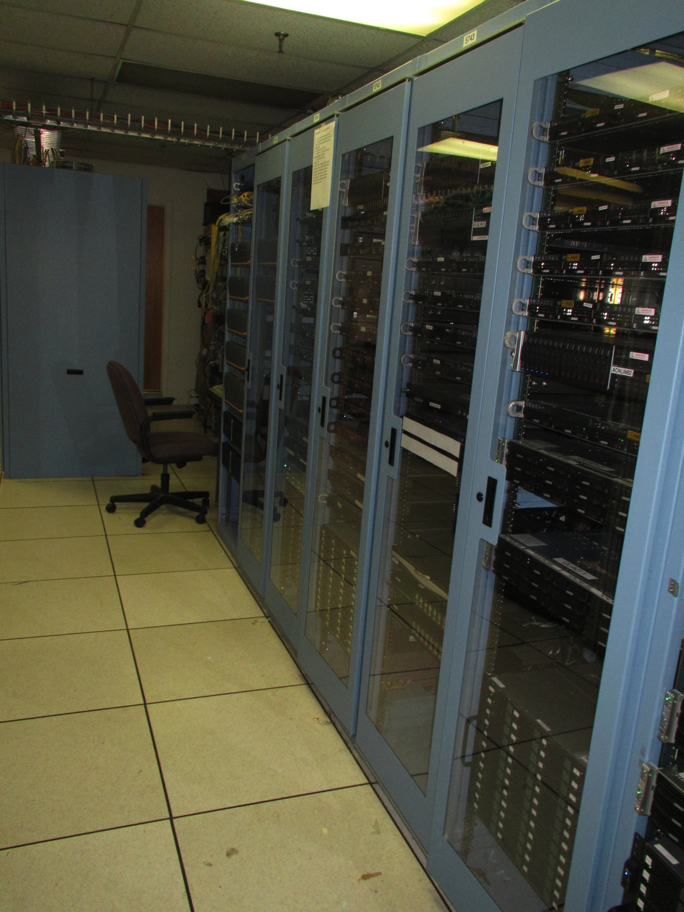

Slide 23
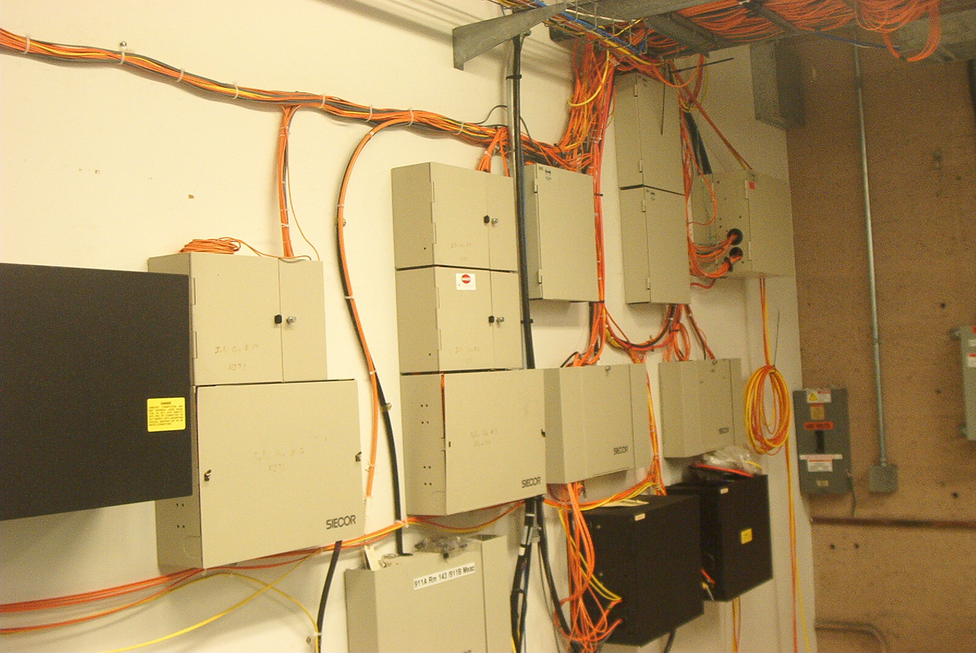

Slide 24
Challenges
There are several things that must be sorted out prior to building surrogate models from machine data.
Live vs logged?
  Building from live data may be easier, but may take longer
    It is easier because you can build the data collector exactly as you want it
  Building from logged data may or may not be faster, but is harder
    First must find the relevant data in 10’s of petabytes repository
    Must ensure data is time correlated
    How to check the data quality? Does the right data exist?
Data for physics models vs Data for statistical models?
  Accelerator data is ‘engineering’ data = no uniform definition for sampling frequencies, bit resolution, raw vs ‘calibrated’, simple values or array’s, etc.
  Is the correct data logged? (e.g., sample times in orbit data)
Destructive vs parasitic data?
  data from multi-wires in beamlines = virtual diagnostics should be built
  IPM’s = need gas leak or not?
  Intensity scans = need dedicated time

Slide 25
ML & Digital Twins

Slide 26
Many little twins … ?
What if we can break up each of the subsystems and describe with some kind of twin?
Booster Injection
Not easy to model, but,
  Beamline and beam parameters are well understood (well enough?), put in bmad
  Multiturn injections (p & ions) are more complex; surrogate model?
Booster Extraction
This can be modeled (have good madx models), could be improved
Bpm’s don’t work in BtA, 30-degree bend made with two 10-degree booster sector bends, can only verify by inserting multiwires
AGS Injection
Well understood – never seen a good model = matching has been challenging
Snakes mess up orbit and optics

Slide 27
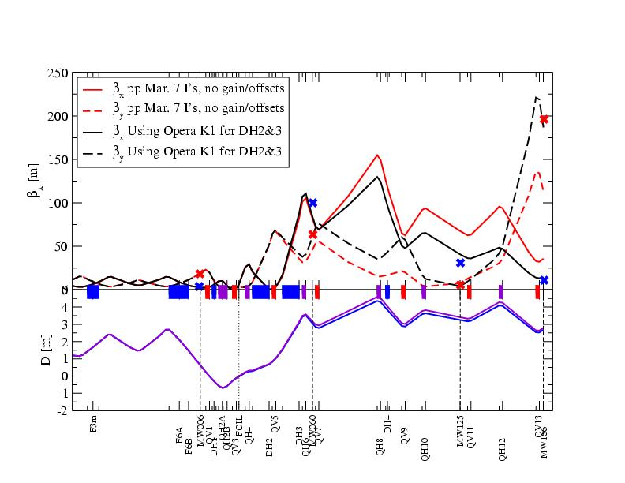
Booster to AGS transfer line optics

Slide 28
Fix Model
Digital Twin of Particle Accelerator
CS
OnLine Model
ORM
TRUST Analysis
Learn Responses
MODEL
Compare
&
Consistency
Check
Particle Accelerator
Disp
Learn Disp & BPM Cal
Tunes
Learn Tune
& Coupling
Chrom
Learn Chrom

Slide 29
End
Thanks!

