Slide 1
Beam Background and
MVTX Operation
Ming, Yasser
08/17/2023
MVTX Electronics Meeting

Slide 2
MVTX Operation Plan and To-Do list
More shielding close to the beam pipe?
What if p+p high backgrounds prevent streaming readout for p+p?
HF Physics, w/o TPC?

Slide 3
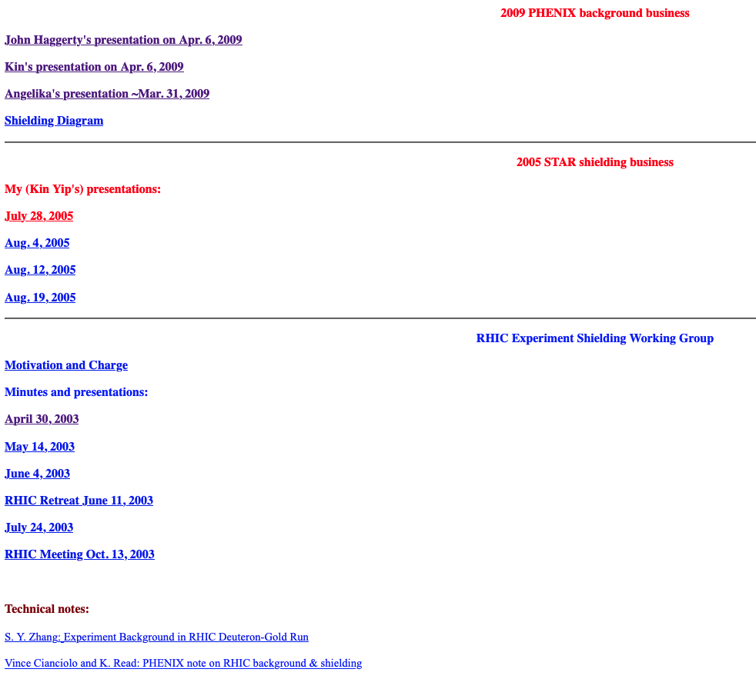
Add more shieling?
http://www.c-ad.bnl.gov/kinyip/Radiation/RHIC_Shielding.html
Beam scrapping on QX magnets? If so, add more shielding between IR and DX/QX magenets
Early slides from Kin Yip, for PHENIX work, 2003,2009 etc.

Slide 4
PHENIX background problem
Works done in 2003 (Minutes and presentations of the RHIC Experiment Shielding Working Group are kept at :
http://www.c-ad.bnl.gov/kinyip/Radiation/RHIC_Shielding.html )
Situation now (some observations) …

Slide 5
In ~2003, we have concluded that
Sources of the background for PHENIX (and 2 others) all believed to be due to beam scraping at the magnet triplets (~Q3).
Simulations have showed it’s better for shieldings to be
  closer to the beampipe
  closer to the IP / MUID
  steel better than concrete etc.
But reality (a lot of stuff) has prevented us from installing everything that we’d have hoped for. Eg. there are some equipment near the beam pipe and somehow the shielding can’t be just next to MUID.
From Kin

Slide 6
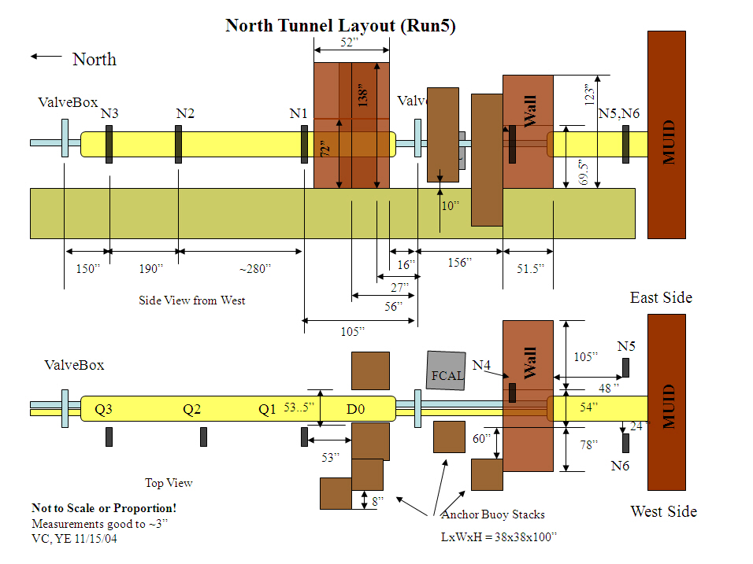
IP
scintillators

Slide 7
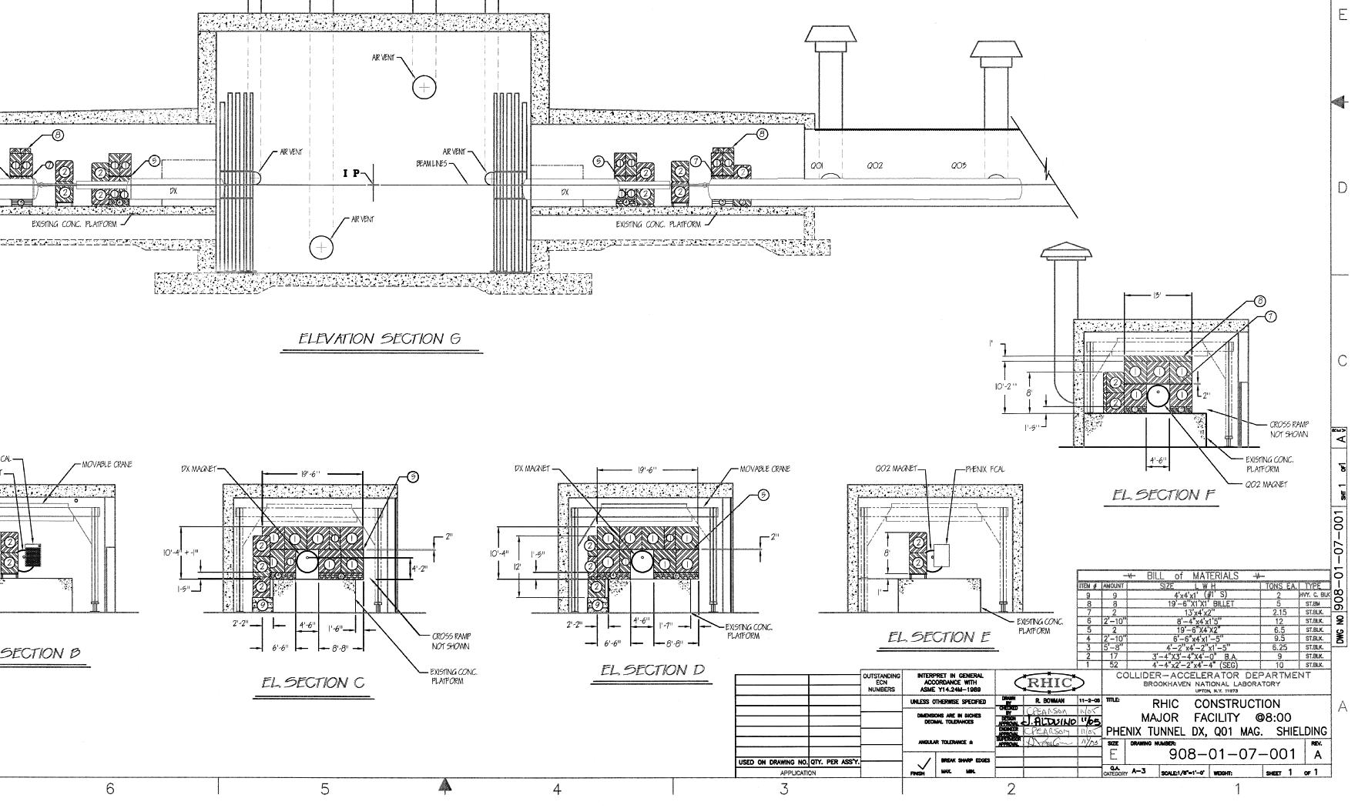
Add more shielding blocks?
Configuration in
~2009?

Slide 8
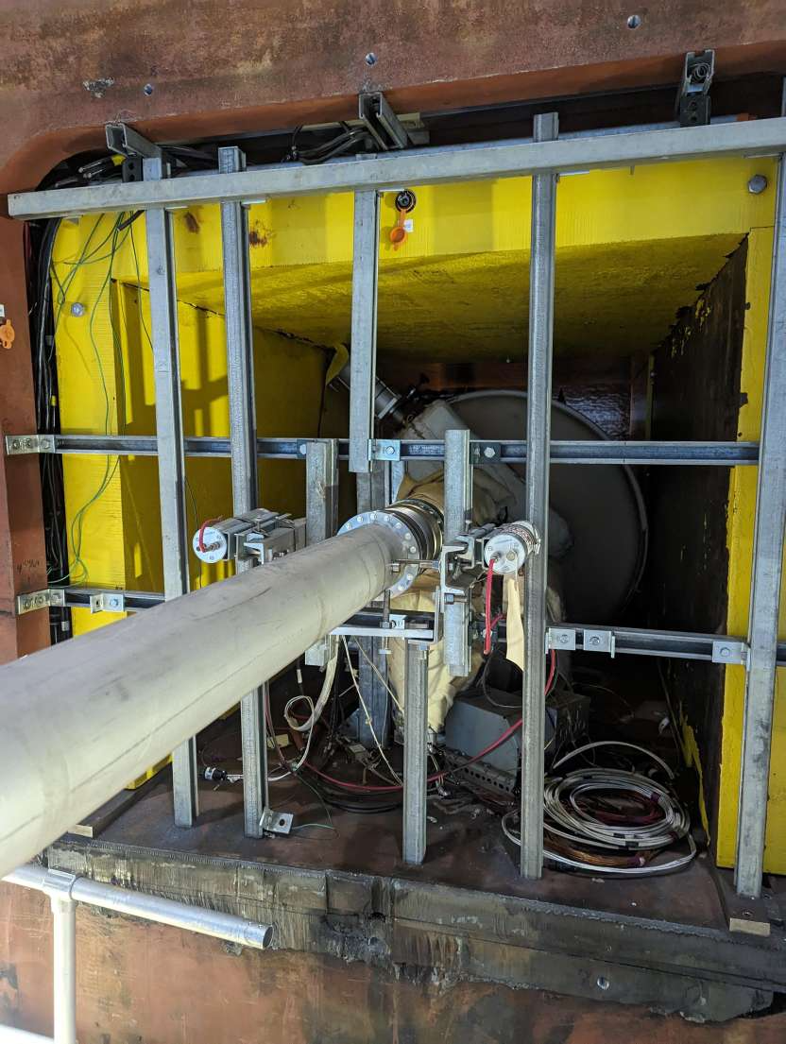
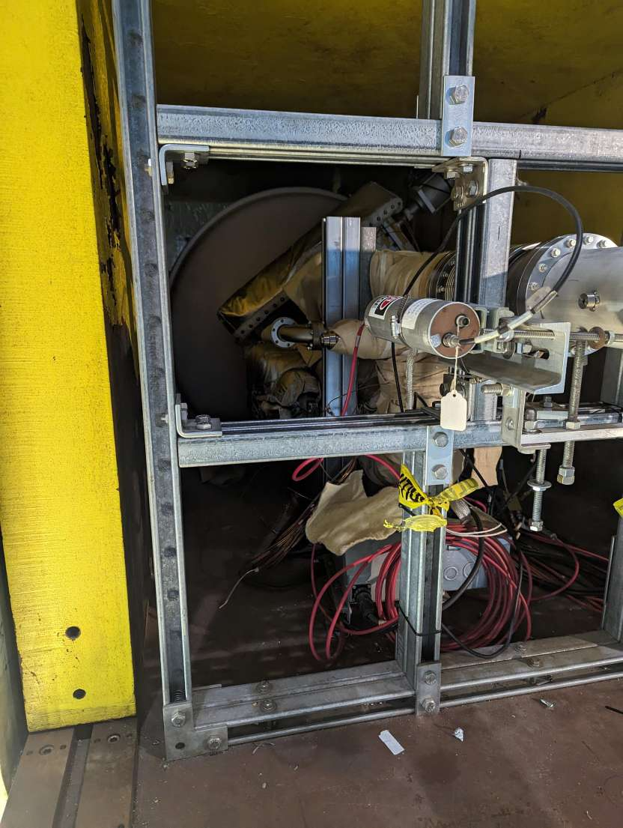
Check feasibility of additional shielding in IR
Photos by Cameron
Visit DX/QC areas
Check the MUID holes
- Add shielding?
Check w/ JohnH about scintillators
- Put N5,N6 (S5,S6) more close to the beam pipe
N6
N6
N5

Slide 9
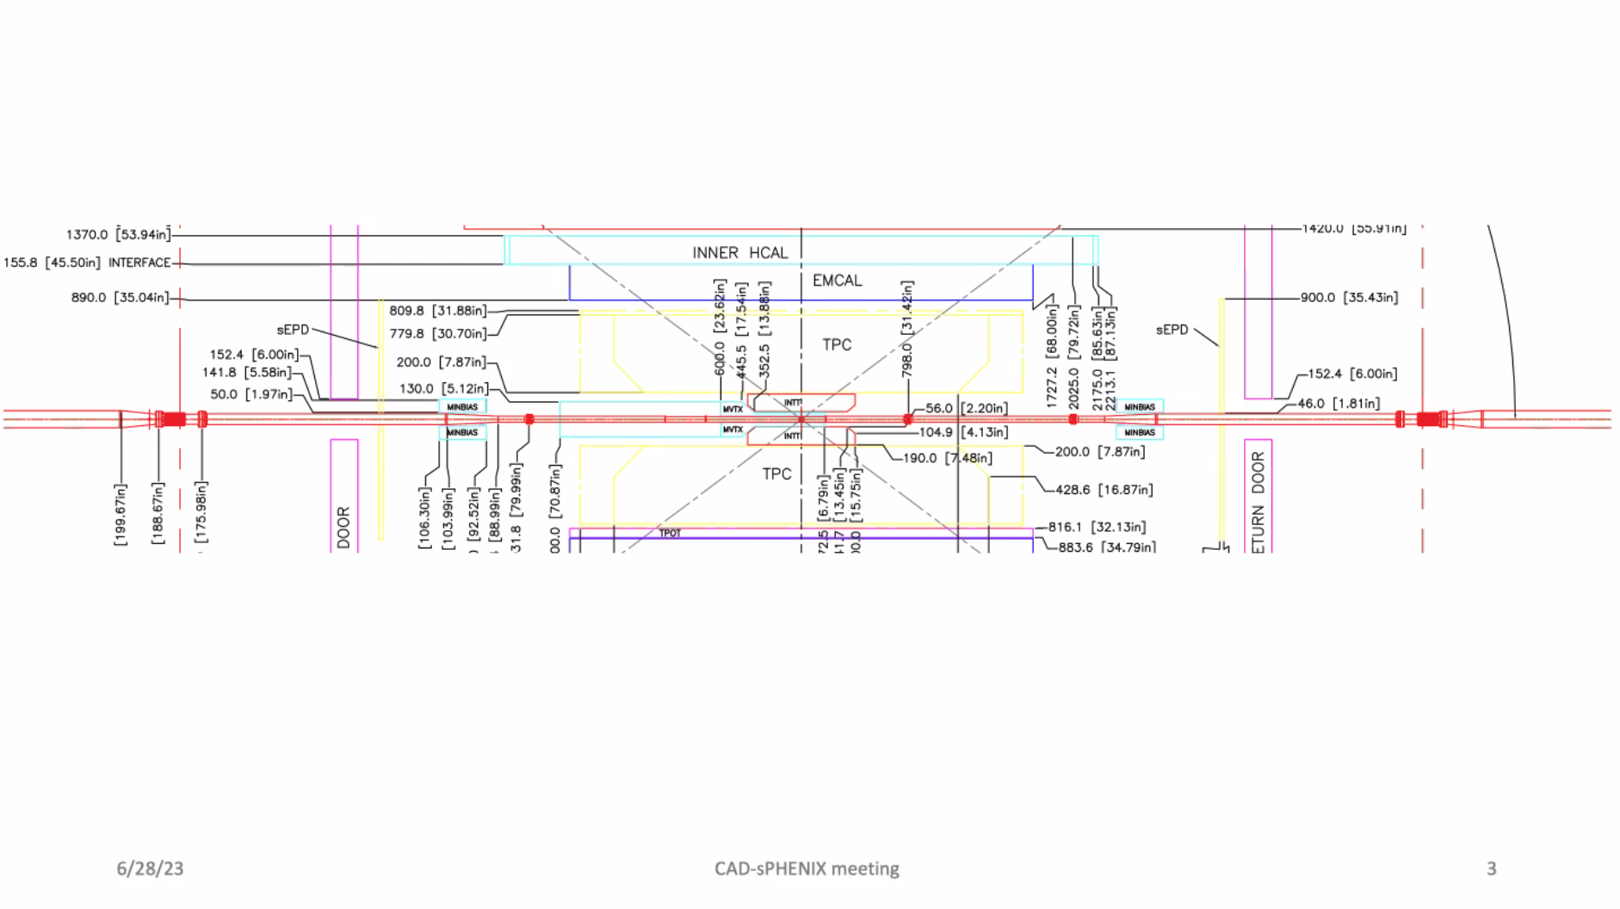
More shielding around beam pipe?
Need more beam background simulations from CAD – . Angelica, Kin Yip
MBD
absorbers between MVTX and MBD?
MVTX:
R = 2.5 ~ 4.5cm. [1”~2” ]
Reduce beam background very close to the BP

Slide 10
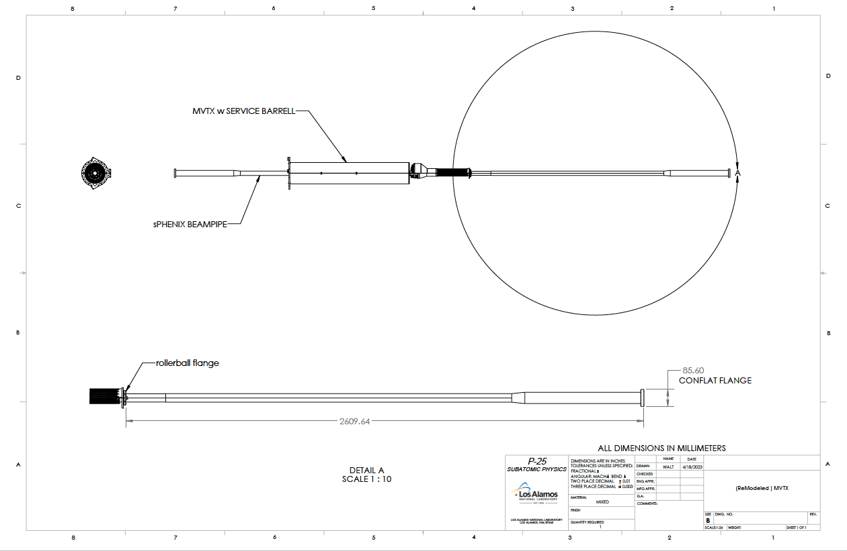
Add beam background monitors?
Blue-beam
Yellow-beam (worse one)
MBD
add beam-background monitor (and/or absorbers) around the BP
to help CAD to tune the beam?
R_BP = 2cm
Al-section

Slide 11
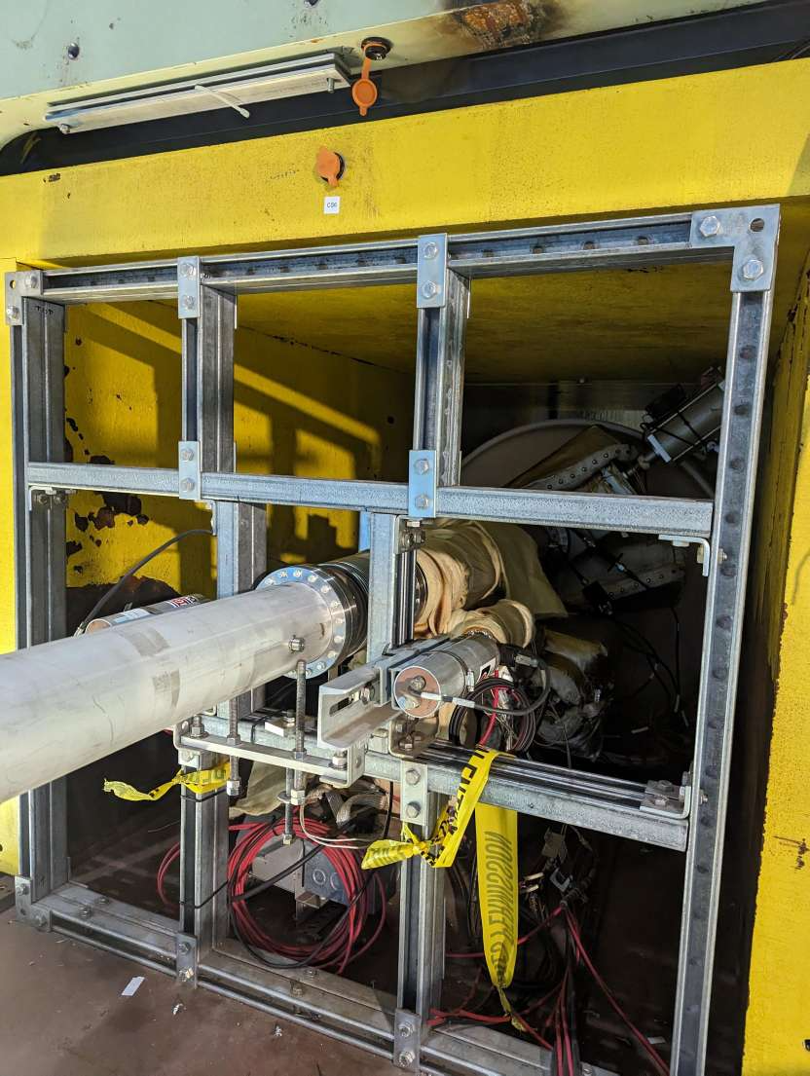
N6
N5

Slide 12
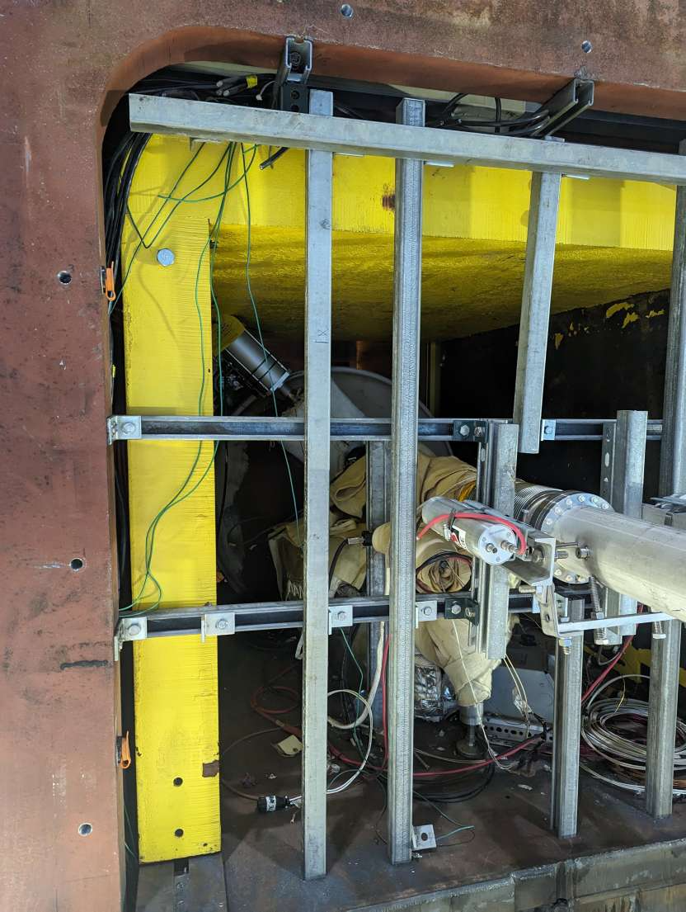
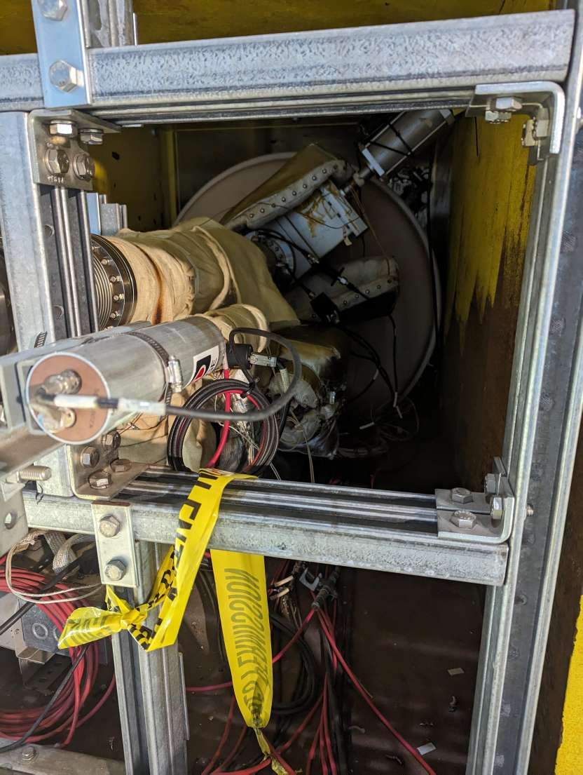
N5
N6

Slide 13
MVTX Operation for p+p: possible “plan-B”
If high backgrounds prevent streaming readout for p+p
  In AuAu, triggered mode okey DAQ ~15kHz, collision 30~50kHz
    MBD LL1 trigger <50KHz, with low latency ~2.5us
    Short strobe ~100ns, to reduce the chance of reading out beam background hits
  In p+p, high collision rate ~3MHz
    MBD LL1 rate for pp: ~ 30% of pp = 1MHz → “1us”
    A lot of pileup events
  Triggered mode with short strobe ~100ns for p+p,
    To reduce the chance of reading out beam background hits
    Readout ~10% of MBD LL1 events, at ~100kHz. (10us intervals)
    more MVTX events than other sPHENIX GL1 triggers (~15kHz)
  Requires fast “LL1” triggers, from MBD or ZDC, latency < 3.5us
HF Physics, w/o TPC?

Slide 14
Beam/Cosmic Trigger Timing:
MVTX, INTT, Hcal, MBD, ZDC …
GL1 latency ~3.5us?
INTT_BCO, TPC/TPOT == GL1-BCO [?] ← MBD + ZDC + HCal/EMCal
collision/cosmic
CR mode with long strobe: Two BCOs,
1) MVTX-Strobe-BCO, and 2)MVTX_GL1_BCO = GL1_BCO+1?
time
Signal
latched here
MVTX
signal
Signal latched here
Triggered mode with short strobe: one BCO,
1) MVTX-Strobe-BCO = MVTX_GL1_BCO = GL1_BCO
time
T0
CR mode with short strobes every ~4us ?
- Associate with GL1 later, no limit on GL1 latency

Slide 15
other slides

Slide 16
After the shieldings were installed, through collimations and vernier scans separately for the beams, Angelika has observed that S4-6 don’t seem to be affected by the background and S1-3 don’t seem to be affected by the collisions.
S1-3 rates are ~same as previous years but S4-6 rates have increased significantly this year.
PHENIX MUID have seen 2 components, highest @ gap-0 (closest to the IP) and 2nd highest @ gap-4 (furthest from the IP).
Gap-0 rates go to ~0 when the beams were not colliding.

Slide 17
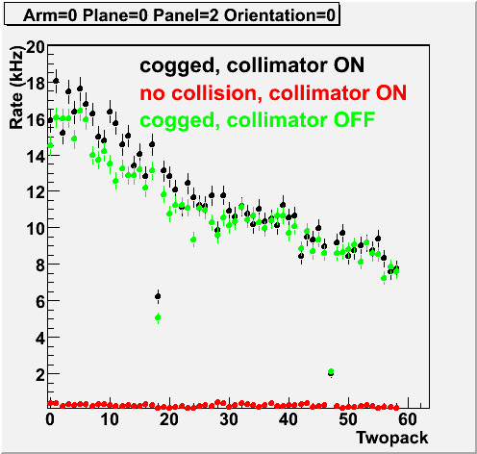
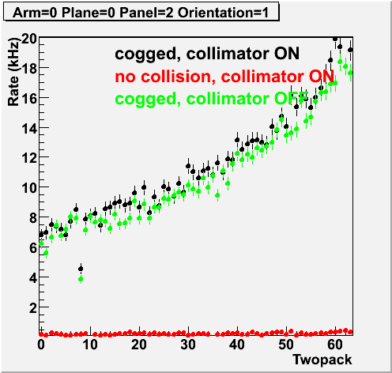
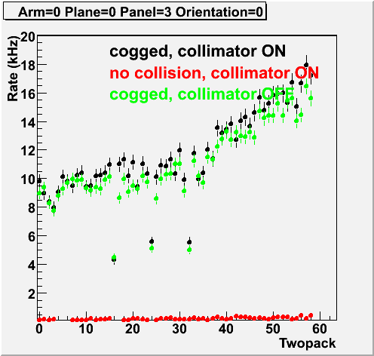
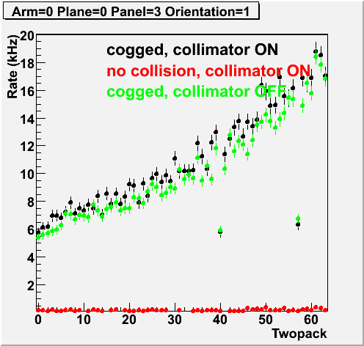
Rates from clock trigger sample

Slide 18
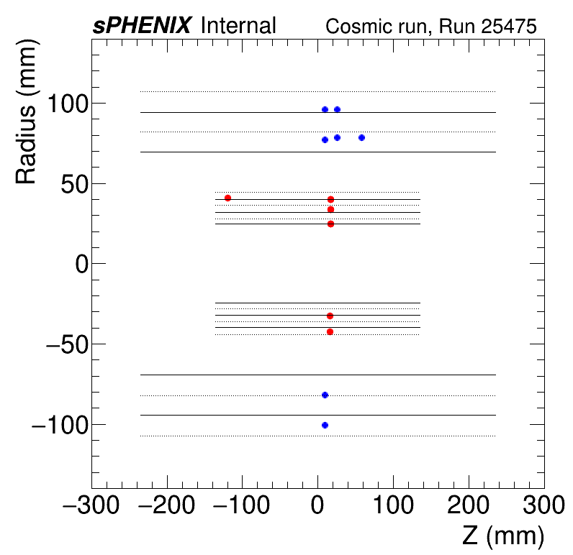
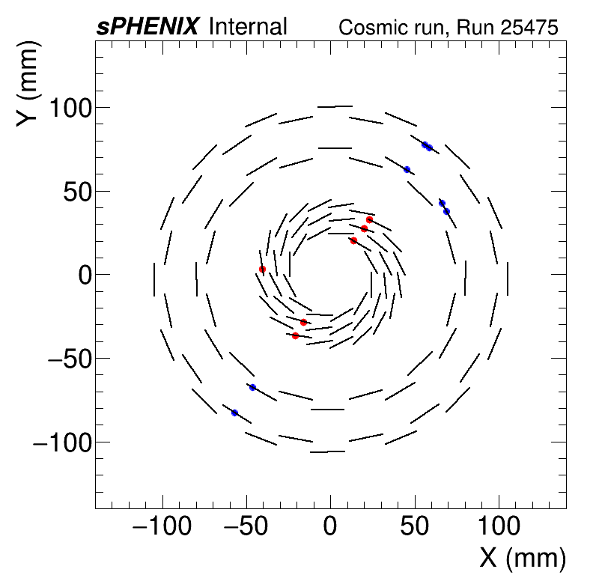
MVTX + INTT Cosmic Ray Events – very nice progress!
MVTX BCO is 883499075070 while INTT BCO is 883499075069

Slide 19
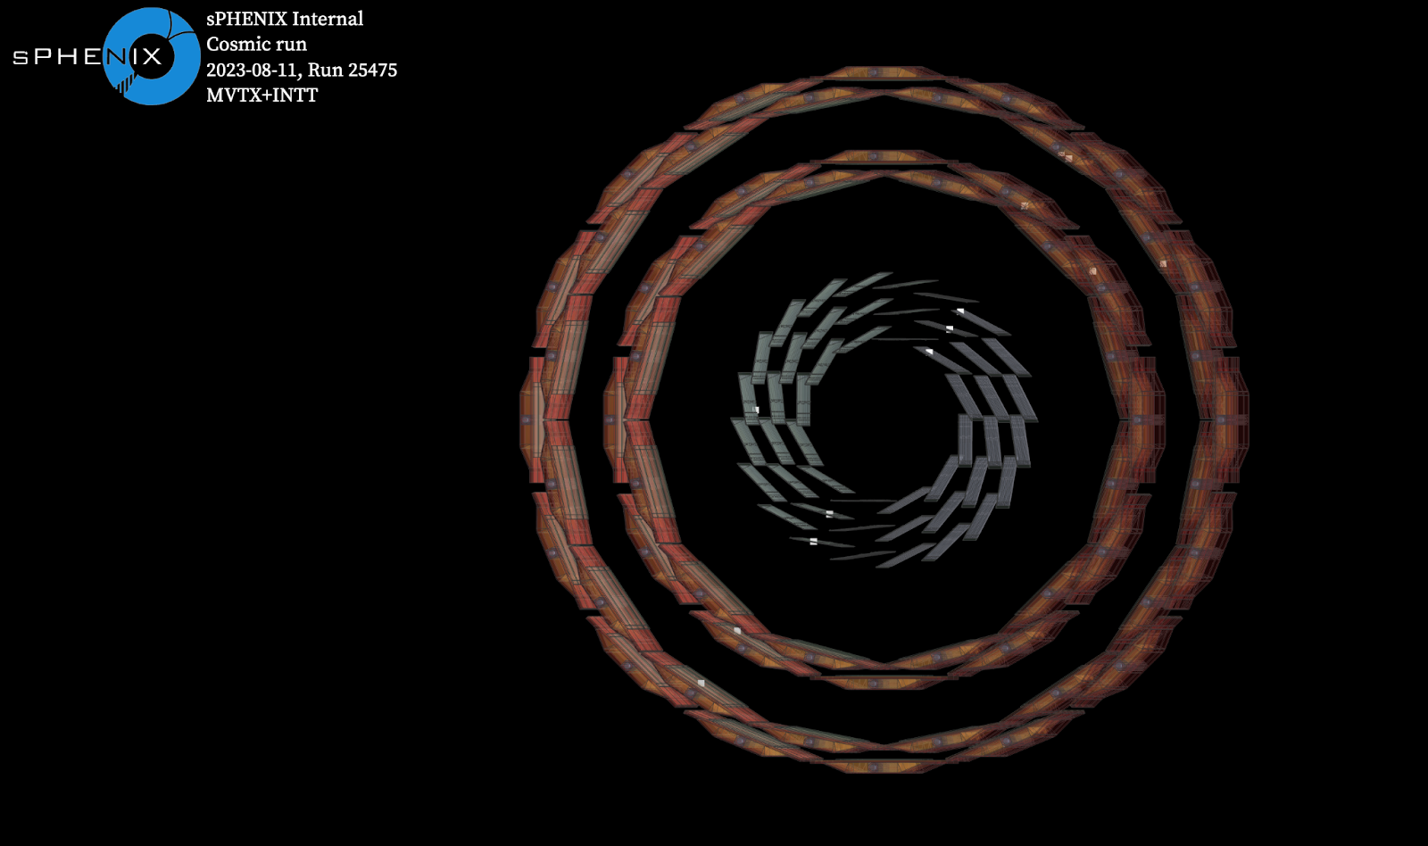
MVTX + INTT Cosmic Ray Events
MVTX BCO is 883499075070 while INTT BCO is 883499075069

Slide 20
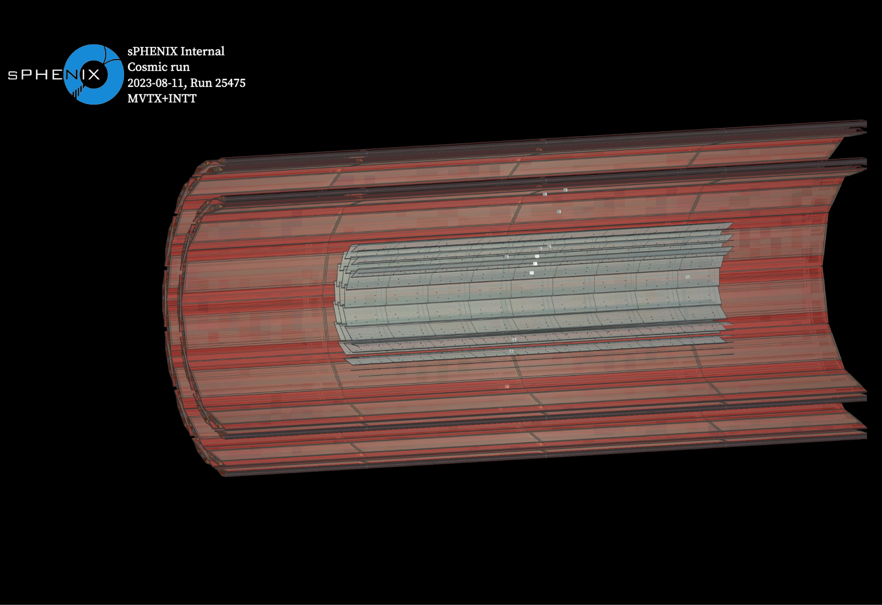
MVTX + INTT Cosmic Ray Events
MVTX BCO is 883499075070 while INTT BCO is 883499075069

Slide 21
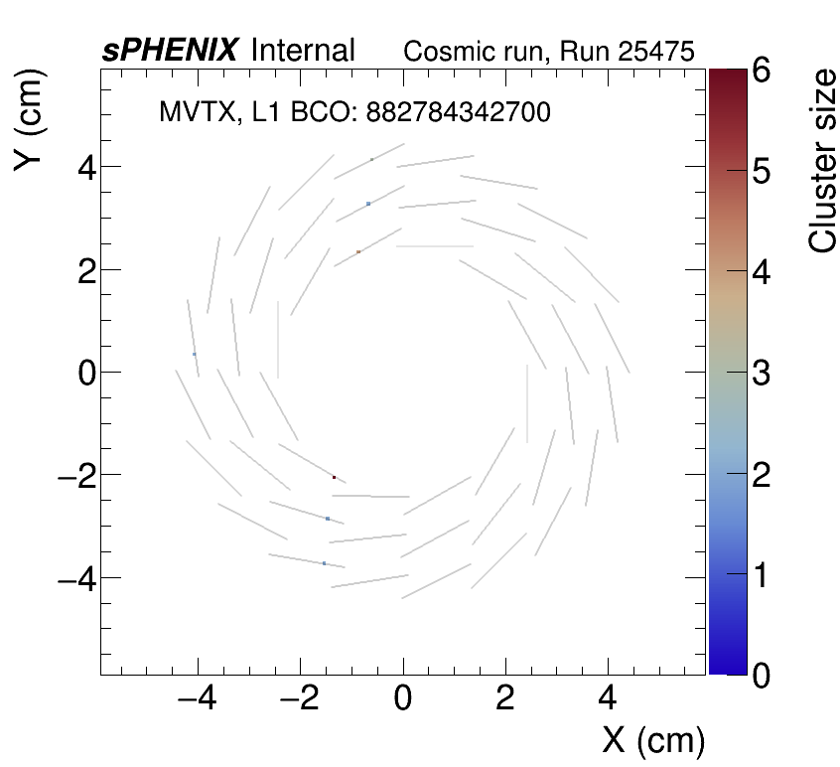
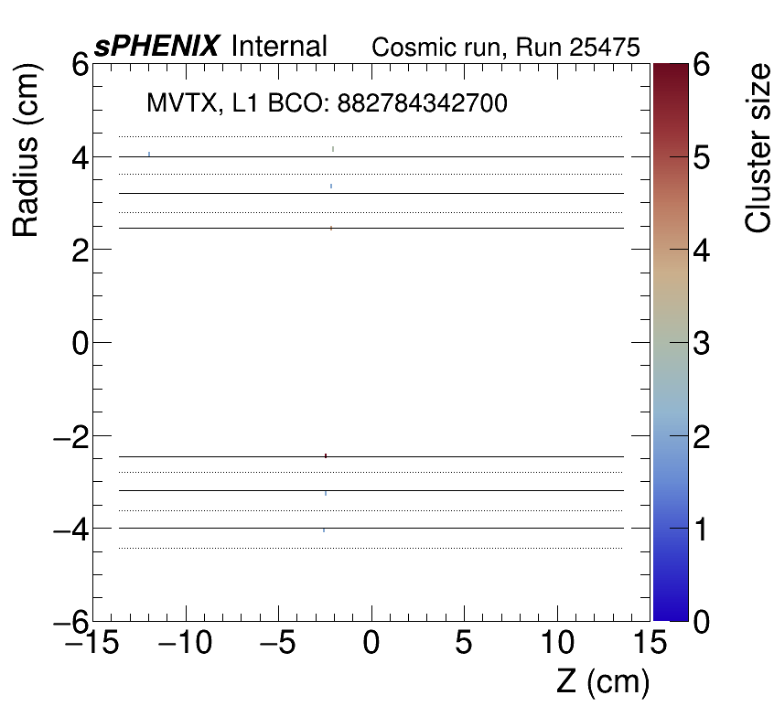
Simple clustering algorithm (after isolated hit removal): adjacent hits form edges, edges with common hits are connected to form clusters. Clusters should have at least 2 pixel hits
Updated by Hao-Ren on Aug 14th

Slide 22
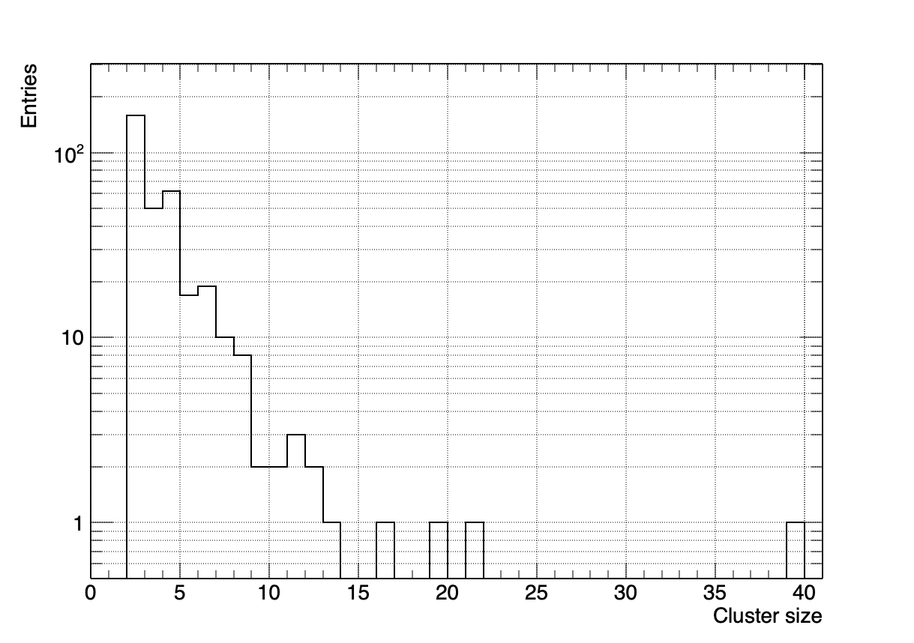
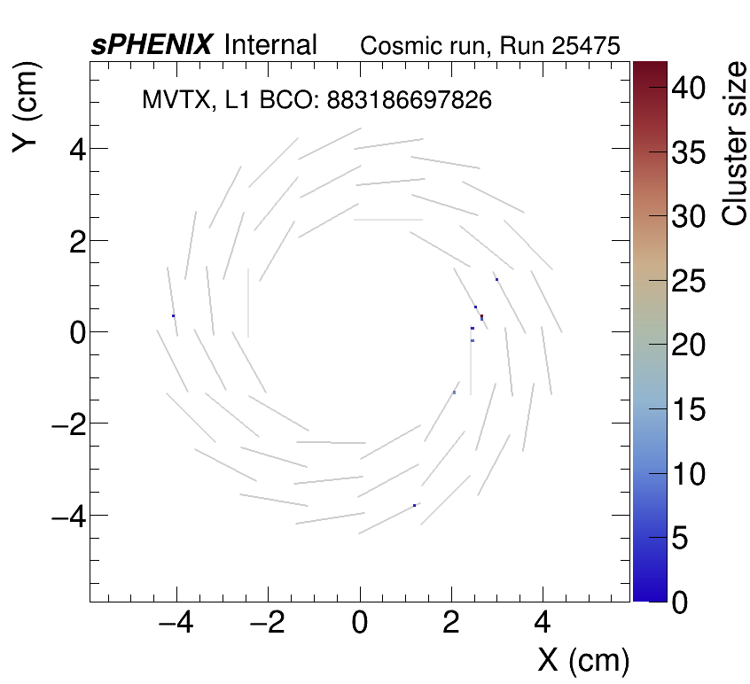
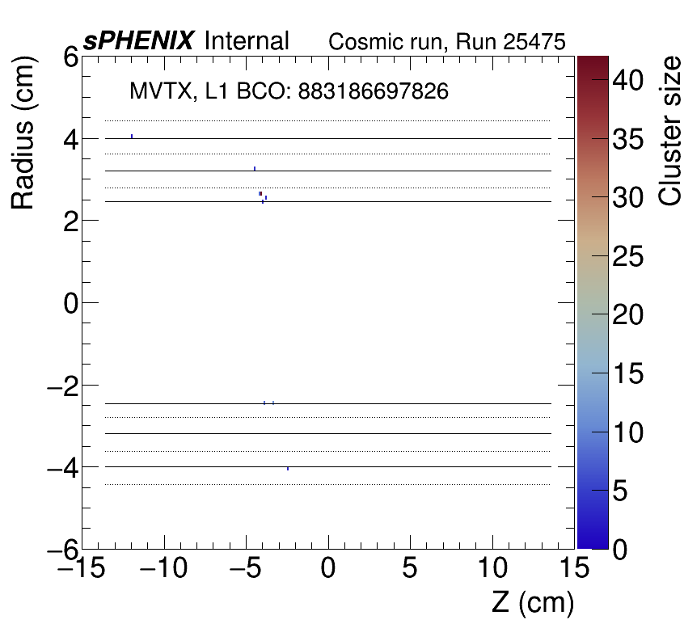
Simple clustering algorithm (after isolated hit removal): adjacent hits form edges, edges with common hits are connected to form clusters. Clusters should have at least 2 pixel hits
histogram->GetMean() = 3.693

Slide 23
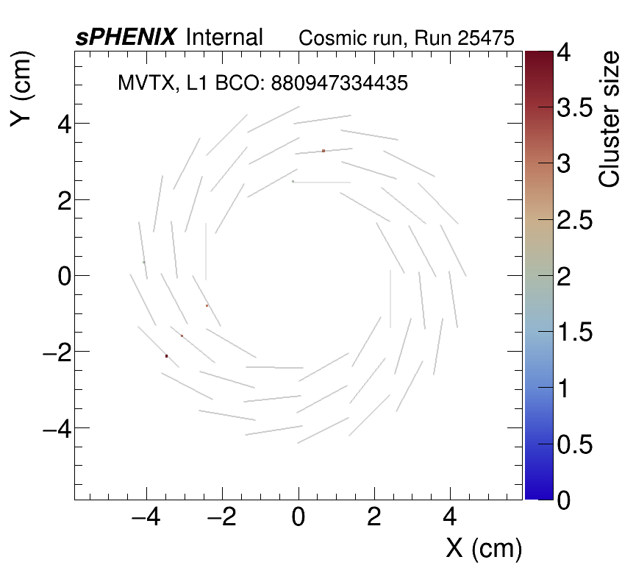



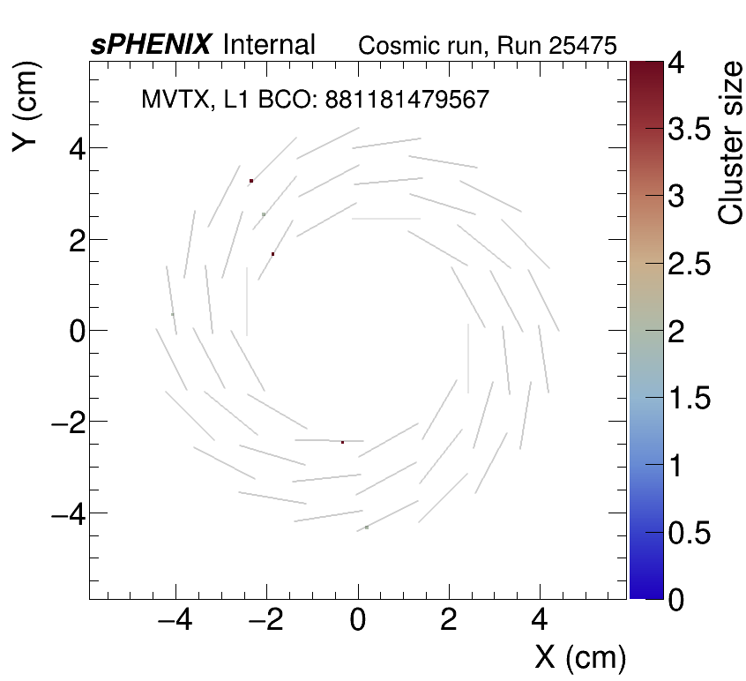
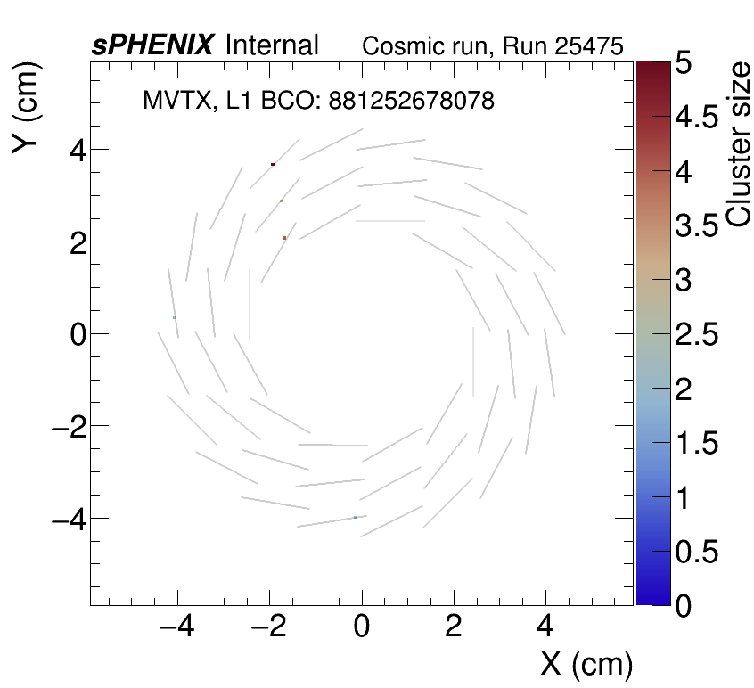
Unmasked noisy pixels?

Slide 24
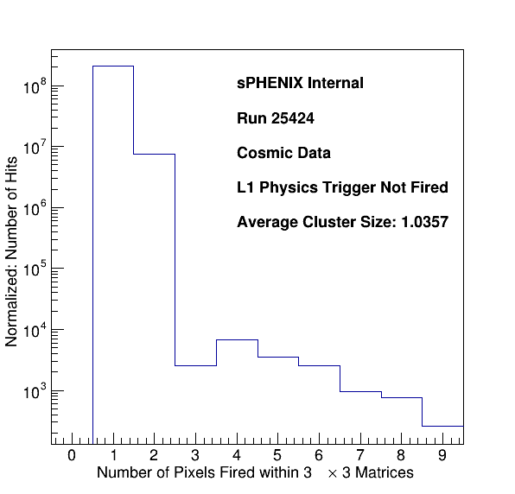
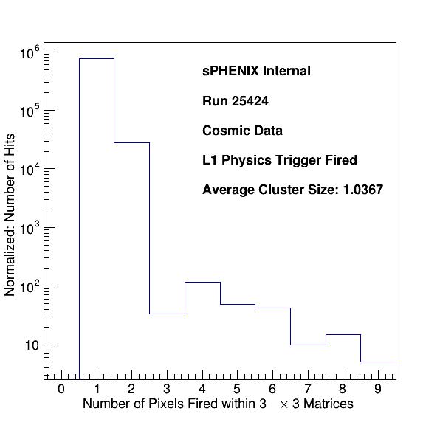
Cosmic Eve nt Cluster Size Study
Taken Hao-Ren’s idea of cluster finding but keep count the cluster size of all hit
When L1 physics trigger is NOT fired, all hit are basically noise only
When L1 physics trigger is fired, the hits consist of cosmic ray signal and noise
Average cluster size: L1 physics trigger fire > not fired
If we require at least 2 pixels cut, we can reject some background noise

Slide 25
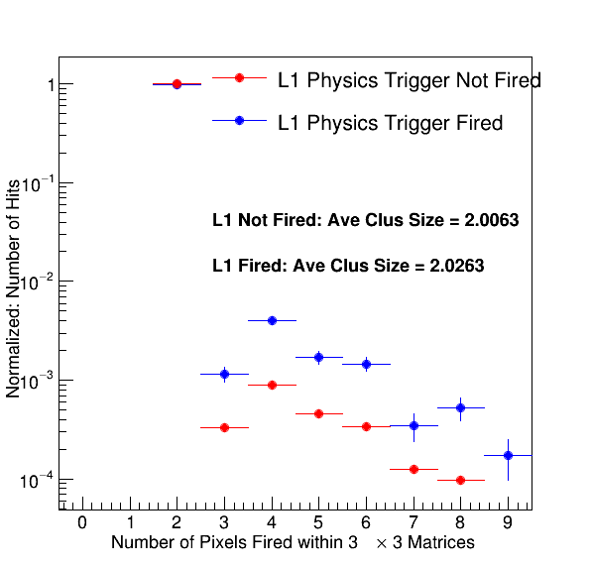
After At Least 2 Pixel Selections
L1 trigger events has more >= 3 clusters than L1 trigger not fired
L1 trigger events also has larger average cluster size
Can we do a template fit to extract cosmic events assume L1 not fired is purely MVTX noise?
Can also look into collision runs and single beam runs for this study

Slide 26
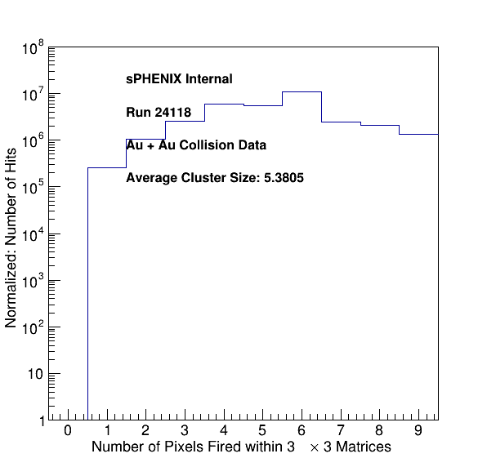
Au + Au Collision Run 21148
Larger cluster nearby is seen
Need to look more inside the studies
Run full clustering algorithm for better understanding

Slide 27
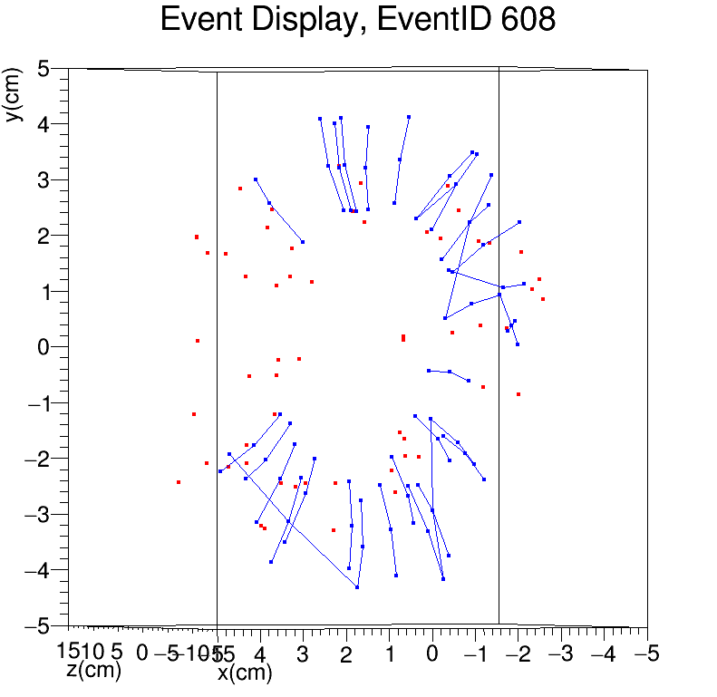
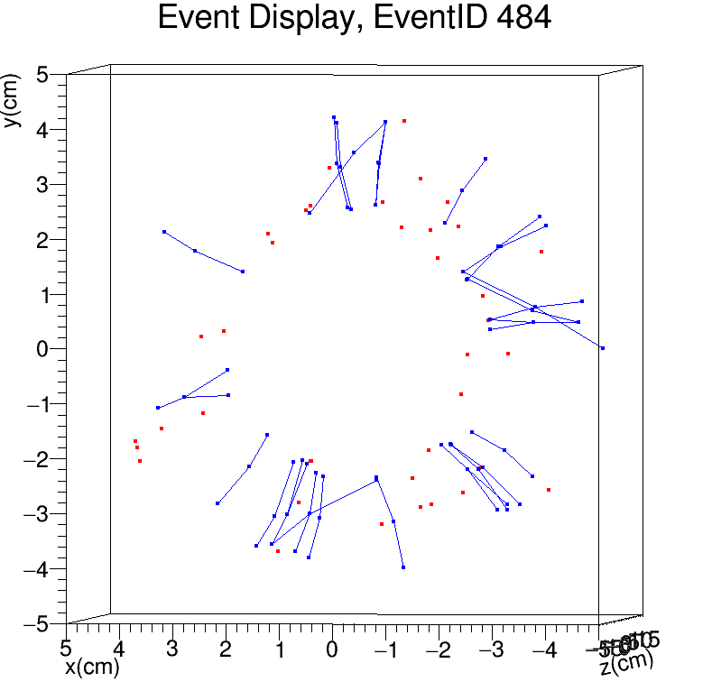
AuAu event - from JaeHyun
Run: 20124

Slide 28
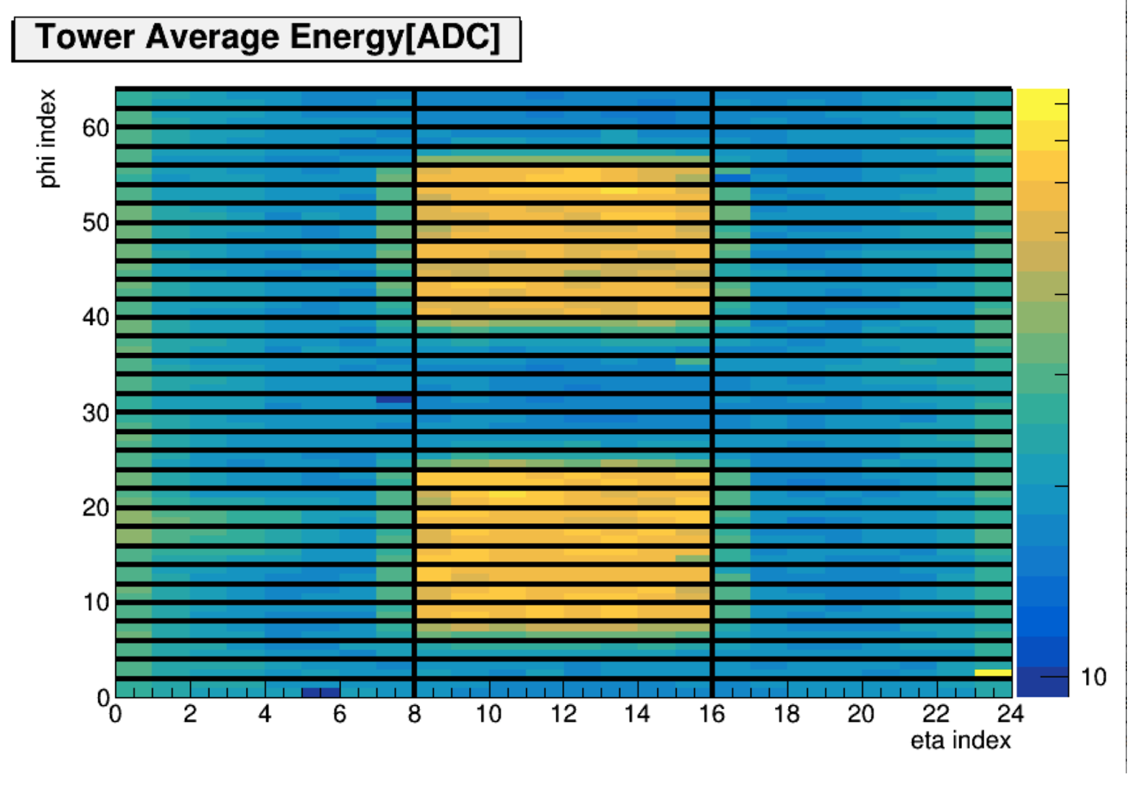
HCal Cosmic Trigger Setup: Top and Bottom
MVTX

Slide 29
Updated Plan for MVTX Commissioning w/o Beams
No beam but sPHENIX commissioning till early Oct. 2023
  Access to IR after magnet off (Monday)?
Readout and control integration
  Calibrations – noise and threshold scan, hot/dead pixels, done!
  Sphenix big partition global readout, with INTT and other detectors – cosmic run etc., done!
  Prepare for pp run: what is new in p+p?
    MBD sees ~30% of p+p collisions,
    high rate ~ 1MHz
    Default – streaming readout
    Could run in triggered mode (with MBD/ZDC)?
Closing the gaps
  Mockup in 510 first, nose roller dummy, other ideas?
  Risk factors?
  one problematic stave, L1xx?
Online/offline analysis
  Cosmic with INTT, internal alignment etc.
  RCDAQ decoder
Other improvements and spares
  Filters for the cooling system , DAQ2 cooling fix? DAQ2 stopped w/o known reasons?
  PLC modules
  Short SamTec cables production, in BNL procurement department
  Help CAD to reduce the backgrounds? Beam simulations, add additional shielding to the MVTX/sPHENIX BP
sPHENIX commissioning workfest this week: Mon-Wed
https://indico.bnl.gov/event/20205/
discuss plans for no-beam run etc.
- Hcal/EMCal trigger available
GL1 latency, ~3.5us?
Cosmic triggers
- MVTX + INTT + EMCal/HCal
Check MVTX sensor noise,
w/ and w/o B-field

Slide 30
Offline Analysis
Optimal delta_BCO for MVTX+INTT matching
  Collision time = [BCO_INTT – dT1];
    dT1 = INTT internal delay
  Corresponding MVTX hit BCO = [BCO_MVTX - dT2]
    dT2 = MVTX internal delay
  MVTX hit integration time ~ 5us (~ 50 BCO’s)
    Strobe length = 44us
rcdaq decoder
  Online/Offline analysis
  Event pooling …
Online monitor
Offline reconstruction
  Cluster
  Alignment
  Tracking
Possibility of doing physics with already
collected MVTX data of AuAu?
Cluster size
Tracklets distributions
Internal alignment

Slide 31
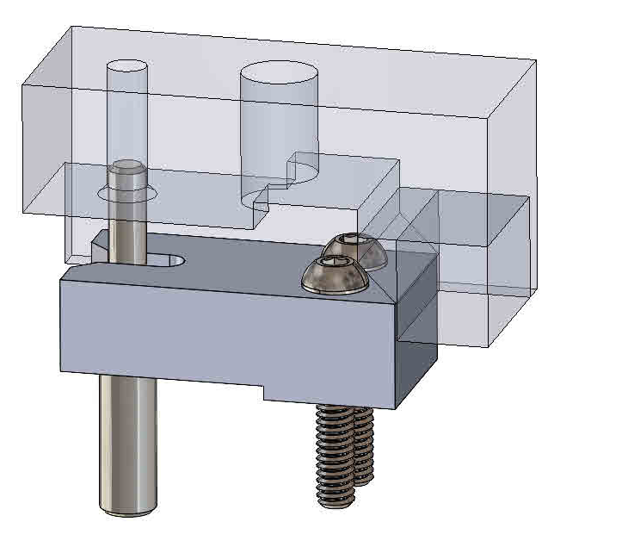
Rollerball pin capture block -1
Walt

Slide 32
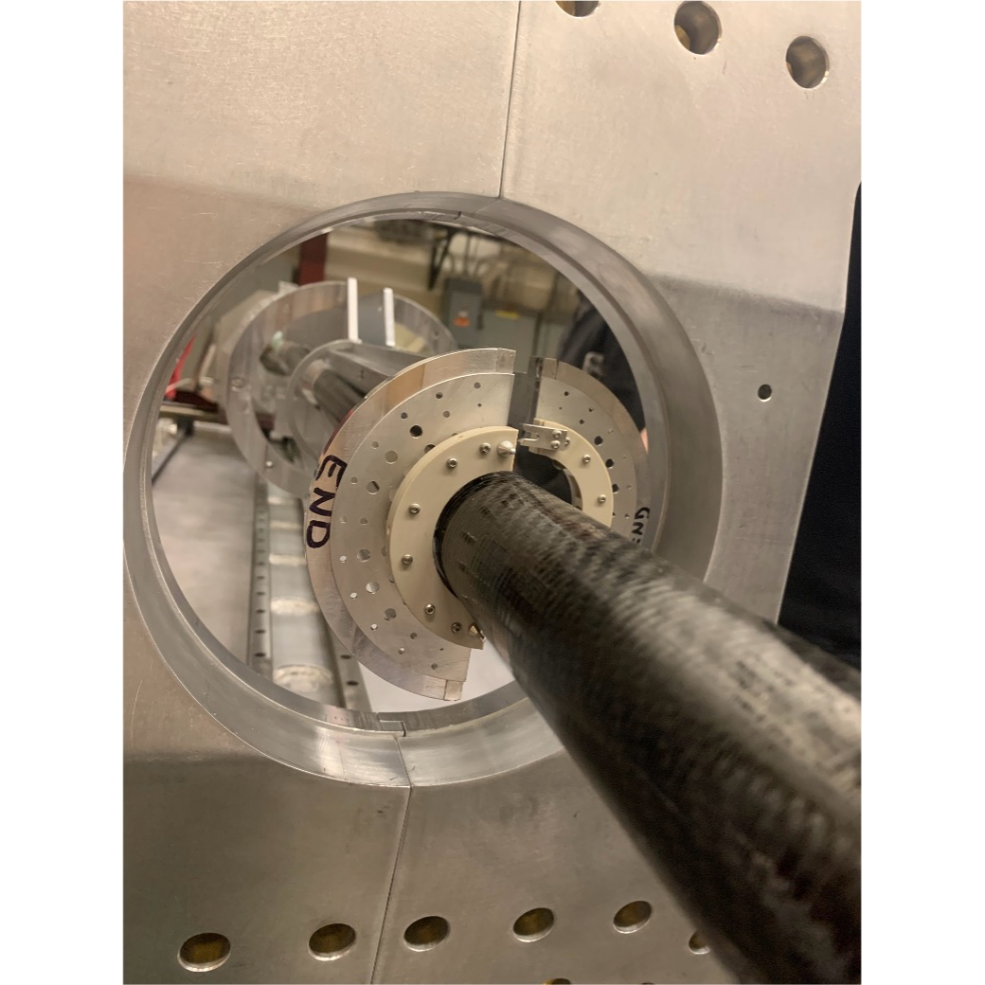
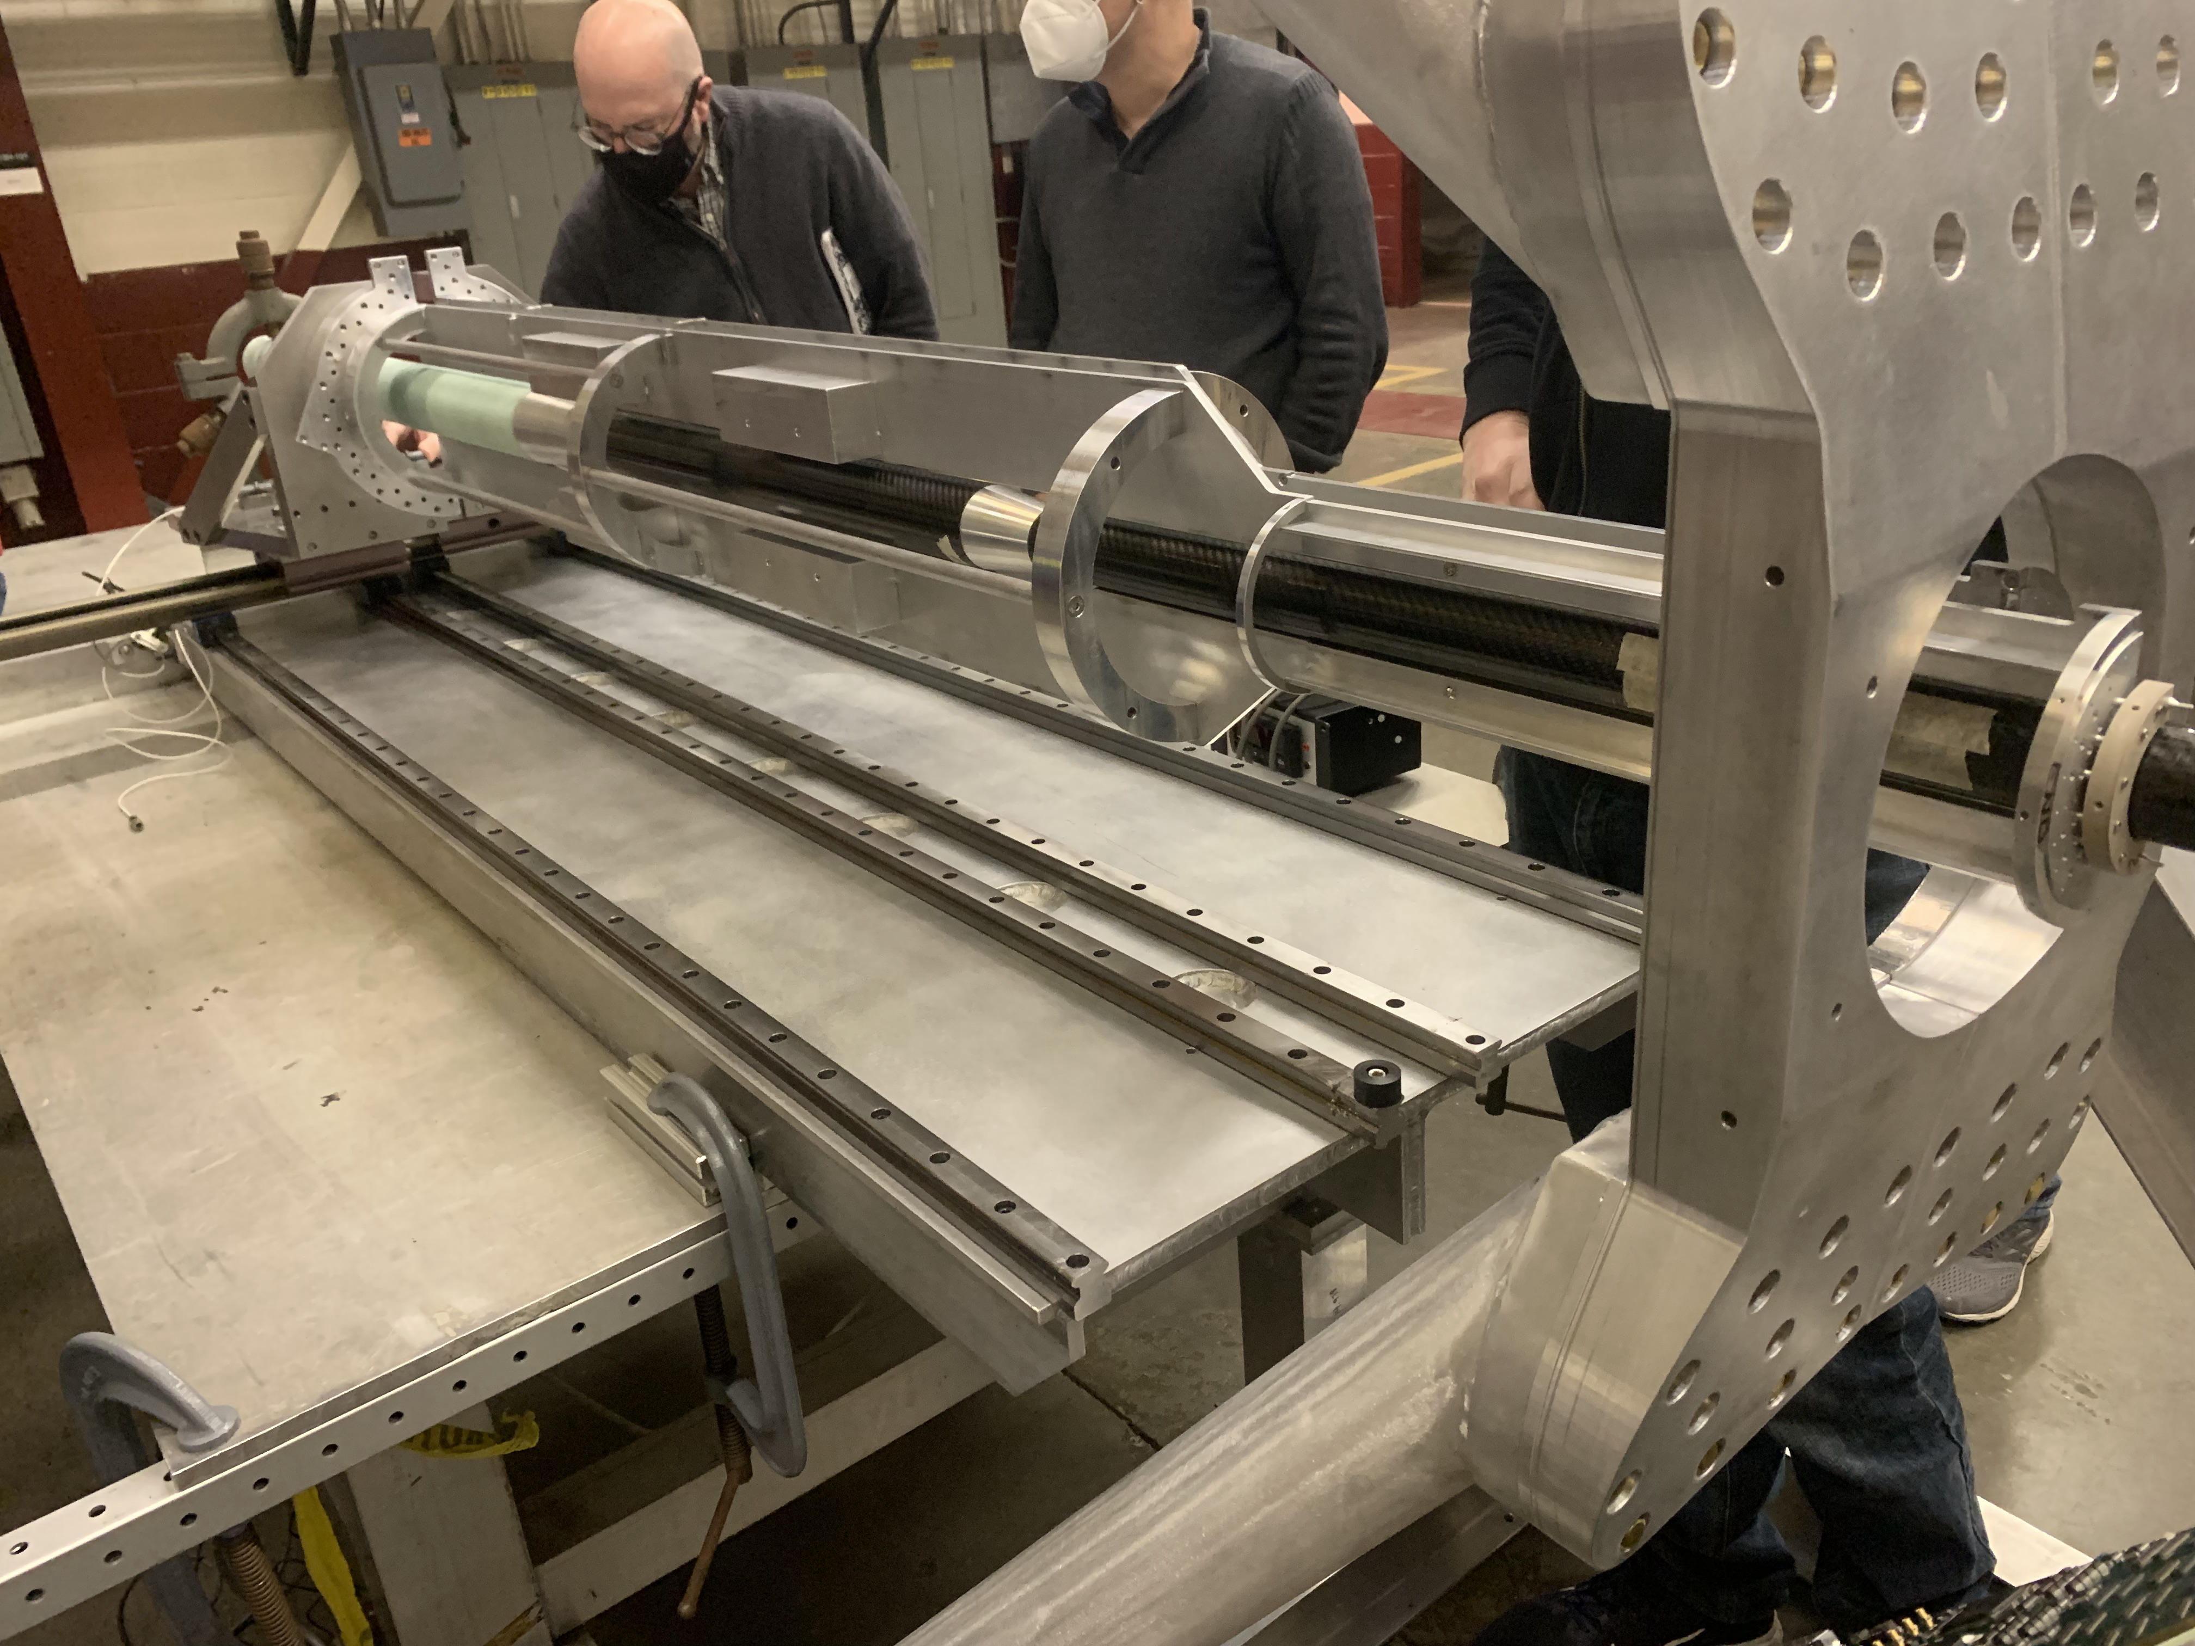

Slide 33
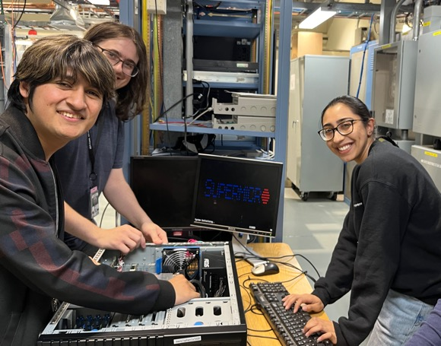
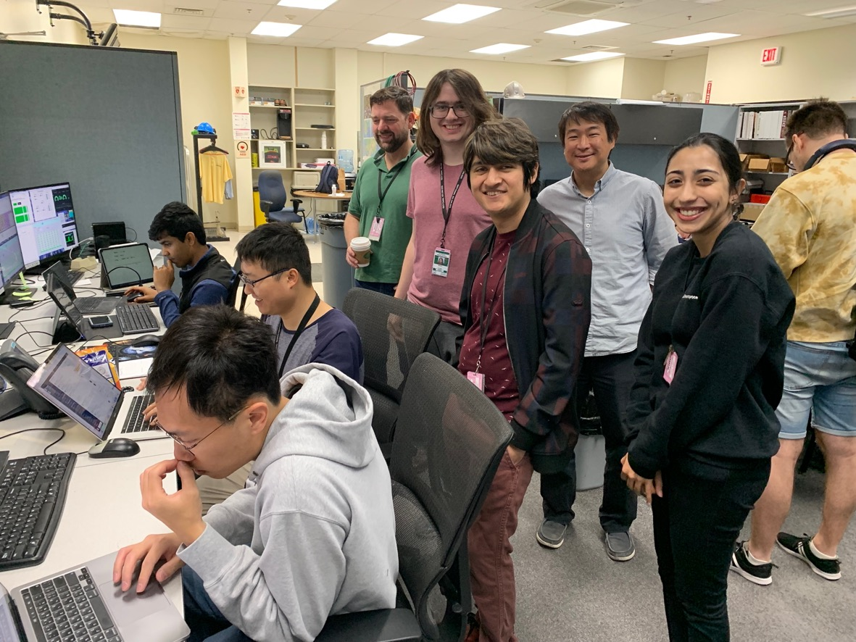
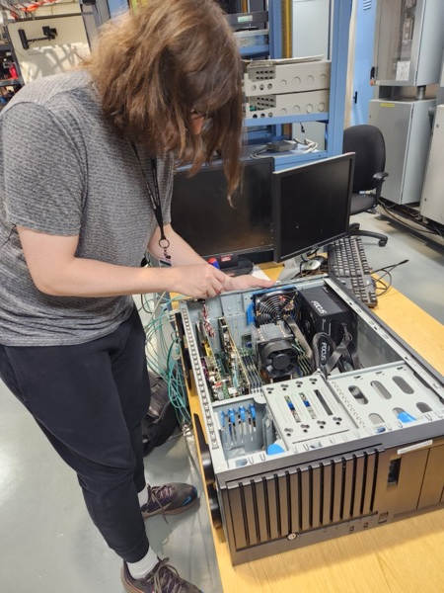
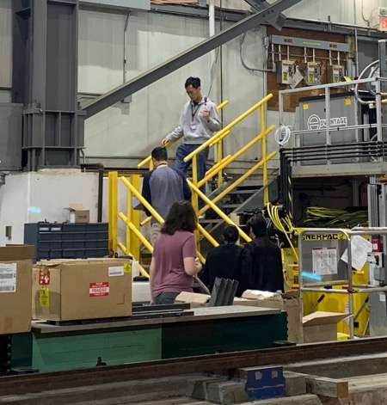
8/12 last day for UConn Students at BNL:
- Great work by our summer students, thank you!

Slide 34
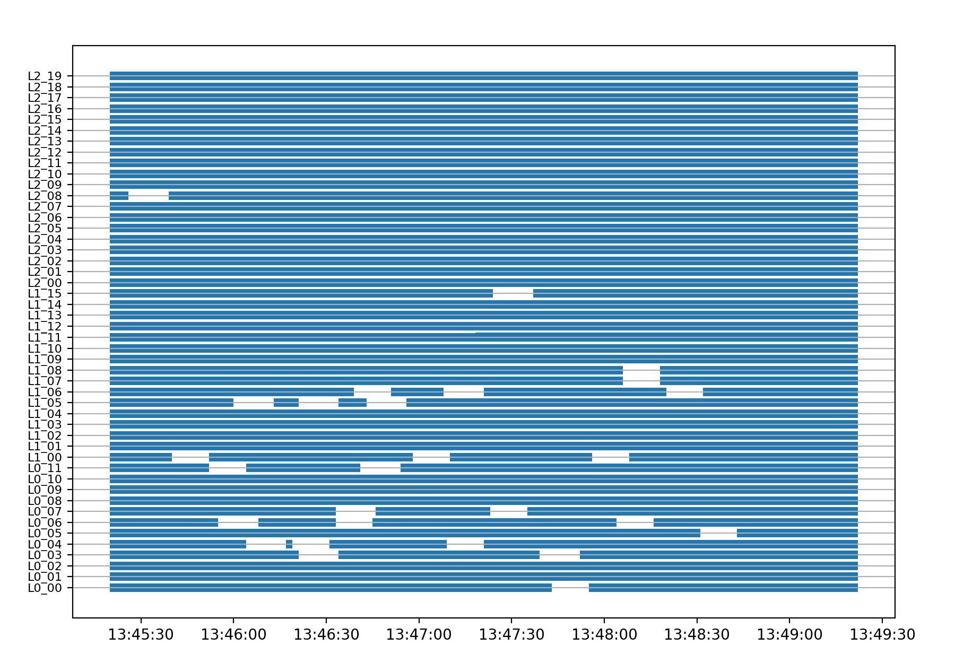
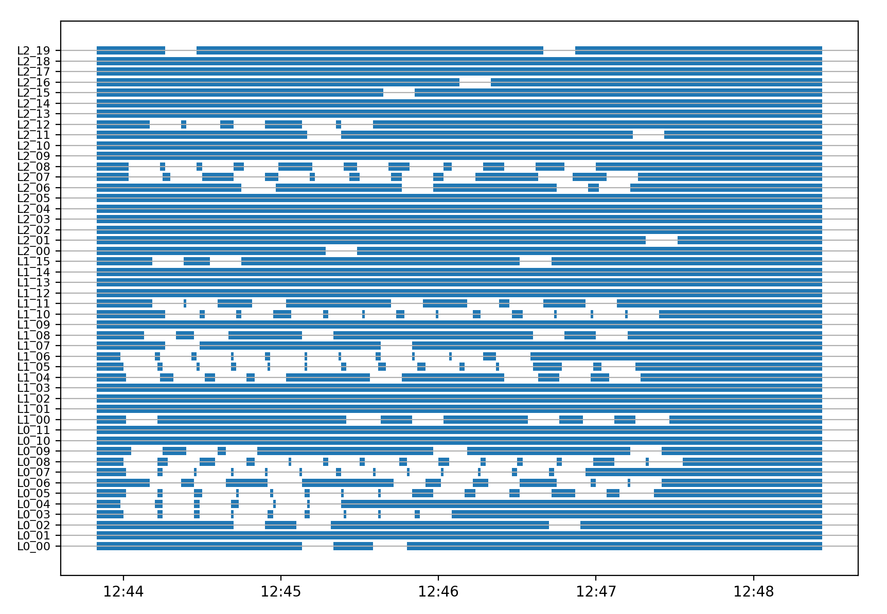
Some progress … much reduced background achieved with “aggressive beam collimation”
Note: Slower progress was out of MVTX control. We needed C-AD experts on site (working hours only) then RHIC went down on Tuesday afternoon and was only recovered on Sunday night. We’re now trying to understand GTM updates that were launched last week
Stave auto-recovery activity vs time
Before collimation -
After collimation
From Michael

Slide 35
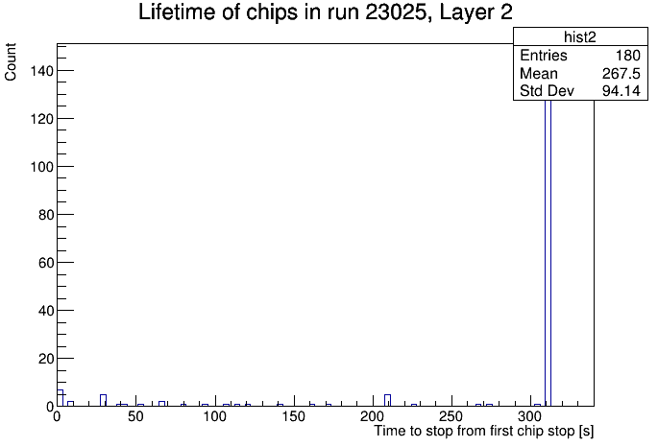
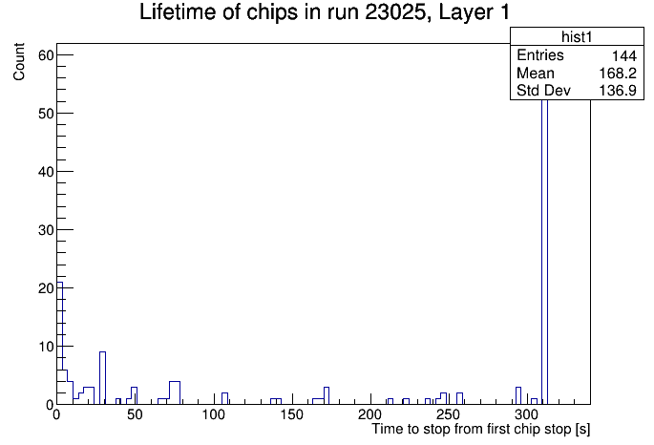
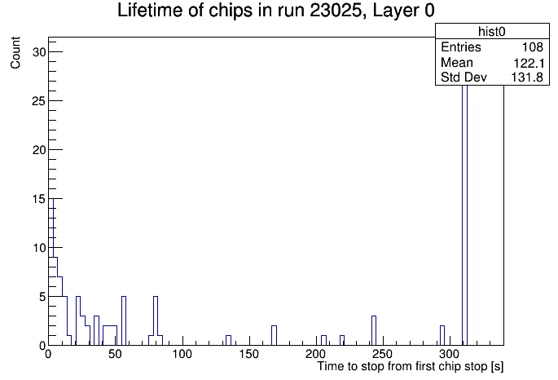
Chip lifetime - L0 - L2, 07/28/2023
- clear layer dependence seen
from Alessio
Run: 23025
L2: 180sec,
less errors
L1: 144sec
L0: 108sec
many errors

Slide 36
Status and Plan
7/31/2023
Continue working with CAD on beam background reduction
  More tests with single beam, with aggressive beam collimation, at the end of fills in coming days
  Add more shielding?
Explore alternative MVTX readout for this year
  Chip auto-recovery ON
  Triggered mode with short strobe
    Low latency MBD LL1 trigger to MVTX
    GL1 latency ~3.5us, good enough?
From today’s 9 o’clock meeting
  MVTX background:
    try aggressive collimation at end of this store (the one that came in at 11am), so around 7pm
    beta* change: we will run a test tomorrow morning to increase beta* to 5 m (currently beta* = 0.7) in order to decrease background from the triplets as much as possible
    There is an existing ramp with this beta* in both IRs
Priority: To take data with the rest of sPHENIX subsystems

Slide 37
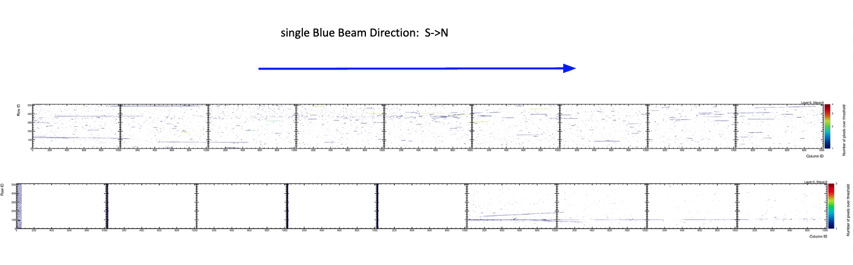
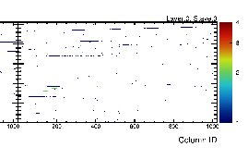

Slide 38
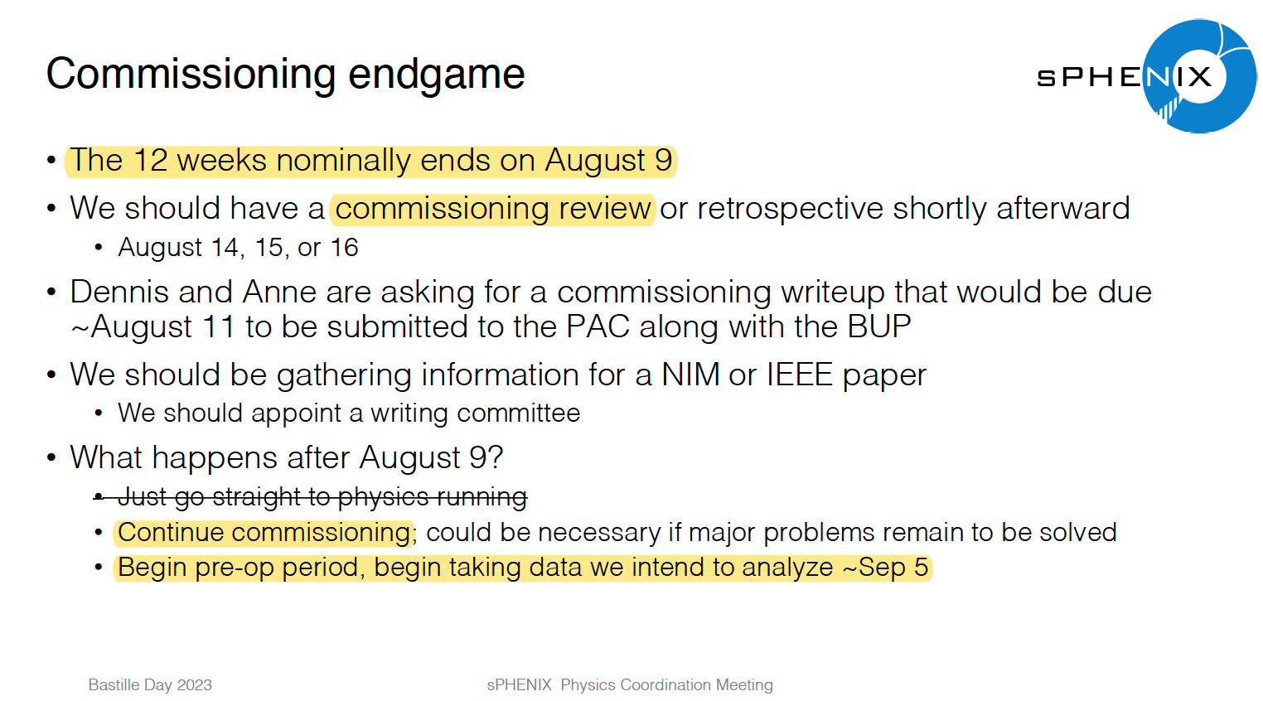
Commissioning ends in 4 weeks, ~ Aug 9th
John H.

Slide 39
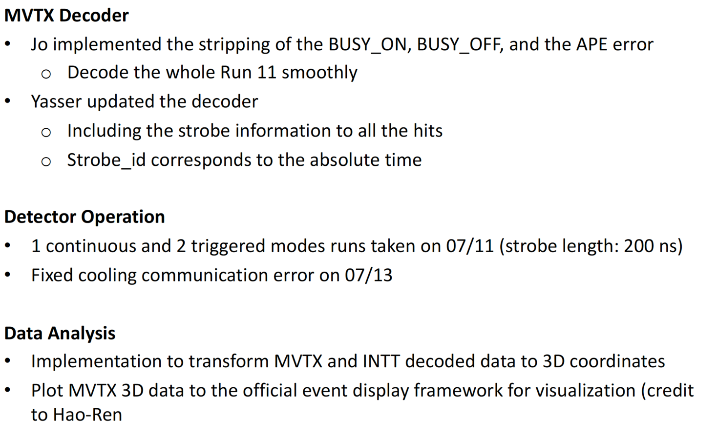
Work in progress
7/17/2023
From Zhaozhong
private decoder for raw data checking
rcdaq decoder with pooling in progress
a new integrated control panel - WinCC
3D event display

Slide 40
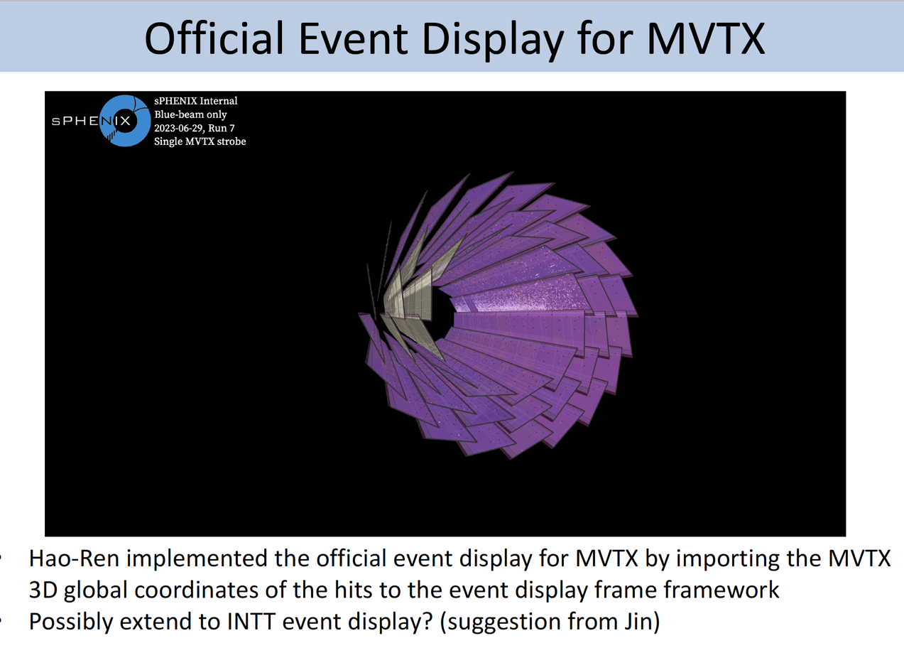

3D Display
Thanks to Thomas Marshall and Aditya Dash for helps on setting up the sPHENIX event display
Cameron, Hao-Ren, Xudong, Zhaozhong, Gursimram, Ricardo, Alessio et al
Blue-beam only. 1000 <= nHits <= 3000, all staves. 474 HBF
Animation: https://drive.google.com/file/d/1LAlCgzGYSgwGTLRb3m5pHxqWM89TMxZn/view?usp=sharing

Slide 41

T0
~10ns
Rising 1~2us
Width ~5us
~Readout
starts
~5us

