Slide 1
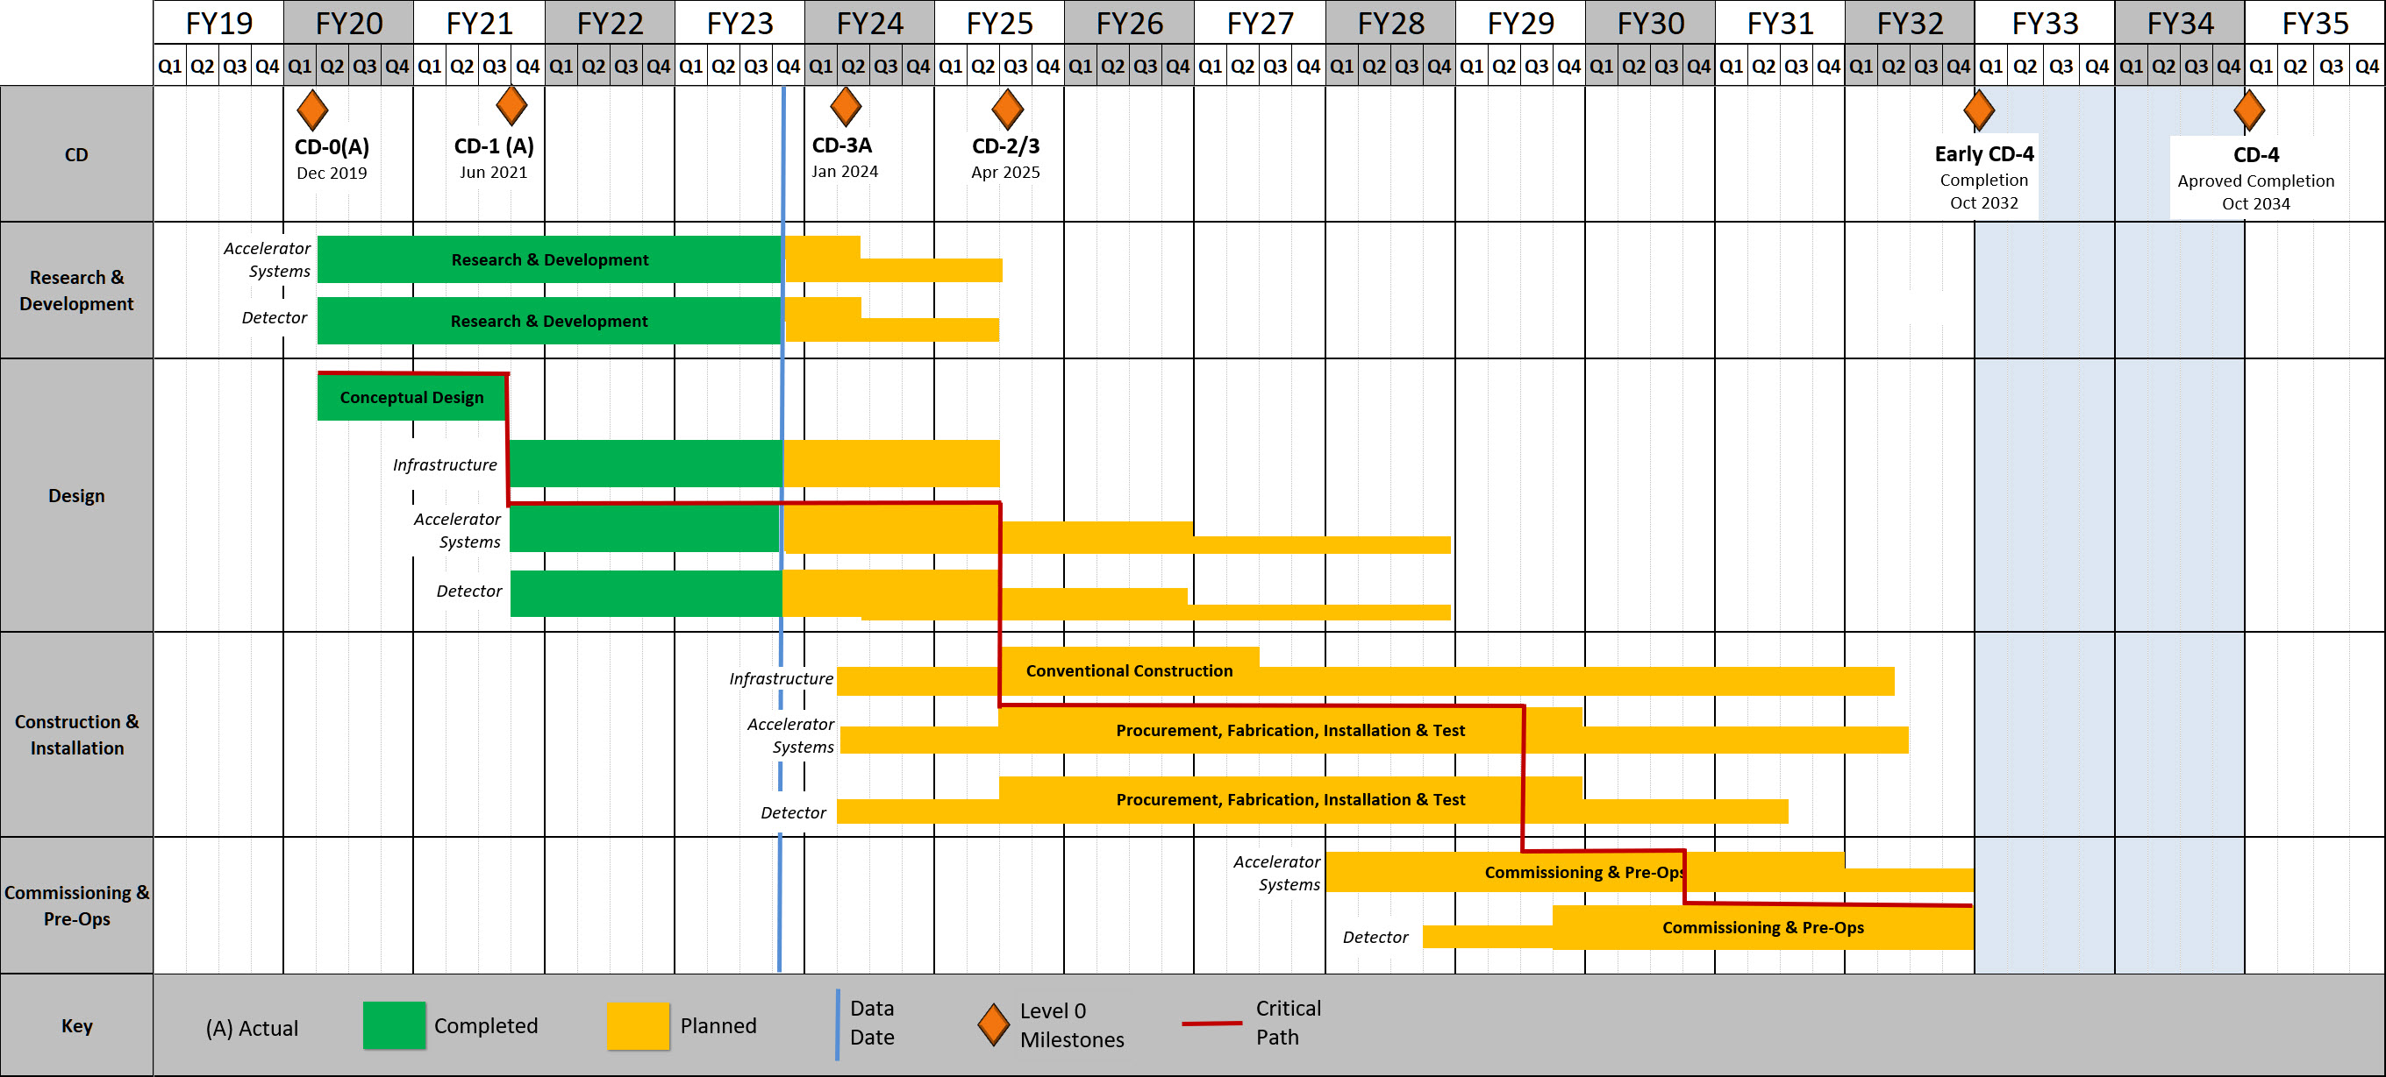
Project Schedule Overview

