Slide 1
Summary on ITS-3 ALICE –EIC SiC
Overall a very positive and successful meeting → clear goal to cooperate as much as possible in boundary conditions.
Main lessons learned and next steps
ITS3 open to sharing their sensor design with EIC → necessary agreements will need to be put in place in the next month.
ITS3 development made significant progress → received a lot of critical technical information to guide the next steps in R&D for both sensor and system design/integration of the ePIC SVT
but there remains still some risk in the ITS development → ALICE team will need to remain focused on their requirements and timeline challenges
→ ITS3 welcomes/seeks partnership in development with EIC designers contributing to ITS3
→ Received extremely valuable input to overall schedule and workforce needs for EIC SVT
Example: relation between schedule for ITS3 ER2/ER3 submission and evaluation and the
EIC/LAS development schedule → adjust our schedule to give more time for the sensor
modifications and the schedule and integrate lessons learnt from ITS3
→ ITS3 suggests we put in place a backup plan as our workforce is still growing, and the
overall EIC SVT schedule is aggressive
All the inputs are currently folded in an updated plan by the EIC SVT team
Updates will be presented in the respective ePIC meetings (TIC & TWG) by the SVT team

Slide 2
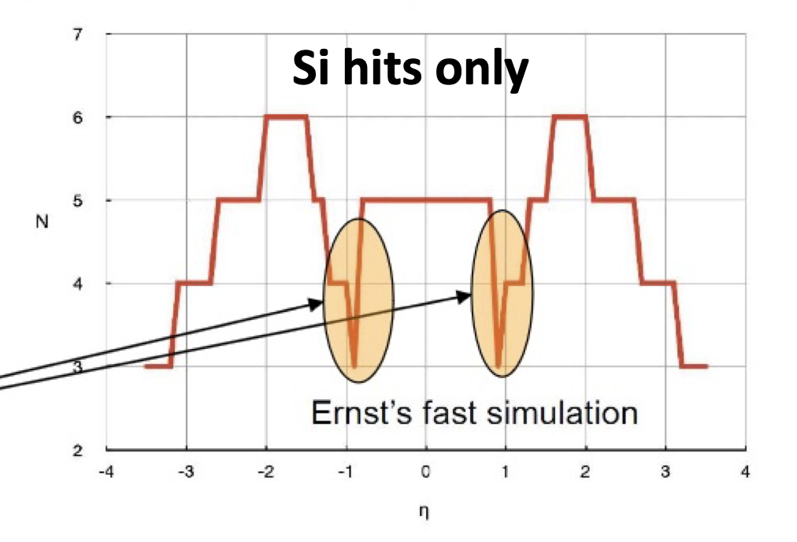
Issues solved by new layout
low number of hits in certain rapidity ranges → need more planes
solve impact from 5 (2) μs MAPS frame accumulation time
→ need enough hits from fast detectors to form a
tracklet with a good pointing resolution
→ need to utilize ToF and maybe Barrel-ECal AstroPix
as possible
Note: Barrel ToF has good t-resolution but spatial resolution is not not to great

Slide 3
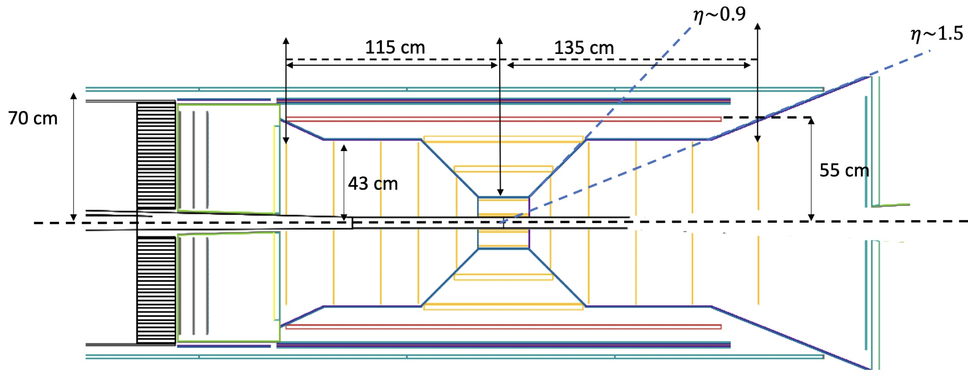
The two big issues to solve first
Lepton Side:
reduce lever arm of Si-disks or reduce pfRICH to have space for two layers of MPGDs in front of pfRICH
Hadron Side:
add 2 layers of MPGDs in the region between last Si-Disk and ToF
Barrel:
move AC-LGAD/ToF in, have MPGD layer directly in-front of DIRC (use DIRC segmentation)
need to optimize length of MPGD and/or service solution to see it solves the 0.9 to 1.5 gap
→ MPGD is also important for track information for DIRC
General: see service routing optimization can help with gap minimization
All of these changes have been made in absolute close contact to engineering team

