Slide 1
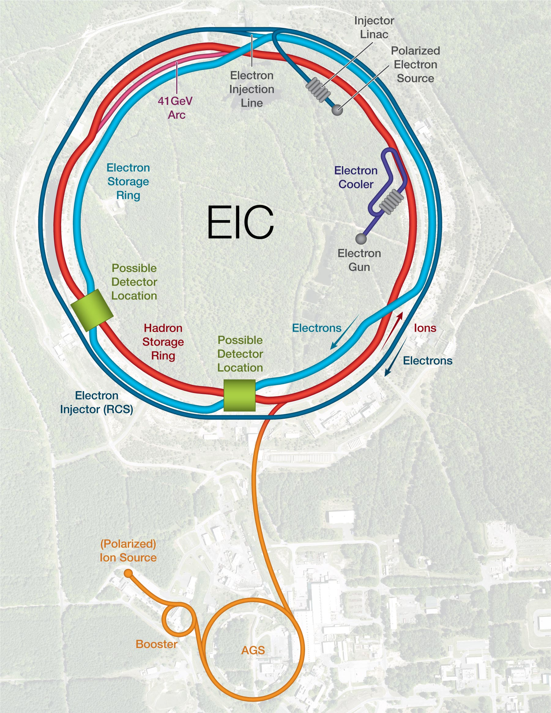
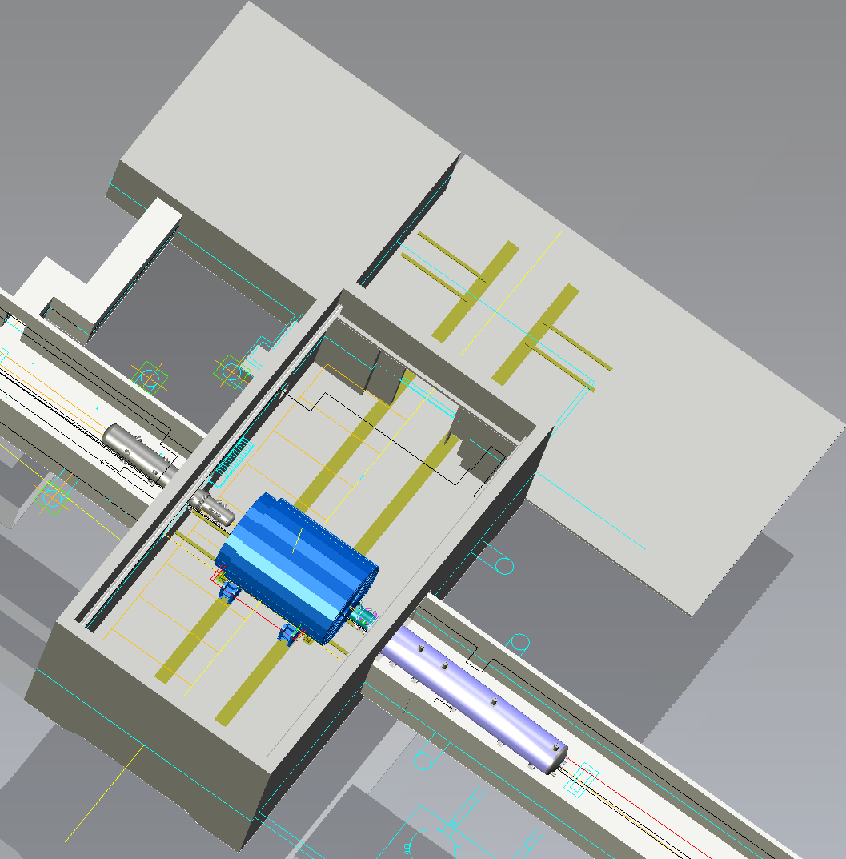

EIC – IP-6
Control
&
DAQ-ROOM
Ring Inside
Possible
2nd Detector
Location
Assembly
Hall
Project
Detector
Location
Hadron
Ring Outside
Electrons
IP-6 provides an interaction region with
a hall with all infrastructure needed for a collider detector
Assembly hall provides amble space for installation and maintenance.

Slide 2
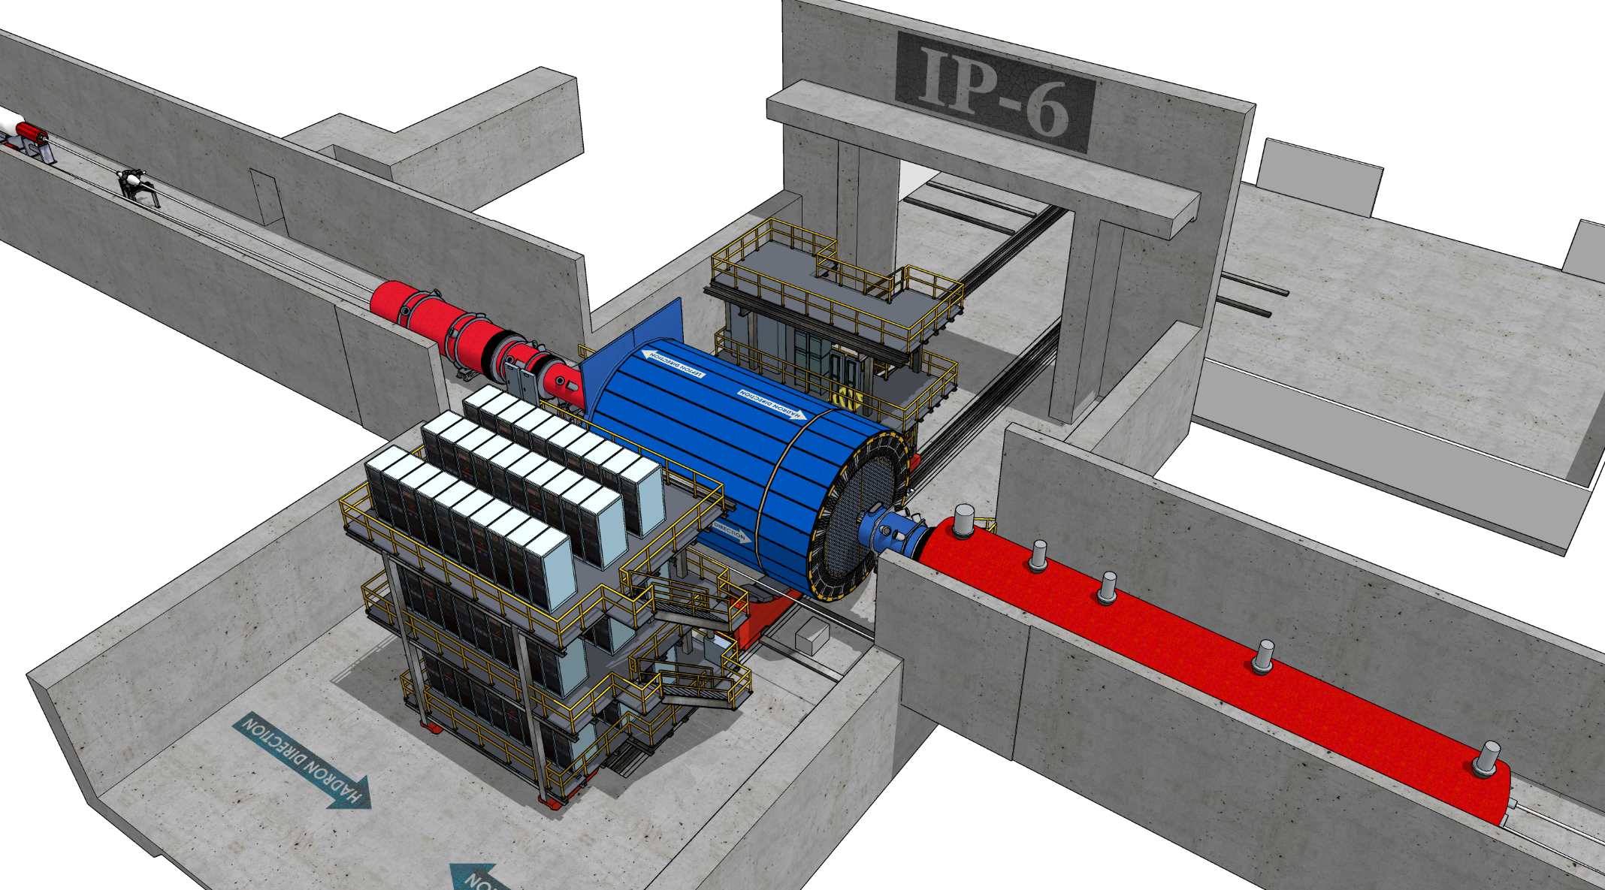
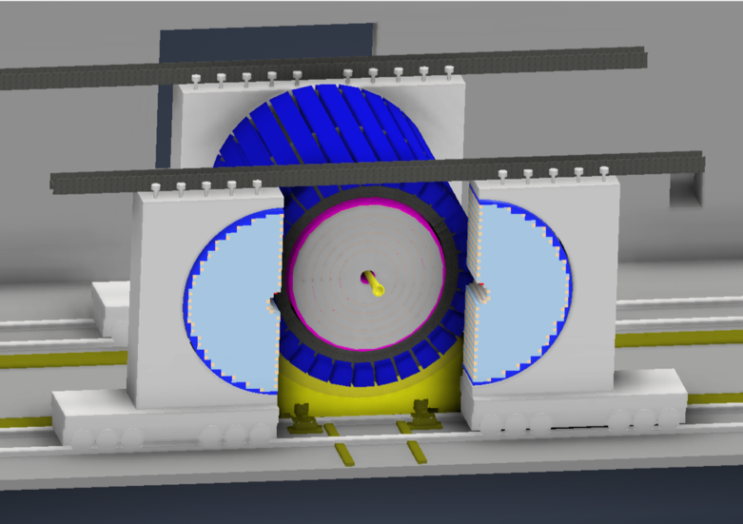
IR-Integration and Interfaces
Space Constrains:
-4.5 m – IP – +5m not negotiable
<50 cm space to 1st IR-magnets occupied by vacuum pumps, valves, …..
IP moved 81 cm towards ring inside compared to RHIC; y: 432 cm above floor
RCS to IP: radial distance 335.2 cm at a height of 372 cm above floor
Maximum outer radius ~ 3.2 m
limited installation possible in Collider Hall
endcap hadron calorimeters need to be split transverse to beam pipe
RCS vacuum needs to be broken
Electrons
Hadrons
RCS
9.5 long detector does not fit through the door
Door-Size: 823 cm x 823 cm
endcaps need to remain in collider hall, if central detector rolls in assembly hall

