Slide 1
WBS 6.10 & 6.10.01
Detector Overview and Requirements
E.C. Aschenauer (BNL) & R. Ent (JLab)
EIC Detector Comprehensive
Design Review
August 29-30, 2023

Slide 2
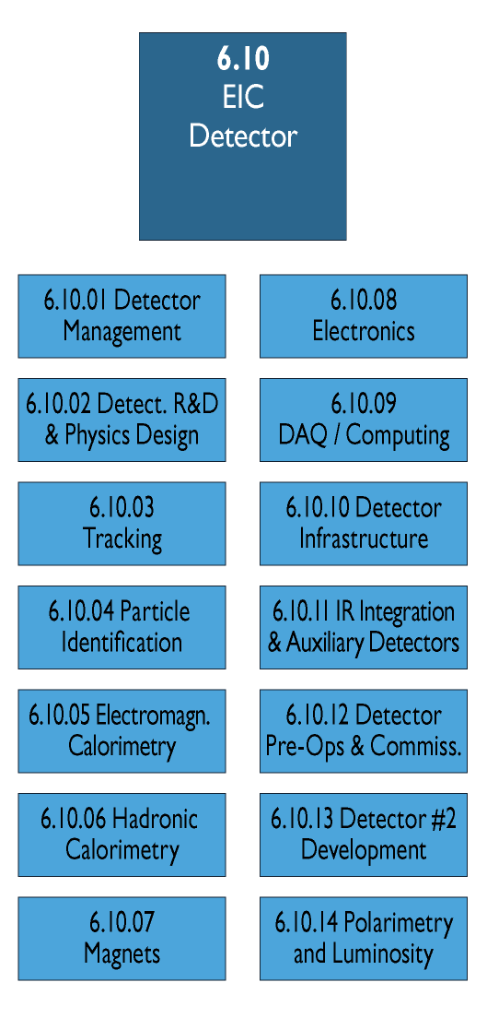
WBS 6.10 EIC Detector & 6.10.01 Management
6.10 Scope:
This WBS covers the cost for R&D, PED and construction of a general-purpose reference detector capable of the physics program detailed in the NAS review at full center-of-mass energy range (20 GeV and 140 GeV) and luminosity (10³³⁻³⁴ cm⁻²s⁻¹). The detector consists of a solenoidal magnet, the central detector with 5 subsystems and a lepton and hadron endcap with each 5 subsystems. Further data-acquisition and trigger, infrastructure and integration as well as online and offline software efforts are included in the scope. In addition, the auxiliary detectors needed to tag particles with very small scattering angles both in the outgoing lepton and hadron beam direction (Roman Pots, Zero-degree Calorimeter and low Q2-tagger).
6.10.01 Scope:
This WBS covers the effort to manage the EIC experimental equipment project, this includes amongst others a project director, a lead engineer, people to work on the resource loaded schedule and support the EVMS reporting. It also includes travel to visit production sites.
Deliverables:
EIC detector designed, constructed and commissioned.

Slide 3
Detector Overview and Requirements - Outline
(short) EIC introduction (for the new DAC members)
EIC detector scope
EIC high-level schedule
EIC detector requirements
How we work and integrate ePIC
Risks & Other Challenges
Design and design review status
Change Control and Records of Decision
EIC detector Resources Review Board and International Engagement
Note: still a work in progress, some slides to finalize and the order is still a bit chaos

Slide 4
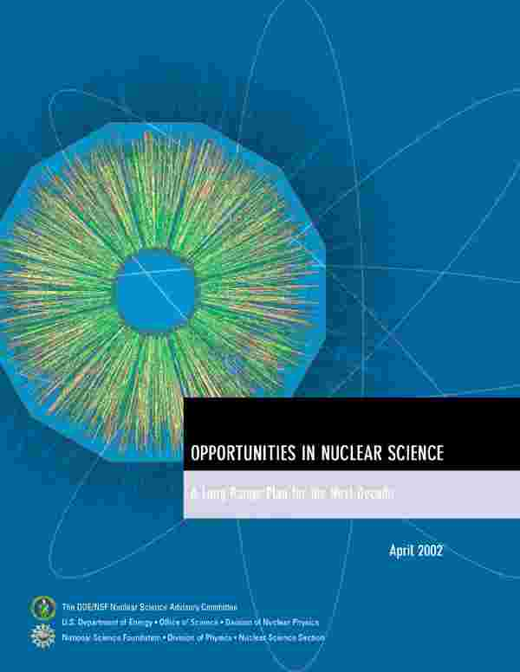
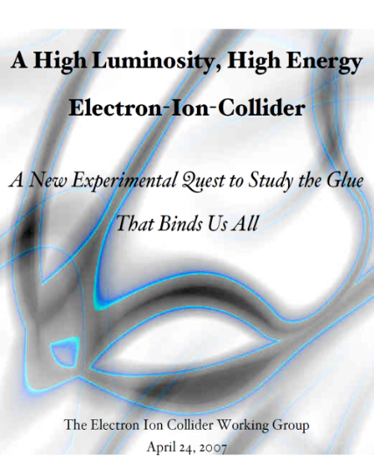
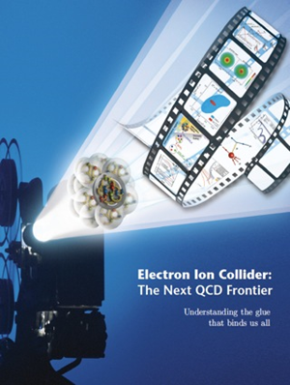

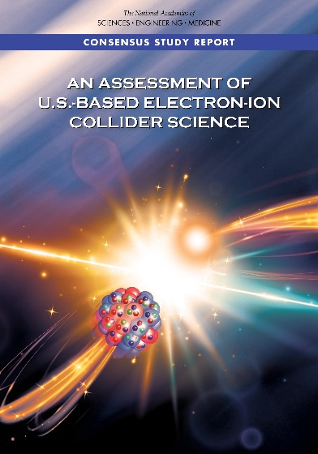
The Scientific Foundation for an EIC was Built Over Two Decades
Electron-Ion Collider..absolutely central to the nuclear science program of the next decade.
2002
“a high-energy high-luminosity polarized EIC [is] the highest priority for new facility construction following the completion of FRIB.”
2007
The science questions that an EIC will answer are central to completing an understanding of atoms as well as being integral to the agenda of nuclear physics today.”
2009
2010
Gluons and the Quark Sea at High Energies
2012
2013
2015
Major Nuclear Physics Facilities for the Next Decade
2018
2021
NSAC
“…essential accelerator and detector R&D [for EIC] should be given very high priority
in the short term.”
“We recommend the allocation of resources …to lay the foundation for a polarized Electron-Ion Collider…”
March 14, 2013
“..a new dedicated facility will be essential for answering some of the most central questions.”
“The quantitative study of matter in this new regime [where abundant gluons dominate] requires a new experimental facility: an Electron Ion Collider..”
arXiv:2103.05419
Science Requirements and Detector Concepts for the EIC – Drives the requirements of EIC detectors

Slide 5
EIC Science Landscape
EIC: Understanding the Glue that Binds Us All - Without gluons binding the quarks, there would be no nucleons, no atomic nuclei… no visible world!
A huge leap in accessible kinematics landscape (into the land of gluons and the quark sea) for polarized e-N and unpolarized e-A reactions!

Slide 6
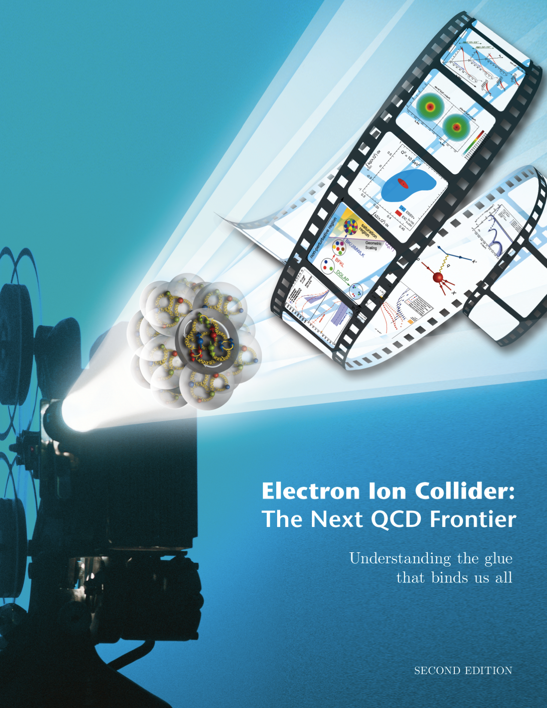
EIC Science is Well Known and Highly Cited
EIC White Paper that guided the EIC science written following a 10-week program at the Institute for Nuclear Theory
  Electron-Ion Collider: The Next QCD Frontier: understanding the glue that binds us all
  arXiV:1212.1701 & Eur. Phys. J. A 52 (2016) 9, 268 – 1459 citations (08/20/2023)
Year-long EIC User Group driven EIC Yellow Report activity (December 2019 – February 2021)
  Science Requirements and Detector Concepts for the EIC – The Yellow Report set the (initial) requirements.
  arXiv:2103.05419 & Nucl. Phys. A 1026 (2022) 122447 – 595 citations (08/20/2023)
Requirements have then been further updated during proposal and follow-up processes

Slide 7
Progress Since CD-1
BNL and TJNAF Jointly Leading Efforts Towards Experimental Program | BNL and TJNAF Jointly Leading Process to Select Project Detector
2021 | EIC Yellow Report (https://arxiv.org/abs/2103.05419) | February 2021
 | Call for Collaboration Proposals for Detectors https://www.bnl.gov/eic/CFC.php | March 2021
 | Collaboration Proposals for Detectors Submitted | December 2021
2022 | Decision on Project Detector – “ECCE” | March 2022
 | Process to consolidate ECCE & ATHENA to the EIC Project Detector ePIC | Spring 2022
 | EPIC Collaboration* Formed – 160 institutions | July 2022
2023 | All subdetector technologies defined | April 2023
EIC Project detector fully defined by 04/2023

Slide 8

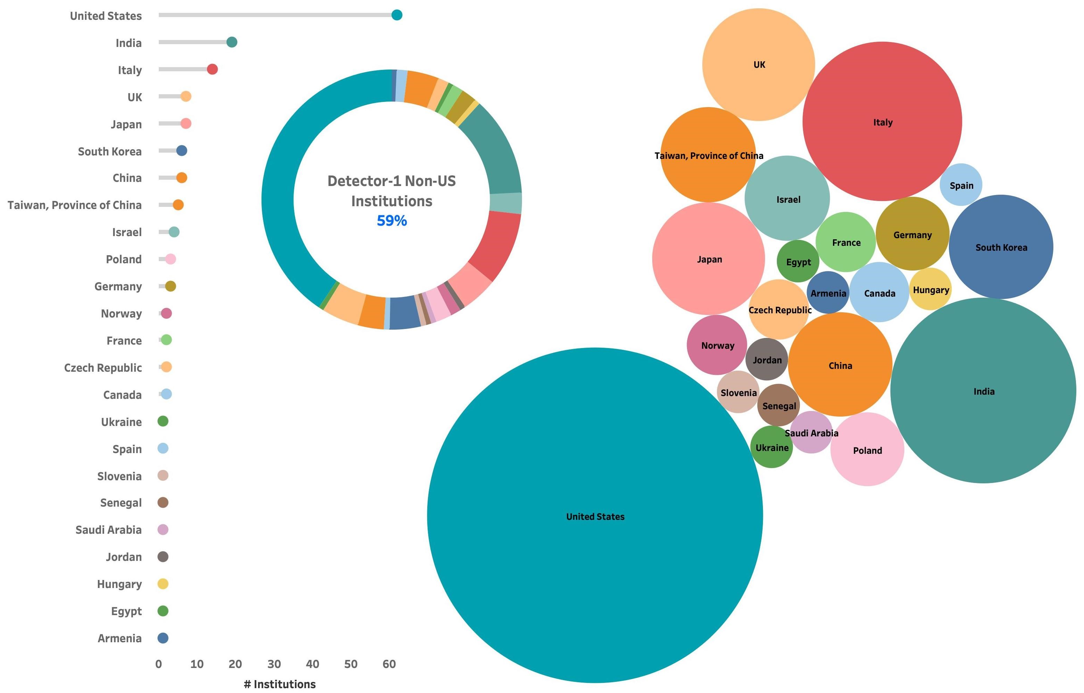
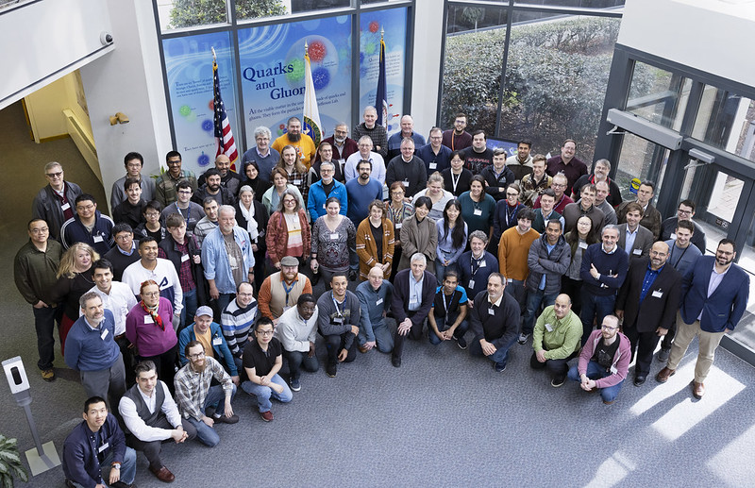
The ePIC Collaboration
171 institutions
24 countries
500+ participants
11 new institutions joined ePIC July 2023
A truly global pursuit for a new experiment at the EIC!
ePIC non-US
Institutions
59%
ePIC Spokesperson:
John Lajoie (Iowa State)
ePIC Deputy Spokesperson:
Silvia Dalla Torre (INFN Trieste)

Slide 9
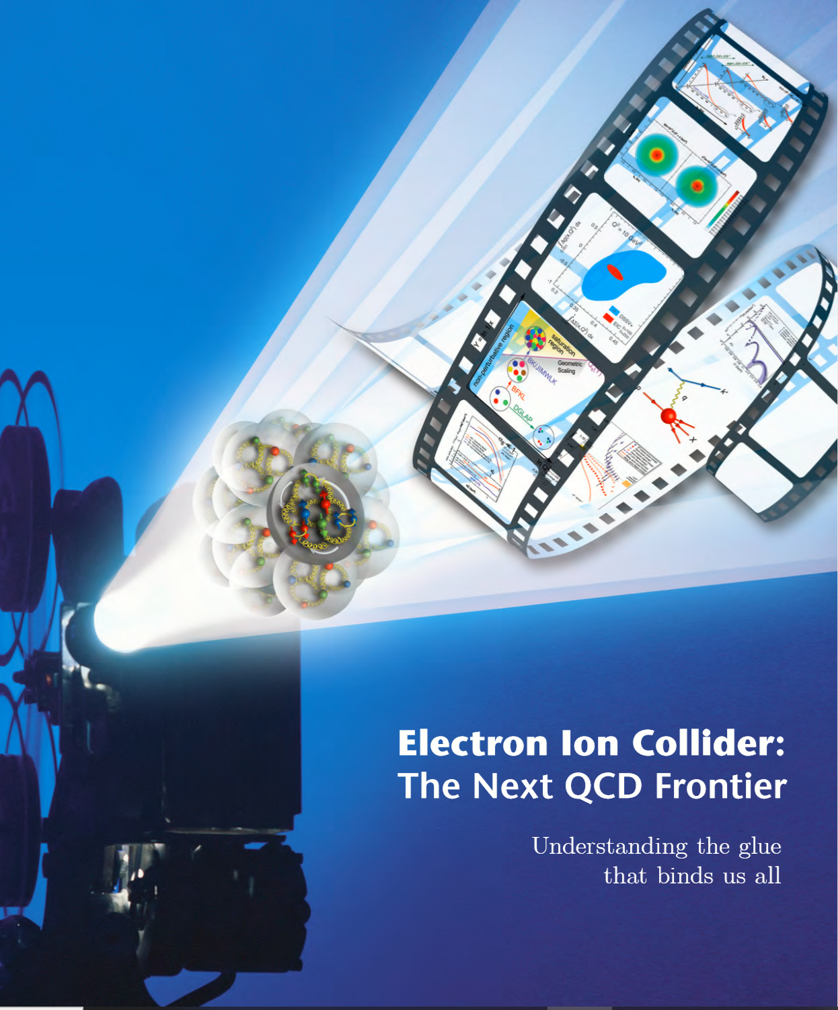

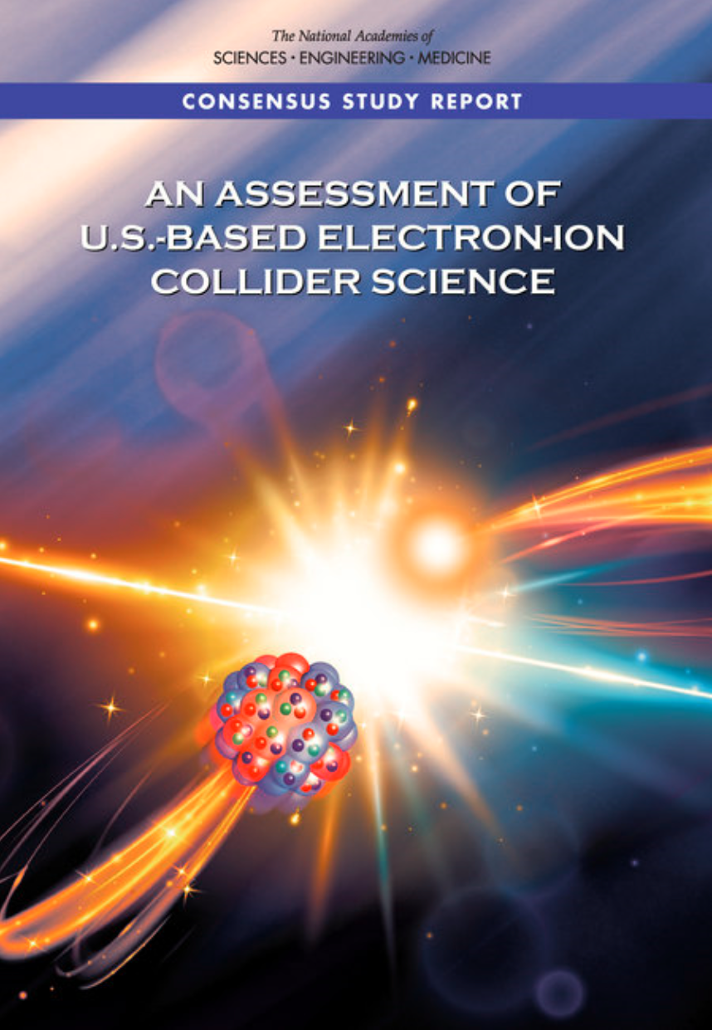
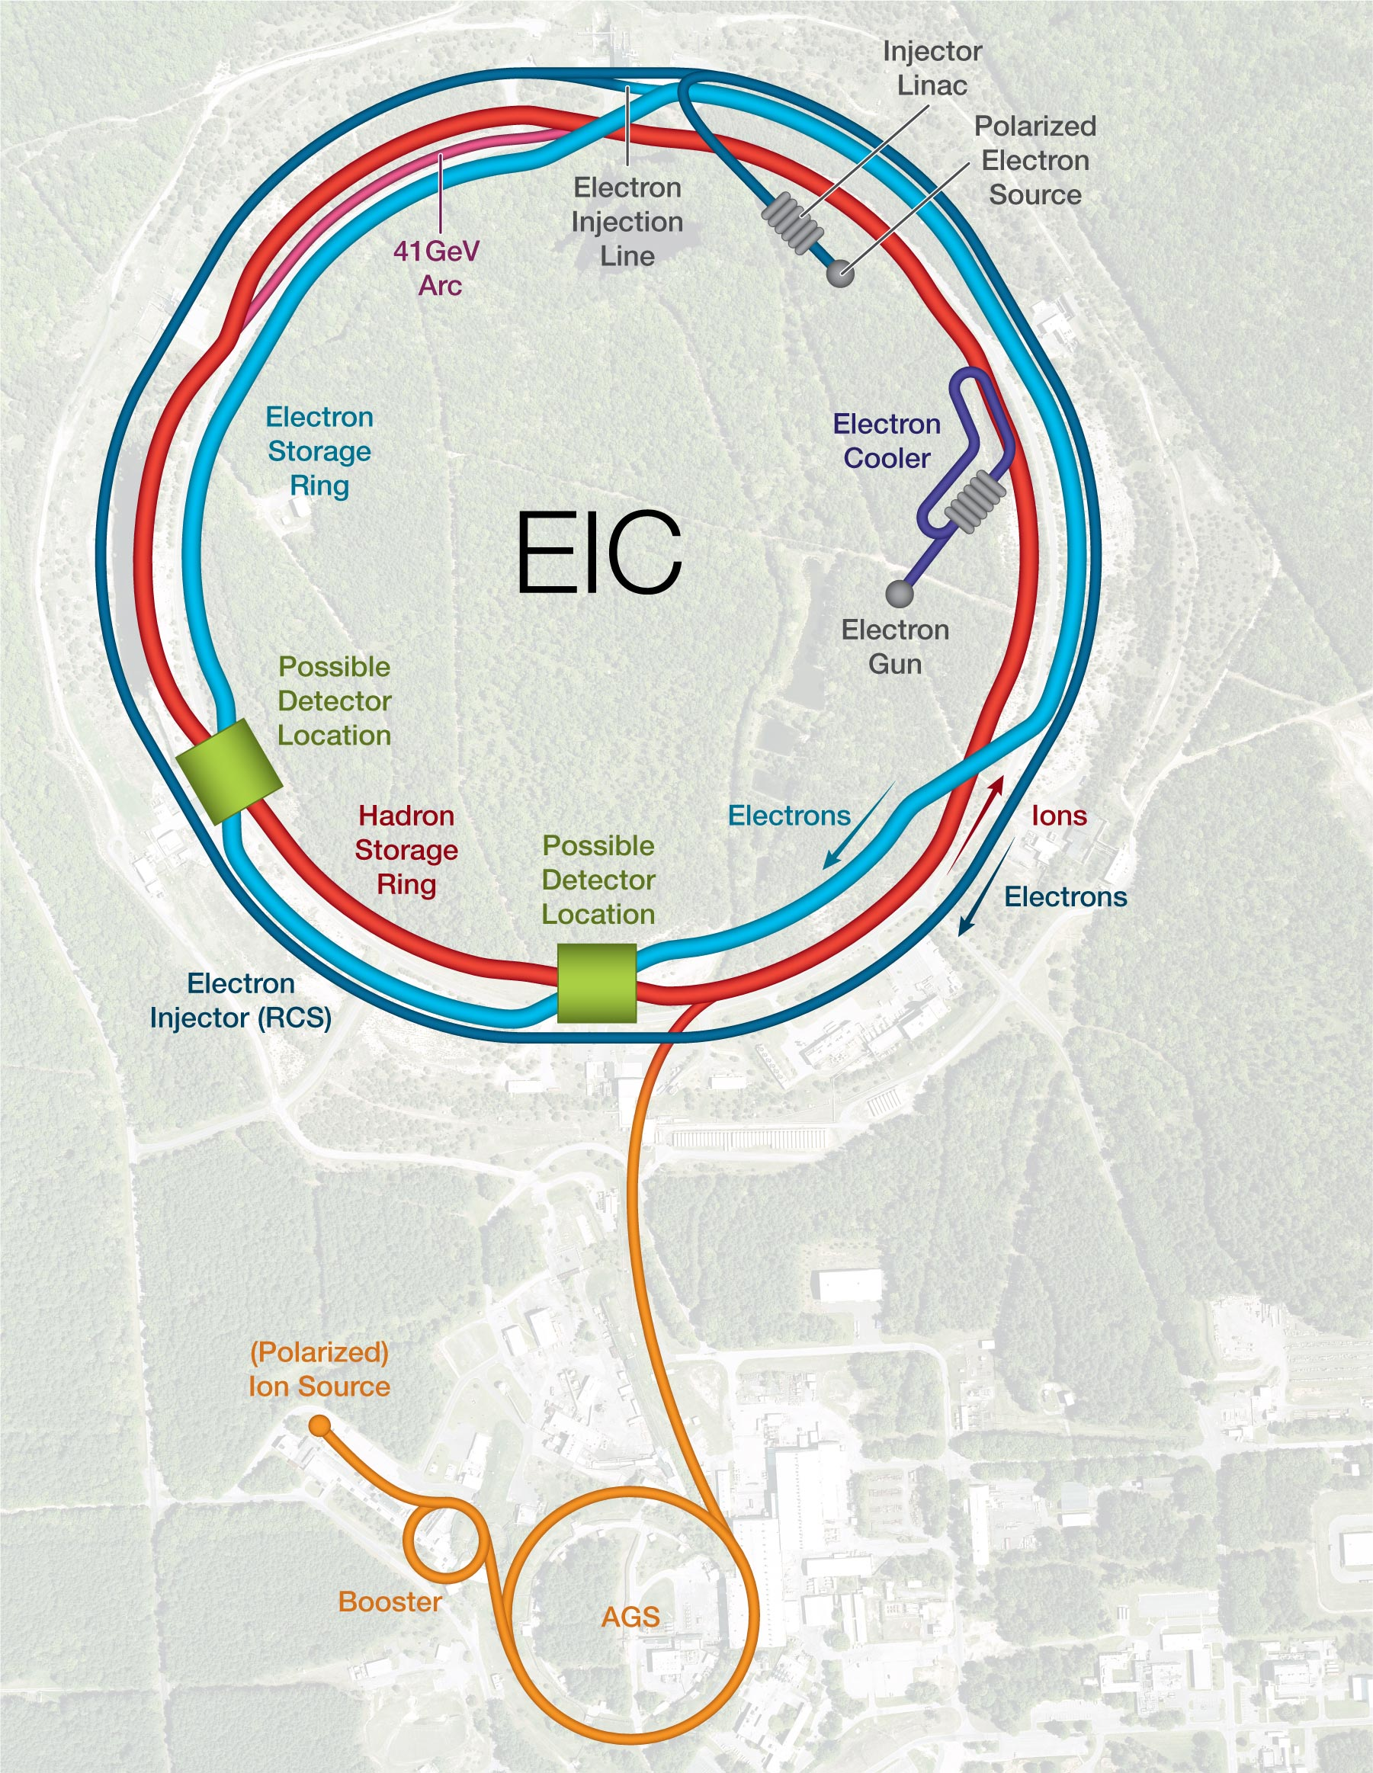
EIC Scope
Project Design Goals
High Luminosity: L= 10³³ – 10³⁴cm⁻²sec⁻¹, 10 – 100 fb⁻¹/year
Highly Polarized Beams: 70%
Large Center of Mass Energy Range: E_{cm} = 29 – 140 GeV
Large Ion Species Range: protons – Uranium
Large Detector Acceptance and Good Background Conditions
Accommodate a Second Interaction Region (IR) @ IR-8
Possible
2nd Detector
Location
IR-8
Project
Detector
Location
IR-6
p/A beam
e beam
p: 41 GeV, 100 to 275 GeV
e: 5 GeV to 18 GeV

Slide 10
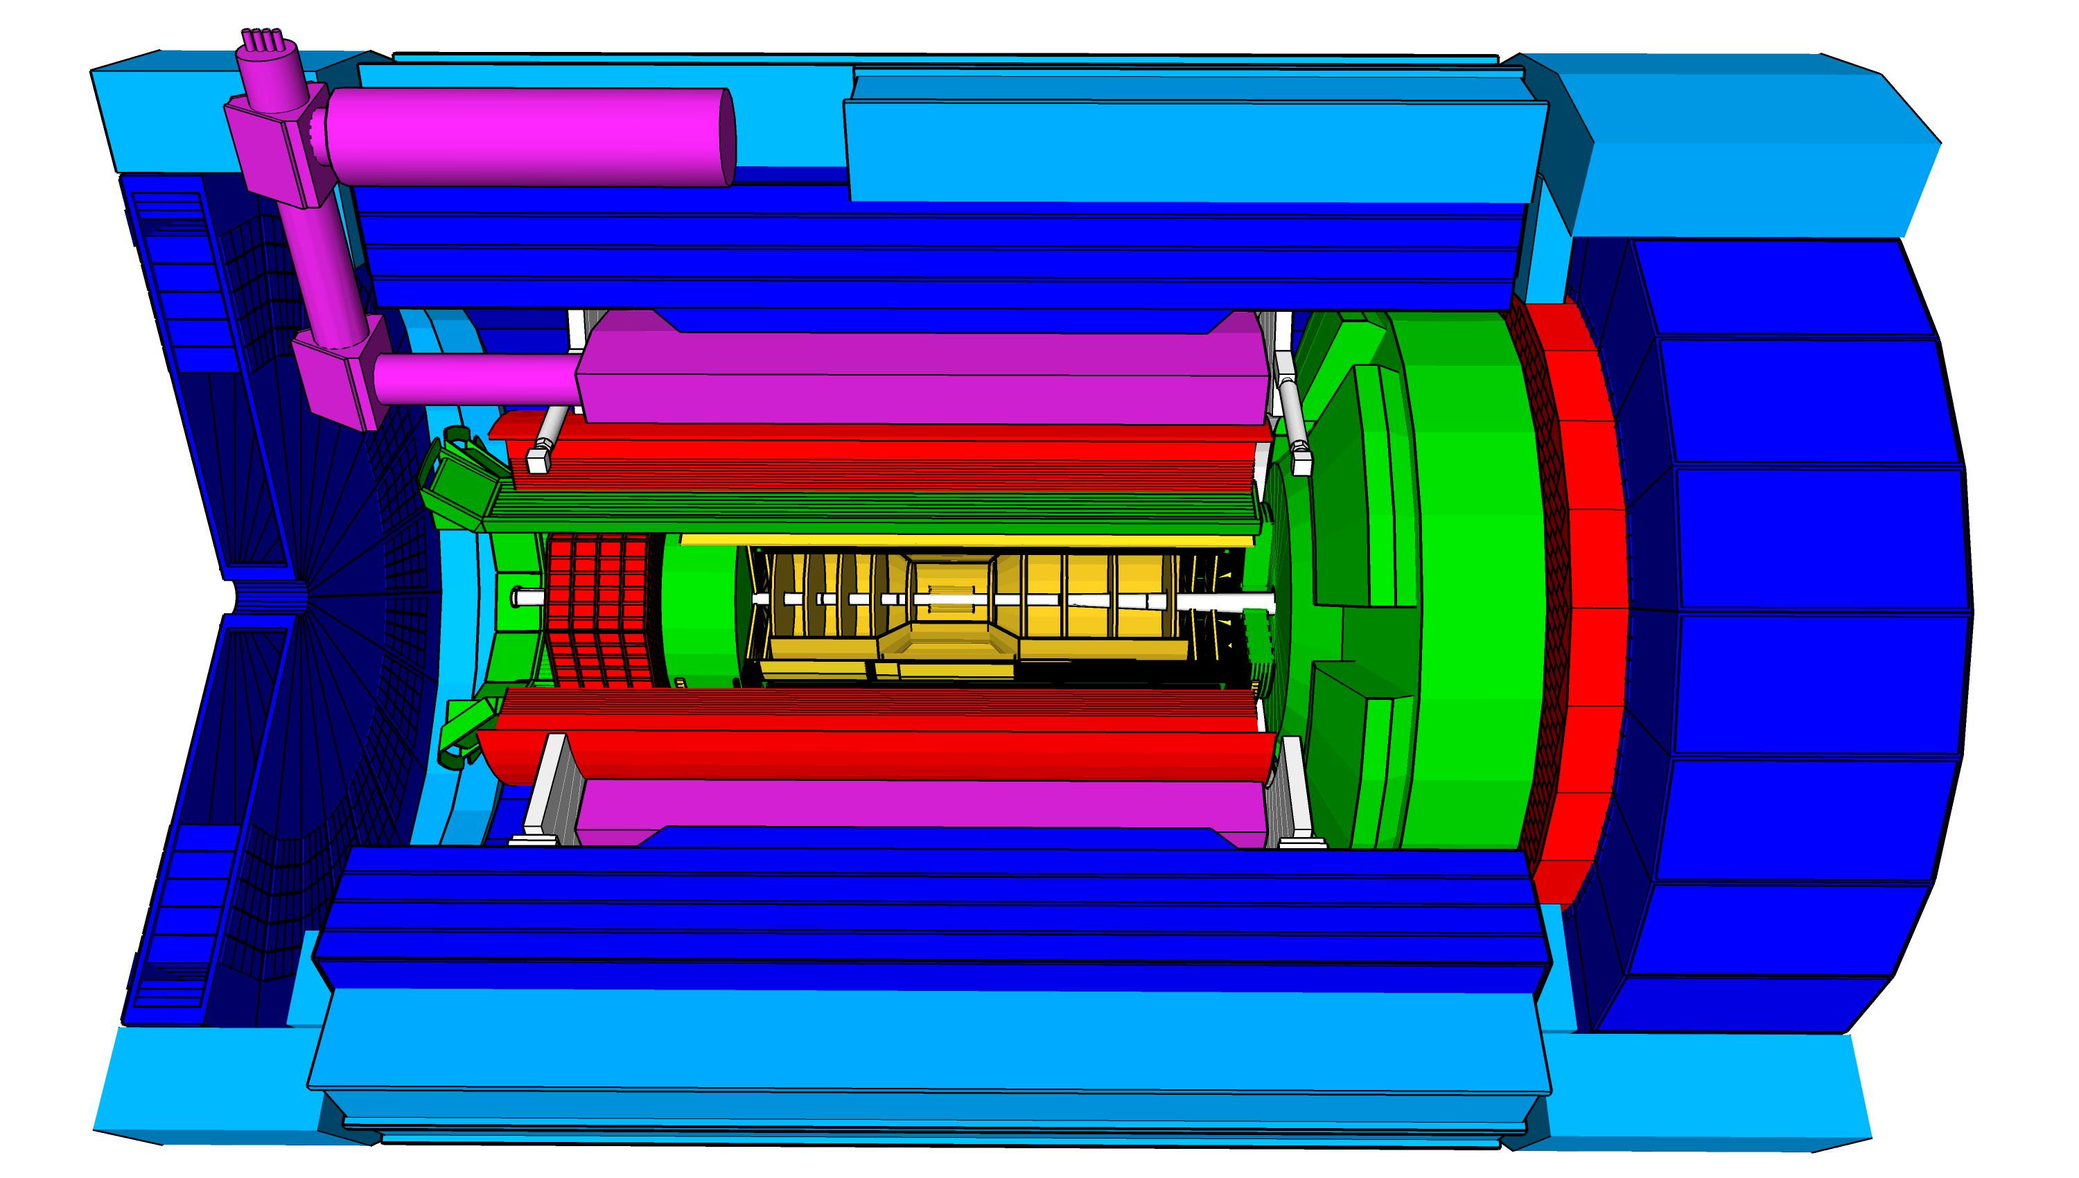
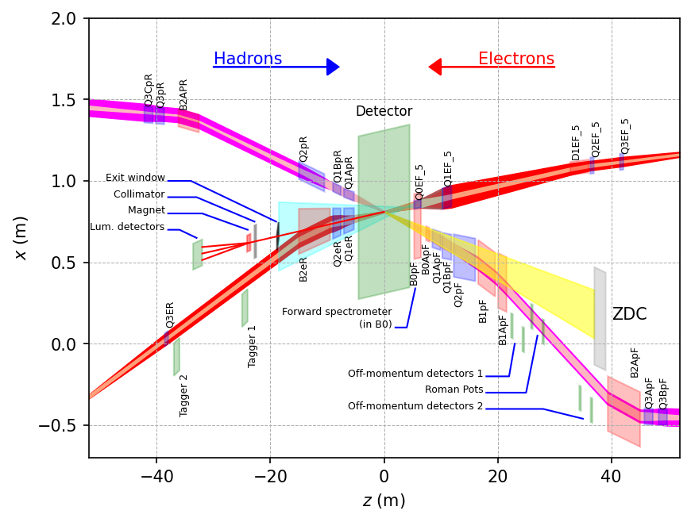
ePIC Detector
hadronic calorimeters (HCAL)
Asymmetric beam energies
→ require an asymmetric detector Barrel
with electron and hadron endcap
→ 9.5 m
→ Tracking, particle identification, EM
calorimetry and hadronic calorimetry
functionality in all directions
→ very compact Detector Integration
will be key
Imaging science program with protons and nuclei
→ requires specialized detectors
integrated in the Interaction Region
over 80 m
Science program required momentum resolution
→ requires a large bore 2T magnet
(1.7 T magnet operation point, stretch goal 2T)
that has same geometry as the BaBAR magnet.
Streaming readout electronics model
→ highest scientific flexibility
Solenoidal Magnet
e/m calorimeters (ECal)
Time.of.Flight (ToF), DIRC,
RICH detectors
MPGD trackers
MAPS tracker
23 Subdetectors
incl. Polarimeters
+ Data Acquisition
9.5 m

Slide 11
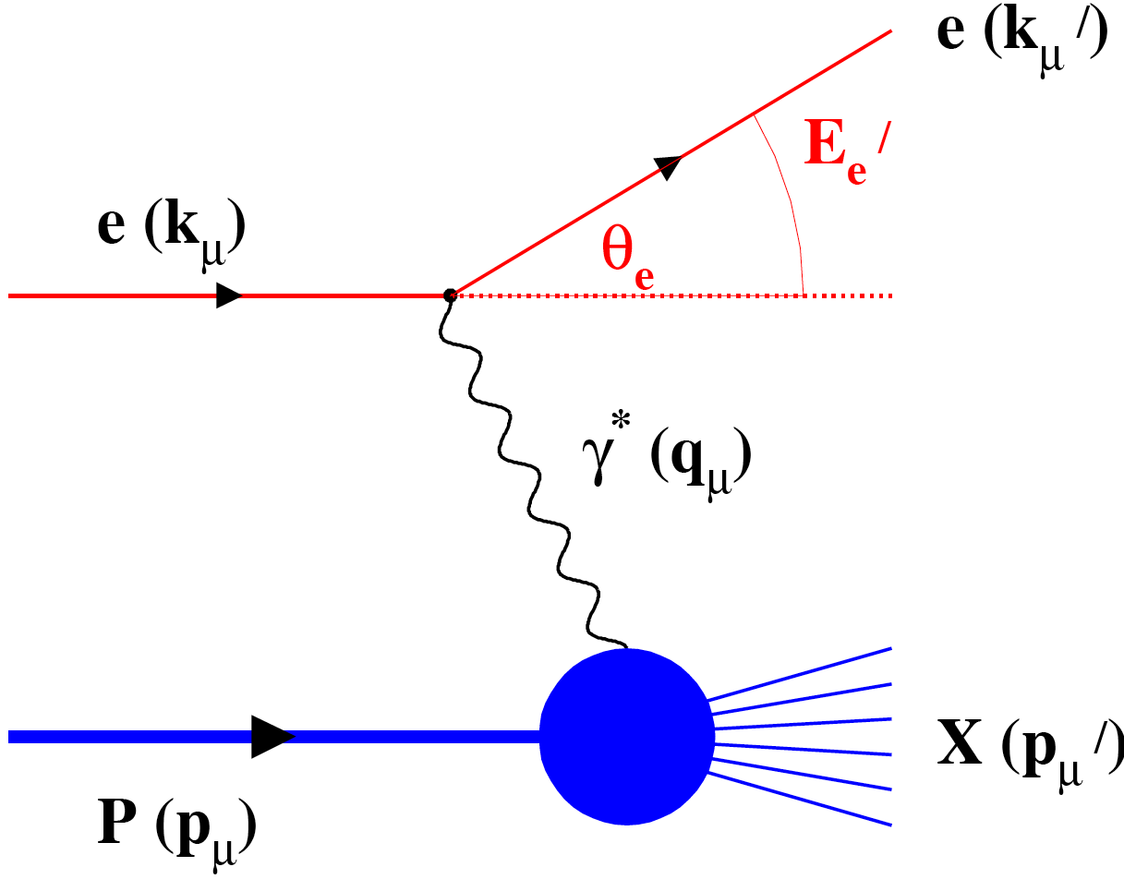
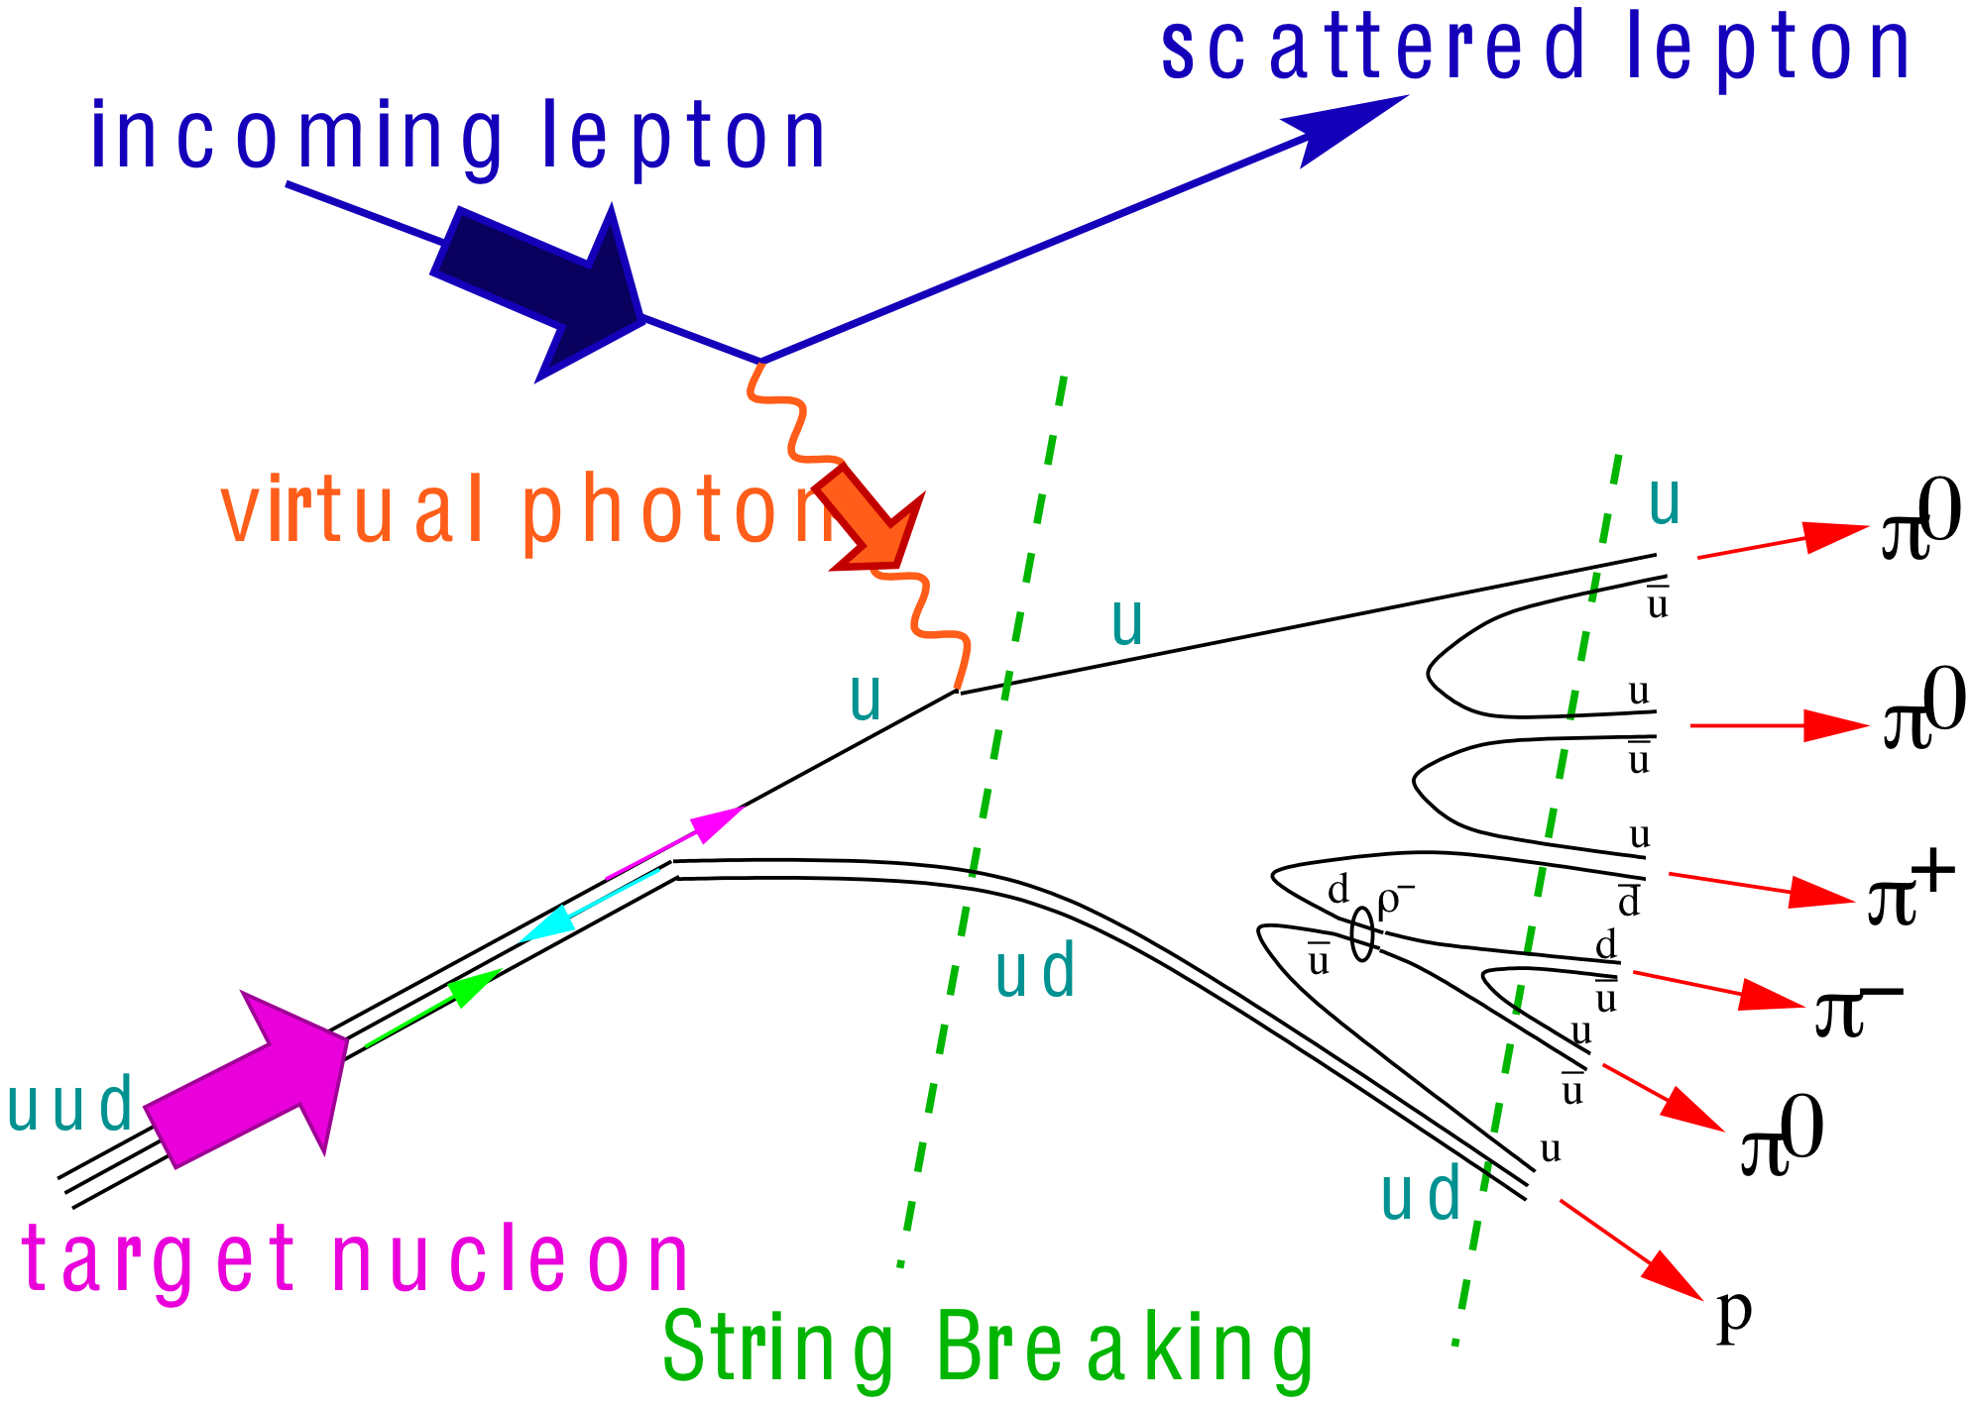
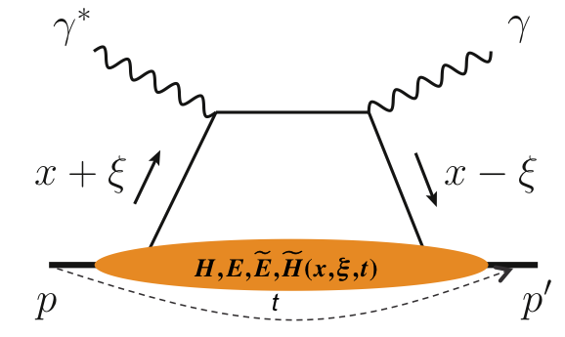
What Is Needed Experimentally?
experimental measurements categories to address EIC physics:
Parton Distributions in nucleons and nuclei
Spin and
Flavor structure of nucleons and nuclei
Tomography Transverse Momentum Dist.
QCD at Extreme Parton Densities - Saturation
Tomography
Spatial Imaging
inclusive DIS
semi-inclusive DIS
exclusive processes
measure scattered lepton
multi-dimensional binning: x, Q²
reach to lowest x, Q² impacts
Interaction Region design
measure scattered lepton
and hadrons in coincidence
multi-dimensional binning:
x, Q², z, p_{T}, Q
particle identification over entire region is critical
measure all particles in event
multi-dimensional binning:
x, Q², t, Q
proton p_{t}: 0.2 - 1.3 GeV
  cannot be detected in main detector
  strong impact on Interaction Region design
∫Ldt:
1 fb⁻¹
10 fb⁻¹
10 - 100 fb⁻¹
machine & detector requirements

Slide 12
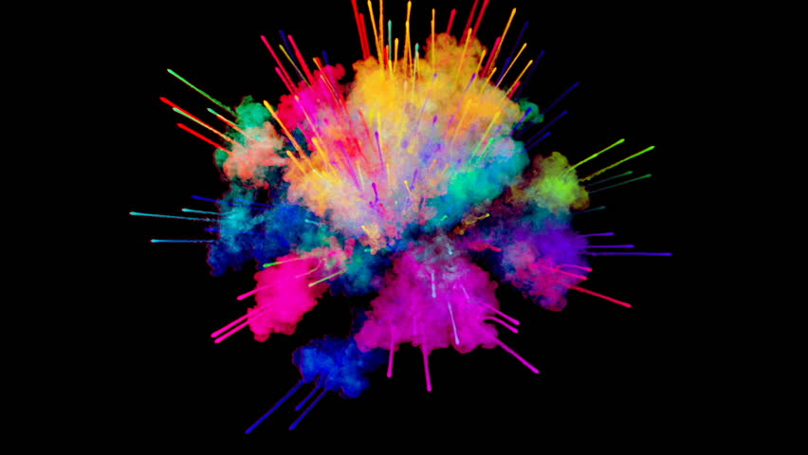
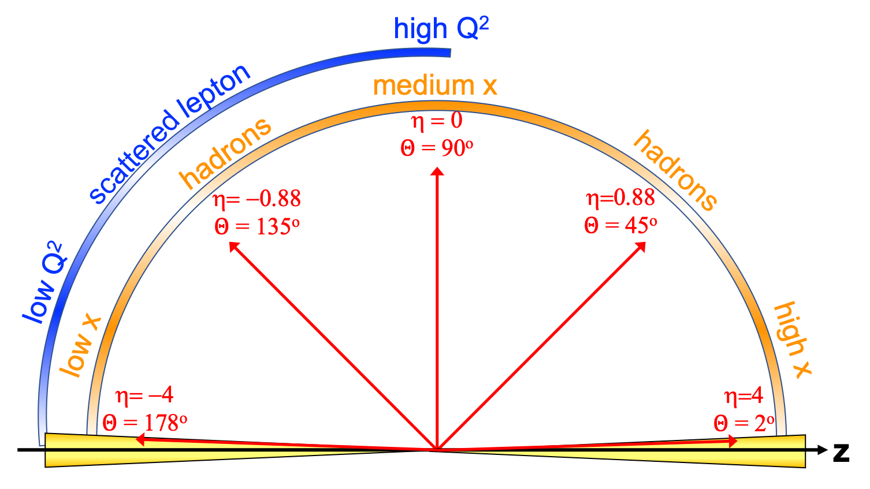
EIC General Purpose Detector: Concept
p/A beam
electron beam
inclusive DIS:
semi-inclusive DIS
Backward-η
Forward-η
hadronic calorimeters
solenoid magnet
ToF, DIRC,
RICH detectors
e/m calorimeters
MPG & MAPS trackers
Central
Detector
HCAL
Lepton
Endcap
Magnet
Hadron
Endcap
HCAL
ECAL
HCAL
ECAL
ECAL
Tracking
PID
PID
PID
Tracking
very low Q²
scattered lepton
Bethe-Heitler photons
for luminosity
Tracking
particles from nuclear
breakup and
from diffractive reactions
exclusive DIS
ZDC
Luminosity Detector
Forward Tracking
Low Q²-Tagger

Slide 13
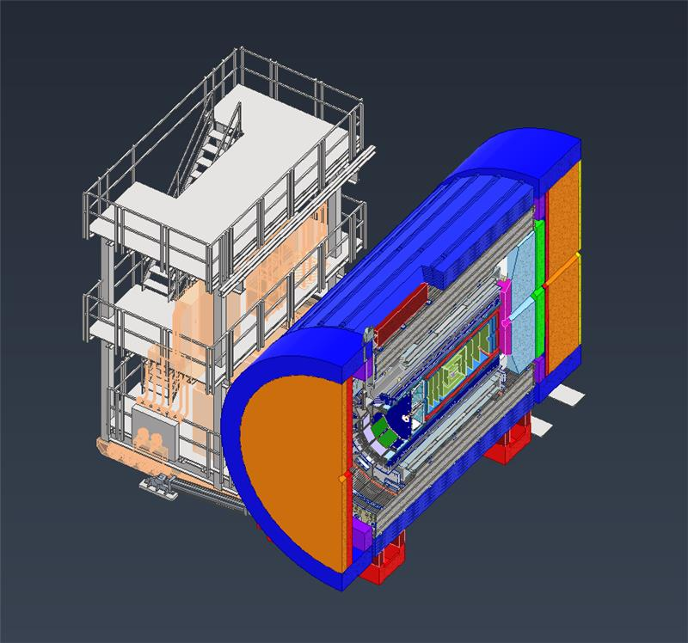
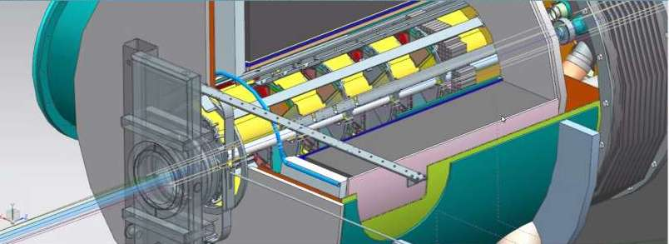
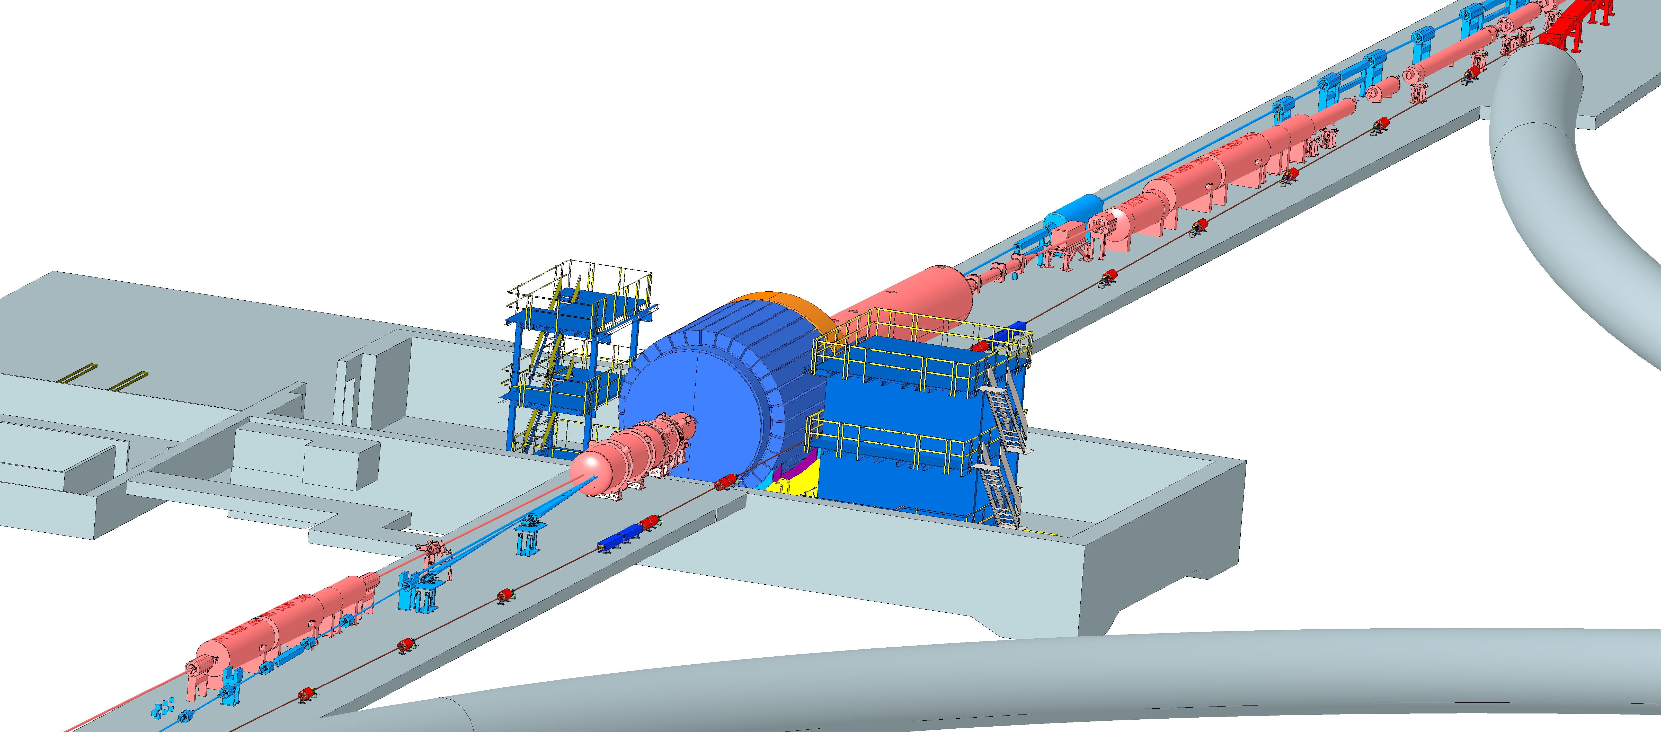
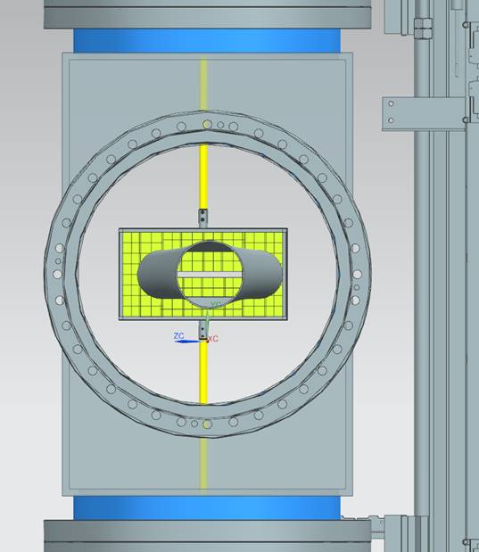
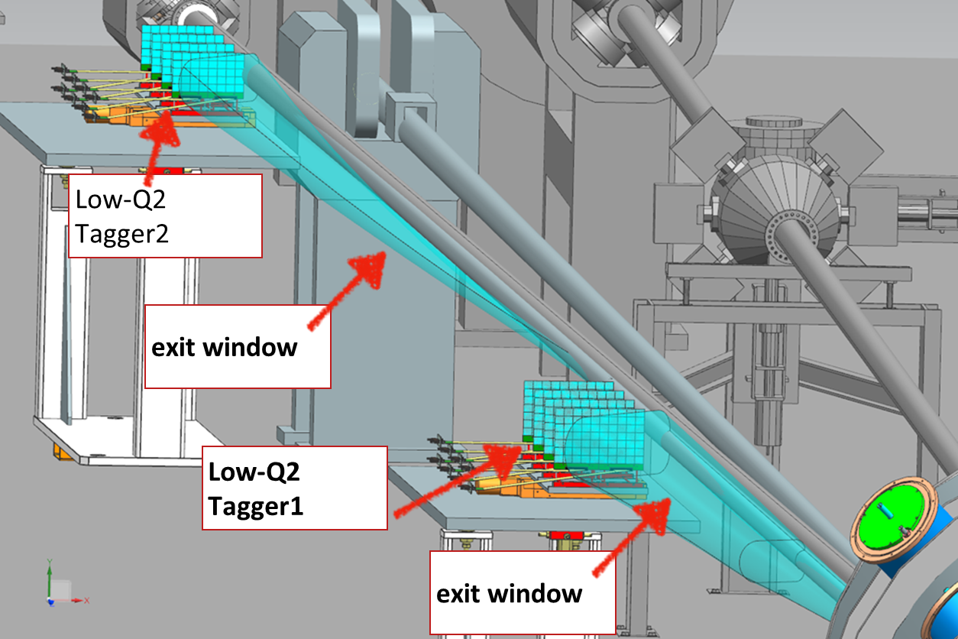
Interaction Region Layout
Central Detector
ESR Forward side
Detectors in B0 magnet
Roman Pots
Forward Side
SC Magnet Cryostat
HSR Injection Line
Central Detector
Rear Side
SC Magnet Cryostat
HSR Forward Side
HSR: Hadron Storage Ring
ESR: Electron Storage Ring
RCS: Rapid Cycling Synchrotron
SC: Superconducting
HSR
Rear Side
RCS
With Detector Bypass
Low-Q2 Detectors
ESR Rear side
every cm counts… → integration and communication with accelerator team is crucial

Slide 14
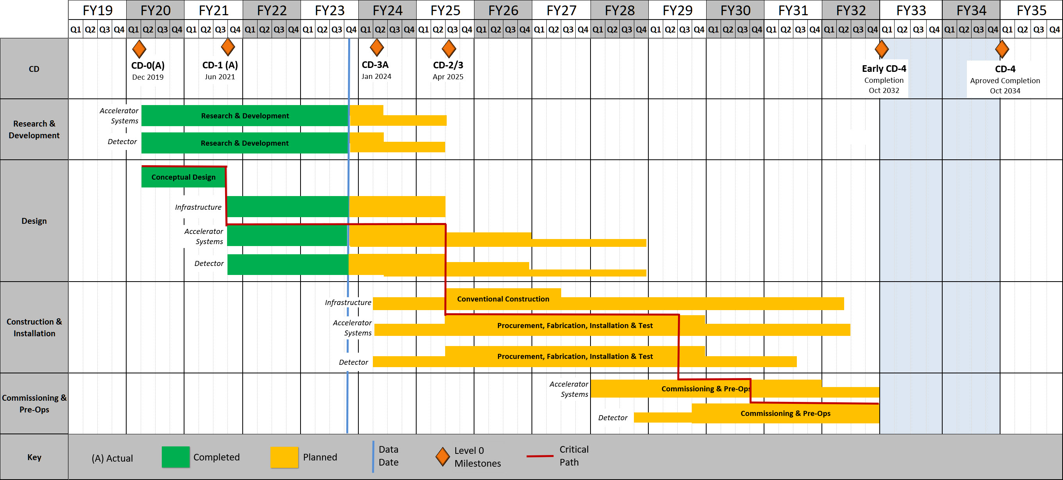
EIC High Level Project Schedule
Construction Phase
Science Phase
Conclusion of RHIC Operations
The thinner bars indicate that R&D and design
can continue at a small level beyond CD-2 and CD-3
for LLP construction
starts at CD-3A
Recent change replaced CD-4A with project internal milestones
The logic remains the same though, we start accelerator commissioning with an instrumented beam pipe and the detector in the Assembly Hall. The detector only rolls in later.

Slide 15
Schedule – High-Level View
CD-1 June 29, 2021
CD-3A (planned) January 2024
→ CD-3A review will be November 14-16, 2023.
CD-2/CD-3 (planned) April 2025
→ CD-2/CD-3 review will be ~January 2025
We are planning to have a Technical Design Report by the end of 2024.
We have about 2 years of engineering and design efforts behind us and about 1.5 years to go to CD-3.
For Long-Lead Procurement items that are part of the CD-3A the design has to be sufficiently mature ~now to initiate procurements in early 2024.
It is understood that in some areas the distinction between E&D and construction is murky, known examples for the ePIC detector are the Si sensors and ASICs. These by nature can have some E&D activities beyond the CD-3 date (the thinner line).
The logic of the detector schedule is further driven around the date at which the magnet is at BNL and has been quality tested, and the date at which the detector has to be complete in the Assembly Hall for early pre-ops.

Slide 16
EIC Detector Incremental Design Reviews – up to March 2023
We have periodic incremental design reviews, with some serving as Preliminary Design Review and ultimately Final Design Reviews.
Completed:
  Magnet Incremental Design and Safety Review (6.10.07) – Preliminary 30% Design – Feb. 23, 2022
  IR Integration and Ancillary detectors (6.10.11) – April 27, 2022
  Electronics/Computing Subsystem Status Review (6.10.08 & 6.10.09) – August 29-30, 2022
  Magnet Incremental Design and Safety Review (6.10.07) – 60% Design – October 18-19, 2022
  Calorimetry Review (6.10.05 & 6.10.06) – December 6-8, 2022
  Polarimetry Review (6.10.14) – January 17-18, 2023
The project detector R&D (6.10.02) is separately reviewed by the DAC
Scientific computing & associated infrastructure is a dependency for the EIC
  EIC Detector Software Infrastructure Review held in collaboration with host labs – August 22, 2022
  Review of ePIC Software and Computing is planned for October 19-20, 2023

Slide 17

Since April & Upcoming in EIC Detector Arena
April 3 + 4: 1st Resource Review Board meeting @ SBU & BNL
July 5 + 6: Particle Id Detectors Interim Design Review
    Reviewers: Peter Krizan (U Ljubljana), Floris Keizer (CERN),
    Ana Amelia Machado (UniCamp), Koji Nakumura (KEK), Justin Stevens (W&M)
July 21: Final Design Review of the PbWO4 Crystals for the ePIC Backward EM Calorimeter
    Reviewers: Eugene Chudakov (JLab), Dipangkar Dutta (MSU)
August 28 + August 31: DAC Review of Detector R&D
            FY23 progress and FY24 continuation requests
August 29 + 30: DOE CD-3A Design Review by DAC
September 13: Final Design Review of the SciFi for cECal & fECal
September 14: Final Design Review of the SiPMs for ECals, HCals & dRICH
September 25: Final Design Review of the forward HCal W & steel
October 5 + 6: Final Design Review of Magnet (MARCO)
October 10-12: DOE CD-3A Director’s Review
November 14-16: DOE CD-3A Independent Project Review
December 7 + 8: 2nd Resource Review Board meeting @ GWU
December (TBD): Preliminary Design Review of Far-Forward/Far- Backward Detectors

Slide 18
Long Lead Procurements for CD-3A
Selection already accounts for design changes and recent technology choices
WBS 6.10.07 1.7 T Solenoid
  Magnet is long-lead as the detector assembly and installation requires the availability of the fully-tested magnet
  limited world-wide vendors and long production time (estimated from recent 12 GeV magnets)
  CD-3A scope is for full magnet but does neither include a final phase of testing nor the cryo can/cryo flex line and power supply.
Electromagnetic and Hadronic Calorimeters and SiPMs
  WBS 6.10.04, 05, 06 SiPMs for calorimeters and dRICH
  → Need 778907 SiPMs - 7 different types
  CD-3A scope is one phase (321096 SiPMs) out of two for forward HCal
  WBS 6.10.05 PbWO4 crystals – CD-3A scope is first two years of procurements (1500 pieces)
  WBS 6.10.05 fECAL and Barrel ECal SciFi need in total ~7500 km
  CD-3A scope is 1875 km first of four phases
  WBS 6.10.06 forward HCal: Steel and Tungsten plates
  CD-3A scope is first of two phases (~50%)
All these long-lead items are driven by
  limited world-wide vendors → competition by other projects around the world
  production times and capability and/or labor-intensive manufacturing tasks
  SiPMs staggered procurement
Final Design Reviews for LLPs: for magnet complete design to initiate a vendor design-build contract, for other systems a review to justify specifications for procurement.

Slide 19
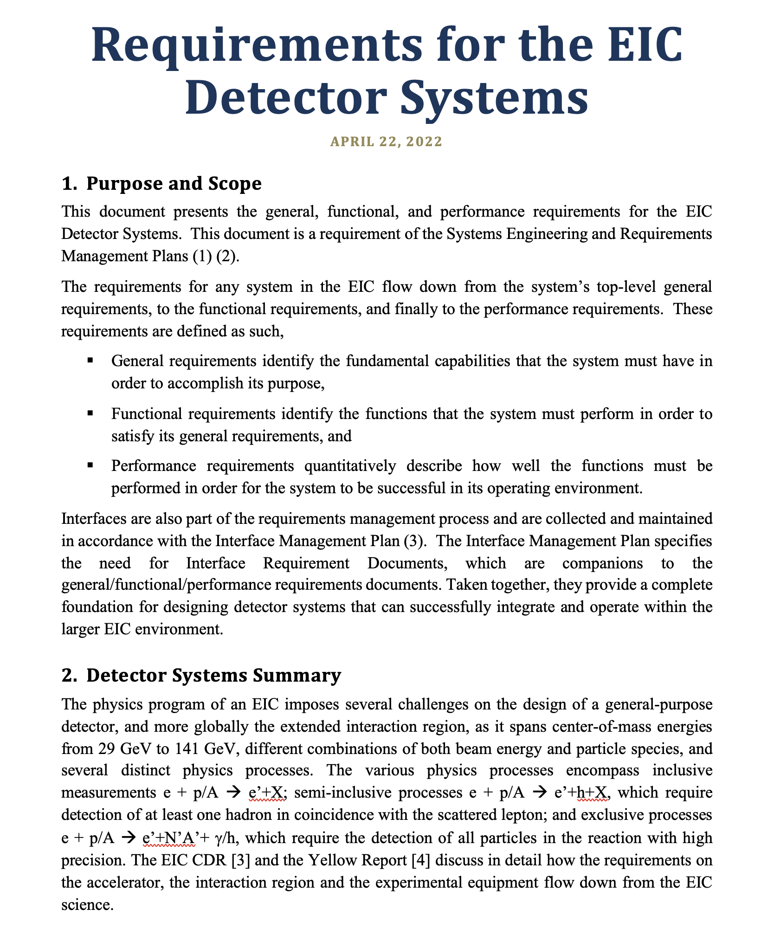
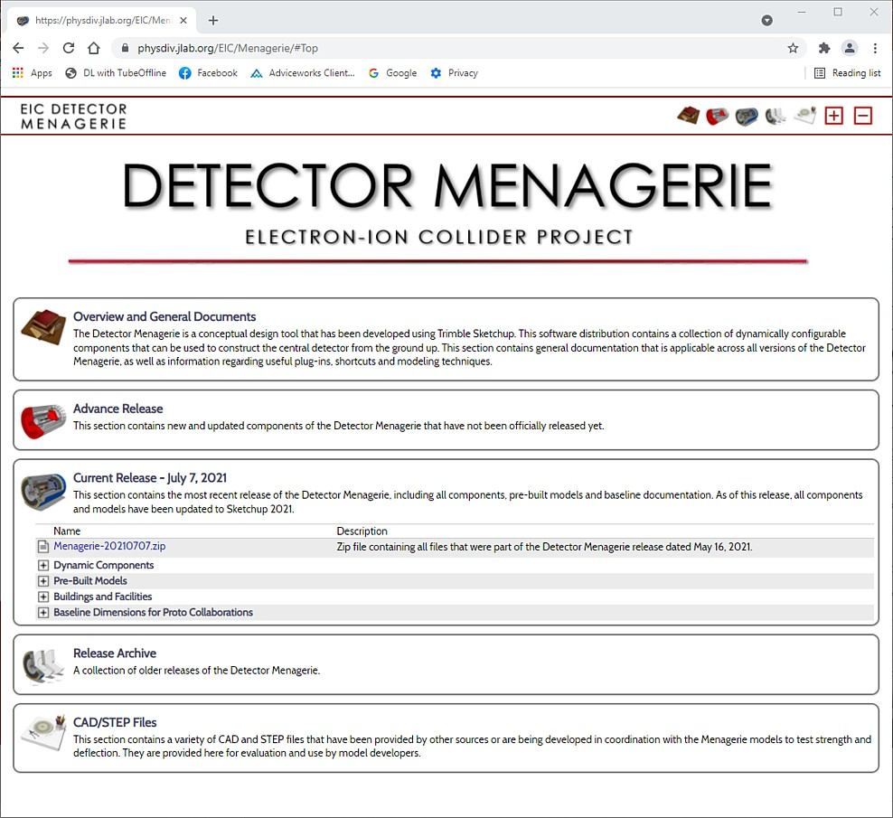
EIC Detector Systems Engineering – Progress
Crucial to invest in systems engineering given the high integration level of EIC
Similar, need to provide easy access to requirements and interfaces for the large EIC user community
In cooperation with the Systems Engineering Group, a common nomenclature has been developed for identifying sub-systems
Sub-system identifiers for the building blocks for creating unique requirement and interface identifiers.
As part of our requirements gathering process, a hierarchy of requirement categories has been established.
  General Requirements What is it?
    These are the highest level requirements that define the function or purpose of the sub-system with respect to the overall system.
  Functional Requirements What does it do?
    These requirements identify the features and capabilities that the sub-system must have in order to satisfy its general requirements.
  Performance Requirements How well does it have to do it?
    These requirements quantify the performance levels that must be met by the sub-system during operation. These requirements provide the minimal critical specification that the engineering staff will use to design the system.
All requirements exist within a hierarchy and should have traceability from top to bottom; i.e. no orphaned requirements.
Requirements should be concise, and definitions should be limited to a single concept.
Requirements documented
User-Shared Design Tools
More in Walt’s talk on flow of requirements, and all further talks will illustrate requirements.

Slide 20
The ePIC Detector
Defined:
subdetector envelopes
geometry database for users and GEANT simulations: https://eic.jlab.org/Geometry/
Requirements and Interfaces: https://eic.jlab.org/Requirements/

Slide 21
WBS 6.10 EIC Detector & 6.10.01 Management
How We Work:
The highest-level detector management consists of:
Elke & Rolf L2 Leads
Walt Akers 6.10 Systems Engineer
Fernando Barbosa Chief Electrical Engineer
Rahul Sharma Chief Mechanical Engineer
We have
Weekly meetings with ePIC spokesperson and deputy
Weekly meetings with the mechanical engineering team
Biweekly meetings with the electrical engineering team
Weekly meetings with the Detector Control Account Managers
As needed meetings with various detector subsystems
Walt, Fernando and Rahul have also separate meetings, for Walt with the Systems Engineering Group, for Rahul with also various non-BNL/non-Jlab engineers/designers, etc.
We report at the biweekly ePIC meetings and many other meetings on general detector progress or requested topics

Slide 22
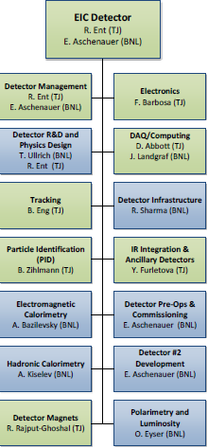
WBS 6.10 EIC Detector & 6.10.01 Management
Green/blue shows nominal JLab/BNL responsibility
Do not use this CAM responsibility organization as Black and White, we work together as a scientific collaboration
  L4 Electron Polarimetry “in the blue” does have a JLab CAM, Detector R&D and DAQ/Computing is joined
  The Si sensor design is much more natural to BNL
  The Si sensor QA or Si tracker integration and MPGDs JLab does have valuable expertise
  The PbWO4 Electromagnetic Calorimetry is much more aligned with JLab user experience
  The experience in Hadronic Calorimetry is very limited at JLab but BNL has built HCals
We include user efforts where it makes sense, and lean to more
We use synergy with BNL’s and Jlab’s science programs and Advanced Computing efforts at each lab as much as possible
  Natural for EIC future science goals
  Natural synergy with streaming readout and AI/ML
  Also natural synergy in certain detector technologies and user interests (RICH, DIRC, PbWO4, MPGDs)

Slide 23

Next Stage (ongoing) – integrating ePIC collaboration
6.10.04 Particle
Identification
Level-3
L4 CAM from Project
+
DSTC from
L3 CAM from Project
6.10.04.01 Backward RICH
Level-4
6.10.04.02 Barrel DIRC
Level-4
6.10.04.03 dRICH
Level-4
6.10.04.04 Time-of-Flight
Level-4
Work Package lead
from
6.10.04.04.01
bToF
Level-5
6.10.04.04.02
fToF
Level-5
Work Package lead
from
Work Package lead
from
Work Package lead
from
Work Package lead
from
Work Package lead
from
Here a bit trickier as we have
to think how to roll up at L5 and
the collaboration suggested to
add a common system at L5

Slide 24
Detector Technical Change Control Board (TCCB)
Copy process as has been used for the accelerator as it works well.
Will have more people with detector expertise in the TCCB for such change requests. We need to involve the detector collaboration to initiate documentation for change requests and use their technical board or equivalent to ensure the change request is consistent with the NAS science requirements, and then use the "detector TCCB" to ensure the project part.
As final step it goes to the EIC Management Team (EMT) for the formal approval.
Proposed detector TCCB:
  Qiong Wu (chair)
  Person with detector experience to take notes and help Qiong
  Elke Aschenauer
  Rolf Ent
  detector lead mechanical engineer (Rahul Sharma, 6.10.10 CAM)
  detector lead electronics engineer (Fernando Barbosa, 6.10.08 CAM)
  two members of the ePIC collaboration (Silvia Dalla Torre, Technical Coordinator)
  three accelerator L2 leads or alternate: HSR, ESR and IR to ensure overlap
  relevant L3 CAM of the WBS the change is requested for
  add subject matter experts as needed (for example Charlie Folz for infrastructure).
Always included in TCCB process: Ferdinand Willeke and Todd Satogata
Note: After the TCCB advise, the formal baseline change control is done through the EMT but in obeyance of the various thresholds in the Project Execution Plan.

Slide 25
Technical Change Control Process - Detector
This is a five-step change control process:
  The detector collaboration initiates a possible change in baseline scope
  The collaboration technical board or equivalent ensures the change is consistent
  with the NAS science requirements and initiates the change request
  → The above process was recently used for the two final ePIC detector technology decisions (after the detector proposal process): the backward particle identification detector choice and the barrel EM calorimeter detector choice
  → What then follows is to prepare input for the detector TCCB
  This includes detailed changes in cost, schedule and risk → implement in P6
  and science and technical justification for the change ← input from ePIC
  The detector TCCB collects wide input, discusses, and gives advise
  The Project Technical Director gives approval
  The EIC Management Team needs to approve the formal baseline change control

Slide 26
Recent ePIC Detector Changes
Up to now, we have not needed to invoke the full detector technical change process as after deliberations with the EIC Management Team the changes were accepted through a Record of Decision.
Three changes were made:
  Adopt a new magnet with 1.7 T design goal and 2 T stretch goal
    This required +5M$ but was a must for the tracking requirements
    The existing BaBar/sPHENIX magnet could only reach 1.15T – engineering risk assessment also captured as Technical Note.
  Change from a modular to a proximity-focusing RICH in the backward region
    No change in cost, schedule or risk
  Change from a Sci-glass based to an imaging EM calorimeter in barrel region
    Costs absorbed in EIC scope cost changes list (and reduced to before)
Changes are fully integrated in P6 for all systems affected (for example, for the barrel EM calorimeter change this could impact the 6.10.05 EM calorimetry, the 6.10.08 electronics, the 6.10.09 DAQ/computing (was nil), and the 6.10.10 Infrastructure (was in the end small).

Slide 27
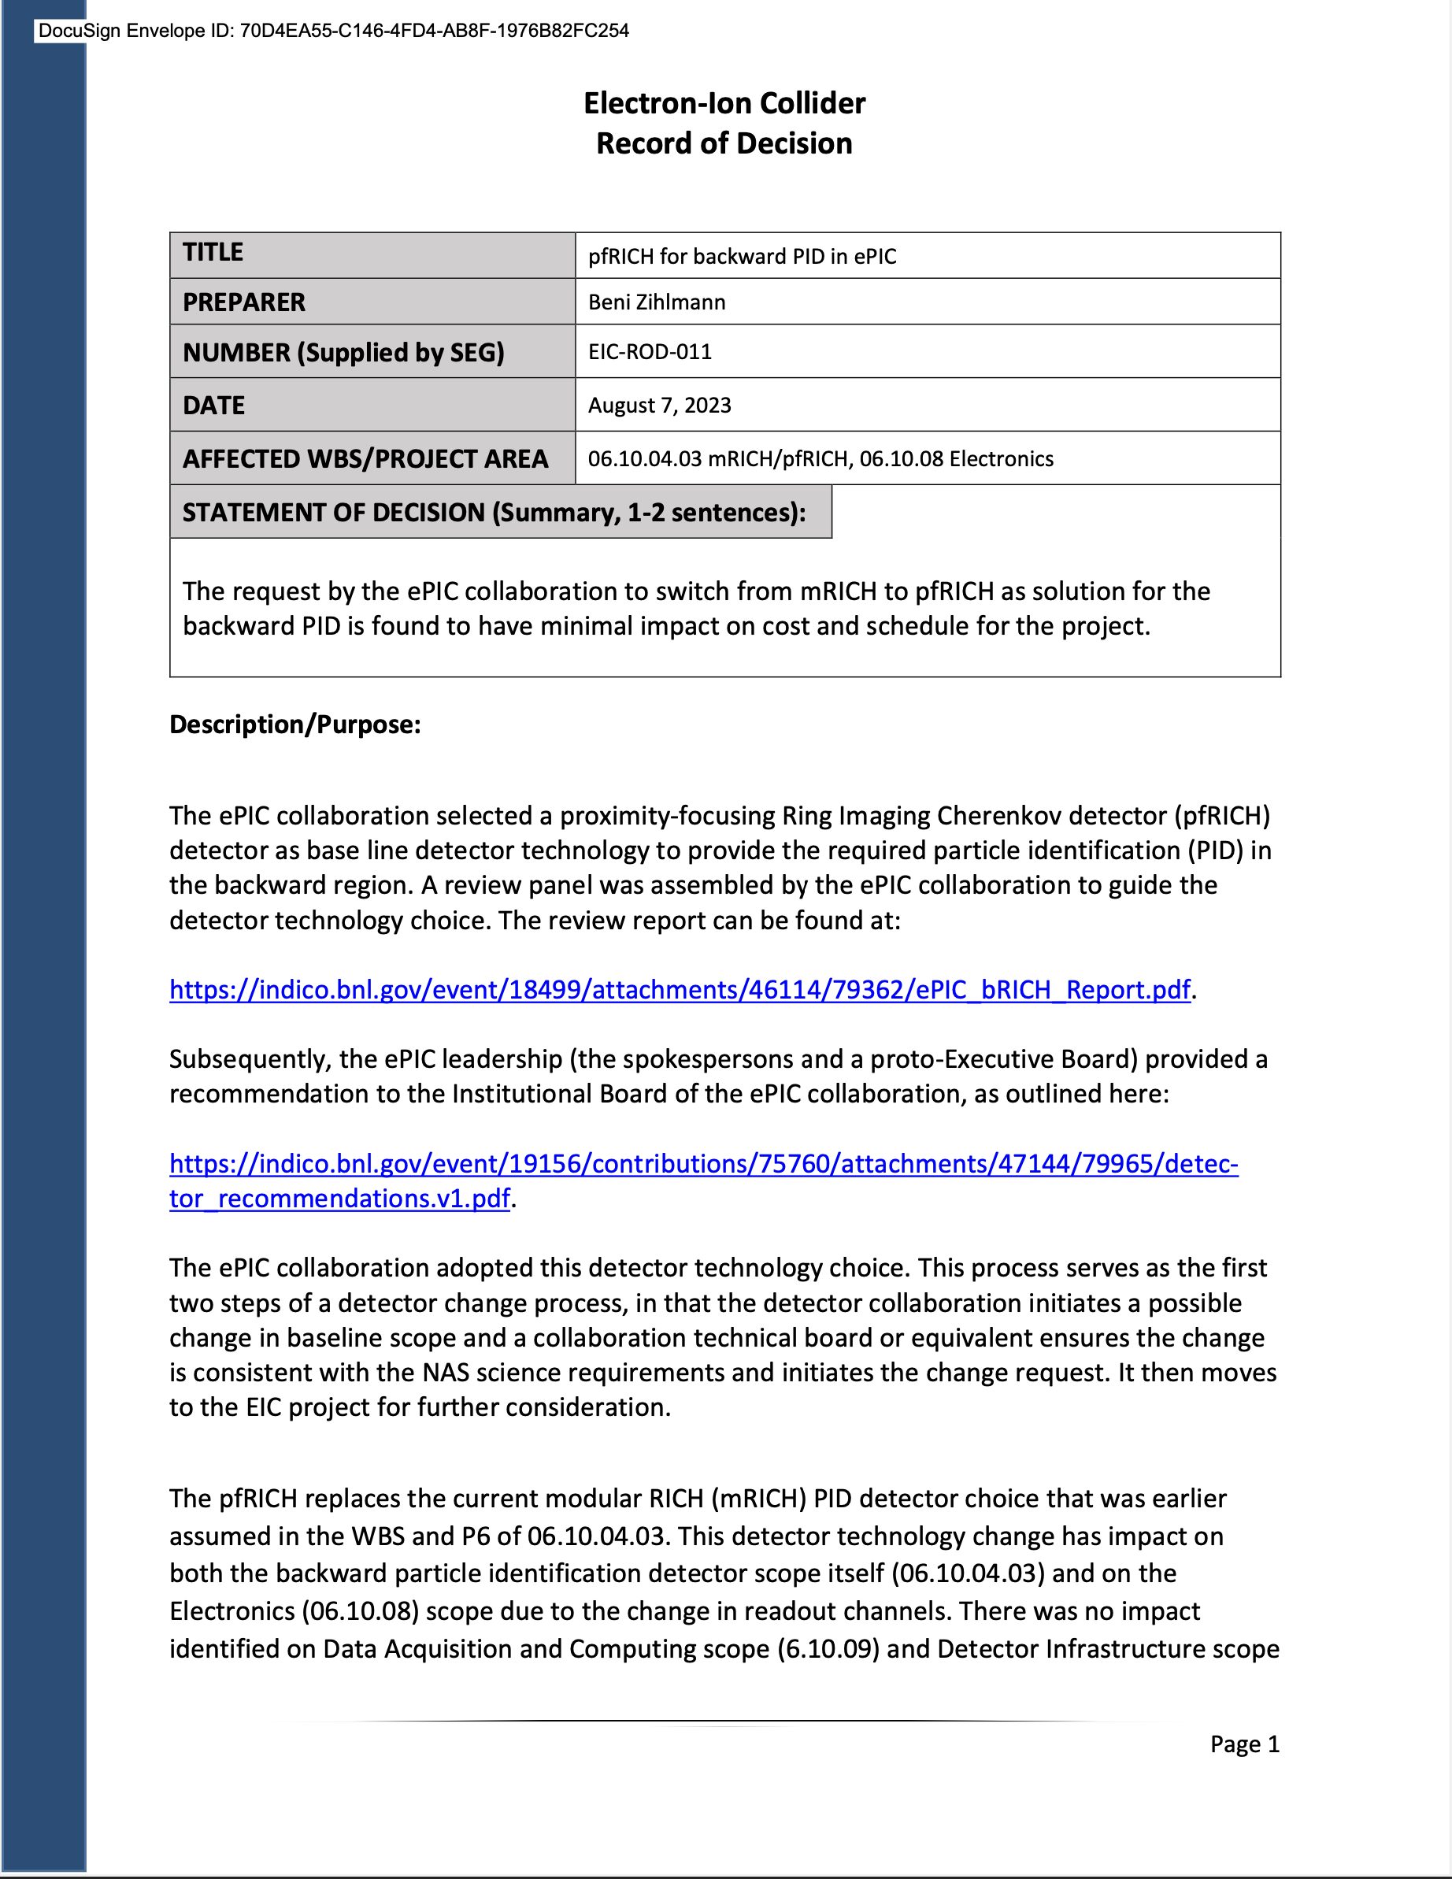
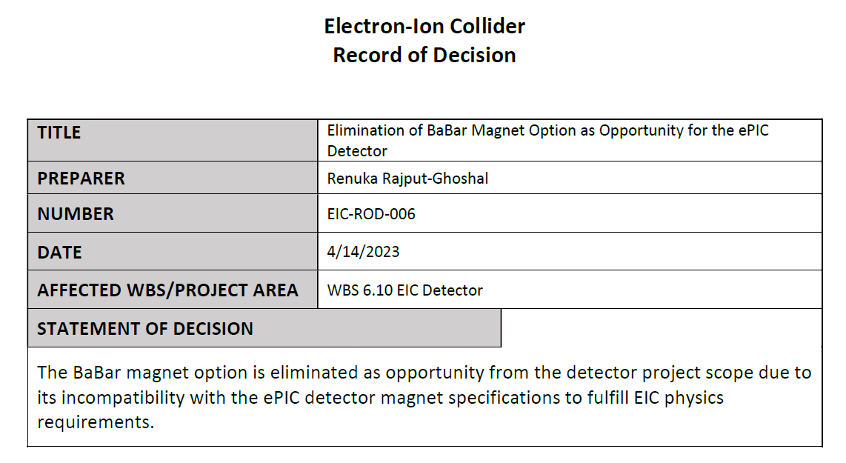
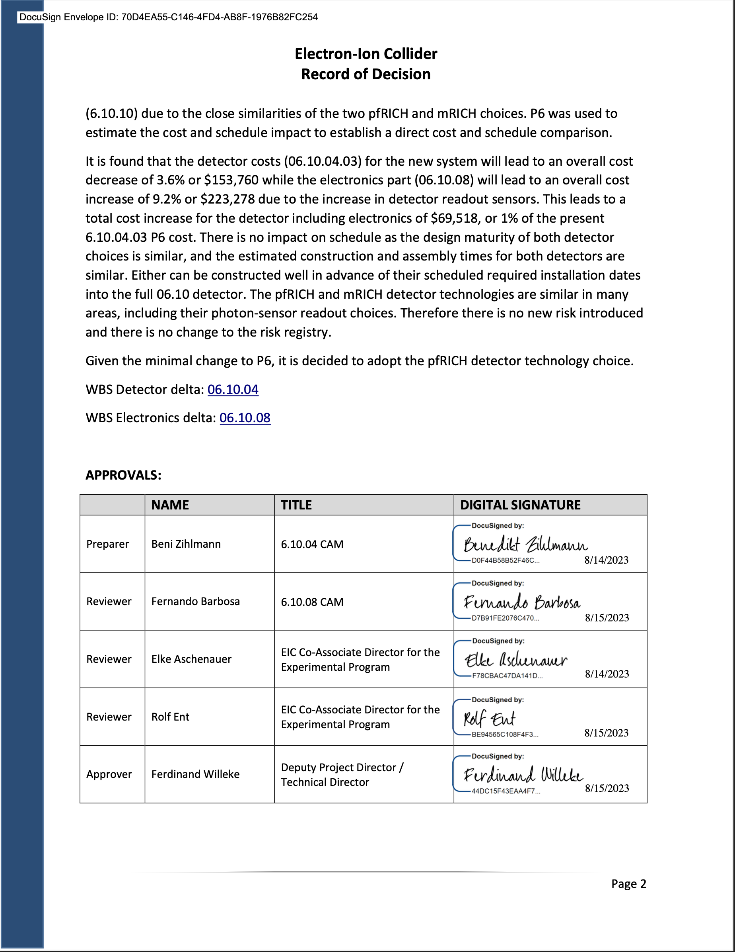
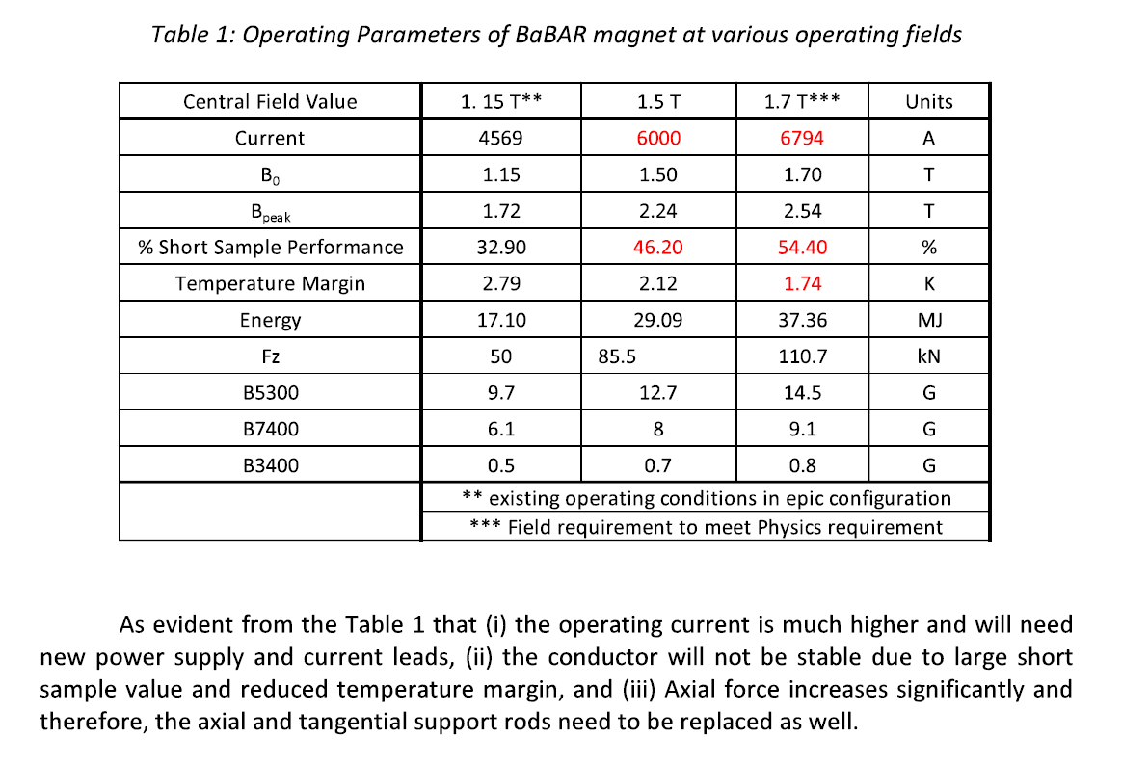
Detector Record of Decisions - Examples
Adopt pfRICH
Rule out reuse of BaBar magnet

Slide 28
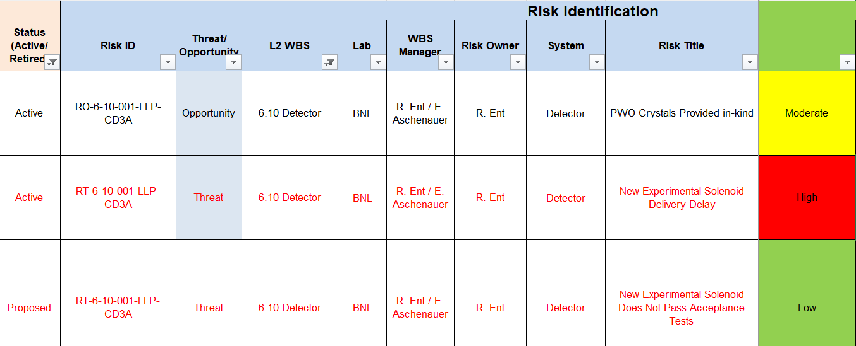
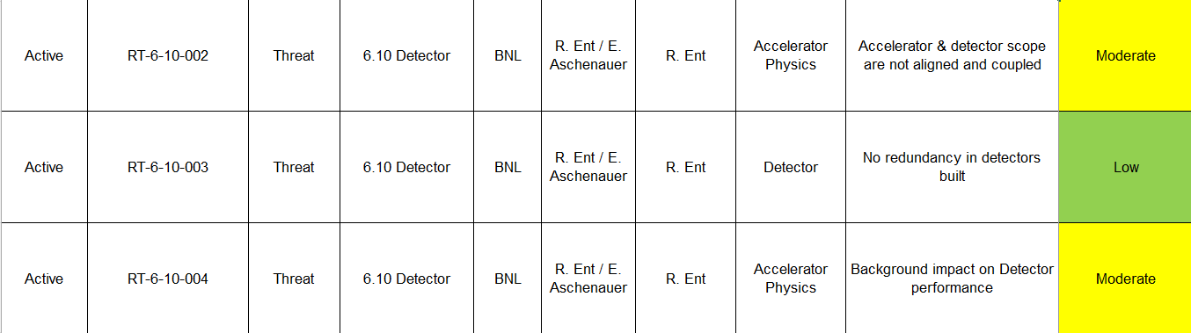
Risk – High-Level View
@10/21 OPA Status Review → @06/22 FPD Review → @08/23 DAC review
3 High risk s → 2 retired, 1 High Risk → 1 High Risk (magnet delay)
7 Moderate risks → 1 retired, 1 new → 2 retired, 1 new, 6 moderate risks
4 Low risks → 1 retired, 1 new → several new (11 low risks now)
→ now also opportunities (in-kind)
Detector high risk: magnet delay
Detector moderate risks: accelerator/detector integration, backgrounds, DIRC bar reuse (or not), failure to reach $100M in-kind goal, hadron polarimetry @ EIC beam currents, AC-LGAD.

Slide 29
Other Ongoing Challenges
Funding for and completion of project detector R&D.
  Setting up procurements at national labs causes often long delay of detector R&D contracts (and thus) milestones
  Expectation is for detector R&D to be completed by CD-2/CD-3 (with as possible exception some remaining R&D on Si/ITS3 sensors & ASICs).
  ITS3 sensor dependency is a single point of failure vulnerability.
Formalizing interest of international EIC user community into formal in-kind agreements.
Ensuring IR and detector scope remain to go hand in hand and in phase.
Familiarizing the international ePIC collaboration with working in DOE Project mode.
Vigilance about user-provided equipment and US/DOE safety codes and equipment requirements.

Slide 30
Next – Technical Design Report Planning
We will start the process of writing a draft TDR later this 2023, and then this will continue towards a first version of a TDR in 2024.
Working model will be similar as we used to create the CDR, Elke/Rolf with engagement of ePIC leadership, and a mix of the project CAMs and EPIC WG representatives. At the late phases the editing rights will become more restricted. We plan to use where we can input from the CDR, YR, proposals, technical notes, etc.
Chapter 2: Physics Goals and Requirements (should be short, < 50 pages)
2.1 EIC Context and History (like CDR 2.2 or YR section 1)
2.2 The Science Goals of the EIC and the Machine Parameters (like CDR 2.3)
2.3 The EIC Science (follow YR structure)
2.4 Scientific Requirements
Chapter 3: Interaction Region 6 Overview (Elke/Rolf contributing)
Chapter 8: Experimental Systems (can be long such that we can use as standalone detector TDR)
8.1 Experimental Equipment Requirements Summary (like CDR 8.2)
8.2 General Detector Considerations and Operations Challenges (YR 10, CDR 8.3)
8.3 EIC Detector
8.4 Detector R&D Summary
8.5 Detector Integration
8.6 Detector Commissioning and Pre-Operations
Chapter 11: Commissioning (Elke/Rolf contributing)
Appendix-B: Integration of a Second Experiment (mainly emphasizing feasibility, luminosity sharing, polarization with two experiments, and first-order checks of magnets/acceptance)

Slide 31
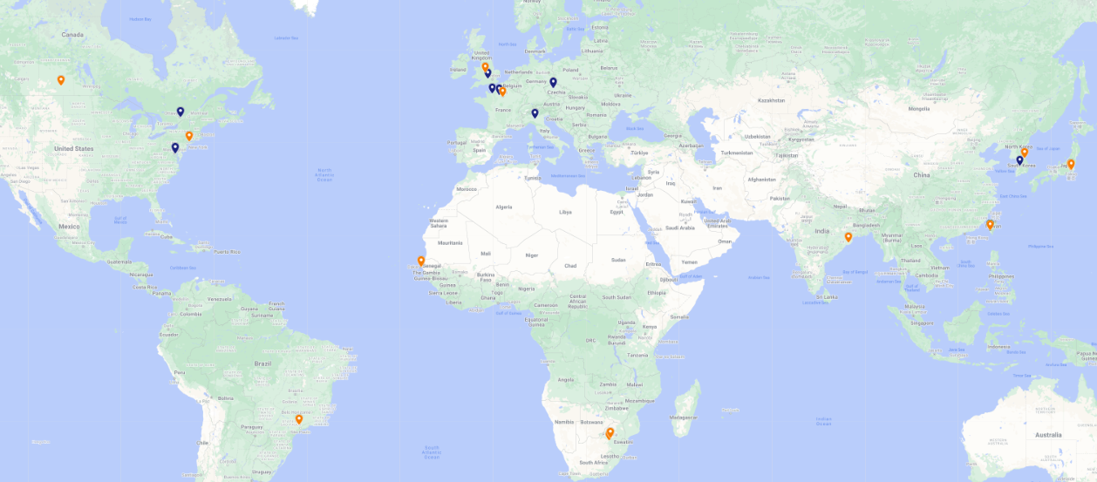
1st Resource Review Board (RRB) Meeting
First meeting on April 3-4, 2023, at Stony Brook University.
DOE and the host labs promoting the EIC as a facility “fully international in character.”
12 countries participating: Blue markers: RRB members; Orange markers: Observers
Agenda reflected what we expect to have in future RRB meetings.
RRB Charter ratified at 1st meeting. Initial Co-Chairs: Haiyan Gao (BNL), Diego Bettoni (INFN).
2nd meeting planned for December 7 + 8 in Washington, DC.
  Topics will include: Common Fund (or not) discussion, Computing (What is expected from partners), Governance (How does change control work for in-kind contributions), Quality Assurance (how does that get folded in reviews and planning documents), International agreements.

Slide 32
Non-DOE Interest & In-Kind – Updated 07/05/23
Entity | Interest and Important Facts
NSF | NSF-MSRI pre-proposal submitted by 10 US universities – aims at full scope of backward EM calorimetry (eECal). Armenia, Czech, France/IN2P3 as unfunded contributors. Invited to submit proposal. Final NSF review is ongoing.
CERN | MAPS sensor design developed by CERN/ITS-3 Group providing synergy with ALICE. Synergy of gaseous-based Cherenkov detectors and photon-sensors with ALICE & LHCb. Synergy of Forward AC-LGAD design with CMS endcap timing layer.
Armenia | Contributions, mainly labor to eECal and many EM calorimetry and particle id detectors component tests.
Canada | EIC included in 2022 Canadian Subatomic Physics Long-Range Plan; Interested in Compton Polarimetry, Barrel Electromagnetic Calorimetry and Software
China | Forward EM Calorimeter
Czech | Working with funding agency; Interested in eECal (PbWO4 crystals and glass) and Silicon
France/IRFU | Interested in MPGD/racking, electronics. Provided in-kind contributions to SC magnet design and interested to continue labor oversight during magnet construction.
France/IN2P3 | International contribution to backward EM calorimetry (including in-kind design) and to readout electronics (two ASICs for AC-LGAD detectors and Calorimetry). IRFU & IN2P3 discussing together for higher-level contributions.
India | Consortium is working with Funding agency; Interested in detector software (non-project scientific contribution), contributions to DAQ/slow controls. Investigating further hardware contributions (including possible links with Si plants).
Italy/INFN | Aims at major scope of forward particle identification detector (dRICH), at (part of) the Si/MAPS tracker scope, and at photo-sensor contributions. Further investigating possible interest in EIC detector magnet scope.
Israel | B0 Detectors (Si tracking and PbWO4)
Japan | Interested in a US-Japan agreement; Aims at full scope of Zero-Degree Calorimeter in collaboration with Taiwan/Korea. Pursuit of full scope of barrel AC-LGAD detector as EIC-Asia consortium. Contribution to DAQ/streaming. Possible aerogel.
Korea | Aims at major scope for fiber-based barrel EM calorimeter, Also work packages for barrel AC-LGAD and Si-based hadronic calorimetry for ZDC.as part of EIC-Asia consortium (includes also Japan,Taiwan), Collaboration on Si tracking detector.
Poland | Actively working with ministry/funding agency; Interested in detectors along the beam line (luminosity detector, Roman Pots)
Taiwan | Pursuit of full scope of barrel AC-LGAD as part of EIC-Asia consortium. LYSO-based EM calorimeter for ZDC, Also optical readout/fiber. Possible later interest in PCBs. Computing.
UK | STFC seed funding for UK detector R&D (3M£). Interest in Si/MAPS tracker, polarimetry and detectors along the beams (Low-Q2/TimePix). Follow-up STFC/UKRI request for 5-7 years submitted early 2023 (includes accelerator part).

Slide 33
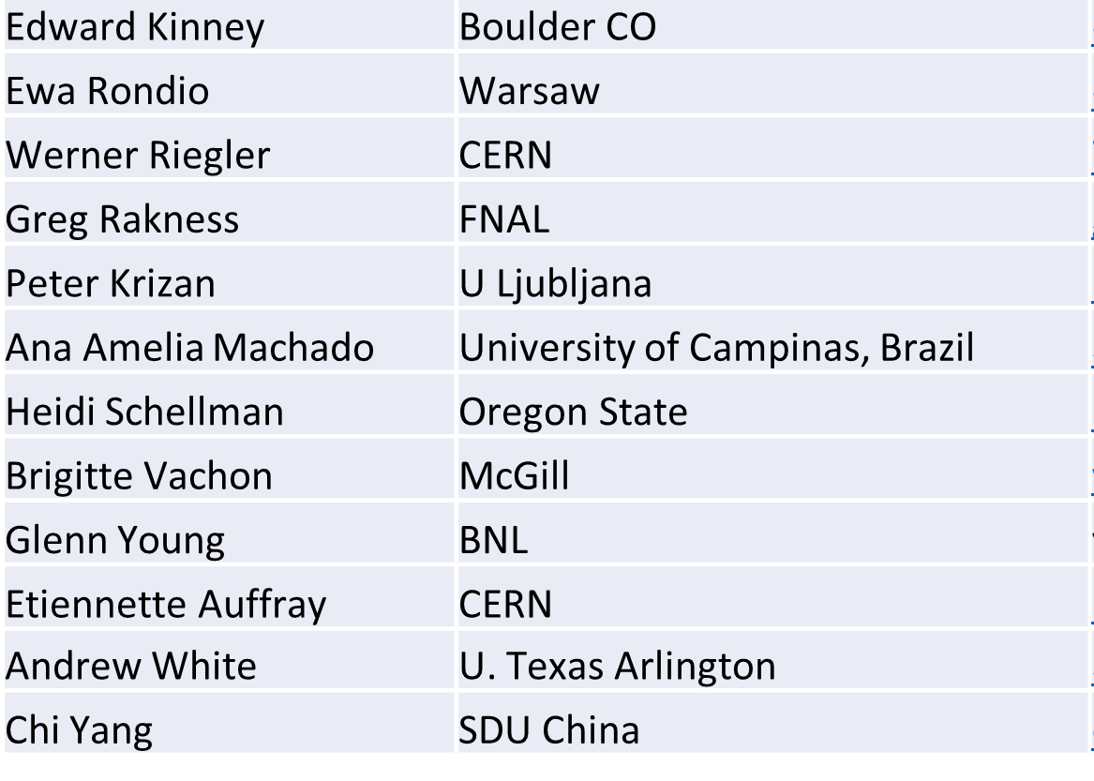
Detector Advisory Committee (DAC)
We assembled the DAC in 2020
Per the charter, 1/3 of the committee was replaced early 2023
Meetings to date:
  September 28-29, 2020. Bring the DAC up to speed and prepare them for upcoming charges, e.g., related to input on assessment of the call for Expressions of Interest (EoI).
  December 18, 2020. Update DAC on the EIC Project and Yellow Report status, the EoI assessment, international engagement, and planning for call for detector proposals.
  March 24-26, 2021. Transition from the generic EIC detector R&D to the Project detector R&D.
  December 2021 – January 2022. Evaluation of detector technologies, cost and schedule as input to the Detector Proposal Advisory Panel.
  October 19-21, 2022. Review the ongoing project detector R&D. Advise for the FY23 detector R&D.
This week: Review next phase of Project Detector R&D and status of ePIC design.
Edward Kinney (Chair) | Boulder CO
Ken Wyllie | CERN
Petra Merkel | FNAL
Antonis Papanestis | Rutherford Appleton Laboratory
Peter Krizan | U Ljubljana
Ana Amelia Machado | University of Campinas, Brazil
Heidi Schellman | Oregon State
Brigitte Vachon | McGill
Stefano Miscetti | INFN Frascati
Etiennette Auffray | CERN
Andrew White | U. Texas Arlington
Chi Yang | SDU China

Slide 34
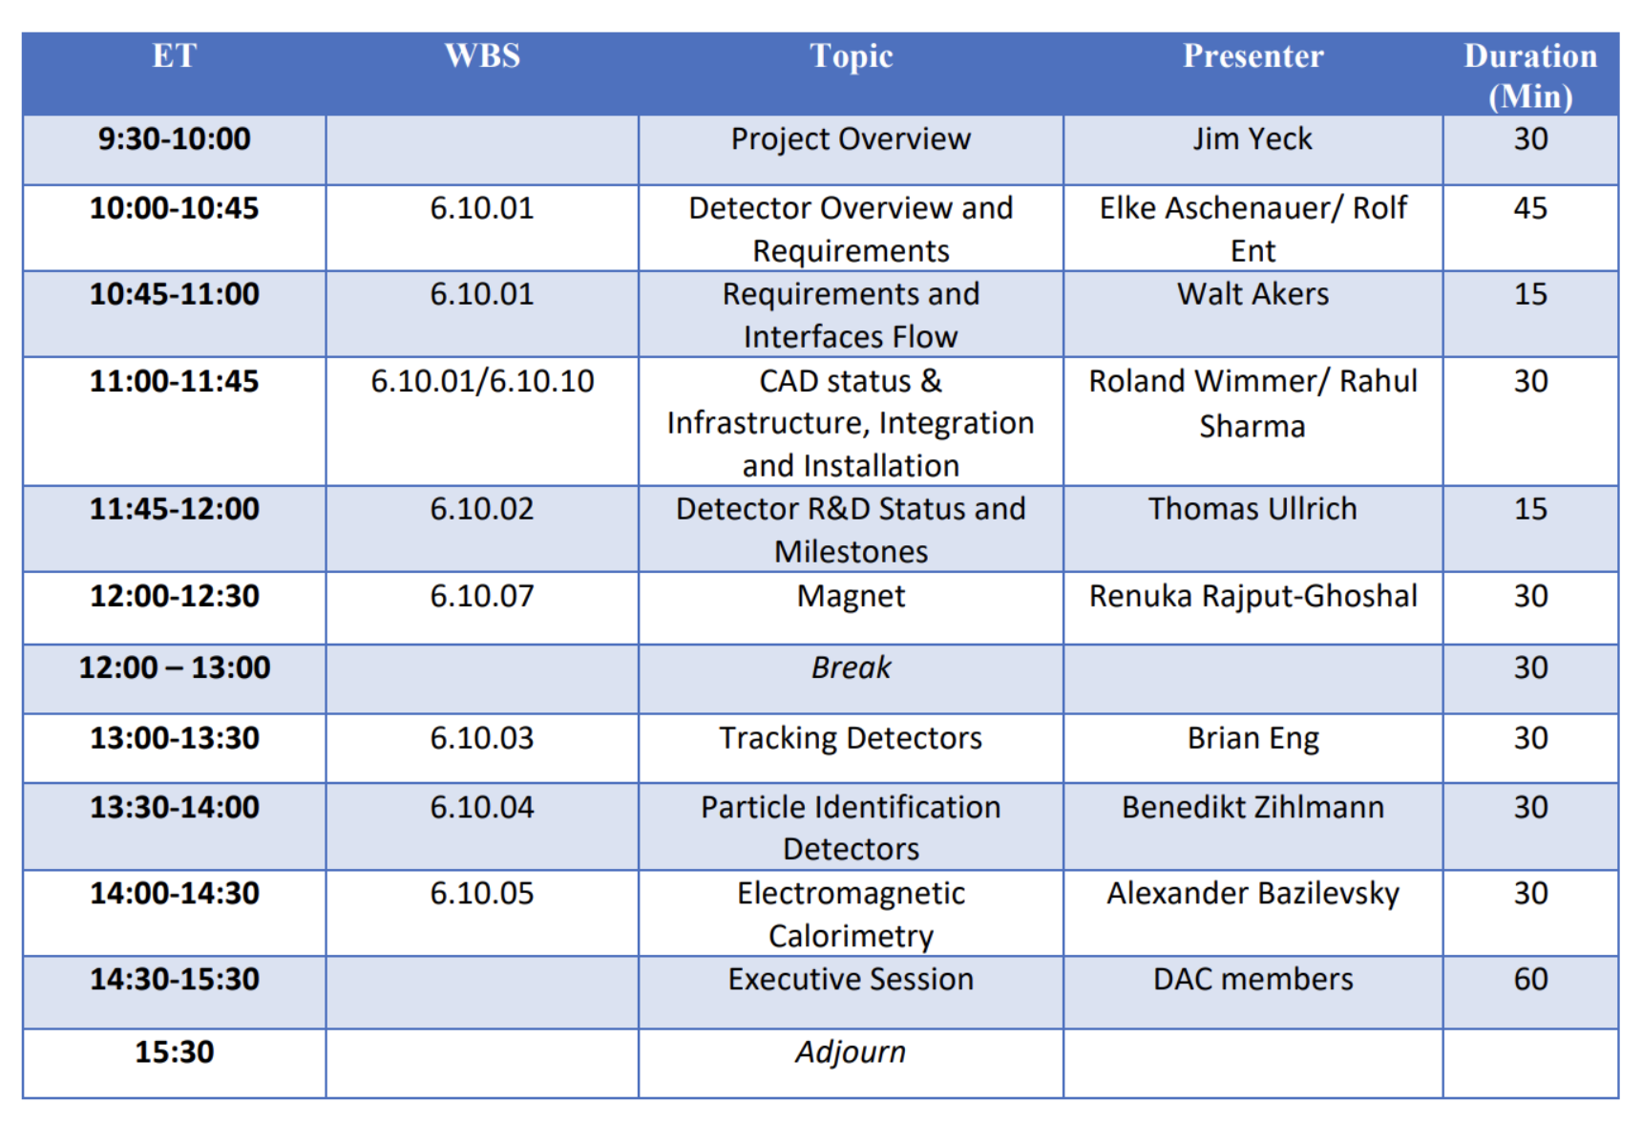
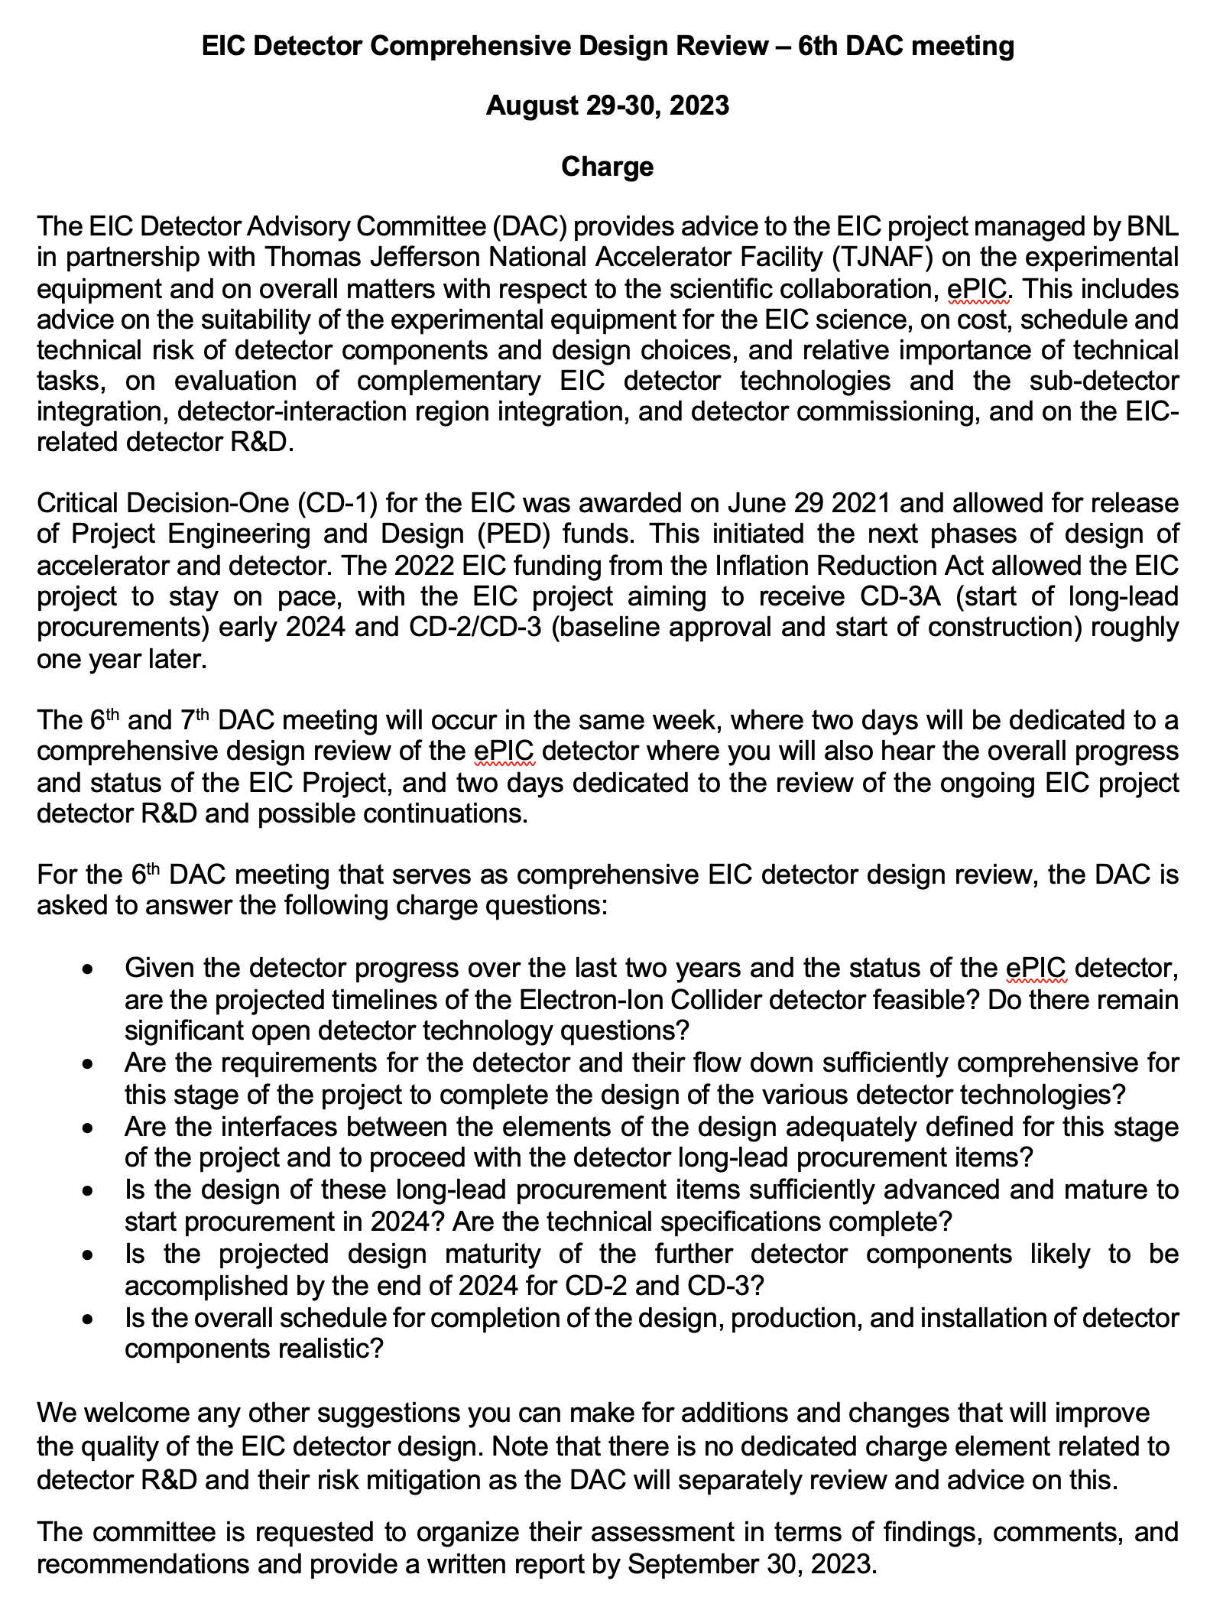
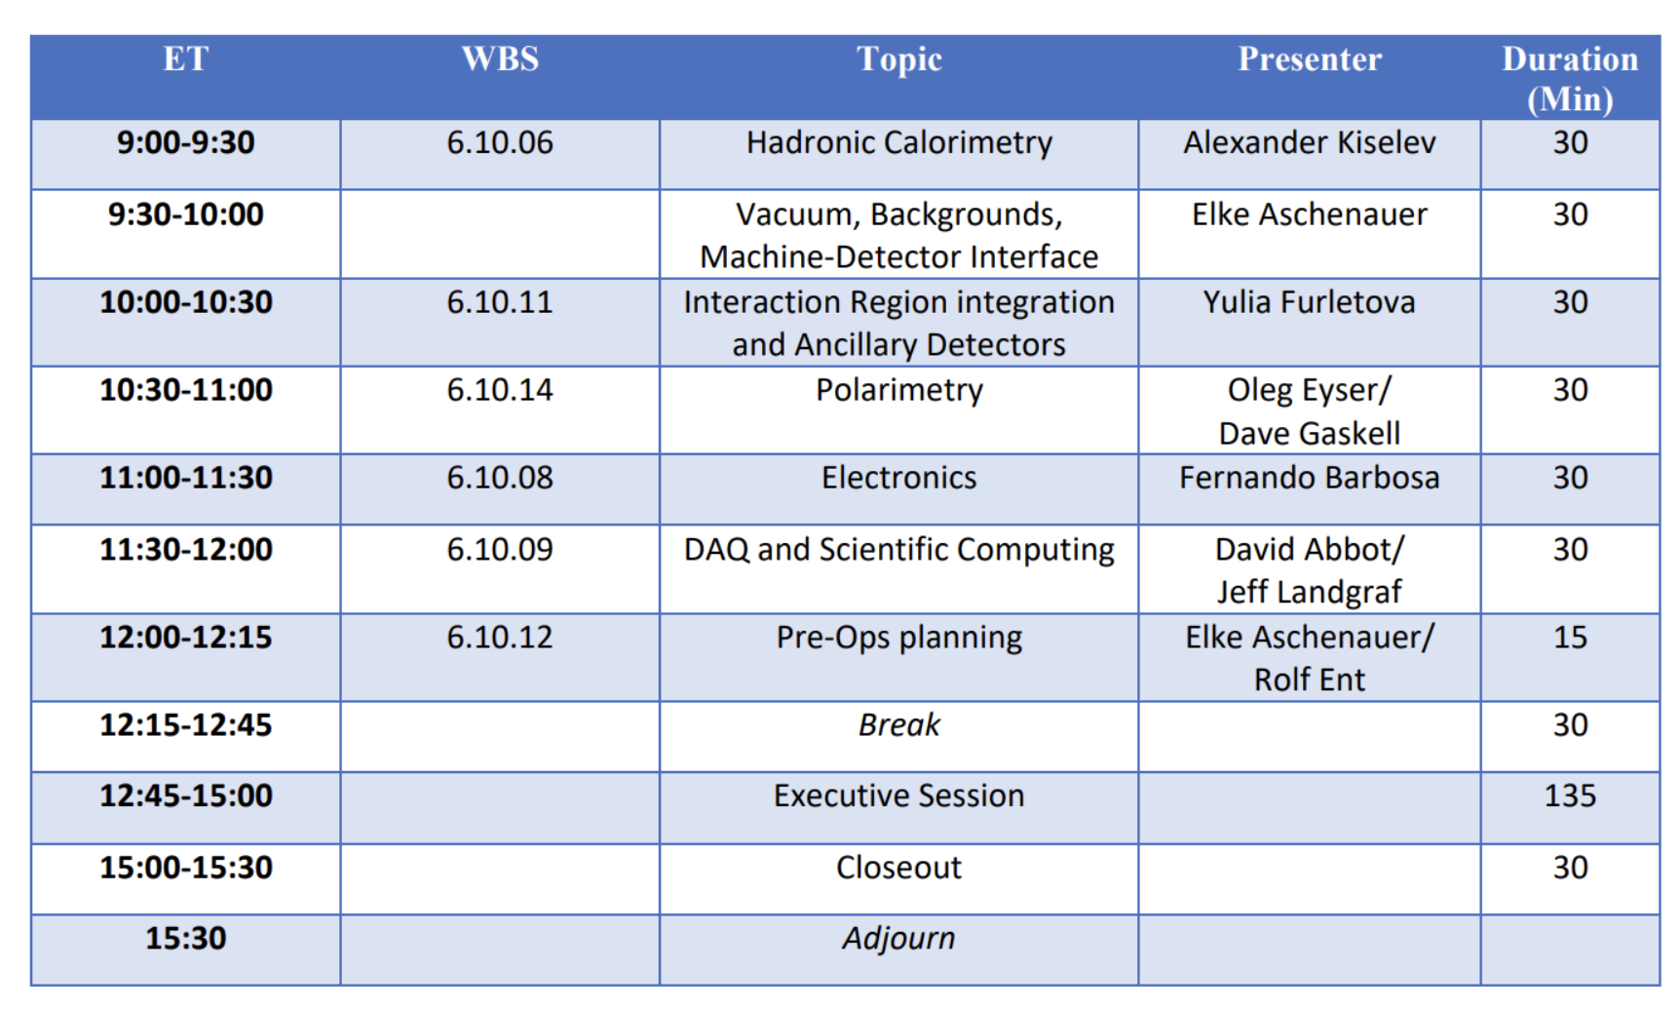
DOE CD-3A Design Review
Reviewers: DAC

Slide 35


Slide 36
Where to find Information
Wiki-page: https://wiki.bnl.gov/EPIC/index.php?title=Project_Information
Public Sharepoint: ePIC
Detector Requirements: https://eic.jlab.org/Requirements/
Geometry Database: https://eic.jlab.org/Geometry/Detector/Detector-20230108185912.html
Updated ePIC figures: Updated ePIC Figures

Slide 37
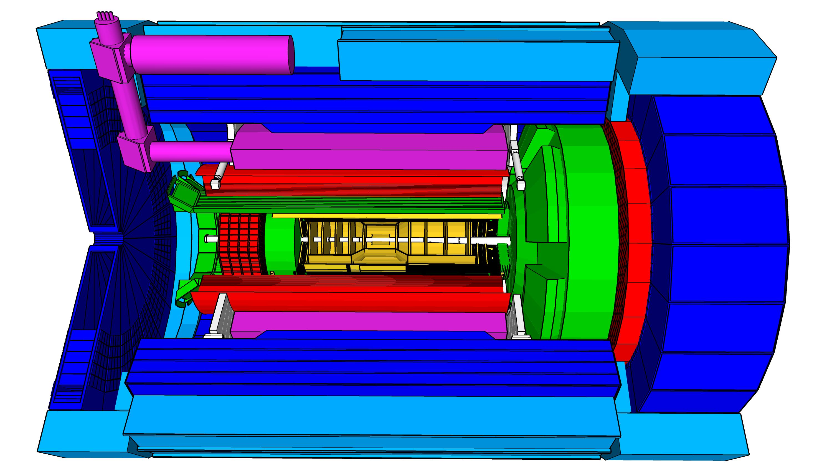
High Level Installation Schedule
Oct 2028
Jan 2029
CD-3
04/2025
April 2029
Milestone
P0_0305_0900
CD-4
09/2034
Dec 2029
early CD-4
09/2032
June 2030
Oct 2030
Jan 2031
Construction
Pre-OPS
IR-6 ready
for installation
Transition into
Operations
Early start of
Operations
&
Science
Start of
Operations
&
Science
lower half
barrel Hcal
installed
Solenoid
delivered
Endcap HCals
completed
Solenoid
Field mapping
done in beam position
Hadron Endcap
Detectors
installed
Trackers, dRICH
ECal
done in IP-6 Assembly Hall
Barrel Ecal
ready
for installation
Barrel Hcal
& Solenoid
installed
followed by low
power test
Lepton Endcap
Detectors
installed
Trackers, bRICH
ECal
Barrel Detectors
installed
ECal, DIRC,
ToF, Trackers
Take Away:
Solenoid and Barrel HCal need to be ready by Jan 2029
all other subdetectors need to be ready between 06/29 to 06/30 depending on their location in the detector

Slide 38
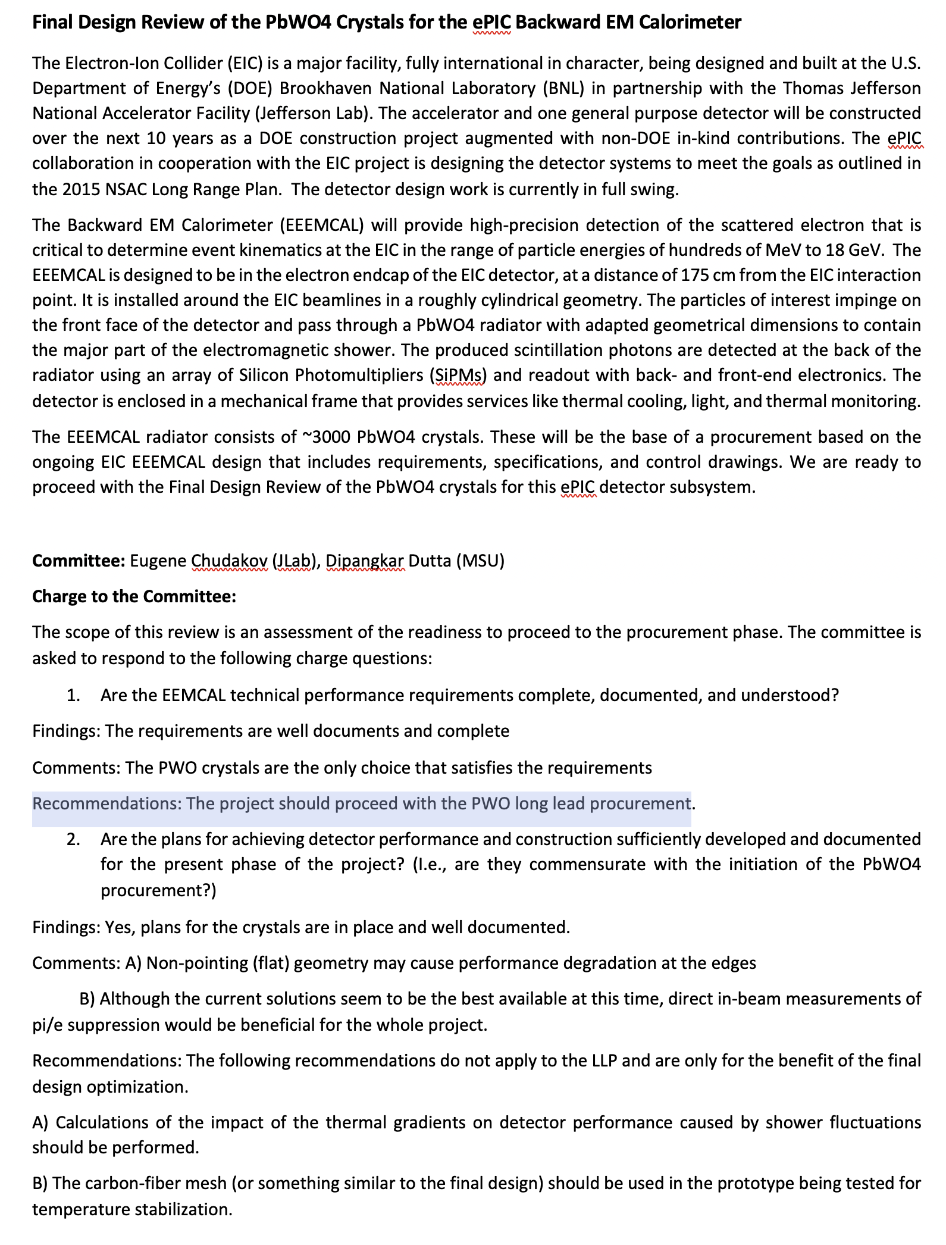
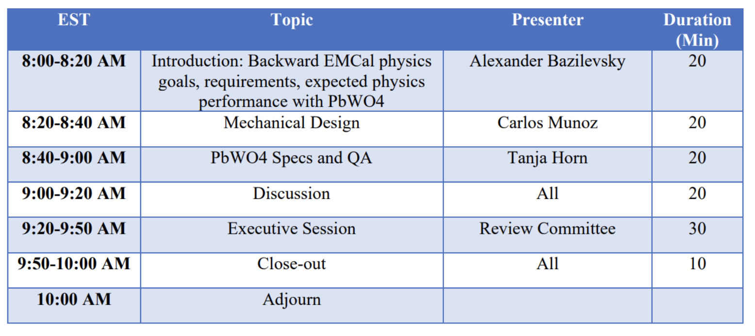
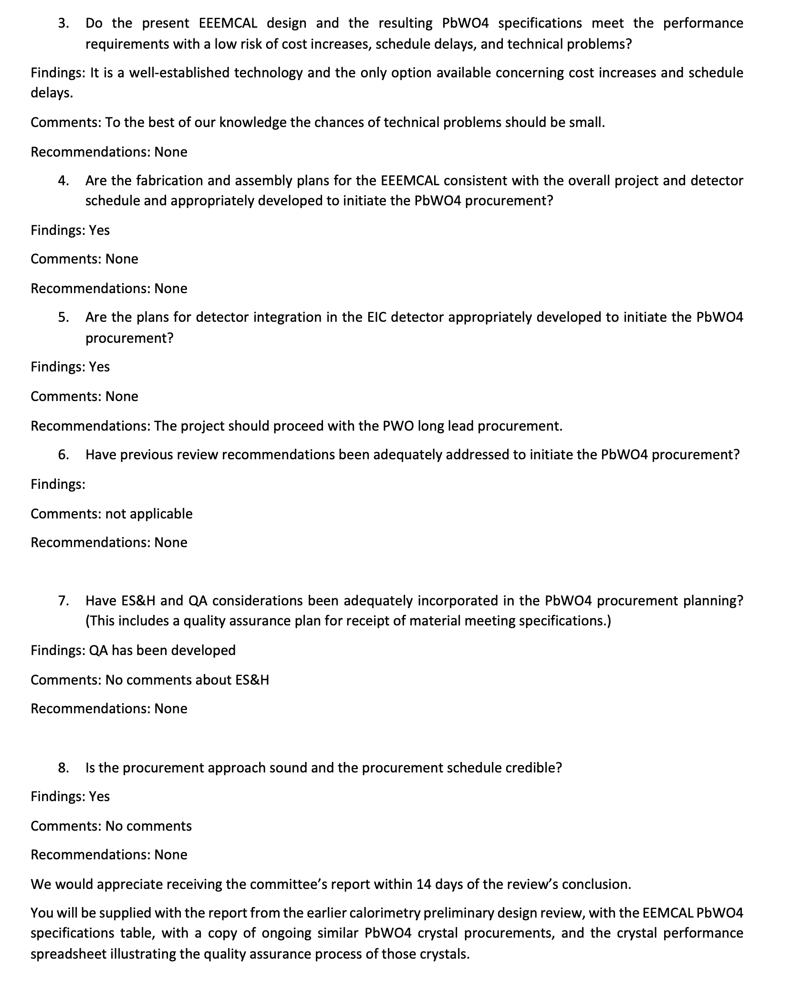
PbWO4 Crystals FDR
Passed all recommendations are to improve overall design
Other LLP reviews will be very similar

Slide 39
EIC Experimental program preparation
BNL and TJNAF Jointly Leading Efforts Towards Experimental Program | BNL and TJNAF Jointly Leading Process to Select Project Detector
2020 | Call for Expressions of Interest (EOI) https://www.bnl.gov/eic/EOI.php | May 2020
 | EOI Responses Submitted | November 2020
 | Assessment of EOI Responses | On-going&
2021 | Call for Collaboration Proposals for Detectors https://www.bnl.gov/eic/CFC.php | March 2021
 | BNL/TJNAF Proposal Evaluation Committee | Spring 2021
 | Collaboration Proposals for Detectors Submitted | December 2021
2022 | Decision on Project Detector – baseline “ECCE” | March 2022
 | Process to consolidate ECCE & ATHENA to the EIC Project Detector | Spring 2022
 | ePIC Collaboration* Formed – 160 institutions | July 2022
2023 | ePIC Charter ratified & elected Leadership Team | February 2023
 | 1st Resources Review Board Meeting | April 2023
 | ePIC Detector remaining technology choices made | April 2023
&Remains ongoing until formal agreements are in place – it originally led to confirmation that in-kind level assumed for the EIC detector was in range.
*Merger of two large ATHENA and ECCE proposals

Slide 40
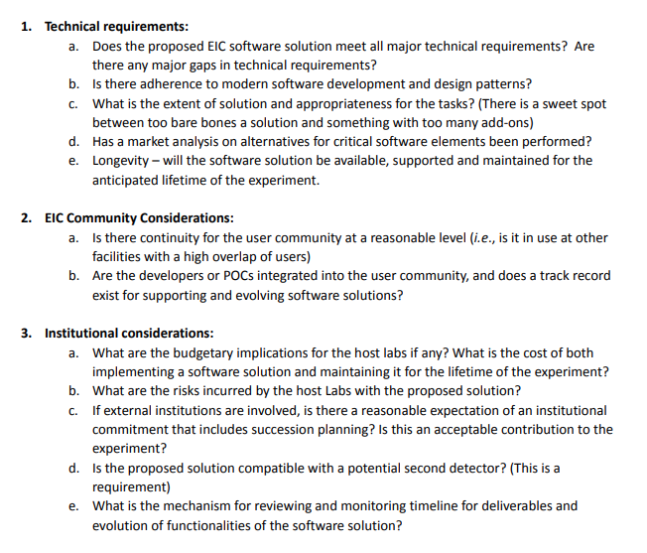
EIC Detector Software Infrastructure Review
Scientific computing & associated infrastructure is a dependency for the EIC
Held in collaboration with Host Labs, August 22-23, 2022
Scope:
  Evaluate choices made throughout software decision schedule
  Evaluate user community involvement with software
  Evaluate international contributions and risks
Reviewers:
  David Brown (LBNL)
  Mohammad Al-Turany (GSI)
Observers:
  Amber Boehnlein (JLab)
  Eric Lancon (BNL)
  Haiyan Gao (BNL)
  David Dean (JLab)
Broad and deep charge
Recommendations:
  Strengthen connection between C&S/SimQA (RE: ePIC working groups) with host lab computing and software support staff
  Develop a long term timeline for major software infrastructure
  Clarify computing and software requirements on data handling, processing, and access
  Ensure project needs associated with the CD process are being met by planned development and productions

Slide 41
Integration of ePIC Collaboration and Project Example I: Magnet
6.10.07 Magnets
Level-3
Rolf & Elke
Level-2
This example assumes a continuation of the engineering and design by a CEA Saclay-JLab-BNL collaboration, and an in-kind magnet by an international collaborator(s)
Integrating Collaborators:
6.10.07 L3-Manager: Renuka Rajput-Ghoshal
L3 Technical Point-Of-Contact:
Valerio Calvelli (CEA Saclay)
Work Package(s) Magnet: TBD (int’l collaborator(s))
Work Package Cryocan, Cryoflex Line, etc: Renuka
Timeline:
The magnet is foreseen as a Long-Lead Procurement item which means that some in-kind agreement should be in place at the CD-3A review.
We will need a control account manager (CAM) at each WBS level. WBS levels go down to where it is meaningful to accumulate cost and schedule variance. There can be many Work Packages below.

Slide 42
Integration of ePIC Collaboration and Project Example II: Si Detectors
6.10.03 Tracking
Level-3
Rolf & Elke
Level-2
6.10.03.01 Silicon Vertex Tracker
Level-4
6.10.03.02 MPGD Tracking
Level-4
Integrating Collaborators:
6.10.03 L3-Manager: Brian Eng
6.10.03.01 L4-Manager: Brian Eng
L4 Technical Point-Of-Contact: Si consortium, one of the consortium leadership
    Laura Gonella (U Birmingham)
    Ernst Sichtermann (LBNL)
    Giacomo Contin (INFN Trieste)
Work Package Owners: TBD
Timeline:
Silicon is not a long-lead procurement so a draft in-kind agreement should be in place at the CD-2/CD-3 review.
We will need a control account manager (CAM) at each WBS level. WBS levels go down to where it is meaningful to accumulate cost and schedule variance. There can be many Work Packages below.

Slide 43
(Draft) TDR – more details on section on Experimental Systems
.
8.1 Experimental Equipment Requirements Summary (like CDR 8.2)
8.2 General Detector Considerations and Operations Challenges (YR 10 and CDR 8.3)
8.2.1 Beam Energies, Polarization, Versatility, Luminosities (like YR 10.1)
8.2.2 Rates and Multiplicities (like CDR 8.3.1)
8.2.3 Interaction Region Integration, Vacuum and Backgrounds (like CDR 8.3.2)
8.2.4 Systematic Uncertainties (like YR 10.5)
8.3 EPIC Detector CAM(s) and ePIC collaboration contact(s)
8.3.1 Magnet For each subsection end with R&D and design maturity
8.3.2 Tracking
8.3.3 Electromagnetic Calorimetry
8.3.4 Hadronic Calorimetry
8.3.5 Particle Identification
8.3.6 Far-Forward Detectors
8.3.7 Far-Backward Detectors
8.3.8 Polarimetry and Luminosity Detector
8.3.9 Readout Electronics and Data Acquisition
8.3.10 Software, Data Analysis and Data Preservation (EICUG SWG?)
8.4 Detector R&D Summary
8.5 Detector Integration (Walt, Rahul, Tim/Christian, Fernando, Roland, Dan, Elke, Rolf)
8.5.1 Experimental and Assembly Hall Infrastructure (like CDR 8.7.1, YR 13.1)
8.5.2 Interaction Region and Protection (include also YR 13.2)
8.5.3 Support Frames and Installation Fixtures (new, ask Roland and Walt to draft)
8.5.4 Detector Alignment (like YR 13.4)
8.5.5 Schedule and Installation (like CDR 8.7.2, YR 13.3)
8.5.6 Access and Maintenance (like CDR 8.7.3, YR 13.5)
8.5.7 System Engineering and Interface Controls (links to later global Section 12 on System Engineering)
8.6 Detector Commissioning and Pre-Operations

Slide 44
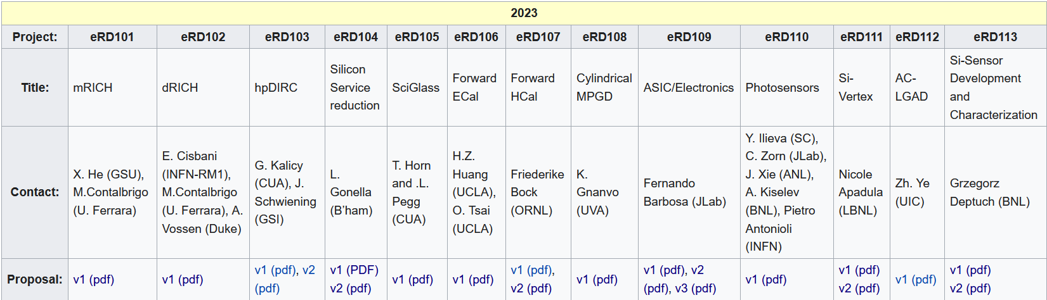
EIC Project Detector R&D Program & In-Kind
https://wiki.bnl.gov/conferences/index.php/ProjectRandDFY23
INFN-Ferrara, Glasgow
INFN-Roma1, INFN-Ferrara
GSI
IJCLab-Orsay, INFN-Genova, AANL/Armenia
Valparaiso
IJCLab-Orsay, CEA Saclay, INFN-Torino
IJCLAB/Omega/
Saclay/NCKU
International
Partners
Birmingham, Brunel, RAL, INFN-Bari, INFN-Trieste, IMP, CCNU
Nurnberg, GSI, INFN-Bologna, Cosenza, Ferrara, Genova, Trieste
Birmingham, Brunel, RAL, INFN-Bari, INFN-Trieste, IMP, CCNU
Chinese EMCal
Consortium
CEA Saclay
Strong synergies with CERN
CERN – EIC R&D Day November 2021 https://indico.cern.ch/event/1063927/
MAPS: ALICE-3 – ITS-3 development
PID: LHC-b and ALICE-3
Photon-sensors: LAPPDs with LHC-b
MPGD: long-term CERN R&D program RD51
DAQ: strong developments on streaming DAQs for all LHC experiments
AI/ML and high-performance distributed computing

