Slide 1
06.10.10 Integration, Installation and Infrastructure (Triple I Group)
Rahul Sharma (L3) Chief Mechanical Engineer
Roland Wimmer (ME) and Dan Cacace (ME)
ePIC Design Review
August 29, 2023

Slide 2
Outline
Charge Questions:
Are the interfaces between the elements of the design adequately defined for this stage of the project and to proceed with the detector long-lead procurement items?
Is the design of these long-lead procurement items sufficiently advanced and mature to start procurement in 2024? Are the technical specifications complete?
Is the projected design maturity of the further detector components likely to be accomplished by the end of 2024 for CD-2 and CD-3?
Is the overall schedule for completion of the design, production, and installation of detector components realistic?
Triple I Team
EPIC Detector, Assembly Hall and Experimental Hall
In Kind/Reused Items
CAD Models
EPIC Full Model Overview
dRICH
pfRICH prototype
DIRC Support
Services Layout & Management
Installation Sequence (Barrel)
Barrel EMCal Installation
Endcap Design
Carbon Fiber Support Structures for Inner Detectors
Power
Magnetic Forces Analysis
Cooling Systems and Gas Systems
Summary/Next Steps

Slide 3
EPIC Triple I Team:
Rahul Sharma (BNL) – Chief Mechanical Engineer
Walt Akers (JLAB) – Systems Integration
Roland Wimmer (BNL)– Mechanical Engineer
Dan Cacace (BNL) – Mechanical Engineer
Alex Eslinger (JLAB) – Mechanical Engineer – pfRICH and dRICH Design
Ron Lassiter (JLAB)– Forward Detectors - Mechanical Engineer
Karim Hamdi (BNL)– Mechanical Designer
Tim Camarda (BNL) – Electronics Engineer
Avishay Mizrahi (Tel Aviv) – Mechanical Engineer - DIRC
Joshua Crafts (CUA) – Postdoc - EEEMCAL
Tom O’Connor and Kevin Bailey (ANL) – Barrel EMCAL Design
Andreas Jung (Purdue University) – AC LGAD and Carbon Fiber Support Structure
Johnathan Smith (JLAB)
Eric Anderssen and Joe Silber (LBNL)
Regular weekly engineering meetings are held to discuss and resolve engineering problems and check progress. Hope to add 2 more Mechanical Engineers and a Mechanical Designer to the group soon as the project evolves.

Slide 4
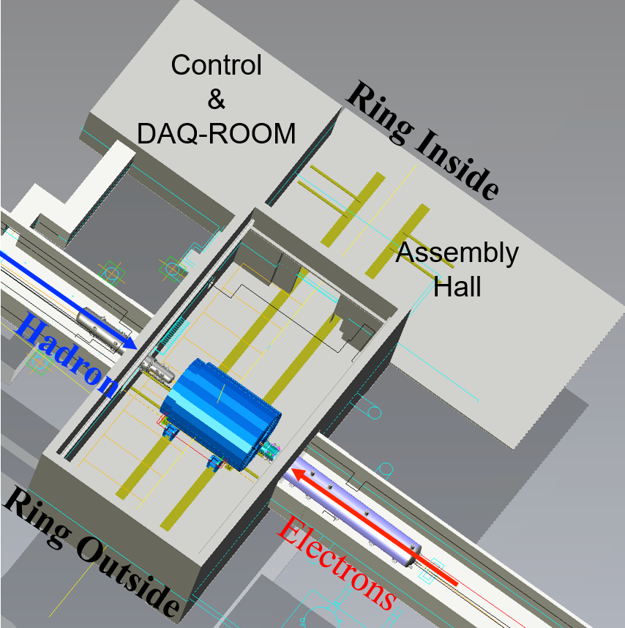
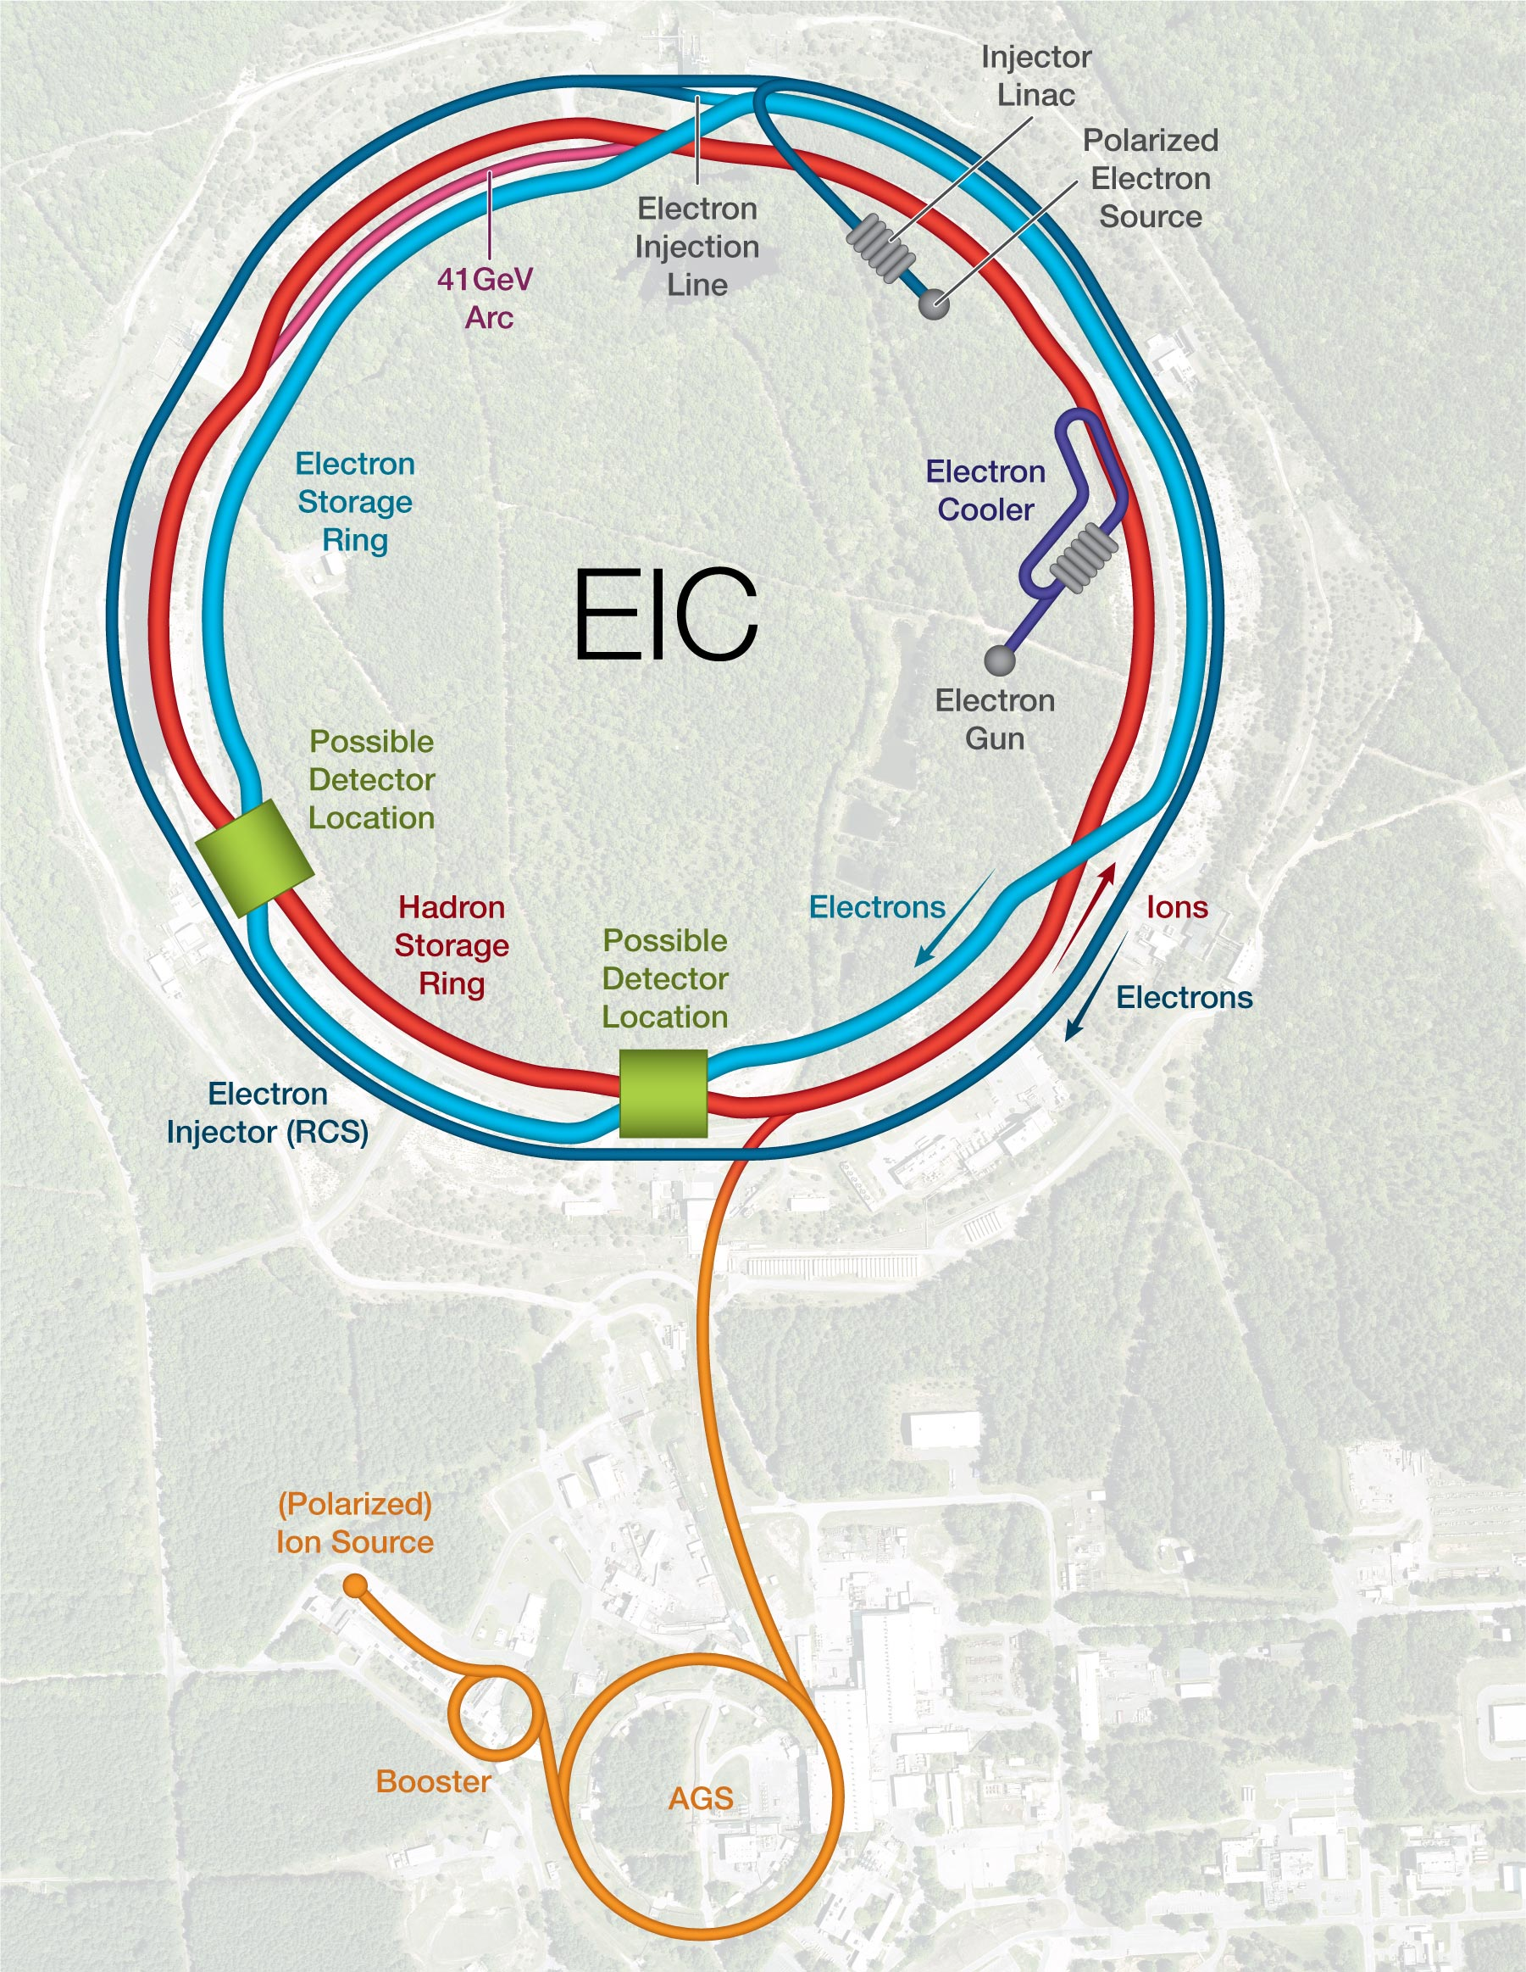

EIC – IP-6
North
Possible
2nd Detector
Location
Project
Detector
Location
East
IP-6 provides an interaction region with a hall with all infrastructure needed for a collider detector
Assembly hall provides ample space for installation and maintenance.
EPIC Detector Barrel will be assembled in the Assembly Hall
End Caps will be assembled in the Experimental Hall
During maintenance shutdown detector can be rolled out from experimental hall to the Assembly Hall

Slide 5
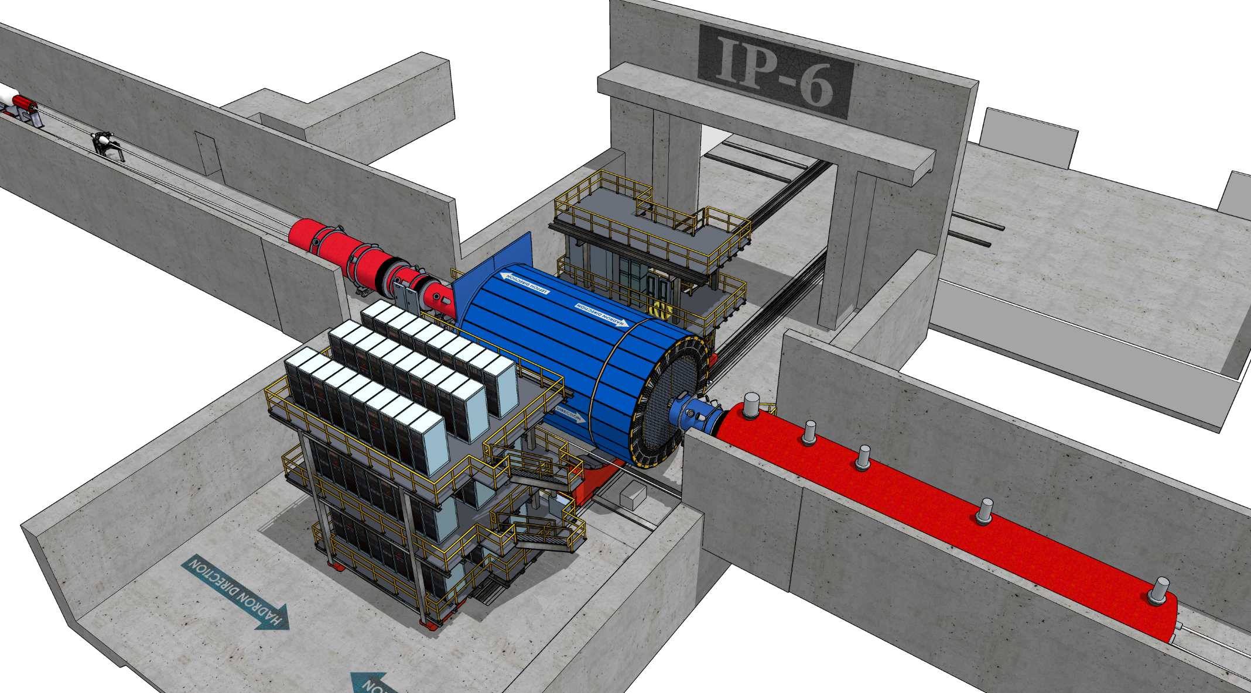
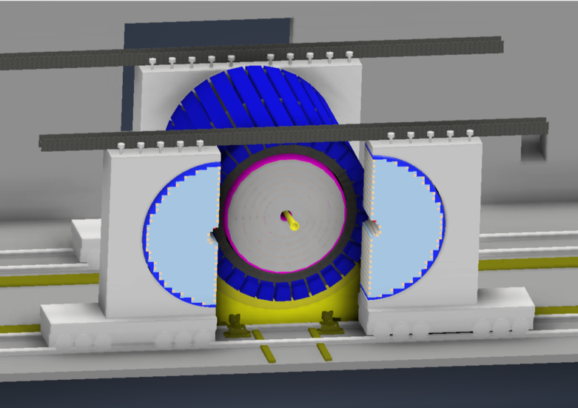
IR-Integration and Interfaces
Space Constrains:
-4.5 m – IP – +5m not negotiable
<50 cm space to 1st IR-magnets occupied by vacuum pumps, valves, …..
IP moved 81 cm towards ring inside compared to RHIC; y: 432 cm above floor
RCS to IP: radial distance 335.2 cm at a height of 372 cm above floor
Maximum outer radius ~ 3.2 m
limited installation possible in Collider Hall
Endcap hadron calorimeters need to be split transverse to beam pipe
RCS vacuum needs to be broken
Electrons
Hadrons
RCS
9.5 long detector does not fit through the door
Door-Size: 823 cm x 823 cm
endcaps need to remain in collider hall, if central detector rolls in assembly hall

Slide 6
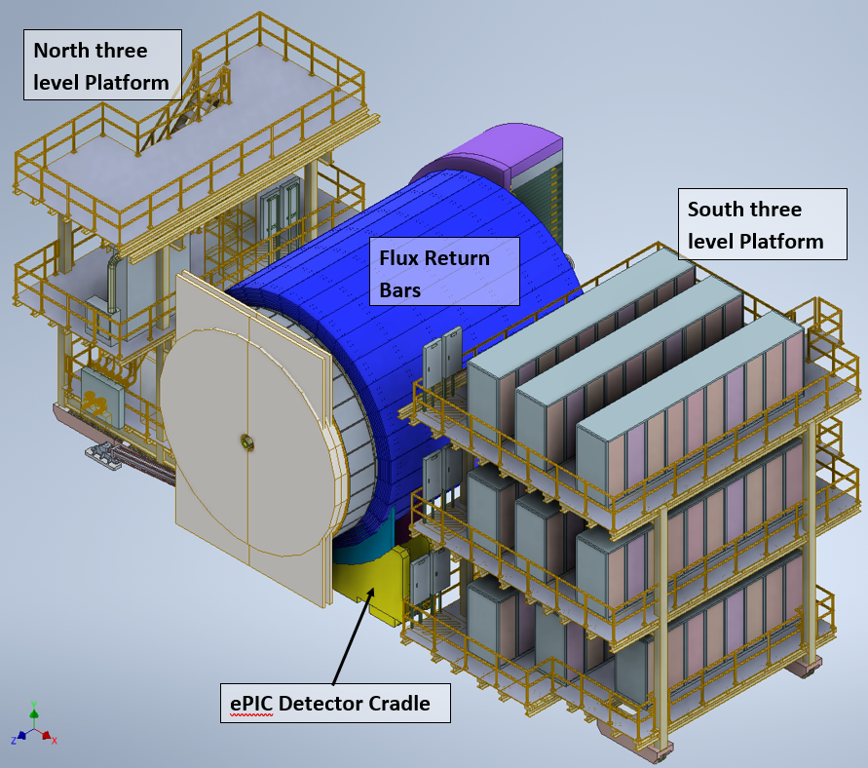
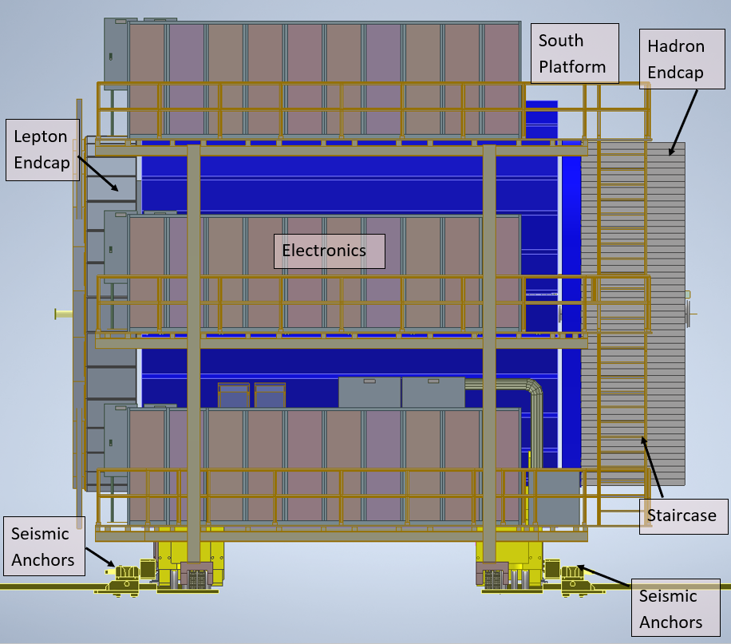
In Kind/Reused Items
We reuse infrastructure from existing detector (STAR) in 1006.
North and South Platform for STAR will be modified and used for EPIC. Modifications needed to clear the path for opening of End Caps.
Detector Cradle from existing detector will also be reused.
Plan on using same pistons and moving mechanism from STAR. Pistons will be refurbished and new control unit with hydraulic lines is also needed.
Barrel HCAL will be reused from sPHENIX.
Existing Seismic Anchors will also have to be repositioned
Endcaps are designed in two halves and need to be moved out of the way to Access Barrel:
Endcaps will be designed in two halves
New Design for Moving Mechanism for Endcaps (shown on later slides). New Rails needed as well for End caps.

Slide 7
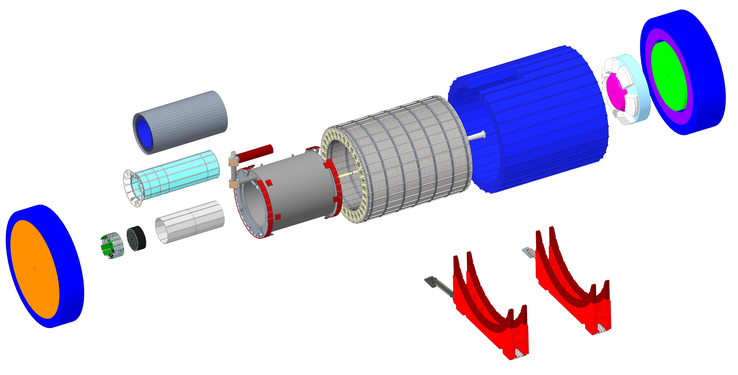
EPIC Exploded View
BARREL ELECTROMAGNETIC CALORIMETER
SECTOR 5
FLUX RETURN (Star)
DIRC
Detection of Internally Reflected Cherenkov light
SILICON
DETECTOR
BARREL HADRON
CALORIMETER
Z
PF-RICH
DETECTOR
SECTOR 6
HADRON
CALORIMETER
ENDCAP
dual
RICH
ELECTRONS
Beam pipe
HADRONS
IP6
SC SOLENOID
ELECTROMAGNETIC
CALORIMETER
LEPTON ENDCAP
Detector Carriage

Slide 8
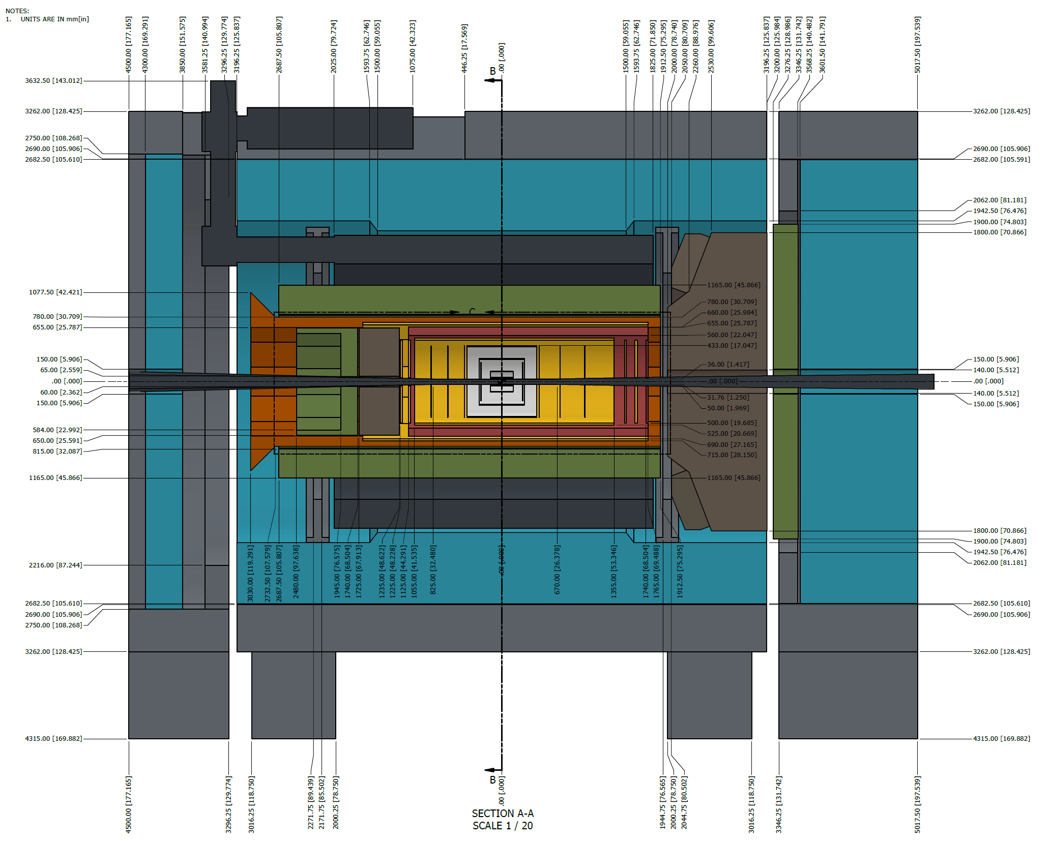
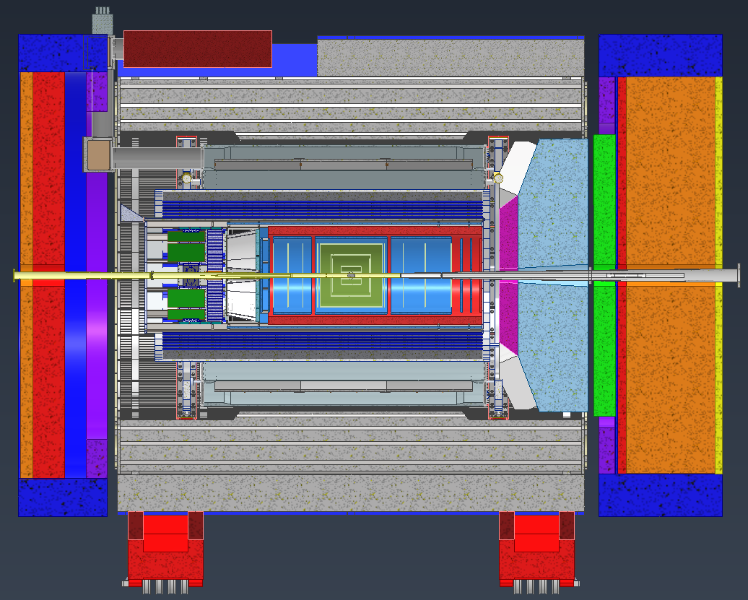
EPIC Full Model Overview

Slide 9
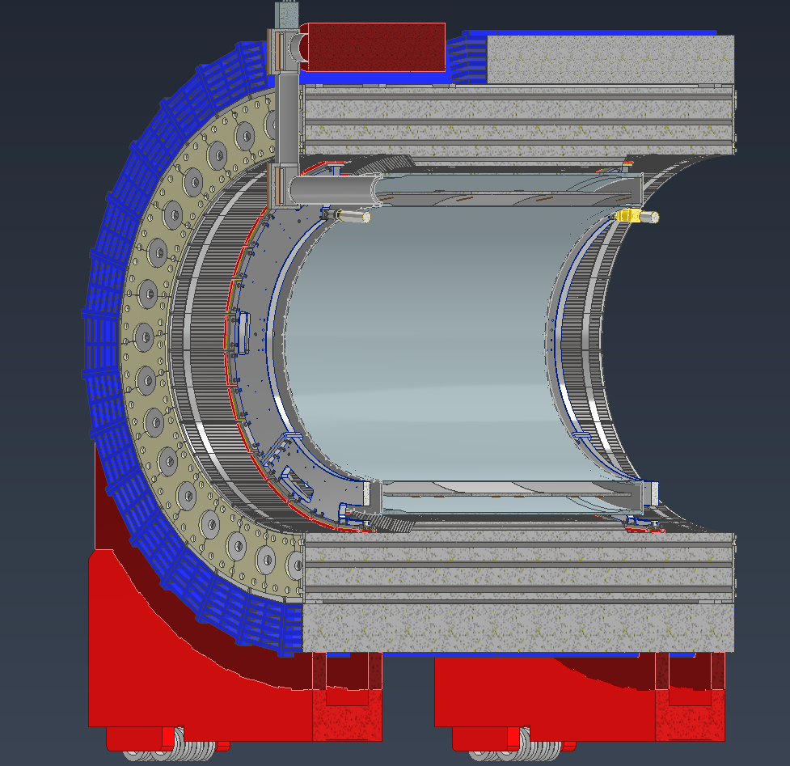
Model Overview (Outer Detectors and Super Conducting Magnet)
Flux Return Bars
Chimney
Barrel HCAL:
Reusing the sPHENIX barrel HCAL
sPHENIX dog-bones and inner support rings provide support for the HCAL
Detector Cradle:
STAR Cradle will be the base of the Barrel Structures. It will have the mechanism to Roll EPIC in and out of the Experimental Hall.
Solenoid :
Using the same jack placement and leveling system that sPHENIX uses for its magnet
Support Rings:
Reusing the sPHENIX support rings
Tobe altered slightly to accommodate end rings for the barrel EMCAL supports
Dog-Bones
Barrel HCAL
SC Magnet
Support Rings
Support Webs
Detector Cradle

Slide 10
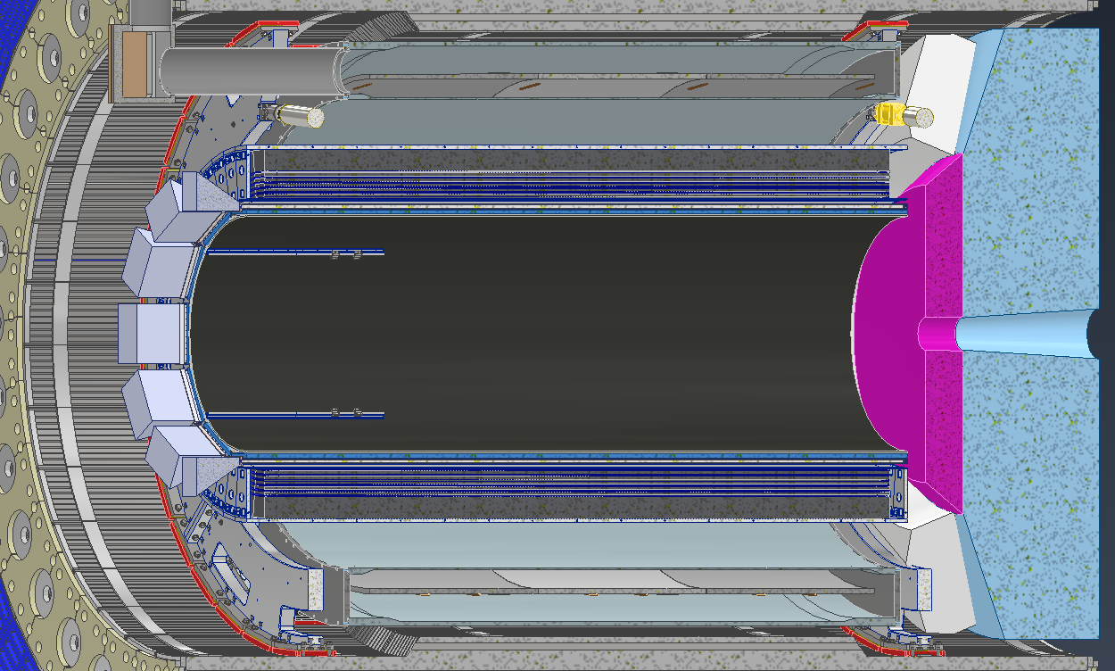
Model Overviews (Outer Detectors)
Barrel EMCAL
dRICH
EMCAL:
Will be supported by the inner support rings from sPHENIX
There will be 2 end rings that will mount the EMCAL to the support rings
dRICH:
Currently there are slight interference issues that are being addressed.
Services from the inner detectors need space to pass in between the sensor boxes
Will be discussed in more detail in later slides
DIRC:
Still being developed and is being modified heavily as constraints change
Will be discussed in more detail in later slides
DIRC & support

Slide 11
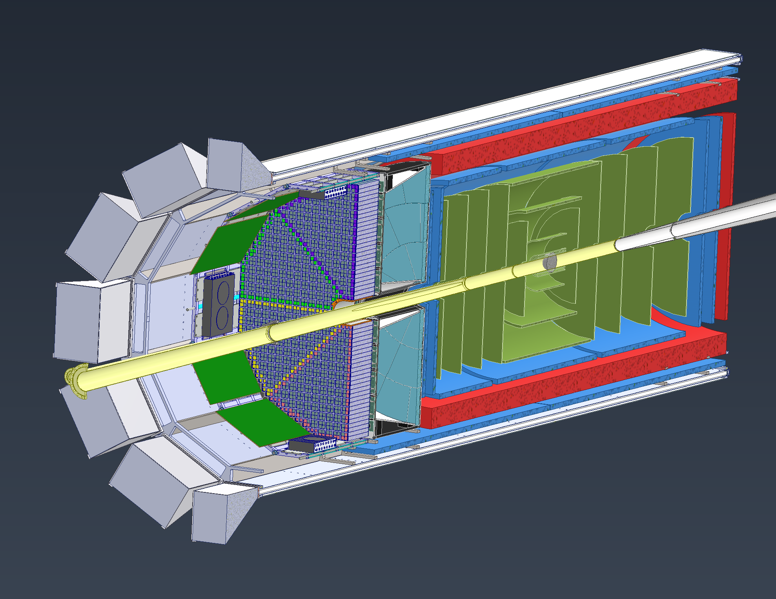
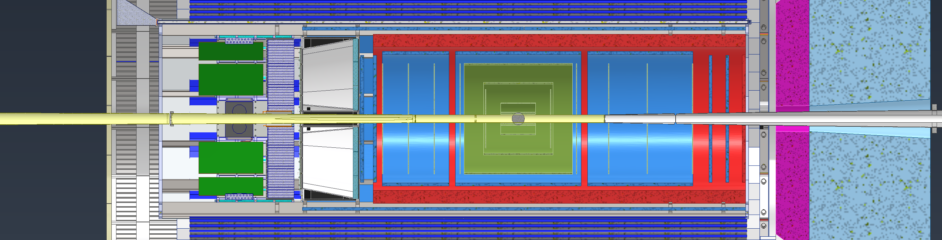
Model Overviews (Inner Detectors)
EEEMCAL: Will be slid in on rails at 3 & 9 O’clock positions
pfRICH: Will most likely use the same rail structure that the EEEMCAL uses
AC-LGAD: Cylinder and disk models are placeholders. A support structure is being developed that will house the AC-LGAD, Inner MPGDs & disks and all the Silicon Trackers
MPGDs: Consists of outer and inner barrel layers along with 4 disks, 2 on each end. Outer layer will be supported with the DIRC
Silicon Vertex & Sagita Silicon: Will use same support structure as other inner detectors
Si Disks: 10 Disks total, 5 each side, using same support structure as other inner detectors
MPGDs
Silicon Trackers
AC-LGAD
pfRICH
EEEMCAL
Beampipe
Si Disks

Slide 12
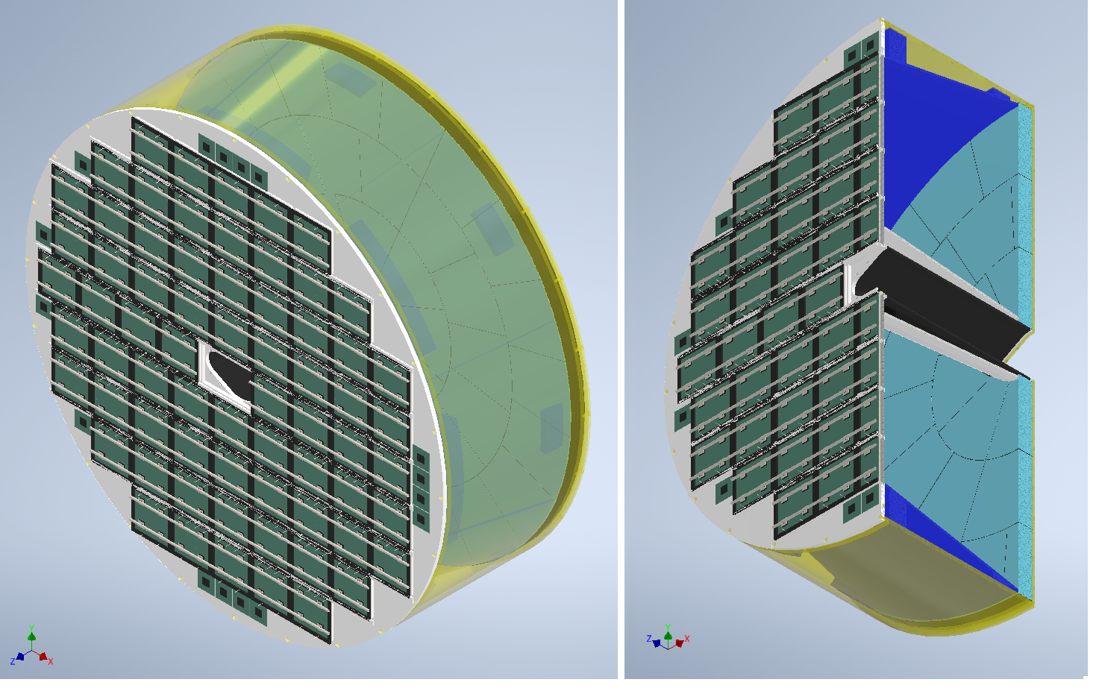
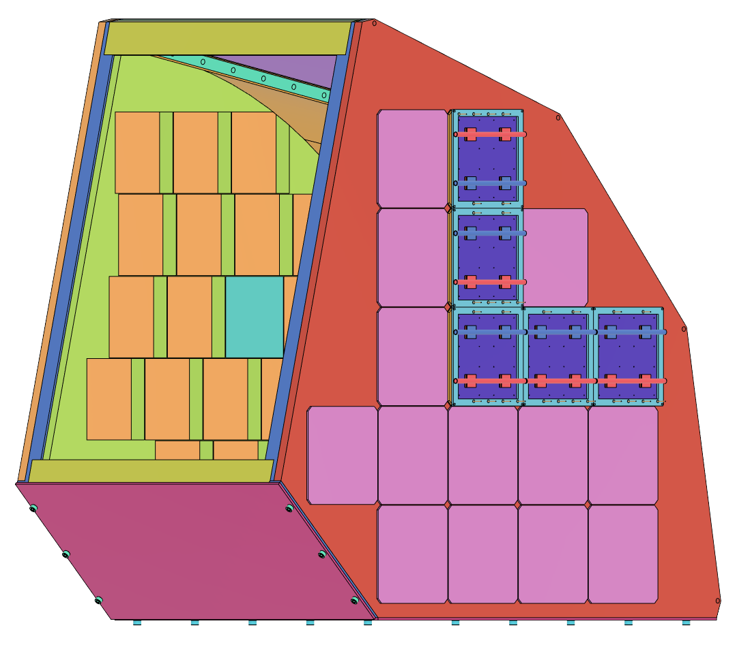
pfRICH
Mirrors
Aerogel Tiles
Sensors
Support Structure
pfRICH Prototype
pfRICH Full Detector Model
Detail design in progress and interference issues with beampipe resolved.
Design of prototype ready. Building and testing the prototype at Fermilab in 2024. The purpose is to address technical risks associated with the detector. Specific parameters of its main components will be evaluated for their impact on performance, such as the HRPPD photosensors, the aerogel tiles and the Time-of-Arrival (ToA)/ADC based electronics.

Slide 13
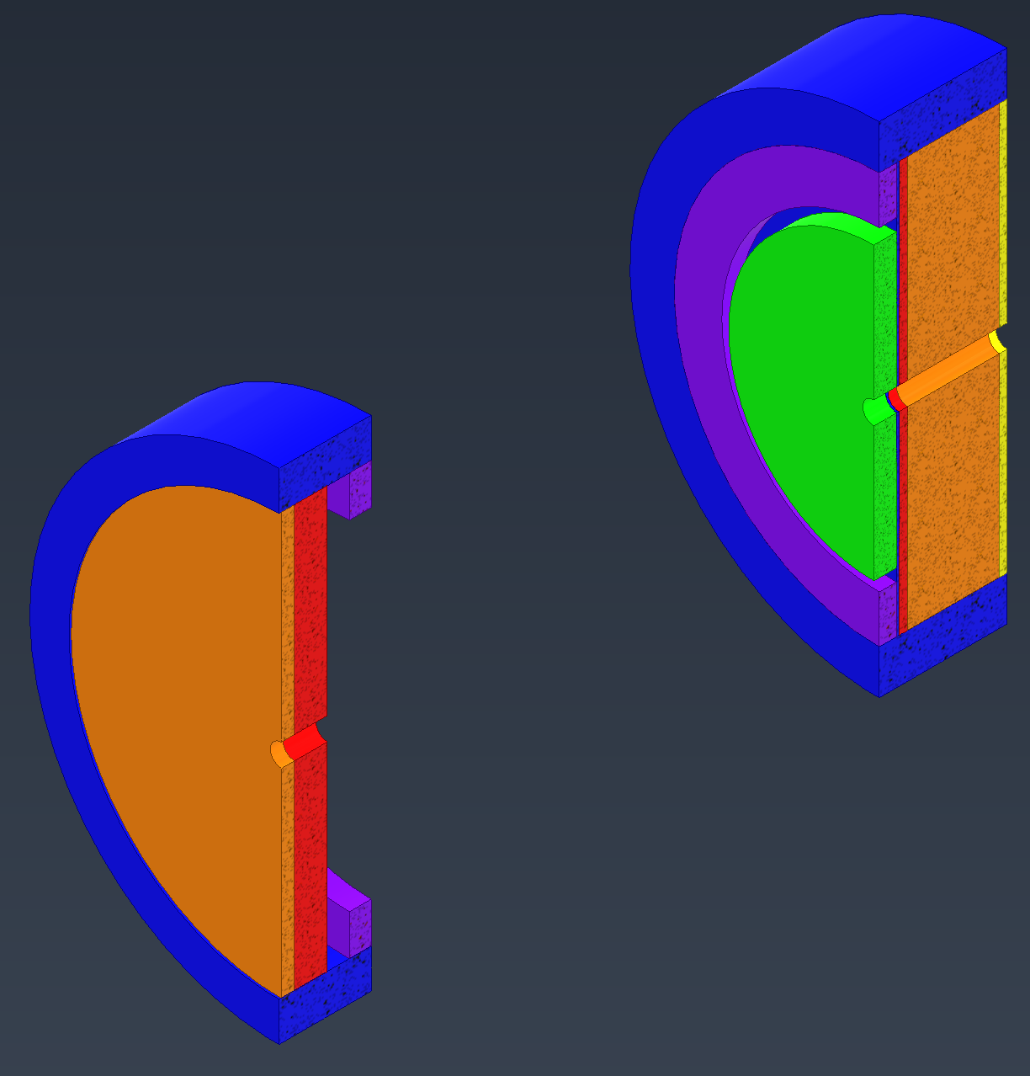
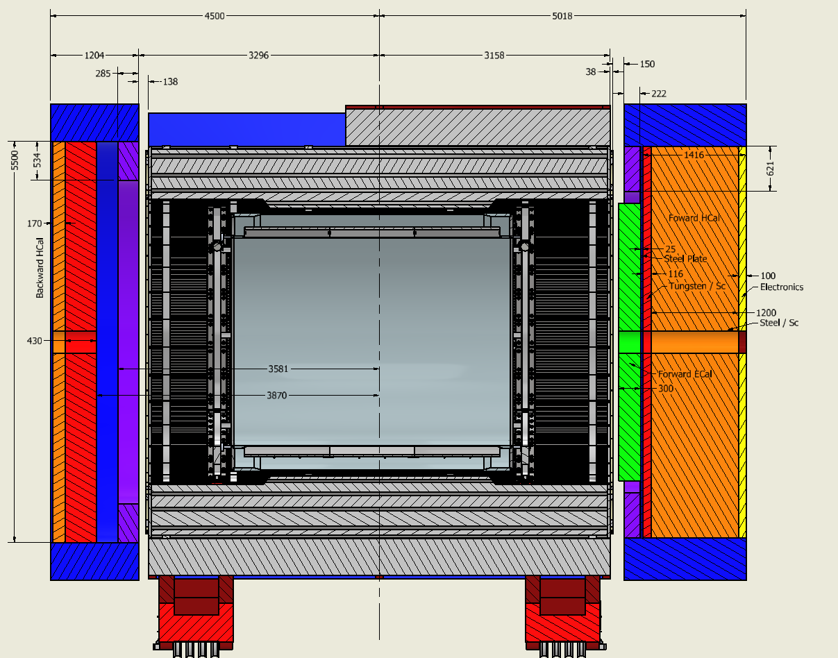
Model Overviews (Endcaps)
Hadron HCAL
Hadron EMCAL
Flux Return
Lepton HCAL

Slide 14
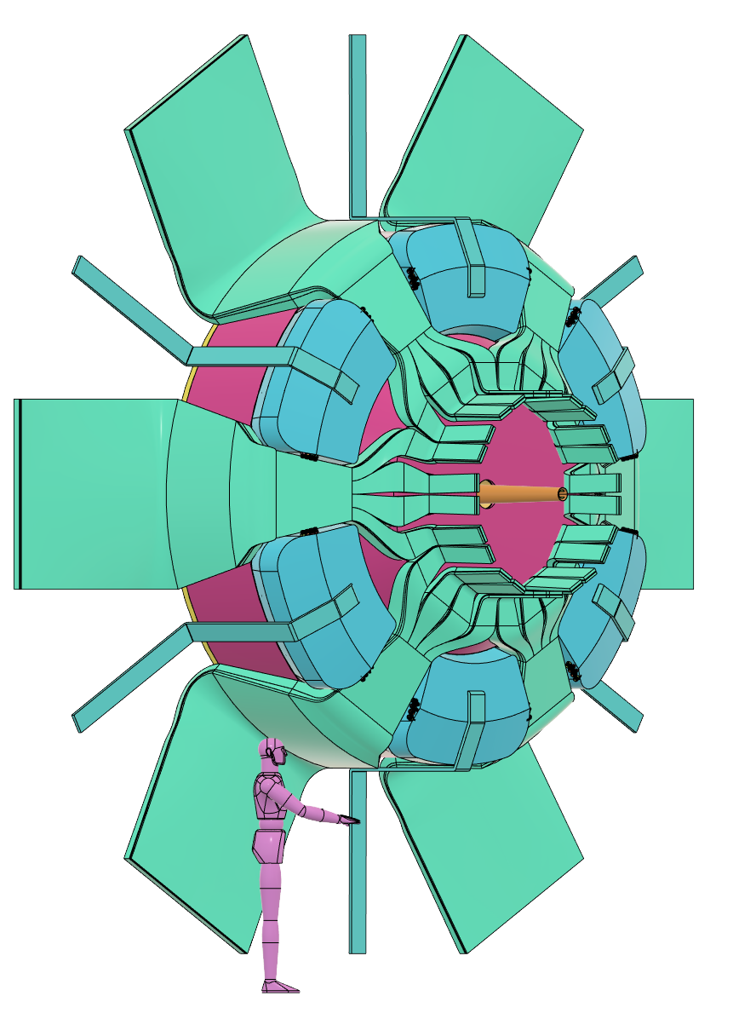
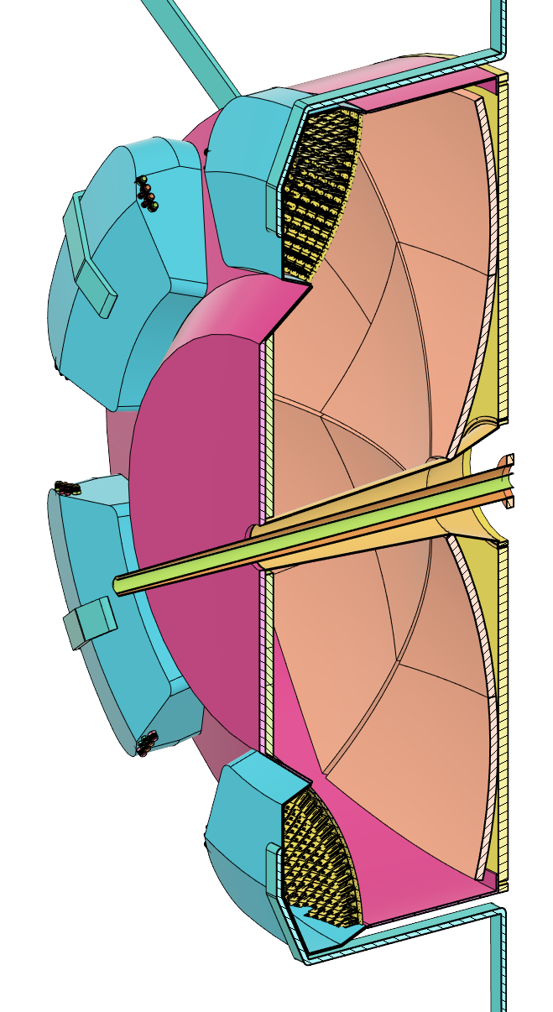
dRICH Overview
Services Representation
Spherical
Mirrors
Recent global positional changes have reduced integration interferences, however there are still a few minor areas of concern that are being addressed
Installation and support designs for the dRICH are still being developed but consistent with the overall design schedule
Sensor
Boxes
Gas
Volume
Inner Beampipe
Housing
Aerogel
Spherical
Sensor Plane
Estimated Weight: 2000kg

Slide 15
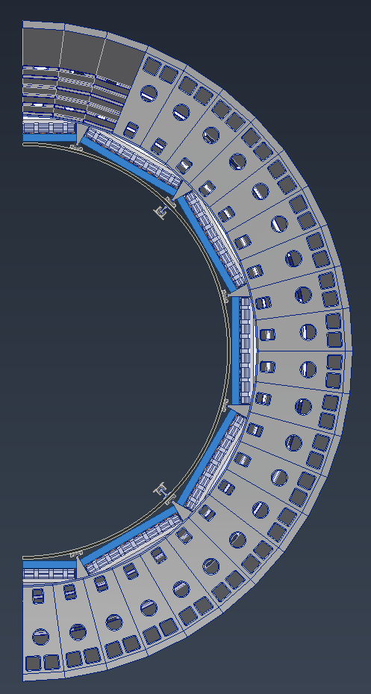
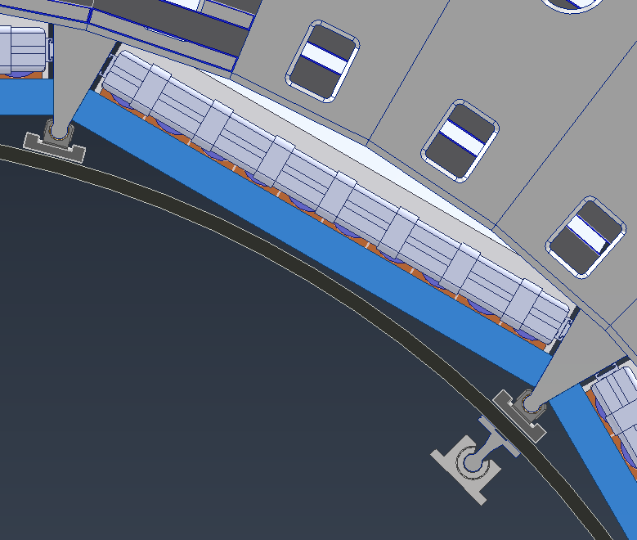
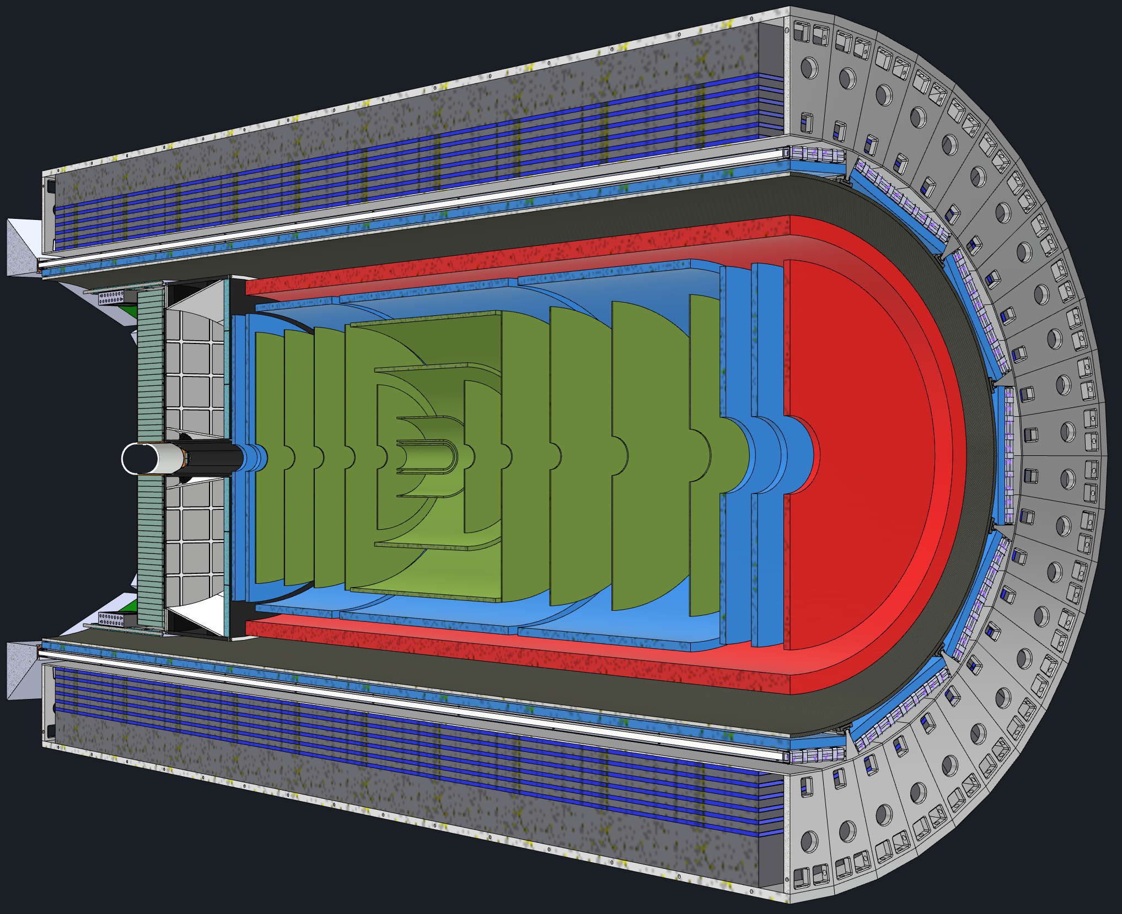
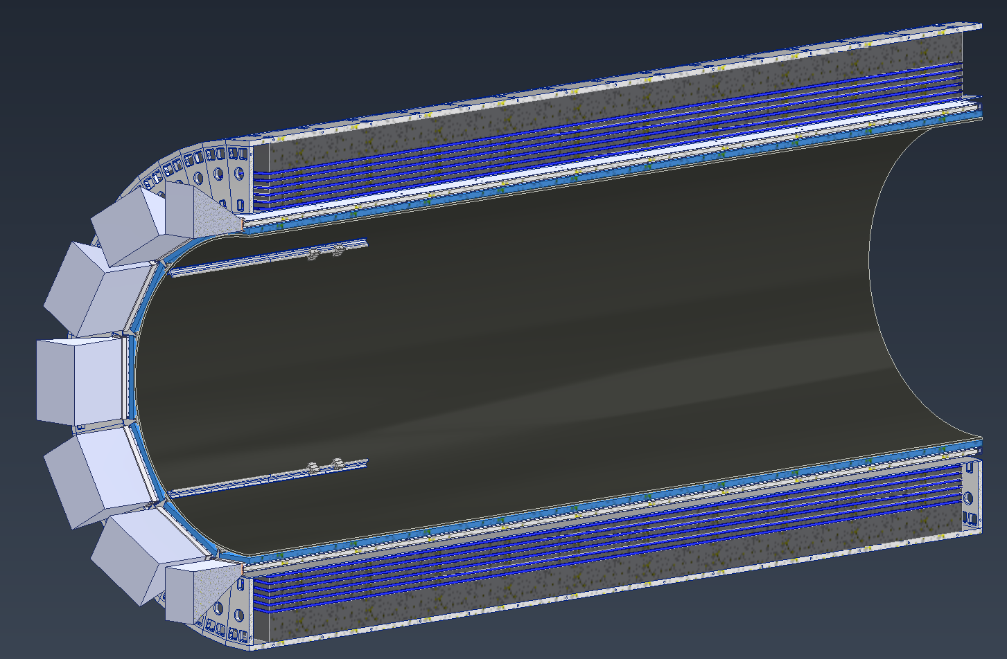
DIRC Support
DIRC Barboxes
Current plan is to use barrel EMCAL for support of Inner Detectors/Waiting for Barrel EMCAL group to confirm the design of Barrel EMCAL.
Outer MPGDs and DIRC barboxes will be nested in the area between rails.
A carbon fiber Support Structure supported using Barrel EMCAL will support all the inner detectors
Separate Rails will be used for EEEMCAL and pfRICH Installation
Gaps between the EEEMCAL and the carbon fiber cylinder will allow for inner services to be brought out
Outer MPGDs
CF Support Structure
Rails to Support Inner Detectors
Barrel EMCAL

Slide 16
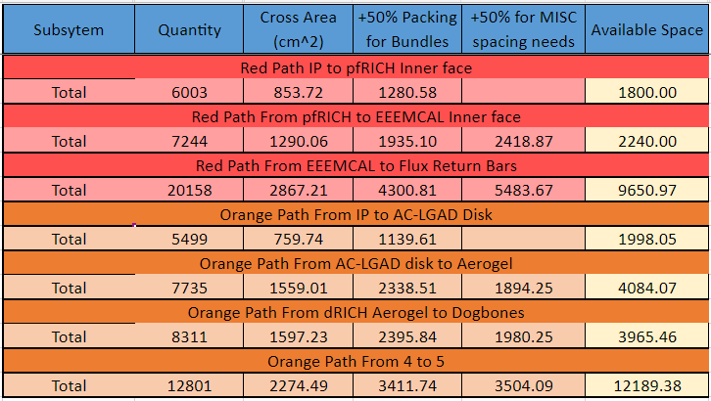
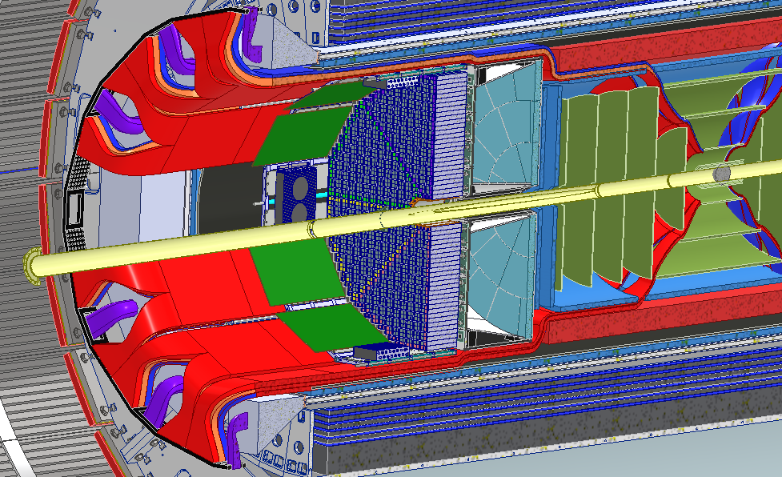
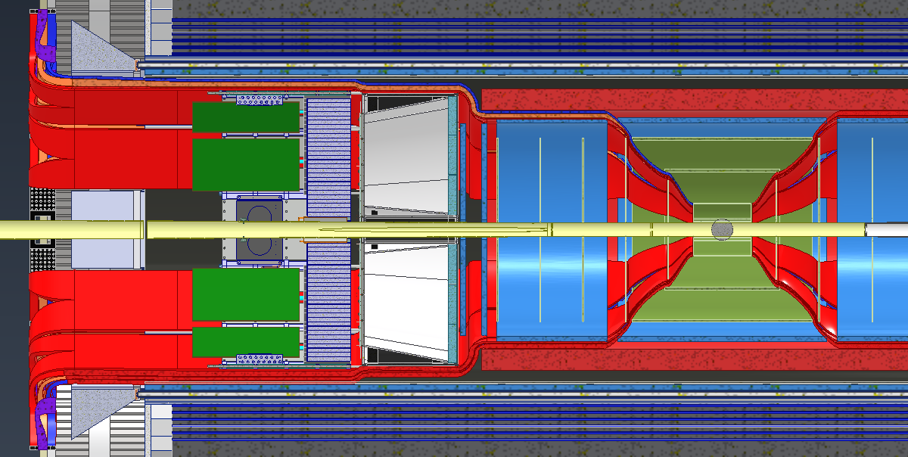
Services Layout
Services (Cable and Cooling Line Estimates) were collected from various subgroups.
Services Layout is shown in snapshots below:

Slide 17
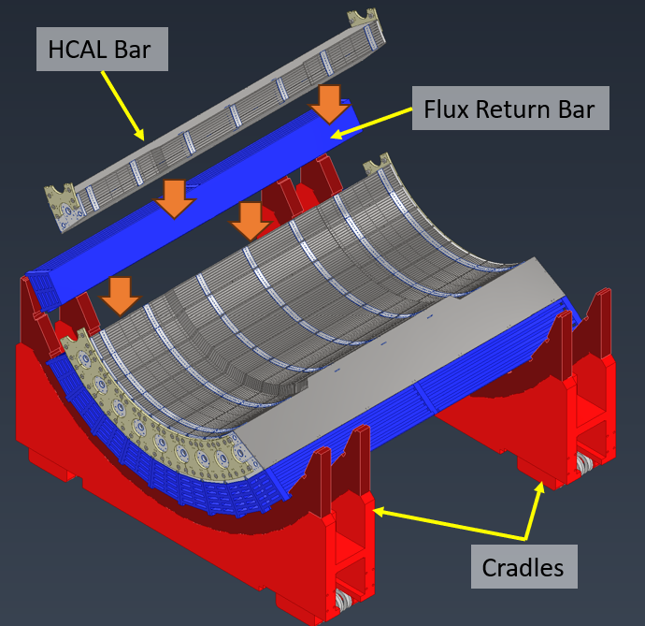
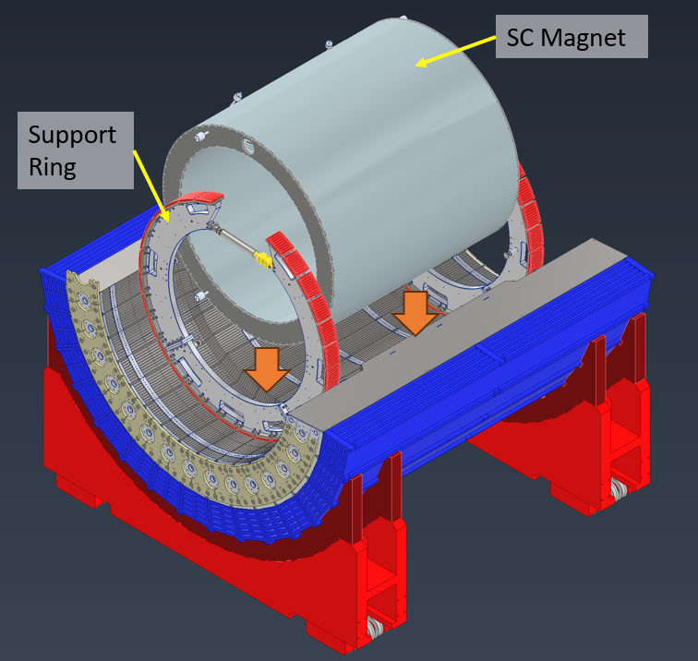
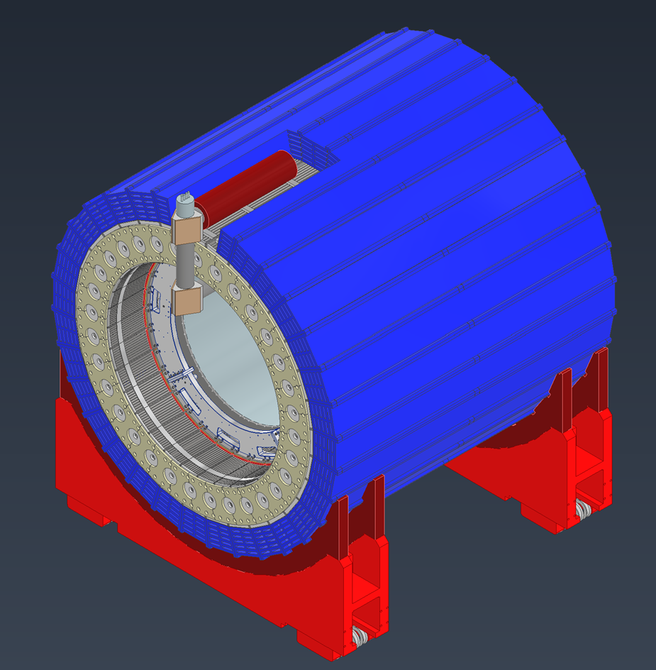
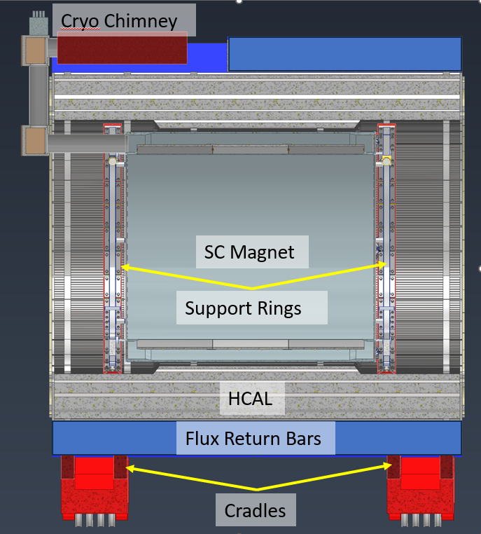
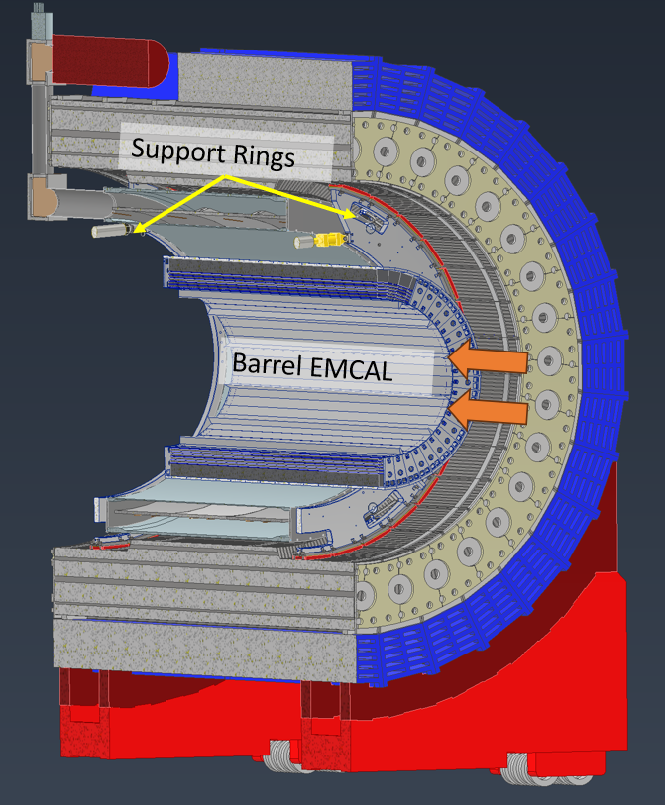
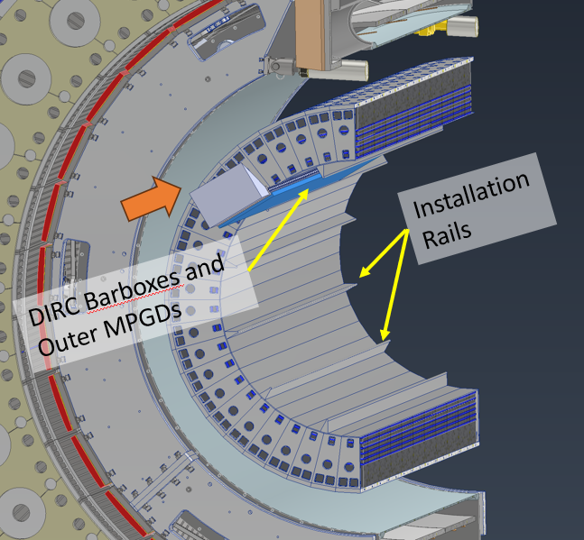
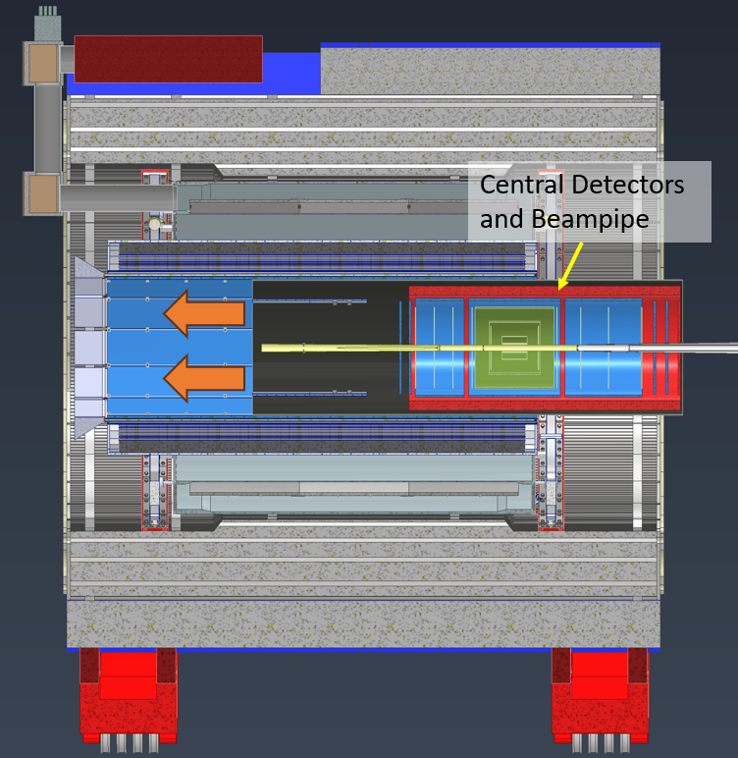
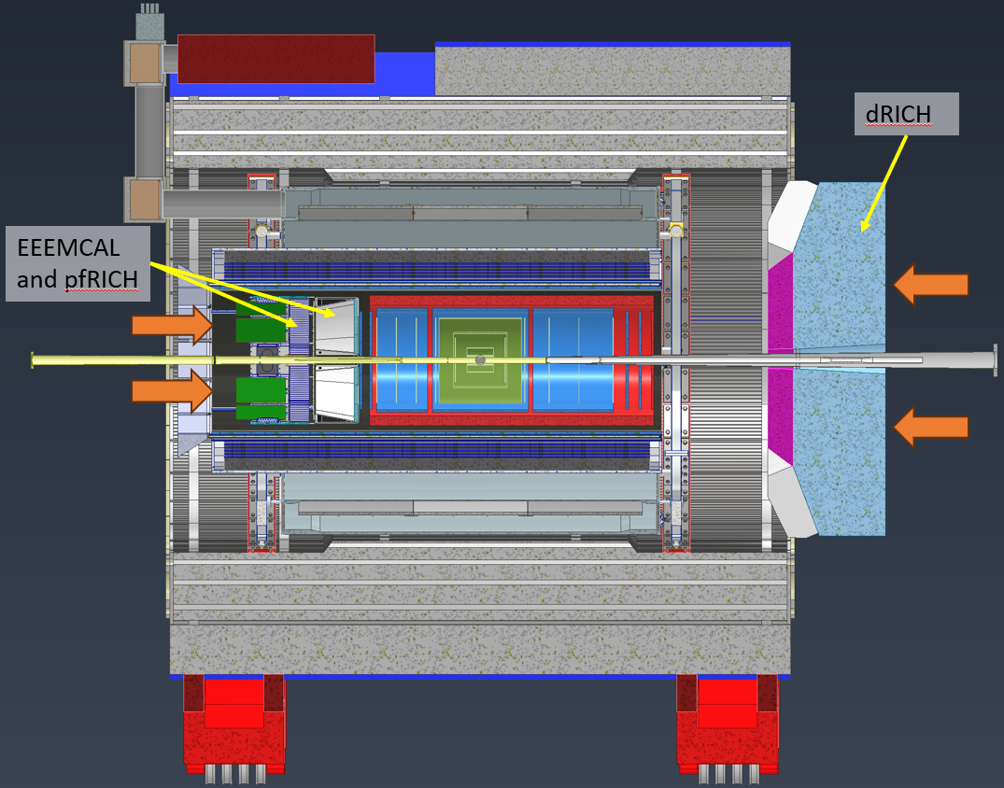
Installation Sequence (Barrel)

Slide 18
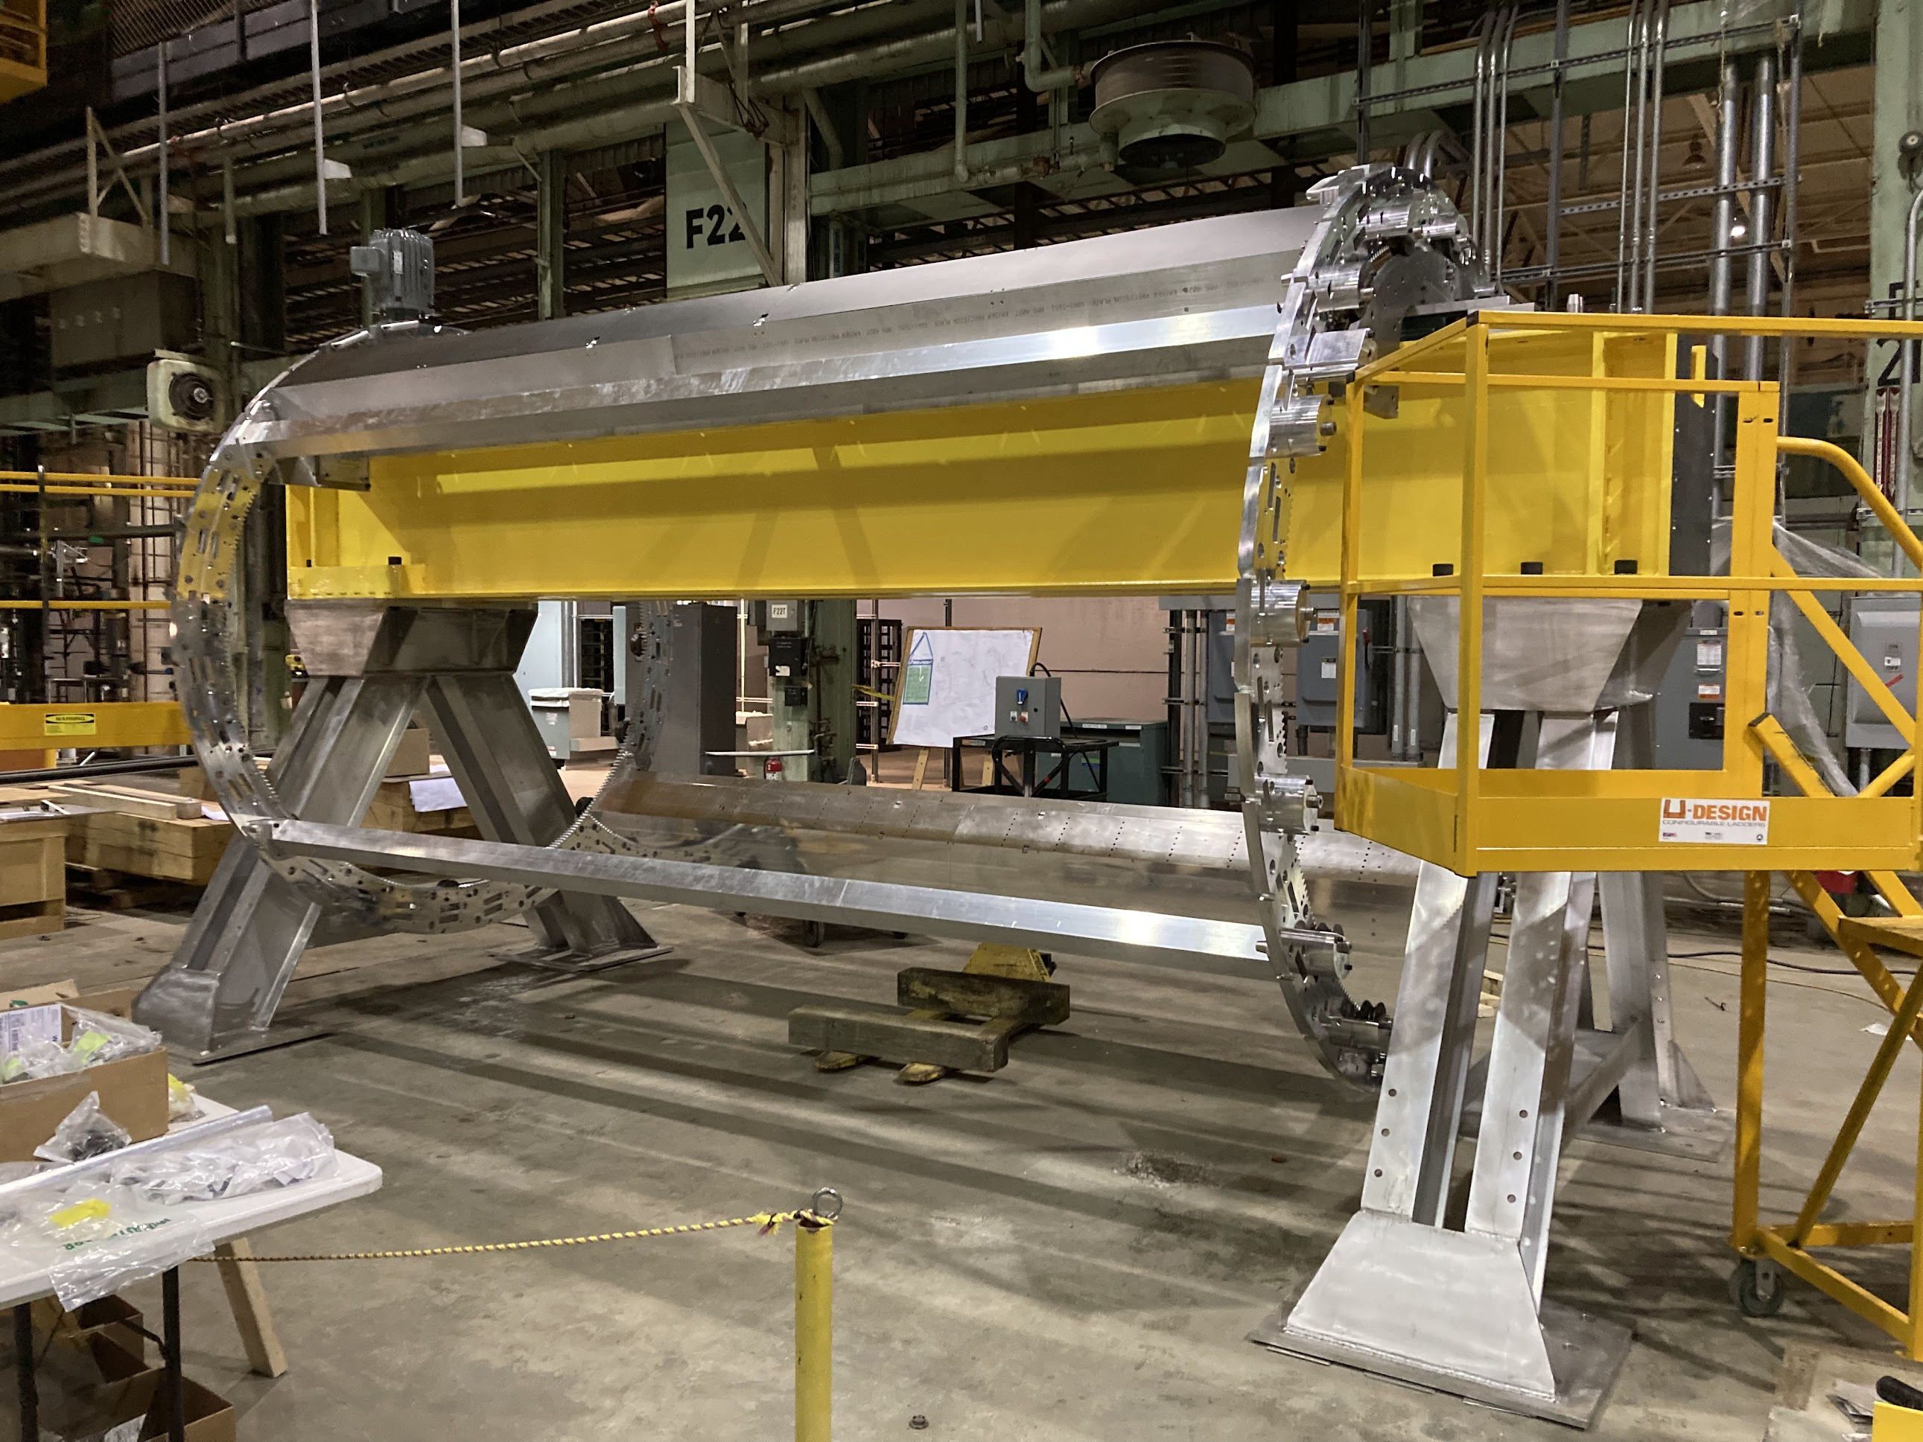
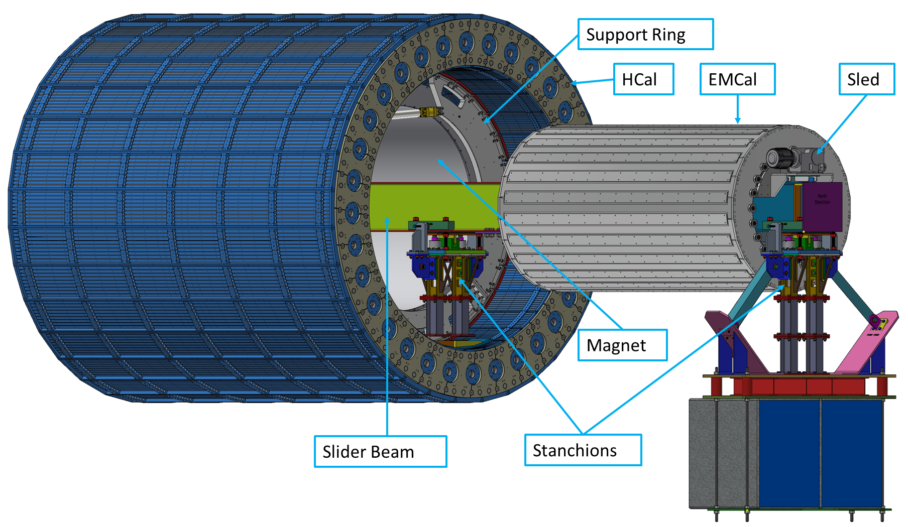
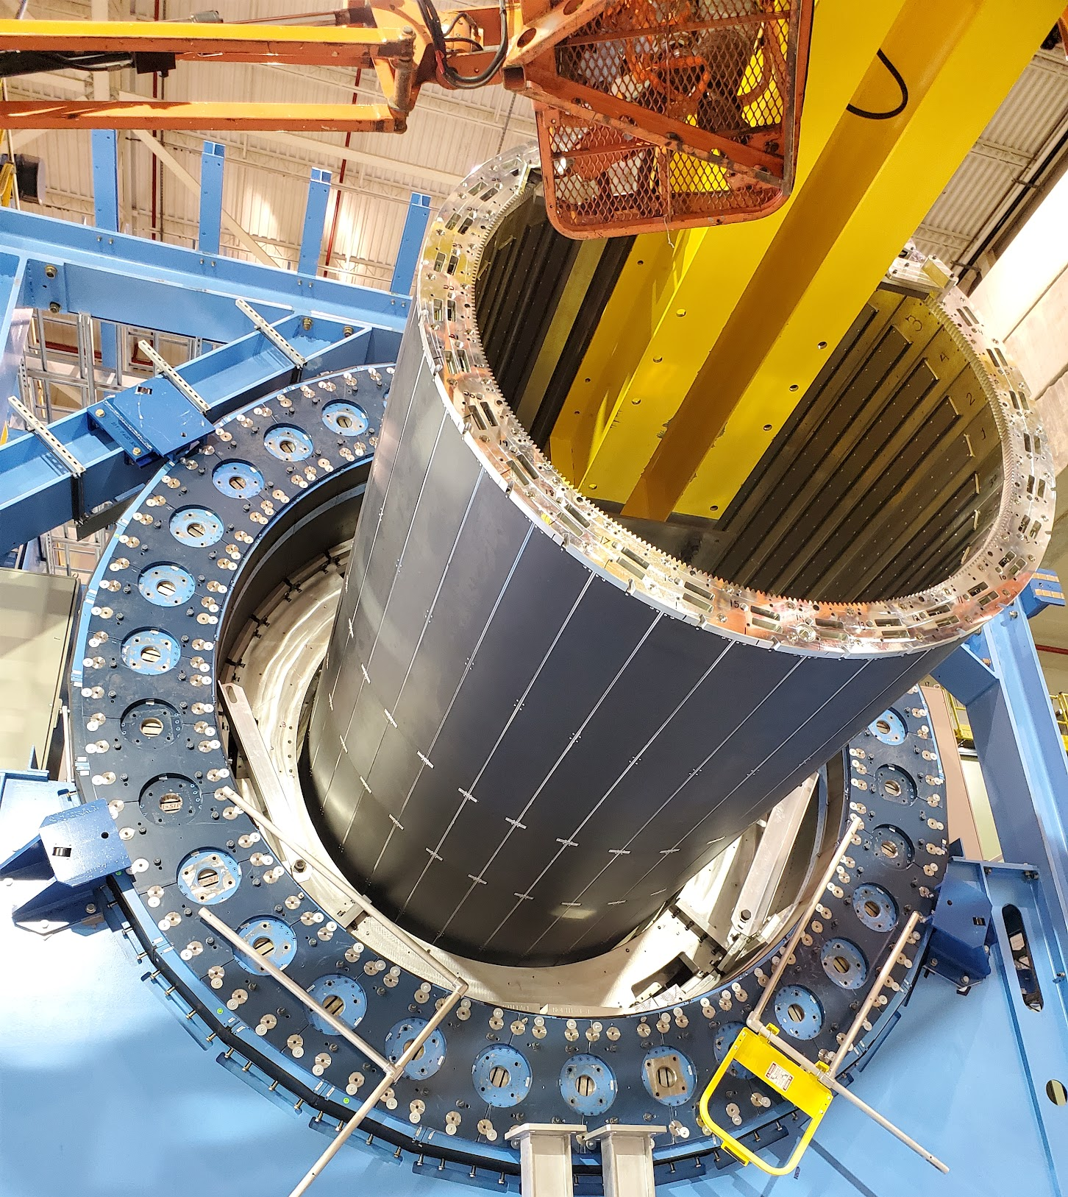
Barrel EMCal Installation
We plan to use existing installation tooling from sPHENIX that was used to install Inner HCAL as shown in photos
Assemble Barrel EMCal on sled, A-frames and section of I-beam.
The I-beam is inserted into the HCal and supported on stanchions.
The Barrel EMCal is rolled in via the sled on the I-beam.
The Barrel EMCal is attached to the support rings.
The I-beam and stanchions are removed.

Slide 19
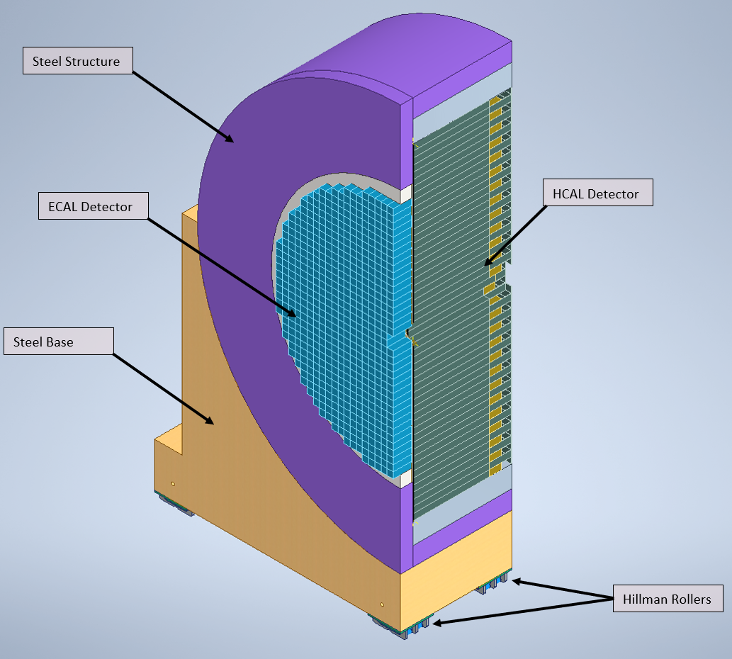
Endcap Design
End Cap Structures accommodate HCAL and EMCAL Detectors
End Caps will be designed as two halves with a vertical split that will allow opening of End Caps for maintenance of detectors in the Barrel
Endcaps will be assembled in the Experimental Hall and will not impact Barrel Assembly/Installation. It can also be done in parallel with Barrel Assembly if additional resources are available.
Following Design and Analysis tasks need to be completed as next steps:
Seismic Analysis – Detailed Seismic Analysis required to figure out size of anchors and to determine stability during movement.
Analysis of Magnetic Forces for HCAL blocks and pins needed.
Pinning/Securing of HCAL/EMCAL detector Blocks
Rails for Endcaps
Moving Mechanism presenting challenge due to one corner being inaccessible.
Guiding Mechanism for Endcaps
North and South Platform Modifications to resolve interference issues

Slide 20
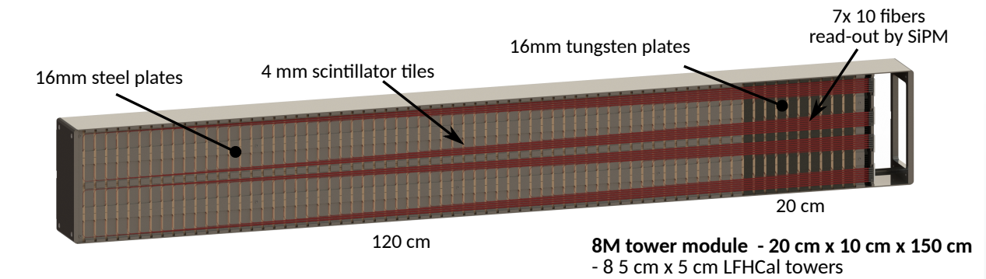
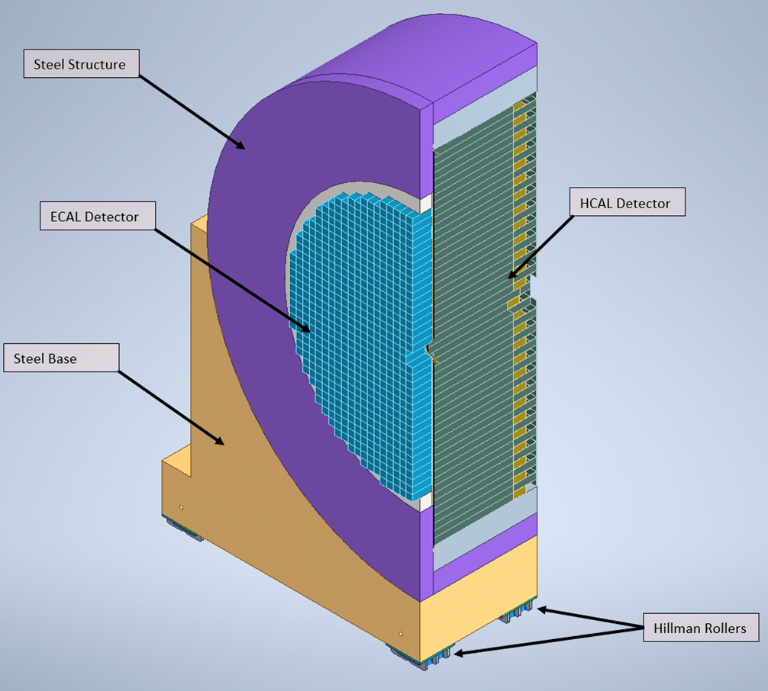
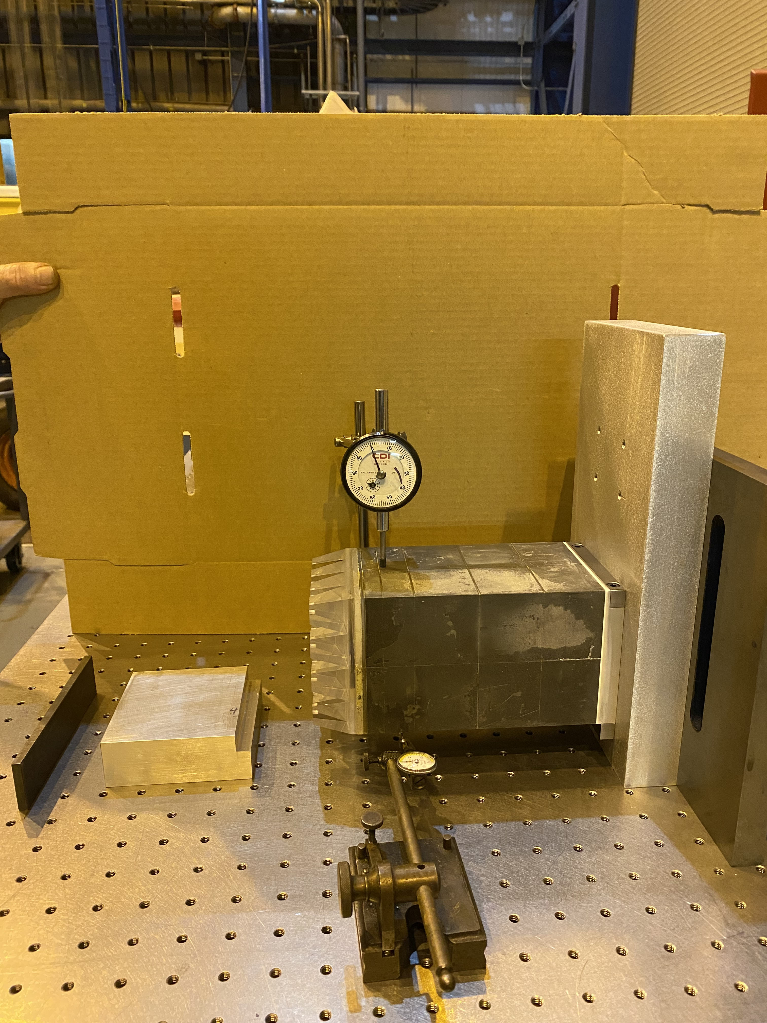
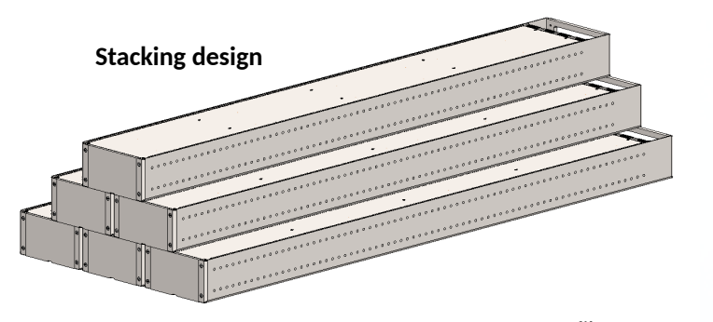
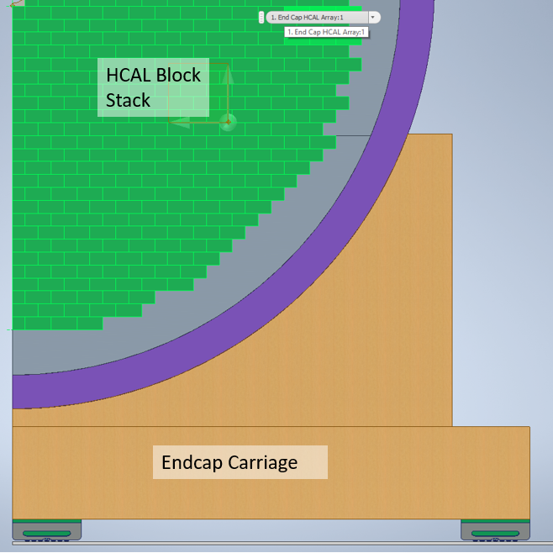
Hadron Endcap EMCAL and HCAL Mounting Scheme

Slide 21
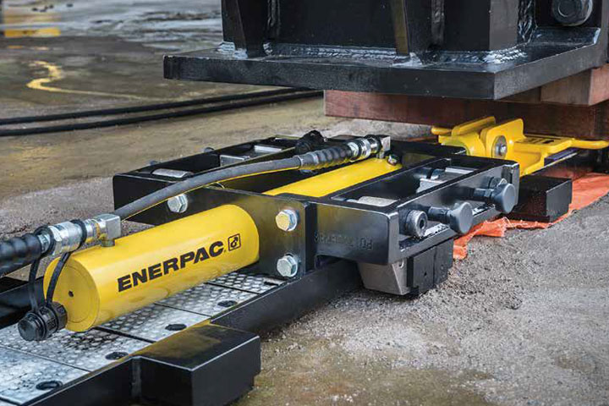
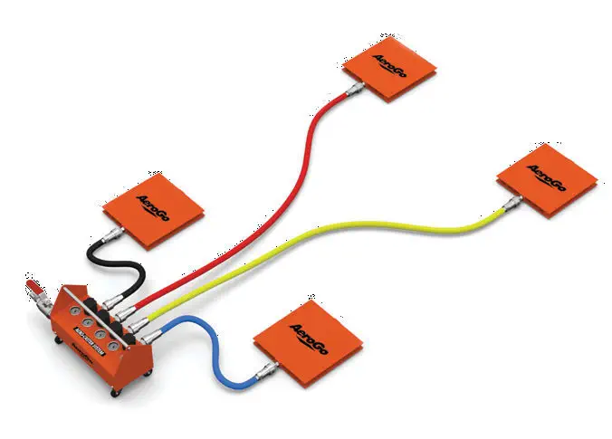
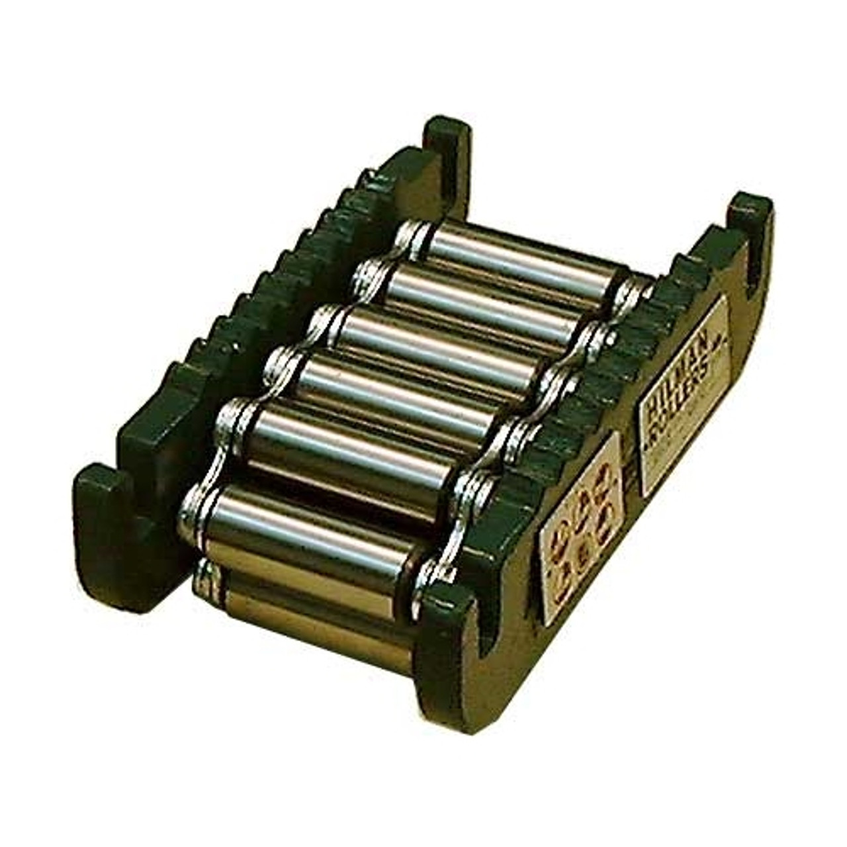
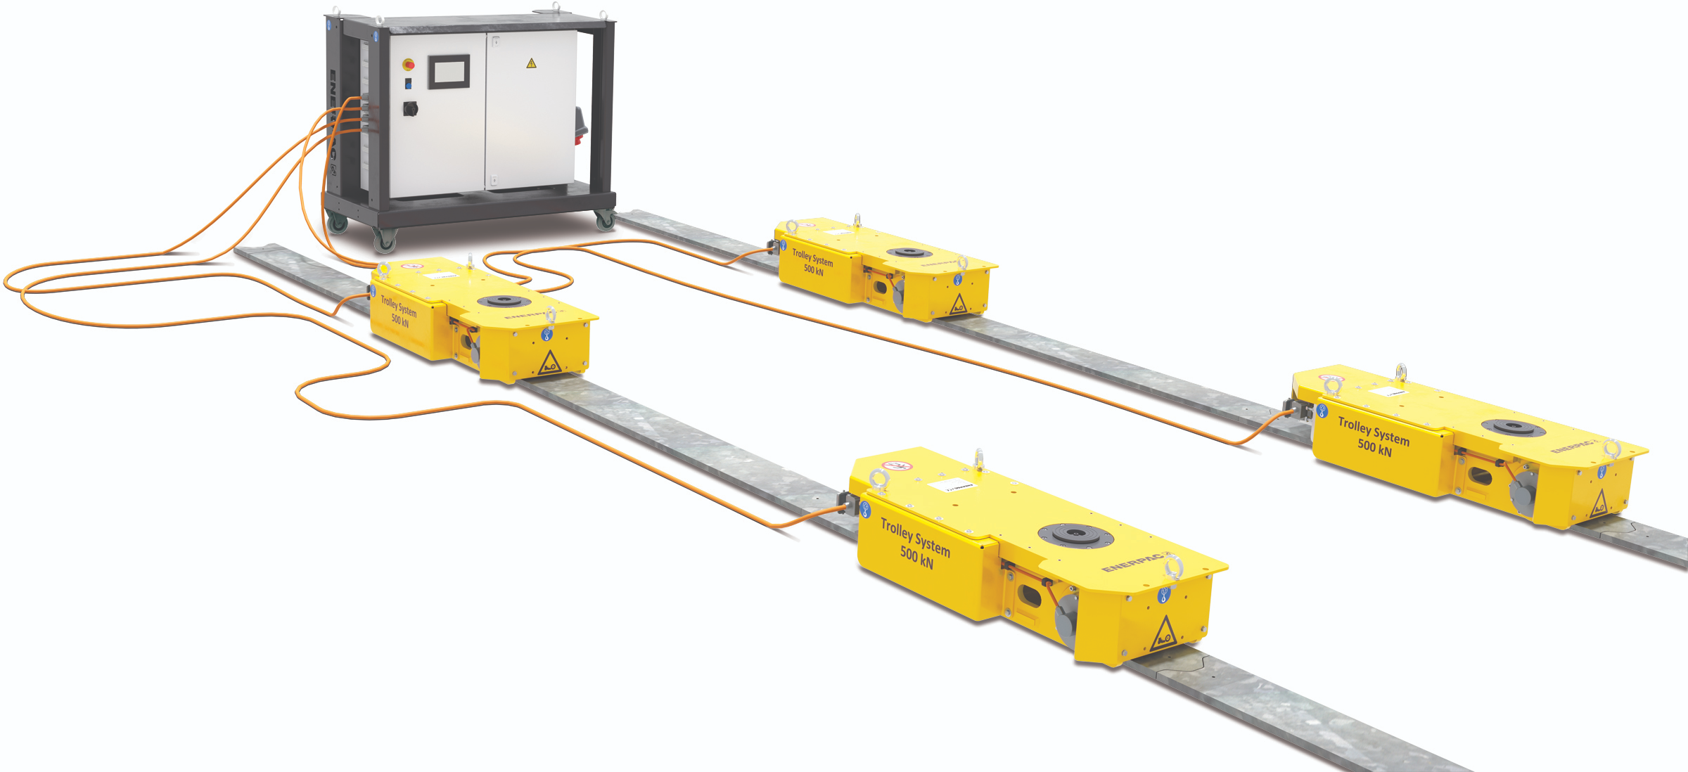
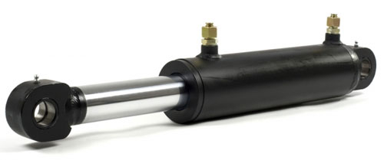
Endcap Rails and Moving Mechanisms
Endcap moving mechanisms need to move Endcap Halves along X axis with vertical adjustment capability (Y axis). Movement in Z may be required?
Concepts being considered:
Hillman Rollers and Hydraulic Pistons (Currently used at STAR).
Air Bearings/Air Pallets
Hydraulic Skidding System
Motorized Trolley System
Currently evaluating Concepts as viable design choices against design criteria.
Moving mechanism can also be combination of two concepts.
May need to visit companies before making design decision.

Slide 22
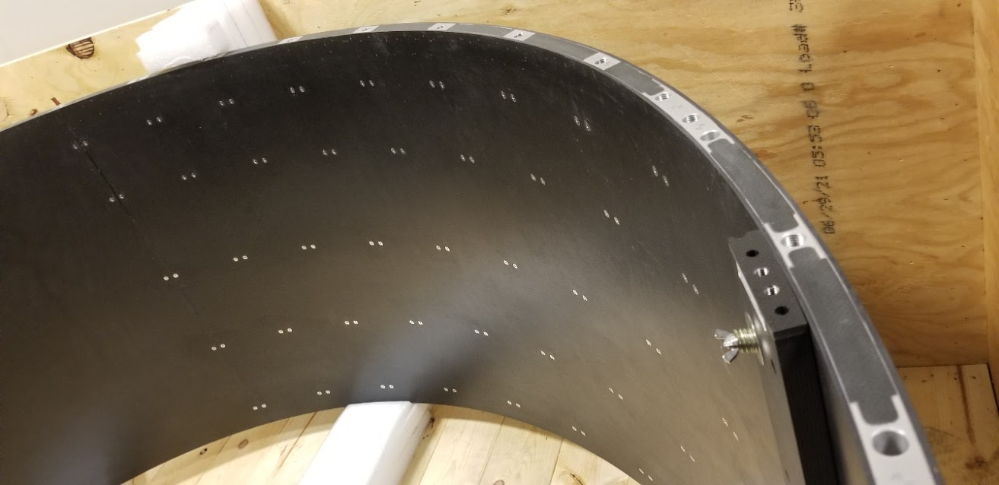
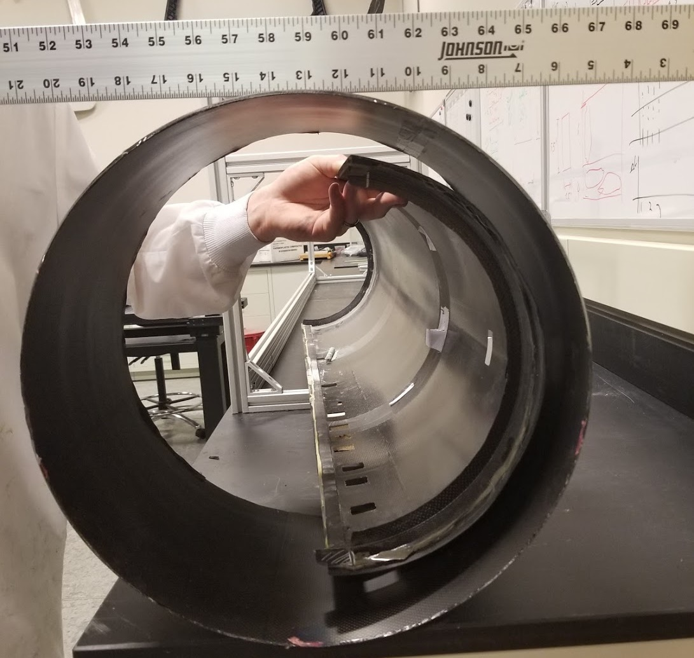








Carbon Fiber Support Structures for Inner Detectors
Carbon Fiber Strucutures as shown used at other experiments (STAR, CMS etc.) will be used for supporting Inner Detectors.
Plan to prototype and test structures for strength as well as deflections to compare it with FEA results.
Service Cylinder
ITST
Purdue Mechanics Lab

Slide 23
Power
MARCO (SC Magnet) Power:
New Power Supplies will be used
Water cooled lead with current capacity >4000 Amps are in place and can be used. Trying to find legacy documents from STAR is turning out to be a challenge.
Magnet DAQ Rack will be placed on Third Level
Power requirements for detectors are being estimated and compared to available power.
Detector Electronic Racks on South Platform: Current assumption is that available power is enough. Trying to collect requirements and verify the assumption.

Slide 24

ePIC Detector Electronics Power & Services Page 1
Detector | Type | Front End LV Power | HV Bias | LV Power Supply Type | HV Power Supply Type | Power Supply Location | LV Power Feed | LV Feed Cables (Tray Rated) | Cooling (Board Electronics)
EE HCAL | SiPM | 200W | 50W@ 50V | MPV 4016I | Wiener MPV 8120I | S. Platform, 19” rackmount | 10V @ 20A | 4x 14 AWG | Liquid
E-EE EMCAL | SiPM | 500W | 500W@50V | MPV 4016I | Wiener MPV 8120I | W. Platform, 19” rackmount | 10V @ 50A | 4x 12AWG | Convection
pfRICH | HRPPD | 260W | 70W@3kV | MPV 4018I | CAEN A1515BV | S. Platform, 19” rackmount | 1.2V@ 220A | 14x 12AWG | Liquid/ Neg. pressure
EE MPDG Disk | uRWELL | 350W | 1.5W@1.5kV | MDH-07/16 | CAEN A1515BV | S. Platform, 19” rackmount | 10V @ 315A | 2x 10AWG | Liquid
Outer Barrel MPGD | uRWELL | 1.6kW | 1.5W@1.5kV | MDH-07/16 | CAEN A1515BV | S. Platform, 19” rackmount | 10V @160A | 12x 12AWG | Liquid
Inner Barrel MPGD | uRWELL | 700W | 1.5W@1.5kV | MDH-07/16 | CAEN A1515BV | S. Platform, 19” rackmount | 10V@120A | 15x 12AWG | Liquid
MAPS Disk | EIC-LAS | 3kW | Derived from LV system | MPV 4018I | N/A | S. Platform, 19” rackmount | 3.6V@ 960A | 48x 10AWG | Liquid
MAPS Sagita Layer3 | EIC-LAS | 680W | Derived from LV system | MPV 4018I | N/A | S. Platform, 19” rackmount | 2.4V@ 194A | 16x 12AWG | Liquid
MAPS Sagita Layer4 | EIC-LAS | 1.4kW | Derived from LV system | MPV 4018I | N/A | S. Platform, 19” rackmount | 4.8V @ 235A | 18x 12AWG | Liquid
MAPS Vertex | EIC-LAS | 200W | Derived from LV system | MPV 4018I | N/A | S. Platform, 19” rackmount | 1.2V @ 60A | 4x 12 AWG | Liquid

Slide 25
ePIC Detector Electronics Power & Services (PAGE 2) Continued….
Detector | Type | Front End LV Power | HV Bias | LV Power Supply Type | HV Power Supply Type | Power Supply Location | LV Power Feed | LV Feed Cables (Tray Rated) | Cooling (Board Electronics)
Barrel HCAL | SiPM | 220W | 1.6W @50V | MPV 8016I | MPV 8120I | S. Platform, 19” rackmount | 10V @ 22A | 8x 16AWG | Liquid
Barrel ECAL | SiPM + AstroPix | 1.6kW | 1W @50V & 100W @ 400V | MDH-07/16 | MPV 8120I & EHS F005p | S. Platform, 19” rackmount | 10V @ 160A | 16x 12AWG | Liquid
DIRC | HRPPD | 300W | 70W@3kV | MPV 4018I | CAEN A1515BV | S. Platform, 19” rackmount | 1.2V@ 250A | 16x 12AWG | Liquid
Barrel TOF | AG-LGAD | 2400W | 4W@400V | PL506 | CAEN A1625 | S. Platform, 19” rackmount | 10V @ 240A | 12x 10AWG | Liquid
HE TOF | AG-LGAD | 10.6kW | 4W@400V | PL506 | CAEN A1625 | S. Platform, 19” rackmount | 10V @ 1,060A | 48x 10AWG | Liquid
dRICH | SiPM | 300W | 23W@70V | MPV 4016I | MPV 8120I | S. Platform, 19” rackmount | 10V @ 30A | 4x14AWG | Liquid
FWD ECAL | SiPM | 2.8kW | 750W@ 50V | PL506 | MPV 8120I | W. Platform, 19” rackmount | 10V @ 280A | 20x 12AWG | Liquid
HE HCAL | SiPM | 1.7kW | 3kW@ 50V | PL506 | MPV 8120I | E. Platform, 19” rackmount | 10V @ 170A | 12x 12 AWG | Convection
Note: Refer to ePIC Services on-line Spreadsheet for details of power distribution
August 2023, T.Camarda for BNL EE Group

Slide 26


MARCO Yoke Forces (Magnetic Forces
Detail Analysis of Magnetic forces on all magnetic components need to be analyzed.
EPIC Carriage
Flux Return Bars
End Caps
HCAL and EMCAL detectors with magnetic components

Slide 27


Cooling Systems and Gas Systems
Gas Systems
Gas Detectors such as MPGDs need Gas Systems for mixing and delivery of required gases. We will design and build gas systems for the required detectors.
Cooling Systems
Need to fully gather cooling requirements for all the detectors and integrate cooling in the design.

Slide 28
Summary
We will further develop the designs of various sub detectors and their support structures.
Identification of conflicts and resolution.
Cabling plan needs to be further developed with cable trays etc.
All detectors and structures need to be analyzed for Seismic and Magnetic Forces.
Moving Mechanisms for Endcaps need to be finalized and integrated into the design.
Power requirements for various detectors and electronics need to be further developed.
Grounding scheme for Magnet and detectors need to developed.
Cooling Requirements need to be further developed.
Gas Systems need to be designed (This can wait for now).
Safety systems (Fire Suppression, Smoke Detection and Interlock systems) need to be designed (This can wait for now).

Slide 29
Backup slides

Slide 30

Services Layout and Management
Totals for services passing from one point to the next are shown below
There are a few locations where more space is needed based off current estimates

