Slide 1
WBS 6.10.07
Solenoid Magnet
Renuka Rajput-Ghoshal (JLab)
EIC Detector Comprehensive
Design Review
August 29-30, 2023

Slide 2
Outline
EIC High Level Project Schedule
Magnet Description
Detector Solenoid Magnets Schedule
Magnet- Long Lead Procurements
Timeline
How we work
ePIC Detector Solenoid (MARCO) Overview
Magnet Specification
3D Magnetic Design Results
Magnetic Circuit
Conductor Definition, Conductor Margin and Sample Conductor Testing
Magnet Assembly
Mechanical Analysis
Cryogenic Design
Thermal Analysis
Instrumentation
ESH&Q- Electrical and Pressure vessel
Summary and What Next

Slide 3
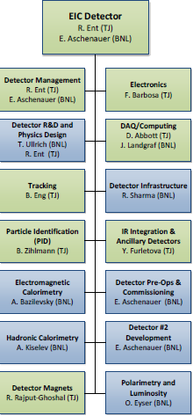
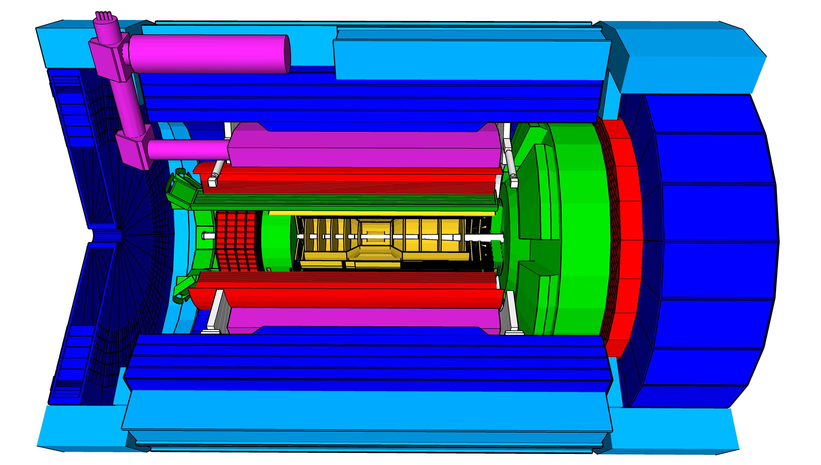
Solenoid Magnet
Assumptions:
  1.7 T central field (point design value, 2 T stretch goal)
  Aligned along the electron beam
  Fits in the allocated space radially and axially
Current Status:
  60% design review complete in October 2022
  90% design review scheduled for October 5-6, 2023

Slide 4
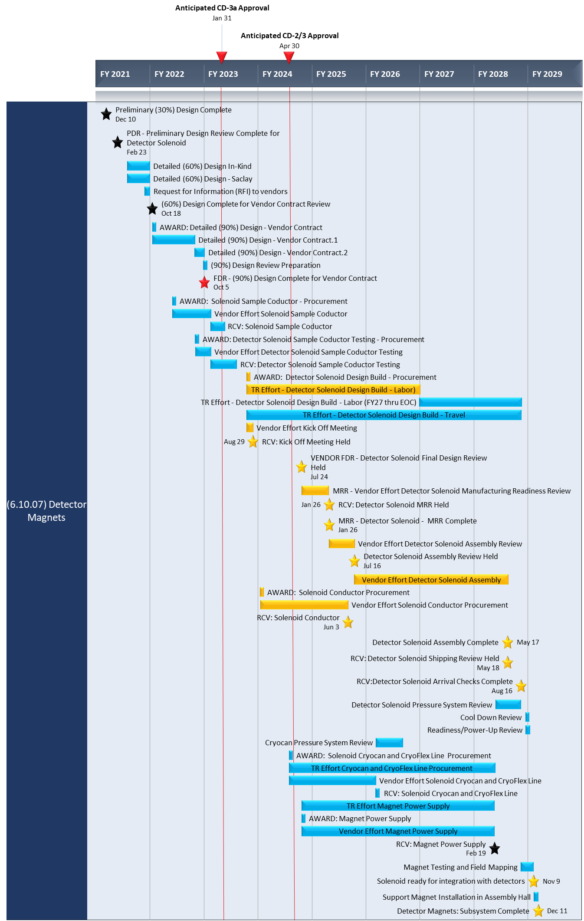
Detector Solenoid Magnets Schedule

Slide 5
Magnet- Long Lead Procurements
  The estimated time for magnet manufacturing is ~5 years (based on JLab 12GeV experience)
    Magnet size- This magnet is much bigger than 12GeV magnets
    Conductor used in this magnet will be Rutherford cable in Copper channel (SC strands+ Rutherford cable+ Copper channel+ Soldering cable in channel),
    Limited vendor base for the magnet manufacturing and conductor supplier
    Trial runs of conductor manufacturing for the quality assurance
  Large Superconducting magnet -> Bigger Technical challenge
  Procurements are likely on, or near, the critical path, at least for the 6.10 detector scope - Detector solenoid is required to install all the detectors. The estimated installation time is 17 months.
  Description of Procurement for Magnet: “Vendor Design-Build” We will provide a 'Performance Specification’, a working design and a Statement of Work (SOW) to the vendor who then completes the design, produces their own manufacturing drawings and builds the magnet. It gives the vendor an option to validate and modify the design!
Charge #6
Average Time for Magnet completion = 5.73 years

Slide 6
Timeline
CD-0 Approval December 2019
CD-1 Approval June 2021
Incremental (30%) Design and Safety Review February 2022
DPAP closeout report – led to reduced field (< 3 T) March 2022
60% design team formation and kick off meeting May 3, 2022
60% Mid-Project Progress meeting June 28, 2022
Point design adjusted to stretch goal of 2 T August 10, 2022
60% Design and safety Review October 18, 2022
90% design contract with CEA, Saclay in place December 2022
Found qualified vendor willing to make conductor January 2023
Magnet RFI out March 2, 2023
Sample Conductor order April 14, 2023
90% Mid-Project Progress meeting April 18, 2023
Long Lead Procurement Review June 26, 2023
90% Design completion and review October 2023
CD3A Review November 14-16, 2023
Charge #4

Slide 7
How we work
Collaboration of Jefferson Lab, CEA Saclay and Brookhaven National Lab
30% Design done as in-kind contribution by CEA Saclay in collaboration with Jefferson Lab Magnet Group
BNL provides subject matter expert information on infrastructure and integration
60% design done as contract with CEA Saclay augmented with Jefferson Lab work and further in-kind contributions of CEA Saclay
90% design work is also being carried out as contract with CEA Saclay augmented with Jefferson Lab work and further in-kind contributions of CEA Saclay.
Expectation is that vendor contract may follow similar pattern for vendor oversight.
Further discussions ongoing on international engagement on magnet construction phase

Slide 8
High Level View
Charge #4, #6
Magnet Design is very mature for this stage of project, the two most important design parameters are conservative: large temperature margin and large critical current margin.
Incremental Design and Safety Review (30% review) completed on February 23, 2022,
60% (PDR) Design and safety Review was completed on October 19, 2022,
  90% design review scheduled for October 5-6
  All the analysis work is either complete or near completion.
  All the design margin are well within the design range.
  Sample Conductor order is placed, working on finding the sample conductor test plan
  The conductor will be “Government Furnished Item” to the magnet manufacturing vendor.
  Magnet RFI was out, 5 responses received for magnet RFI, 2 response are very reasonable.
  The design work is well on track to for CD3A

Slide 9
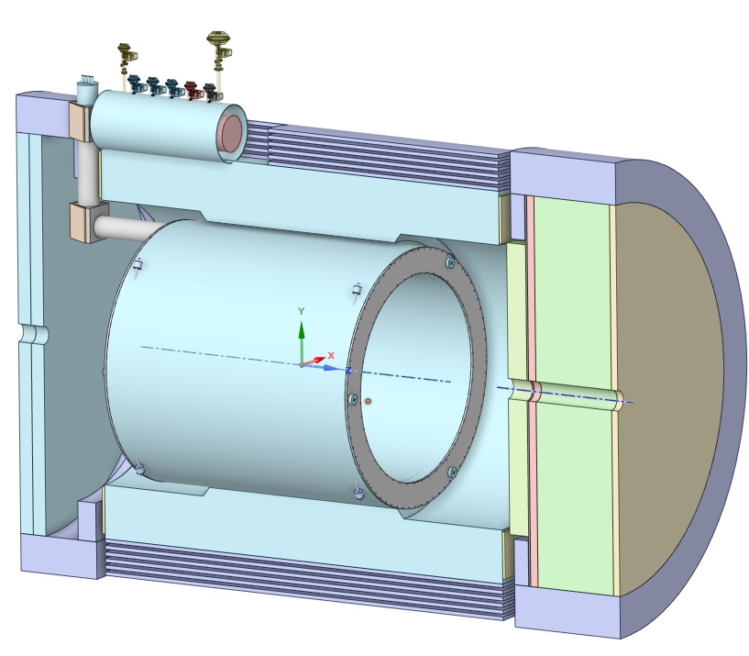
ePIC Detector Solenoid (MARCO) Overview
Superconducting Detector Solenoid
3.5 m long coil, 2.84 m room temperature bore diameter
2 T on-axis field
Operating Temperature 4.5 K
Conductor: Copper Cladded, Rutherford Cable made with NbTi superconducting strands

Slide 10
ePIC Detector Solenoid Magnet Specifications
Charge #2

Slide 11
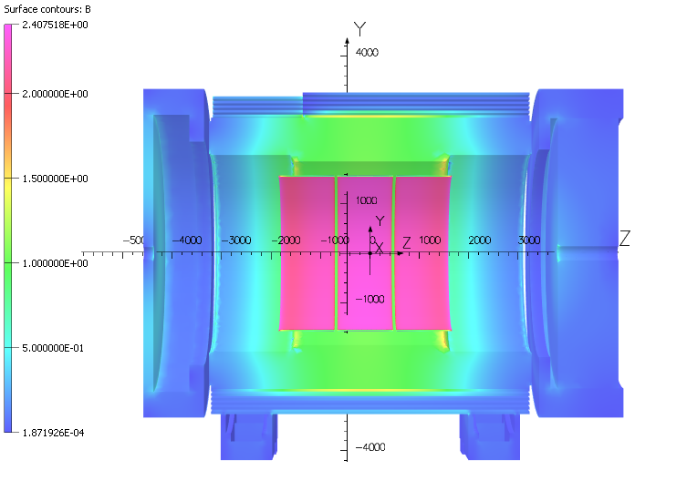
Magnetic Design Results
Coil is divided in 3 module
Each module has 6 layers
Parameter | V7.6.2.2.10 3D | Units
Current | 3924 | A
# turns | 1668
B₀ | 2.000 | T
Homogeneity | 12.7 | %
Projectivity | 3.28 | Tmm²/A
Bpeak (MOD 3) | 2.671 | T
Energy | 45.010 | MJ
Inductance | 5.846 | H
Fz MOD 1 | 11.88 | MN
Fz MOD 2 | 57.5 | kN
Fz MOD 3 | -11.97 | MN
Fz tot | -32.4 | kN
Fr Tot | 112 | N
B5300 | 15.3 | G
B7200 | 10.9 | G
B3400 | 2.4 | G
Magnet is 10 cm off center
3 modules are chosen, mainly
Feasible single length conductor manufacture
Ease of coil manufacturing
Magnet quench protection
Note: Mitigation of higher stray field on lepton is in progress, latest model B5300 <10G, verification is in progress

Slide 12
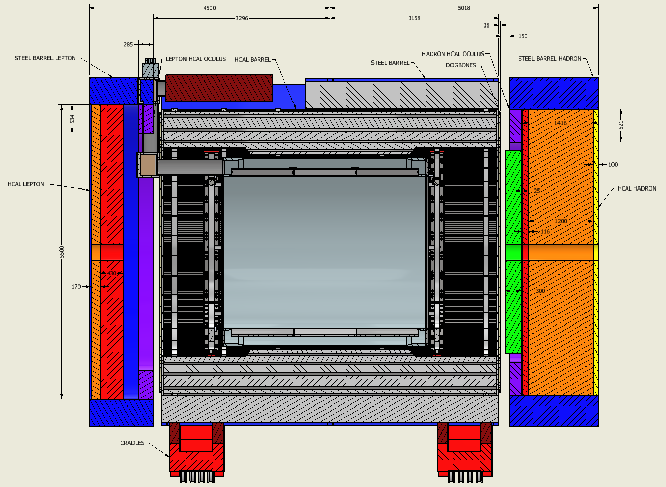
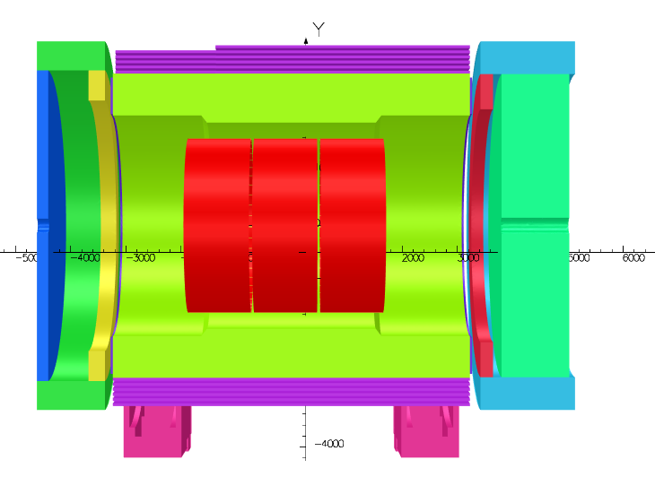
Magnetic Circuit
Charge #3
Object Name | Iron Fraction
HCal Barrel | 70% iron
Dogbones | 66% iron
HCal Hadron | 75% iron
HCal Lepton | 85% iron
HCal Hadron Oculus | 100% iron
HCal Lepton Oculus | 100% iron
Steel Barrel | 100% iron
Steel Barrel Hadron | 100% iron
Steel Barrel Lepton | 100% iron
Cradles | 100% iron
Magnet is Asymmetrically placed in Hcal, therefore asymmetric axial force on the magnet.
Hcal works as Flux return and shield
Extra steel is added for shielding
Any additional magnet steel component will need detailed analysis and might not be possible due to the asymmetric axial forces in the magnet

Slide 13
Conductor Definition
 | Parameters | Values | Units
Strand | Strand diameter | 0.7 | mm
 | Cu/NbTi | 1.3
 | Ic @ 2.6T & 4.7K | > 680 | A
 | Filament diameter | < 30 | µm
 | RRR Cu | > 80
Cable | NbTi strands | 20
 | Transposition pitch | 50 | mm
Channel | RRR Cu | > 100
 | Copper section (Final) | 43.7 | mm²
Conductor | Nominal current | 3924 | A
 | RRR conductor | > 100
 | Temp. margin @ 2.6T & 4.7K | 2.5 | K
 | Hot spot Temperature | 71.4 | K
 | σ_{0.2%} @ 293K | > 165 | MPa
 | Unit length (supposed) | 1.05 | km
 | Total length (supposed) | 18.9 | km
Fiber Glass Insulation
20×Ø=0.7
R~0.3
1.26
(2.31)
5.12
4.6
6.78
Copper
11.4
11.92
Dimensions are in mm
Order of conductor samples put in place based on these specifications !
Working on sample conductor qualification
Conductor is similar to the conductor used for 11.7 T MRI magnet at CEA, Saclay

Slide 14
Conductor Margin @ 4.7 K
B₀ | 1.5 T | 1.7 T | 2.0 T | Units
Current | 2900 | 3296 | 3924 | A
B_{peak} | 1.925 | 2.187 | 2.602 | T
Temp. margin | 3.1 | 2.9 | 2.5 | K
Load line margin | 60.6 | 55.3 | 46.8 | %
I / Ic(T_{m},B_{peak}) | 17.3 | 21.3 | 28.8 | %
> 1.5 K
Robust and safe operating parameters
<30 %
Bottura scaling law [1]
Parameters for the fit (C.R. Spencer)
Bc20 | 14.5 [T] | α | 0.57
Tc0 | 9.2 [K] | β | 0.9
n | 1.7 | γ | 1.9
C0 | 73000 [TA/mm²]
I_{c} degradation: 15%
Iseult conductor | Ic degradation
Cabling process | <5%
Soldering process | <5%
[1] Luca Bottura. A practical fit for the critical surface of NbTi. IEEE transactions on applied superconductivity, 10(1):1054–1057, 2000.

Slide 15
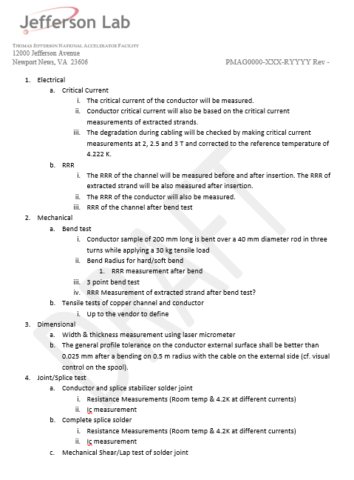
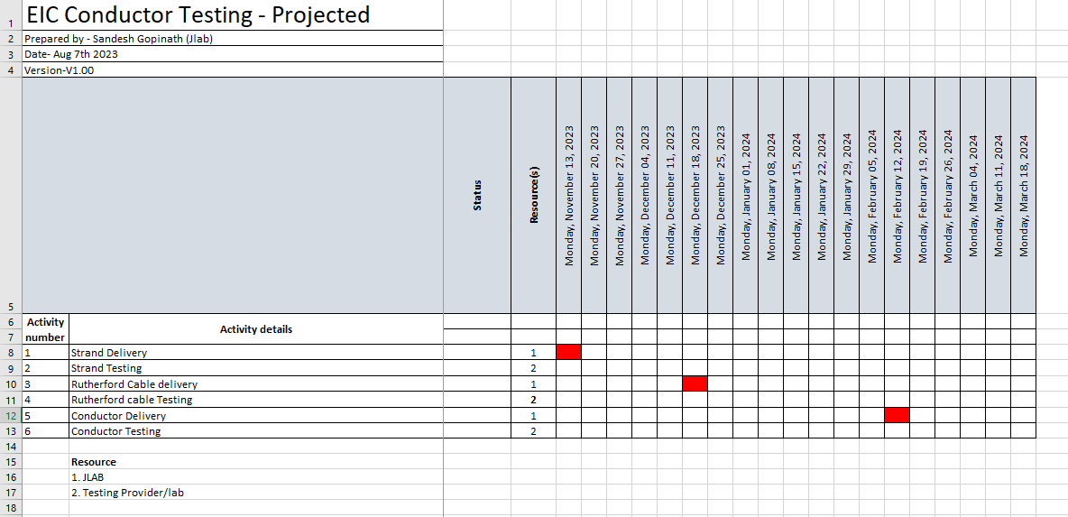
Sample Conductor Testing
Sample Conductor tests summarized
  LUVATA to characterize Ic & RRR performance based on strand measurements at each manufacturing stage.
  External test facility to perform whole conductor & cable characterization, Splice joint tests and possibly duplicate tests performed by LUVATA
Multiple Test facilities contacted; University of Durham, BNL, CERN, FSU
  Positive meetings took place with Durham and BNL
LUVATA Delivery Schedule
Sample Conductor Tests

Slide 16
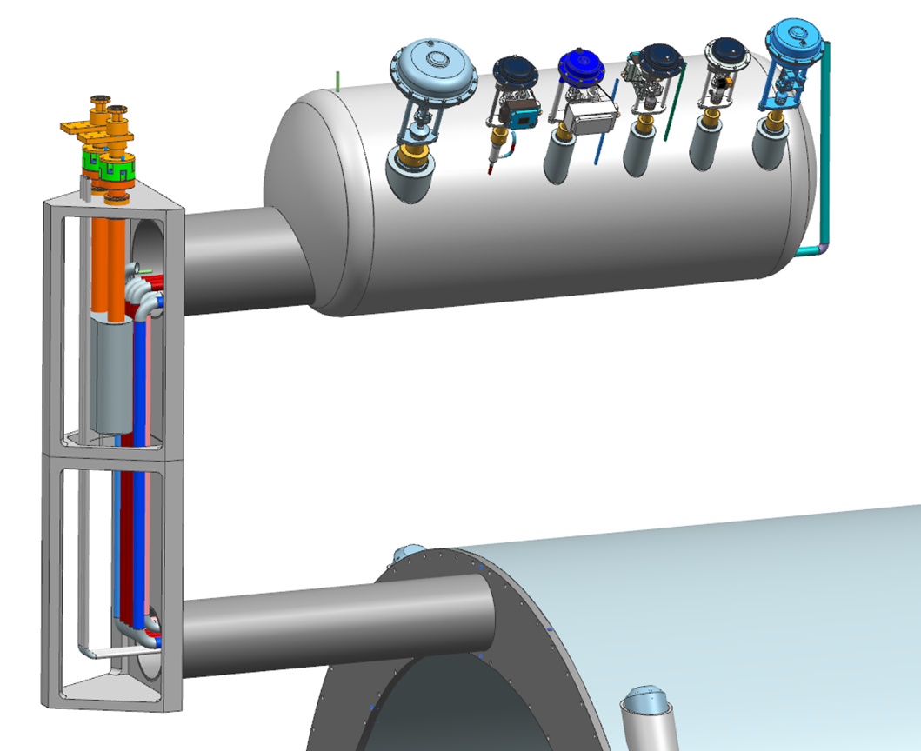
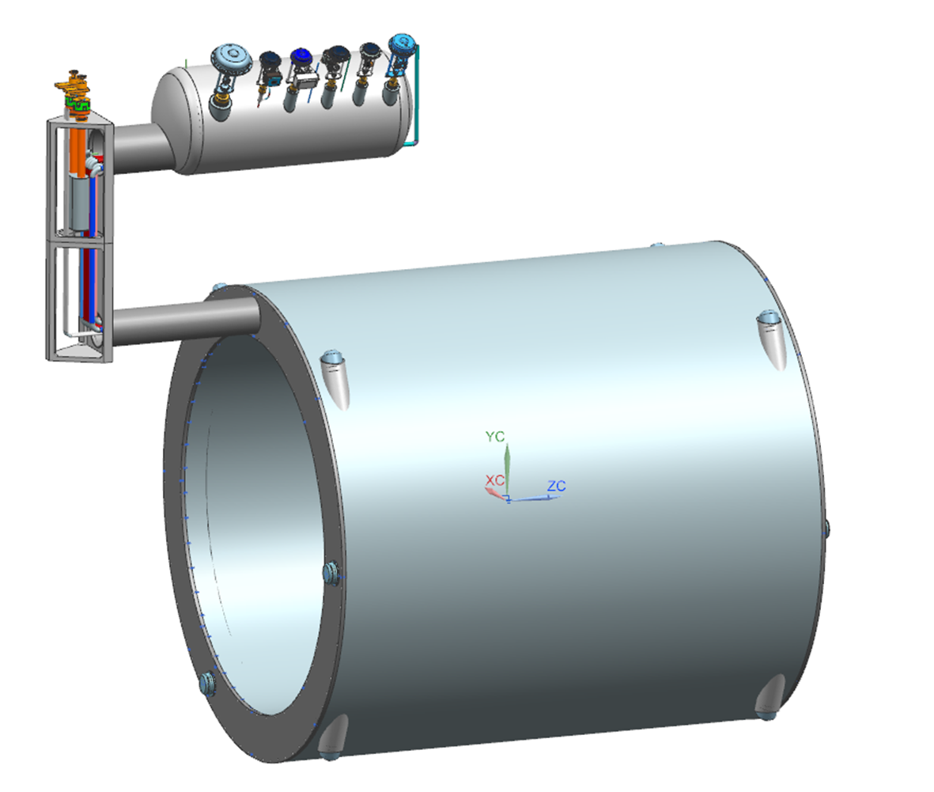
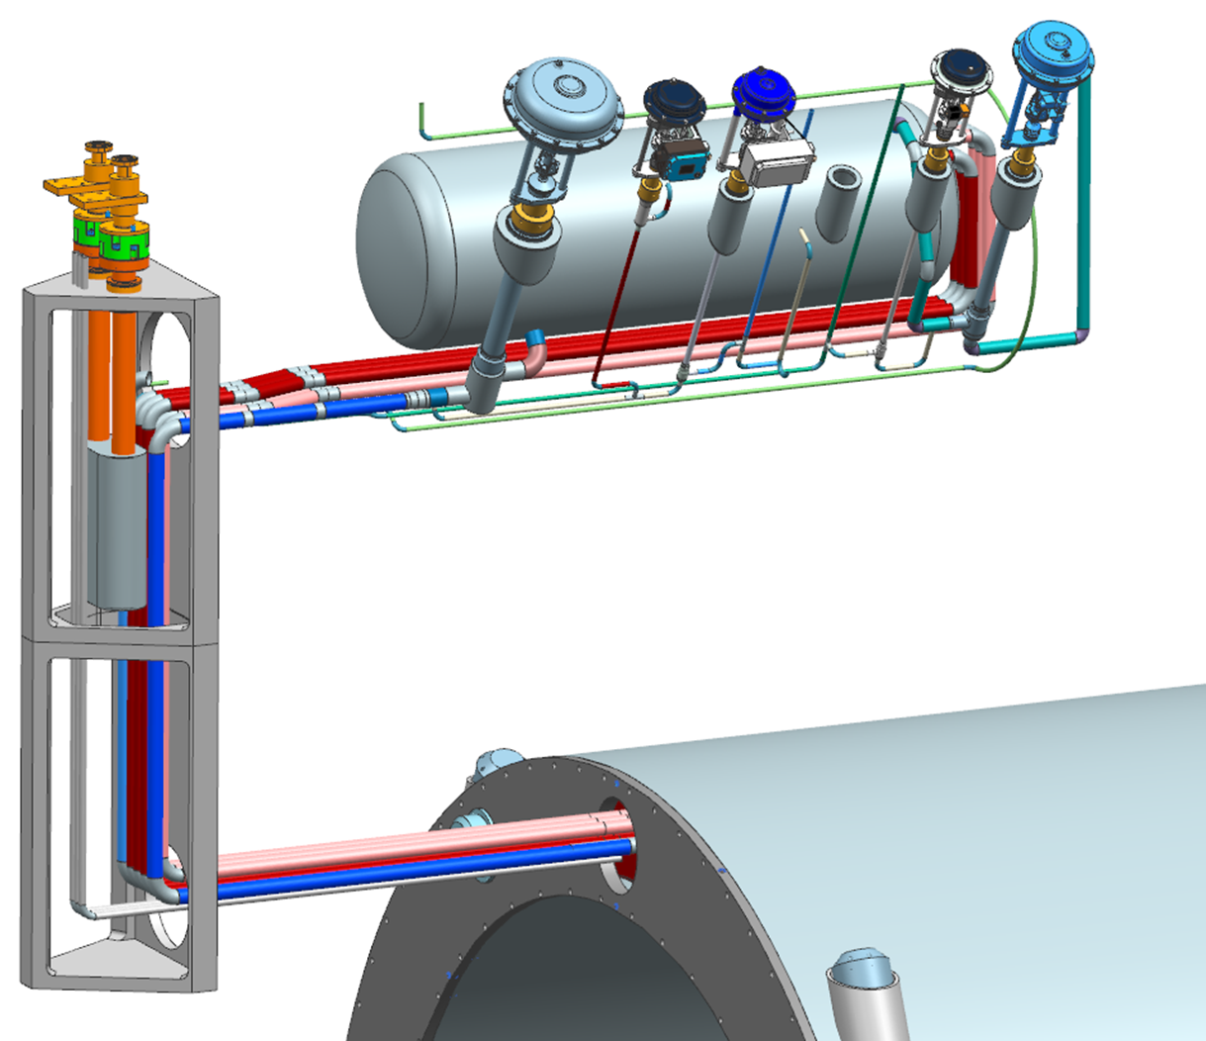
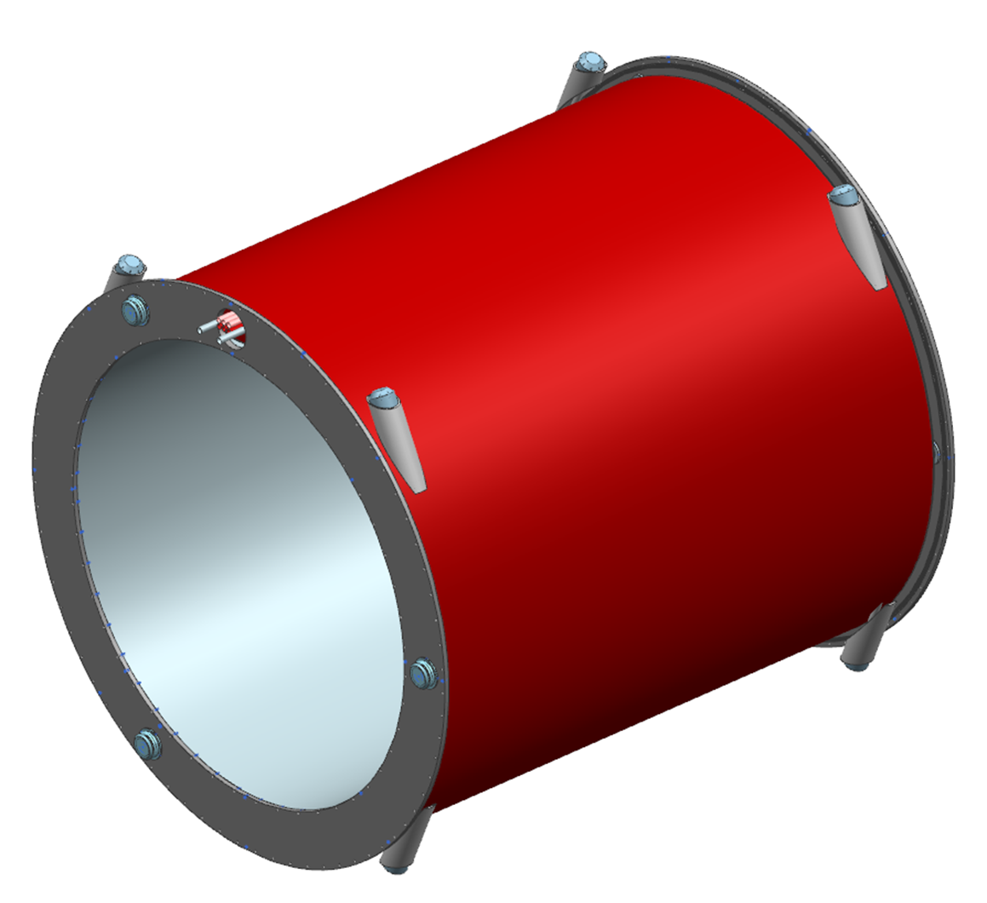
Magnet Assembly
Current Leads
Current Leads
Helium Phase Separator
Cryostat Assembly
Conductor and Current Lead exit currently being developed
Chimney
Final Chimney geometry and design TBD
Chimney Components - In Work
Helium Return
(Primary)
Conductor, Plumbing and Instrumentation
Exiting magnet and routing to Chimney
Thermal Shield
Current Leads
Radial Tie-Rods
Helium Supply
(Redundant)
Helium Return
(Redundant)
Helium Supply
Helium Supply
(Primary)
Instrumentation
Axial Tie-Rods
Axial Tie-Rods

Slide 17
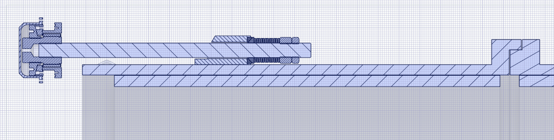
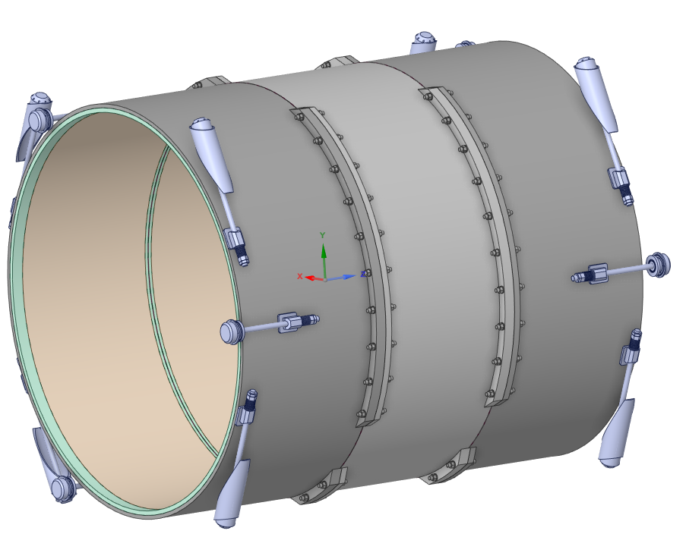
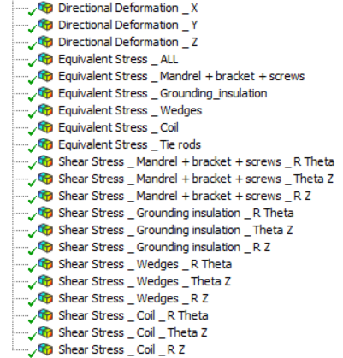
Mechanical Design
Finalizing the detailed Analysis
Mandrel design completed
Tie-rods finalized
2D analysis complete
3D analysis almost complete
MECH Design includes
Nominal CASE
How to transport the magnet
Tolerances
Complete for Self weight
Working on
Self weight + cool down + energization + shipping

Slide 18
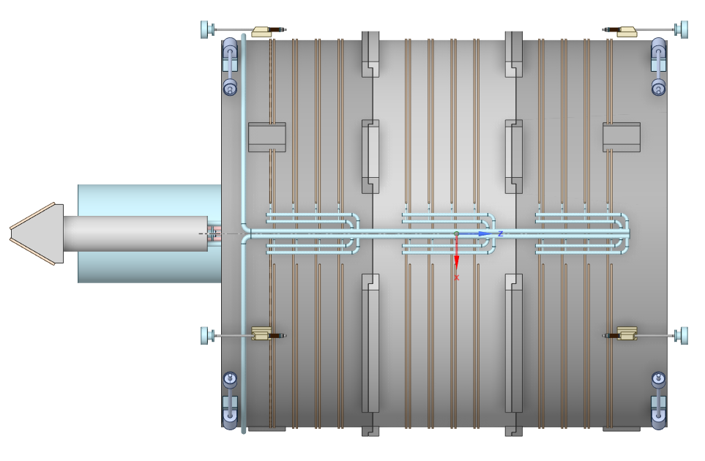
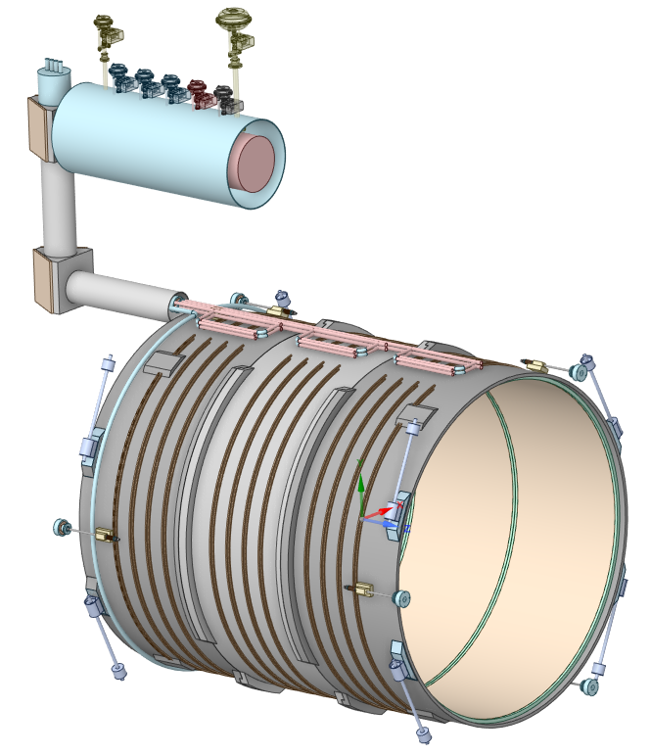
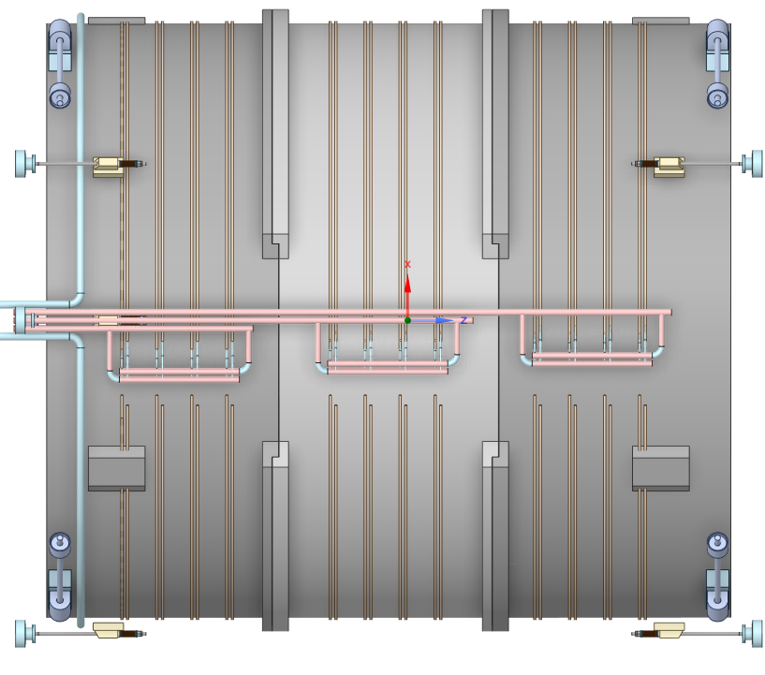
Cryogenics Design
Bottom view
Vacuum pumps to be mount here
Redundant cooling system to ensure thermosiphon working properly
Top view
2 thermosiphons (main + spare)
Phase separator design finalizing
Thermal shield design finalizing

Slide 19
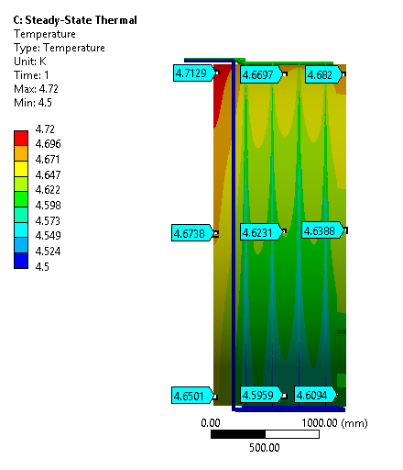
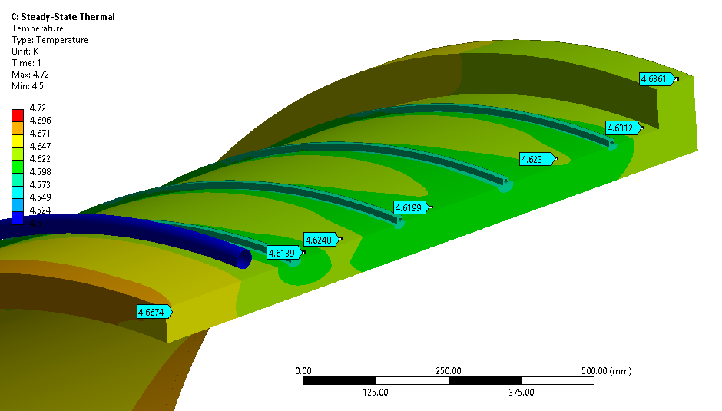
FEA Thermal
Thermal analysis of temperature gradient completed using single phase liquid helium flow and half-module sub-model
Temperature gradient seen across coil thickness ≈ 0.04 K
Peak temperatures of 4.72 K to the Z extents of the mandrel
Cold Mass Longitudinal Temperature gradient ≈ 0.05 K
FEA Sub-Model
Magnet can be ramped to full field at 1A/s (total ramp up time 1 hr 15 minutes)
Estimated time to cool down magnet from room temperature to operating temperature 8-10 days
Cold Mass Thickness Temperature gradient ≈ 0.04 K

Slide 20
Instrumentation
Voltage taps (eventually double for redundancy)
  36 for the solenoids (18 DP)
  4 for the busbars (2 DP)
  4 for the current leads (2 DP)
  2 for Utot (1 DP)
2 DCCT (1 for PS and one for magnet)
3 Heaters
2 Vacuum gages
PT 100 thermal sensors:
  10 on the thermal shield
  6 on the current leads
Flow meter:
  2 for the current leads
  2 to 4 for the thermosiphons inlet and outlet
  2 for the 50 K shield inlet and outlet
2 He level gages
2 Manometer (pressure sensor)
One load sensor by tie-rods
CERNOX thermal sensors:
  12 distributed on the magnet and the shell
  6 on the phase separator and thermosiphon inlet and outlet
Magnet is well instrumented with proper redundancy in instrumentation

Slide 21
ESH &Q- Electrical
Power Supply Specification- Draft version is complete, working on the final specifications document
Vapor Cooled Leads- Specification is finalized and is incorporated in the chimney
Water Cooled Leads- Specification document is almost final

Slide 22
ESH &Q- Pressure Vessel
Status of ASME Code Analysis
Vacuum vessel:
  The model was set up now. Waiting for the live loads to be finalized. Once mechanical analysis is complete, the live loads will be incorporated .
Helium separator and its vacuum vessel:
  The model was set up already. Once cryogenic analysis is complete, the model will be updated and analyzed
Piping system:
  Work in progress
All the analysis will be complete by Mid-September

Slide 23
Summary and What Next
Summary
  The 90% design reviewed is scheduled for October 5 and 6, 2023.
  The magnet and the conductor both are long lead procurements.
  The magnet is ready for CD3A.
What Next
  Complete all the analysis work by Mid-September,
  Finalize the sample conductor testing plans
  Prepare for 90% design review
  Prepare magnet RFQ document and design report
  Prepare for the conductor procurement

Slide 24
Questions?

Slide 25
Back up

Slide 26
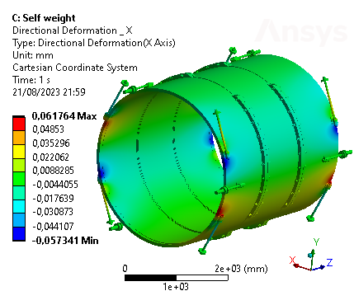
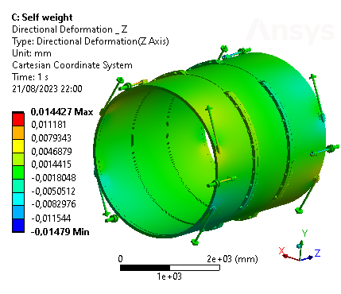
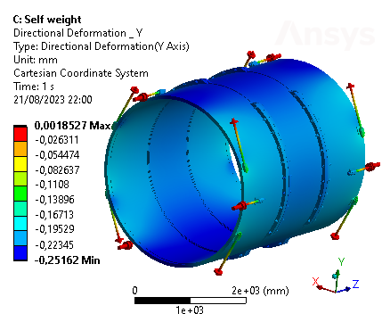
Displacement due to Self Weight
DISPL. X (mm)
DISPL. Z (mm)
DISPL. Y (mm)

Slide 27
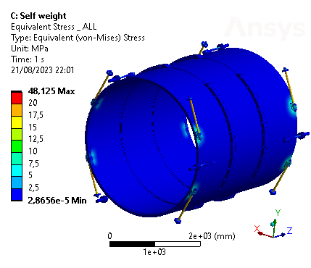
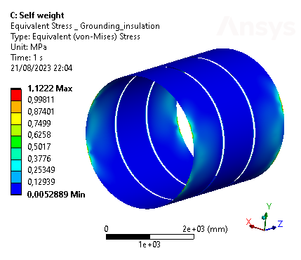
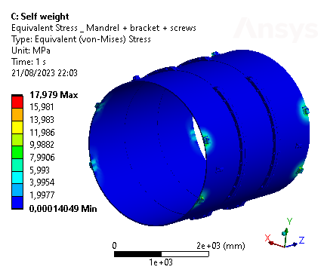
Equivalent Stress due to Self Weight
EQ. STRESS (MPa)
All the parts
EQ. STRESS (MPa)
Grounding insulation
EQ. STRESS (MPa)
Mandrel/brackets/screws

Slide 28
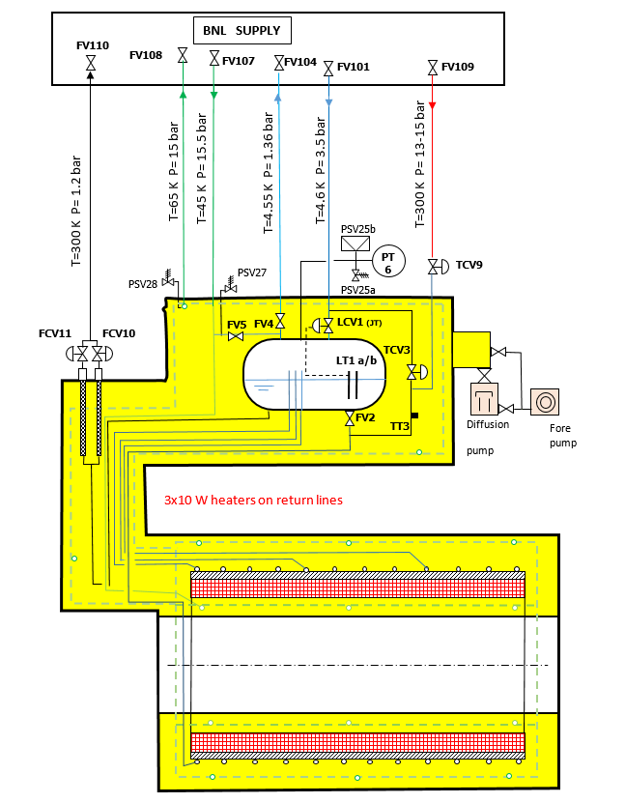
Cooling Scheme

Slide 29
Phase Separator
Phase Separator Impact:
Asymmetry of the iron
Fz = -5.6 kN

Slide 30
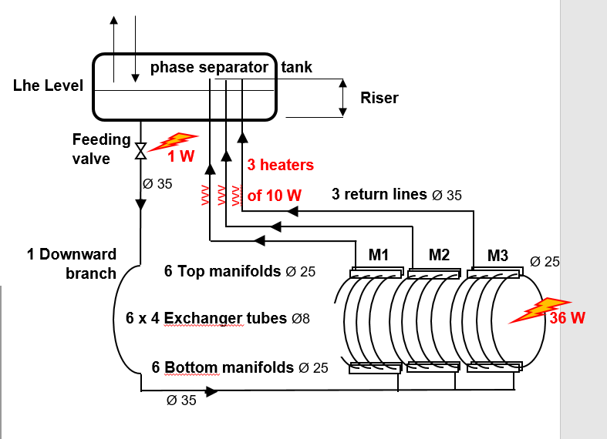
Chimney
Thermosiphon
CRYO
Thermosiphon
1 main circuit + 1 spare
1 feeding line
3 return lines (1 for each module)
3X10 W heaters
1 line LHe for the current leads
Thermal shield
1 main circuit + 1 spare
CURRENT LEADS
2 resistive current leads
Connection to the vacuum pumping unit
1 line LHe for the current leads

Slide 31
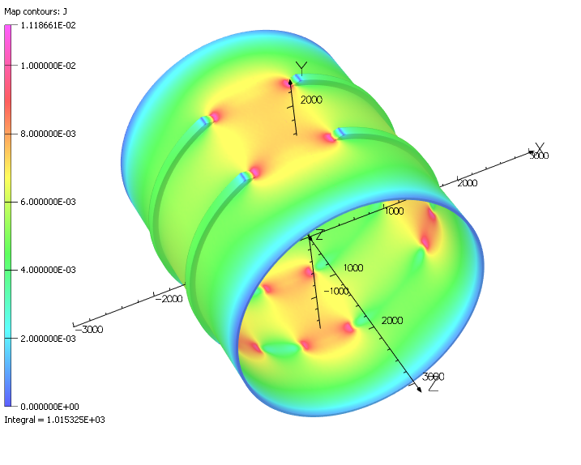
3D Transient Analysis –RAMP UP
Parameter | V7.6.2.2.10 | Units
Current | 3924 | A
# turns | 1668
B₀ | 2.000 | T
Energy | 45.010 | MJ
Inductance | 5.846 | H
Ramp | 1 | A/s
Power | 3.642 | W
Eddy current | -1015.32 | A
R mandrel (P/I²) | 3.516 | μΩ
M mandrel | 3.570 | mH
L mandrel* | 2.346 | μH
k | 0.964
Power density dissipated in element centroid in file
MARCO_v7.6.2.2.10_Power.table

