Slide 1
WBS 06.10.04
Particle Identification Detectors
Benedikt Zihlmann
EIC Detector Comprehensive
Design Review
August 29-30, 2023

Slide 2
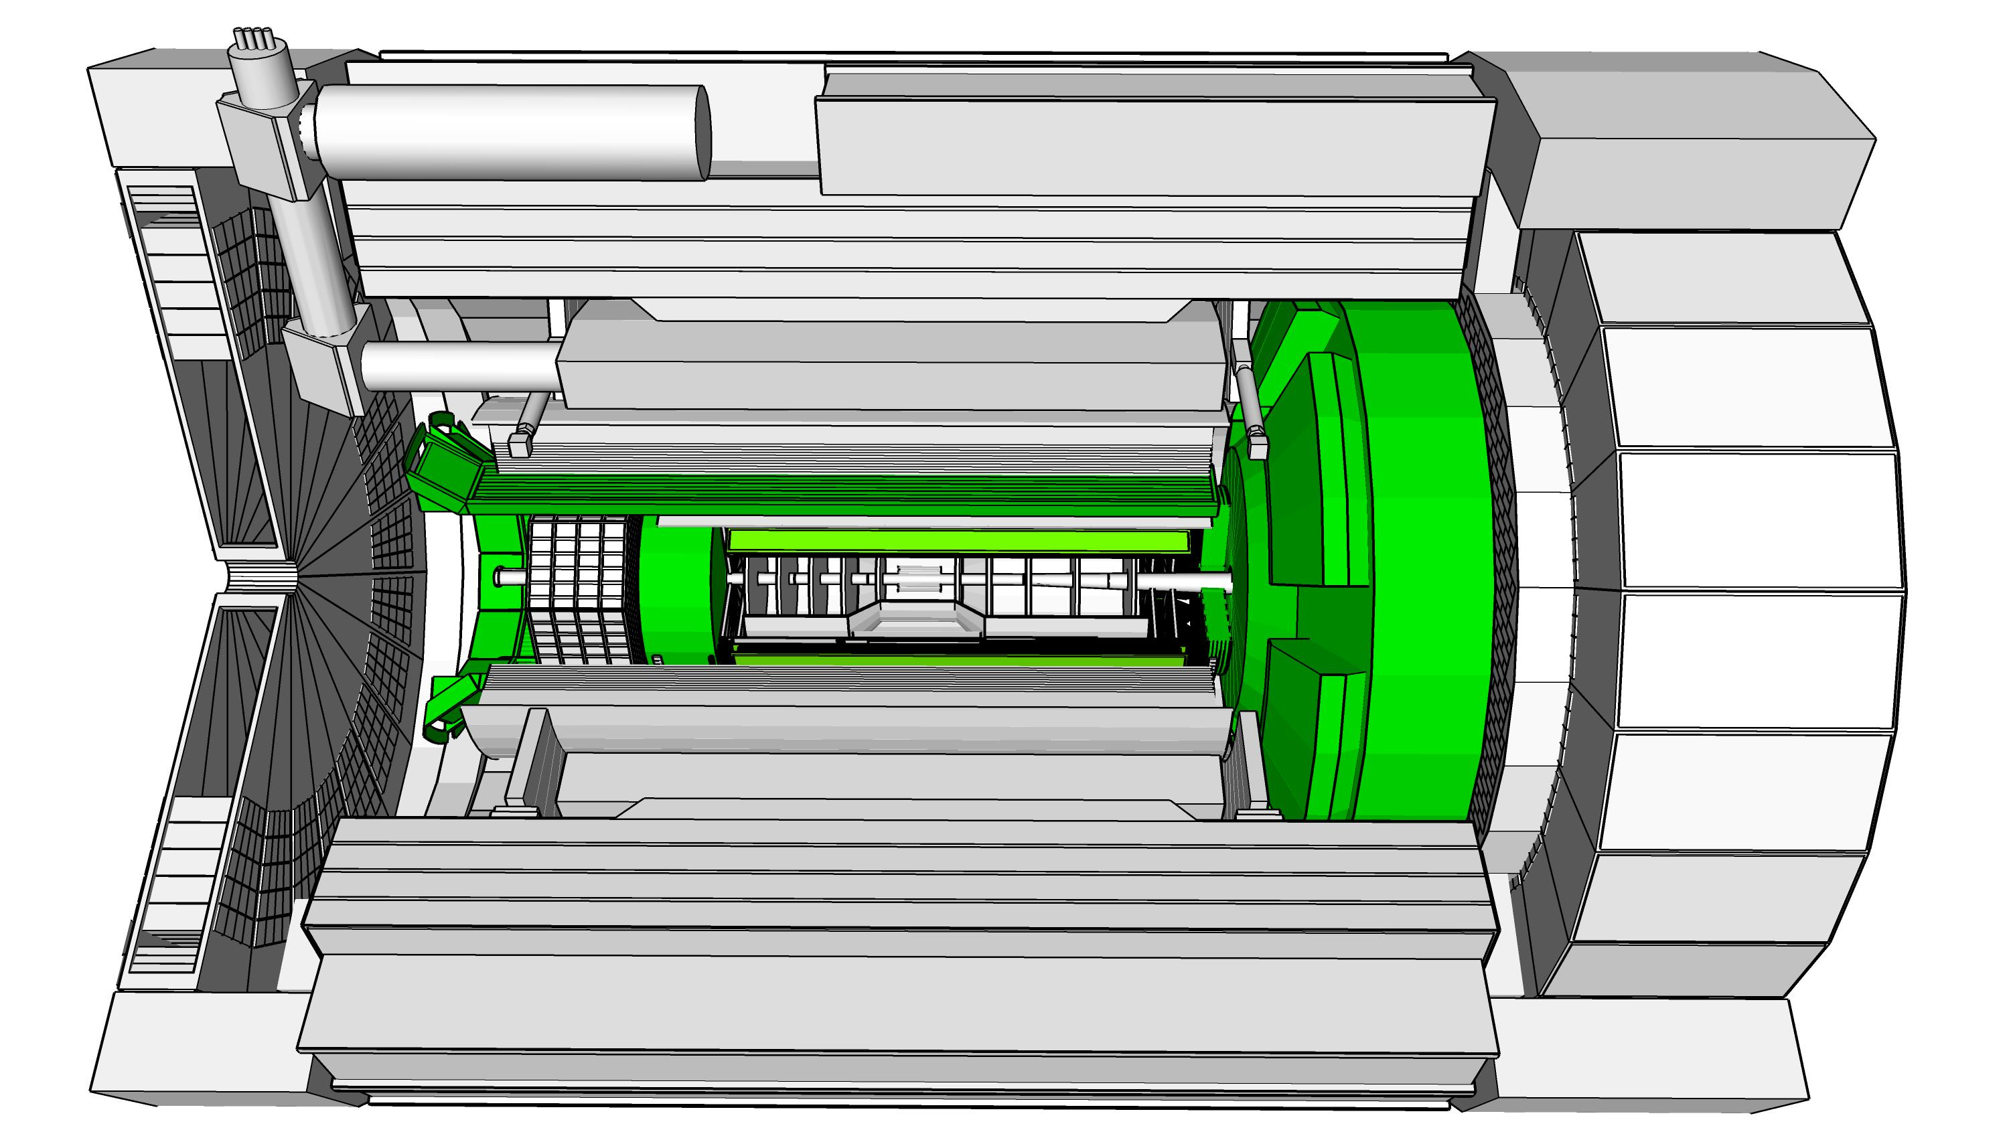
PID Detector Overview
Purpose: Particle identification over 4π in central region
Cherekov Detectors
bRICH: backward RICH
hpDIRC: high perf. DIRC
dRICH: dual RICH
TOF Detectors (AC-LGAD)
Barrel TOF
Forward TOF
Particle Identification Detector Technical Design Review
July 5-6 2023
3 Recommendations
22 comments
electron
hadron

Slide 3
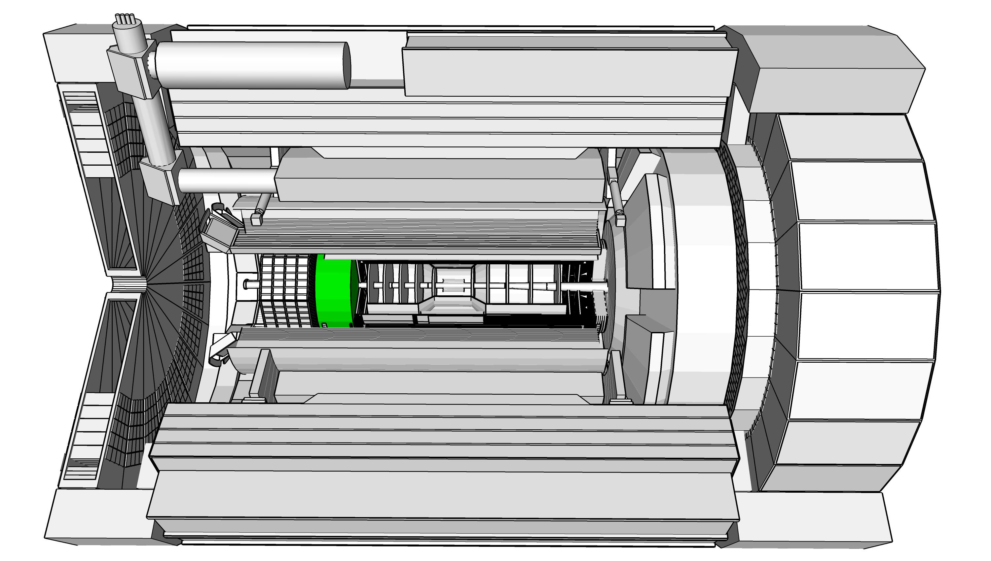
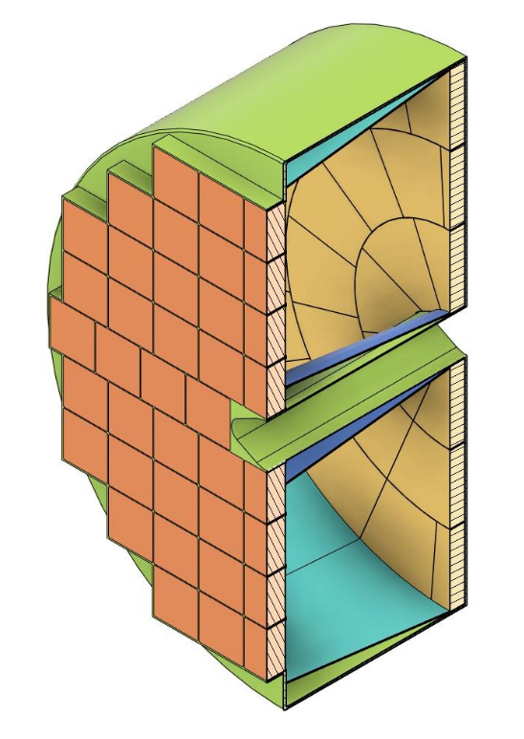
pfRICH Detector
Charge #2
Requirements:
3σ π/K separation up to 7 GeV/c
Rapidity coverage: -3.5 < η < -1.65
Timing resolution 20ps for TOF at low momenta (< 1.5GeV/c)
Interface requirements:
Track path length for TOF determination
Implementation:
Aerogel Radiator: n∼1.04(5)
Dry Nitrogen gas volume
Carbon fiber shell (low mass)
Conical inner and outer mirrors (acceptance increase)
Photo Sensors HRPPD for timing (TOF)
Cooling for photo sensors
HV for PMT, LV for electronics, fiber optics for DAQ
Side Note: The pfRICH detector replaced the mRICH in the backward region as the base line detector system for PID (ePIC collaboration decision April 2023)

Slide 4
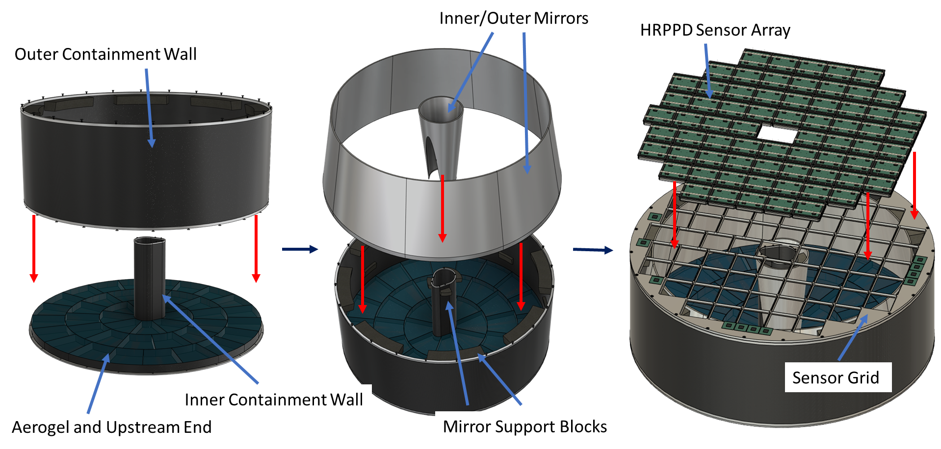
pfRICH Detector Design
Charge #2,3
Photo Sensors:
1024 channels/HRPPD
ASIC digitizer (backplane)
69632 channels overall
Frame and Mirrors based on carbon fiber composites.
Frame shape change to octagon considered.

Slide 5
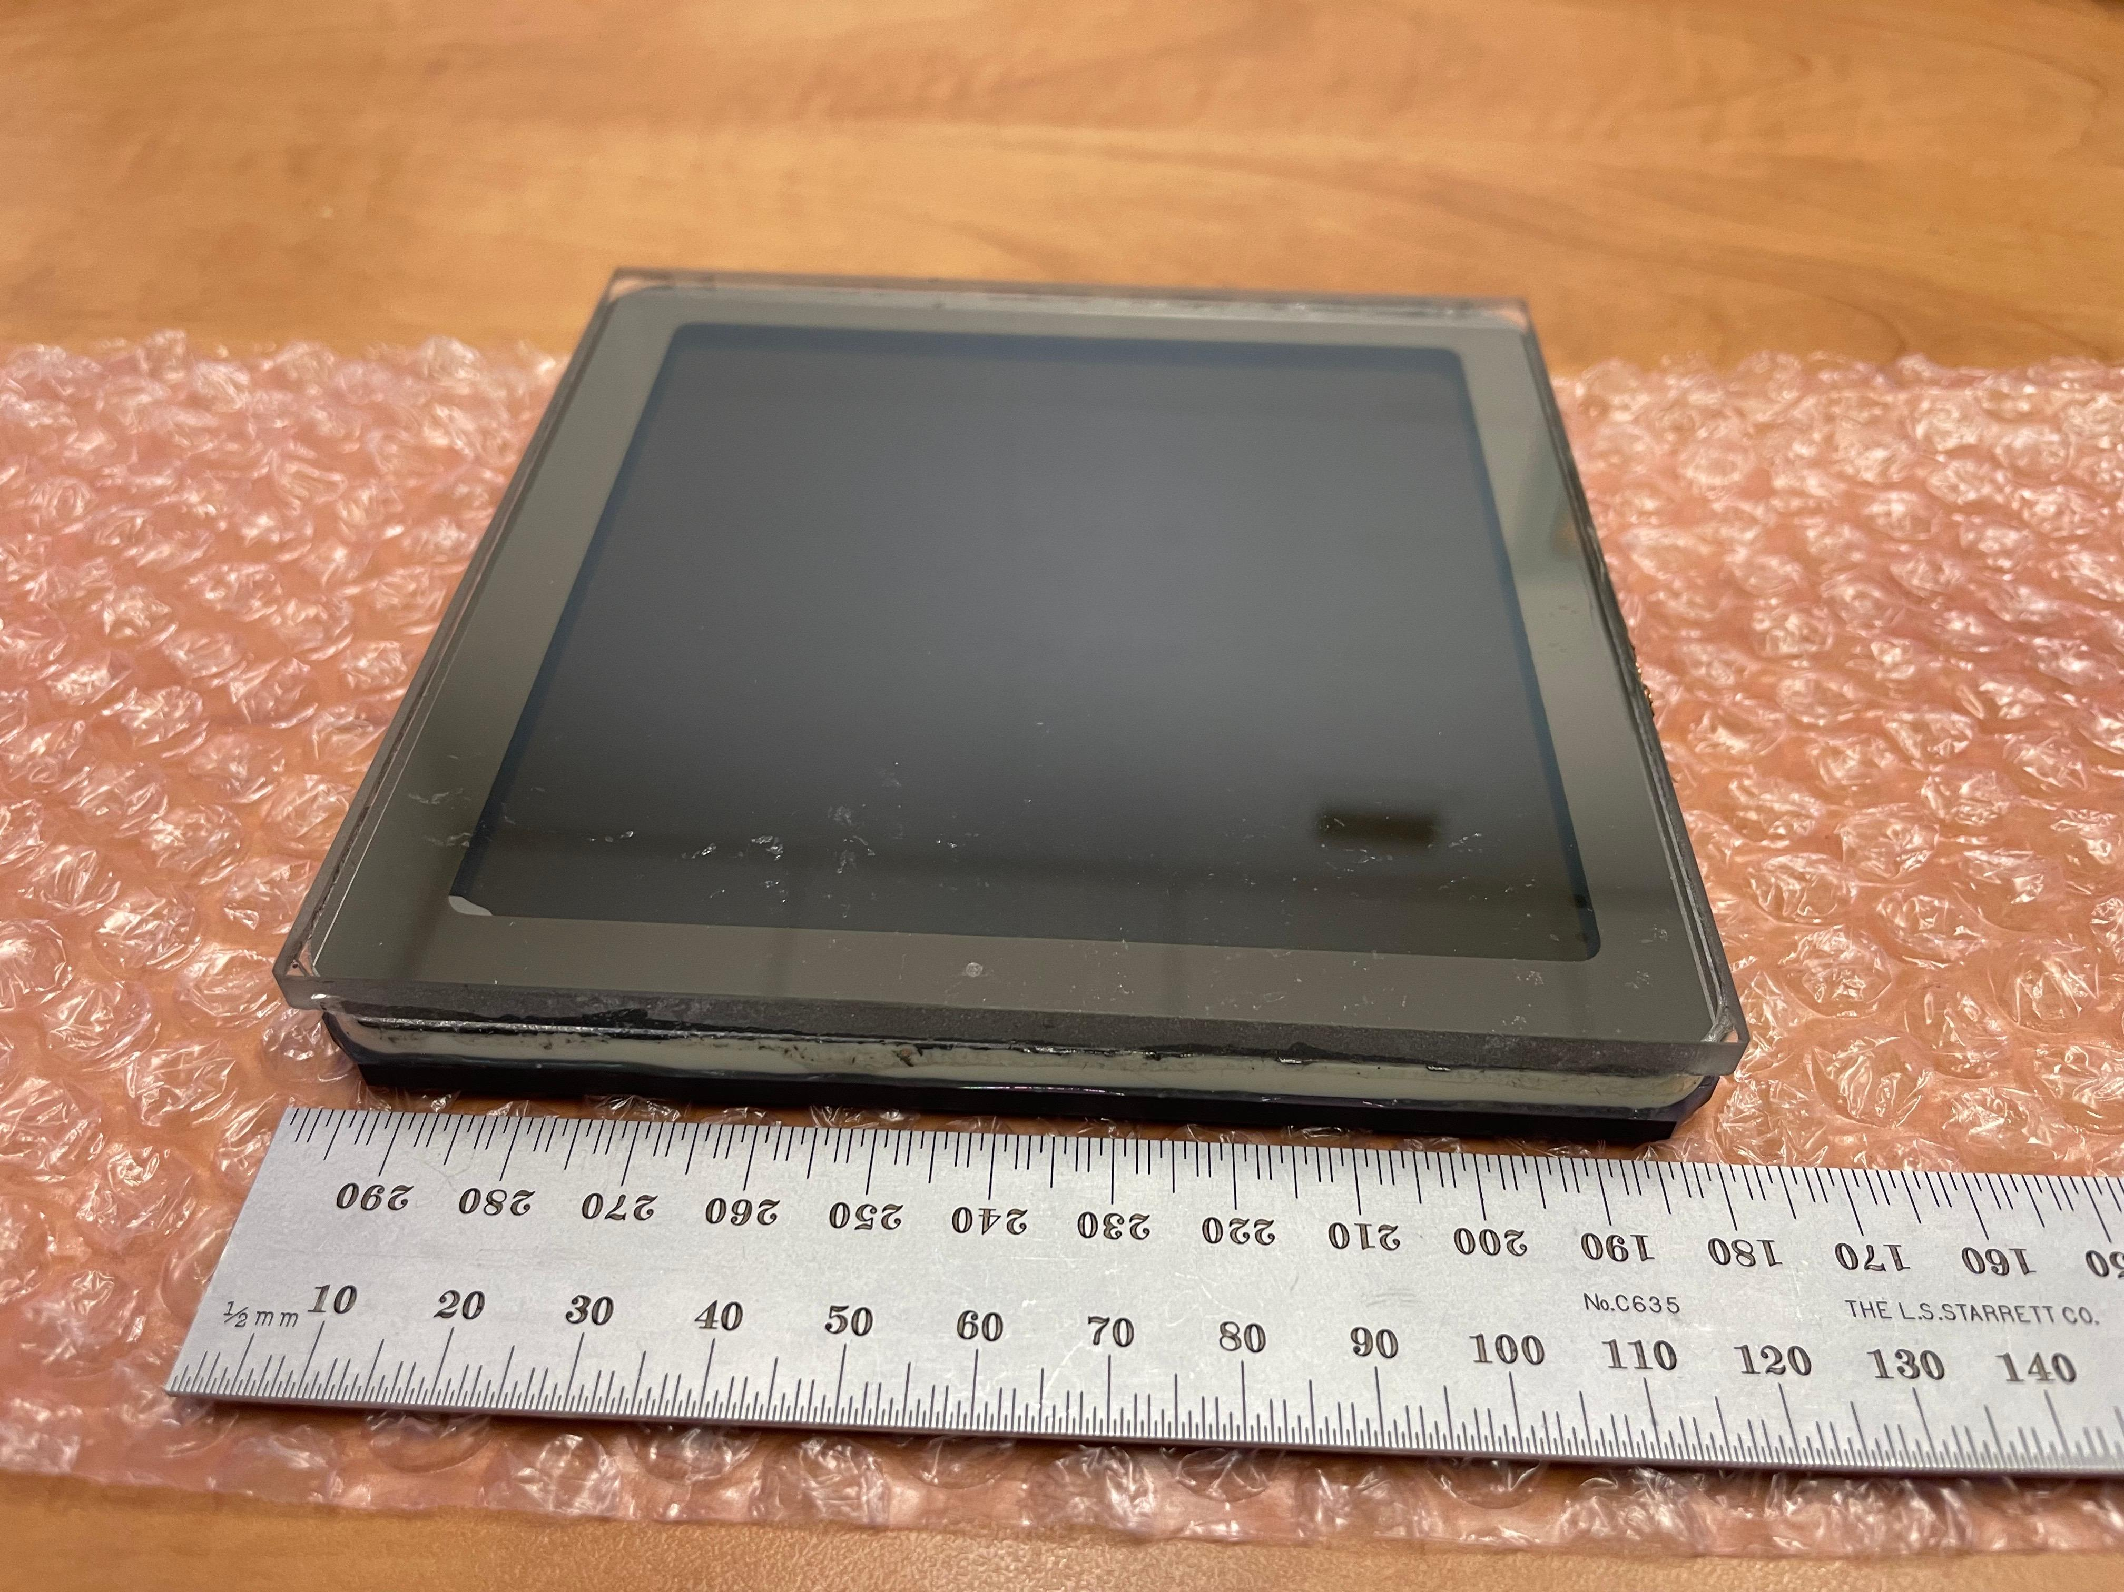
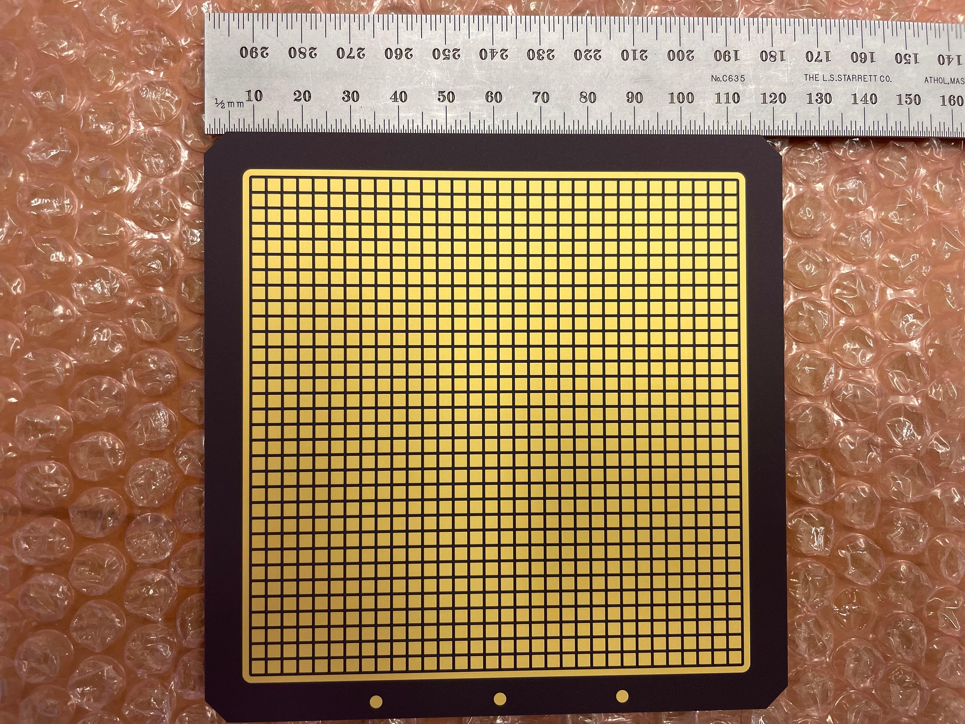
pfRICH HRPPD
Charge #2,3
HRPPD: High Rate Pico-second Photon Detector
Photo sensitive area: about 10cm x 10cm
Multi channel plate technology
Built by INCOM
For EIC minimize frame, optimze active area
Integrated readout with ASICs
1024 channel over 10cm by 10 cm active area
AC-coupled readout demonstrated
Operational in high magnetic field (increased HV)
eRD110 R&D FY24 evaluate engineering test article

Slide 6
pfRICH Detector Efforts towards FDR
Charge #2,5,6
HRPPD engineering test article by INCOM:
  5 HRPPDs on order, 10/2/23-2/2/24
  Q&A test facility at Yale (construction now)
Aerogel Chiba Japan: n=1.04(5)
  Procurement of test samples in preparation
  Q&A test facility at Temple Univ. (construction now)
Detector Mirrors: Carbon-fiber low mass substrate
  Test production in progress: substrate by Purdue, mirroring at Stony Brook
Detector quadrant: Vessel, Carbon-fiber low mass (and all the above)
  PED request in process
  Build full scale sector evaluate/test all components within the assembly
  Do test beam measurements

Slide 7
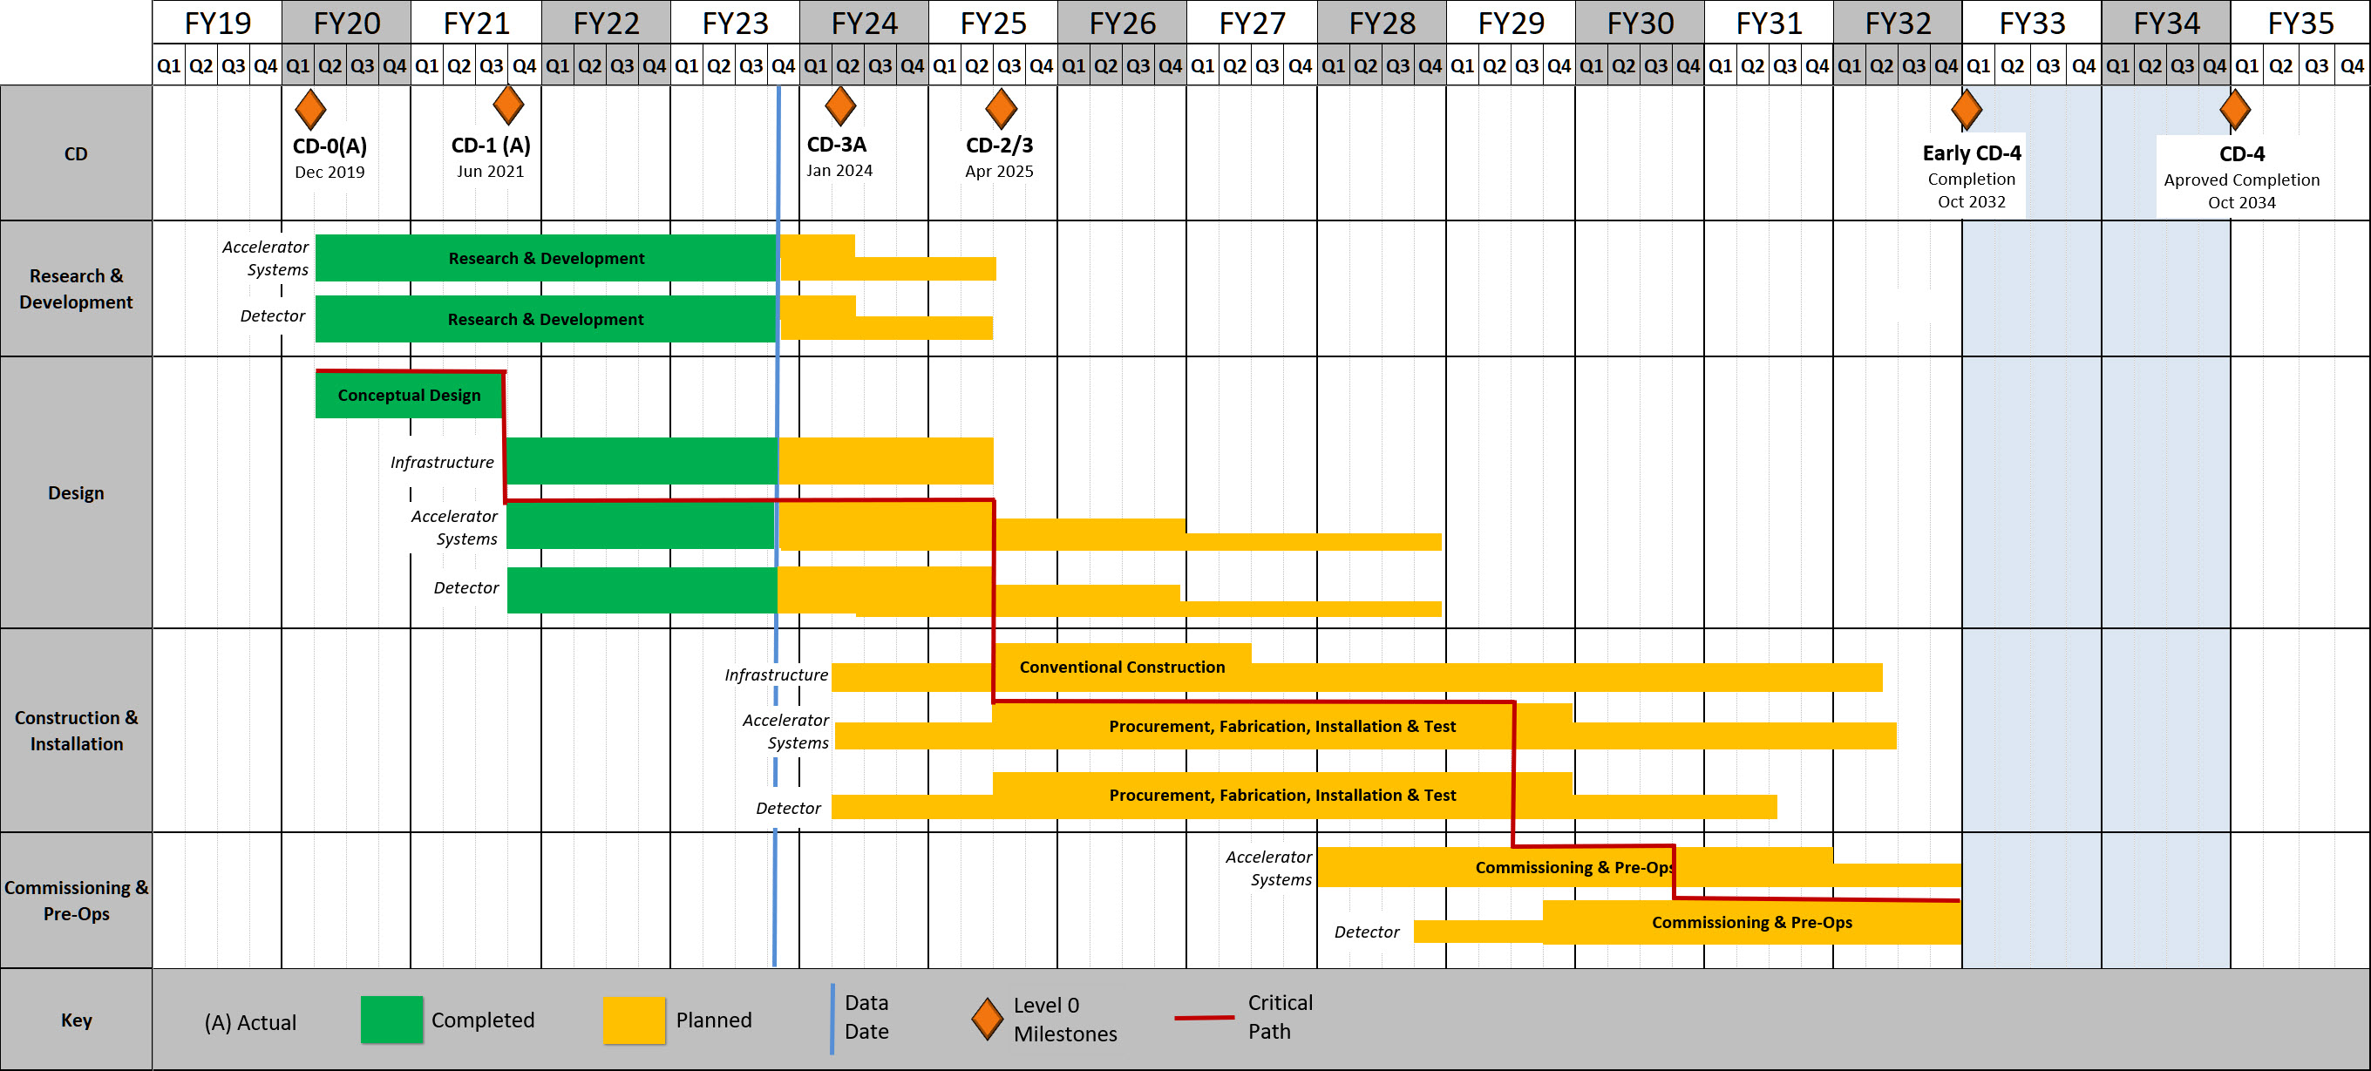
pfRICH Detector Time Line
Charge #2,5,6
FDR Nov. 2024
Construction start May 25
Aerogel Q&A: Temple/Ferrara
HRPPD Q&A: Yale
Carbon Fiber Vessel and Mirror: Purdue, SBU
Construction complete: EoY 28

Slide 8
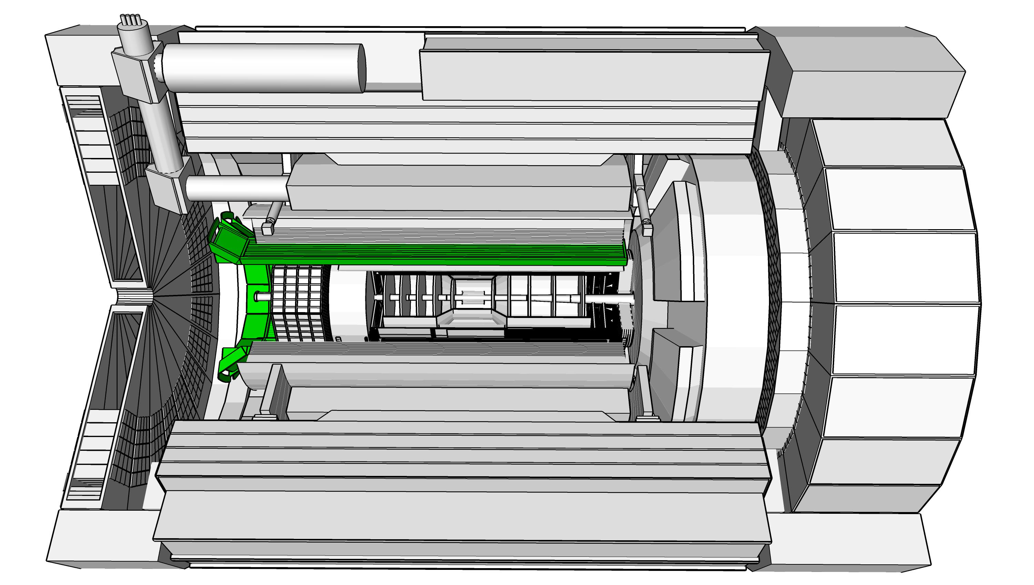
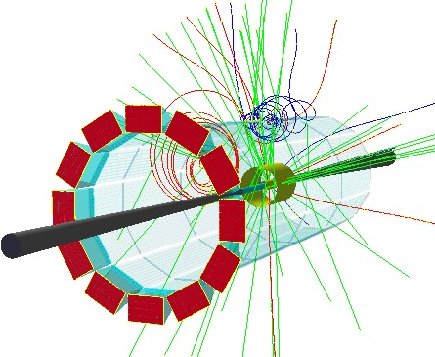
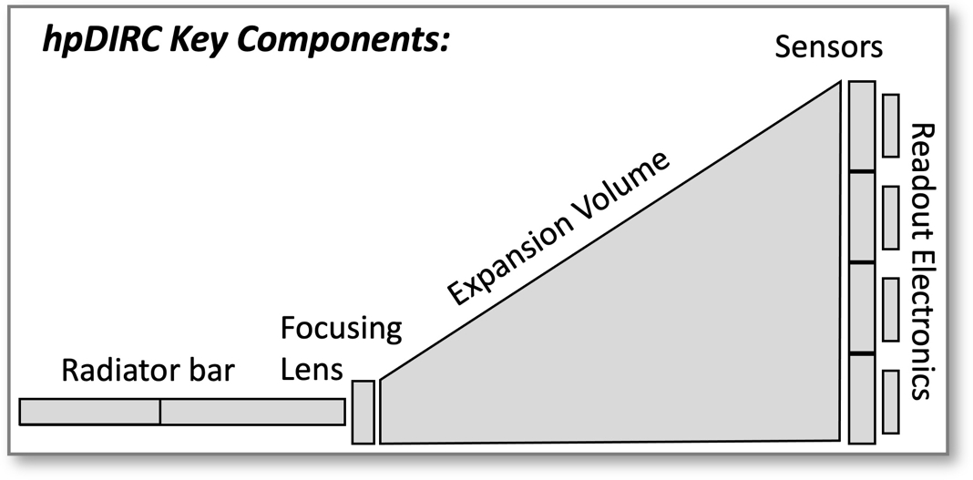
hpDIRC Detector
Charge #2,
Requirements:
3σ π/K/p separation up to 6 GeV/c
Rapidity coverage: -1.5 < η < 1.5
0.5 mrad tracking resolution at 6 GeV/c (impact angle and loc.)
Inteface Requirements:
0.5 mrad tracking resolution at 6 GeV/c (impact angle and loc.)
Implementation:
Fused Silica Radiator
Lens system (rad. Hard sapphire)
Fused Silica expansion volume (prism)
Photo Sensors MCP-PMT
Cooling for photo sensors
HV for PMT, LV for electronics, fiber optics for DAQ
Carbon fiber shell/box (low mass)
Dry Nitrogen protective gas

Slide 9
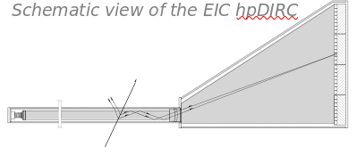
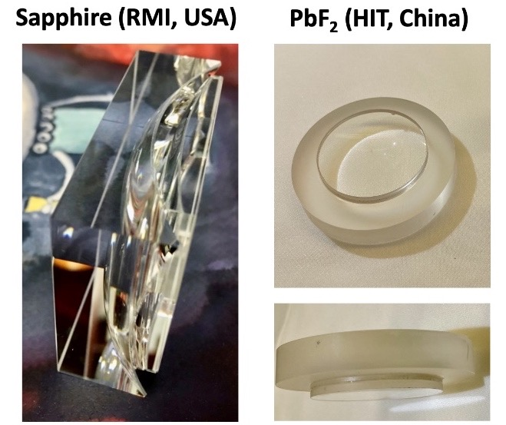
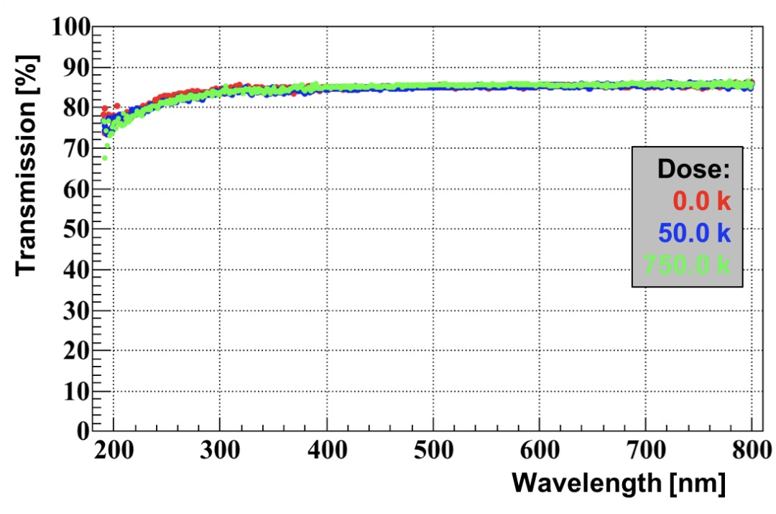
hpDIRC Detector
Charge #2,4
hp = high-performance
Employ lens system on radiator exit
Focusing light on photon sensor plane
Enhance angular detection resolution ≤1mrad
3σ π/K separation up to at least 6 GeV/c
Radiation hardness demonstrated
(
dose from
60
Co)
𝛾

Slide 10
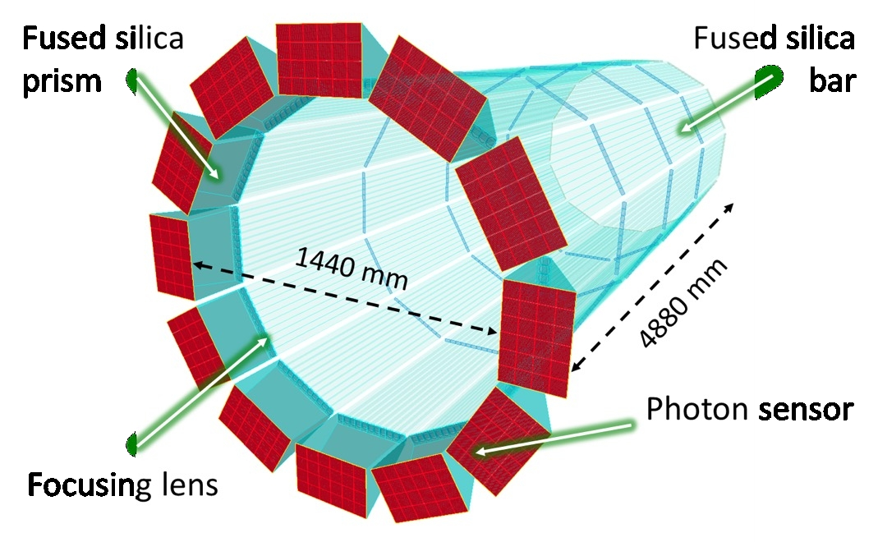
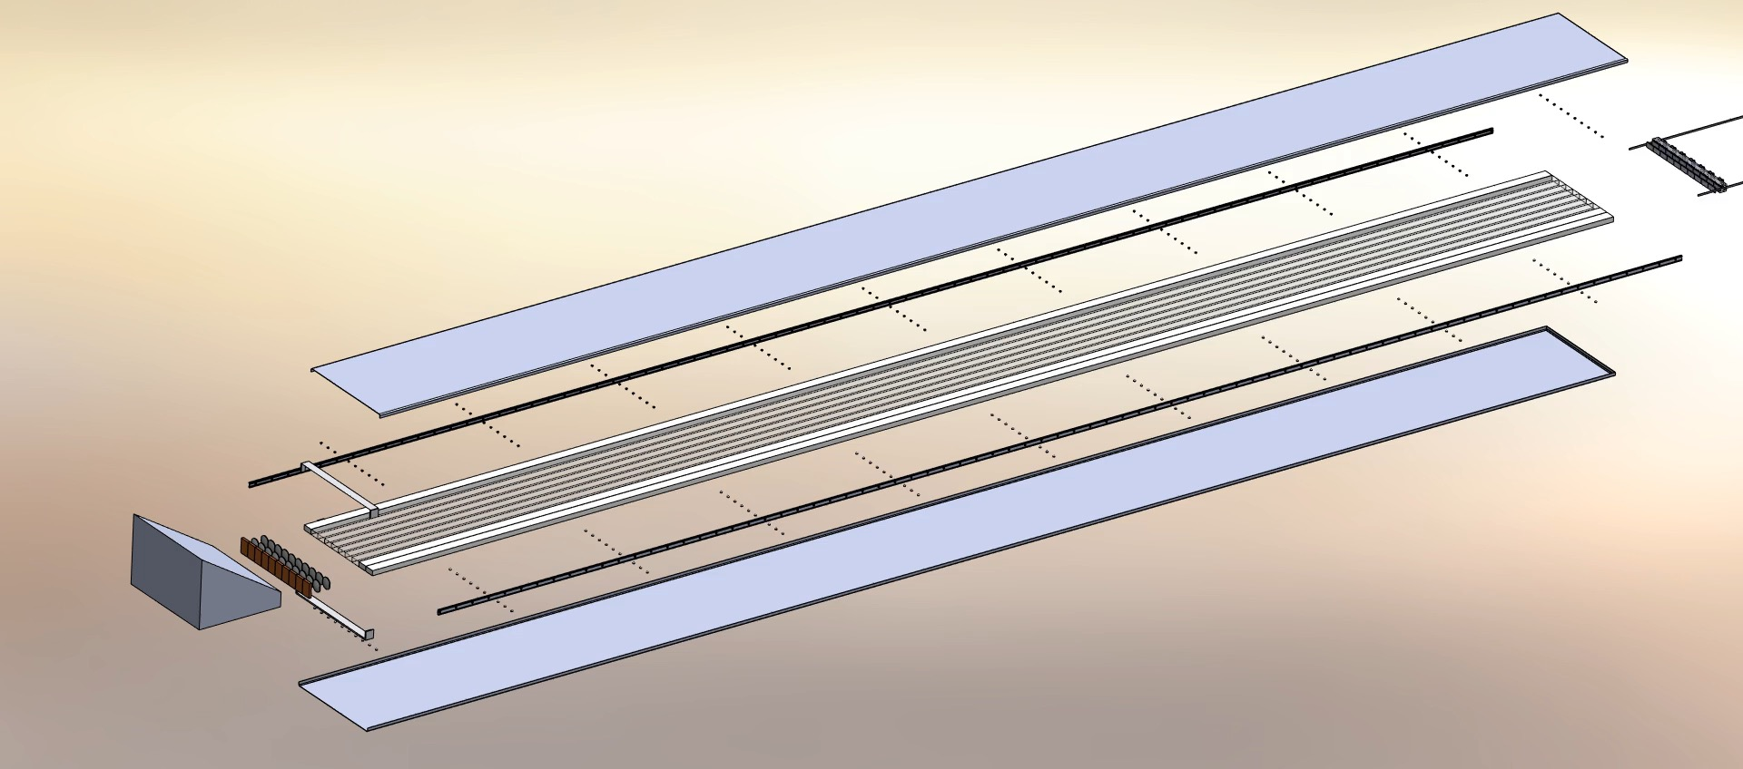
hpDIRC Design
Charge #2,4
Very similar to PANDA Barrel-DIRC development
12 Bar-Boxes
Fused silica bars
  From SLAC BaBar, need refurbishment
Lens system
  Designed and tested in prototype (PANDA)
  Material radiation hardness tests complete
  Sapphire choice of material
Prism Fused Silica
Photo sensors MCP-PMT (288 total)
  73728 channels overall
  Potential Alternative HRPPD, synergy with pfRICH
HV for PMT, LV for electronics, fiber optics for DAQ
Cooling of Photo Sensors and electronics
Dry Nitrogen gas to protect radiator

Slide 11
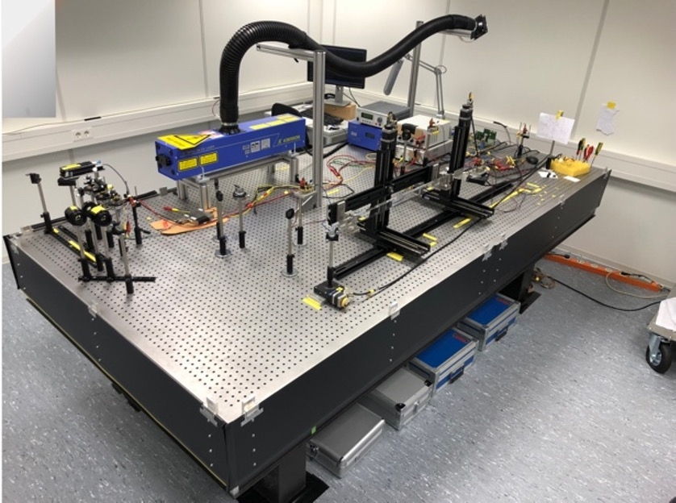
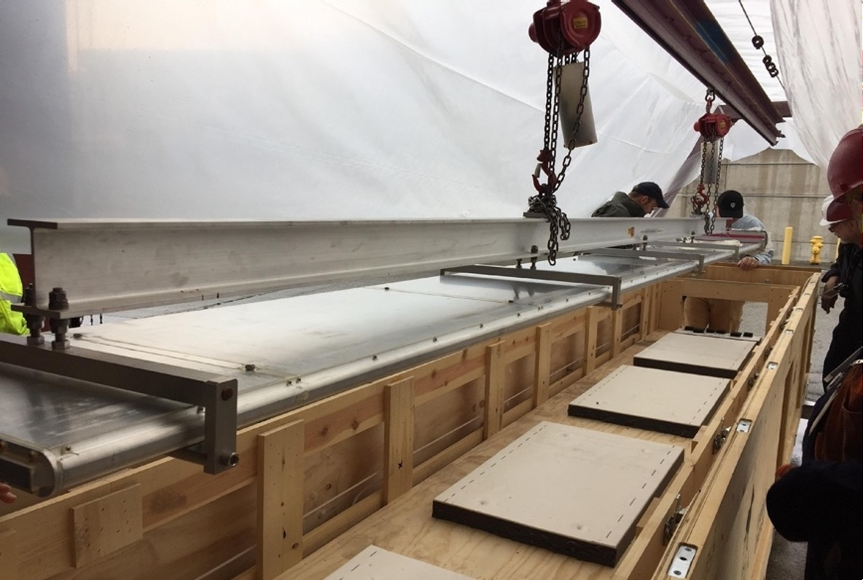
hpDIRC Radiator refurbishment
Charge #2
Transfer BaBar DIRC boxes from SLAC to JLAB
  IEWO in progress
  Transport expected late fall 2023
Disassemble and refurbish fused silica bars
  At JLAB, work area in preparation
  Expected start towards end of 2023
Determine optical quality of individual bars
  At JLAB, laser lab under construction, all equipment on hand
Important to validate the re-usage of the fused silica radiator bars for the hpDIRC project!

Slide 12
Charge #2,5,6
hpDIRC Time Lines
FDR Aug. 2024
Construction start June 25
First full box assembly for testing early 2028 with cosmic ray test at SBU
Full detector ready mid 2029
First PID detector to be installed, mid 2030

Slide 13
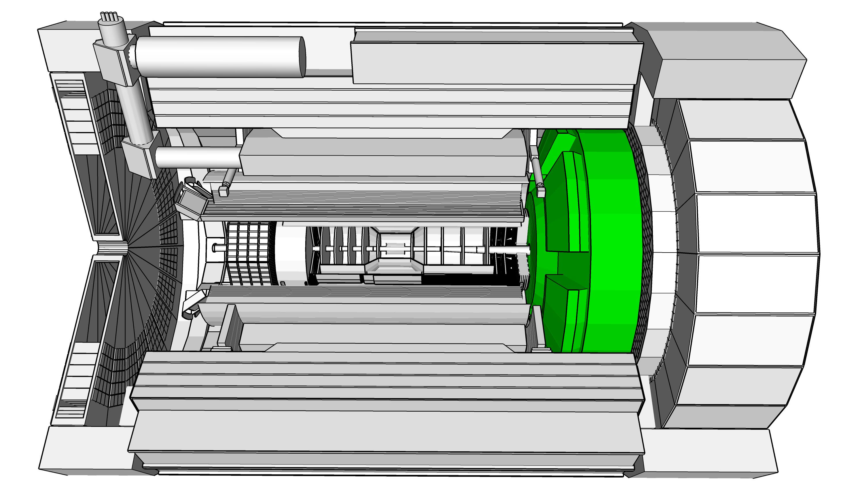
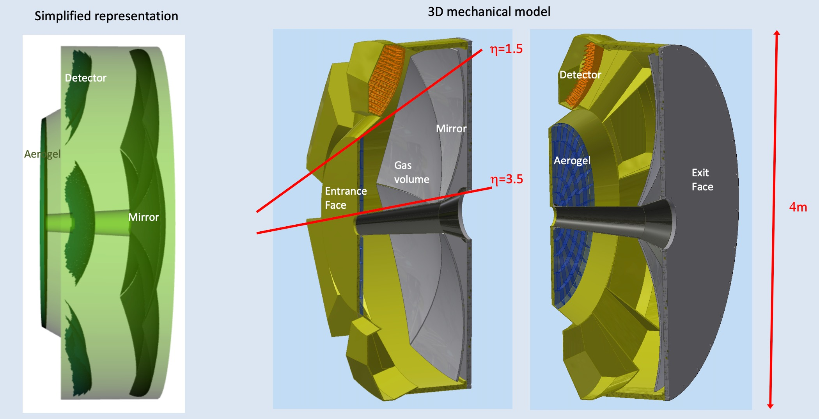
dRICH (dual-RICH)
Charge #2
Requirements:
3σ π/K/p separation up to 50 GeV/c
Rapidity coverage: 1.5 < η < 3.5
Interface Requirements:
Tracking resolution <0.5mrad
Minimal magnetic field gradient in detector gas volume
Implementation:
Radiators:
  Aerogel n=1.02
  C2F6 gas close circuit
Carbon fiber vessel (low mass)
Large mirrors
Photo Sensors SiPM
Cooling of SiPM to -40 deg. C
LV for sensors and electronics
Fiber optics for DAQ

Slide 14
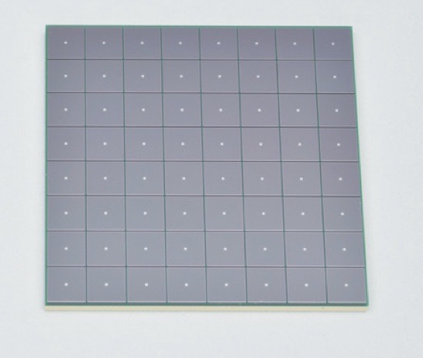
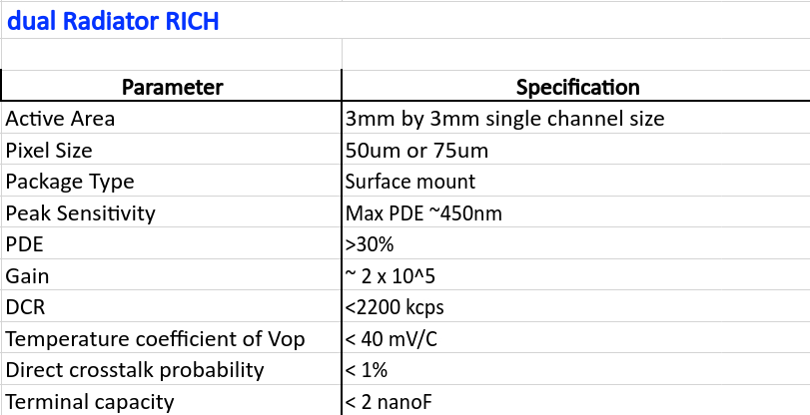
dRICH towards FDR: SiPM
Charge #2,3,4,5,6
Photo Senors SiPM
  Radiation hardness tests ✓
  Annealing tests ✓
  Dark rate tests ✓
  Cooling tests ✓
  Integrated cooling with in-situ annealing ✓
Best Candidate Hamamatsu S13361-3050 (LLP)
SiPM specifications defined
LLP SiPM design review: Sep. 14

Slide 15
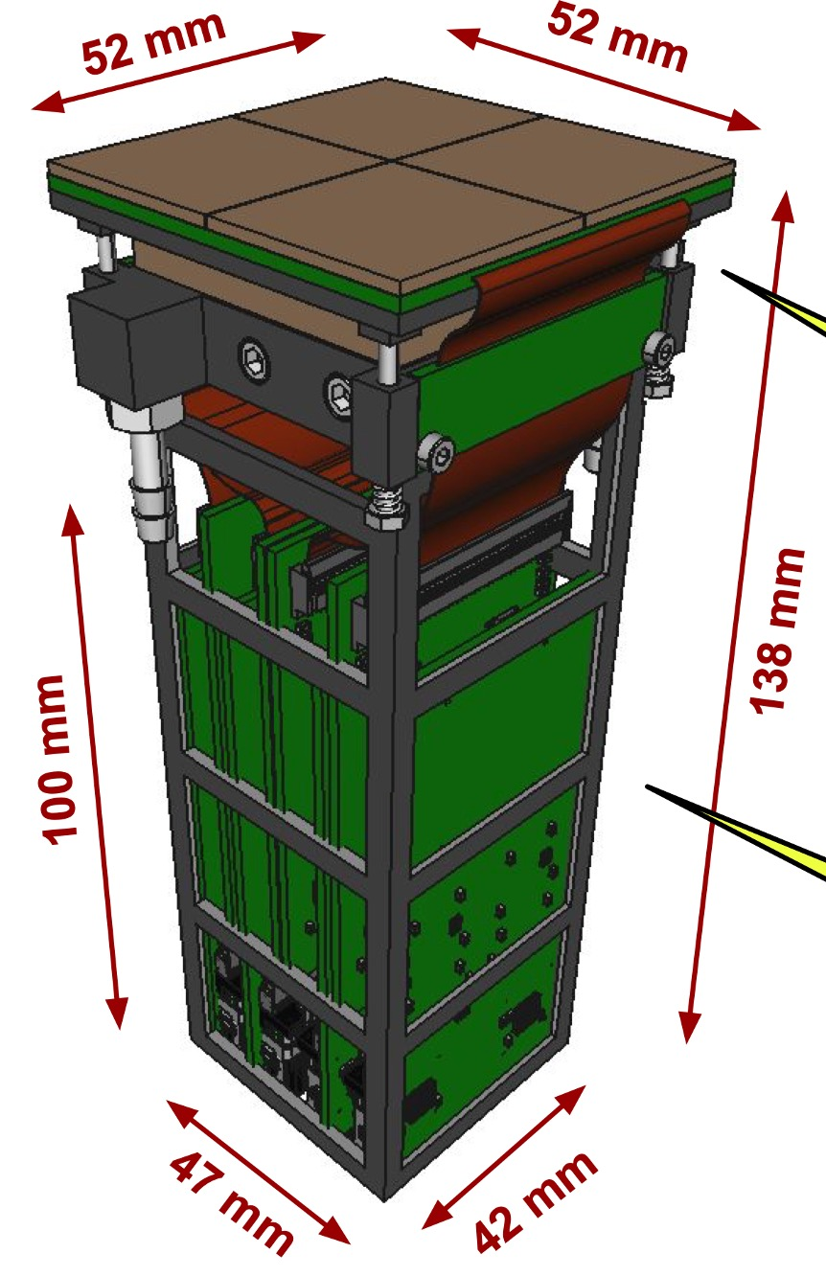
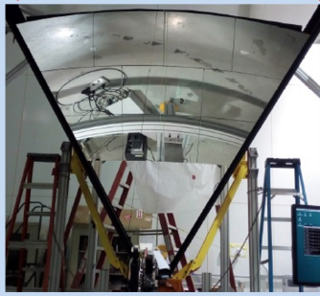
dRICH towards final design
Charge #2,3
Carbon fiber mirror construction
Based on Clas12 experience
roughness driven by mandrel 1-2 nm rms
surface accuracy better than 0.2 mrad
radius reproducibility better than 1 %
Photo sensor module with integrated cooling and annealing:
256 channels/module (4 ASICs)
832 modules/sector
6 sectors
319488 channels overall

Slide 16
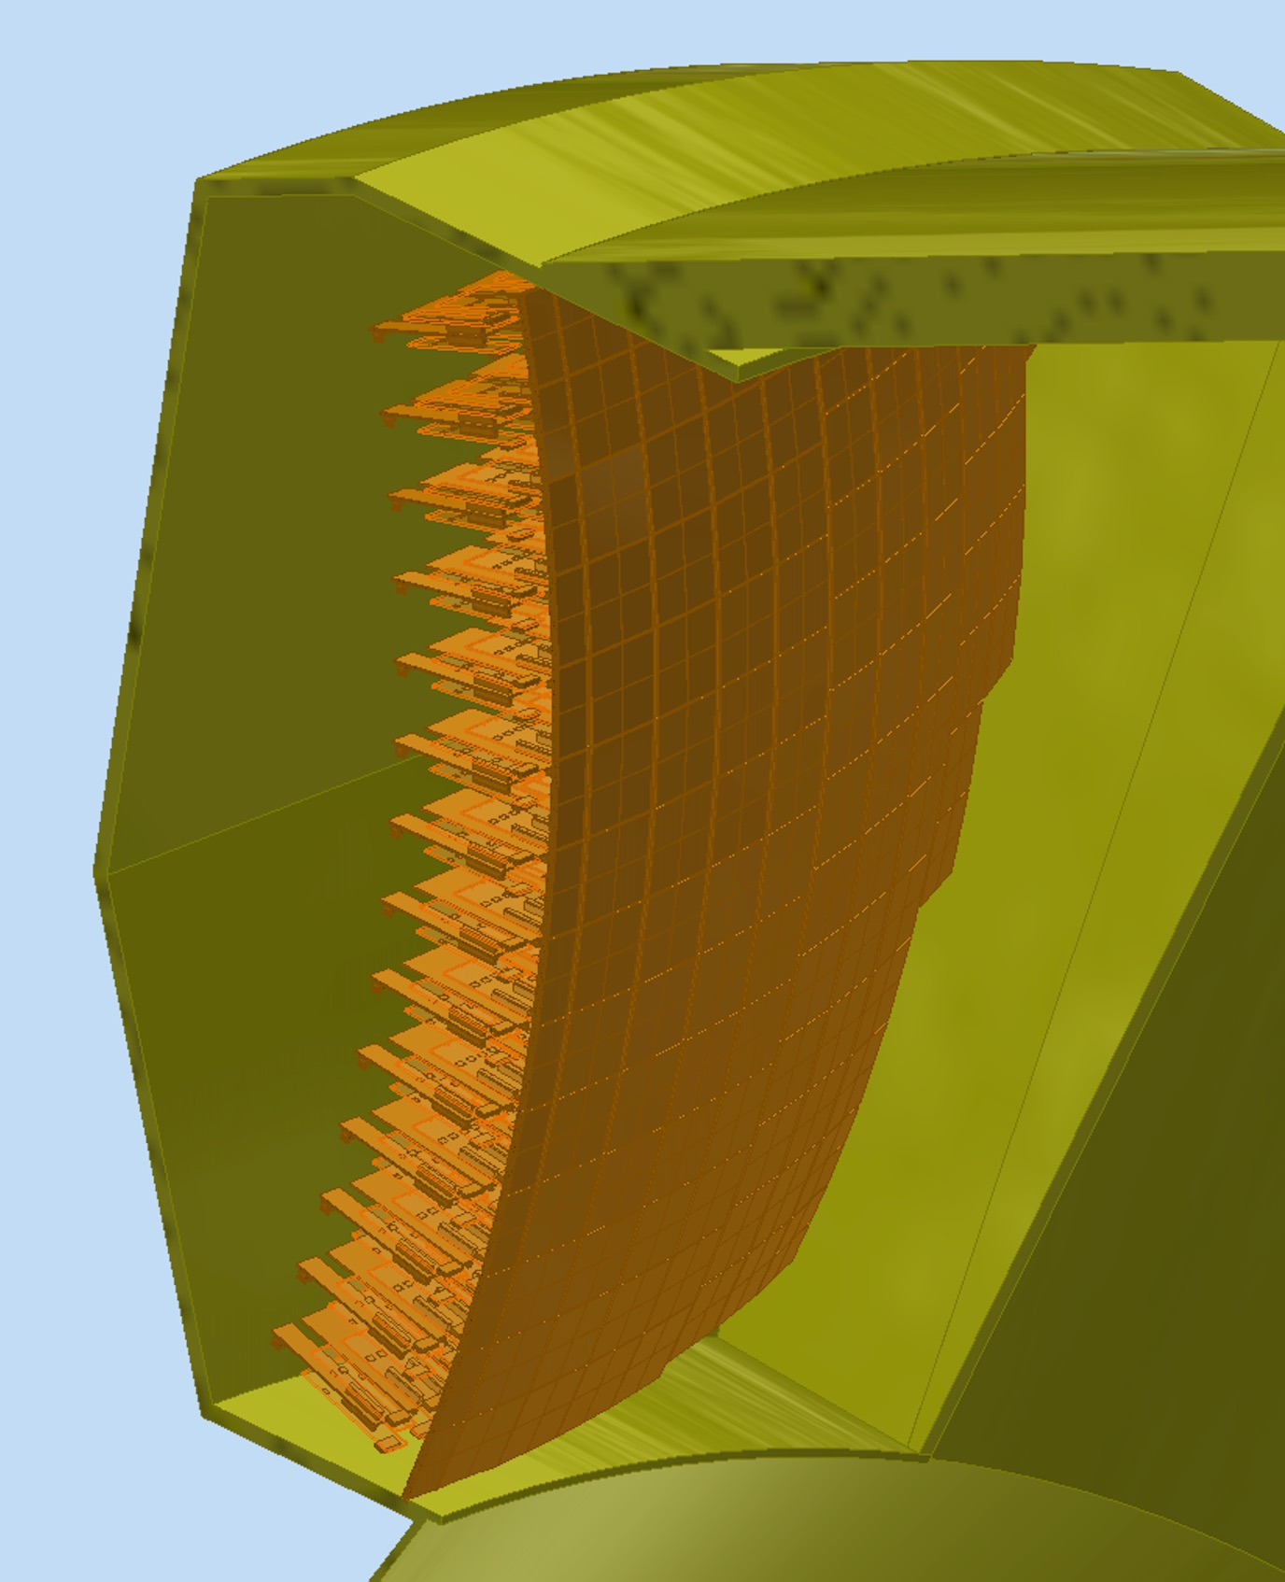
dRICH towards FDR
Charge #2,3,5,6
Focal plane sensor array at -40 deg. C
Separated by window from C2F6 gas
PID Review Recommendation: simulation of SiPM array at various operating temperatures and impact on quartz window and gas radiator
Recovery and recirculation system of C2F6
Mirrors carbon fiber composite
Vessel carbon fiber composite
Aerogel n=1.02
  Samples on order from Chiba Japan
  Synergy with pfRICH, Q&A at Temple and Ferrara
  First engineering samples expected in November

Slide 17
Charge #2,3,5,6
dRICH time lines
FDR Nov. 2024
Construction start June 25
Detector Complete early 2030
Detector Installation fall 2030

Slide 18
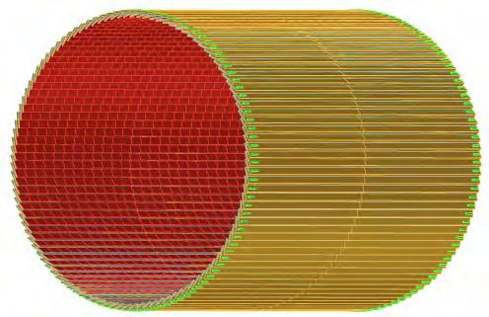
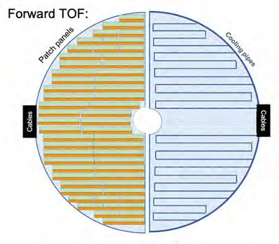
TOF Detector Barrel and forward endcap
Charge #2
Requirements:
3σ π/K/p separation up to 1.3 GeV/c
Rapidity coverage: -1.5 < η < 1.5
Track path length needed
AC-LGAD strips 0.5mm x 10mm
4kW cooling
Requirements:
3σ π/K/p separation up to 2.4 GeV/c
Rapidity coverage: 1.5 < η < 3.5
Track path length needed
AC-LGAD pixels 0.5mm x 0.5mm
13kW cooling

Slide 19
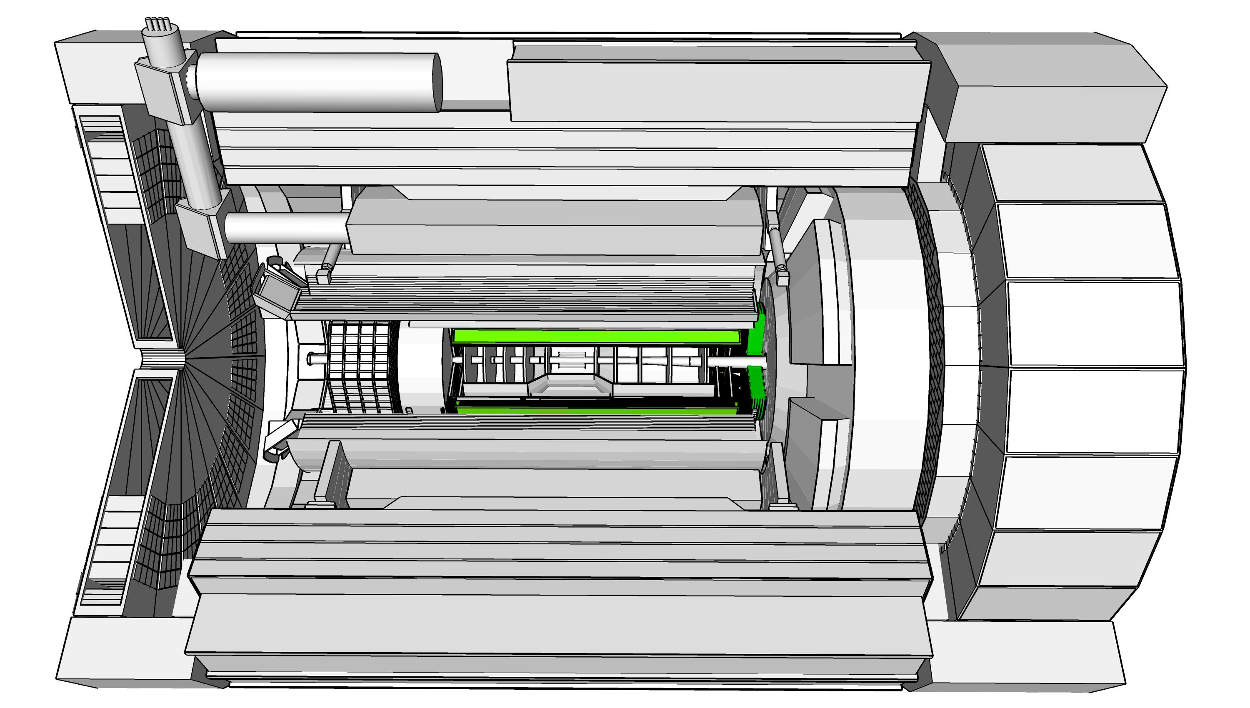
TOF technology
Charge #2
AC-LGAD Sensors (similar to CMS endcap timing layer)
Barrel: Strip Sensor 3.2 x 4 cm^2 (2 ASICs)
  1 module with 64 strip sensors (16384 channels)
  144 modules: overall 2359296 channels
Endcap: Pixel Sensor 1024 channels
  1 board 25 sensors (24576 channels)
  212 boards: overall 5210112 channels
Significant cooling requirements
  Barrel 4kW
  Endcap: 13kW
Carbon fiber support structure with integrated cooling
  Design evaluations ongoing
  ¼ barrel demonstration prototype
  Stave carbon fiber structure to support sensors
  FEA of structure and cooling system planed

Slide 20
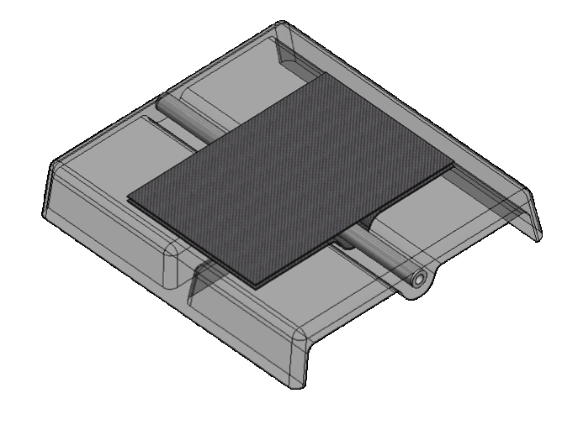
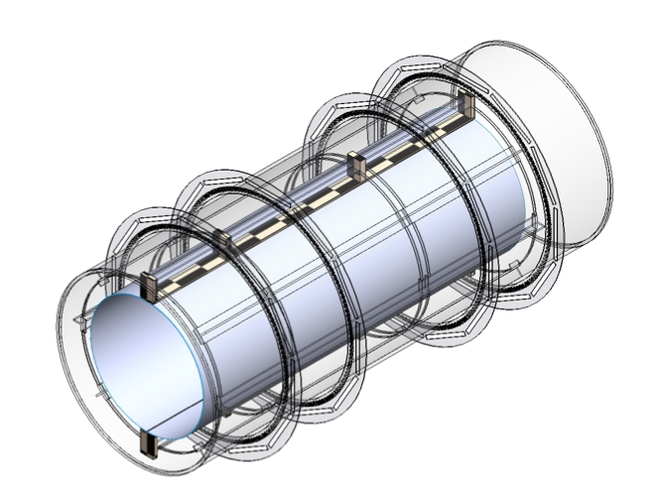
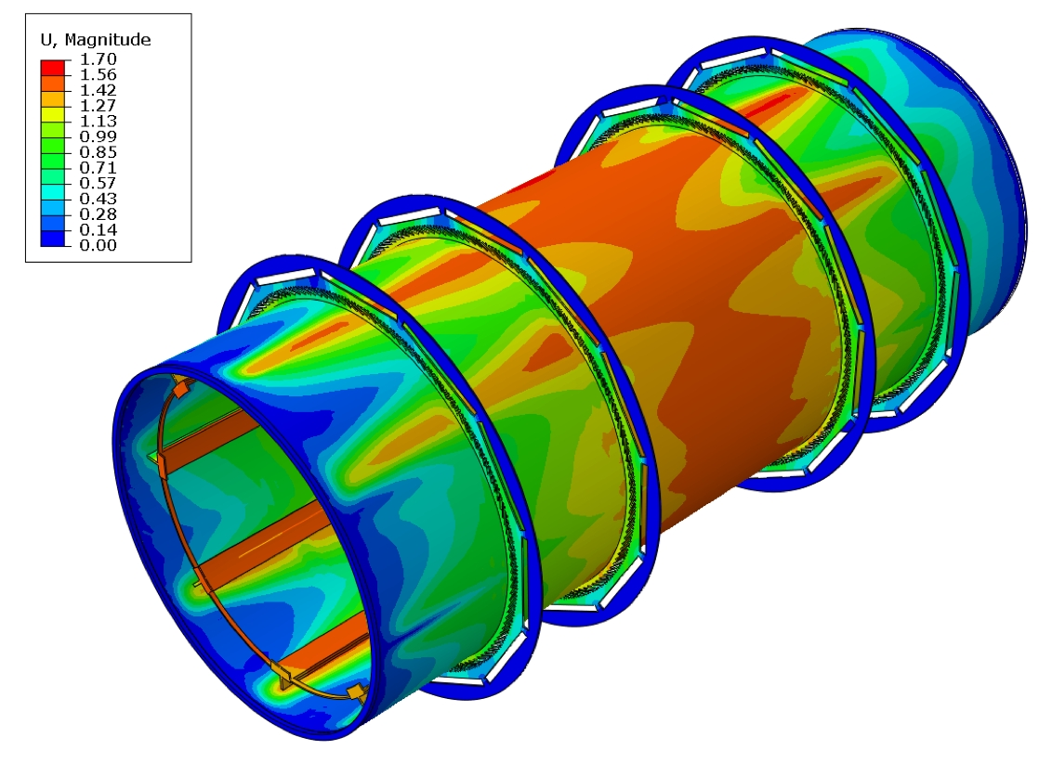
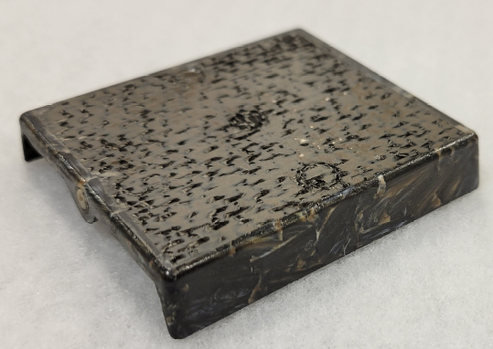
TOF stave and support structure
Charge #2
Stave and support structure based on carbon fiber composite with integrated cooling
Build upon experience from eRD112
Detector engineering design evaluation under way: (Purdue, NCKU)
Construction of ¼ barrel full length (carbon fiber composite)
Evaluate the integration of cooling into the structure
End-cap low mass support structure engineering test
FEA of the support structure and tolerances
Thermal property studies and analysis of barrel and endcap

Slide 21
Charge #2,3,5,6
TOF time lines
FDR Nov. 2024
Sensor & ASIC preproduction
2025/2026
Module Production and Assembly 2027/2028
Construction complete 2029
Ready for Installation 2030

Slide 22
Conclusion
Given the detector progress over the last two years and the status of the ePIC detector, are the projected timelines of the Electron-Ion Collider detector feasible? Do there remain significant open detector technology questions?
  The technology questions for all PID detectors are addressed and understood .
Are the requirements for the detector and their flow down sufficiently comprehensive for this stage of the project to complete the design of the various detector technologies?
  The design requirements and geometry constraints for all PID detectors are defined and tracked by EIC System Engineering.
Are the interfaces between the elements of the design adequately defined for this stage of the project and to proceed with the detector long-lead procurement items?
  The interfaces for all PID are defined and tracked by EIC System Engineering.
Is the design of these long-lead procurement items sufficiently advanced and mature to start procurement in 2024? Are the technical specifications complete?
  The dRICH detector system is the only PID detector with a LLP item, the SiPMs. The specifications for these devices are understood and defined and manufacturer is identified.
Is the projected design maturity of the further detector components likely to be accomplished by the end of 2024 for CD-2 and CD-3?
  All technical aspects of the design of the PID detectors are identified and understood.
Is the overall schedule for completion of the design, production, and installation of detector components realistic?
  The construction schedule for all PID detector systems has ample time between construction complete and installation.

