Slide 1
Background and Detector Impact
Elke-Caroline Aschenauer (BNL)
Co-Associate Director for the
EIC Experimental Program
EIC Detector Comprehensive
Design Review
August 29-30, 2023

Slide 2
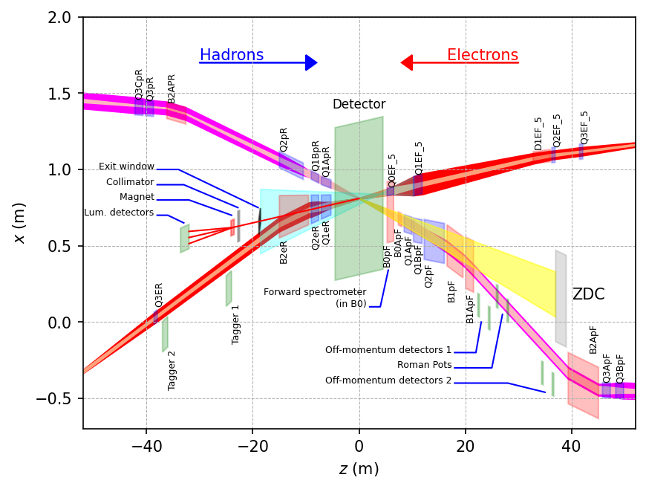
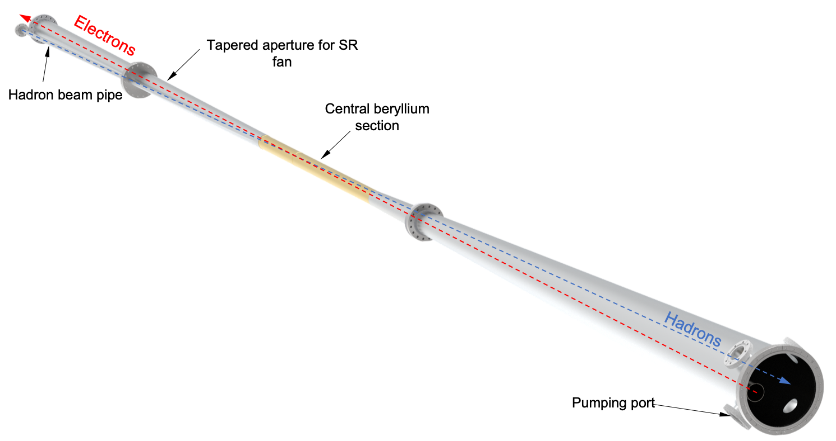
Beam Background / Radiation at IR
The HERA and KEK experience show that having backgrounds well understood, is crucial for the EIC collider and detector performance
There are several background/radiation sources :
primary collisions
beam-gas induced
synchrotron radiation
Note:
different to HERA and KEK the length of beam pipe the both beam share, is thanks to the crossing angle minimized
GEANT4
Ring Inside
Ring Outside

Slide 3
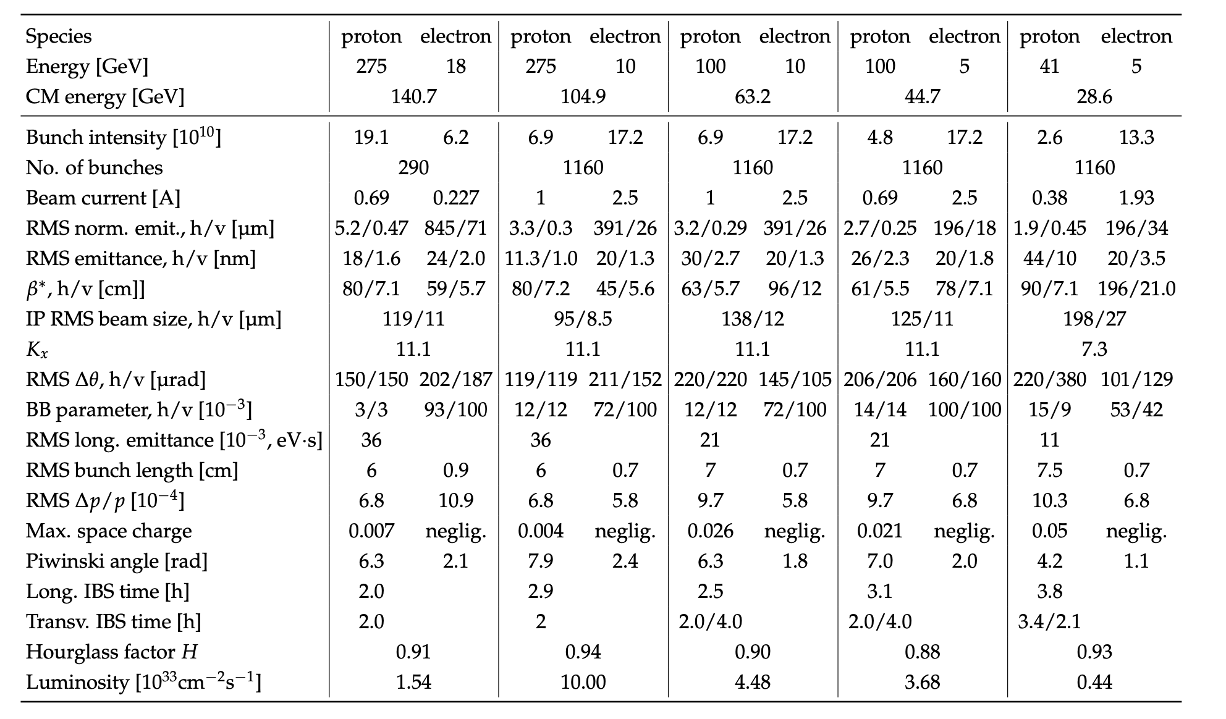
EIC Beam Parameters
electron beam current and energy impact electron beam gas background and synchrotron radiation
→ Radiated SR power: P(kW)=88.46 E_{B}(GeV)⁴ / r(m)² I (A)
hadron beam current impacts hadron beam gas
beam energies and luminosity impact the radiation and neutron fluence

Slide 4
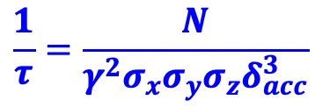
Beam Background / Radiation at IR
Both beams
Touschek scattering is related to intra-beam scattering, leads to particle loss, and hence a reduction in the beam lifetime → simulated by accelerator colleagues → design of momentum collimators
Touschek: Single-scattering IBS, so to speak. Transfer of transverse momentum, from the transverse focusing, into the
longitudinal direction when two electrons scatter off each other. The resulting longitudinal momentum exceeds the bucket height.
Touschek lifetime: from EIC-CDR is 5.27 h @ 10 GeV
and such not a major concern for EIC
$$\frac{1}{τ}=\frac{N}{γ^{2}σ_{x}σ_{y}σ_{z}δ_{acc}^{3}}$$
GEANT4

Slide 5
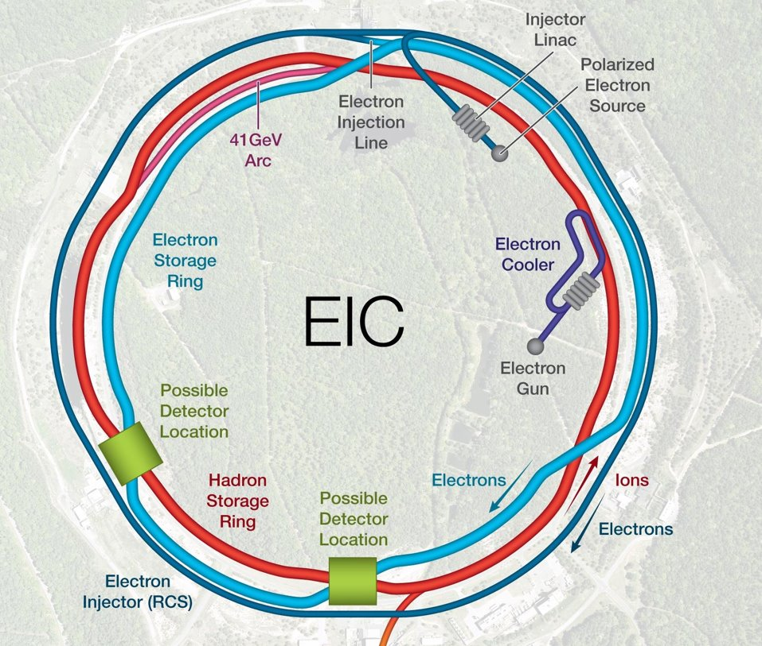
Beam Background / Radiation at IR
Electron beam:
Higher order mode losses
Local heating at injection and ramp (short bunches)
degradation of vacuum
not relevant for EIC as we inject on energy and keep impedance low in the IR
background due to de-excitation of beam if bunches are replaced
Note: 1 electron bunches are replaced per 1 s
There should be “no” background for the experiment as the idea is to shave off the electron tails beyond 6 σ in the transfer line.
Electrons are injected on orbit and on energy (with reasonable errors) in one sigma, this is also required to not impact the proton beam performance
Injection is at IP-12
a 6 σ electron beam would always be well within the aperture limits of of 13.5/23 σ.
GEANT4

Slide 6
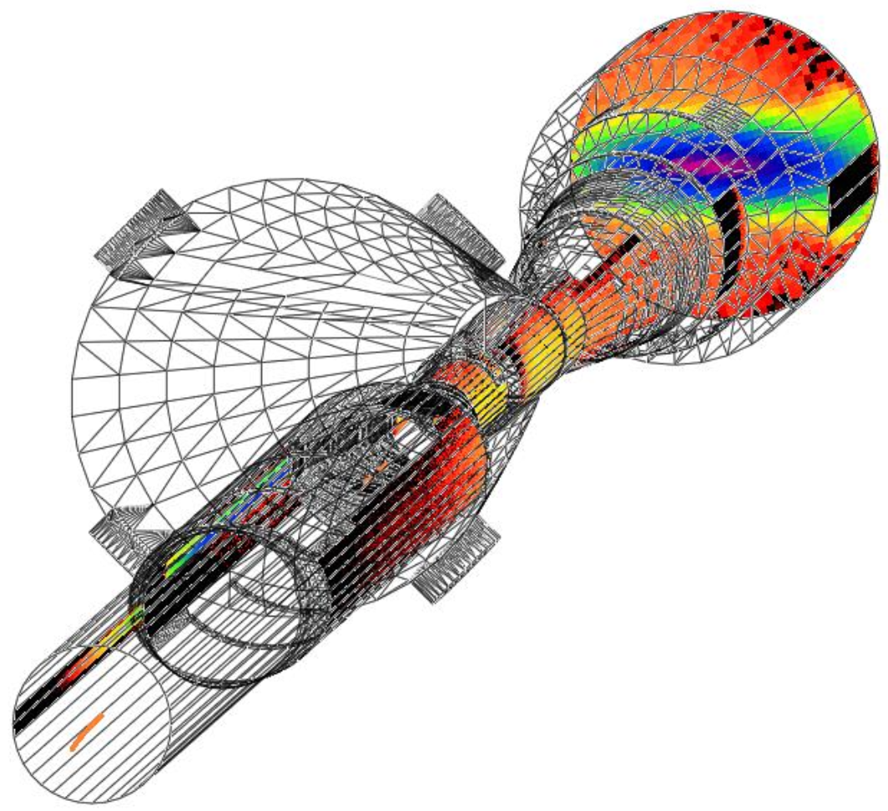
Beam Background / Radiation at IR
Electron beam:
Synchrotron radiation
extensive simulations by of SR by accelerator background WG group
SynRad+ modeling software
Input:
3D model of beampipe
Beam emittance, current Magnet locations and fields
bunch geometry – core and tails
Output:
Synchrotron Radiation – Position, Flux, Energy, Direction
Synchrotron Radiation Mitigation:
Photon absorber configuration:
Horizontal plane only
Annular configuration
Length, diameter, position
Beamline dimensions:
Wider beam pipe for
13.5 σ clearance in x
23 σ clearance in y
Beampipe material/structure
2-5 μm Au coding
Sawtooth/ridge texture for photon absorption

Slide 7
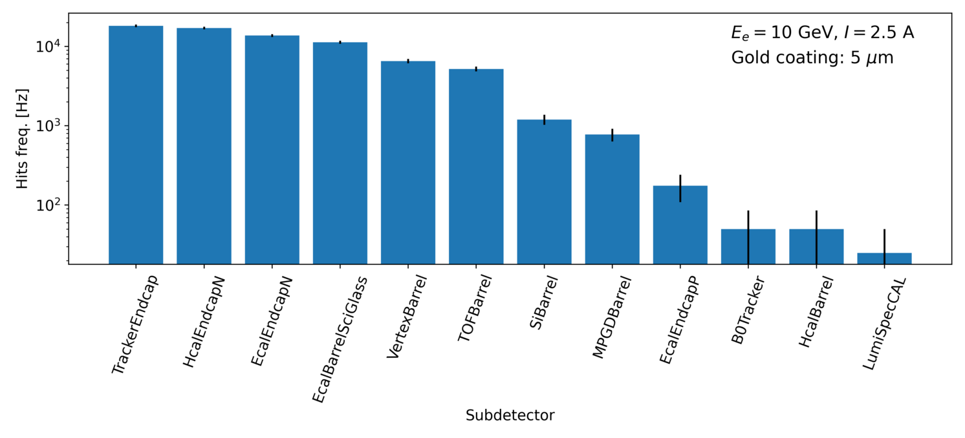
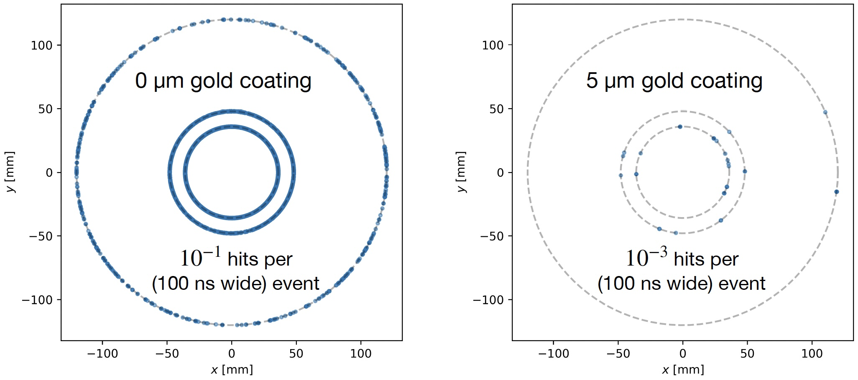
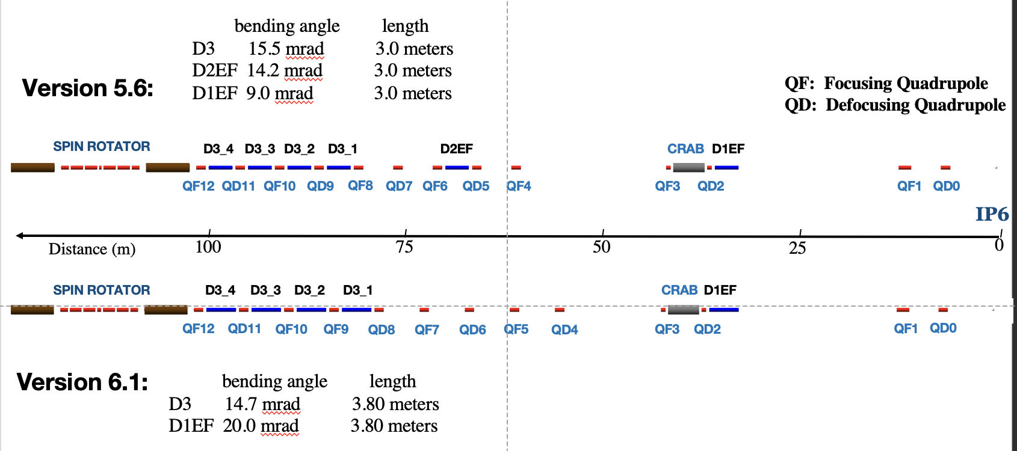
Synchrotron Radiation Results
Rates in different subdetectors:
Effect of gold coating on SR
→ Example μvertex MAPS layers
Need to repeat all synchrotron radiation studies due to recent lattice change

Slide 8
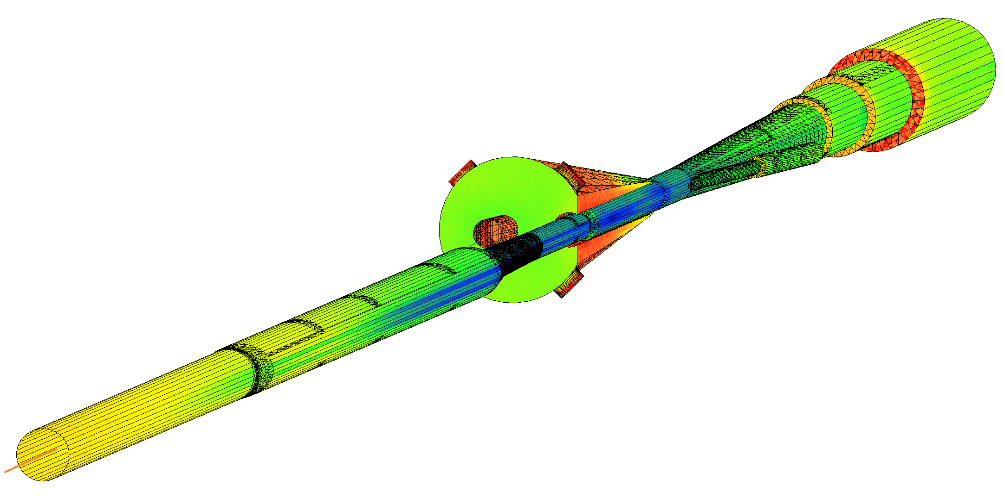
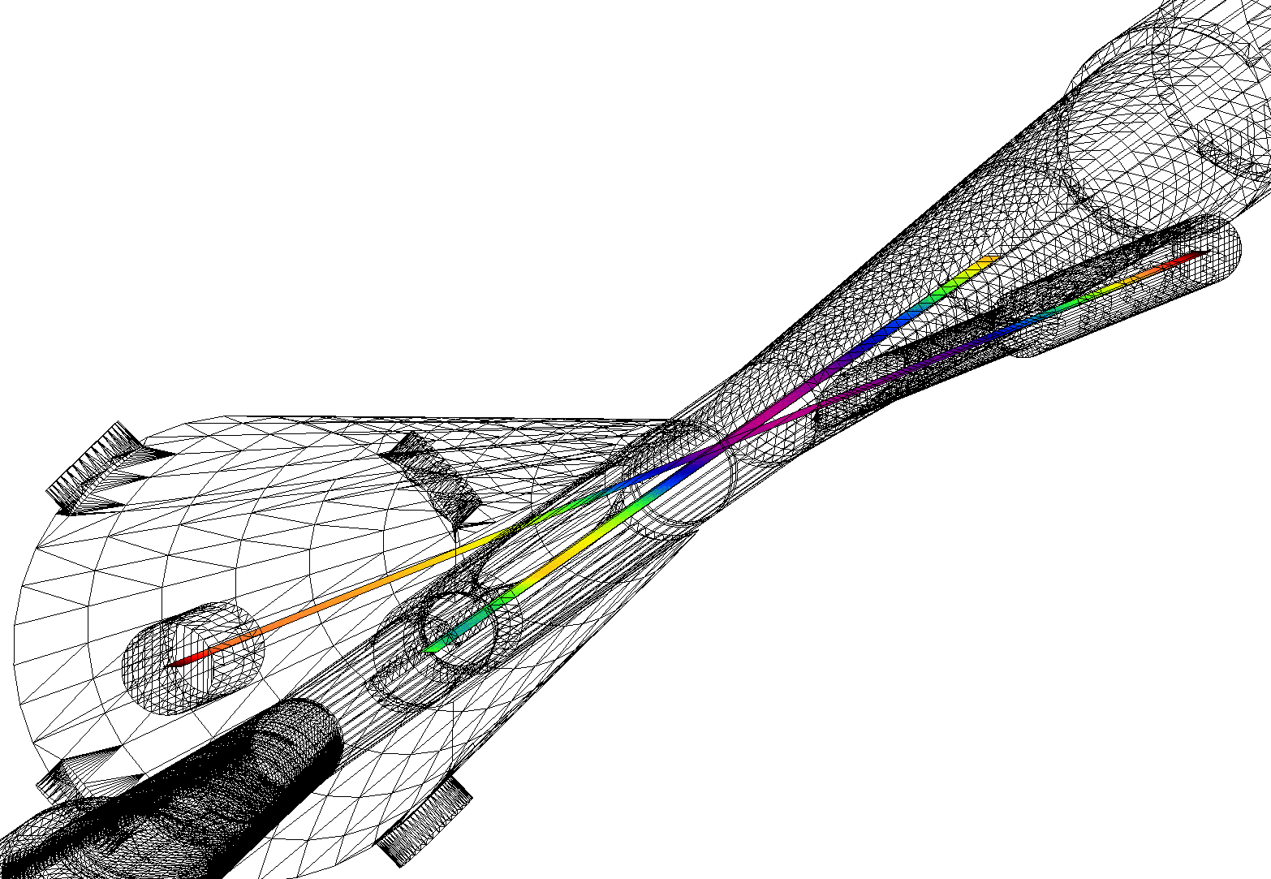
SynRad+/Molflow+ Coupled Simulations
Pump ports
Geometry imported from SynRad+ to Molflow+
Photon flux density on surfaces
Convert to desorption
Pressure profile along beamlines
Applied as surface outgassing
SR no impact on vacuum of far-forward beam pipe → ZDC, RP, ….

Slide 9
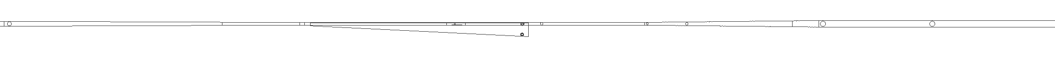
Pressure Profile Inside Forward Cryostat
eR IP1
FPA
eF IP1
eF IP2
eF IP3
eF IP4
eF IP5
Detector
Q0eF
Q1eF
10GeV, 2.5A
e-beam
100 Ahr, no pumps in cryostat
+5/-15m Avg: 1.5e-7
+4.5/-5m Avg: 3.5e-8
10,000 Ahr, no pumps in cryostat
+5/-15m Avg: 1.3e-8
+4.5/-5m Avg: 3.3e-9
10,000 Ahr, all pumps
+5/-15m Avg: 3.0e-9
+4.5/-5m Avg: 2.7e-9
IP
Note all simulations use blue curve:
10000 Ah correspond to 5month @ 10³⁴ cm²s⁻¹
→ beam pipe bake-out absolutely critical to keep a good vacuum

Slide 10
Beam Gas Background
Electron beam:
Beam gas interactions
generation of non-gaussian tails → accounted in accelerator simulations
Off momentum electrons → will be shielded by collimators → simulations of collimation system underway
Big contribution for detector background
Bethe-Heitler process: e_{Beam} + H²_{restgas} → e’ + γ + H²_{restgas}
Kinematics: fixed target → particles boosted towards outgoing electron direction
Generate real tracks not random hit pattern like SR
Mitigation: excellent vacuum
Proton beam:
Low beam lifetime during injection and ramping → collimator setup → simulation by accelerator colleagues, but ample experience for 21 y of RHIC running
Beam gas interactions
concern: large hadronic cross section p/A + H²_{restgas}
Secondary interactions with aperture limitations, i.e. magnets, beam pipe, masks
Beam-gas interactions are also a source of neutrons that thermalize within the detector hall and can cause damage → need still to model it
Kinematics: fixed target → particles boosted towards outgoing hadron direction
Generate real tracks not random hit pattern like SR
Mitigation: excellent vacuum
GEANT4

Slide 11
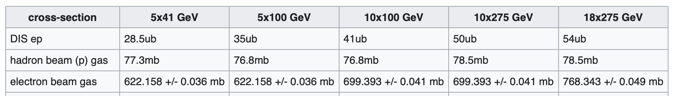
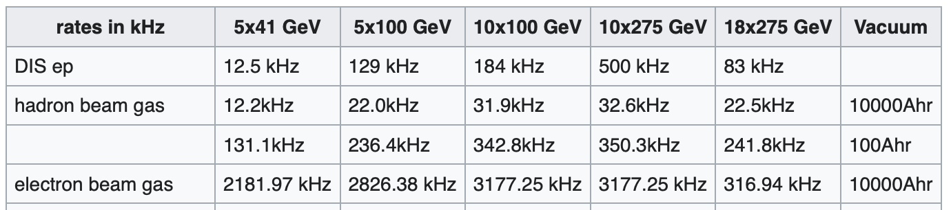
Cross Section and Rate Comparisons
Different to hadron-hadron colliders beam related background cross-sections are larger than signal cross-section
Remember:
electron beam current and energy impact electron beam gas background and synchrotron radiation
hadron beam current impacts hadron beam gas

Slide 12
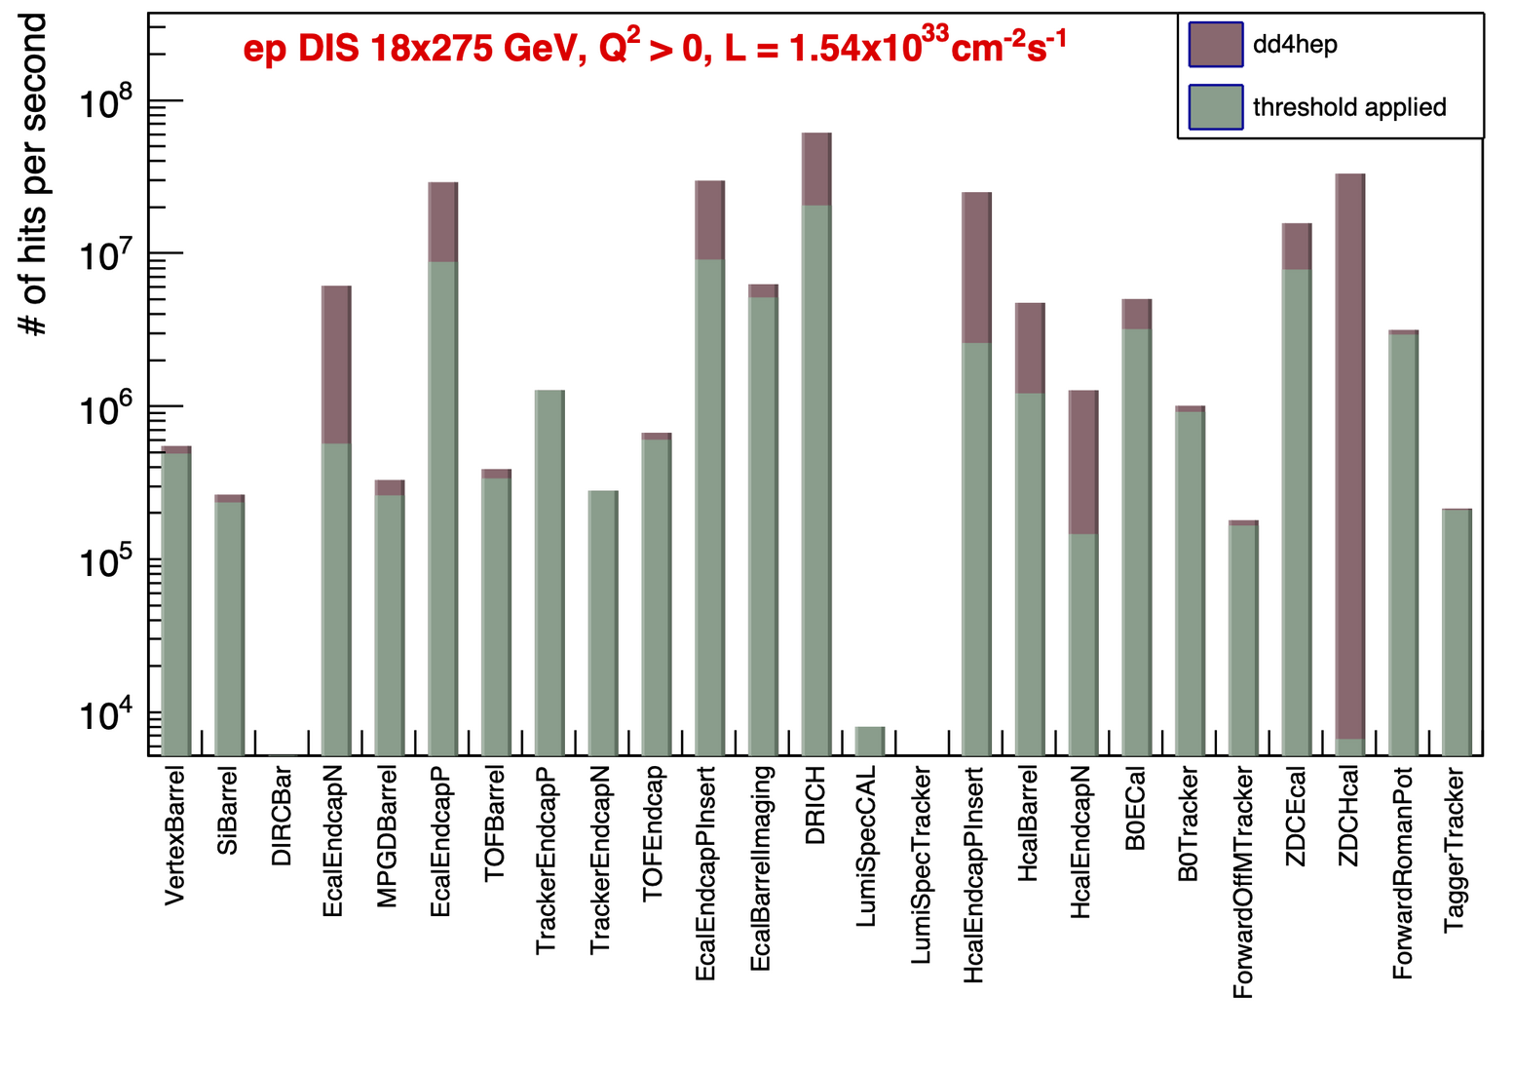
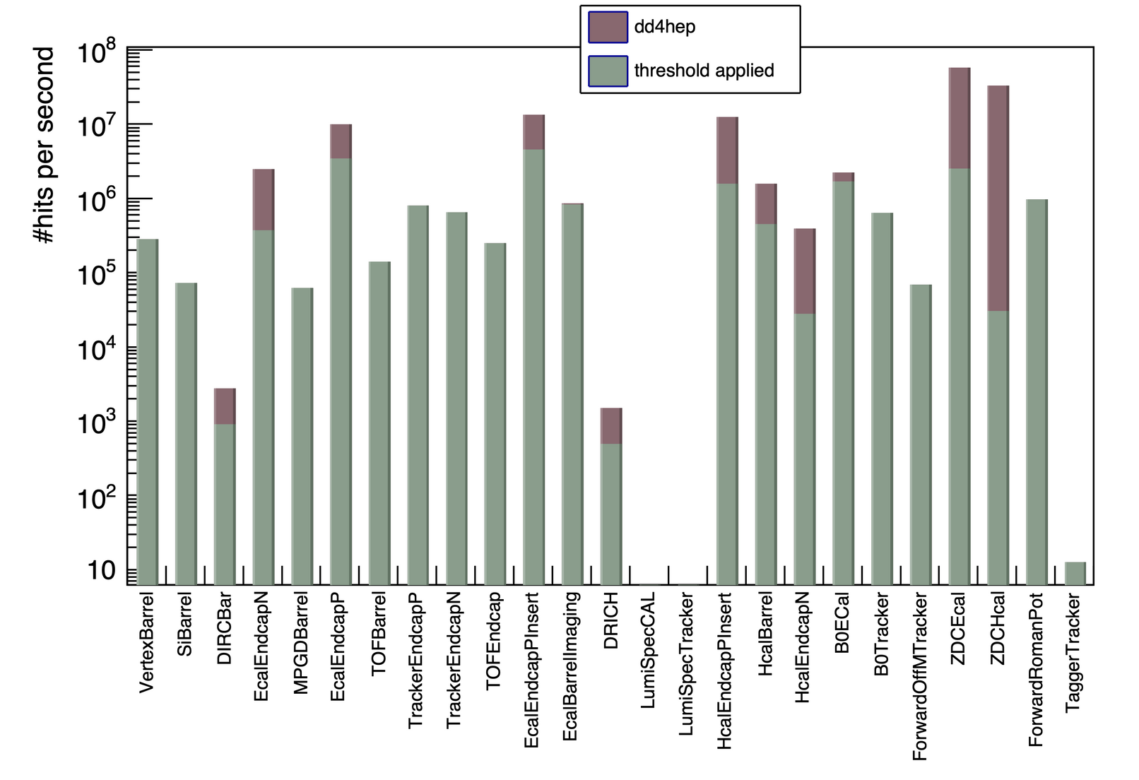
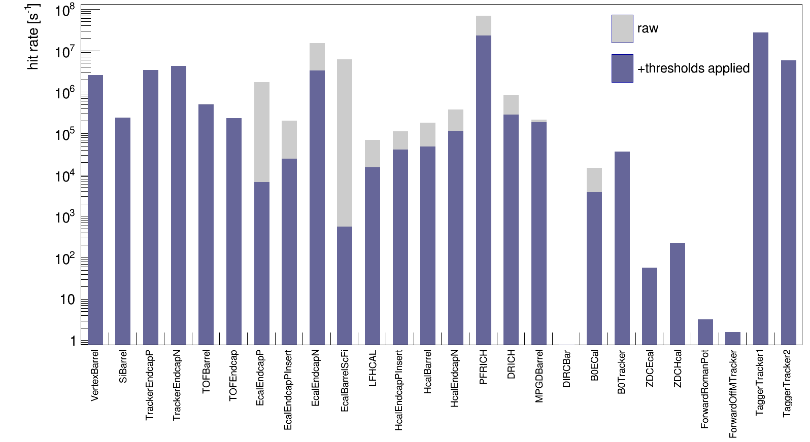
DIS and Beam Gas Background Rates
Hadron Beam Gas
protons: 275 GeV
vacuum after 10000 Ah
Electron Beam Gas
10 GeV
vacuum after 10000 Ah

Slide 13
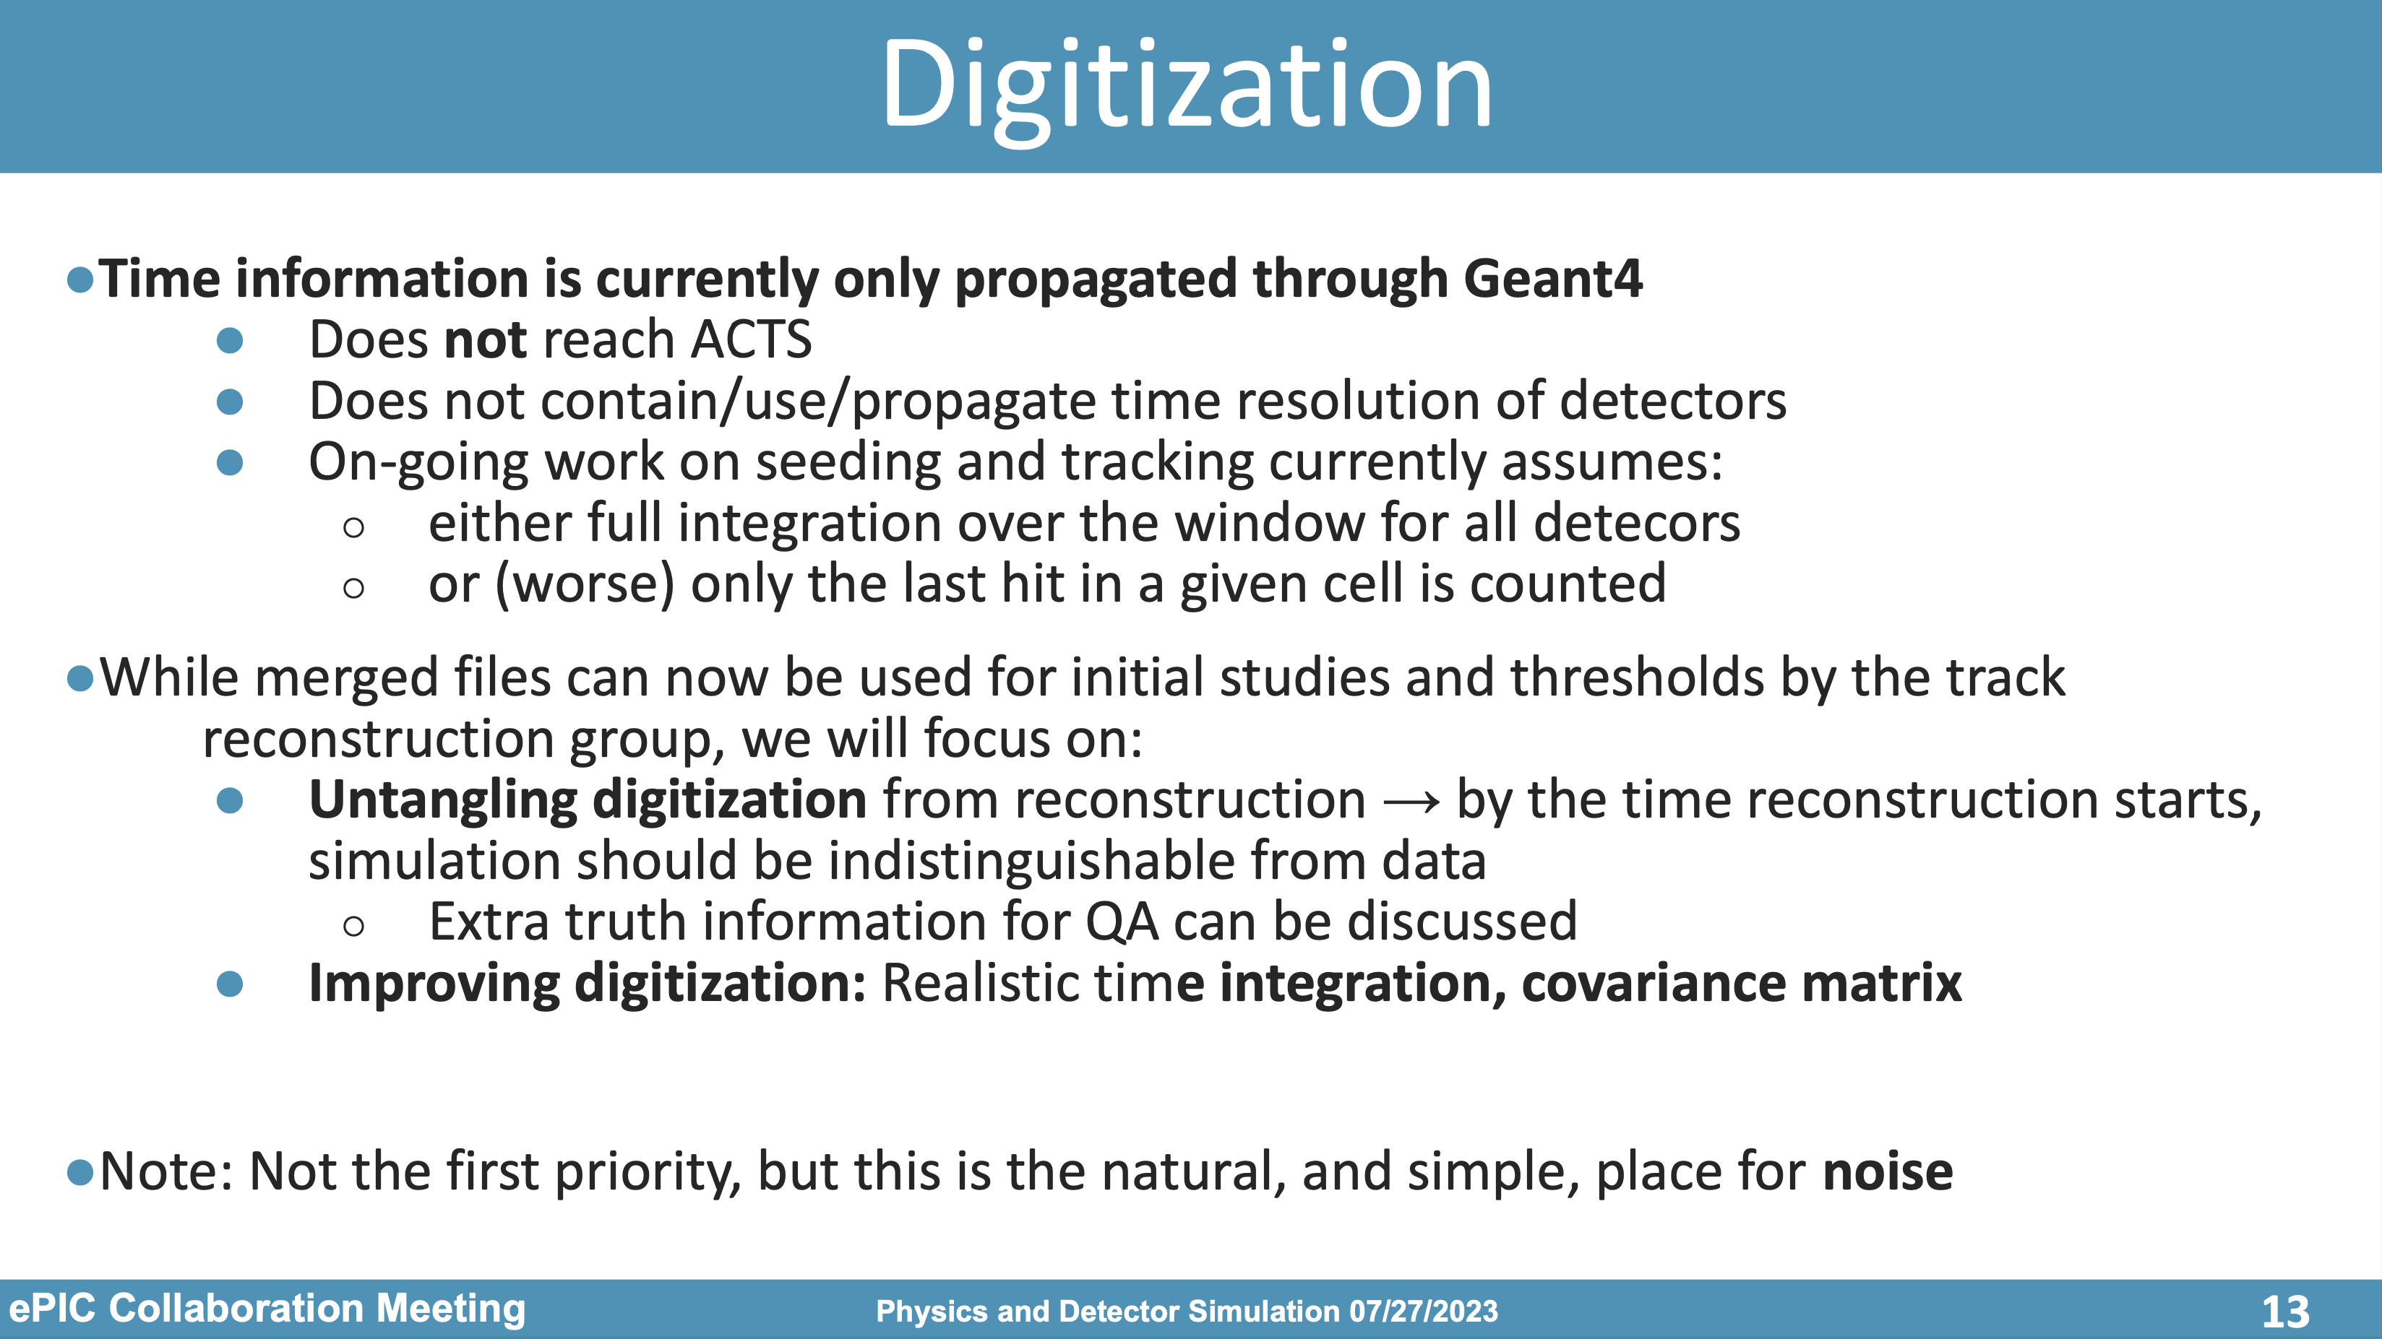
Impact of Beam Background on Detector Performance
Goal: Embedding of beam background events in DIS signal event in MC simulations
Merge with a given signal (DIS, particle gun):
Select a time slice width, e.g. 2μs for MAPS integration time
Place signal event(s) at random point(s) in the slice
Select how many background events to add from Poisson distribution
Draw random events, or SR photons from weighted distribution
Place at uniformly random times

Slide 14
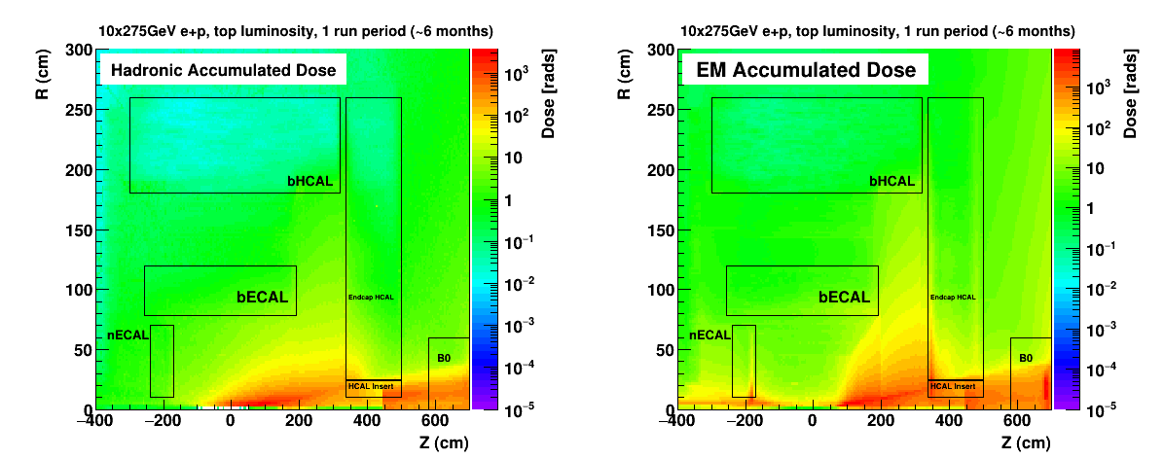
Radiation at IR
Primary collisions contribute a substantial fraction of the ionizing radiation and low energy neutron fluence in the experimental hall
Simulations use Pythia-6 well tuned to HERMES, COMPASS and HERA
rates: “min-bias” DIS data → Q²> 10⁻⁹ GeV²
Validation: Yuri Fisyak et al. NIM A 756 (2014) 68-72, arXiv:1310.2495
Study dependence on physics-list in GEANT-4 → especially for low energy neutrons

Slide 15
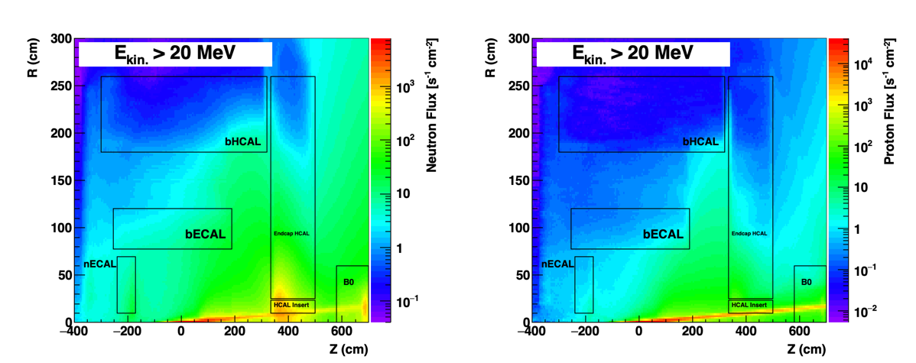
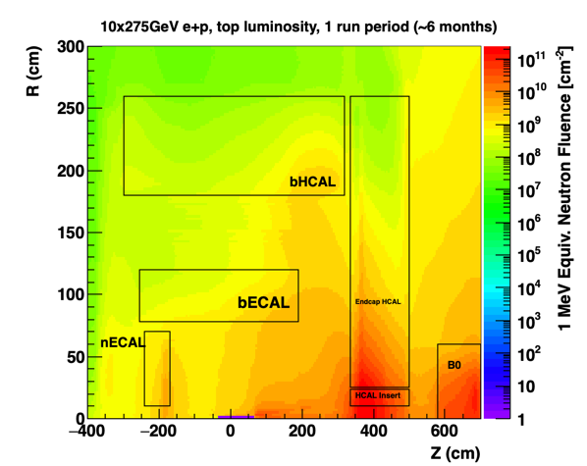
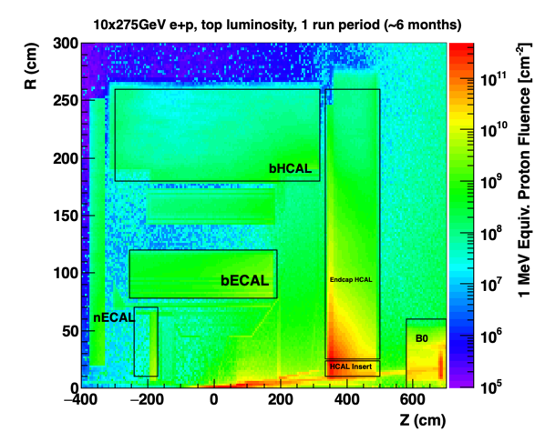
Proton and Neutron Radiation

Slide 16
Summary and Outlook
All background sources are understood and simulated
well documented on the wiki: https://wiki.bnl.gov/EPIC/index.php?title=Background
good vacuum is critical to keep beam gas related backgrounds under control
Impact of SR and beam gas events on detector performance understudy
embedding of beam backgrounds in DIS events under way
Next studies
ion beam gas events
update SR studies with new electron lattice
study beam gas event contribution to radiation and neutron fluence

Slide 17


Slide 18
Lessons from HERA II upgrade
HERA performed an upgrade to increase luminosity by a factor of 5
Mainly by squeezing the beam more at the IP by redesign of the IR
The upgrade increased backgrounds dramatically → Several month shutdown to implement improvements
Main culprits:
no careful simulations prior to the upgrade
Proton beam-gas interactions most severe background
Needed an extremely good vacuum to mitigate this
Synchrotron radiation background
Background to detectors
Excess heating of beam pipe
Can damage flanges, etc.
Can heat beam pipe, decreasing vacuum
Electron beam-gas

Slide 19
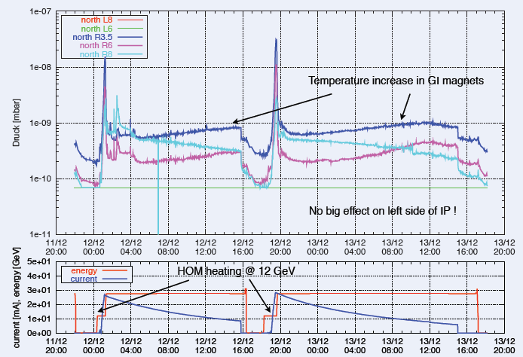
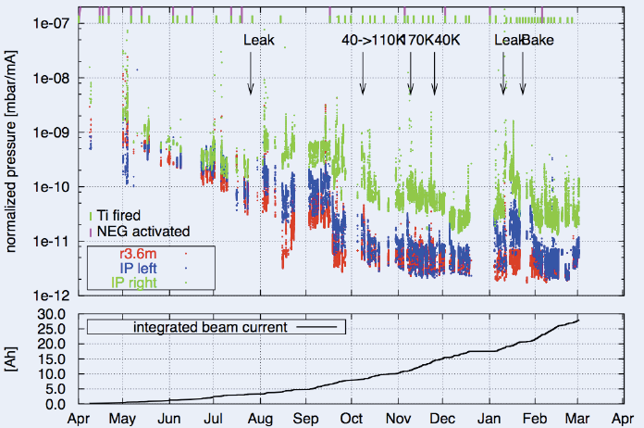
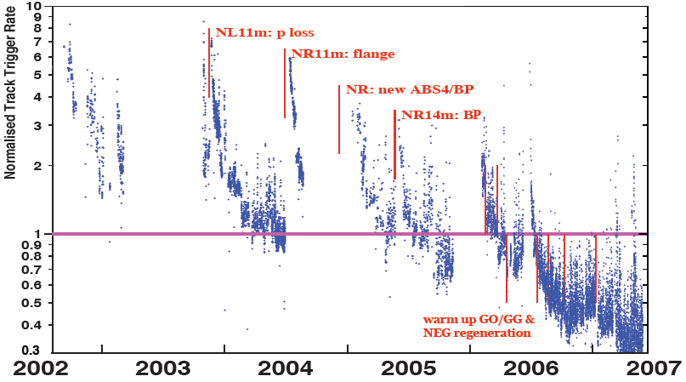
Lessons from HERA II upgrade
Dynamic pressure increase due
to thermal and photo desorption
Pressure vs. integrated electron
current 2002 - 03
Proton Beam Gas Background
Two time constants for vacuum
conditioning
Short term after leaks 20 – 30 days
Long term 600 days

