Slide 1
WBS 6.10.14 Polarimetry
Oleg Eyser (BNL) / Dave Gaskell(JLab)
EIC Detector Comprehensive Detector Design Review
August 29-30, 2023

Slide 2
Requirements
#2 requirements
Charge questions:
Given the detector progress over the last two years and the status of the ePIC detector, are the projected timelines of the Electron-Ion Collider detector feasible? Do there remain significant open detector technology questions?
Are the requirements for the detector and their flow down sufficiently comprehensive for this stage of the project to complete the design of the various detector technologies?
Are the interfaces between the elements of the design adequately defined for this stage of the project and to proceed with the detector long-lead procurement items?
Is the design of these long-lead procurement items sufficiently advanced and mature to start procurement in 2024? Are the technical specifications complete?
Is the projected design maturity of the further detector components likely to be accomplished by the end of 2024 for CD-2 and CD-3?
Is the overall schedule for completion of the design, production, and installation of detector components realistic?
Polarized Electron Beams | Polarized Hadron Beams
Highly polarized beams, P≈70%
Fast feedback for machine setup
Excellent measurement of absolute polarization, ΔP/P≈1%
Non-destructive polarimetry
Bunch-by-bunch polarization measurement (fill pattern: P↑,P↓, Δt≈10 ns)
Bunch replacement every few minutes (Sokolov-Ternov ΔP↑≠ΔP↓) | Polarization decay (ΔP≈1-2%/h)
 | Transverse bunch polarization profile
Polarization vector at experiment (transverse, longitudinal)

Slide 3
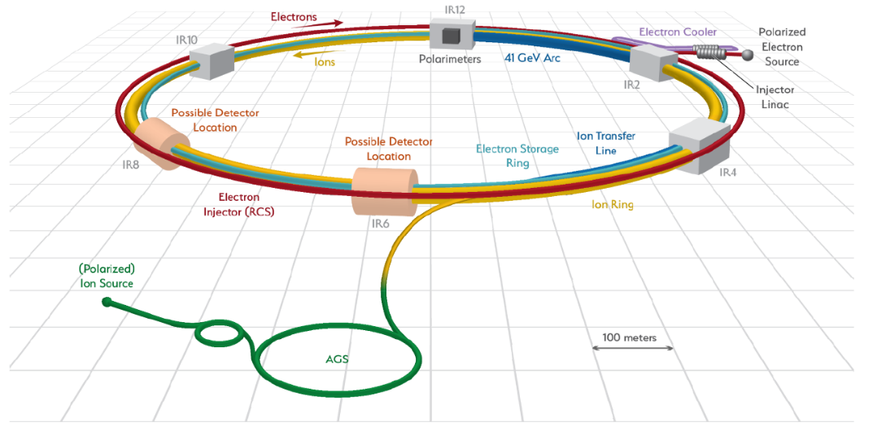
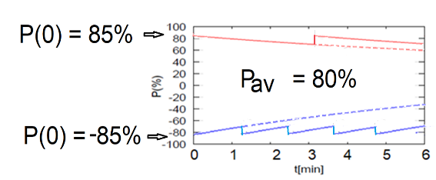

Overview
#2 requirements
#3 interfaces
IR-6 / ePIC
Local polarimetry
Inside spin rotators
Fiber target for hadron polarization orientation
Compton backscattering for electron polarization
IR-4
Hadron polarimetry
HJET for absolute polarization
Fiber target for time dependence and bunch profile
$$10 \text{ns}$$
transverse
longitudinal
Electron bunches are replaced every few seconds.
Hadron bunches are stored for many hours.

Slide 4
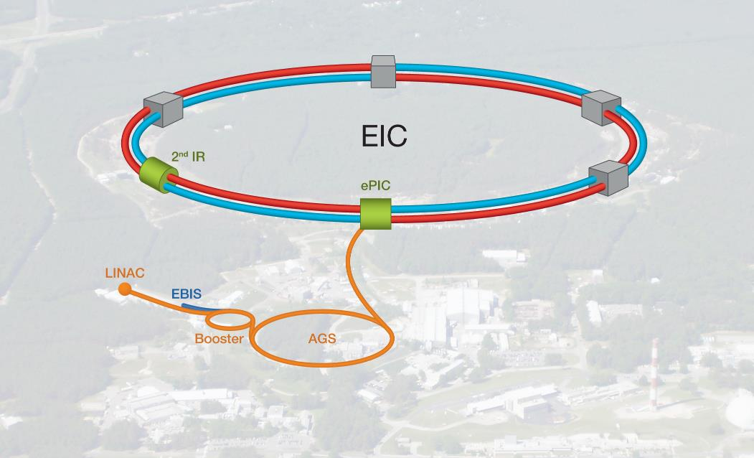
Electron Polarimetry – WBS 6.10.14.01
#2 requirements
#3 interfaces
Electron Storage Ring Compton (ESR)
→ Upstream of IP6, between IP and spin rotating solenoid
Will measure polarization for each bunch
Measure both transverse and longitudinal beam polarization
Detect backscattered photon and scattered electron
Rapid Cycling Synchrotron Compton (RCS)
Primarily for machine setup – less stringent precision requirements
Detect backscattered photons, multi-photon mode
Average over several bunches
Rapid Cycling Synchrotron Compton polarimeter
e-beam
Electron Storage Ring Compton polarimeter

Slide 5
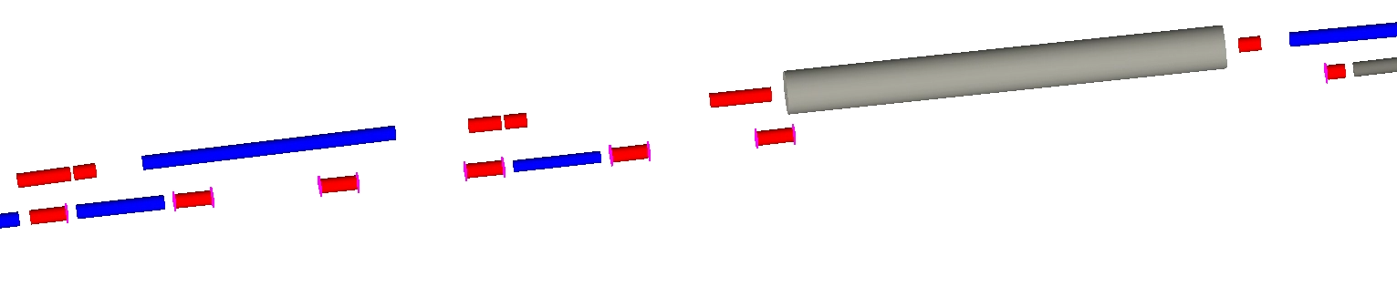
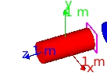
Electron Storage Ring Compton
#2 requirements
#3 interfaces
#5 design maturity
Will operate in “single photon” mode
Crab cavity
Hadron beamline
Q3EF
electron beamline
*
Q5EF
(+12.2 T/m)
Q4EF
(-4.15 T/m)
Q6EF
(-18.6 T/m)
D2EF4
(0.29 T)
Q8EF Xfocusing
Q7EF
D3EF4
Laser IP
72 m upstream of IP-6
Electron detector
9.7 m from Laser IP
Photon detector
29 m from Laser IP
Polarization components at Laser IP
Polarimeter Components:
RF-pulsed laser system (under development)
Position sensitive detectors (diamond strips) for scattered electrons and backscattered photons
Calorimeter for backscattered photons
Beam energy | P_{L} | P_{T}
5 GeV | 96.5% | 26.1%
10 GeV | 86.4% | 50.4%
18 GeV | 58.1% | 81.4%
Sim axes at Q9EF

Slide 6
ESR Compton – Laser System
#2 requirements
#3 interfaces
#5 design maturity
Laser system based on similar system used in JLab injector and LERF
Gain-switched diode seed laser – variable frequency, few to 10 ps pulses @ 1064 nm
→ Variable frequency allows optimal use at different bunch frequencies (100 MHz vs 25 MHz)
Fiber amplifier → average power 10-20 W
Optional: Frequency doubling system (LBO or PPLN)
Insertable in-vacuum mirror for laser polarization setup
Gain-switched seed laser components procured under earlier generic EIC R&D → (Ciprian Gal et al.)
Fiber amplifier ordered → work will restart at JLab in existing Compton polarimetry laser lab

Slide 7
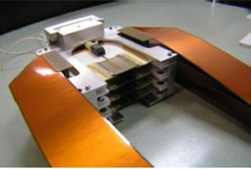
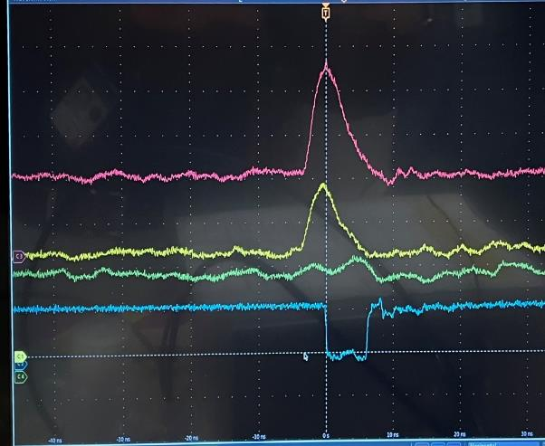
Position Sensitive Detectors
#1 technology questions
#5 design maturity
Position sensitive detectors needed to measure:
Scattered electrons → P_{L}
Backscattered photons → P_{T}
Technology choice – diamond strips → radiation hard, good time response
Diamond used during Q-Weak expt at Jlab → no performance degradation after 10 MRad of exposure
Required detector segmentation = 500 μm (electrons)/100-200 μm (photons)
Detector size = 6 cm (electrons)/ 5 cm (photons)
Custom ASIC required → new “FLAT32” chip based on “CALYPSO” (used at LHC) under development for Jlab/MOLLER
Already meets timing requirements of EIC (10 ns)
JLab Hall C diamond detector
10 ns

Slide 8
Photon Calorimeter
#1 technology questions
On-going value engineering (cost/risk)
Good energy resolution required for longitudinal polarization measurements, but fast time response required for bunch-by-bunch measurements
Tungsten-powder calorimeter (similar to STAR Forward Upgrade) satisfies timing requirements for Compton polarimeters
Scintillating fiber embedded in tungsten powder
Ample experience with such detectors at BNL
Detector size 16 x 16 mm²
Initially, that long time component rules out lead-tungstate
Recent publication suggests time response at room temperature may be acceptable
M. Follin et al 2021 JINST 16 P08040

Slide 9
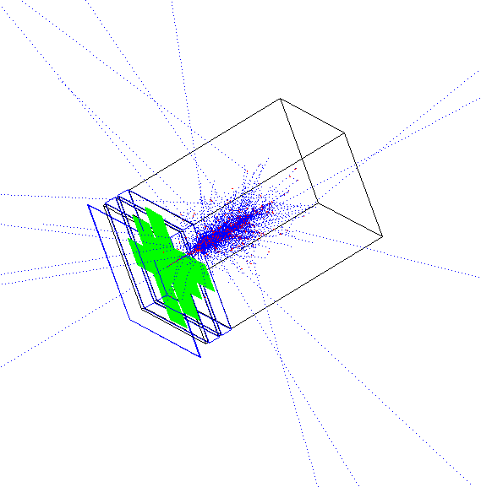
ESR Compton – Detector Simulations
Need high position resolution for backscattered photons for transverse polarization measurement
Best results from longitudinally segmented calorimeter with (x-y) diamond strips
0.5 cm thick PbWO4
20 cm long block
Overall efficiency 60% w/adequate resolution
x and y diamond strips

Slide 10
ESR Compton – Beamline Design and Synchroton Backgrounds
#2 requirements
#3 interfaces
#5 design maturity
Beampipe design for region downstream of laser-electron beam collisions underway
Need photon exit window and room to accommodate scattered electrons and electron detector
Impedance likely an issue – electron detector may need to be outside beam pipe, but this could limit how much of the spectrum we can detect
Synchrotron backgrounds at 18 GeV require 2 cm tungsten shield! → Although polarimeter location has been chosen, need to iterate with machine group to minimize synchrotron backgrounds (dipole bend too large)
Zhengqiao Zhang (BNL)

Slide 11
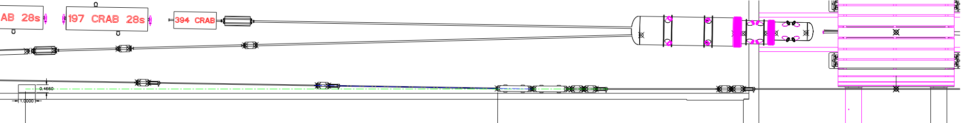
Rapid Cycling Synchrotron Compton
#2 requirements
#3 interfaces
#5 design maturity
RCS properties
RCS accelerates electron bunches from 0.4 GeV to full beam energy (5-18 GeV)
Bunch frequency → 2 Hz
Bunch charge → up to 28 nA
Ramping time = 100 ms
Polarimetry challenges
Analyzing power often depends on beam energy
Low average current
Bunch lifetime is short
Compton polarimeter can also be used for measurement of polarization in RCS
Measurements will be averaged over several bunches – can tag accelerating bunches to get information on bunches at fixed energy
Requires measurement in multiphoton mode (many backscattered photons/electron bunch)
Bijan Bhandari - BNL
Photon detector
Laser IP

Slide 12
Transverse Polarimetry in Multi-Photon mode
#1 technology questions
#2 requirements
#5 design maturity
Highest precision transverse Compton polarimeter operated in single photon mode (HERA)
RCS requires position sensitive measurement in multi-photon mode
Need highly segmented detector sensitive to signal size (not just counts above threshold)
LEP polarimeter operated in this fashion, although with relatively low precision
Simulations will guide the detector technology choice based on requirements for radiation hardness and position resolution
Note: RCS Compton only needed for machine setup

Slide 13
Overview
#2 requirements
#3 interfaces
IR-6 / ePIC
Local polarimetry
Inside spin rotators
Fiber target for hadron polarization orientation
Compton backscattering for electron polarization
IR-4
Hadron polarimetry
HJET for absolute polarization
Fiber target for time dependence and bunch profile
$$10 \text{ns}$$
transverse
longitudinal
Hadron bunches are stored for many hours.

Slide 14
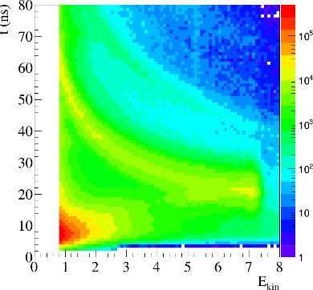
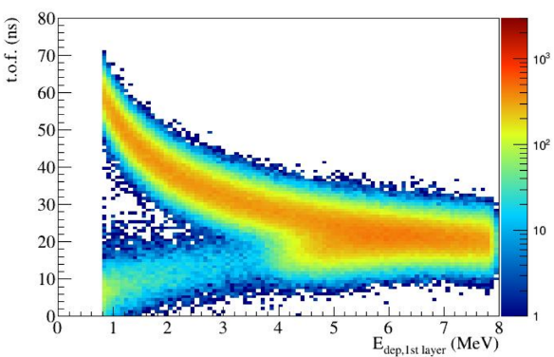
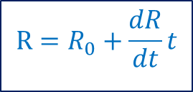
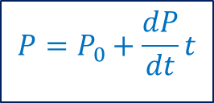
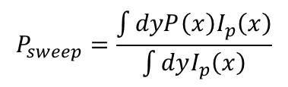
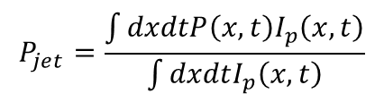
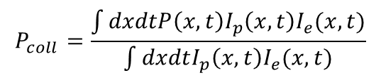
Hadron Polarimetry – WBS 6.10.14.02
#2 requirements
#3 interfaces
Using transverse spin asymmetries from elastic recoil
Based on RHIC experience
Absolute polarimeter: HJET
Fast polarimeter: ultra-thin fiber target
Measure energy, angle, time-of-flight
$$P=P_{0}+\frac{dP}{dt}t$$
$$R=R_{0}+\frac{dR}{dt}t$$
$$P_{coll}=\frac{\int{dxdtP\left(x,t\right)I_{p}\left(x,t\right)I_{e}(x,t)}}{\int{dxdtI_{p}\left(x,t\right)I_{e}(x,t)}}$$
RHIC Data
Simulation (PYTHIA+GEANT4)
$$P_{jet}=\frac{\int{dxdtP\left(x,t\right)I_{p}\left(x,t\right)}}{\int{dxdtI_{p}\left(x,t\right)}}$$
$$P_{sweep}=\frac{\int{dyP\left(x\right)I_{p}\left(x\right)}}{\int{dyI_{p}\left(x\right)}}$$

Slide 15
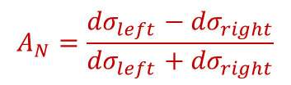
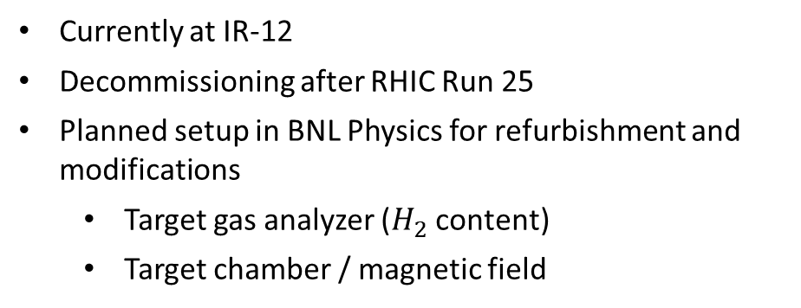
IR-4 Layout
#2 requirements
#3 interfaces
#5 design maturity
Choice of location driven by size of HJET setup and the following drift space
RCS
ESR
Sector 3
Sector 4
HSR Q4
D0 replacement dipole
HSR Triplet
3X HSR 98 MHz
10X Kickers
Hadron Storage Ring
Tagger location & drift space
HJET
Carbon polarimeter
Currently at IR-12
Decommissioning after RHIC Run 25
Planned setup in BNL Physics for refurbishment and modifications
Target gas analyzer ($H_{2}$ content)
Target chamber / magnetic field
Phys. Rev. Lett. 123, 162001 (2019)
$$A_{N}=\frac{{dσ}_{left}−{dσ}_{right}}{{dσ}_{left}+{dσ}_{right}}$$

Slide 16
Local Polarimeter at IR-6
#2 requirements
#3 interfaces
#5 design maturity
Spin rotators for longitudinal polarization
Crab cavities for increased luminosity in collision
Limited space in hall / straight section
Polarimeter in incoming hadron beam
Single target chamber similar to IR-4 device
Primarily for polarization vector determination

Slide 17
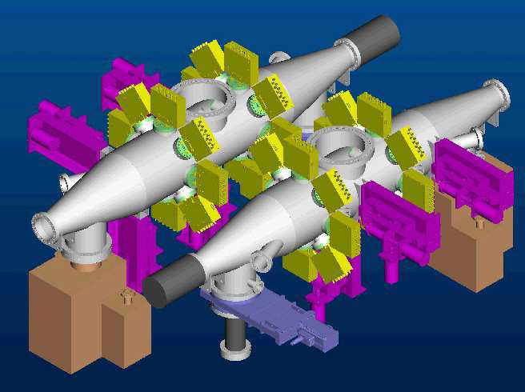
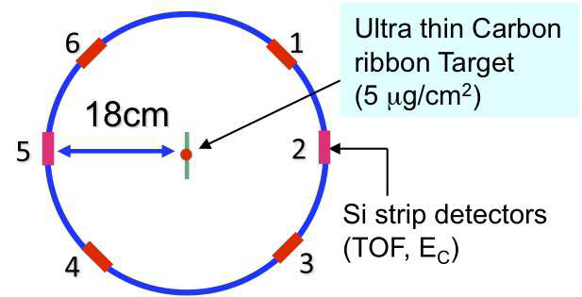
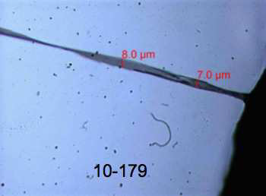
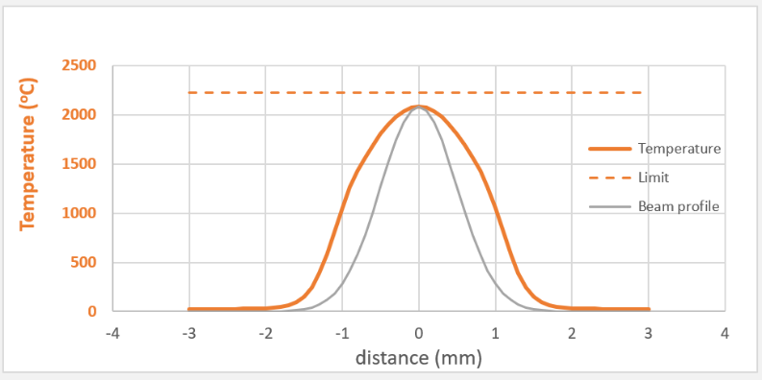
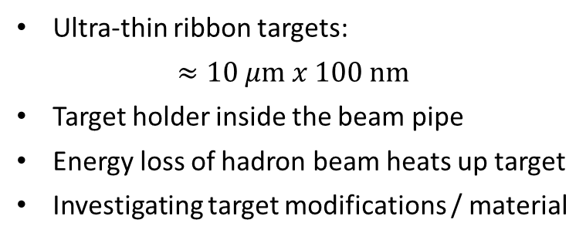
Fiber Target Polarimeters
#1 technology questions
#2 requirements
#5 design maturity
Ultra-thin ribbon targets:
$$≈10 μ\text{m} x 100 \text{nm}$$
Target holder inside the beam pipe
Energy loss of hadron beam heats up target
Investigating target modifications / material

Slide 18
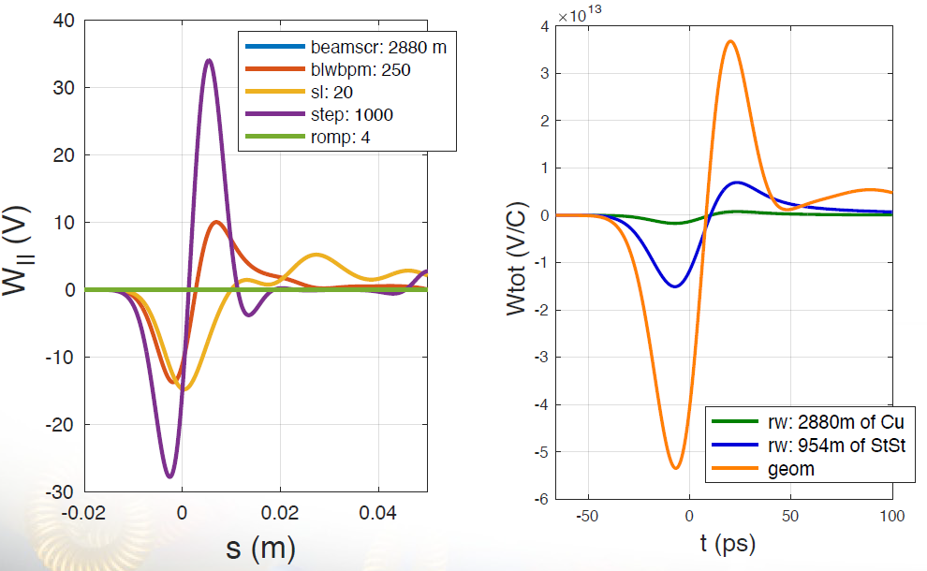
Impedance in Polarimeter Chamber
#2 requirements
#3 interfaces
#5 design maturity
A. Blednyk (BNL)
Usability of existing chambers to be verified for EIC short bunch spacing (GHz)
Fiber target chambers
Single-Bunch - Ok
Higher order modes → Pumping ports will require RF shielding
Simulations with targets are the next step
Hydrogen Jet (IP4)
Single-Bunch simulations in progress
Single bunch simulation for geometric and resistive wall wakefields

Slide 19
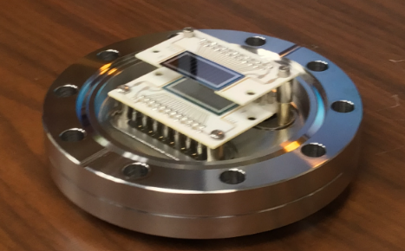
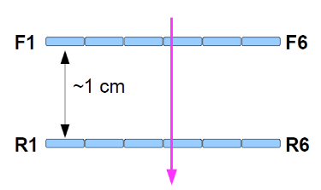
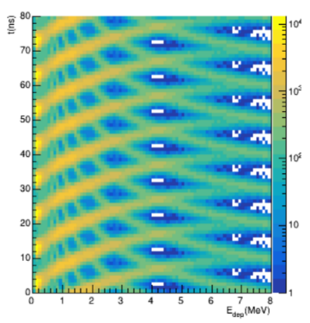
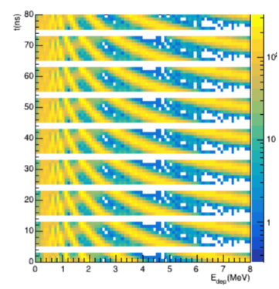
Hadron Polarimeter R&D
#2 requirements
#3 interfaces
#5 design maturity
(Part of WBS 6.02.03 Accelerator R&D)
Second detector layer installed in pC polarimeter
Included in DAQ since start of Run22 operations
Data from RHIC Run 22
Hybrid simulation
PYTHIA & GEANT
Repeated with 10 ns bunch spacing
Veto punch through particles
Tof vs. Ekin in layer 1 (F)
with a match in second layer (R)
Proton time-of-flight

Slide 20
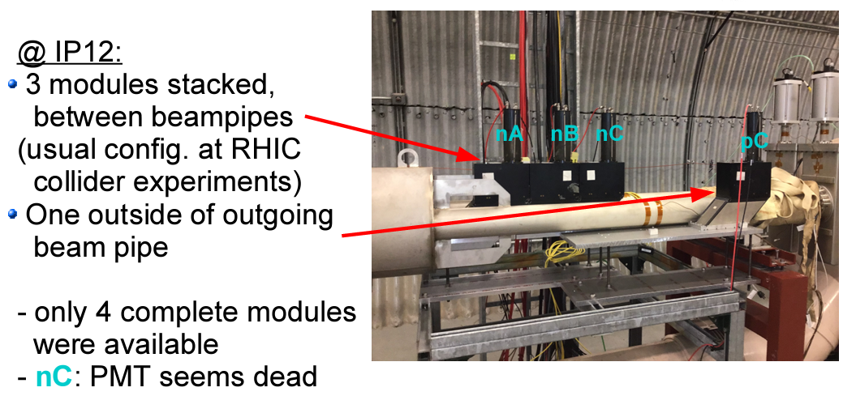

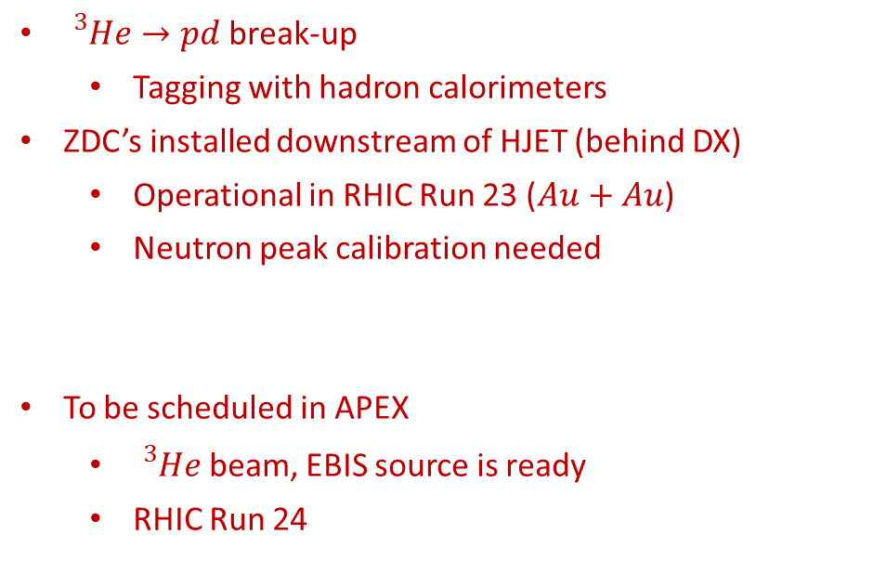





Hadron Polarimetry R&D
#2 requirements
#3 interfaces
#5 design maturity
(Part of WBS 6.02.03 Accelerator R&D)
${}_{}^{3}{He}→pd$ break-up
Tagging with hadron calorimeters
ZDC’s installed downstream of HJET (behind DX)
Operational in RHIC Run 23 ($Au+Au$)
Neutron peak calibration needed
To be scheduled in APEX
${}_{}^{3}{He}$ beam, EBIS source is ready
RHIC Run 24
$$p:e/m=1$$
$$\int{B\text{d}l}$$
$$h:e/m=2/3$$
$$d:e/m=1/2$$
$$h$$
target
$$n:e/m=0$$
DX

Slide 21
Polarimetry Subsystem Status Review
Review took place Jan. 17-18, 2023
Tuesday, Jan. 17
08:00-08:30 Executive Session
08:30-09:00 Welcome and Introduction to the EIC Project (Elke Aschenauer and Rolf Ent)
09:00-09:30 Polarized Beams at the EIC (Vadim Ptitsyn)
09:30-10:10 Hadron Polarimetry Overview (Oleg Eyser)
10:10-10:40 R&D for Hadron Polarimetry
10:40-11:00 Break
11:00-11:40 Electron Polarimetry Overview (Dave Gaskell)
11:40-12:10 Backgrounds for Compton Polarimetry (Mike Sullivan)
12:10-12:40 Laser System for Compton Polarimetry (Ciprian Gal)
Wednesday, Jan. 18
09:00-11:30 Executive Session
11:30-12:00 Closeout
Committee:
Dipangkar Dutta (Mississippi State University)
Jenny List (DESY)
Paolo Lenisa (Ferrara University)
Frank Rathmann (Julich)

Slide 22
Polarimetry Subsystem Status Review
Summary of Recommendations
Electron Polarimetry
Develop alternative detector concept based on silicon
Detailed simulations including all backgrounds and shielding
Explore transverse polarization measurements using synchrotron radiation
More detailed detector requirements for RCS polarimeter
Hadron Polarimetry
Target gas analyzer should be used to determine molecular fraction in the H-Jet
Explore using thinner Si detectors in both H-Jet and p-Carbon polarimeters to veto punch through events
In addition to exploring new target materials for p-Carbon polarimeter, explore larger beam size
Obtain beam time with AGS p-C polarimeter to test detectors
Theoretical assessment 3He-3He analyzing power
Further 3He studies during remaining RHIC runs
On-going/scheduled
alternatives under discussion
On-going effort, not part of initial baseline

Slide 23
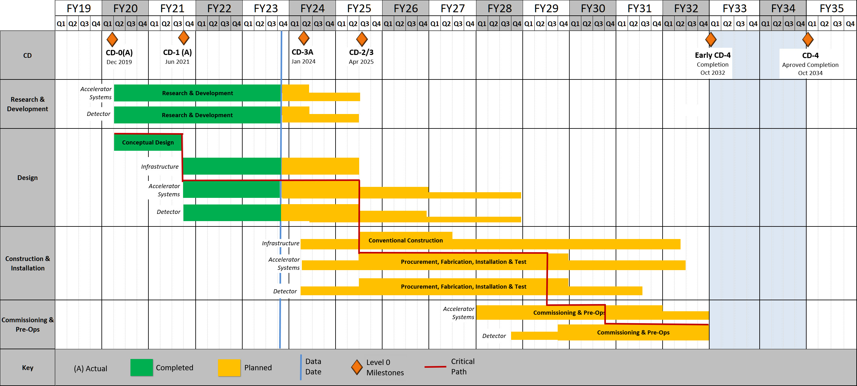
Polarimetry Schedule
#6 schedule
Final RHIC operations
Final commissioning
Polarimeters ready for beam development
(L2_0600 Construction of Components Complete)
Final Design Review

Slide 24
Summary
The basic polarimetry methods and detector technologies are established. Options for value engineering are under discussion.
The requirements and interfaces, mostly with the accelerator, are defined.
The design is progressing towards CD2/3 in FY25.
Demands at EIC are higher than at previous facilities, some improvements are still needed.
Future modifications beyond the EIC baseline are not precluded within the current scope.
All polarimeters have to be ready for operation with the start of polarized beam development. Some polarimeters are for solely for beam development, while others provide constant monitoring throughout physics data taking.
The schedule has significant float.

Slide 25
EXTRA

Slide 26
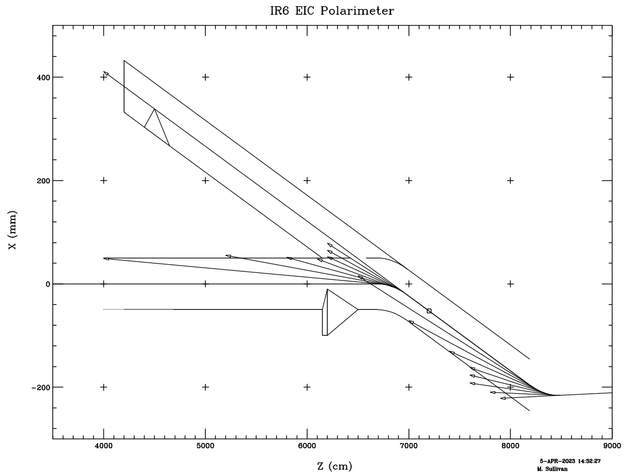
ESR Compton – Synchrotron Radiation
Mike Sullivan (SLAC)
Mask needed to mitigate SR on photon exit window
120 W remains with broad peak at the center of the window
→ May need a fairly thick W shield (≥ 2 cm) for the 18 GeV beam
10 GeV beam has a softer photon energy spectrum → 2 mm of W looks to be quite effective in blocking all of the SR photons at this beam energy
Water cooling

Slide 27
ESR Lattice Update
Old lattice
dipole
“Compton” dipole removed from new lattice
New lattice
New ESR lattice not compatible with existing Compton design
→ Not clear new lattice can accommodate Compton requirements

Slide 28
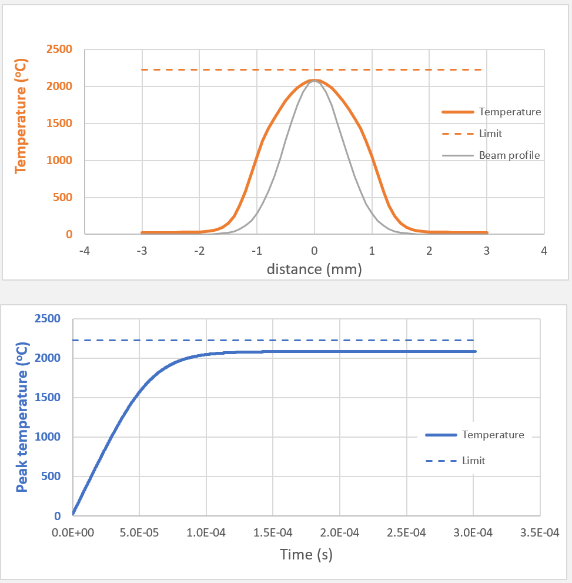
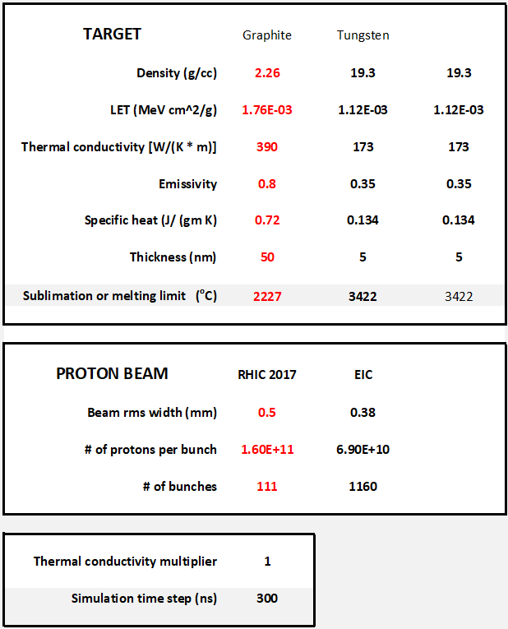
Beam Heating of Target Material
*Calculation by Peter Thieberger
RHIC conditions

Slide 29
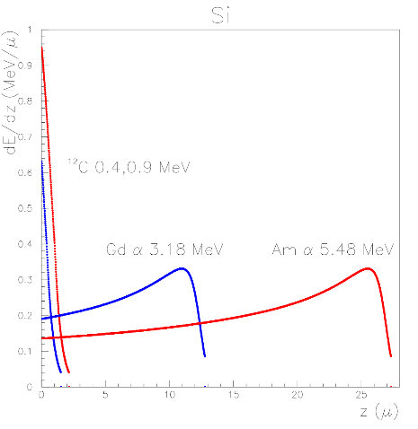
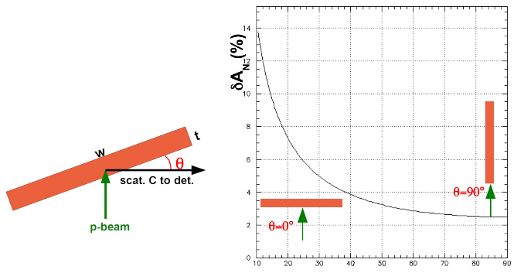
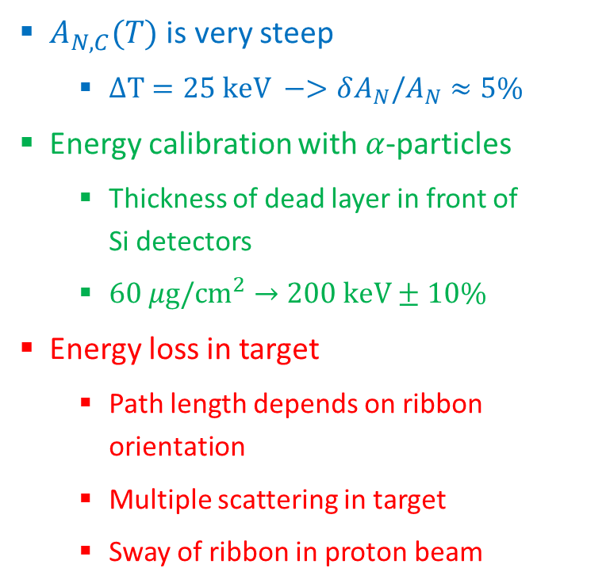

Carbon Polarimeter
$A_{N,C}(T)$ is very steep
$ΔT=25 \text{keV} −>δA_{N}/A_{N}≈5\%$
Energy calibration with $α$-particles
Thickness of dead layer in front of Si detectors
$60 μ\text{g}\text{/}{\text{cm}}^{2}→200 \text{keV}±10\%$
Energy loss in target
Path length depends on ribbon orientation
Multiple scattering in target
Sway of ribbon in proton beam
Measured energy
Dead layer
$$z≈0.25−0.5 μ\text{m}$$

