Slide 1
Electronics EIC Comprehensive Design Review
Fernando Barbosa (TJNAF)
L3, Chief Electrical Engineer
30 August 2023

Slide 2
Outline
Requirements and Design Philosophy
Streaming Readout
Architecture
Chain & Development
Channels
Electronics
eRD109 Initiatives
Summary of Electronics Developments
Scope of Effort
EIC Electronics Needs, Infrastructure, Standards, Grounding
EHS&Q Processes
Timeline
Summary
Charge Questions:
Timelines feasible? Open technology questions?
Comprehensive requirements to complete the design?
Interfaces and LLPs?
LLPs design and specifications?
Design maturity for CD-2 and CD-3?
Schedule of design, production and installation realistic?

Slide 3
Requirements and Design Philosophy
Charge Questions: 2
Maximize synergies in electronics:
Use same designs and architectures across sub-detectors, as much as possible. A number of variants are to be expected.
Minimize number of distinct devices: fewer part #s, less maintenance.
Design re-use from proven implementations, including ASIC IP blocks.
Minimize cabling, services:
Fibers feature predominantly in our approach to signal/data transport but copper-based interfaces will still be used extensively.
Electronics, including digitizers, close to the detector as much as possible and where applicable.
Limit FPGA use inside detector volume.
Serviceability as a design criteria.
Triggerless operation of the electronics as default; triggered operation for calibration, test, de-bugging.
Meet current US standards per NEC, UL, FCC, NEMA:
There are equivalency and harmonization agreements for various norms.
Equipment assessment reviews for conformance to EHS&Q.

Slide 4
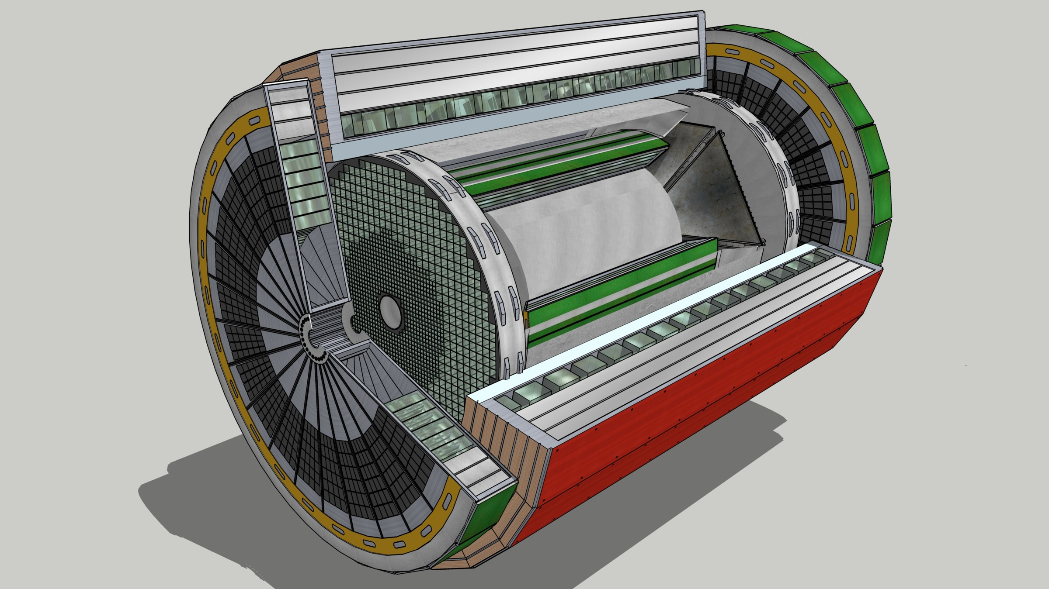
EIC Streaming Readout Architecture
Charge Questions: 2
Standardized Nomenclature
Front-End Electronics
DAQ
Detector
FEB
(Front End Board)
RDO
(Readout Board)
DAM + Computing (Data Aggregation Module)
Total
BW: O(100 Tbps)
BW: O(10 Tbps)
GTU
(Global Timing Unit)
Bunch Crossing ~ 10.2 ns/98.5 MHz
Event Rate ~ 2 us/500 kHz
Low occupancy.
L ~ 100 m
fiber
Jitter ~ 5 ps
ASIC
Goal: O(100 Gbps)
Fiber
Switch / Server / Link-Exchange: Readout
Switch / Server: Processing
Switch / Server: Buffer
FEB
Storage
FPGA
Fiber
Monitoring
RDO
FEB
LVDS ~ 20-30 m*
Analog ~ 20m
Power Supply System
(HV, LV, Bias)
Cooling Systems
Data
Configuration & Control
Power
*LVDS – ANSI/TIA/EIA-644A standard. Maximum cable length dependent on data rate.
w/ Jin and Kai

Slide 5
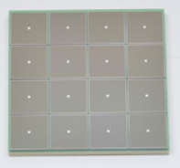
EIC Readout Chain
Charge Questions: 2, 5
Global Timing Unit (GTU)
-Interfaces to Collider, Run Control & DAM
-Config & Control
-Clock & Timing
Nomenclature standardized after August 2022 Electronics & DAQ Review.
On Detector
SMT BGA
Name
Design
Function
Attributes
Sensor
Detector Specific
-Multi-Channel Sensor
-MAPS
-AC-LGAD
-MPGD
-MCP-PMT
-SiPM
-LAPPD
Adapter
Detector Specific
-HV/Bias Distribution
-HV divider
-Interconnect Routing
-Sensor Specific
-Passive
Front End Board
(FEB)
Detector Specific
-Amplification
-Shaping
-Digitization
-Zero Suppression
-Bias Control & Monitoring
-ASIC/ADC
-Discrete
-Serial Link
Readout Board
(RDO)
Few Variants
-Communication
-Aggregation
-Formatting
-Data Readout
-Config & Control
-Clock & Timing
-FPGA
-Fiber Link
Data Aggregation Module (DAM)
Common
-Computing Interface
-Aggregation
-Software Trigger
-Config & Control
-Clock & Timing
-Large FPGA
-PCIe
-Ethernet
Computing
Common
-Data Buffering and Sinking
-Calibration Support
-QA/Scalers
-Collider Feedback
-Event ID/Building
-Software Trigger
-Monitoring
-COTS
-Ethernet

Slide 6
EIC Readout Chain (cont.)
Charge Questions: 2, 5
FEB – Front-End Boards
Custom designed for each detector and populated with ASICs, large magnetic fields.
ASICs designed to process analog signals and digitization tailored to each type of detector technology. Data reduction (e.g. zero suppression) is desirable.
Simplification of testing and calibration operations with triggered-mode configuration.
Data transport via copper cabling.
Limit use of FPGAs.
RDO – Readout Boards
Custom designed to process and aggregate data streams from multiple FEBs.
Interface standardization to downstream DAM, Link Exchange/FELIX boards.
FPGAs are dominant components on these PCBs.
Algorithms reduce data flow (e.g., zero suppression)
Data transport via optical fibers.
Global Timing
High speed and precision combines custom designed and COTS componentry.
Provides synchronization of and clock distribution to the readout elements.
Jitter ~ 5 ps.
Network Switches/Servers/Computing/Link Exchange (FELIX)
High performance COTS infrastructure.
Enables further reduction of data flow prior to storage via sophisticated algorithms, e.g., ML and AI.
Radiation levels are much lower O(100) than at LHC. Studies have been performed to inform readout technology selection..

Slide 7
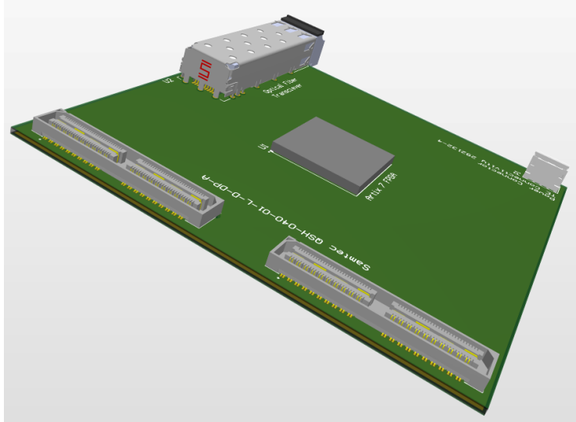
Readout Chain Development
Charge Questions: 2, 5
“Coalesce” specifications to minimize the number of ASIC/FPGA/PCB part numbers.
Power is nominally 1 W ± 0.25 W per ASIC (64 ch, 32 ch). Cooling systems will be an integral part of the detector design.
Serviceability as a design criteria. Reliability assessment of componentry.
ASIC Development timeline is critical ~ 3.5 – 4 Years
Revise and adapt present designs is our strategy.
Design re-use of IP blocks from existing ASICs.
Standardization of data format (header, timestamp, etc.) at the system design level.
Firmware development requires specialized expertise in close connection with both the detector development and the DAQ systems.
Testing and integration (w/ detectors/prototypes) takes considerable time and resources.
RDO footprint defined and passed on to ME.
RDO
Optical Transceiver – To DAM/FELIX
Artix7 FPGA
Power Connector
Cable Connectors – From FEBs
4”x4”x0.6” (102x102x15.24 mm)

Slide 8
ePIC Readout Channels (w/ Project P6 updates in WBS 6.10.08)
Charge Questions: 2
Detector System | Channels | Nominal Readout Technology | eRD109 Initiatives
Si Tracking: 3 vertex layers, 2 sagitta layers, 5 backward disks, 5 forward disks | 7 m^2 36 B pixels 5,200 MAPS sensors | MAPS – ITS-3
MPGD tracking: layers + disks | 202 k | Strips | SALSA
Calorimeters: (in P6) Forward: LFHCAL pECAL Barrel: HCAL ECAL SciFi/Pb Imaging Si Backward: ECAL nHCAL | 63,280 19,000 1536 5760 500 M 3256 3240 | SiPM SiPM SiPM SiPM Si - ASTROPIXV4 SiPM SiPM | H2GCROC Discrete/H2GCROC H2GCROC H2GCROC Discrete H2GCROC
Far Forward: B0: 4 AC-LGAD layers 2 Roman Pots 2 Off Momentum ZDC: Crystal Calorimeter 32 Silicon pad layer 4 silicon pixel layers 2 boxes scintillator | 1 M 560 k x 2 320 k x 2 400 11520 160 k 72 | AC-LGAD AC-LGAG AC-LGAD APD Si AC-LGAD PMT/SiPM | EICROC EICROC EICROC Discrete/HGCROC/H2GCROC HGCROC EICROC Discrete/HGCROC/H2GCROC
Far Backward: Low Q Tagger 1 Low Q Tagger 2 2 Calorimeters | 1.3 M 480 k 700 | Si – Timepix4 Si – Timepix4 PMT/SiPM | Discrete/HGCROC/H2GCROC
PID-TOF Barrel TOF CTTL Hadron Endcap TOF FTTL | 2.2 M 5.6 M | AC-LGAD AC-LGAD | EICROCx/FCFD EICROC
PID-Cherenkov: dRICH pfRICH hpDIRC | 344,064 69632 69362 | SiPM HRPPD MCP-PMT/HRPPD | ALCOR HGCROC/EICROC/FCFD HGCROC/EICROC/FCFD
HGCROC – Si/PMTs
H2GCROC – SiPMs
EICROC – AC-LGAD
eRD109
eRD109
eRD109

Slide 9
ePIC Readout Electronics
Charge Questions: 2
EICROC and HGCROC families of ASICs have similar interfaces and follow similar developments at OMEGA/IN2P3.
Detector Group | Channels | AC-LGAD | SiPM/PMT | MPGD
 | MAPS | AC-LGAD, HRPPD | SiPM/PMT | MPGD
Tracking | 36 B |  |  | 202 k
Calorimeters | 88 M |  | 123 k
Far Forward | 300 M | 2.3 M | 170 k
Far Backward | 146 M |  | 2 k
PID |  | 7.8 M + 140k | 320 k
TOTAL | 36.5 B | 10.24 M | 615 k | 202 k
ASIC | ITS-3 | EICROC FCFD | Discrete/COTS HGCROC3 ALCOR | SALSA
HRPPD
eRD109

Slide 10
eRD109 – R&D Initiatives
Charge Questions: 1, 2, 5, 6
Addresses ASIC and Electronics R&D needs.
FY23 Proposals submitted in October 2022
Contract awards took longer than expected.
FY24 Proposals submitted in July 2023
Contract awards should now be in synch with FY funding
Continuation of previous work.
Duration of 4 Years.
ASIC & Electronics:
Discrete/COTS – Calorimeters, SiPMs, 12-14 bit
H2GCROC – Calorimeters, SiPMs, 10 bit
EICROC - AC-LGAD, pixel
FCFD – AC-LGAD, strip
ALCOR – dRICH, SiPM, 1 p.e.
SALSA – MPGD.
Summary follows and more details at DAC R&D Review 31 August 2023.

Slide 11
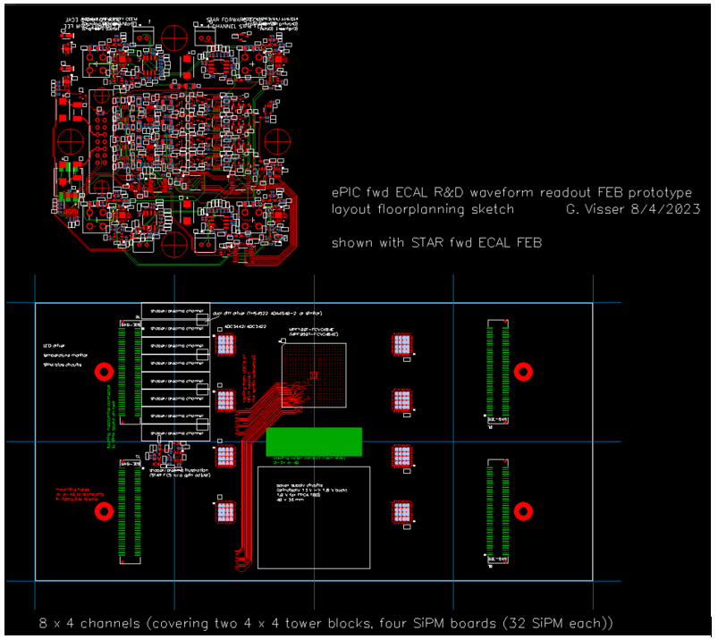
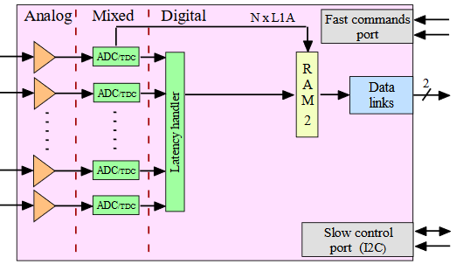
Summary of Electronics Developments
Charge Questions: 1, 2, 5, 6
Calorimeters – SiPMs – Discrete/COTS (IU)
32 ch Waveform Digitizer
12/14-bit TI ADC3422
Microsemi MPF100T-FCVG484E Polarfire (radiation hard FPGA)
CERN DC/DC converter bPOL12V_V6 or LTC3601
Cabling, Power, Cooling, Packaging.
Design, Fab: FY23 –FY24
Tests + Beam: FY24 – FY25
Engineering Article: FY25
Production: FY25 – FY26
Calorimeters – SiPMs – b) H2GCROC variant
(OMEGA/IN2P3/ORNL)
ePIROC
1D, 72 ch. (ePIC will use 64 ch of these)
65 nm CMOS
Charge (ADC+TOT) + Time (TOA)
Cdin: 5-50 pF
Dynamic Range: 1-10 pC
Timing: 100-120 ps
ADC: 10b
39.4 MHz operation from BX 98.5 MHz
Links: 1260.8 Mbps @ 39.4 MHz, multiple
Power: 10-15 mW/ch
Radiation tolerant
No Change
Modify trig, mem, CLK dist.
Design Backend: FY23 - FY24
H2GCROC (ePIROCv0) : FY24 – FY25
H2GCROC (ePIROC): FY26

Slide 12
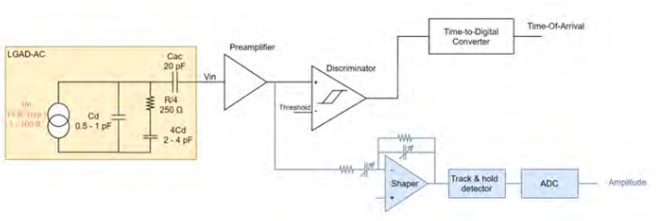
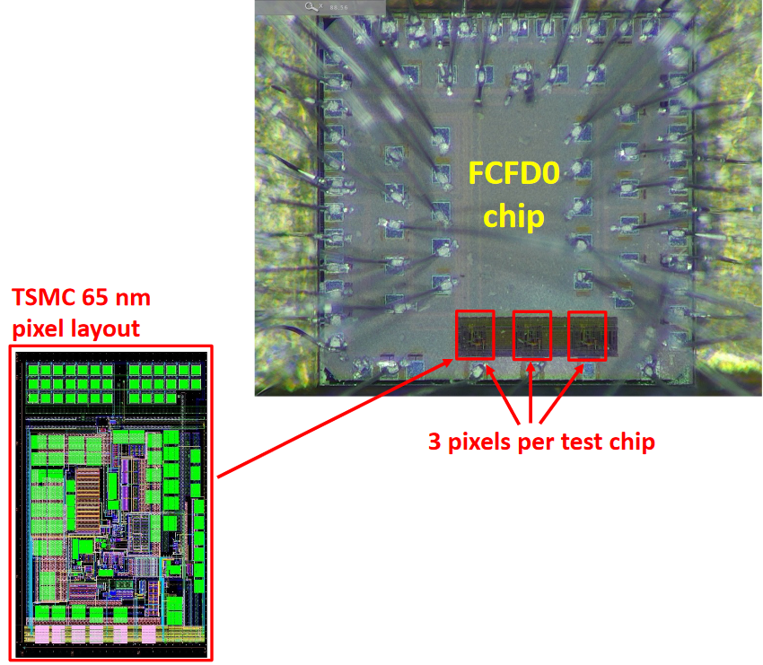
AC-LGAD pixel – EICROC (OMEGA/IN2P3/IJCLab/CEA-IRFU/AGH)
2D, 32x32 pixel readout
65 nm CMOS
Preamp, Discriminator, TOA, ADC
Cdin: 1-5 pF
Dynamic Range: 1-50 fC
Timing: 15-20 ps
ADC: 8b
39.4 MHz operation from BX 98.5 MHz
Links: 1260.8 Mbps @ 39.4 MHz, multiple
Power: <1 mW/ch
Packaging: Bump+Wire bonds
Radiation tolerant
Charge Questions: 1, 2, 5, 6
One pixel – EICROC0
Sensor
EICROC0: FY23
EICROC0_v1: FY23 – FY24
EICROC1: FY24 – FY25
EICROC2: FY26
AC-LGAD strip – FCFD (FNAL)
128 ch strip readout
65 nm CMOS
Constant Fraction Discriminator
Plus TDC, ADC, interfaces
Cdin: <15 pF
Dynamic Range: 5-40 fC
Timing: 10-30 ps
Links: ~Gbps, multiple
Considerable synergy with FNAL need for FCFD.
FCFDv1: FY23
FCFDv2: FY24 – FY25
FCFDv3: FY25

Slide 13
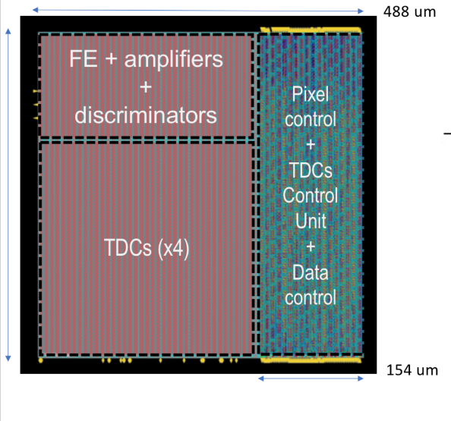
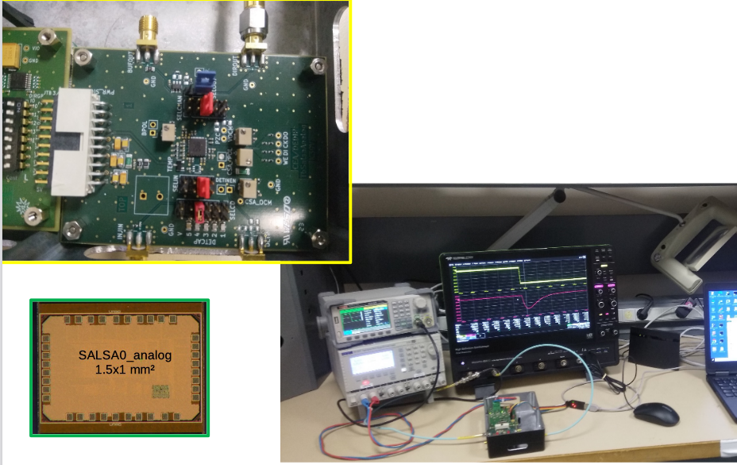
dRICH – SiPM – ALCOR (INFN)
Charge Questions: 1, 2, 5, 6
2D 8x8 pixel readout
110 nm CMOS
Dual polarity, RCG Amplification, conditioning, inhibit , digitization.
Modes of operation: single-photon tagging or time and charge.
Triggerless and triggered operation.
25 ps TDCs, TOA+TOT
5 MHz input
4 or 8x 640 Mbps LVDS links.
SPI configuration.
ALCOR v2: FY23
ALCOR v3: FY24 – FY26
ALCOR v4: FY26
MPGD – SALSA (CEA-Saclay, U. Sao Paulo)
64 Ch
65 nm CMOS
Peaking time: 50 – 500 ns;
Inputs: Cdin<200 pF; Dual polarity
ADC: 12 bits, 5 – 50 MSPS.
Extensive data processing capabilities
I2C configuration.
Triggerless and triggered operation;
Several 1 Gbps links.
Power: 15 mW/Ch
SALSA1: FY23
SALSA2: FY24
SALSAf: FY25 – FY26
SALSA: FY26

Slide 14
Scope of the effort
Charge Questions: 1, 2, 5, 6
Approximate quantities and costs.
Costs include mask sets, fabrication and packaging, wrt quantities needed.
 | #ASICs | #Wafers | E/P Run | Cost/ch ($)
Discrete/COTS | 711 digitizers | na | na | 56
H2GCROC | 1.2 k | 3 | E | 5
EICROC | 76 k | 152 | P | 0.2
FCFD | 18 k | 37 | P | 0.2
ALCOR | 5.4 k | 11 | E | 1
SALSA | 3.2 k | 7 | E | 2
COTS
65 nm
65 nm
65 nm
110 nm
65 nm
For 12” (300 mm) wafers, ~500 chips per wafer.
It may be possible to merge H2GCROC and EICROC for lower costs.
MPW – Multiple Project Wafer run – most of eRD109: <$25 k – 3 months
Engineering (E) run - <25 wafers: $350 k – 6 – 8 months
Production (P) run: $250 k masks + $5 k per wafer – 1 year
Packaging: $3-$5 per chip.

Slide 15
EIC Electronics Needs - Summary
Charge Questions: 2, 5
ASICs – Application Specific Integrated Circuits
Electronic components & PCBs – consignment/turnkey fabrication - Qty. < 1,000.
Cabling – Turnkey fabrication of cables and optical fibers (COTS) - Qty. > 1,000.
Power Supplies – Multi-channel, Low Noise, Floating, Modules:
Low Voltage (LV) - < 15 VDC, 5 A – 10A range per channel. Qty. < 1,000.
Bias - < 100 VDC, mA range per channel. Qty. < 10,000.
High Voltage (HV) - < 8 kV, mA range per channel. Qty. < 1,000.
Racks and Cooling – COTS. Qty. < 100.
Infrastructure and Standards
Environment 21°C ± 2°C, RH <50%.
Grounding In detector interaction region area by bonding of segregated loads via multiple, low inductance conductors to existing infrastructure.
Cabling NEC 2011 NFPA 70, UL CL2 or better.
Cable Routing NECA/NEMA 105-2007. Open cable tray systems.
EMI & RFI FCC part 15, Class B, CISPR 11/EN55011 Class B, CISPR 22/EN 55022 Class B and EN 61000-6-3, or equivalent.
Power Supplies Floating and referenced at the detector ground.
Racks Open frame, COTS with cable managers.
NOTE: Exceptions or non-conformance to these standards must be approved prior to installation.

Slide 16
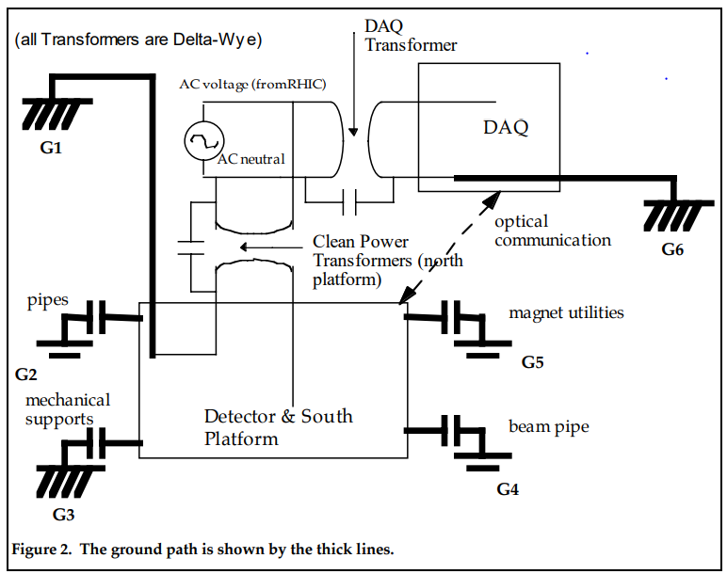
Grounding
Charge Questions: 2, 5
Power Supply & Cooling Systems
Use COTS units – Wiener, CAEN, …
Grounding & Shielding
Builds upon the STAR installation, uses floating supplies referenced to ground at the detector for low noise and good signal integrity plus ground fault monitor.
Grounding
Column in IR
Grounding in
DAQ House
Low Impedance connection via 6, 4/0 cables.
*Minimize capacitive coupling (G2 – G5).
STAR Note 202A, H. Matis, D. Jared

Slide 17
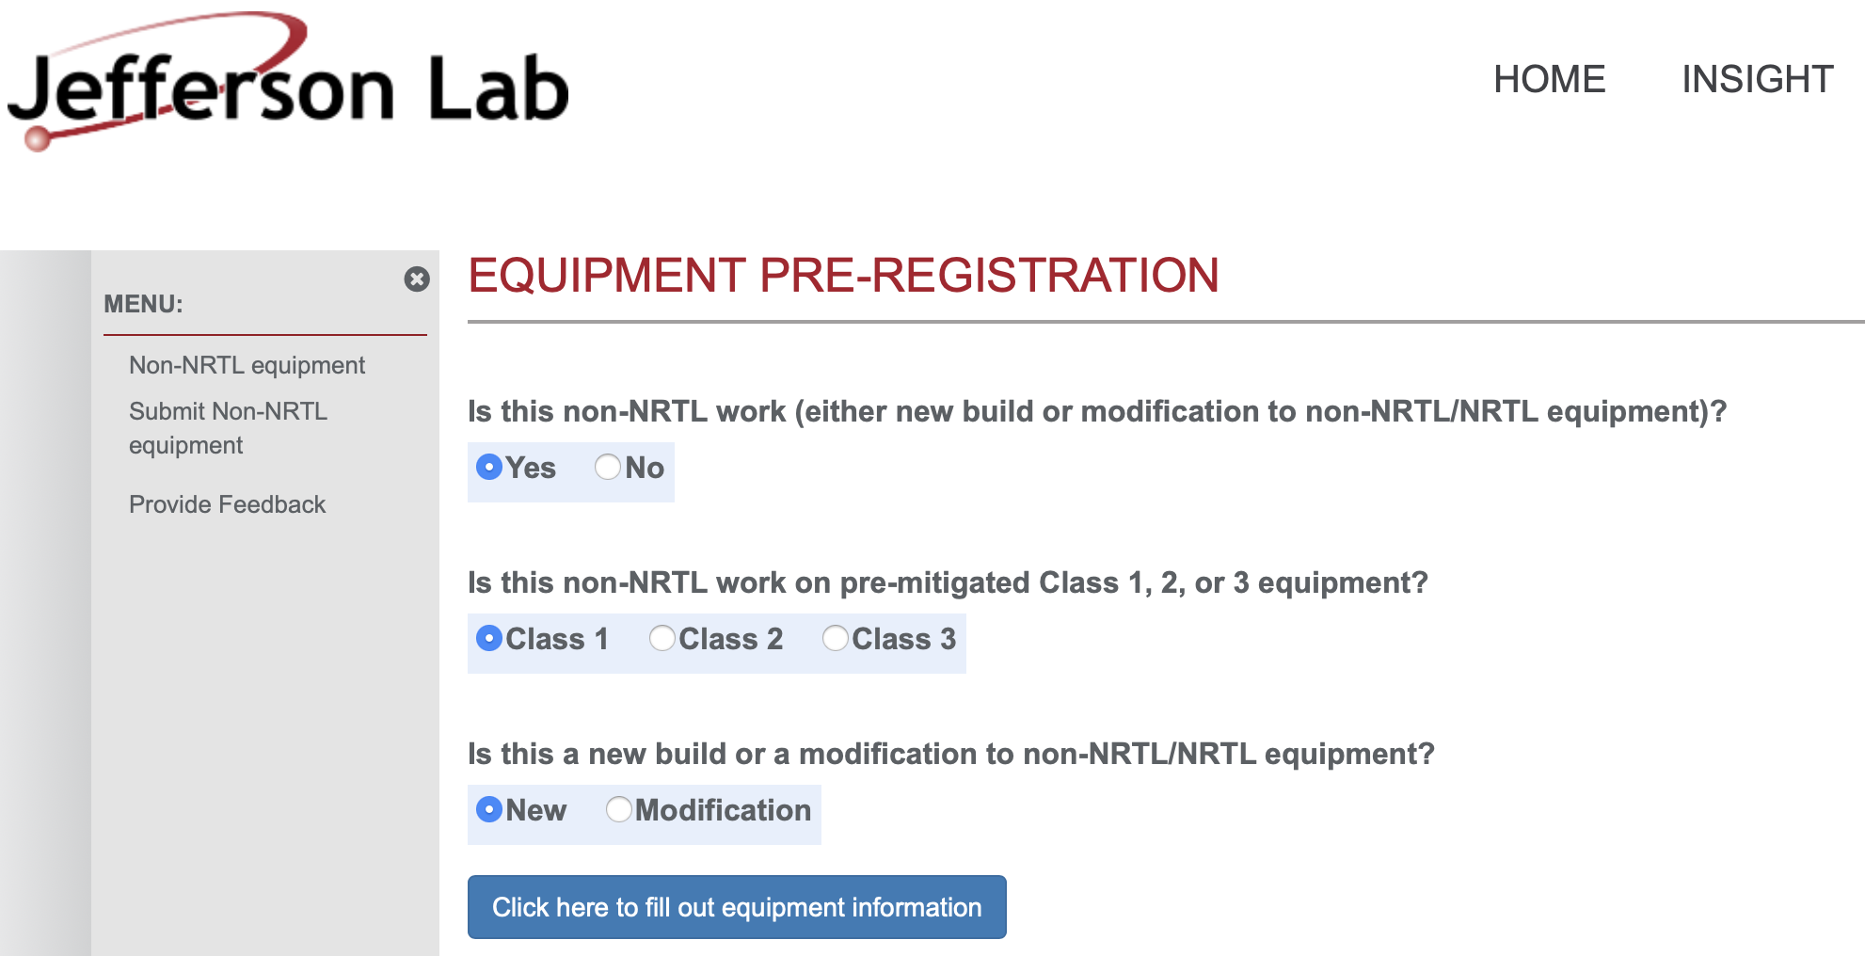
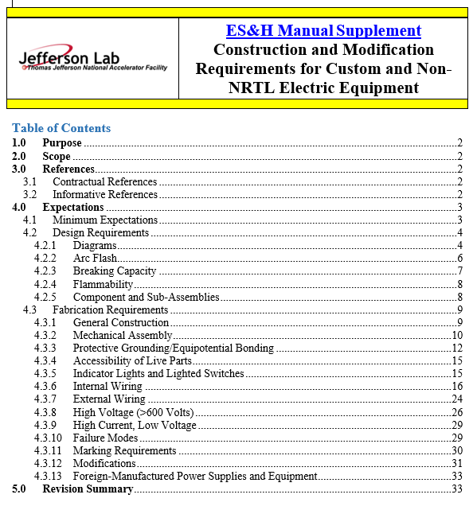
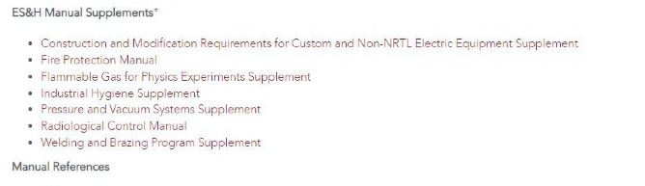
BNL and JLAB have EHS&Q processes for “in-kind” Electronics
Charge Questions: 2
Custom electronics built by collaborators for use in experiments at JLAb must go through a registration process first.
This is any equipment that is NOT certified by a Nationally Recognized Test Lab (NRTL) like UL and recognized by OSHA.
The JLAB EHS&Q Manual has a supplement guide for construction and/or modification of any custom or non-NRTL equipment.

Slide 18
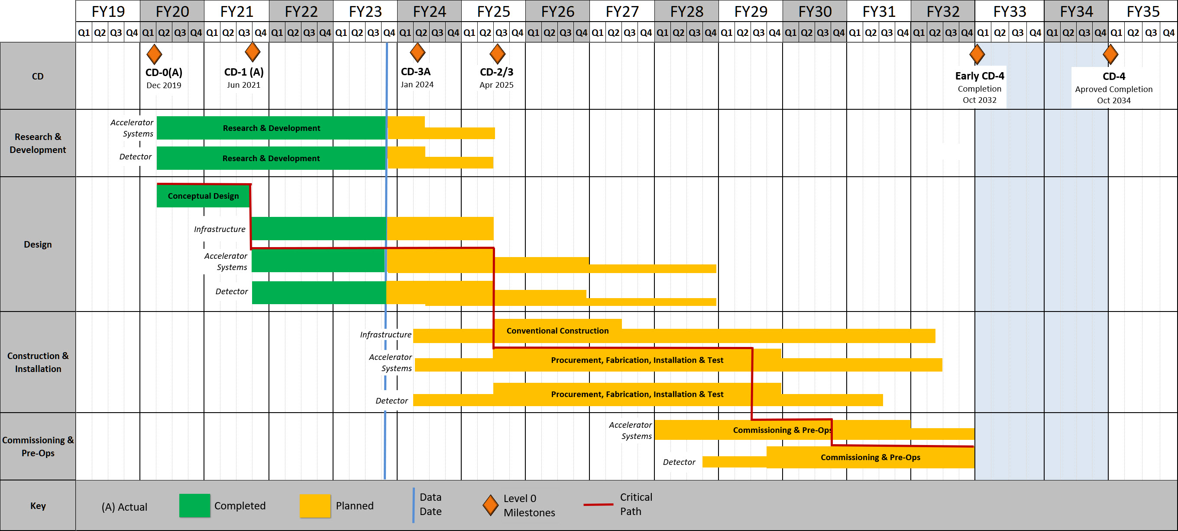
Timeline
Charge Questions: 6
Construction and Installation includes procurements and deliveries and are initiated at different times of this phase.
eRD109 until mid FY27
(refer to talk by Thomas U.)
ASIC Production mostly in FY26
R&D
Engineering Articles
Design until 9/2028
Construction
4/2025 to 4/2031
Bulk of Construction & Installation phase for Electronics: April 2025 – October 2029.
Installation of some items may be extended to April 2031.

Slide 19
Summary
ePIC is actively developing a streaming readout architecture, benefiting from resources within its large collaboration and to meet the physics goals of the EIC.
Nomenclature has been standardized.
Developing the readout electronics by building upon previous developments, with design re-use as a guiding principle:
Converged on readout and technology solutions.
Refining detector requirements (ch rates, Cdin, etc.) and services to inform electronics specifications towards final implementations, ~Fall 2023.
Design is maturing, targeting CD-2 and CD-3.
ASIC development timelines are within the R&D projected schedules. We must remain vigilant, however. There are no known supply-chain issues currently.
Developments are within the R&D, design, construction and installation schedules.

