Slide 1
WBS 6.10.09 DAQ and Scientific Computing
Jeff Landgraf and David Abbott
L3 CAMs
EIC Detector Comprehensive
Design Review
August 29-30, 2023

Slide 2
Overview
The technology and scale of the ePIC DAQ
Streaming readout community
Streaming architecture
System components and operational concept
Component counts & expected data
Requirements Flow Down
Status of Components
Schedule
(Charge 1)
(Charge 2)
(Charge 5)
Charges
Given the detector progress over the last two years and the status of the ePIC detector, are the projected timelines of the Electron-Ion Collider detector feasible? Do there remain significant open detector technology questions?
Are the requirements for the detector and their flow down sufficiently comprehensive for this stage of the project to complete the design of the various detector technologies?
Are the interfaces between the elements of the design adequately defined for this stage of the project and to proceed with the detector long-lead procurement items?
Is the design of these long-lead procurement items sufficiently advanced and mature to start procurement in 2024? Are the technical specifications complete?
Is the projected design maturity of the further detector components likely to be accomplished by the end of 2024 for CD-2 and CD-3?
Is the overall schedule for completion of the design, production, and installation of detector components realistic?
(Charge 6)

Slide 3
EIC Streaming Readout Community
Charge #1 – feasibility and technology
The EIC Streaming Readout (SRO) Consortium
Formed in 2018 with the goals of engaging the nuclear physics community to explore a streaming readout architecture for the EIC detectors.
Series of ten workshops so far since 2018 (next in Oct 2023)
Led to adoption of SRO for Yellow Report the physics program for EIC.
ePIC Electronics/DAQ Working Group
Conveners: F. Barbosa (JLab), J. Huang (BNL), J. Landgraf (BNL)
Regular meetings to focus on design and requirements specifically for the new ePIC detector
Interface to detectors, readout, DAQ, online processing, monitoring and control.
ePIC Software/Computing Working Group
Conveners: M. Diefenthaler (Jlab), S. Joosten (ANL), T. Wenaus (BNL), W. Deconinck (UM)
Coordinate software development for EIC physics
ePIC Software/Computing Streaming DAQ Working Group
Conveners: M. Battaglieri (JLab), J. Huang (BNL)
Streaming Reconstruction
EIC Project L3 CAMs (DAQ/Online, Electronics)
D. Abbott (JLab), J. Landgraf (BNL), F. Barbosa (JLab)
Project management (cost/schedule)
Coordination between relevant EIC working groups (including Detectors)

Slide 4
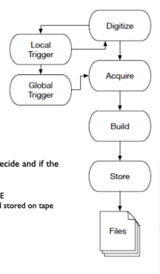
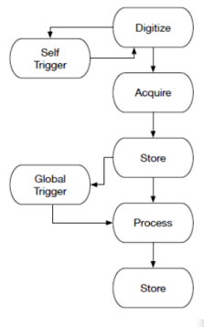
ePIC Streaming Readout
Charge #1 – feasibility and technology
Streaming Readout (SRO)
Features of ePIC SRO
No global trigger
No custom trigger electronics
Zero-suppress early (ASICs)
Hits identified by time stamp rather than by event
Flexibility in event selection
Can be performed with all channels available
Can be performed in CPU, FPGA, or GPU
Cons
SRO has greater sensitivity to noise and background
Triggered DAQ
(Marco Battaglieri INFN)

Slide 5
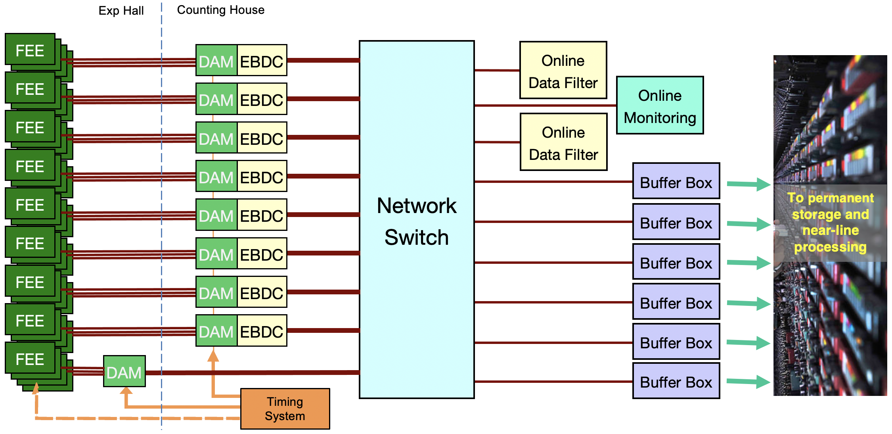
ePIC Streaming DAQ/Computing Architecture
Charge #1 – feasibility and technology
Bunch Crossing ~ 10.2 ns/98.5 MHz
Interaction Rate ~ 2 us/500 kHz
Low occupancy.
BW O(100Tbps)
RDO
RDO
RDO
RDO
ePIC DETECTOR
BW O(10Tbps)
RDO
RDO
RDO
BW O(100Gbps)
RDO
RDO
Distributed clock
jitter ~5ps

Slide 6
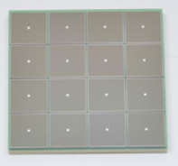
EIC Readout Chain
Charge #1 – feasibility and technology
Global Timing Unit (GTU)
-Interfaces to Collider, Run Control & DAM
-Config & Control
-Clock & Timing
On Detector
SMT BGA
Name
Design
Function
Attributes
Sensor
Detector Specific
-Multi-Channel Sensor
-MAPS
-AC-LGAD
-MPGD
-MCP-PMT
-SiPM
-LAPPD
Adapter
Detector Specific
-HV/Bias Distribution
-HV divider
-Interconnect Routing
-Sensor Specific
-Passive
Front End Board
(FEB)
Detector Specific
-Amplification
-Shaping
-Digitization
-Zero Suppression
-Bias Control & Monitoring
-ASIC/ADC
-Discrete
-Serial Link
Readout Board
(RDO)
Few Variants
-Communication
-Aggregation
-Formatting
-Data Readout
-Config & Control
-Clock & Timing
-FPGA
-Fiber Link
Data Aggregation Module (DAM)
Common
-Computing Interface
-Aggregation
-Software Trigger
-Config & Control
-Clock & Timing
-Large FPGA
-PCIe
-Ethernet
Computing
Common
-Data Buffering and Sinking
-Calibration Support
-QA/Scalers
-Collider Feedback
-Event ID/Building
-Software Trigger
-Monitoring
-COTS
-Ethernet

Slide 7
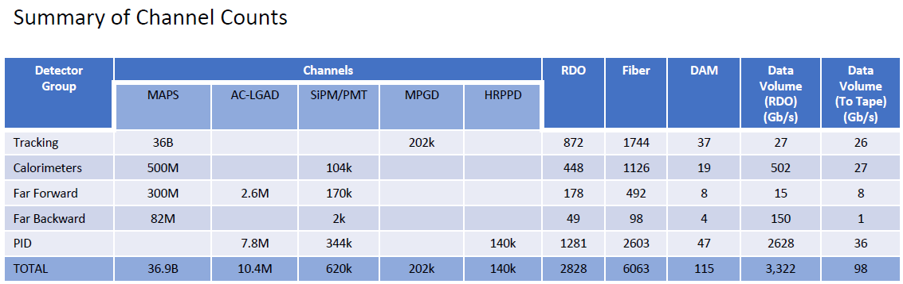
Charge #1 – feasibility and technology
Summary of Data Flow
Detector
FEB
Copper
RDO
Fiber
DAM
PCI/Eth
Readout Computer
Eth
100% Occupancy | 27.5-1760 Pb/sec
Aggregate | 3.4 Tb/sec
Noise | 3 Tb /sec
Signal from Physics + Background | 400 Gb / sec
Aggregate | 99 Gb/sec
Collision Signal | 38 Gb/sec
Synchrotron Rad | .01 Gb/sec
Electron Beam | 4 Gb/sec
Hadron Beam | 22 Gb/sec
Noise | 35 Gb/sec
Aggregate | 3.4 Tb/sec
Per fiber (Avg) | 1.85 Gb/sec

Slide 8


Charge #1 – feasibility and technology
Significant Filtering Challenges:
After several years in a radiation environment, “noise” dominates signal at the RDO by factors up to x7.5
dRICH – SiPMs requiring single photon sensitivity
Dark currents increase with radiation damage
Expect several years before annealing necessary to reduce dark currents
Electron Bremsstrahlung in Far Backward
Bremsstrahlung will produce up to 18 particles / Bunch Crossing.
Signal needs to be summarized, but full data is only needed in conjunction with central detector collisions
Main Strategy for dRICH/Far Backward
Supply enough bandwidth to account for maximum data volume to the DAM boards
Apply cross-detector correlation filter in nearby detectors in DAM / Readout computers to reduce recorded data volume
Summary of Data Flow
Detector
FEB
Copper
RDO
Fiber
DAM
PCI/Eth
Readout Computer
Eth
100% Occupancy | 27.5-1760 Pb/sec
Aggregate | 3.4 Tb/sec
Noise | 3 Tb /sec
Signal from Physics + Background | 400 Gb / sec
Aggregate | 99 Gb/sec
Collision Signal | 38 Gb/sec
Synchrotron Rad | .01 Gb/sec
Electron Beam | 4 Gb/sec
Hadron Beam | 22 Gb/sec
Noise | 35 Gb/sec
Aggregate | 3.4 Tb/sec
Per fiber (Avg) | 1.85 Gb/sec

Slide 9

Charge #1 – feasibility and technology
Data Filtering
Cluster finding accounts for the balance of the calculated noise reduction, and for the reduced signal data volume.
Additional methods are being considered including AI/ML techniques for pattern recognition and/or data compression
These functions will be performed in the DAM boards and the Online computing farm
Summary of Data Flow
Detector
FEB
Copper
RDO
Fiber
DAM
PCI/Eth
Readout Computer
Eth
100% Occupancy | 27.5-1760 Pb/sec
Aggregate | 3.4 Tb/sec
Noise | 3 Tb /sec
Signal from Physics + Background | 400 Gb / sec
Aggregate | 99 Gb/sec
Collision Signal | 38 Gb/sec
Synchrotron Rad | .01 Gb/sec
Electron Beam | 4 Gb/sec
Hadron Beam | 22 Gb/sec
Noise | 35 Gb/sec
Aggregate | 3.4 Tb/sec
Per fiber (Avg) | 1.85 Gb/sec

Slide 10

Charge #1 – feasibility and technology
After online processing we expect roughly equal contributions from collision hits, beam background hits, and noise.
Summary of Data Flow
Detector
FEB
Copper
RDO
Fiber
DAM
PCI/Eth
Readout Computer
Eth
100% Occupancy | 27.5-1760 Pb/sec
Aggregate | 3.4 Tb/sec
Noise | 3 Tb /sec
Signal from Physics + Background | 400 Gb / sec
Aggregate | 99 Gb/sec
Collision Signal | 38 Gb/sec
Synchrotron Rad | .01 Gb/sec
Electron Beam | 4 Gb/sec
Hadron Beam | 22 Gb/sec
Noise | 35 Gb/sec
Aggregate | 3.4 Tb/sec
Per fiber (Avg) | 1.85 Gb/sec

Slide 11
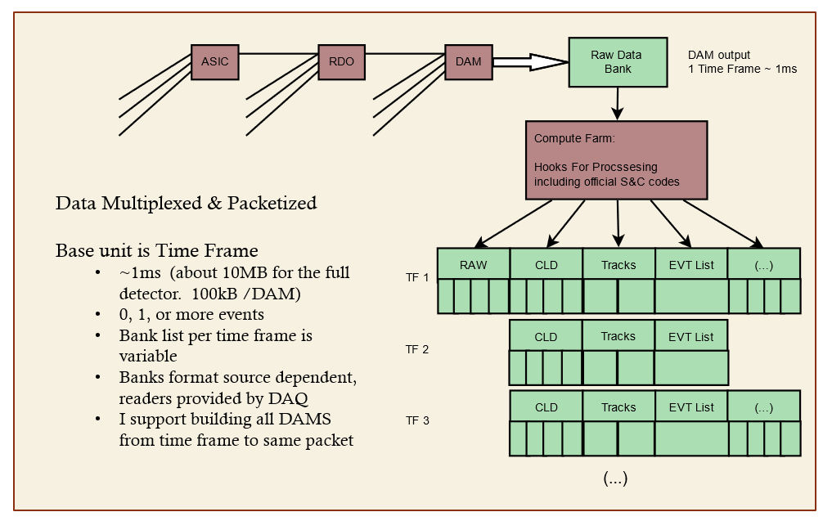
Charge #1 – feasibility and technology
DAQ Computing
Time Frames (~1ms)
Up to ~500 events
~10MB output data
~3.4MB from RDO average / DAM
~100kB to Tape average / DAM
Routing data
Formatting data
Processing data
DAM FPGA & CPUs
Cluster finding
Software triggering
Sanity Checkers
QA Monitoring
Metadata
Slow controls integration
Scalers / continuously running DAQ components

Slide 12
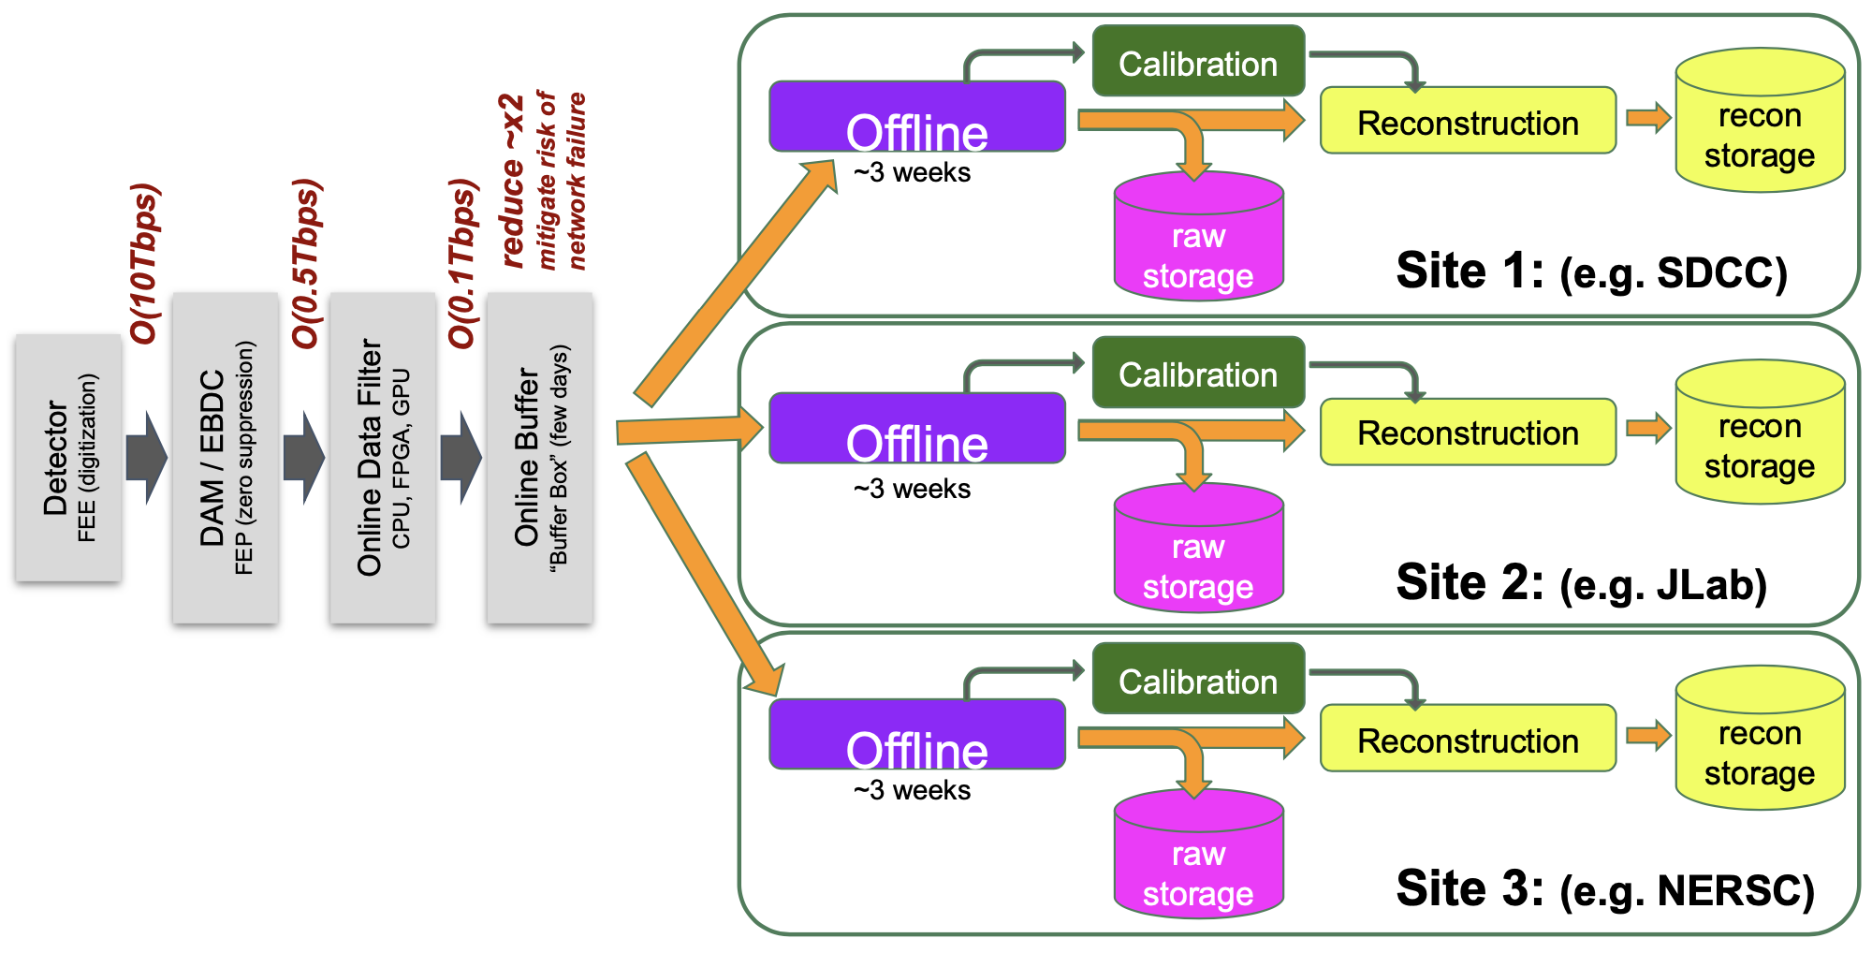
Boundary between Online and Offline
Charge #1 – feasibility and technology
The streaming architecture allows for some blurring of the offline and online processing with respect to calibrations, QA monitoring, and potential seed analysis to improve reconstruction turn around. These aspects are not yet fully specified
Require an interface to allow sharing of code between offline / online processing
Local buffering provides elasticity in the transfer of data to computing facilities
Offline buffering will allow several weeks for calibration and reconstruction.

Slide 13
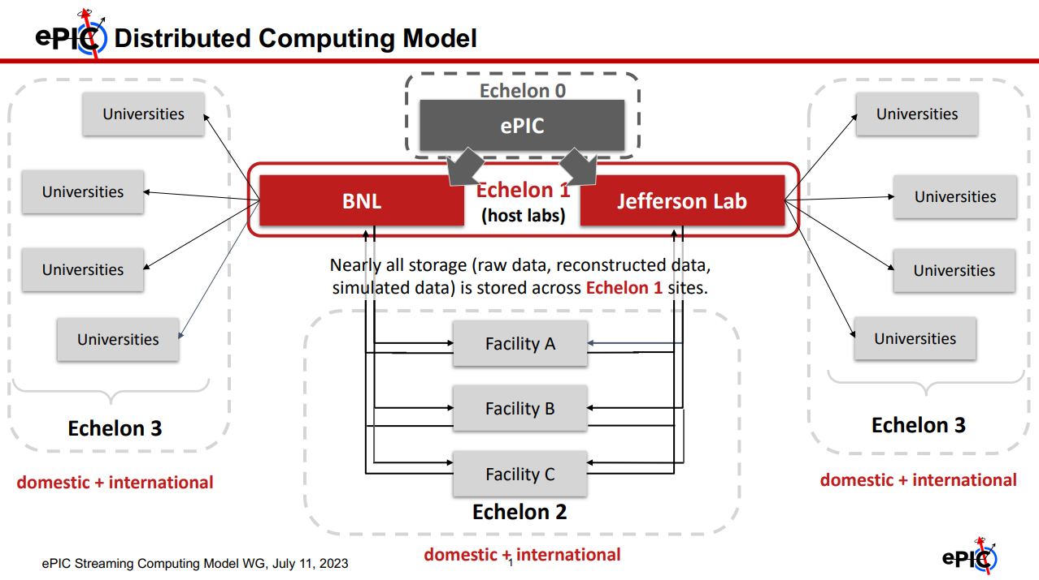
ePIC Scientific Computing
Charge #1 – feasibility and technology
The organization of the scientific computing is handled by the ePIC collaboration
The computing group is actively implementing the scientific software as well as defining the data model to best interact with the streaming DAQ system.
A primary goal for this collaboration is to provide an environment that can provide a real-time interplay with the running experiments.
For more information reference this review or planned reviews of the ePIC software
August 22, 2022 – EIC Software Infrastructure Review https://indico.bnl.gov/event/16676/
October 19-20, 2023 - ePIC software and Computing model review
December, 2023 - ePIC presents the updated computing model to he EIC Resource and Review Board

Slide 14
Charge #2 – Requirements
ePIC DAQ Requirements Summary
General
Requirements
Read out all detector data and transfer to external facilities
Prefer COTS solutions to avoid cost, risk, obsolescence
Functional
Requirements
Sufficient space, power, environment, and proximity to sensors
Streaming, continuous operation, while supporting independent detector operation
Define components and specify the DAQ must provide sufficient links and processing power
Provide common hardware, software, and network for detector slow controls efforts
Performance
Requirements
Specific Environmental/Power requirements
Online Computing Network must support >=100Gb/s per node and >=400Gb/s external
Readout fibers from Front ends must support >=10Gb/s per fiber and 10Tb/s aggregate
Timing system must deliver clock with <100ps jitter, and support <5ps jitter for selected detectors
72 hours of elasticity buffer in online computer nodes
Sufficient computing power to perform needed online processing

Slide 15
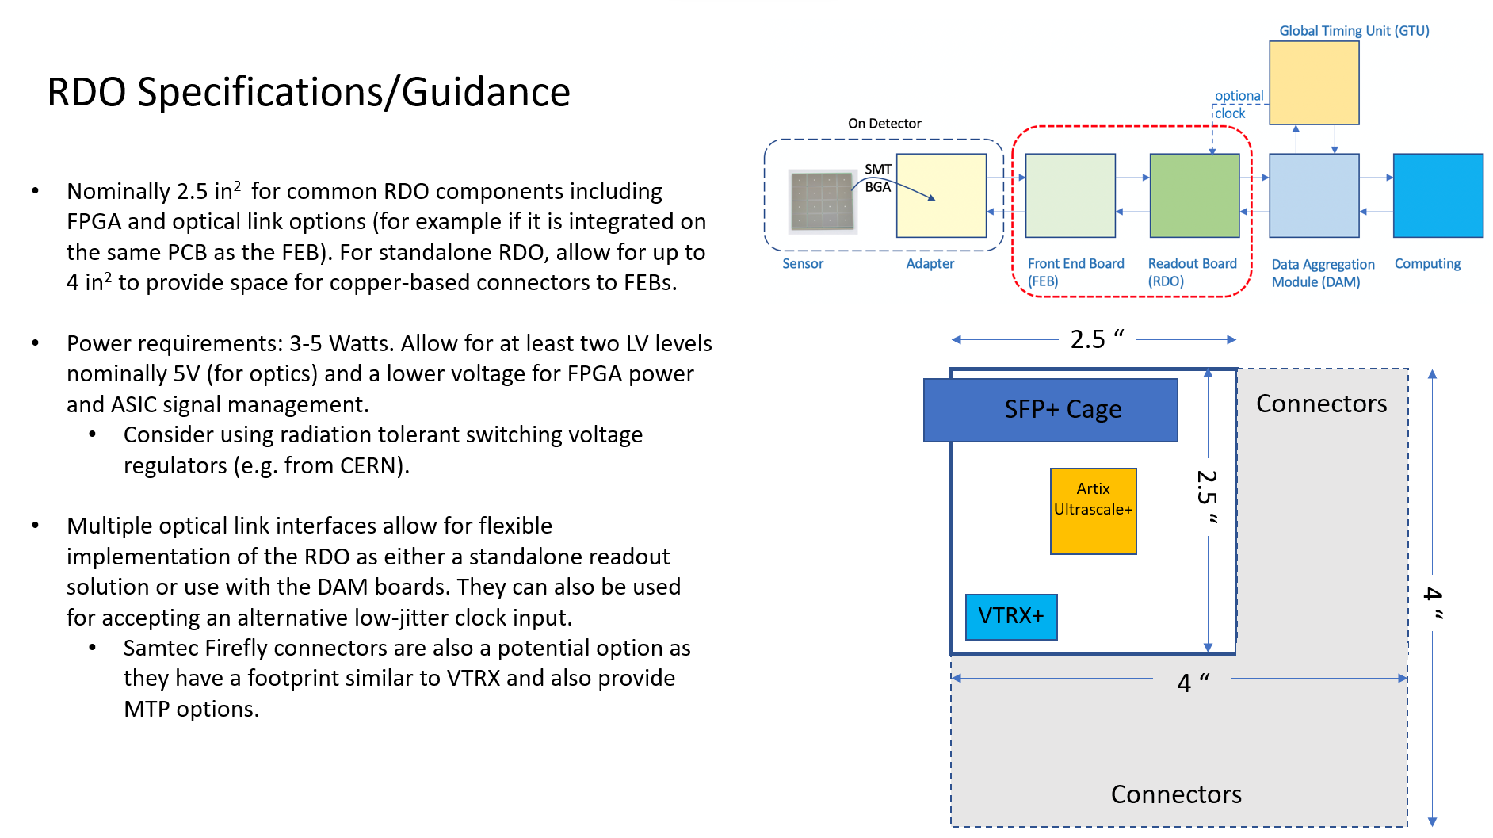
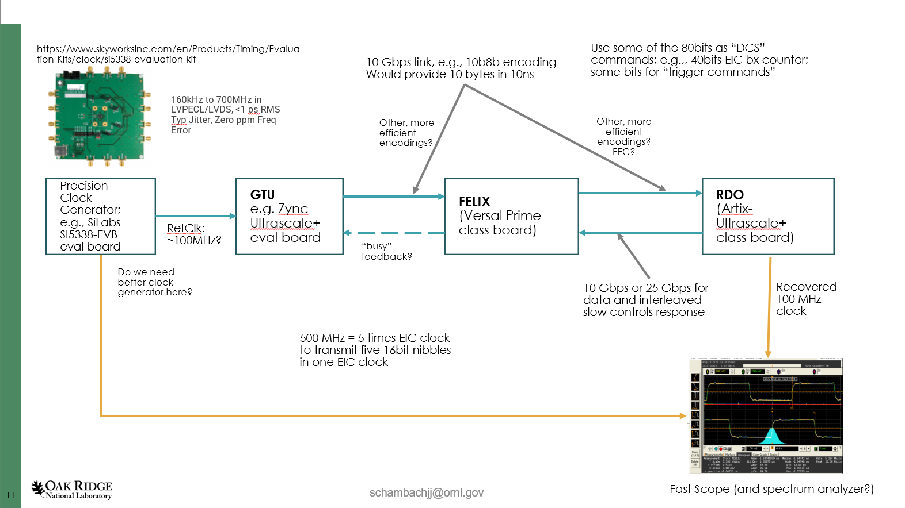
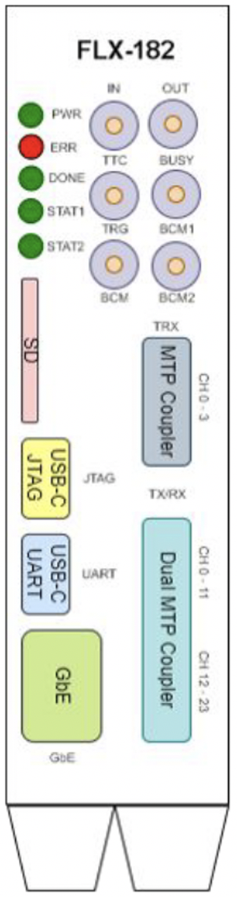
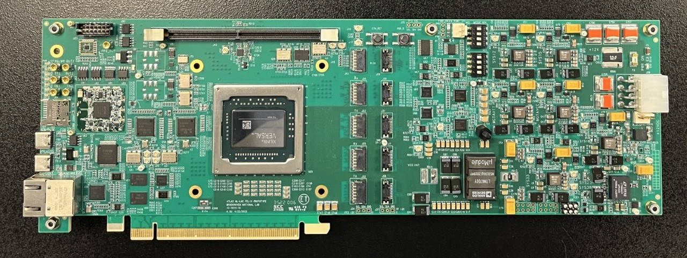
System Component Status
Charge #5 – Design Maturity
Detailed Electronics Design starts with CD3. The current status is that we are evaluating system design and interactions between components
RDO Status:
Mocking up with devkits for initial studies
Nominal 2.5” x 2.5” for common elements + connector space
FPGA defined by price (Artix Ultrascale+ Class)
Power 3-5 Watts. 2 LV +5V for optical interfaces, lower for FPGA/digital components
Accept 2 or 3 fibers for potential Hi-Res Timing
Timing Protocol
Defines the data flow between the GTU, RDO, and DAM boards
Optical Protocol Requirements
Timing (<=5ps Hi-Res Detectors)
Timing (<=100ps Lo-Res Detectors)
Timing phase stability on power cycle
Configuration and slow control monitoring passthrough for ASICS/FEBs
Real-Time Command / Control
Data Transfer (>=10 or 25 Gb/s per RDO)
Optical protocol choices under evaluation
ePIC – simple custom protocol
GPT in FPGA
Dedicated Clock/Reconstructed Clock (2 or 3 fibers per RDO)
GTU status:
Mocking up with devkits for initial studies
Interface to collider (Bunch crossing clock, Spin Patterns per bunch crossing)
Distribution of timing to ~100 DAMs + ~220 RDOs of Hi-Res Timing Detectors
Interface to Run Control
DAM Status:
Obtained Board From Omega
Versa FPGA
24 x 10 PCIe Gen4 x16 or 100Gb Ethernet
24 Firefly links 10Gb/s or 25Gb/s options
48 link upgrade planned
Additional front panel I/O

Slide 16
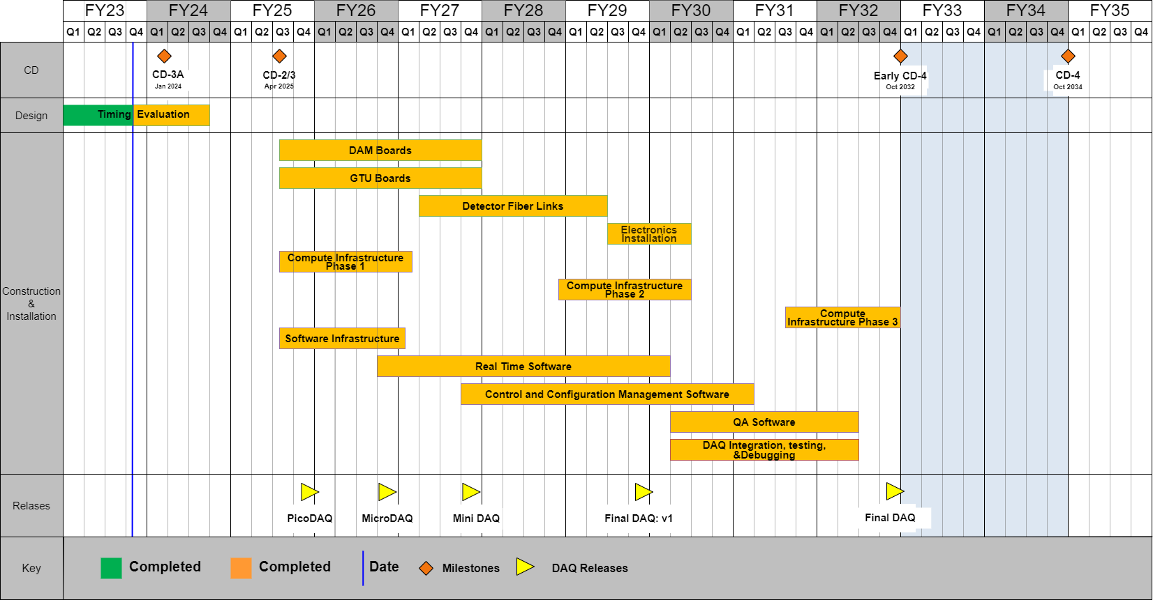
EIC DAQ/Computing schedule
Charge #6 – Schedule
The DAQ and computing schedule is planned to be somewhat accelerated in relation to the full detector construction.
A functional DAQ will be necessary for small scale detector testing as well as commissioning and pre-ops.
Hardware and software development early in the construction phase will produce a series of releases with increasing functionality
Computing resources are staged in order to make purchases when the hardware is needed, taking advantage of price savings and performance improvements in time

Slide 17
Conclusion
Given the detector progress over the last two years and the status of the ePIC detector, are the projected timelines of the Electron-Ion Collider detector feasible? Do there remain significant open detector technology questions?
We have presented the technologies and status of their development for the ePIC DAQ
Are the requirements for the detector and their flow down sufficiently comprehensive for this stage of the project to complete the design of the various detector technologies
We have summarized the DAQ requirements
Are the interfaces between the elements of the design adequately defined for this stage of the project and to proceed with the detector long-lead procurement items?
The interfaces are defined, but there are no LLP directly defined by 6.10.09
Is the design of these long-lead procurement items sufficiently advanced and mature to start procurement in 2024? Are the technical specifications complete?
N/A, no LLP for 6.10.09
Is the projected design maturity of the further detector components likely to be accomplished by the end of 2024 for CD-2 and CD-3?
The system should be fully defined by the end of 2024, although electronics board design starts with CD3
Is the overall schedule for completion of the design, production, and installation of detector components realistic?
We have presented the scope and schedule of the DAQ system

Slide 18
Backup

Slide 19
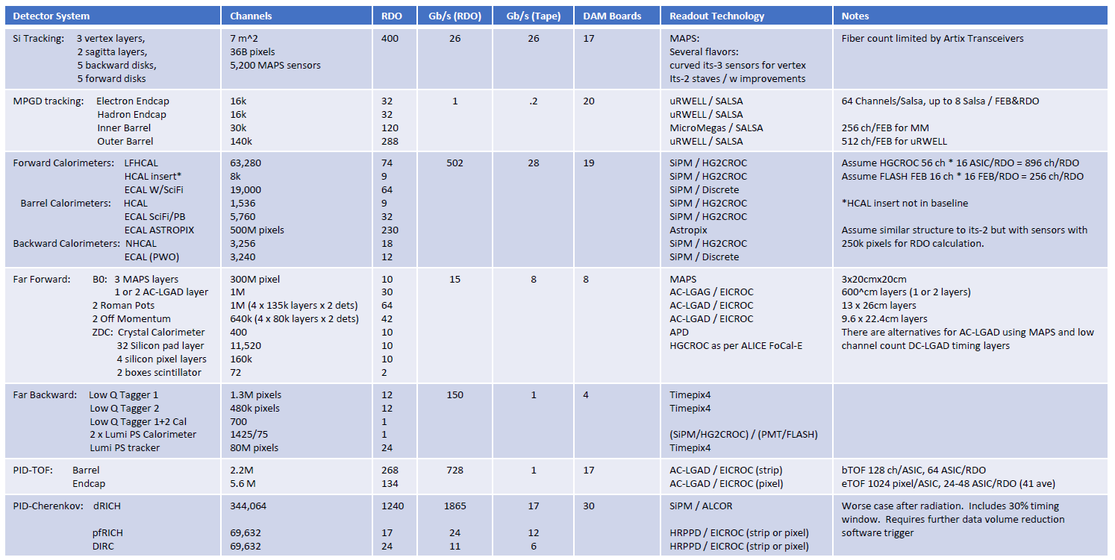
EPIC Detector Scale and Technology Summary:

Slide 20
RDO Discussions
Physical Characteristics
Locations
Size
Power / Cooling
Radiation Requirements
Link distances/rates
Optical Protocol Requirements
Timing (5ps / 50-100ps)
I2C for ASICs/FEBs
Real-Time Command / Control
Data Transfer (10Gb/s / 25 Gb/s)
Optical Protocol Choices
ePIC – simple custom protocol
GPT in FPGA
Dedicated Clock/Reconstructed Clock (2 or 3 fibers/RDO?)

Slide 21
RDO Discussions
RDO / Timing subgroup to mock up GTU/DAM/RDO to answer these questions
Slow startup due to time constraints of group members
Devkits being distributed
Arrangements for FELIX 182 slow but progressing
Hope to start getting answers this fall
Protocol document
Timing measurements

Slide 22
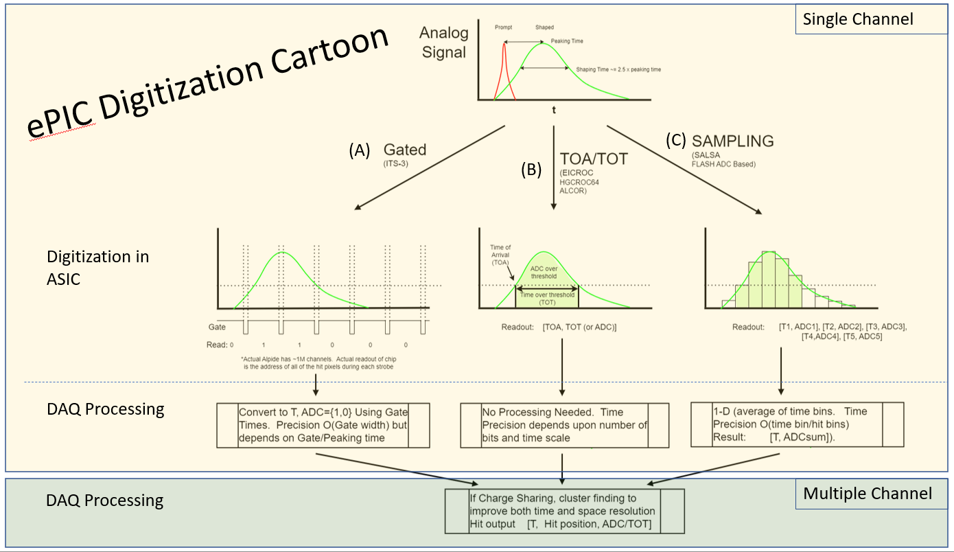
Data Volumes
Distilled volumes from
Background Group Simulations provide hits/sec above detector thresholds
Synchrotron Radiation
Hadron Beam
Electron Beam
DIS (18x275 scaled to 500khz)
Noise estimates from
“digitization spreadsheet”
E&DAQ WG presentations
Bits / hit = Charge Sharing *
Hit Duration *
Bits Per Hit
Cluster finding (where possible) reduces hit size to BitsPerHit
Cluster finding (when possible) reduces noise x 10^-5
Software “triggering” for Far Backward/dRICH
Charge sharing / Time Sharing / noise estimates should be considered VERY preliminary

Slide 23
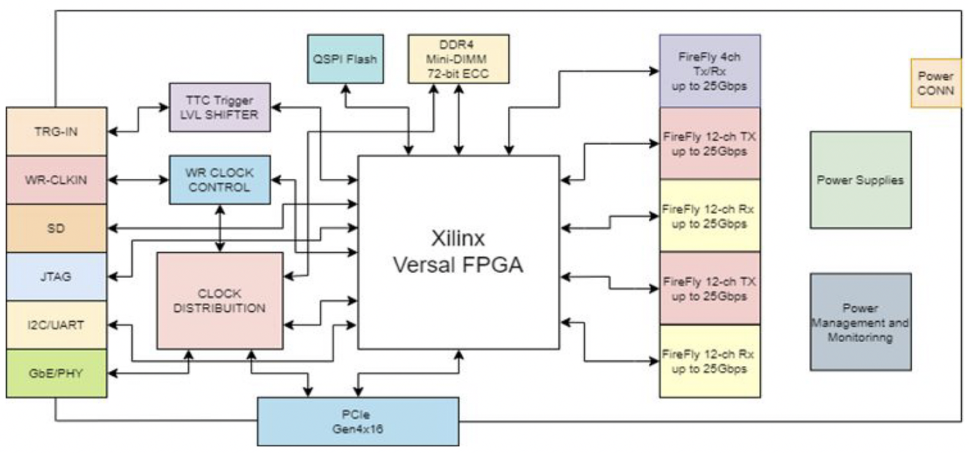
DAM Option - Front-End Link Exchange (FELIX)
Originally developed for ATLAS at CERN
Design team is based at Brookhaven
Current version (FLX-172) in use at BNL for sPHENIX
New board being prototyped now for ATLAS HL-LHC running.
FPGA: Xilinx Versal Prime XCVM1802
PCIe Gen4 x16
24 Firefly links with 3 config options
24 links @ 25Gbs
24 links @ 10Gbs
12 @ 25Gbs + 12 @ 10Gbs
4 additional Firefly links
Front Panel: Fiber I/O
Additional 3 Inputs, 3 Outputs
1 DDR4 Mini-UDIMM
USB-JTAG/USB-UART
Block Diagram of FLX-182 Prototype
Notes: The Xilinx Versal Prime is a SoC.- Dual Core ARM Cortex
Power usage ~133W. No power through PCIe.
Can be implemented as a stand alone device (no Server)

Slide 24
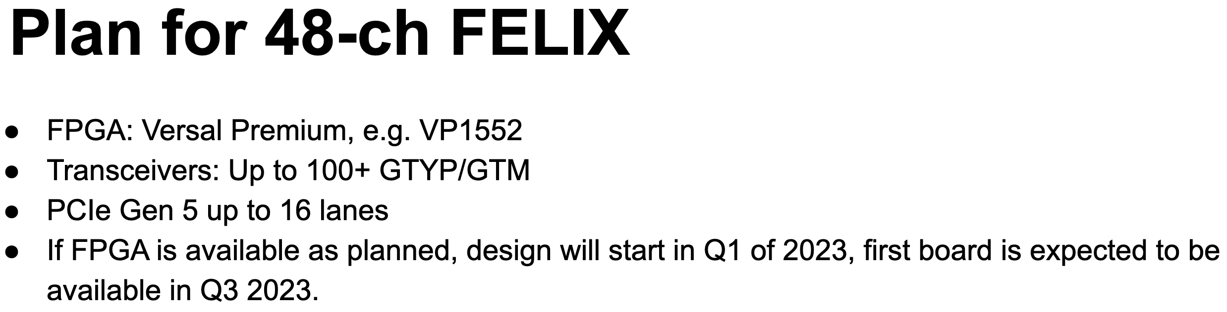
FELIX timelines
10 boards were produced in early 2023.
DAQ Working Group has recently acquired one of these boards for testing
General technical support for the FELIX Hardware should be available through the end of HL-LHC operation.
(i.e. into the late 2030s for Run 5)

Slide 25
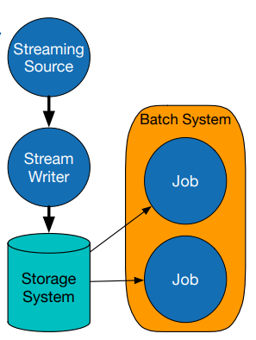
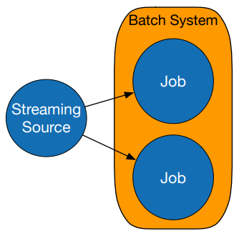
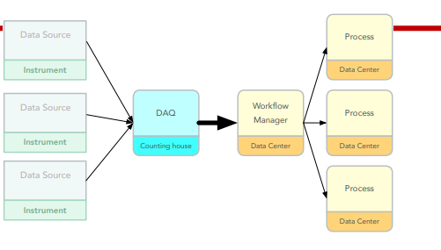
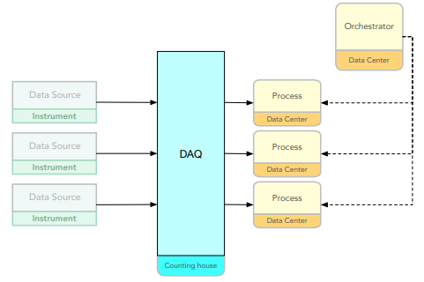
S&C Streaming DAQ WG
Two streaming concepts
(Electronic) No Level-0 trigger
(Institutional) Rapid turn around of reconstructed data (streaming as opposed to batch processing)
The focus of the group is the institutional requirements and organization
International Collaboration
Tasks to be done and associated institutional requirements
Support for streaming model
Automated data handling
Automated calibration tools
Automated monitoring tools
We expect this may lead also to links between the DAQ and the streaming reconstruction for rapid turn around of critical information such as calibrations
Batch options: (reconstruction is human driven)
Streaming options: (reconstruction is data driven)
Graham Heyes

