Slide 1
WBS 6.10.12
Pre-Ops Detector
E.C. Aschenauer (BNL)
EIC Detector Comprehensive
Design Review
August 29-30, 2023

Slide 2
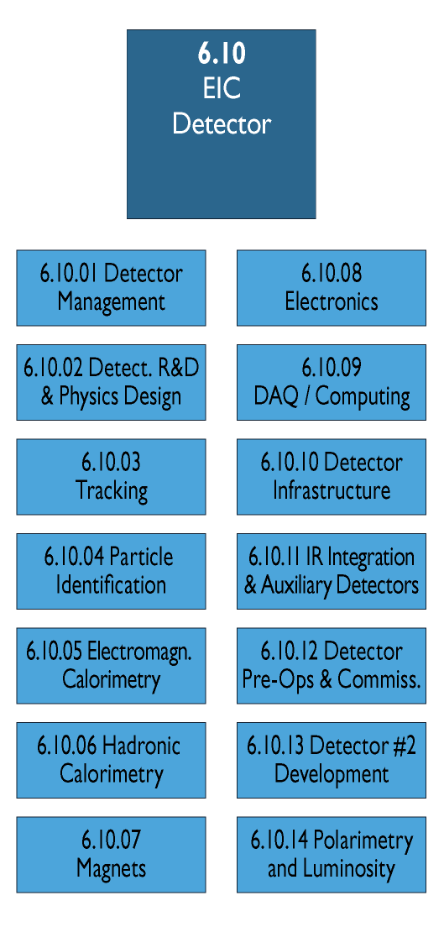
WBS 6.10.12 Pre-OPS
Scope:
This WBS covers all activities to commissions the detector first with cosmic and then with beam to be ready for data taking.
Big Picture:
Two commissioning periods
  First detector commissioning in assembly hall with cosmic
  Commissioning with beam
Note:
all subcomponents will be tested before installation not part of Pre-Ops
during collider commissioning without detector, we will have the beam-pipe around the IP with detectors to understand backgrounds and other beam related parameters

Slide 3
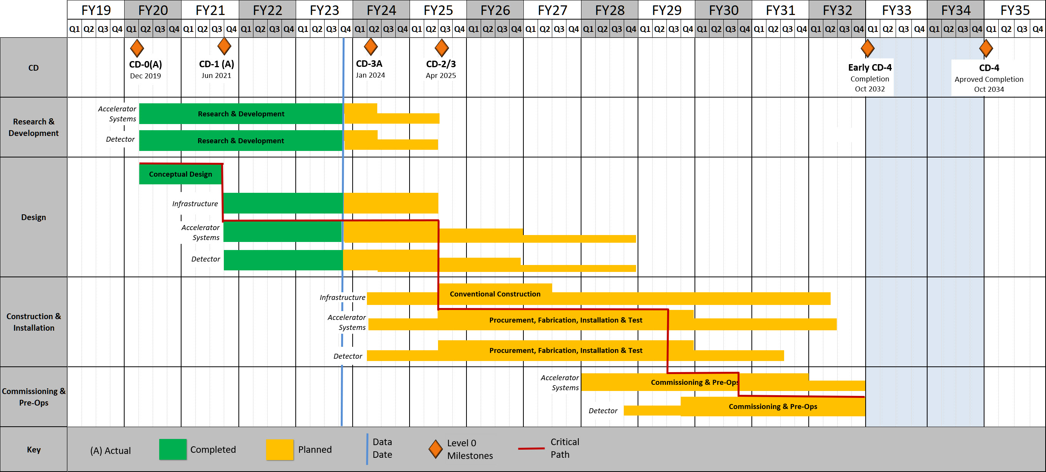
EIC high Level Project Schedule
Recent change replaced CD-4A with project internal milestones - PO_0305_0900:
  Detector Assembled and Ready for Cosmic Data Taking
  → this milestone is a predecessor for L2 milestone
  L2_0600-Construction of Components Complete

Slide 4
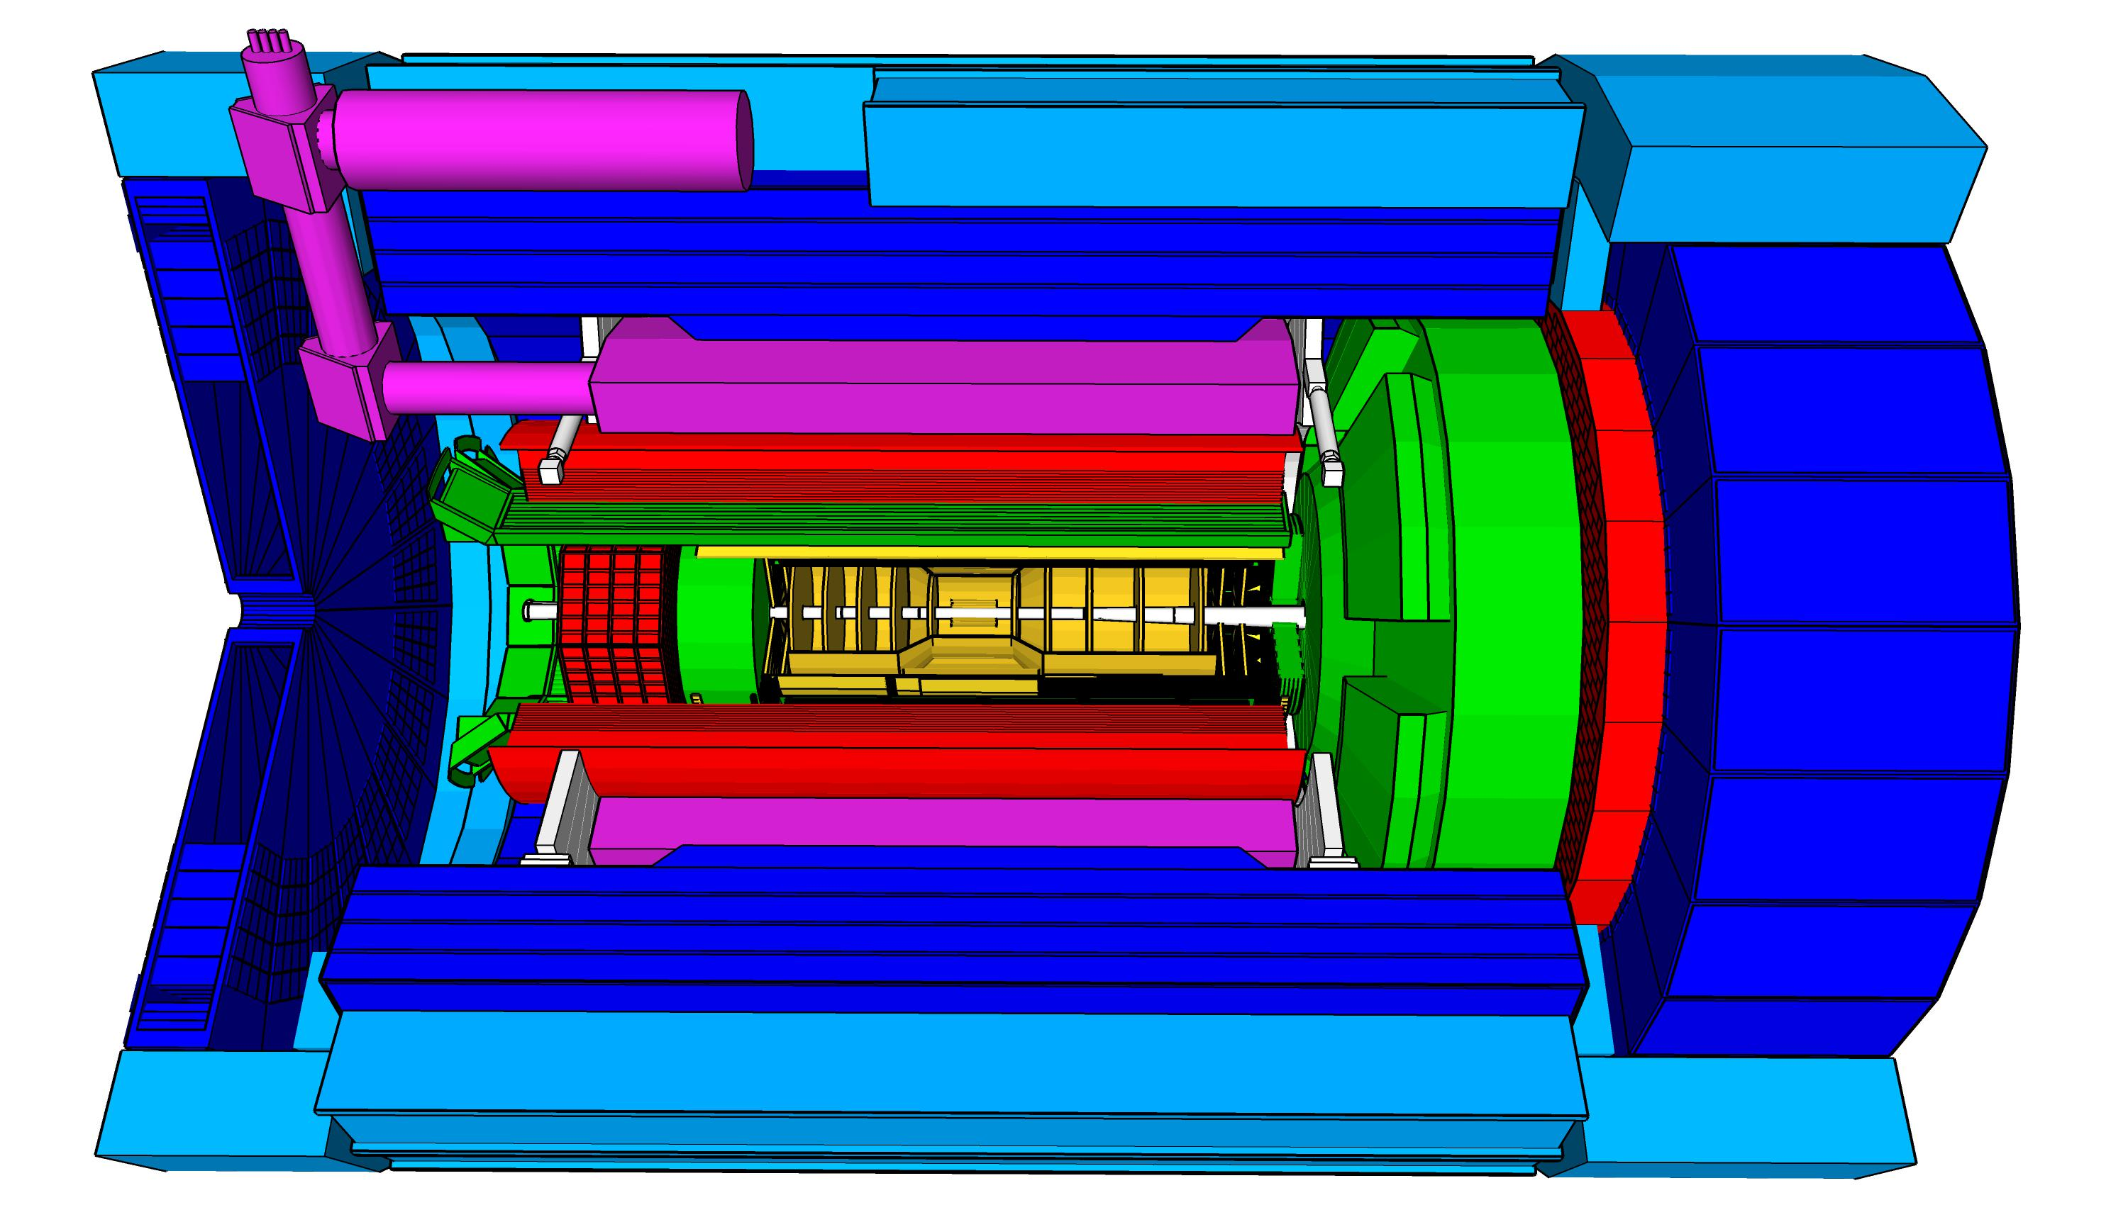
High Level Installation Schedule
Oct 2028
Jan 2029
CD-3
04/2025
April 2029
Milestone
PO_0305_0900
CD-4
09/2034
Dec 2029
early CD-4
09/2032
June 2030
Oct 2030
Jan 2031
Construction
Pre-OPS
IR-6 ready
for installation
Detector Assembled and Ready for Cosmic Data Taking
Early start of
Operations
&
Science
Start of
Operations
&
Science
lower half
barrel Hcal
installed
Solenoid
delivered
Endcap HCals
completed
Solenoid
Field mapping
done in beam position
Hadron Endcap
Detectors
installed
Trackers, dRICH
ECal
done in IP-6 Assembly Hall
Barrel Ecal
ready
for installation
Barrel Hcal
& Solenoid
installed
followed by low
power test
Lepton Endcap
Detectors
installed
Trackers, bRICH
ECal
Barrel Detectors
installed
ECal, DIRC,
ToF, Trackers
Take Away:
Solenoid and Barrel HCal need to be ready by Jan 2029
all other subdetectors need to be ready between 06/29 to 06/30 depending on their location in the detector

Slide 5
KPPs for Detector
PreOps activities aligned with original CD-4A KPPs
KPP | Performance Measure | Threshold KPP | Objective KPP | Ultimate PP
DET-4a | Detector | Detector subsystem component testing complete. | Detector subsystems constructed and tested with cosmic rays. | Same as Objective
Detector sits as a whole in the assembly hall and gets tested with cosmic
KPP | Performance Measure | Threshold KPP | Objective KPP | Ultimate PP
DET-4 | Detector | Detector installed and ready for beam operations. | Inelastic scattering events in e-p and e-A collisions measured in Detector. | Inclusive, semi-inclusive, and exclusive events measured as the basis for 3D maps of subatomic quark-gluon structure.
Detector is moved into the collision hall to take first collision data

Slide 6
Resource Assumptions
For shift-work, we assume one person each shift is dedicated to project requirements, with further shift-personnel contributed by the EIC user community. We assume a little over 5 weeks of dedicated 24/7 operations for detector commissioning, which amounts to 880 hours of science labor.
For magnet commissioning and detector commissioning with cosmic tests, we assume the magnet commissioning is dominated by technical labor, and the detector commissioning by scientific labor. For the latter, we assumed 1 FTE-year on average per detector technology, bridging a two-year period, with 1/2 of this for technical labor for repairs. The magnet commissioning is assumed to also bridge two year, but with ramped down efforts the second year, with 8 FTE-years integrated.
For the full-system detector cosmic tests, we assumed two people 24/7 for a full integrated time period of 5 weeks, and 10 weeks of intermittent work on repairs by technical staff (two people, for 12 hours each day, including weekends).
A significant load of the commissioning will be covered by the scientific collaboration

Slide 7


