Slide 1
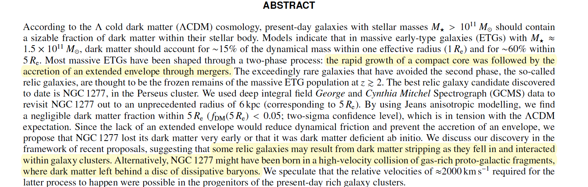
The massive relic galaxy NGC1277 is dark matter deficient
From dynamical models of integral-field stellar kinematics out to five effective radii?
A&A 675, A143 (2023)
https://doi.org/10.1051/0004-6361/202346291

Slide 2
At first, the massive ETG progenitors
suffer a dissipative collapse that results in a compact rotating object (known as a blue nugget) whose star formation is rapidly quenched perhaps due to active galactic nucleus (AGN) feedback.
During the second phase, the passive evolution of the stellar population turns the blue nugget into a red
one, and most of the growth of the stellar mass of the object comes from the accretion of an extended pressure-supported envelope through dry accretion.

Slide 3
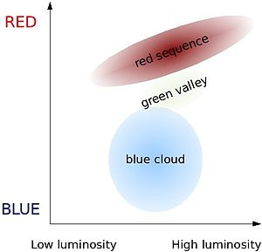
Galaxy Color Magnitude Diagram wikipedia
Late Type Galaxy – has blue, younger stars (like formed lately),
more star formation., flatter shapes spirals and disks
Early Type Galaxy – has redder, older stars ( like formed early),
not much star formation, rounder shapes like ellipticals
Increasing
metallicity
Collisions can
trigger change from
Blue cloud to red sequence
Collapse directly from ”uniform” universe
Makes “blue nuggets” star-forming compact regions , likely by direct collapse
Stars in nugget age and redden, making red nugget.
If the nugget resides in a region with gas or collisions,
more gas can be incorporated, disk or outer part can grow
New star formation can quenched by running out of gas or strangulation

Slide 4
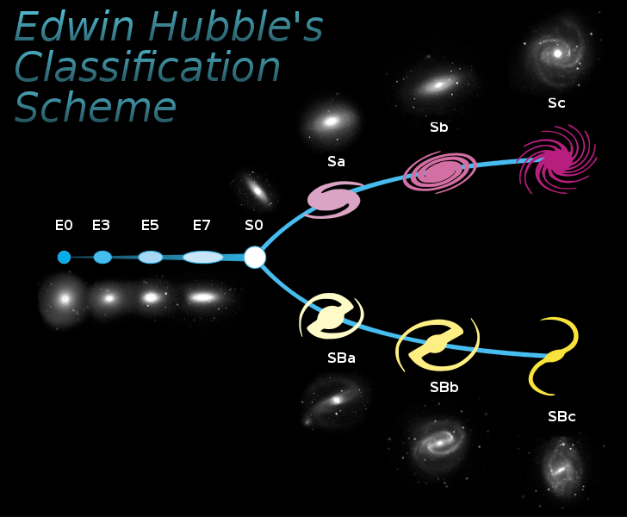

Slide 5
Collapses, due to gravity,
Stars form,
blue, due to youth
Blue Nugget
Stars age and Redden
Red Nugget
Gas and DM?
Gas Used Up
Possible mass growth by dry accretion from mergers
Typically Large BH for the mass involved
Time ->

Slide 6
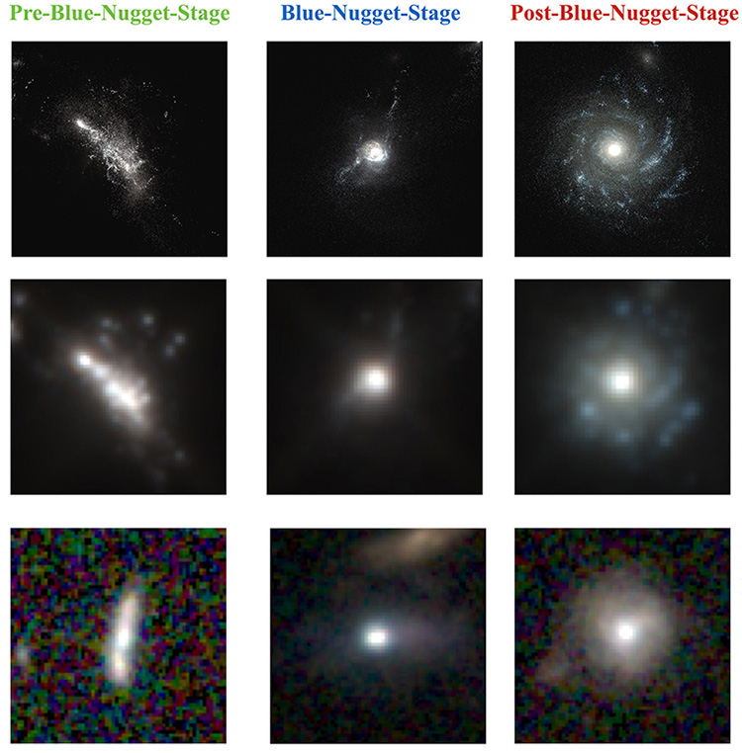
Images of Simulated Blue Nuggets
https://www.universetoday.com/tag/blue-nuggets/
“Deep Learning Identifies High-z Galaxies in a Central Blue Nugget Phase in a Characteristic Mass Range
Arxiv 1804.07307

Slide 7
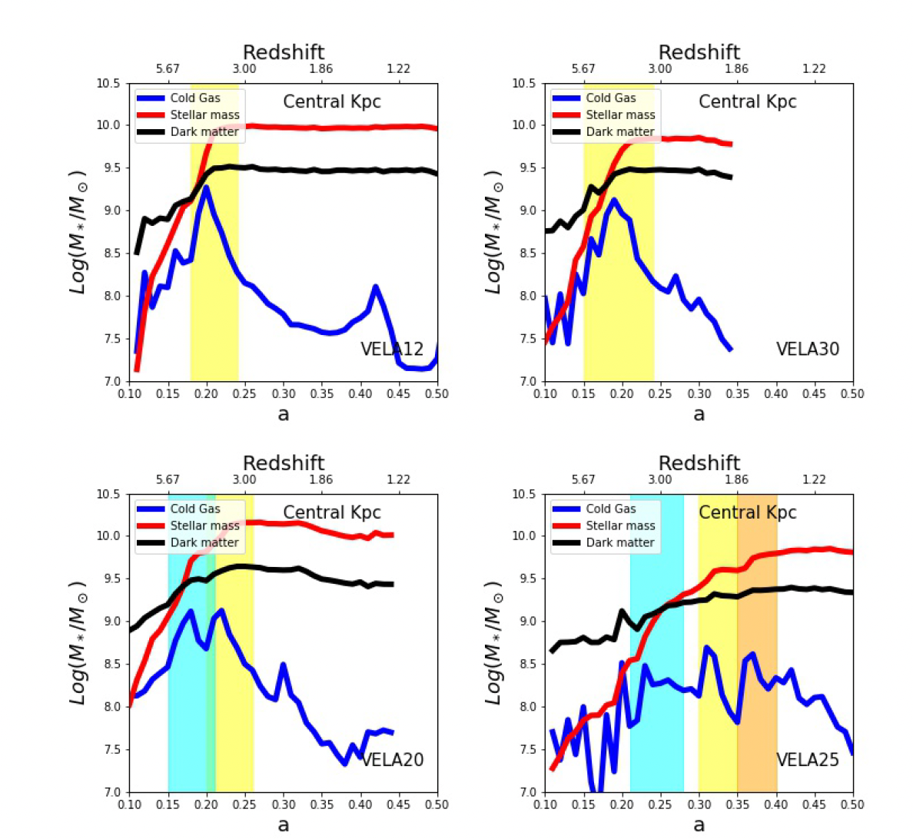
Figure 1. Definition of the different phases. Both the cold gas and the stellar mass in the central kpc are used to define the BN phase. The blue and red line show the evolution of the cold gas and stellar masses in the central kpc as a function of time. The black line is the dark matter mass. (Adapted from Zolotov et al. 2015). The yellow shaded region shows the main BN event as defined in this work (see text for details). The second and third events are shown in cyan and orange respectively. The ranking refers to the intensity of the event and no to the time of occurrence (see text for details). Each panel shows a different galaxy.
The top panels show clear examples of massive galaxies with one unique BN phase. The bottom panels show more complex cases with more than one BN event

Slide 8
Red Nuggets could be seen in the low z universe as nuclei of Massive Galaxies. But then there is pollution by the material accreted. When a galaxy undergoes many collisions, the core is disrupted. But if there are some Red Nuggets which has escaped collisions and mergers, then it would be good to study.
NGC 1277 seems to be a galaxy that has lived in such a low interaction area.

Slide 9
Data Sources and Assumptions
George and Cynthia Mitchell Spectrograph
(GCMS), an integral field spectrograph at the 2.7m
Harlan J. Smith telescope at the McDonald Observatory. Fibers 4.16”
The adaptive optics-assisted Near-infrared Integral Field Spectrometer (NIFS;
McGregor et al. 2003) at the Gemini North telescope.
Assume a flat Universe with a Hubble-
Lemaître constant of H0 = 71 km s⁻¹ Mpc⁻¹ and a matter density m0 = 0:265
Given a redshift of z = 0.017195 for the Perseus Cluster (Bilton & Pimbblet 2018),
we determine that the comoving distance to the galaxies is d = 72.4 Mpc.
The luminosity distance is d_{L} = 73.6 Mpc and the angular diameter distance is
d_{A} = 71.1 Mpc, which means that 1” corresponds to 345 pc.

Slide 10
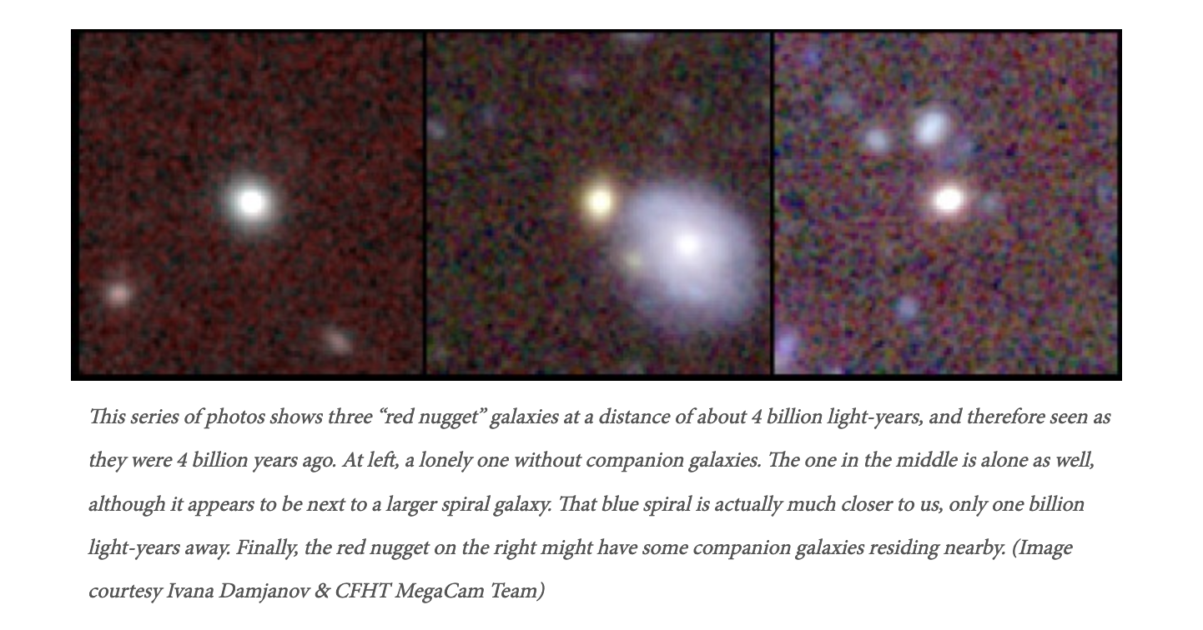
DISCOVERY OF NINE INTERMEDIATE REDSHIFT COMPACT QUIESCENT GALAXIES IN THE SLOAN
DIGITAL SKY SURVEY
Ivana Damjanov, Igor Chilingarian, Ho Seong Hwang, and Margaret J. Geller
Red Nuggets between redshift z = 0.2 and z = 0.6, in the Sloan Digital Sky Survey (SDSS) spectro-
photometric database. All nine galaxies have archival Hubble Space Telescope (HST) images. Surface
brightness profile fitting confirms that all nine galaxies are extremely compact (0.4 <Re,c < 6.6 kpc
with the median Re,c = 0.74 kpc) for their velocity dispersion (110 < v < 340 km s−1; median
= 178 km s−1)
Dynamical masses >10¹⁰M_{solar}
arXiv:1309.2948v1 [astro-ph.CO] 11 Sep 2013

Slide 11
Seeking Red Nuggets
To identify compact systems we search for objects identified photometrically as stars (in the PhotoObj view) but with a redshift in our target range (from the SpecObj view).

Slide 12
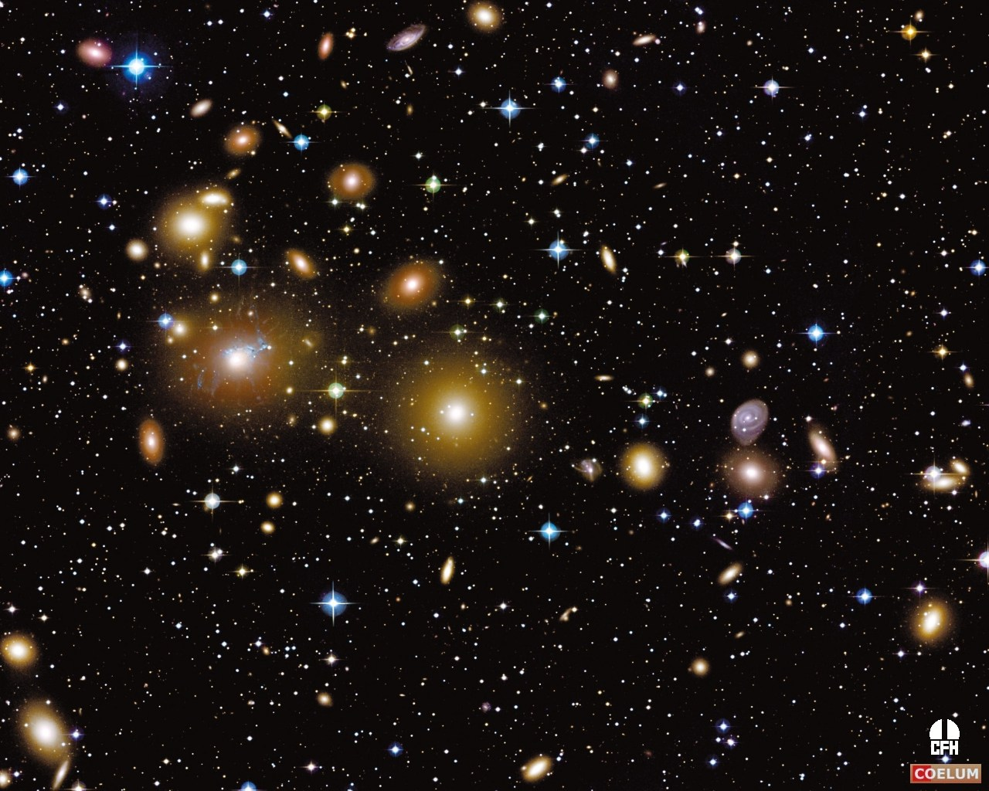
Perseus Cluster from APOD

Slide 13
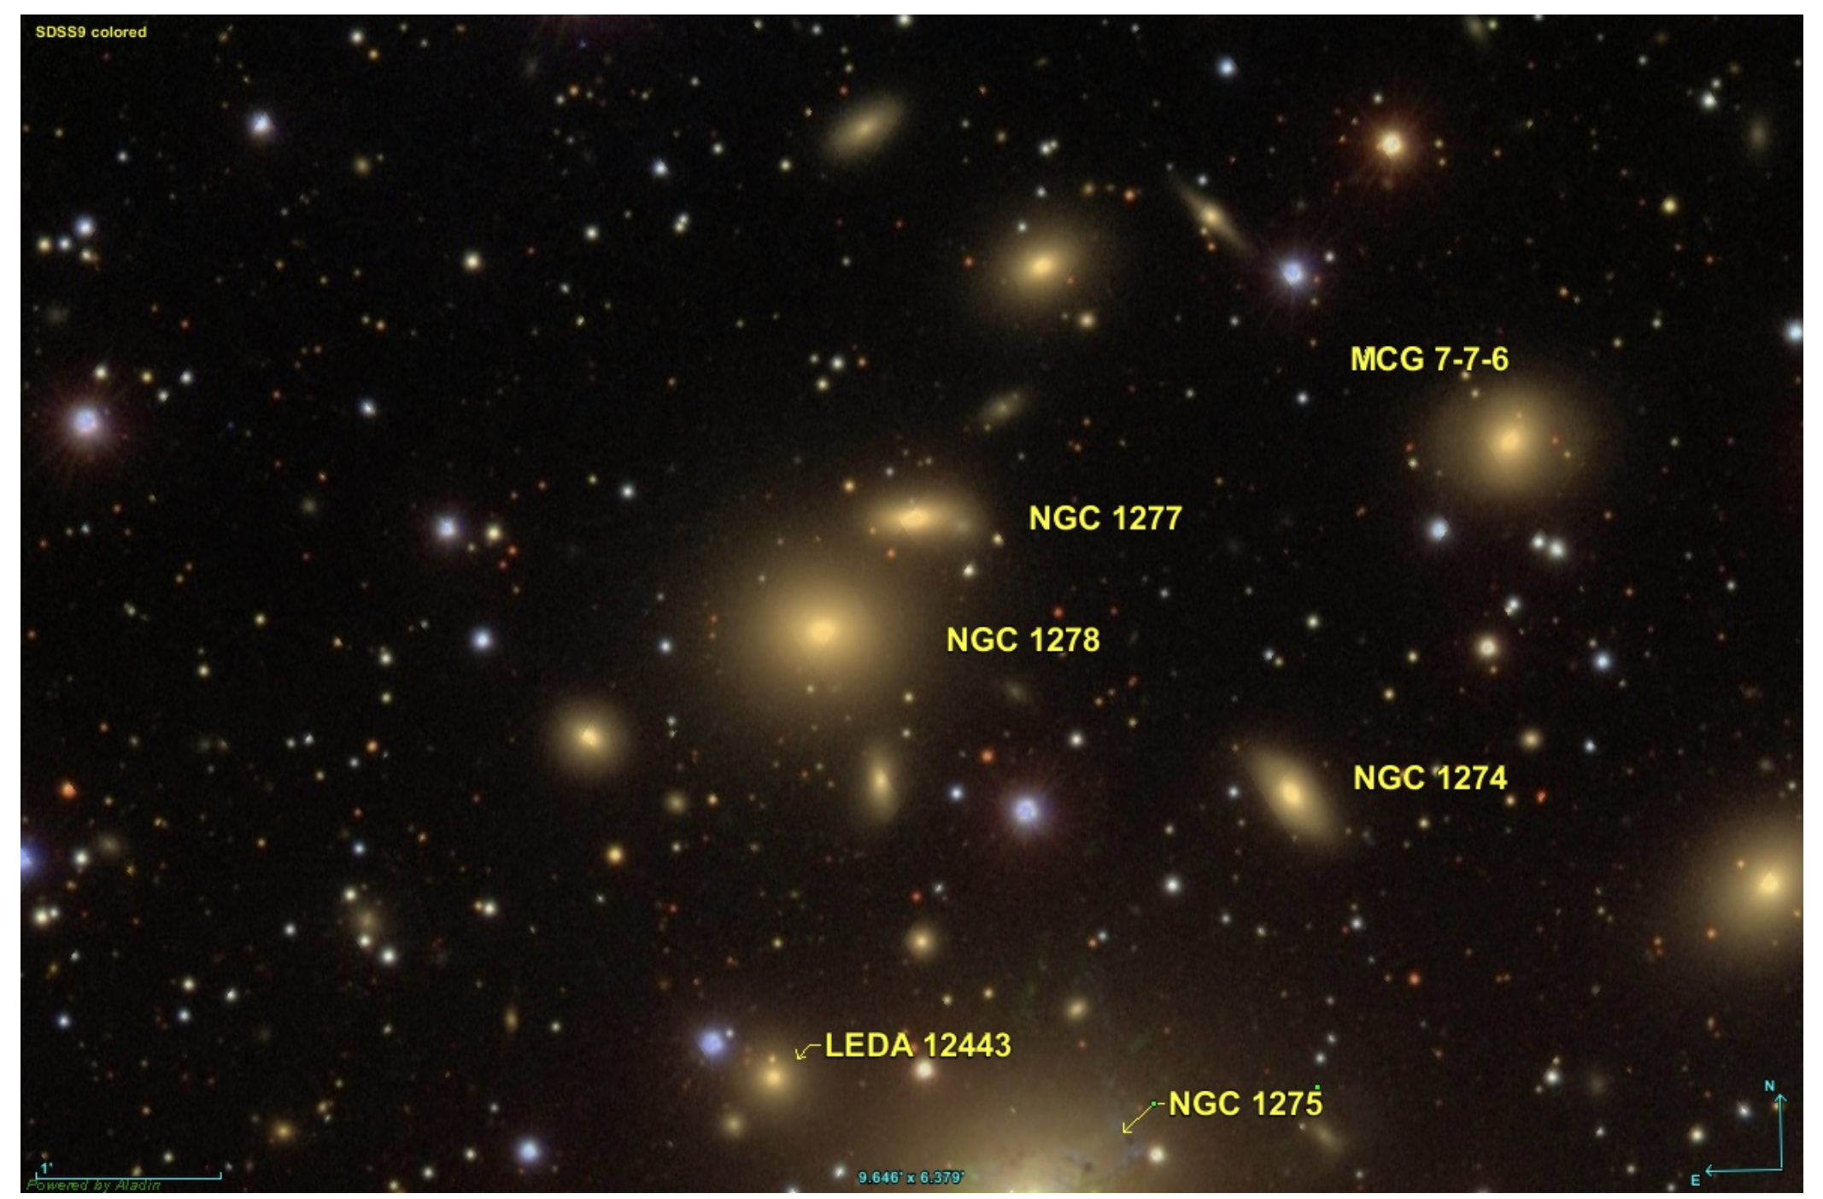
Perseus Cluster with NGC 1277 and NGC 1278

Slide 14
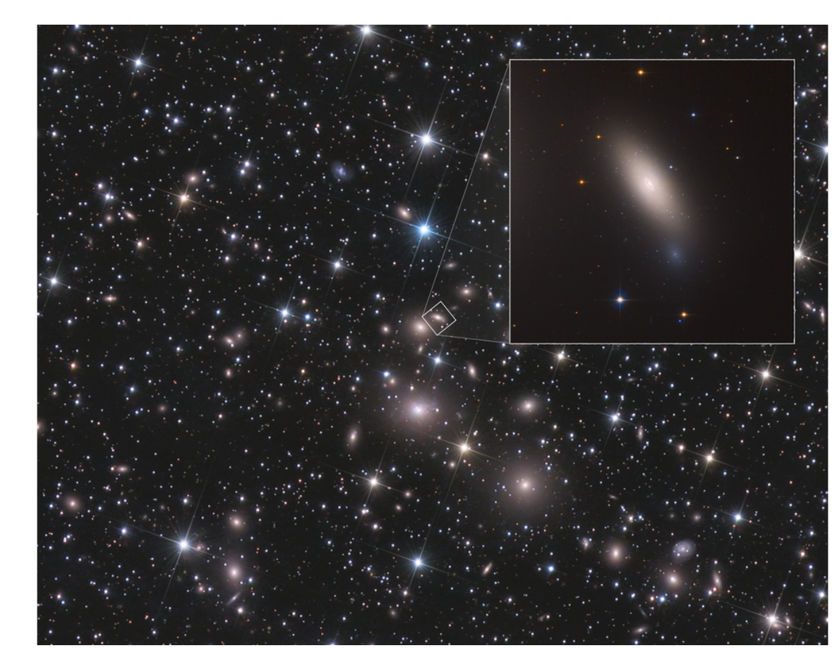
NGC 1277 and NGC 1278
https://hubblesite.org/contents/media/images/2018/17/4135-Image.html
NGC 1277
NGC 1278

Slide 15
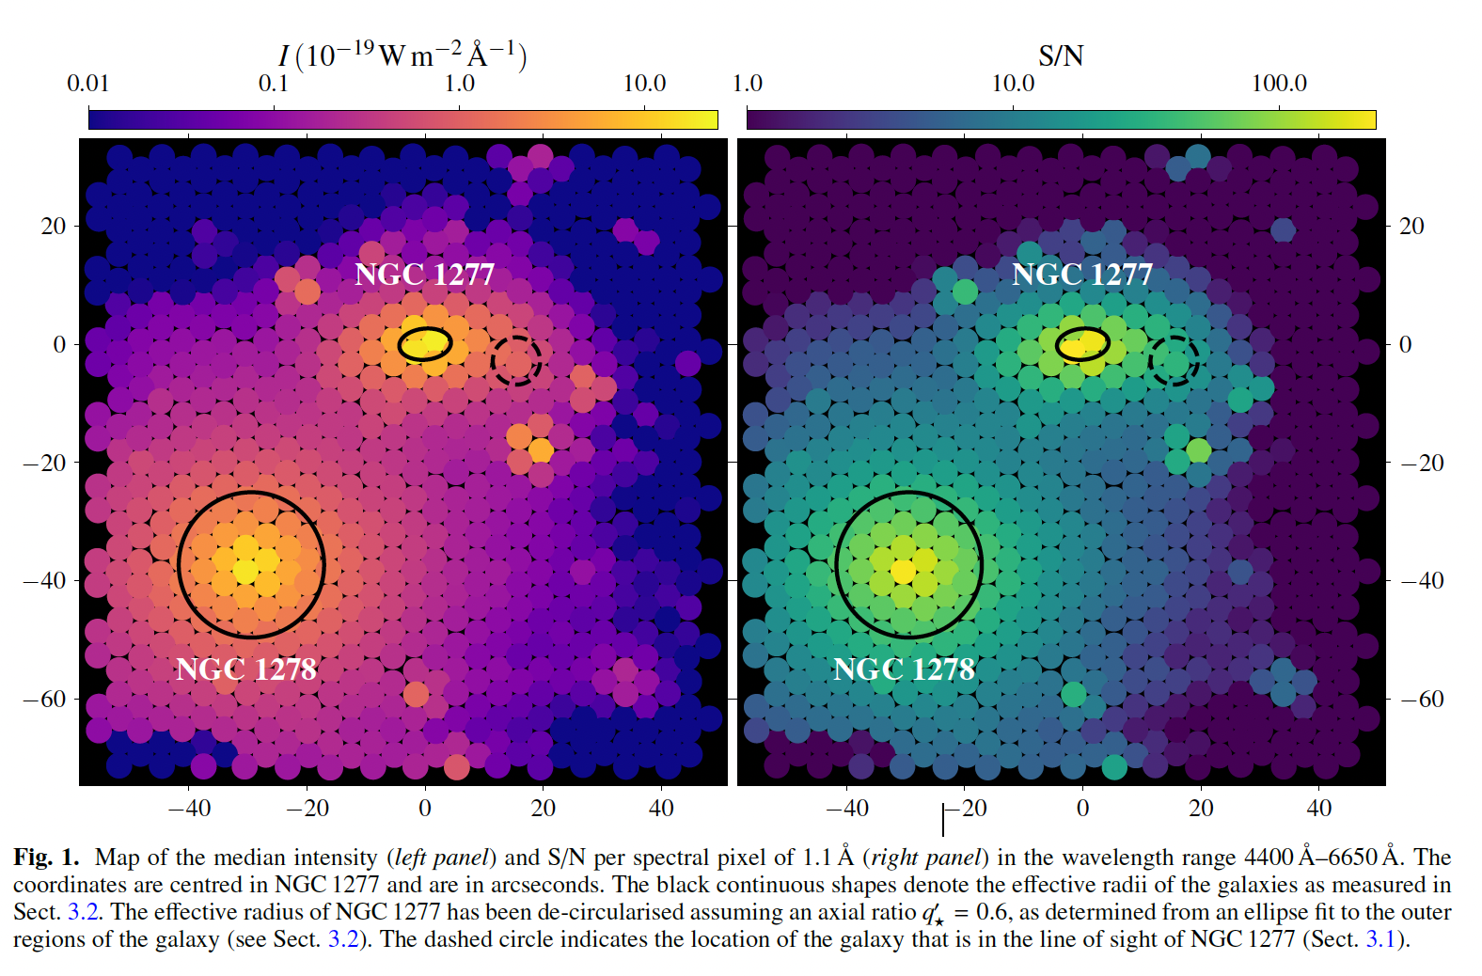
NGC 1277 bottom heavy initial mass function (excess low mass stars)
Fast Rotator
Massive BH
NG 1278 thought to be about the same mass
Measured velocities at distance from center by using several fibers and matching spectrum
With a doppler shifted version. One fiber is 4.16 sec of arc which is 1.3 Kpc at distance 265 Mpc.
The seeing is below the angular diameter of each fiber.
NGC 1277 has a massive BH first est 17x10⁹ M_{solar} later revised down to 5x10⁹ M_{solar}
But still large for a galaxy this size

Slide 16
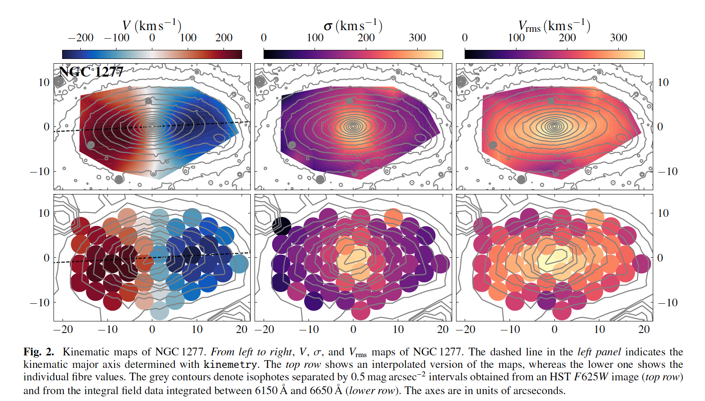
You can see the rotation in general from the leftmost.
The σ is residuals representative of rotation around the center.
The rotation (middle column) goes toward zero at the edges.

Slide 17
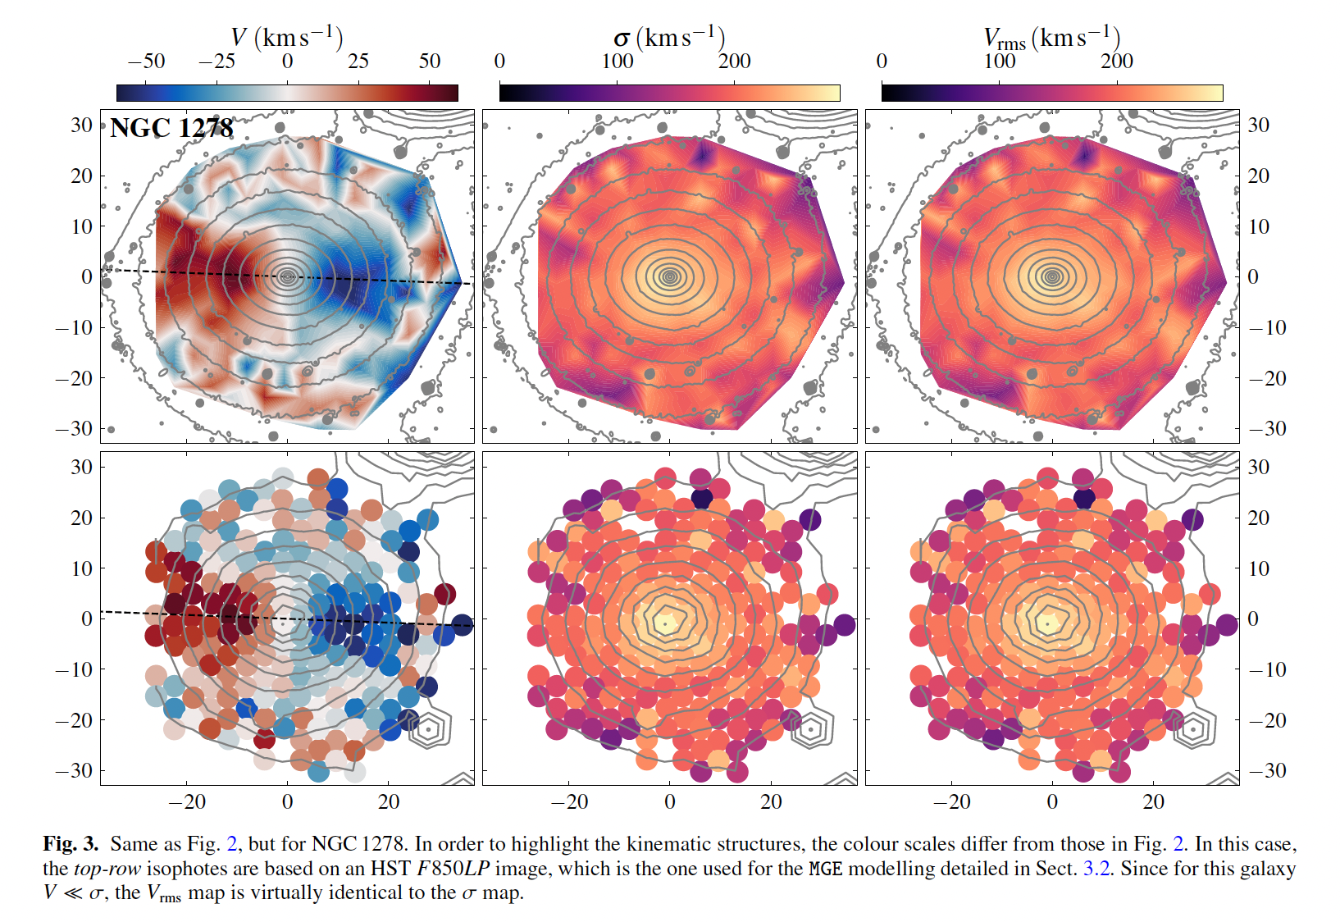
Jeans anisotropic modeling (JAM) is a method of determining the stellar kinematics of early-type galaxies. It uses multi-Gaussian expansion (MGE) to fit the Jeans equations to photometric data of the galaxy without presuming symmetry (isotropy) in the distribution of the motion of its stars.

Slide 18
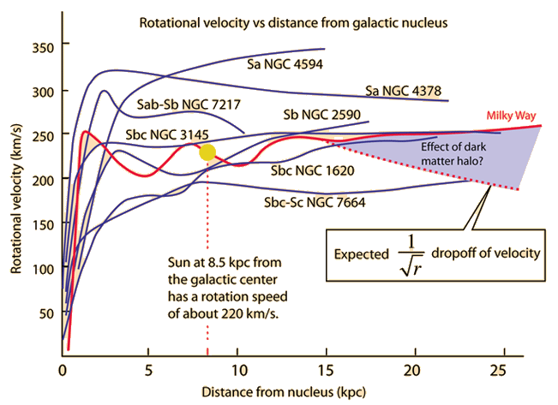
Carroll & Ostlie
Ch 24

Slide 19
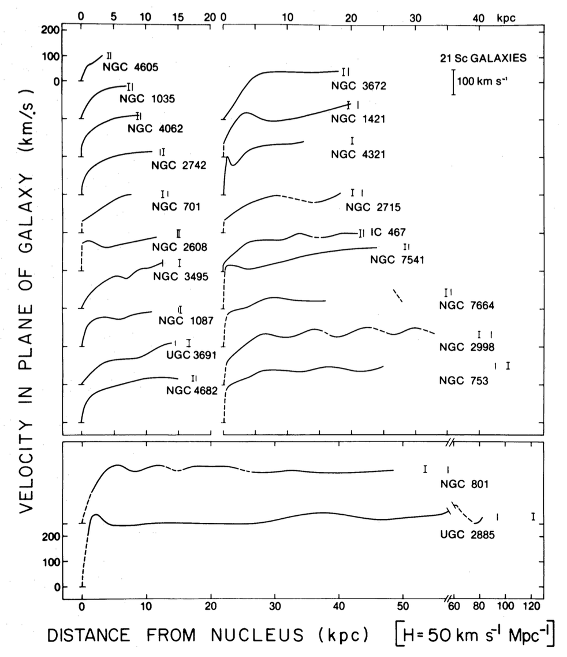

Slide 20
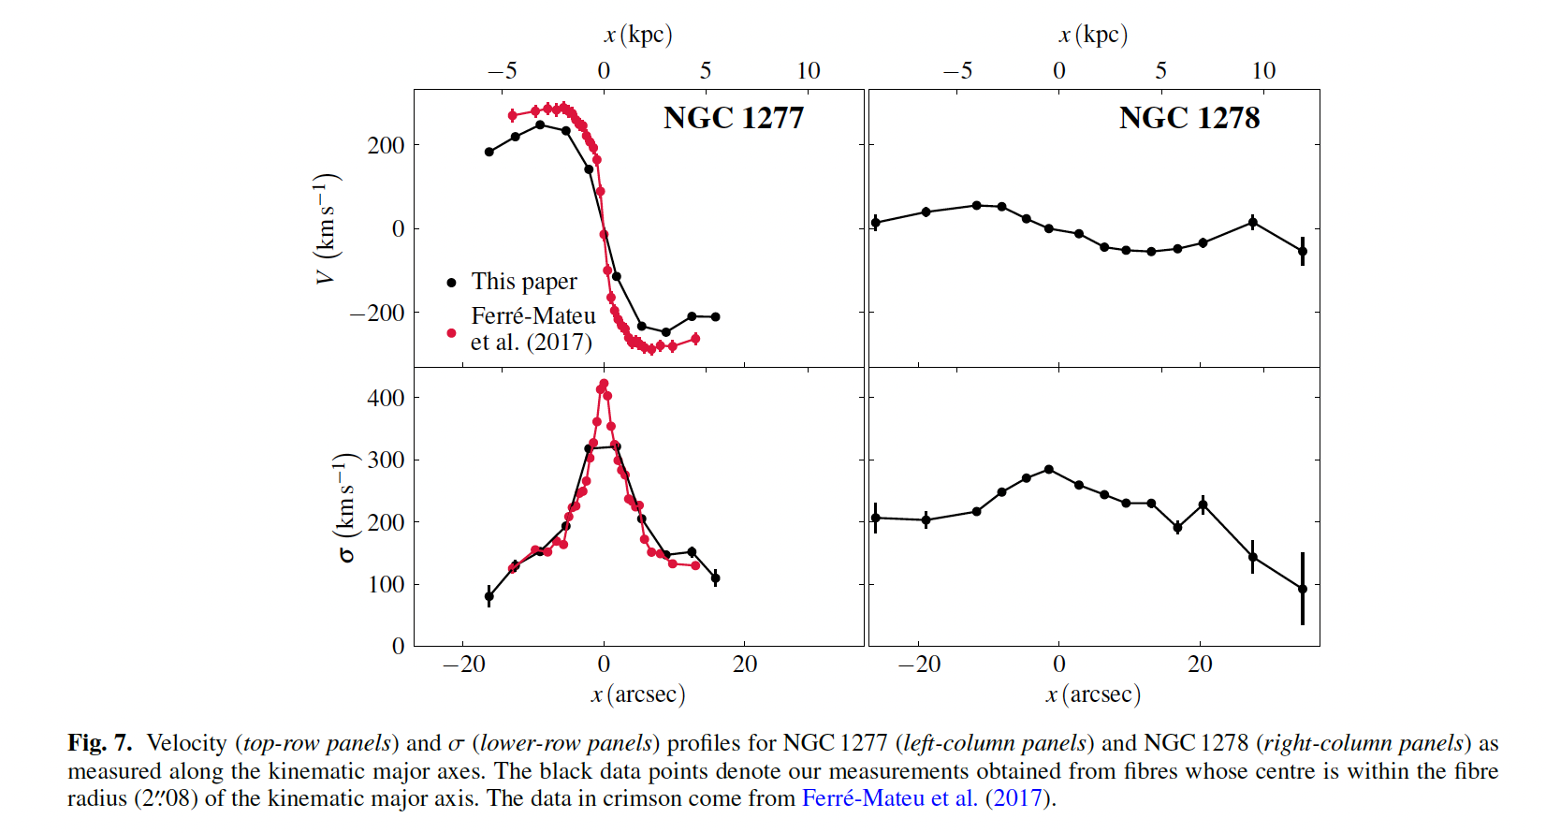
Velocity stays high(ish)
Due to Dark Matter
Velocity stays drops
compared
to central region
Due to Lack of Dark Matter

Slide 21
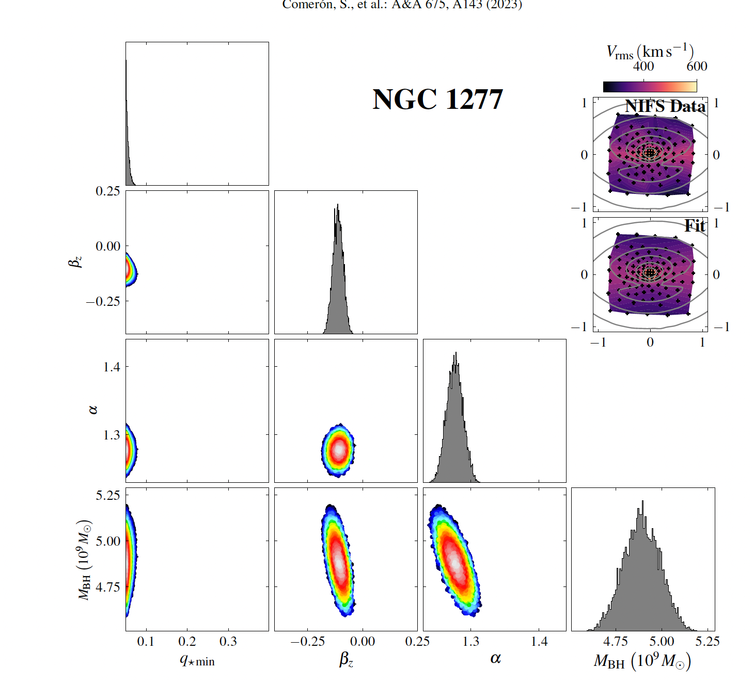

Dark matter set to zero
In the contour plots blue regions correspond to the three-sigma confidence level and white regions denote maximum likelihood
Ratio of
M/L vs Saltpeter IMF
Black Hole
Mass
The intrinsic flattening of the flattest component q_{*min}

Slide 22
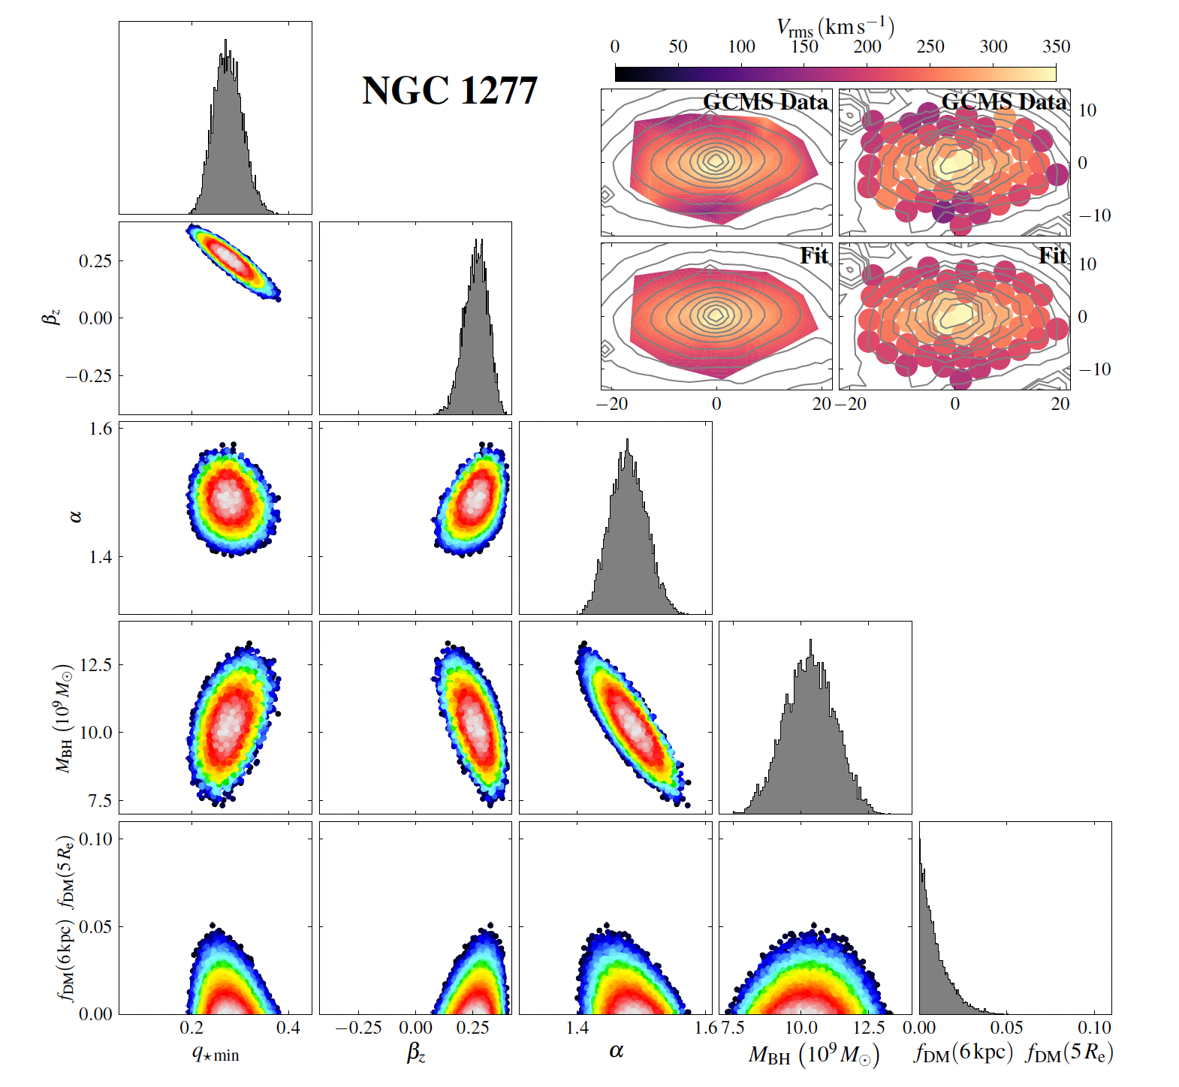
In the contour plots blue regions correspond to the three-sigma confidence level and white regions denote maximum likelihood
Ratio of
M/L vs Saltpeter IMF
Black Hole
Mass
Dark Matter Density
The intrinsic flattening of the flattest component q_{*min}

Slide 23
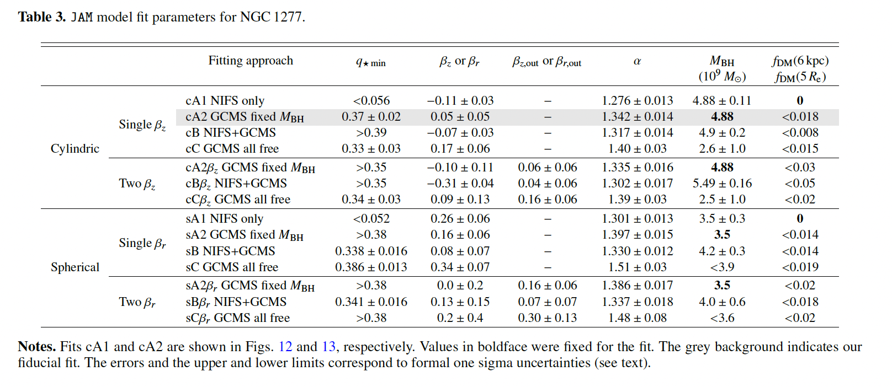
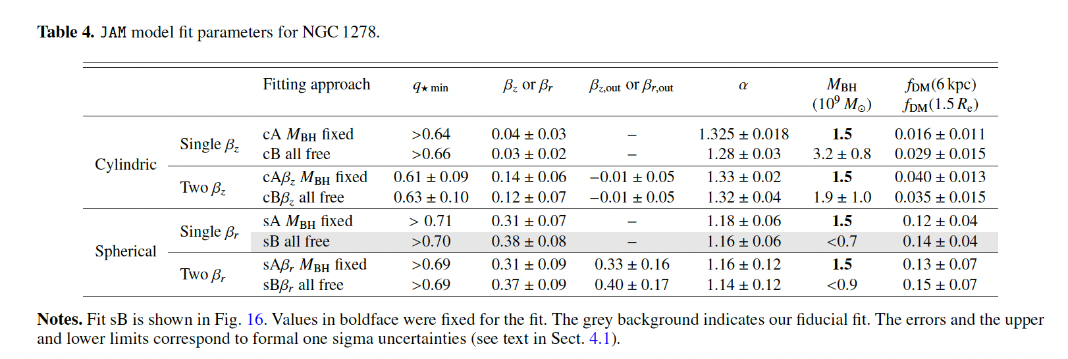
The intrinsic flattening
of the flattest component q_{*min}
Models fitted to the data
Dark Matter Fraction
Mass of Black Hole

Slide 24
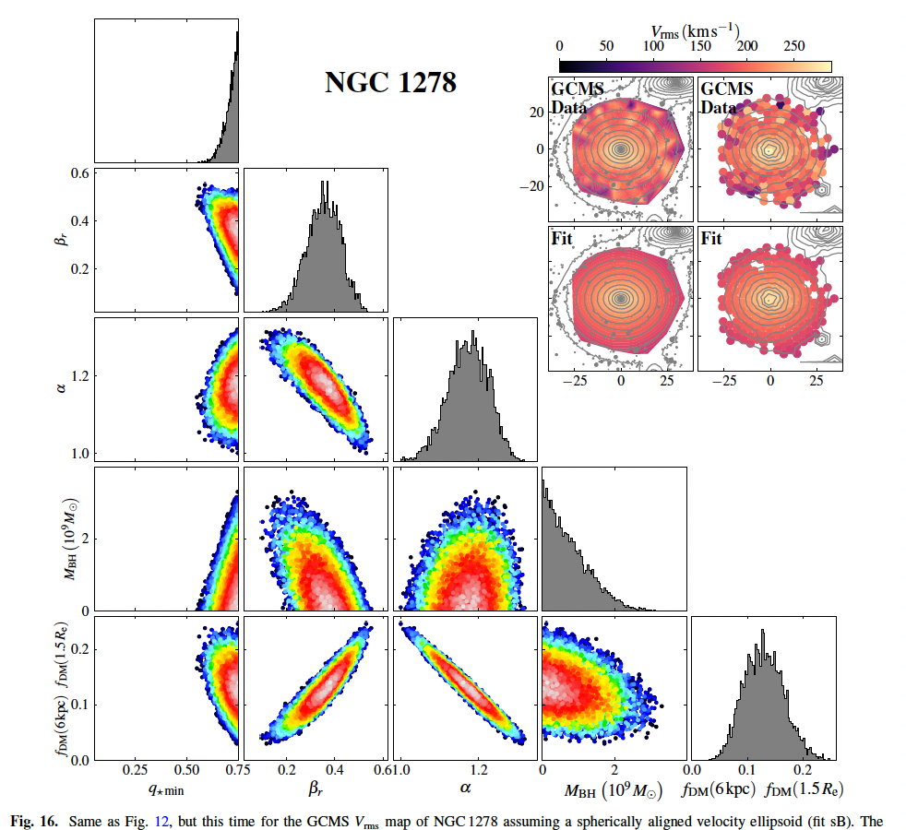
In the contour plots blue regions correspond to the three-sigma confidence level and white regions denote maximum likelihood
Ratio of
M/L vs Saltpeter IMF
Black Hole
Mass
Dark Matter Density
The intrinsic flattening of the flattest component q_{*min}

Slide 25
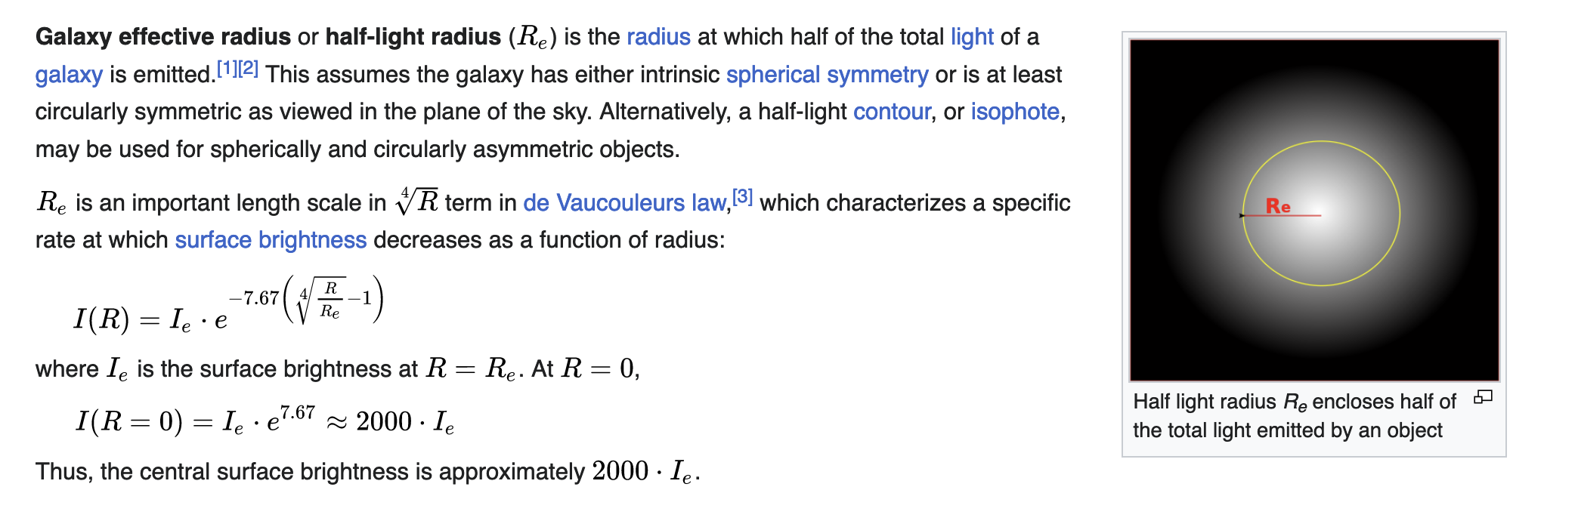
From Wikipedia

Slide 26
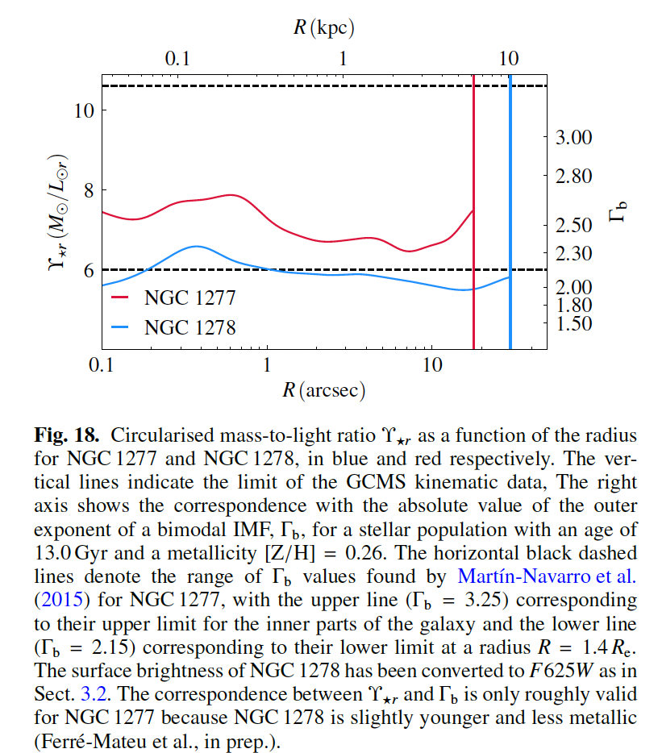

Slide 27
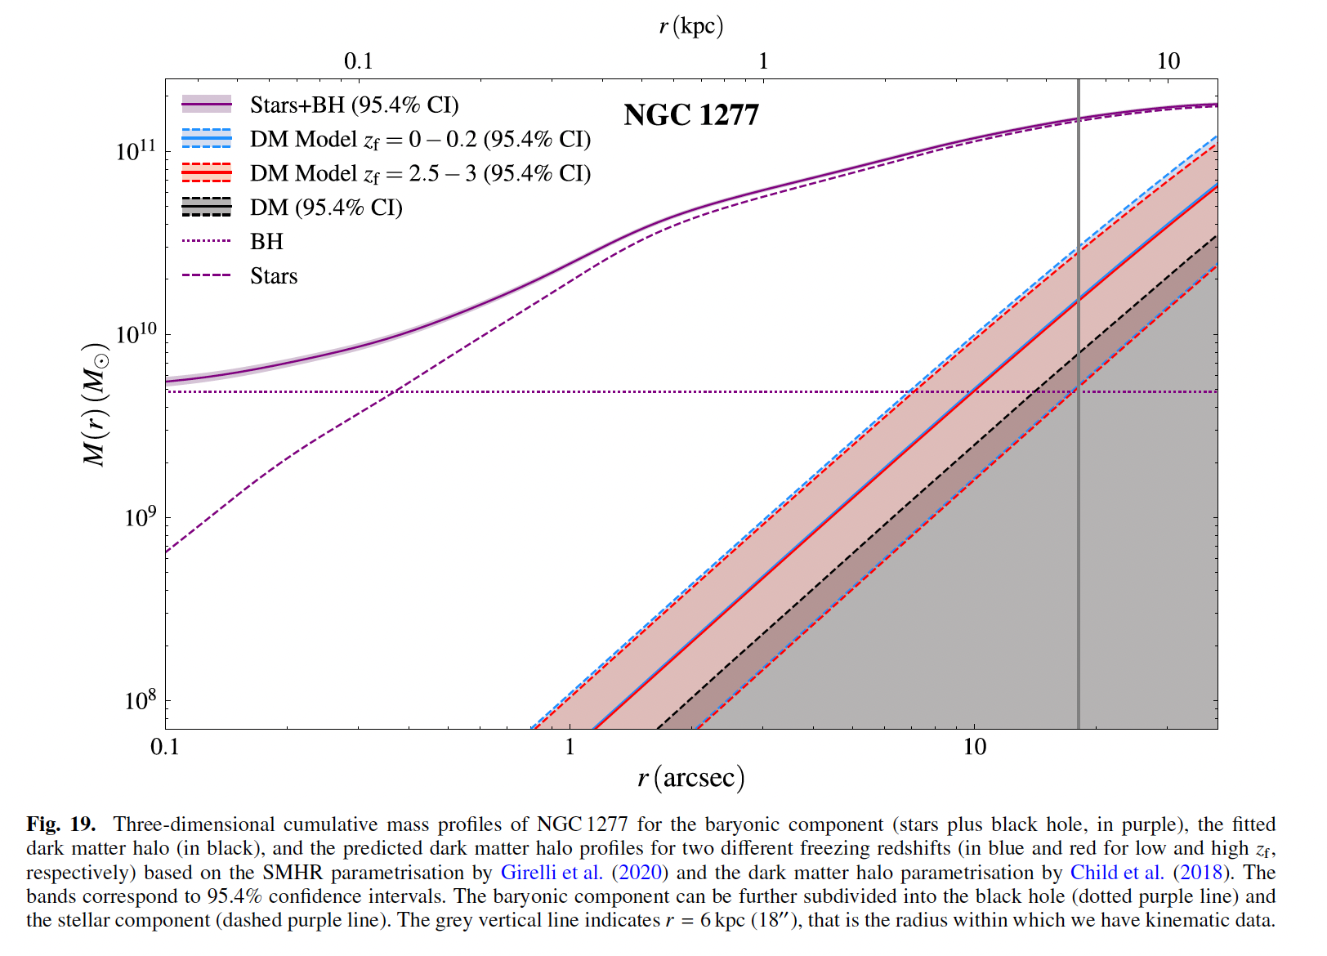
6 R_{eff}

Slide 28
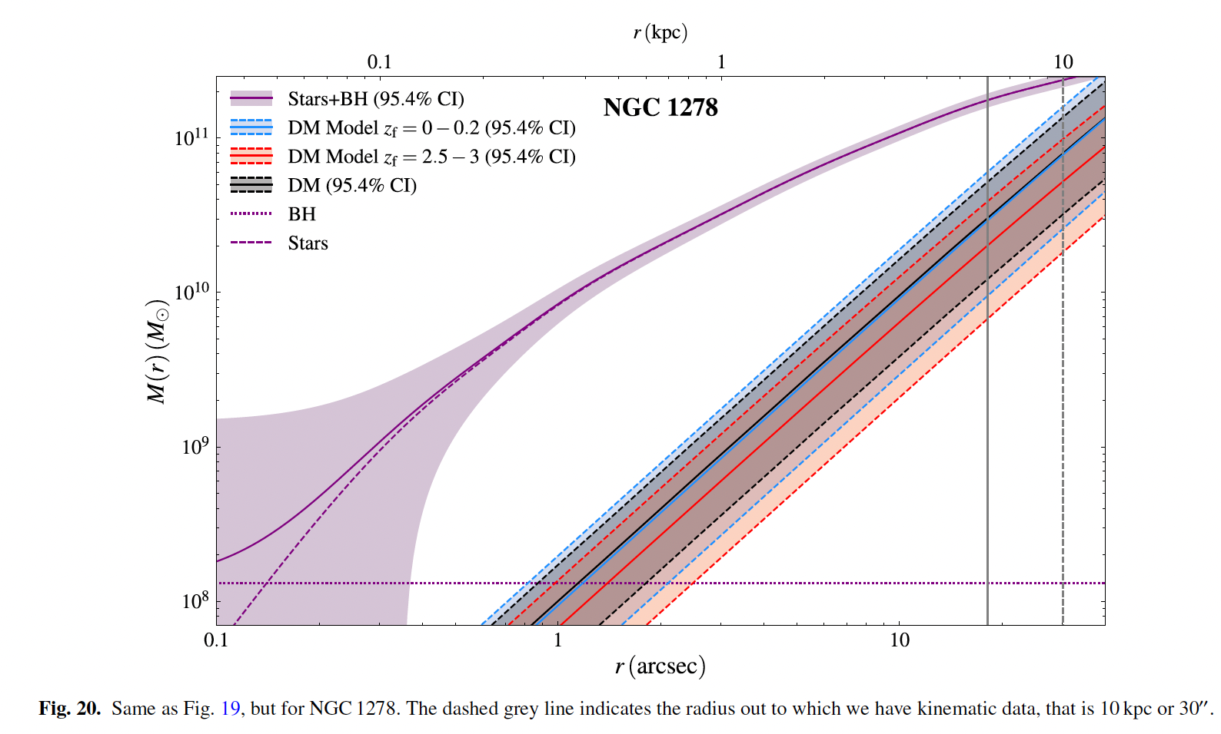

Slide 29
