Slide 1
EIC Project Update
Elke Aschenauer and Rolf Ent
Co-Associate Directors for the Experimental Program
ePIC General Meeting
September 7th 2023

Slide 2
Outline
Recent and upcoming Detector-Related Reviews
Detector Advisory Committee (DAC)
DAC comprehensive design review
Closeout excerpts
Some recent progress: Services & Integration, Installation, RDOs, …

Slide 3
Recent & Upcoming Detector-Related Project Meetings
April 3 + 4: 1st Resource Review Board meeting @ SBU & BNL
July 5 + 6: Particle Id Detectors Interim Design Review
Reviewers: Peter Krizan (U Ljubljana), Floris Keizer (CERN). Ana Amelia Machado (UniCamp), Koji Nakumura (KEK),
Justin Stevens (W&M)
July 21: Final Design Review of the PbWO4 Crystals for the ePIC Backward EM Calorimeter
Reviewers: Eugene Chudakov (JLab), Dipangkar Dutta (MSU)
August 28 + August 31: DAC Review of Detector R&D
FY23 progress and FY24 continuation requests
August 29 + 30: DOE CD-3A Design Review by DAC
September 13: Final Design Review of the SciFi for bECal & fECal
September 14: Final Design Review of the SiPMs for ECals, HCals & dRICH
September 25: Final Design Review of the forward HCal W & steel
October 5 + 6: Final Design Review of Magnet (MARCO)
October 10-12: DOE CD-3A Director’s Review
Folds in Design Review reports of DAC, MAC, Infrastructure Committee; Concentrates on CD-3A Long Lead Procurement Items
November 14-16: DOE CD-3A Independent Project Review
December 7 + 8: 2nd Resource Review Board meeting @ Washington
December (TBD): Preliminary Design Review of Far-Forward/Far- Backward Detectors

Slide 4
Detector Advisory Committee (DAC)
We assembled the DAC in 2020
Per the charter, 1/3 of the committee was replaced early 2023
Meetings to date:
September 28-29, 2020. Bring the DAC up to speed and prepare them for upcoming charges, e.g., related to input on assessment of the call for Expressions of Interest (EoI).
December 18, 2020. Update DAC on the EIC Project and Yellow Report status, the EoI assessment, international engagement, and planning for call for detector proposals.
March 24-26, 2021. Transition from the generic EIC detector R&D to the Project detector R&D.
December 2021 – January 2022. Evaluation of detector technologies, cost and schedule as input to the Detector Proposal Advisory Panel.
October 19-21, 2022. Review the ongoing project detector R&D. Advise for the FY23 detector R&D.
This week: Review next phase of Project Detector R&D and status of ePIC design.
Edward Kinney (Chair) | Boulder CO
Ken Wyllie | CERN
Petra Merkel | FNAL
Antonis Papanestis | Rutherford Appleton Laboratory
Peter Krizan | U Ljubljana
Ana Amelia Machado | University of Campinas, Brazil
Heidi Schellman | Oregon State
Brigitte Vachon | McGill
Stefano Miscetti | INFN Frascati
Etiennette Auffray | CERN
Andrew White | U. Texas Arlington
Chi Yang | SDU China

Slide 5
EIC Project Detector R&D
https://wiki.bnl.gov/conferences/index.php/ProjectRandDFY24
Review by DAC:
Monday August 28 and Thursday August 31. Agenda: https://indico.bnl.gov/event/20113/
Closeout: https://indico.bnl.gov/event/20113/contributions/78874/attachments/49503/84573/DAC-Closeout-0823.pptx
Expect final report in September.
Started process of folding DAC recommendations into FY24 contract planning.

Slide 6
Closeout Presentation of Detector Advisory Committee
EIC Comprehensive Review
August 30, 2023
Participating Members: E. Auffray, , E. Kinney, P. Merkel, S. Miscetti, A. Papanestis, H. Schellman, B. Vachon, A. White, K. Wyllie, C. Yang
Thanks to Elke Aschenauer, Rolf Ent, Thomas Ullrich, and Anna Mendez!
Thanks to EIC Project Team, ePIC Collaboration, and all the presenters!

Slide 7
DAC Design Review – Closeout Excerpts
Amazing progress in the last two years, congratulations to all working on the EIC for this enormous achievement
The committee was very impressed with the organization of the detector development using a formal systems engineering approach. Its use seems critical in keeping control on the myriad requirements needed for engineering design as well as detector performance.
Once again, the demonstrated systems engineering approach gives confidence that the interfaces are sufficiently well defined that the long-lead items can be procured with small risk
Many of the components are already in advanced stages of design, nearly ready for a CD2/3 review.
The infrastructure, integration and installation effort is well advanced and supported.
Several detector systems are still requiring prototype/production cycles. The silicon tracker development is tied to the ITS3/ALICE development, and continues past CD2/3, as does the development of the various ASICs.
Some less advanced systems, which we nonetheless feel can be ready for CD2/3 are the electron polarimeters, the dual RICH, the far forward and backward detectors, the TOF detectors.

Slide 8
Global Comments
Congratulations on rapid development of a nearly complete design for the EIC detector. This was extremely impressive to the committee, especially in the organization of the many different project components and tasks. This inspired confidence in the successful completion of this incredibly complex facility.
Enormous progress in developing a coherent design for detector to carry out EIC research goals, with minimal open technology choices
Recommend continued study of the detector readout and DAQ strategy. In particular, the resource necessary to support all aspects of the R&D, production and commissioning, throughout the period between CD2/3 and CD4.

Slide 9
DAC Design Review – Our Summary I
Tremendous progress over last two years
Systems engineering approach to requirement flow and interface collection process received kudos
Many of the components are already in advanced stages of design…
The infrastructure, integration and installation effort is well advanced and supported.
Congratulations on rapid development of a “nearly complete” design for the EIC detector. This was extremely impressive to the committee, especially in the organization of the many different project components and tasks. This inspired confidence in the successful completion of this incredibly complex facility.

Slide 10
DAC Design Review – Our Summary II
Far-forward detectors are at a less advanced stage of design, with open technology choices being investigated.
→ We asked Yulia to make a table of baseline detector choices based on the requirements. Any alternate technology will need to go through the change process vetted by ePIC and a possible later formal project change control process.
→ We will start frequent meetings with far-forward/far-backward groups.
Dual RICH flagged as one system that is less advanced
→ We need to make decisions here on the design, as the dRICH also affects service integration, installation, maintenance plans, etc.
MPGDs flagged in many areas
What is proposed is a long R&D program and this is not compatible with the EIC project. We need to define the path forward and make decisions.
We will start frequent meetings with the MPGD/tracking groups to expedite.
Will share the final report with the collaboration as soon as it becomes available

Slide 11
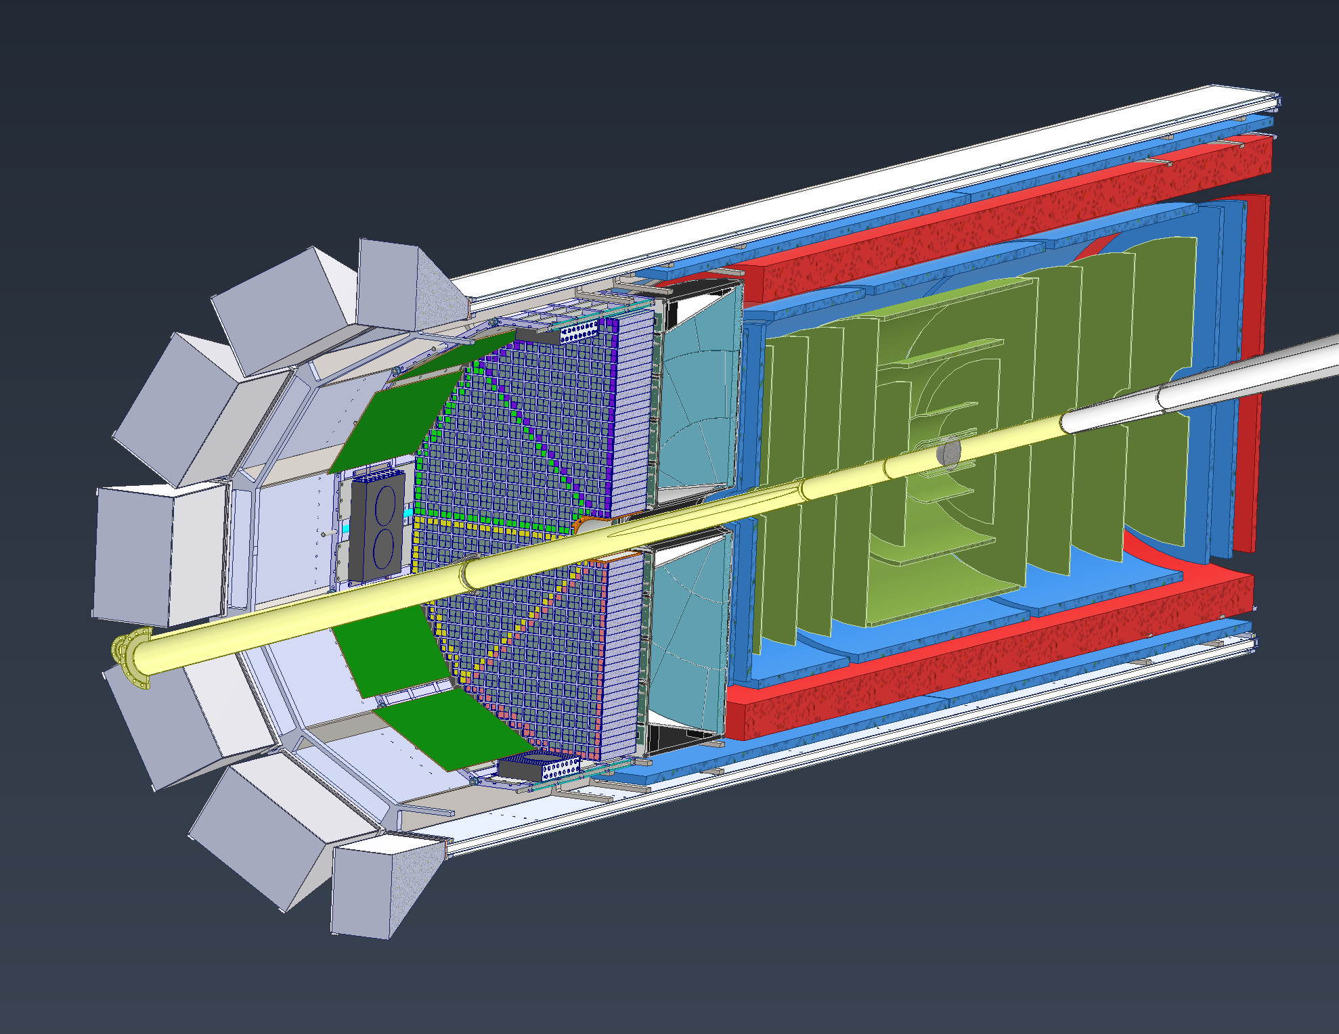
Integration Model Overview – Inner Detector
EEEMCAL: Will be slid in on rails at 3 & 9 O’clock positions
pfRICH: Will most likely use the same rail structure that the EEEMCAL uses
AC-LGAD: Cylinder and disk models are placeholders. A support structure is being developed that will house the AC-LGAD, Inner MPGDs & disks and all the Silicon Trackers
MPGDs: Consists of outer and inner barrel layers along with 4 disks, 2 on each end. Outer layer will be supported with the DIRC
Silicon Vertex & Sagitta Silicon: Will use same support structure as other inner detectors
Si Disks: 10 Disks total, 5 each side, using same support structure as other inner detectors
MPGDs
Silicon Trackers
AC-LGAD
pfRICH
EEEMCAL
Beampipe
Si Disks

Slide 12
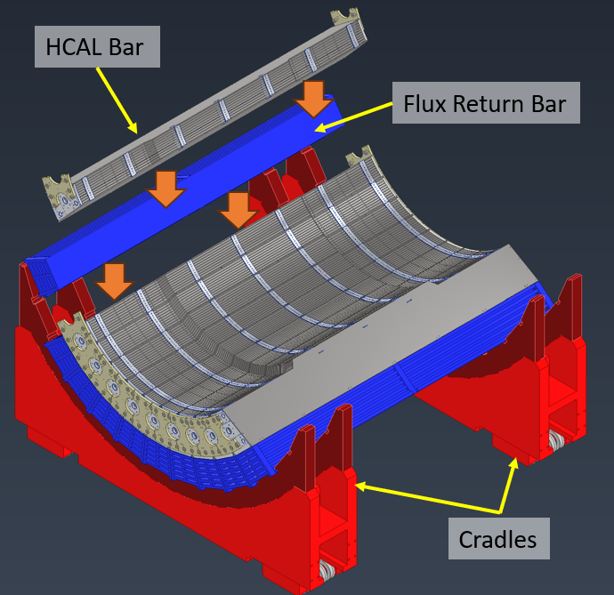
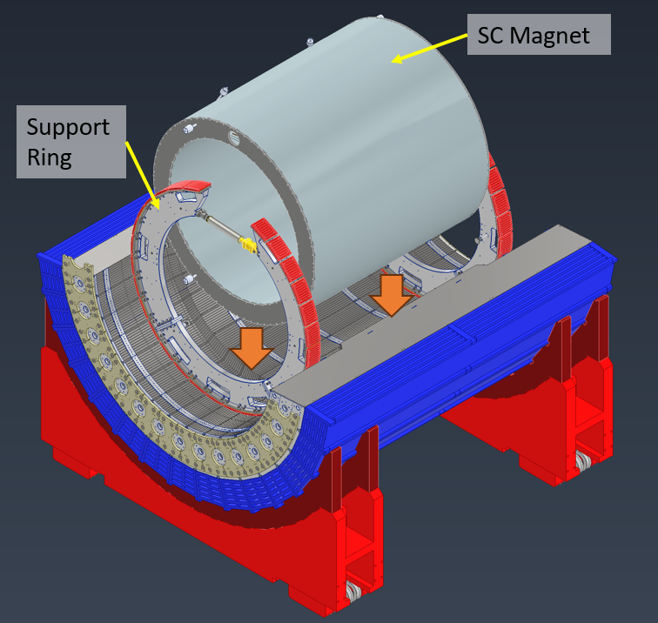
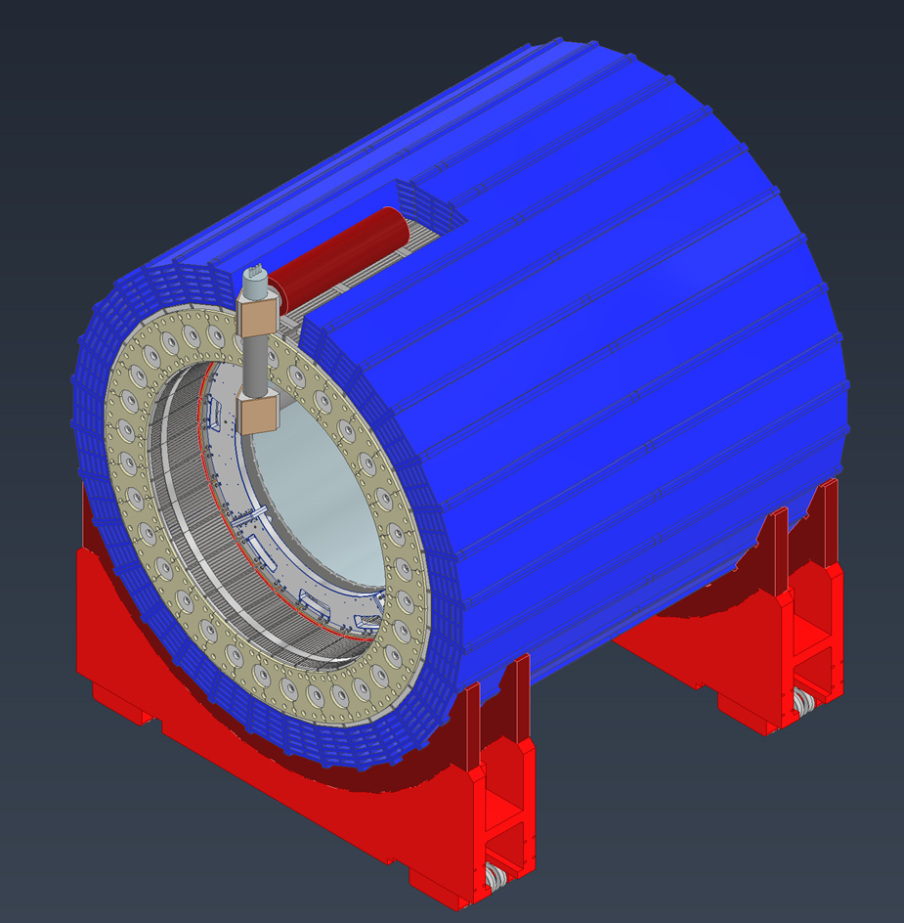
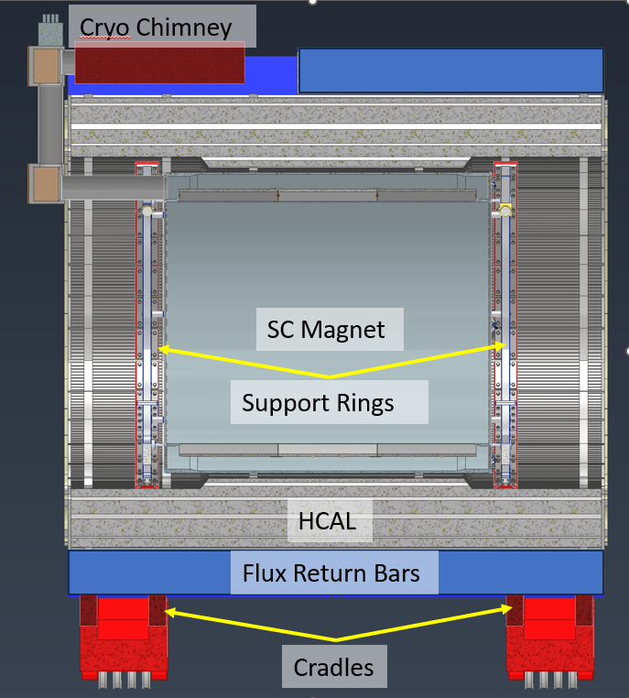
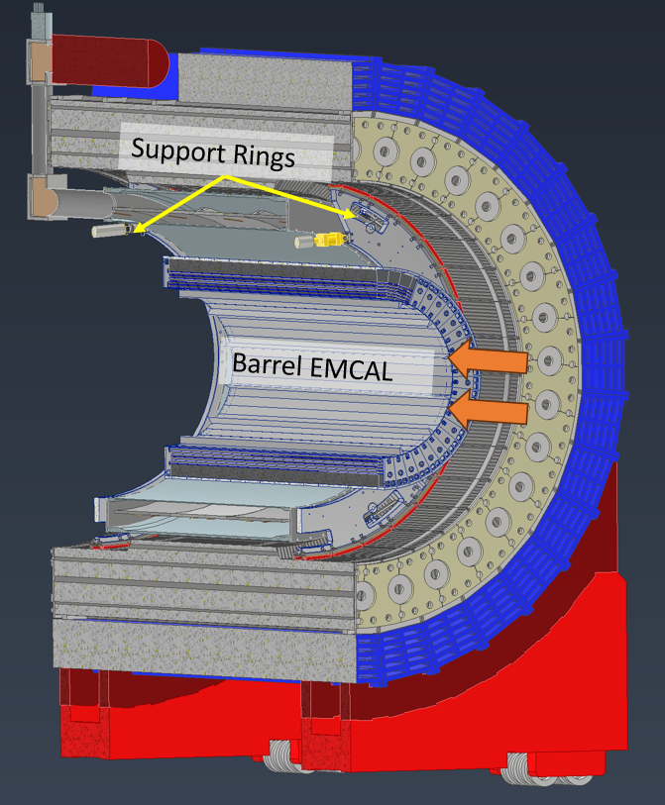
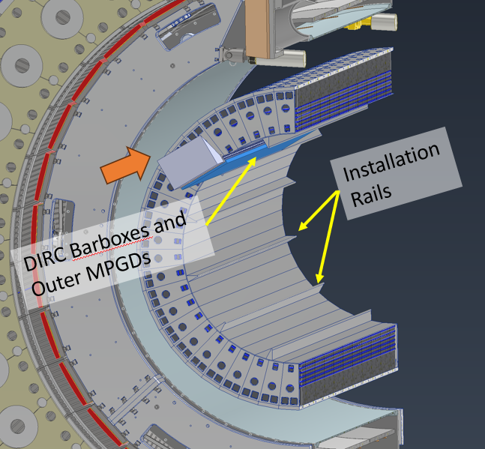
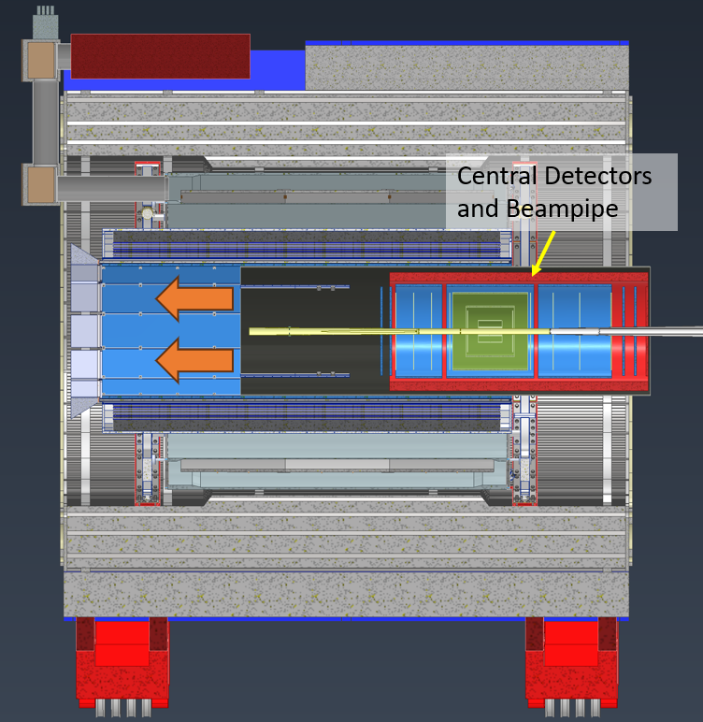
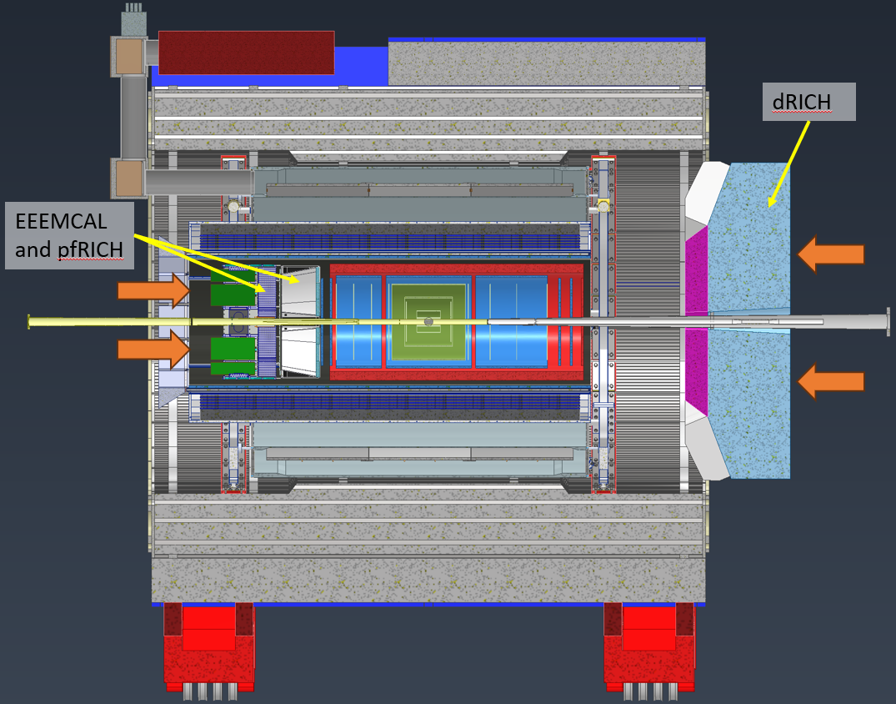
Installation Sequence (Barrel)
12

Slide 13
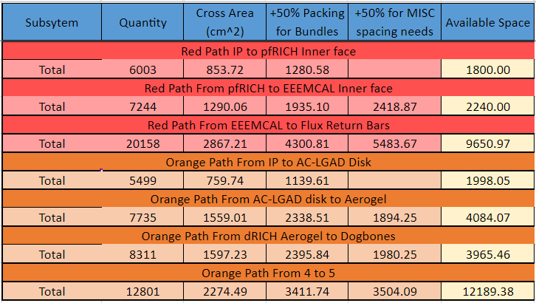
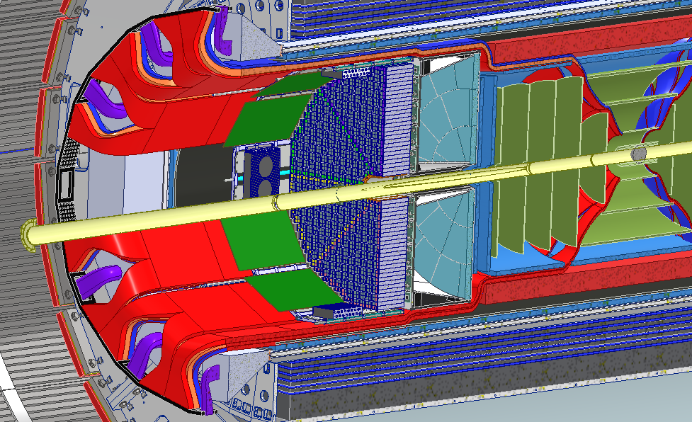
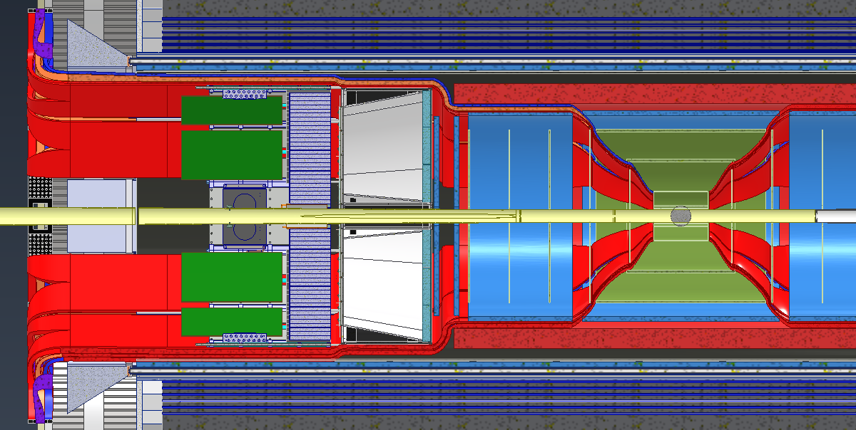
Integration – Services Layout
Services (Cable and Cooling Line Estimates) were collected from various subgroups.
Services Layout is shown in snapshots below:

Slide 14
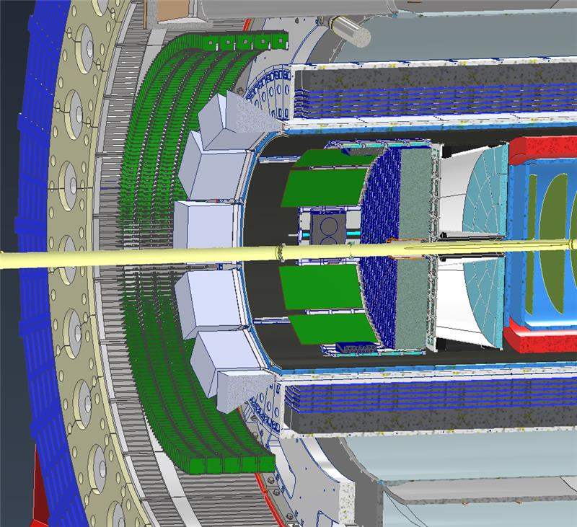
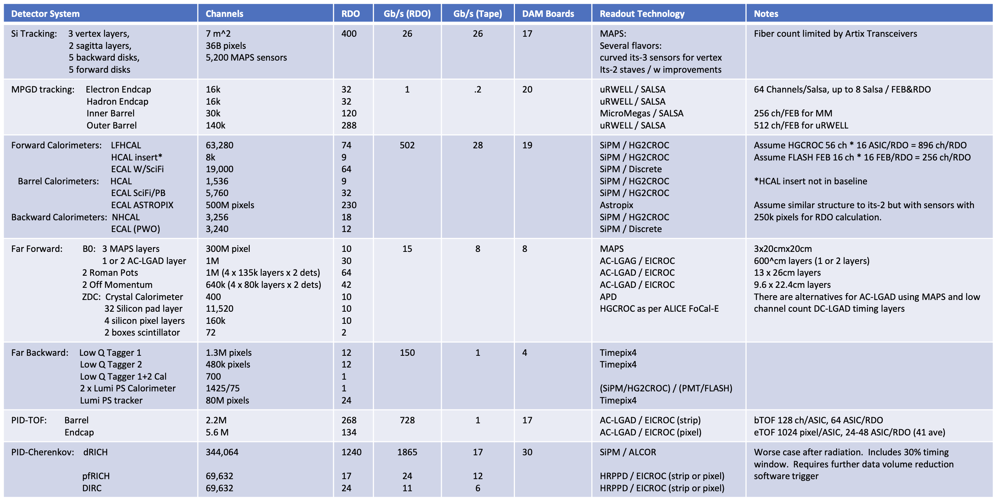
Integration – RDOs
1000 RDOs
Need to get realistic numbers of RDOs per subsystem (@present ~2800 → 1400 each side)
→ please help DAQ WG conveners to collect
the numbers
need to know where the RDOs need to sit
→ inside the detector volume or on the
platforms
→ basically, no space on hadron side, maybe
can hide some between bECal and
Solenoid
numbers below need work → need robust criteria how many FEBs per RDO
→ requires to know rate per readout channel
1000 RDOs for illustration.
Not realistic: need space for support, cables, …
At best can fit few 100
This is “easy” side…
Got already today good news on number of RDOs
Thank you ! for the fast help to resolve this issue
Looking for more good news

Slide 15
Thresholds to be implemented in simulations
Two major types of detectors with respect to applying thresholds in the MC
First type of detectors are the ones for which the energy is summed like in calorimeters. If one particle is hitting for example a PbW04 tower the deposited energy of this one particle is summed and if two particles are hitting a tower, the energy deposited from both particles is summed. One applies the threshold what is called a valid on the summed energy / ADC value.
The other type of detectors are these ones no energy is summed. In this case I have a large pixilation, such that the probability for two particles hitting the same pixel is close to zero. In this case if the one particle does not deposit enough energy in the detector to trigger a response one gets no hit. Examples are the MAPS and also the MPGDs as they are implemented in dd4hep in a pixelized way. So here thresholds can be and should be placed is on the energy/momentum of the particle, the way it was implemented.
The latter also works for Cherenkov detectors, because if a particle of a certain type (pion, Kaon, proton, electron) is not above the Cherenkov threshold of the respective radiator no Cherenkov photons are produced.
Please fill excel-sheet at
EPIC Detector Digitization Model.09.2023.xlsx
by Friday CoB

Slide 18
DAC Design Review – Closeout Excerpts
Charge 1: Given the detector progress over the last two years and the status of the ePIC detector, are the projected timelines of the Electron-Ion Collider detector feasible? Do there remain significant open detector technology questions?
Amazing progress in the last two years, congratulations to all working on the EIC for this enormous achievement.
Projected timelines are aggressive, but appear feasible. Primary acknowledged risks are delays in the production of the magnet and silicon tracker.
The silicon tracker development will also require close attention. Again, in the event of serious issues with the 65nm yields what will be the consequences and planning for the SVT
All central detector technologies have been chosen and appear appropriate. Several technologies still require significant further R&D in order to confirm that they will provide the required performance: Silicon Tracker, 𝜇RWELL tracker, Imaging Sci/Fi tracking calorimeter, and AC-LGAD Tracker
Far-forward detectors are at a less advanced stage of design, with open technology choices being investigated.
ASIC development should be closely monitored as it has often taken significantly more time and effort than originally planned.

Slide 19
DAC Design Review – Closeout Excerpts
Charge 2: Are the requirements for the detector and their flow down sufficiently comprehensive for this stage of the project to complete the design of the various detector technologies?
The committee was very impressed with the organization of the detector development using a formal systems engineering approach. Its use seems critical in keeping control on the myriad requirements needed for engineering design as well as detector performance.
Design of the detector integration and installation are developing well; the interaction of project engineering staff with detector groups appeared excellent
…
A comprehensive description of the survey/alignment/monitoring and calibration strategy for the hardware components of all detector systems is needed.
→ Sensible, will fold into preparations future reviews

Slide 20
DAC Design Review – Closeout Excerpts
Charge 3: Are the interfaces between the elements of the design adequately defined for this stage of the project and to proceed with the detector long-lead procurement items?
Once again, the demonstrated systems engineering approach gives confidence that the interfaces are sufficiently well defined that the long-lead items can be procured with small risk
…
A summary of the different types of SiPM being planned for long procurement would be useful for evaluating whether they are optimal in pixel size and environmental sensitivity.
→ Fold into preparations for SiPM Final Design Review of 09/14

Slide 21
DAC Design Review – Closeout Excerpts
Charge 4: Is the design of these long-lead procurement items sufficiently advanced and mature to start procurement in 2024? Are the technical specifications complete?
The magnet design is nearly completed and seemed ready to advance to procurement within a few months. The specifications are clear and the design appears quite mature, with good cooling system redundancy.
The large number of SiPMs needed requires long lead time; the background conditions are varied within the detector so that close attention to the specifications are needed
Design of the forward HCALs is quite advanced, and the long lead items seem sufficiently specified.
The recent choice of the imaging calorimeter technology made this design less mature; however, as it is based on the existing GLUE-X calorimeter, the long lead purchase of the scintillating fiber and SiPMs are specified sufficiently well. It was not mentioned how long it would take to procure sufficient astropix detectors and what services/conditions they require for reliable operation.
→ not surprising given the recent adaptation of this barrel EMCal choice

Slide 22
DAC Design Review – Closeout Excerpts
Charge 5: Is the projected design maturity of the further detector components likely to be accomplished by the end of 2024 for CD-2 and CD-3?
Many of the components are already in advanced stages of design…
The infrastructure, integration and installation effort is well advanced and supported.
Several detector systems are still requiring prototype/production cycles. The silicon tracker development is tied to the ITS3/ALICE development, and continues past CD2/3, as does the development of the various ASICs. The 𝜇RWELL endcap/barrel tracker prototype needs validation with beam test as does the imaging calorimeter, the AC-LGAD and the pfRICH prototype. This leads to some risk for being ready in time, especially given difficulties in obtaining test beam time.
It is not clear how the choice of 𝜇RWELL technology will be made given foil production times (not only at the prototype stage but also in full production).
…
Some less advanced systems, which we nonetheless feel can be ready for CD2/3 are the electron polarimeters, the dual RICH, the far forward and backward detectors, the TOF detectors.

Slide 23
DAC Design Review – Closeout Excerpts
Charge 6: Is the overall schedule for completion of the design, production, and installation of detector components realistic?
The overall schedule appears realistic given that the schedule does not have added contingency, and in many cases is based on actual experience at RHIC and Jlab. It is nonetheless quite aggressive and ambitious, and will require careful monitoring of critical milestones. The magnet and SVT remain high risk items.
Development of contingency plans would be useful for understanding the effects of delays which occur in the schedule. Flexibility in the schedule should be maintained as much as possible to minimize risk to the project.

