Slide 1
ePIC Collaboration News
J. Lajoie, S. Dalla Torre
July 13, 2023

Slide 2
Hey John, start the recording….

Slide 3
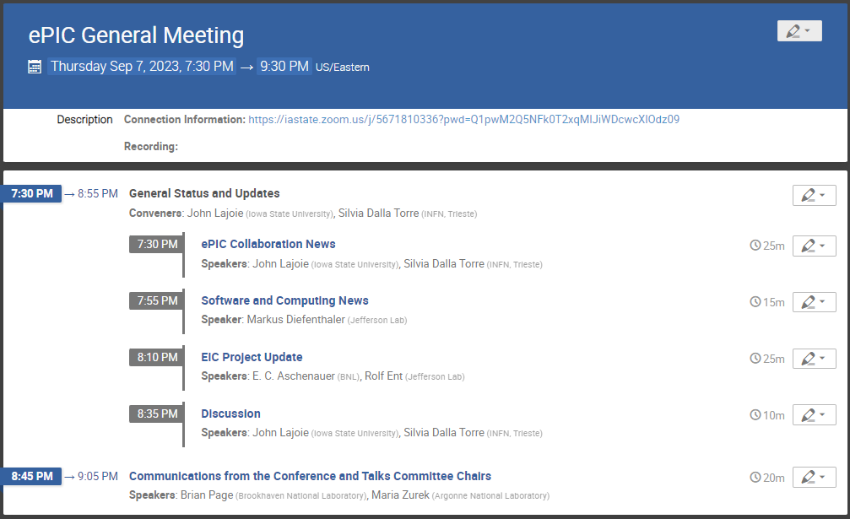
Today’s Agenda
News
Communication from Conference and Talks Committee

Slide 4
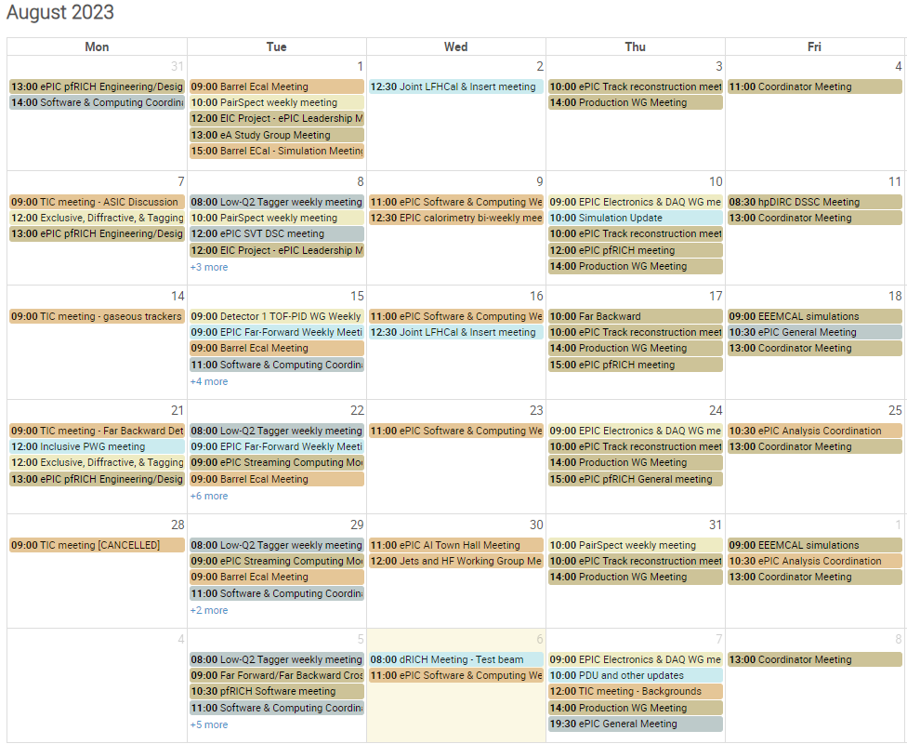
ePIC is busy!
ePIC had a busy month, despite the well-deserved vacations!
~100 Meetings!
(…and this doesn’t include the project meetings and reviews…)

Slide 5
Reviews, Reviews, Reviews…
July 5 + 6: Particle Identification Detectors Interim Design Review
July 21: Final Design Review of the PbWO4 Crystals for the ePIC Backward EM Calorimeter (LLP)
August 28 + 31: DAC Review of Detector R&D
August 29 + 30: ePIC Comprehensive Design Review by DAC
September 13: SciFi Applications Final Design Review (LLP)
September 14: SiPM Applications Final Design Review (LLP)
September 25: Final Design Review Forward HCAL W & Steel (LLP)
October 5 + 6: Final Design Review of Magnet (MARCO)
October 10-12: DOE CD-3A Director’s Review
October 19-20: ePIC Computing Model Review
TBD : DOE CD-3A Independent Cost Review
November 14-16: DOE CD-3A Independent Project Review
December 7 + 8: 2nd Resource Review Board meeting @ Washington DC
December (TBD): Preliminary Design Review of Far-Forward/Far-Backward Detectors
More details in Project Update talk
(Not needed)

Slide 6
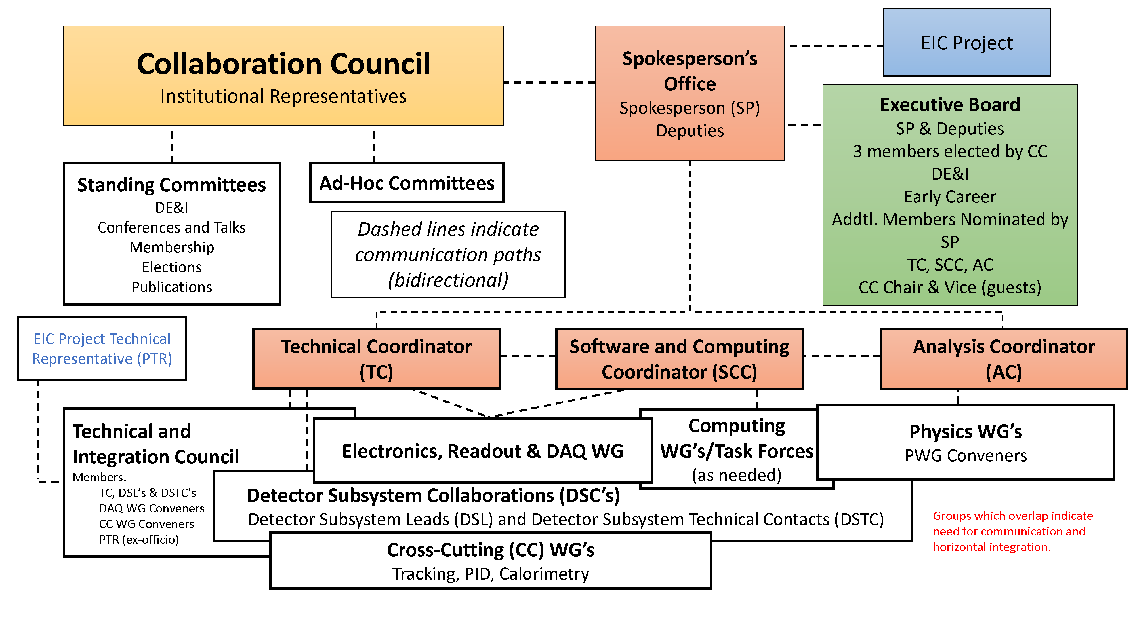
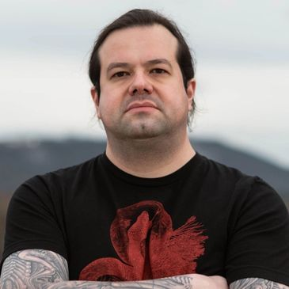
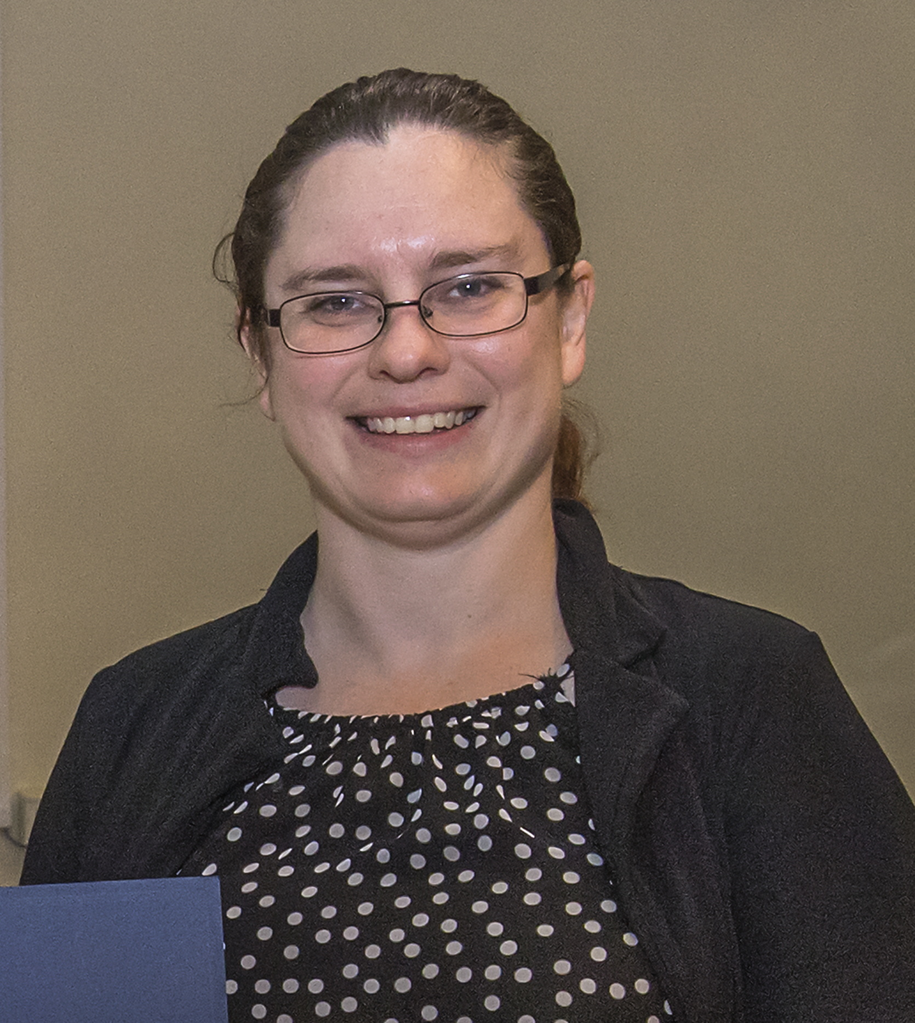
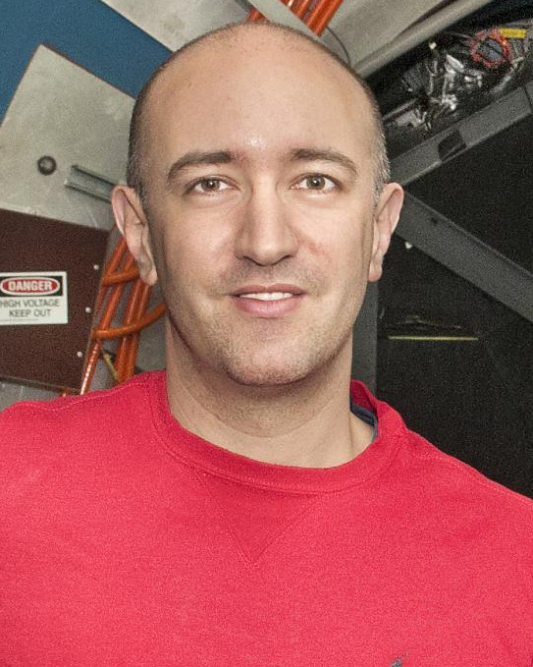
ePIC Collaboration Structure
SC Coordinator
• Markus Diefenthaler (JLab, SCC)
• Wouter Deconinck
(U. of Manitoba, Deputy SCC for Operations)
• Sylvester Joosten
(ANL, Deputy SCC for Development)
• Torre Wenaus
(BNL, Deputy SCC for Infrastructure)
Analysis Co-Coordinators
• Rosi Reed (Lehigh Univ.)
• Salvatore Fazio (Univ. Calabria)
Technical Coordinator
• TBD

Slide 7
Technical Coordination in ePIC
We are still working to find a technical coordinator for ePIC
Not just saying this, active discussions are ongoing
This is a complicated problem:
At this stage this is a collaboration position, not a lab position
We are asking for a substantial commitment from an individual and their institution
Everyone is busy with multiple commitments
Nevertheless, we believe that the best long-term solution for ePIC is a committed Technical Coordinator
Timescale is likely months not weeks
Until a new TC is in place, Silvia will continue to organize the TIC meetings

Slide 8
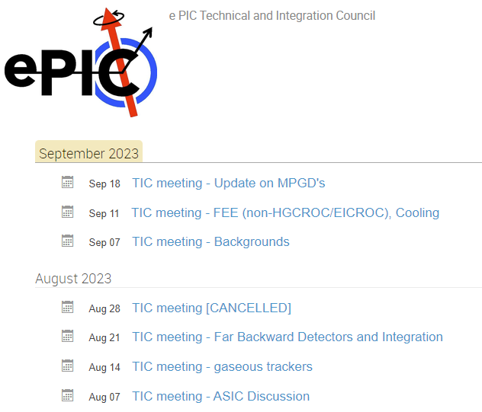
Technical Integration Council
Continuing dedicated meetings on key topics within ePIC:
Main meeting recorded and posted
Open to the collaboration!
Followed by closed discussion with SP Office, CC WG Conveners, and Project Representative
Notes from each meeting sent to TIC list and posted on Indico site
Action items are documented so they can be followed up on
Working to set TIC agendas 2-3 weeks ahead of time

Slide 9
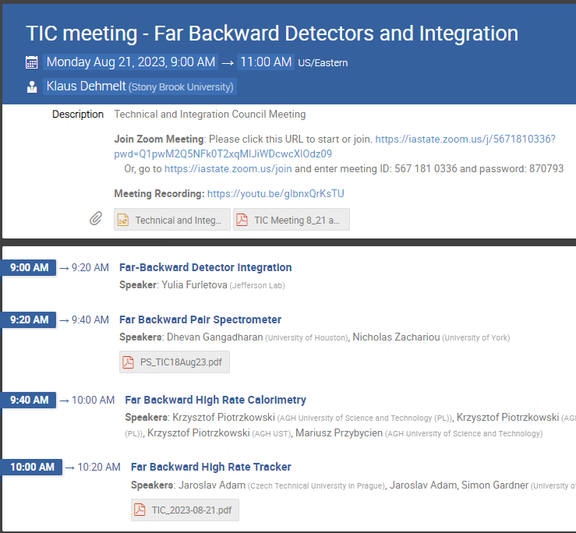
News from TIC (I)
August 21st: Far-Forward and Far-Backward Detectors
https://indico.bnl.gov/event/19417
Goal: Understand the status of the FBWD integration
Integration (Yulia):
There has been substantial evolution and improvement of the designs for the luminosity monitor (location further down the beamline and the additional of a sweeper magnet) and the low-Q^2 tagger (the possibility of a secondary vacuum and impact on beam impedance) as a result of the excellent work of the DSC’s. These design revisions need to be integrated with the beamline design and questions about the impact on beam impedance, the required thickness of exit windows, etc. answered in order to proceed to a detailed technical design. At the present time, engineering resources for the project are heavily subscribed and the work done is prioritized. The far-backward DSC’s should not expect substantial engineering progress until December at the earliest due to the limited engineering resources.

Slide 10
News from TIC (II)
August 21st (cont.)
Pair Spectrometer (Nick):
Optimization work is underway to determine the optimal number of planes in the pair spectrometer, given the good position resolution of the planned 2D W/SciFi calorimeters. This effort should be seen as part of the work important required to map the requirements to the detector performance specifications and we look forward to the results of these ongoing studies. It should be noted that the addition of a sweeper magnet should be seen as a refinement of the conceptual design, and should not need a change control process to proceed.
High Rate Tracker (Simon):
There was some discussion during the meeting about how events with backgrounds included are created for simulations. For the high-rate tracker, the TimePix will generate hits with a ~400ps timing resolution and therefore will be able to separate backgrounds from preceding and following bunch crossings. Currently the events are created by adding background events flat in time without respecting the time structure of additional crossings, but in a way that is perfectly reasonable for studying detectors in the central barrel that have a long (10us) integration time. Events created this way are not necessarily appropriate for studying backgrounds in the far-backward detector systems, but the framework used is flexible and it should be possible to create an appropriate sample for the far-backward detectors. Simon will follow up with the Background Task Force to discuss the details.

Slide 11
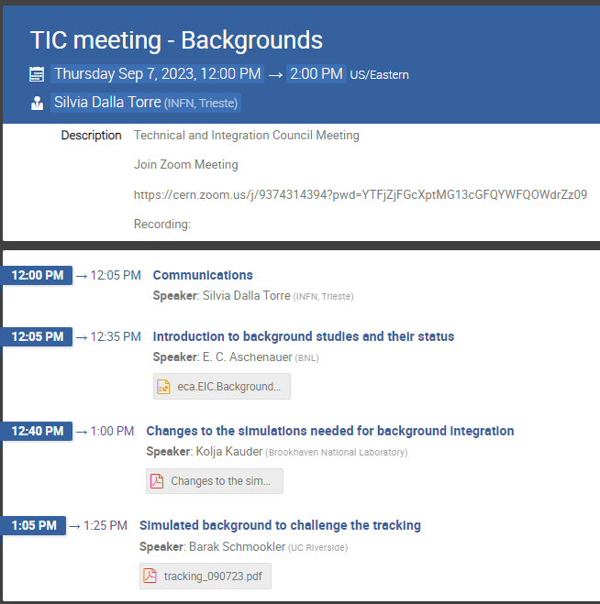
News from TIC (III)
September 7th : Backgrounds
Urgent Call from Background Task Force to DSC’s:
Please follow the following link and fill the respective EPIC Detector Digitization Model.09.2023.xlsx
especially for the calorimeters and please update the information for the trackers
If the direct link does not work go to General Documents and edit the file called EPIC Detector Digitization Model.09.2023.xlsx
If there are any questions about this either reply to this email or post questions to the epic mattermost background channel https://chat.epic-eic.org/main/channels/background-embedding
The deadline for this request is CoB Friday.
DSC input and engagement is required!

Slide 12
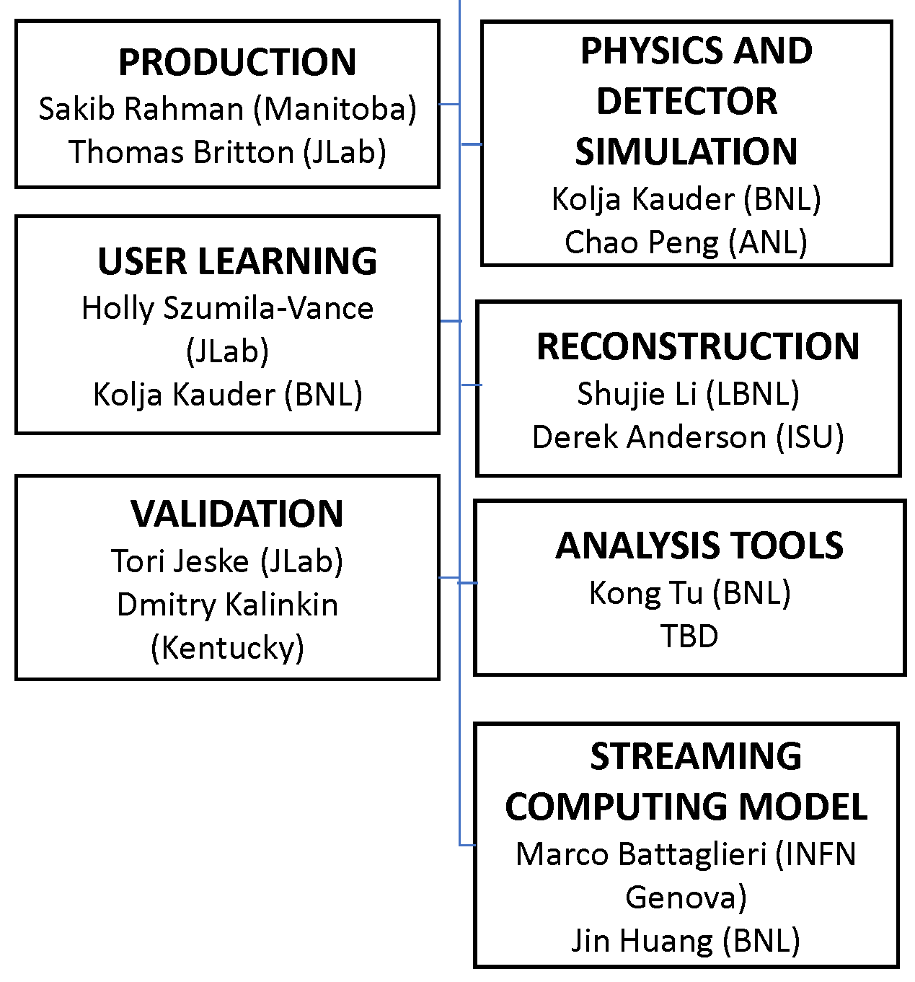
Software and Computing
Lots of activity in Software and Computing:
Regular simulation “campaigns” established
Steady progress from DSC’s on more realistic detector descriptions
Steady progress on reconstruction
Steady progress on validation
Steady production for each campaign
Work on improving detector thresholds (with Background TF)
Longer-term work on improving analysis module framework
AI Town Hall Meeting Aug 30th : https://indico.bnl.gov/event/20374
Streaming Model/DAQ WG’s have held four joint meetings in preparation for the October review of the ePIC Streaming Data Model
July 11, 18 and Aug 22nd, 29th
Markus will present S&C news after me…

Slide 13
Software and Computing Workshop
Sept. 20-22 @ UIC
In-person attendance encouraged, but remote participation possible
Register at:
https://indico.bnl.gov/event/20159/

Slide 14
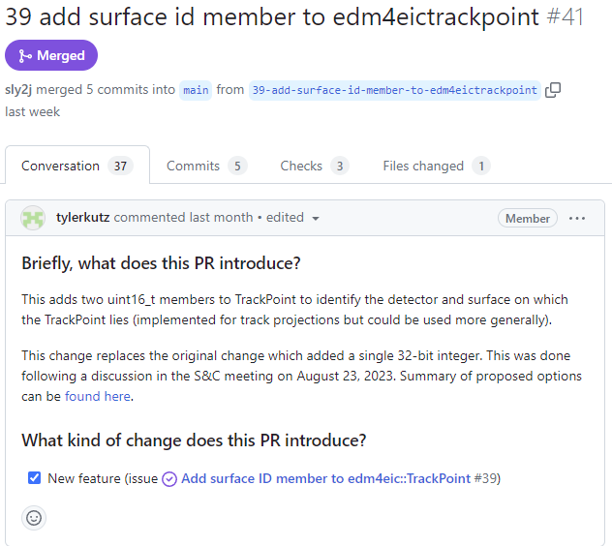
Analysis
Efforts in Analysis are moving forward:
Daniel Brandenburg and Tyler Kutz have led the way with proposed changes to the data model
Necessary for track/cluster associations, etc.
First step in the work of the Task Forces
Extensive but productive discussions with S&C
PWG Meetings:
https://indico.bnl.gov/category/492/
Bi-Weekly Analysis Coordination Mtgs:
Off-week with General Meetings
Open to the collaboration
https://indico.bnl.gov/category/475/
Will schedule an update from Rosi and Sal at the next General Meeting

Slide 15
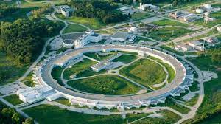
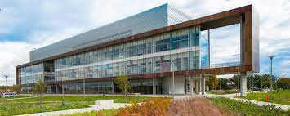
Next Collaboration Meeting – Jan 2024
Jan 9-13th, 2024 @ ANL
Planning on 2-3 days of parallel workfests followed by 2-3 days of plenary sessions
DSC/WG Leadership asked for workfest proposals:
Expect discussions w/in DSC’s/WG’s
Due Sept. 22nd
Cross-cutting efforts encouraged!
ePIC leadership will work with local organizers
Appreciate Yale, Temple and UTK/ORNL offer to host collab meeting!

Slide 16
Upcoming General Meeting Schedule
Now that the summer is over, we want to get back to regularly scheduled general meetings every two weeks, in rotation:
Sept 22nd @ 10:30AM ET
Oct 5th @ 7:30PM ET
Oct 20th @ 10:30AM ET
Nov 2nd @ 7:30PM ET
Nov 17th @ 10:30AM ET (Immediately following CD-3A review)
Nov 30th @ 7:30PM ET
Dec 15th @ 10:30AM ET
CC Meetings will be called by the CC Chair as needed

Slide 17
EICUG Membership
The EICUG is a vital organization to promote the interests of the EIC community!
Without the EICUG we would never have gotten far enough to form ePIC!
Please register your institution!
Check with your EICUG IB representative to get registered as a member
https://www.eicug.org/content/join.html

Slide 19
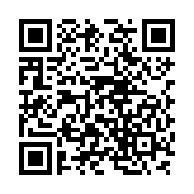
ePIC Resources – Get Connected!
Mailing Lists – https://lists.bnl.gov/mailman/listinfo
Indico Agenda - https://indico.bnl.gov/category/402/
Wiki - https://wiki.bnl.gov/EPIC
ePIC Software Training:
https://eic.github.io/tutorial-setting-up-environment/
https://eic.github.io/tutorial-geometry-development-using-dd4hep/
https://eic.github.io/tutorial-simulations-using-ddsim-and-geant4/
https://eic.github.io/tutorial-jana2/
Recordings: https://www.youtube.com/@eicusergroup1532
QR code for Mattermost channels:

