Slide 1
Project R&D FY23
VFM_ADC
Grzegorz W. Deptuch, Syed Hassan, Soumyajit Mandal, Nicholas St. John
(EIC-SC)
08 / 22 / 2023

Slide 2
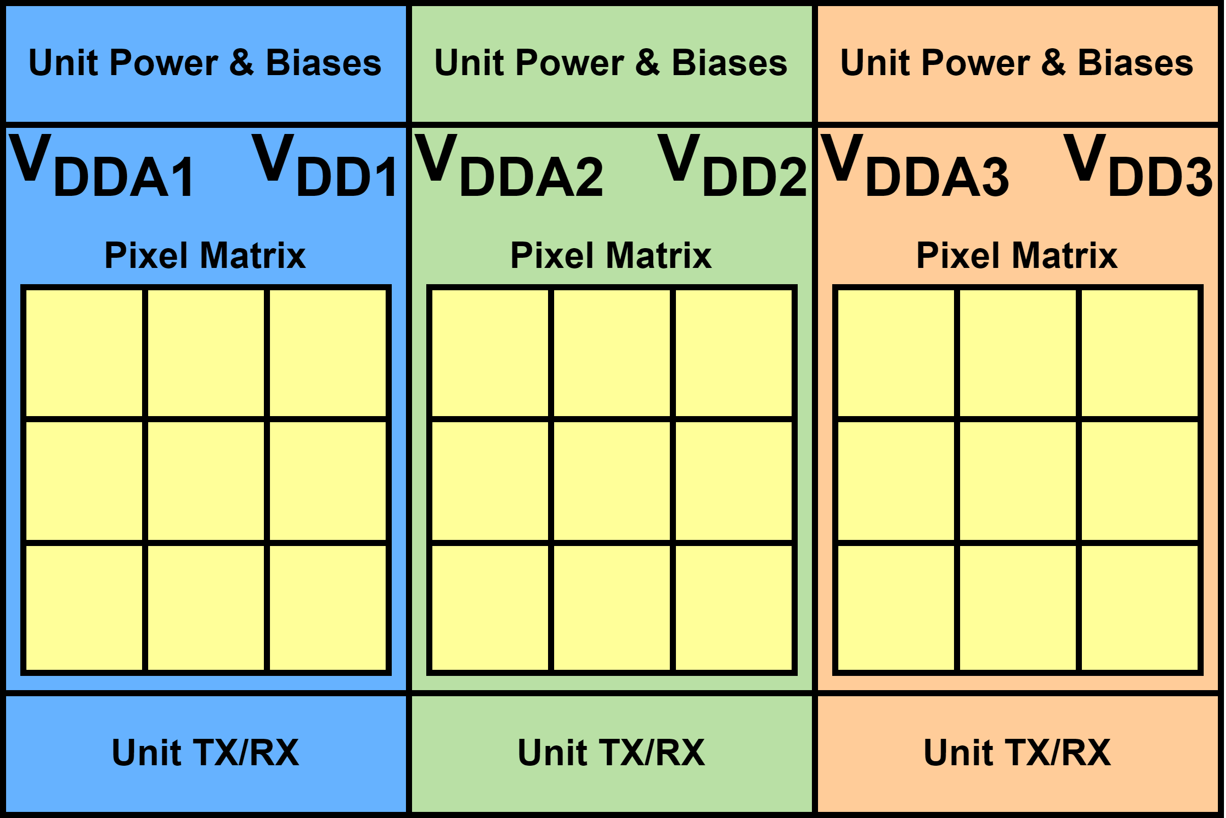
Introduction
ALICE-ITS3 / EIC large-area reticle- stitched sensors will be made up of multiple “units” (Repeated Sensor Units - RSU) of pixels with their own respective domains and peripheries;
These separate peripheries will contain power management and communication (slow-control + data transmission) circuitry per domain;
Proposed units will be identical but autonomous from one another;
Illustrates given power regulation scheme with local, per RSU regulators

Slide 3
Motivation
Ability to monitor performance of a pre-defined set of “vital” signals may be required for:
  QA prior to assembly / on-wafer testing;
  troubleshooting in operation;
  applying corrections;
Anticipated list of system vitals:
  unregulated power supply input;
  regulated digital power supply;
  regulated analog power supply;
  Temperature;
  pixel bias voltages/currents;
  radiation-damage sensor output;
  sensor / transistors leakage current monitors;
  suggestions welcome;
required vital signals are generally slowly varying and monitoring need not be done continuously

Slide 4
VFM_ADC one of contributions to ALICE-ITS3
Vital Functions Monitoring Analog-to-Digital converter (VFM_ADC):
  small, silicon footprint ADC (not to increase insensitive area when embedded in RSU);
  low-power (not consuming any power when not used);
  medium resolution (10b) and medium speed (100 kSps - 1 MSps);
  on-demand, triggerable conversion (“ADC, start conversion”Æ“ADC ended conversion” + fetch data;
  with input multiplexor and interfaces to sources of signals to be monitored (scalers for voltages out of ADC input range);
  interfacing to slow control for programming calibration settings and configuration;
  Interface for data to output (through slow control of data stream);
VFM_ADC development requires close interactions with ALICE_ITS3 team
design was started with assumption of availability of >1.2 V power supply, whereas recent on-sensors power regulation seems to yield only 1.2 V

Slide 5
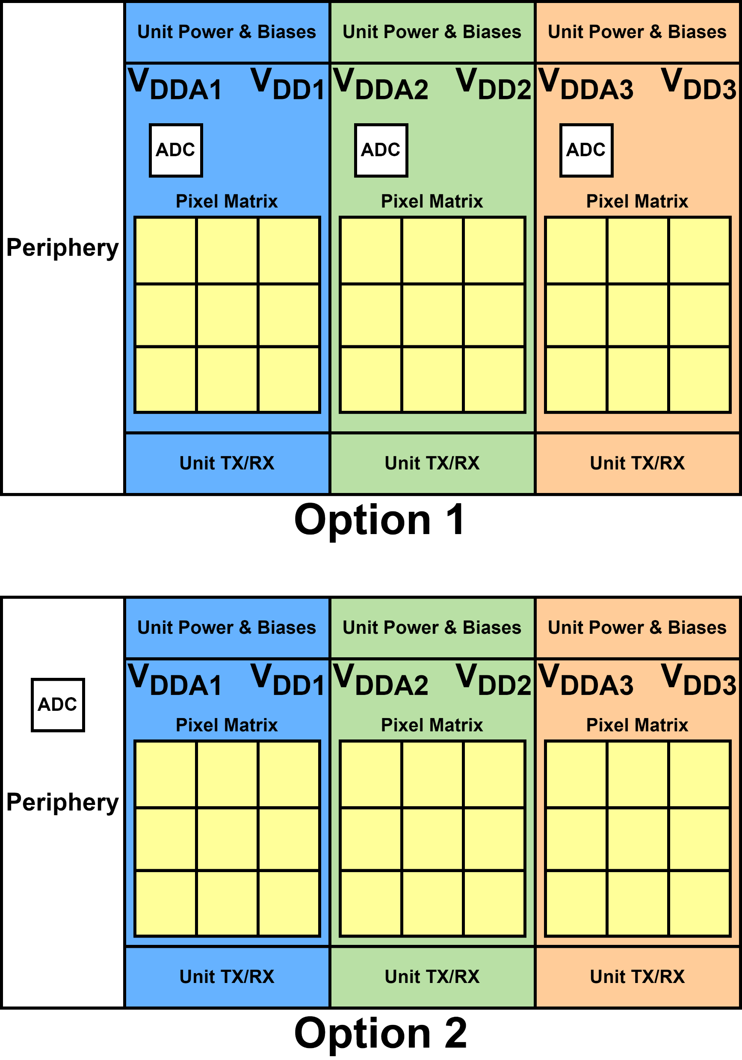
Placement of ADC (1)
Location of ADC entails, either:
  sources to monitor local and sending distant data;
  receiving distant sources and producing local data
There are two proposed options to consider:
  Option 1: place an individual VFM_ADC within each repeated sensor unit (RSU)
  Option 2: Place ADC within the periphery

Slide 6
Placement of ADC (2)
ADC within RSU
ADC within periphery
Pros
  signals to monitor are all close to ADC;
  monitoring of multiple signals in each RSU with local multiplexing;
  spatial distribution of temperature across entire sensor can be measured;
Cons
  input control signals and outputs must be provided as commands (slow control?);
  traces carrying reference and calibration must be fed across entire chip;
  powering must be providing avoiding self-dependence;
Pros
  input control signals, outputs, references and calibration are all close to ADC;
Cons
  signals to monitor must be fed across chip;
  single temperature of chip can be measured;
  per RSU multiplexing may be needed to allow monitoring multiple signals or monitored signals may be limited to periphery only;
  multiplexing of multiple signals per RSU may require slow control commands anyway;
within RSU option preferred to obtain more granular monitoring

Slide 7
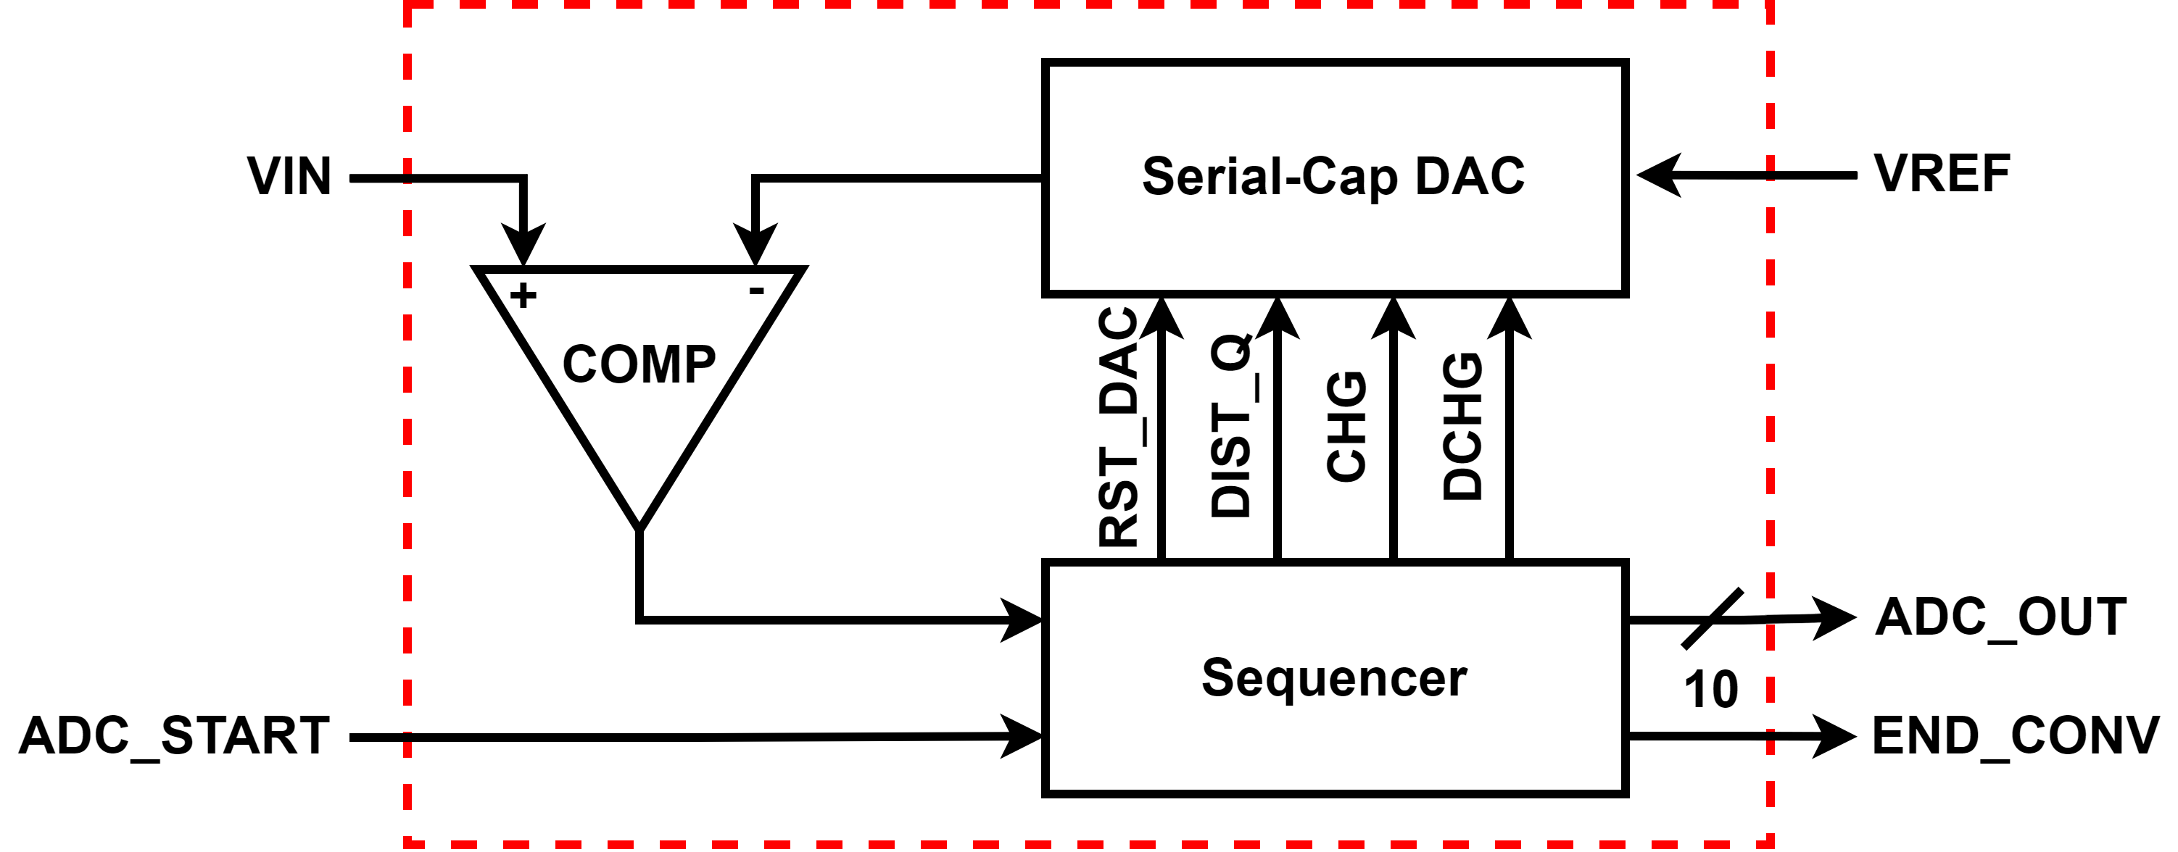
ADC Architecture
VFM_ADC exploits charge-redistribution SAR architecture [1];
serial DAC is different from typical SAR as it uses only two capacitors
(+ charge conservation) to minimize occupied area;
output of serial DAC is compared with input voltage
in multiple steps: MSB is computed first, LSB last;
comparator output is used by sequencer, which contains all digital control to construct DAC voltages and store results;
conversion process for N-bit ADC requires N(N+1) operational cycles, where N is the number of bits (10 in our case, so 110 operational cycles obtainable from 55 clock pulses):
  area minimization Æ longer conversion time;
  acceptable due to on-demand functionality and slowly changing inputs;
reference voltage is required for DAC:
  plausible implementation methods are discussed later;
Architecture | # Clock Cycles | # of Unit Elements
Binary-Weighted | N | 512
Charge-Redistribution | N(N+1) | 2
[1] R. E. Suarez, P. R. Gray and D. A. Hodges, "All-MOS charge-redistribution analog-to-digital conversion techniques. II," in IEEE Journal of Solid-State Circuits, vol. 10, no. 6, pp. 379-385, Dec. 1975, doi: 10.1109/JSSC.1975.1050630.

Slide 8
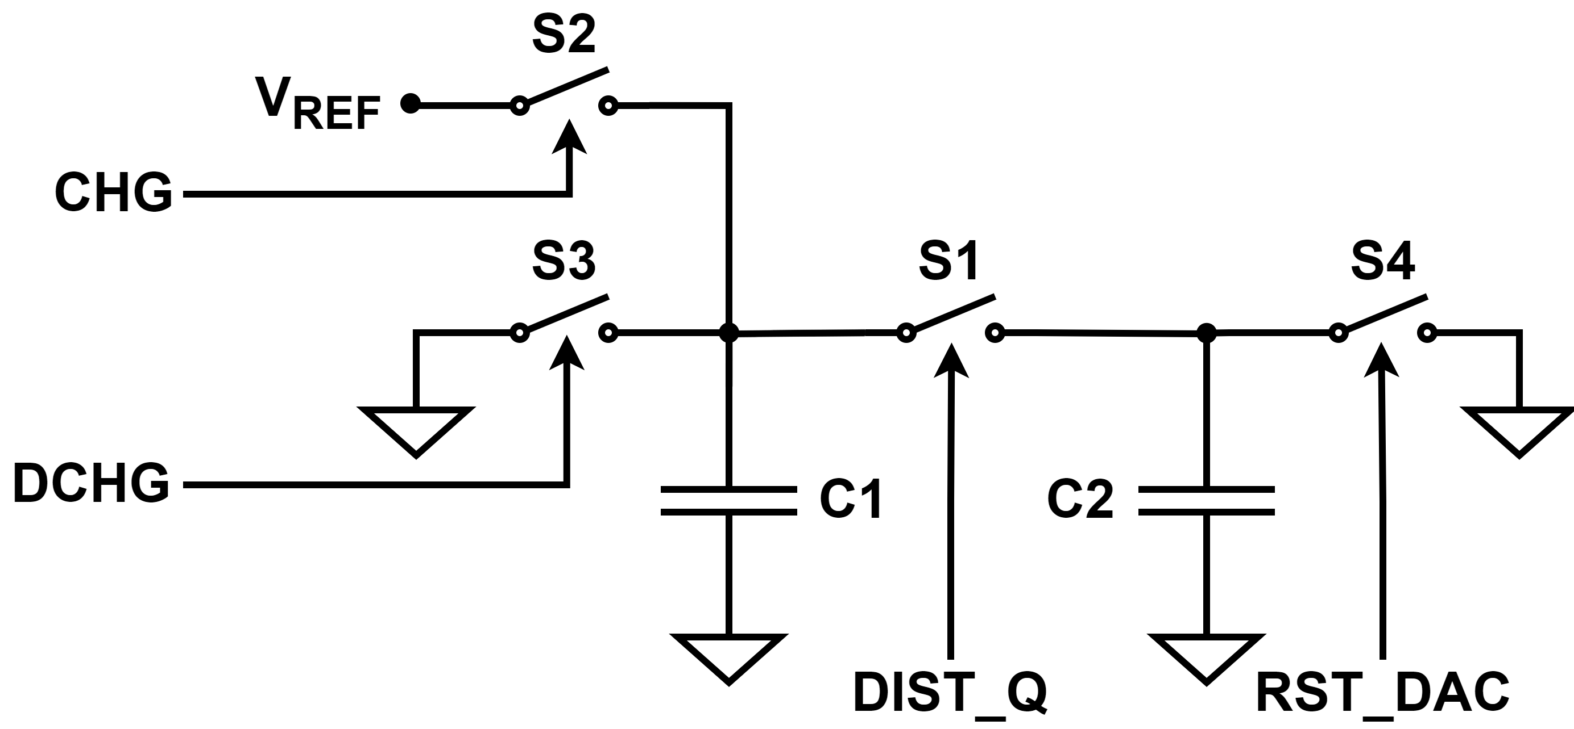
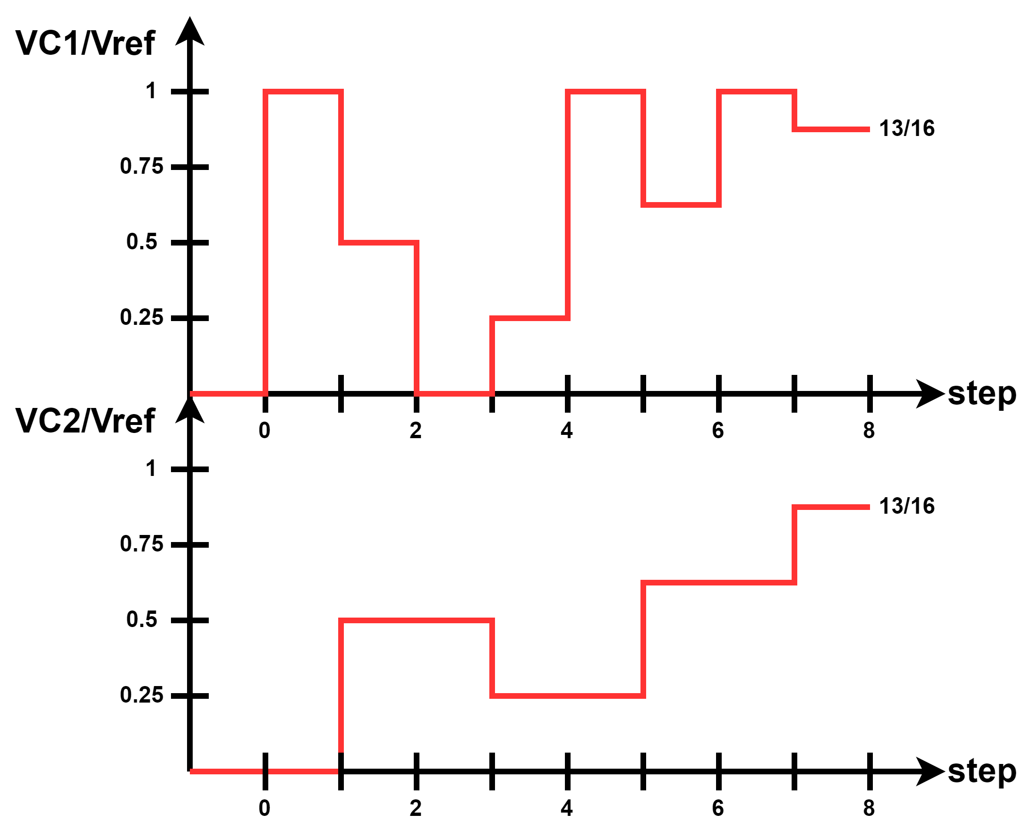
DAC Operation
two-capacitor charge-redistribution DAC Æ low-power and minimal-area requirements;
basic operation is as follows:
  C1 and C2 are capacitors of the same value
  C1 is pre-charged to VREF (GND) for d_{n-1} = 1(0)
  C2 is simultaneously discharged via S4
  S1 is closed to distribute charge across caps generating
  fractional voltage: (VC1 – VC2)/2
  process is repeated for all other input bits (but C2 is not discharged)
  output voltage is read from C2 (readout must be 0 input capacitance)
  In this example, LSB is utilized first
1
0
1
1
synthesized
voltage
process illustrated for input word 1101

Slide 9
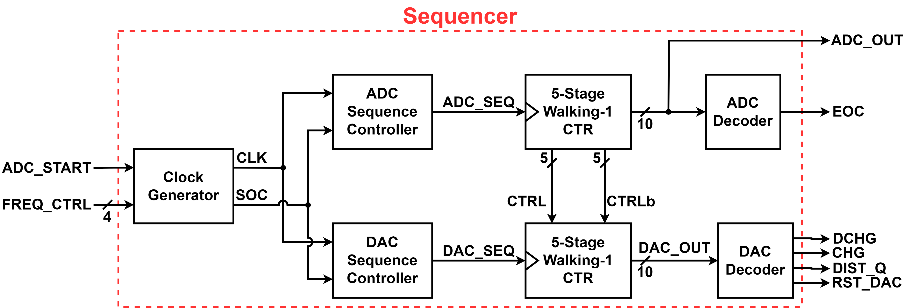
Sequencer Operation
sequencer contains all digital circuits, custom digital realization;
internal, pausable clock generator
with programmable output frequency starts
only when ADC is triggered
two walking-1 Johnson counters stepping
through DAC and ADC operational sequence:
  since DAC charge/discharge steps increases per the ADC bit, walking-1 counters work in tandem acting as a nested for-loop
sequencer was designed with custom gates to minimize the number of transistors
Nested For-Loop

Slide 10
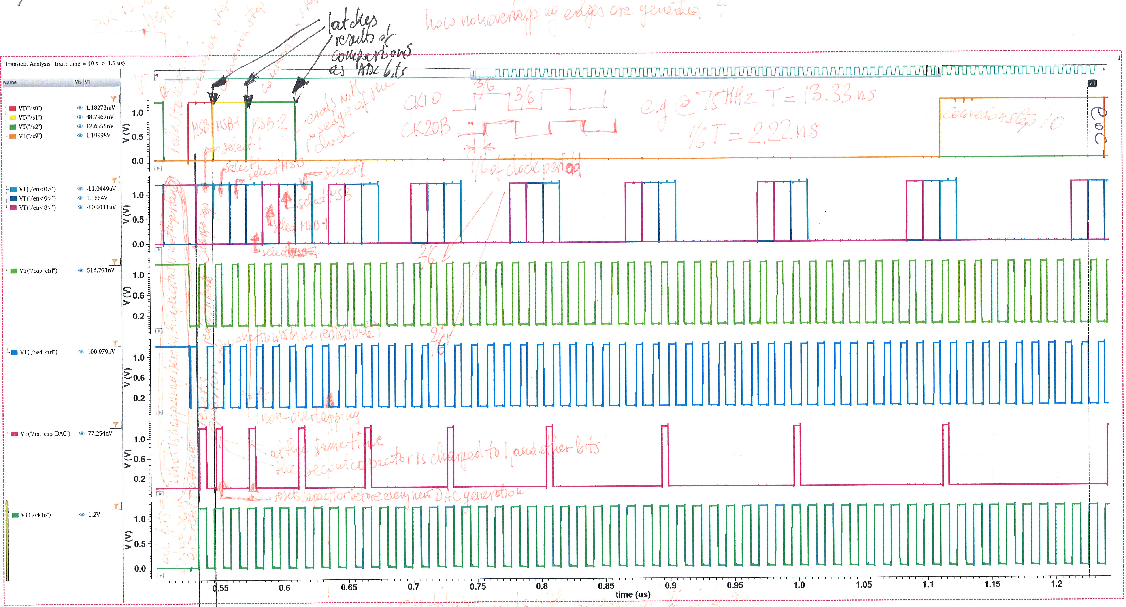
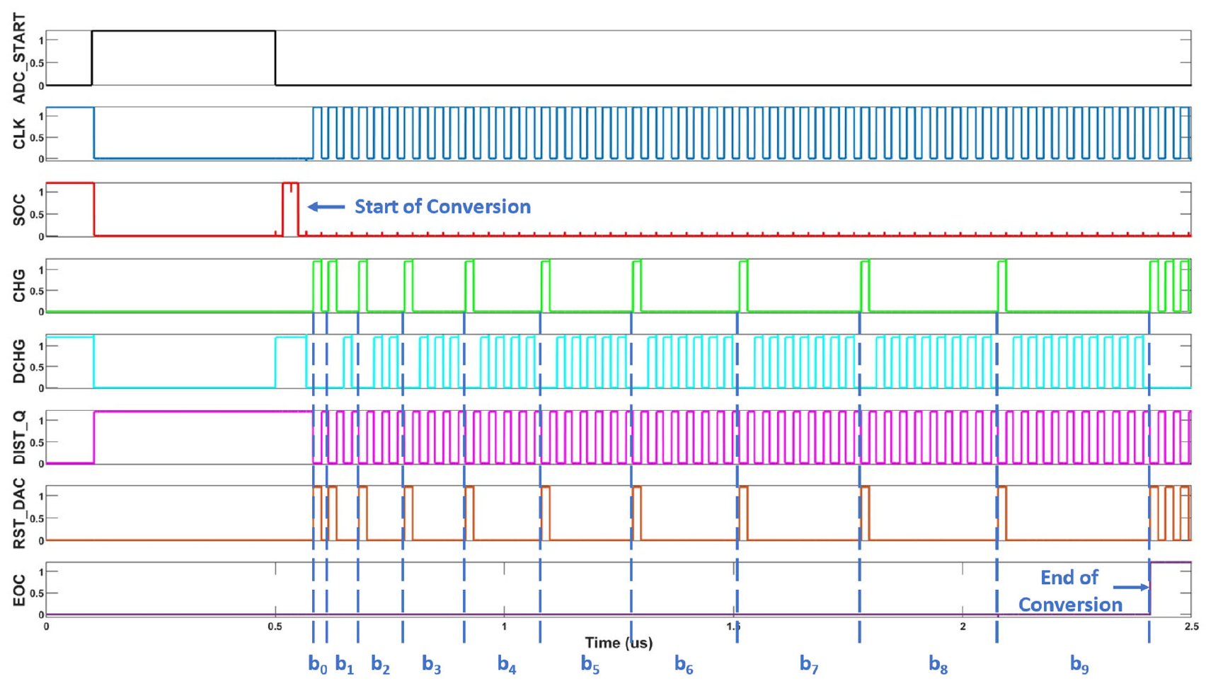
Progress of physical implementation
external walking-1 loop
nested hardware “for loops”
internal walking-1 loop
55 pulses
charge / discharge DAC capacitance
+
55 pulses
redistribute charge
=
110 cycles (total)
reset DAC = new bit
pauseable clock
Sequencer requires generation of 55 clock pulses / 1 conversion

Slide 11
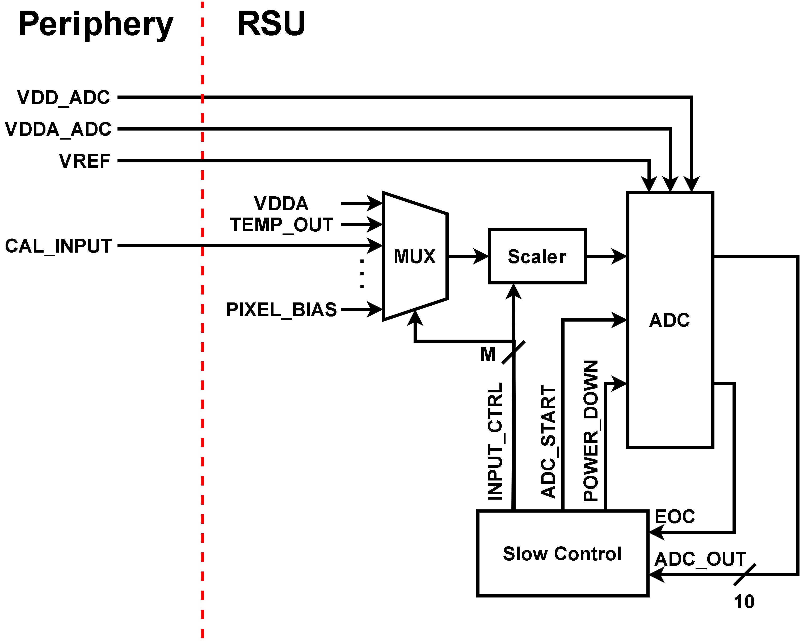
ADC Implementation – assuming “in RSU VFM_ADC”
Top-level diagram of ADC within RSU
input MUX selects one of the vital signals for routing in for A-toD conversion;
scaler circuit is used to “translate” any input to fall within the range of the ADC (explained later)
advantage of VFM_ADC design is simplicity that may trade input range for a minimal complexity

Slide 12
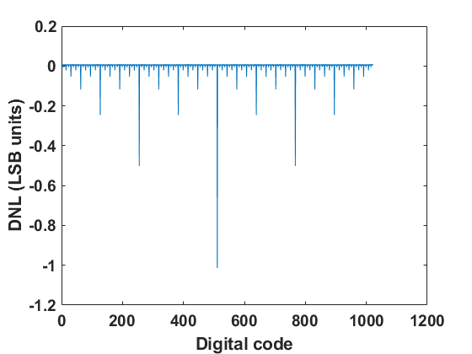
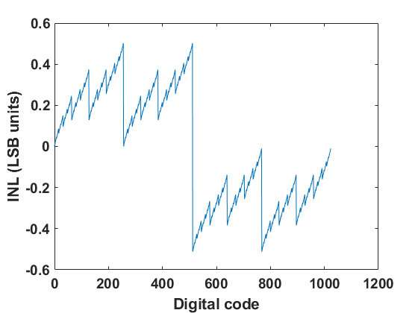
Matching of DAC Capacitors – Trimming DAC
INL and DNL for mismatch of capacitors = 0.2%
DAC capacitors (C1 and C2 in slide 5) must match to achieve required resolution of the ADC (10b);
capacitors will be slightly mismatched due to variations in manufacturing and parasitics and must be corrected;
figures show that to achieve a desired error of 0.5 LSB, charge redistribution capacitors are allowed to be mismatched only by 0.2%!
trimming DAC, made of an array of small capacitors adjusts C1 and C2 to match;
trimming DAC settings will only need to be setup once and will be done during calibration (explained later)

Slide 13
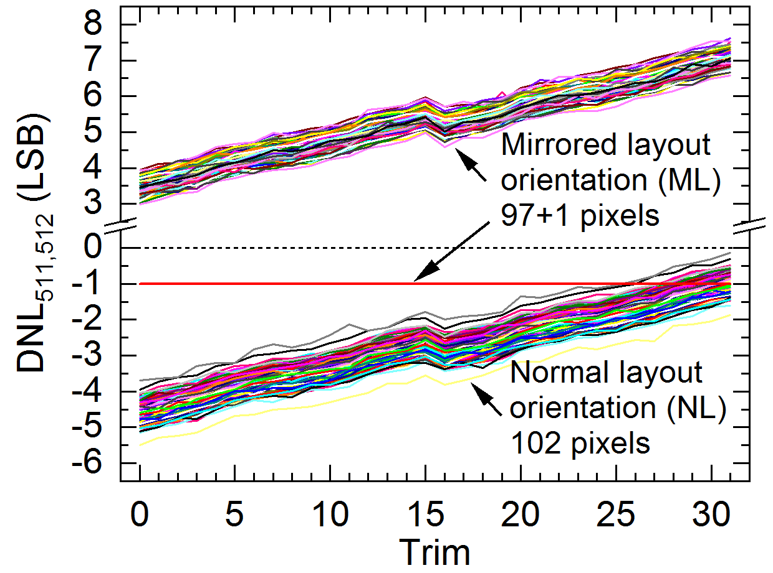
Choice of Nominal DAC Capacitance
nominal value of capacitance of charge redistribution capacitors affects performance as well as efficiency of the ADC;
If C_{nom} is too small:
  kT/C noise will dominate;
  matching of capacitors with high precision is difficult;
If C_{nom} is too large:
  circuit area æ;
  power consumption æ to charge such big capacitors;
good balance between these constraints Æ (150 – 250) fF
  Monte Carlo simulations in TPSCo 65nm to model dispersion of the capacitors are required to determine required range of the trimming DAC;
  6-bit tuning range sufficient (implementation in TSMC 65nm);

Slide 14
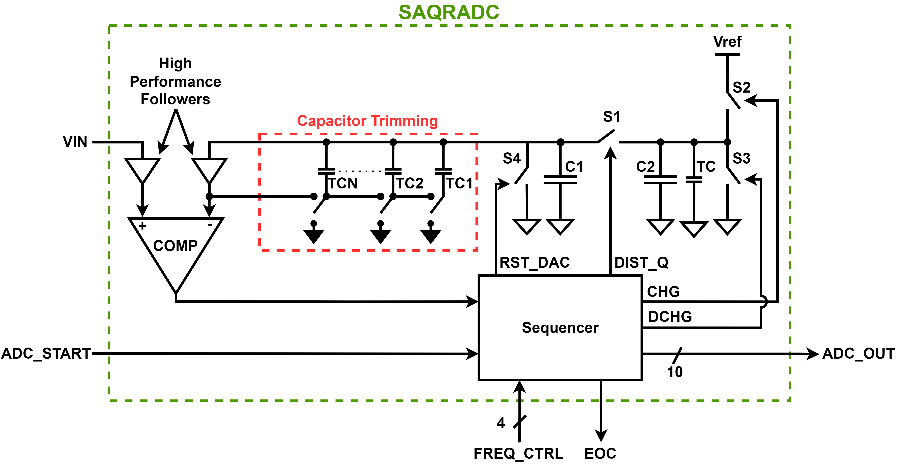
Matching of DAC Capacitors – Minimizing Parasitic Capacitance
parasitic capacitances connected to charge redistribution capacitors must be minimized or made even and not signal-dependent;
minimization of parasitic capacitances is next after using the trimming DAC to minimize mismatching of C1 and C2;
parasitic capacitance sources are:
  switches S1-S4 e minimum size switches,
  which add very little parasitics,
    furthermore, symmetricity of switches is crucial;
    + a bit of parasitics/layout asymmetries;
  comparator input
    comparator input is a source-follower designed with
    input capacitance nearing zero (< 0.1 fF) and signal independent;
trimming of C1 and C2 is achieved with additional metal overlap capacitors (a few tens of aF steps) that can be turned on/off via bootstrapping

Slide 15
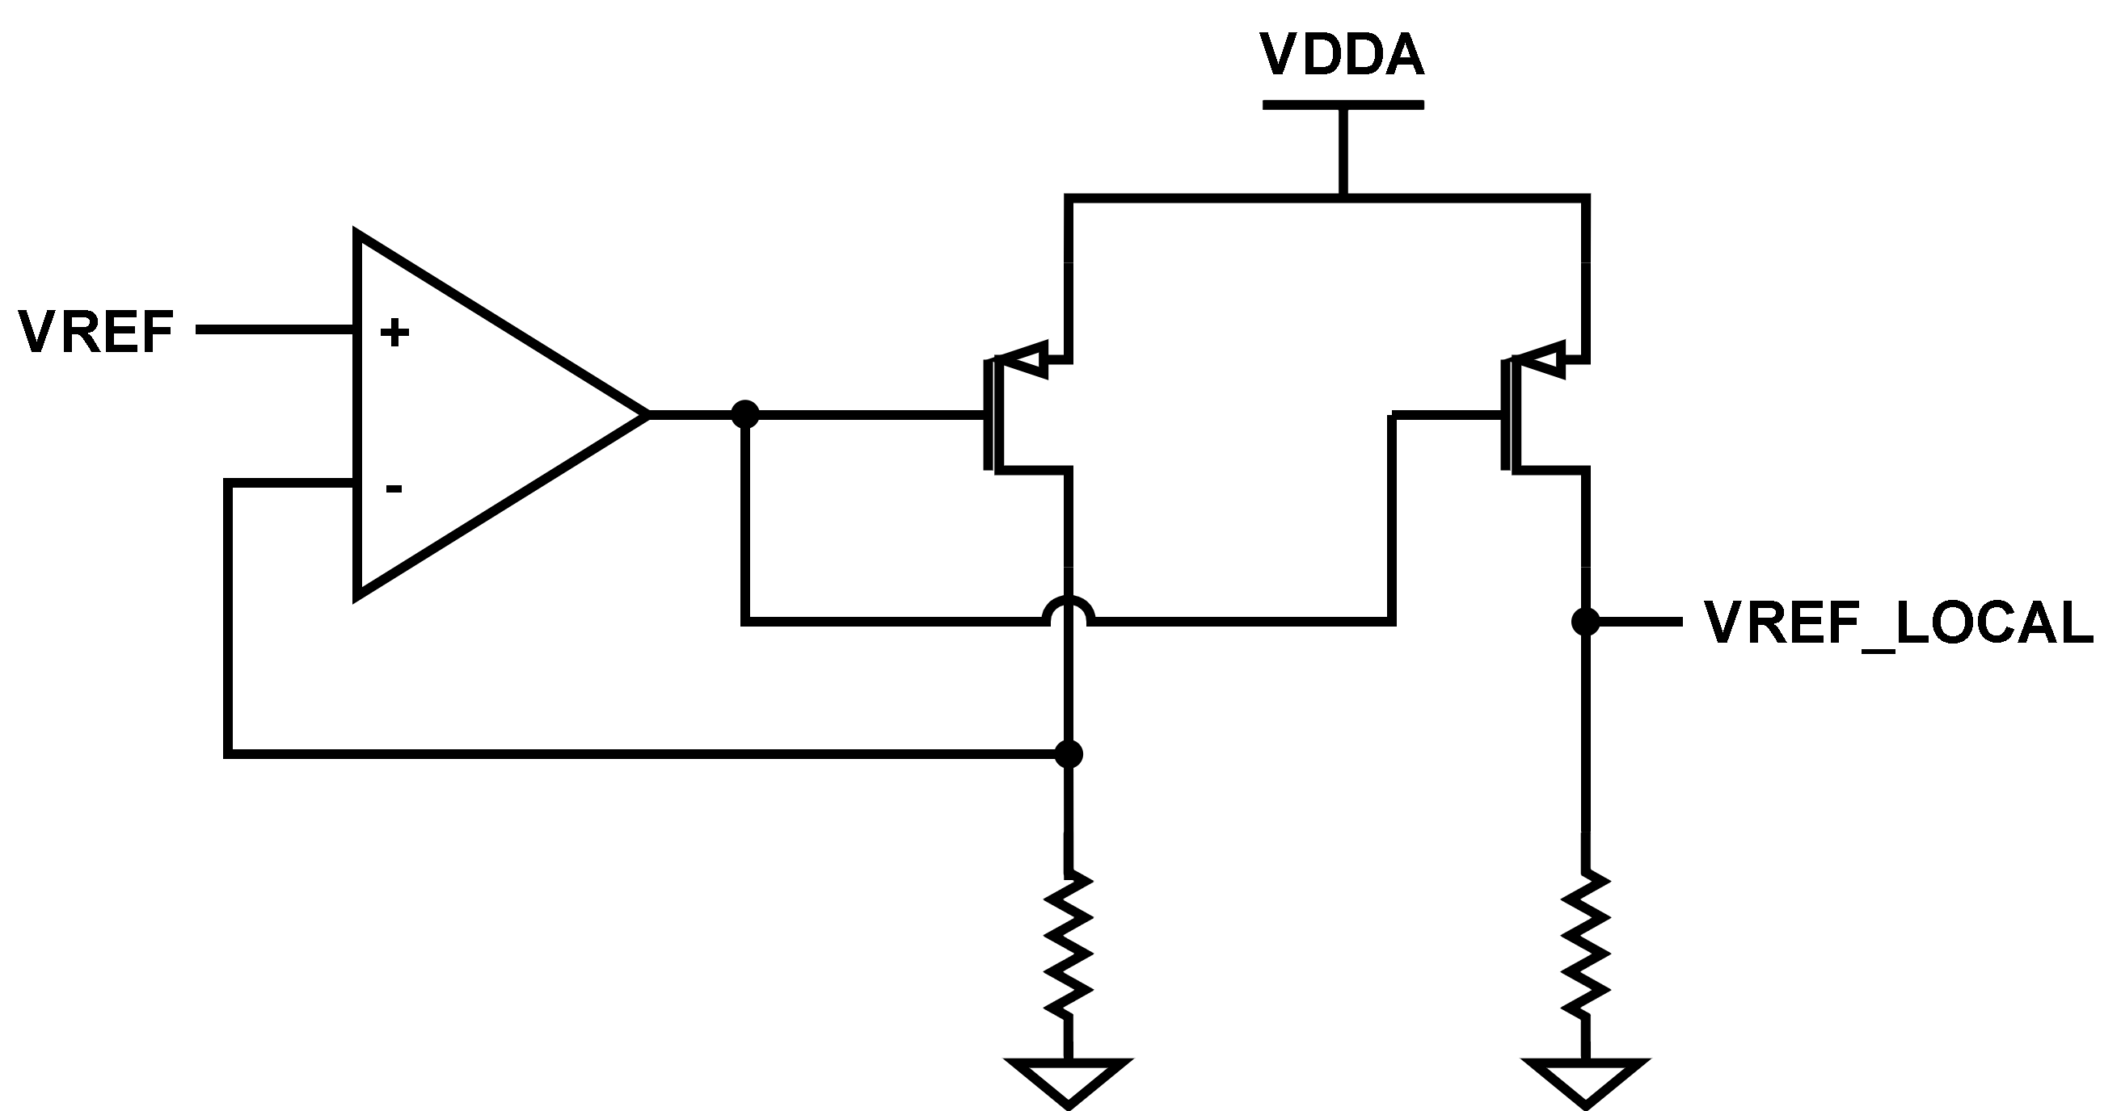
Generation of DAC Reference Voltage
capacitive DAC requires reference voltage that will charge one of charge redistribution capacitors when d_{N-1} = 1;
this voltage will need to be, either, generated inside ADC (per VFM_ADC in each RSU) or fed from outside to VFM_ADC (one for all ADCs);
reference voltage generator requirements:
  low-impedance output to charge capacitor within required time,
  P_{ower}V_{oltage}T_{emperature} corners robust,
  Ideally would one referencefor all VFM_ADCs,
there are three main options to provide this reference voltage:
  low-impedance trace fed to all VFM_ADCs
  local PVT-robust reference voltage
  set VREF to VDDA
under investigation

Slide 16
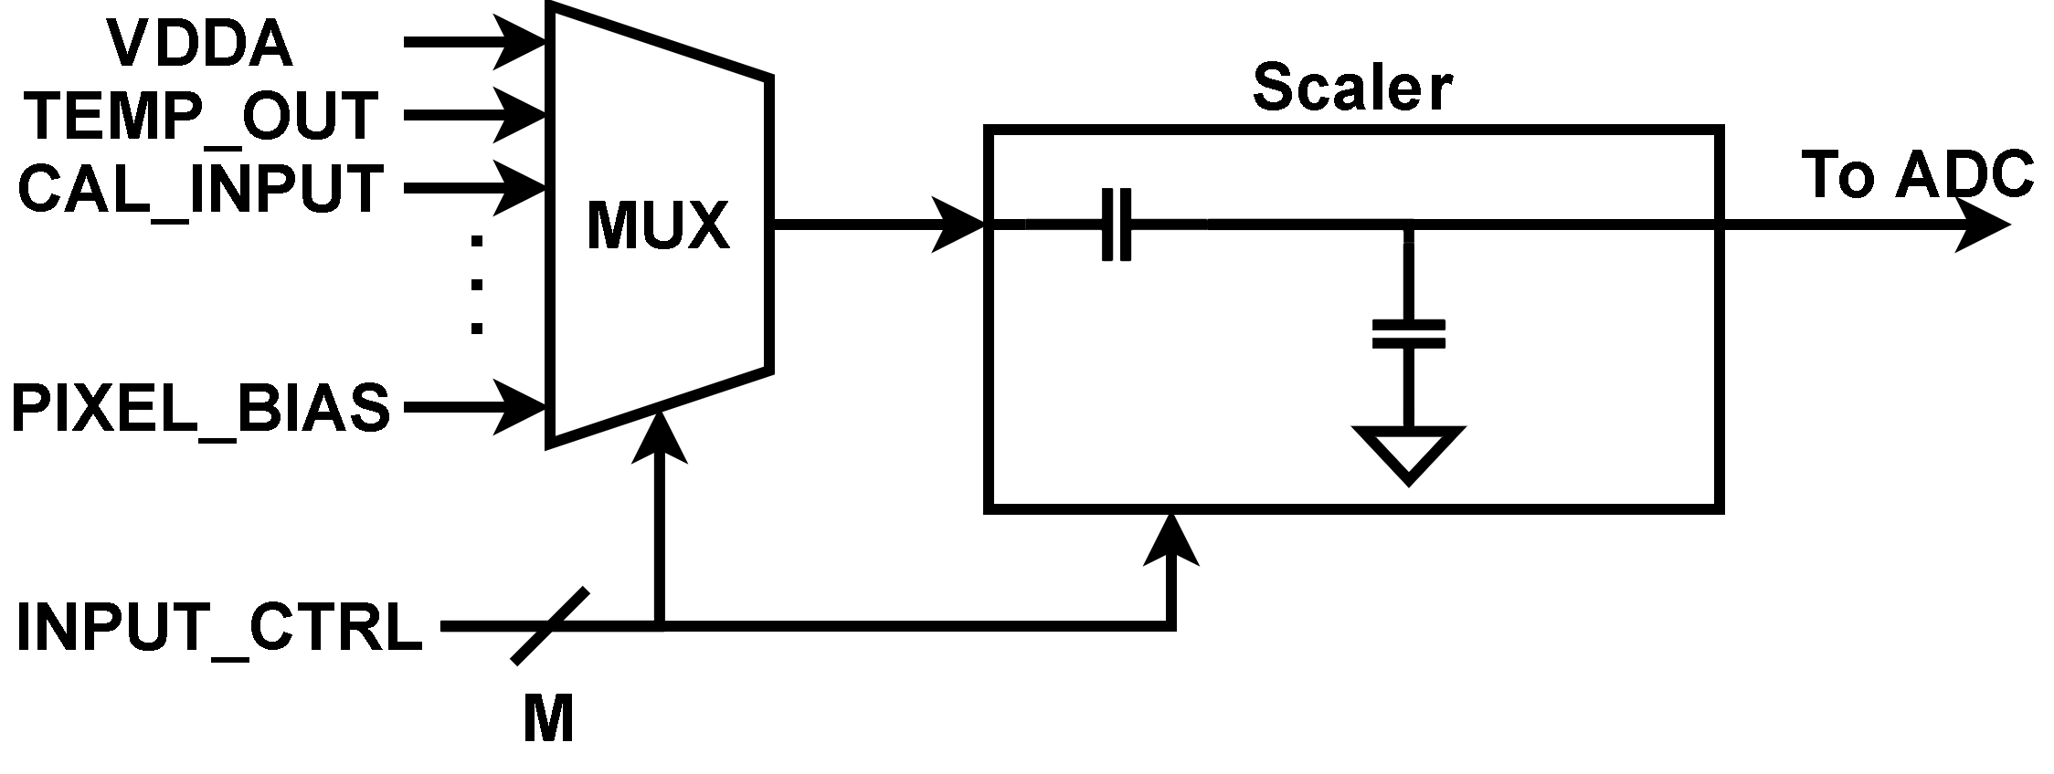
Connecting Signals to VFM_ADC
variety of different input signals will be measured by VFM_ADC Æ so inputs must be multiplexed;
some signals may operate on higher power supply than VFM_ADC (also it depends on power regulation scheme and available power supplies on sensors), but still rail-to-rail operation is required
(for monitoring power supplies):
  input scaler circuit (capacitive divider) can translate
  signals that are above or below (0 – 1.2) V operating
  range into that of VFM_ADC,
  control of scaler will be part of the sequencer.
this input scaler can be implemented via
simple charge divider since input capacitance of VFM_ADC input is zero;
  scaler can be used as opposed to buffer due to zero input capacitance from comparator.

Slide 17
Calibration
calibration is simpler than for binary-weighted SAR ADC;
  only single weight set (trimming DAC) needs to be adjusted and stored,
  known input signal needs to be converted multiple times for varied capacitive DAC settings to obtain set that results in best DNL/INL.
what will the input signal be?
  high resolution ramps (stepped static signal) are difficult to implement, and the calibration process will be slow
  low-distortion, precise sine waves are simpler to create
    this input signal will need to be routed across the entire chip
    frequency of input sine wave needs to be determined
code-Density Test (CDT) will be used to analyze the test results and set the capacitive trimming DAC weights
  this process is fast and simple
calibration should only need to be repeated if there are power supply issues or accumulated radiation damage

Slide 18
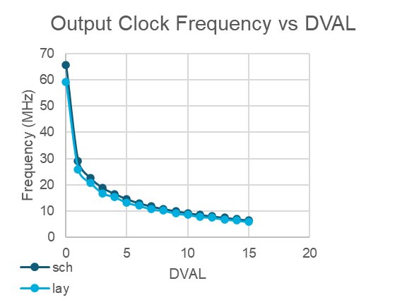
Status of VFM_ADC
schematics of all analog blocks are made but tuning is required;
sequencer schematic is done, and layout is underway;
on-demand clock generator within sequencer is laid out and extracted view has been tested
  layout area was minimized
  all routing was limited to lower two metal layers
  higher metal layers will be saved to implement charge redistribution capacitors as M_{etal}O_{xide}M_{etal} structures
Clock frequency (layout)
(5.916 – 59.25) MHz

Slide 19
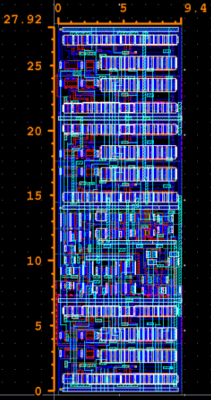
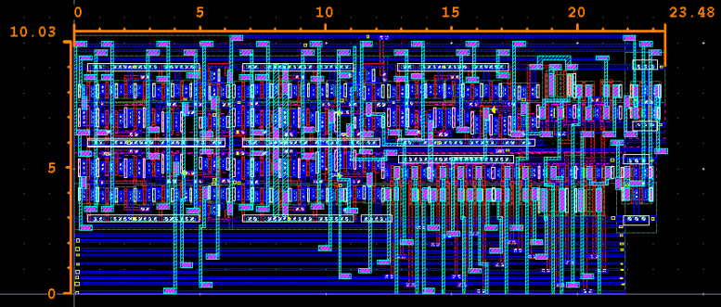
Progress of Physical Implementation
Sequencer layout is underway
Design-for-Manufacturability and recommended layout rules used;
estimate total area to be occupied by VFM-ADC;
assess of performance of full-custom logic in comparison with another
65 nm CMOS process (in-pixel ADC);
~40% of total sequencer design
pauseable, clock generator of configurable frequency
Johnson counter based walking-1, external loop sequencer

Slide 20
Conclusion
on-demand VFM_ADC designed for low-power and minimum area is underway in TPSCo 65 nm;
there are variety of decisions still to be made on how best to implement this on-demand ADC scheme within whole Large Area Sensors to integrate within THE SYSTEM;
target as one of test structure for ER2 submission and inclusion in full sensors;
VFM_ADC Characteristics
Resolution | Input Range | Conversion Time | Layout Area | # of External Signals Needed
10 bits ENOB: >10bits | (0 – 1.2) V* | (0.82 – 8.36) μs | (3,000 – 5,000) μm²** | 4 (VDD, VDDA, VREF, CAL_INPUT)
*: assuming availability of >1.2 V power supply, i.e. 1.8V **: estimated

Slide 21

Reserve
Slides

Slide 22
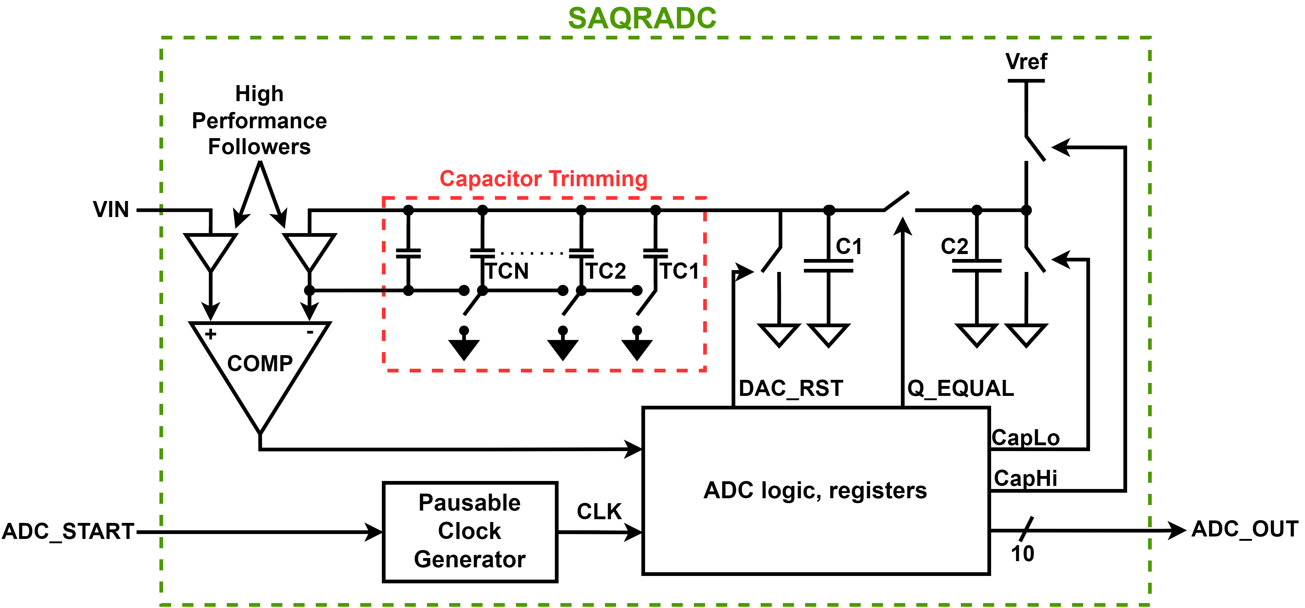
VFM_ADC - summary
monitoring of essential signals and levels within an ASIC (temperature, bias voltage/current values, etc.) requires some kind of processing on analog,
standard ADC architectures are large, power-hungry, and suited for running continuously which is not necessary as the signals to be monitored need to only be checked on occasion,
sompact, low-power ADC that can run on command while shutting itself down while not in use is pursued.
A compact Succesive Approximation Charge (Q) Redistribution (SAQRADC) ADC running off of a pausable clock generator
Key Features:
10-bit resolution
pauseable clock generator
DAC with 2 sampling capacitors of ~220fF
capacitor trimming to tens of attofarads
High-gain comparator with high performance source followers with gain > 0.999 and Cin < 0.1fF
IEEE JSSC, 10(6), 379–385
Presented at: https://indico.cern.ch/event/1285331/contributions/5401017/attachments/2645783/4579639/ER2_Presentation.pdf

Slide 23
ALICE ITS3 – ePIC MAPS development
Areas highlighted as desired contributions to the ALICE-ITS3 MAPS (04/25/2023):
(SRAM) Development of dual-port Static Random Access Memory (SRAM), either as a compiler code or at least as full custom block (TPSCo 65nm contains single port SRAM compiler and it does not use DFM recommended rules) for buffering data for data transmission at the Repeated Sensor Unit (RSU) peripheries.
(LP_StCells) Development of standard cells library (take care of the subset of cells) oriented on Low-Power (non-minimum Lengths of FETs) and respecting recommended rules, target 9T version, including timing characterization with Liberate (BNL/RAL interested).
(HV_StCells) Development of standard cells, minimal subset, suitable for operation at HV (required for power management, i.e., operation when no core power is ON).
(VFM_ADC) Development of small footprint ADC for Vital Functions Monitoring (VFM) with interfacing circuitries suited for connecting signals to be monitored and interfacing to slow control and fetching data to output through slow control of data stream interface (BNL started).
(LDoC_ULVS) Development of Long-Distance on-Chip (LDoC) Ultra-Low-Voltage Signaling (ULVS) data transmission for sending data from stitched Repeated Sensor Units (RSU) to the peripheral area, where Time Division Multiple Access (TDMA) interrace connects to the lpGBT IP for data aggregation of high-speed links for data transfer off MAPS sensors (BNL interested).
(F_D/R) Development of fast driver/receiver blocks (RAL already involved).

