Slide 1
eAST Physics List
eAST Physics List is downloadable at https://github.com/eic/east/tree/main/PhysicsList
Currently it works with Geant4 version 11.1-patch01
Also works with versions 10.7-patch02 and higher
eAST Physics List consists of two parts.
Baseline: common for all components
Optional extensions/alternatives: specific to detector components
eAST Phyiscs List
FTFP_BERT is the baseline.
Tailored to EIC energy scale
Need beam test data for further tuning / validation
Non-templated hard-coded modular physics list for easy to read, understand and optimized
Capable to alternate physics options for each detector component (region)
Notes:
Original FTFP_BERT
FTF and BERT are blended between 3 GeV and 6 GeV
eAST
FTF and BERT are blended between
10 GeV and 12 GeV (pion)
5 GeV and 12 GeV (proton, neutron)

Slide 2
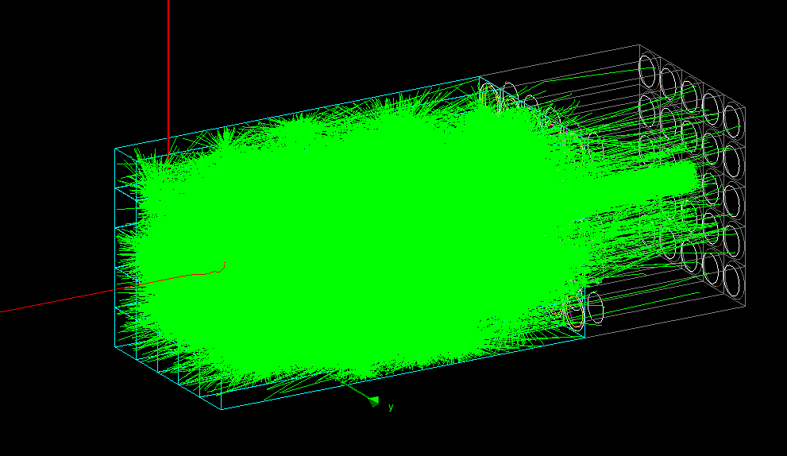
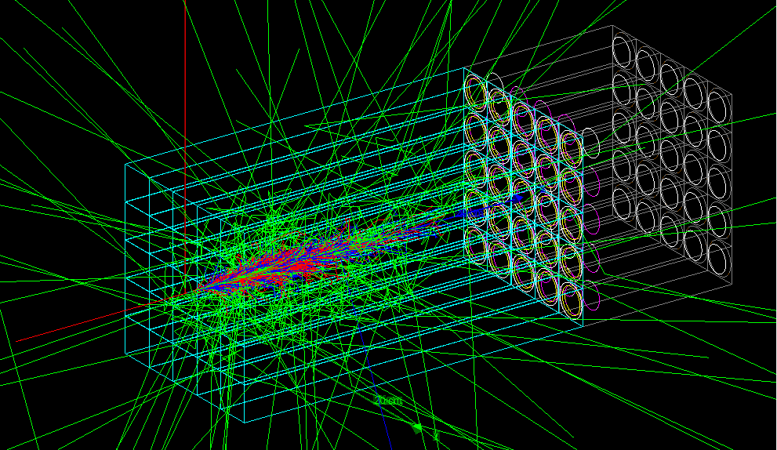
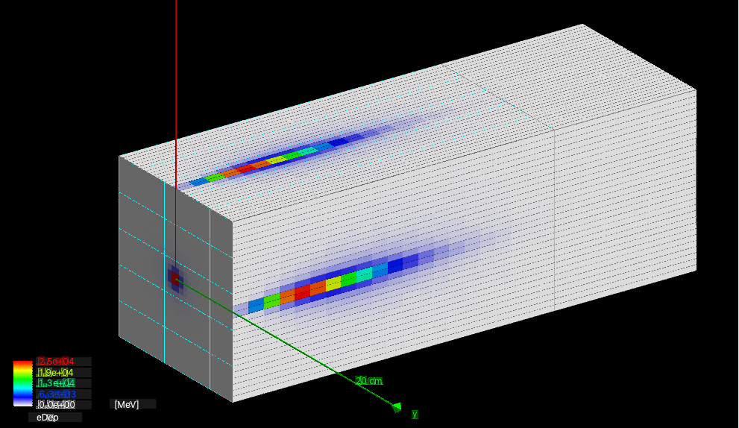
5 GeV e-
Full simulation with optical photon transport to photo-multipliers
18.41 sec/event
x 154
Full simulation except optical photon transport
0.119 sec/event
Requires parameter tuning of energy deposition → PM pulse height
x 137
Shower parameterization with GFlash
0.00087 sec/event
Requires tuning of GFlash parameters

Slide 3
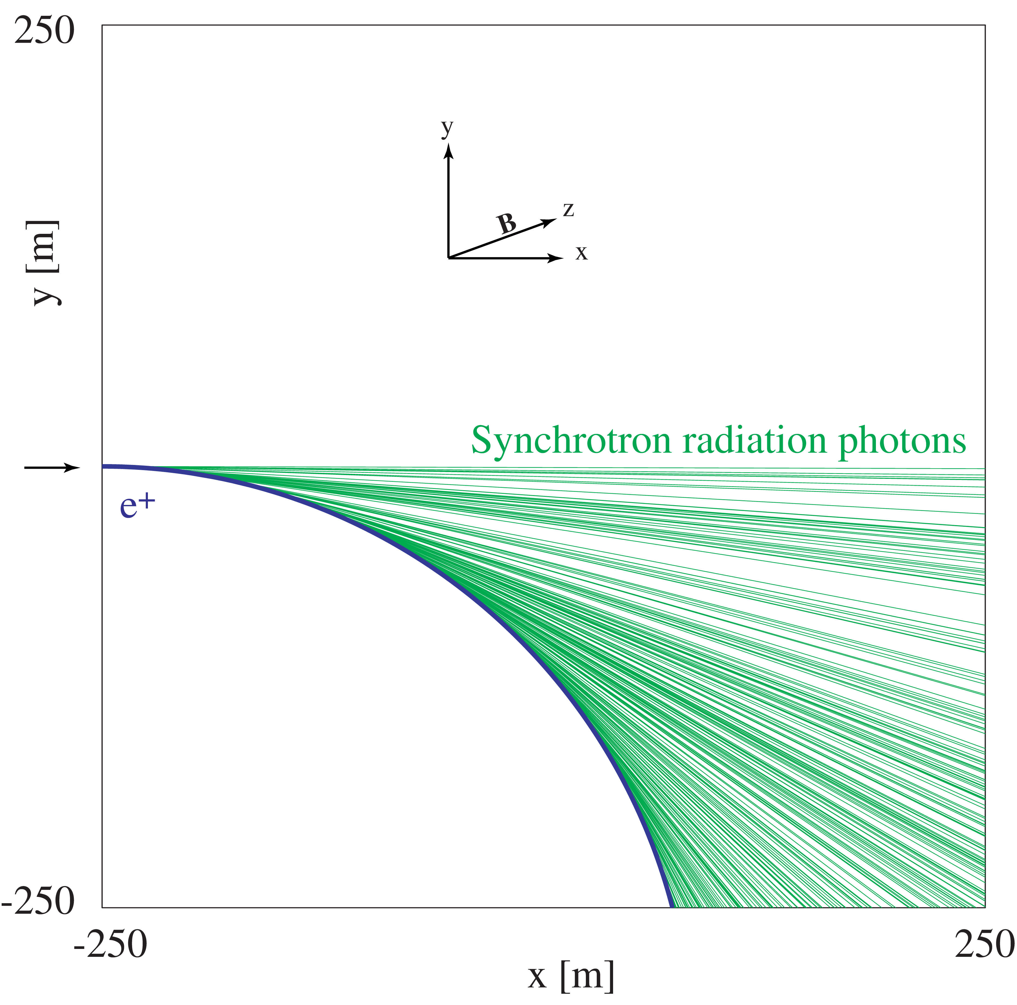
EM Physics
Default
EM Option 0 : commonly used by LHC experiments https://geant4-userdoc.web.cern.ch/UsersGuides/PhysicsListGuide/html/electromagnetic/Opt0.html
Alternative
EM Option 4 : most accurate (the best Geant4 can do), but slower https://geant4-userdoc.web.cern.ch/UsersGuides/PhysicsListGuide/html/electromagnetic/Opt4.html
Should be applied only for the interested region
Optical photon processes are optional.
Synchrotron radiation
G4SynchrotronRadiation process must be explicitly added.
Should be applied only within the beam pipe.
G4StepLimiter should also be added.
The maximum step length of a charged particle with magnetic field integration in vacuum is 1 km.
10 GeV e+ in 0.1 T field

Slide 4
Hadronic physics
Separate class for different particles
eASTProtonPhysics.cc
eASTNeutronPhysics.cc
eASTPionPhysics.cc
π+, π- (π0 handled implicitly by models)
eASTKaonPhysics.cc
K+, K-, K0L, K0S (K0, anti-K0 handled implicitly by models)
eASTHyperonPhysics.cc
Λ, Σ+, Σ-, Ξ0, Ξ-, Ω- (Σ0 handled implicitly by models)
eASTAntiBaryonPhysics.cc
anti-(p, n, d, t, 3He, α), anti-(Λ, Σ+, Σ-, Ξ0, Ξ-, Ω-)
eASTIonPhysics.cc
p, n, d, t, 3He, α, generic ion
eASTGammaLeptoNuclearPhysics.cc
Very similar to FTFP_BERT, but wider use of Bertini
Better precision in medium energy (below 10 GeV)
Default FTFP_BERT blends Bertini and FTF models at [3.0 GeV, 6.0 GeV] for all particle types
eAST physics list blends Bertini and FTF models
[10 GeV, 12 GeV] (pion)
[5 GeV, 12 GeV] (proton, neutron)

Slide 5
eASTProtonPhysics
Inelastic process
Models
Bertini cascade from 0 to 12 GeV
FTFP from 5 GeV to 100 TeV
Cross section
Barashenkov-Glauber-Gribov (BGG) inelastic at all energies
Elastic process
Model
G4ChipsElasticModel at all energies
Cross section
G4ChipsProtonElasticXS at all energies

Slide 6
eASTProtonPhysics
void eASTProtonPhysics::ConstructProcess()
{
// Low energy elastic model
auto* elMod = new G4ChipsElasticModel();
// Use Bertini cascade for low energies
auto* loInelModel = new G4CascadeInterface;
loInelModel->SetMinEnergy(0.0);
loInelModel->SetMaxEnergy(12.0*GeV);
// Use FTFP for high energies
auto* ftfp = new G4TheoFSGenerator("FTFP");
auto* stringModel = new G4FTFModel;
auto* stringDecay
= new G4ExcitedStringDecay(new G4LundStringFragmentation);
stringModel->SetFragmentationModel(stringDecay);
auto* preCompoundModel
= new G4GeneratorPrecompoundInterface();
ftfp->SetHighEnergyGenerator(stringModel);
ftfp->SetTransport(preCompoundModel);
ftfp->SetMinEnergy(5*GeV);
ftfp->SetMaxEnergy(100*TeV);
// Cross section
auto* inelCS
= new G4BGGNucleonInelasticXS(G4Proton::Proton() );
auto* elCS = new G4ChipsProtonElasticXS;
G4ProcessManager* procMan
= G4Proton::Proton()->GetProcessManager();
// Elastic process
auto* pProcEl = new G4HadronElasticProcess;
pProcEl->RegisterMe(elMod);
pProcEl->AddDataSet(elCS);
procMan->AddDiscreteProcess(pProcEl);
// Inelastic process
auto* pProcInel
= new G4HadronInelasticProcess
("ProtonInelasticProcess",G4Proton::Proton() );
pProcInel->RegisterMe(loInelModel);
pProcInel->RegisterMe(ftfp);
pProcInel->AddDataSet(inelCS);
procMan->AddDiscreteProcess(pProcInel);
}

Slide 7
eASTNeutronPhysics
Inelastic process
Same models and cross sections as proton inelastic
Elastic process
Model
Same model as proton elastic
Cross section
G4NeutronElasticXS at all energies
Capture process
Model
G4NeutronRadCapture at all energies
Cross section
G4NeutronCaptureXS
eASTNeutronPhysics by default implements a neutron killer.
Neutrons are killed after traveling 10 μsec.

Slide 8
eASTNeutronPhysics
void eASTNeutronPhysics::ConstructProcess()
{
// Low energy elastic model
auto* elMod = new G4ChipsElasticModel();
// Use Bertini cascade for low energies
auto* loInelModel = new G4CascadeInterface;
loInelModel->SetMinEnergy(0.0);
loInelModel->SetMaxEnergy(12.0*GeV);
// Capture model
auto* capModel = new G4NeutronRadCapture();
// Use FTFP for high energies
auto* ftfp = new G4TheoFSGenerator("FTFP");
auto* stringModel = new G4FTFModel;
auto* stringDecay = new G4ExcitedStringDecay
(fragModel = new G4LundStringFragmentation);
stringModel->SetFragmentationModel(stringDecay);
auto* preCompoundModel
= new G4GeneratorPrecompoundInterface();
ftfp->SetHighEnergyGenerator(stringModel);
ftfp->SetTransport(preCompoundModel);
ftfp->SetMinEnergy(5*GeV);
ftfp->SetMaxEnergy(100*TeV);
// Cross section sets
auto* inelCS
= new G4BGGNucleonInelasticXS(G4Neutron::Neutron() );
auto* elCS = new G4NeutronElasticXS;
auto* capCS = new G4NeutronCaptureXS;
G4ProcessManager* procMan
= G4Neutron::Neutron()->GetProcessManager();
// Elastic process
G4HadronElasticProcess* nProcEl = new G4HadronElasticProcess;
nProcEl->RegisterMe(elMod);
nProcEl->AddDataSet(elCS);
procMan->AddDiscreteProcess(nProcEl);
// Inelastic process
auto* nProcInel = new G4HadronInelasticProcess
("NeutronInelasticProcess",G4Neutron::Neutron() );
nProcInel->RegisterMe(loInelModel);
nProcInel->RegisterMe(ftfp);
nProcInel->AddDataSet(inelCS);
procMan->AddDiscreteProcess(nProcInel);
// Capture process
auto* nProcCap = new G4NeutronCaptureProcess("nCapture");
nProcCap->RegisterMe(capModel);
nProcCap->AddDataSet(capCS);
procMan->AddDiscreteProcess(nProcCap);
// Neutron cut (kill neutrons that live too long)
G4NeutronKiller* nKiller = new G4NeutronKiller();
nKiller->SetTimeLimit(10.*microsecond);
procMan->AddDiscreteProcess(nKiller);
}

Slide 9
eASTPionPhysics
Inelastic process
Models
Bertini cascade from 0 to 12 GeV
FTFP from 10 GeV to 100 TeV
Cross section
G4PiNuclearCrossSection with Glauber-Gribov extension at all energies
Elastic process
Model
G4HadronElastic from 0 to 1 GeV
G4ElasticHadrNucleusHE above 1 GeV
Cross section
Barashenkov-Glauber-Gribov (BGG) elastic at all energies
π- stopping process
Bertini absorption at rest

Slide 10
eASTPionPhysics
void eASTPionPhysics::ConstructProcess()
{
// Low energy elastic model
auto* loElModel = new G4HadronElastic();
loElModel->SetMaxEnergy(1.0001*GeV);
// High energy elastic model
auto* hiElModel = new G4ElasticHadrNucleusHE();
hiElModel->SetMinEnergy(1.0*GeV);
// Use Bertini cascade for low energies
auto* loInelModel = new G4CascadeInterface;
loInelModel->SetMinEnergy(0.0);
loInelModel->SetMaxEnergy(12.0*GeV);
// Use FTFP for high energies
auto* ftfp = new G4TheoFSGenerator("FTFP");
auto* stringModel = new G4FTFModel;
auto* stringDecay = new G4ExcitedStringDecay
(fragModel = new G4LundStringFragmentation);
stringModel->SetFragmentationModel(stringDecay);
auto* preCompoundModel
= new G4GeneratorPrecompoundInterface();
ftfp->SetHighEnergyGenerator(stringModel);
ftfp->SetTransport(preCompoundModel);
ftfp->SetMinEnergy(10*GeV);
ftfp->SetMaxEnergy(100*TeV);
// pi+
auto* procMan = G4PionPlus::PionPlus()->GetProcessManager();
// elastic
auto* pipProcEl = new G4HadronElasticProcess;
pipProcEl->RegisterMe(loElModel);
pipProcEl->RegisterMe(hiElModel);
pipProcEl->AddDataSet(
new G4BGGPionElasticXS(G4PionPlus::PionPlus() ) );
procMan->AddDiscreteProcess(pipProcEl);
// inelastic
auto* pipProcInel = new G4HadronInelasticProcess
("PionPlusInelasticProcess", G4PionPlus::PionPlus() );
pipProcInel->RegisterMe(loInelModel);
pipProcInel->RegisterMe(ftfp);
pipProcInel->AddDataSet(
new G4BGGPionInelasticXS(G4PionPlus::PionPlus() ) );
procMan->AddDiscreteProcess(pipProcInel);

Slide 11
eASTPionPhysics
// pi-
procMan = G4PionMinus::PionMinus()->GetProcessManager();
// elastic
auto* pimProcEl = new G4HadronElasticProcess;
pimProcEl->RegisterMe(loElModel);
pimProcEl->RegisterMe(hiElModel);
pimProcEl->AddDataSet
(new G4BGGPionElasticXS(G4PionMinus::PionMinus() ) );
procMan->AddDiscreteProcess(pimProcEl);
// inelastic
auto* pimProcInel = new G4HadronInelasticProcess
("PionMinusInelasticProcess", G4PionMinus::PionMinus() );
pimProcInel->RegisterMe(loInelModel);
pimProcInel->RegisterMe(ftfp);
pimProcInel->AddDataSet
(new G4BGGPionInelasticXS(G4PionMinus::PionMinus() ) );
procMan->AddDiscreteProcess(pimProcInel);
// stopping
auto* bertAbsorb = new G4HadronicAbsorptionBertini;
procMan->AddRestProcess(bertAbsorb);
}

Slide 12
ParticleHP (was NeutronHP)
Below 20 MeV incident energy, Geant4 provides several models for treating n, p, d, t, 3He and α interactions in detail
The high precision models (ParticleHP) are data-driven and depend on a large database of cross sections, etc.
G4NDL database is available for download from the Geant4 web site
TENDL optional database is also available
Elastic, inelastic, capture and fission models all use this isotope-dependent data
Very good agreement with MCNP
There are also optional models to handle thermal scattering from chemically bound atoms.
ParticleHP is not included by default to eAST physics list.
Neutron killer should be disabled (or extended to ~ 1 sec).
For precise single-event upset simulation, you may want to consider
Radioactive decay process
Geometry-based event biasing

