Slide 1
SHUNT LDO for Serial
Powering
Soniya Mathew
STFC RAL
23 August 2023
Notes:
The abstract pattern can be removed or repositioned if required. Be careful to ‘Send to Back’ so that it does not obscure any important information.

Slide 2
SLDO recap
Notes:
The abstract pattern can be removed or repositioned if required. Be careful to ‘Send to Back’ so that it does not obscure any important information.

Slide 3
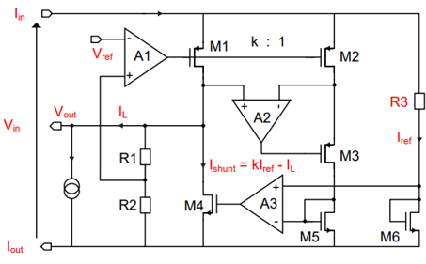
Shunt LDO
Combining the Shunt Regulator and LDO design.
SLDO has an ohmic characteristic which generates
Vin when constant Iin is supplied to the module
Simplified SLDO Diagram
M. Karagounis, D. Arutinov, M. Barbero et al. ‘An Integrated Shunt-LDO Regulator
for Serial Powered Systems’. In: Proc. of the European Solid-State Device Conference,
ESSCIRC 2009 (2009), pp. 276–279. doi: 10.1109/ESSCIRC.2009.5325974.
https://indico.cern.ch/event/879686/contributions/3706455/attachments
/1975390/3287622/SLDO_RD53B_Features.pdf

Slide 4
SLDO design
Notes:
The abstract pattern can be removed or repositioned if required. Be careful to ‘Send to Back’ so that it does not obscure any important information.

Slide 5
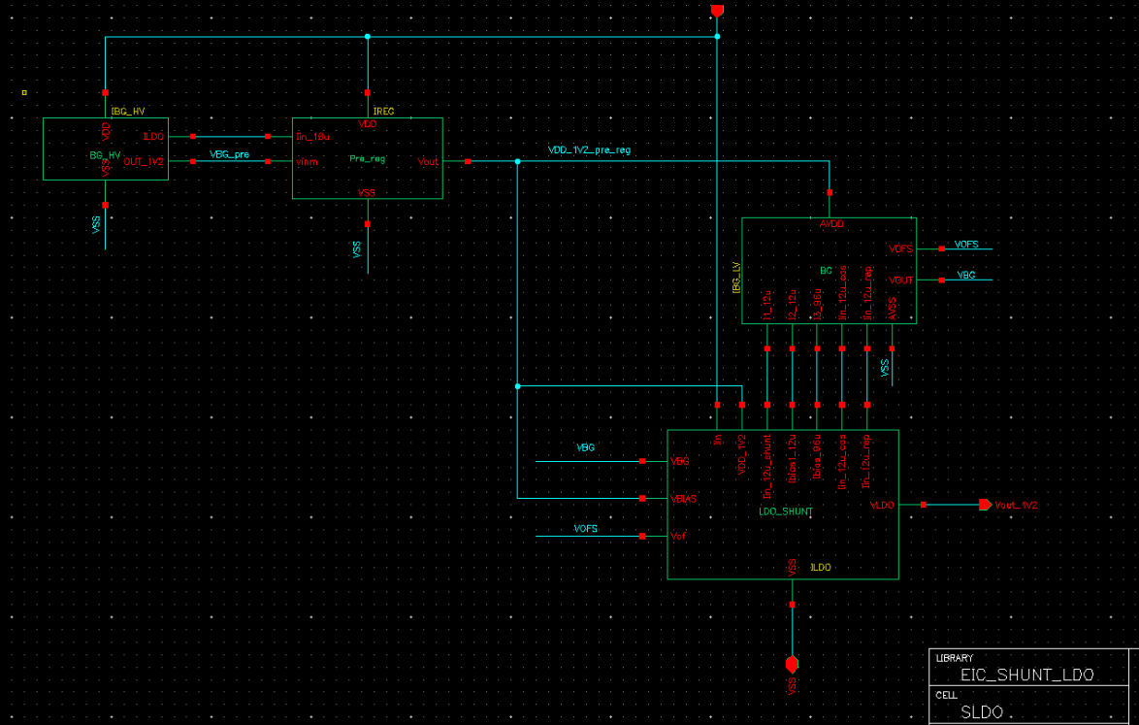
SLDO Schematic Design in Cadence
BG HV:
Supplied from VIN
Output:1.2V
Pre-Reg:
Supplied from VIN
Output:1.2V
BG:
Supplied from Pre-reg
Output:0.6V
SLDO:
Supplied from VIN
Output:1.2V
BG_HV
Pre-Reg
BG
SLDO

Slide 6
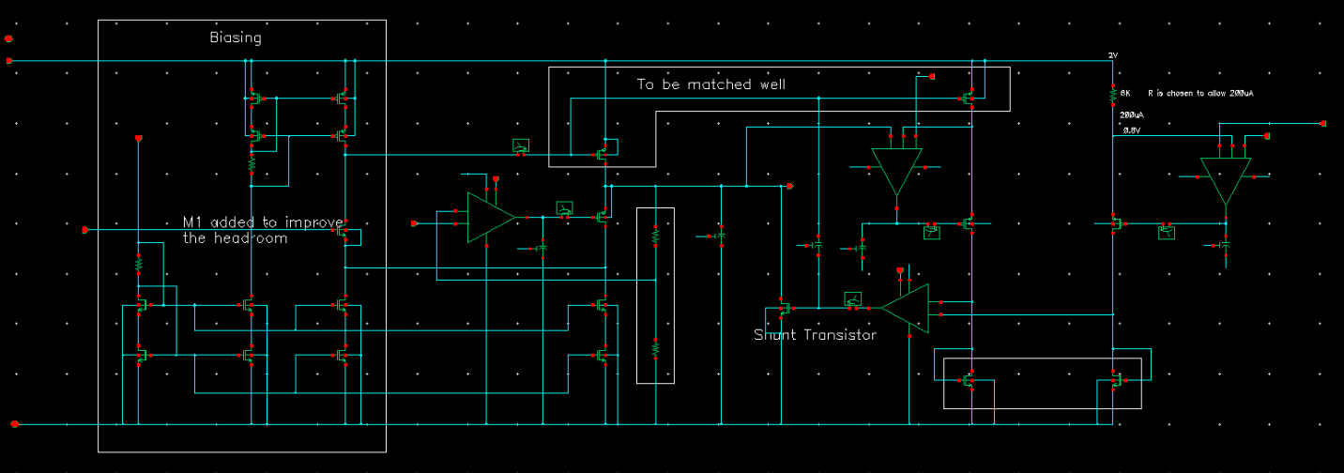
SLDO Schematic Design in Cadence
Biasing
LDO FVF
SHUNT
OFFSET-CORRECTION
Specifications:
For the Nominal current of 200 mA -> Vin generated is 2V)
Iload -> 180mA
Shunt Current ->20mA

Slide 7
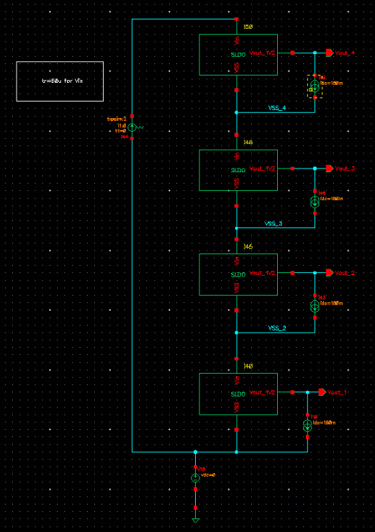
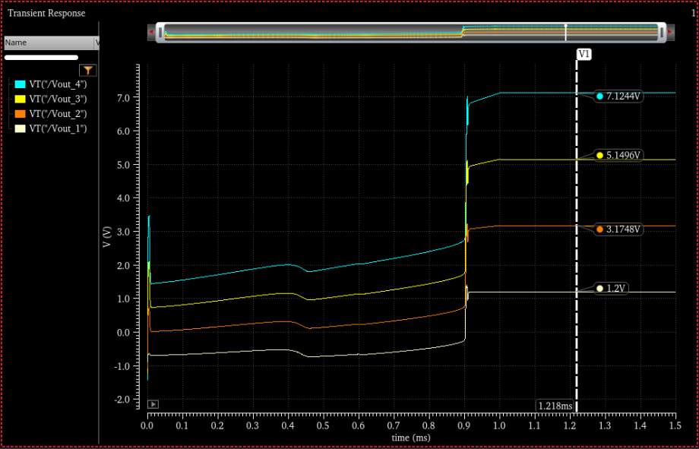
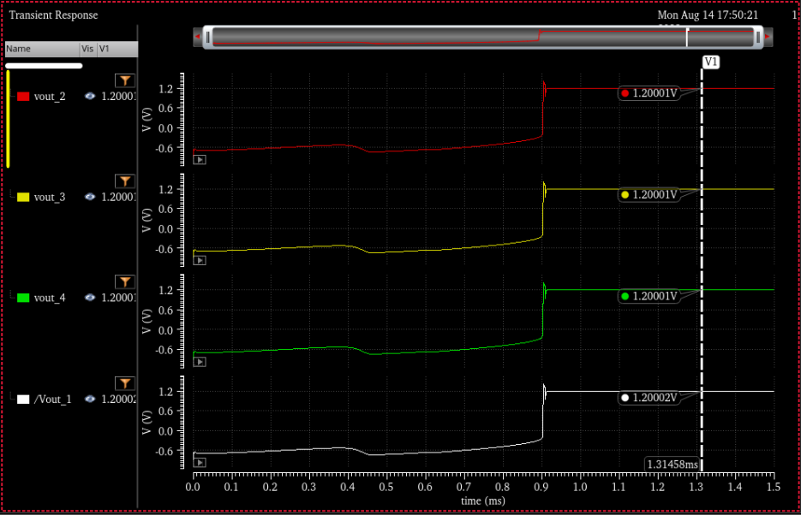
Verification of Serial Powering
Each of the outputs are w.r.t the local ground

Slide 8
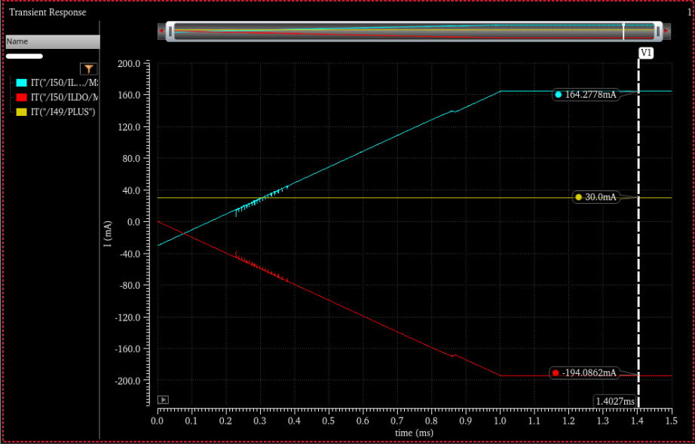
Verification of Serial Powering
SHUNT current
E.g.1:When the load current is 30mA
Current through the pass transistor is 194mA and through the shunt Transistor 164mA
Load current
Total current

Slide 9
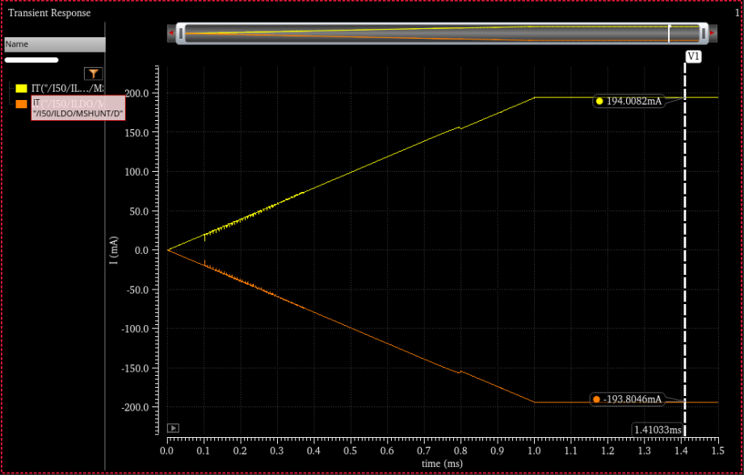
Verification of Serial Powering
SHUNT current
E.g.1:When the load current is 0mA
Current through the pass transistor is 194mA and through the shunt Transistor 194mA
This verifies the shunt functionality
Load current =0
Total current

Slide 10
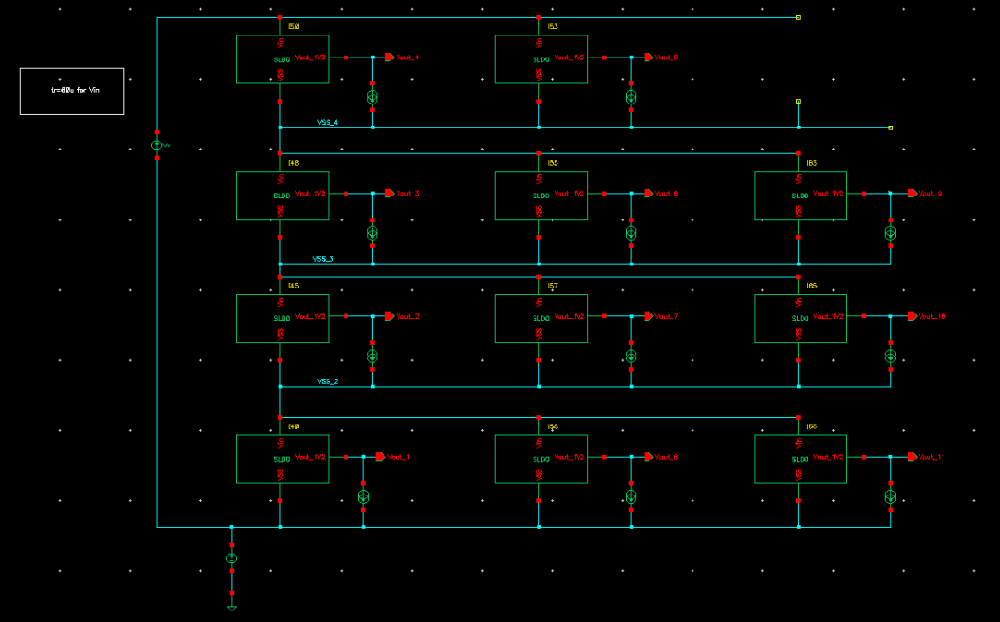
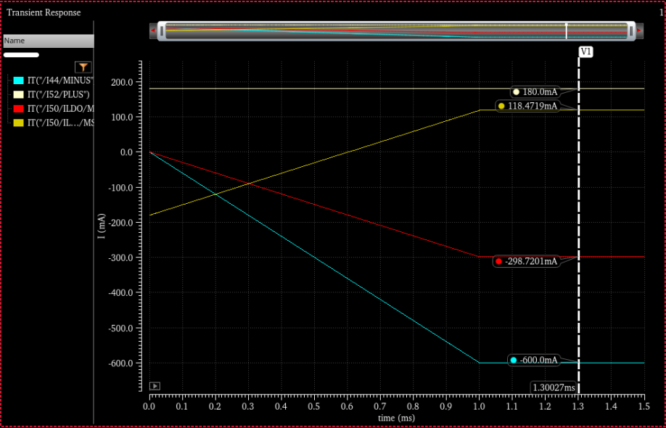
Verification of Serial Powering
When One SLDO is disconnected
Load Current
Shunt Current
Current per SLDO
Total Current(Iin)

Slide 11
Next Steps
Verification in different corners
Transient, PSRR,Line Regulation,Load regulation Simulations.
Verification for different error scenarios
Eg (One SLDO disconnected, One SLDO with shorted output, one SLDO
Not stable)
Add trimming option to the bandgap resistors.
Adding Protection features such as over voltage protection, under-shunt protection etc.

