Slide 1
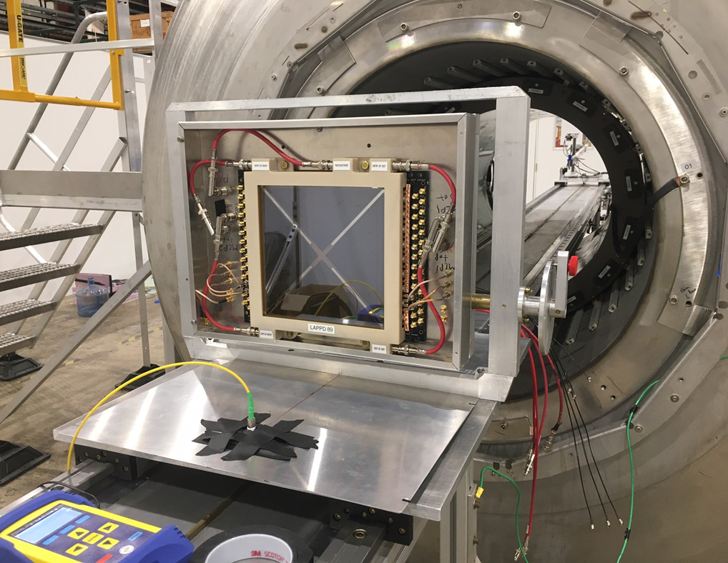
magnetic field test of LAPPD at ARGONNE
Junqi xie
Medium Energy Physics
Argonne National Laboratory
9700 S Cass Ave., Lemont, IL 60439

Slide 2
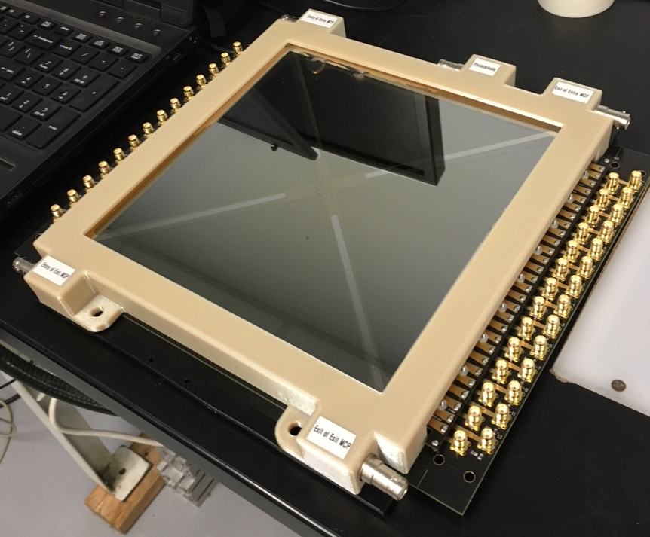
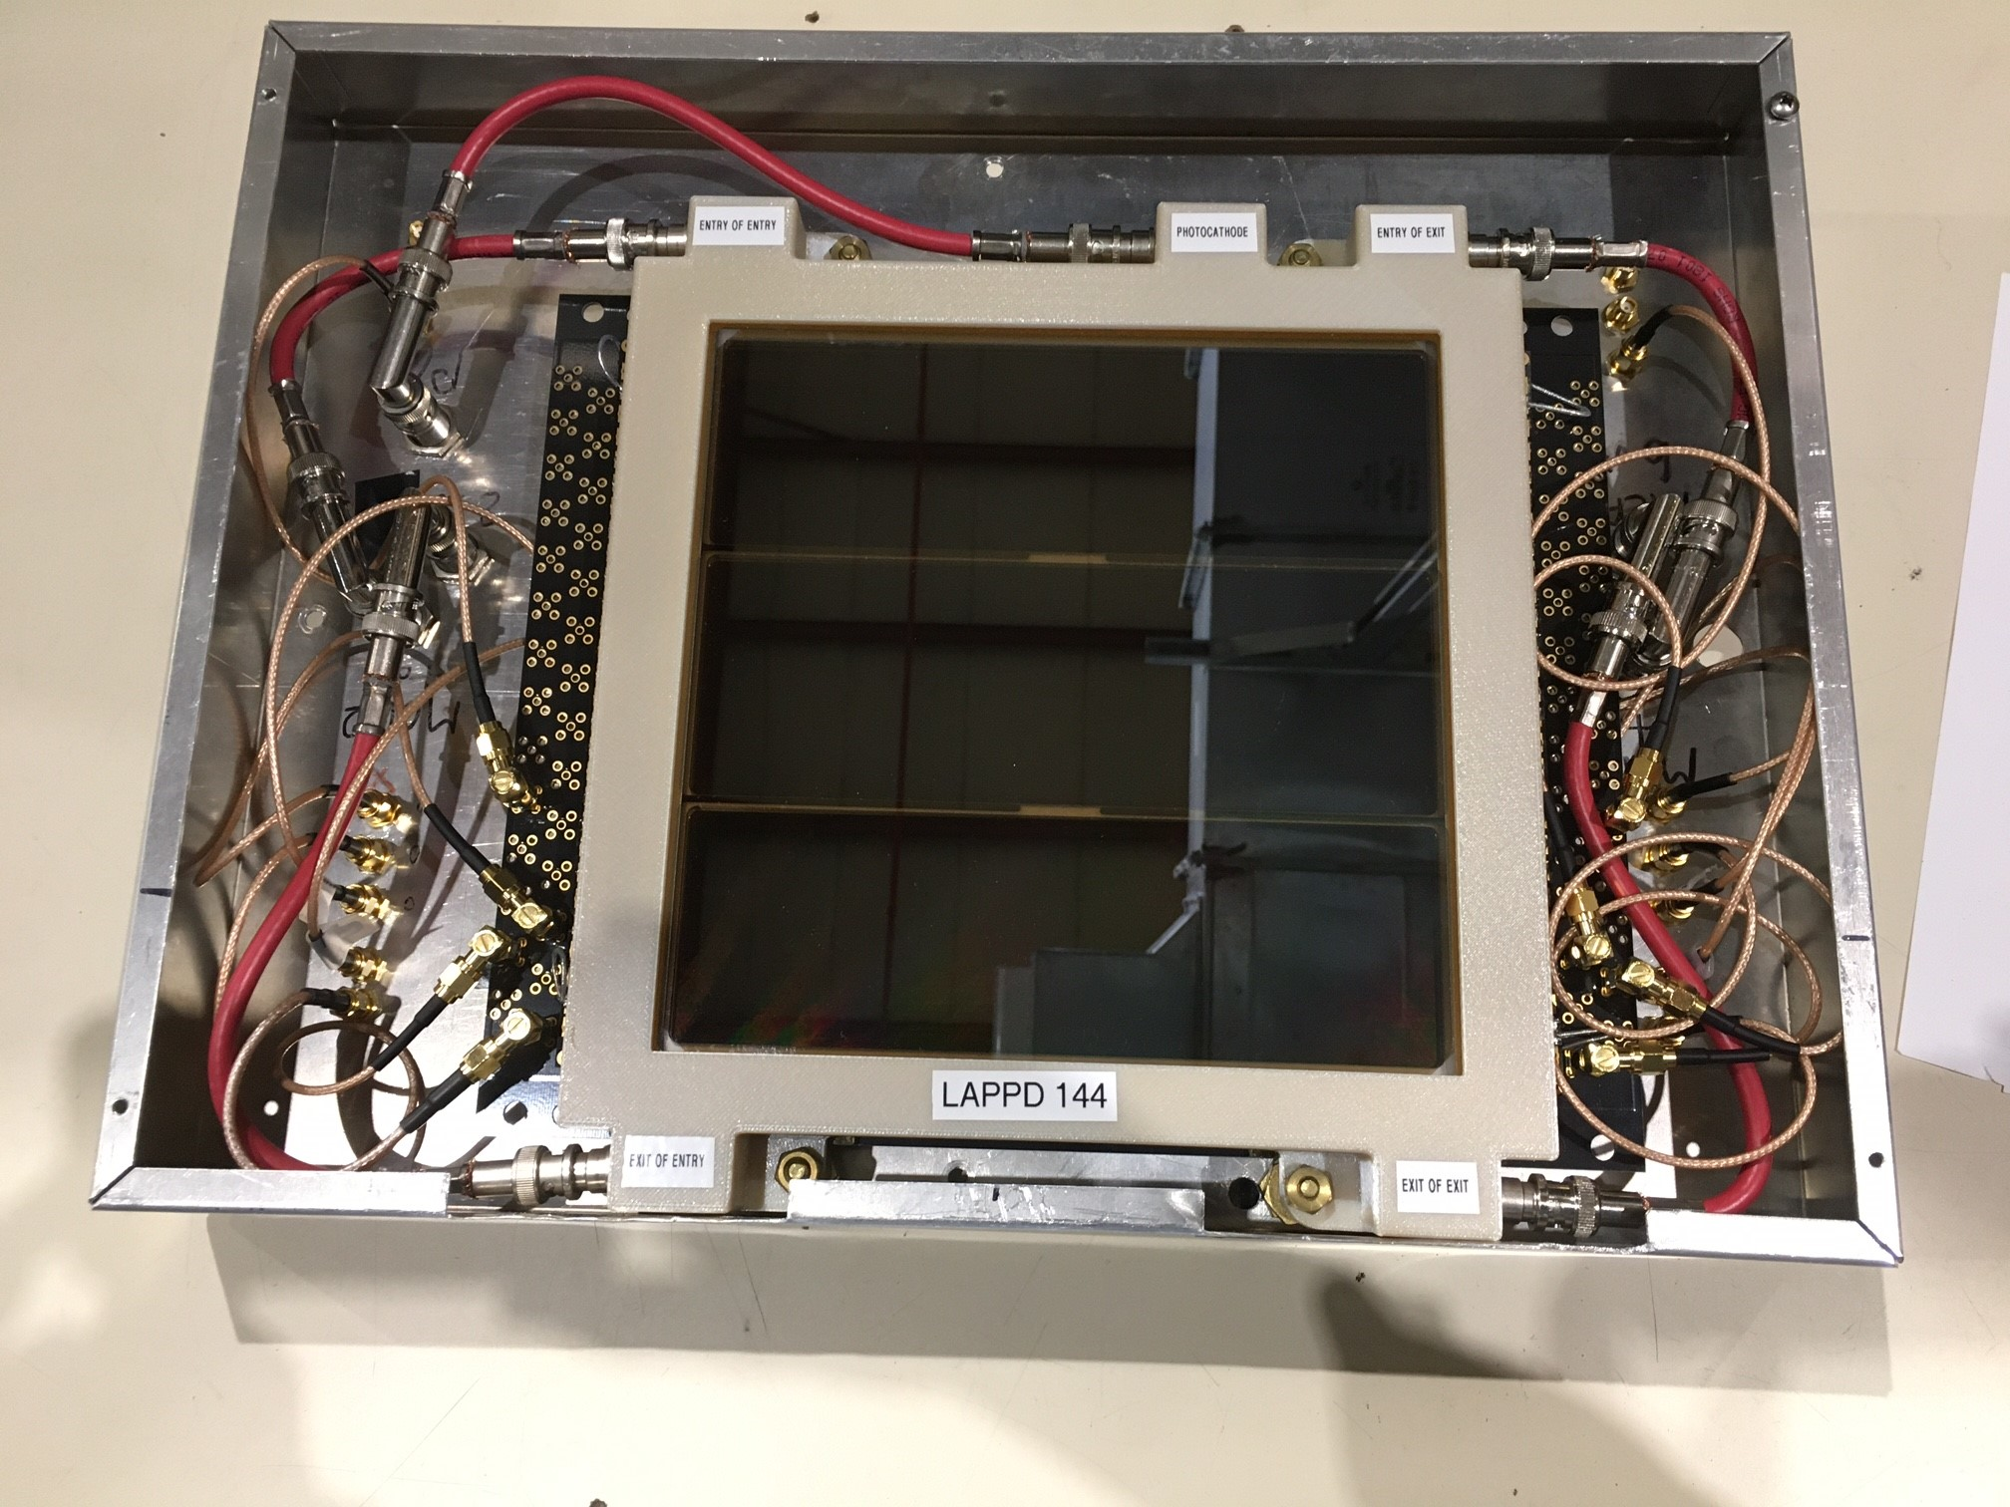
LAPPD/HRPPD received at anl
 | LAPPD#118 | LAPPD#144 | HRPPD#6
Detector size | 20x20 cm | 20x20 cm | 10x10 cm
Pore size | 20 µm | 20 µm | 10 µm
Readout scheme | Stripline | Capacitive coupled | Directly Coupled Readout
Quantum Efficiency (365 nm) | 23.9% | 17.8% | 5.3%
Gain | 10⁶ - 10⁷ | 10⁶ - 10⁷ | 10⁶ – 10⁷
Support geometry | Center cross | Center strip | No cross

Slide 3
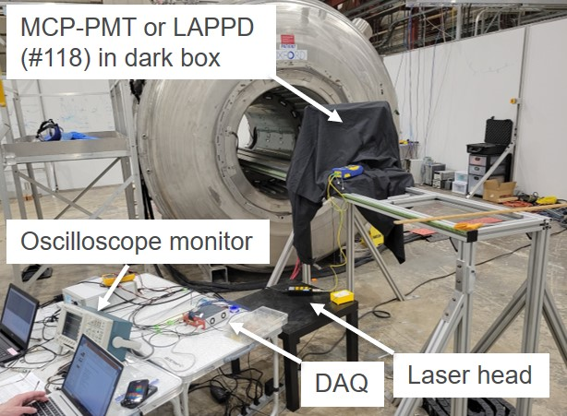
Magnetic field TOLERANCE TESTING SETUP
Magnetic field strength:
0.02 T to 1.45 T
Photon source:
Picosecond laser system
Fiber optics
Digital attenuator.
Dark box:
Movable on a trail into the magnet
DAQ:
CAEN DT5742b desktop digitizer
Rotation in the magnetic field:
Photosensor tips into or out of the region of stronger magnetic field
Move the photosensor in or out at each angle to compensate for the change in field strength

Slide 4
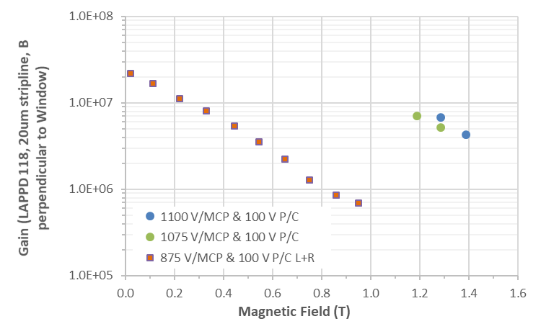
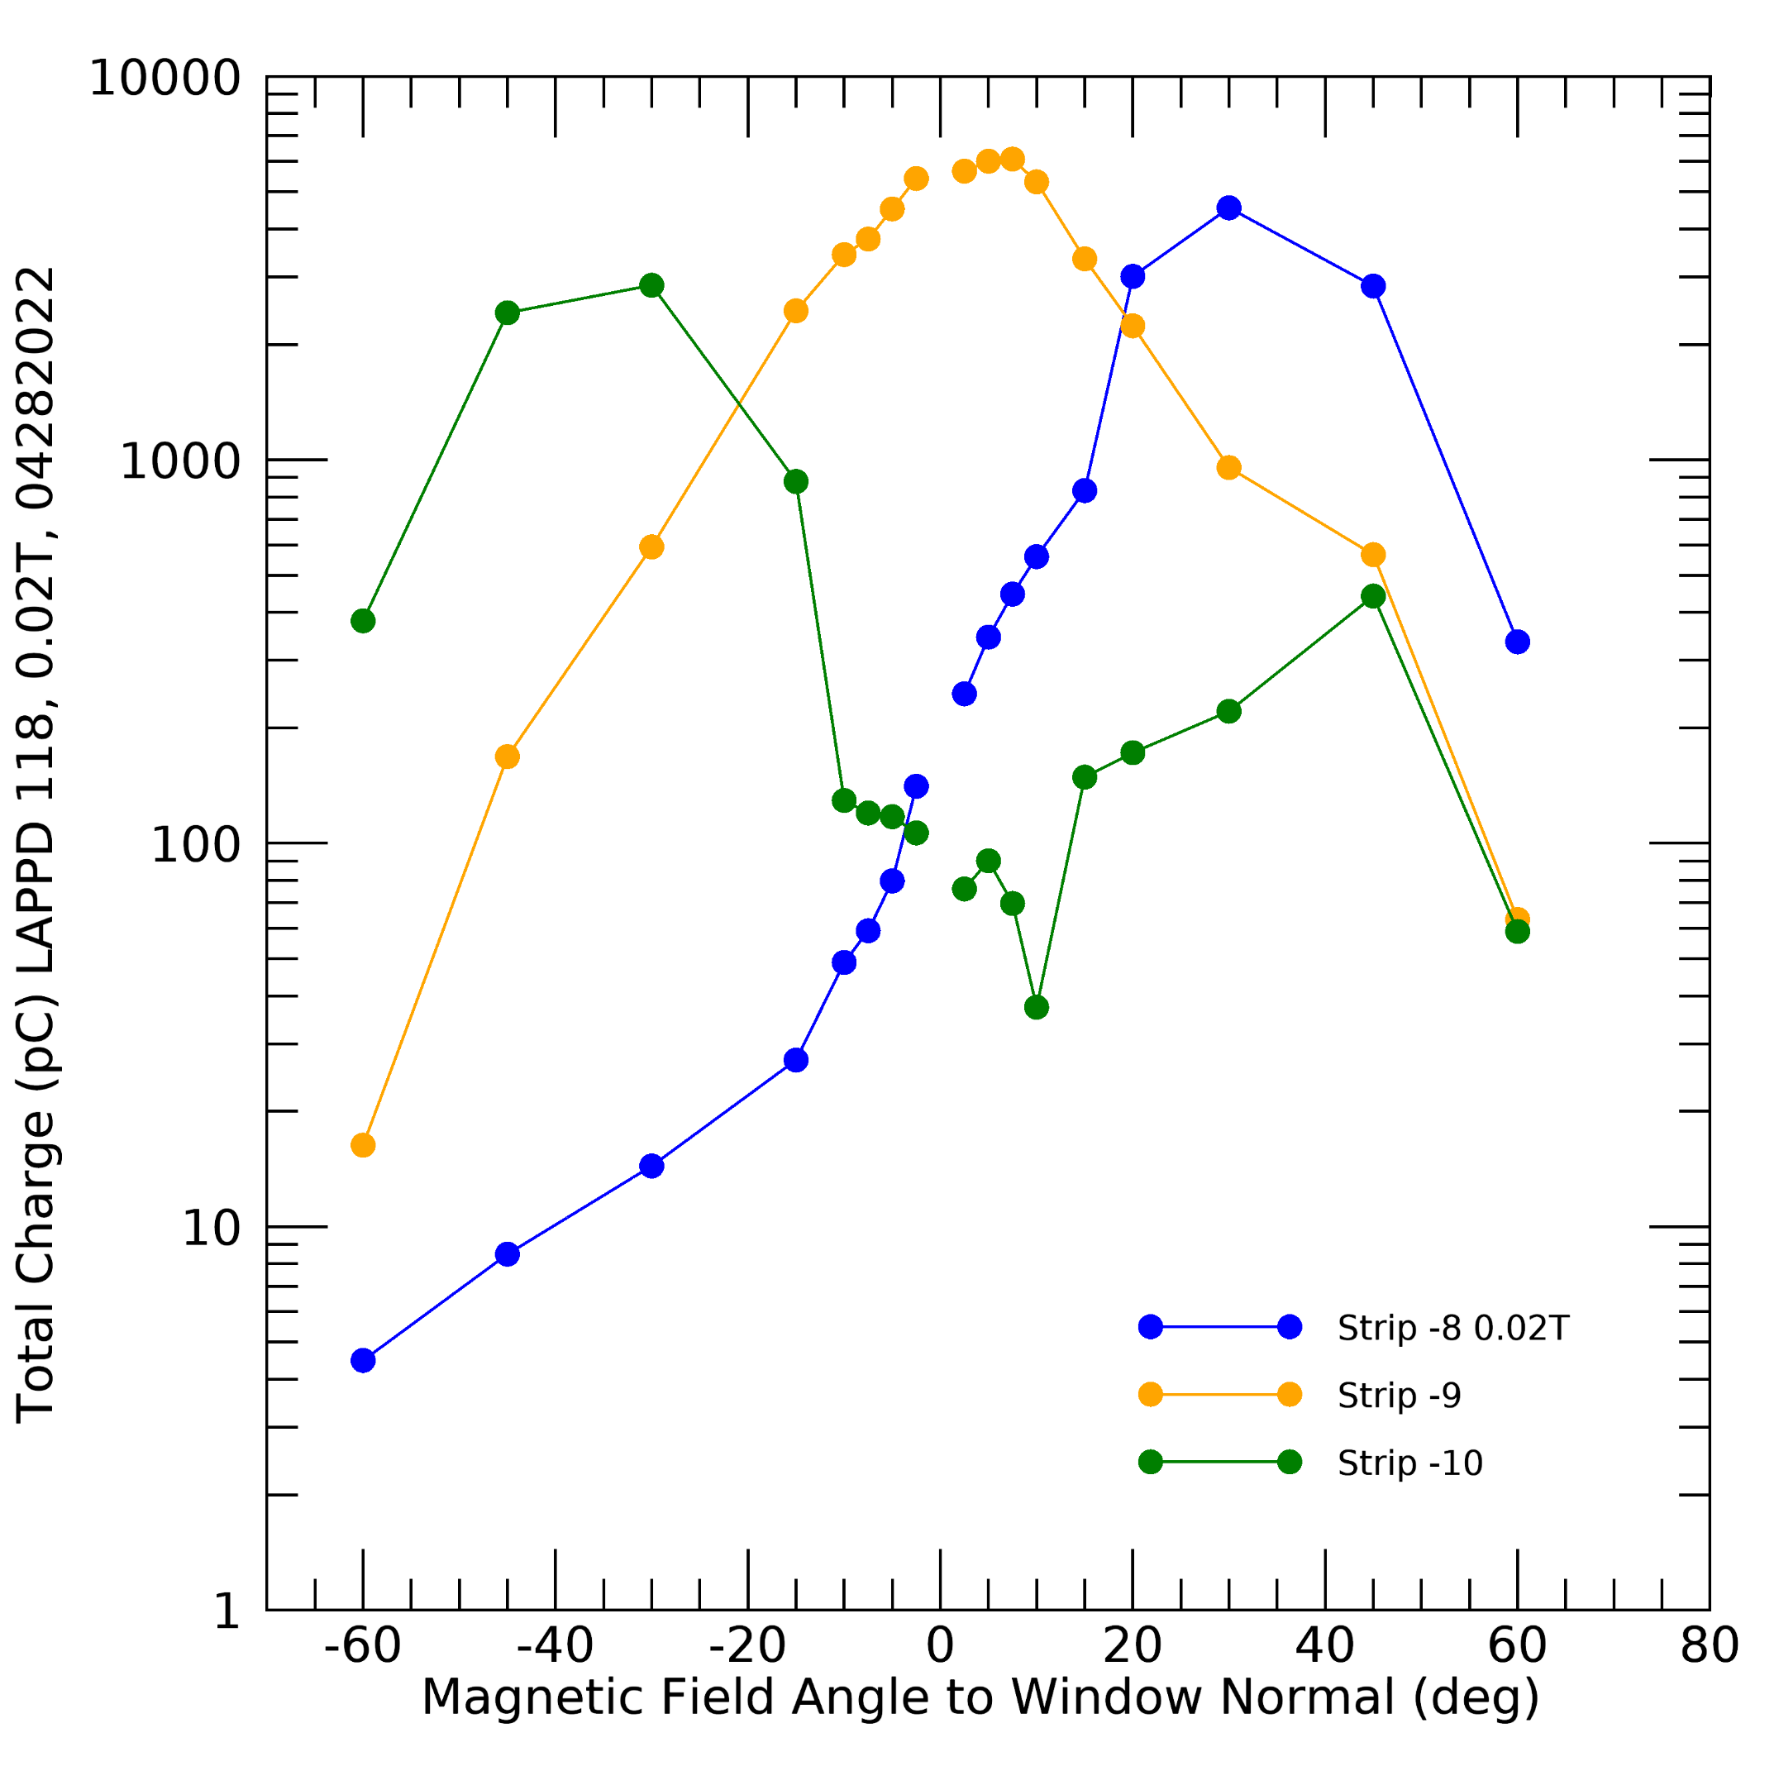
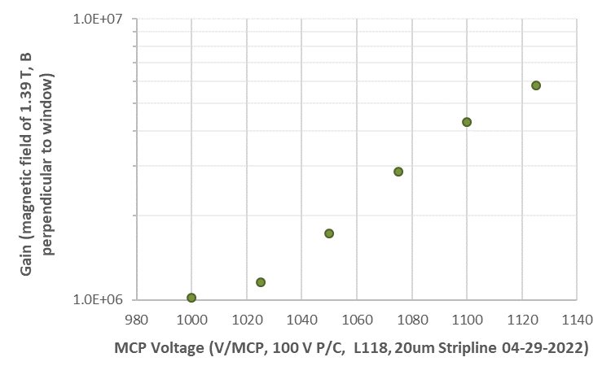
LAPPD 118
 | LAPPD#118
Detector size | 20x20 cm
Pore size | 20 µm
Readout scheme | Stripline
Quantum Efficiency (365 nm) | 23.9%
Gain | 10⁶ - 10⁷
Support geometry | Center cross
Gain is shown as a function of magnetic field strength. The gain declines as the field strength increases.
Gain can be recovered at higher field strengths by increasing the photocathode and MCP voltages.
Device shows angle dependence on magnetic field direction.

Slide 5
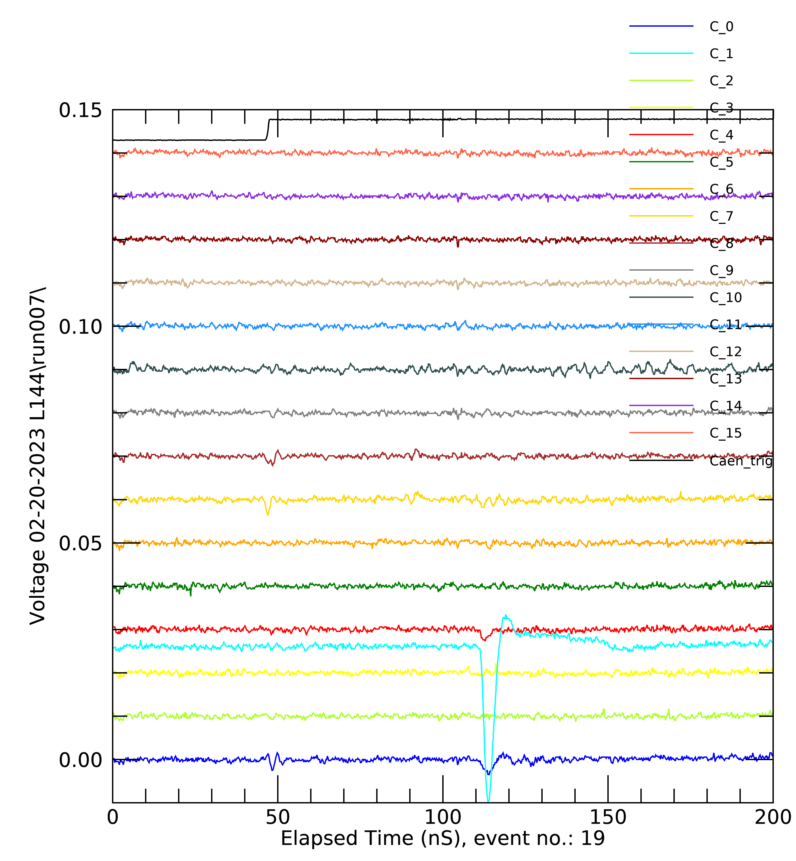
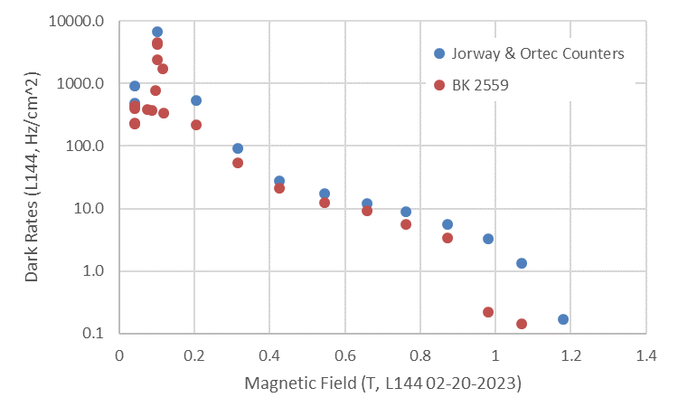
LAPPD 144
 | LAPPD#144
Detector size | 20x20 cm
Pore size | 20 µm
Readout scheme | Capacitive coupled
Quantum Efficiency (365 nm) | 17.8%
Gain | 10⁶ - 10⁷
Support geometry | Center strip
Device shows localized signal, cross talk is not obvious.
Dark counts decline with increasing magnetic field strength, a persistent count rate peak was observed at one field strength, much like a resonance.

Slide 6
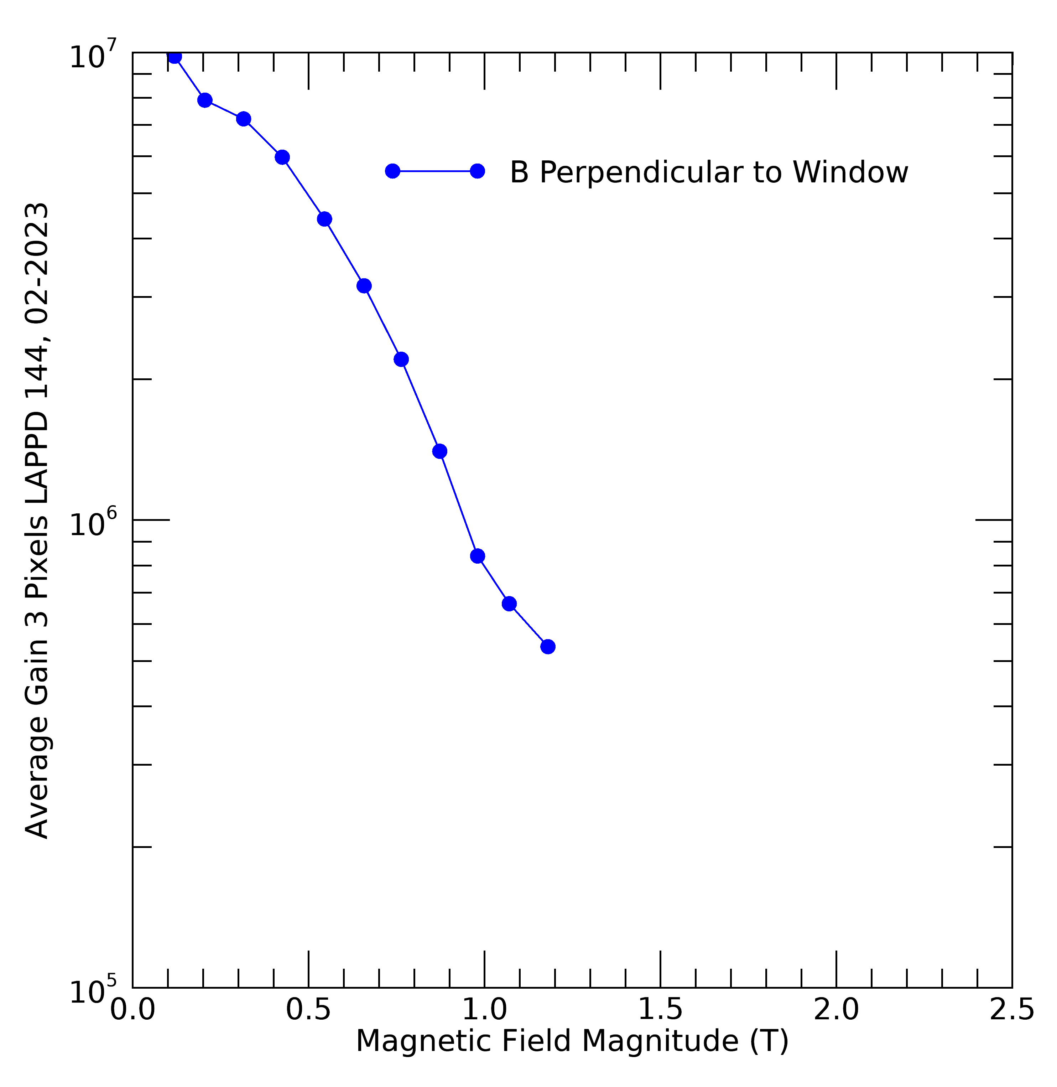
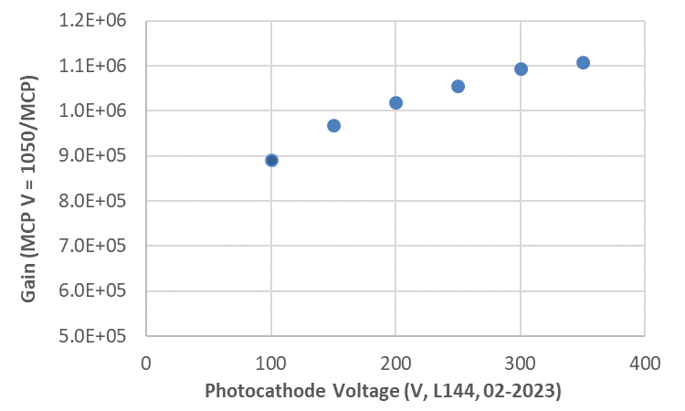
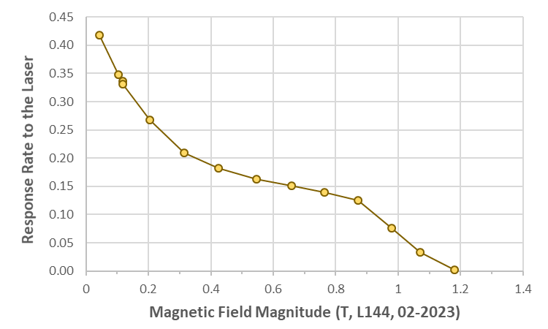
LAPPD 144
 | LAPPD#144
Detector size | 20x20 cm
Pore size | 20 µm
Readout scheme | Capacitive coupled
Quantum Efficiency (365 nm) | 17.8%
Gain | 10⁶ - 10⁷
Support geometry | Center strip
The gain declines as the field strength increases, similar behavior as #118, same pore size.
Gain can be recovered at higher field strengths by increasing the bias voltages.
Detection efficiency was estimated, decrease with increasing magnetic field strength

Slide 7
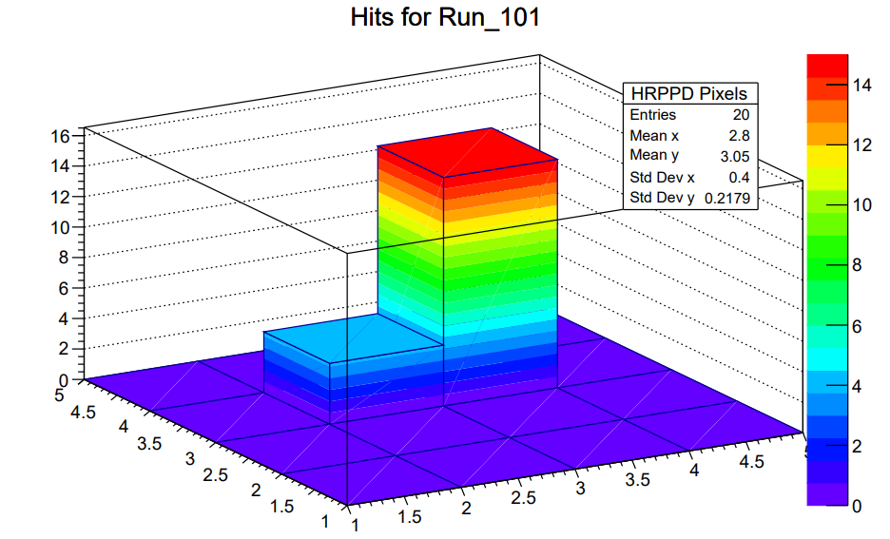
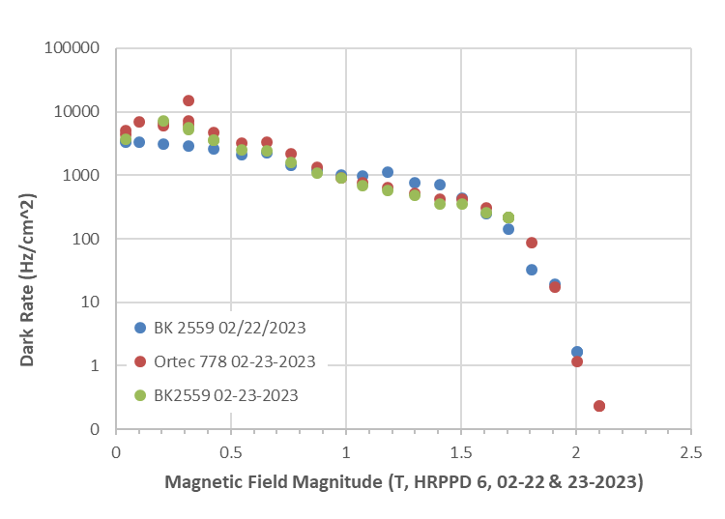
HRPPD #6
 | HRPPD#6
Detector size | 10x10 cm
Pore size | 10 µm
Readout scheme | Directly Coupled Readout
Quantum Efficiency (365 nm) | 5.3%
Gain | 10⁶ – 10⁷
Support geometry | No cross
Device shows good localized signal, minimal cross talk.
Dark counts decline with increasing magnetic field strength

Slide 8
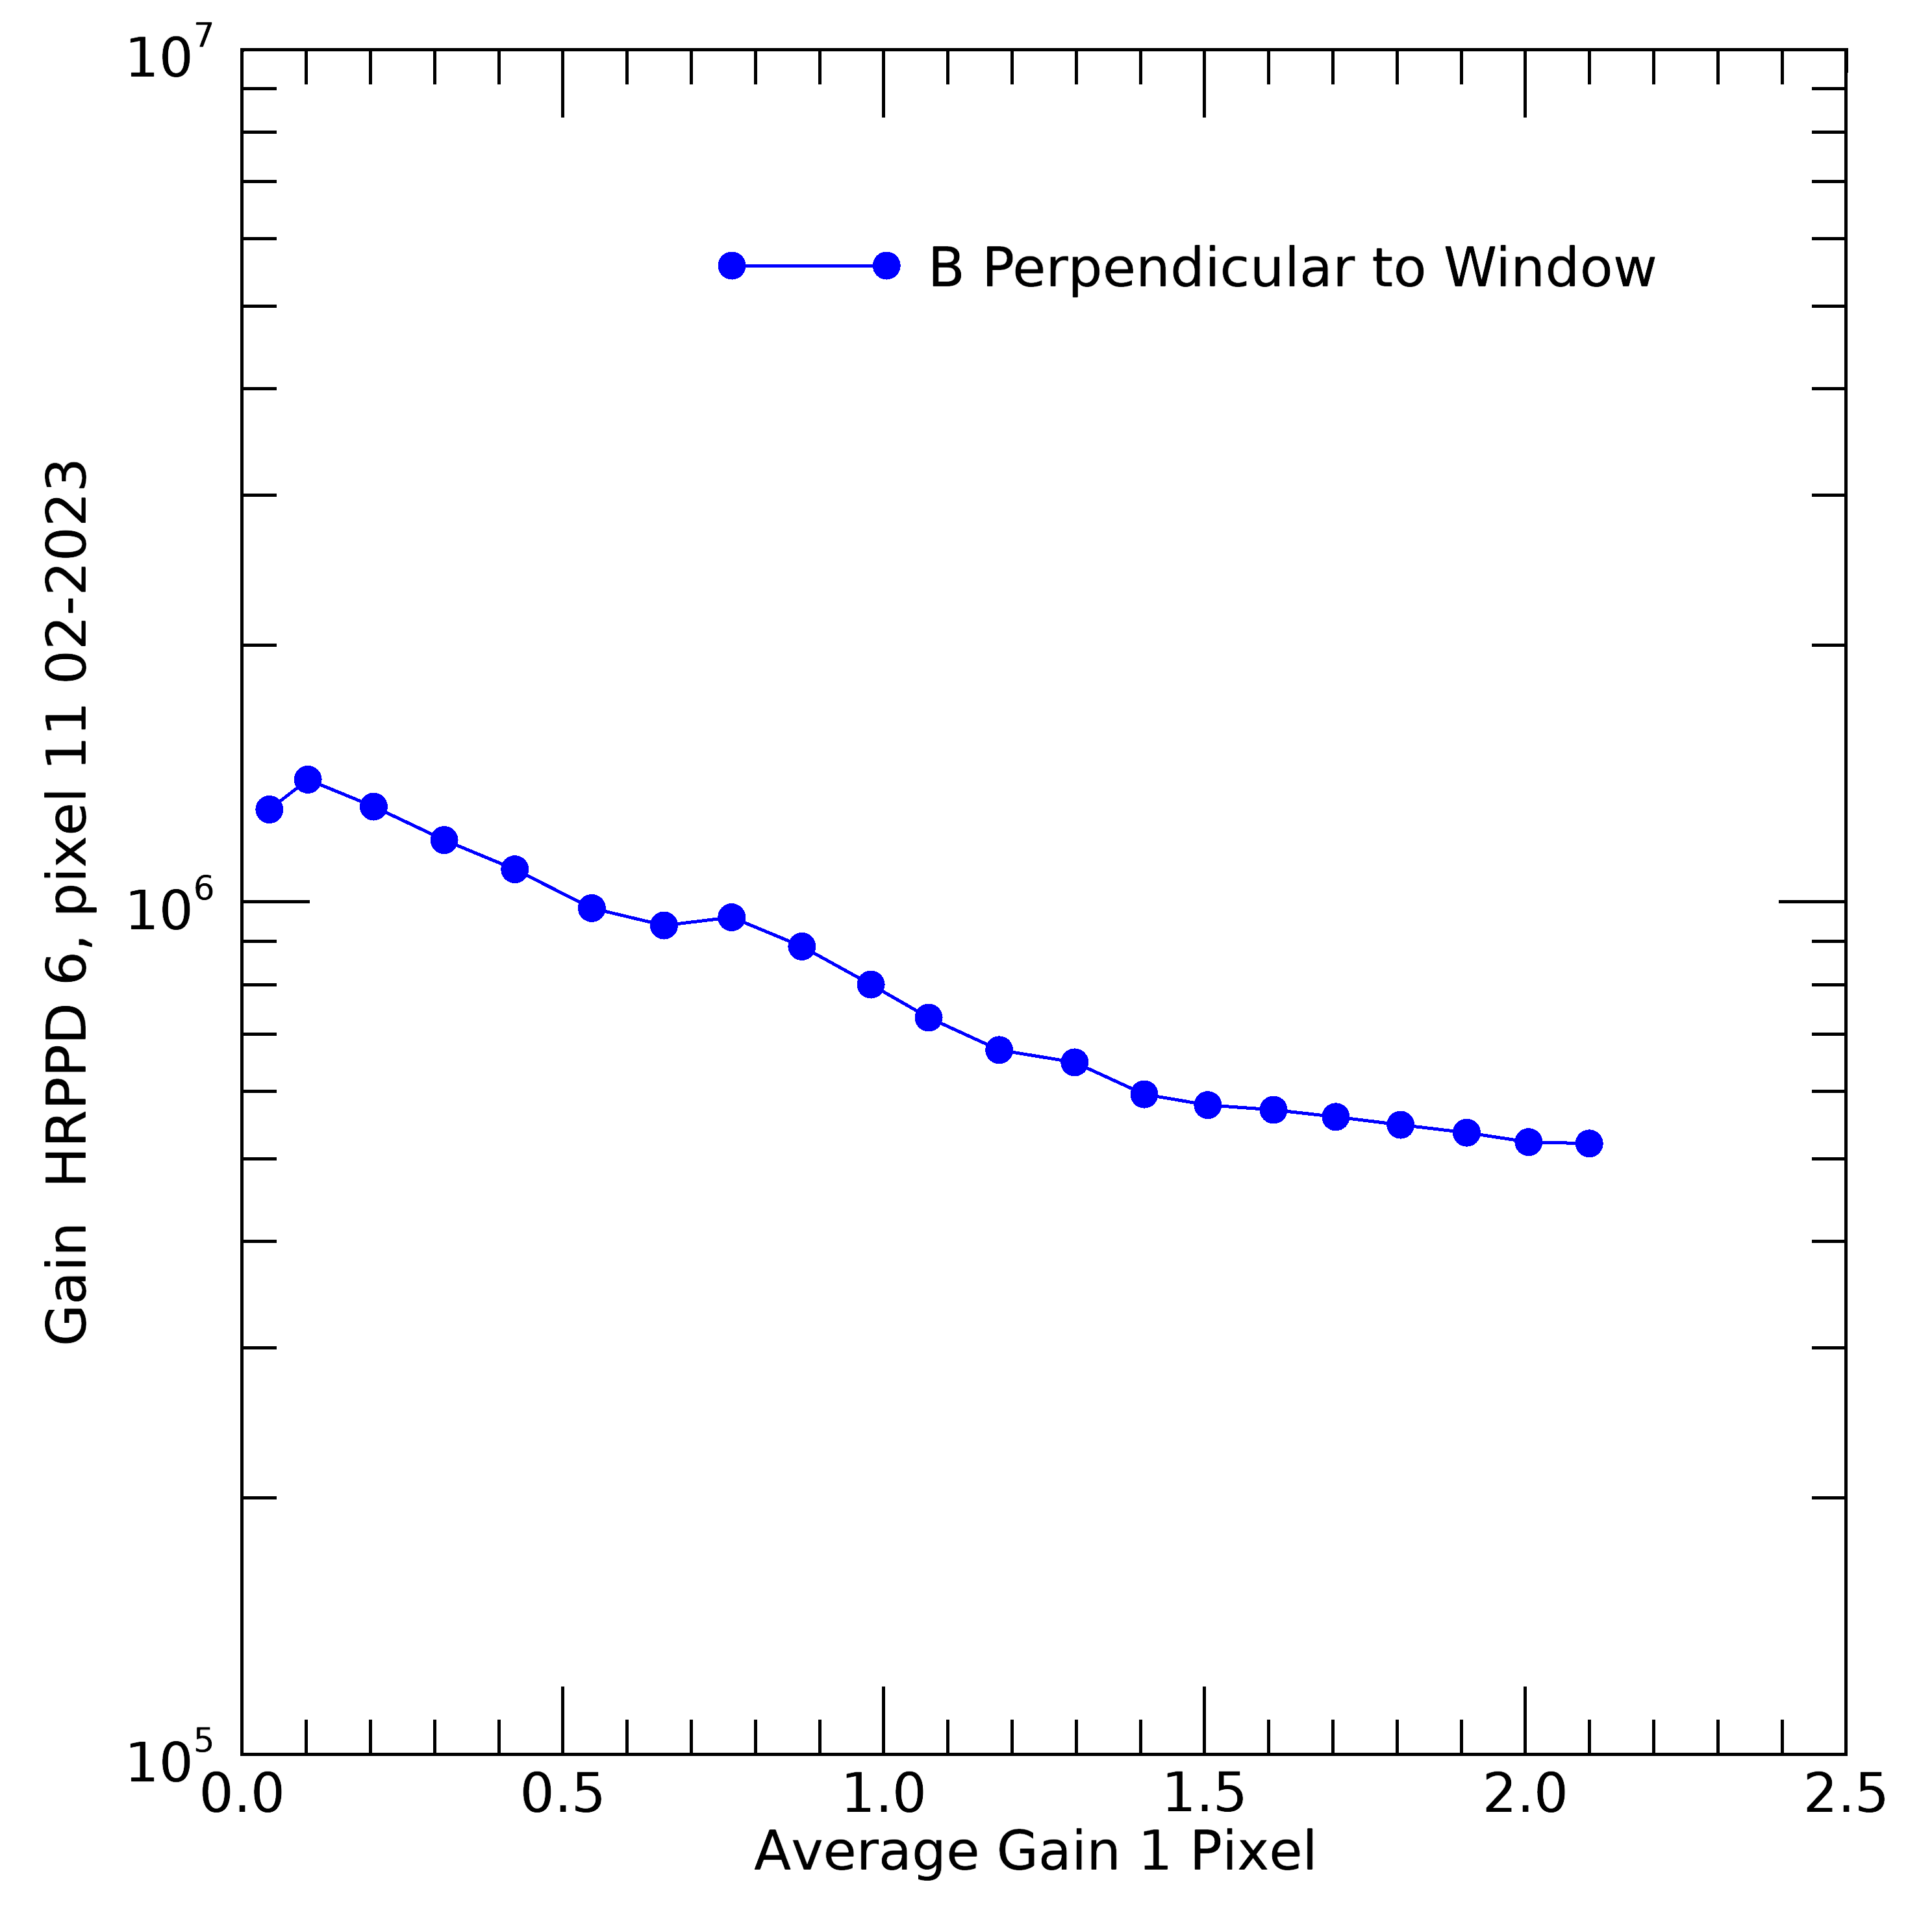
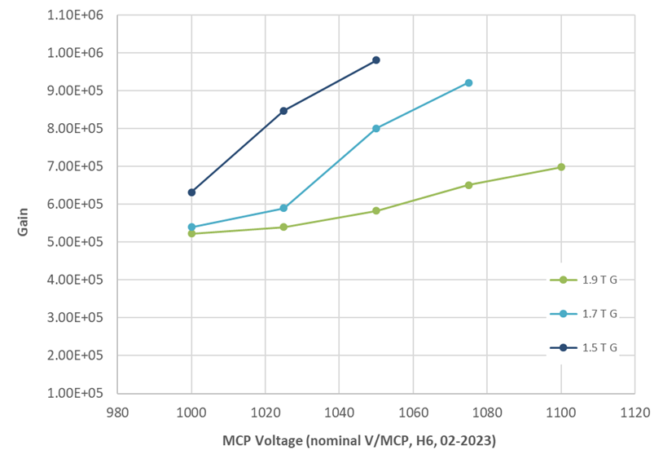
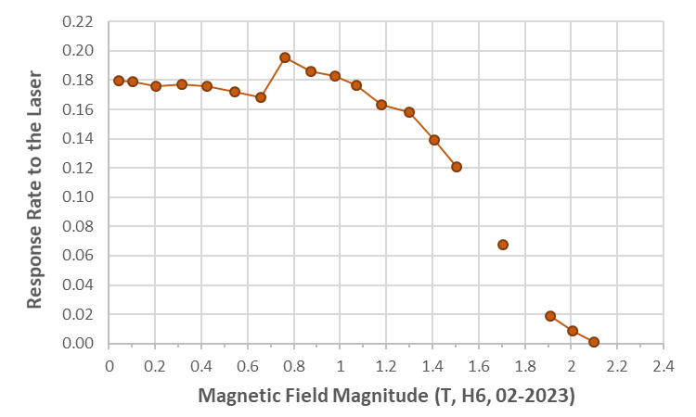
HRPPD #6
 | HRPPD#6
Detector size | 10x10 cm
Pore size | 10 µm
Readout scheme | Directly Coupled Readout
Quantum Efficiency (365 nm) | 5.3%
Gain | 10⁶ – 10⁷
Support geometry | No cross
Good magnetic field tolerance above 1.5 Tesla
Gain can be recovered by increasing bias voltages
Detection efficiency decreases with increasing magnetic field strength

Slide 9
Summary & future test
Summary:
Received LAPPD/HRPPDs were tested for magnetic field tolerance.
Magnetic field tolerance is strongly related to MCP pore size
Gain can be recovered by increasing bias voltages in high magnetic field strength
HRPPD with 10 um pore size MCPs seems to work in pfRICH condition
All those tested LAPPD/HRPPDs are not the final version device for EIC application.
Future test:
Incom will deliver 5 HRPPDs to EIC-PID
Quantum efficiency distribution map will be done in FY2024
Test of a final version HRPPD will be completed in FY2024

