Slide 1
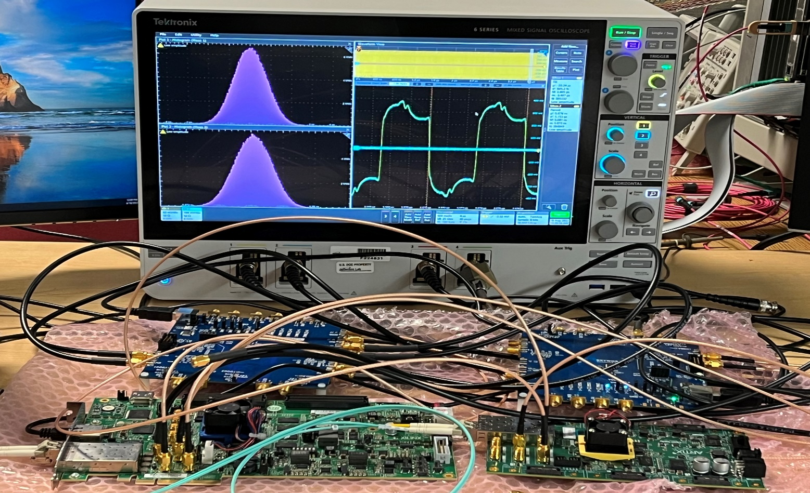
ePIC Clock (Control) Distribution Test
“DAM”
KCU105
(xcku040)
“RDO”
XEM8320
(xcau25p)
Clock jitter cleaner
Si5394A
Clock Source
Si5344H
OUT
IN
OUT
ClkRefIn
GTH_Tx
GTY_Rx
RxRecClk
IN#3
OUT#3
Tektronix
MSO64
8 GHz, 25 GSps
Si5394A
Si5344H
KCU105
XEM8320

Slide 2
2 SiliconLab Clock Evaluation boards setting
Si5344H:
XTAL: 48 MHz
Output0: 98.5 MHz
Output1: 197 MHz, or 98.5 MHz
Output2: 250 MHz
Output3: 100 MHz
Si5394A:
XTAL: 48 MHz
Input0: 98.5 MHz
Input1: 197 MHz
Input2: 156.25 MHz
Input3: FeedBack
Output0: 98.5 MHz
Output1: 197 MHz
Output2: 250 MHz
Output3: ZDM_98.5MHz
Clock generator
Clock jitter cleaner, Clock generator for FEB
All the scope traces are triggered by the Si5344H output#1, while the output#0 is used as (KCU105) ClkRef for the MGT
The scope’s measurement functions, Time Interval Error (TIE), Clock frequency, Clock period are used.

Slide 3
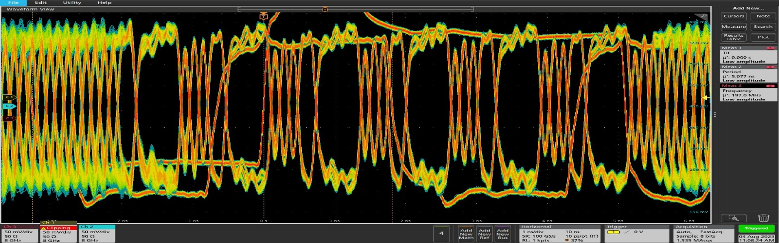
3 Rx Recovered clock (ClkRef_out), with regular 8b/10b coding
Downlink (KCU105→XEM8320, to simulate DAM → RDO) Encoding:
Eight Bytes (8b/10b) payload per Clock (98.5 MHz)
7.88 Gbps line rate
Equivalent (downlink) control: 6.304 Gbps
Connections between KCU105 and XEM8320:
SMA co-ax copper cables for 3.1, 3.2, 3.3
SFP optic transceivers and LC fiber for 3.4
5.076ns, half clock cycle
DownLink scope trace: Unit Interval (UI): ~ 127 ps
Example scope trace:
  Six bytes K28.5 (COMMA) and Two bytes data per (98.5 MHz) clock cycle

Slide 4
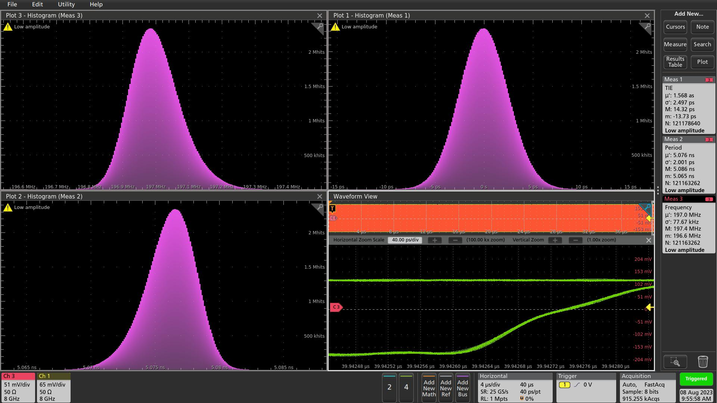
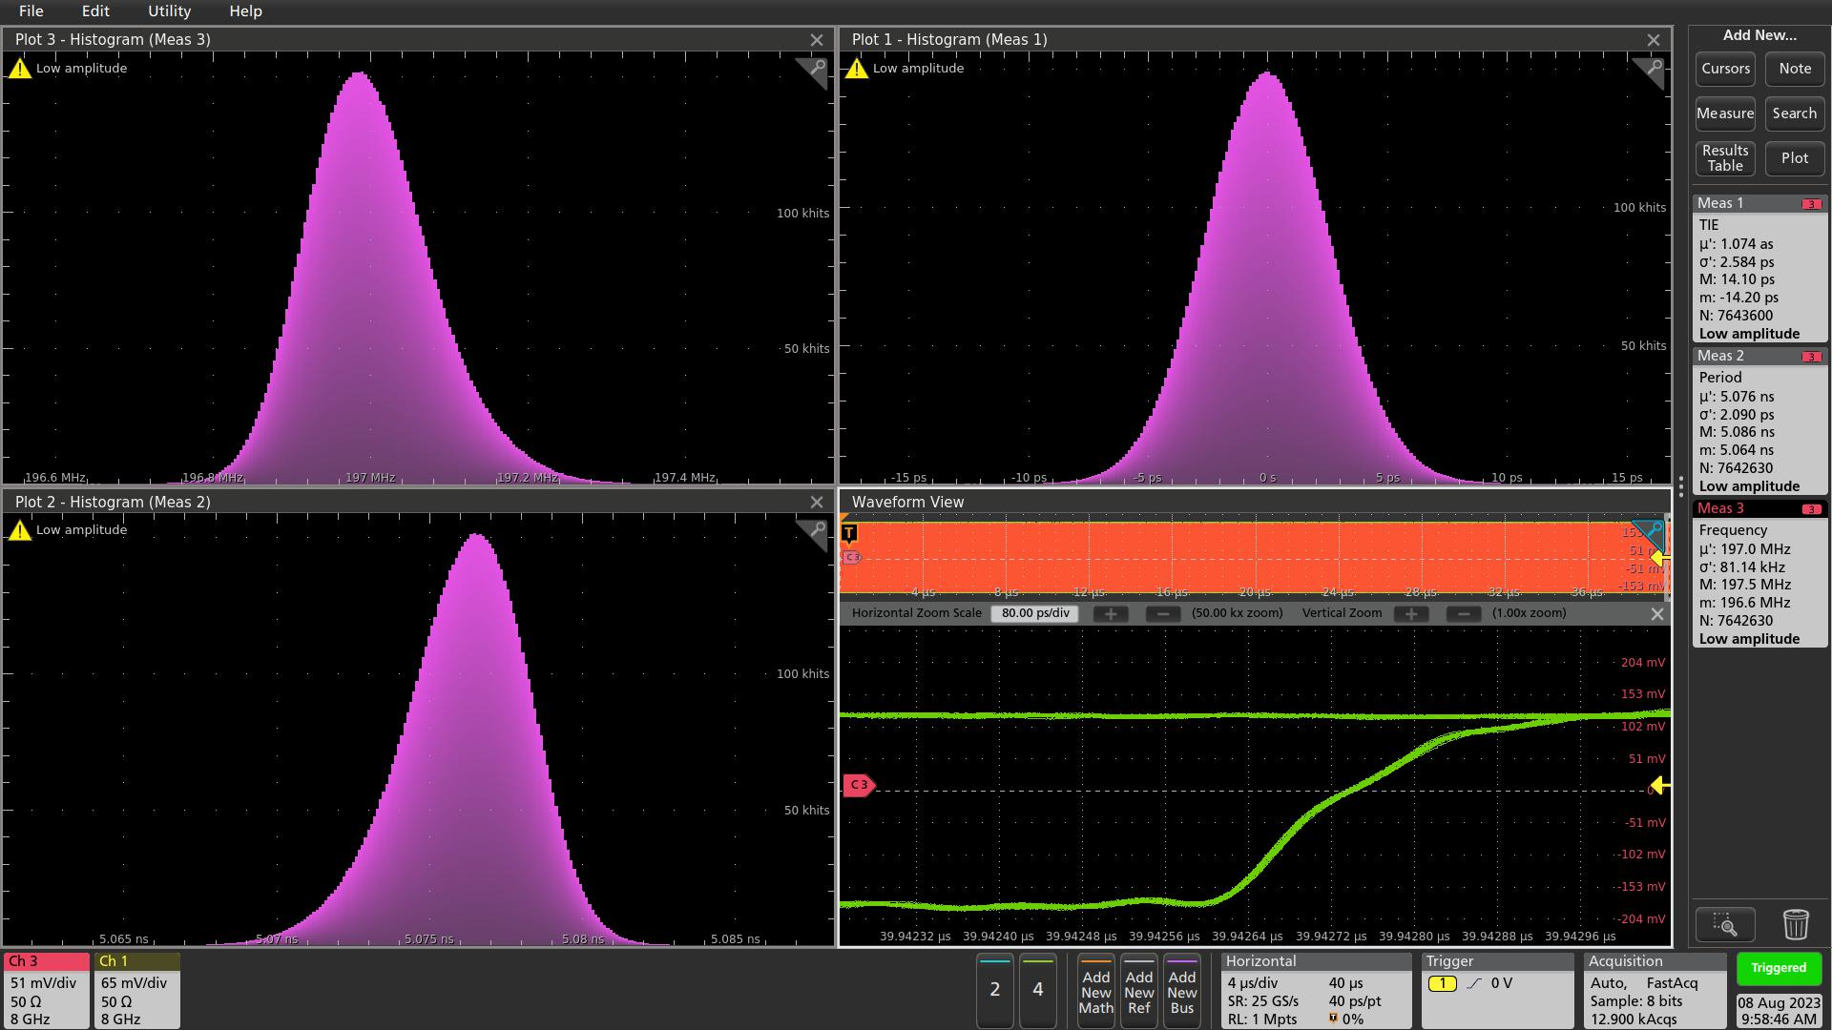
3.1 Rx Recovered clock (ClkRef_out), with regular 8b/10b coding
Frequency
TIE
Frequency
TIE
Period
Period
A), All eight bytes are K28.5 (COMMA)
RxRecClk: TIE σ = 2.5 ps , phase stable @ 40 µs
B), Six bytes are K28.5 (COMMA), Two bytes data
RxRecClk: TIE σ = 2.6 ps , phase stable @ 40 µs

Slide 5
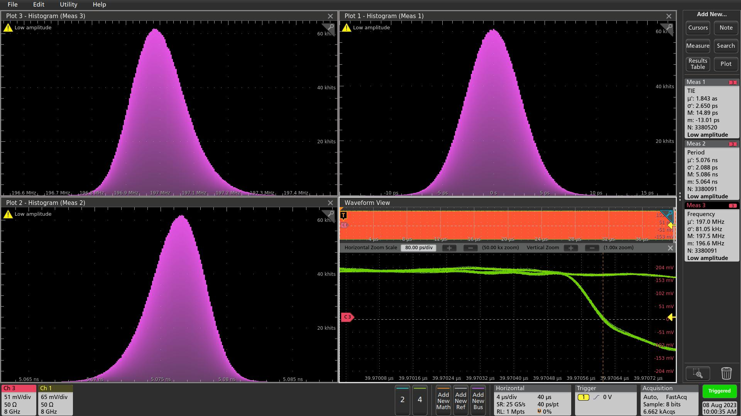
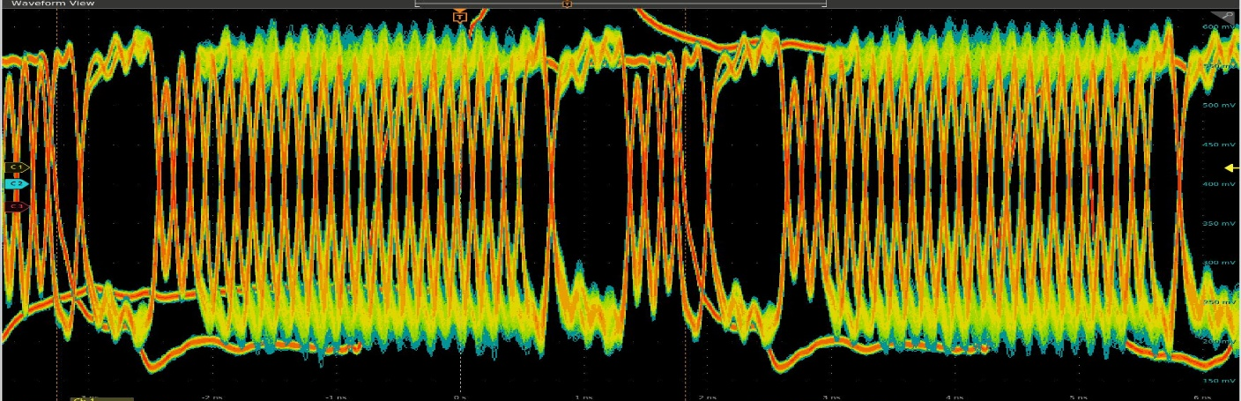

3.2 Rx Recovered clock (ClkRef_out), with regular 8b/10b coding
Frequency
TIE
Frequency
TIE
Period
Period
C), Four bytes are K28.5 (COMMA), four bytes are data
RxRecClk: TIE σ = 2.65 ps , phase stable @ 40 µs
D), Two bytes are K28.5 (COMMA), Six bytes are data
RxRecClk: TIE σ = 2.8 ps , phase stable @ 40 µs

Slide 6

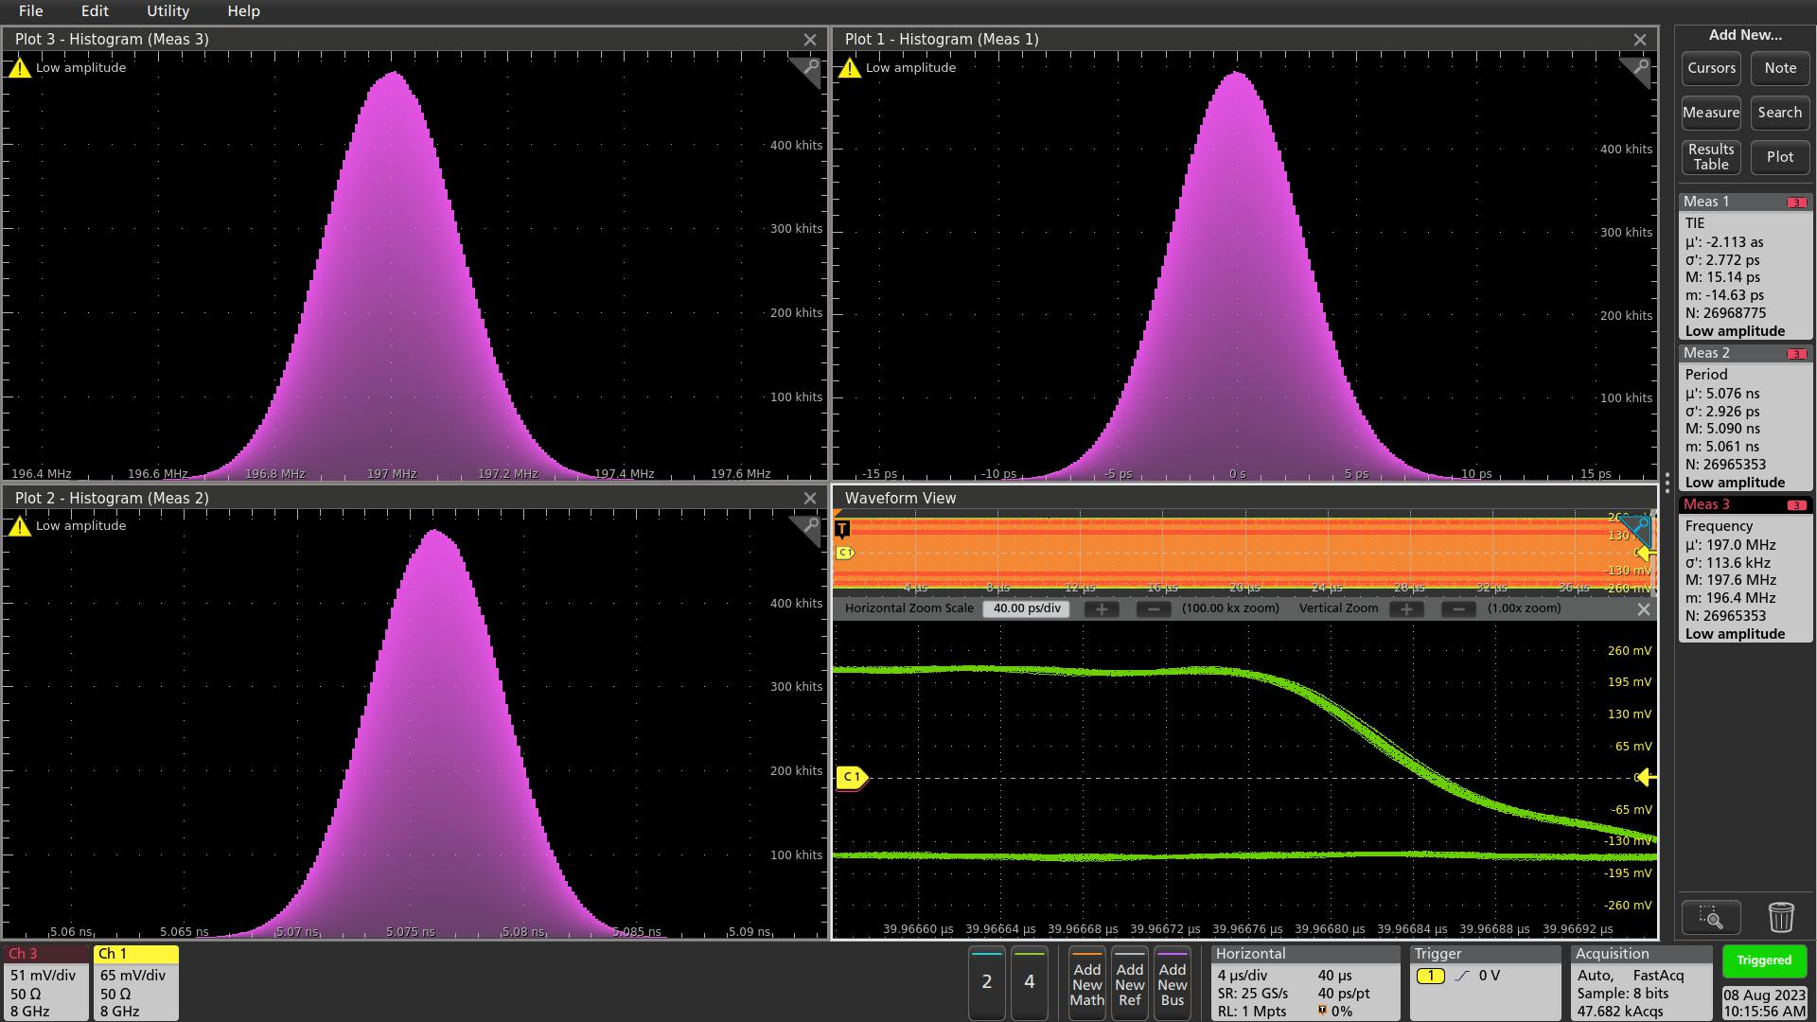
3.3 Rx Recovered clock (ClkRef_out), with regular 8b/10b coding
Frequency
TIE
Frequency
TIE
Period
Period
E), All eight bytes are regular data
RxRecClk: σ = 2.87 ps, phase stable @ 40 µs
F), (= D), Two bytes are K28.5 (COMMA), Six bytes are data
RxRecClk: σ = 2.77 ps , phase stable @ 40 µs

Slide 7
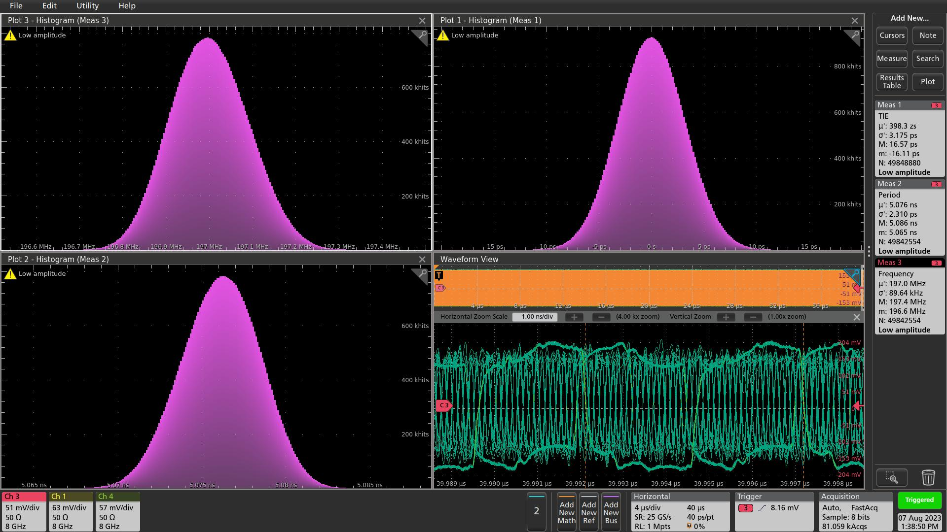
3.4 Rx Recovered clock (ClkRef_out), with regular 8b/10b coding, SFP
Frequency
TIE
Period
All eight bytes are regular data
RxRecClk: TIE σ = 3.2 ps, Phase stable @ 40 µs
Through Avago AFBR-710SMZ optic transceivers and a short multimode LC fiber (850nm)

Slide 8
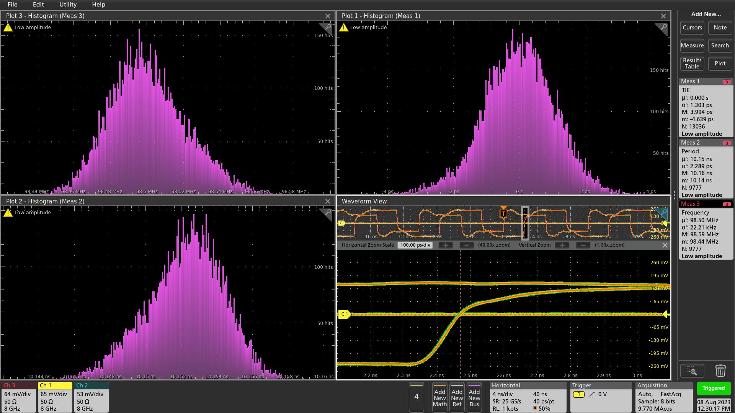
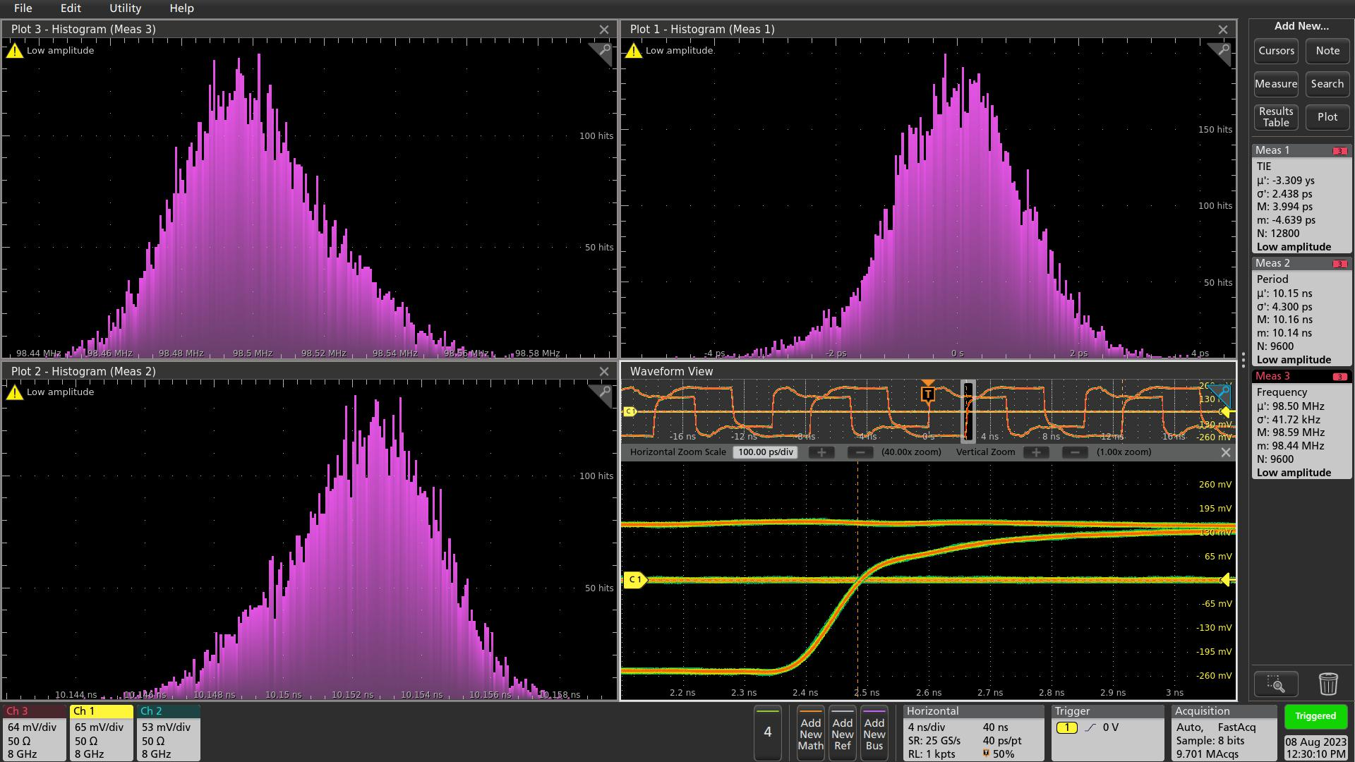
4.1 Jitter cleaning of the Rx Recovered clock
Frequency
TIE
Period
Filtered Clock
drift
Jitter cleaned (by Si5394A) clock:
TIE: σ = 1.3 ps
But, the phase is (slowly) drifting. (Si5394A: Loop BW 88Hz)
“scope traces captured several seconds later”

Slide 9
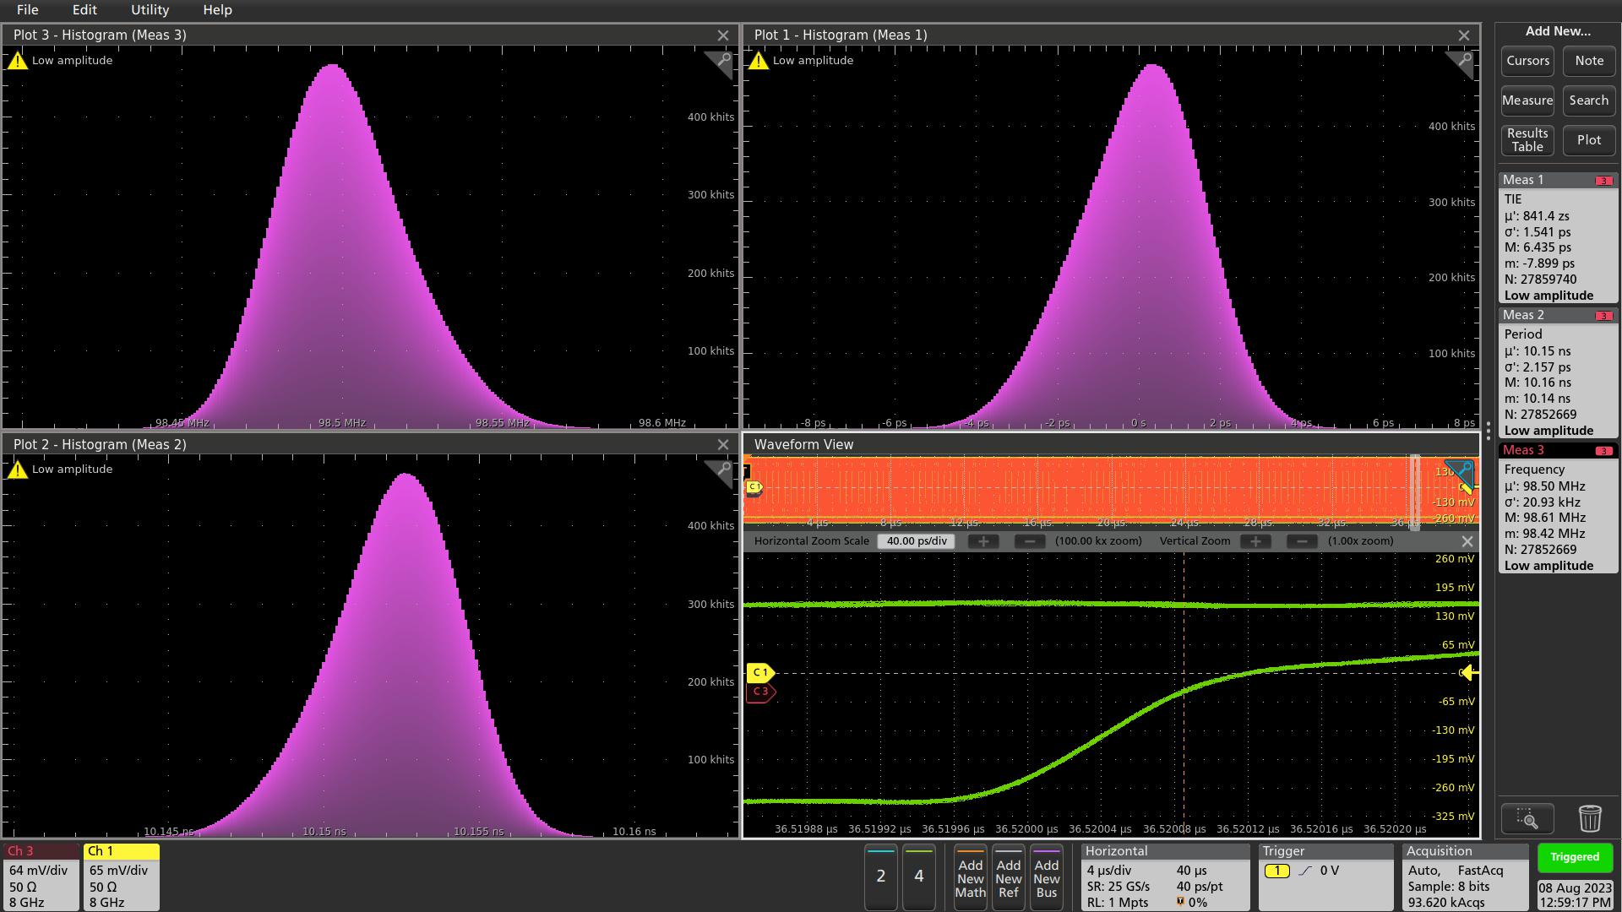
4.2 Jitter cleaning of the Rx Recovered clock (Loop BW at 2.8 KHz)
Frequency
TIE
Period
40 ps
No drift
Jitter cleaned (by Si5394A) clock:
TIE: σ = 1.54 ps @ 40 µs
Si5394A, Loop BW 2.8 KHz
Stable phase relative to the original 98.5 MHz clock
Scope trace (lower right) at ~ 36 µs after (original 98.5 MHz clock) trigger

Slide 10
5 Test Summary (so far)
The GTY recovered clock works
  The TIE (σ) is below 4 ps
  The phase is stable. The recovered clock reproduces the original (GTH_Ref) Clock.
The Clock jitter cleaner can further improve the recovered clock
  The cleaned clock TIE (σ) is below 2 ps,
  The jitter cleaner Loop Bandwidth needs be ~ KHz, not ~Hz, to match with the GTY.

Slide 11
6.1 To do in the near future
Implement the link coding in the new FELIX card (VERSAL chip);
Recovered clock phase stability (on power cycle, reset etc)
    CERN Tclink technique: ‘fix’ the TX Phase Interpolator, ‘fix’ the Rx equalizer;
To explore the possibility of FELIX clock input (or ePIC clock distribution from GTM):
FELIX
versal
Dedicated differential Clock (98.5 MHz)
985 Mbps (one byte 8b/10b per 98.5 MHz clock)
to simulate the Fast control from GTM
985 Mbps (8b/10b at 98.5 MHz)
To simulate the Status of the FELIX
FPGA IOB, not MGT

Slide 12
6.2 To do in the farther future
RDO prototype: for clock recovery design verification in the ‘real world’, long-term recovered clock stability test
Zero Delay FB
optional emergency circuit I²C
IN3
OUT
N* 98.5 MHz
O1
pseudoClock
98.5 MHz
O1
O2
1:2 fanout
Si53x5
Fiber
RX
197 or
98.5 MHz
IN
FEB
Optic transceiver
O0
O2
TX
Phase difference detection
RX
RxRecClk
FEB
GTY
control
TX
ClkRef
GENIO
FPGA
xcau25p
RDO

Slide 13
Thank you

Slide 14
Backup slides

Slide 15
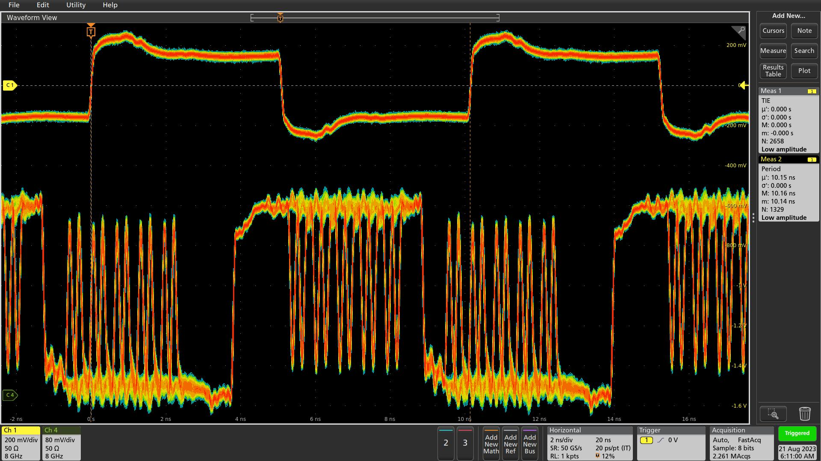
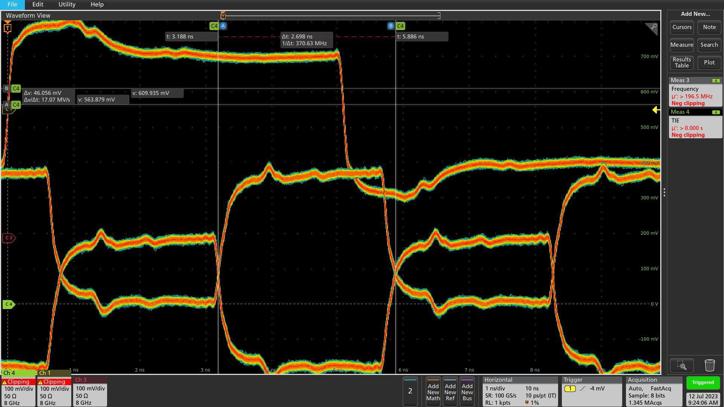
6.2 To do in the farther future, Why the phase Difference detection is needed
XEM8320, UltraScale+ ARTIX, GTY RxRecClk
Frequency: 197 MHz
RxRecClock: σ < 3 ps
But, the phase is jumping at n*(UI = 127 ps) on reset/power.
Encoding: 7.88 Gbps line rate (UI = ~127 ps)
80 bits per clock (98.5 MHz) period.
1111111111,1x1x11x1x1,1x1x11x1x1,1x1x111111,000000x0x0,0x0x00x0x0,0x0x00x0x0,0000000000: similar like the scope trace
1111111111,1111111111,1111111111,1111111111,0000000000,0000000000,0000000000,0000000000: ‘pseudo 98.5 MHz clock’

Slide 16
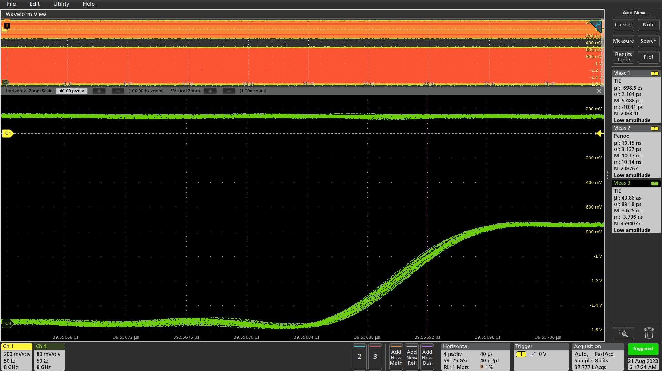
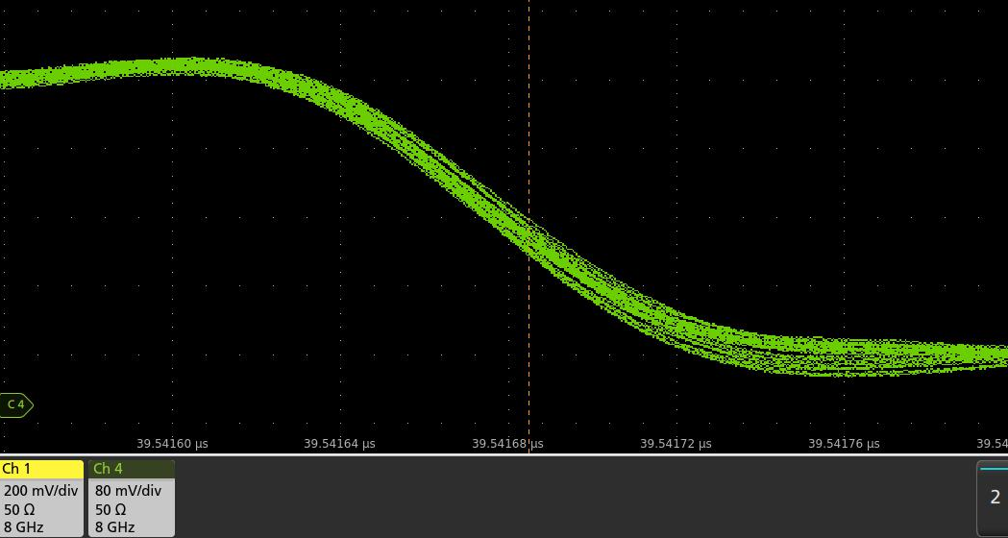
3 Low Pass filter for Clock recovery, Clock feature in TX
Zoom In on the edges
98.5 MHz clock
40 ps
Downlink, 80 bits per cycle
40 ps
Encoding: 7.88 Gbps line rate (UI = ~127 ps)
One 8b/10b payload at Clock (98.5 MHz) high,
One 8b/10b payload at Clock low,
Equivalent control: 1576 Mbps. (can be: 788 Mbps global, 788 Mbps sub-system)
39541.64ns
39541.68ns
The ‘Clock’ edge P_P < 20 ps

Slide 17
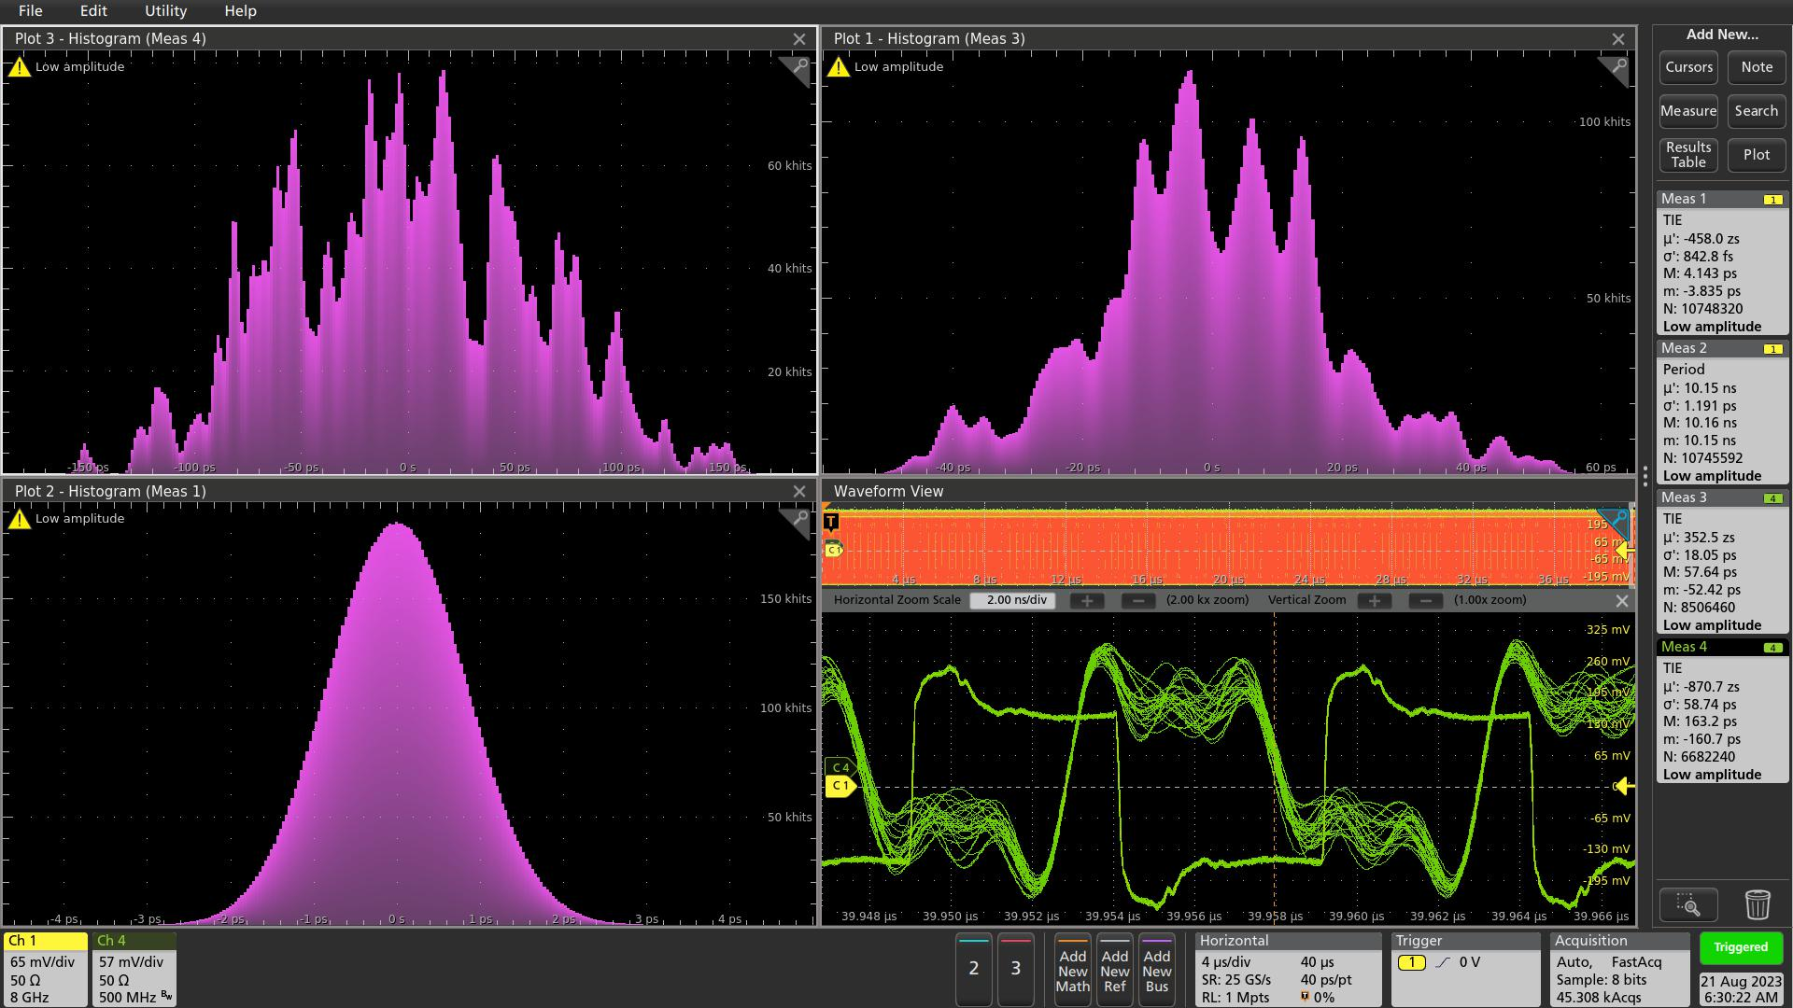
3.1 Low Pass filter for Clock recovery, Clock feature in TX, BW = 500 MHz
Falling Edges, TIE
Rising edges, TIE
LowPass Filter:
500 MHz,
TIE measurement at 40 µs
(~ 8 km fiber delay)
GTH Ref_Clock: σ < 1 ps
Rising Edge: σ = 18 ps
Falling Edge: σ = 60 ps
Ref_Clock, TIE

Slide 18
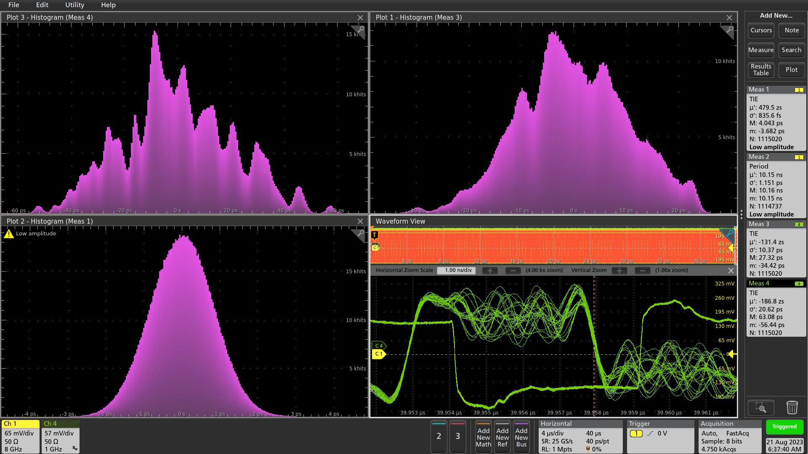
3.2 Low Pass filter for Clock recovery, Clock feature in TX, BW = 1 GHz
Falling Edges, TIE
Rising edges, TIE
LowPass Filter:
1 GHz,
TIE measurement at 40 µs
(~ 8 km fiber delay)
GTH Ref_Clock: σ < 1 ps
Rising Edge: σ = 11 ps
Falling Edge: σ = 21 ps
Ref_Clock, TIE
Need jitter cleaner

Slide 19
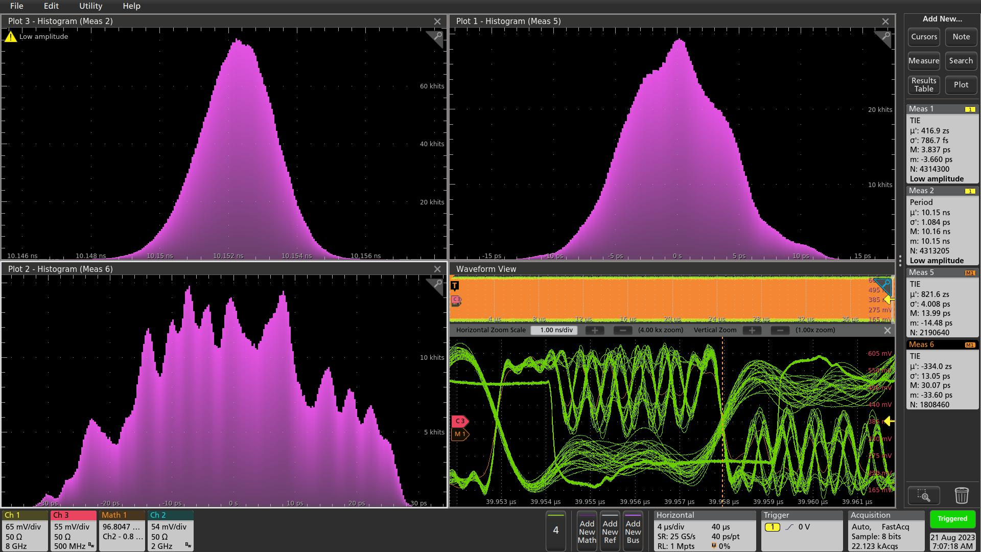
3.3 Low Pass filter for Clock recovery, Clock feature in TX, BW = 2 GHz
Rising edges, TIE
LowPass Filter:
2 GHz,
TIE measurement at 40 µs
(~ 8 km fiber delay)
GTH Ref_Clock: σ < 1 ps
Rising Edge: σ = 4 ps
Falling Edge: σ = 13 ps
Ref_Clock, TIE
Falling Edges, TIE
The measurement is on the MATH, Ch#2 – 0.8*Ch#3
Ch#2: TX+, BW 2 GHz
Ch#3: TX-, BW 500 MHz

Slide 20
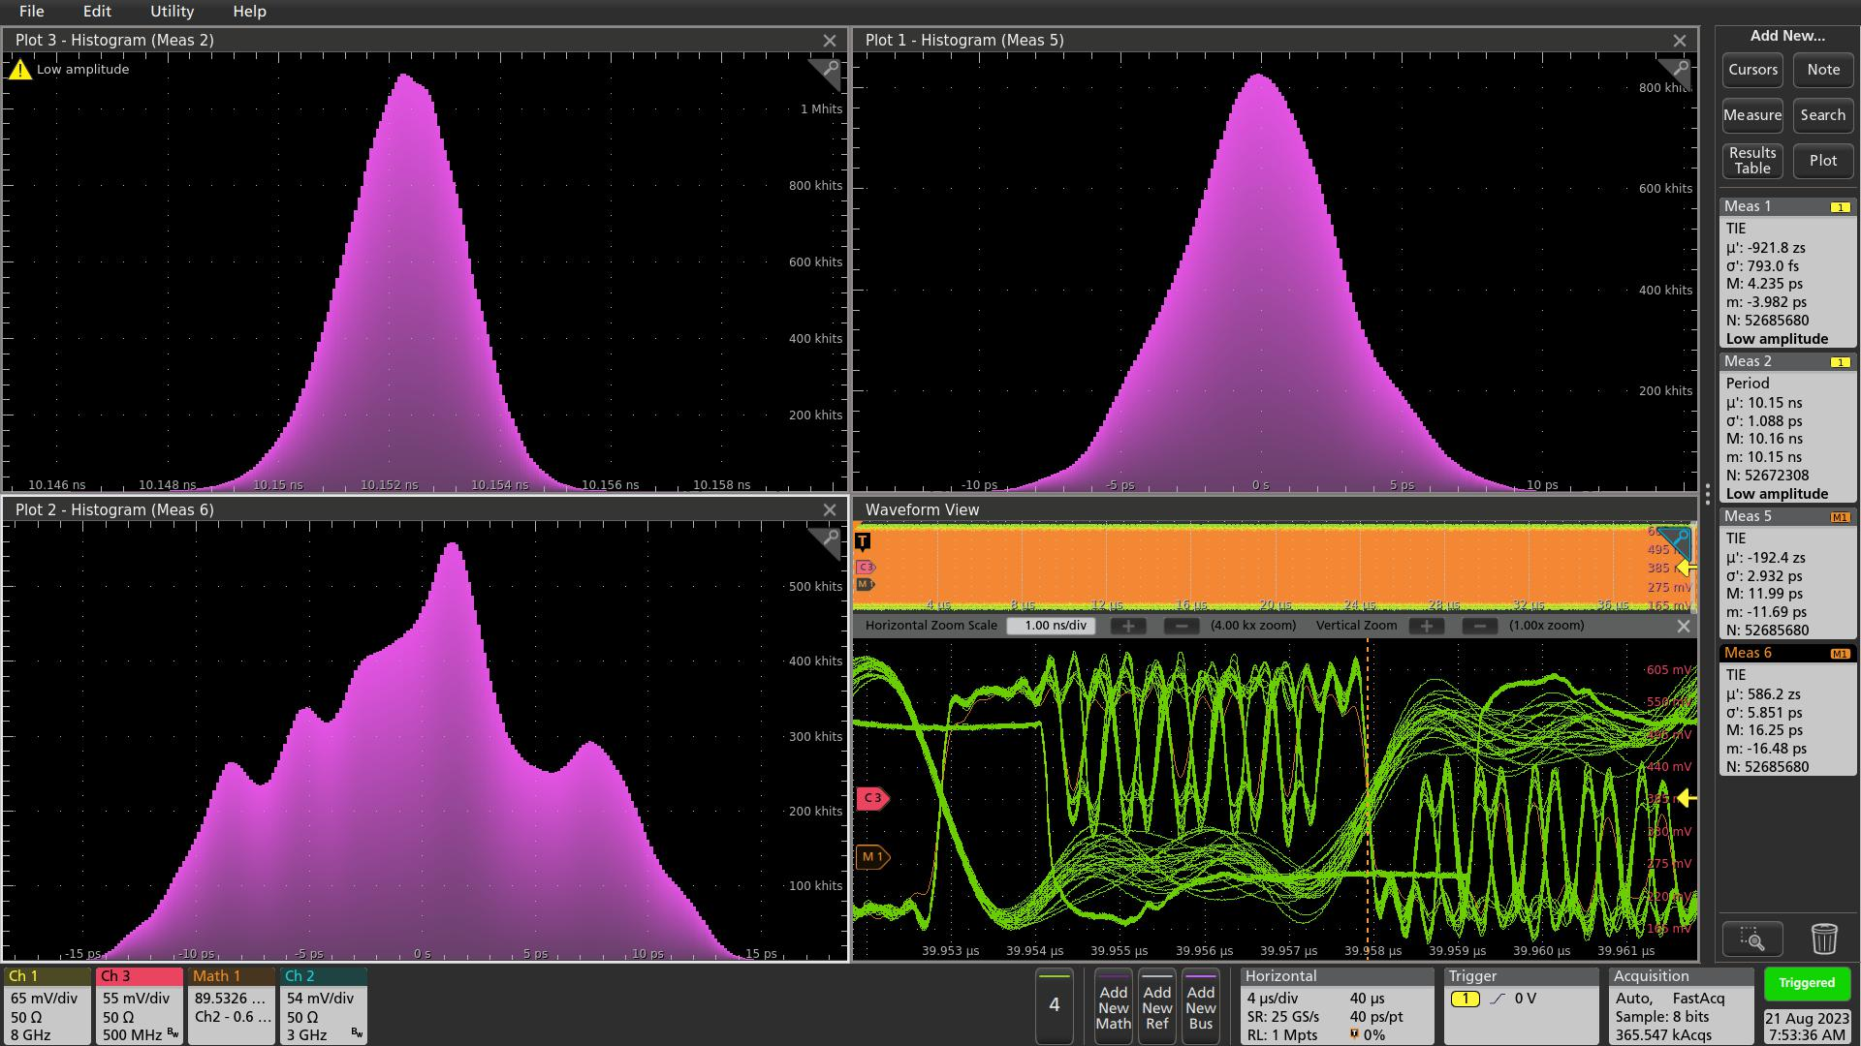
3.4 Low Pass filter for Clock recovery, Clock feature in TX, BW = 3 GHz
Rising edges, TIE
LowPass Filter:
3 GHz,
TIE measurement at 40 µs
(~ 8 km fiber delay)
GTH Ref_Clock: σ < 1 ps
Rising Edge: σ = 3 ps
Falling Edge: σ = 6 ps
Ref_Clock, Period
Falling Edges, TIE
Ch#2
The measurement is on the MATH, Ch#2 – 0.6*Ch#3
Ch#2: TX+, BW 3 GHz
Ch#3: TX-, BW 500 MHz
MATH
Ch#3
Clock
Hard to implement

Slide 21
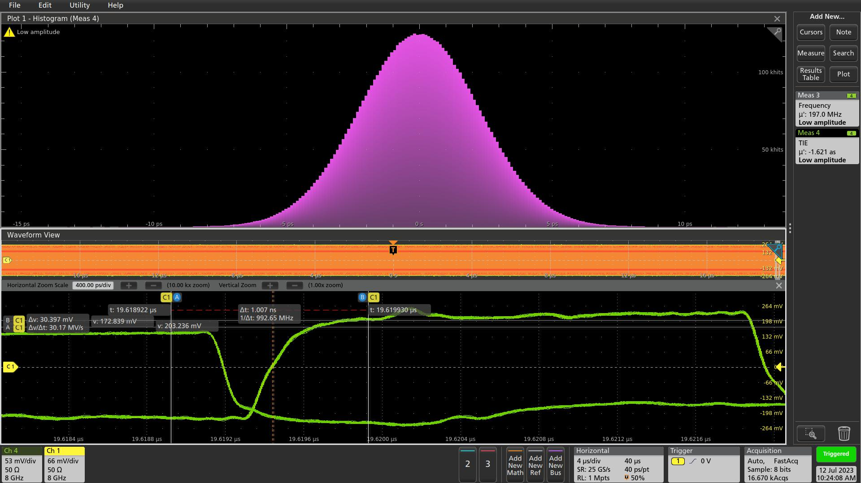
3.5 Rx Recovered clock (ClkRef_out), with Clock feature in TX
XEM8320, UltraScale+ ARTIX, GTY RxRecClk
Frequency: 197 MHz
RxRecClock: σ = 2.0 ps @ TIE measurement at 400ns range (80 meter fiber equivalent);
RxRecClock: σ = 3.0 ps @ TIE measurement at 40 µs (20 µs before and after trigger) range;

