Slide 1
dN/dη with INTT
Tomoya Kato (Rikkyo university)

Slide 2
intro
Topics
1 pseudorapidity acceptance by INTT
2 number of particle with using BRAHMS Collaborations data
*BRAHMS Collaborations data

Slide 3
pseudorapidity acceptance by INTT
Tomoya Kato

Slide 4
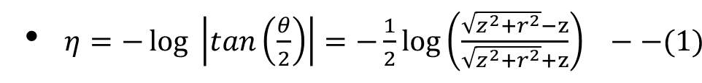
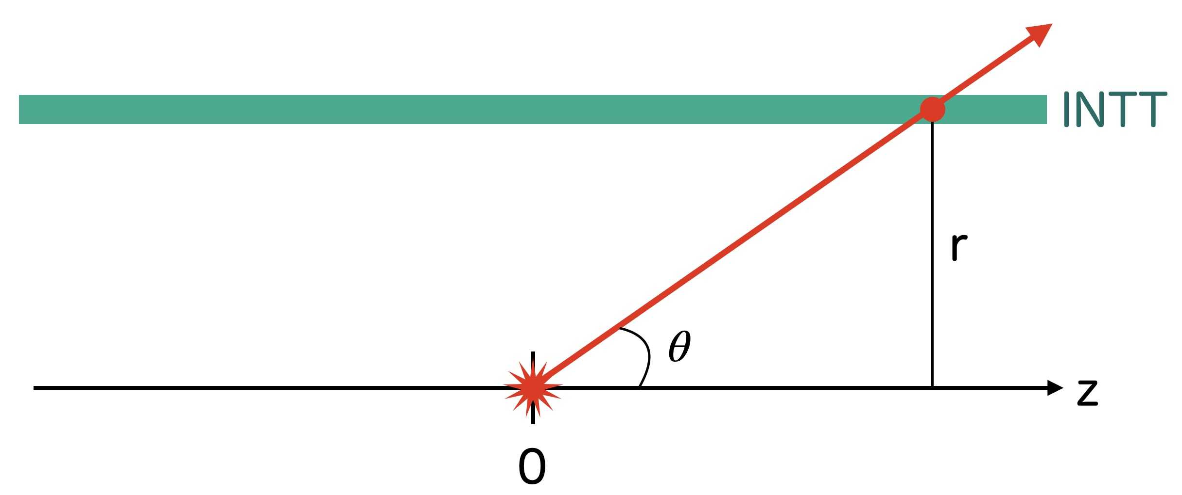
I calculated the pseudorapidity
pseudorapidity is given by equation (1) . Z is the direction of the beam axis and r is the radius of the ladder

Slide 5
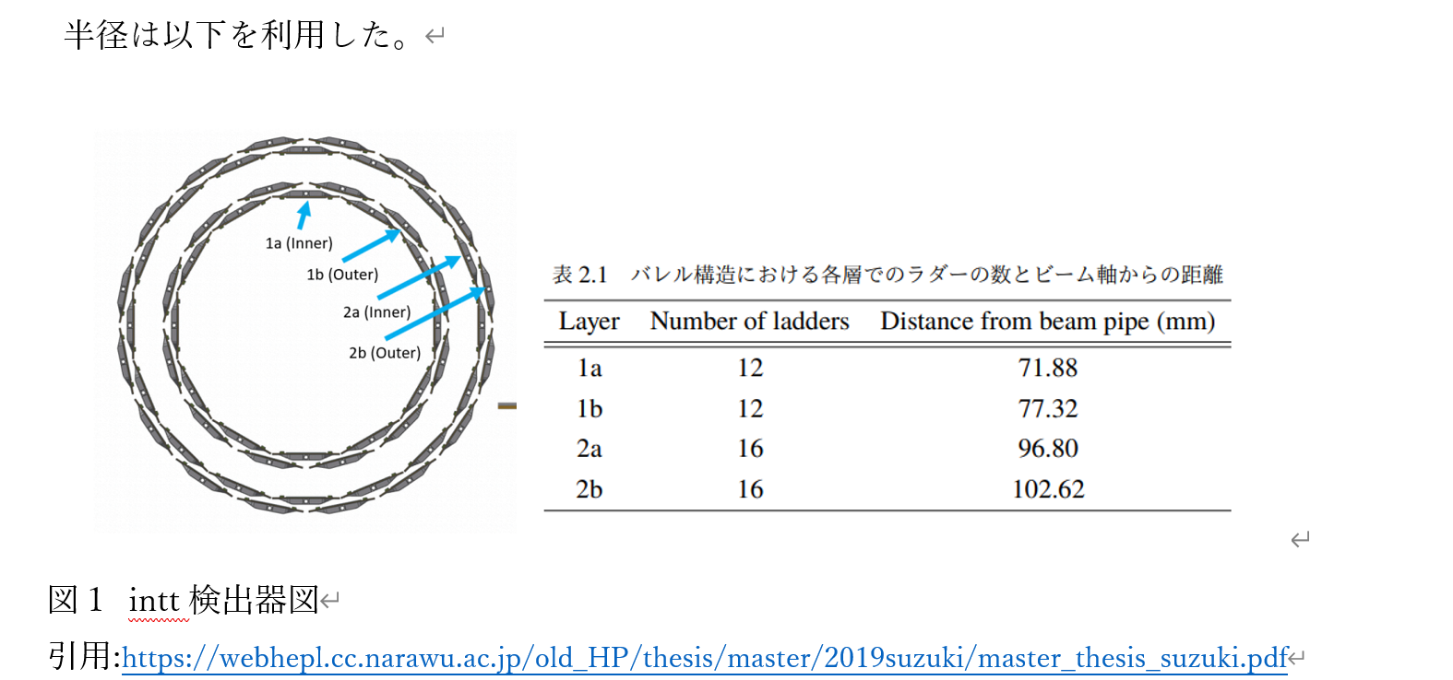




Result1 : collision point at the origin
radius
[cm]

Slide 6
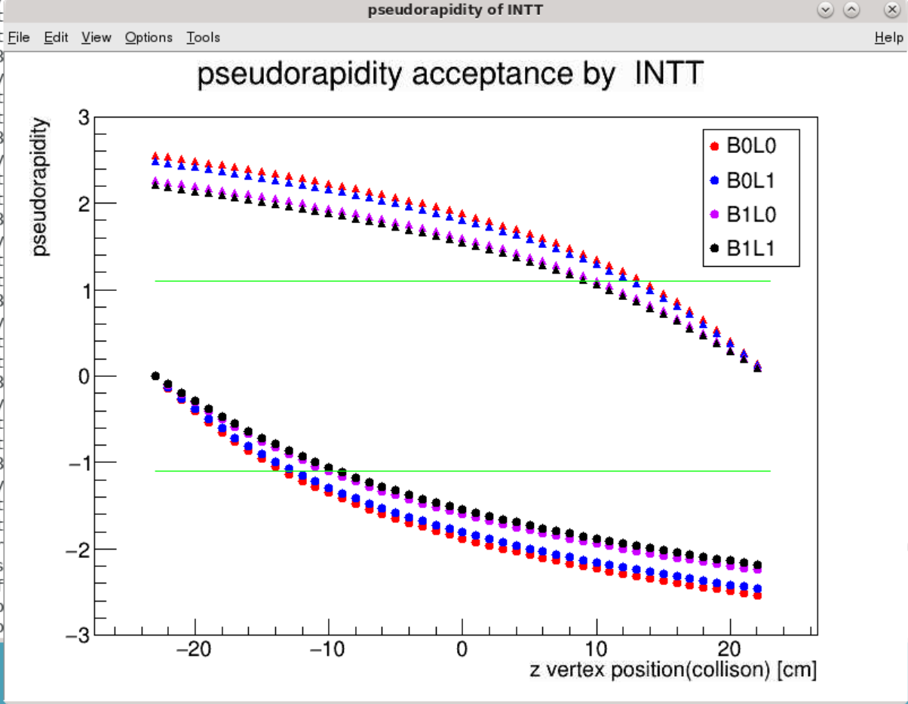
Result2: pseudorapidity depends on collision point
B0L0
B0L1
B0L0
B0L0

Slide 8
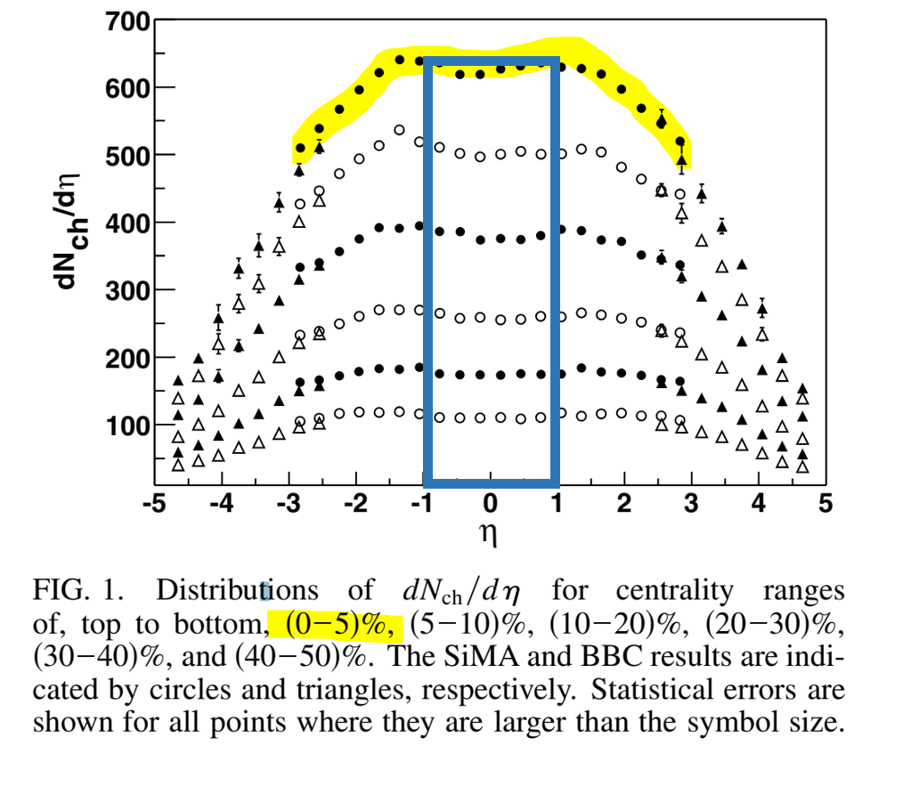
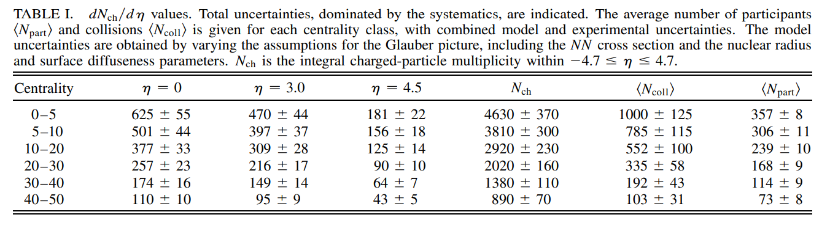


Number of particle from collision?
z =0
Error was calculated form bottom table.

Slide 9
Number of particle(z=23)
Why z=23?
because it is a collision point for ZERO filed data.
z =23

