Slide 1
FCFD ASIC TIC Meeting
Fernando Barbosa (TJNAF)
L3, Chief Electrical Engineer
11 September 2023

Slide 2
ePIC Readout Channels (w/ Project P6 updates in WBS 6.10.08)
Detector System | Channels | Nominal Readout Technology | eRD109 Initiatives
Si Tracking: 3 vertex layers, 2 sagitta layers, 5 backward disks, 5 forward disks | 7 m^2 36 B pixels 5,200 MAPS sensors | MAPS – ITS-3
MPGD tracking: layers + disks | 202 k | Strips | SALSA
Calorimeters: (in P6) Forward: LFHCAL pECAL Barrel: HCAL ECAL SciFi/Pb Imaging Si Backward: ECAL nHCAL | 63,280 19,000 1536 5760 500 M 3256 3240 | SiPM SiPM SiPM SiPM Si - ASTROPIXV4 SiPM SiPM | H2GCROC Discrete/H2GCROC H2GCROC H2GCROC Discrete H2GCROC
Far Forward: B0: 4 AC-LGAD layers 2 Roman Pots 2 Off Momentum ZDC: Crystal Calorimeter 32 Silicon pad layer 4 silicon pixel layers 2 boxes scintillator | 1 M 560 k x 2 320 k x 2 400 11520 160 k 72 | AC-LGAD AC-LGAG AC-LGAD APD Si AC-LGAD PMT/SiPM | EICROC EICROC EICROC Discrete/HGCROC/H2GCROC HGCROC EICROC Discrete/HGCROC/H2GCROC
Far Backward: Low Q Tagger 1 Low Q Tagger 2 2 Calorimeters | 1.3 M 480 k 700 | Si – Timepix4 Si – Timepix4 PMT/SiPM | Discrete/HGCROC/H2GCROC
PID-TOF Barrel TOF CTTL Hadron Endcap TOF FTTL | 2.2 M 5.6 M | AC-LGAD - Strip AC-LGAD | EICROCx/FCFD EICROC
PID-Cherenkov: dRICH pfRICH hpDIRC | 344,064 69632 69362 | SiPM HRPPD MCP-PMT/HRPPD | ALCOR HGCROC/EICROC/FCFD HGCROC/EICROC/FCFD
HGCROC – Si/PMTs
H2GCROC – SiPMs
EICROC – AC-LGAD
eRD109
eRD109

Slide 3
ePIC Readout Electronics
EICROC and HGCROC families of ASICs have similar interfaces and follow similar developments at OMEGA/IN2P3.
Detector Group | Channels | AC-LGAD | SiPM/PMT | MPGD
 | MAPS | AC-LGAD, HRPPD | SiPM/PMT | MPGD
Tracking | 36 B |  |  | 202 k
Calorimeters | 88 M |  | 123 k
Far Forward | 300 M | 2.3 M | 170 k
Far Backward | 146 M |  | 2 k
PID |  | 7.8 M + 140k | 320 k
TOTAL | 36.5 B | 10.24 M | 615 k | 202 k
ASIC | ITS-3 | EICROC FCFD | Discrete/COTS HGCROC3 ALCOR | SALSA
HRPPD
eRD109

Slide 4
Scope of the effort
Approximate quantities and costs.
Costs include mask sets, fabrication and packaging, wrt quantities needed.
 | #ASICs | #Wafers | E/P Run | Cost/ch ($)
Discrete/COTS | 711 digitizers | na | na | 56
H2GCROC | 1.2 k | 3 | E | 5
EICROC | 76 k | 152 | P | 0.2
FCFD | 18 k | 37 | P | 0.2
ALCOR | 5.4 k | 11 | E | 1
SALSA | 3.2 k | 7 | E | 2
COTS
65 nm
65 nm
65 nm
110 nm
65 nm
For 12” (300 mm) wafers, ~500 chips per wafer.
It may be possible to merge H2GCROC and EICROC for lower costs.
MPW – Multiple Project Wafer run – most of eRD109: <$25 k – 3 months
Engineering (E) run - <25 wafers: $350 k – 6 – 8 months
Production (P) run: $250 k masks + $5 k per wafer – 1 year
Packaging: $3-$5 per chip.

Slide 5
eRD109 – R&D Initiatives
Addresses ASIC and Electronics R&D needs.
FY23 Proposals submitted in October 2022
Contract awards took longer than expected.
FY24 Proposals submitted in July 2023
Contract awards should now be in synch with FY funding
Continuation of previous work.
Duration of 4 Years.
ASIC & Electronics:
Discrete/COTS – Calorimeters, SiPMs, 12-14 bit
H2GCROC – Calorimeters, SiPMs, 10 bit
EICROC - AC-LGAD, pixel
FCFD – AC-LGAD, strip
ALCOR – dRICH, SiPM, 1 p.e.
SALSA – MPGD.
Summary follows and more details at DAC R&D Review 31 August 2023.

Slide 6
FY23 eRD109 Proposals
 | File | Authors | Sub-Detector | Sensor Type | Readout Solution
A | eRD109_pECAL_readout_prototype_FINAL | G. Visser (IU), et al. | Calorimeter | SiPM | Discrete, COTS
B | eRD109CalorimeterReadout | N. Novitzky (ORNL), et al. | Calorimeter | SiPM | ASIC (HGCROCv3)
C | eRD109-alcor | M. Ruspa (INFN), et al. | dRICH | SiPM | ASIC (ALCOR)
D | ACLGAD_ASIC_Electronics_FY23 | Z. Ye (UIC), et al. | Central, Far-Forward | AC-LGAD | ASIC (EICROC1, FCFD1) (2)
E | eRD109_SALSA_proposal_vfinal1 | D. Neyret (CEA), et al. | Micromegas, GEM, MicroRWell | MPGD | ASIC (SALSA)
Contract Awards – this took longer than expected.
 | Detector/Technology | Discrete/ASIC | Group | Awarded
A | Calorimeter | Discrete | IUCF | April 2023
B | Calorimeter | H2GCROC | ORNL | April 2023
C | dRICH | ALCOR | INFN | April 2023
D | AC-LGAD | EICROC | Omega/IN2P3 | See below
 |  | FCFD | FNAL | June 2023
 |  | Barrel L-M Serv. Hybrid | ORNL | April 2023
 |  | 3rd Party Evaluation | UCSC | Pending Legal
E | MPGD/µRWell | SALSA | CEA | May 2023
 |  |  | USP | May 2023
Considerable commitment of resources by OMEGA/IN2P3 will enable accelerated and targeted developments.

Slide 7
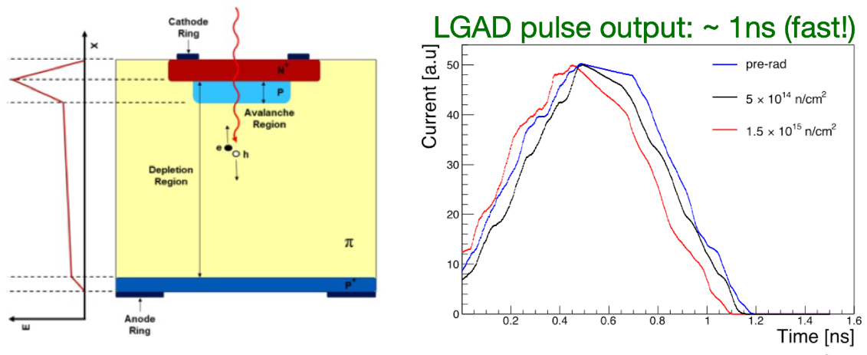
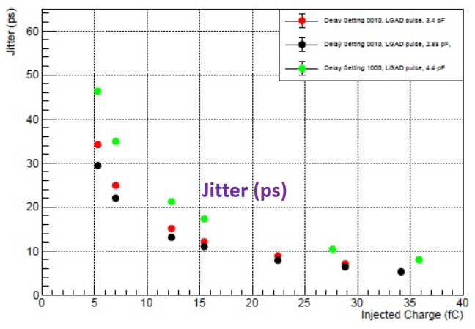
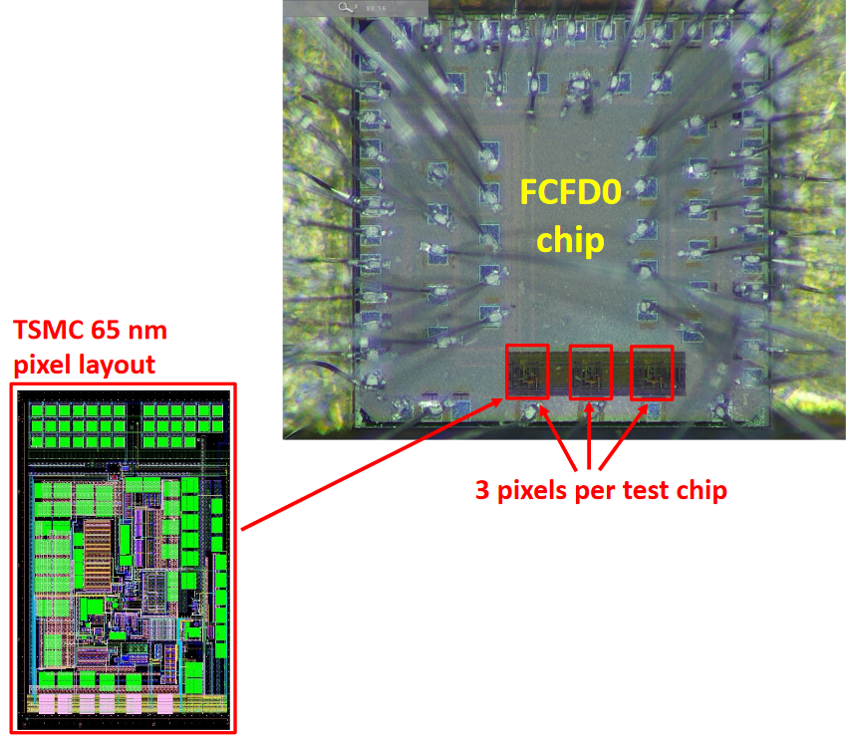
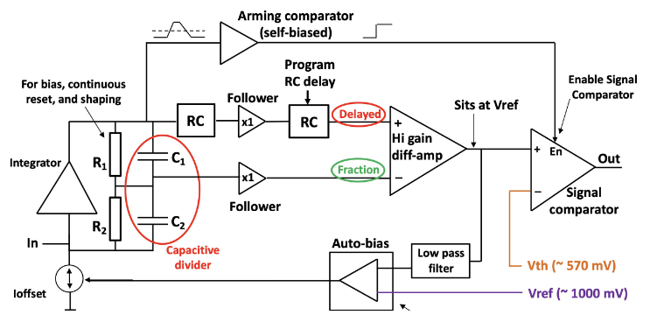
Proposal D - AC-LGAD strip – FCFD (FNAL)
128 ch strip readout
65 nm CMOS
Constant Fraction Discriminator
Plus TDC, ADC, interfaces
Cdin: <15 pF
Dynamic Range: 5-40 fC
Timing: 10-30 ps
Links: ~Gbps, multiple
Considerable synergy with FNAL.
ASIC Progress Summary:
FCFDv0 – characterization with charge injection, laser, beta, and proton beam.
<25 ps @ >6 fC timing.
FCFDv1 – 6 channel designed and submitted (August 2023).
FCFDv1: FY23
FCFDv2: FY24 – FY25
FCFDv3: FY25

Slide 8
FY24 eRD109 Proposals & Costs
Budget requests for each of the five (5) proposals:
 | File | Authors | FY24 ($k) | FY25 ($k) | Notes
A | eRD109_FY24_waveform_readout_prototype_Gerard | G. Visser (IU), et al. | 62 | 43
B | eRD109ProposalFY24_Norbert | N. Novitzky (ORNL), et al. | 84.4 | 82.4 | Note 1
C | eRD109-application_ALCOR_INFN_TO_BO_Michela | M. Ruspa (INFN), et al. | 60 | Not provided | Note 2
D | eRD109-FY24-20230710_Zhenyu | Z. Ye (UIC), et al. | 390 | Not provided | Note 3
E | eRD109_2024_SALSA_proposal_vfinal2_Damien | D. Neyret (CEA), et al. | 221 | 300 | Note 4
Note 1: ORNL $64 k; IJCLab $20.4 k.
Note 2: INFN-BO $20 k; INFN-TO $40 k.
Note 3: proposal D is further detailed as follows:
FY24 proposals continue the work started in FY23.
Plus realization of the 5 ps precision clock distribution with AC-LGAD+EICROC0.
 | ACLGAD_ASIC_Electronics_FY24 | FY24 ($k)
1 | EICROC ASIC (IJCLab) | 85
2 | FCFD ASIC | 40
3 | Barrel Low-Mass Service Hybrid (ORNL) | 45
4 | High Precision Clock Distribution (BNL/Rice/UIC) | 220
Mostly labor for development of associated PCBs, circuitry, etc. for readout.
High Precision Clock Distribution allocation: BNL $137 k; Rice $49 k; UIC $34 k.
Note 4: IRFU $157 k; USP $64 k.

Slide 9
Timeline
eRD109 schedules in P6 – from Thomas U.:
eRD109 in P6 End Date Readout
Calorimeters 9/30/2025 Discrete/H2GCROC
AC-LGAD 9/30/2025 EICROC/FCFD
dRICH 1/2/2026 ALCOR
MPGDs 3/31/2026 SALSA
LAPPD/MCPMT 1/4/2027 EICROC/FCFD
FCFD or a variant of the EICROC will address the readout needs of the Barrel TOF (AC-LGAD strips), pfRICH and hpDIRC (HRPPD/MCP-PMT).

Slide 10
Summary
There were delays in awarding FY23 eRD109 contracts, ~6 months relative to the start of the FY23 funding. However, there has been good progress overall.
FY24 eRD109 proposals submitted by 7 July 2023. Contract awards are more likely to coincide with FY24 funding (October 2023) and also due to continuation of FY23 efforts. This will help better align projects with funds and will allow projects to continue uninterrupted.
FCFD effort is lead by Artur Apresyan at FNAL.
FCFDv1 (6 channel) submitted to TSMC through IMEC, August 2023:
Chip passed all of the required checks by IMEC.
Work on chip documentation in progress.
Expect testing in November-December 2023.
Test PCB under development: standalone tests and with AC-LGAD sensors.
FCFDv2 FY24-FY25:
To include TDC, readout and global circuitry.
FCFDv3 FY25 production.

