Slide 1
Perspectives, Status and Timelines for thin-gap MPGDs for ePIC
Kondo Gnanvo
On behalf of the eRD108 Consortium / DSC Gaseous Trackers
TIC weekly Meeting - 09/18/2023

Slide 2
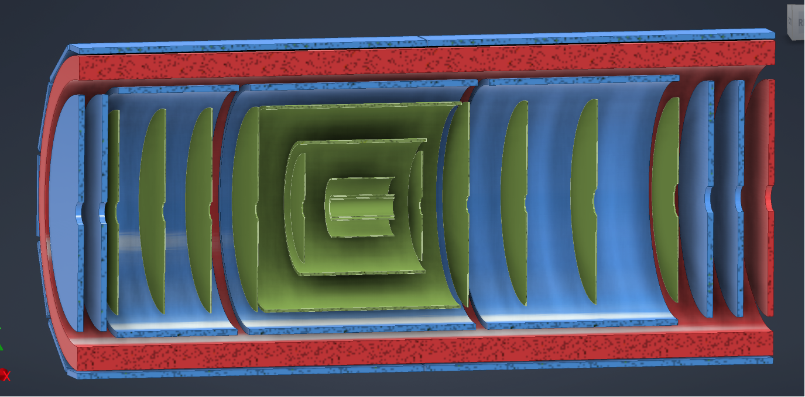
Overview of MPGD Trackers in ePIC
Barrel Outer µRWELL Layer
Backward µRWELL Disks
Forward µRWELL Disks
Inner Cyl Micromegas Barrel Layer CyMBaL

Slide 3
ePIC µRWELL trackers
Endcap µRWELL disc module:
Half disk (radius 50 cm) twin (double-sided) hybrid GEM-µRWELL thin gap detector
2D (r-phi)-strip capacitive-sharing readout: pitch ~1.2 mm (low capacitance)
Barrel Outer µRWELL Tracker:
180 cm × 36 cm planar twin (double-sided) hybrid GEM-µRWELL thin gap detector
2D (diagonal X-Y)-strip capacitive-sharing readout: pitch ~1.2 mm (low capacitance)
Readout electronics for all ePIC µRWELL trackers:
Same readout electronics as for ePIC barrel inner Micromegas tracker (CyMBal)
SALSA + FEB + RDO readout chain
475 mm
500 mm
End cap µRWELL disk module
1800 mm
Gas outlet
Front side
HV cable
340 mm
360 mm
HV divider
1740 mm
Gas inlet
Barrel Outer µRWELL Tracker

Slide 4
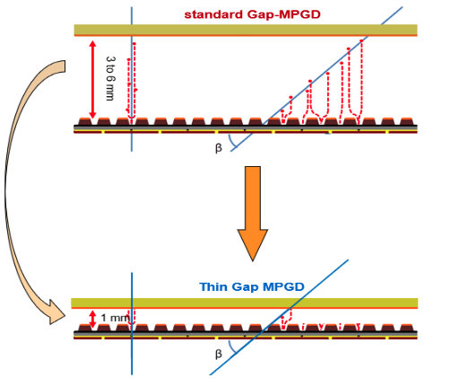
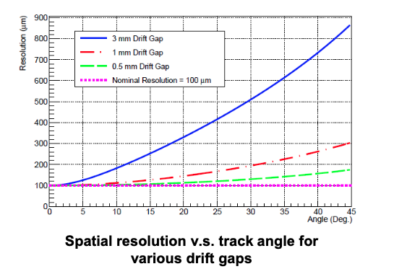
Why developing thin-gap MPGDs for ePIC
Motivation
Incoming track at large angle: Ionization in drift volume generates signal on too many strips → spatial resolution limited by drift gap d for large angle tracks
Lorentz angle in high B field: Another source of degradation of the spatial resolution performance that depends on the drift volume
General issue with MPGDs i.e. GEM, µRWELL and Micromegas detectors
Proposed Solution
Reducing the drift gap from 3 mm to < 1mm is one approach to recover at least to some degree good spatial resolution performance
Address both large angle tracks and E × B effect simultaneously
Bonus advantage ➔ time resolution inversely proportional to drift gap
Thin-gap & Hybrid GEM-µRWELL technology seems the best candidate
d

Slide 5
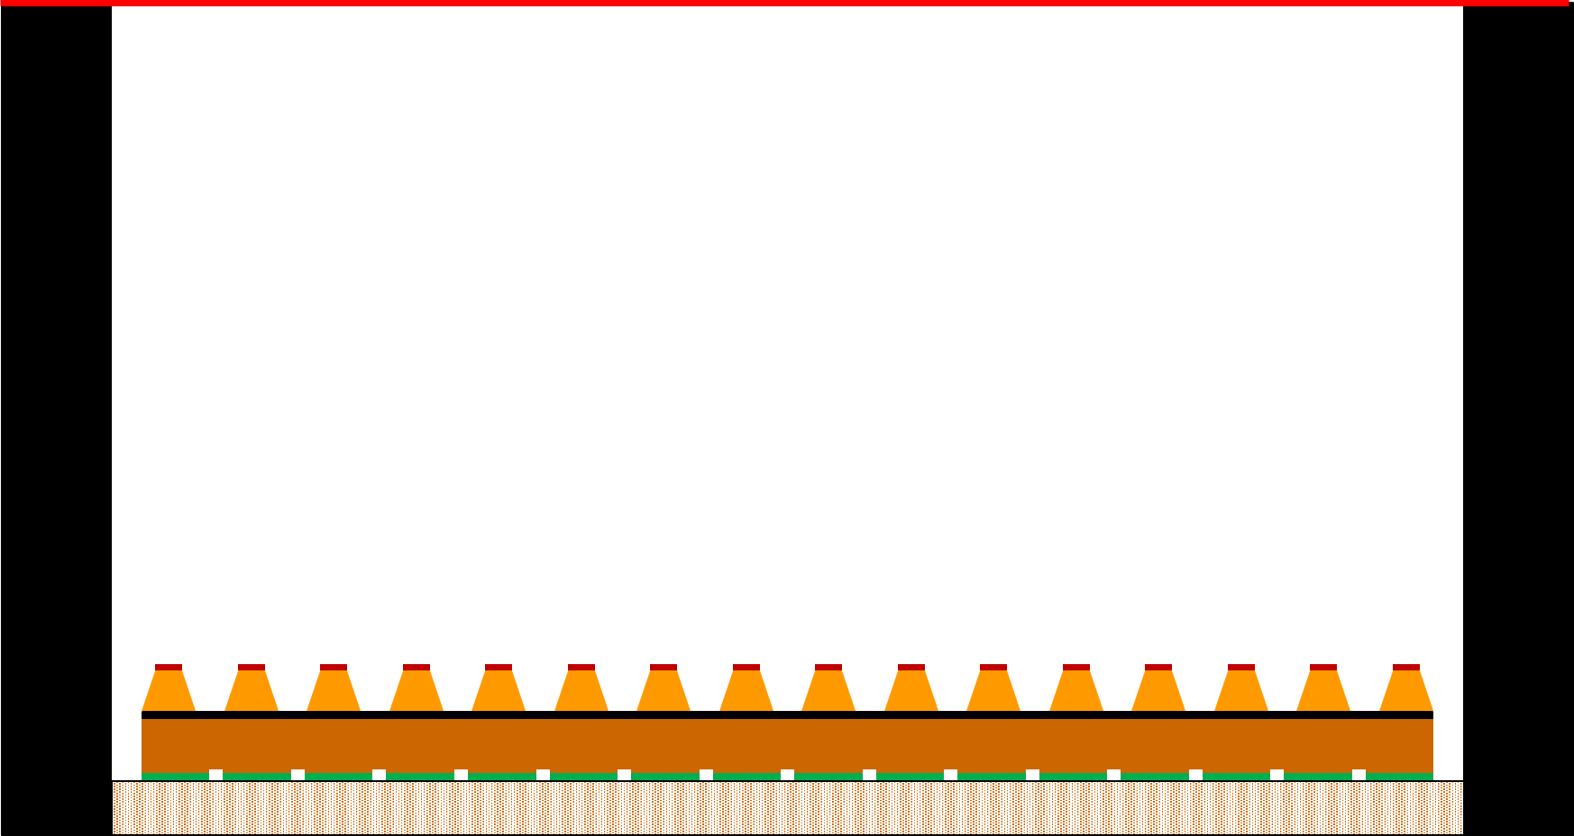
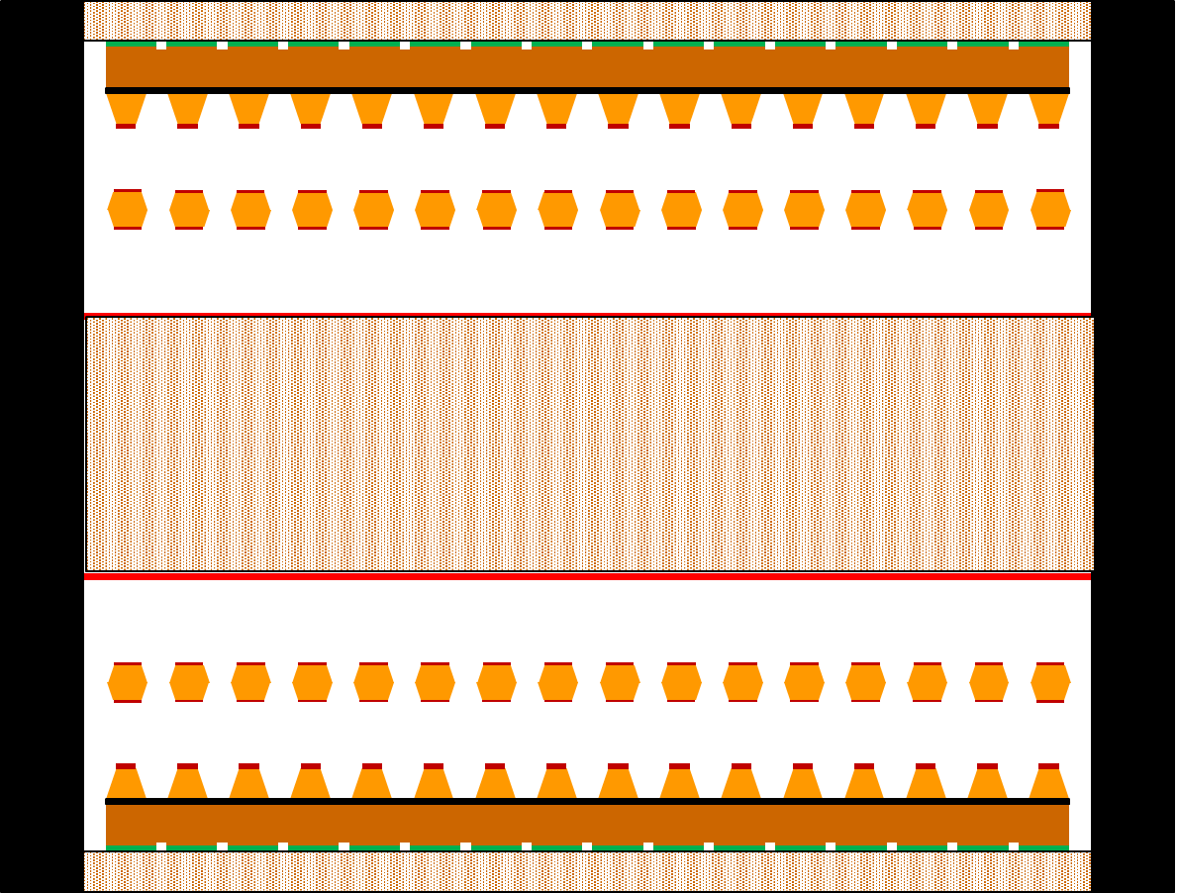
Pros and cons of thin gap µRWELL technology options
 | Standard µRWELL - 2D strip readout | Thin-gap µRWELL - 2D strip readout | Hybrid thin-gap GEM-µRWELL - 2D strip readout GEM pré-amplification µRWELL amplification | Twin (double-sded) hybrid thin-gap GEM-µRWELL × 2
Nominal spatial resol. (perpendicular tracks) | Excellent ~70 µm | Excellent < 70 µm | Excellent < 70 µm | Excellent < 70 µm
Position resol. @ large angle | Really poor | Good, can be limited by S/N | Good | Good
Timing resolution | 10 - 20 ns | < 10 ns | < 10 ns | < 10 ns
Detector efficiency | Full efficiency > 97% | ~ 75% with Ar-mixture ~ 90% with Xe-mixture? | ~ 85% with Ar-mixture > 95% with Xe-mixture | 98% 1-hit with Ar mixture 72% 2-hit with Ar mixture
Pros | Simple structure | Simple structure Good position resolution possible @ large angle Excellent time resolution | Good position resolution @ large angle Excellent time resolution Robustness & stability | Same as for hybrid thin gap GEM-µRWELL + Full efficiency (Ar mixture) 2-hit capability Compact detector
Con | Poor position resol. average time resol. | limited efficiency High gain with single amplification ➔ Possible stability issues | limited efficiency (with Ar-based mixture) Complex structure Assembly challenges | Even more complex structure Assembly challenges
Drift gap ~ 3mm
drift gap ~1mm
GEM
Drift gap ~1mm
1mm

Slide 6
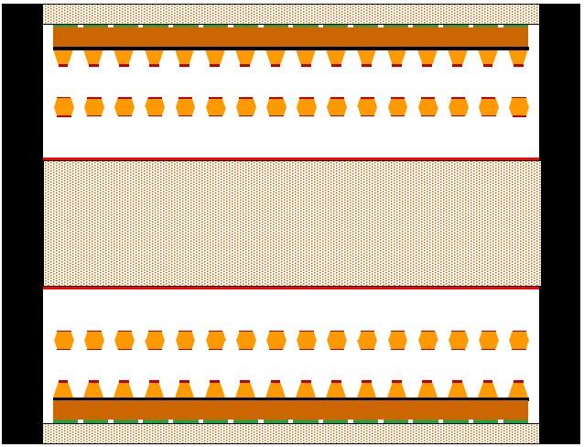
eRD108 choice: Thin Gap hybrid GEM-µRWELL
Hybrid thin-gap GEM-µRWELL (with Xe-based mixture)
Hybrid amplification (GEM-µRWELL) with GEM pre-amplification:
Large S/N to compensate for small number of primaries
HV on each device at low / safe operation voltage point
Safety margin for HV for unexpected issue with large detectors
Single detector module but with hybrid amplification:
Single hit detection efficiency > 95% for 1 mm thin gap
No benefit for 2-hit capability
Xe gas cost and availability (Kr gas an alternative option)
Gas purification / recirculation system needed
Xe slower gas than Ar ➔ time resolution ~ 2 times worse
Twin (double-sided) hybrid thin-gap GEM-µRWELL (with Ar-based gas mixture)
Same technology choice as hybrid thin-gap GEM-µRWELL but
Double-sided detector with shared cathode support structure:
Compact 2-detector-in-one approach ➔ will fit the ePIC envelop
Full efficiency with Ar-based gas mixture
An OR of the two layers ensures a single hit detection efficiency ~98%
An AND gives a 2-hit efficiency ~72% ➔ tracklet for pattern recognition
Twin Hybrid Thin-Gap GEM-µRWELL
Single hybrid thin-gap GEM-µRWELL
1 mm
5 ~ 10 mm honeycomb
GEM
1 mm
µRWELL
1 mm
1 mm

Slide 7
Timeline for ePIC thin-gap hybrid GEM-µRWELL R&Ds
Year #1: Targeted R&D – eRD108 FY24:
Design of the 2D readout structure of large thin gap hybrid GEM-µRWELL prototype
Design & fabrication of mock-up prototypes to study mechanical structures, HV stabilities, gap uniformity, gas flowing structure
Full-size Outer Barrel Module and end cap disc with Cu-clad Kapton foils for µRWELL, GEM and readout foils
Investigate mechanical structures of support frame options (honeycomb, Carbon Fiber / FR4, w or w/o spacer …)
Perform HV stress test for 1 mm ionization and transfer gap with mock-up prototypes
Join the heavy gas (Xe, Kr) purification / recirculation effort with EIC Generic MPGD-TRD R&D consortium
Participate to joint beam test at Fermilab with TRD effort to test small scale gas recirculation system
Year #2: PED – Design and procurement of the parts of pre-production full-size thin-gap hybrid GEM-µRWELL prototypes:
Design of all parts (2D readout structure, GEM and µRWELL foils) of large thin gap hybrid GEM-µRWELL prototype
Design of the mechanical structure / support frames the prototypes (End cap discs and Outer barrel modules)
Procurement of the µRWELL-R/O PCBs, GEM foils from CERN and the support frames from commercial vendors
Year #3: PED – Assembly and test of the pre-production full-size thin-gap hybrid GEM-µRWELL prototypes:
Assembly of the full-size (180 cm × 360 cm) Outer Barrel hybrid Thin Gap GEM-µRWELL module prototype
Assembly of the full-size (100 cm × 50 cm) end cap Thin Gap GEM-µRWELL half disc prototype
Test and characterization of the prototypes in institution labs (x-ray and cosmic tests, HV setting and gas system optimization
Final test in beam test at Fermilab for efficiency / position resolution studies with various gas mixtures

Slide 8
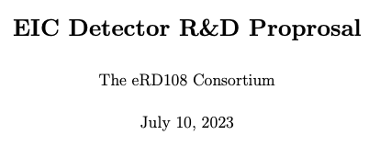
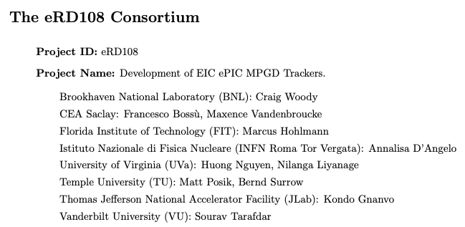
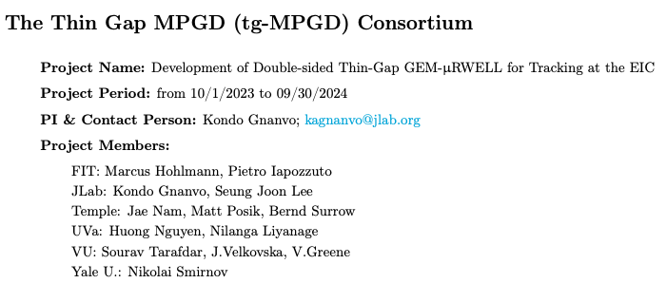
Ongoing R&D on thin-gap hybrid GEM-uRWELL
2 EIC related- R&D programs for the development thin Gap Hybrid GEM-uRWELL technology
EIC FY24 Project - eRD108 Proposals: Design of full-size modules and construction and test of mock-up prototypes
Mock-up prototypes to investigated mechanical issues associated with large area. We can not complete the design, fabrication and characterization of full-size working prototypes in a 1-year time frame - This is a 3-year thin-gap MPGD development program
EIC FY23 Generic R&D – Thin Gap Consortium proposal: Medium-size prototypes to fully investigate all challenges related new approach ➔ we want to concentrate on Ar-CO2 gas mixture
https://wiki.bnl.gov/eic/upload/ERD108_Proposal_FY24_Final.pdf
https://wiki.bnl.gov/eic/index.php?title=File:20230714_eRD_tgMPGD_Proposal_FY23_Final.pdf

Slide 9
Comments from DAC – Project R&D meeting closeout section
eRD108 –MPGD: Outer Barrel µRWELL Layer
A layer of planar detectors using hybrid GEM-μRWELL technology, arranged in a circle is proposed for the outer barrel tracking layer in front of the hpDIRC.
Provide fast timing hits as an aid to pattern recognition and improve the determination of the angles of charged particles entering the hpDIRC.
A full-size prototype is planned to address stability issues albeit with a mock μRWELL foil.
Many technical challenges (foil stretching, low mass materials, HV stability) must be overcome in a short time to create a reliable final design.
There is a risk posed by using a Ph.D. student to design and fabricate the prototype.
Explore the possibility of employing professional design engineers.
eRD108 –MPGD: Endcap µRWELL Layers
To provide additional tracking hits in the endcap regions of ePIC two planar MPGD disks at each end were added to the baseline design. An additional benefit would be providing fast hit points for background rejection.
One year is a very short time to accomplish the design and development of new large-area μRWELL chambers particularly given the issue of charge-up and chamber integrity using light-weight materials.
Reliance on students for design tasks poses a risk.
The anticipated one-year needed for the CERN workshop to fabricate large-area μRWELL foils pushes chamber construction and testing well into FY25.
No beam testing of large area μRWELL chambers poses a risk.
What is the proposed strategy and impact of the services for the forward disks?
Explore the possibility of employing professional design engineers.

Slide 10
Groups involved in the realization?
Institutions | Contacts | Expressed interest | Anticipated contribution (Here, I am speculating) | Past and present experience in MPGD for NP and HEP experiments
University of Virginia | N. Liyanage, H. Nguyen | Barrel Outer µRWELL Trackers | Design, assembly, commissioning, Installation? | SBS GEMs, PRad GEMs, MOLLER GEMs, CLAS12 µRWELL, EIC R&Ds
Jefferson Lab | K. Gnanvo, Seung Joon Lee, D. Weisenberger | Barrel Outer µRWELL Trackers | Design, assembly, commissioning, Installation? | SBS GEMs, PRad GEMs, CLAS12 µRWELL, CLAS12 Micromegas, BoNuS and BoNuS12 rTPC GEMs
Florida Tech | M. Hohlmann | Hadron end cap µRWELL discs | Design, assembly, commissioning, Installation? | CMS GEMs, EIC R&Ds
BNL | C. Woody, A. Kiselev, B Azmoon | Electron end cap µRWELL discs | Design, assembly, commissioning, Installation? | PHENIX HBD, sPHENIX TPC, EIC R&Ds …
INFN (Roma Tor Vergata) | A. D’Angelo | end cap µRWELL discs | Design, assembly …? | CLAS12 µRWELL, EIC R&Ds
Vanderbilt U. | S. Tarafdar | end cap µRWELL discs | Design, assembly, commissioning, Installation? | sPHENIX TPC GEM readout, EIC R&Ds …
Temple U. | M. Posik, B. Surrow | end cap µRWELL discs Barrel Outer µRWELL | Will let Matt comments | STAR FGT, sPHENIX TPC GEM readout, EIC R&Ds
Korean Institutions contribution | I. Yoon | Production of GEM and µRWELL foils | In kind contribution (GEM foils and µRWELL PCBs)? | CMS GEMs foil production

Slide 11
Summary
Twin (Double-sided) Thin Gap Hybrid GEM-µRWELL is eRD108 preferred option for ePIC µRWELL trackers
Same technology and configuration will be developed for both Barrel Outer Tracker and Endcap discs
Only detector size / shape and strip readout geometry and segmentation will differ
Full efficiency, good timing and spatial resolution, stable operation configuration, redundancy and double-hit capability with standard non-flammable and cheap Ar-CO2 gas mixture
Need a sustained & dedicated R&D & PED effort
We estimate a 3-year R&D (and /or PED) effort to complete a full-size working prototypes for both barrel and end cap trackers
No show-stopper or serious concerns with the technology choice but a few challenges need to be addressed
ePIC µRWELL trackers instrumented with SALSA electronics
Use same readout electronics and DAQ scheme as CyMBaL
Only minor difference in the implementation between subsystems
Large MPGD community in ePIC Coll. interested in the effort
Several US institutions with proven experience in MPGD tracking systems for large scale NP & HEP experiments
EU (INFN Roma) and Asia (Korean MPGD consortium) institutions

Slide 12
Backup

Slide 13
µRWELL Technology: Maturity for ePIC Trackers
Is the technology mature for ePIC? Yes and No
The answer below to this question are only my personal but I hope unbiased opinion based on my experience with the technology so far
Is µRWELL mature for ePIC? Yes
µRWELL as MPGD technology is not fundamentally different from the other 2 mature MPGDs (GEM and Micromegas)
Amplification structure (µRWELL foil) is based on the same concept and base material as a GEM foil
Operating concept of µRWELL detector is very similar to Micromegas (single amplification stage) detector unlike triple-GEM
Concept of resistive MPGD (with DLC) to ensure stable operation of single-stage amplification was pioneered for Micromegas detector (ATLAS Small Well MM, T2K TPC MM readout, CLAS12 MVT…) ➔ so there is nothing fundamentally
There is a lots of effort in MPGD community in EU, US and Asia to bring the technology to maturity level for large scale experiments
Is µRWELL mature for ePIC? No
Has never been used in an experiment so far so the community can feel a little bit nervous about investing in this option for ePIC
Challenges and issues are expected, specially for large area devices because it is new ➔ but this is the case for every technology
Thought there is no show-stopper that needs to cause concerns

Slide 14
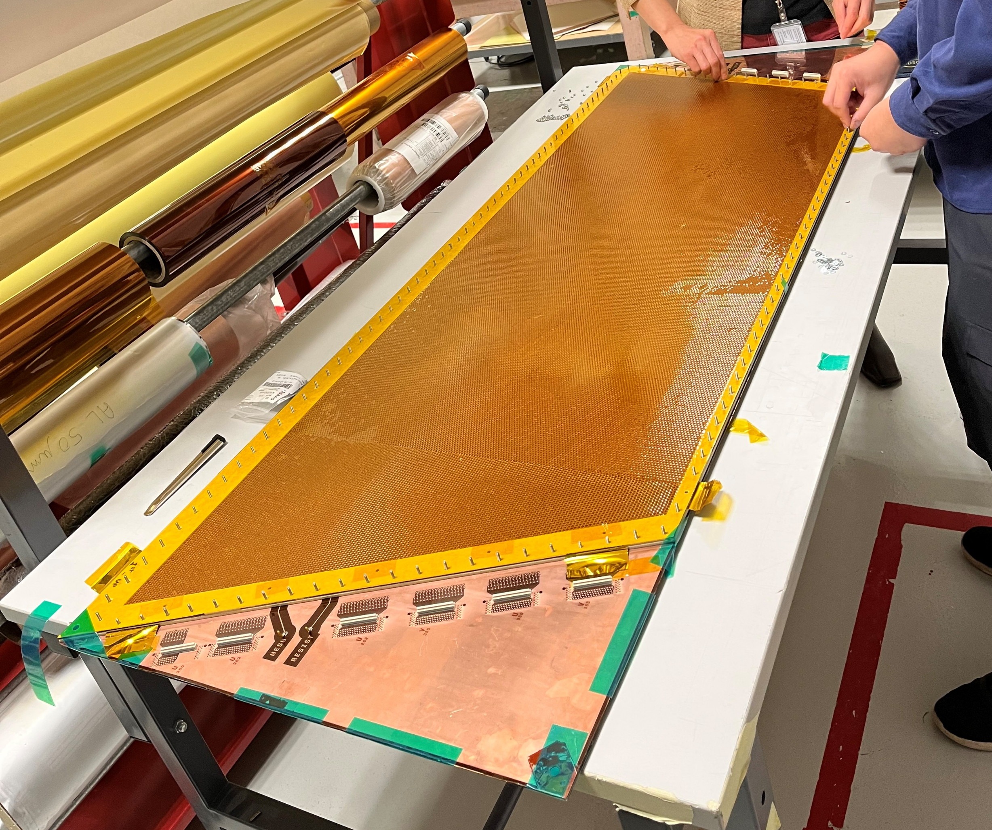
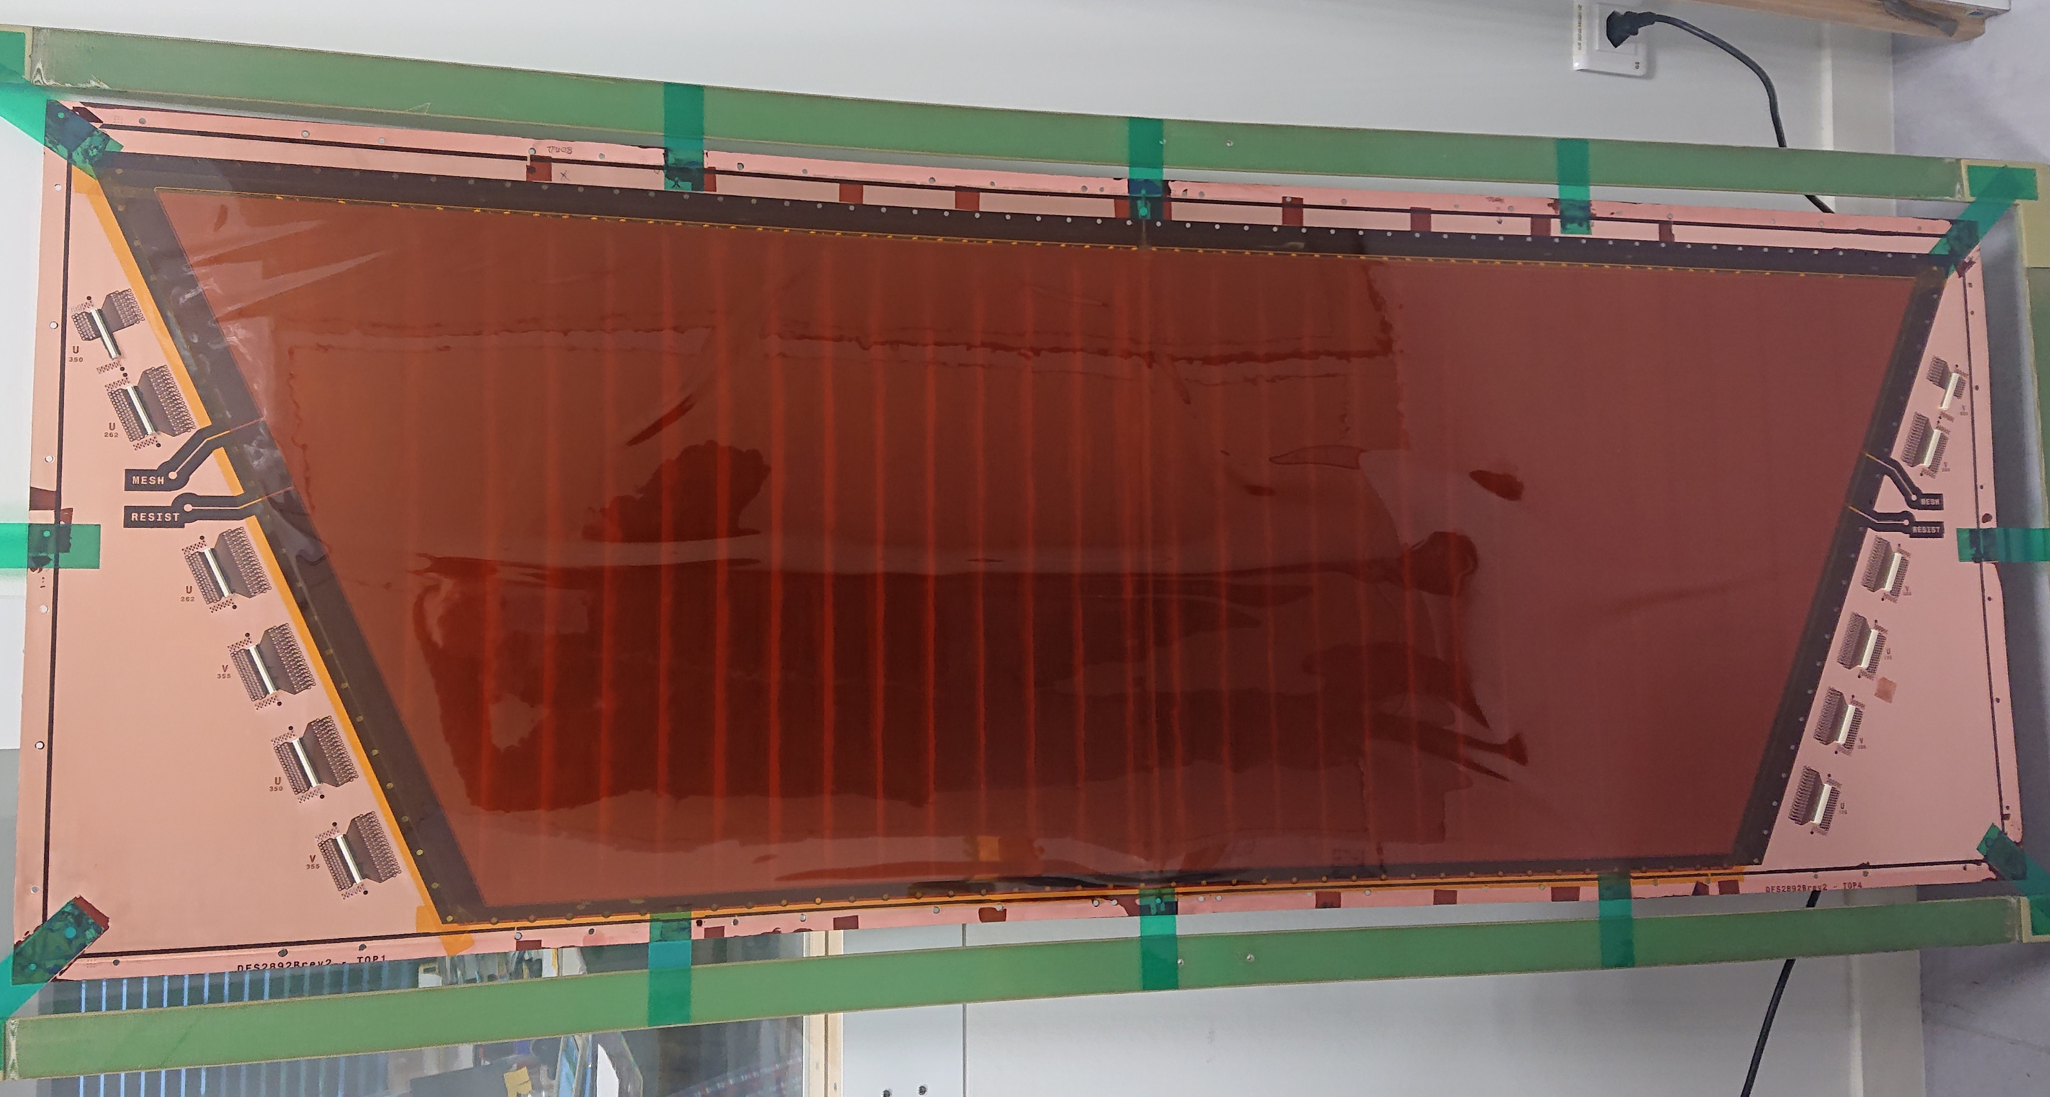
µRWELL technology: Recent experience
Is the technology mature for ePIC? Yes and No
CLAS12 recently built a large µRWELL prototype for High Lumi Upgrade of its forward tracker active area: Trapezoid [146 cm – 101 cm ] × 54 cm
The dimension are similar to the largest module needed for ePIC Barrel Outer Tracker
The prototype has been under test at JLab since early 2023
As expected, some issues with this first attempt for large area ➔ the collaboration is investigating
Fully assembled detector
µRWELL + capaSh RO PCB

Slide 15
ePIC Outer µRWELL Barrel Tracker
Gas outlet
Front side
HV cable
340 mm
360 mm
HV divider
1740 mm
Gas inlet
12 × FEBs
23 × 128-ch flat cables / RO planes
2 RO planes per modules = 46 cables
1450 U-strips
1450 V-strips
Back side
Outer µRWELL module:
Readout strips: Capacitive-sharing 45-degree U-V strips
Pitch: 1.2 mm pitch
2 (double-sided modules) × 2 × 1450 U-V strips = 5800 strips
46 × 128-pins flat cables + connectors on the back of the chamber
12 FEBs (assuming 8 SALSA chips / FEB) ➔ ~ 6000 channels
2 gas lines (inlet and outlet)
1 × HV cable for (2 kV, 1 mA)
Outer µRWELL tracker: ➔ 2 × 12 modules (24 modules)
2 × 12 ×12 ×FEBs = 288 FEBs
2 × 12 × 46 = 1104 × 128-pins flat cables / connectors
142,312 readout channels
48 gas lines
24 HV cables

Slide 16
ePIC End Cap µRWELL discs
32 x 128-ch flat cables
6 × FEBs
Back side
475 mm
Front side
Endcap µRWELL disc module: (double-sided hybrid)
Readout strips: Capacitive-sharing 45-degree r-phi strips
Pitch: 1.2 mm pitch
~2 × 1570 phi-strips + ~ 2 × 400 r-strips = ~4k strips
32 (2 × 16) 128-pins flat cables + connectors on the back of the chamber
2 × 4 FEBs (assuming 8 SALSA / FEB) ➔ ~ 4 kch
2 gas lines (inlet and outlet)
HV cable for (2 kV, 1 mA)
2 × ePIC Endcap µRWELL disc trackers: EE (2 × 2 half-discs)
2 × 2 × 8 × FEBs = 32 FEBs
2 × 2 × 32 = 128 × 128-pins flat cables + connectors
~16k readout channels
8 gas lines
4 HV cables

Slide 17
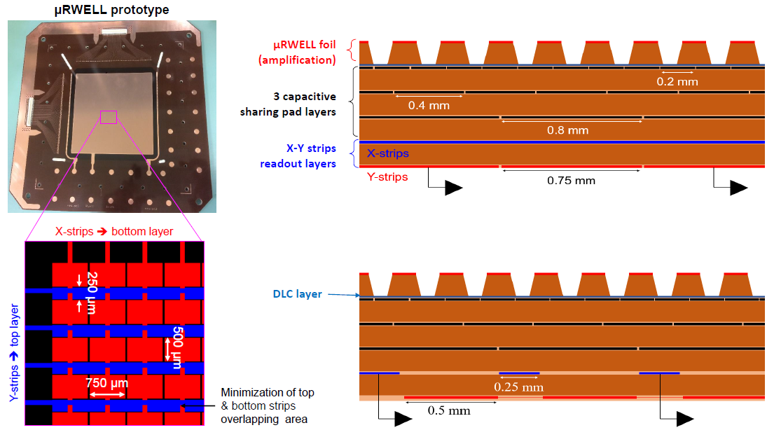
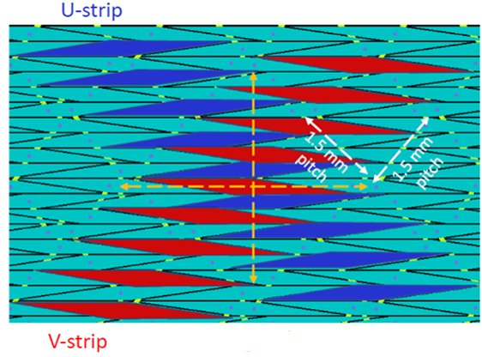
R&D on thin-gap MPGDs – (EIC FY22 Generic R&D)
3 thin-gap hybrid GEM-µRWELL prototypes already successfully tested in beam
Proto #1, (#2): 1-mm, (0.5-mm) drift) / 1-mm induction with capacitive-sharing X-Y strip readout
Proto #3: 1-mm drift / 0.5-mm induction with 2D zigzag strip readout
Preliminary results:
Good efficiency in Ar/CO2 ➔ 85% for 1-mm drift prototypes and ~ 75% for 0.5-mm drift
Good S/N was easily achievable ➔good spatial resolution performance expected
Test in beam at CERN in a couple of weeks
Impact of B-field (1.5 T) on spatial resolution performance
This R&D effort need to be supported in a sustained way for the next couple of years for the technology to be ready for ePIC
Are there any remaining R&Ds? Yes
hybrid amplification with 1 mm drift gap
1 mm
GEM
1 mm
µRWELL
Two configurations for amplification
µRWELL with capacitive-sharing strip readout
2D zigzag strip readout

Slide 18
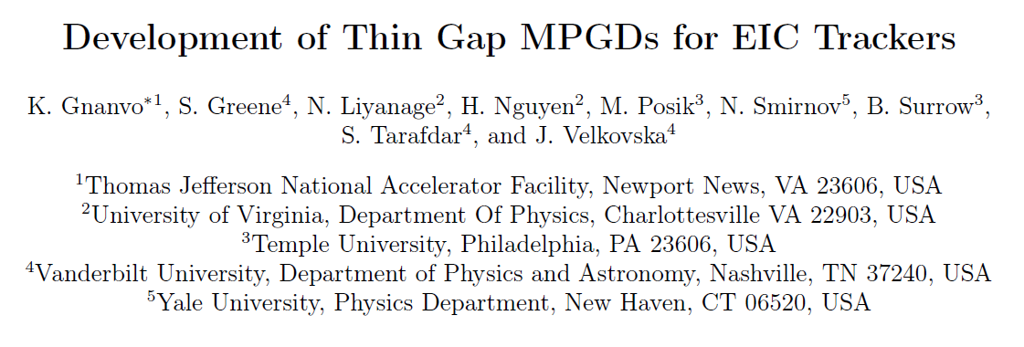
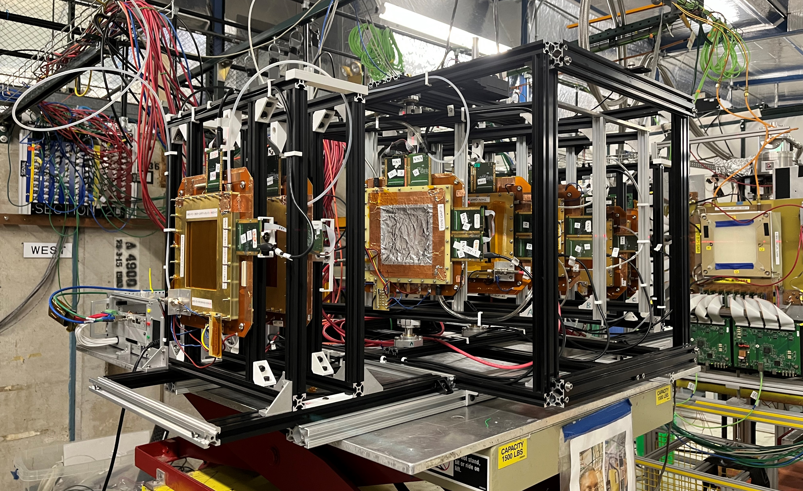
R&D on thin-gap MPGDs – (EIC FY22 Generic R&D)
Are there any remaining R&Ds? Yes
https://www.jlab.org/sites/default/files/eic_rd_prgm/files/2022_Proposals/20220725_eRD_tgMPGD_Proposal_final_EICGENRandD2022_23.pdf
Fermilab beam test (June 07 – 13, 2023)
10 Thin Gap MPGD prototypes tested
All three technologies: µRWELL, Micromegas, GEMs
Single amplification vs. hybrid amplification
Capacitive-sharing R/O vs. zigzag structures
CERN beam test (August 30 – September 06, 2023)
Test in B field at CERN for E × B measurement :
B-Field up to 1.5 T
SRS crate
Rotation stand with prototypes under test
Upstream tracker
Test beam team:
Jefferson Lab: Kondo Gnanvo, Seung Joon Lee
Temple U: Jae Nam
Vanderbilt U: Sourav Tarafdar
UVa: Huong Nguyen, Minh Dao, Xinzhan Bai
Yale U: Nikolai Smirnov

Slide 19
R&D needs for ePIC µRWELL trackers
Any issue with the foreseen ASIC FEE SALSA? ➔ NO
SALSA electronics will be used for both CyMBaL and all ePIC µRWELL Trackers
The readout electronics is being developed jointly by Saclay and San Paolo groups
Don’t anticipate any significant difference in the implementation system used by all ePIC MPGD trackers
Details like numbers of chips / FEB or needs for long micro-coax flat cables etc … will be decided based on specific needs and constraints of each sub tracker system i.e. Outer barrel will likely used long micro-coax flat cables, CyMBaL likely not
We had a very productive meeting with DAQ colleagues on Friday 11th to discuss ePIC MPGD readout and DAQs
Indico link: https://indico.bnl.gov/event/20280/
Also see Marco talk on SALSA for MPGDs
We don’t see any issue on this area
Need to clarify the space availability for ePIC MPGD trackers cables and services in the forward backward of the detector
Looks like very tight space that will make it difficult to integrate all the cables and FEB boards
First naïve assumption on next slides assume FEB board ➔ red boxes are place holders for that
If not, we wll have to rethink a number of assumption in term of volume and material thickness to have FEB on the back of the chambers

Slide 20
Summary
 | Barrel Outer µRWELL Tracker | HE µRWELL tracker | HE µRWELL tracker
Technology | Double Thin Gap Hybrid µRWELL | Double Thin Gap Hybrid µRWELL | Double Thin Gap Hybrid µRWELL
2D R/O | 2D Capacitive-sharing diagonal X-Y strips | 2D Capacitive-sharing diagonal r-phi or U-V strips | 2D Capacitive-sharing diagonal R-PHI or U-V strips
Spatial resolution | 150 µm for 0 – 45º tracks in 2T | 150 µm for 0 – 45º tracks in 2T | 150 µm for 0 – 45º tracks in 2T
Timing resolution | ~10 ns | ~10 ns | ~10 ns
Efficiency | 98% single hit 70% double hit | 98% single hit 70% double hit | 98% single hit 70% double hit
Material budget | 1 – 2 % X_{o}/X | 1 – 2 % X_{o}/X | 1 – 2 % X_{o}/X

Slide 21
ePIC µRWELL Tracker
 | Barrel Outer µRWELL tracker | Hadron end cap µRWELL disc | Electron end cap µRWELL disc | Total
Number of modules | 24 | 4 | 4
R/O channels (pitch 1.2 mm) | 140k (24 × 6000) | 16k (4 × 4000) | 16k (4 × 4000) | 172k
Number of FEBs (8 SALSA / FEB) | 288 (24 × 12) | 32 (4 × 8) | 32 (4 × 8) | 352
Micro-coax flex 128-pins flat cables (> 2.5 m) | 1104 (24 × 46) | 128 | 128 | 1360
LV lines | 288 (24 × 12) | 32 (4 × 8) | 32 (4 × 8) | 352
Firefly per FEB to RDO (12-pairs cables) | 288 (24 × 12) | 32 (4 × 8) | 32 (4 × 8) | 352
Gas lines (inlet and outlets) | 48 (24 × 2) | 8 | 8 | 64
HV (distribution through resistive divider) | 24 | 4 | 4 | 64

Slide 22
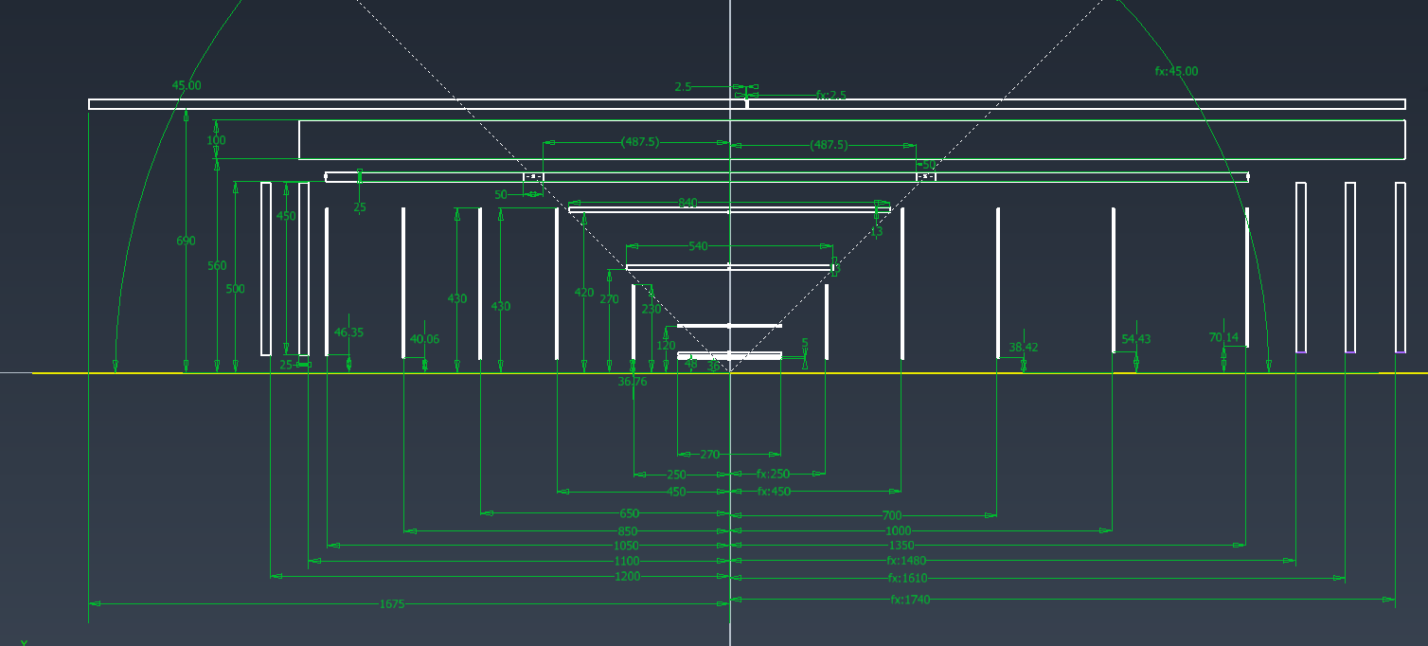
ePIC MPGD cables & services routing
Assuming some place reserved for MPGD services
Red: Outer MPGD barrel
Blue: Inner MPGD barrel
Yellow: HE and EE end cap discs

Slide 23
Technology of choice for ePIC µRWELL trackers:
Thin-Gap Hybrid GEM-µRWELL
Default configuration will have:
GEM for pre-amplification and µRWELL amplification
1-mm drift gap (cathode to GEM) and 1-mm induction gap (GEM to uRWELL/RO PCB)
0.5 mm gap will also be explored
Double-sided amplification structures.
2D capacitive-sharing strips
Large area capability:
Length of barrel outer module ➔ up to 180 cm
Radius of end cap disc module ➔ ~50 cm
➔ minimize dead area and material thickness
Same technology for the barrel outer layer and EE and HE discs
Only shape and strip arrangement will be different
1 mm
1 mm
5 mm honeycomb
1 mm
1 mm

