Slide 1
Zero-Field Cosmic Display for sPHENIX Tracker with TPC
Thomas Marshall for the Tracking Detector Groups
August 30, 2023

Slide 2
Overview
TPC 100 frame cosmics display
Updates to TPC hit mapping
First cosmic event display with full sPHENIX tracking system: MVTX + INTT + TPC + TPOT
Run 25926: cosmic run without B field on 08/23/2023
Analysis Note

Slide 3
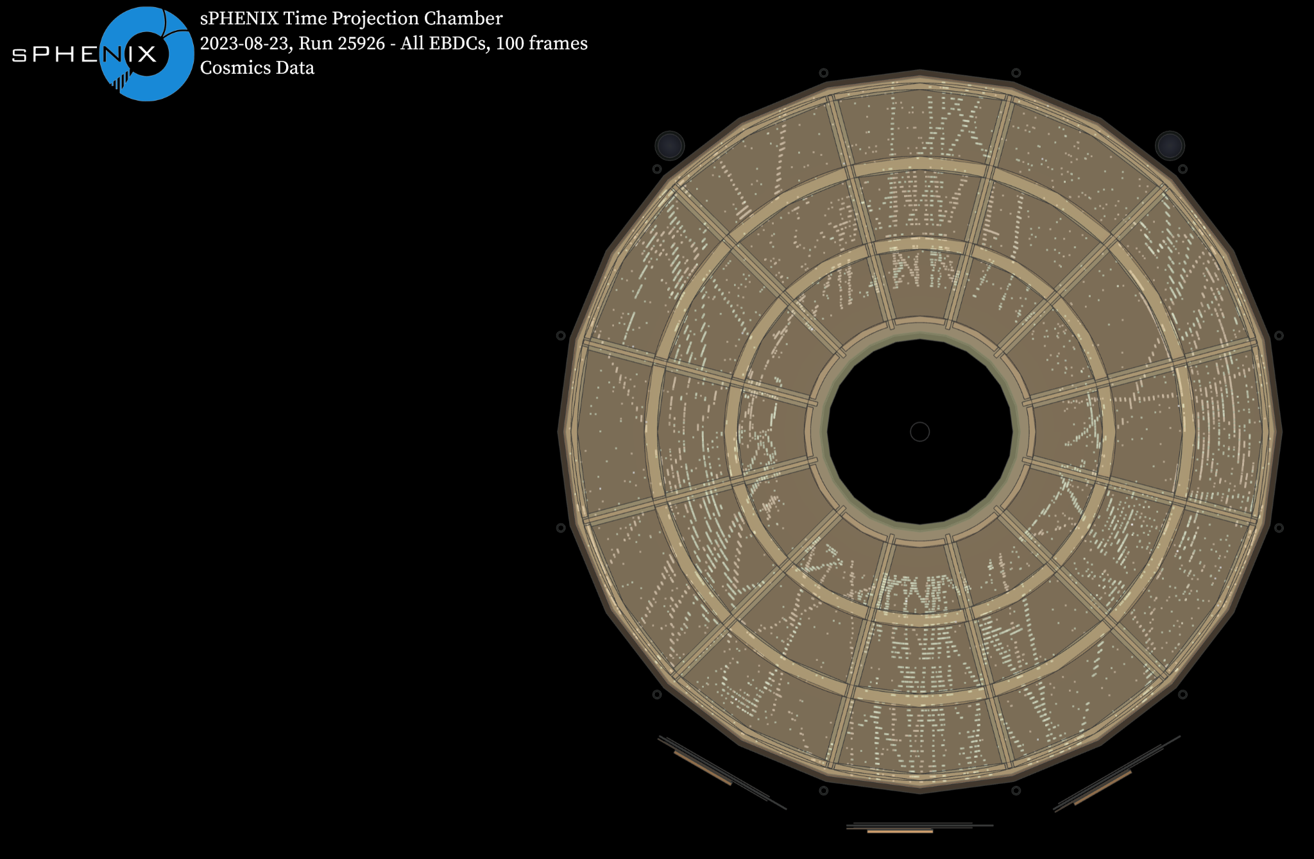
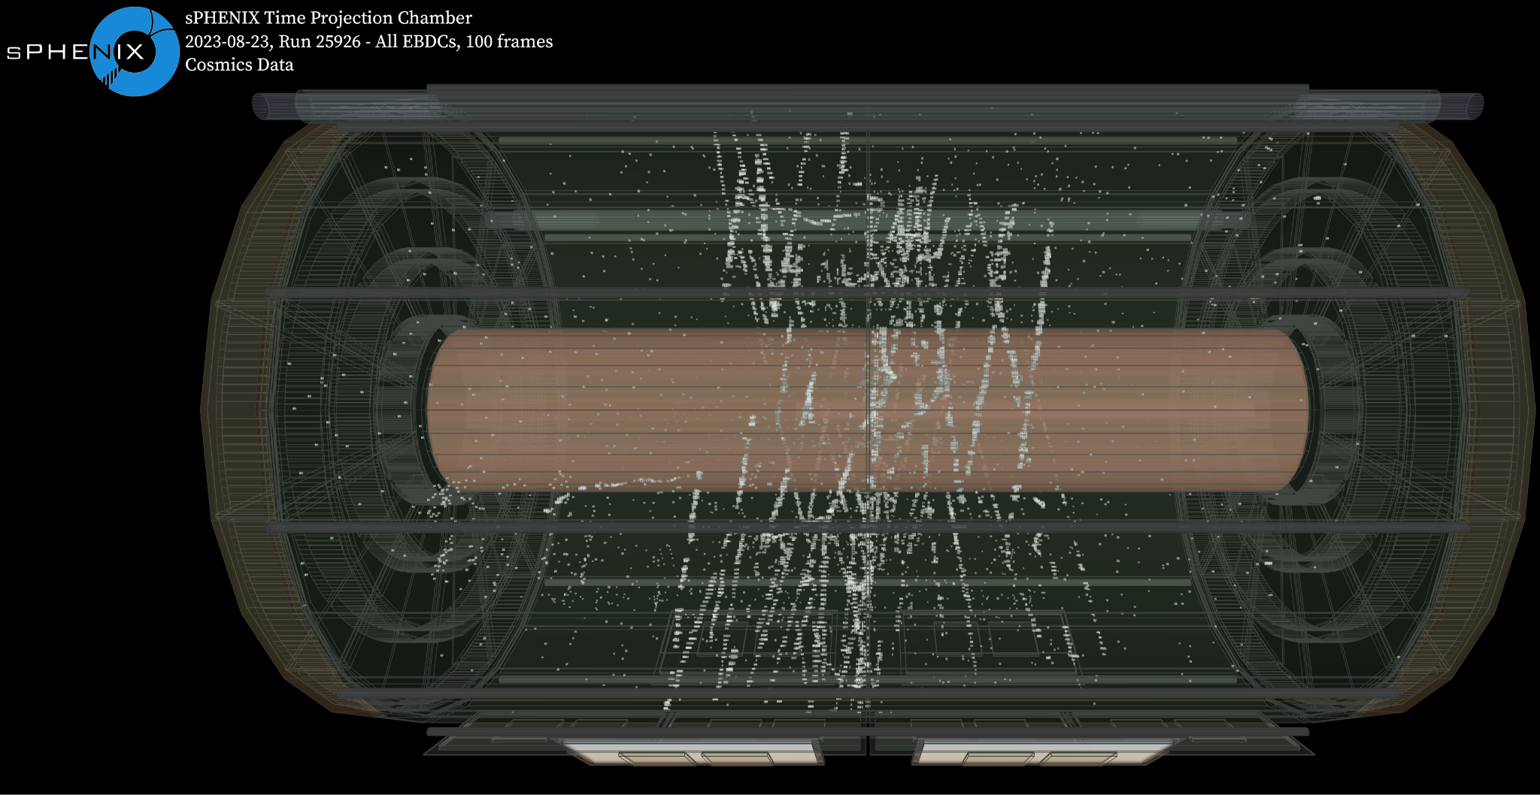
TPC 100 Frame Cosmics Check

Slide 4
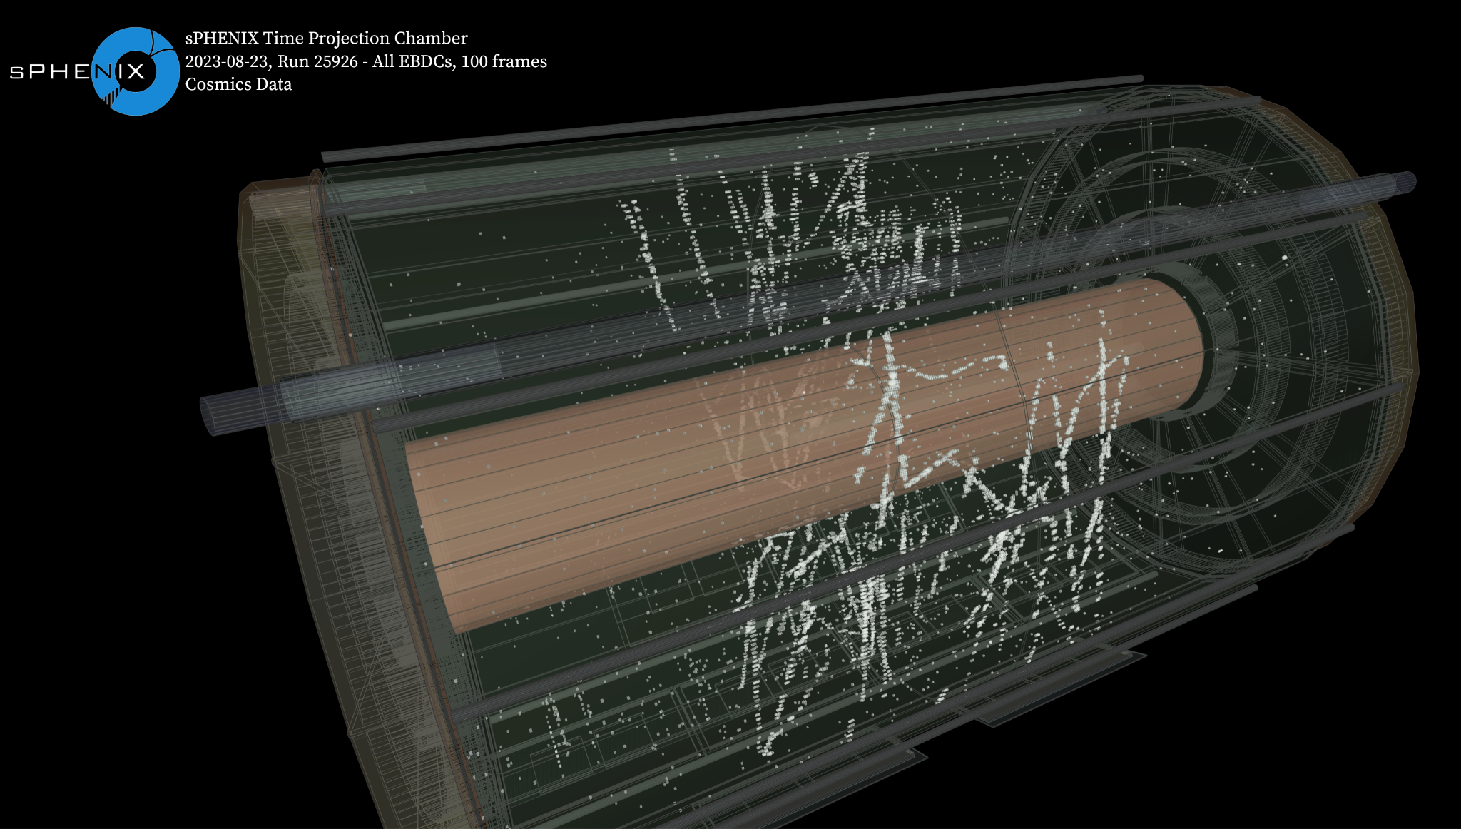
TPC 100 Frame Cosmics Check
First triggered cosmic data in the TPC
Allows us to check large-scale TPC channel mapping
Fixed an azimuthal mapping issue when displaying hits from one endcap vs the other
Fixed the local FEE mapping for each sector
Notes:
Cross-sector cosmic rays were used to align the sign of the azimuth channel order

Slide 5
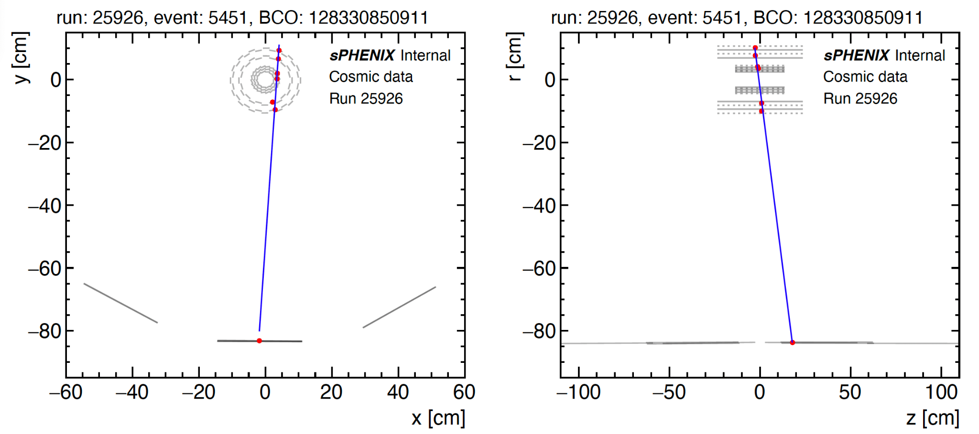
MVTX + INTT + TPOT 2-dimensional display
Straight line fit to the center of the MVTX, INTT, and TPOT clusters
Clear cosmic track
Help study TPC distortion and alignment among tracking subsystems

Slide 6
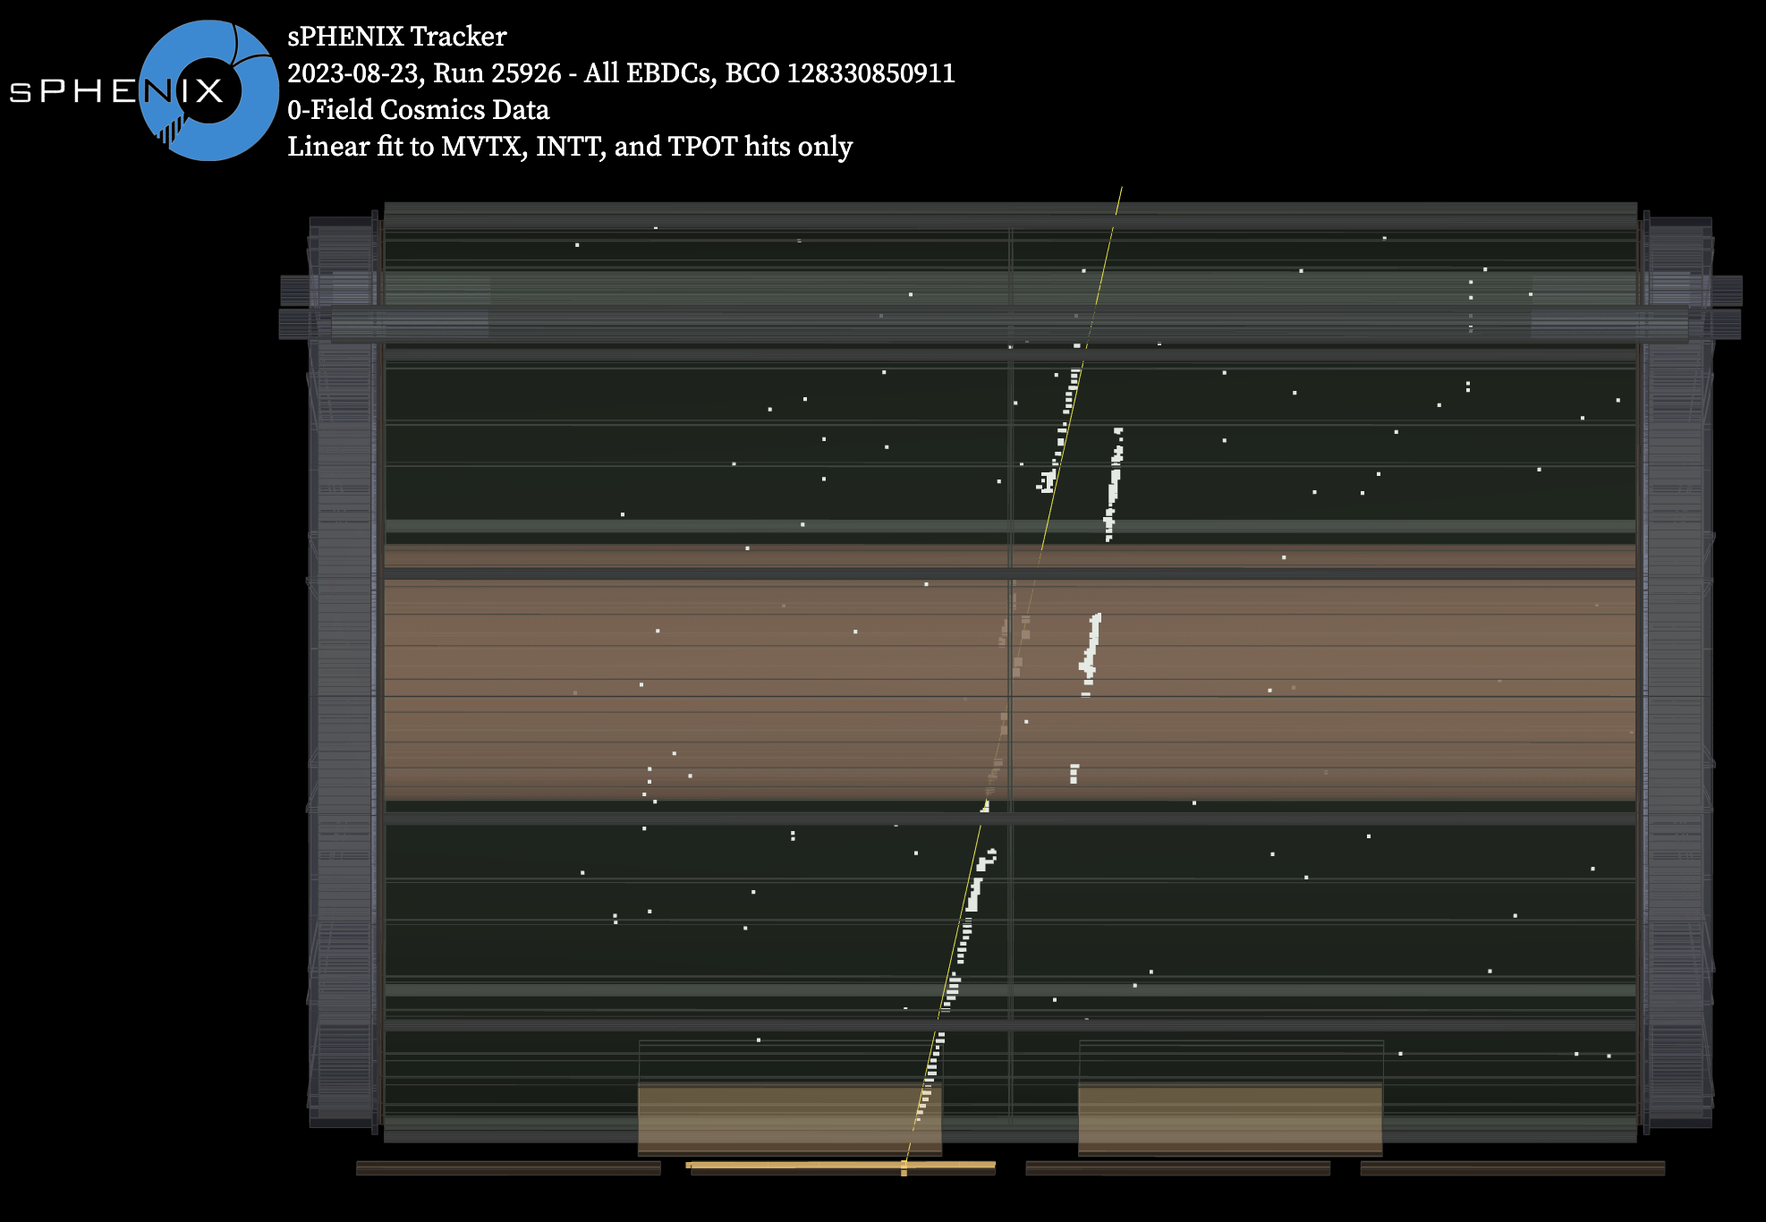
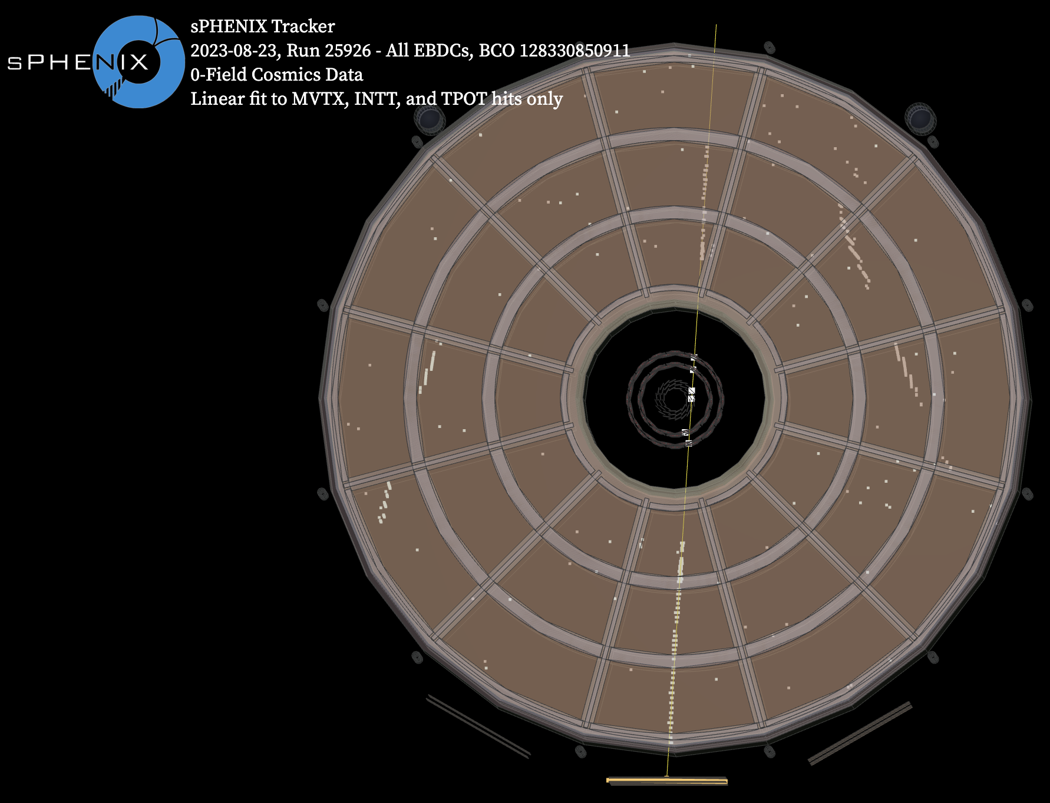
sPHENIX Tracker Cosmic Event with TPC

Slide 7
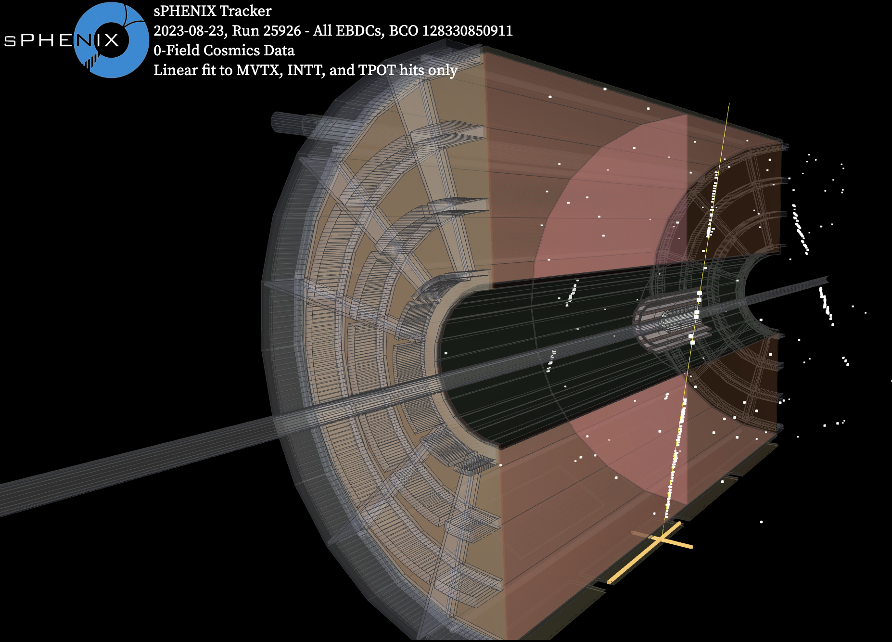
sPHENIX Tracker Cosmic Event with TPC
Hits from a single BCO value (128330850911) in each tracking detector (MVTX,INTT,TPC, and TPOT)
Subsystem hit criteria on following slides

Slide 8
MVTX, INTT, TPOT Hit Cuts and Mapping
More details in the note
Top and bottom oHCal trigger used
MVTX - streaming readout, hits clusterized, geometric center used as position, cut on clusters with at least 2 pixels, 3 clusters total required for a BCO to be labeled an event
INTT - triggered readout, clustering performed column-by-column, cluster position given by (ΣE*pos)/(ΣE), E = energy deposit quantified by 3 bit chip, known hot spots masked, clusters with size > 4 removed, 2 clusters in inner and outer layer needed
TPOT - required at least one cluster in one of the 16 TPOT modules

Slide 9
TPC Hit Cuts and Mapping
Only considering waveforms within the 2 TPC frame window in each sector that matches the nominal BCO value listed
2 frames = 1 full drift time in the TPC
Channel pedestal mean and sigma calculated using first 10 data points in all waveforms for a given channel
Only looking at channels with 20 ADC < mean < 200 ADC and no checksum errors
A hit is any sample with an ADC at least 5 sigma and at least 10 ADC above the channel mean
Removing channels with over 50 cuts to get rid of noisy streaks
Innermost 10 cm of TPC is field shaping region, not meant to show hits

Slide 10
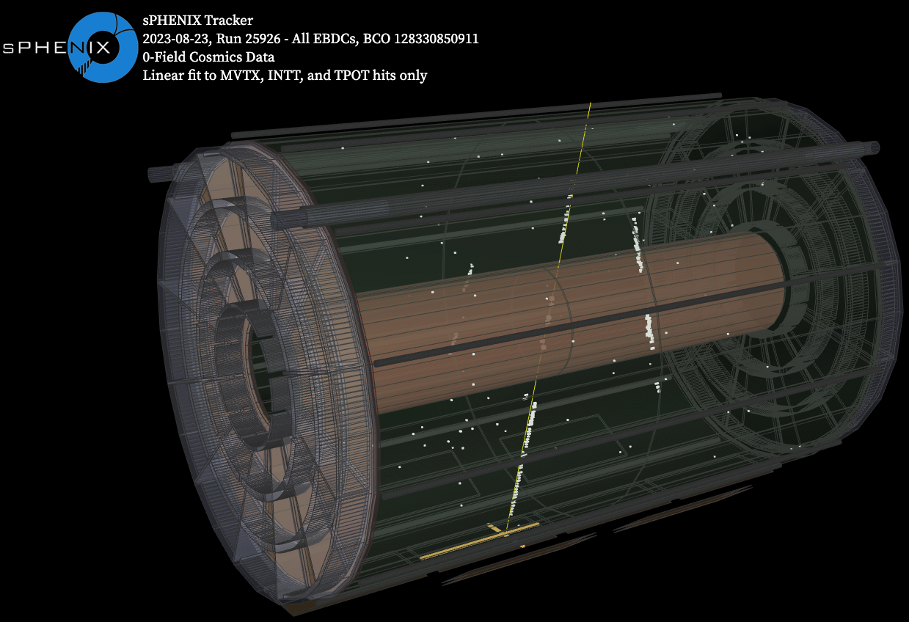
sPHENIX Tracker Cosmic Event with TPC Fit
Linear fit of the hits from the same display

Slide 11
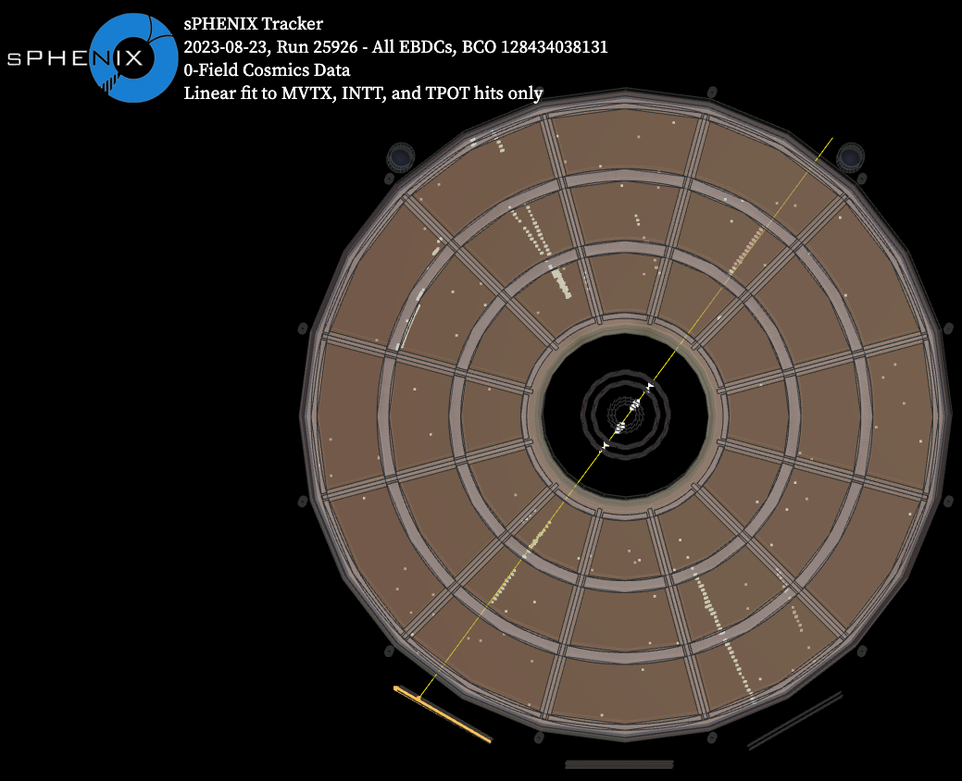
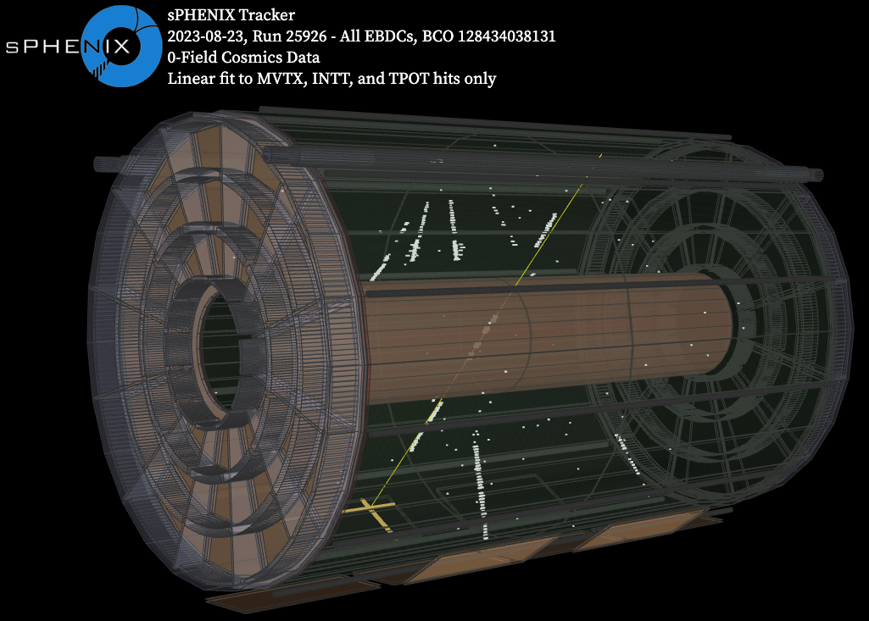
sPHENIX Tracker Cosmic Event with TPC

Slide 12
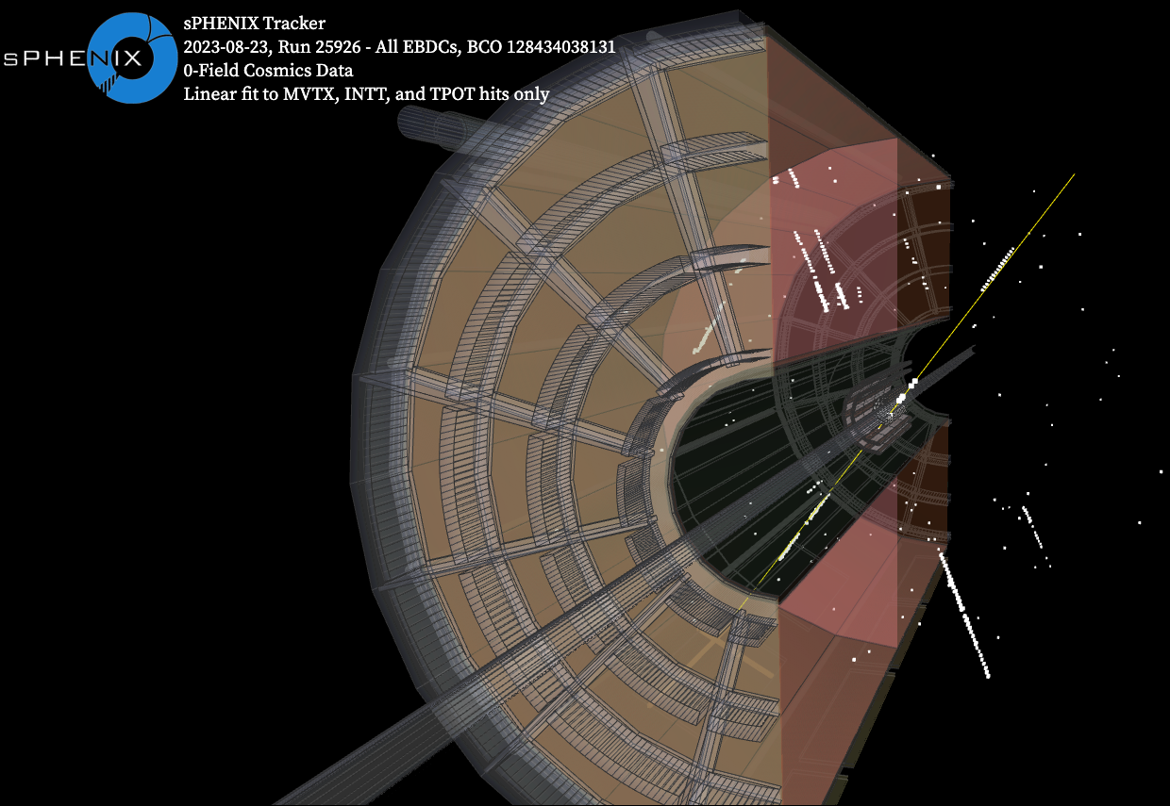
sPHENIX Tracker Cosmic Event with TPC
All hits from a single BCO value (128434038131) in each tracking detector (MVTX,INTT,TPC, and TPOT)
Same cuts and mapping as mentioned previously
Track unfortunately passed through 3 no-gain GEM modules

Slide 13
TPC Au+Au Event Displays (previously approved, new channel mapping)

Slide 14
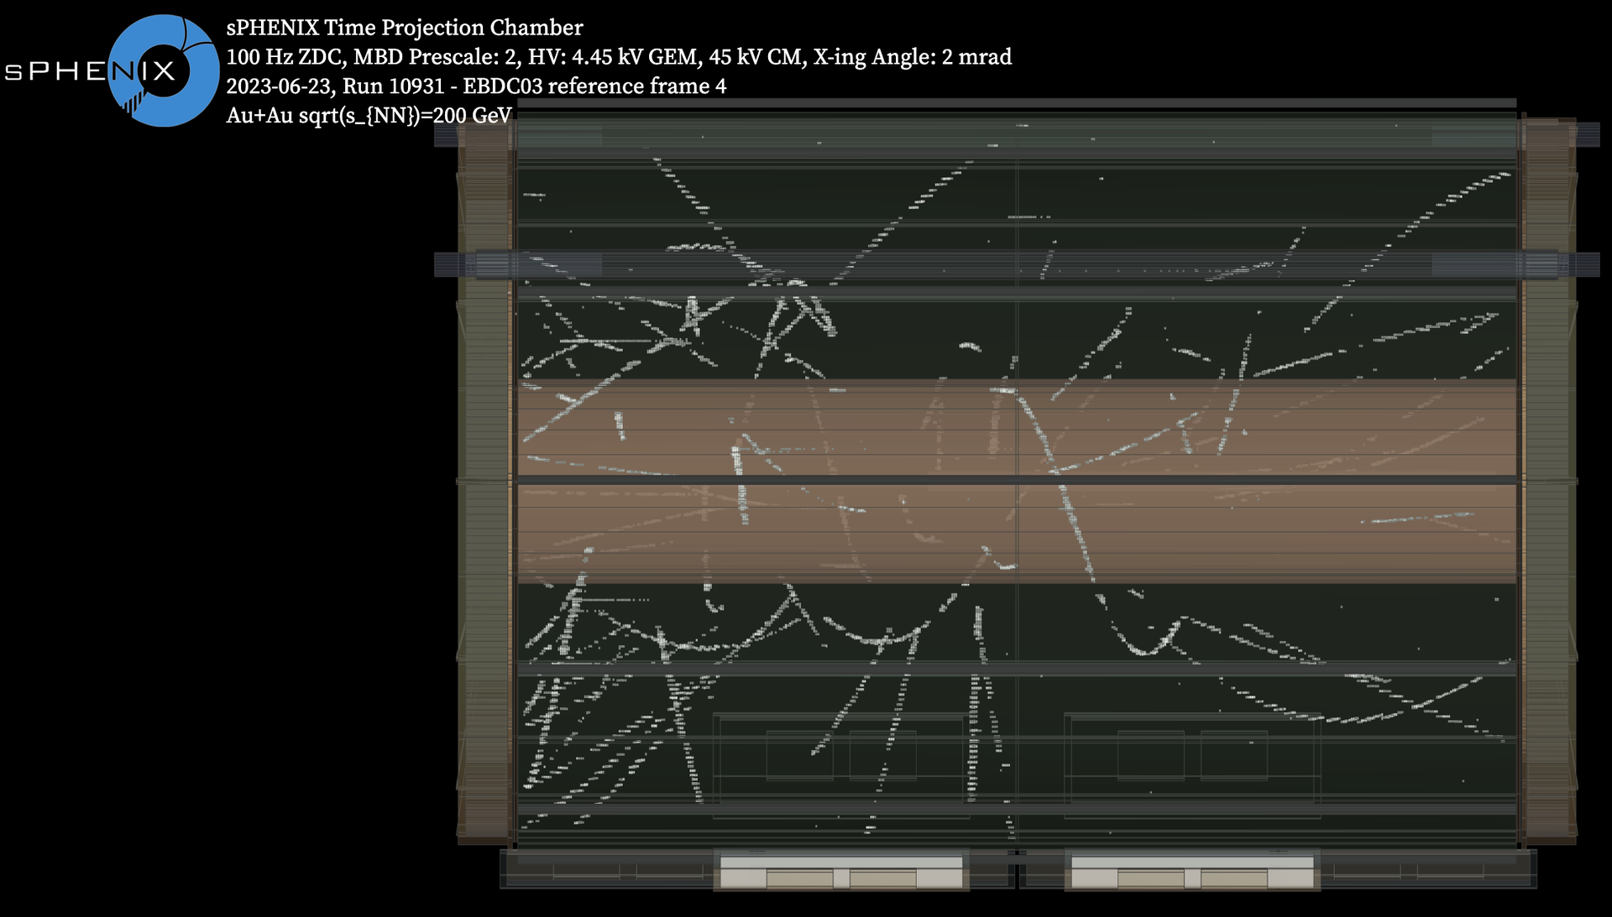
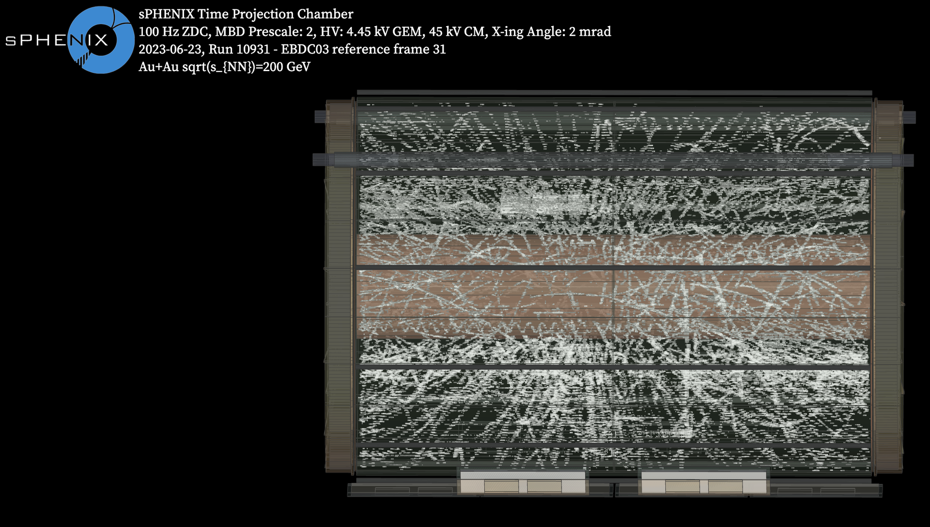
TPC Au+Au Event Displays (previously approved, new channel mapping)

Slide 15
Summary of Figures Needing Approval
100 frame TPC cosmics display for first triggered TPC cosmics data
BCO 12833085091 cosmics tracking display with all tracking subsystems and track fit
BCO 128434038131 cosmics tracking display with all tracking subsystems
Updated (previously approved) TPC Au+Au collision displays from run 10931 with updated correct channel mapping

