Slide 1
Pythia8 occupancy studies
Henry Klest

Slide 2
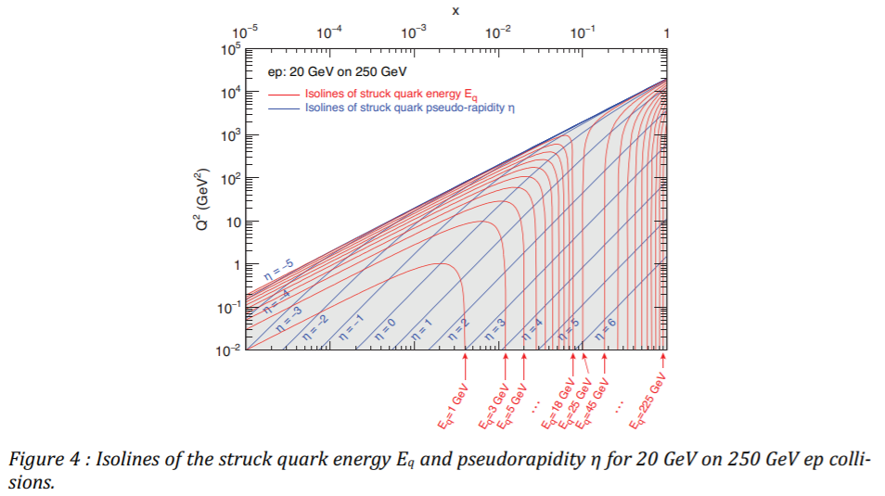
Goals & setup
Determine necessary SciFi resolution in Z
Most challenging for us will probably be jets at very high Q²
High multiplicity & likelihood to be in the barrel
Pythia 8.303 + Dire
Used in my HERA high Q² event shape analysis
Acceptable to first order, but fewer multi-jet events than in data
Non-radiative, lepton PDF off
Study Q² > 1000 GeV²
Cross section of ~280 pb
10M events simulated, corresponds to something like 35 fb⁻¹

Slide 3
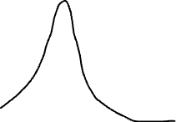
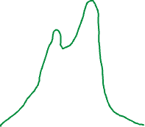
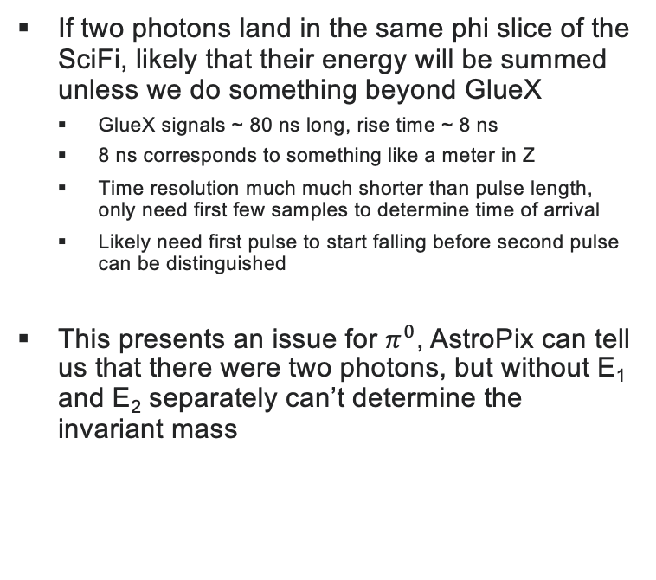
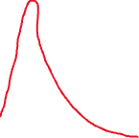
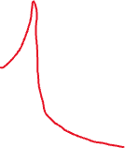
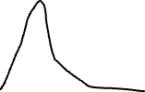
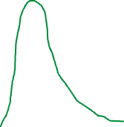
motivation
Pulse 1
Pulse 2
Summed Pulses
If two photons land in the same phi slice of the SciFi, likely that their energy will be summed unless we do something beyond GlueX
GlueX signals ~ 80 ns long, rise time ~ 8 ns
8 ns corresponds to something like a meter in Z
Time resolution much much shorter than pulse length, only need first few samples to determine time of arrival
Likely need first pulse to start falling before second pulse can be distinguished
This presents an issue for $π^{0}$, AstroPix can tell us that there were two photons, but without E₁ and E₂ separately can’t determine the invariant mass

Slide 4
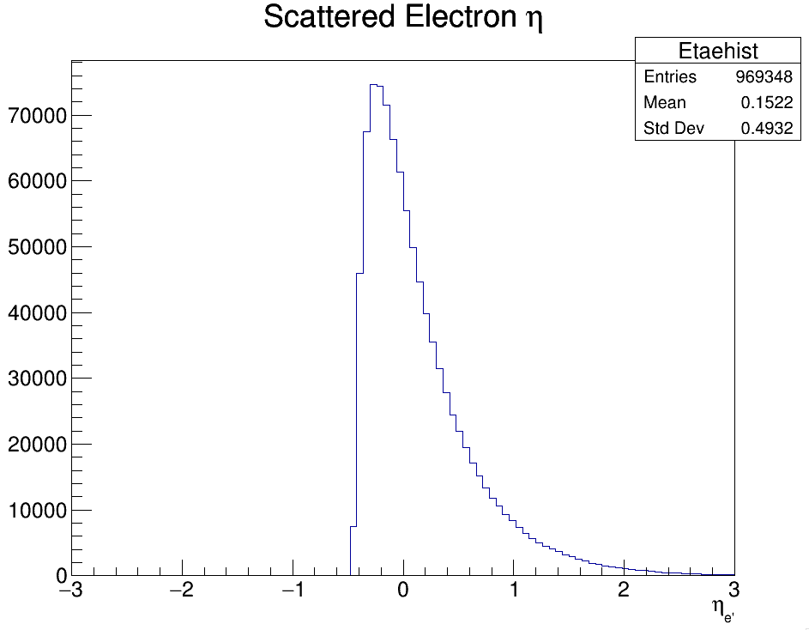
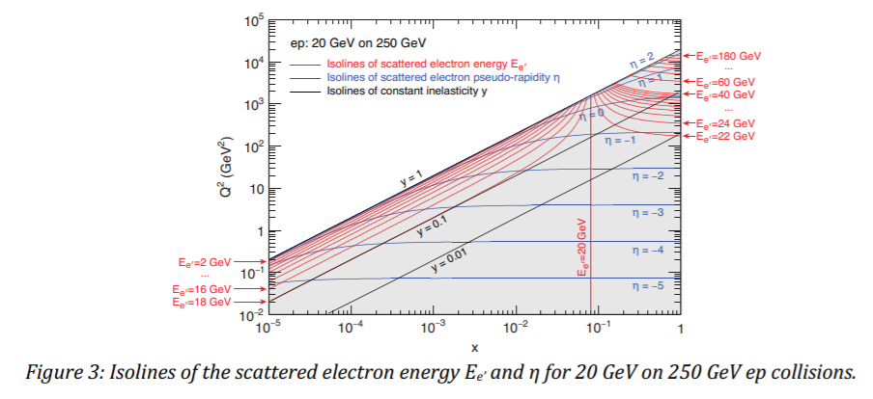
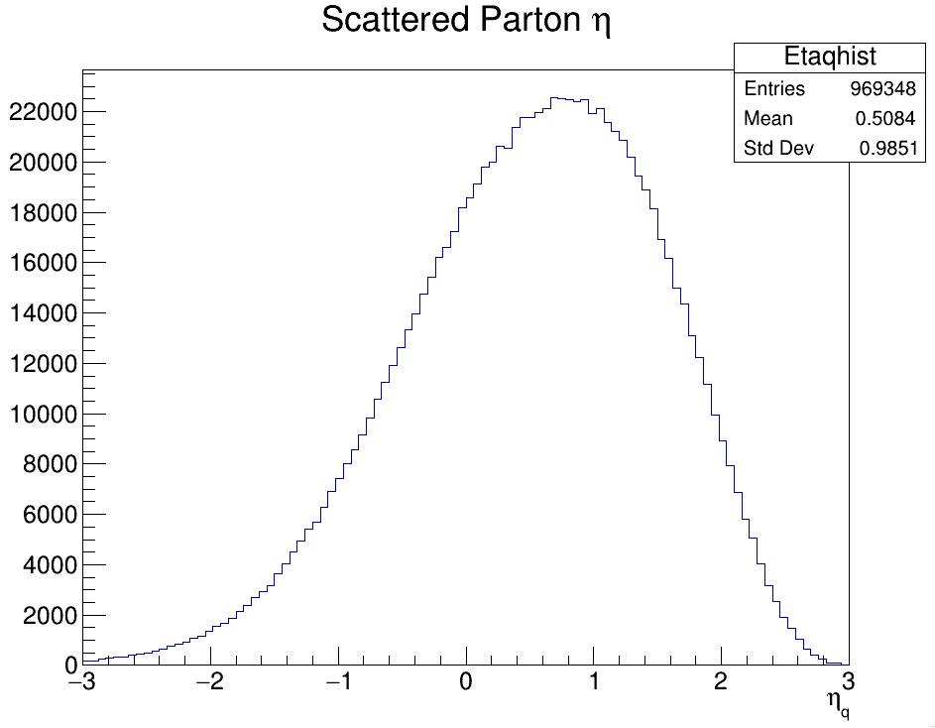
Kinematics

Slide 5
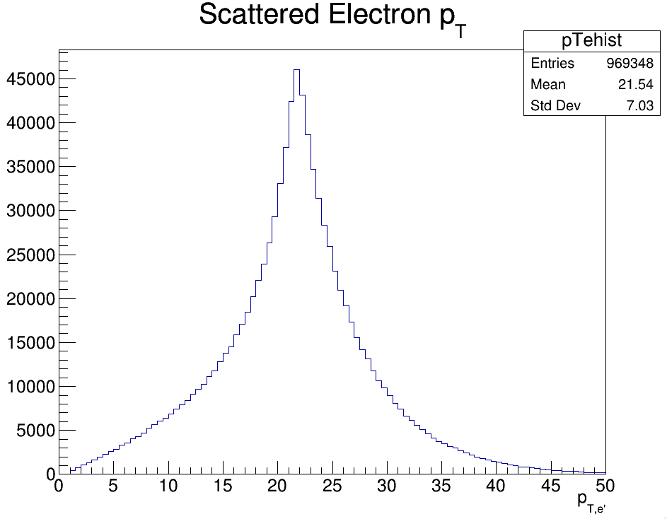
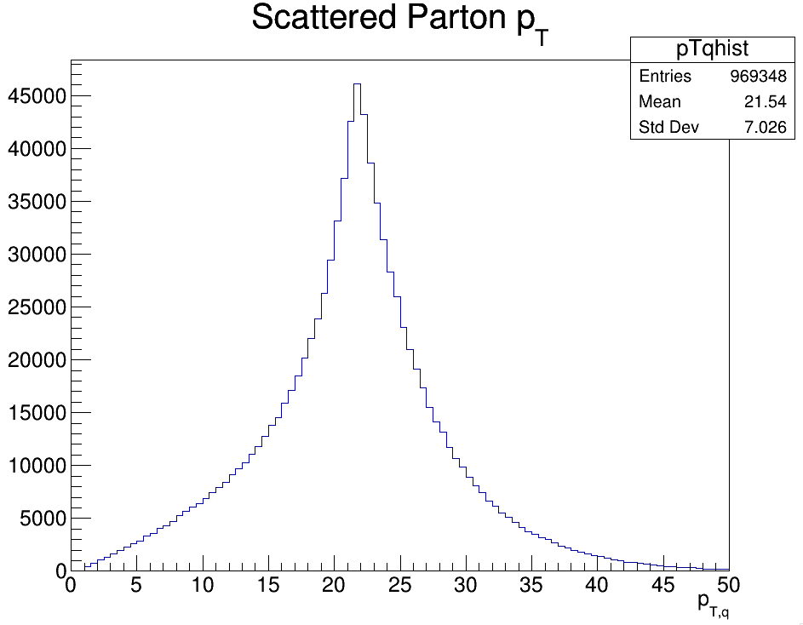
Kinematics

Slide 6
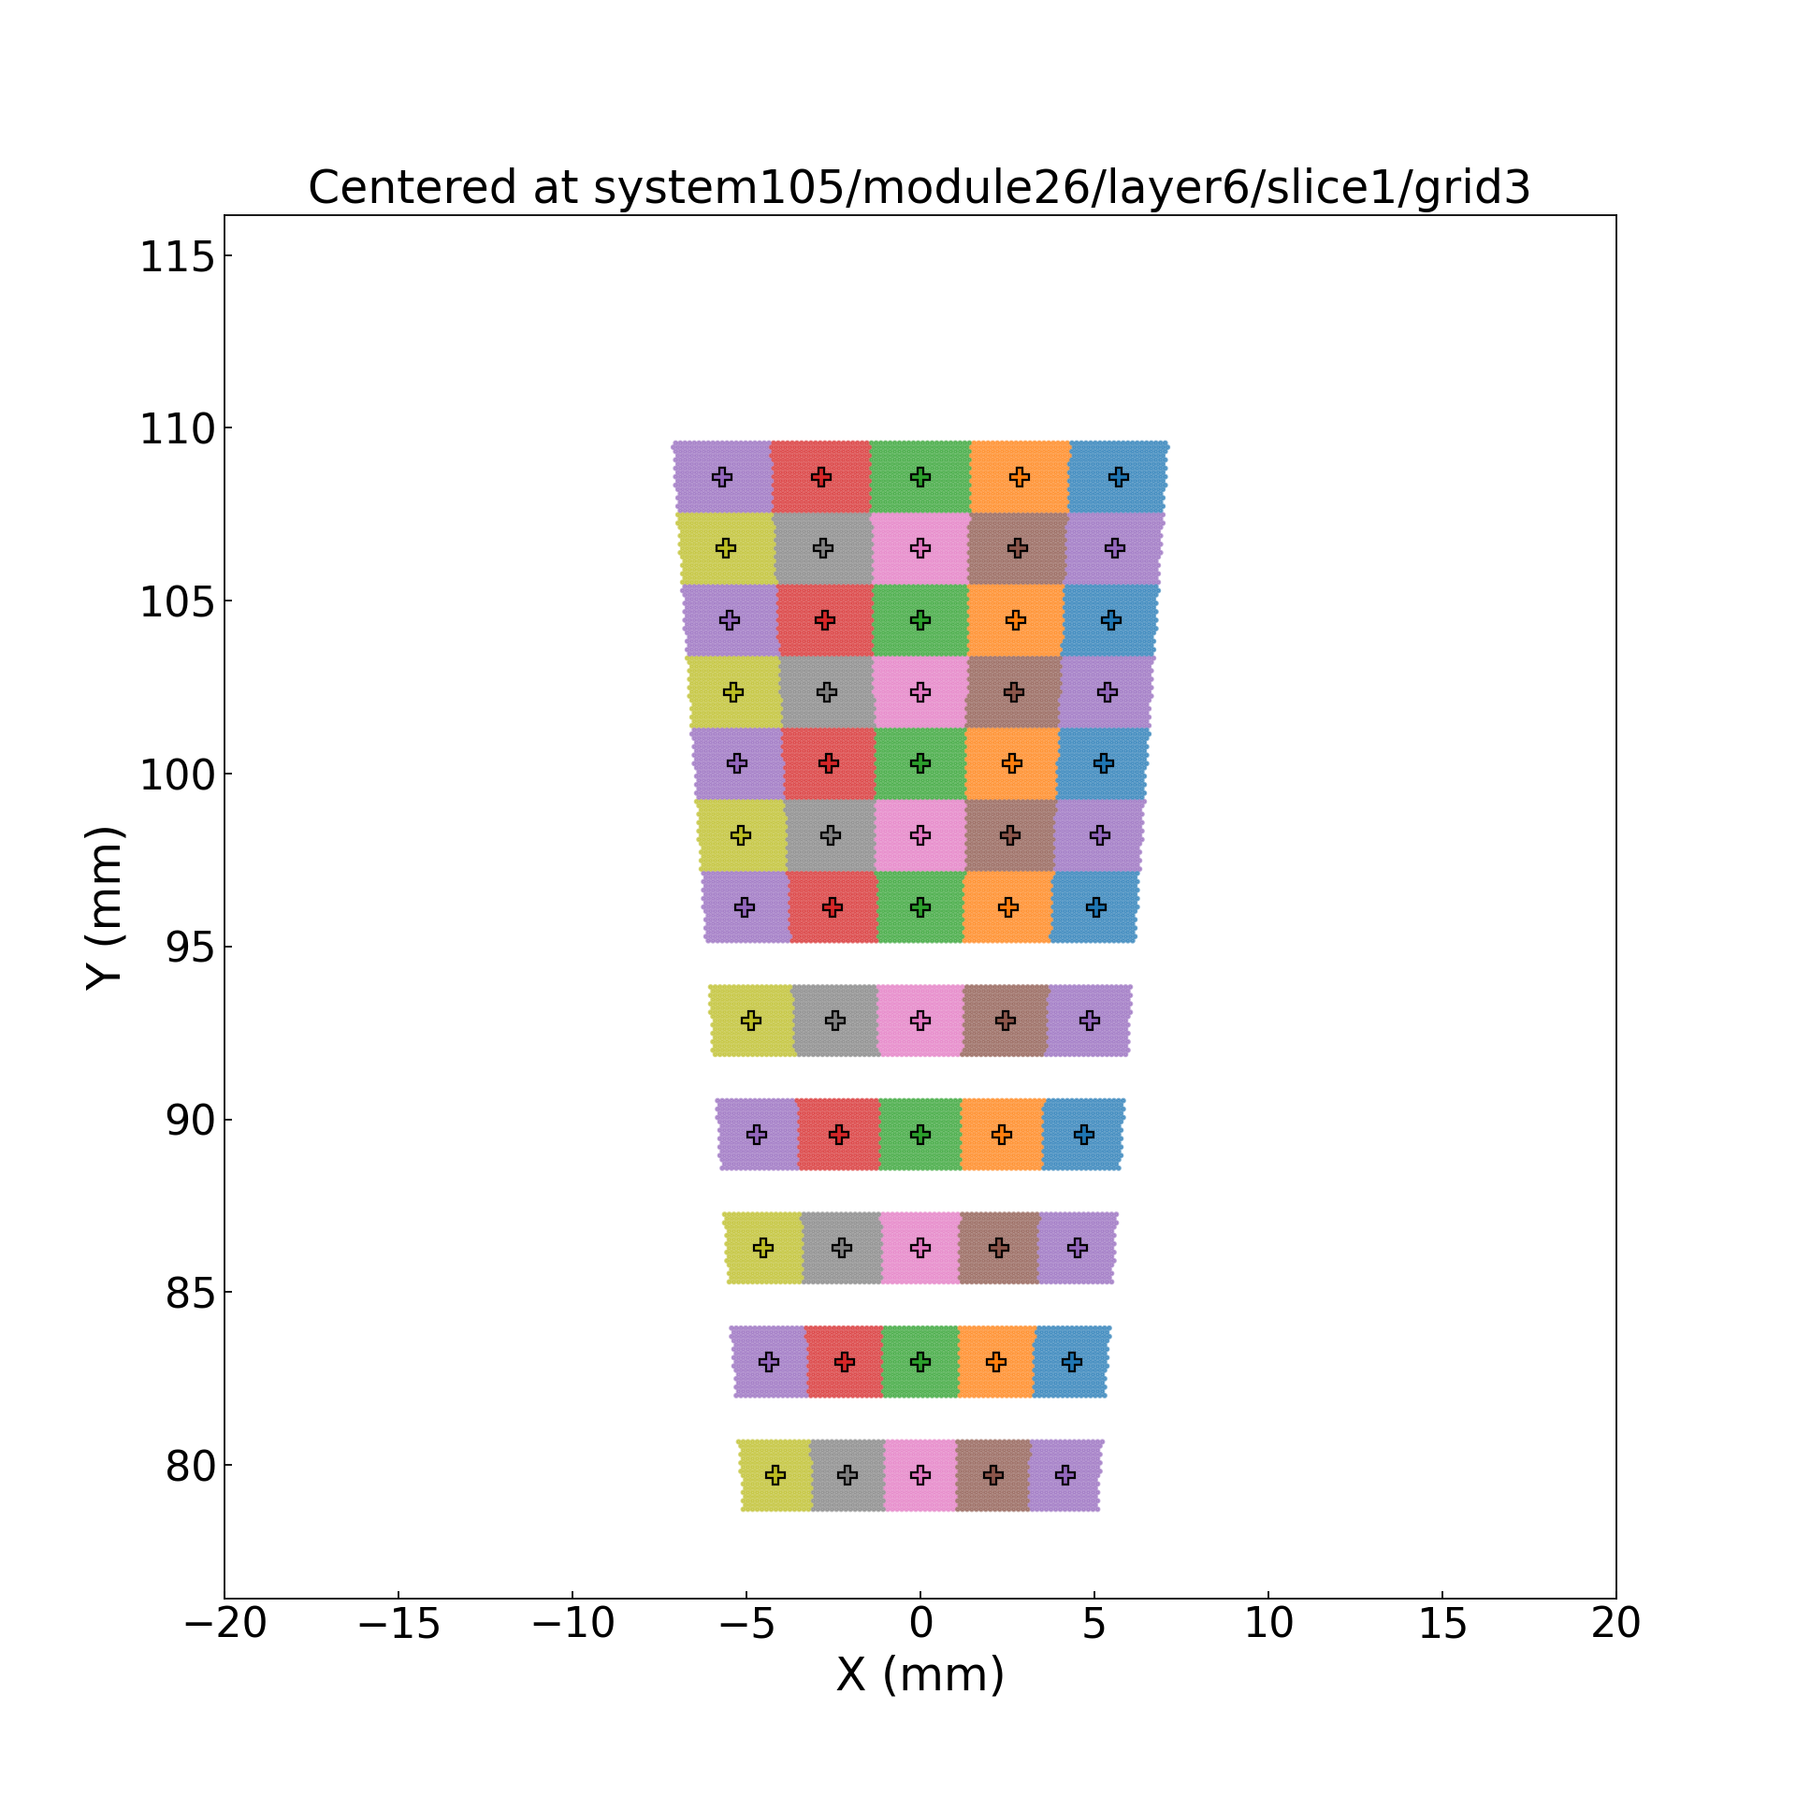
Simulation
For these high Q² events, how likely are we to have two photons in the same event registered by the same SiPM*
48 Modules, 5 SiPMs wide, each SiPM covers 1/240th of the azimuth
Assume for now that particles striking the same phi slice are integrated
Charged particles will have energy well measured by inner detectors, likely to deposit only MIP energy
Can subtract tracker energy from total measured in Ecal
Big worry is neutrals, especially photons
*If signals are too slow, could even have photons from different events overlapping

Slide 7
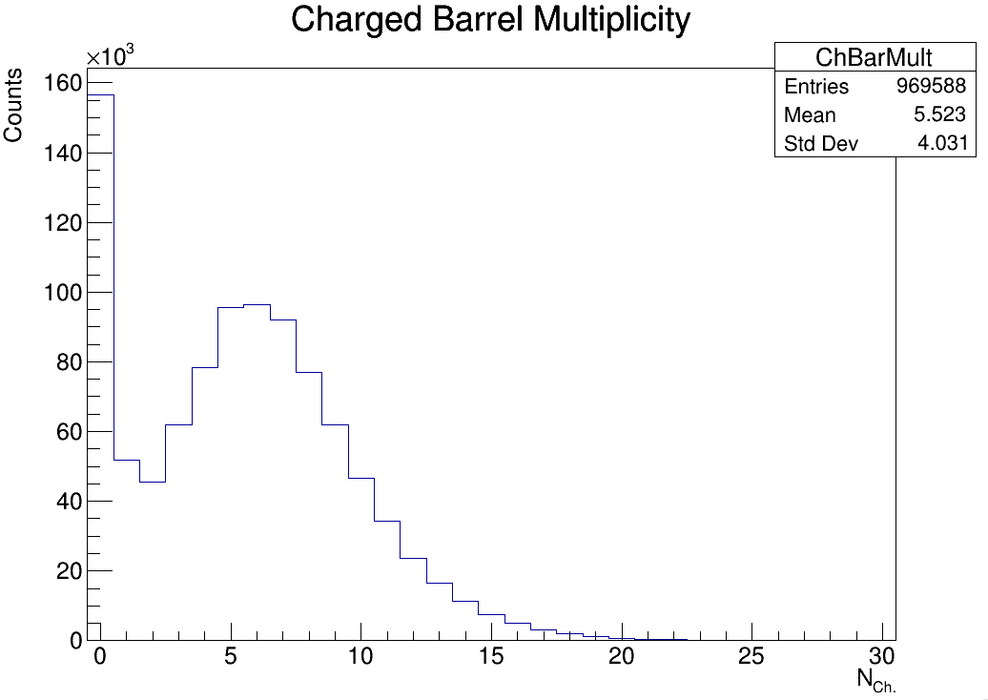
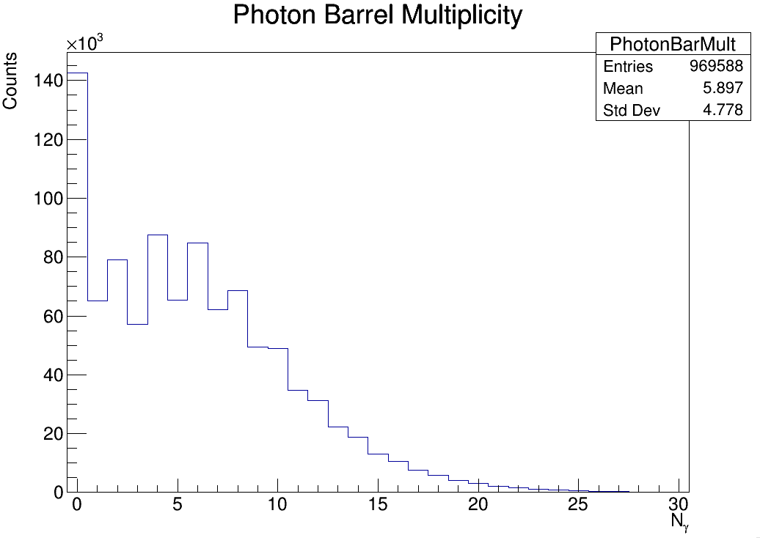
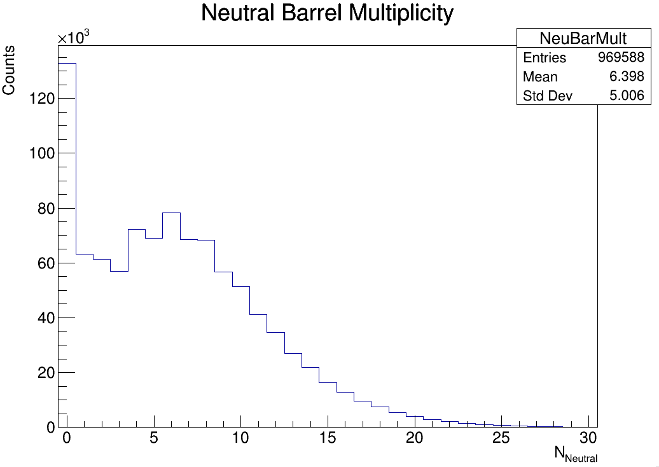
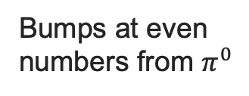
Multiplicities in Barrel
Bumps at even numbers from $π^{0}$
Peaks at 0 could be an artifact
Barrel defined as pseudorapidities between -1.7 and 1.3

Slide 8
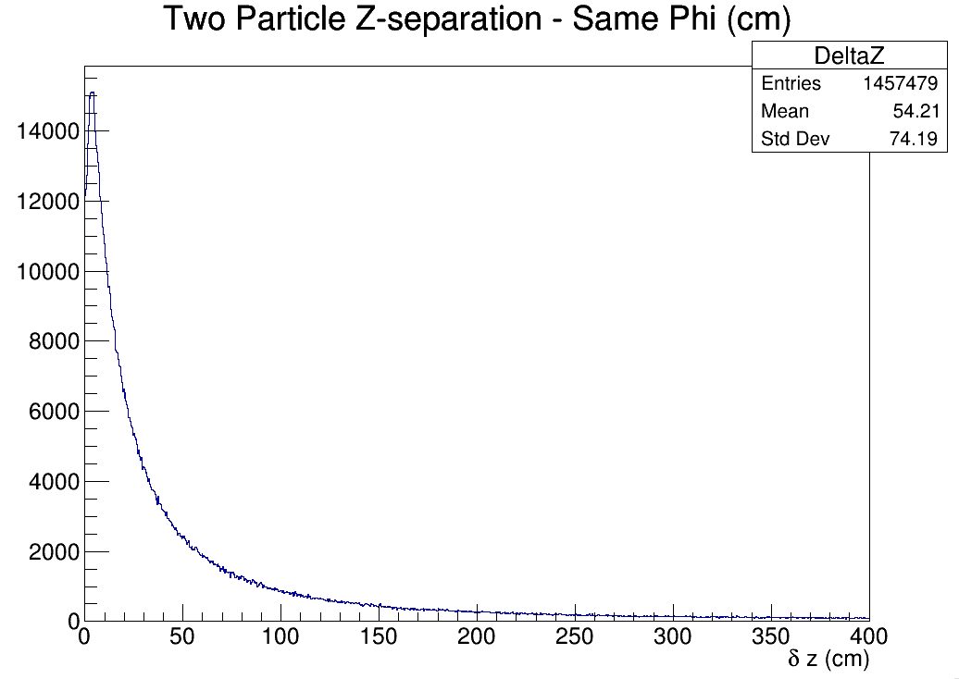
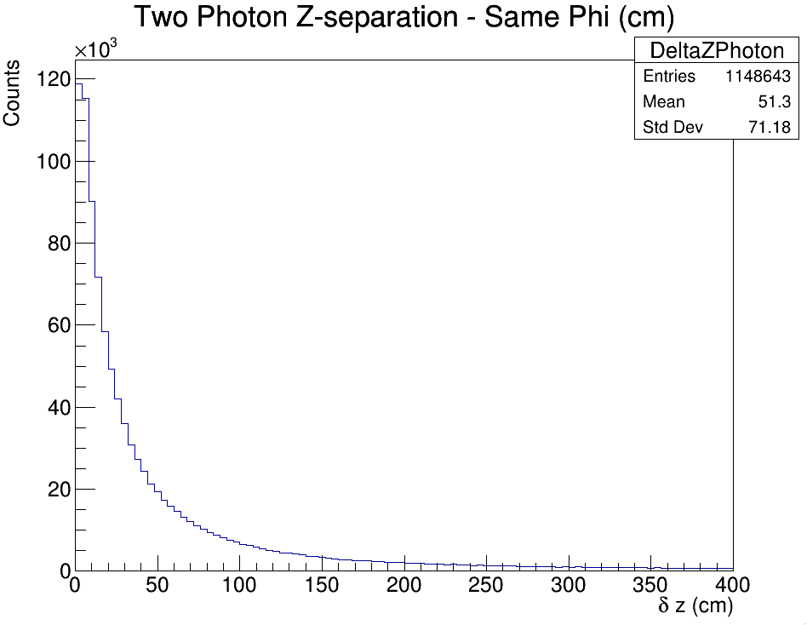
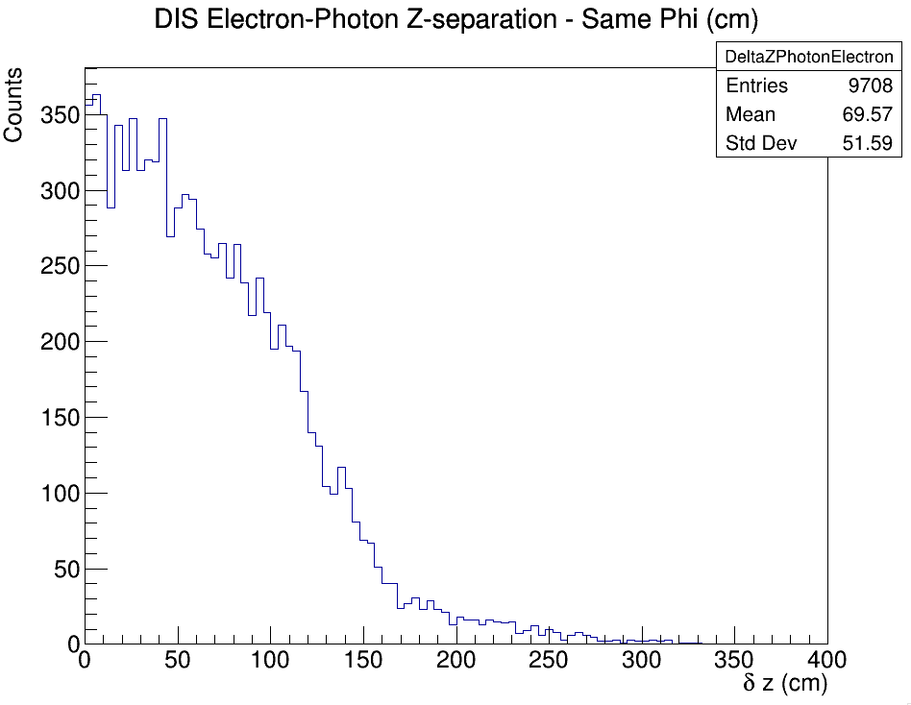
Particles in Same Phi Slice
Unfortunately, particles in the same phi slice tend to also be close in Z
Imagine a Gaussian jet in x,y space

Slide 9
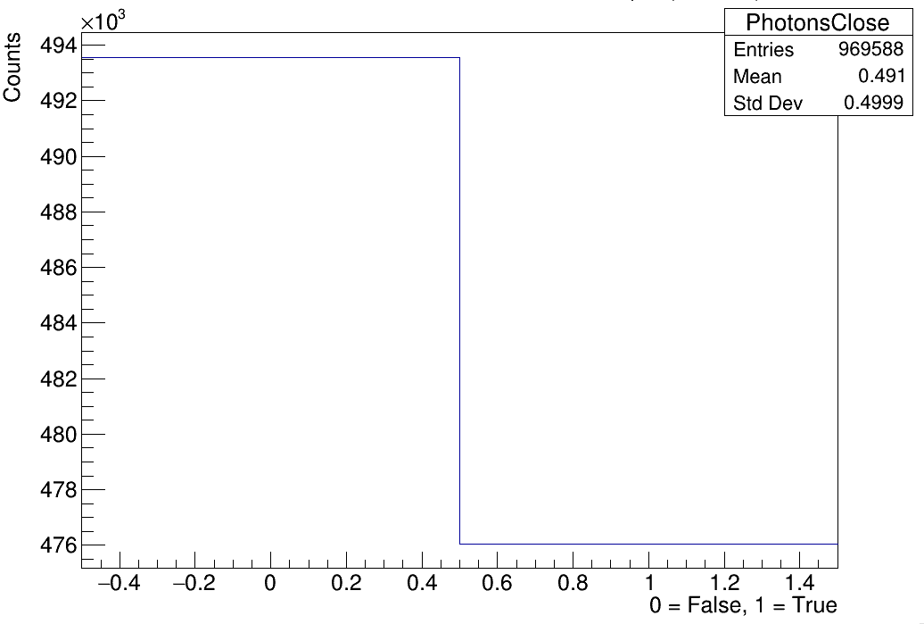
Likelihood that an event has two photons in the same phi slice
~50%

Slide 10
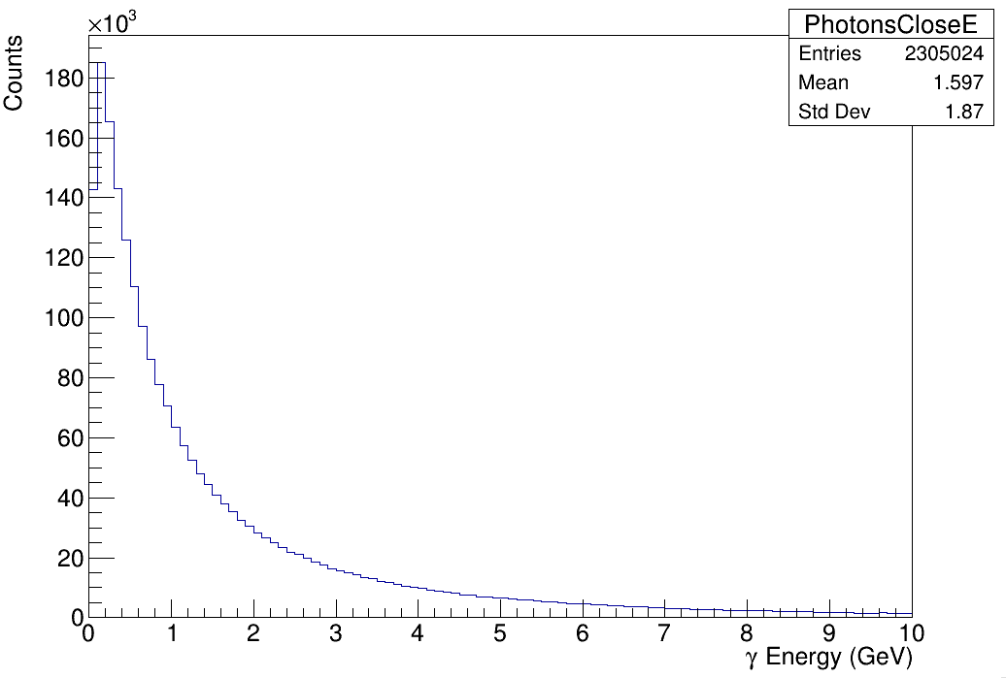
Energy of those two photons in the same phi slice

Slide 11
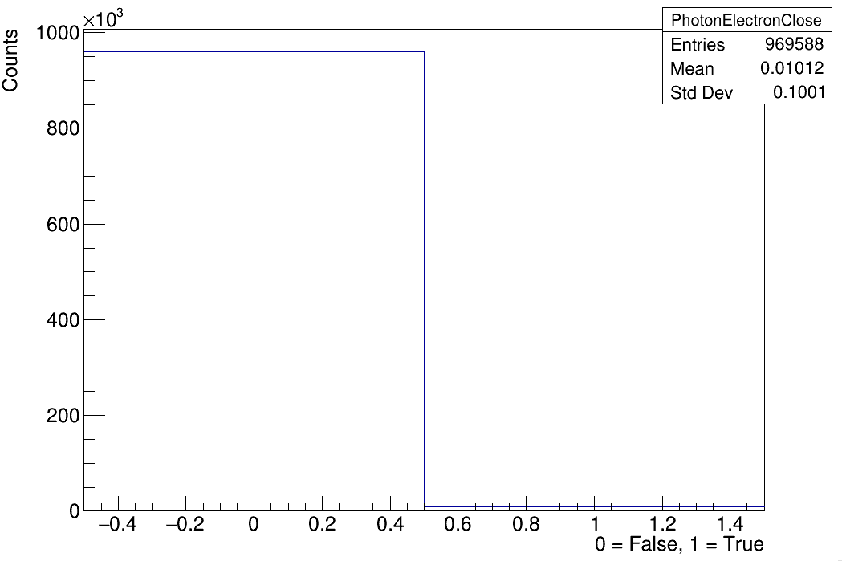
Likelihood that an event has a photon in the same phi slice as the DIS electron
1%

Slide 12
Conclusion
High Q² will be challenging on the SciFi
Considering here only impact position, no spreading of showers between SiPMs which will certainly happen, real case is likely worse
Would be nice if we could somehow distinguish two hits in the same phi slice
Faster SiPM? Faster scintillation? Higher refractive index fiber?
Which factor dominated the GlueX pulse width?

Slide 13
