Slide 1
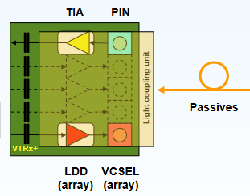
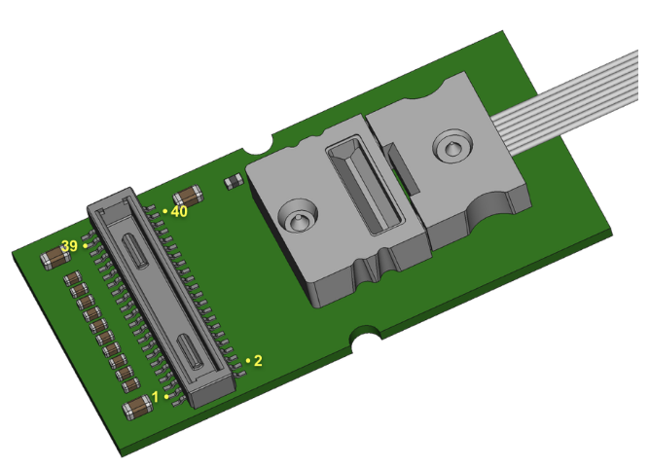
1 - VTRX+ - Versatile Link + Optical Link Module
TX: 5-10 Gbps
Rx: 2.5 Gbps
Pd ~ 250 mW
20 mm x 10 mm
~ $150.
1 RX
4 Tx
Multi-Mode Fiber
Rad Hard ASICs
COTs – Rad Tol screened
CERN-initiated production in early 2024.
Information requested (Ken Wyllie) on needed documentation to commit to production, to purchase, user’s manual – no feedback yet.
We need input from you as to the needs and quantities (~1000 for MAPS, ~1300 for dRICH, …)

Slide 2
2 – Qmin - Qmax
We need to finalize the specifications/requirements for the ASICs:
Minimum signal of interest
Maximum expected signal
Maximum rates per channel (Elke).
Sub-Detector groups to provide these specs (from simulations, tests, …).
These quantities need to be finalized this Fall 2023.
3 – Development Commitments
Soon, we need to assess and establish responsibilities for development of the electronics & DAQ HW/FW/SW for all the sub-detectors:
Adapter, FEB, RDO, GTU, DAM, cabling, tests, …
Parts or full RO chain.
List of sub-detectors with institutions, groups, people, …

