Slide 1
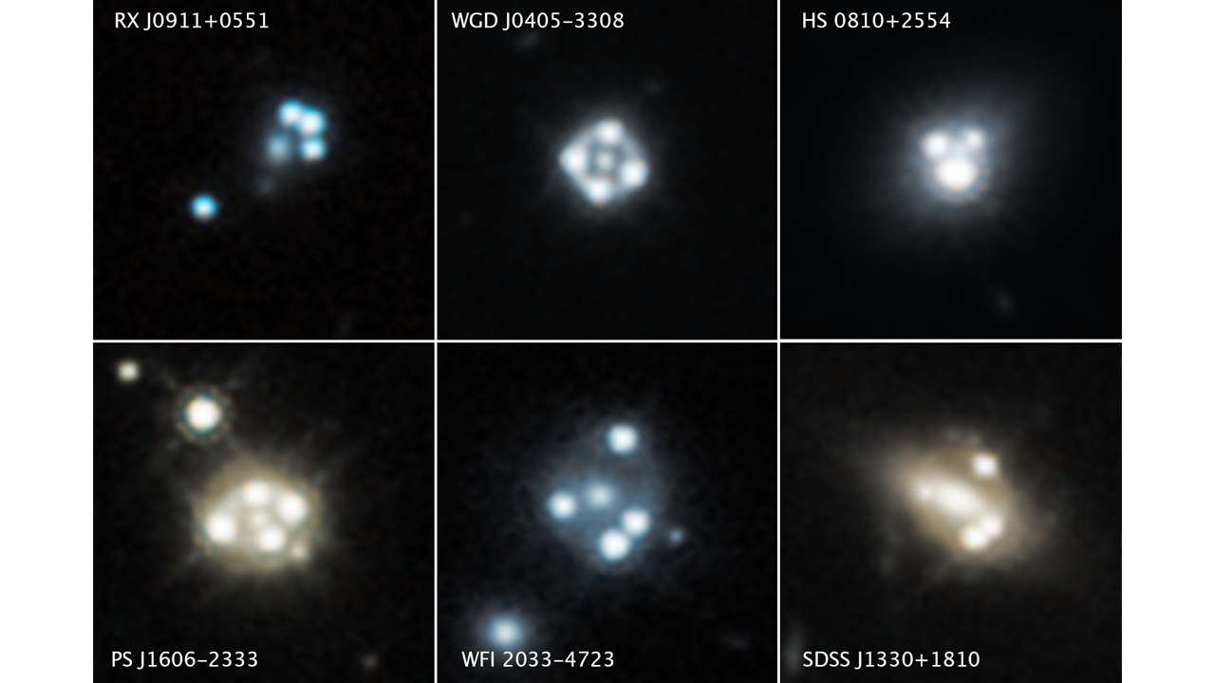
Cosmology from
Redshift Drift
31 August 2023
Mike Sivertz
Mike Sivertz – 31 August 2023

Slide 2
The Redshift Difference in Gravitational Lensed Systems: A Novel Probe of Cosmology Chengyi Wang, Krzysztof Bolejko and Geraint F. Lewis
Sydney Institute for Astronomy, School of Physics, A28, The University of Sydney, NSW 2006, Australia
School of Natural Sciences, College of Sciences and Engineering, University of Tasmania, Private Bag 37, Hobart, TAS 7001, Australia
Looking for the cosmological expansion of the universe from a single observation.
Slipher (1913) predicted cosmological expansion.
Friedmann & Lemaistre (1927) developed theory of expansion.
Hubble (1929) observed it.
Accelerating expansion observed by Riess and Perlmutter (1998-99)
Sandage developed Redshift drift (1961)

Slide 3
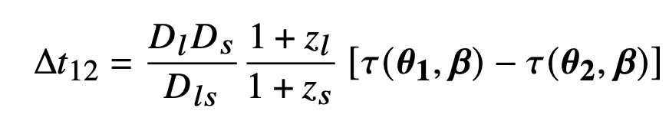

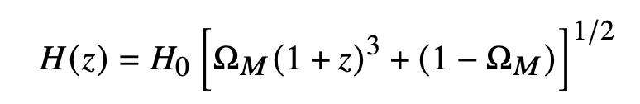
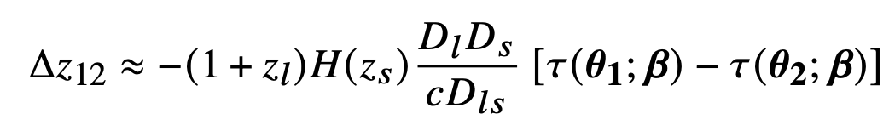
Time delay and redshift difference
D_{l} is the angular diameter distance to the lens
D_{s} is the angular diameter distance to the source
D_{ls} is the distance from the lens to the source
z_{l} is the lens redshift, z_{s} is the source redshift
τ_{i} is the observation time of event i at angle θ_{i} and lens angle β.
Solving for Δz₁₂ = z₂ – z₁ for small Δz gives

Slide 4
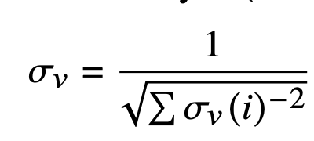
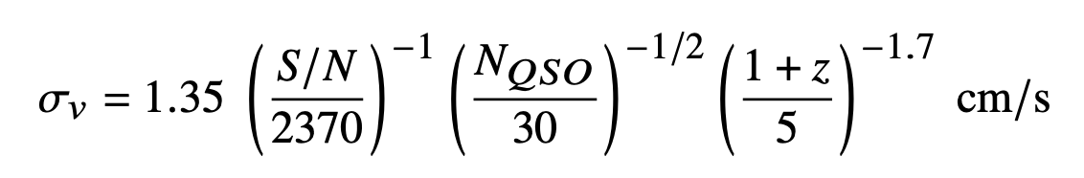
Instrument requirements
Extremely Large Telescope (ELT) – 40 meter mirror
Precision spectrometry:
Spectroscopic resolution: R = λ/Δλ = c/Δv = 0.5, 1 and 2 x 10⁵
The spectral lines are fit on a pixel by pixel basis, looking for systematic shifts in intensity up or down, caused by the differential redshift.

Slide 5
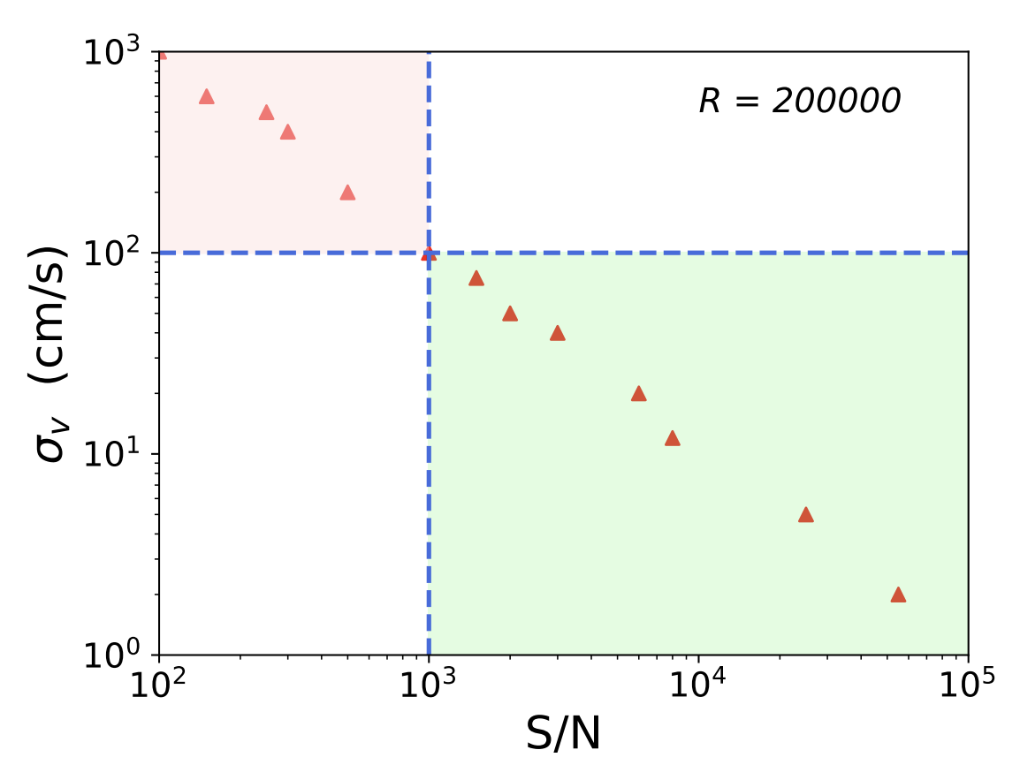
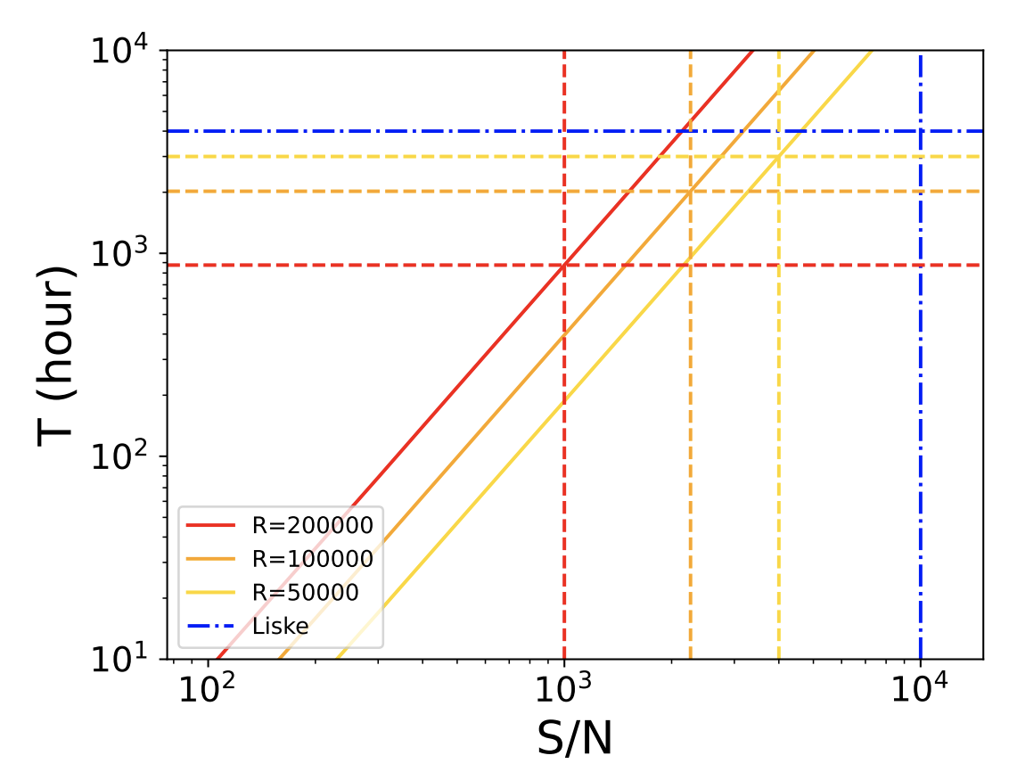
Discovery potential

Slide 6
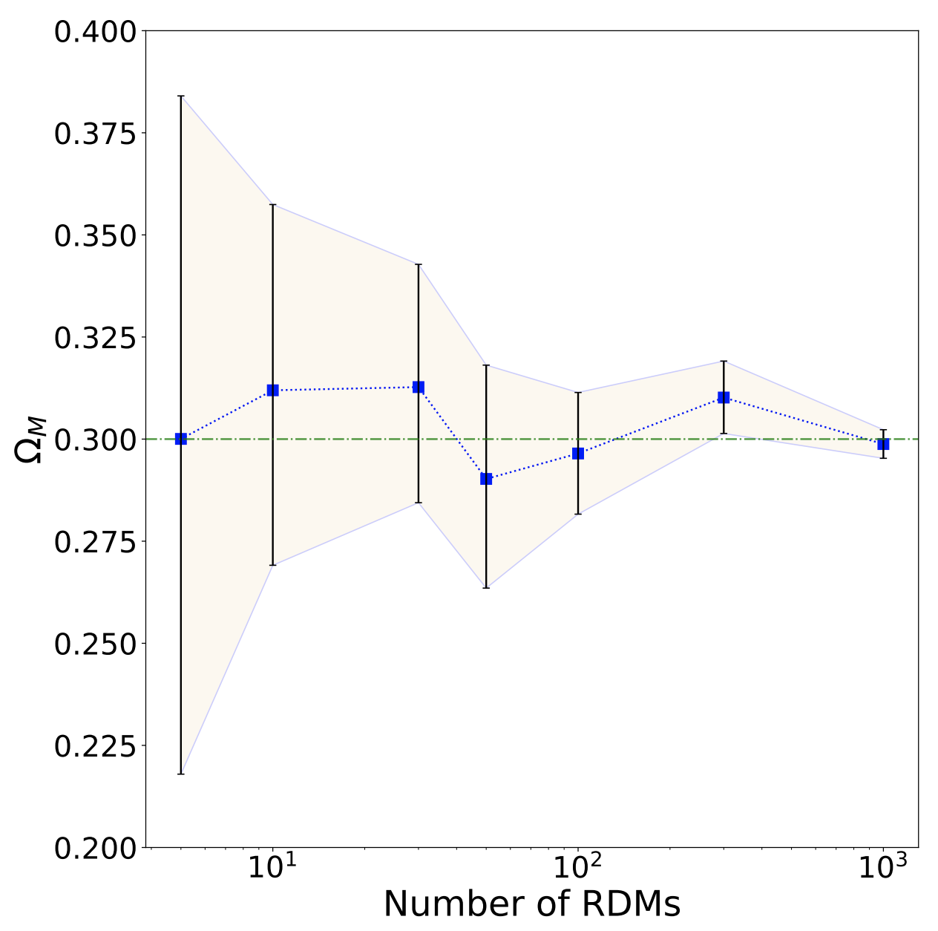

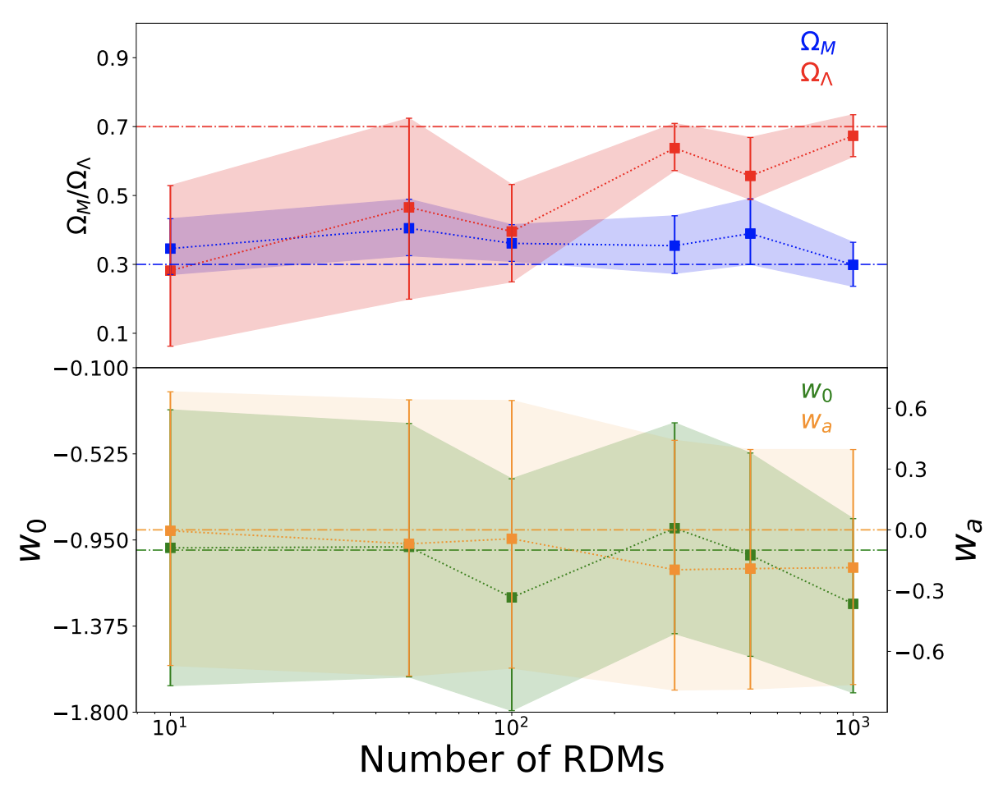

Cosmology Implications
Flat

Slide 7
Drawbacks
The results are sensitively dependent upon the lens model.
This paper makes use of a rather general symmetric lens model (non-singular ellipsoidal) for the lens.
There is a second order dependence on the peculiar velocity of the lens itself. Analyses are being developed to remove this dependence.

