Slide 1

Update on the NSAC
Nuclear Data Charge Reports
Lee Bernstein
Department of Nuclear Engineering
UC-Berkeley
Nuclear Science Division
Lawrence Berkeley National Laboratory
Briefing to the NDAC
September 13, 2023

Slide 2
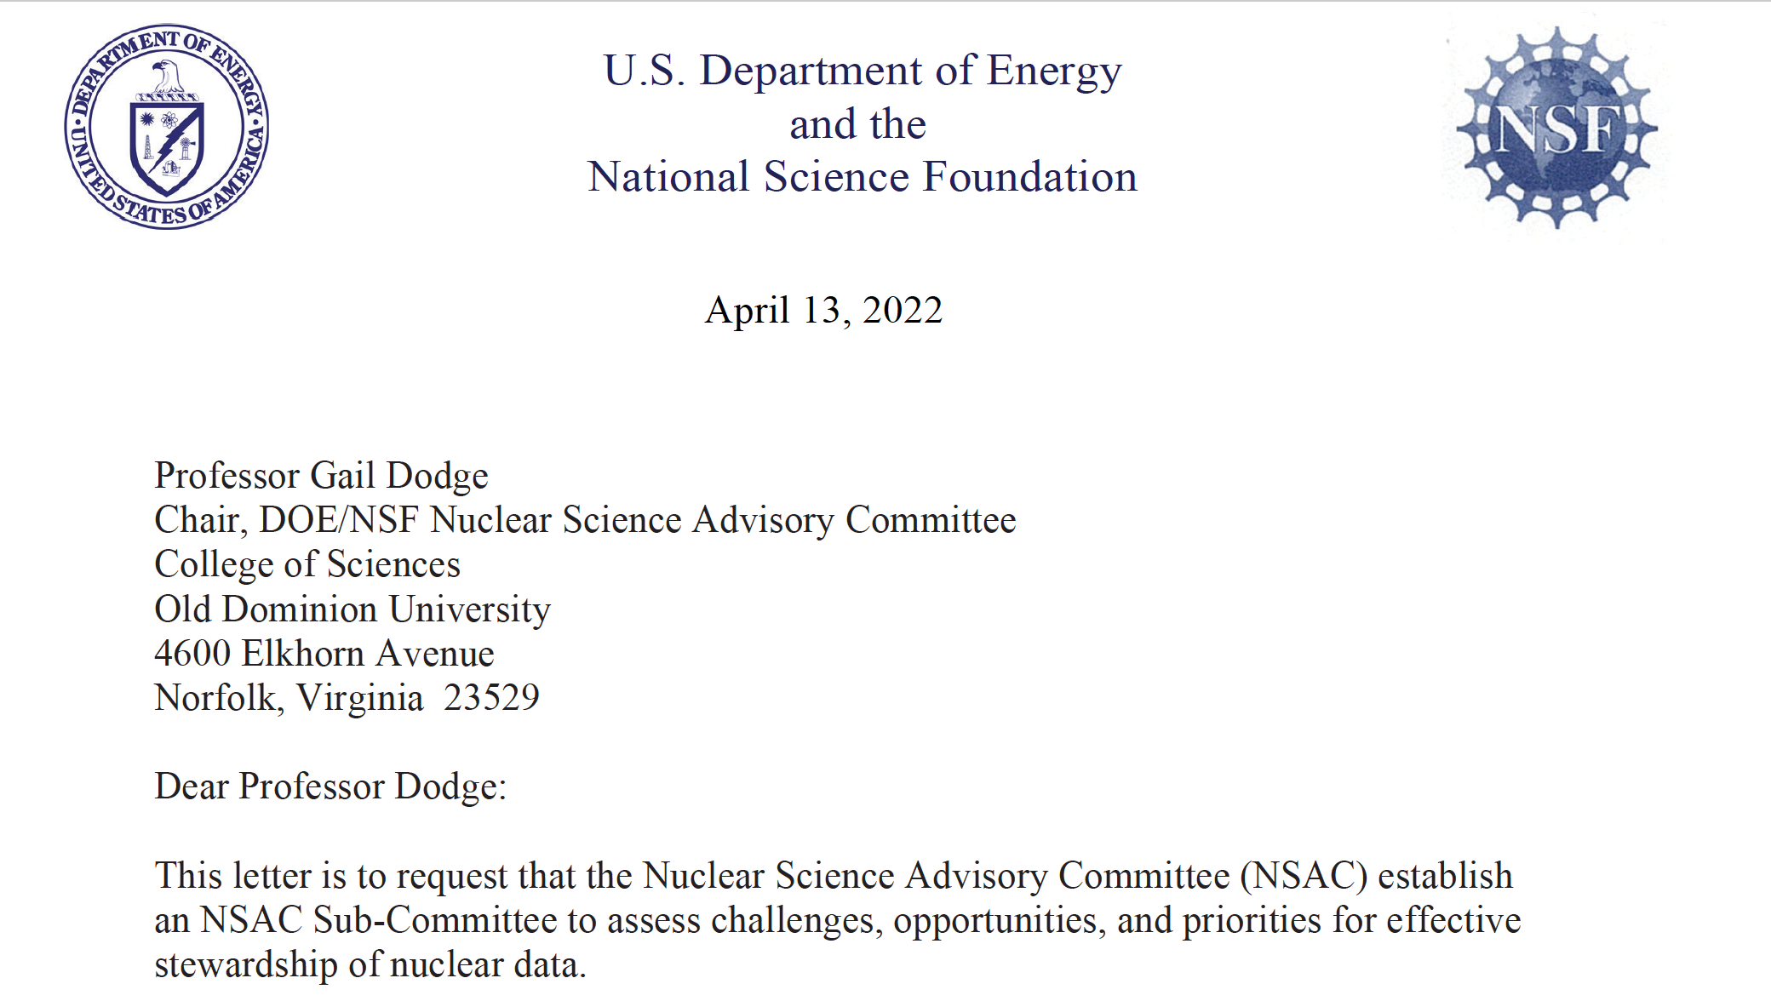
In 2022 NSAC was asked to prepare two reports “to assess challenges, opportunities, and priorities for effective stewardship of nuclear data”
“Increasingly, access to accurate, reliable nuclear data plays an essential role in the success of Federal missions such as non-proliferation, nuclear forensics, homeland security, national defense, space exploration, clean energy generation, and scientific research. Data access is also key to innovative commercial developments such as new medicines, automated industrial controls, energy exploration, energy security, nuclear reactor design, and isotope production.”
Goal: “To develop a strategic plan with prioritized recommendations to guide
federal investment in the U.S. Nuclear Data Program (USNDP)”
Notes:
Replace figures as appropriate

Slide 3
The NSAC Nuclear Data (NSAC-ND) Charge Subcommittee
Person | Org | Person | Org
Friederike Bostelmann | ORNL | Arjan Koning | IAEA/Petten
Mike Carpenter | ANL/Atlas | Ken LaBel & Tom Turflinger | NASA & Aerospace
Mark Chadwick | LANL | Caroline Nesaraja | ORNL
Max Fratoni | UCB | Syed Qaim | Jülich
Ayman Hawari | NC State | Catherine Romano | Aerospace
Lawrence Heilbronn | UTK | Sunniva Siem | Univ. of Oslo
Calvin Howell | TUNL | Artemis Spyrou | MSU
Jo Ressler | LLNL | Etienne Vermeulen | LANL
Thia Keppel | J-lab | Ramona Vogt | LLNL
All of these people were chosen based on their experience in nuclear data and some of the applications that rely on it

Slide 4
The First Part of the Charge (due 9/15/22)
Assess USNDP Status, which would include the following actions:
  Assess and document recent achievements in nuclear data and their impact.
  Input from USNDP staff
  Survey current and future federal and non-federal needs for reliable, accurate, secure, accessible nuclear data.
  Input from the NSAC Nuclear Data Charge Subcommittee (NSAC-ND)
  Assess the role, competitiveness, and importance of the USNDP in an international context.
  Input from USNDP and IAEA staff

Slide 5
The first report by the numbers…
  Totals: 88 pages, 6 Chapters, 30 figures, 7 tables, 293 references
    USNDP since 2018-now Accomplishments: 25 items; 23 pages
    International efforts/collaborations: 4 pages
    Nuclear Data needs (50 pages): Basic Science (8); Energy (9), including 4 detailed tables); Medical (8); National Security (3); Nonproliferation (8); Space (10).
    Crosscutting Needs: Workforce Development; Ongoing Fission Evaluation; Accelerated Decay Data Evaluation; Statistical Structure Evaluation; (n,x) data & High energy data (5 pages).
Some information was moved to the second report and a final version released on January 22, 2023

Slide 6





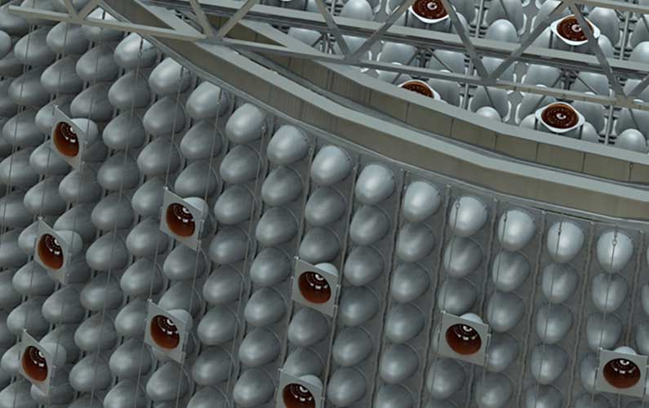
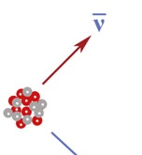
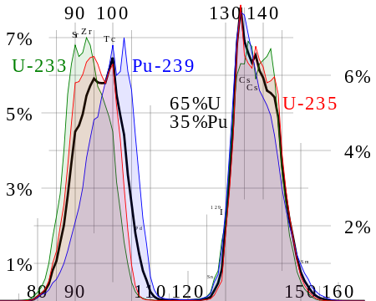


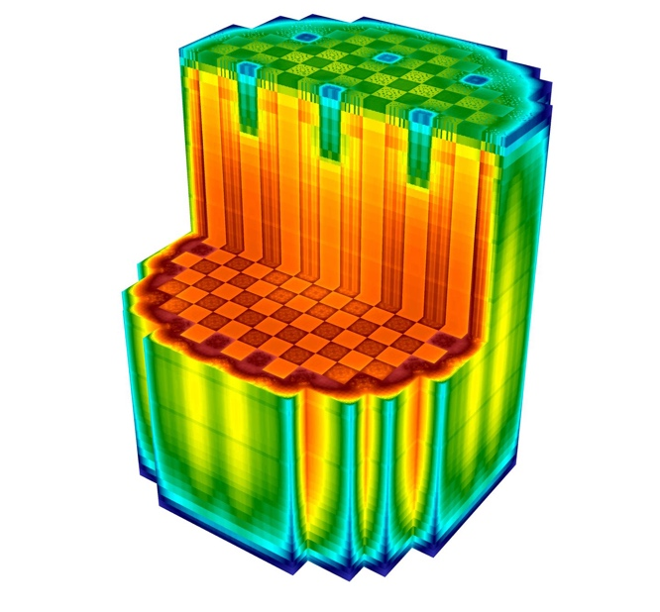


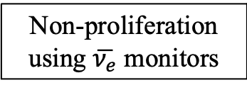
Here are two examples of “hidden” nuclear data
Decay Data
Non-proliferation using $\overline{ν_{e}}$ monitors
Model
Physics beyond the standard model
Fission Product Yield Distribution Data
Decay Heat calculations
The codes often hide
shortcomings in the underlying nuclear data
Notes:
Replace figures as appropriate

Slide 7
It also produced an interconnected view between nuclear data and applications
Low Energy
Structure
(n,x)
Reactions
Or in simplified form…
Nuclear
Astrophysics
Decay
Data
Applications
Nonpro-
liferation
High-energy
Reactions
Nuclear data
National
Security
Fission
Energy
Discrete and
Statistical
Properties
Medical
Space
Stopping
Powers
Target
Fabrication
MCNP
Stable
Beams
TALYS
COH
EMPIRE
Facilities &
Capabilities
RIB
FLUKA
/PHITS
Codes
RHIC
Neutron
Beams
GEANT
Thanks to Artemis Spyrou!

Slide 8
The Second Part of the Charge
Based on the USNDP Status Report (from part 1), provide recommendations for maintaining effective stewardship of nuclear data, which includes the following actions:
  Identify challenges for nuclear data stewardship in the future, including identifying and prioritizing the most compelling opportunities to enhance and advance NP stewardship of nuclear data and the impact if those opportunities can be realized.
  Describe possible ways the Nuclear Data (ND) community can work to train and retain a diverse, equitable, and inclusive workforce capable of sustaining the U.S. ND enterprise.
  Identify access needs for facilities and instrumentation, crosscutting opportunities with other federal programs, and potentially mutually beneficial interactions with other domestic and international stakeholders.

Slide 9
The Second Part of the Charge
Based on the USNDP Status Report (from part 1), provide recommendations for maintaining effective stewardship of nuclear data, which includes the following actions:
  Identify challenges for nuclear data stewardship in the future, including identifying and prioritizing the most compelling opportunities to enhance and advance NP stewardship of nuclear data and the impact if those opportunities can be realized.
  Describe possible ways the Nuclear Data (ND) community can work to train and retain a diverse, equitable, and inclusive workforce capable of sustaining the U.S. ND enterprise.
  Identify access needs for facilities and instrumentation, crosscutting opportunities with other federal programs, and potentially mutually beneficial interactions with other domestic and international stakeholders.
The first report and input from the USNDP was used

Slide 10
The Second Part of the Charge (due 1/30/23)
Based on the USNDP Status Report (from part 1), provide recommendations for maintaining effective stewardship of nuclear data, which includes the following actions:
  Identify challenges for nuclear data stewardship in the future, including identifying and prioritizing the most compelling opportunities to enhance and advance NP stewardship of nuclear data and the impact if those opportunities can be realized.
  Describe possible ways the Nuclear Data (ND) community can work to train and retain a diverse, equitable, and inclusive workforce capable of sustaining the U.S. ND enterprise.
  Identify access needs for facilities and instrumentation, crosscutting opportunities with other federal programs, and potentially mutually beneficial interactions with other domestic and international stakeholders.
The first report was used for this
…and we solicited input from the USNDP

Slide 11
The second report by the numbers…
  Main Body: 41 pages, 4 Chapters, 9 figures/tables, 123 references
    Executive Summary (2 pages)
    Challenges and Opportunities for Nuclear Data (28 pages)
    Diverse, Equitable & Inclusive Workforce Development (3 pages)
    Facilities and Instrumentation Access Needs (8 pages)
  Appendix: Domestic Nuclear Data Generating Facilities
    21 Facilities @ 17 National Labs and Universities
    Updated & Expanded from the 2015 NDNCA Whitepaper Appendix D.

Slide 12
Three critical “Take Aways” from the Second Report
  Continued support is necessary for the existing nuclear reaction (ENDF), structure (ENSDF) and mass (AME) evaluation efforts.
  A number of new initiatives are required to address societies evolving nuclear data needs. These initiatives will require a concerted recruitment effort and support over time to build.
  These new evaluators should be a part of any experimental activities to ensure expedite data incorporation and ensure a good understanding of the nominal values and uncertainties of the data being measured.
  Collaboration is Essential

Slide 13
A key finding is that USNDP members should be part of Topical Nuclear Data Collaborations (TNDC)
  The TNDC brings together application and data subject matter experts and includes workforce development in its project plan.
  Data would be published in appropriate peer-reviewed journals as well as being incorporated into new or existing databases.
This paradigm is already used by NP
(e.g., FIRE) and by NA-22 (e.g., ventures)
Think of the evaluators on these teams as being embedded

Slide 14
Fourteen Nuclear Data Thrust Areas were presented including eleven new initiatives
}
Existing USNDP Efforts
✓ - Covered at a WANDA
Supporting Structure Evaluation Capabilities
Enhance Reaction Evaluation Capabilities
Maintain Atomic Mass and Nuclear Property Evaluation
Nuclear Astrophysics Evaluation
Develop Statistical Nuclear Structure Data Evaluation and Databases
Establish Methods for Continuous Fission Evaluation
Targeted Accelerated Decay Data Evaluations
Provide Comprehensive, Consistent Neutron Reaction and Structure Data
Charged-particle stopping powers measurement and evaluation
Comprehensive reaction measurement and evaluation to E/A≤10 GeV/amu)
Provide Nuclear Data for Fusion Energy
Continue Development of Modern Data Formats
AI/ML for Modern Nuclear Data Compilation, Evaluation, and Dissemination
Create an Infrastructure for Data Preservation and Open Data
✓
}
✓
Topical USNDP Initiatives
✓
✓
✓
Part of a new Space
Nuclear Data Initiative
✓
✓
A workshop took place at the White House in May 2023 and will be a topic at WANDA 24
✓
}
Enabling
USNDP
Initiatives
✓
✓

Slide 15
These 14 crosscutting nuclear data topics map onto all of the topic areas presented in the first report
}
Existing USNDP Efforts
}
New USNDP Initiatives
}
Enabling
USNDP
initiatives

Slide 16
Each nuclear data initiative is presented in 4 parts
  Issue: Identification of a crosscutting nuclear data need;
  Background: A discussion of how the initiative is related to the need;
  Recommendation: A recommendation of how to carry out the initiative, including an estimate of the additional workforce needs and a recruitment/training timeline;
  Impact: The societal benefits that would result from carrying it out.
The initiatives are targeted towards intelligent non-experts

Slide 17
The First Three Topics Support Existing Core Programs
Support the nuclear structure evaluation workforce to improve the currency, consistency, and accessibility of the Evaluated Nuclear Structure Data File (ENSDF);
Enhance nuclear reaction evaluation within the USNDP in support of the Evaluated Nuclear Data File (ENDF) through expansion of the workforce and integration of high-performance computing, automation, and machine learning;
Continue atomic mass evaluation in support AME and NUBASE databases.
Continued support for these foundational activities is essential

Slide 18
These are followed by 8 new initiatives
Establish a coordinated effort to improve evaluation and modeling in nuclear astrophysics for stellar dynamics, multi-messenger astronomy and nucleosynthesis;
Initiate and maintain an effort to develop and maintain nuclear structure evaluation beyond discrete states, including nuclear level densities, photon strength functions and photonuclear data for improved reaction modeling, and exploring nuclear structure at finite temperature;
Maintain an ongoing effort for correlated fission data evaluation, including cross sections, fragment yields, ν(A), ν(E_{ν}) for nuclear energy, national security, nonproliferation and basic science;

Slide 19
These are followed by 8 new initiatives (cont.)
Form a panel of experts to annually update key evaluated decay data for targeted high-value nuclides for national security, nonproliferation and medical applications;
Maintain comprehensive, consistent (n,x) structure and reaction data for energy, national security, nonproliferation & planetary nuclear spectroscopy;
Develop and maintain evaluated charged-particle stopping power data for detector design, space effects, isotope production and ion beam therapy;
Extend reaction evaluation to higher energies for space exploration and medical nuclide production.
Address Nuclear Data for fusion energy systems including tritium production and materials damage cross section.

Slide 20
The last three initiatives build a robust nuclear data infrastructure for the 21st century
The continued development of new data formats to accommodate all nuclear data types and improve access by modern software systems.
The design and incorporation of artificial intelligence and machine learning tools to improve the nuclear data evaluation process.
The creation of an infrastructure for open data and data preservation for use by the entire nuclear physics community.
Each new initiative requires 1-2 FTE an ongoing basis

Slide 21
The time scale of this expansion can be adjusted to fit funding and recruitment profiles

Slide 22
Conclusions
A few typos have been corrected since the 2/13/23 release.
Input from the report will be used for portions of the Long Range Plan (e.g., applications, low-energy program etc.)
Special Thanks
Ramona Vogt, Cathy Romano, Bethany Goldblum,
Jo Ressler and many of my colleagues in the USNDP

