Slide 1

LBNL/UC-Berkeley
NDAC Report
Lee Bernstein
Department of Nuclear Engineering
UC-Berkeley
Nuclear Science Division
Lawrence Berkeley National Laboratory
Briefing to the NDAC
September 13, 2023

Slide 2
The Bay Area Nuclear Data Group: 2022→2023
Last | First | Institution | Position | Support
Apgar | Catherine | UCB | Grad Student | Isotopes
Araj | Ruby | UCB | Grad Student | NSSC/LLNL
Basunia | Shamsu | LBNL | Research Scientist | NP (100%)
Batchelder | Jon | UCB | Research Engineer | NP (75%)
Bernstein | Lee | UCB/LBNL | Joint Faculty Staff | NP/UC (37.5%)
Brand | Chris | UCB | Grad Student | LLNL
Brown | Josh | UCB | Research Engineer | NE/NP (10%)
Goldblum | Bethany | UCB/LBNL | Staff Scientist | NP/UC (33%)
Gordon | Joey | UCB | Grad Student | NE/LLNL
Hurst | Aaron | UCB | Research Engineer | NP/NA-22 (30%)
Laplace | Thibault | UCB | Research Engineer | NSSC/NA-22
Nagel | Tyler | UCB | Grad Student | NE
Rice | Emma | UCB/LBNL | Grad Student | LBNL
Thatcher | Devin | LBNL | Grad Student | LBNL
Voyles | Andrew | UCB | Research Engineer | Isotopes/NP (25%)
Myers | Keenan | UCB | Grad Student | NNSA/SSAA
Jacob | Robert | UCB | Grad Student | Google
Rose | Greg | UCB | Grad Student | LLNL
Hernandez | Isabel | UCB | Grad Student | NSSC
Lee | Abby | UCB | Grad Student | Chancellor’s Fellow
Sun | Dajie | UCB | Postdoc | NorthStar
Georgiadou | Anastasia | UCB | Postdoc | DOE-NE/NA-22
Supported Undergraduates as of 7/23
Last | First | Project | Grad
Hebert | Rebecca | Isotopes | 2025
Tannous | Speero | BELLA | 2023
Goyal | Sanjana | NP | 2026
Basunia | Shamsu | LBNL | Staff Scientist | NP (100%)
2021-2023 Ph.D. Grads
Last | First | Post-Grad Job
Matthews | Eric | Expert Analytics
Fox | Morgan | Terrestrial Energy
Lo | Austin | ORNL
Lewis | Amanda | NNL
Morrell | Jon | LANL
Stephenson* | Sarah | Congressional Fellow
Vincente-Valdez* | Pedro | Mythic Software
Awedisean | Preston | LLNL
Dai | Anthony | LANL
Goldblum | Bethany | UCB/LBNL | Faculty Scientist | NP/UC (10%)
M. Wiedeking starting @ LBNL (2023)
https://nucleardata.berkeley.edu
Notes:
Bold face for staff funded at least in part by NP (USNDP).

Slide 3
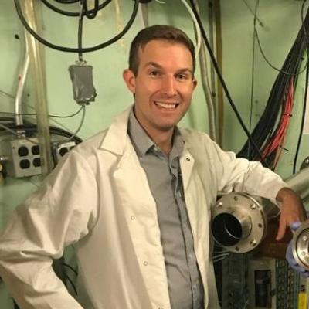
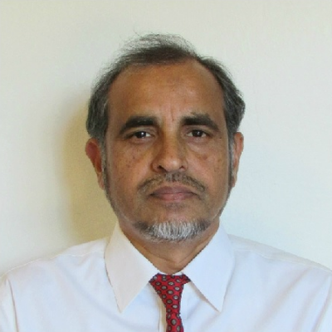
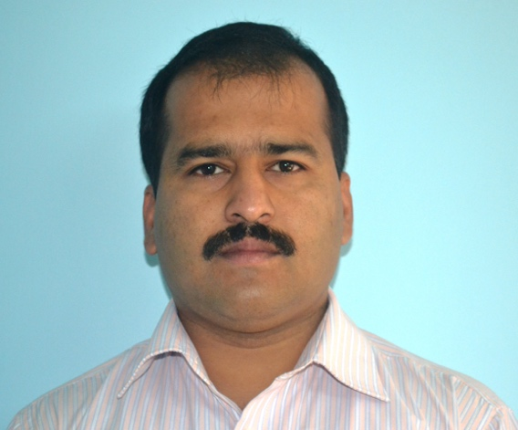
Nuclear structure evaluation
  FY 21,22,23:
  Submitted (58 nuclides + 1 (India))
    A=24 (Basunia, Chakraborty – 8 nuclides)
    A=30 (Basunia – 9 nuclides, Chakraborty (India) – 1 nuclide)
    A=81 (Basunia – 15 nuclides)
    A=191 (Basunia – 13 nuclides)
    A=213 (Basunia – 12 nuclides)
    A=222 (Balraj et. al., (ICTP) – 1 nuclide of 11)
  Published (42 nuclides)
    A=23 (8 nuclides), Basunia, Chakraborty, NDS 171, 1, 2021
    A=24, Basunia, Chakraborty, NDS 186, 3, 2022
    A=186 (14 nuclides), Batchelder, Hurst, Basunia, NDS 183, 1, 2022
    A=213, Basunia, NDS 181, 475, 2022
  Ongoing:
    A=25 (Basunia, Chakraborty)
  Reviewed:
    Three mass chains
  FY 24: (plan)
  A=169, Basunia, Voyles
    A.S. Voyles will study structure evaluation under Basunia
  Dr. Anagha Chakraborty (India) worked at ~0.1 FTE over the years and recently received seed funding from IAEA to continue ENSDF evaluation
A.S. Voyles
A. Chakraborty
M.S. Basunia
Notes:
Voyles has the deliberate mind set needed for structure evaluation and has already made contributions to decay data from our work in isotope production. He’s also early career (30), which the ENSDF workforce desperately needs.

Slide 4
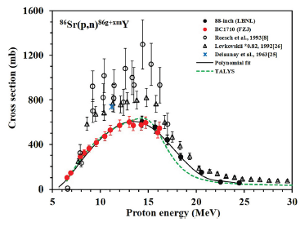
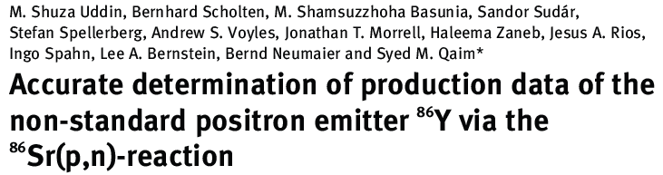
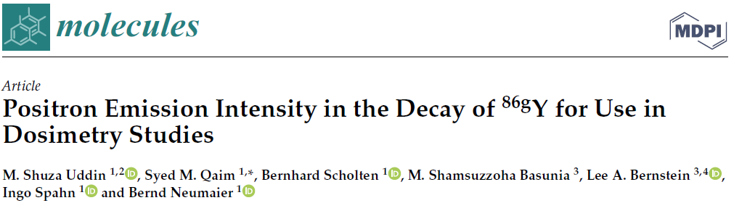
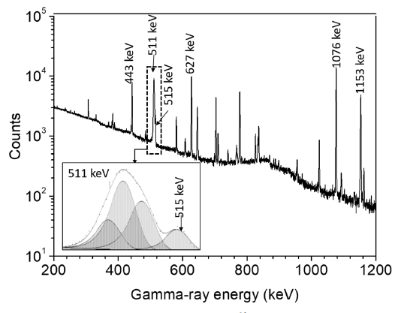
Shamsu has also been leading LBNL in a collaboration with FZ Jülich to improve nuclear data for the production cross section of ⁸⁶Y and its positron emission probability
Excitation function for the formation of the radionuclide ⁸⁶Y in the proton irradiation of an enriched ⁸⁶Sr target
E_{p}=14-7 MeV yield 291 MBq/μAh
A typical γ-ray spectrum of the ⁸⁶SrCO₃ sample irradiated with 8 MeV protons with an inset showing an expanded region near 511 keV
Improved production cross sections of ⁸⁶Y, theranostic pair of ⁹⁰Y, from (p,n) measurements at LBNL and FZ Jülich have been published;
Positron emission probability (%β⁺ = 27.2 ± 2.0) was also measured by the 511-keV annihilation radiation and compares well with 27.9 ± 1.2 deduced using the latest decay scheme (2020Gu18)
Five papers since 2020

Slide 5

Berkeley Evaluated Alpha & proton Radioactivity (BEApR*)
An Online Global Heavy Charged Particle Database/Horizontal Evaluation
(a work in progress)
Physics motivated! – In many cases levels in daughter nuclei have only been observed via heavy charged particles
Goal is to aid researchers and for use as a teaching tool.
  Systematics
  Relationships between Energy & Branching Ratio
  Competition between different decay modes
Involves the entire chart of the nuclides
Provides a comprehensive overview of the topic.
Evaluates and gives recommended values based on all available experimental data.
All information in one place
  Allows users to look at patterns/trends in the data which can lead to the discovery of new physical phenomena.
Targeted (and complete) references– different from NSR
  All papers, conference proc. and reports included.
Explicit refs for T_{1/2}, Energy, BR, etc.
Organized by T_{z} / α-chain
Will be updated monthly
J.C. Batchelder
https://nucleardata.berkeley.edu/research/betap.html
Notes:
This work complements Batchelder’s standing in the nuclear physics community studying proton-rich nuclei (he founded PROCON!). Note that he published 5 papers in collaboration with ORNL this past year alone.

Slide 6
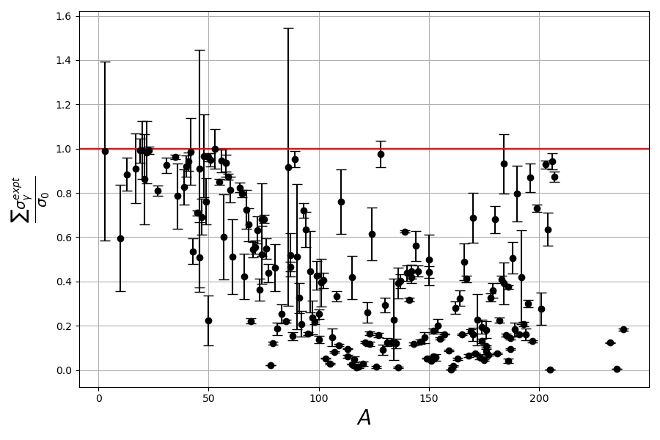
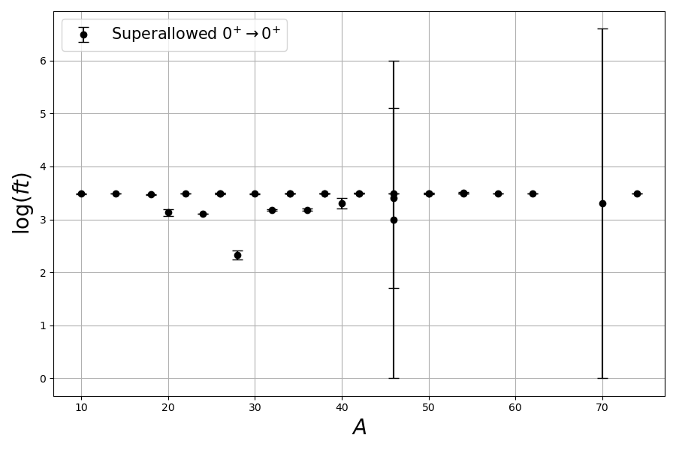
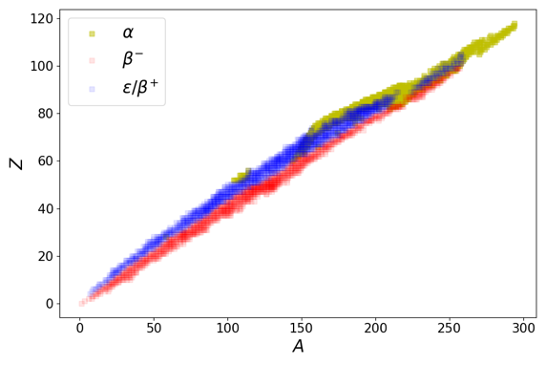

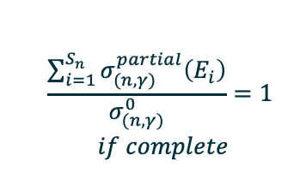
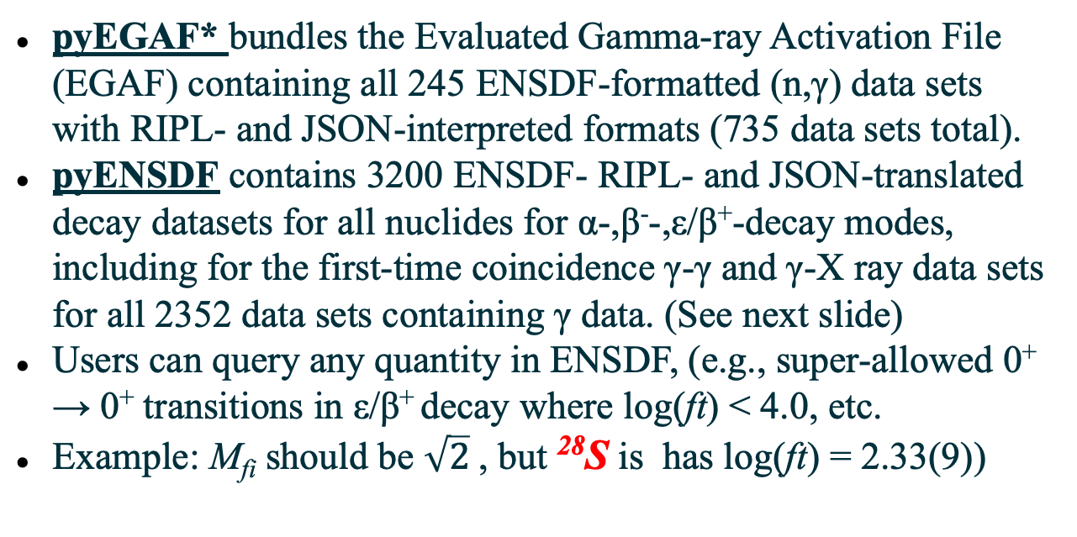
pyEGAF and pyENSDF: Open-source Python libraries
pyEGAF* bundles the Evaluated Gamma-ray Activation File (EGAF) containing all 245 ENSDF-formatted (n,γ) data sets with RIPL- and JSON-interpreted formats (735 data sets total).
pyENSDF contains 3200 ENSDF- RIPL- and JSON-translated decay datasets for all nuclides for α-,β⁻-,ε/β⁺-decay modes, including for the first-time coincidence γ-γ and γ-X ray data sets for all 2352 data sets containing γ data. (See next slide)
Users can query any quantity in ENSDF, (e.g., super-allowed 0⁺ → 0⁺ transitions in ε/β⁺ decay where log(ft) < 4.0, etc.
Example: M_{fi} should be $\sqrt{2}$ , but ²⁸S is has log(ft) = 2.33(9))
pyEGAF
$$\frac{\sum_{i=1}^{S_{n}}{σ_{(n,γ)}^{partial}\left(E_{i}\right)}}{σ_{(n,γ)}^{0}}=1$$
$if complete$
pyENSDF
α
ε/β⁺
Tools included to handle, manipulate, analyze and visualize both original ENSDF and derived coincidence data sets.
β⁻
Project available on PyPI and GitHub:
pip install pyegaf (252 downloads from 9/8-9/13!)
A.M. Hurst
*Manuscript submitted to NIM A.
Notes:
Note that this modernization effort was funded from both USNDP and non-USNDO sources.

Slide 7
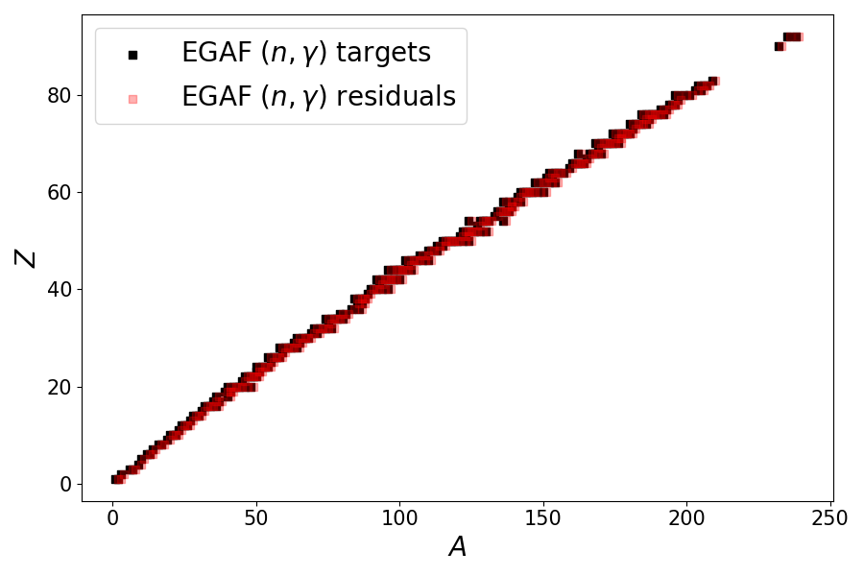
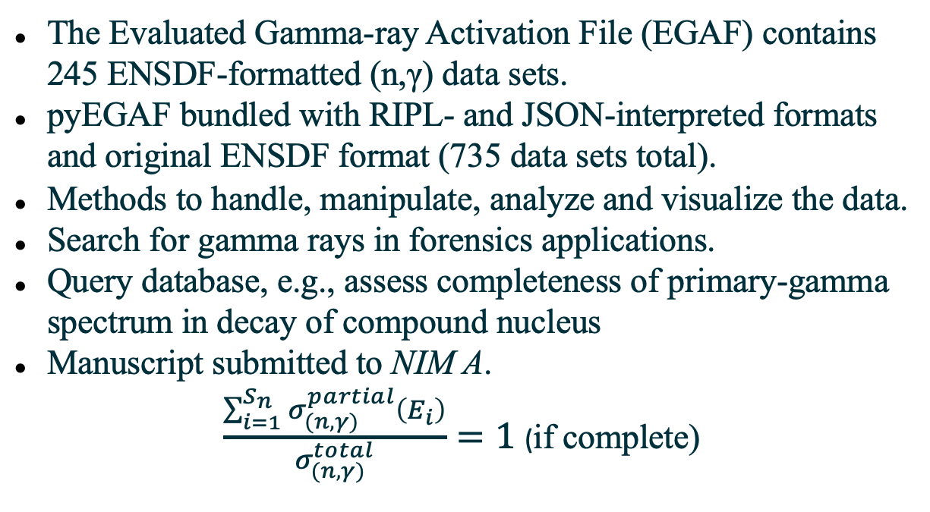
pyEGAF: Open-source Python library for (n,γ) data
The Evaluated Gamma-ray Activation File (EGAF) contains 245 ENSDF-formatted (n,γ) data sets.
pyEGAF bundled with RIPL- and JSON-interpreted formats and original ENSDF format (735 data sets total).
Methods to handle, manipulate, analyze and visualize the data.
Search for gamma rays in forensics applications.
Query database, e.g., assess completeness of primary-gamma spectrum in decay of compound nucleus
Manuscript submitted to NIM A.
$\frac{\sum_{i=1}^{S_{n}}{σ_{(n,γ)}^{partial}\left(E_{i}\right)}}{σ_{(n,γ)}^{total}}=1$ (if complete)
Project available on PyPI and GitHub:
https://github.com/AaronMHurst/python_egaf.git
A.M. Hurst

Slide 8
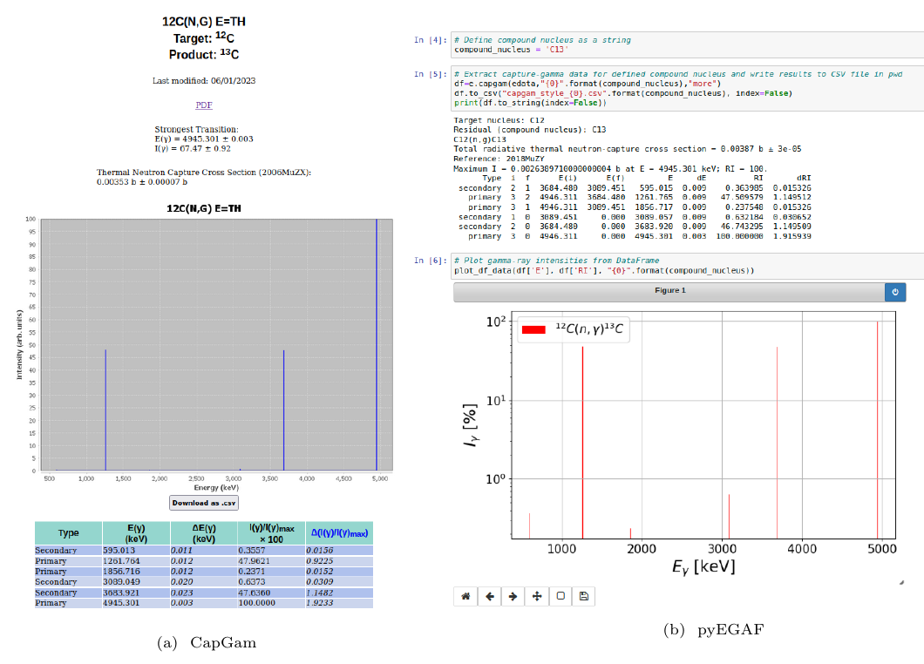
pyEGAF has many applications, e.g., render data cf. CapGam
pyEGAF provides everything CapGam gives:
  Gamma-ray type (primary/secondary) , E_{γ}, relative I_{γ}.
  Plots, CSV exports.
pyEGAF has additional info:
  Associated level indices and energies.
  Enhanced interactivity.
pyEGAF can also provide absolute gamma-intensity info according to user preference:
  Isotopic partial cross section;
  Elemental partial cross section;
  Population per neutron capture.
A.M. Hurst

Slide 9

pyENSDF: Open-source Python library for ENSDF decay data
Approximately 3200 decay-data sets in ENSDF encompassing α-,β⁻-,ε/β⁺-decay modes.
pyENSDF bundled with RIPL- and JSON-translated ENSDF-decay datasets for all nuclides.
pyENSDF also bundled with JSON-formatted coincidence γ-γ and γ-X ray data sets for all nuclides containing γ data (2352 data sets). (See next slide)
Methods to handle, manipulate, analyze and visualize both original ENSDF and derived coincidence data sets.
Query any quantity or trend in ENSDF, e.g., super- allowed 0⁺ → 0⁺ transitions in ε/β⁺ decay where log(ft) < 4.0, etc.
Example: M_{fi} should be = (2)^{1/2}, but ²⁸S is much lower (log(ft) = 2.33(9))
A.M. Hurst, B.D. Pierson, B.C. Archambault, L.A. Bernstein, S.M. Tannous, EPJ (Web of Conf.) 284, 18002 (2023).
A.M. Hurst

Slide 10
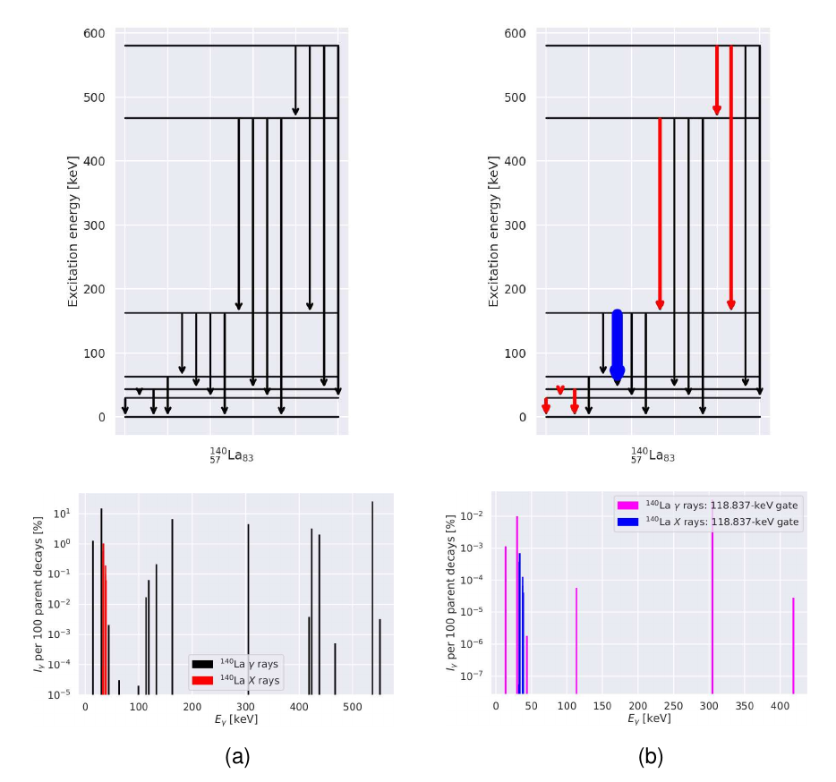
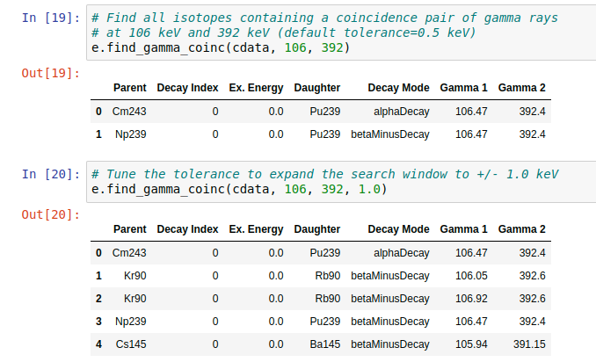
Query γ/γ and γ/X-ray coincidence data (w/DTRA - B. Pierson, PNNL)
Retrieve all γ-γ and γ-X ray coincidence pairs in a given nucleus or find all coincidence pairs for defined gating transition.
Gate at 118.8 keV (4 → 2 transition) in ¹⁴⁰La following β⁻-decay of ¹⁴⁰Ba reveals coincidences.
Forensics: Search for γ-γ and γ-X ray coincidences or singles, e.g. γ(106)-γ(392):
Query for ²³⁹Np → ²³⁹Pu
A.M. Hurst
Notes:
This effort was started using DTRA funding, but the USNDP carried it over the finish line.

Slide 11
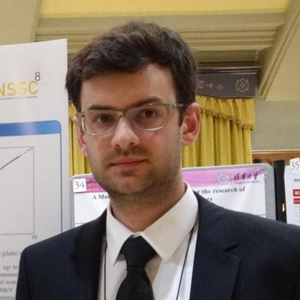
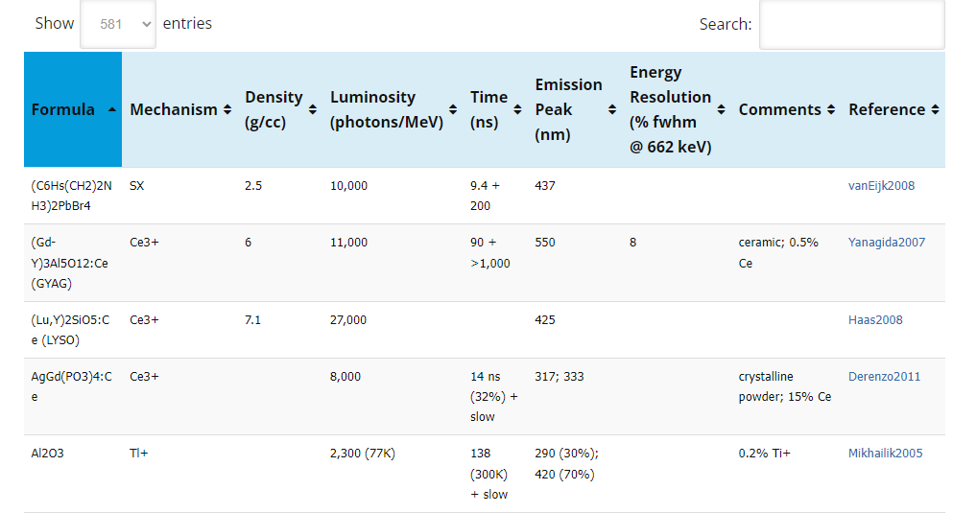
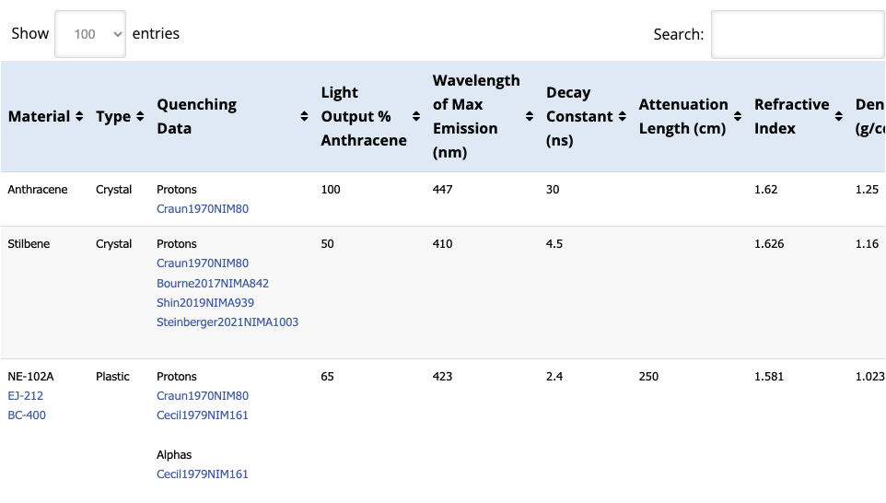
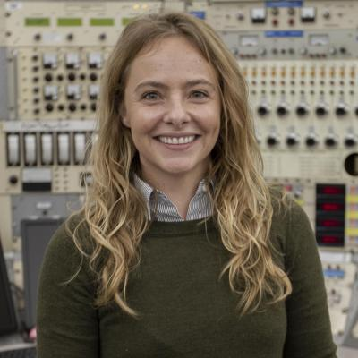
Nuclear Data Library for Scintillators
Inorganic scintillators:
Modernization of https://scintillator.lbl.gov/
Initially developed under a DHS project focused on the discovery and development of new inorganic scintillating materials
Organic scintillators:
New addition focused on scintillator response to neutrons and charged particles
Important for modeling detector response for nuclear physics and applications
T. Laplace
B. Goldblum
The creation of a scintillator database was called for in at both the WANDA 2020 and WONDRAM workshops
Notes:
Entirely non-USNDP funded, but used by both NP (antineutrino spectroscopy)) and non-NP researchers.

Slide 12
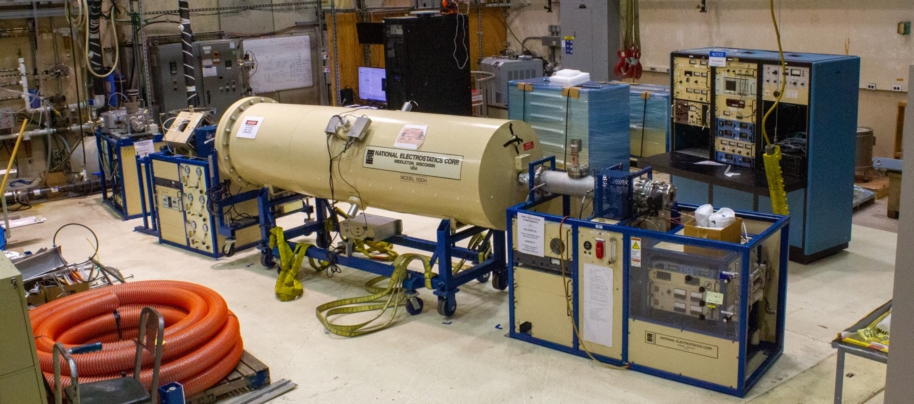
New UCB Initiative Starting August 2023
The Nuclear Technology Innovation Laboratory (NTIL)
The College of Engineering is providing $1M over 5 years to establish a new nuclear science and engineering center
The NTIL will bring together unique resources on the UCB campus for use in academic and commercial research:
  A Pelletron for (p/d/α,γ) cross section measurements for advanced reactors & astrophysics and for surface characterization via RBS (Bernstein, Hosemann)
  Two new neutron sources with Associated Particle Imaging (Bernstein, Siefman)
  A suite of SEM, FIB microscopes for nuclear materials characterization (Hosemann)
  Advanced Neutron Transport Modeling (Fratoni)
  Detector development (Vetter);
  Molten salt laboratories (Scarlat);
  Radiochemistry Facilities (Abergel)
  Inaugural Director – L.A. Bernstein
Facility for University-based Reactor and Nuclear Astrophysics Capture Experiments (FURNACE)
Adelphi DT108 neutron sources with Associated Particle Imaging (DT-API)
Neutron
α
Notes:
Note that the Dean could have given this to other faculty, but she chose a focus on nuclear data! ☺

Slide 13
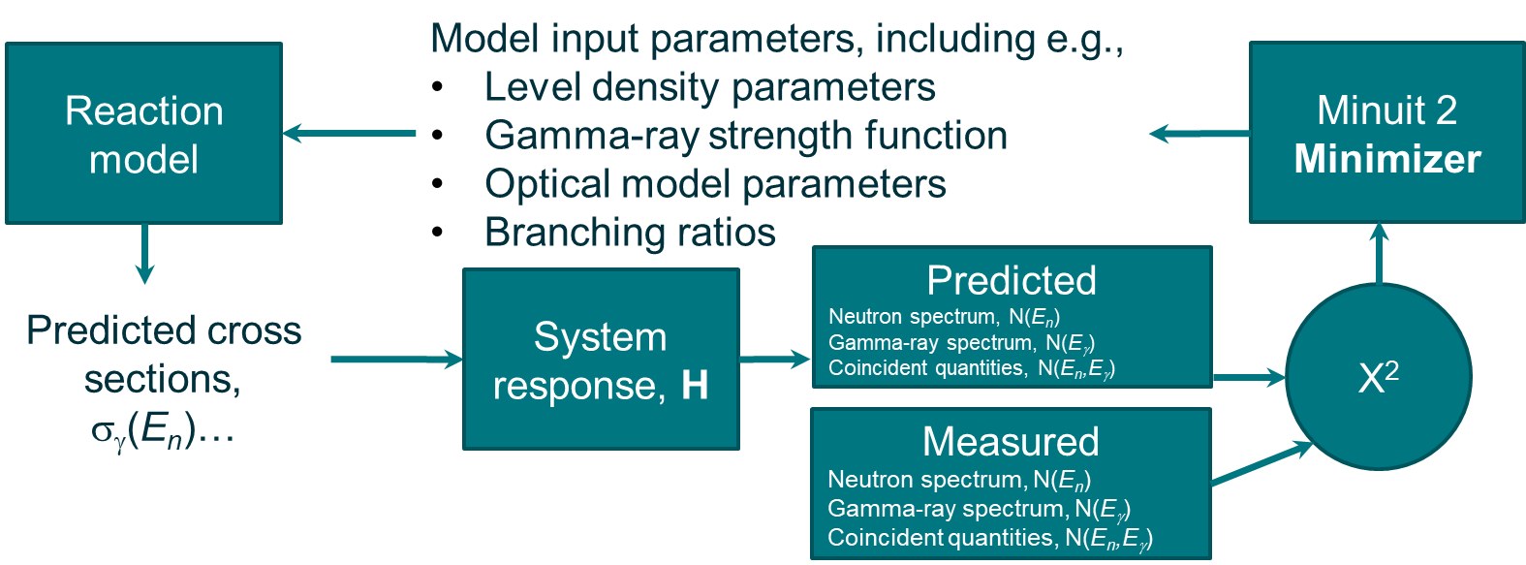
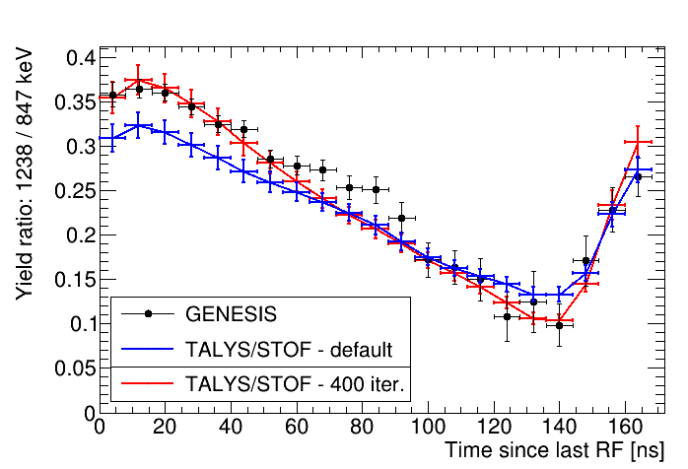
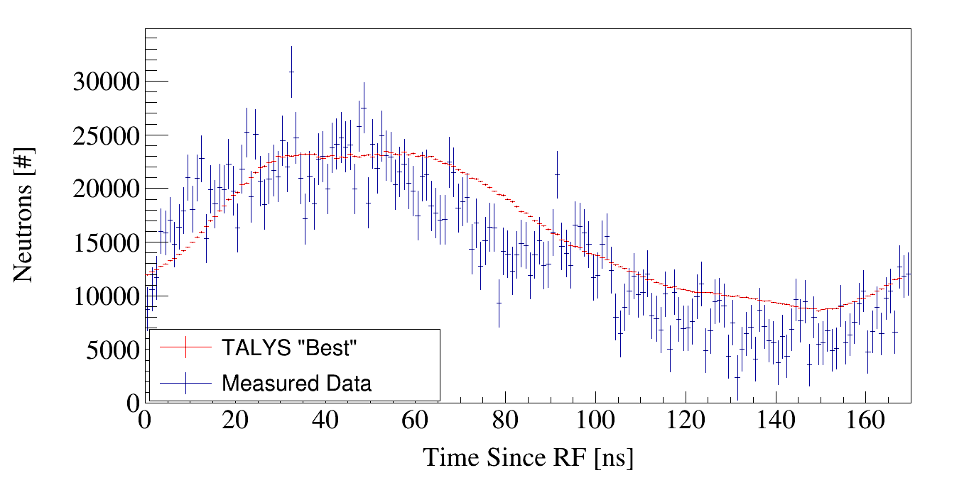

A new paradigm using GENESIS
Forward fitting Evaluation to Measurement (example from ⁵⁶Fe)
χ²
Josh Brown
Measured
Neutron spectrum, N(E_{n})
Gamma-ray spectrum, N(E_{γ})
Coincident quantities, N(E_{n}, E_{γ})

Slide 14
Conclusions
Exciting new staff changes (Basunia, Goldblum) and additions (Wiedeking)
While the core of our group remains nuclear data with outside funding sources allowing us to grow new complementary efforts.
Focus here is on database work. We’re doing lots of great (and fun!) experimental activities as well.
The NTIL opens many new possibilities to address outstanding nuclear data needs identified in the NSAC report

